Slide 1
Time Series Econometrics
Analysis of Nonstationary Data
Outline
Introduction
Stationarity and Unit Root
Analysis of Nonstationary Data

Slide 2
Introduction
A sequence of random variables is called stochastic process.
A particular realization of the stochastic process is called time series.
Hence, time series is generated by a stochastic or random process.
As sample is to a population in cross section data, realization (time series) is to a random process.

Slide 3
Stationary and unit root

Slide 4
Stationary and unit root

Slide 5
Stationary and unit root

Slide 6
Trend and difference stationary process

Slide 7
Non-stationary time series

Slide 8
Non-stationary time series

Slide 9
Non-stationary time series

Slide 10
Integrated time series

Slide 11
Integrated time series

Slide 12
Spurious regression

Slide 13
Spurious regression

Slide 14
Test of stationarity: unit root

Slide 15
Test of stationarity: unit root

Slide 16
Test of stationarity: unit root

Slide 17
Test of stationarity:

Slide 18
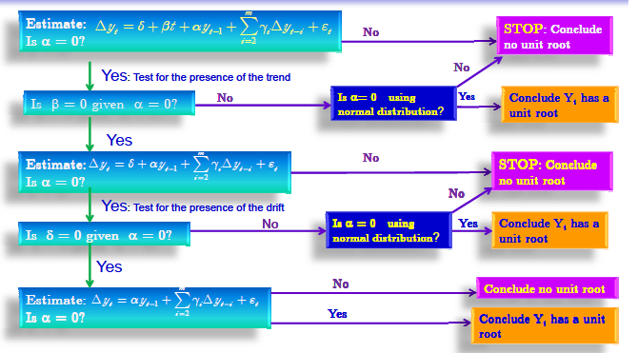
Con’d

Slide 19
Linear combination and coinetgration
If the time series variables under consideration, Y and X, are the same order of integration though they are individually non stationary, the estimation of regression equation of Y on X or X on Y in level form [or static form] by OLS method is referred to as cointegration regression.
Inshort if the linear combination of non-stationary series is stationary we can say that there is cointegraion.
If two or more series are individually integrated but some linear combination of them has a lower order of integration, then the series are said to be cointegrated.
A common example is where the individual series are first-order integrated (I(1)) but some (cointegrating) vector of coefficients exists to form a stationary linear combination of them.

Slide 20



Linear combination and coinetgration
If there exists a stationary linear combination of nonstationary random variables, the variables combined are said to be cointegrated.
The old woman and the boy are unrelated to one another, except that they are both on a random walk in the park. Information about the boy's location tells us nothing about the old woman's location.
The old man and the dog are joined by one of those leashes that has the cord rolled up inside the handle on a spring. Individually, the dog and the man are each on a random walk. They cannot wander too far from one another because of the leash. We say that the random processes describing their paths are cointegrated.

Slide 21
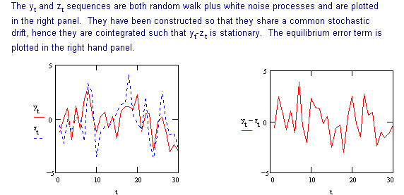
Linear combination and coinetgration

Slide 22
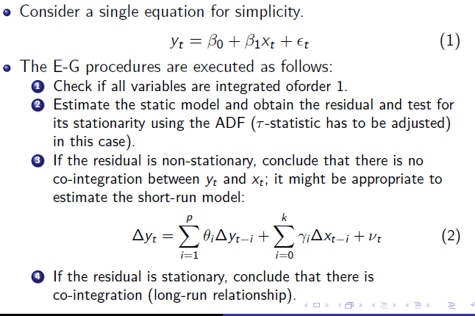
The Engle-Granger Methodology

Slide 23
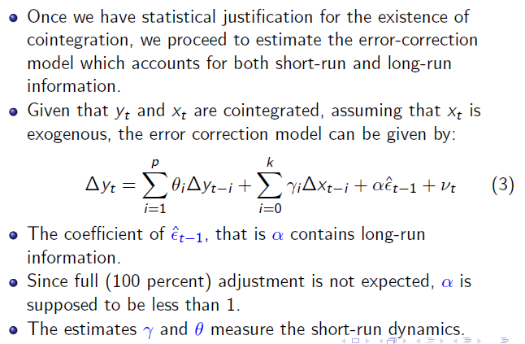
Con’d

Slide 24
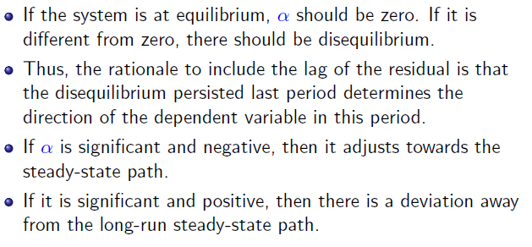
Con’d

Slide 25
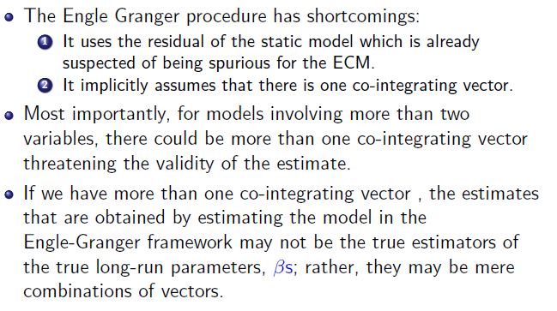
Con’d

