Slide 1
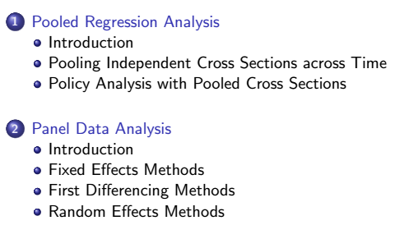
Outline

Slide 2
Pooled regression analysis
Introduction:
An independently pooled cross section is obtained by sampling randomly from a population at different points in time.
Such a data set has an important feature from statistical point of view in the sense that it consists of independently sampled observations.
It has to be distinguished from panel data or longtidunal data which is a record of data over time across the same units of the sample.
In the case of pooled data, individual units on which data is collected do not have to be the same.
One reason for using independently pooled cross sections is to increase the sample size.

Slide 3
Pooled regression analysis
By pooling random samples drawn from the same population at different point in time, we can get more precise estimators and test statistics with more power.
Pooling is helpful only if the relationship between the dependent variable and at least some of the independent variables remain constant over time.
Standard estimation techniques such as OLS are applicable.
The fact that the population may have different distribution can be handled by allowing the intercept to differ using time dummies.
The pattern of coefficients of the time dummies might be of interest in itself: example includes women’s fertility over time, and changes in the return to education

Slide 4
Panel Data
A panel data combines cross-sectional and time series dimensions
Some of the advantages of panel data (also called longitudinal data) are :
It explicitly accounts for heterogeneity across individual units.
It helps capture cross-section specific attributes and time series
It gives more variability, more degrees of freedom, less collinearity among covariates, and more efficiency.
It minimizes the bias caused by aggregation in pure time series data.
An important motivation for panel data models is heterogeneity

Slide 5
Panel Data
A major aspect in the formulation and estimation of panel
data model is whether there is unobserved heterogeneity which is correlated with the covarate(s).
In the presence of unobserved heterogeneity that is believed to have been correlated with one or more of the covariates, fixed effects model is used.
In fact, this is one way of dealing with endogeneity problem.
An alternative specification of the panel data model with the assumption that there is no correlation between the unobserved effects and the covariate(s) is the random effects model

Slide 6
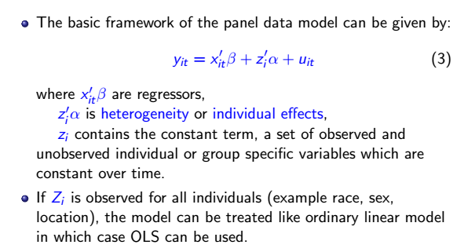
Panel Data

Slide 7
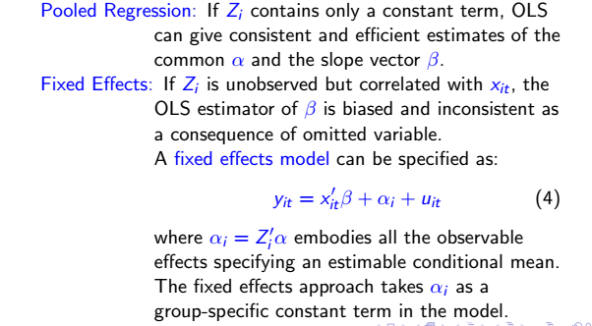
Panel Data

Slide 8
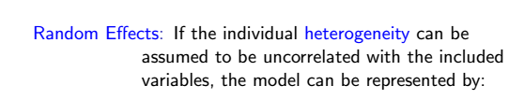
Panel Data

Slide 9
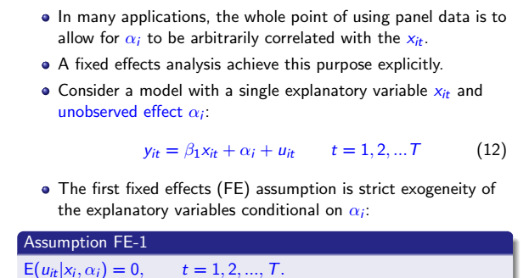
Fixed effect

Slide 10
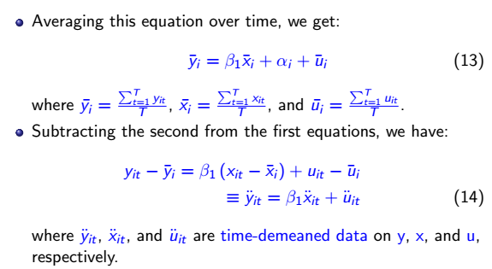
Fixed effect

Slide 11
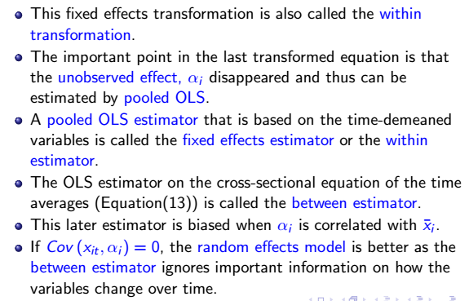
Fixed effect

Slide 12
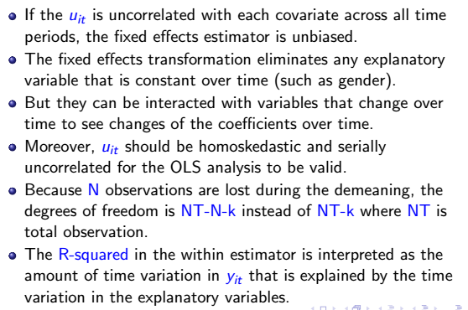
Fixed effect

Slide 13
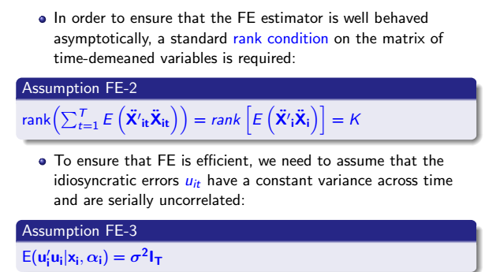
Fixed effect

Slide 14
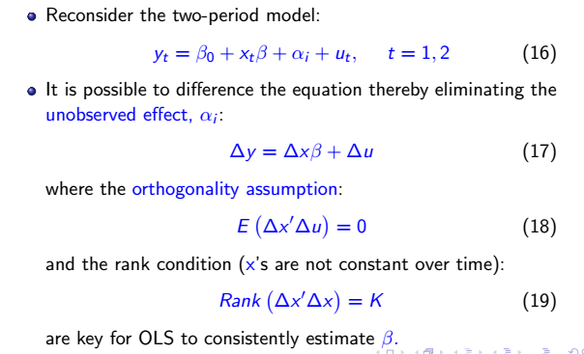
First differencing method

Slide 15
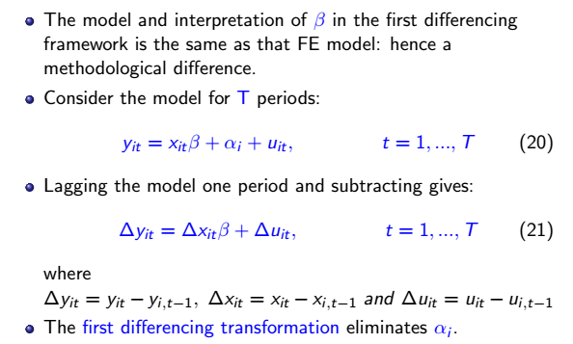
First differencing method

Slide 16
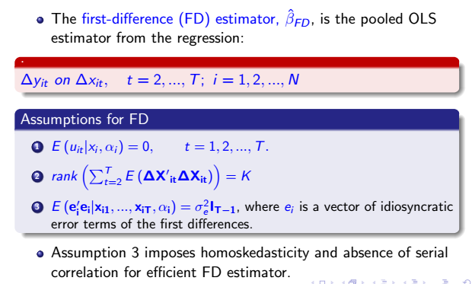
First differencing method

Slide 17
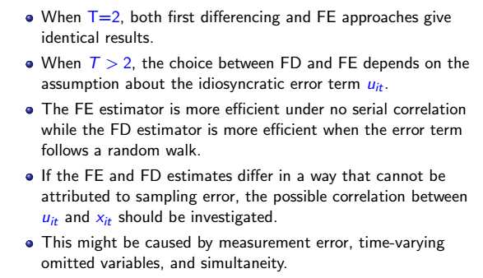
Fixed effect vs First differencing

Slide 18
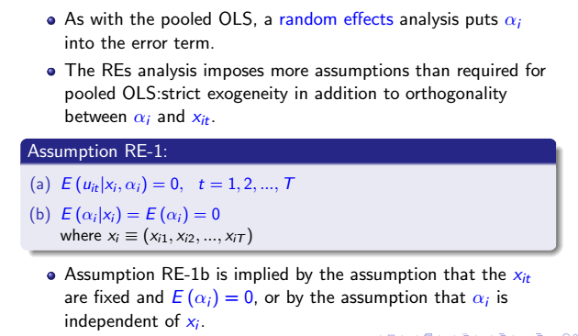
Random effect method

Slide 19
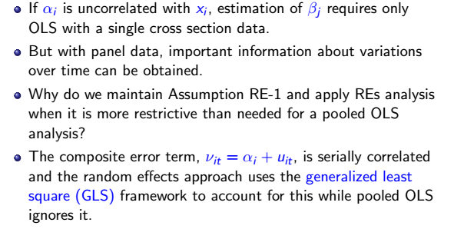
Random effect method

Slide 20
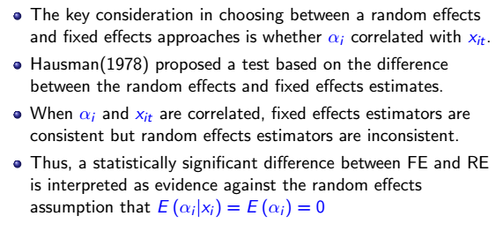
The Hausman test

Slide 21
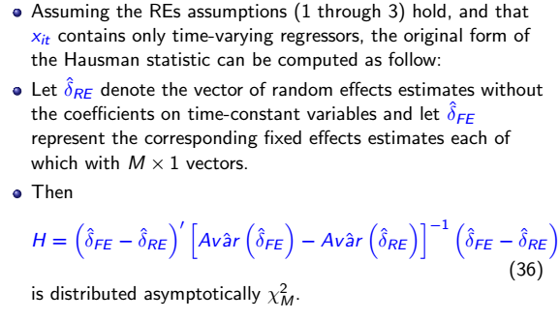
The Hausman test

