Slide 1
CHAPTER -3
TRANSPORTATION & ASSIGNMENT PROBLEM

Slide 2
3.1 Transportation problem
Transportation problem
Transportation problems deals with shipments from a number of source to a number of destinations. Typically each source is supply limited, each destination has known demand and the shipment cost between sources and destinations are given.
The objective of such models is to determine how many units should be shipped from each source /origin to each destination so that total transportation costs are minimized.

Slide 3
3.1.1 Characteristics of transportation problems
A limited supply of commodity is available at certain sources or origins such as factories.
There is a demand for the commodity at several destinations such as warehouse, distribution centers
The quantity of supply at each source and the demand or requirements at each destination is assumed to be constant.
The shipping (transportation ) costs per unit from each source to each destination are assumed to be constant.

Slide 4
Con’t
5. No shipments are allowed between sources or between destinations and again all supply and demand quantities are given in whole numbers (integers)
6. The problem is to determine how many units to ship from each source to each destinations so that all demand are satisfied at the minimum total shipping cost.

Slide 5
Assumptions
The transportation algorithm requires the assumption that:
All goods be homogeneous, so that any origin is capable of supplying any destination,
Transportation costs are a direct linear function of the quantity shipped over any route
The total quantity available is equal to the total demand

Slide 6
3.1.2 Formulating transportation Model
A transportation problem typically involves a set of sending locations, which are referred to as origins, and a set of receiving locations, which are referred to as destinations. In order to develop a model of a transportation problem, it is necessary to have the following information :
Supply quantity (capacity) of each origin.
Demand quantity of each destination.
Unit transportation cost for each origin-destination route.

Slide 7
Example :
Transportation table
To From | Project #1 | Project #2 | Project #3 | Supply
Farm A | C11 | C12 | C13 | S1
Farm B | C21 | C22 | C23 | S2
Farm C | C31 | C32 | C33 | S3
Demand | D1 | D2 | D3

Slide 8
3.2 Methods for Finding Initial Solution
There are three method to find initial feasible solution.
The Northwest-corner method.
Least cost method (An intuitive approach)
Vogel’s Approximation Method

Slide 9
1. The Northwest-corner method(NCM)
The northwest corner method is a systematic approach for developing an initial feasible solution. Its chief advantages are that it is simple to use and easy to understand. Its chief drawback is that it does not take transportation costs into account.
The northwest corner method gets its name because the starting point for the allocation process is the upper left-hand (Northwest) corner of the transportation table. For the ABC company problem, this would be the cell that represents the route from Farm A to Project #1. The following set of principles guides the allocation:

Slide 10
Con’t
i. Begin with the upper left-hand cell, and allocate as many units as possible to that cell. This will be the smaller of the row supply and the column demand. Adjust the row and column quantities to reflect the allocation.
ii. Remain in a row or column until its supply or demand is completely exhausted or satisfied, allocating the maximum number of units to each cell in turn, until all supply has been allocated (and all demand has been satisfied because we assume total supply and demand are equal).

Slide 11
Example :
1. ABC company has contracted to provide topsoil for three residential housing developments. Topsoil can be supplied from three different “farms” as follows:
Farm Weekly capacity (cubic yards)
A 100
B 200
C 200
Demand for the topsoil generated by the construction projects is:
Project Weekly demand(cubic yards)
1 50
2 150
3 300

Slide 12
Con’t
The manager of the ABC company has estimated the cost per cubic yard to ship over each of the possible routes:
Cost per cubic yard to
From Project #1 Project #2 Project #3
Farm A Birr4 Birr 2 Birr 8
Farm B 5 1 9
Farm C 7 6 3
Required
a. Solve the problem by north west-corner method ?

Slide 13
Solution
The first step is to arrange the information into a transportation table. This is shown in the following table:
To From | Project #1 | Project #2 | Project #3 | Supply
Farm A | 4 | 2 | 8 | 100
Farm B | 5 | 1 | 9 | 200
Farm C | 7 | 6 | 3 | 200
Demand | 50 | 150 | 300 | 500

Slide 14
Initial Feasible Solution
To From | Project #1 | Project #2 | Project #3 | Supply
Farm A | 4 50(first) | 2 50(second) | 8 | 100
Farm B | 5 | 1 100(third) | 9 100(fourth) | 200
Farm C | 7 | 6 | 3 200(last) | 200
Demand | 50 | 150 | 300 | 500

Slide 15
Con’t
The total cost is found by multiplying the quantities in “completed” (i.e. non empty) cells by the cell’s unit cost and, then, summing those amounts. Thus:
Total cost = 50(4) + 50(2) + 100(1) + 100(9) + 200(3) = $1900

Slide 16
2. Least Cost Method(LCM)
This approach, also known as the minimum-cost method, uses lowest cell cost as the basis for selecting routes. The procedure is as follows:
i. Identify the cell that has the lowest unit cost. If there is a tie, select one arbitrarily. Allocate a quantity to this cell that is equal to the lower of the available supply for the row and the demand for the column.
ii. Cross out the cells in the row or column that has been exhausted (or both, if both have been exhausted), and adjust the remaining row or column total accordingly.
iii. Identify the cell with the lowest cost from the remaining cells. Allocate a quantity to this cell that is equal to the lower of the available supply of the row and the demand for the column.
iv. Repeat steps (ii) and (iii) until all supply and demand have been exhausted.

Slide 17
Example :
1. ABC company has contracted to provide topsoil for three residential housing developments. Topsoil can be supplied from three different “farms” as follows:
Farm Weekly capacity (cubic yards)
A 100
B 200
C 200
Demand for the topsoil generated by the construction projects is:
Project Weekly demand(cubic yards)
1 50
2 150
3 300

Slide 18
Con’t
The manager of the ABC company has estimated the cost per cubic yard to ship over each of the possible routes:
Cost per cubic yard to
From Project #1 Project #2 Project #3
Farm A Birr4 Birr 2 Birr 8
Farm B 5 1 9
Farm C 7 6 3
Required
a. Solve the problem by least cost method ?

Slide 19
Con’t
The first step is to arrange the information into a transportation table. This is shown in the following table:
To From | Project #1 | Project #2 | Project #3 | Supply
Farm A | 4 | 2 | 8 | 100
Farm B | 5 | 1 | 9 | 200
Farm C | 7 | 6 | 3 | 200
Demand | 50 | 150 | 300 | 500

Slide 20
Con’t
Initial Feasible Solution for the ABC company using the LCM
To From | Project #1 | Project #2 | Project #3 | Supply
Farm A | 4 50 | 2 | 8 50 | 100
Farm B | 5 | 1 150 | 9 50 | 200
Farm C | 7 | 6 | 3 200 | 200
Demand | 50 | 150 | 300 | 500

Slide 21
Con’t
Therefore :
Total cost = 50(4) + 50(8) + 150(1) + 50(9) + 200(3) = $1800

Slide 22
3. Vogel’s Approximation Method (VAM)
The third method for determining an initial solution is based on the concept of penalty cost or regret. If a decision maker incorrectly chooses from several alternative courses of action, a penalty may be suffered (and the decision maker may regret the decision that was made). In transportation problem, the courses of action are the alternative routes and a wrong decision is allocating to a cell that does not contain the lowest cost.

Slide 23
Con’t
With VAM the basis of allocation is unit cost penalty i.e. that column or row which has the highest unit cost penalty (difference between the lowest and the next highest cost) is selected first for allocation and the subsequent allocations in cells are also done keeping in view the highest unit cost penalty

Slide 24
Steps in VAM
Operational steps:
Step 1: for each column and row, determine its penalty cost by subtracting their two of their least cost .
Step 2: select row/column that has the highest penalty cost
in step 1
Step 3: assign as much as allocation to the selected row/column that has the least cost
Step 4: Block those cells that cannot be further allocated
Step 5: Repeat above steps until all allocations have been
assigned

Slide 25
Example
From To | A | B | C | Supply
1 | 6 | 8 | 10 | 150
2 | 7 | 11 | 11 | 175
3 | 4 | 5 | 12 | 275
Demand | 200 | 100 | 300 | 600

Slide 26
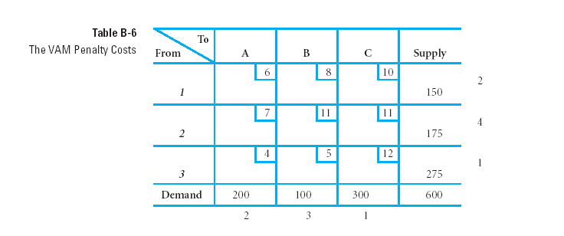
Subtracting their two of their least cost
Step 1
(8-6)
(11-7)
(5-4)
(6-4) (8-5) (11-10)

Slide 27
Steps 2 & 3
Step 2:
Highest penalty
cost
Step 3: this has the least cost

Slide 28
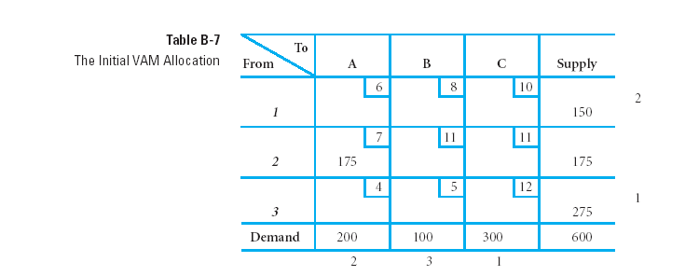
Step 4
---
---

Slide 29
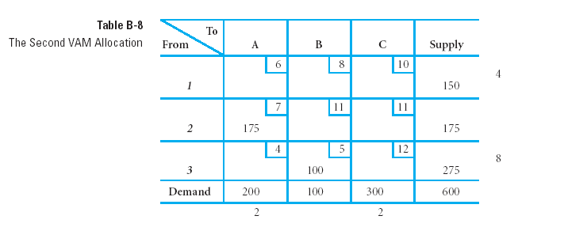
Step 5
Second Iteration
---
---
---

Slide 30
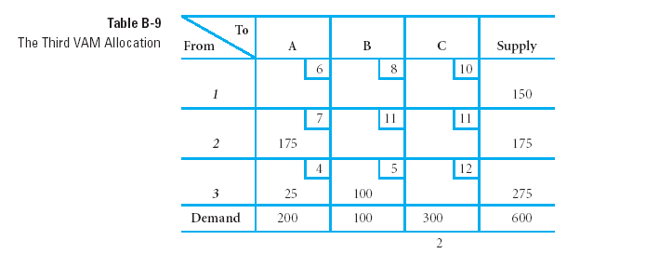
3rd Iteration of VAM
---
---
---
---

Slide 31
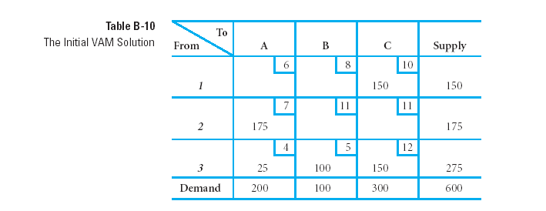
Initial tableau for VAM

Slide 32
Con’t
Therefore;
Total cost = (150x10)+(7x125) +(25x4)+(100x5)+(150x12)= $5,125

Slide 33
Evaluating a Solution for Optimality
There are two methods. Such as:
The Stepping-stone method
The MODI method

Slide 34
1. The Stepping-stone method
The Stepping-stone method involves tracing a series of closed paths in the transportation table, using one such path for each empty cell. The path represents a shift of one unit into an empty cell, and it enables the manager or analyst to answer a “what-if” question
The stepping-stone path also can be used to determine the maximum number of units that can be shifted into the empty cell, as well as modifications to other completed cells needed to compensate for the shift into the previously unused cell.

Slide 35
Con’t
Rules for tracing Stepping-stone paths:
i. All unoccupied cells must be evaluated. Evaluate cells one at a time.
ii. Except for the cell being evaluated, only add or subtract in occupied cells. (It is permissible to skip over unoccupied cells to find an occupied cell from which the path can continue.)
iii. A path will consist of only horizontal and vertical moves, starting and ending with the empty cell that is being evaluated.
iv. Alter + and . signs, beginning with a + sign in the cell being evaluated.

Slide 36
Con’t
The general implication of the plus and minus signs is that cells with + signs mean one unit would be added, cells with a minus(-) sign indicate one unit would be subtracted.
Example:

Slide 37
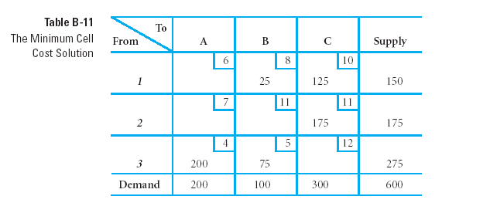
Con’t
Let consider the following initial tableau from the Min Cost algorithm
There are
Non-basic variables
These are basic
variables

Slide 38
Stepping stone
+
-
-
+
The above saying that, we add min value of all –ve cells into cell that has “+” sign, and subtracts
the same value to the “-ve” cells
Thus, max –ve is min (200,25) = 25, and we add 25 to cell A1 and B3, and subtract it from B1 and A3

Slide 39
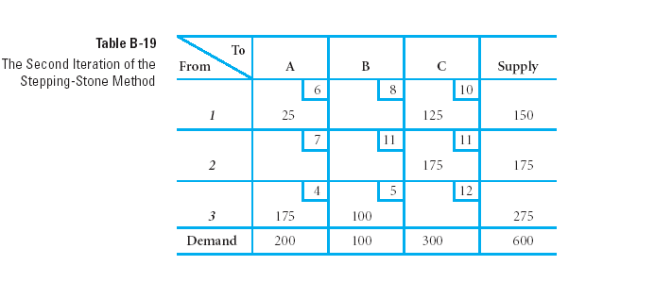
Stepping stone
The above tableaus give min cost = 25*6 + 120*10 + 175*11
175*4 + 100* 5 = $4525

Slide 40
2. The Modified Distribution Method (MODI)
MODI is a modified version of the stepping-stone method in which math equations replace the stepping-stone paths.
- In the table, the extra left-hand column with the u_{i} symbols and the extra top row with the v_{j} symbols represent values that must be computed.
- Computed for all cells with allocations :
u_{i} + v_{j} = c_{ij} = unit transportation cost for cell _{ij}.

Slide 41
Con’t
There are five steps: such as
1. Develop an initial solution.
2. Compute the u_{i} and v_{j} values for each row and column.
3. Compute the cost change, k_{ij}, for each empty cell.
4. Allocate as much as possible to the empty cell that will result in the greatest net decrease in cost (most negative k_{ij})
5. Repeat steps 2 through 4 until all k_{ij} values are positive or zero

Slide 42
Example
Initial feasible solution
Total cost= (8*25)+(125*10)+(175*11)+(200*4)+(75*5)=4450
From TO | A | B | C | Supply
1 | 6 | 8 25 | 10 125 | 150
2 | 7 | 11 | 11 175 | 175
3 | 4 200 | 5 75 | 12 | 275
Demand | 200 | 100 | 300 | 600

Slide 43
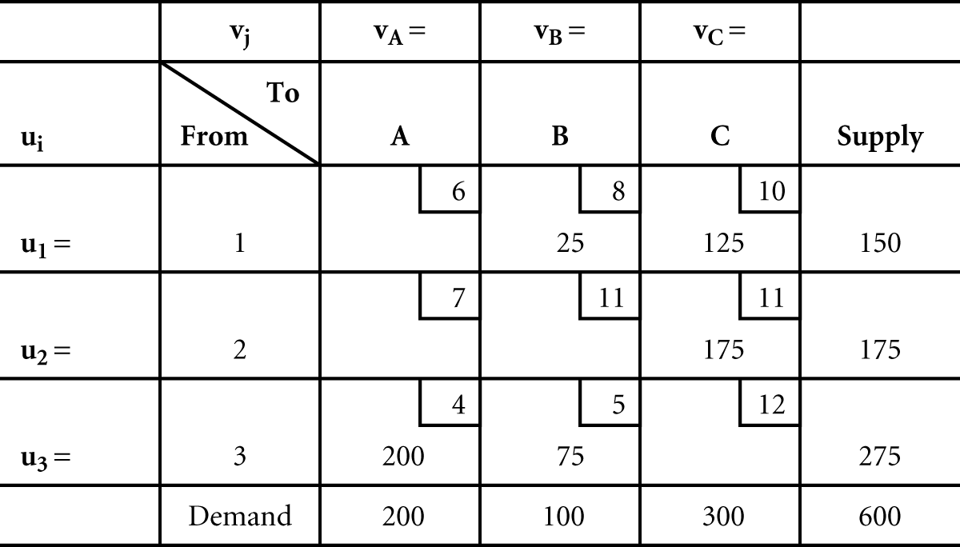
Solution
The Minimum Cell Cost Initial Solution

Slide 44
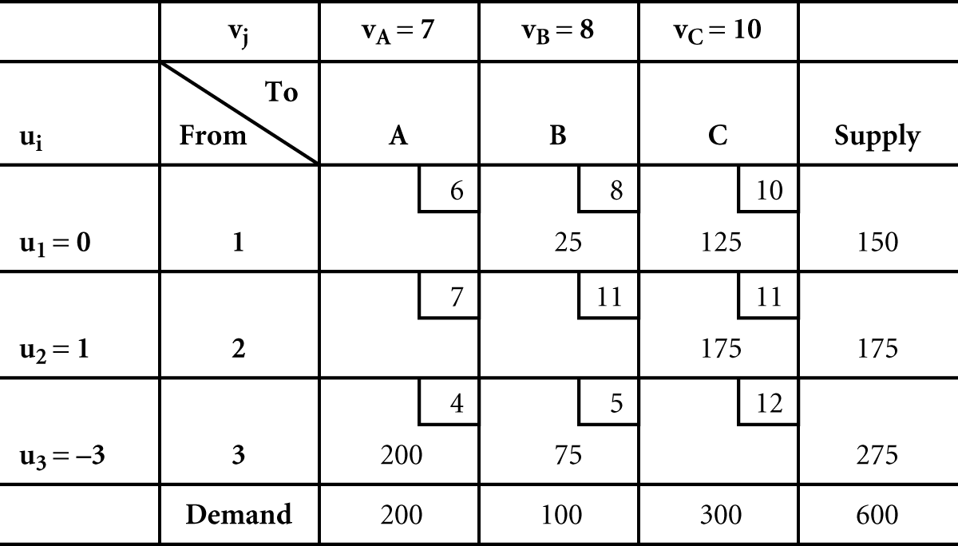
The Modified Distribution Method (MODI)
(2 of 6)
- Formulas for cells containing allocations:
x_{1B}: u₁ + v_{B} = 8
x_{1C}: u₁ + v_{C} = 10
x_{2C}: u₂ + v_{C} = 11
x_{3A}: u₃ + v_{A} = 4
x_{3B}: u₃ + v_{B} = 5
- Five equations with 6 unknowns, therefore let u₁ = 0 and solve to obtain:
v_{B} = 8, v_{C} = 10, u₂ = 1, u₃ = -3, v_{A}= 7
The Initial Solution with All ui and vj Values

Slide 45
The Modified Distribution Method (MODI)
(3 of 6)
- Each MODI allocation replicates the stepping-stone allocation.
- Use following to evaluate all empty cells:
c_{ij} - u_{i} - v_{j} = k_{ij}
where k_{ij} equals the cost increase or decrease that would occur by allocating to a cell.
- For the empty cells in Table :
x_{1A}: k_{1A} = c_{1A} - u₁ - v_{A} = 6 - 0 - 7 = -1
x_{2A}: k_{2A} = c_{2A} - u₂ - v_{A} = 7 - 1 - 7 = -1
x_{2B}: k_{2B} = c_{2B} - u₂ - v_{B} = 11- 1 - 8 = +2
x_{3C}: k_{3C} = c_{3C} - u₃ -v_{C} = 12 - (-3) - 10 = +5

Slide 46
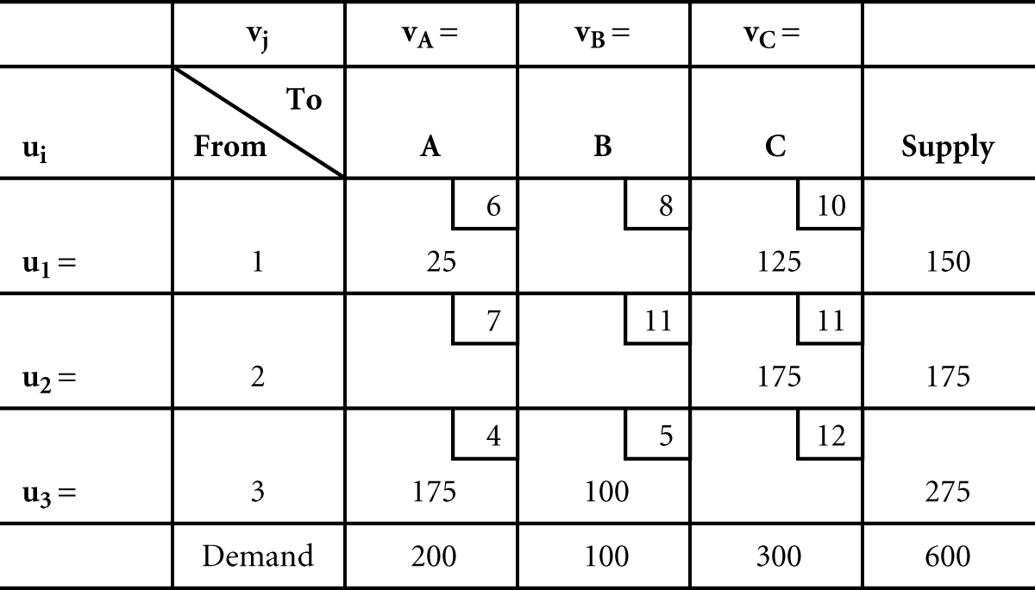
The Modified Distribution Method (MODI)
(4 of 6)
- After each allocation to an empty cell, the u_{i} and v_{j} values must be recomputed.
The Second Iteration of the MODI Solution Method

Slide 47
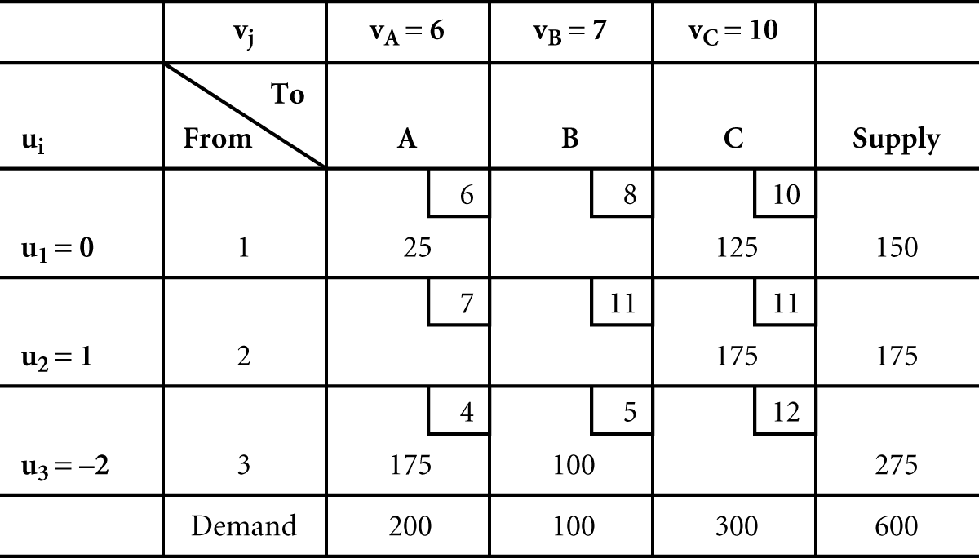
The Modified Distribution Method (MODI)
(5 of 6)
-
Recomputing u_{i} and v_{j} values:
x_{1A}: u₁ + v_{A} = 6, v_{A} = 6 x_{1C}: u₁ + v_{C} = 10, v_{C} = 10 x_{2C}: u₂ + v_{C} = 11, u₂ = 1
x_{3A}: u₃ + v_{A} = 4, u₃ = -2 x_{3B}: u₃ + v_{B} = 5, v_{B} = 7
The New ui and vj Values for the Second Iteration

Slide 48
The Modified Distribution Method (MODI)
(6 of 6)
- Cost changes for the empty cells, c_{ij} - u_{i} - v_{j} = k_{ij};
x_{1B}: k_{1B} = c_{1B} - u₁ - v_{B} = 8 - 0 - 7 = +1
x_{2A}: k_{2A} = c_{2A} - u₂ - v_{A} = 7 - 1 - 6 = 0
x_{2B}: k_{2B} = c_{2B} - u₂ - v_{B} = 11 - 1 -7 = +3
x_{3C}: k_{2B} = c_{2B} - u₃ - v_{C} = 12 - (-2) - 10 = +4
- Since none of the values are negative, solution obtained is optimal.
- Cell 2A with a zero cost change indicates a multiple optimal solution.
Therefore : Total cost: (6*25)+(10*125)+(11*175)+(175*4)+(5*100)=4525

Slide 49
SPECIAL ISSUES
Alternate Optimal Solutions- Sometimes, transportation problems have multiple optimal solutions. In such instances, it can be useful for a manager to be aware of alternate solutions, because this gives the manager an option of bringing non-quantitative considerations into the decision.
Degeneracy- A solution is degenerate if the number of occupied cells is less than the number of rows plus the number of columns minus one. i.e., there are too few occupied cells to enable all the empty cells to be evaluated (m+n-1 >number of occupied cell).

Slide 50
Con’t
3. Unacceptable Routes-In some cases, an origin-destination combination may be unacceptable. This may be due to weather factors, equipment breakdowns, labor problems, or skill requirements that either prohibit, or make undesirable, certain combinations (routes).
4. Unequal Supply and Demand- if supply and demand are not equal so, it is necessary to modify the original problem so that supply and demand are equal. This is accomplished by adding either a dummy column or a dummy row.

Slide 51

ASSIGNMENT PROBLEMS

Slide 52
3.2 Assignment Problems
The Assignment Problem is a special case of Transportation Problem (T.P.) in which the number of sources and destinations are the same, and the objective is to assign the given job (task) to most appropriate machine (person) so as to optimize the objective like minimizing cost.
The assignment is a problem because people posses varying abilities for performing different jobs and, therefore, the costs of performing the jobs by different people are different. Obviously, if all persons could do a job in the same time or at the same cost then it would not matter who of them is assigned the job.
Example : Assignment of workers to machines, clerks to various counters, salesmen to different sales areas, service crews to different districts.

Slide 53
Characteristics of the Assignment Problem
The availability resources are finite in numbers such as availability of workers, machines, project managers, sales man, jobs etc.
These availability resources can be assigned only on one to one basis. i.e job can be assigned to particular employee only once.
The outcome (result) are expressed in terms of cost, time or profit
The assignment methods aim at either cost minimization or profit maximization.
For one to one assignment, the problem has to be of the balanced type, otherwise it has to be converted into a balanced problem or in to square matrix.

Slide 54
Presentation of the assignment problem
The problem can be presented by the following tables:
Cost or time taken by workers on various job is indicated in matrix cells as cells as Cij
Workers | jobs
 | A | B | C | D
1 | C1a | C1b | C1c | C1d
2 | C2a | C2b | C2c | C2d
3 | C3a | C3b | C3c | C3d
4 | C4a | C4b | C4c | C4d

Slide 55
Hungarian Assignment method (HAM)
There are 6 steps :
Step 1. Locate the smallest cost element in each row of the cost matrix. Then subtract this smallest from each element in that row. As a result, there shall be at least one zero in each row of this new matrix.
Step 2. Now consider each column of the reduced cost matrix from step 1 and locate smallest element in it. Subtract the smallest value from each element of the column . There would , again be at least one zero in each column of the second reduced cost matrix.

Slide 56
Con’t
Step 3: Draw the minimum number of horizontal and vertical lines to cover the all zero elements. If the number of lines drawn is equal to the number of rows/columns (n) the solution is optimal, and proceeds to step 6. If the number of lines drawn is smallest than n, go to step 4.
Step 4. Select the smallest uncovered cost element of the modified matrix from step 3. Subtract this element from all uncovered elements including itself and add this element to each value located at the intersection of any lines.
Step 5: Repeat steps 3 and 4 until an optimal solution is obtained.
Step 6:make feasible job assignments on zero elements .

Slide 57
Example
Assign workers 1,2,3,4 to jobs A,B,C,D. time taken by workers from different jobs are given in the matrix.
Workers | Job
 | A | B | C | D
1 | 45 | 40 | 51 | 67
2 | 55 | 40 | 61 | 53
3 | 49 | 52 | 48 | 64
4 | 41 | 45 | 60 | 55

Slide 58
Solution
Step 1: Row minima's have been identified. These values are to be subtracted from all values of the respective rows
Workers | Jobs |  |  |  | Row minima
 | A | B | C | D
1 | 45 | 40 | 51 | 67 | 40
2 | 55 | 40 | 61 | 53 | 40
3 | 49 | 52 | 48 | 64 | 48
4 | 41 | 45 | 60 | 55 | 41

Slide 59
Con’t
Reduced time matrix is obtained thus ( revised time matrix I)
Workers | jobs
 | A | B | C | D
1 | 5 | 0 | 11 | 27
2 | 15 | 0 | 21 | 13
3 | 1 | 4 | 0 | 16
4 | 0 | 4 | 19 | 14
Column minima | 0 | 0 | 0 | 13

Slide 60
con’t
Step 2: now we obtain minimum values of each column from the above reduced time matrix I and subtract these from each respective column elements to achieve revised matrix. II
Workers | Jobs
 | A | B | C | D
1 | 5 | 0 | 11 | 14
2 | 15 | 0 | 21 | 0
3 | 1 | 4 | 0 | 3
4 | 0 | 4 | 19 | 1

Slide 61
Con’t
Step 3: Now drawing minimum number of horizontal/ vertical lines to cover all zero elements we get matrix III below
Workers | Jobs
 | A | B | C | D
1 | 5 | 0 | 11 | 14
2 | 15 | 0 | 21 | 0
3 | 1 | 4 | 0 | 3
4 | 0 | 4 | 19 | 1

Slide 62
Con’t
Since, the number of lines draw is 4=n, the solution is optimal. So proceed step 6
Step 6: making assignments on zero elements , we obtain
Hence, jobs have been assigned on zero elements 4A,1B,3C,2D
Total time=41+40+48+53=182 min(optimal)
Workers | Jobs
 | A | B | C | D
1 | 5 | 0 | 11 | 14
2 | 15 | 0 | 21 | 0
3 | 1 | 4 | 0 | 3
4 | 0 | 4 | 19 | 1

Slide 63
Reading Assignment
Special Issues
Unbalanced Assignment Problems
Constrained/Prohibited/ Assignment Problems
Maximization Case in Assignment Problem

Slide 64
End

