Slide 1
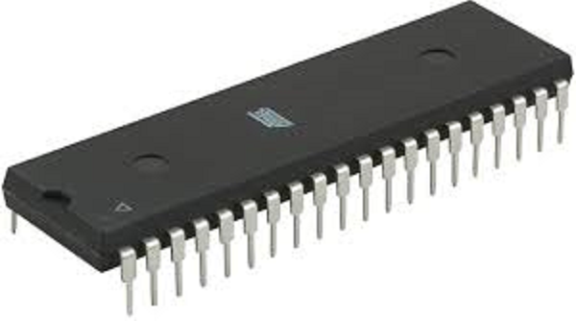
Chapter Two
8051 Microcontroller

Slide 2
Reading
Reading:
Muhammad Ali Mazidi, Janice Gillispie Mazidi, Rolin D. McKinlay, “The 8051 Microcontroller and Embedded Systems using Assembly and C”, 2nd Edition, Prentice Hall

Slide 3
CPU families used in microcontrollers
Microcontroller family defines the controllers architecture.
All microcontrollers of a family
contain the same processor core and hence are code-compatible.
they may differ in the additional components like the number of timers or the amount of memory.
There are numerous microcontrollers on the market: Intel 8051, Motorola MC68HC11, PIC, HC, AVR,ARM and others.

Slide 4
CPU families used in microcontrollers
In 1981,Intel Corporation introduced an 8-bit microcontroller called the 8051(Intel refers to it as MCS-51)
The 8051 microcontroller family became widely popular after Intel allowing other manufactures to make and market any flavor of the 8051.
but remaining code-compatible.
The 8051 family has the largest number of diversified suppliers: Intel, Atmel, Philips, AMD, Infineon and others.

Slide 5
Overview of 8051 family
The 8051 is an 8-bit processor and it has
128 bytes of RAM
4K bytes of on-chip ROM
Two 16-bit timers
One serial port
Four I/O ports, each 8 bits wide

Slide 6
8051 Microcontroller
External Interrupts
Interrupt
Control
4k
ROM
128 bytes
RAM
Timer 0
Timer 1
CPU
OSC
Bus
Control
4 I/O Ports
Serial
P0 P2 P1 P3
TXD
RXD
Addr/Data

Slide 7
8051 Family

Slide 8
8051 pin diagram
P1.0
1
40
Vcc
P1.1
2
39
P0.0(AD0)
P1.2
3
38
P0.1(AD1)
P1.3
4
8051
37
P0.2(AD2)
P1.4
5
36
P0.3(AD3)
P1.5
6
35
P0.4(AD4)
P1.6
7
34
P0.5(AD5)
P1.7
8
33
P0.6(AD6)
RST
9
32
P0.7(AD7)
(RXD)P3.0
10
31
EA/VPP
(TXD)P3.1
11
30
ALE/PROG
(INT0)P3.2
12
29
PSEN
(INT1)P3.3
13
28
P2.7(A15)
(T0)P3.4
14
27
P2.6(A14)
(T1)P3.5
15
26
P2.5(A13)
(WR)P3.6
16
25
P2.4(A12)
(RD)P3.7
17
24
P2.3(A11)
XTAL2
18
23
P2.2(A10)
XTAL1
19
22
P2.1(A9)
GND
20
21
P2.0(A8)

Slide 9
I/O Ports
I/O pins are generally grouped into ports of 8 pins, which can be accessed with a single byte access.
Pins can either be input only, output only, or most commonly— bidirectional, that is, capable of both input and output.
Apart from their I/O capabilities, most pins have one or more alternate functions to save pins and keep the chip small.

Slide 10
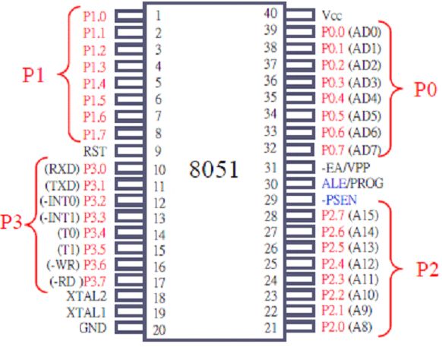
8051 I/O ports
8051 MCU has four ports P0, P1, P2, and P3 and each use 8 pins

Slide 11
8051 I/O ports
Port 0 （pins 32-39）：P0（P0.0-P0.7）
8-bit R/W - General Purpose I/O
Or acts as a multiplexed low byte address and data bus for external memory design.
Port 1 （pins 1-8） ：P1（P1.0-P1.7）
Only 8-bit R/W - General Purpose I/O
Port 2 （pins 21-28）：P2（P2.0-P2.7）
8-bit R/W - General Purpose I/O
Or high byte of the address bus for external memory design.

Slide 12
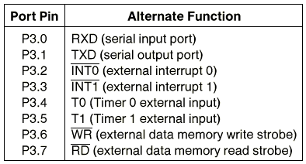
8051 I/O ports
Port 3 （pins 10-17）：P3（P3.0～P3.7）
General Purpose I/O: if not used by the internal peripherals (timers) or external interrupts.

Slide 13
Other pins
EA（pin 31）：external access
The EA pin is connected to GND to indicate the code is stored externally.
For 8051, EA pin is connected to Vcc.
PSEN（pin 29）：program store enable
This is an output pin and is connected to the OE pin of the ROM.
ALE（pin 30）：address latch enable
It is an output pin and is active high.
8051 port 0 provides both address and data.
The ALE pin is used for de-multiplexing the address and data when Port 0 is in use.

Slide 14
ROM in 8051
The original 8051 microcontroller has 4K bytes on-chip ROM.
No member of 8051 family can have more than 64K bytes ROM:
The program counter is a 16-bit register

Slide 15
RAM in 8051
There are 128 bytes of RAM in the 8051(Assigned addresses 00 to 7FH)
The 128 bytes are divided into three different groups as follows:
A total of 32 bytes from locations 00 to 1FH are set aside for register banks and the stack
A total of 16 bytes from locations 20H to 2FH are set aside for bit-addressable read/write memory
A total of 80 bytes from locations 30H to 7FH are used for read and write storage, called scratch pad.

Slide 16
RAM of 8051

Slide 17
Register Banks

Slide 18
Register Banks
The 32 bytes from address 00 to 1F hex are divided into 4 banks of registers in which each bank has 8 registers, R0-R7.
Register bank 0 is the default when 8051 is powered up.
That is by default RAM locations 0, 1,2,3,4,5,6 and 7 are accessed with names R0, R1, R2, R3, R4, R5, R6 and R7 when programing the 8051.
We can switch to other banks by use of the PSW(program status word) register.
Bits D4 and D3 of the PSW are used to select the desired register bank.

Slide 19
Program Status Word (PSW)
The program status word (PSW) register, also referred to as the flag register, is an 8 bit register.
Only 6 bits are used
CY (carry), AC (auxiliary carry), P (parity), and OV (overflow).
The PSW3 and PSW4 are designed as RS0 and RS1, and are used to change the register banks.
Program Status Word (PSW) Register
MSB
LSB
CY | AC | -- | RS1 | RS0 | OV | -- | P
D₇ | D₆ | D₅ | D₄ | D₃ | D₂ | D₁ | D₀

Slide 20
Program Status Word (PSW)
The carry flag (CY)
Set whenever there is a carry out from the D7 bit.
It is affected after an 8-bit addition or subtraction.
It can also be set to 1 or 0 directly by instructions "SETB C" and "CLR C” respectively
Auxiliary carry (AC)
indicates a carry from D3 to D4 during addition and subtraction operations.
The overflow flag (OV)
set whenever the result of a signed number operation is too large, causing the high-order bit to overflow into the sign bit.

Slide 21
Program Status Word (PSW)
The parity flag (P)
The parity flag reflects the number of 1s in the A (accumulator) register only.
If the register A contains an odd number of 1s, then P = 1. And
P = 0 if A has an even number of 1s.
We can select the corresponding Register Bank bit using RS0 and RS1 bits.

Slide 22
Stack in 8051
The stack is a section of RAM used by the CPU to store information temporarily.
The register used to access the stack is called the stack pointer (SP) register.
The stack pointer in the 8051 is only 8 bit wide, which means that it can take value of 00 to FFH.
When the 8051 is powered up
the SP register contains value 07 RAM location.
08 is the first location used for the stack by the 8051.

Slide 23
bit-addressable RAM
16 byte locations from 20H to 2FH are bit addressable.
Provide 128 bits (16*8) of RAM bit-addressability
They are address as 0 to 127 Decimal (00h-7Fh)
The bit addresses 0-7 are the first byte of internal RAM location 20H and bit addresses 8-0FH are second byte of internal RAM location 21H

Slide 24
bit-addressable RAM
Example: Which byte of RAM each of the following instructions modify?
a) Setb 42h
b) Clr 0Fh
c) Setb 05
Answer:
a) Bit 2 of RAM location 28H
b) Bit 7 of RAM location 21H
c) Bit 5 of RAM location 20H

Slide 25
Timers and Counters
Timers and counters are distinguished from one another largely by their use, not by their logic.
Both are built from adder logic with registers to hold the current value, with an increment input that adds one to the current register value.
A timer has its count connected to a periodic clock signal to measure time intervals.
A counter has its count input connected to an aperiodic signal in order to count the number of occurrences of some external event.

Slide 26
Timers in 8051
Original 8051 has 2 timers.
Timers increment on each system clock.
Timer registers (TH0, TL0, TH1, TL1) can be read or written to.
Timer overflow can cause “interrupts” or set SFR bits high.
16 bits
16 bits
TH0 : TL0
TH1 : TL1
Timer 0
Timer 1

Slide 27
Interrupts
There are two techniques which can be used by the processor to communicate with I/O(peripheral) devices: Polling and Interrupt.
Polling: In this technique the processor polls the device (asks question) repeatedly at regular intervals to check if the device has completed the given task or has any new task to execute.
Interrupt: An interrupt is a signal sent from a peripheral to the processor. A peripheral may send an interrupt signal to a processor when it has some job to perform which requires the processor’s intervention.

Slide 28
Interrupts Vs Polling
An interrupt is like a shopkeeper. If one needs a service or product, he goes to him and tells him his needs.
In case of interrupts, when the flags or signals are received, they notify the controller that they need to be serviced.
The polling method is like a salesperson. The salesman goes from door to door while requesting to buy a product or service.
Similarly, the processor keeps monitoring the flags or signals one by one for all devices and provides service to whichever component that needs its service.

Slide 29
Interrupts
An interrupt is an event that disrupts the normal execution of a program and causes the execution of special instructions.
Interrupt signals can cause a program to suspend itself temporarily to service the interrupt by branching into another program called Interrupt Service Routines (ISR) for the specified device which has caused the interrupt.
When the ISR completes, the processor returns to the work that was interrupted.
The interrupts can be either hardware interrupts or software interrupts.

Slide 30
Hardware Interrupts
Hardware Interrupts: A hardware interrupt is an electronic alerting signal sent to the processor from an external device, like a disk controller or an external peripheral.
For example, when we press a key on the keyboard, it triggers hardware interrupt which causes the processor to read the keystroke.

Slide 31
Software Interrupts
Software Interrupts: A software interrupt is caused either by an exceptional condition or a special instruction in the instruction set which causes an interrupt when it is executed by the processor.
For example, if the processor's arithmetic logic unit runs a command to divide a number by zero, to cause a divide-by-zero exception, thus causing the computer to abandon the calculation or display an error message.
Software interrupt instructions work similar to subroutine calls.

Slide 32
Interrupt Service Routine (ISR)
For every interrupt, there must be an interrupt service routine (ISR), or interrupt handler.
When an interrupt occurs, the microcontroller runs the interrupt service routine.
For every interrupt, there is a fixed location in memory that holds the address of its interrupt service routine, ISR.
The table of memory locations that holds the addresses of ISRs is called the Interrupt Vector Table.

Slide 33
Steps to Execute an Interrupt
When an interrupt gets active, the microcontroller goes through the following steps:
The microcontroller closes the currently executing instruction and saves the address of the next instruction (PC) on the stack.
It jumps to the memory location of the interrupt vector table that holds the address of the interrupts service routine.

Slide 34
Steps to Execute an Interrupt
The microcontroller gets the address of the ISR from the interrupt vector table and jumps to it.
It starts to execute the ISR until it reaches the last instruction of the subroutine which is RETI (return from interrupt).
Upon executing the RETI instruction, the microcontroller returns to the location where it was interrupted.
First, it gets the program counter (PC) address from the stack by popping the top bytes of the stack into the PC.
Then, it start to execute from that address.

Slide 35
Interrupt
Program
time t

Slide 36
Interrupt
Program
Program
Interrupt Service Routine
time t

Slide 37
Interrupts in 8051
External Interrupts
Interrupt
Control
4k
ROM
128 bytes
RAM
Timer 0
Timer 1
CPU
OSC
Bus
Control
4 I/O Ports
Serial
P0 P2 P1 P3
TXD
RXD
Addr/Data

Slide 38
Interrupts in 8051
There are six interrupts including RESET in 8051.
Interrupt
Reset
External Interrupt 0
Timer 0 overflow
External Interrupt 1
Timer 1 overflow
Serial

Slide 39
Enabling and Disabling an Interrupt
Upon Reset, all the interrupts are disabled even if they are activated.
The interrupts must be enabled using software in order for the microcontroller to respond to those interrupts.
A special function register called IE (interrupt enable) register is responsible for enabling and disabling the interrupt.
IE is a bit-addressable register.

Slide 40
IE (Interrupt Enable) Register of 8051
MSB
LSB
EA | -- | -- | ES | ET1 | EX1 | ET0 | EX0
EA (IE.7) – Enable All interrupts.
ES (IE.4)– Enable Serial port interrupt.
ET1 (IE.3)– Enable Timer 1 interrupt.
EX1 (IE.2)– Enable External 1 interrupt.
ET0 (IE.1)– Enable Timer 0 interrupt.
EX0 (IE.0) – Enable External 0 interrupt.

Slide 41
IE (Interrupt Enable) Register of 8051
To enable an interrupt, we take the following steps:
Bit D7 of the IE register (i.e EA) must be high to allow the rest of register to take effect.
The value of EA
If EA = 1, interrupts will be enabled and will be responded to, if their corresponding bits in IE are high.
If EA = 0, no interrupts will respond, even if their associated pins in the IE register are high.

Slide 42
Interrupt Priorities
What if two interrupt sources interrupt at the same time?
Each interrupt source can also be individually programmed to one of the two priority levels by setting or clearing a bit in the SFR named IP (Interrupt Priority).
A low-priority interrupt can be interrupted by a high-priority interrupt.
If two interrupt requests of different priority levels are received simultaneously, the request of higher priority is serviced.

Slide 43
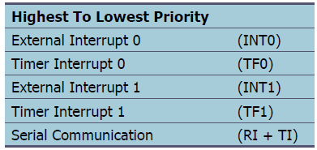
Interrupt Priority in 8051
If interrupt requests of the same priority level are received simultaneously, an internal polling sequence determines which request is serviced.
When the 8051 is powered up, the priorities are assigned according to the following.

Slide 44
IP(Interrupt Priority) Register of 8051
We can alter the sequence of interrupt priority by assigning a higher priority to any one of the interrupts by programming the IP (interrupt priority) register.
To give a higher priority to any of the interrupts, we make the corresponding bit in the IP register high.
When two or more interrupt bits in the IP register are set to high:
While these interrupts have a higher priority than others, they are serviced according to the sequence of priorities when the microcontroller powered on.

Slide 45
IP(Interrupt Priority) Register of 8051
MSB
LSB
-- | -- | -- | PS | PT1 | PX1 | PT0 | PX0
PS (IP.4)–Defines the Serial port interrupt priority level.
PT1 (IP.3)– Defines the Timer 1 interrupt priority level.
PX1 (IP.2)– Defines the External Interrupt 1 priority level.
PT0 (IP.1)– Defines the Timer 0 interrupt priority level.
PX0 (IP.0) – Defines the External Interrupt 0 priority level.

Slide 46
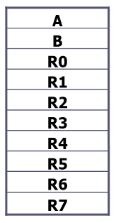
Registers in 8051
Most of 8051 register are 8-bit registers.
The most widely used registers
A (Accumulator)
For all arithmetic and logic instructions
B, R0, R1, R2, R3, R4, R5, R6, R7
PC (program counter)is 16 bits register

Slide 47
Assembly languages
CPU can work only in binary.
A program that consists of 0s and 1s is called machine language.
Assembly languages provided mnemonics for the machine code instructions.
Low-level language, deal directly with the internal structure of the CPU.
Assembler is program used to translate assembly language program into machine code.

Slide 48
Structure of Assembly Language
A given Assembly language program is a series of statements, or lines of
Assembly language instructions
Tell the CPU what to do
Directives
Give directions to the assembler
do not generate any machine code and are used only by the assembler
An Assembly language instruction includes:
A mnemonic (abbreviation easy to remember)
The commands to the CPU, telling it what to do with those items.
Optionally followed by one or two operands
The data items being manipulated

Slide 49
Assembly language instruction
An Assembly language instruction consists of four fields:
[label : ] mnemonic [operands] [;comment]
The label field allows the program to refer to a line of code by name.
A mnemonic-The commands to the CPU, telling it what those to do with those items.
Operands-The data items being manipulated.
Comments may be at the end of a line or on a line by themselves.
The assembler ignores comments

Slide 50
ORG 0H ;start(origin)at location 0
MOV R5, #25H ;load 25H into R5
MOV R7, #34H ;load 34H into R7
MOV A, #0 ;load 0 into A
ADD A, R5 ;add contents of R5 to A
ADD A, R7 ;add contents of R7 to A
ADD A, #12H ;add to A value 12H
HERE: SJMP HERE ;stay in this loop
END; end of asm source file

Slide 51
Assembler directive
ORG (origin)
The ORG directive is used to indicate the beginning of the address.
The number that comes after ORG can be either in hex and decimal.
END
This indicates to the assembler the end of the source (asm) file.
The END directive is the last line of an 8051 program.
the code anything after the END directive is ignored by the assembler.

Slide 52
Assembler directive
EQU (equate)
This is used to define a constant without occupying a memory location.
When the label appears in the program, its constant value will be substituted for the label.
COUNT EQU 32
MOV R2, #COUNT

Slide 53
Assembly language instruction
Data transfer instructions
Addressing modes
Data processing (arithmetic and logic)
Program flow instructions

Slide 54
Data Transfer Instructions
MOV dest, source dest ← source
Stack instructions
PUSH byte ;increment stack pointer, ;move byte on stack
POP byte ;move from stack to byte, ;decrement stack pointer
Exchange instructions
XCH A, byte ;exchange accumulator and byte
XCHD A, byte ;
The XCHD instruction exchanges the low-order nibble of the accumulator with the low-order nibble of the specified internal RAM location. The internal RAM is accessed indirectly through R0 or R1.

Slide 55
Addressing Modes
Addressing Modes: Immediate, Register, Direct, Register indirect.
Immediate Mode – The source operand is a constant
mov A, #0 ;put 0 in the accumulator
;A = 00000000
mov R4, #11h ;put 11hex in the R4 register
;R4 = 00010001
Register Addressing – either source or destination is one of CPU register.
MOV R0,A
MOV A,R7

Slide 56
Addressing Modes
Direct Mode – specify data in RAM by its 8-bit address.
Mov A, 70h ; copy contents of RAM at 70h to A
Mov R0,40h ; copy contents of RAM at 40h to R0
Register Indirect – the address of the source or destination is specified in registers. Only R0 and R1 used for this purpose.
MOV A,@R0 ;move contents of RAM whose
;address is held by R0 into A

Slide 57
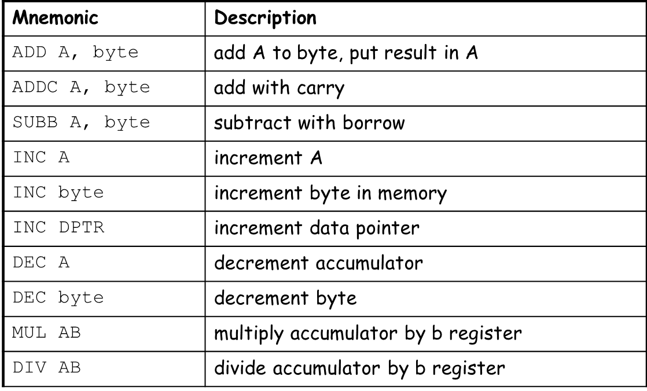
Data Processing Instructions
Arithmetic Instructions
Affect the flags, such as Carry Flag (CY), Overflow Flag (OV) etc, in the PSW register.

Slide 58
Logic Instructions
Bitwise logic operations
(AND, OR, XOR, NOT)
ANL ➔ AND
ORL ➔ OR
XRL ➔ XOR
CPL ➔ Complement

Slide 59
Other Logic Instructions
CLR - clear
RL – rotate left
RLC – rotate left through Carry
RR – rotate right
RRC – rotate right through Carry
SWAP – swap accumulator nibbles
mov A, #72h ; A ← 72h
SWAP A ; A ← 27h

Slide 60
Rotate
Rotate instructions operate only on A
RL A
Mov A,#0F0 ; A← 11110000
RL A ; A← 11100001
RR A
Mov A,#0F0 ; A← 11110000
RR A ; A← 01111000

Slide 61
Rotate through Carry
RRC A
C
MOV A, #0A9H ; A ← A9
ADD A, #14H ; A ← BD (10111101), C←0
RRC A ; A ← 01011110, C←1
RLC A
MOV A, #3CH ; A ← 3CH(00111100)
SETB C ; C ← 1
RLC A ; A ← 01111001, C←0
C

Slide 62
Program flow instructions
Unconditional jumps (“go to”):
The unconditional jump is a jump in which control is transferred unconditionally to the target location.
Conditional jumps:
Jump only if a certain condition is met
Call and return

Slide 63
Unconditional jump instructions
In the 8051 there are two unconditional jumps:
LJMP (long jump) and SJMP (short jump)
LJMP (long jump)
3-byte instruction
First byte is the opcode
Second and third bytes represent the 16-bit target address
Any memory location from 0000 to FFFFH
SJMP (short jump)
2-byte instruction
First byte is the opcode
Second byte is the relative target address
The relative address 00 to FFH is divided into forward and backward jumps

Slide 64
Unconditional jump instructions Application
Unconditional jump instructions Application
Infinite Loop: Microcontroller application programs are almost always infinite loops.
START: MOV C, P3.7
MOV P1.6, C
SJMP START

Slide 65
Conditional Jumps
These instructions cause a jump to occur only if a condition is true. Otherwise, program execution continues with the next instruction.
LOOP:MOV A, P1
JZ LOOP ;if A=0,goto LOOP, else goto next instruction
MOV B, A

Slide 66
Conditional jumps

Slide 67
More Conditional Jumps

Slide 68
Iterative Loops
For A = 0 to 4 do
{…}
CLR A
LOOP: ...
INC A
CJNE A, #4, LOOP
For A = 4 to 1 do
{…}
MOV R0, #4
LOOP: ...
DJNZ R0, LOOP

Slide 69
CALL INSTRUCTIONS
Call instruction is used to call subroutine
Subroutines are often used to perform tasks that need to be performed frequently.
This makes a program more structured in addition to saving memory space.
LCALL (long call)
3-byte instruction
First byte is the opcode
Second and third bytes are used for address of target subroutine (Subroutine is located anywhere within 64K byte address space)

Slide 70
Call and Return
Call is similar to a jump, but
Call pushes PC on stack before branching
lcall <address > ; stack ← PC
Return is also similar to a jump, but
Return instruction pops PC from stack to get address to return to
ret ; PC ← stack

Slide 71
Call and Return
call to the subroutine
Main: ...
lcall sublabel
...
...
sublabel: ...
...
ret
the subroutine

