Slide 1
CHAPTER ONE
Benefits and Risks Associated with Physical Activity

Slide 2
Public Health Perspective for Current Recommendations
Over 20 Years ago, the American College of Sports Medicine (ACSM) in conjunction with the Centers for Disease Control and Prevention (CDC) the U.S. Surgeon General, and the National Institutes of Health issued landmark publications on PA and health.
An important goal of these reports was to clarify for exercise professionals and the public the amount and intensity of PA needed to improve health, lower susceptibility to disease (morbidity), and decrease premature mortality. In addition, these reports documented the dose-response relationship between PA and health (i.e., some activity is better than none, and more activity, up to a point, is better than less).

Slide 3
CONT
In 1995, the CDC and ACSM recommended that “every U.S. adult should accumulate 30 min or more of moderate PA on most, preferably all, days of the week”.
The intent of this statement was to increase public awareness of the importance of the health-related benefits of moderate intensity PA.

Slide 4
The A
The ACSM-AHA Primary Physical Activity (PA) Recommendations CSM-AHA Primary Physical Activity (PA) Recommendations
All healthy adults aged 18–65 yr should participate in moderate intensity aerobic PA for a minimum of 30 min on 5 d · wk−1 or vigorous intensity aerobic activity for a minimum of 20 min on 3 d · wk−1.
Combinations of moderate and vigorous intensity exercise can be performed to meet this recommendation.
Moderate intensity aerobic activity can be accumulated to total the 30 min minimum by performing bouts each lasting ≥10 min.

Slide 5
CONT
Every adult should perform activities that maintain or increase muscular strength and endurance for a minimum of 2 d · wk−1.
Because of the dose-response relationship between PA and health, individuals who wish to further improve their fitness, reduce their risk for chronic diseases and disabilities, and/or prevent unhealthy weight gain may benefit by exceeding the minimum recommended amounts of PA.

Slide 6
PA Guidelines Advisory Committee Report
Physical Activity Guidelines Advisory Committee, to review the scientific evidence on PA and health published since the 1996 U.S. Surgeon General’s Report
This committee found compelling evidence regarding the benefits
of PA for health as well as the presence of a dose-response relationship for many diseases and health conditions.
Two important conclusions from the Physical Activity Guidelines Advisory Committee Report that influenced the development of the PA recommendations are the following:

Slide 7
CONT
Important health benefits can be obtained by performing a moderate amount of PA on most, if not all, days of the week.
Additional health benefits result from greater amounts of PA.
Individuals who maintain a regular program of PA that is longer in duration, of greater intensity, or both are likely to derive greater benefit than those who engage in lesser amounts

Slide 8
CONT
All Americans should participate in an amount of energy expenditure equivalent to 150 min · wk−1 of moderate intensity aerobic activity, 75 min
wk−1 of vigorous intensity aerobic activity, or a combination of both
These guidelines further specify a dose-response relationship, indicating

Slide 9
2008 PA Guidelines Advisory Committee Recommendation
Additional health benefits are obtained with 300 min · wk−1 or more of moderate intensity aerobic activity, 150 min · wk−1 or more of vigorous intensity aerobic activity, or an equivalent combination of moderate and vigorous intensity aerobic activity.
Adults should do muscle strengthening activities that are moderate or high intensity and involve all major muscle groups in ≥2 d · wk−1 because these activities provide additional health benefits.

Slide 10
HEALTH BENEFITS OF REGULAR PA & EXERCISE
Evidence to support the inverse relationship between regular PA and/or exercise and premature mortality, CVD/CAD, hypertension, stroke, osteoporosis, T2DM, metabolic syndrome (METSYN), obesity, AND cancers, depression, functional health, falls, and cognitive function continues to accumulate

Slide 11
Benefits of PA and exercise
Improvement in Cardiovascular and Respiratory Function
Increased maximal oxygen uptake resulting from both central and peripheral adaptations
Decreased minute ventilation at a given absolute submaximal intensity
Decreased myocardial oxygen cost for a given absolute submaximal intensity
Decreased heart rate and blood pressure at a given submaximal intensity
Increased capillary density in skeletal muscle
Increased exercise threshold for the accumulation of lactate in the blood
Increased exercise threshold for the onset of disease signs or symptoms
(e.g., angina pectoris, ischemic ST-segment depression, claudication)

Slide 12
Reduction in Cardiovascular Disease Risk Factors
Reduced resting systolic/diastolic pressure
Increased serum high-density lipoprotein cholesterol and decreased serum triglycerides
Reduced total body fat, reduced intra-abdominal fat
Reduced insulin needs, improved glucose tolerance
Reduced blood platelet adhesiveness and aggregation
Reduced inflammation

Slide 13
Decreased Morbidity and Mortality
Primary prevention (i.e., interventions to prevent the initial occurrence)
Higher activity and/or fitness levels are associated with lower death rates from CAD
Higher activity and/or fitness levels are associated with lower incidence rates for CVD, CAD, stroke, Type 2 diabetes mellitus, metabolic syndrome, osteoporotic fractures, cancer of the colon and breast, and gallbladder disease
Secondary prevention (i.e., interventions after a cardiac event to prevent another)
Based on meta-analyses (i.e., pooled data across studies), cardiovascular and all-cause mortality are reduced in patients with post-myocardial infarction (MI) who participate in cardiac rehabilitation exercise training,

Slide 14
Other Benefits
Decreased anxiety and depression
Improved cognitive function
Enhanced physical function and independent living in older individuals
Enhanced feelings of well-being
Enhanced performance of work, recreational, and sport activities
Reduced risk of falls and injuries from falls in older individuals
Prevention or mitigation of functional limitations in older adults
Effective therapy for many chronic diseases in older adults
CAD, coronary artery disease; CVD, cardiovascular disease.

Slide 15
Risks Associated with Physical Activity and Exercise
Although the benefits of regular PA are well established, participation in exercise is associated with an increased risk for musculoskeletal injury (MSI) and cardiovascular complications.
MSI is the most common exercise-related complication and is often associated with exercise intensity, the nature of the activity, preexisting conditions, and musculoskeletal anomalies.
Adverse cardiovascular events such as sudden cardiac death (SCD) and acute myocardial infarction (AMI) are usually associated with vigorous intensity exercise. SCD and AMI are much less common than MSI but may lead to long- term morbidity and mortality.

Slide 16
Exercise-Related Musculoskeletal Injury
Participation in exercise and PA increases the risk of MSI.
The intensity and type of exercise may be the most important factors related to the incidence of injury.
Walking and moderate intensity physical activities are associated with a very low risk of MSI, whereas jogging, running, and competitive sports are associated with an increased risk of injury.
The risk of MSI is higher in activities where there is direct contact between participants or with the ground (e.g., football, wrestling) versus activities where the contact between participants or with the ground is minimal or nonexistent (i.e., baseball, running, walking).

Slide 17
CONT
For any given dose of PA, individuals who are physically inactive are more likely to experience MSI when compared to their more active counterparts.
Commonly used methods to reduce MSI (e.g., stretching, warm-up, cool- down, and gradual progression of exercise intensity and volume) may be helpful in some situations; however, there is a lack of controlled studies confirming the effectiveness of these methods.
A comprehensive list of strategies that may prevent MSI can be found elsewhere

Slide 18
Sudden Cardiac Death Among Young Individuals
The most common causes of SCD in young individuals are congenital and hereditary abnormalities including hypertrophic cardiomyopathy, coronary artery abnormalities, and aortic stenosis.
Prevention of Exercise Related Cardiac Events
Because of the low incidence of cardiac events related to vigorous intensity exercise, it is very difficult to test the effectiveness of strategies to reduce the occurrence of these events. According to a recent statement by the ACSM and AHA, “Physicians should not overestimate the risks of exercise because the benefits of habitual physical activity substantially outweigh the risks.”
This report also recommends several strategies to reduce these cardiac events during vigorous intensity exercise:

Slide 19
Health care professionals should know the pathologic conditions associated with exercise-related events so that physically active children and adults can be appropriately evaluated.
Physically active individuals should know the nature of cardiac prodromal symptoms (e.g., excessive, unusual fatigue and pain in the chest and/or upper back) and seek prompt medical care if such symptoms develop
Participants should undergo pre-participation screening by qualified professionals.
Athletes with known cardiac conditions or a family history should be evaluated prior to competition using established guidelines.
Health care facilities should ensure their staff is trained in managing cardiac emergencies and have a specified plan and appropriate resuscitation equipment.
Physically active individuals should modify their exercise program in response to variations in their exercise capacity, habitual activity level, and the environment

Slide 20
Sedentary individuals can safely begin a light-to-moderate intensity exercise program; all individuals should participate in the exercise pre-participation screening process to determine the need for medical clearance.
Exercise professionals who supervise exercise and fitness programs should have current training in basic and/or advanced cardiac life support and emergency procedures.
These emergency procedures should be reviewed and practiced at regular intervals.
Finally, individuals should be educated on the signs and symptoms of CVD and should be referred to a physician for further evaluation should these symptoms occur.

Slide 21
Exercise Pre-Participation Health Screening
Historically, the exercise pre-participation health screening process centered on the risk classification (i.e., low, moderate, high) of all individuals which was based on (a) the number of cardiovascular disease (CVD) risk factors and (b) the presence of signs or symptoms and/or known cardiovascular (CV), metabolic, and/or pulmonary disease.
Recommendations for a pre-participation medical examination and exercise testing were then based on the risk classification and proposed exercise intensity.

Slide 22
Exercise pre-participation health screening should bases on:
(a) the individual’s current level of physical activity (PA);
(b) the presence of signs or symptoms and/or known CV, metabolic, or renal disease; and
(c) the desired exercise intensity because these three factors have been identified as important risk modulators of exercise-related CV events.
No longer includes the CVD risk factor profile as part of the decision making for referral to a health care provider prior to the initiating a moderate-to- vigorous intensity exercise program.

Slide 23
No longer recommends a low, moderate, or high risk classification scheme.
Makes general recommendations for medical clearance versus specific recommendations for medical exams or exercise tests, leaving the manner of clearance to the discretion of the health care provider.
Does not automatically refer individuals with pulmonary disease for medical clearance prior to the initiation of an exercise program.
The present ACSM recommendation that the inclusion of exercise testing or any other type of exam, as part of medical clearance, should be left to the clinical judgment of qualified health care providers.
In the new exercise pre-participation health screening procedures, individuals with pulmonary disease are no longer automatically referred for medical clearance because pulmonary disease does not increase the risks of nonfatal or fatal CV complications during or immediately after exercise;

Slide 24
The goals of the new ACSM exercise pre-participation health screening process is to identify individuals:
(a) who should receive medical clearance before initiating an exercise program or increasing the frequency, intensity, and/or volume of their current program;
(b) with clinically significant disease(s) who may benefit from participating in a medically supervised exercise program; and
(c) with medical conditions that may require exclusion from exercise programs until those conditions are abated or better controlled.

Slide 25
The new exercise pre-participation health screening algorithm with respect to:
Determining current PA levels
Identifying signs and symptoms of underlying CV, metabolic, and renal disease
Identifying individuals with diagnosed CV and metabolic disease
Using signs and symptoms, disease history, current exercise participation, and desired exercise intensity to guide recommendations for pre-participation medical clearance

Slide 26
By following a pre-participation screening algorithm taking into account the preceding points, exercise professionals are better able to identify participants who are at risk for exercise- or PA-related CV complications.
The algorithm is designed to identify individuals who should receive medical clearance before initiating an exercise program or increasing the frequency, intensity, and/or volume of their current program and may also help to identify those with clinically significant disease(s) who may benefit from participating in a medically supervised exercise program and those with medical conditions that may require exclusion from exercise programs until those conditions are abated or better controlled

Slide 27
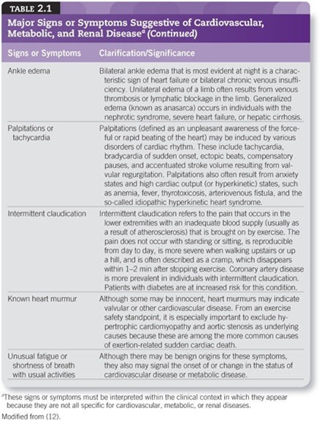

Slide 28
Exercise pre-participation health screening guideline:
Pre-participation health screening before initiating PA or an exercise program is a two-stage process:
1. The need for medical clearance before initiating or progressing exercise programming is determined using the updated and revised ACSM screening algorithm and the help of a qualified exercise or health care professional.
In the absence of professional assistance, interested individuals may use self-guided methods
2. Medical clearance should be sought from an appropriate health care provider (e.g., primary care or internal medicine physician, cardiologist). The manner of clearance should be determined by the clinical judgment and discretion of the health care provider

Slide 29
Pre-participation health screening Methods
Pre-participation health screening by a self-screening tool should be done for all individuals wishing to initiate an exercise program.
Physical Activity Readiness Questionnaire (PAR- Q) and
AHA/ACSM Health/Fitness Facility Pre-participation Screening Questionnaire and the addition of the PAR-Q+
The PAR-Q was recently updated to the PAR-Q+ which now includes several additional follow-up questions to better guide pre-participation recommendations

Slide 30
The updated PAR-Q+ is evidence-based and was developed, in part, to reduce barriers for exercise and false positive screenings.
The tool uses follow-up questions to better tailor pre-exercise recommendations based on relevant medical history and symptomatology.
The PAR-Q+ may be used as a self-guided exercise pre-participation health screening tool or as a supplemental tool for professionals that may want additional screening resources beyond the new algorithm.
Notably, the cognitive ability required to fully answer the PAR-Q+ may be higher than the original PAR-Q; thus, some individuals may need assistance completing the PAR-Q+.

Slide 31
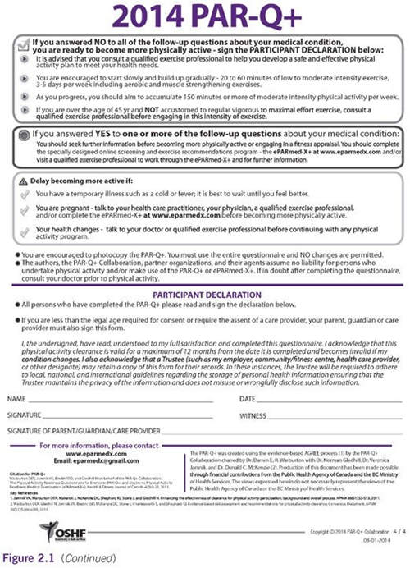

Slide 32
The ACSM pre-participation screening algorithm
The ACSM pre-participation screening algorithm is a new instrument designed to identify participants at risk for CV complications during or immediately after aerobic exercise.

Slide 33
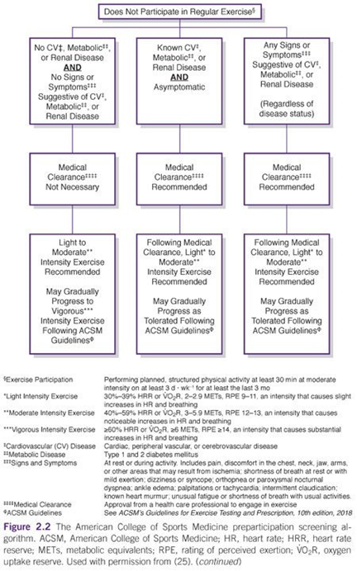

Slide 34
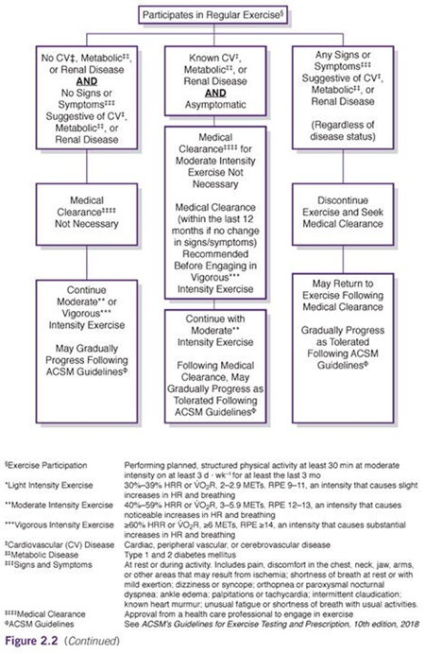

Slide 35
Pre-participation health screening Algorithm Components
The screening algorithm begins by classifying individuals who do or do not currently participate in regular exercise
As designated, participants classified as current exercisers
should have a history of performing planned, structured PA of at least moderate intensity for at least 30 min on three or more days per week during the past 3 mo.
The next level of classification involves identifying individuals with known CV, metabolic, or renal diseases or those with signs or symptoms suggestive of cardiac, peripheral vascular, or cerebrovascular disease, Types 1 and 2 diabetes mellitus (DM), and renal diseases

Slide 36
During the pre-participation screening process, participants should be asked if a physician or other qualified health care provider has ever diagnosed them with any of these conditions.
During pre-participation health screening, hypertension should be considered a CVD risk factor and not a cardiac disease
Once an individual’s disease status has been ascertained, attention should shift toward signs and symptoms suggestive of these diseases.
The CV, metabolic, and renal diseases of concern for pre-participation health screening may be present but undiagnosed in exercise participants.
To better identify those individuals who may have undiagnosed disease, participants should be screened for the presence or absence of signs and symptoms suggestive of these diseases,

Slide 37
Care should be taken to interpret the signs and symptoms within the context of the participant’s recent history, and additional information should be sought to clarify vague or ambiguous responses.
For example, a participant may describe recent periods of noticeable breathlessness.
This occurrence is a nonspecific symptom of CVD as many factors can cause shortness of breath.
Pertinent follow-up questions may include “What were you doing during these periods?” or “Were you more breathless than you would have expected for this activity?”
These questions may provide better clarification to better distinguish expected from potentially pathological signs and symptoms.
An exercise pre-participation health screening checklist is included to guide the exercise professional through the prescreening process.

Slide 38
Desired exercise intensity is the final component in the pre-participation screening algorithm.
Because vigorous intensity exercise is more likely to trigger acute CV events, versus light-to-moderate intensity exercise, in selected individuals, identifying the intensity at which a participant intends to exercise is important.
Guidance is offered in the footnotes of the algorithm on the aforementioned designations as well as what constitutes light, moderate, and vigorous intensity exercise.

Slide 39
Desired exercise intensity is the final component in the pre-participation screening algorithm.
Because vigorous intensity exercise is more likely to trigger acute CV events, versus light-to-moderate intensity exercise, in selected individuals, identifying the intensity at which a participant intends to exercise is important.
Guidance is offered in the footnotes of the algorithm on the aforementioned designations as well as what constitutes light, moderate, and vigorous intensity exercise

Slide 40
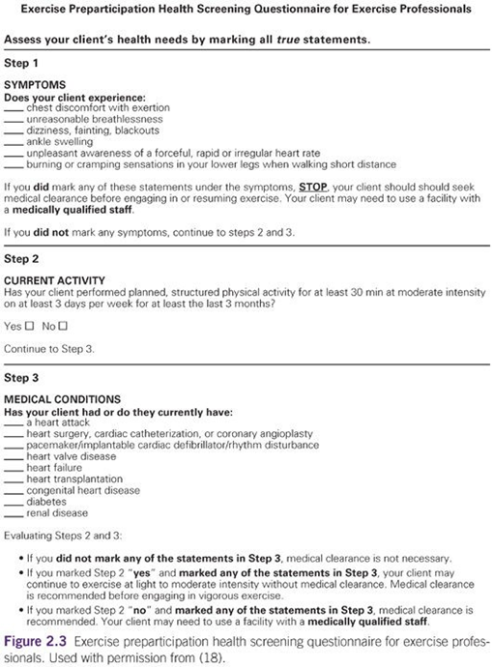

Slide 41
Desired exercise intensity is the final component in the pre-participation screening algorithm.
Because vigorous intensity exercise is more likely to trigger acute CV events, versus light-to-moderate intensity exercise, in selected individuals, identifying the intensity at which a participant intends to exercise is important.
Guidance is offered in the footnotes of the algorithm on the aforementioned designations as well as what constitutes light, moderate, and vigorous intensity exercise

Slide 42
Using the Algorithm
According to the pre-participation screening algorithm, participants are grouped into one of six categories.
Each category is explained later, moving from left to right across Figure 2.2.
Importantly, exercise professionals using this algorithm should monitor participants for changes that may alter their categorization and recommendations.
For example, participants who initially declare no signs or symptoms of disease may develop signs or symptoms only after beginning an exercise program, and this would necessitate more aggressive screening recommendations.
Apparently, healthy participants who do not currently exercise and have no history or signs or symptoms of CV, metabolic, or renal disease can immediately, and without medical clearance, initiate an exercise program at light-to-moderate intensity.

Slide 43
Participants who do not currently exercise and have (a) known CV, metabolic,
or renal disease and (b) are asymptomatic should obtain medical clearance before initiating a structured exercise program of any intensity.
Following medical clearance, the individual may embark on light-to-moderate intensity exercise and progress as tolerated following ACSM Guidelines.
Symptomatic participants who do not currently exercise should seek medical clearance regardless of disease status.
If signs or symptoms are present with activities of daily living, medical clearance may be urgent.
Following medical clearance, the individual may embark on light-to-moderate intensity exercise and progress as tolerated following ACSM Guidelines
Participants who already exercise regularly and have no history or signs or
symptoms of CV, metabolic, or renal disease may continue with their current exercise volume/intensity or progress as appropriate without medical clearance.

Slide 44
Participants who already exercise regularly; have a known history of CV, metabolic, or renal disease; but have no current signs or symptoms (i.e., are clinically “stable”) may continue with moderate intensity exercise without medical clearance.
However, if these individuals desire to progress to vigorous intensity aerobic exercise, medical clearance is recommended.
Participants who already exercise regularly but experience signs or symptoms
suggestive of CV, metabolic, or renal disease (regardless of disease status) should discontinue exercise and obtain medical clearance before continuing exercise at any intensity.

Slide 45
When participants are identified for whom medical clearance is warranted, they should be referred to an appropriate physician or other health care provider.
Importantly, the type of medical clearance is left to the discretion and clinical judgment of the provider to whom the participant is referred because there is no single, universally recommended screening test
Exercise professionals may request written clearance along with special instructions or restrictions (e.g., exercise intensity) for the participant in question, and continued communication between health care providers and exercise professionals is strongly encouraged.

Slide 46
Case studies to determine need for exercise pre-participation medical clearance
CASE STUDY I
A 50-yr-old nonsmoking male was recently invited by colleagues to participate in a 10-km trail run.
He reports currently walking 40 min on Monday, Wednesday, and Friday — something he has done “for years.”
His goal is to run the entire race without stopping, and he is seeking training services.
He reports having what he describes as a “mild heart attack” at 45 yr old, completed cardiac rehabilitation, and has had no problems since.
He takes a statin, an angiotensin-converting enzyme (ACE) inhibitor, and aspirin daily.
During the last visit with his cardiologist, which took place 2 yr ago, the cardiologist noted no changes in his medical condition

Slide 47
CASE STUDY II
A 22-yr-old recent college graduate is joining a gym.
Since becoming an accountant 6 mo ago, she no longer walks across campus or plays intramural soccer and has concerns about her now sedentary lifestyle.
Although her body mass index (BMI) is slightly above normal, she reports no significant medical history and no symptoms of any diseases, even when walking up three flights of stairs to her apartment. She would like to begin playing golf.

Slide 48
CASE STUDY IV
A 60-yr-old woman is beginning a professionally led walking program.
Two years ago, she had a drug-eluting stent placed in her left anterior descending coronary artery after a routine exercise stress test revealed significant ST- segment depression.
She completed a brief cardiac rehabilitation program in the 2 mo following the procedure but has been inactive since.
She reports no signs or symptoms and takes a cholesterol-lowering statin and antiplatelet medications as directed by her cardiologist.

Slide 49
CASE STUDY V
A 35-yr-old business consultant is in town for 2 wk and seeking a temporary membership at a fitness club.
She and her friends have been training for a long-distance charity bike ride for the past 16 wk; she is unable to travel with her bike and she does not want to lose her fitness.
She reports no current symptoms of CV or metabolic disease and has no medical history except hyperlipidemia, for which she takes a HMG-CoA reductase inhibitor (statin) daily.

Slide 50
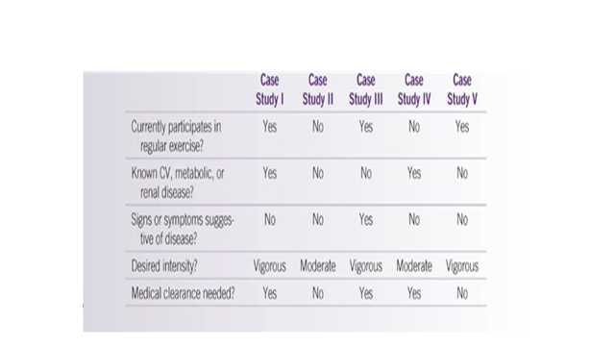
Summary of Case Studies

Slide 51
Risk Stratification For Patients In Cardiac Rehabilitation And Medical Fitness Facilities

Slide 52
American Association of Cardiovascular and Pulmonary Rehabilitation Risk Stratification Criteria for Patients with Cardiovascular Disease
LOWEST RISK
Characteristics of patients at lowest risk for exercise participation (all characteristics listed must be present for patients to remain at lowest risk)
Absence of complex ventricular dysrhythmias during exercise testing and recovery
Absence of angina or other significant symptoms (e.g., unusual shortness of breath, light-headedness, or dizziness, during exercise testing and recovery)
Presence of normal hemodynamics during exercise testing and recovery (i.e., appropriate increases and decreases in heart rate and systolic blood pressure with increasing workloads and recovery)
Functional capacity ≥7 metabolic equivalents (METs)

Slide 53
Non-exercise Testing Findings
Resting ejection fraction ≥50%
Uncomplicated myocardial infarction or revascularization procedure
Absence of complicated ventricular dysrhythmias at rest
Absence of congestive heart failure
Absence of signs or symptoms of post event/post procedure myocardial ischemia
Absence of clinical depression

Slide 54
MODERATE RISK
Characteristics of patients at moderate risk for exercise participation (any one or combination of these findings places a patient at moderate risk)
Presence of angina or other significant symptoms (e.g., unusual shortness of breath, light-headedness, or dizziness occurring only at high levels of exertion [≥7 METs])
Mild-to-moderate level of silent ischemia during exercise testing or recovery (ST-segment depression <2 mm from baseline)
Functional capacity <5 METs
Non-exercise Testing Findings
Rest ejection fraction 40%–49%

Slide 55
HIGHEST RISK
Characteristics of patients at high risk for exercise participation (any one or combination of these findings places a patient at high risk)
Presence of complex ventricular dysrhythmias during exercise testing or recovery
Presence of angina or other significant symptoms (e.g., unusual shortness of
breath, light-headedness, dizziness at low levels of exertion [<5 METs] or during recovery)
High level of silent ischemia (ST-segment depression ≥2 mm from baseline)
during exercise testing or recovery
Presence of abnormal hemodynamics with exercise testing (i.e., chronotropic incompetence or flat or decreasing systolic blood pressure with increasing workloads) or recovery (i.e., severe post exercise hypotension)

Slide 56
Non-exercise Testing Findings
Rest ejection fraction <40%
History of cardiac arrest or sudden death
Complex dysrhythmias at rest
Complicated myocardial infarction or revascularization procedure
Presence of congestive heart failure
Presence of signs or symptoms of post event/post procedure myocardial ischemia
Presence of clinical depression

Slide 57
American Association of Cardiovascular and Pulmonary Rehabilitation Risk Stratification Criteria for Patients with Cardiovascular Disease
(AACVPR)
The AACVPR guidelines provide recommendations for participant and/or patient monitoring and exercise supervision and for activity prescription and restriction.
Clinical exercise professionals should recognize that the AACVPR guidelines do not consider comorbidities (e.g., Type 2 DM, morbid obesity, severe pulmonary disease, debilitating neurological and orthopedic conditions) that may require modification of the recommendations for monitoring and supervision during exercise training.

Slide 58
Pre-exercise Evaluation
The pre-participation evaluation includes:
informed consent procedures,
medical history and cardiovascular disease [CVD] risk factor assessment,
physical examination and laboratory tests,
participant instructions) relate to both the health/fitness and the clinical exercise settings

Slide 59
If an individual is referred for medical clearance, the extent of the pre-exercise evaluation is based on the discretion of the health care provider
A pre-exercise evaluation that includes a physical examination, an exercise test, and/or laboratory tests may be warranted for any individual whenever the exercise professional or health care provider has concerns about an individual’s health status or requires additional information to design an exercise prescription (Ex Rx) or when the exercise participant has concerns about starting an exercise program of any intensity without such a medical evaluation

Slide 60
The healthier populations typically encountered in the health fitness setting generally warrant a less intensive approach to the pre-exercise evaluation.
However, individuals with chronic disease and other health challenges may be encountered in these settings, so exercise professionals are urged to be prudent in identifying those who need medical clearance.
A comprehensive pre-exercise evaluation in the clinical setting generally includes a medical history and risk factor assessment, physical examination, and laboratory tests, the results of which should be documented in the client’s or patient’s file.

Slide 61
INFORMED CONSEN
Obtaining adequate informed consent from participants before exercise testing in health/fitness or clinical settings is an important ethical and legal consideration.
Although the content and extent of consent forms may vary, enough information must be present in the informed consent process to ensure that the participant knows and understands the purposes and risks associated with the test or exercise program in health/fitness or clinical settings.
The consent form should be verbally explained and include a statement indicating the client or patient has been given an opportunity to ask questions about the procedure and has sufficient information to give informed consent
The consent form must indicate the participant is free to withdraw from the procedure at any time

Slide 62
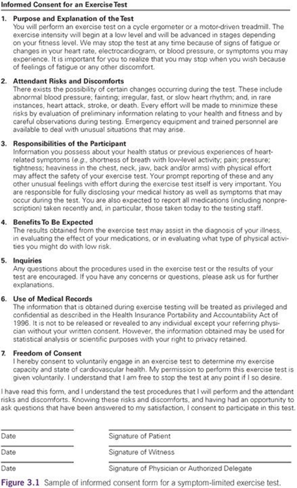

Slide 63
MEDICAL HISTORY AND CARDIOVASCULAR DISEASE RISK FACTOR ASSESSMEN

Slide 64
Components of Medical History
Appropriate components of the medical history may include the following:
Medical diagnoses and history of medical procedures: cardiovascular disease risk factors including hypertension, obesity, dyslipidemia, and diabetes; cardiovascular disease including heart failure, valvular dysfunction (e.g., aortic stenosis/mitral valve disease), myocardial infarction, and other acute coronary syndromes; percutaneous coronary interventions including angioplasty and coronary stent(s), coronary artery bypass surgery, and other cardiac surgeries such as valvular surgeries; cardiac transplantation; pacemaker and/or implantable cardioverter defibrillator;

Slide 65
peripheral vascular disease; pulmonary disease including asthma, emphysema, and bronchitis; cerebrovascular disease including stroke and transient ischemic attacks; anemia; cancer; pregnancy; osteoporosis; musculoskeletal disorders; emotional disorders; and eating disorders
Previous physical examination findings: murmurs, clicks, gallop rhythms, other abnormal heart sounds, and other unusual cardiac and vascular findings; abnormal pulmonary findings (e.g., wheezes, rales, crackles), high blood pressure, and edema
Laboratory findings: plasma glucose, HbA1C, hs-CRP, serum lipids and lipoproteins, or other significant laboratory abnormalities

Slide 66
History of symptoms: discomfort (e.g., pressure, tingling sensation, pain, heaviness, burning, tightness, squeezing, numbness) in the chest, jaw, neck, back, or arms; light-headedness, dizziness, or fainting; temporary loss of visual acuity or speech; transient unilateral numbness or weakness; shortness of breath; rapid heartbeat or palpitations, especially if associated with physical activity, eating a large meal, emotional upset, or exposure to cold (or any combination of these activities)
Recent illness, hospitalization, new medical diagnoses, or surgical procedures

Slide 67
Orthopedic problems including arthritis, joint swelling, and any condition that would make ambulation or use of certain test modalities difficult
Medication use (including dietary/nutritional supplements) and drug allergies
Other habits including caffeine, alcohol, tobacco, or recreational (illicit) drug use
Exercise history: information on readiness for change and habitual level of activity: frequency, duration or time, type, and intensity or FITT of exercise
Work history with emphasis on current or expected physical demands, noting upper and lower extremity requirements
Family history of cardiac, pulmonary, or metabolic disease, stroke, or sudden death

Slide 68
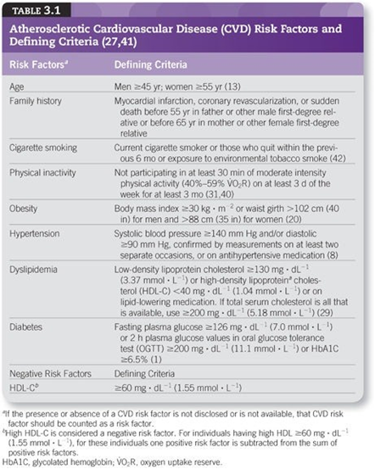

Slide 69
Case Studies to Conduct Cardiovascular Disease Risk Factor Assessment

Slide 70
CASE STUDY I
Female, age 21 yr, smokes socially on weekends (~10–20 cigarettes).
Drinks alcohol one or two nights a week, usually on weekends.
Height = 63 in (160 cm), weight = 124 lb (56.4 kg), BMI = 22.0 kg · m−2.
RHR = 76 beats · min−1,
resting BP = 118/72 mm Hg.
Total cholesterol = 178 mg · dL−1 (4.61 mmol · L−1),
LDL-C = 98 mg · dL−1 (2.54 mmol · L−1),
HDL-C = 62 mg · dL−1 (1.60 mmol · L−1),
FBG = 96 mg · dL−1 (5.33 mmol · L−1).
Currently taking oral contraceptives.
Attends group exercise class two to three times a week. Both parents living and in good health

Slide 71
CASE STUDY II
Man, age 45 yr, nonsmoker.
Height = 72 in (182.9 cm),
weight = 168 lb (76.4 kg), BMI = 22.8 kg · m−2.
RHR = 64 beats · min−1, resting BP = 124/78 mm Hg.
Total cholesterol = 187 mg · dL−1 (4.84 mmol · L−1),
LDL-C = 103 mg · L−1 (2.67 mmol · L−1),
HDL-C = 39 mg · dL−1 (1.01 mmol · L−1), FBG = 88 mg· dL−1 (4.84 mmol · L−1). Recreationally competitive runner,
runs 4–7 d · wk−1, completes one to two marathons and numerous other road races every year.
No medications other than over-the-counter ibuprofen as needed.
Father died at age 51 yr of a heart attack; mother died at age 81 yr of cancer.

Slide 72
CASE STUDY III
Man, age 44 yr, nonsmoker.
Height = 70 in (177.8 cm),
weight = 216 lb (98.2 kg), BMI = 31.0 kg · m−2.
RHR = 62 beats · min−1,
resting BP = 128/84 mm Hg.
Total serum cholesterol = 184 mg · dL−1 (4.77 mmol · L−1),
LDL-C = 106 mg · dL−1 (2.75 mmol · L−1), HDL-C = 44 mg · dL−1 (1.14 mmol · L−1),
FBG = 130 mg · dL−1 (7.22 mmol · L−1).
Reports that he does not have time to exercise.
Father had Type 2 diabetes and died at age 67 yr of a heart attack; mother living, no CVD. No medications.

Slide 73
CASE STUDY IV
Woman, age 36 yr, nonsmoker.
Height = 64 in (162.6 cm),
weight = 108 lb (49.1 kg), BMI = 18.5 kg · m−2.
RHR = 61 beats · min−1,
resting BP = 142/86 mm Hg.
Total cholesterol = 174 mg · dL−1 (4.51 mmol · L−1),
blood glucose normal with insulin injections.
Type 1 diabetes mellitus diagnosed at age 7 yr.
Teaches dance aerobic classes three times a week, walks approximately 45 min four times a week.
Both parents in good health with no history of CVD.

Slide 74
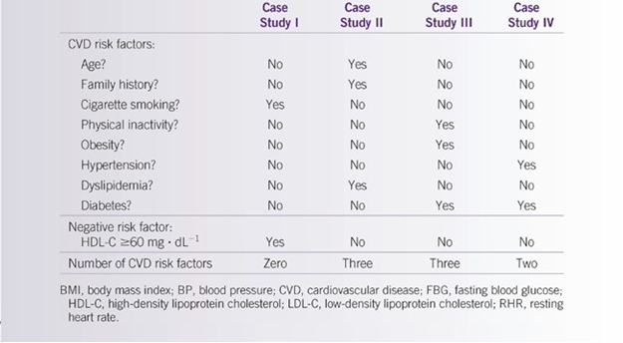
Summary of Cases

Slide 75
Physical Examination And Laboratory Tests

Slide 76
Components of the Pre-participation Physical Examination
Appropriate components of the physical examination may include the following:
Body weight; in many instances, determination of body mass index, waist girth, and/or body composition (body fat percentage) is desirable.
Apical pulse rate and rhythm
Resting blood pressure: seated, supine, and standing
Auscultation of the lungs with specific attention to uniformity of breath sounds in all areas (absence of rales, wheezes, and other breathing sounds)
Palpation of the cardiac apical impulse and point of maximal impulse
Auscultation of the heart with specific attention to murmurs, gallops, clicks, and rubs
Palpation and auscultation of carotid, abdominal, and femoral arteries
Evaluation of the abdomen for bowel sounds, masses, and tenderness

Slide 77
Palpation and inspection of lower extremities for edema and presence of arterial pulses
Absence or presence of tendon xanthoma and skin xanthelasma
Follow-up examination related to orthopedic or other medical conditions that would limit exercise testing
Tests of neurologic function including reflexes and cognition (as indicated)
Inspection of the skin, especially of the lower extremities in known patients with diabetes mellitus

Slide 78
Recommended Laboratory Tests
All Individuals
Fasting serum total cholesterol, LDL cholesterol, HDL cholesterol, and triglycerides
Fasting plasma glucose. For all patients, particularly those who are overweight or obese (BMI ≥25 kg · m−2 or ≥23 kg · m−2 in Asian Americans), testing should begin at age 45 yr.
Testing should be considered in all adults regardless of age who are overweight or obese and have one or more additional risk factors for Type 2 diabetes mellitus: a first-degree relative with diabetes, member of a high-risk ethnic population (e.g.,

Slide 79
History of gestational diabetes, hypertension (BP ≥140/90 mm Hg in adults) or on therapy for hypertension, HDL cholesterol <35 mg · dL−1 (<0.90 mmol · L−1) and/or triglycerides ≥250 mg · dL−1 (≥2.82 mmol · L−1),
Polycystic ovary disease, previously identified impaired glucose tolerance or impaired fasting glucose (fasting glucose ≥100 mg · dL−1; ≥5.55 mmol · L−1) or HbA1C ≥5.7%, habitual physical inactivity, other clinical conditions associated with insulin resistance (e.g., severe obesity), and history of atherosclerotic vascular disease

Slide 80
Individuals with Signs/Symptoms or Known Cardiovascular Disease
Preceding tests plus pertinent previous cardiovascular laboratory tests as indicated (coronary angiography, previous exercise tests)
Carotid ultrasound and other peripheral vascular studies as indicated
Chest radiograph, if heart failure is present or suspected
Comprehensive blood chemistry panel and complete blood count as indicated by history and physical examination

Slide 81
Patients with Pulmonary Disease
Chest radiograph
Pulmonary function tests
Carbon monoxide diffusing capacity
Other specialized pulmonary studies (e.g., oximetry or blood gas analysis)

Slide 82
Blood Pressure
Measurement of resting BP is an integral component of the pre-exercise evaluation.
Subsequent decisions should be based on the average of two or more properly measured, seated BP readings recorded during each of two or more office visits
Specific techniques for measuring BP are critical to accuracy and detection of high BP
In addition to high BP readings, unusual low readings should also be evaluated for clinical significance

Slide 83
Procedures for Assessment of Resting Blood Pressure
Patients should be seated quietly for at least 5 min in a chair with back support (rather than on an examination table) with their feet on the floor and their arms supported at heart level.
Patients should refrain from smoking cigarettes or ingesting caffeine for at least 30 min preceding the measurement.
Measuring supine and standing values may be indicated under special circumstances.
Wrap cuff firmly around upper arm at heart level; align cuff with brachial artery.

Slide 84
Potential Sources of Error in Blood Pressure Assessment
Improper cuff size
Auditory acuity of technician
Rate of inflation or deflation of cuff pressure
Experience of technician
Faulty equipment
Improper stethoscope placement or pressure
Not having the cuff at heart level
Certain physiologic abnormalities (e.g., damaged brachial artery)
Reaction time of technician

Slide 85
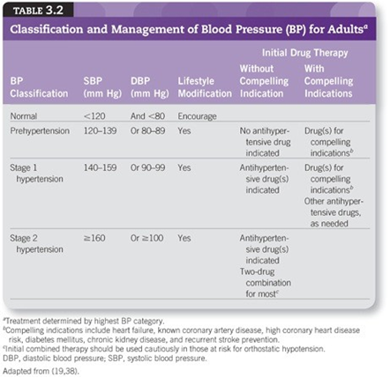

Slide 86
The relationship between BP and risk for cardiovascular events is continuous, consistent, and independent of other risk factors.
For individuals aged 40–70 yr, each increment of 20 mm Hg in systolic blood pressure (SBP) or 10 mm Hg in diastolic blood pressure (DBP) doubles the risk of CVD across the entire BP range of 115/75–185/115 mm Hg. Individuals with an SBP of 120–139 mm Hg and/or a DBP of 80–89 mm Hg have prehypertension and require health- promoting lifestyle modifications to prevent the development of hypertension

Slide 87
Lifestyle modification including PA, weight reduction, a Dietary Approaches
to Stop Hypertension (DASH) eating plan (i.e., a diet rich in fruits, vegetables, low-fat dairy products with a reduced content of saturated and total fat), dietary sodium reduction (no more than 2 g sodium per day), and moderation of alcohol consumption remains the cornerstone of antihypertensive therapy.
Pharmacologic therapy is added when lifestyle interventions have not proven effective in achieving the desired goal

Slide 88
However, most patients with hypertension who require drug therapy in addition to lifestyle modification require two or more antihypertensive medications to achieve the BP goal
The main goal of BP treatment is to decrease the risk of CVD orbidity and mortality and renal morbidity.
In general, the recommended BP goal for most patients is <140/90 mm Hg.
However, the recent guideline recommends initiating pharmacologic therapy for patients ≥60 yr (without DM or chronic kidney disease) at SBP ≥150 mm Hg or DBP ≥90 mm Hg and to treat to an SBP goal of <150 mm Hg and a DBP goal of <90 mm Hg. (19).
Because of differences in the general health of very old patients, the BP goal may be higher than <140/90 mm Hg, and the decision to treat should be made on an individual basis

Slide 89
Lipids and Lipoproteins
the recent AHA Guidelines on the Treatment of Blood Cholesterol to Reduce Atherosclerotic Cardiovascular Risk in Adults, LDL-C is identified as the primary target for cholesterol-lowering therapy.
This designation is based on a wide variety of evidence indicating elevated LDL- C is a powerful risk factor for CVD, and lowering of LDL-C results in a striking reduction in the incidence of CVD.
Table 3.3 summarizes the clinically accepted classifications of LDL-C, total cholesterol, and HDL-C and triglycerides

Slide 90
There is evidence of an association between elevated triglycerides and CVD risk, although adjustment for other risk factors, especially HDL-C, appears to attenuate this relationship.
Non-fasting triglyceride levels have a stronger relationship with CVD risk than do fasting levels . Studies suggest some species of triglyceride-rich lipoproteins, notably small very low-density lipoproteins (VLDLs) and intermediate-density lipoproteins (IDLs), promote atherosclerosis and predispose to CVD
The fundamental principle of guideline recommendations for the treatment of dyslipidemia is that the intensity of therapy should be adjusted to the individual’s absolute risk for CVD.
Therapeutic lifestyle changes are the cornerstone of therapy, with pharmacological therapy to lower LDL-C

Slide 91
Blood Profile Analyses
Multiple analyses of blood profiles are commonly evaluated in clinical exercise programs.
Such profiles may provide useful information about an individual’s overall health status and ability to exercise and may help to explain certain ECG abnormalities
Because of varied methods of assaying blood samples, some caution is advised when comparing blood chemistries from different laboratories.
Table 3.4 gives normal ranges for selected blood chemistries, derived from a variety of sources.
For many patients with CVD, medications for dyslipidemia and hypertension are common.
Many of these medications act in the liver to lower blood cholesterol and in the kidneys to lower BP

Slide 92
Although current recommendations do not suggest performing serial tests of liver function in patients receiving statin drugs, tests such as alanine transaminase (ALT) and aspartate transaminase (AST) may indicate the presence of liver abnormalities induced by the these agents.
Periodic testing of renal function with tests such as creatinine, estimated glomerular filtration rate (GFR), blood urea nitrogen (BUN),UN/creatinine ratio, and serum sodium and potassium levels is indicated in patients prescribed medications that may lead to alterations in renal function.
Indication of volume depletion and potassium abnormalities can be seen in the sodium and potassium measurements

Slide 93
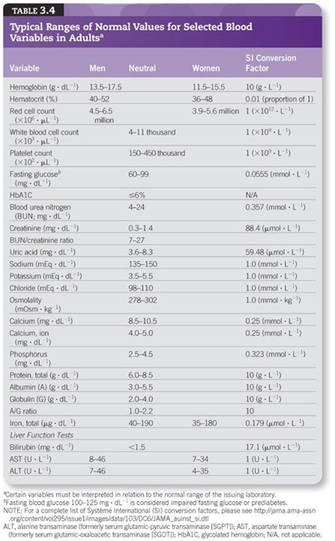

Slide 94
Pulmonary Function
Pulmonary function testing with spirometry is recommended for all smokers >45 yr old and in any individual presenting with dyspnea (i.e., shortness of breath), chronic cough, wheezing, or excessive mucus production (12).
Spirometry is a simple and noninvasive test that can be performed easily.
Indications for spirometry are listed in Table 3.5. When performing spirometry, standards for the performance of the test, as endorsed by the American Thoracic Society (ATS), should be followed

Slide 95
Although many measurements can be made from a spirometric test, the most commonly used include the forced vital capacity (FVC), forced expiratory volume in one second (FEV1.0), FEV1.0/FVC ratio, and peak expiratory flow (PEF).
Results from these measurements can help to identify the presence of restrictive or obstructive respiratory abnormalities, sometimes before symptoms or signs of disease are present.
The FEV1.0/FVC ratio is diminished with obstructive airway diseases (e.g., asthma, chronic bronchitis, emphysema, chronic obstructive pulmonary disease [COPD]) but remains normal with restrictive disorders (e.g., kyphoscoliosis, neuromuscular disease, pulmonary fibrosis, other interstitial lung diseases).

Slide 96
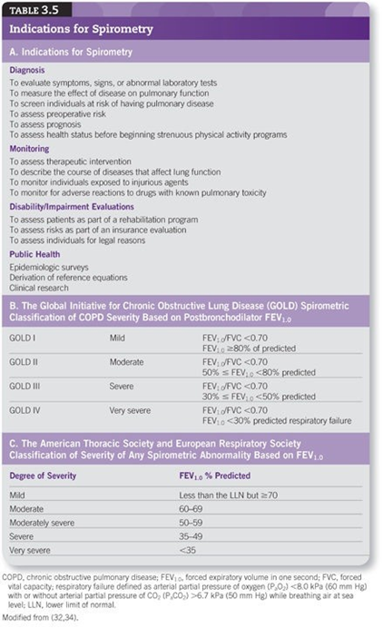

Slide 97
PARTICIPANT INSTRUCTIONS
The following points should be considered for inclusion in such preliminary instructions; however, specific instructions vary with test type and purpose:
At a minimum, participants should refrain from ingesting food, alcohol, or caffeine or using tobacco products within 3 h of testing.
Participants should be rested for the assessment, avoiding significant exertion or exercise on the day of the assessment.
Clothing should permit freedom of movement and include walking or running shoes.
Women should bring a loose-fitting, short-sleeved blouse that buttons down the front and should avoid restrictive undergarments.
If the evaluation is on an outpatient basis, participants should be made aware that the exercise test may be fatiguing, and they may wish to have someone accompany them to the assessment to drive home afterward.

Slide 98
If the exercise test is for diagnostic purposes, it may be helpful for patients to discontinue prescribed cardiovascular medications but only with physician approval.
If the exercise test is for functional or Ex Rx purposes, patients should continue their medication regimen on their usual schedule so that the exercise responses will be consistent with responses expected during exercise training.
Participants should bring a list of their medications including dosage and frequency of administration to the assessment and should report the last actual dose taken.
As an alternative, participants may wish to bring their medications with them for the exercise testing staff to record.
Participants should be instructed to drink ample fluids over the 24-h period preceding the exercise test to ensure normal hydration before testing.

Slide 99
Chapter Two:
Health-Related Physical Fitness Testing and Interpretation

Slide 100
The information obtained from health-related physical fitness testing, in combination with the individual’s medical and exercise history, is used for the following:
Collecting baseline data and educating participants about their present health/fitness status relative to health-related standards and age- and sex- matched norms.
Providing data that are helpful in development of individualized exercise prescriptions (Ex Rx) to address all health/fitness components.
Collecting follow-up data that allow evaluation of progress following an Ex
Rx and long-term monitoring as participants age.
Motivating participants by establishing reasonable and attainable health/fitness goals

Slide 101
Pretest Instructions
The following steps should be taken to ensure client safety and comfort before administering a health-related physical fitness test:
Perform the informed consent process and allow time for the individual undergoing assessment to have all questions adequately addressed Perform exercise pre-participation health screening Complete a pre-exercise evaluation including a medical history and a cardiovascular disease (CVD) risk factor assessment
A minimal recommendation is that individuals complete a self-guided questionnaire such as the Physical Activity Readiness Questionnaire + (PAR- Q+)

Slide 102
Test Organization
The following should be accomplished before the client/patient arrives at the test site:
Ensure consent and screening forms, data recording sheets, and any related testing documents are available in the client’s file and available for the test’s administration.
Calibrate all equipment (e.g., cycle ergometer, treadmill, sphygmomanometer) at least monthly, or more frequently based on use; certain equipment such as ventilatory expired gas analysis systems should be calibrated prior to each test according to manufacturers’ specifications; and document equipment calibration.
Skinfold calipers should be regularly checked for accuracy and sent to the manufacturer for calibration when needed.
Ensure a room temperature between 68° F and 72° F (20° C and 22° C) and humidity of less than 60% with adequate airflow

Slide 103
Test Environment
The environment is important for test validity and reliability. Test anxiety, emotions, room temperature, and ventilation should be controlled as much as possible.
To minimize subject anxiety, the test procedures should be explained adequately and should not be rushed, and the test environment should be quiet and private.
The room should be equipped with a comfortable seat and/or examination table to be used for resting BP and HR

Slide 104
A COMPREHENSIVE HEALTH FITNESS EVALUATION

Slide 105
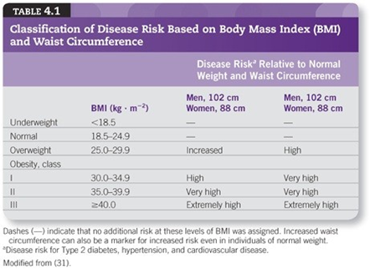
RESTING HEART RATE AND BLOOD PRESSUR
BODY COMPOSITION
  Anthropometric Methods
  Height, Weight, and Body Mass Index

Slide 106
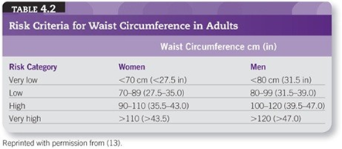
Circumferences
The measurement of regional body circumference can be important to quantify body fat distribution, especially of the waist and hip
The waist-to-hip ratio (WHR) is the circumference of the waist divided by the circumference of the hips

Slide 107
Standardized Description of Circumference Sites and
Procedures
Abdomen: With the subject standing, a horizontal measure is taken at the height of the iliac crest, usually at the level of the umbilicus.
Arm: With the subject standing and arms hanging freely at the sides with hands facing the thigh, a horizontal measure is taken midway between the acromion and olecranon processes.
Buttocks/Hips: With the subject standing and feet together, a horizontal measure is taken at the maximal circumference of the buttocks. This measure is used for the hip measure in the waist-to-hip ratio.
Calf: With the subject standing (feet apart ~20 cm), a horizontal measure is taken at the level of the maximum circumference between the knee and the ankle, perpendicular to the long axis.

Slide 108
Forearm: With the subject standing, arms hanging downward but slightly away from the trunk and palms facing anteriorly, a measure is taken perpendicular to the long axis at the maximal circumference.
Hips/Thigh: With the subject standing, legs slightly apart (~10
cm), a horizontal measure is taken at the maximal
circumference of the hip/proximal thigh, just below the gluteal fold.
Mid-Thigh: With the subject standing and one foot on a bench so the knee is flexed at 90 degrees, a measure is taken midway between the inguinal crease and the proximal border of the patella, perpendicular to the long axis.
Waist: With the subject standing, arms at the sides, feet together, and abdomen relaxed, a horizontal measure is taken at the narrowest part of the torso (above the umbilicus and below the xiphoid process).

Slide 109
Skinfold Measurements
Although BMI and circumferences are anthropometric measures that may be used to assess health risk, they are not true measures of body composition
The skinfold technique is a method that estimates body fat percentage by determining the thickness of several folds of skin across the body.
Body fat percentage determined from skinfold thickness measurements correlates well (r = .70–.90) with hydrodensitometry
Skinfold assessment of body composition is dependent on the expertise of the technician, so proper training (i.e., knowledge of anatomical landmarks) and ample practice of the technique is necessary to obtain accurate measurements.
The accuracy of predicting percent body fat from skinfolds is approximately ±3.5%, assuming appropriate techniques and equations have been used

Slide 110
Standardized Description of Skinfold Sites and Procedures
Skinfold Site
Abdominal :Vertical fold; 2 cm to the right side of the umbilicus
Triceps: Vertical fold; on the posterior midline of the upper arm, halfway between the acromion and olecranon processes, with the arm held freely to the side of the body
Biceps: Vertical fold; on the anterior aspect of the arm over the belly of the biceps muscle, 1 cm above the level used to mark the triceps site
Chest/Pectoral: Diagonal fold; one-half the distance between the anterior axillary line and the nipple (men), or one- third of the distance between the anterior axillary line and the nipple (women)
Medial calf: Vertical fold; at the maximum circumference of the calf on the midline of its medial border
Midaxillary: Vertical fold; on the midaxillary line at the level of the xiphoid process of the sternum. An alternate method is a horizontal fold taken at the level of the xiphoid/sternal border on the midaxillary line.

Slide 111
Subscapular: Diagonal fold (45-degree angle); 1–2 cm below the inferior angle of the scapula
Suprailiac: Diagonal fold; in line with the natural angle of the iliac crest taken in the anterior axillary line immediately superior to the iliac crest
Thigh: Vertical fold; on the anterior midline of the thigh, midway between the proximal border of the patella and the inguinal crease (hip)

Slide 112
PROCEDURES
All measurements should be made on the right side of the body with the subject standing upright.
Caliper should be placed directly on the skin surface, 1 cm away from the thumb and finger, perpendicular to the skinfold, and halfway between the crest and the base of the fold.
Pinch should be maintained while reading the caliper.
Wait 1–2 s before reading caliper.
Take duplicate measures at each site and retest if duplicate measurements are not within 1–2 mm.
Rotate through measurement sites or allow time for skin to regain normal texture and thickness

Slide 113
Generalized Skinfold Equations
MEN
Seven-Site Formula (chest, midaxillary, triceps, subscapular, abdomen, suprailiac, thigh)
Body density = 1.112 − 0.00043499 (sum of seven skinfolds)
+ 0.00000055 (sum of seven skinfolds)2
− 0.00028826 (age) [SEE 0.008 or ~3.5% fat]
Three-Site Formula (chest, abdomen, thigh)
Body density = 1.10938 − 0.0008267 (sum of three skinfolds)
+ 0.0000016 (sum of three skinfolds)2
− 0.0002574 (age) [SEE 0.008 or ~3.4% fat]
Three-Site Formula (chest, triceps, subscapular)
Body density = 1.1125025 − 0.0013125 (sum of three skinfolds)
+ 0.0000055 (sum of three skinfolds)2
− 0.000244 (age) [SEE 0.008 or ~3.6% fat]

Slide 114
WOMEN
Seven-Site Formula (chest, midaxillary, triceps, subscapular, abdomen, suprailiac, thigh)
Body density = 1.097 − 0.00046971 (sum of seven skinfolds)
+ 0.00000056 (sum of seven skinfolds)2
− 0.00012828 (age) [SEE 0.008 or ~3.8% fat]
Three-Site Formula (triceps, suprailiac, thigh)
Body density = 1.0994921 − 0.0009929 (sum of three skinfolds)
+ 0.0000023 (sum of three skinfolds)2
− 0.0001329 (age) [SEE 0.009 or ~3.9% fat]
Three-Site Formula (triceps, suprailiac, abdominal)
Body density = 1.089733 − 0.0009245 (sum of three skinfolds)
− 0.0000025 (sum of three skinfolds)2
+ 0.0000979 (age) [SEE 0.009 or ~3.9% fat]

Slide 115
Conversion of Body Density to Body Composition
Percent body fat can be estimated once body density has been determined.
The most commonly used prediction equation to estimate percent body fat from body density was derived from the two-component model of body composition: [(4.95 / Db) − 4.50] × 100
The prediction of body fat from body density assumes the density of FM and FFM is consistent for the studied population.
However, age, gender, race, and certain disease states may affect the density of FFM, with much of this variance related to the bone mineral density component of FFM

Slide 116
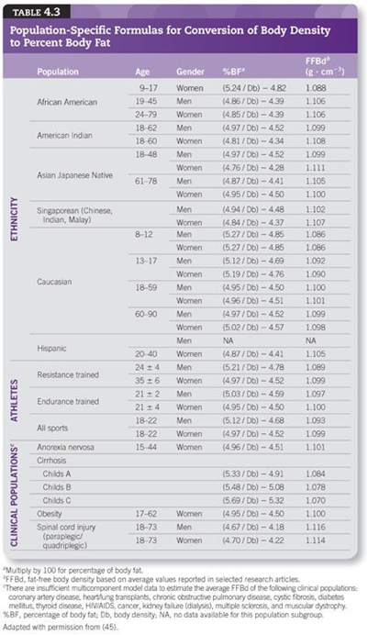

Slide 117
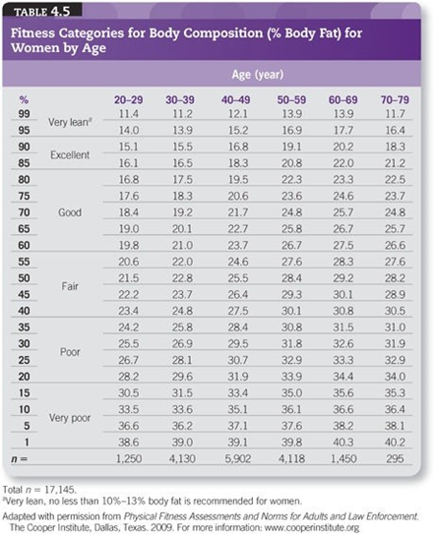

Slide 118
CARDIORESPIRATORY FITNESS
The Concept of Maximal Oxygen Uptake
Maximal volume of oxygen consumed per unit time ( O2max) is accepted as the criterion measure of CRF

Slide 119
General Indications for Stopping an Exercise Test
Onset of angina or angina-like symptoms
Drop in SBP of ≥10 mm Hg with an increase in work rate or if SBP decreases below the value obtained in the same position prior to testing
Excessive rise in BP: systolic pressure >250 mm Hg and/or diastolic pressure >115 mm Hg
Shortness of breath, wheezing, leg cramps, or claudication
Signs of poor perfusion: light-headedness, confusion, ataxia, pallor, cyanosis, nausea, or cold and clammy skin
Failure of HR to increase with increased exercise intensity
Noticeable change in heart rhythm by palpation or auscultation
Subject requests to stop
Physical or verbal manifestations of severe fatigue
Failure of the testing equipment

Slide 120
General Procedures for Submaximal Testing of
Cardiorespiratory Fitness
1. Obtain resting HR and BP immediately prior to exercise in the exercise posture.
2. The client should be familiarized with the ergometer or treadmill. If using a cycle ergometer, properly position the client on the ergometer (i.e., upright posture, ~25-degree bend in the knee at maximal leg extension, and hands in proper position on handlebars)
3. The exercise test should begin with a 2–3 min warm-up to acquaint the client with the cycle ergometer or treadmill and prepare him or her for the exercise intensity in the first stage of the test.
4. A specific protocol should consist of 2- or 3-min stages with appropriate increments in work rate

Slide 121
5. HR should be monitored at least two times during each stage, near the end of the second and third minutes of each stage. If HR is >110 beats · min−1, steady state HR (i.e., two HRs within 5 beats · min−1) should be reached before the workload is increased.
6. BP should be monitored in the last minute of each stage and repeated
(verified) in the event of a hypotensive or hypertensive response.
7. RPE (using either the Borg category or category-ratio scale and additional rating scales should be monitored near the end of the last minute of each stage.
8. Client’s appearance and symptoms should be monitored and recorded regularly.

Slide 122
9. The test should be terminated when the subject reaches 70% heart rate reserve (85% of age-predicted HRmax), fails to conform to the exercise test protocol, experiences adverse signs or symptoms, requests to stop, or experiences an emergency situation.
10. An appropriate cool-down/recovery period should be initiated consisting of either
a. Continued exercise at a work rate equivalent to that of the first stage of the exercise test protocol or lower or
b. A passive cool-down if the subject experiences signs of discomfort or an emergency situation occurs
11. All physiologic observations (e.g., HR, BP, signs, and symptoms) should be continued for at least 5 min of recovery unless abnormal responses occur, which would warrant a longer posttest surveillance period.
Continue low- level exercise until HR and BP stabilize but not necessarily until they reach pre-exercise levels.

Slide 123
Cardiorespiratory Test Sequence and Measures
After the initial screening process, selected baseline measurements should be obtained prior to the start of the exercise test.
A minimum of HR, BP, and RPE should be measured during exercise tests. HR can be determined using the palpation

Slide 124
RPE can be a valuable indicator for monitoring an individual’s exercise tolerance.
Although RPEs correlate with exercise HRs and work rates, large inter individual variability in RPE with healthy individuals as well as patient populations mandates caution in the universal application of RPE scales
The RPE scale was developed to allow the exerciser to subjectively rate his or her physical strain during exercise
Ratings can be influenced by psychological factors, mood states, environmental conditions, exercise modes, age, and thirst

Slide 125
Currently, two RPE scales are widely used: (a) the original Borg or category scale, which rates exercise intensity from 6 to 20 (Table 4.6), and (b) the category-ratio scale of 0–10 (see Figure 5.2).
Both RPE scales are appropriate subjective tools
During exercise testing, the RPE can be used as an indication of impending fatigue.
Most apparently healthy subjects reach their subjective limit of fatigue at an RPE of 18–19 (very, very hard) on the category Borg scale, or 9–10 (very, very strong) on the category-ratio scale; therefore, RPE can be used to monitor progress toward maximal exertion during exercise testing

Slide 126
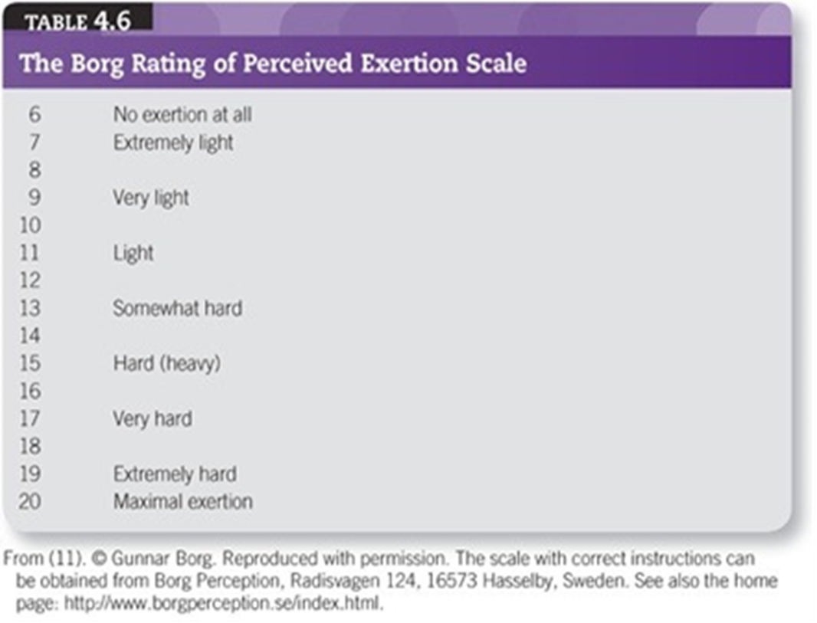

Slide 127
Modes of Testing
Commonly used modes for exercise testing include treadmills, cycle ergometers, steps, and field tests.
The mode of exercise testing used is dependent on the setting, equipment available, and training of personnel. There are advantages and disadvantages of each exercise testing mode:
Field tests consist of walking or running for a predetermined time or distance (i.e., 1.5-mi [2.4 km] walk/run test; 1-mi and 6-min walk test).
The advantages of field tests are they are easy to administer to large numbers of individuals at one time, and little equipment (e.g., a stopwatch) is needed.

Slide 128
Step testing is an inexpensive modality for predicting CRF by measuring the
HR response to stepping at a fixed rate and/or a fixed step height or by measuring post-exercise recovery HR.
Step tests require little or no equipment, steps are easily transportable, stepping skill requires little practice, the test usually is of short duration, and stepping is advantageous for mass testing
Post-exercise (recovery) HR decreases with improved CRF, and test results are easy to explain to participants
Special precautions may be needed for those who have balance problems or are extremely deconditioned.
Some single-stage step tests require an energy cost of 7–9 metabolic equivalents (METs), which may exceed the maximal capacity of some participants
Therefore, the protocol chosen must be appropriate for the physical fitness level of the client. In addition, inadequate compliance to the step cadence and excessive fatigue in the lead limb may diminish the value of a step test.
Most tests do not monitor HR and BP while stepping because of the difficulty of these measures during the test.

Slide 129
Field Tests
Two of the most widely used run/walk tests (subjects may run, walk, or use a combination of both to complete the test) for assessing CRF are the 1.5-mi (2.4 km) test for time and the Cooper 12-min test. The objective of the Cooper 12- min test is to cover the greatest distance in the allotted time period and for the
1.5-ml (2.4 km) test to cover the distance in the shortest period of time.
VO2max can be estimated from using the following equations:
1.5-mi run/walk test
O2max (mL · kg −1 • min −1) = 3.5 + 483 / 1.5 mi time (min)
12-min walk/run test
VO2max (mL · kg −1 · min −1 ) = (distance in meters + 504.9) / 44.73

Slide 130
The Rockport One-Mile Fitness Walking Test is another well-recognized field test for estimating CRF.
In this test, an individual walks 1 mi (1.6 km) as fast as possible, preferably on a track or a level surface, and HR is obtained in the final minute.
An alternative is to measure a 10-s HR immediately on completion of the 1-mi (1.6 km) walk, but this may overestimate the VO2max compared to when HR is measured during the walk.
VO2max is estimated using the following regression equation:
VO 2max (mL · kg −1 · min −1 ) = 132.853 − (0.1692 × body mass in kg) − (0.3877 × age in years) + (6.315 × gender) − (3.2649 × time in minutes) − (0.1565 × HR)
(SEE = 5.0 mL · kg −1 · min −1 ; gender = 0 for female, 1 for male)

Slide 131
Submaximal Exercise Tests
Single-stage and multistage submaximal exercise tests are available to estimate O2max from simple HR measurements. Accurate measurement of HR is critical for valid testing.
Although HR obtained by palpation is commonly used, the accuracy of this method depends on the experience and technique of the evaluator. It is recommended that an ECG, validated HR monitor, or a stethoscope be used to determine HR.
The submaximal HR response is easily altered by a number of environmental (e.g., heat, humidity, dietary (e.g., caffeine, time since last meal), and behavioral (e.g., anxiety, smoking, previous PA) factors.

Slide 132
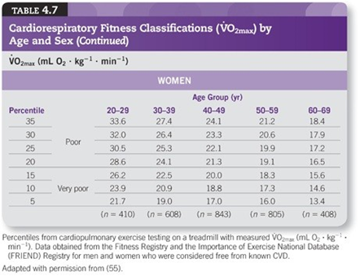
In addition, the test mode (e.g., cycle, treadmill, step) should be consistent with the primary exercise modality used by the participant to address specificity of training issues.

Slide 133
Cycle Ergometer Tests
The Astrand-Ryhming cycle ergometer test is a single-stage test lasting 6 min (5). The pedal rate is set at 50 rpm.
The goal is to obtain HR values between 125 and 170 beats · min−1, with HR measured during the fifth and sixth minute of work.
The average of the two HRs is then used to estimate VO2max from a nomogram (Figure 4.1). The suggested work rate is based on sex and an individual’s fitness status as follows:
men, unconditioned: 300 or 600 kg · m · min−1 (50 or 100 W)
men, conditioned: 600 or 900 kg · m · min−1 (100 or 150 W)
women, unconditioned: 300 or 450 kg · m · min−1 (50 or 75 W)
women, conditioned: 450 or 600 kg · m · min−1 (75 or 100 W)

Slide 134
The modified YMCA protocol is a good example of a multistage submaximal cycle ergometer test that uses two to four 3-min stages of continuous exercise with a constant pedal rate of 50 rpm
Stage 1 requires participants to pedal against 0.5 kg of resistance (25 W; 150 kgm · min−1).
The workload for stage 2 is based on the steady state HR measured during the last minute of the initial stage:
HR <80 bpm — change the resistance to 2.5 kg (125 W; 750 kgm · min−1)
HR 80−89 bpm — change the resistance to 2.0 kg (100 W; 600 kgm · min−1)
HR 90−100 bpm — change the resistance to 1.5 kg (75 W; 450 kgm · min−1)
HR >100 bpm — change the resistance to 1.0 kg (50 W; 300 kgm · min−1)

Slide 135
Use stages 3 and 4 as needed to elicit two consecutive steady state HRs between 110 bpm and 70% HRR (85% HRmax).
For stages 3 and 4, the resistance used in stage 2 is increased by 0.5 kg (25 W; 150 kgm · min−1) per stage.
Normative tables for the YMCA protocol are published elsewhere

Slide 136
Treadmill Tests
The primary exercise modality for submaximal exercise testing traditionally has been the cycle ergometer, although treadmills are used in many settings. The
same submaximal definition (70% HRR or 85% of age-predicted HRmax) is used, and the stages of the test should be 3 min or longer to ensure a steady state HR response at each stage.
The HR values are extrapolated to age-predicted HRmax, and VO2max is estimated using the formula in Table 6.3 from the highest speed and/or grade that would have been achieved if the individual had worked to maximum.
Most common treadmill protocols presented in Figure 5.1 can be used, but the duration of each stage should be at least 3 min.

Slide 137
Step Tests
Step tests are also used to estimate O2max. Astrand and Ryhming (5) used a single-step height of 33 cm (13 in) for women and 40 cm (15.7 in) for men at a rate of 22.5 steps · min−1 (when counting just the leading leg) for 5 min.
These tests require VO2 of about 25.8 and 29.5 mL · kg−1· min−1, respectively.
Because of this, step tests are not a good choice of modality for less fit or diseased clients.
HR is measured in the last minute as described for the Astrand-Rhyming cycle ergometer test, and VO2max is estimated from a nomogram

Slide 138
After stepping is completed, the subject remains standing.
Wait 5 s, take a 15-s HR count, and multiply the HR by 4 to convert to beats · min−1.
O2max is calculated using the formulas below:
For men:
O2max (mL · kg−1 · min−1) = 111.33 − (0.42 × HR)
For women:
O2max (mL • kg−1 • min−1) = 65.81 − (0.1847 × HR)
where HR = heart rate (beats · min−1)

Slide 139
Interpretation of Results:

Slide 140
MUSCULAR FITNESS
Muscular strength and endurance are health-related fitness components that may improve or maintain the following important health-related fitness characteristics:
Bone mass, which is related to osteoporosis
Muscle mass, which is related to sarcopenia
Glucose tolerance, which is pertinent in both the prediabetic and diabetic state
Musculotendinous integrity, which is related to a lower risk of injury including low back pain
The ability to carry out the activities of daily living, which is related to perceived quality of life and self-efficacy among other indicators of mental health
FFM and resting metabolic rate, which are related to weight management

Slide 141
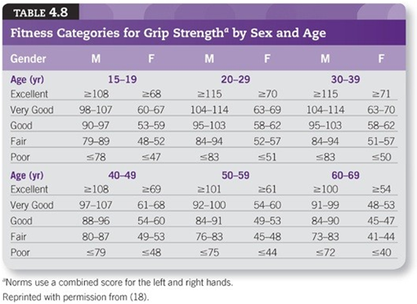
Muscular Strength

Slide 142
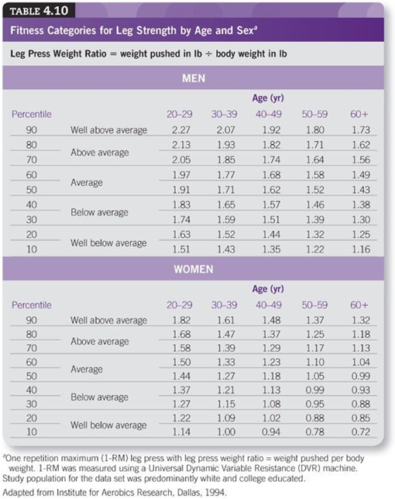

Slide 143
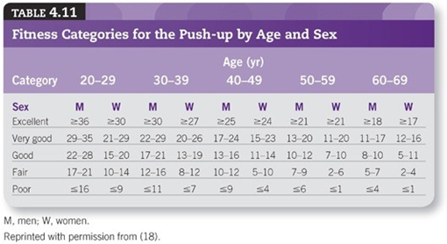
Muscular Endurance

Slide 144
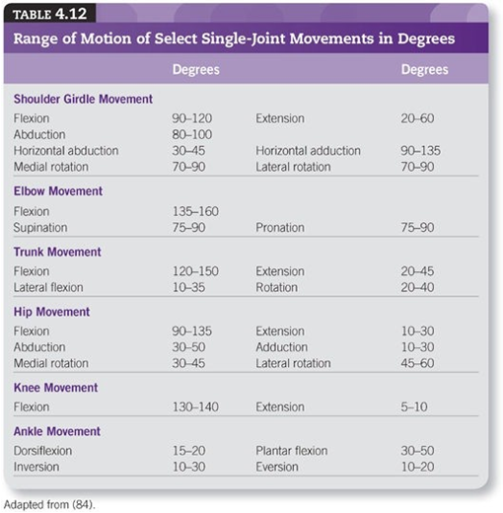
FLEXIBILITY

Slide 145
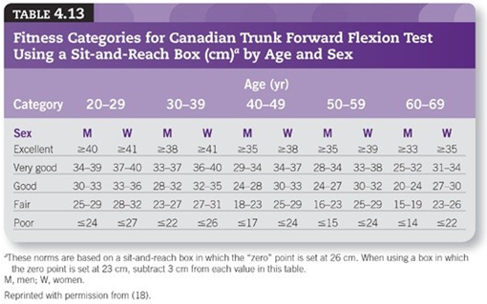

Slide 146
