Slide 1
ECONOMETRICS of UNIVARIATE TIMESERIES

Slide 2
Introduction
A time-series is a set of observations on a quantitative or discrete variable collected over time.
In time series analysis, we analyze the past behavior of a variable in order to predict its future behavior.
The observations from a discrete time series, made at some fixed interval h, at times t1 , t2 ,K, t N may be denoted by x(t1 ), x(t2 ),K, x(t N ).
discrete time series may arise in two ways: by sampling a continuous time series, and by accumulating a variable over a period of time.

Slide 3
Con’d
They pose several challenges to econometricians and practitioners:
  Empirical work based on time series data assumes that the underlying time series is stationary.
  Sometimes autocorrelation results because the underlying time series is non-stationary.
  Some financial time series, such as stock prices, exhibit what is known as the random walk phenomenon. This means the best prediction of the price of a stock tomorrow is equal to its price today plus a purely random shock (or error term). If this were in fact the case, forecasting asset prices would be a futile exercise.

Slide 4
Con’d
  Regression models involving time series data are often used for forecasting. We would like to know if such forecasting is valid if the underlying time series are not stationary.
  Causality tests assume that the time series involved in analysis are stationary. Therefore, tests of stationarity should precede tests of causality.
  Components of a time series
  a. Stochastic Processes
A random or stochastic process is a collection of random variables ordered in time.
a stochastic process is known as aweakly stationary, or covariance stationary, or second-order stationary, or wide sense, stochastic process.
If a time series is stationary, its m ean, variance, and autocovariance (at various lags) remain the same no matter at what point we measure them; that is, they are time in variant.

Slide 5
Con’d
Time series are an example of a stochastic or random process
Mathematically, a stochastic process is an indexed collection of random variables: {xt : t ÎT }. We are concerned only with processes indexed by time, either discrete time or continuous time processes.

Slide 6
Stationary stochastic process: white noise
Inference is most easy, when a process is stationary—its distribution does not change over time.
A process is weakly stationary if its mean and autocovariance functions do not change over time.
Strict stationarity: For any values of j1 , j2 ,K, jN , the joint distribution of the dependent variable depends only on the intervals separating the dates and not on the date itself.
Weak stationarity: We are primarily concerned with weak, or covariance stationarity, such a series has a constant mean and constant, finite variance. The autocovariance depends only on the time difference or lag between the two time points involved

Slide 7
Con’d
Illustration of some stationary time series

Slide 8
    Nonstationary stochastic processes
Although our interest is in stationary time series, one often encounters nonstationary time series, the classic example being the random walk model (RWM).
It is often said that asset prices, such as stock prices or exchange rates, follow a random walk; that is, they are nonstationary.
We distinguish two types of random walks: (1) random walk without drift (i.e., no constant or intercept term) and (2) random walk with drift (i.e., a constant term is present).
The simplest form of stochastic trend is given by the following random walk with drift model:

Slide 9
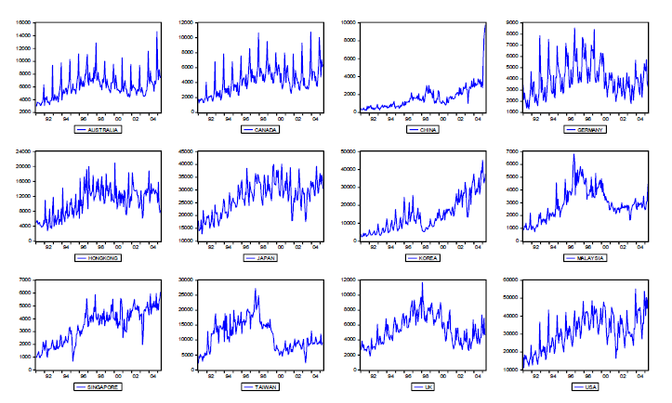
Some nonstationary series

Slide 10
    Trend stationary and difference stationary stochastic processes
The distinction between stationary and nonstationary stochastic processes has a crucial bearing on whether the trend is deterministic or stochastic.
Broadly speaking, if the trend in a time series is completely predictable and not variable, we call it a deterministic trend, whereas if it is not predictable, we call it a stochastic trend.
To make the definition more formal, consider the following model of the time series xt :

Slide 11
Con’d
Where et is a white noise error term and where t is time measured chronologically. Now we have the following possibilities:
Pure random walk If :
It is RWM without drift and is therefore nonstationary.
But note that, if we write the above equation as
it becomes stationary
Hence, a RWM without drift is a difference stationary process(DSP).

Slide 12
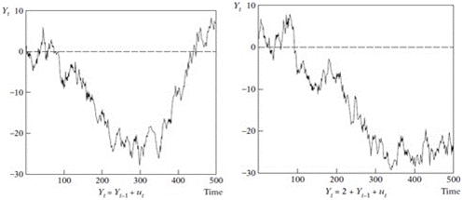
A random walk with and without drift
Random walk with drift ( right)

Slide 13
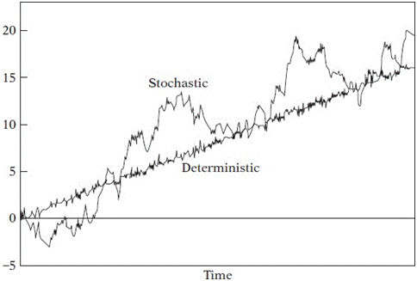
Deterministic trend:
It will be a trend stationary process (TSP)
Deterministic versus stochastic trends

Slide 14
Integrated stochastic processes
Recall that the RWM without drift is nonstationary, but its first difference is stationary.
Therefore, we call the RWM without drift integrated of order 1, denoted as I(1).
Similarly, if a time series has to be differenced twice (i.e., take the first difference of the first differences) to make it stationary, we call such a time series integrated of order 2.
In general, if a (nonstationary) time series has to be differenced d times to make it stationary, that time series is said to be integrated of order d .
If a time series is stationary, it is said to be integrated of order zero, denoted by xt ~ I (0)

Slide 15
Con’d
Most economic time series are generally I(1)
Properties of integrated series

Slide 16
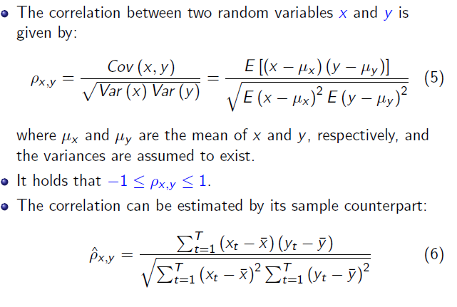
Correlation

Slide 17
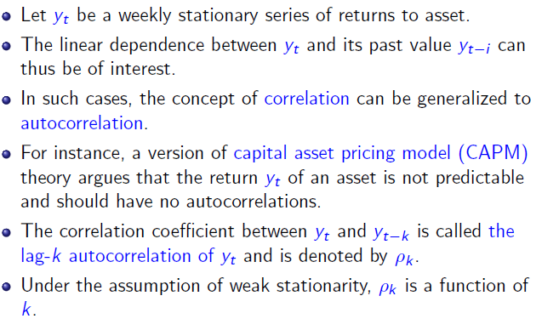
Autocorrelation function

Slide 18
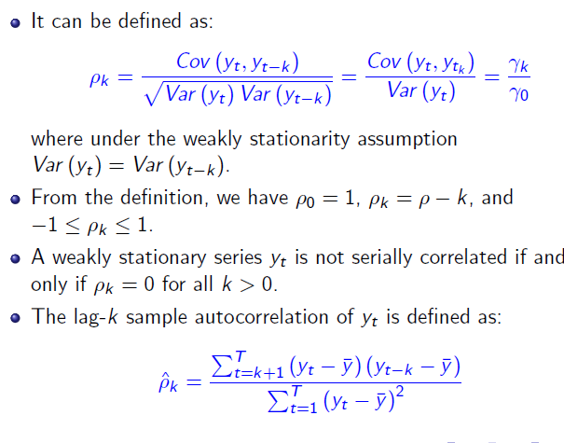
Con’d

Slide 19
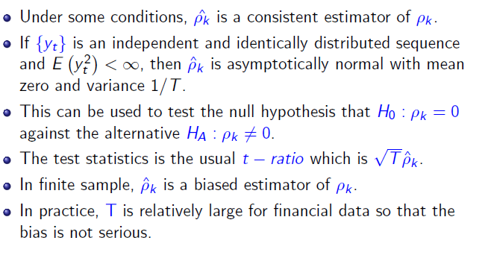
Con’d

Slide 20

Con’d

Slide 21
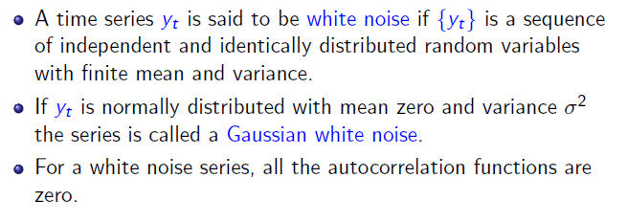
White noise

Slide 22
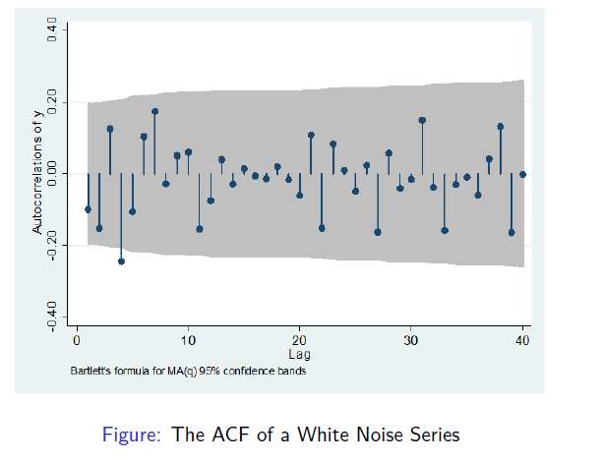
Con’d

Slide 23
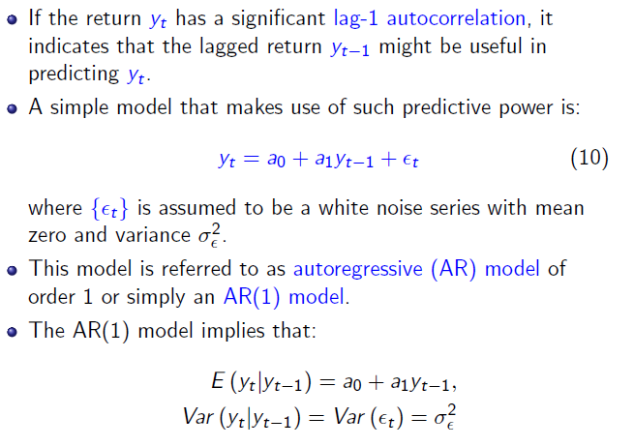
Simple Autoregressive (AR) models

Slide 24
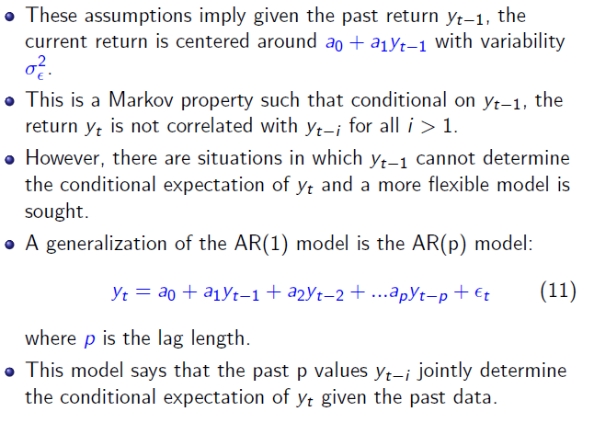
Con’d

Slide 25
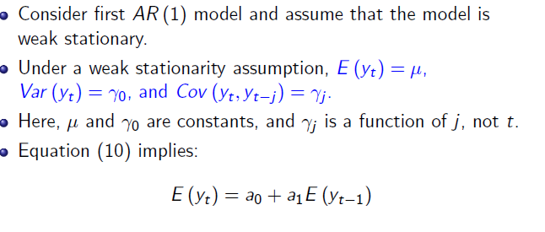
Properties of AR models

Slide 26
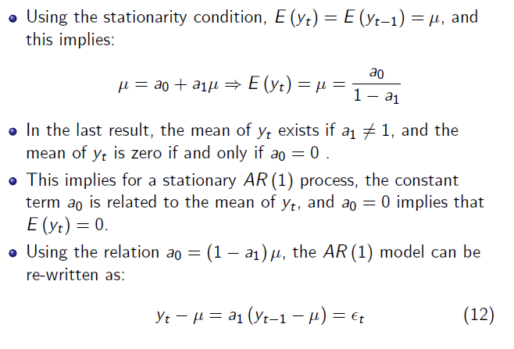
Con’d

Slide 27
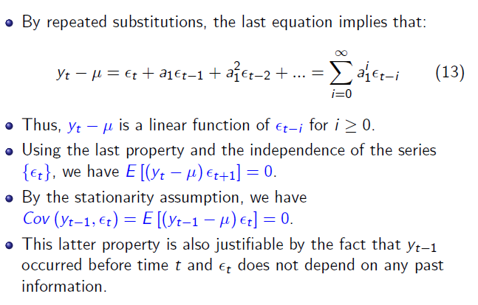
Con’d

Slide 28
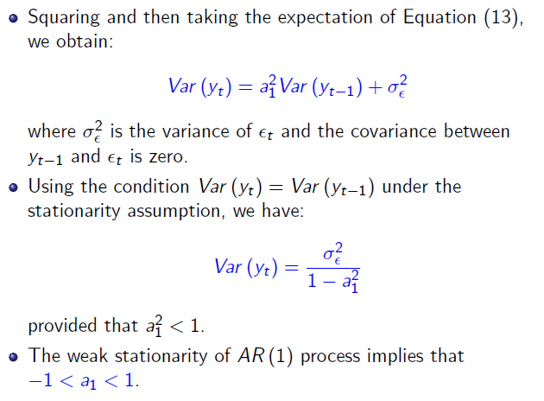
Con’d

Slide 29
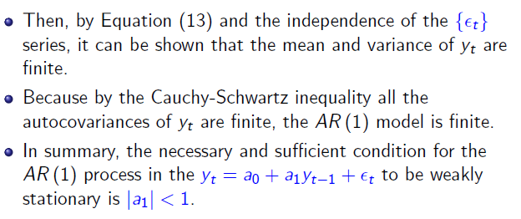
Con’d

Slide 30
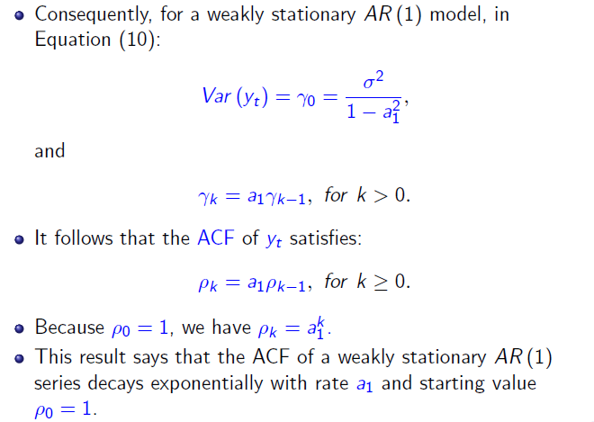
Autocorrelation function of AR(1) models

Slide 31
AR(P) models
AR(p) models

Slide 32
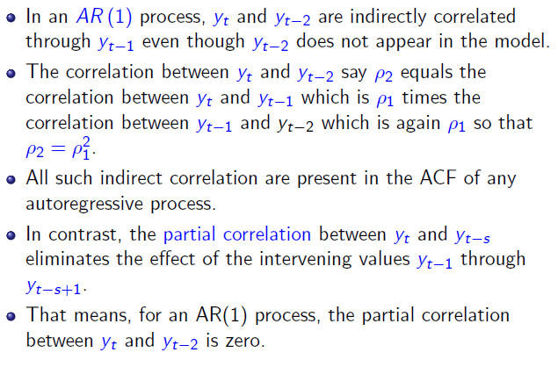
Partial autocorrelation function (PACF)

Slide 33
CON’D
For a pure autoregressive process of lag p, the partial autocorrelation function up to lag p will be the autoregressive coefficients while beyond that lag we expect them all to be zero.
in general there will be a `cut off' at lag p in the partial autocorrelation function.
The correlogram on the other hand will decline asymptotical towards zero and not exhibit any discrete `cut of' point.

Slide 34
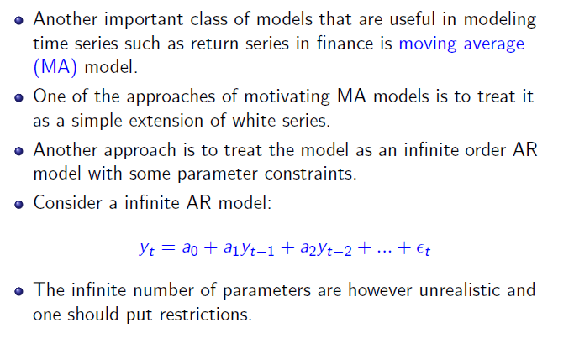
Moving average models(MA)

Slide 35
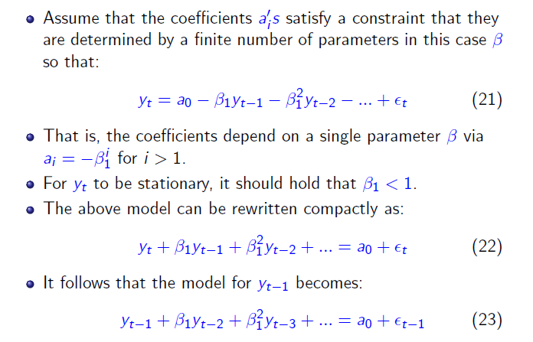
MA

Slide 36
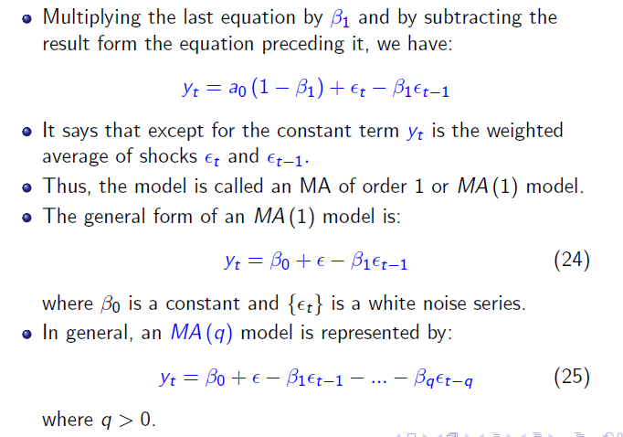
Con’d

Slide 37
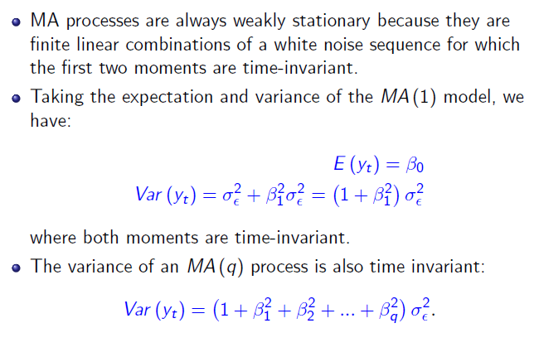
Properties of MA models: stationarity

Slide 38
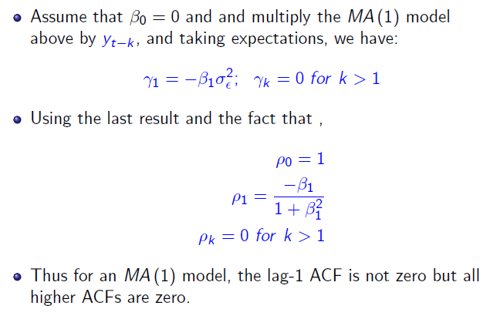
Properties of MA models: autocorrelation function

Slide 39
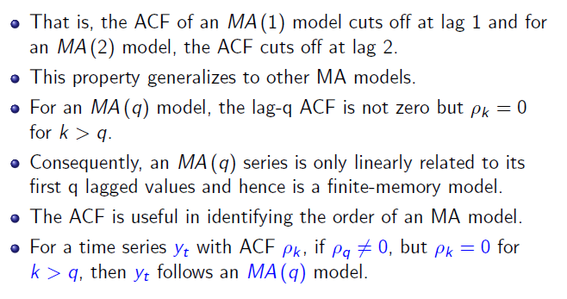
Con’d

Slide 40
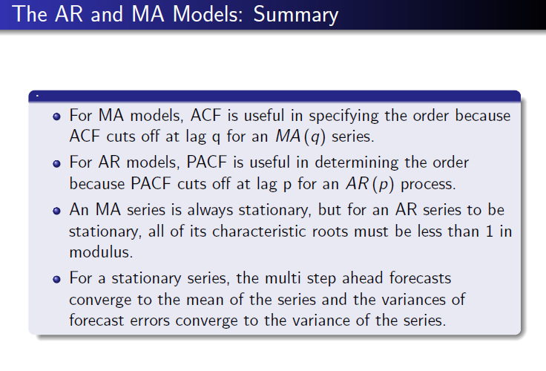

Slide 41
Summary
The autoregressive processes have, in general, infinite non-zero autocorrelation coefficients that decay with the lag.
The AR processes have a relatively “long” memory, since the current value of a series is correlated with all previous ones, although with decreasing coefficients.
A family of processes that have this “very short memory” property are the moving average, or MA processes.
The MA processes are a function of a finite, and generally small, number of its past innovations.

Slide 42
con’d
Rules:
 | ACF | PACF
AR | Geometric | Significant till p lags
MA | Significant till p lags | Geometric
ARMA | Geometric | Geometric

Slide 43
AR(1)

Slide 44
Con’d

Slide 45
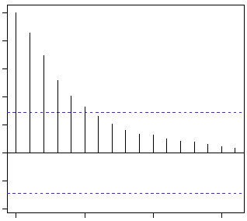
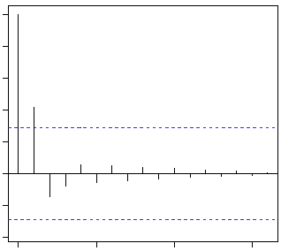
Con’d
ACF PACF

Slide 46
MA(2)
ACF PACF

Slide 47
ARMA Model

Slide 48
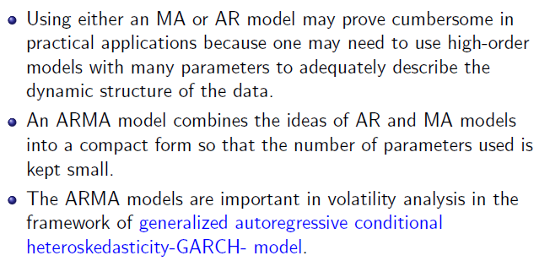
ARMA Model

Slide 49
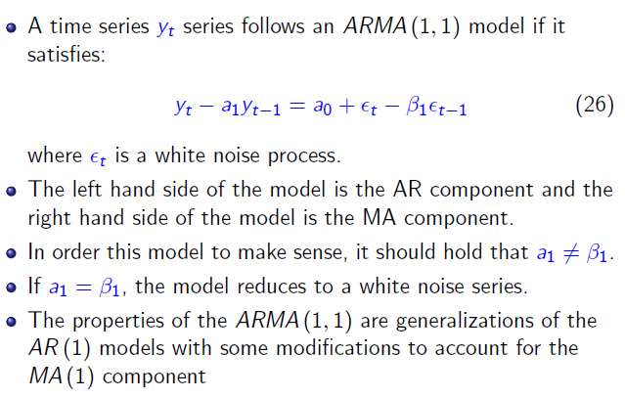
Con’d

Slide 50
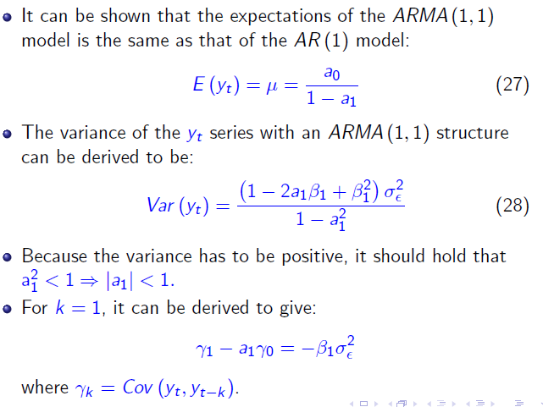
con’d

Slide 51
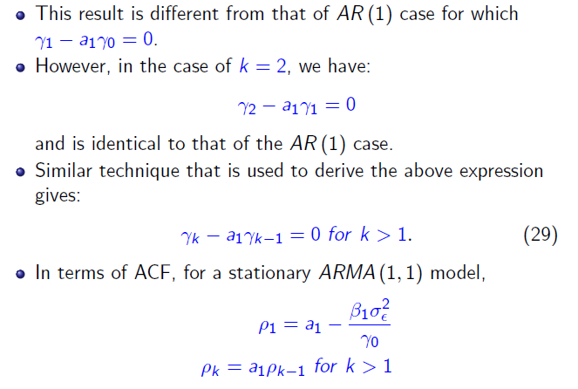
Con’d

Slide 52
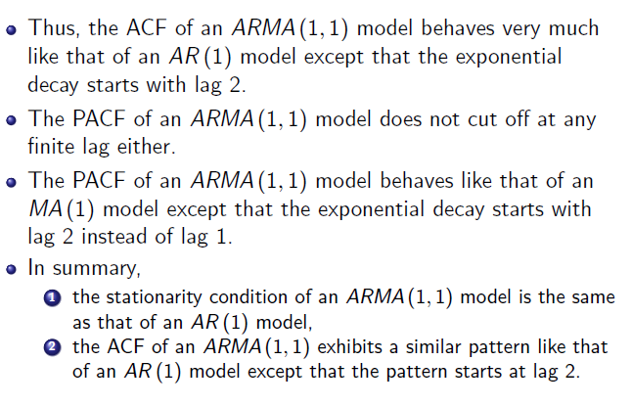
Con’d

Slide 53
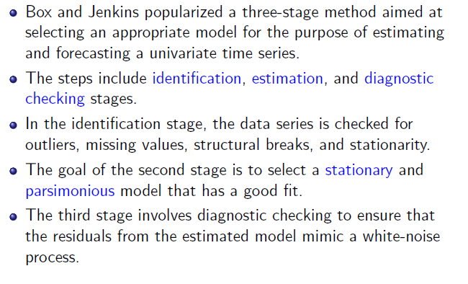
Box-Jenkins model selection

Slide 54
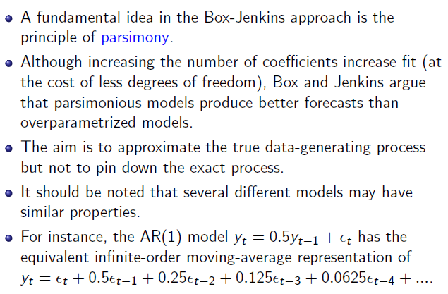
Con’d

Slide 55
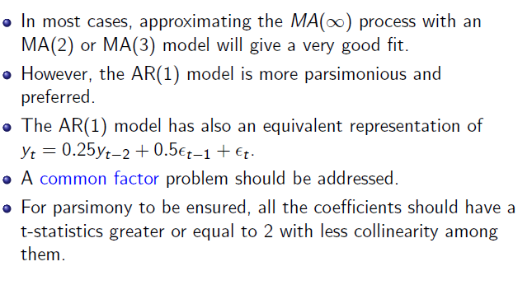
Con’d

Slide 56
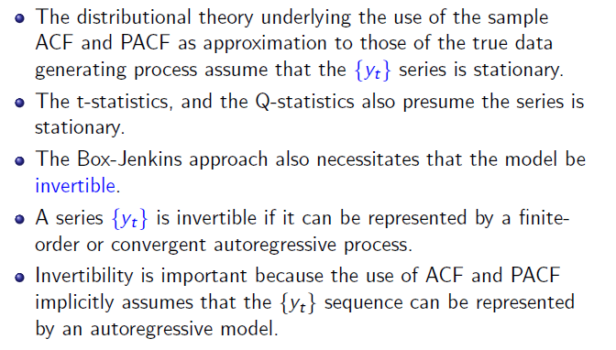
Con’d

Slide 57
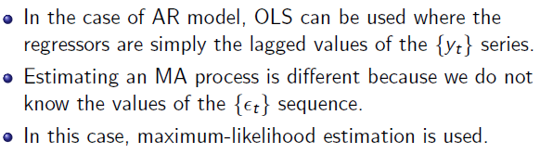
Estimation of ARMA models

