Slide 1
Seminar in Development Economics (DEC 572 )
Abiot.A (PhD Fellow in Econ)

Slide 2
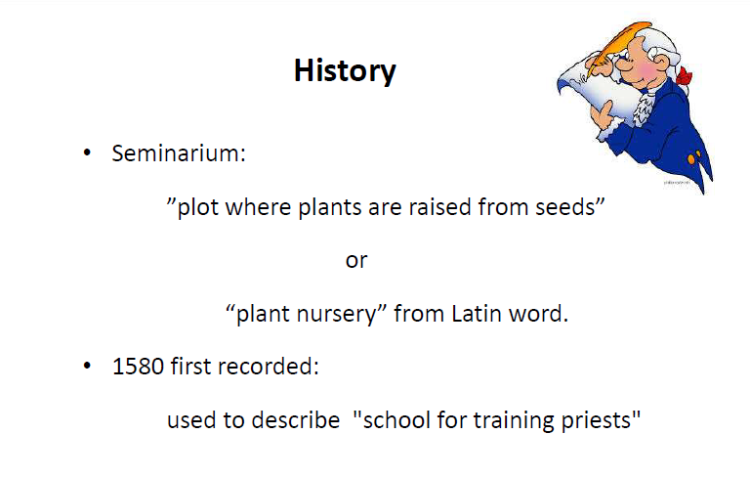

Slide 3
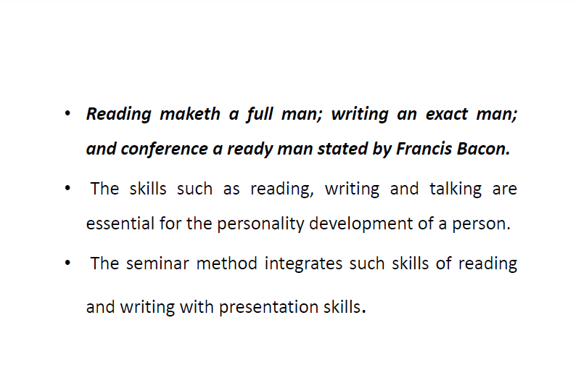

Slide 4
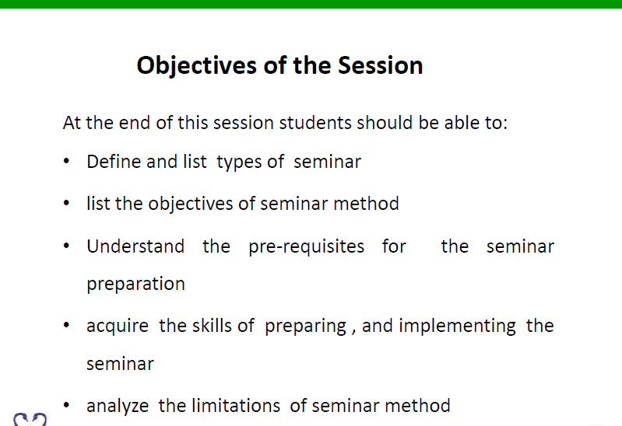

Slide 5
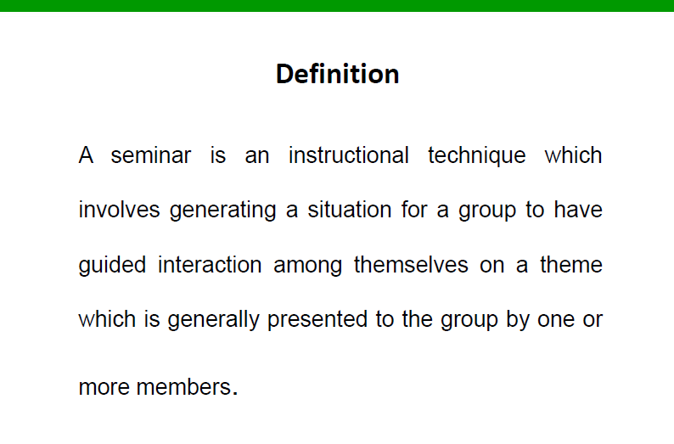

Slide 6
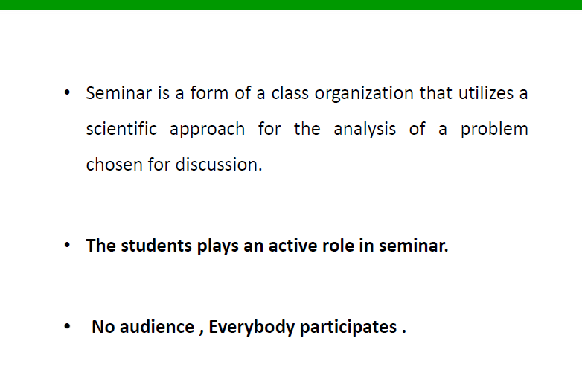

Slide 7
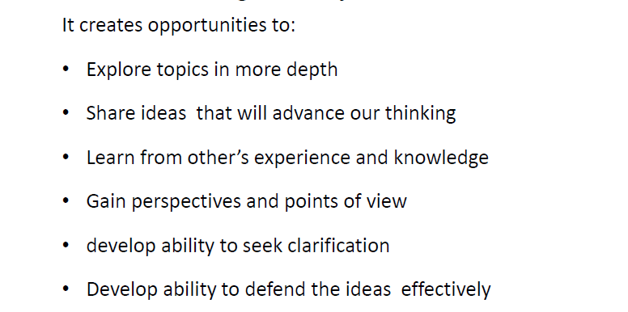
Objectives of seminar

Slide 8
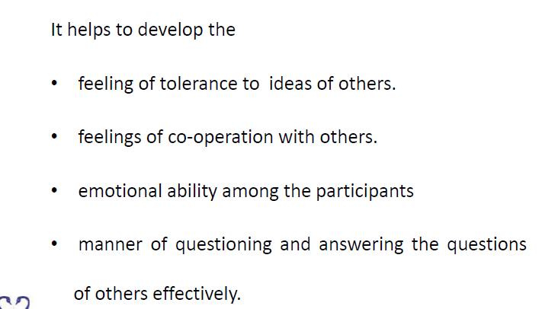

Slide 9


Slide 10
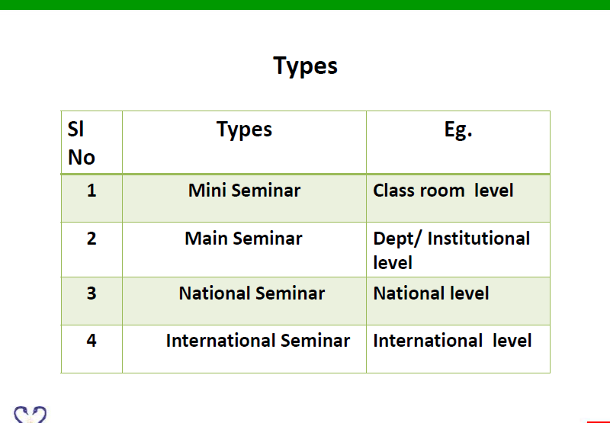

Slide 11


Slide 12
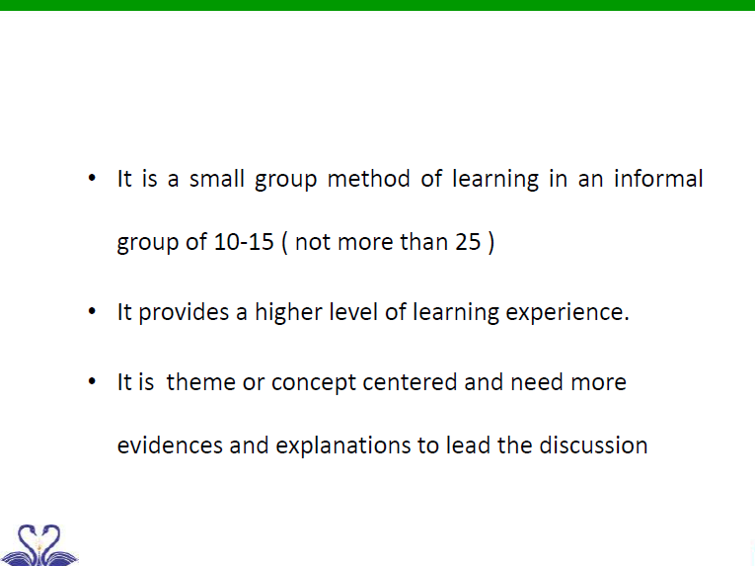

Slide 13
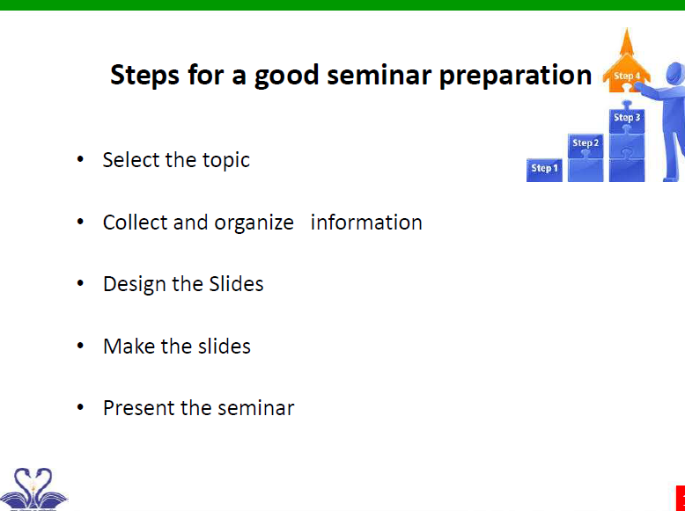

Slide 14
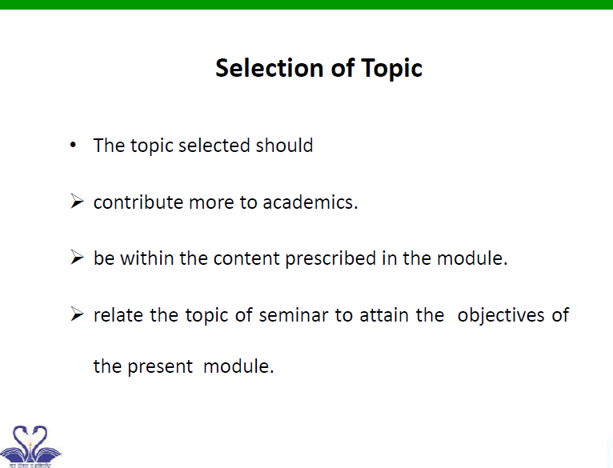

Slide 15
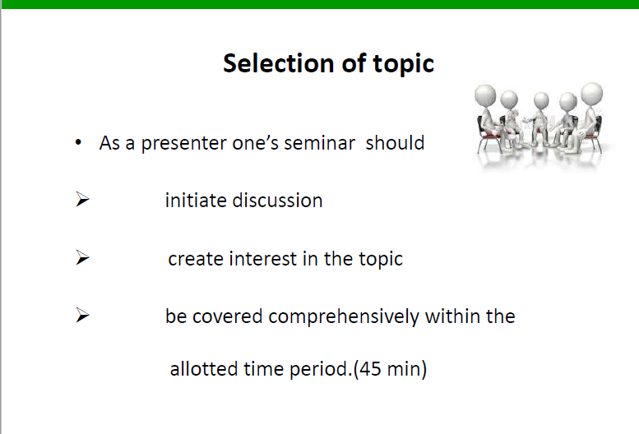

Slide 16
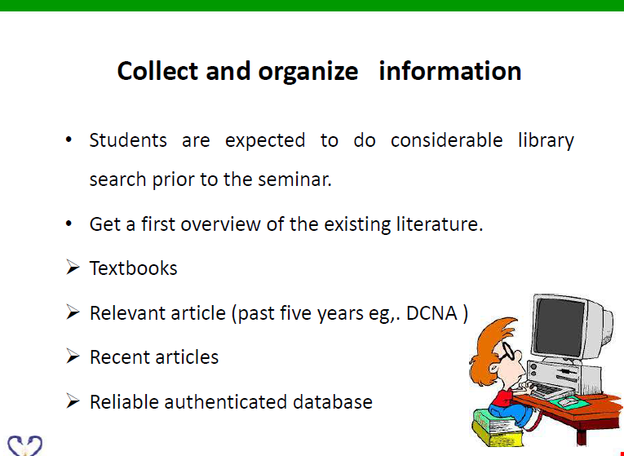

Slide 17
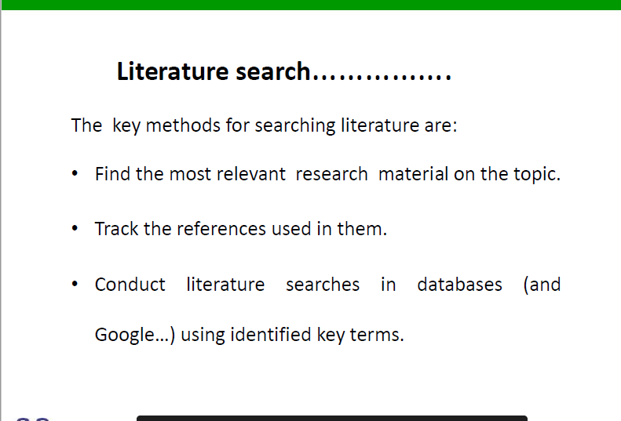

Slide 18
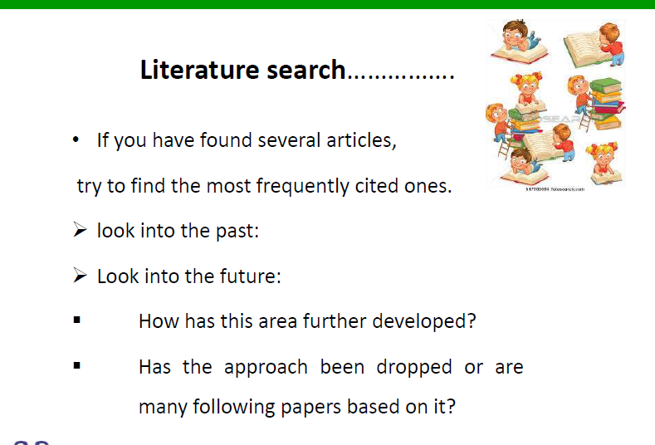

Slide 19
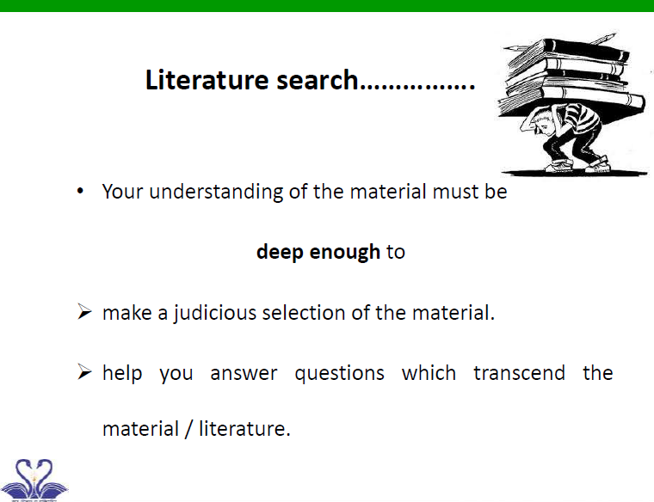

Slide 20
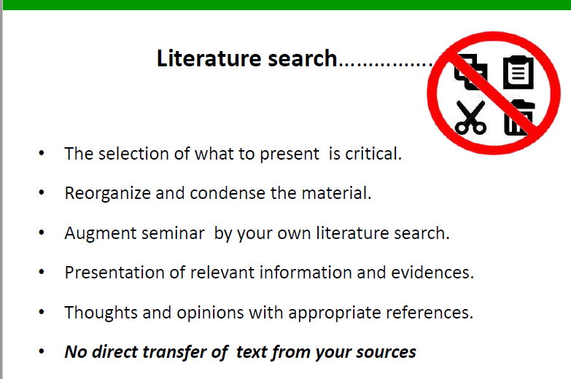

Slide 21
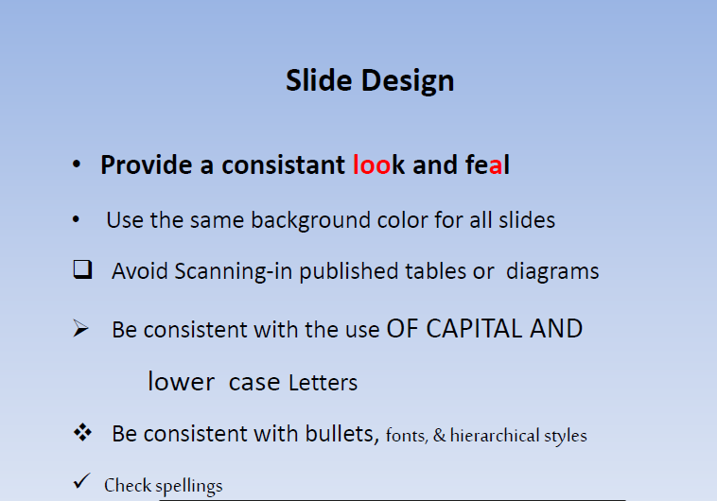

Slide 22
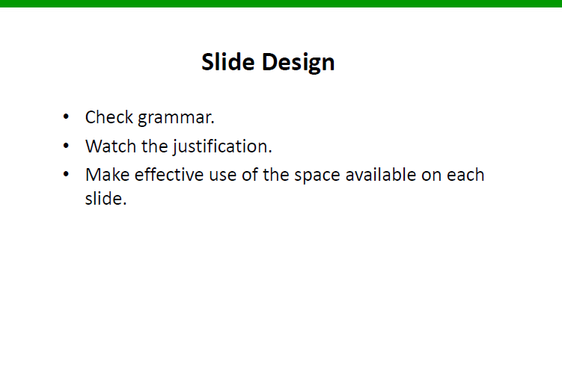

Slide 23
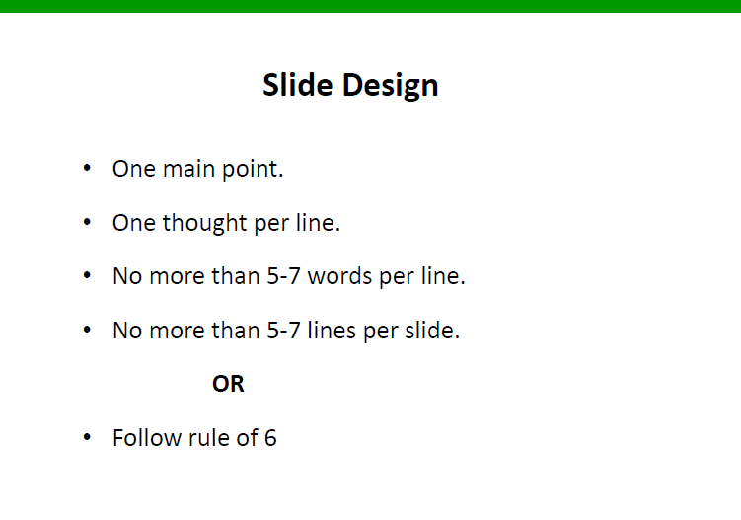

Slide 24
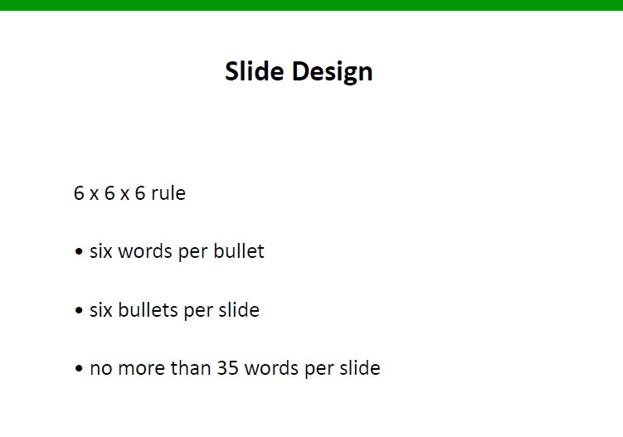

Slide 25
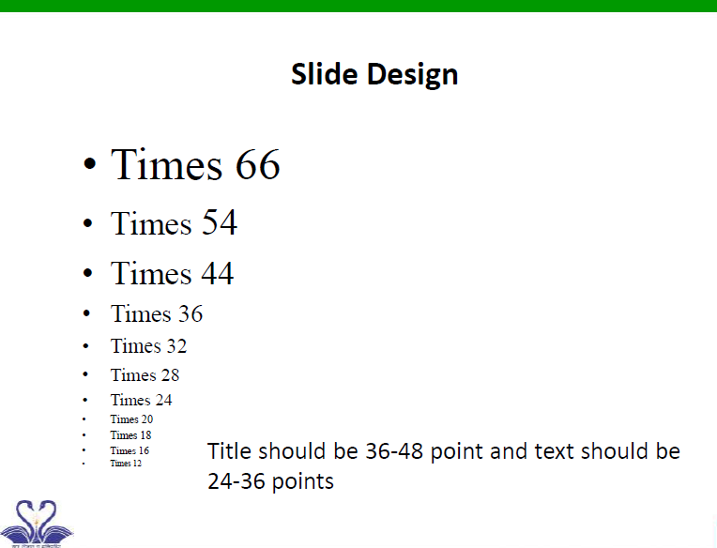

Slide 26
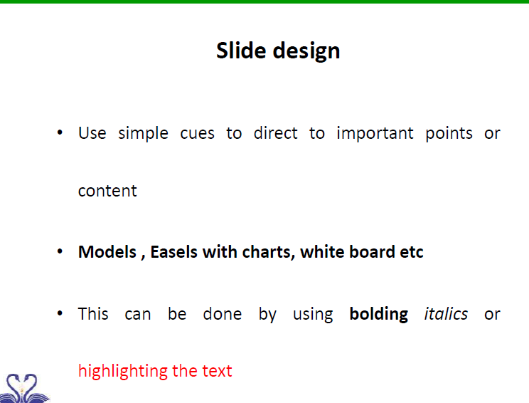

Slide 27
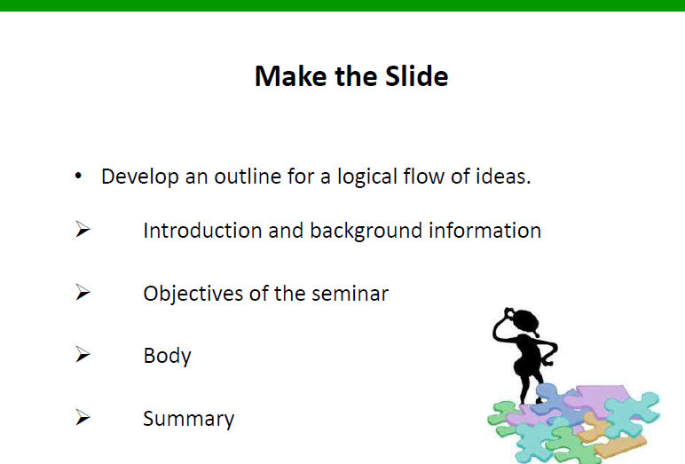

Slide 28
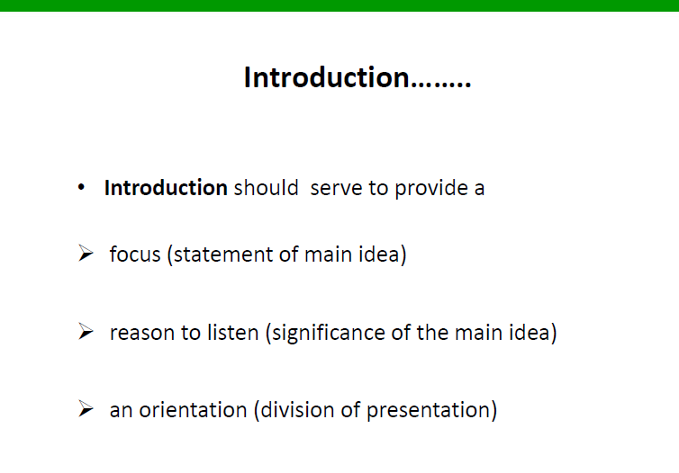

Slide 29
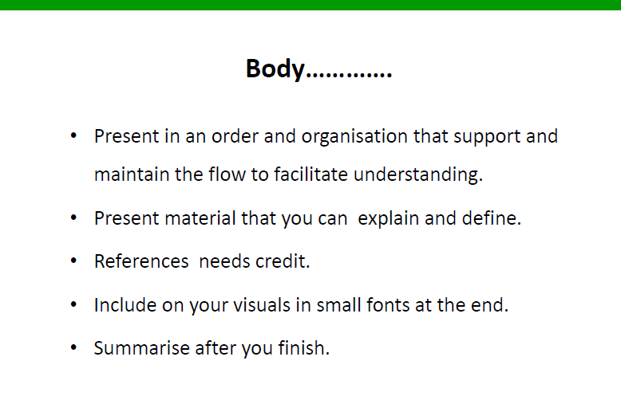

Slide 30
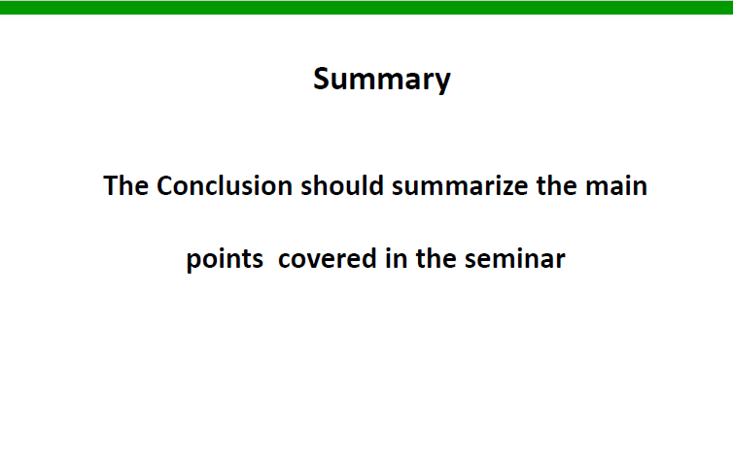

Slide 31
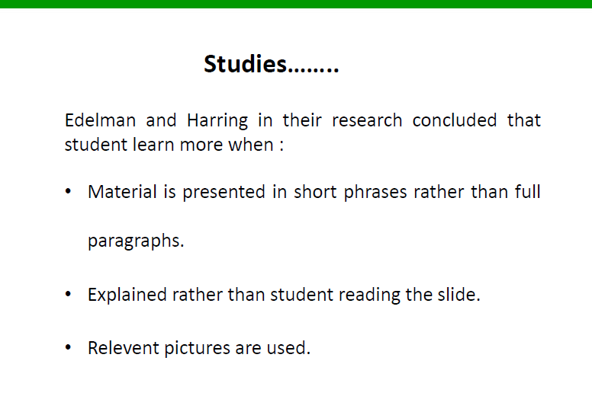

Slide 32
What's the difference between a conference, a seminar, a workshop and a symposium?
There are lots of different types of academic event that you might want to attend, such as conferences, seminars, workshops and symposiums.
Each has its own benefits and drawbacks.
and generally they have a different slant.
Size, for instance, is usually a big factor in whether something is regarded as a conference or a symposium.

Slide 33
Usually the difference between a conference and a symposium is that a conference will be a larger event and a symposium a smaller one.
The difference b/n a conference and a seminar is a conference has a more general theme with a focus on presentations and lectures
whereas a workshop is usually more specific and hands on, so to speak.

Slide 34
What's a conference?
Conferences tend to be the largest events vs. smaller workshops and seminars.
They can number anywhere between fifty attendees to thousands of attendees,
It can be national and international conferences
– national conferences are typically attended primarily by
people living within the country which is hosting the
event, while international conferences can attract visitors across the world

Slide 35
If the conference is a large one, you will find concurrent events.
This means that there might be two, four, or even more talks happening at the same time in different locations.
You need to be organized to find out when and where the talks you want to see are being held,
and you should make good use of your conference timetable which will hold all of this information.

Slide 36
What's a seminar?
The difference between a seminar and a workshop is that
a seminar tends to be held within one institution or university,
a seminar will be a small group of people – say, between five and ten attendees – who come together to focus on a particular issue.
Often seminars will be less formally structured than conferences.
so one person might give a presentation but it will probably be brief.
There is more of a focus on discussion at these events, so do feel free to chime in with your thoughts on the topic at hand.

Slide 37
Another difference between a seminar and a conference is that while conferences usually last for between a few days and a week, seminars will be much shorter.
They may be for an hour or two in the afternoon rather than lasting all day.

Slide 38
What's a workshop?
The difference between a workshop and a conference is that workshops are generally smaller than conferences.
The atmosphere is somewhere between a seminar and a
conference.
it is less structured than a conference but more formal than a seminar.
Workshops are also sometimes more diverse in terms of attendees than other events.

Slide 39
What's a symposium?
The main difference between a symposium and a conference is that a symposium tends to be similar to a conference, but smaller.
The definition of a symposium isn't completely clear – the Oxford Advanced Learner’s Dictionary describes it simply as 'a small conference'.
However, similarly to a workshop, a symposium tends to focus on a particular issue rather than a more general theme. Generally a number of experts will come together in order to present their ideas and papers to one another.

Slide 40
Basic points to remember
1. Introduction:
Generally your introduction part should focus on your title.
Specifically, it should Provide a clear description of the background information/situation to the problem.
Describe the situation as it is currently highlighting important issues to be addressed.
Include information such as the problem area and major research gaps in terms of policy and development issues related to the research.
Should show understanding and genesis of the problem.
Talk about the global perspective followed by the local scenario.
Talk about the target group in the study

Slide 41
2.Statement of the problem
Provide a clear description of the problem that is to be investigated
Indicate exactly what the problem is
Exactly what is the curiosity or the interest which you are trying to satisfy?
Indicate why and how it is a problem.
Give information to support this e.g. by use of statistics or evidence
Clearly show the knowledge gap that the research intends to close.

Slide 42
GENERALLY,IT SHOUD FOCUS ON THE FOLLOWING POINTTS:
This should include
a clear statement that the problem exists,
evidence that supports the existence of the problem,
evidence of an existing trend that has led to the problem,
definitions of major concepts and terms (this can be provided below in a subsection),
a clear description of the setting,
probable causes related to the problem, and
a specific and feasible statement.

Slide 43
3.Objectives
One general objective which should be in line with the title.
Specific objectives- have to be in line with the variables that you hypothesize to influence the phenomenon being investigated.
Should be related to the general objective.
Should not be questions in the questionnaire

Slide 44
4.Literature review
Literature review should include:
Introduction ✓Talk about what the chapter contains.
Theoretical literature
Review the theoretical literature relevant to the problem being investigated showing clearly the linkage of literature review to the research questions/objectives.
Theoretical literature should be reviewed chronologically i.e from the earliest to the latest.

Slide 45
3)Empirical Literature
Review the empirical literature relevant to the problem being investigated showing clearly the linkage of literature review to the research questions/objectives.
Indicate what has been done by other researchers including the methodologies used and identify gaps.
The hypothesized variables may be subheadings of the literature review to form a framework that would help in analysis.

Slide 46
Empirical literature should be reviewed chronologically i.e from the earliest to the latest.
Cite 3-5 references per key section in the text.
Use either APA or Harvard style of citation.
Consistency is important in citation.
Each key variable should be 2-3 pages long if the style of review is as per each variable.
Critique of the existing literature relevant to the study.
Research gaps/A critic of literature

Slide 47
Thank you!

