Slide 1
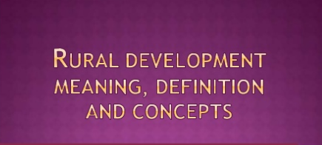
Chapter 1: concepts of rural development

Slide 2
Contents
Concepts and Definitions of Rural Development
Agricultural Economics and Rural Development
Rural Livelihood and Poverty Reduction Strategy
Infrastructure and Rural Development
Agricultural Transformation and Rural Development
Dominant Models of Rural Development

Slide 3
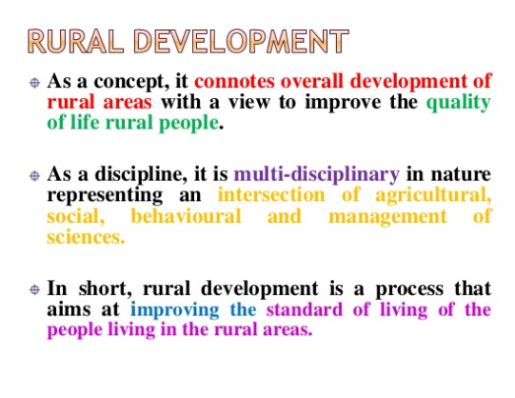

Slide 4
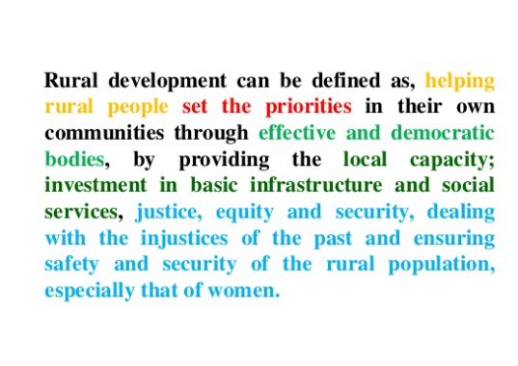

Slide 5
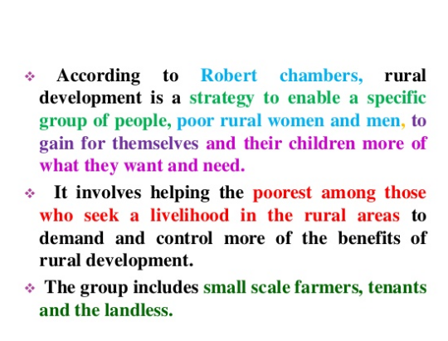

Slide 6
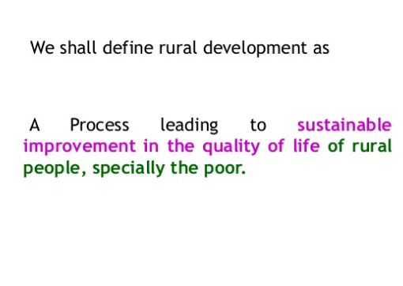

Slide 7
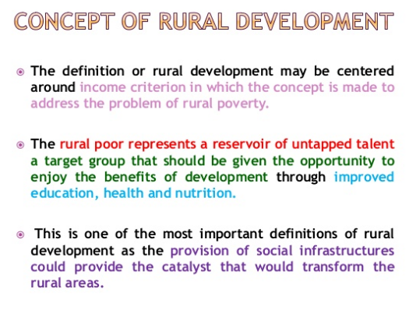

Slide 8
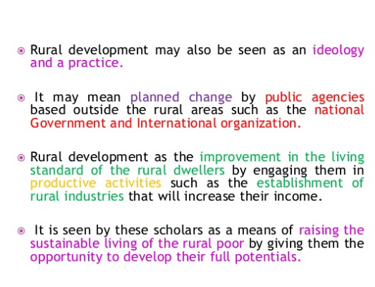

Slide 9
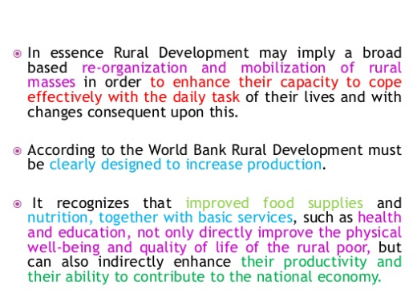

Slide 10
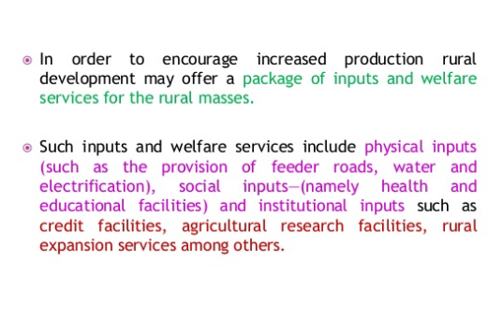

Slide 11
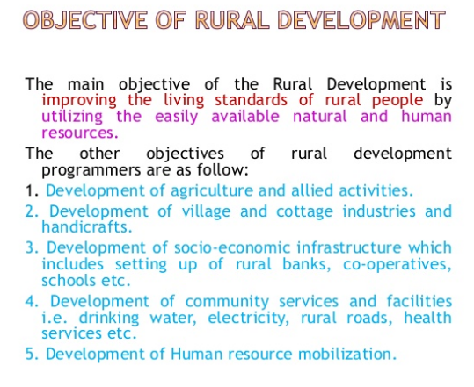

Slide 12
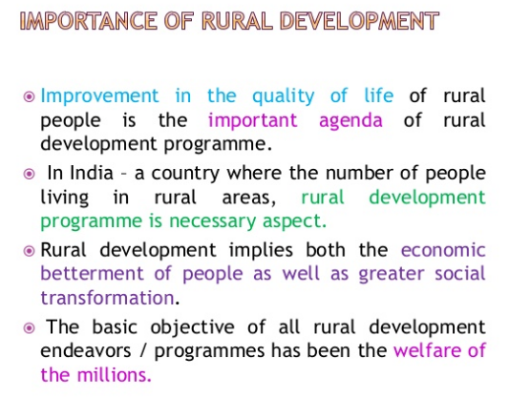

Slide 13
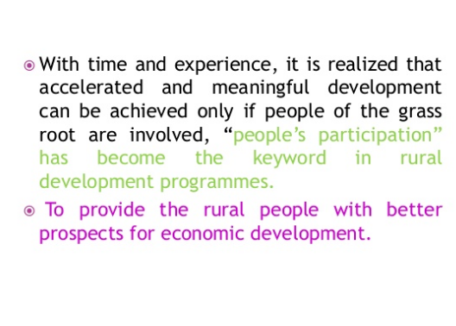

Slide 14
Problems in rural development
About 80% the population of Ethiopia lives in rural areas
There are many obstacles in the RD programs such as
No electricity supply in rural villages
Primitive use of cooking, farming, living, and they have trust on these methods
Illiteracy is the major problem
Poor extension linkages resulted in slow growth
Every one wants to go cities thus villages become vacant and ignored by policy makers

Slide 15

Rural finance

Slide 16


Slide 17
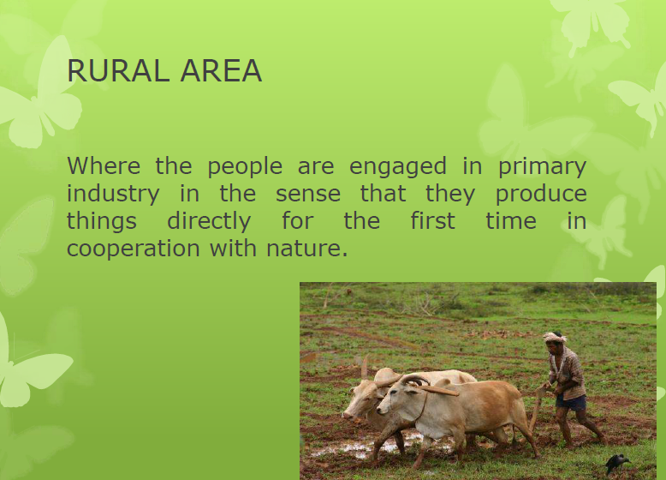

Slide 18
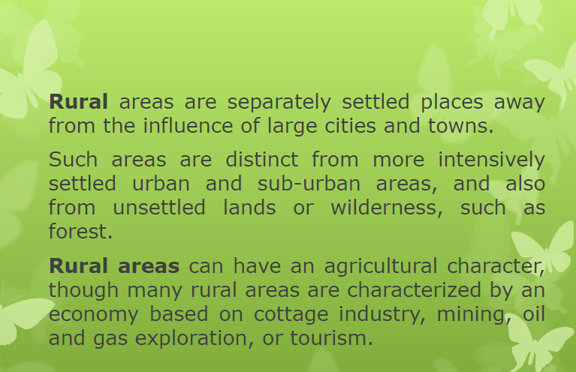

Slide 19
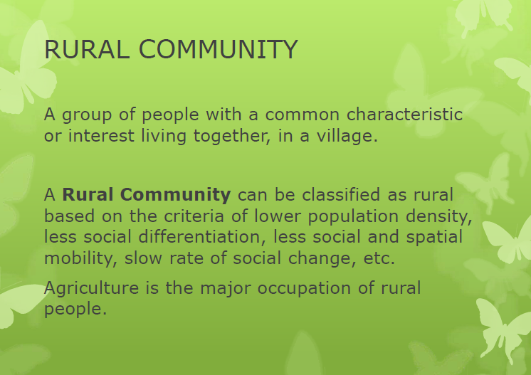

Slide 20
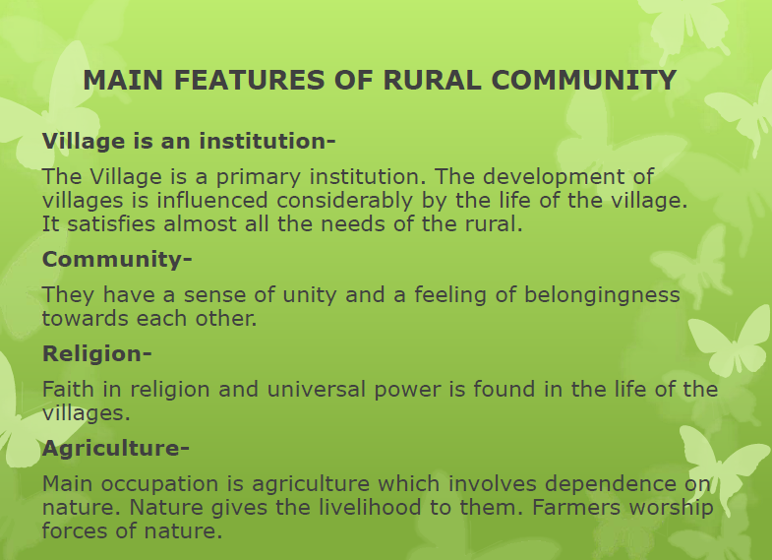

Slide 21
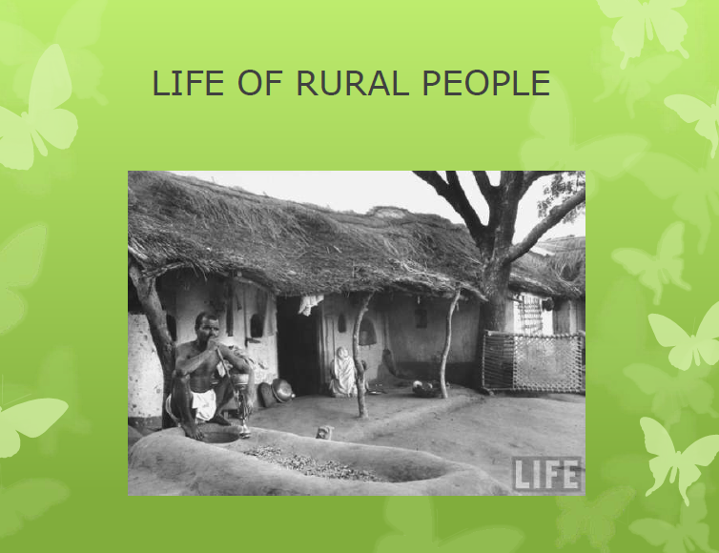

Slide 22
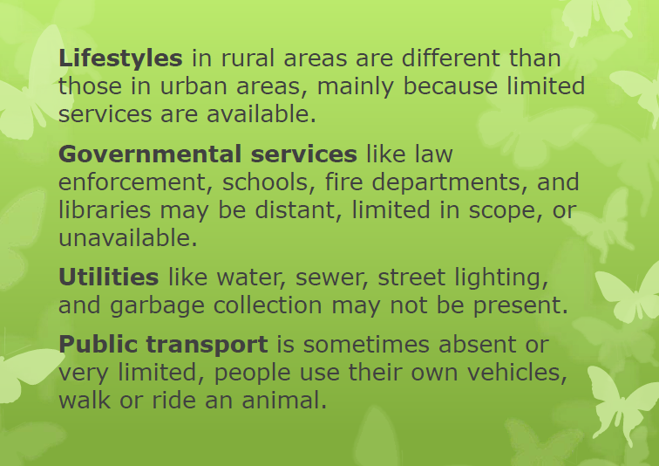

Slide 23
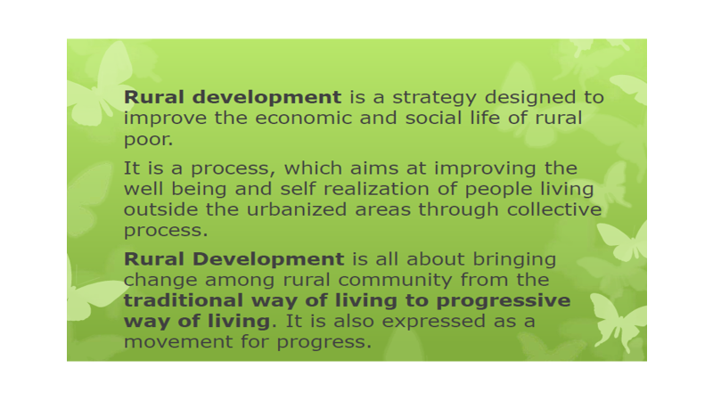

Slide 24
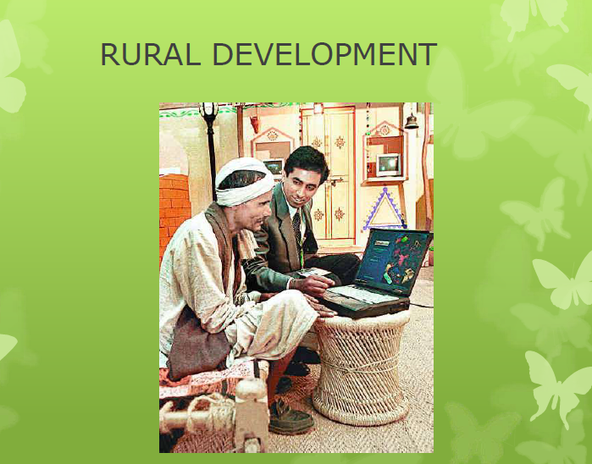

Slide 25
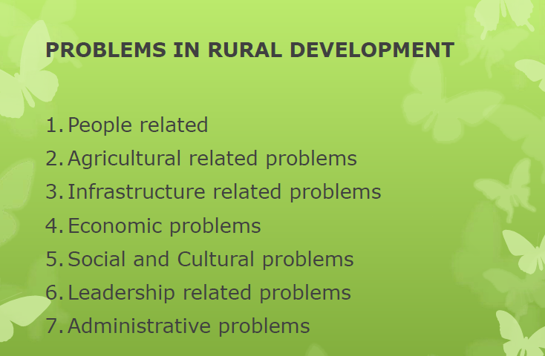

Slide 26
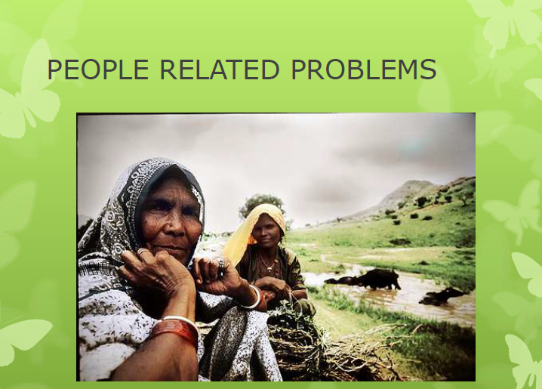

Slide 27
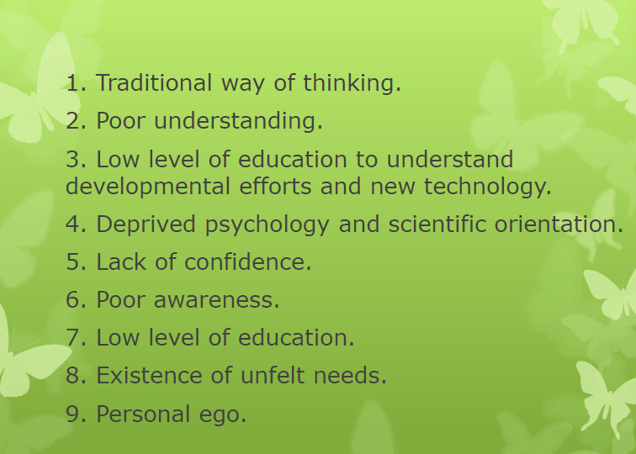

Slide 28
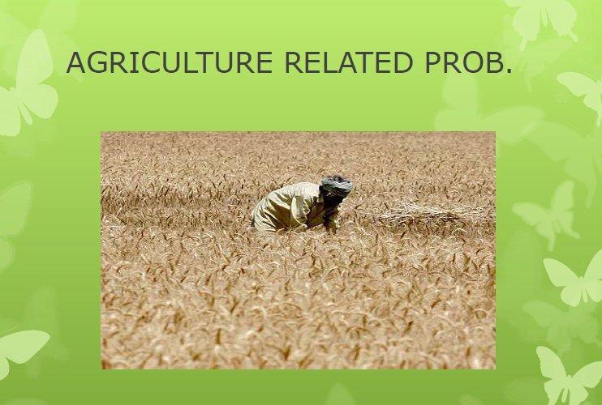

Slide 29
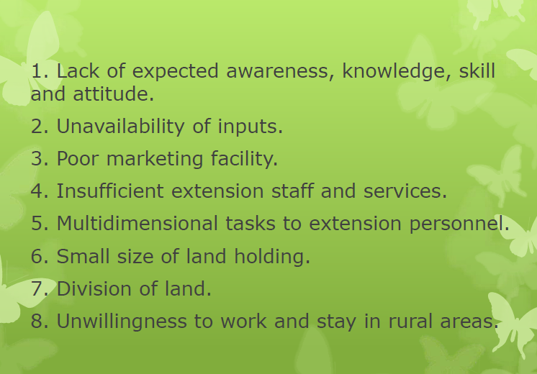

Slide 30
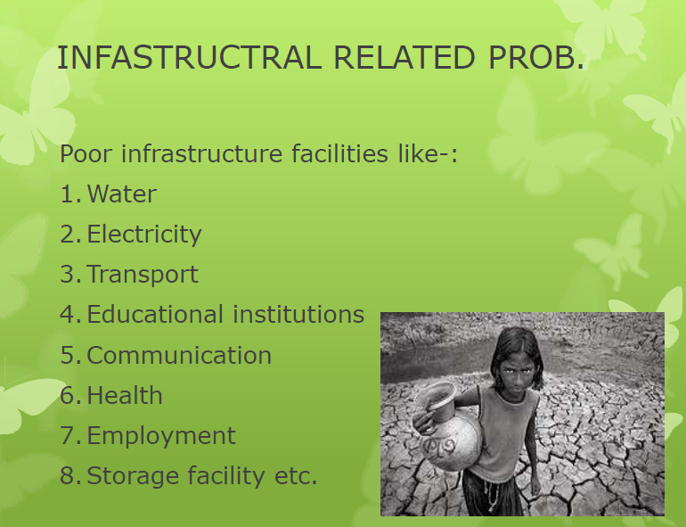

Slide 31
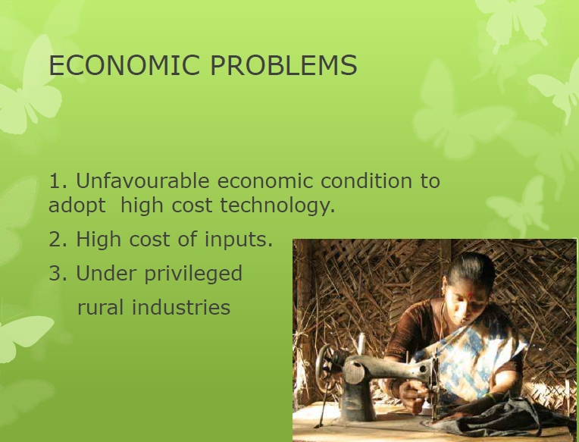

Slide 32
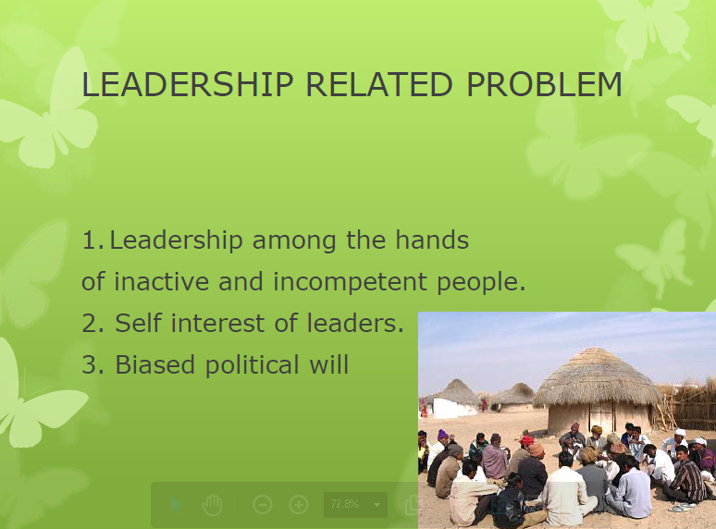

Slide 33
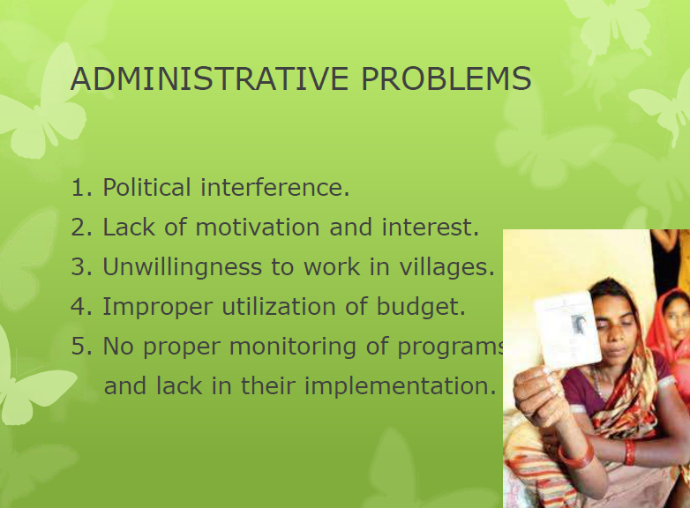

Slide 34
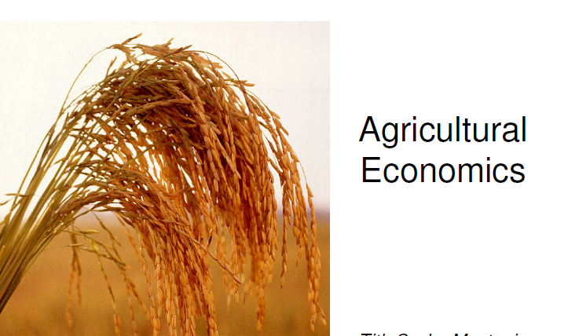
Chapter 2:Agricultural Economics

Slide 35
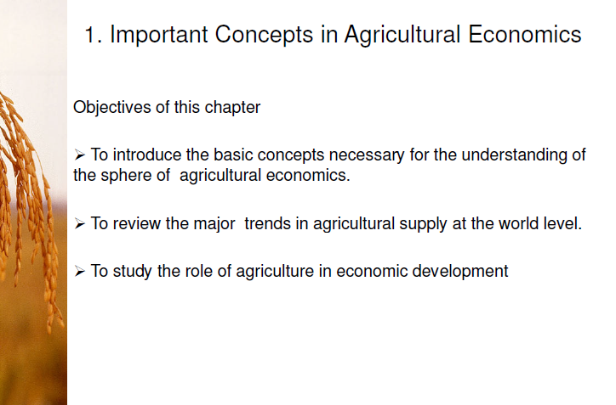

Slide 36
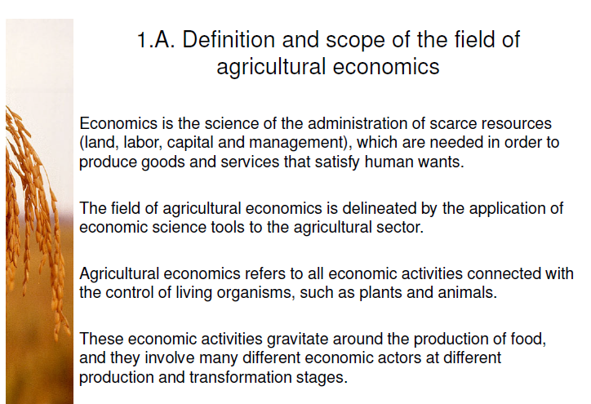

Slide 37
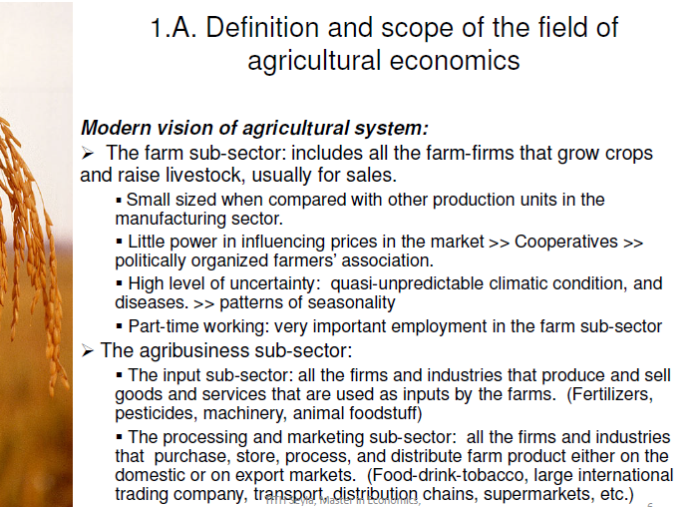

Slide 38
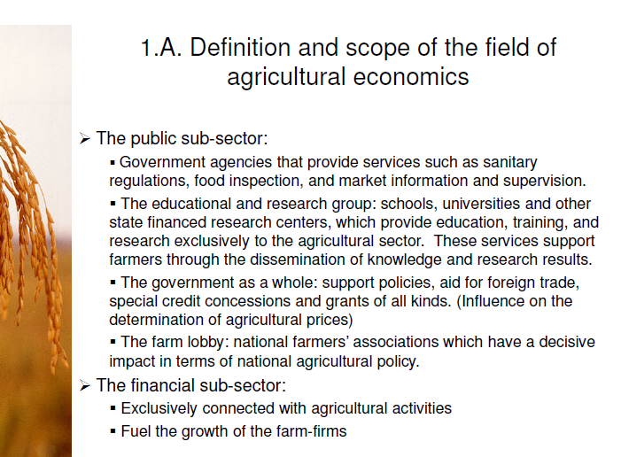

Slide 39
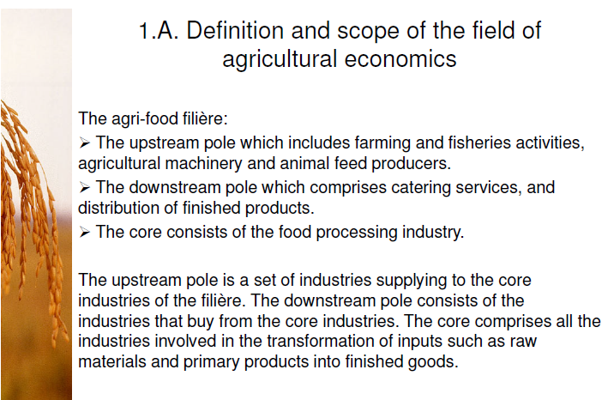

Slide 40
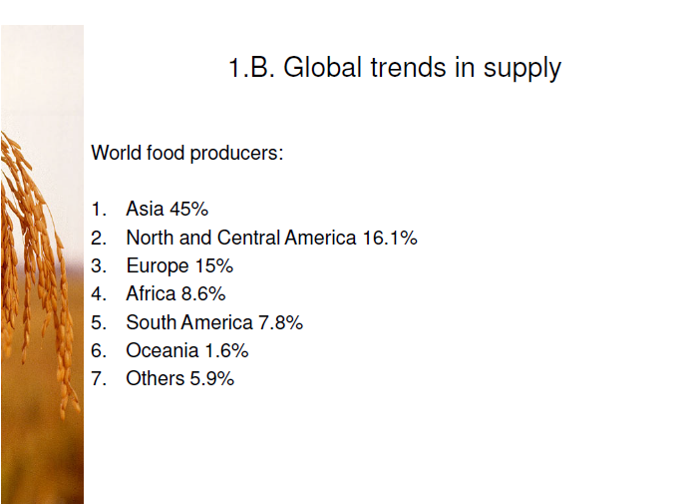

Slide 41
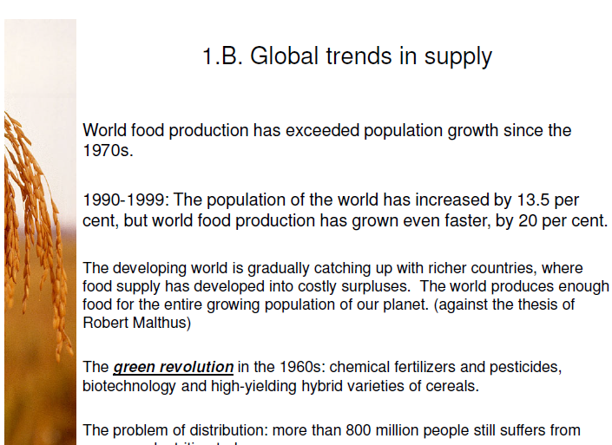

Slide 42
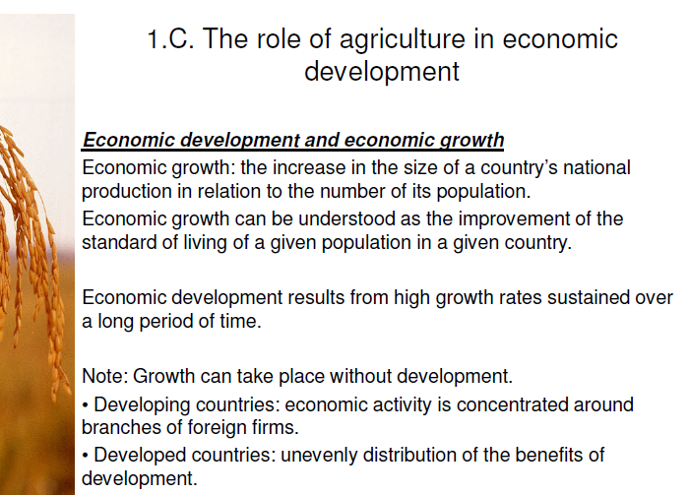

Slide 43
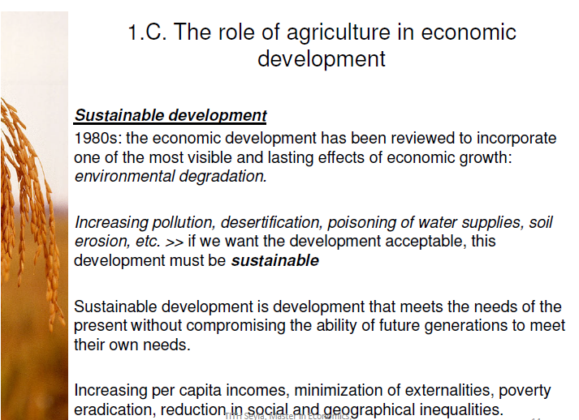

Slide 44
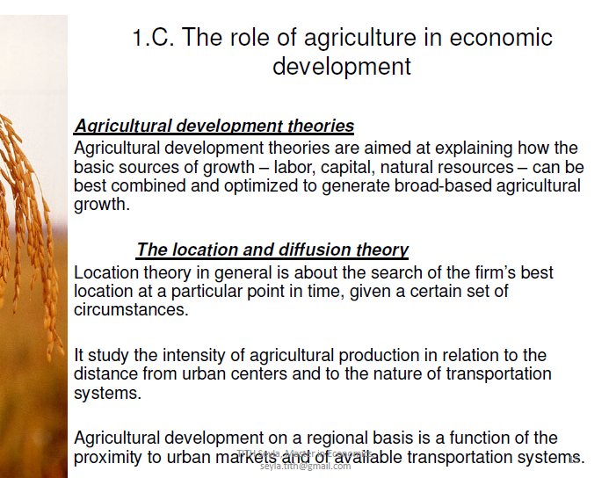

Slide 45
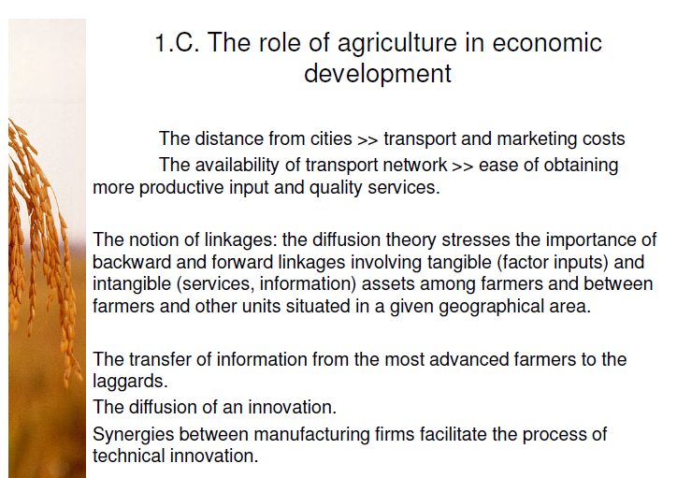

Slide 46
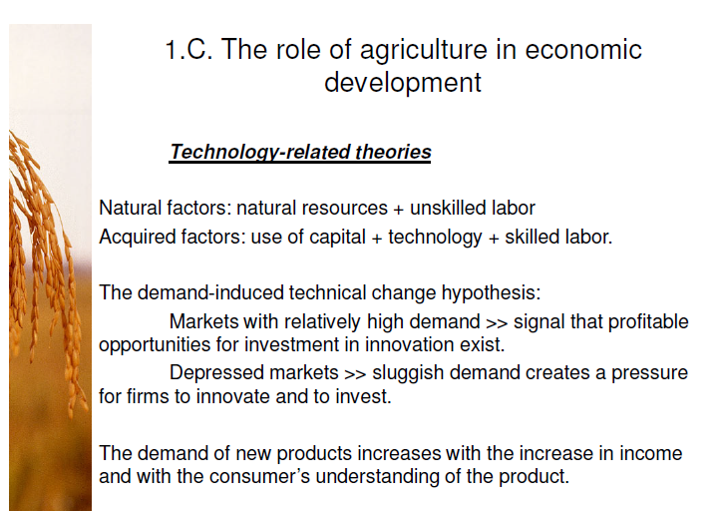

Slide 47
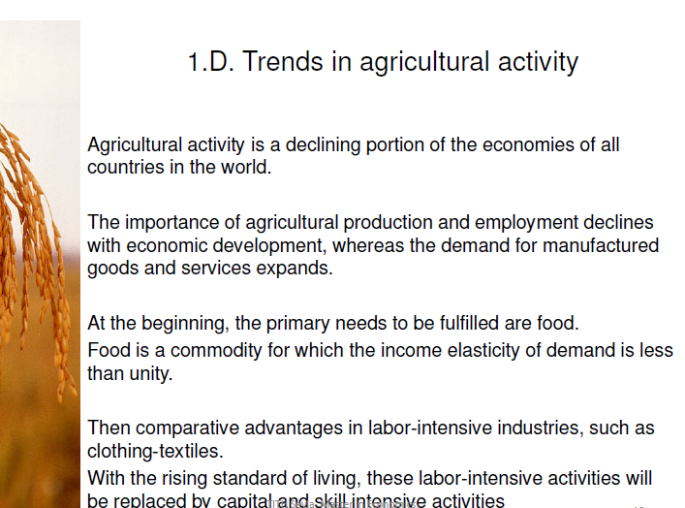

Slide 48
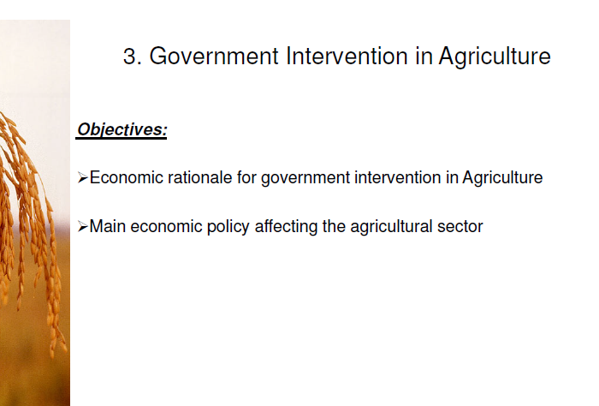

Slide 49
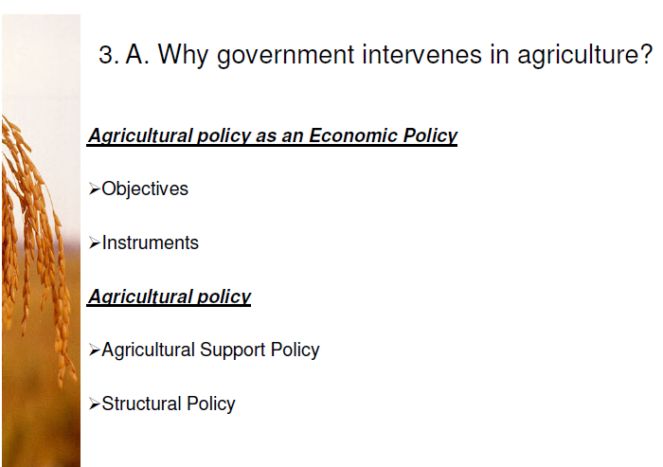

Slide 50
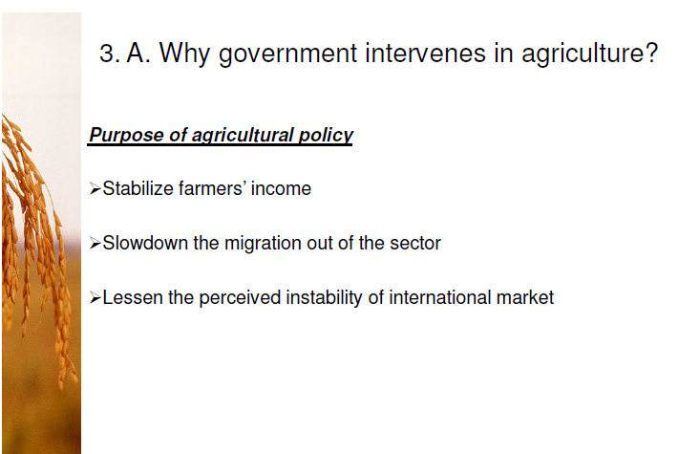

Slide 51
Models of Agricultural Development
The frontier model
The Conservation Model
The Urban Impact Model
(location model)
The Diffusion Model
The High-Payoff Input Model

Slide 52
1. The frontier model
agricultural production increases as a result of expansion in areas cultivated

Slide 53
2. Conservation Techniques
Input produced by agriculture itself
There is a limit on results

Slide 54
3. Urban Impact Model -- Hypotheses
Economic development occurs in a specific location matrix.
These location matrices (growth centres) are primarily industrial-urban.
The existing economic organization works best at or near the centre of a particular matrix of economic development, and
it also works best in those parts of agriculture situated favourably in relation to such a centre; and
it works less satisfactorily in those parts of agriculture situated at the periphery of such a matrix.

Slide 55
Urban Impact Model
Key concepts:
Agriculture must change input combinations
Agriculture must respond to demand changes

Slide 56
3. The Ag. Growth Process
Adopting new inputs; technique
Gaining new information in inputs
Learning about market demands
Works Better Near Urban Areas
Economic information more complete
Less uncertainty

Slide 57
5. High Pay-Offs Inputs
Enhance current resources
Come from outside the agricultural sector
Accompanied by education
In form peasants can use
At price peasants can afford

Slide 58
Policies Implied by the High Pay-off Input Model
Invest in research to produce new technology, but technology based on local conditions.
Invest in capacity of local industry to develop, produce and supply the new inputs.
Invest in capacity of farmers to be able to use the modern inputs
General basic education
Adult education
Extension system

Slide 59
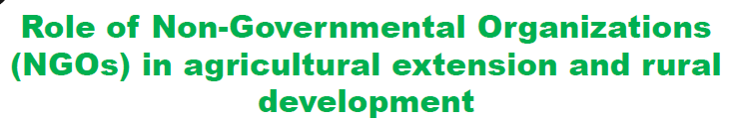

Slide 60
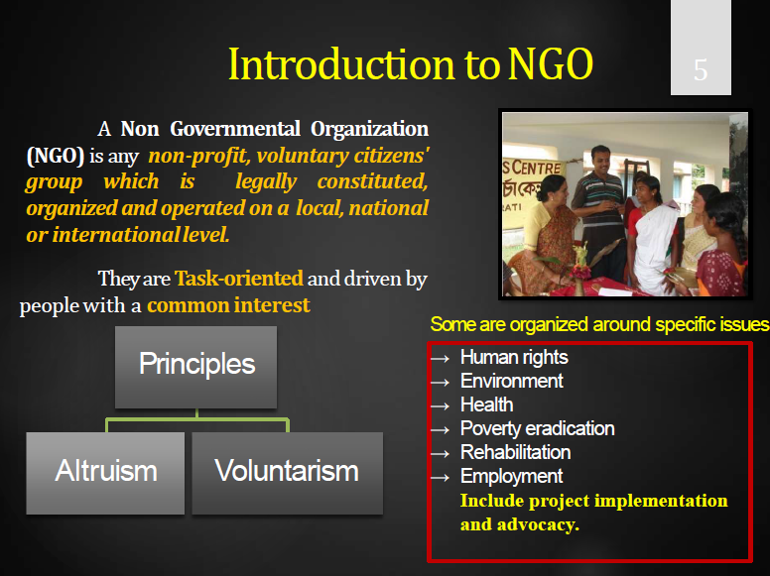

Slide 61
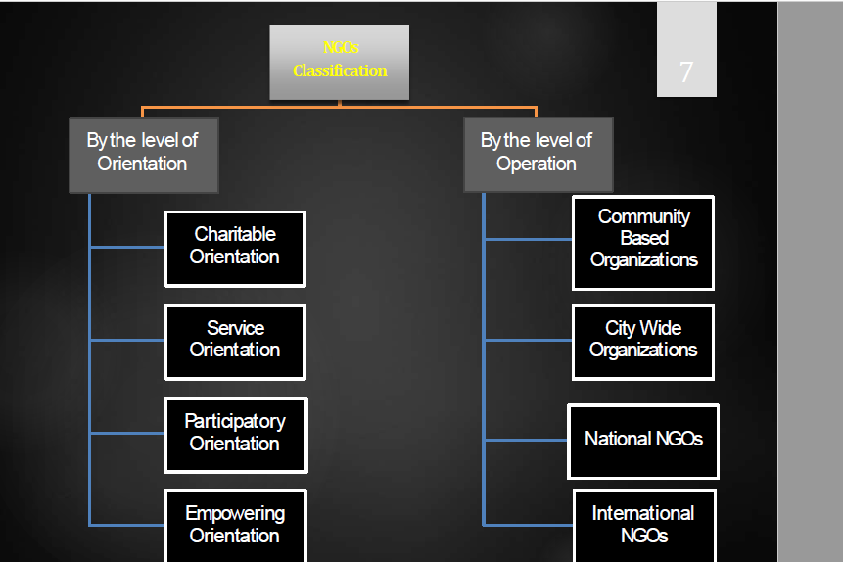

Slide 62
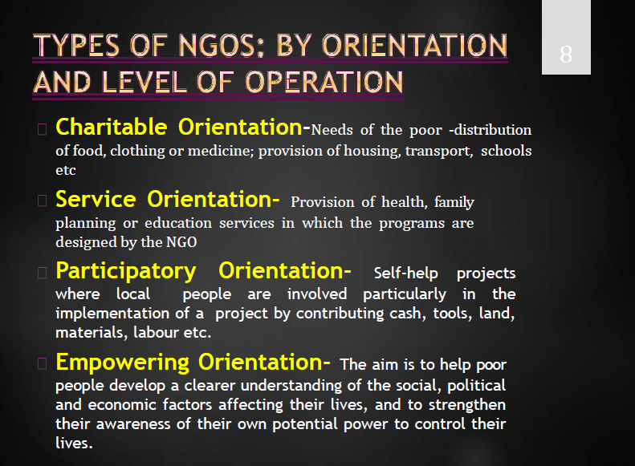

Slide 63


Slide 64


Slide 65


Slide 66


Slide 67


Slide 68

What is agricultural extension?

Slide 69


Slide 70


Slide 71


Slide 72


Slide 73


Slide 74


Slide 75


Slide 76


Slide 77


Slide 78


Slide 79


Slide 80


Slide 81


Slide 82


Slide 83


Slide 84


Slide 85


Slide 86


Slide 87


Slide 88


Slide 89


Slide 90


Slide 91


Slide 92


Slide 93


Slide 94


Slide 95


Slide 96




Slide 97


Slide 98


Slide 99


Slide 100


Slide 101


Slide 102


Slide 103


Slide 104

Chapter three: Rural Livelihoods and poverty Reduction strategy

Slide 105


Slide 106


Slide 107



Slide 108



Slide 109


Slide 110


Slide 111


Slide 112


Slide 113


Slide 114


Slide 115


Slide 116


Slide 117


Slide 118


Slide 119


Slide 120


Slide 121

modernization

Slide 122


Slide 123


Slide 124


Slide 125


Slide 126


Slide 127


Slide 128


Slide 129


Slide 130


Slide 131


Slide 132


Slide 133


Slide 134


Slide 135


Slide 136


Slide 137


Slide 138


Slide 139


Slide 140


Slide 141


Slide 142


Slide 143


Slide 144


Slide 145


Slide 146


Slide 147


Slide 148


Slide 149


Slide 150


Slide 151


Slide 152

LIVLIHOOD AND RURAL DIVERSIFICATION

Slide 153


Slide 154


Slide 155


Slide 156


Slide 157


Slide 158


Slide 159


Slide 160


Slide 161


Slide 162

Poverty reduction strategies

Slide 163


Slide 164


Slide 165


Slide 166


Slide 167


Slide 168


Slide 169


Slide 170


Slide 171


Slide 172


Slide 173


Slide 174


Slide 175


Slide 176


Slide 177


Slide 178


Slide 179


Slide 180


Slide 181


Slide 182

Chapter Four

Slide 183


Slide 184


Slide 185


Slide 186


Slide 187


Slide 188


Slide 189


Slide 190


Slide 191


Slide 192


Slide 193


Slide 194
Chapter 5: Agricultural transformation and rural development

Slide 195


Slide 196


Slide 197


Slide 198


Slide 199


Slide 200


Slide 201


Slide 202


Slide 203


Slide 204


Slide 205


Slide 206


Slide 207


Slide 208


Slide 209


Slide 210


Slide 211


Slide 212


Slide 213


Slide 214


Slide 215


Slide 216


Slide 217


Slide 218


Slide 219


Slide 220


Slide 221


Slide 222


Slide 223


Slide 224


Slide 225


Slide 226


Slide 227


Slide 228


Slide 229


Slide 230


Slide 231


Slide 232


Slide 233


Slide 234


Slide 235


Slide 236


Slide 237


Slide 238


Slide 239

Implications of agricultural growth for poverty reduction in Ethiopia

Slide 240


Slide 241


Slide 242


Slide 243


Slide 244


Slide 245


Slide 246


Slide 247


Slide 248
Chapter 6:
Dominant Models of Rural Development
8.1 Approaches to rural development
Four approaches
A sectoral approach
A multisectoral approach
A territorial approach
A local approach

Slide 249
1. A sectoral approach
The immediate post-war model centred on the agricultural sector.
Increasing food production was a first priority and other objectives, such as enhancing rural employment and services, were seen as following directly from the production support given to the agricultural sector
Agricultural decline promotes rural depopulation and a decline in rural service provision.
Thus, a policy to stimulate agricultural production not only supports domestic food supply, agricultural employment and farm incomes, it also deters outmigration from rural areas and supports the rural economy and service provision more generally.

Slide 250
2. A multisectoral approach
Farm “diversification”
Farmers were encouraged to look for alternative sources of income
by adding value to agricultural products,
by making use of farm assets, especially land and buildings for non-agricultural uses,
by undertaking agricultural work on other farms and
by becoming involved in non-agricultural economic activities off the farm.

Slide 251
3. A multisectoral approach
Area based approach
recognises the wider interactions within the rural economy and the importance of social and environmental as well as economic issues.
the establishment of new economic activity associated with the most advanced sectors of a modern economy, such as in information technology, and many areas have gained employment from the establishment of new firms and types of employment.

Slide 252
4. A local approach
the differentiation between rural areas and the variation in individual circumstances within areas promotes a search for actions that recognise the specificity of solutions at most local levels.
These changes have reflected both forces fundamentally associated with national economic change and other factors more governed by local circumstances.

Slide 253
5.1. Models of rural Development
1. The Human Capital Model
is based on the following two assumptions, which have been ignored in the classical theory of development.
Human physical and mental capabilities are partly inherited and partly acquired, and they vary from individual to individual.
Human capital directly contributes to development through its positive effect on productivity, and through reduction in resistance to the diffusion of new technologies in the economy, especially in the rural sector.

Slide 254
This model shifts the emphasis from physical capital formation to human capital formation and from industrial development to rural development, as a basis for overall development.

Slide 255
5.2.2 Gandhian Model to Rural Development
Employment oriented planning to replace production oriented planning
Emphasis on development of agriculture as a means of enlarging employment
Emphasis on small industries as against large industries Final Choose

Slide 256
5.3 Self-Help Group Model
SHG refers to "self-governed, peer controlled information group of people with similar socio-economic background and having a desire to collectively perform common purpose."
SHG are voluntarily coming together for achieving the following.
To save small amount of money regularly.
To mutually agree to contribute a common fund.

Slide 257
To meet their emergency needs.
To have collective decision making.
To solve conflicts through collective leadership mutual discussion.
To provide collateral free loan with terms decided by the group at the market driven rates.

Slide 258
5.3.3Characteristics of SHGs
The important characteristics of self-help groups are as follows:
They usually create a common fund by contributing their small savings on a regular basis.
The groups evolve a flexible system of operations often with the help of the non-governmental organizations (NGOs) and manage their common pooled resource in a democratic manner.
Groups consider loan requests in periodical meetings, with competing claims on limited resources being settled by consensus regarding greater needs.

Slide 259
loan is mainly on the basis of mutual need and trust with minimum documentation and without any tangible security.
The amounts loaned are small, frequent and for short duration.
Rates of interest vary from group to group depending upon the purpose of loans and are often higher than those of banks but lower than those of moneylenders.
At periodical meetings, besides collecting money, emerging rural, social and economic issues are discussed.
Defaulters are rare due to group pressure and intimate knowledge of the end use of the credit as also the borrower's economic resources.

Slide 260
5.3.4 Functions of SHGs
The important functions of SHG are the following:-
Enabling members to become self-reliant and self-dependent.
Providing a forum for members for discussing their social and economic problems.
Enhancing the social status of members by virtue of their being members of the group.
Providing a platform for members for exchange of idea.

Slide 261
Developing and encouraging the decision making capacity of members.
Fostering a spirit of mutual help and cooperation among members.
Instilling in members a sense of strength and confidence which they need for solving their problems.
Providing organizational strength to members.
Providing literacy and increasing general awareness among members, and
Promoting numerically and equipping the poor with basic skills required for understanding monetary transactions.

Slide 262
Thus, the SHGs function on the principle of the five 'p's.
Propagator of voluntarism
Practitioner of mutual help
Provider of timely emergency loan
Promoter of thrift and savings, Final Match and
Purveyor of credit.

Slide 263
5.4 Public-Private Partnership (PPP) Model
A ppp is a partnership between the public sector and the private sector for the purpose of delivering a project or service traditionally provided by the public sector.

Slide 264
Why should governments consider ppp?
This model enables governments to accurately measure, budget and manage the total cost of ownership of a building with guarantees from the private sector. This results in:
Cost effective and efficient capital market access to address new and existing property needs
Greater governance, transparency and discipline of public spending
Timely construction of building projects
Innovative building designs and operational strategies
Continuous improvement in life safety, building operations and energy efficiency
Job creation for your community

Slide 265
5. Pre-requisites for a successful ppp program
P3s are successful when the weight and magnitude of these types of projects is understood by all parties.
Both the public and private sectors must meet their commitments in order to transfer risk and deliver quality buildings. These includes,
Political commitment (continuity of policy)
Enabling legislation (enabling legislation…concession laws, tax anomalies)
Expertise (capacity building in both sectors)
Project prioritization (focus to improve success rates)
Deal flow and standardization (regularity of deals based on standard contracts)

Slide 266
"ትልልቅ ኢኮኖሚያዊ ሃሳቦችን ባስተምርም በርሃብ ለሚጠቁ ዜጎች ወዲያው ምንም ጠብ የሚል ነገር አለመኖሩ ያስቆጨኛል" Dr. Muhammad Yunus (Development economics)፡፡
በዓለም ላይ ብዙ ኢኮኖሚስቶች ከድህነት እንዴት መውጣት እንደሚቻል ቢያስተምሩም ያወሩትን እራሳቸው አድርገውት አይገኙም ነገር ግን ሙሃመድ የኑስ በ100 ሀገራት የሚተገበር የአነስተኛ ብድር አቅርቦት ተቋም በማቋቋም ሚሊዮኖችን ከድህነት ለማውጣት በቅቷል፤ በዚህም ተግባሩ ሙሃመድ የኑስ እና ያቋቋመው ግራሚን ባንክ በጋራ የ2006 የዓለም የሰላም የኖቤል ሽልማት አግኝተዋል፡፡

Slide 267
በምዕተ ዓመቱ ከተፈጠሩ 12 ስራ ፈጣሪዎች መካከል አንዱ የሆነው ኢኮኖሚስት፤ በ2008 'Top 100 Global Thinkers' ከሚባሉት ውስጥ በደረጃ 2ኛው ነበር! ለምን ባንክ እንዳቋቋመ ሲጠየቅ፡-
“In 1974 we ended up with a famine in the country.
People were dying of hunger and not having enough to eat.
And that's a terrible situation to see around you.
And I was feeling terrible that here I teach Elegant_theories_of_economics, and those theories are of no use at the moment with the people who are going hungry.
So I wanted to see if as a person, as a human being, I could be of some use to some people”.

Slide 268
Thank you!!!

