Slide 1
Limited dependent variable
Outline
Models for Binary Choices
Ordered Choice Models
Models for Unordered Multiple Choices

Slide 2
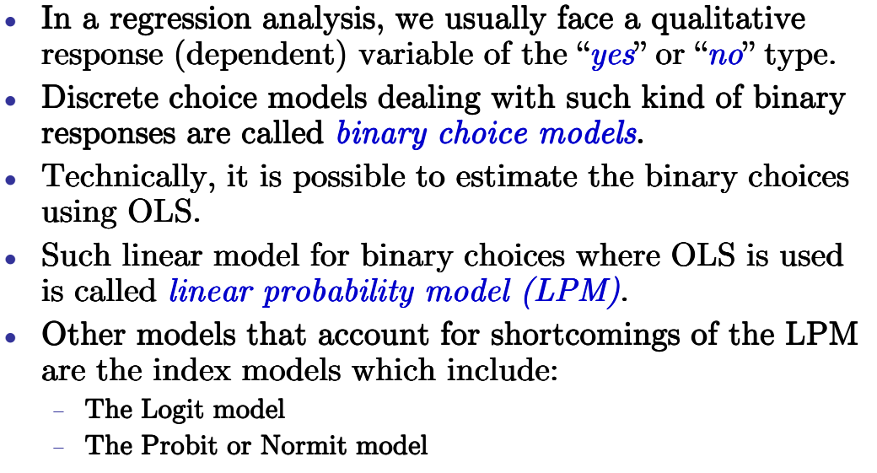
Binary choice models

Slide 3
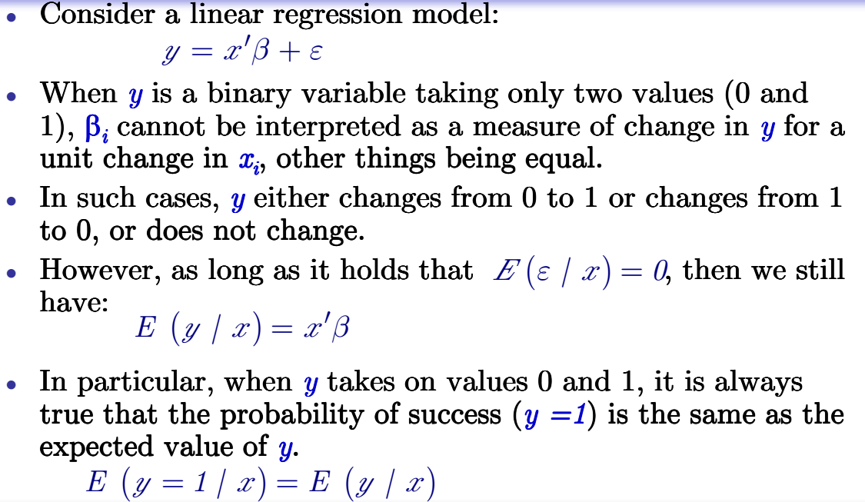
Linear probability model (LPM)

Slide 4
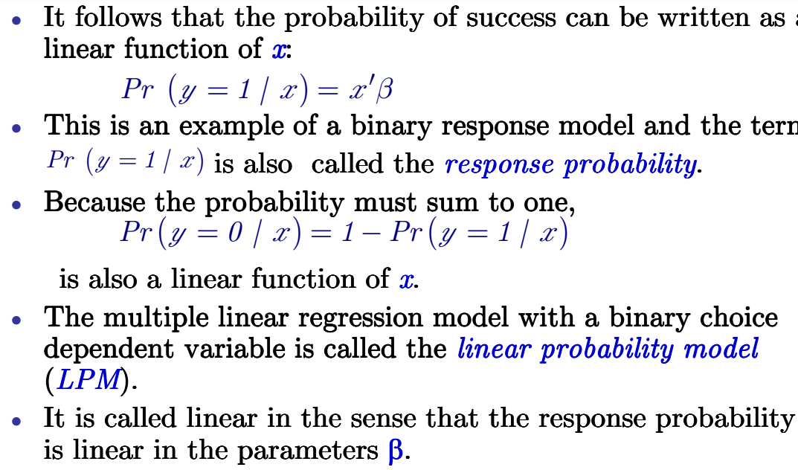
Linear probability model (LPM)

Slide 5
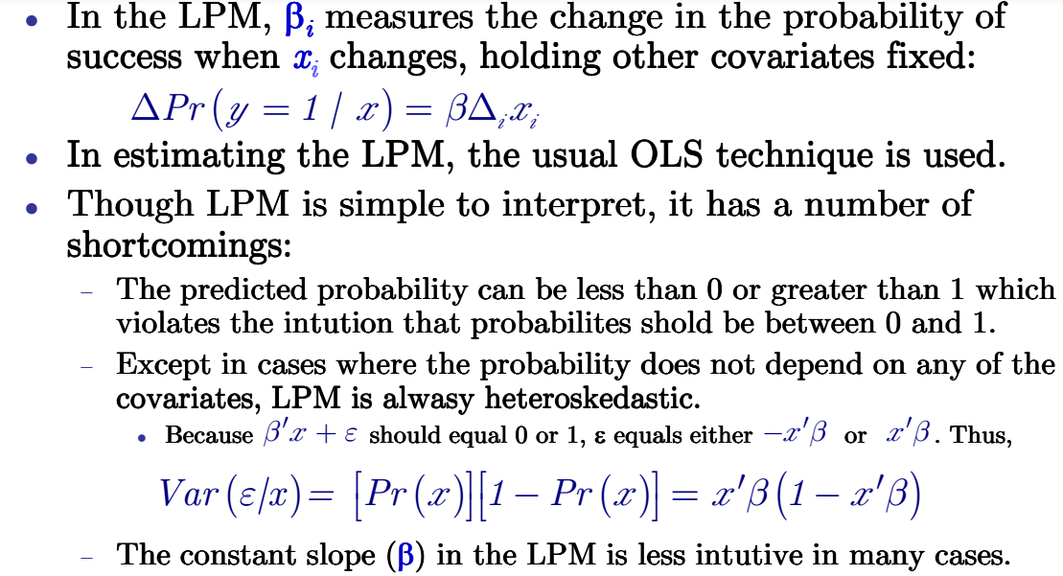
Linear probability model (LPM)

Slide 6
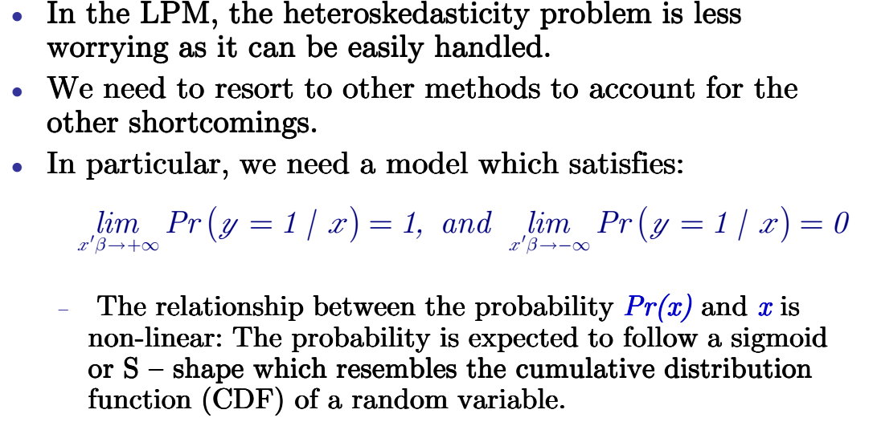
Index models: logit and probit

Slide 7
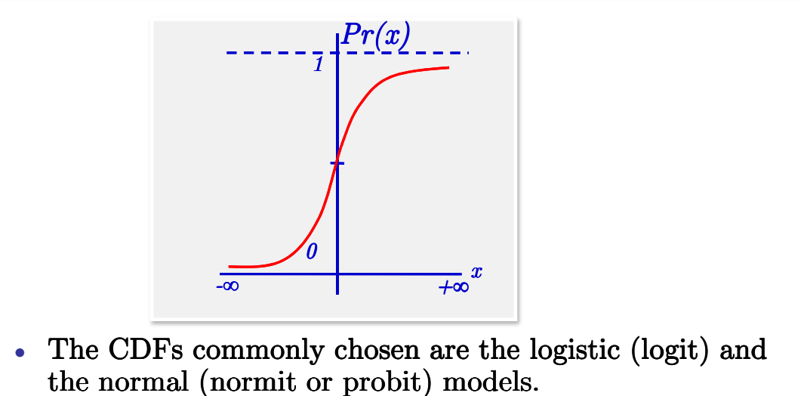
logit and probit

Slide 8
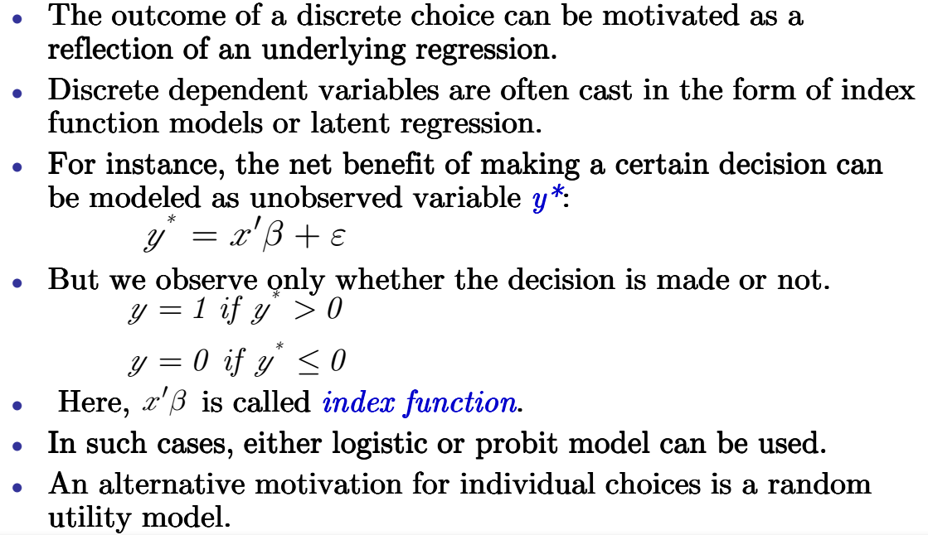
logit and probit

Slide 9
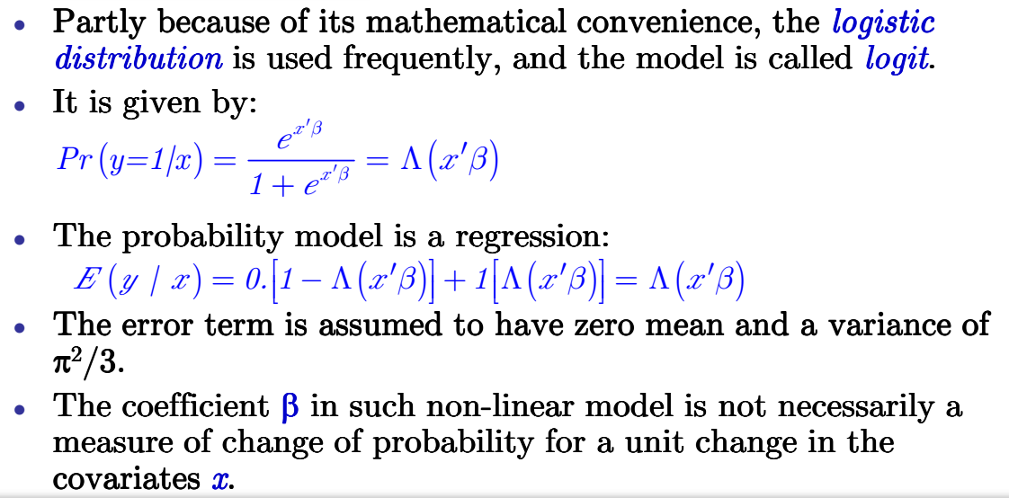
Logit model

Slide 10
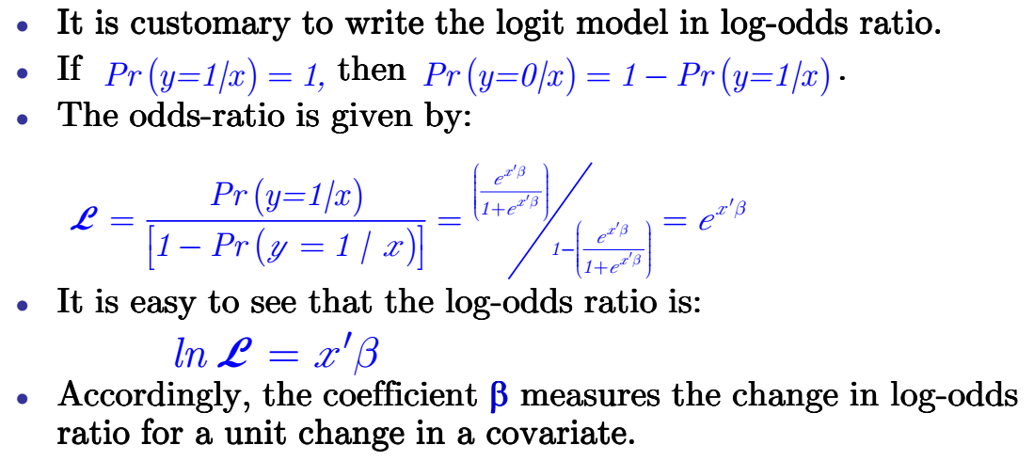
Logit model

Slide 11
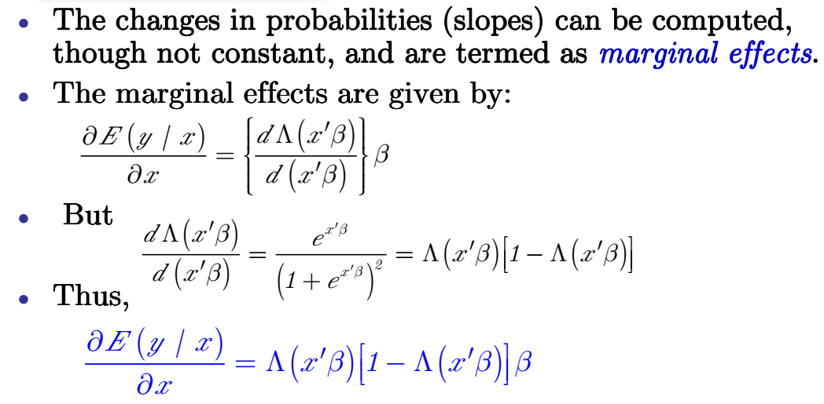
Logit model

Slide 12
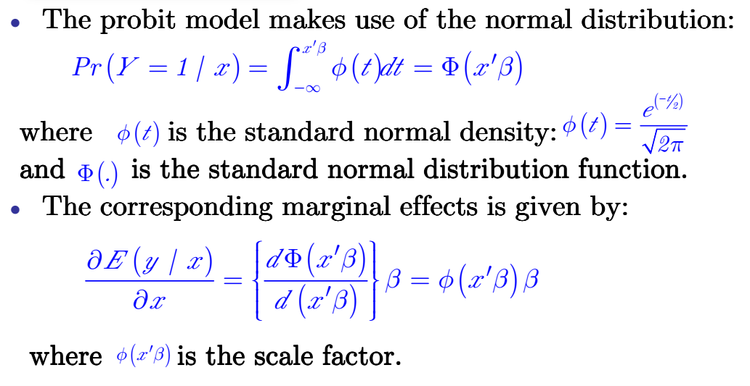
Probit model

Slide 13
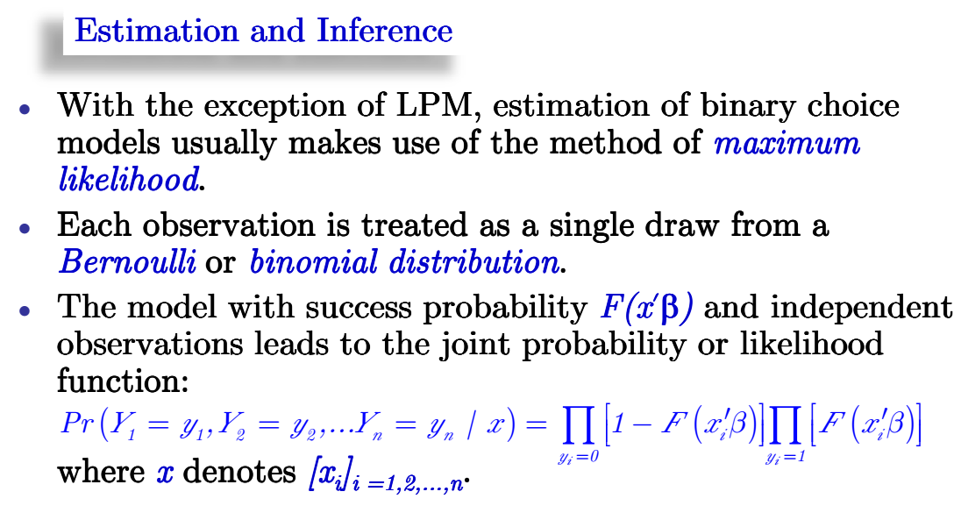
Logit and Probit models

Slide 14
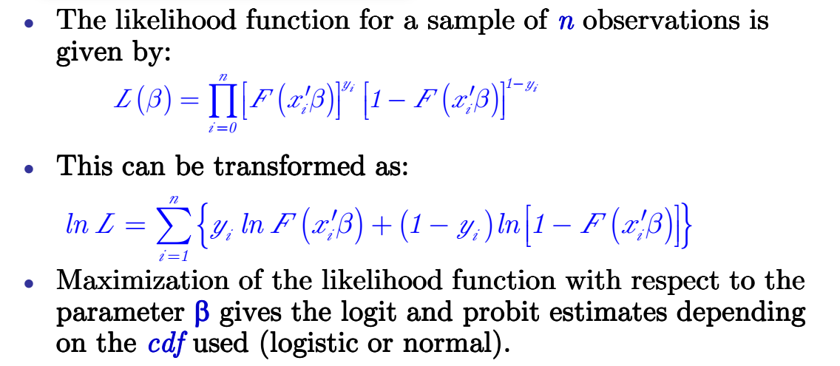
Logit and Probit models

Slide 15
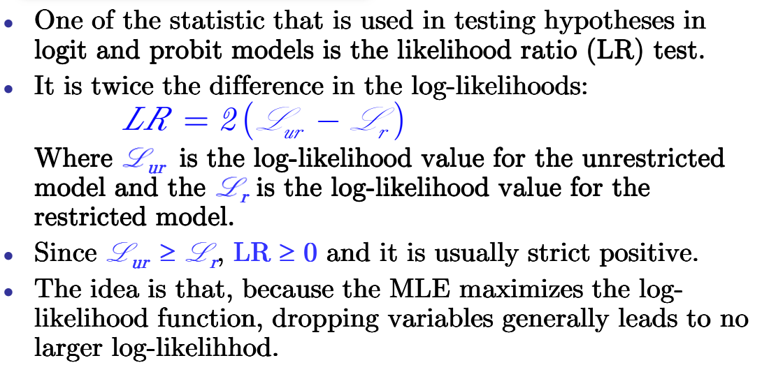
Logit and Probit models

Slide 16
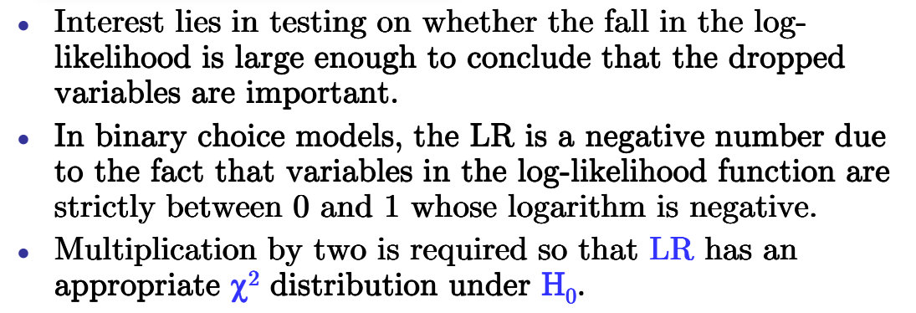
Logit and Probit models

Slide 17
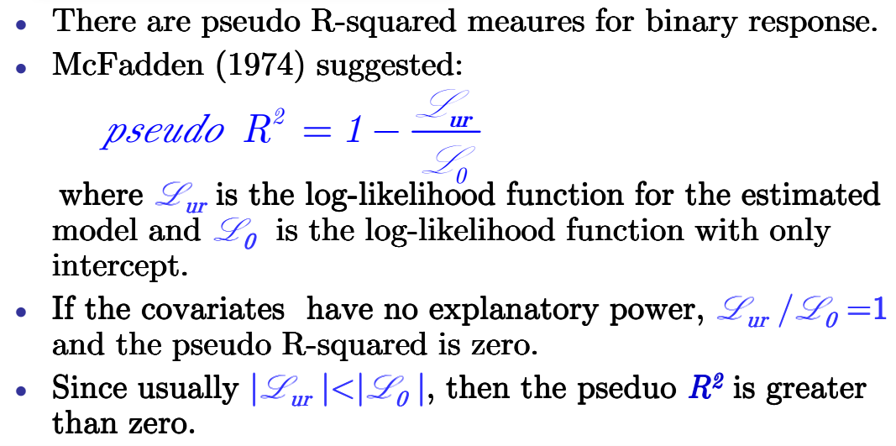
Logit and Probit models

Slide 18
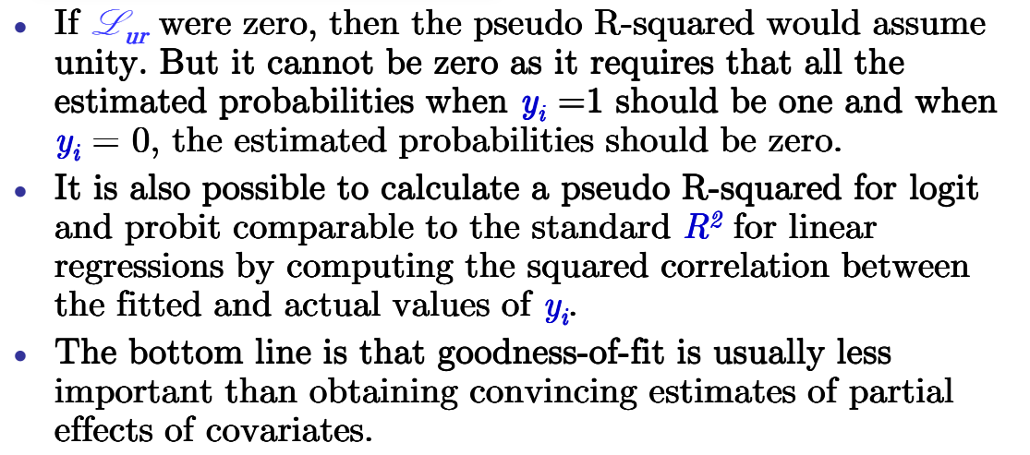
Logit and Probit models

Slide 19
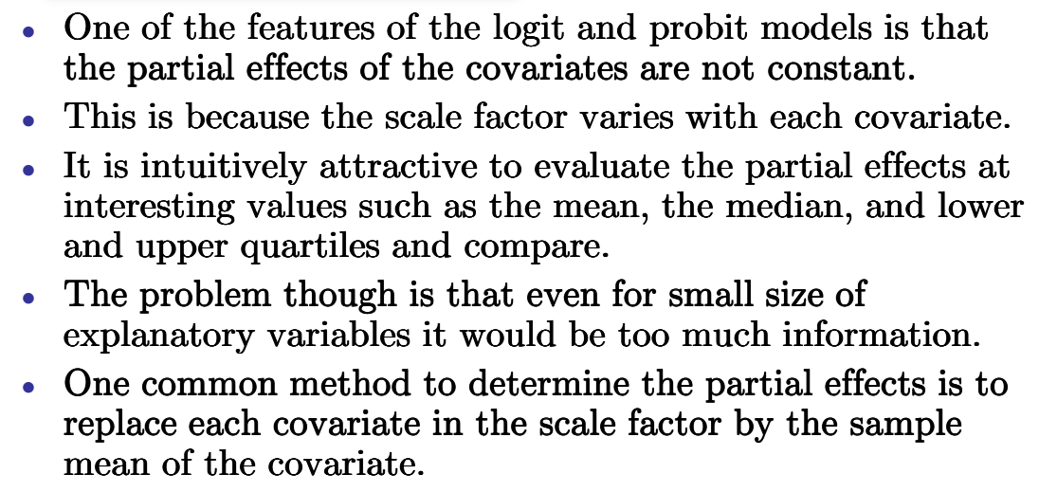
Logit and Probit models

Slide 20
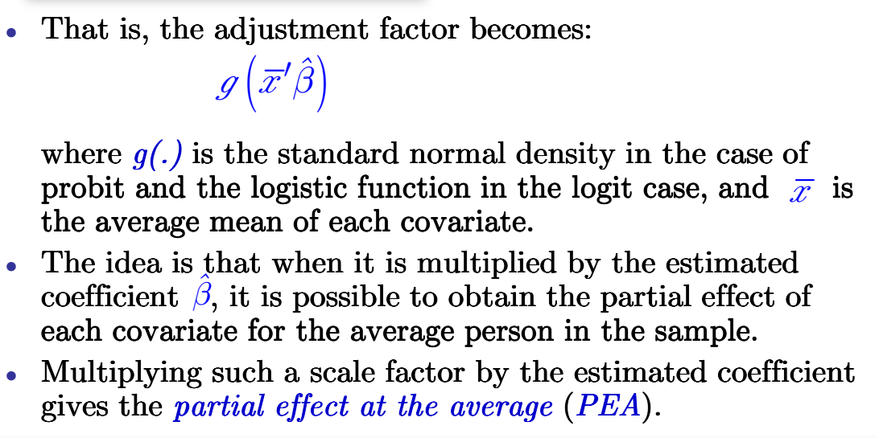
Logit and Probit models

Slide 21
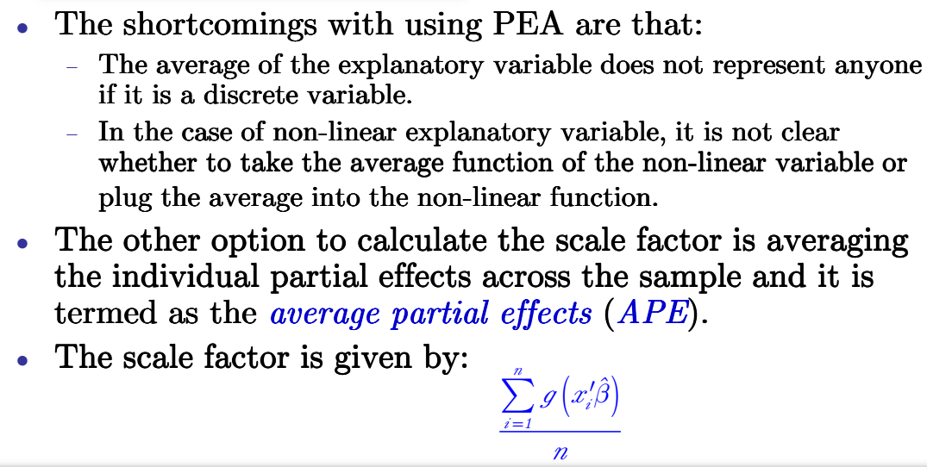
Logit and Probit models

Slide 22
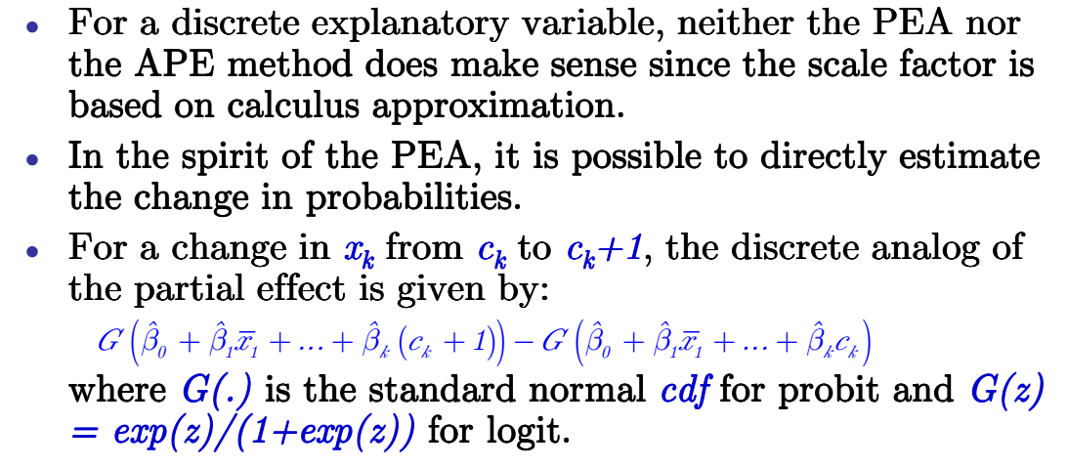
Logit and Probit models

Slide 23
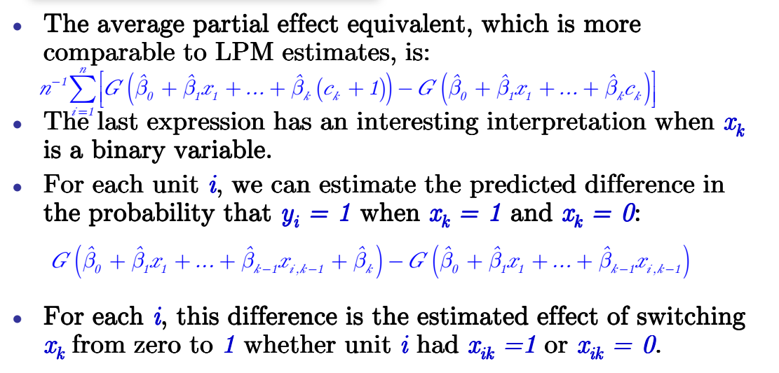
Logit and Probit models

Slide 24
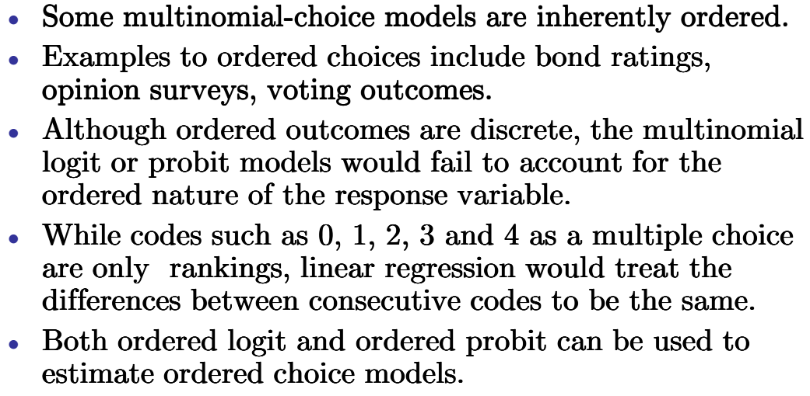
Ordered choice models

Slide 25
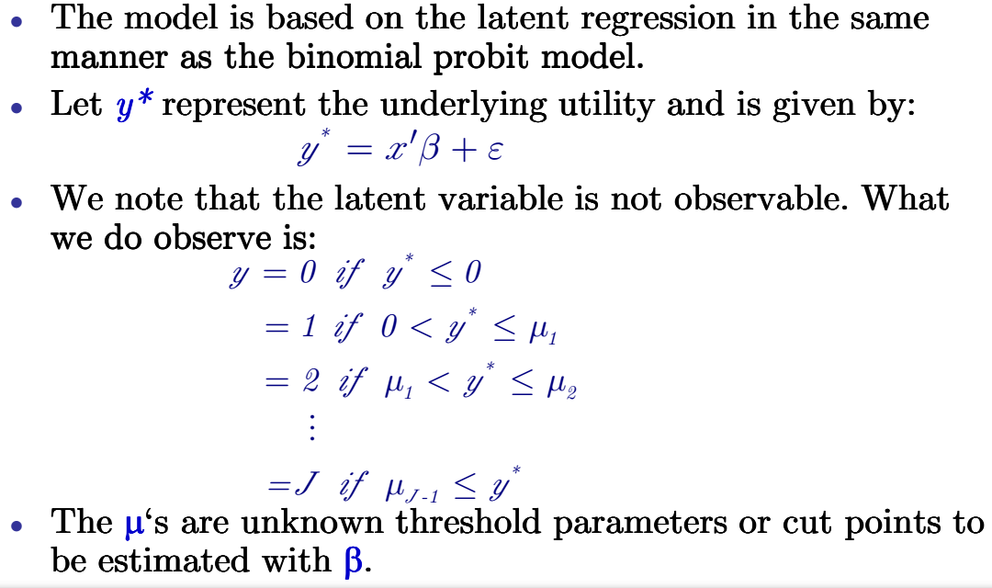
Ordered probit model

Slide 26
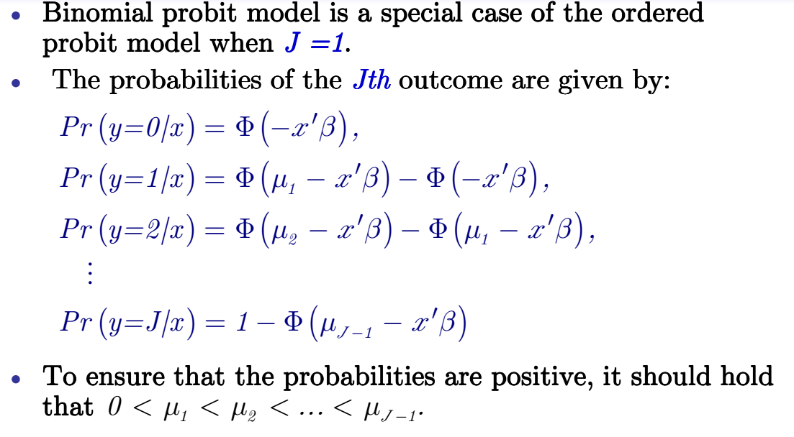
Ordered probit model

Slide 27
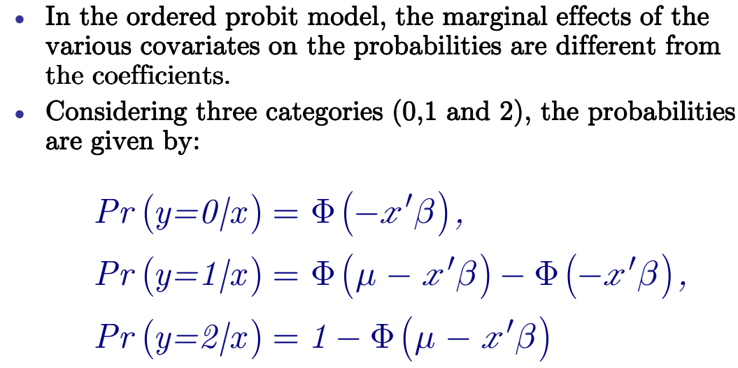
Ordered probit model

Slide 28
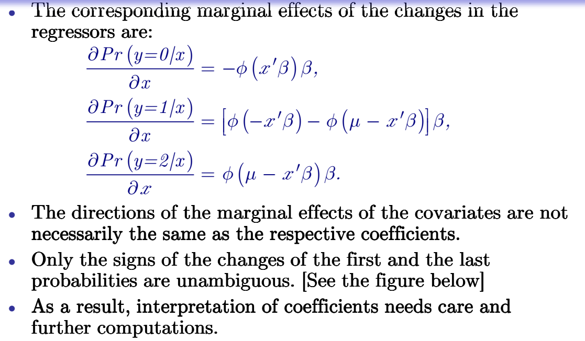
Ordered probit model

Slide 29
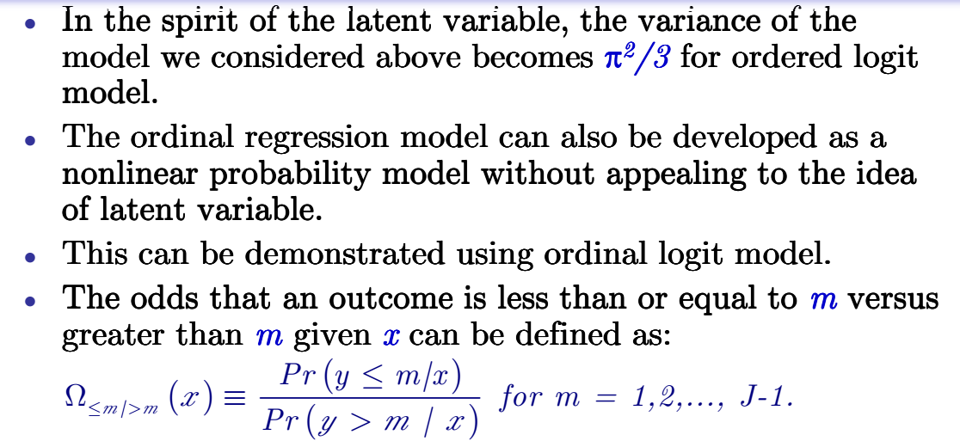
Ordered probit model

Slide 30
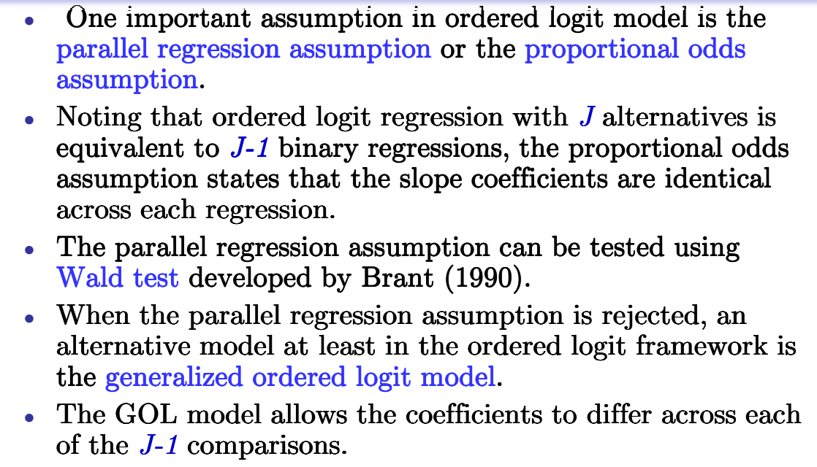
Ordered probit model

Slide 31
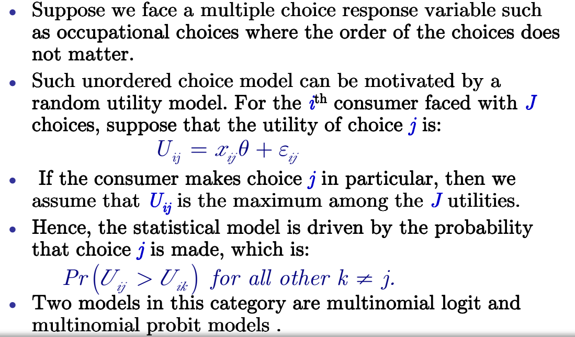
Unordered multinomial models

Slide 32
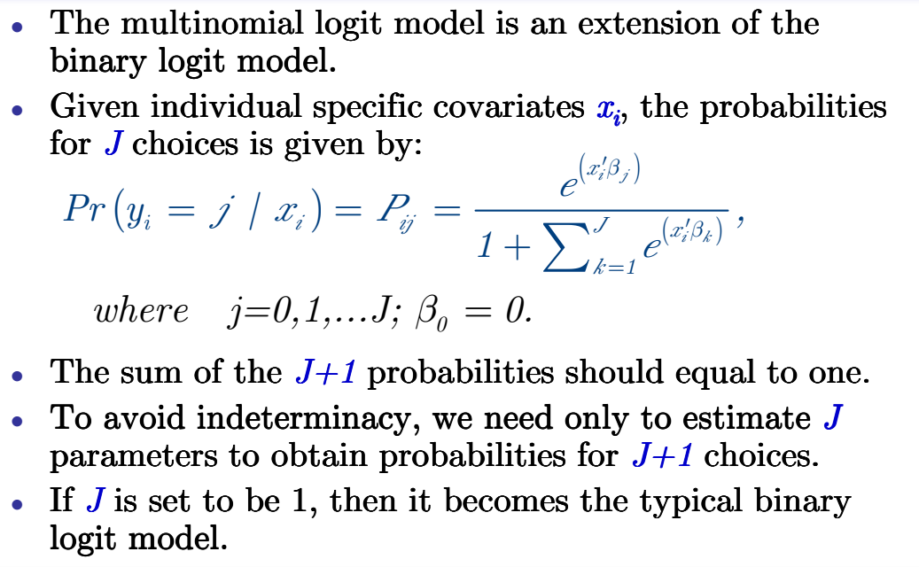
Multinomial logit

Slide 33
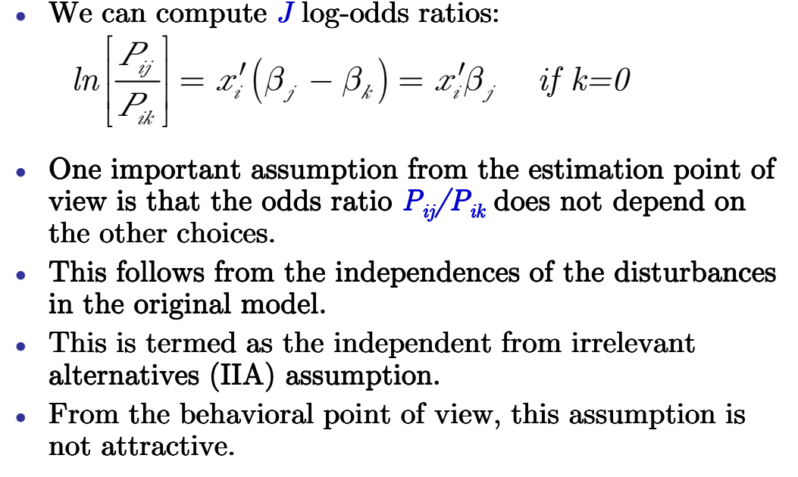
Multinomial logit

Slide 34
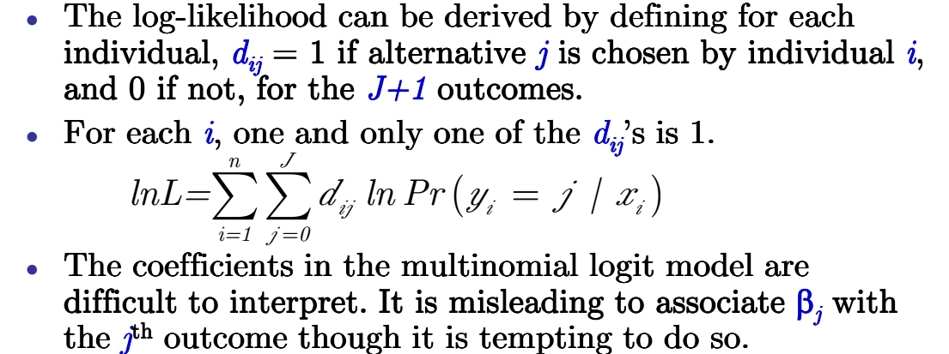
Multinomial logit

