Slide 1
Financial econometrics

Slide 2
Basic terms
Parameter: It is a descriptive measure (value) computed from the population.
It is the population measurement used to describe the population.
Statistic: a measure used to describe the sample. It is a value computed from the sample.
Sampling frame: A list of people, items or units from which the sample is taken.
Data: Data as a collection of related facts from which conclusions may be drawn.
Variable: A certain characteristic which changes from object to object and time to time.

Slide 3
Scales of Measurement
Nominal Scale: Consists of ‘naming’ observations or classifying them into various mutually exclusive categories.
classified by some quality it possesses rather than by an amount or quantity.
example: Religion: Christianity, Islam, Hinduism, etc.; Sex: Male, Female
Ordinal Scale: Whenever observations are not only different from category to category, but can be ranked according to some criterion. The variables deal with their relative difference rather than with quantitative differences.
have meaningful inequalities.
Example: Individuals may be classified according to socio-economic as low, medium & high

Slide 4
Interval Scale: not only possible to order measurements, but also the distance between any two measurements is known but not meaningful quotients. Example: time period in years like 1989, 2015 etc
Ratio Scale: - continues variable : Example: Variables such as age, height, length, income, etc
Types of data (variables)
Time series: a set of observations on the values that a variable takes at different times.
Cross-sectional data: data on one or more variables collected at the same point in time
Pooled data: combination of time series and cross-section data
Panel data: a special type of pooled data in which the same cross-section unit is surveyed overtime.

Slide 5
Variables can be classified as continuous and discrete variables.
Continuous Variables: - are usually obtained by measurement not by counting. These are variables which assume or take any decimal value when collected. The variables like age, time, height, income, price, temperature, and etc are all continuous since the data collected from such variables can take decimal values.
Discrete Variables: - are obtained by counting. A discrete variable takes always whole number values that are counted. Example variables such as number of students, number of errors per page, number of accidents on traffic line, number of defective or non-defective items produced in production line.
Various econometricians used different ways of wordings to define econometrics. But if we distill the fundamental features/concepts of all the definitions, we may obtain the following definition.

Slide 6
Definition of econometrics
Econometrics: is a science which integrates economic theory, economic statistics, and mathematical economics to investigate the empirical support the general schematic law established by economic theory.
It is a special type of economic analysis and research in which the general economic theories, formulated in mathematical terms, is combined with empirical measurements of economic phenomena.
Starting from the relationships of economic theory, we express them in mathematical terms so that they can be measured. We then use specific methods, called econometric methods in order to obtain numerical estimates of the coefficients of the economic relationships.
Econometrics is the application of statistical and mathematical techniques to the analysis of economic data with a purpose of verifying or refuting economic theories.
In short, econometrics may be considered as the integration of economics, mathematics, and statistics for the purpose of providing numerical values for the parameters of economic relationships and verifying economic theories.

Slide 7
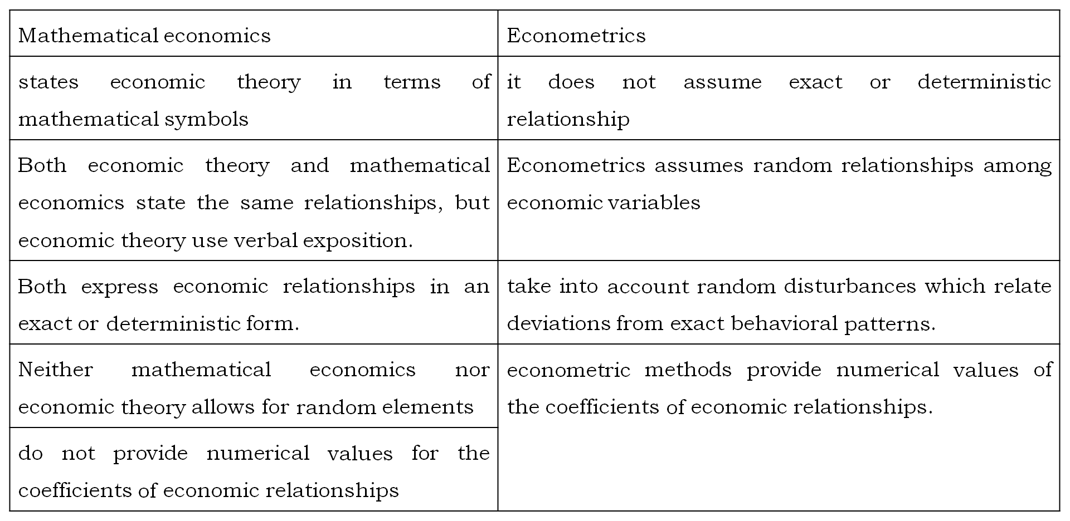
Econometrics vs. mathematical economics

Slide 8
Econometrics and modeling
Economic models:
Economic models consist of the following three basic structural elements.
A set of variables
A list of fundamental relationships and
A number of strategic coefficients
Econometric models:
The most important characteristic of economic relationships is that they contain a random element which is ignored by mathematical economic models which postulate exact relationships between economic variables.

Slide 9
Methodology of econometrics
Econometric research is concerned with the measurement of the parameters of economic relationships and with the predication of the values of economic variables.
econometric research or inquiry generally proceeds along the following lines/stages.
Specification the model
Estimation of the model
Evaluation of the estimates
Evaluation of he forecasting power of the estimated model

Slide 10
Economic Theory
Mathematic Model
Econometric Model
Data Collection
Estimation
Hypothesis Testing
Application
in control or
policy
studies
Forecasting

Slide 11
Theory
Math. Model
Econometrics model
As income increases ,consumption also increases, but not as much as income
Yi = B1 + B2Xi +ui
Yi= f(xi)=B1 +B2Xi
Deterministic part
Deterministic &stochastic components

Slide 12
Why do we need to include the stochastic (random) component?
Omission of variables.
There may be measurement error in collecting data.
We may use poor proxy variables.
The functional form may not be correct.
There is randomness on human behavior.
Vagueness of theory
Unavailability of Data
Principle of parsimony

Slide 13
Definition of the Simple Regression Model
premise: y and x are two variables, representing some population, and we are interested in “explaining y in terms of x,” or in “studying how y varies with changes in x.”
example: y is hourly wage and x is years of education
In writing down a model that will “explain y in terms of x,” we must confront three issues.
there is never an exact relationship between two variables, how do we allow for other factors to affect y?
what is the functional relationship between y and x?
how can we be sure we are capturing a ceteris paribus relationship between y and x?
We can resolve these ambiguities by writing down an equation relating y to x. A simple equation is …….(1)

Slide 14
Equation (1)defines the simple linear regression model. It is also called the two-variable linear regression model or bivariate linear regression model because it relates the two variables x and y.

Slide 15
The variable u, called the error term or disturbance in the relationship, represents factors other than x that affect y.
A simple regression analysis effectively treats all factors affecting y other than x as being unobserved.
Equation (1) also addresses the issue of the functional relationship between y and x.
If the other factors in u are held fixed, so that the change in u is zero, ∆U=0, then x has a linear effect on y:

Slide 16
PRF and SRF
e.g. Weekly family income X (Birr), and consumption Y(Birr)

Slide 18
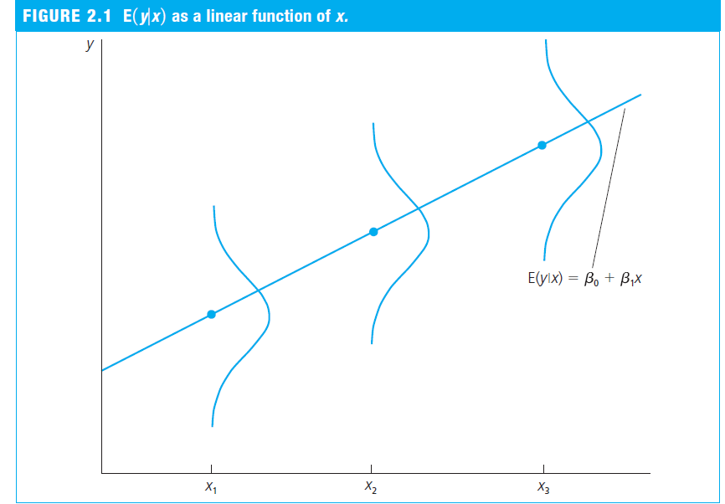
PRF

Slide 19
PRF

Slide 20
SRF

Slide 21
SRF

Slide 22
SRF

Slide 24
Deriving ordinary least squares (OLS)

Slide 25
Con…..

Slide 26
Con…

Slide 27
Con…

Slide 28
Con…

Slide 29
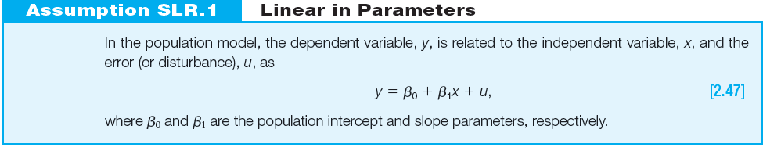
Assumptions of SLR(for unbiased estimates)

Slide 30
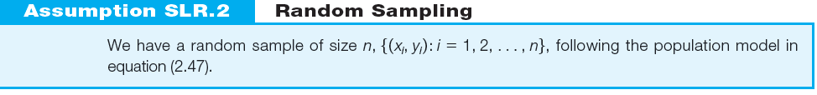
Assumptions…

Slide 31
Assumptions…

Slide 32
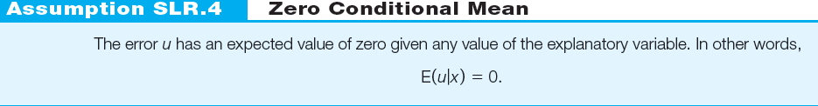
Assumptions…

Slide 33
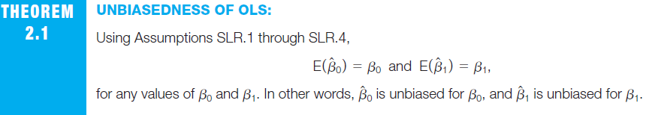

Slide 34
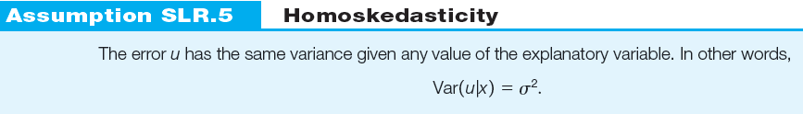
Assumptions of SLR

Slide 35
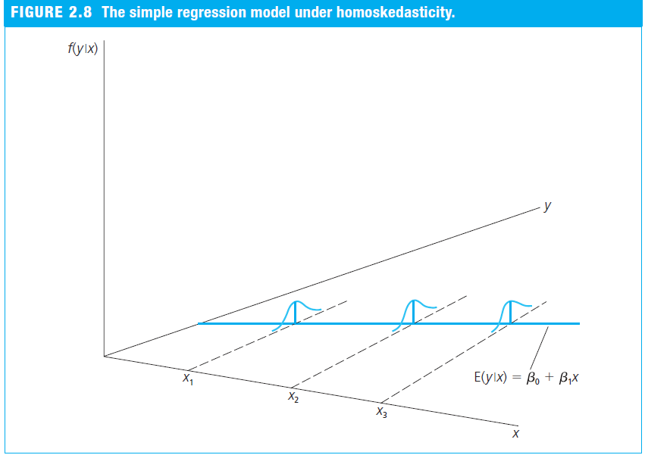
Con…

Slide 36
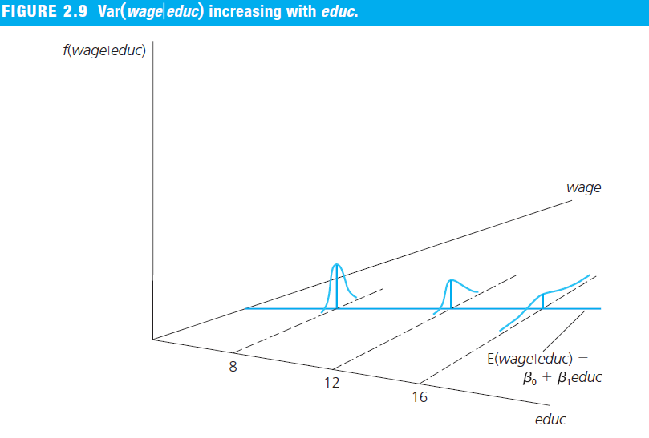
Example: Heteroskedasticity in a Wage Equation

Slide 37
theorem 2.2: variances of the OLS estimators under assumptions SLR.1 through SLR.5

Slide 38
Estimating the Error Variance

Slide 39
Statistical properties of OLS estimates

Slide 40
The coefficient of determination

Slide 41
The coefficient of determination
It is a number that summarizes how well the OLS regression line fits the data.

Slide 42
Units of Measurement and Functional Form
Two important issues in applied economics are
understanding how changing the units of measurement of the dependent and/or independent variables affects OLS estimates and
knowing how to incorporate popular functional forms used in economics into regression analysis.

Slide 43
The Effects of Changing Units of Measurement on OLS Statistics
If the dependent variable is multiplied by the constant c—which means each value in the sample is multiplied by c—then the OLS intercept and slope estimates are also multiplied by c
if the independent variable is divided or multiplied by some nonzero constant, c, then the OLS slope coefficient is multiplied or divided by c, respectively.
changing the units of measurement of only the independent variable does not affect the intercept.
the goodness of fit of the model is not depend on the units of measurement of variables.

Slide 44
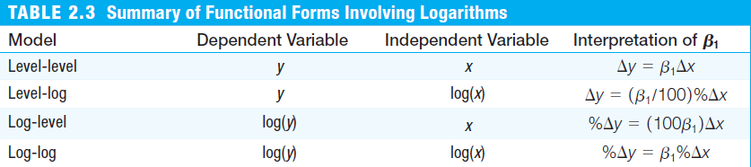
Incorporating Nonlinearities in Simple Regression

Slide 45
Hypothesis test

Slide 46
Hypothesis test

Slide 47
Hypothesis test

Slide 48
Hypothesis test

Slide 49
Hypothesis test

Slide 50
Hypothesis test

Slide 51
Hypothesis test

Slide 52
Hypothesis test

Slide 53
Summary
Given a random sample, the method of ordinary least squares is used to estimate the slope and intercept parameters in the population model.
two issues of practical importance: (1) the behavior of the OLS estimates when we change the units of measurement of the dependent variable or the independent variable and (2) the use of the natural log to allow for constant elasticity and constant semi-elasticity models.
under the four Assumptions SLR.1 through SLR.4, the OLS estimators are unbiased. The key assumption is that the error term u has zero mean given any value of the independent variable x. Unfortunately, there are reasons to think this is false in many social science applications of simple regression, where the omitted factors in u are often correlated with x.
When we add the assumption that the variance of the error given x is constant, we get simple formulas for the sampling variances of the OLS estimators.

Slide 54
the variance of the slope estimator increases as the error variance increases, and it decreases when there is more sample variation in the independent variable.
The Gauss-Markov assumptions for simple regression , It is important to remember that only SLR.1 through SLR.4 are needed to show estimators are unbiased. We added the homoskedasticity assumption, SLR.5, to obtain the usual OLS variance formulas

Slide 55
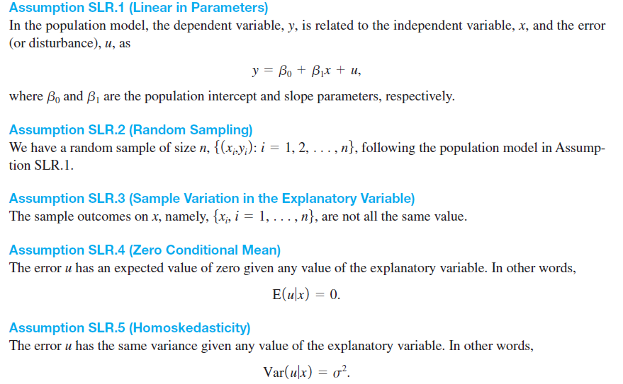

Slide 56
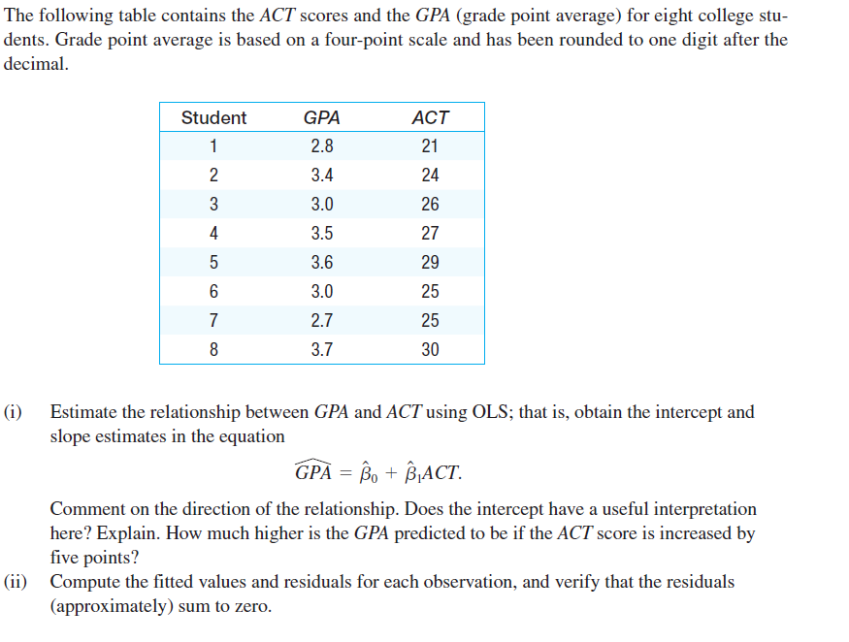
Exercise1.

Slide 57
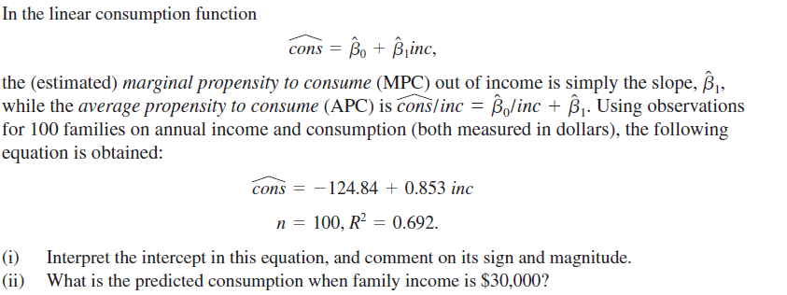
Exercise2.

Slide 58
Chapter Two: The Classical Multiple Linear Regression Model
Multiple regression analysis is more amenable to ceteris paribus analysis because it allows us to explicitly control for many other factors that simultaneously affect the dependent variable.
This is important both for testing economic theories and for evaluating policy effects when we must rely on nonexperimental data.
Because multiple regression models can accommodate many explanatory variables that may be correlated, we can hope to infer causality in cases where simple regression analysis would be misleading.
Naturally, if we add more factors to our model that are useful for explaining y, then more of the variation in y can be explained.
Thus, multiple regression analysis can be used to build better models for predicting the dependent variable.

Slide 61
assumption

Slide 62
OLS estimators derivation

Slide 64
Coefficient of determination

Slide 65
Hypothesis testing

Slide 66
Specification in multiple regression፡ Accounting for nonlinearities

Slide 67
Model Selection Criteria
Be consistent with theory; that is, it must make good economic sense.
Have weakly exogenous regressors
Exhibit parameter constancy; that is, the values of the parameters
Exhibit data coherency; that is, the residuals estimated from the model must be purely random (technically, white noise). In other words, if the regression model is adequate, the residuals from this model must be white noise. If that is not the case, there is some specification error in the model.
Be encompassing; that is, the model should encompass or include all the rival models in the sense that it is capable of explaining their results. In short, other models cannot be an improvement over the chosen model.

Slide 68
Regression with dummy variables
Dummy variables indicate the presence or absence of a “quality” or an attribute, such as male or female, black or white, Catholic or non-Catholic, Democrat or Republican, they are essentially nominal scale variables. One way we could “quantify” such attributes is by constructing artificial variables that take on values of 1 or 0, 1 indicating the presence (or possession) of that attribute and 0 indicating the absence of that attribute.
For example 1 may indicate that a person is a female and 0 may designate a male; or 1 may indicate that a person is a college graduate, and 0 that the person is not, and so on.
Variables that assume such 0 and 1 values are called dummy variables.
Such variables are thus essentially a device to classify data into mutually exclusive categories such as male or female.

Slide 69
Con…
Dummy variables can be incorporated in regression models just as easily as quantitative variables.
Caution in the Use of Dummy Variables
If a qualitative variable has m categories, introduce only (m − 1) dummy variables.
Unless there may happen dummy variable trap, that is, the situation of perfect collinearity or perfect multicollinearity,
Thus, For each qualitative regressor the number of dummy variables introduced must be one less than the categories of that variable.

Slide 70
Con…
The category for which no dummy variable is assigned is known as the base, benchmark, control, comparison, reference, or omitted category. And all comparisons are made in relation to the benchmark category.
The intercept value represents the mean value of the benchmark category.
The coefficients attached to the dummy variables are known as the differential intercept coefficients because they tell by how much the value of the intercept that receives the value of 1 differs from the intercept coefficient of the benchmark category.
If a qualitative variable has more than one category the choice of the benchmark category is strictly up to the researcher.

Slide 71
Regression with dummy variables: interpretations

