Slide 1
Chapter Four
Financial Markets in the Financial System

Slide 2
What is a market?
A market is a “place” where goods and services are exchanged or a market refers to an institution or arrangement that facilitates the purchase and sale of goods & services.
A financial market is a place where individuals and organizations wanting to borrow funds are brought together with those having a surplus of funds or in short a financial market is a market where financial assets are traded.
Financial markets bring together people and organizations wanting to borrow money with those having surplus funds

Slide 3
Functions of financial markets
Transfer of resources: Financial markets facilitate the transfer of real economic resources from lenders to ultimate borrowers.
Enhancing income: financial markets allow lenders earn interest /dividend on their surplus investible funds, thus contributing to the enhancement of the individual & the national income.
Productive usage: Financial markets allow for the productive use of the funds borrowed, thus enhancing the income & the gross national production.
Capital formations: financial markets provide a channel through which new savings flow to aid capital formation of a country.

Slide 4
Cont’d
Price determination: financial markets allow for the determination of the price of the traded financial asset through the interaction of buyers & sellers, i.e., through demand & supply.
Sale mechanism: financial markets provide a mechanism for selling of a financial asset by an investor so as to offer the benefits of marketability & liquidity of such assets.
Information: the activities of the participants in the financial market result in the generation and the consequent dissemination of information to the various segments of the market, so as to reduce the cost of transaction of financial assets.

Slide 5
Three Primary ways by which Capital is
Transferred between Savers and
Borrowers
Direct Transfer
Direct transfers of money and securities occur when a business sells its stocks or bonds directly to savers, without going through any type of financial institution.
2. Financial intermediary
Transfers through financial intermediaries occur when a bank or mutual fund obtains funds from savers, issues its own securities in exchange, and then uses these funds to purchase other securities.

Slide 6
Cont’d
3. Investment bankers
Transfers through an investment banking house occur when the investment bank serves as a middleman and facilitates the issuance of securities.
These middlemen help corporations design securities that will be attractive to investors, buy these securities from the corporations, and then resell them to savers in the primary markets.

Slide 7
Types of financial market
There are many different financial markets in a developed economy, each dealing with a different type of instrument and a different set of customers.

Slide 8
Primary Vs Secondary market
Primary market: Primary markets are the markets in which corporations sell newly issued securities to raise capital.
The middleman in the primary market is called an investment banker (it provides underwriting function)

Slide 9
Cont’d
Companies raise new capital in the primary market through:
Public issues
Right issue
Private placement

Slide 10
Cont’d
  In public issue/ offering: companies sell new securities to the public (to all individuals and institutions).
  In right issue: Offering of securities may be made only to the existing shareholders. Thus, when securities are offered only to the company’s existing shareholders, it is called right issue.
  Private placement: Instead of public issue of securities, a company may offer securities privately only to a few investors. This is referred to as private placement. The investment bankers may act as a finder, that is, the bank locates the institutional buyer for a fee.

Slide 11
Cont’d
Secondary Market: Secondary market refers to a market where securities are traded after being initially offered to the public in the primary market and/or listed on the Stock Exchange or Secondary markets are the markets in which existing (already outstanding) securities are traded among investors.
Secondary market comprises of equity markets and the debt markets.

Slide 12
Functions of Secondary market
It provides regular information about the value of a security to the issuer of the security
It provides the opportunity for the original buyers of the asset to reverse their investment by selling it for cash.
It brings together many interested parties & so can reduce the costs of searching for likely buyers & sellers of the assets

Slide 13
The difference between the Primary Market and the Secondary Market
In the primary market, securities are offered to public for subscription for the purpose of raising capital or fund.
In the secondary market already existing/pre-issued securities are traded among investors.
In the secondary market the issuer of the asset does not receive funds from the buyer unlike primary market, rather, the existing issue changes hands and funds flow from the buyer of the asset to the seller in secondary market.

Slide 14
Money vs. Capital market
Money markets are the markets for short-term, highly liquid debt securities, those securities that mature in less than one year.
Characteristics of money market
Short term funds are borrowed & lent
No fixed place for conduct of operations
Dealings may be conducted with or without the help of brokers.

Slide 15
Cont’d
Funds are traded for a maximum period of one year.
Liquid
Low expected return
Low degree of risk

Slide 16
Objectives of money markets
a) Providing an equilibrium mechanism for ironing out short-term surplus & deficit.
b) Providing a focal point for central bank intervention for influencing liquidity in the economy.
c) Providing access to users of short term money to meet their requirements at a reasonable price.

Slide 17
Securities Traded in Money Markets
Call money market
Treasury Bills.
Certificate of Deposit (CDs).
Commercial Papers.

Slide 18
Capital Market
Capital markets are markets that trade equities (stocks) and debts (bonds) instruments with maturities of more than one year.
Given their longer maturity, these instruments experience wider price fluctuations in the secondary markets in which they trade than do money market instruments.
For example, their longer maturities subject these instruments to both higher credit (bankruptcy) risk and interest risk than money market instruments.

Slide 19
Cont’d
Capital market securities have a higher expected return and more risk than money market securities
Securities traded in the capital market
1. Bonds and Mortgages:
  Bonds are long-term debt obligations issued by corporations and government agencies
  Mortgages are long-term debt obligations created to finance the purchase of real estate
  Bonds and mortgages specify the amount and timing of interest and principal payments

Slide 20
Cont’d
2. Mortgage-Backed Securities
Mortgage-backed securities are debt obligations representing claims on a package of mortgages.
The investors who purchase these securities receive monthly payments that are made by the homeowners on the mortgages backing the securities.

Slide 21
Cont’d
3. Stocks:
  Stocks (equity) are certificates representing partial ownership in corporations
  Investors may earn a return by receiving dividends and capital gains
  Stocks have a higher expected return and higher risk than long-term debt securities
  They are classified as capital market securities because they have no maturity and therefore serve as a long-term source of funds.

Slide 22
Organized Vs over-the-counter markets (OTC)
  A visible market place for secondary market transactions is an organized exchange-Auction market (eg., NYSE, BSE etc)
  Some transactions occur in the over-the-counter (OTC) market (a telecommunications network) eg., Nasdaq

Slide 23
Foreign Exchange Market
The foreign exchange market is a market where foreign currencies are bought and sold.
The foreign exchange market is an over-the-counter market. That is, it does not denote a particular place where dealers assemble and transact foreign currencies
Major Participants
Individuals
Firms
Banks
Government
International agencies

Slide 24
Derivative Market
Derivative is a tradable financial instrument or product whose value depends on the value of some underlying asset.
Very often, the underlying derivatives are the price of the traded asset.
For example, a stock future is a derivative whose value depends on the price of the stock.

Slide 25
Cont’d
Risk Management is most important function of derivatives. Risk management is not about the elimination of risk rather it is about the management of risk. Financial derivatives provide a powerful tool for limiting risks that individuals and organizations face in the ordinary conduct of their businesses.
Derivatives shift the risk from the buyer of the derivative product to the seller and as such are very effective risk management tools.

Slide 26
Types of Derivatives
Forwards: an agreement that obligates the holder to buy or sell an asset at a predetermined delivery price during a specified future time. In other words, a contract made today for delivery of an asset at a pre-specified time in the future at a price agreed upon today
Futures: A futures contract is an agreement between two parties to buy or sell an asset at a certain time in the future at a certain price. Futures contracts are special types of forward contracts in the sense that the former are standardized exchange.

Slide 27
Comparison between forward contract and future contract
Forward Contract | Future Contract
Private contract between two parties | Traded on an exchange
Not standardized | Standardized contract
Usually one specific delivery date | Ranges of delivery date
Settled at the end of contract | Settled daily
Some credit risk | No credit risk

Slide 28
Cont’d
There are two positions in forward contract:
Long position:
A party assumes a long position agrees to buy the underlying asset on a specified date for a specified price. That is, it is a position of owning the underlying asset that a long position holder plans to sell in the future. It is long the good.

Slide 29
Cont’d
2. Short position:
Party assumes a short position agrees to sell the underlying asset on a specified date for a specified price. That is, it is a position of expecting to purchase or borrowing the underlying asset in the future in order to deliver to the long position holder.

Slide 30
Example
A wheat farmer has just planted a crop that is expected to yield 500 quintals. To eliminate the risk of a decline in the price of wheat before the harvest, the farmer can sell 500 quintals of wheat forward. Dire Dawa food complex factory may be willing to take the other side of the contract. The two parties agree today on a forward price of Birr 850 per quintal, for delivery four months from now when the crop is harvested. No money changes hands now. In four months, the farmer delivers the 500 quintals of wheat to Dire Dawa food complex factory in exchange of Birr 425,000.

Slide 31
Cont’d
Payoffs from forward contract. Consider the position of Dire Dawa Food complex in the trade.
The contract obligates Dire Dawa food complex to buy 500 quintals for Br 850 per quintal and again obligates the farmer to sell 500 quintals of wheat at the same price at the end of the fourth month.
If the spot price of wheat rose to say Br 900 per quintal at the end of 4 month, the forward contract would be worth Br 25,000 (Br 450,000 – Br 425,000) to Dire Dawa food complex factory

Slide 32
Cont’d
The contract enable Dire Dawa food complex to purchase 500 quintals of wheat at Br 850 per quintal rather than at Br 900.
Similarly, if the spot exchange rate fell to Br 800 at the end of 4 months, the forward contract would have a negative value to Dire Dawa food complex of Br 25,000 because it would lead to the Dire Dawa food complex paying Br 25,000 more than the market price for the wheat.

Slide 33
Cont’d
In general, the payoff from forward contract can be calculated for long and short position holders as follows:
For long position holder: Payoff = S_{T} − K
For short position holder: payoff = K − S_{T}
Where, K is the delivery price and S_{T} is the spot price of the asset at maturity of the contract

Slide 34
Cont’d
C. Options: An Option is a contract which gives the right, but not an obligation, to buy or sell the underlying at a stated date and at a stated price.
While a buyer of an option pays the premium and buys the right to exercise his option, the writer of an option is the one who receives the option premium and therefore obliged to sell/buy the asset if the buyer exercises it on him. Options are of two types - Calls and Puts options:

Slide 35
Cont’d
‘Calls’ give the buyer the right but not the obligation to buy a given quantity of the underlying asset, at a given price on or before a given future dates.
‘Puts’ give the buyer the right, but not the obligation to sell a given quantity of underlying asset at a given price on or before a given future date.

Slide 36
Cont’d
Options may also classified as:
America Option: It can be exercised at any time up to the expiration date.
European Option: It can be exercised only on the expiration date.

Slide 37
Example: Call option
Assume that an investor buys a European call option with a strike price of Birr 100 per share to purchase 100 shares of NILE Company for a cost of Birr 5 per share. The expiration date of the option is in 90 days. The current price of the stock is Birr 98.
a. What would be the total transaction cost?
b. In what condition an investor exercise his right?
c. What would be the net profit or loss if the price of the stock is Birr 104 and 107 on the expiration date?
d. What would be the maximum net loss of an investor if he does not exercise his right?

Slide 38
Solution
a. Total transaction cost = Transaction cost per share × Number of share
= Birr 5/ share × 100 shares
= Birr 500
b. Since the holder of the call option is hoping that the price of the underlying asset will increase, it should always be exercised at the expiration date if the stock price is above the strike price. (i.e., above Birr 100).

Slide 39
Cont’d
c. Net profit or loss = Total revenue – Total cost
Total Revenue = Selling price × Number of share
= Birr 104/share × 100 shares
= Birr 10,400
Total cost = Purchase cost + transaction cost
= ( Birr 100/ share × 100 shares) + Birr 500
= Birr 10,000 + Birr 500
= Birr 10,500
Net loss = 10,400 – 10,500 = (Birr 100)
d. The maximum loss will be equal to total transaction cost. Thus, it is Birr 500.

Slide 40
Example: Put option
Assume that an investor buys a European put option to sale 100 shares of Y-company with a stick price of Birr 70. The price of an option to sell on share is Birr 7 per share. The current stock price is Birr 65 and the expiration date is in 3 months.
What will be the total transaction cost or initial investment?
At what share price an investor exercise his right?
What would be the net profit /loss, if the stock price is Birr 72 and Birr 61 on the expiration date?

Slide 41
Solution
The transaction cost = Birr 7 /share X 100 shares= Birr700
b. An investor will exercise his right, when the stock price is below Birr 70 on the expiration date.
c. Assumption 1. Stock price is Birr 72
Since the stock price is greater than the exercise /strike price on the expiration data, exercising the right will increase the total loss. That is, exercising the right will increase the total loss to Birr 900.
However, if an investor does not exercise his right, his net loss will be only the transaction cost, i.e. Birr 700. Thus, an investor shall not exercise.

Slide 42
Cont’d
Assumption 2. Stock price is Birr 61
Since the stock price is less than the exercise /strike price on the expiration date, an investor can buy 100 share of Y-company for Birr 61 /share and sell the same share for Birr 70 under the terms of the put option.
As a result, the net gain is Birr 200.
Total cost = (Birr 61/share X 100 share) + (Birr 7/share X 100 share)
= Birr 6100 + 700 = Br. 6800
Total revenue= Birr 70/share X 100 share = $ 7000
Net gain = 7000 – 6800 = Birr 200

Slide 43
Reading assignment
Explain the difference between future and option?

Slide 44
Cont’d
D. Warrants: Options generally have lives of up to one year. The majority of options traded on exchanges have maximum maturity of nine months. Longer dated options are called Warrants and are generally traded over-the counter
E. Swaps: Swaps are private agreements between two parties to exchange cash flows in the future according to a prearranged formula. They can be regarded as portfolios of forward contracts. The two commonly used swaps are :

Slide 45
Cont’d
Interest rate swaps: These entail swapping only the interest related cash flows between the parties in the same currency or it refers to exchanging of fixed rate obligation with floating rate obligation.
Currency swaps: These entail swapping both principal and interest between the parties, with the cash flows in one direction being in a different currency than those in the opposite direction or it refers to the agreement to exchange currency differentials.

Slide 46
Example: Interest Rate Swap
If company A issues bond to Mr x at a floating rate and on the other hand company B issues issues bond to Mr y at a fixed interest rate obligation and if later the cash flow of company A is stable where as the cash flow of company B is fluctuating, both companies can enter interest rate swap in order to avoid interest rate risk (i.e company A should pay fixed interest to Mr B and company B pays floating rate to Mr A).

Slide 47
Example: Currency Swap
Assume that Mr x who is living in US wants to invest in Ethiopia by borrowing dollar in US and again assume that Mr y who is an Ethiopian investor wants to invest in US by borrowing in Ethiopia. In this case the two parties enter currency swap to avoid foreign exchange risk b/c both parties are required to pay interest rate and principal amount in terms of their respective country currency, so by exchanging the payment of interest and principal amount, they can avoid currency risk (i.e. Mr x pays for Mr y and Mr y pays for Mr x b/c both parties are earning with respect to the currency of their investing country)

Slide 48
Pricing of Derivatives
Pricing of Futures
The relationship between futures price and spot price can be written in terms of cost of carry. "Cost of Carry” includes storage costs, transportation costs, insurance costs, interest costs, other opportunity costs as well as interest/dividend receipts and other opportunity benefits.
Futures Price = Spot (Cash) Price + Cost of Carry

Slide 49
Cont’d
2. Pricing of Options
The price of the option is known as the premium. Option Premium is the price the buyer has to pay the seller to purchase the right to buy/sell the asset at the strike price. Option premiums can be divided into two components: time value and intrinsic value.
Option Premium = Intrinsic Value + Time Value

Slide 50
Cont’d
Intrinsic Value
The amount an option holder can realize by exercising the option immediately. Intrinsic value refers to what the option is actually worth. Intrinsic value is always positive or zero.
Intrinsic value of a Call Option = underlying product price - strike price
Intrinsic value of Put Option = Strike price - underlying product price

Slide 51
Cont’d
Time Value (Extrinsic Value)
Time value is the amount option buyers are willing to pay for the possibility that the option may become profitable prior to expiration due to favorable change in the price of the underlying.
Time has value, since the longer the option has to go until expiry, the more opportunity there is the underlying price to move a level such that the option becomes profitable.

Slide 52
Cont’d
The time value is the premium value that exceeds the intrinsic value.
Other factors being equal, the time value of an option will increase with the amount of time remaining to expiration, since the opportunity for a favorable change in the price of the underlying is greater.

Slide 53
Exercise
If the strike price for a call option is $100 and the spot price of the underlying is $105, then what is its intrinsic value?
If the price of a call option with a strike price of $100 is $9 when the spot price of the underlying is $105, then what is the time and intrinsic value of this option?

Slide 54
Factors That Influence the Option Price
The following factors influence the option price:
Demand and supply
Unexpected news
Spot price of the underlying
Strike price
Time to expiration of the option
Expected price volatility of the underlying over the life of the option
Short-term risk-free rate over the life of the option
Anticipated cash dividends on the underlying stock or index over the life of the option

Slide 55
Option Pricing Models
Option Pricing Model is a mathematical formula used to calculate the theoretical value of an option.
The theoretical option pricing models are used by option traders for calculating the fair value of an option on the basis of the different influencing factors.
The most popular is the one developed by Fischer Black and Myron Scholes in 1973 for valuing European call options (i.e. Black Scholes Model)

Slide 56
Cont’d
Black and Scholes (1973) are pioneers in pricing option theory.
They started from the principle that if options are properly evaluated, there can be undoubtedly no gain from the sale and purchase of options and underlying assets.
By imposing certain assumptions and using arbitrage arguments, using this principle, they introduced a formula for determining the theoretical value of an option.

Slide 57
Cont’d
Black-Scholes model for determining the price of a European option is extensively used in practice because it requires knowledge of observable parameters like the underlying asset price, the strike price, the time to maturity of the option, the continuously compounded risk free interest rate and a parameter to be estimated independently, the underlying assets volatility.
The Black-Scholes option pricing model provides the fair (or theoretical) price of a European call option on a non-dividend-paying stock

Slide 58
Assumptions of Black Scholes Model
This model is based on a set of assumptions of which the most restrictive are:
The underlying asset yield are normally distributed
Volatility remains constant throughout the life of the option
There are no transaction costs and it can borrow money at the risk free rate.
The formula for the Black-Scholes model is
C = SN(d1) − Ke^{-rt} N(d2)

Slide 59
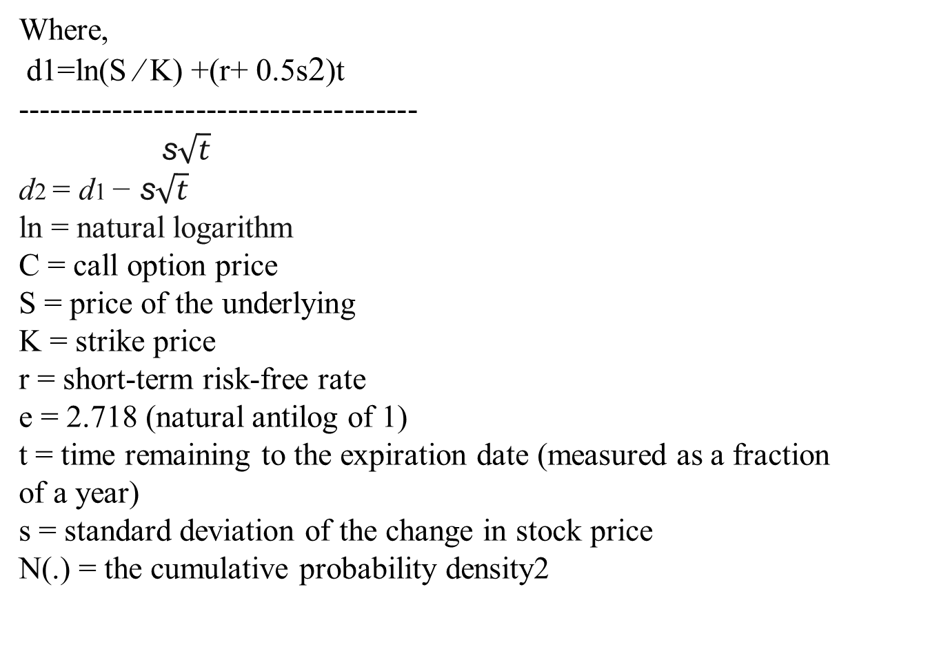
Cont’d
Where,
d1=ln(S ⁄ K) +(r+ 0.5s2)t
--------------------------------------
s$\sqrt{t}$
d2 = d1 − s$\sqrt{t}$
ln = natural logarithm
C = call option price
S = price of the underlying
K = strike price
r = short-term risk-free rate
e = 2.718 (natural antilog of 1)
t = time remaining to the expiration date (measured as a fraction
of a year)
s = standard deviation of the change in stock price
N(.) = the cumulative probability density2

Slide 60
Example
To illustrate the Black-Scholes model, assume the following values
Strike price = $45
Time remaining to expiration = 183 days
Spot stock price = $47
Expected price volatility = standard deviation = 25%
Risk-free rate = 10%

Slide 61
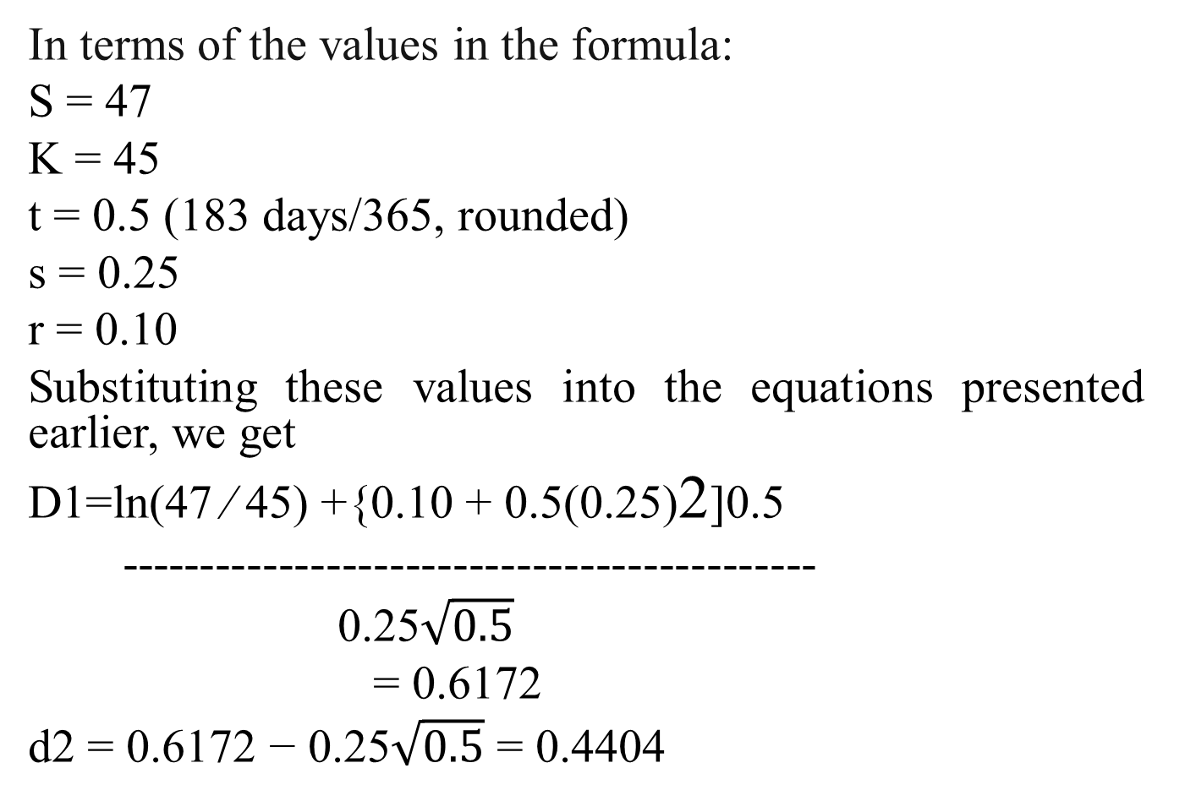
Cont’d
In terms of the values in the formula:
S = 47
K = 45
t = 0.5 (183 days/365, rounded)
s = 0.25
r = 0.10
Substituting these values into the equations presented earlier, we get
D1=ln(47 ⁄ 45) +{0.10 + 0.5(0.25)2]0.5
--------------------------------------------
0.25$\sqrt{0.5}$
= 0.6172
d2 = 0.6172 − 0.25$\sqrt{0.5}$ = 0.4404

Slide 62
Cont’d
From a normal distribution table:
N(0.6172) = 0.7315 and N(0.4404) = 0.6702
Then:
C = 47 (0.7315) − 45 (^{e−(0.10)(0.5)}) (0.6702) = $5.69

Slide 63
Cont’d
Advantage of Black-Scholes Model
The main advantage of the Black-Scholes model is speed. It enables to calculate a very large number of option prices in a very short time.
Drawbacks of Black-Scholes Formula
1. Does not account for dividends
2. Only account for European options

Slide 64
Reading Assignment
Binomial and other Option Pricing Models??

Slide 65
Individual Assignment (20%)
Discuss about the establishment of secondary capital market in Ethiopia (i.e. its feasibility) or contents may include:
Current status of the establishment of the market in Ethiopia (even as compared to other African countries)
Opportunities
Challenges

Slide 66
End of chapter Four!

