Slide 1
Chapter Five
Interest Rate Determination and Bond Valuation

Slide 2
Two major important risks for financial institutions (Banks)
A. Credit Risk
A major part of the business of financial institutions is making loans, and the major risk with loans is that the borrow will
not repay.
Credit risk is the risk that a borrower
will nor repay a loan according to the terms of the loan, either defaulting entirely or making late payments of interest
or principal.

Slide 3
Cont’d
Once again, the concepts of adverse selection and moral hazard will provide our framework to understand the principles financial managers must follow to minimize credit risk, yet make successful loans.
Adverse selection is a problem in the market for loans because those with the highest credit risk have the biggest incentives to borrow from others.

Slide 4
Cont’d
Moral hazard plays as role as well. Once a borrow has a loan, she / he may engage in risky projects to produce the highest payoffs, especially if the project is financed mostly with debt.
Solving Asymmetric Information Problems: financial managers have a number of
tools available to assist in reducing or eliminating the asymmetric
information problem:

Slide 5
Cont’d
  Screening: collecting reliable information about prospective borrowers. This has also lead some institutions to specialize in regions or industries, gaining expertise in evaluating particular firms or individuals.
  Monitoring: requiring certain actions, or prohibiting others, and then periodically verifying that the borrower is complying with the terms of the loan contact.

Slide 6
Cont’d
  3. Long-term Customer Relationships: past information contained in checking accounts, savings accounts, and previous loans provides valuable information to more easily determine credit worthiness.
  4. Loan Commitments: arrangements where the bank agrees to provide a loan up to a fixed amount, whenever the firm requests the loan.
  5. Collateral: a pledge of property or other assets that must be surrendered if the terms of the loan are not met ( the loans are called secured loans).

Slide 7
Cont’d
  6. Compensating Balances: reserves that a borrower must maintain in an account that act as collateral should the borrower default.
  7. Credit rationing: (1) lenders will refuse to lend to some borrowers, regardless of how much interest they are willing to pay, or (2) lenders will only finance part of a project, requiring that the remaining part come from equity financing.

Slide 8
Cont’d
B. Interest Rate Risk
The risk that arises for bond owners from fluctuating interest rates is called interest rate risk.
How much interest rate risk a bond has depends on how sensitive its price is to interest rate changes.
This sensitivity directly depends on two things: the time to maturity and the coupon rate, i.e:
1. All other things being equal, the longer the time to maturity, the greater the interest rate risk.
2. All other things being equal, the lower the coupon rate, the greater the interest rate risk.

Slide 9
Bond features and prices
A bond is normally an interest-only loan, meaning that the borrower will pay the interest every period, but none of the principal will be repaid until the end of the loan.
Coupon
It is the stated interest payment made on a bond.
Face value
The principal amount of a bond that is repaid at the end of the term. Also, called par value.

Slide 10
Cont’d
Coupon rate
The annual coupon divided by the face value of a bond.
Maturity
Specified date on which the principal amount of a bond is paid.

Slide 11
Bond Values and Yields
To determine the value of a bond at a particular point in time, we need to know the number of periods remaining until maturity, the face value, the coupon, and the market interest rate for bonds with similar features.
This interest rate required in the market on a bond is called the bond’s yield to maturity (YTM). This rate is sometimes called the bond’s yield for short.
Given all this information, we can calculate the present value of the cash flows as an estimate of the bond’s current market value.

Slide 12
Cont’d
Bond value = C* [1- 1/(1 + r)t]/r + F/(1 + r)t
Bond value Present value of the coupons + Present value of the face amount.
where
C = Coupon paid each period
r = Rate per period
t =Number of periods
F = Bond’s face value
Interest rates and bond prices have an "inverse relationship" – meaning, when one goes up, the other goes down.

Slide 13
Finding the Yield to Maturity
The yield to maturity (“YTM”) is the rate that makes the market price of the bond equal to the present value of its future cash flows. It is the unknown r.
Given a bond value, coupon, time to maturity, and face value, it is possible to find the implicit discount rate, or yield to maturity, by trial and error only.
To do this, try different discount rates until the calculated bond value equals the given value.
Remember that increasing the rate decreases the bond value.

Slide 14
Cont’d
For example, suppose we are interested in a six-year, 8 percent coupon bond. A broker quotes a price of $955.14. What is the yield on this bond? We’ve seen that the price of a bond can be written as the sum of its annuity and lump-sum components. Knowing that there is an $80 coupon for six years and a $1,000 face value, we can say that the price is:
$955.14 =$80 *[1 - 1/(1 + r)6]/r + 1,000/(1 + r)6

Slide 15
Cont’d
where r is the unknown discount rate, or yield to maturity. We have one equation here and one unknown, but we cannot solve it for r explicitly. The only way to find the answer is to use trial and error.
We can speed up the trial-and-error process by using what we know about bond prices and yields. In this case, the bond has an $80 coupon and is selling at a discount. We thus know that the yield is greater than 8 percent. If we compute the price at 10 percent:

Slide 16
Cont’d
Bond value = $80 * (1 - 1/1.106)/.10 + 1,000/1.106=$80*4.3553+1,000/1.7716=$912.89
At 10 percent, the value we calculate is lower than the actual price, so 10 percent is too high. The true yield must be somewhere between 8 and 10 percent. You would probably want to try 9 percent next. If you did, you would see that this is in fact the bond’s yield to maturity

Slide 17
Different types of bonds
Corporate bonds
Government bonds / municipal bonds
Zero coupon
Income bonds
Convertible bonds
Put bonds
Floating rate bonds

Slide 18
Cont’d
A particularly interesting type of floating-rate bond is an inflation-linked bond. Such bonds have coupons that are adjusted according to the rate of inflation (the principal amount may be adjusted as well).

Slide 19
Inflation and Interest Rates
Real Versus Nominal Rates
Nominal rates -Interest rates or rates of return that have not been adjusted for inflation
Real rates- Interest rates or rates of return that have been adjusted for inflation
2. The Fisher Effect-our discussion of real and nominal returns illustrates a relationship often called the Fisher effect (after the great economist Irving Fisher). Because investors are ultimately concerned with what they can buy with their money, they require compensation for inflation.

Slide 20
Cont’d
Therefore, the Fisher effect indicates the relationship between nominal returns, real returns, and inflation.
Let R stand for the nominal rate and r stand for the real rate. The Fisher effect tells us that the relationship between nominal rates, real rates, and inflation can be written as:
1 + R = (1 + r) * (1 + h)
where h is the inflation rate.
The nominal rate is approximately equal to the real rate plus the inflation rate:
R ≈ r + h

Slide 21
Example
If investors require a 10 percent real rate of return, and the inflation rate is 8 percent, what must be the approximate nominal rate? The exact nominal rate?
First of all, the nominal rate is approximately equal to the sum of the real rate and the inflation rate: 10% + 8% = 18%. From the Fisher effect, we have:
1 + R = (1 + r) * (1 + h) = 1.10 * 1.08 = 1.1880
R=1.1880-1=18.8%
Therefore, the nominal rate will actually be closer to 19 percent.

Slide 22
Determinants of Bond Yields
The Term Structure of Interest Rates
The term structure of interest rates is the relationship between nominal interest rates on default-free, pure discount securities and time to maturity.
To be a little more precise, the term structure of interest rates tells us what nominal interest rates are on default-free, pure discount bonds of all maturities.

Slide 23
Cont’d
These rates are, in essence, “pure” interest rates because they involve no risk of default and a single, lump-sum future payment.
In other words, the term structure tells us the pure time value of money for different lengths of time.
When long-term rates are higher than short-term rates, we say that the term structure is upward sloping, and, when short-term rates are higher, we say it is downward sloping.

Slide 24
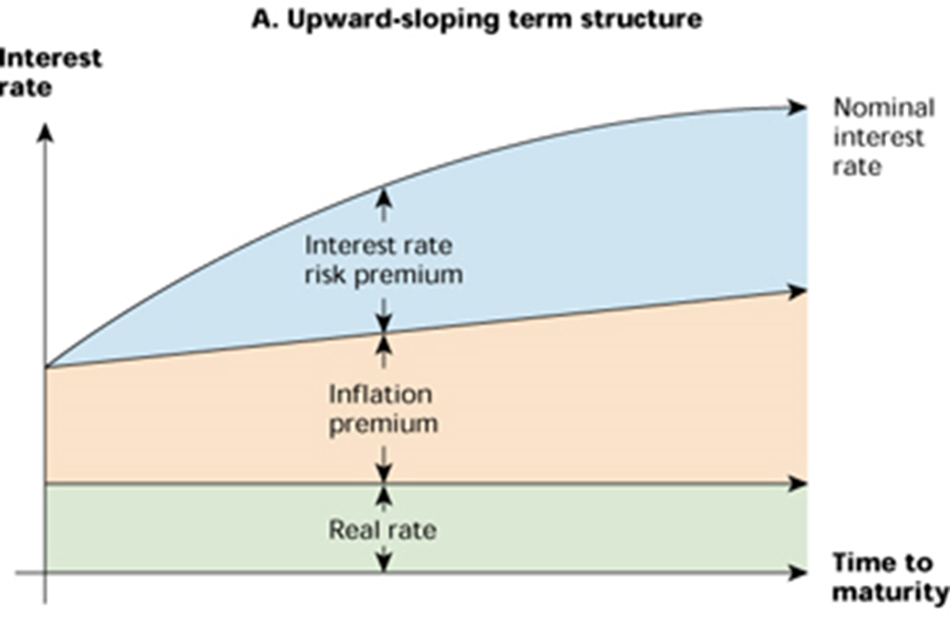
Cont’d

Slide 25
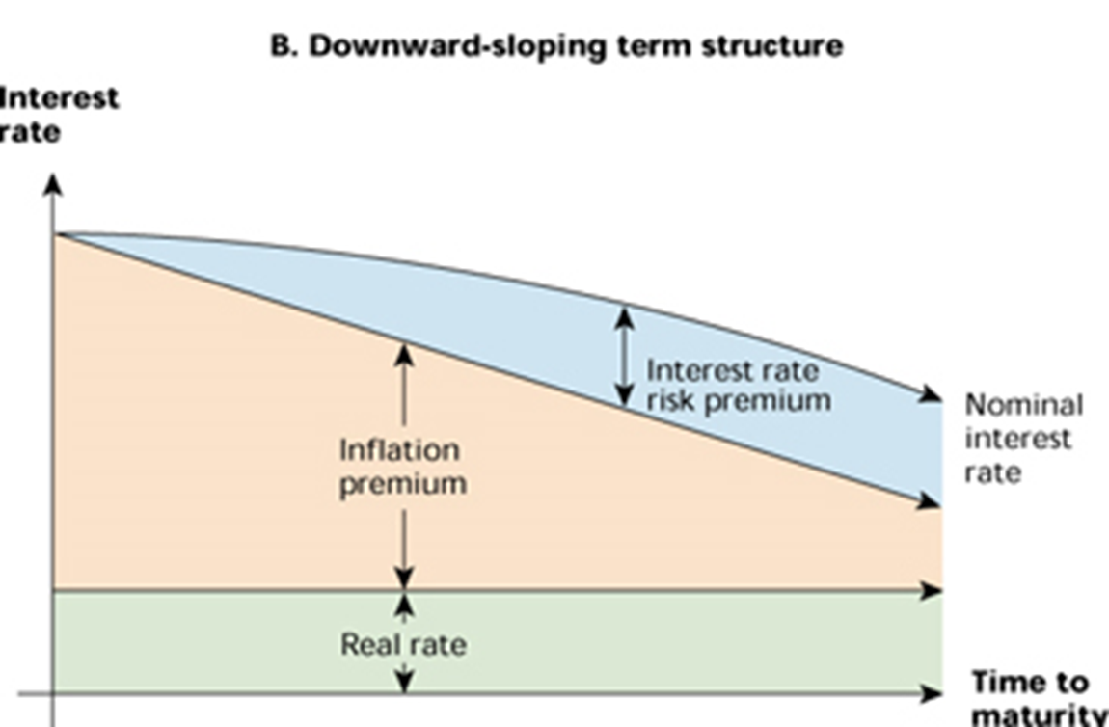
Cont’d

Slide 26
Cont’d
The term structure can also be “humped.” When this occurs, it is usually because rates increase at first, but then begin to decline as we look at longer- and longer term rates.
The most common shape of the term structure, particularly in modern times, is upward sloping, but the degree of steepness has varied quite a bit.

Slide 27
Cont’d
What determines the shape of the term structure? There are three basic components. The first two are the ones we discussed in our previous section, the real rate of interest and the rate of inflation.
The real rate of interest is the compensation investors demand for forgoing the use of their money. You can think of it as the pure time value of money after adjusting for the effects of inflation.
When the real rate is high, all interest rates will tend to be higher, and vice versa

Slide 28
Cont’d
In contrast, the prospect of future inflation very strongly influences the shape of the term structure.
Investors thinking about loaning money for various lengths of time recognize that future inflation erodes the value of the dollars that will be returned. As a result, investors demand compensation for this loss in the form of higher nominal rates. This extra compensation is called the inflation premium.
Therefore, inflation premium is defined as the portion of a nominal interest rate that represents compensation for expected future inflation.

Slide 29
Cont’d
If investors believe that the rate of inflation will be higher in future, then long-term nominal interest rates will tend to be higher than short-term rates. Thus, an upward sloping term structure may be a reflection of anticipated increases in inflation. Similarly, a downward-sloping term structure probably reflects the belief that inflation will be falling in the future.

Slide 30
Cont’d
The third, and last, component of the term structure has to do with interest rate risk. As we discussed earlier in the chapter, longer-term bonds have much greater risk of loss resulting from changes in interest rates than do shorter-term bonds. Investors recognize this risk, and they demand extra compensation in the form of higher rates for bearing it. This extra compensation is called the interest rate risk premium. Therefore, interest rate risk premium is defined as The compensation investors demand for bearing interest rate risk.

Slide 31
Cont’d
The longer is the term to maturity, the greater is the interest rate risk, so the interest rate risk premium increases with maturity.
Putting the pieces together, we see that the term structure reflects the combined effect of the real rate of interest, the inflation premium, and the interest rate risk premium.

Slide 32
Bond Yields and the Yield Curve
The shape of the yield curve is a reflection of the term structure of interest rates.
In fact, the Treasury yield curve (which refers to a plot of the yields on Treasury notes and bonds relative to maturity) and the term structure of interest rates are almost the same thing. The only difference is that the term structure is based on pure discount bonds, whereas the yield curve is based on coupon bond yields

Slide 33
Cont’d
As a result, Treasury yields depend on the three components that underlie the term structure—the real rate, expected future inflation, and the interest rate risk premium.
Treasury notes and bonds have three important features that we need to remind you of: they are default-free, they are taxable, and they are highly liquid.
This is not true of bonds in general, so we need to examine what additional factors come into play when we look at bonds issued by corporations or municipalities.

Slide 34
Cont’d
The first thing to consider is credit risk, that is, the possibility of default. Investors recognize that issuers other than the Treasury may or may not make all the promised payments on a bond, so they demand a higher yield as compensation for this risk. This extra compensation is called the default risk premium.
The second thing to consider is tax, that is, investors demand the extra yield on a taxable bond as compensation for the unfavorable tax treatment. This extra compensation is the taxability premium or it is the portion of a nominal interest rate or bond yield that represents compensation for unfavorable tax status.

Slide 35
Cont’d
Finally, bonds have varying degrees of liquidity. As a result, if you wanted to sell quickly, you would probably not get as good a price as you could otherwise. Investors prefer liquid assets to illiquid ones, so they demand a liquidity premium on top of all the other premiums we have discussed. liquidity premium is the portion of a nominal interest rate or bond yield that represents compensation for lack of liquidity. As a result, all else being the same, less liquid bonds will have higher yields than more liquid bonds.

Slide 36
Conclusion
If we combine all of the things we have discussed regarding bond yields, we find that bond yields represent the combined effect of no fewer than six things. The first is the real rate of interest. On top of the real rate are five premiums representing compensation for (1) expected future inflation, (2) interest rate risk, (3) default risk, (4) taxability, and (5) lack of liquidity. As a result, determining the appropriate yield on a bond requires careful analysis of each of these effects.

Slide 37
End of chapter five!

Slide 38
Chapter Six
Financial Markets and Institutions in Ethiopia-Group Assignment
Prepare your own term paper on the current status of financial sector and financial market in Ethiopia

