Slide 1
CHAPTER FIVE
PREPARING SCIENTIFIC PAPER AND PRESENTATION

Slide 2
Scientific Research Writing
Scientific Research Writing is the communication between author(s) and readers in indirect way.
One does not write to himself/herself, writing is targeted for the benefit of others.
Focus on the need of the reader, not on the writer’s desire.
The key to making writing informative is organization.
It begins with proposal writing
Research paper: is written to record a particular topic in an academic area of arts/sciences/social sciences. It is detailed and follow a strict format of referencing, books/papers/or other reliable sources.

Slide 3

Proposal writing
Research proposal is the detailed plan of study or
A specific course of action will be followed or
It is a document which sets out your ideas in an easily accessible way.
Why Proposal Writing?
In order to carry out research, in general financing is required.
Convince others that the project you have designed is important, worth the effort.
Convince others that you have the ability to carry out the research design and report the findings.

Slide 4
Generate funds to sustain the research units operation.
There are several national and international sources of funding and the process for obtaining funding is realized through proposal submission and review.
The objective in writing a proposal is to describe:
      what you will do?
      Why it should be done?
      How you will do it and
      What you expect will result?
Being clear about these things from the beginning will help you to complete your research in a timely fashion.

Slide 5
A well- thought out and well- writing proposal can be judged according to three main criteria:
Is it adequate to answer the research question and achieves the study objective?
Is it feasible in the particular set-up for the study?
Does it provide enough detail that can allow another investigator to do the study and arrive at comparable results?
What makes a good proposal?
A well-prepared application should require minimal effort on the part of the reviewer.
Proposals must demonstrate high scientific quality.
The requested funds must be in proportion to the proposed project (cost-effectiveness).

Slide 6
Components of a scientific research
Difference between a research report and a research proposal
Research Proposal
A Title
Summary
An Introduction
Statement of the problem
Objective/aim of the study
Materials and methods
    Study area
    Study design
    Sample size
    Sampling methods
    Description of variables
Work plan
Budget
Reference/Bibliography
Appendices
Research Report
A Title
An Abstract
An Introduction
A literature review
Materials and Methods
Results
Discussion
Conclusion
Acknowledgement
Reference/Bibliography
Appendices

Slide 7
TITLE PAGE
This is the first impression the reader gets and greatly contributes to the visibility of the paper.
The title should be short and clear, not include jargon or non-standard and unexplained abbreviations and the reviewer should be able to understand from the title the intentions of the research.
A good title is defined as the fewest possible words that adequately describe the contents of the paper.
The title is extremely important and must be chosen with great care as it will be read by thousands, whereas few will read the entire paper

Slide 8
Indexing and abstracting of the paper depends on the accuracy of the title.
An improperly titled paper will get lost and will never be read.
Avoid Acronyms that are known only to specialized community
It should capture the fundamental nature of the experiments and findings
Example 1: Action of Antibiotics on Bacteria
    Action: should be defined
    Antibiotics: should be listed
    Bacteria: should be listed
    Example 2: Too vague: "Measuring a nerve response in a Frog"
    Just right: "The Effects of Ethanol on the Compound Action Potential of a Frog Sciatic Nerve"

Slide 9
How to Prepare the Title?
Make a list of the most important keywords
Think of a title that contains these words
The title could state the conclusion of the paper
The title NEVER contains abbreviations, chemical formulas, proprietary names or jargon
Think, rethink of the title before submitting the paper
Be very careful of the grammatical errors due to faulty word order
Avoid the use of the word “using”

Slide 10
The abstract is the last section to be written (after completion of the paper). It tells us what the study is about. It can start with a sentence or two outlining the work and stating the objective
It should provide a brief summary of each of the main sections of the paper:
State the principal objective and scope of the investigation
Describe the methods used (without too many details)
Summarize the results, and (major implications of the paper that must be consistent with the study)
State the principal conclusions (without overestimating their possible relevance)

Slide 11
In the abstract the present tense should be used to refer to facts already established in the field, while the findings from the current study should be dealt with in the past tense.
➢ The ideal length is approximately, 250 words; average range, 150 – 250 words.
➢ Avoid abbreviations/acronyms/jargon (except in rare cases)
➢ Don’t use self-promoting statements
-such as “Our findings unambiguously confirm that….”
The best way to conclude an Abstract is to be assertive, direct statement approach,
-such as -we conclude that….., These data suggest that….,This study indicates….., These results further support…., Our data indicate….., etc
Key Words; Usually 5/6 indicative words
➢ The keywords enable the database searching of the article and should be provided in compliance with the instructions to authors.
Don’t cite references

Slide 12
Short description of an abstract
Short sentences, but not telegraphed
No references, tables or figures
No acronyms, abbreviations..
No excessive details

Slide 13
INTRODUCTION
What did you/others do? Why did you do it?
The aim of the introduction is to introduce the topic to the readers in a straight forward way, avoiding excessive wordiness
Must include literature review as well as relevant Figures, Tables, Schemes, etc….
Start the section with a general background of the topic.
Add 2-3 paragraphs that discuss previous work.
Point out issues that are being addressed in the present work.
Keep in mind, the fact that, you are telling a story.

Slide 14
    Some questions to ask yourself before you start writing
Why is the study need to be done? (purpose, importance, …)
What is the problem/question/hypothesis that needs to be addressed? Overall goal, specific aims?
What is the scope of the study? What is the range of my inquiry? What I am going to do? How many subjects are there?
What is the significance? Why is it important? Articulate only your most important “significance” statement.
Have I adequately reviewed the literature?

Slide 15
Guidelines for writing the Introduction part
Consider that the readers:
  Are intelligent and scientists
  May not know the topic at all
  Few will know it as well as you do
Try to put yourself in the readers‘ position
Adapt your language to your audience
Introduce the topic broadly (helps the reader)
Avoid jargon

Slide 16
Keep your writing concise and on target
Use acronyms and abbreviations sparingly
Is the abbreviation necessary at all! If it only used once (or twice) then it isn‘t!
Use the active voice as much as possible
Avoid lengthy or unfocused reviews of previous research.
Avoid general reference works such as textbooks.
Define any specialized terms or abbreviations

Slide 17
Advices on the Introduction
The first sentence should briefly and concisely state the question or hypothesis; that is, describe the problem you are addressing and state the purpose of the study.
Define the biological or chemical context of the problem:
Define obscure terms.
Significance: Articulate the importance of the work
Don’t use “et al.” in the introduction. Use the term “colleagues” or “co-workers”
Short sentences work best.
The introduction should answer the following question in the reader’s mind: “Why should I care about this study?”
Do not include findings of the present study (preliminary data) in the introduction, if any. Also do not include a detailed discussion of methods or results you expect.
Ask yourself: “Is the introduction focused and relevant?”

Slide 18

AIMS AND OBJECTIVES
The aims should describe what you intend to achieve by doing this piece of work.
Your objectives are the small steps you need to reach in order to achieve your aim.
Aims and objectives should be realistic, consistent, and link them to methods, timetable, and outcomes.
OBJECTIVE: what the project is trying to achieve. Objectives should be SMART
Specific
Measurable
Attainable
Realistic
Time bound
Must state what action will be performed and what will be accomplished
I will do A, so I can accomplish B

Slide 19
LITERATURE REVIEW
Is a classification and evaluation of what accredited scholars and researchers have written on a topic.
Recognize relevant information what literature exists, and your informed evaluation of the literature.
Is organized according to a guiding concept such as your research objective, thesis, or the problem/issue you wish to address.
A literature review must develop questions for further research.

Slide 20
Questions to Ask Yourself
Do I have a specific question which my literature review helps to define?
What type of literature review am I conducting?
How good are my information seeking skills?
Is there a specific relationship between the literature I've chosen to review and the problem I've formulated?
Have I critically analyzed the literature I use?
Have I cited and discussed studies contrary to my perspective?
Will the reader find my literature review relevant, appropriate, and useful?
What were the authors trying to discover?
How was the data collected?
What information do you have on the sample?
What was measured and what were the results?
What do the authors conclude and to what do they attribute their findings?
Can you accept the findings as true?
How can you apply these findings to your own work?

Slide 21
MATERIALS AND METHODS (EXPERIMENTAL SECTION)
Divide this section into Materials & Methods,
Characterization, Measurements and Data analysis
Materials and Methods
Methods: How did you do it?
The methods section is one of the most important parts of a scientific manuscript and its aim is to give the reader all the necessary details to replicate the study.
The two essential elements of this section are a clear presentation of the study design and the identification and description of the measurement parameters used to evaluate the purpose of the study.
Mention all methods/chemicals/instruments etc used
Refer previously reported procedures
Describe new methods carefully, clearly and completely

Slide 22
Use diagrams (schemes) where possible
Describe the experimental design in detail
Must identify accurately experimental animals, plants, and microorganisms used by genus, species and strain
The source of subjects studied, number of individuals in each group used, their sex, age, and weight must be clearly stated
For chemicals used, include exact technical specifications and source or method of preparation.
Avoid the use of trade names of chemicals, generic or chemical names are preferred.

Slide 23
The Components of Materials and Methods
Reagents and equipments or software programs.
  Where were they purchased?
  Who gave them to you (name, institutional affiliation)?
  What was the quality of the reagent (i.e. purity)?
  Indicate the supplier of the kits. For equipment you want to use in your study, specify the model number, name of the manufacturer, and city and state where the manufacturer/supplier is located.
2. Description of specific methods. It is advisable to use sub-headings.
3. Statistical methods
Report the software program you want to use in order to analyze your data.

Slide 24
RESULTS
Answers to the objectives
What did you find?
Omit redundant/unnecessary results
Do not remove those that invalidate the initial hypothesis
Present your data as clearly as possible
Use tables and figures: the aim is to transfer the information to the reader
Results section is the core or heart of the paper and written in the past tense

Slide 25
It needs to be clearly and simply stated since it constitutes the new knowledge contributed to the world
The purpose of this section is to summarize and illustrate the findings in an orderly and logical sequence, without interpretation
The text should guide the reader through the findings, stressing the major points
Do not describe methods that have already been described

Slide 26
Methods of presenting the data
Directly in the text, In a table or In a figure
All figures and tables must be accompanied by a textual presentation of the key findings
Never have a table or figure that is not mentioned in the text
Tables are appropriate for large or complicated data sets that would be difficult to explain clearly in text.
Figures are appropriate for data sets that exhibit trends, patterns, or relationships that are best conveyed visually.
Any table or figure must be sufficiently described by its title and caption or legend, to be understandable without reading the main text of the results section.
The order of figures should follow the discussion themes and not the sequence they were conducted

Slide 27
DISCUSSION
It is the hardest section to write
What do the results mean?
Describe a healthy, detailed discussion and be careful with your data interpretation
Don‘t just repeat in the text what is already clear in the table/figure and discuss only the main points
Discuss your data first then how your data compare or contrast with other previous works.
Avoid Citing every argument with a published work
For example, "Our results on the cyclisation of the brominated derivatives (Table 1) were in general agreement with those reported by Smith and Jones²¹. We can confirm that....................

Slide 28
Components of the discussion
Try to present the principles, relationships, and generalizations shown by the Results
Point out any exceptions or any lack of correlation and define unsettled points
Show how your results and interpretations agree or contrast with previously published work
Discuss the theoretical implications of your work, and any possible practical applications.
State your conclusions as clearly as possible
Summarize your evidence for each conclusion

Slide 29
CONCLUSIONS
The conclusion is a separate, last paragraph that should present a concise and clear "take home" message avoiding repetition of concepts already expressed.
Summarize the implications of your research findings for policy makers, practitioners, or other researchers
Include brief discussion on future perspectives and/or application of present work to other disciplines.
Identify potential for future research or recommendations should be addressed only if appropriate.
Important: Do not rewrite the abstract.

Slide 30
ACKNOWLEDGEMENTS
Opportunity to thank those directly/indirectly involved in the scientific study
Remember to thank those participating in:
Technical support
Provision/collection of samples
Providing an analysis or identification
Providing comments
Providing money! (funding agency)
Do not use the word “wish”, simply write “I thank …..” and not “I wish to thank…”
Show the proposed wording of the Acknowledgement to the person whose help you are acknowledging

Slide 31
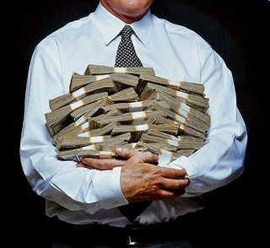
BUDGET
Be aware that funders vary as to what they are prepared to pay in terms of direct project costs, such as staff and equipment, and indirect costs, such as overheads.
The funder might request to approve before hand own inputs or inputs from other institutions participating in the project.
The proposal should contain a detailed budget.
The budget asked should be in proportion to the volume and complexity of the work activities.

Slide 32
REFERENCES
Referencing is a standardized way of acknowledging the sources of information and ideas that you have used in your document.
A list of all the references used in the text must be written.
The styles vary for different journals. (Use ENDNOTE, Ref Works., Vancouver/Harvard vs ApA style).
  Harvard format (the name and year system) is the most widely used
  Alphabet-Number system is a modification of name and year system
  Citation order system
Some journals require complete titles of the cited references

Slide 33
In-text citations
In name and year system:
Citation in the text is followed by the author’s last name and year of publication between parentheses.
  If they were two authors then both last names are written.
  If more than two then the only first author’s name is written followed by the abbreviation et al.
  Eg. Schwarz, G., (2005). Molybdenum cofactor biosynthesis and deficiency. Cell. Mol. Life Sci., 62, 2792-2810.
If a single statement requires more than one citation then the references are arranged chronologically from oldest to more recent, separated by semicolons.

Slide 34
  If more than one reference share the same year then they are arranged alphabetically within the year.
In alphabet-number system:
Citation by number from an alphabetically arranged numbered reference list.
In citation order system:
The references are numbered in the order they are mentioned in the text
Reference List
Any papers not cited in the text should not be included.
Reference lists allow readers to investigate the subject in greater depth.
A reference list contains only the books, articles, and web pages etc that are cited in the text of the document. A bibliography includes all sources consulted for background or further reading.

Slide 35
Appendices: You may include all relevant information, such as Raw data, Logistic, etc…
Plagiarism: is intellectual theft. It means use of the intellectual creations of another without proper attribution. Plagiarism may take two main forms, which are clearly related:
To steal or pass off as one's own the ideas or words, images, or other creative works of another.
2. To use a creative production without crediting the source, even if only minimal information is available to identify it for citation.
Credit must be given for every direct quotation, for paraphrasing or summarizing a work (in whole, or in part, in one's own words), and for information which is not common knowledge.”
“ Plagiarism is strictly forbidden’’

Slide 36
Presentation of scientific paper
Presentation outline
Introduction
Objective
Experimental part
Result and discussion
Conclusion
Acknowledgement

Slide 37
Top tips for successful presentations
1) Understand Your Audience
The key to strong preparation is a thorough understanding of your audience
Who are they?
What is their theoretical knowledge?
What is their practical knowledge?
What is their level of education?
What is their knowledge of terminology?
How fast can they pick up new ideas?
How wide is their concentration span?
What are their expectations?
What do they need to know?
What are they interested in?

Slide 38
Class Activity:
How would you approach the following audience groups?
A) Experts B) Novices (beginners) C) Mixed
Experts
  Eliminate introductory material
  Can be much more focused on the “interesting” results
Novices (beginner)
  Assume your audience is intelligent but knows nothing
  80% of material should be introductory
Mixed
  Most difficult
  60% of material should be introductory

Slide 39
2) Establish Your Objectives
Good presenters focus on their audience, they address real people with real needs.
Poor presenters don’t address real people, so they don’t get a real response.
Think about why you are making the presentation. Is it:
To inform?
To persuade?
To entertain?
You will often have a mixture of some or all of these objectives

Slide 40
3) Choosing and organizing the content
What are you trying to tell the audience?
  Tell them what you are going to tell them
  2-3 points for 15 minute talks
  3-4 points for 30 minute talks
  4-6 points for 1 hour talks
Write a basic outline
  Make a rough draft with slides
  Figure out how many slides you can use
  Slides without graphics should be up for at least 30 sec
  Slides with graphics should be up for at least 1 min and cut what is not necessary
  4) Be Prepared
The key to a successful presentation is a careful and intelligent preparation.
We cannot all be brilliant, witty, or elegant public speakers, but we can all produce a polished and professional performance if we want to.
Class activity: Is presentation an art or a skill?

Slide 41
5) Select an appropriate Timing
Class Activity
If you have the mandate to choose a day (time) to give your presentation, which one would you prefer? At what time?
Monday
people are thinking about their week
Tuesday
The best times are thus:
Tuesday to Thursday, 10am-12 midday!
Wednesday
Thursday
Friday
people are thinking about their weekend
Before lunch
people are thinking about food
After lunch
people are sleepy
End of day
people are tired

Slide 42
6) Have a clear structure
Once you have thought about the message and your key points, you need to fit them into a structure that will produce the response you want
Make the structure of your presentation clear early on (outline of the presentation)
An audience feels more comfortable if they know where they are throughout a presentation
Preparing slides
Use a sans serif font e.g. Arial
Use bold face type
Don’t use italics or caps
Choose a size that is easy to read (36 – 18 font, preferably 24)

Slide 43
Cont…d
Make the headline a sentence and keep it left-justified
Try to include an image on every visual
Avoid diagrams that are too complex
Use white or light color backgrounds
Don’t use lists with more than 6 items
Break long lists into multiple slides
Don’t use complete sentences
Try to keep list items to 6 words or less
Don’t use abbreviations or acronyms

Slide 44
Preparing slides with graphics
Add graphics to viewer
retention
Try to avoid large lists
Keep graphics simple
  Use white or light colored backgrounds
  Take care of color blind people
Make all text readable

Slide 45
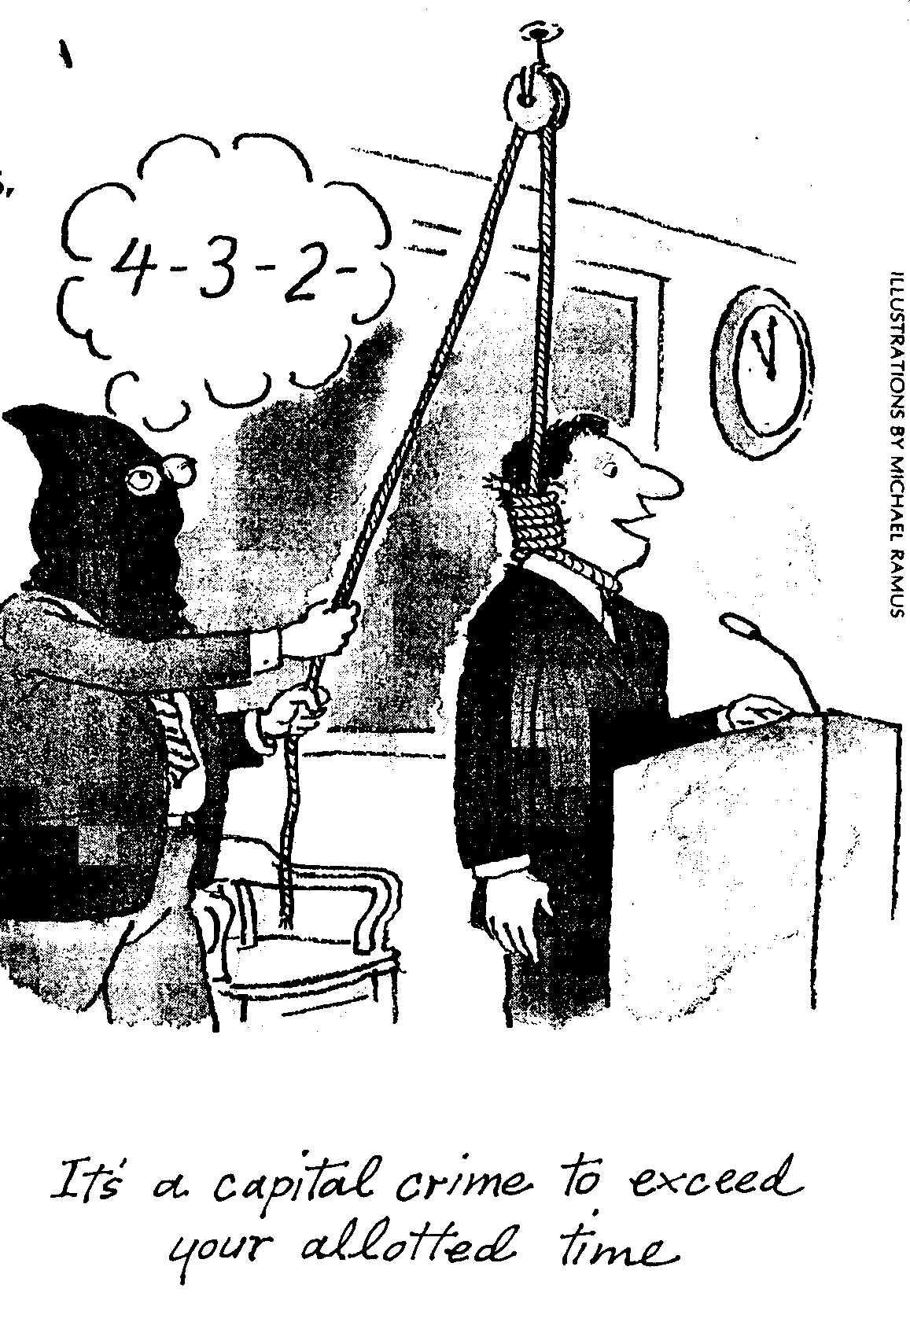
Think carefully about content and timing
Make sure you have finished speaking before your audience has finished listening.
When preparing your presentation, decide:
  What you want to include
  How much time you have
  How much your audience can handle
Develop a structure that is flexible enough for you to adapt as you see your time is going.

Slide 46
Plan your delivery
You should address the audience
If your listeners do not feel that you are talking to them personally, they might think they should have stayed at home and just listened to a recording of your presentation So:
Speak directly to the audience
Speak clearly
Speak at the right speed
Use the right kind of language
Spoken language is different from written language
Written language tends to have
Long sentences
Complex vocabulary
Complex arguments
Spoken language should
Have shorter sentences
Use simpler vocabulary and simpler arguments

Slide 47
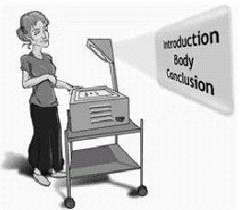
The structure of the presentation
Structure your presentation according to the guidelines, facilities and time allocated
Seminars 15 minutes
Proposal 15 minutes
Progress reports 15 minutes
Thesis defense 30 minutes
YOU MUST LEAVE YOUR AUDIENCE WITH A SENSE THAT THEY HAVE BEEN GIVEN A WELL STRUCTURED AND ORGANISED PRESENTATION!

Slide 48
The structure of the presentation
Introduction: Give an overview and what you intend to accomplish during the presentation
Body: This should be a logical sequence of information and should be well supported with evidence, visual aids and audience involvement
Conclusion: This is where you point out to the audience how you have achieved what you promised in the introduction
IMPORTANT
Proper citation of previous works is required where ever applicable.
Finally, thinks the following very carefully,
  What are you going to do?
  How are you going to do it?
  What are you going to get?
  What is the contribution to the global society and scientific community?

