Slide 1
Debre Markos University
College of natural and computational science
Chemistry Department (3rd year)
Environmental chemistry and toxicology (Chem3114)
Email:- minbaleend2009@gmail.com
By: Minbale E.

Slide 2
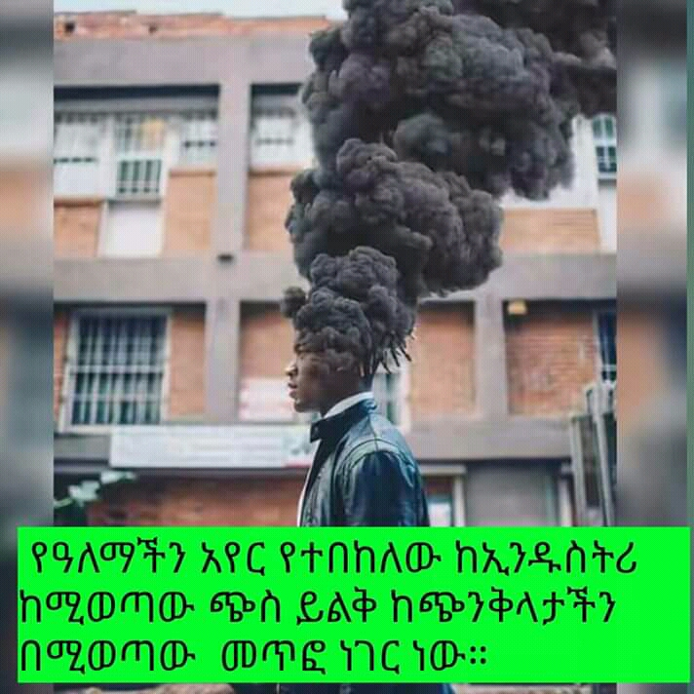

Slide 3
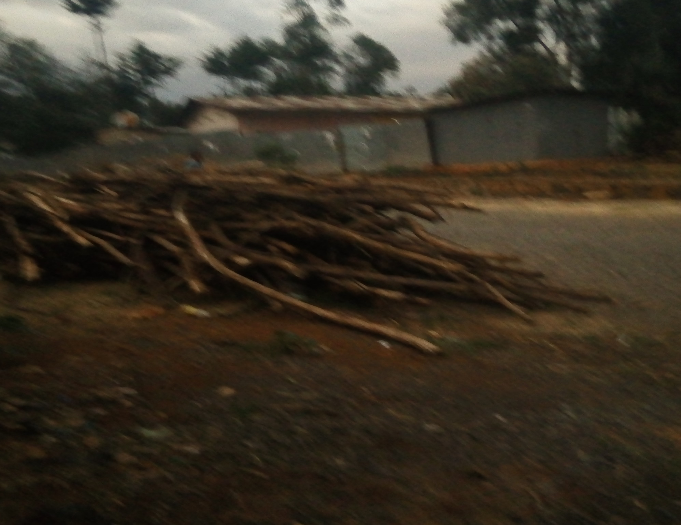

Slide 4
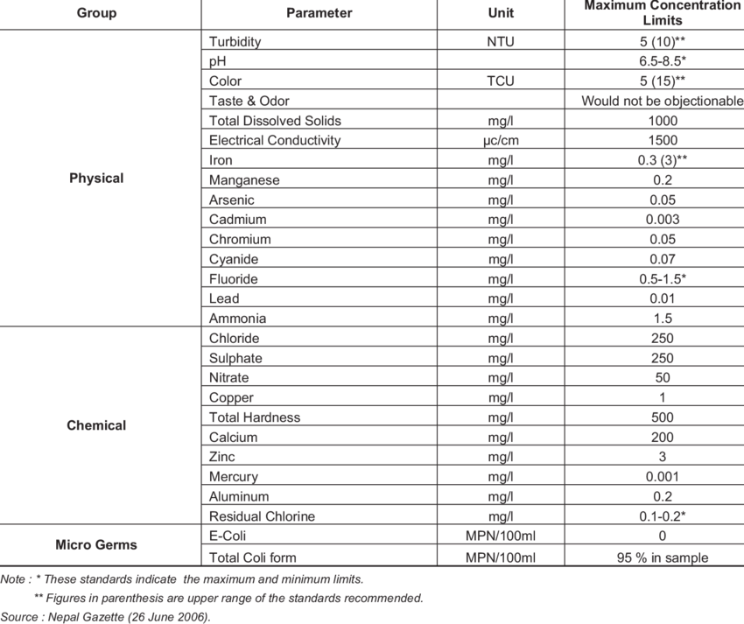

Slide 5
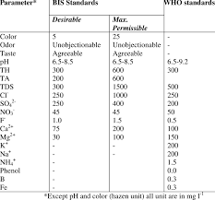

Slide 6
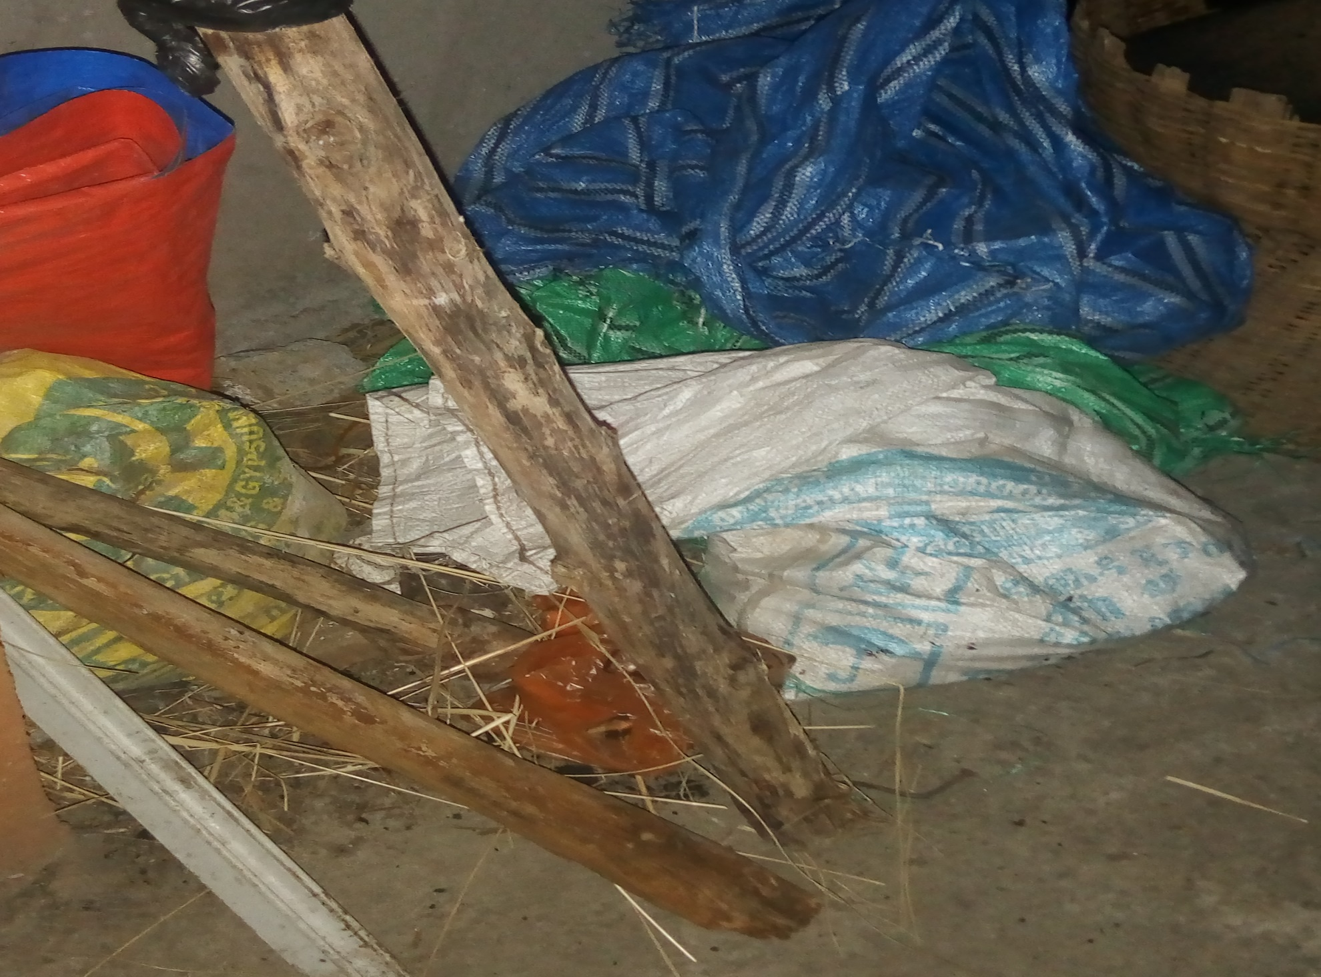

Slide 7
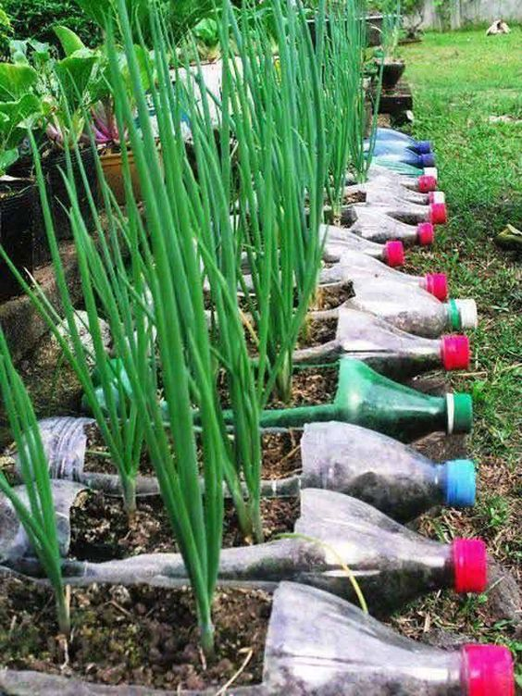

Slide 8
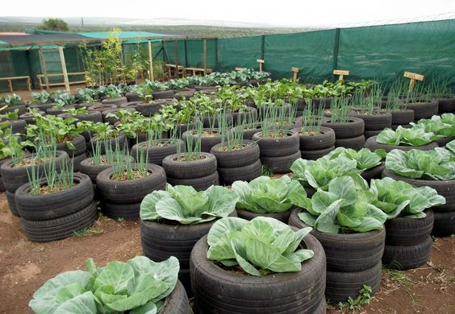

Slide 9
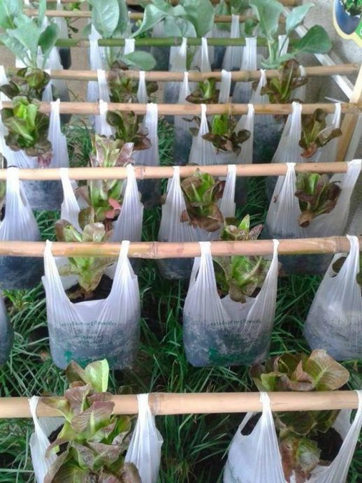

Slide 10


Slide 11
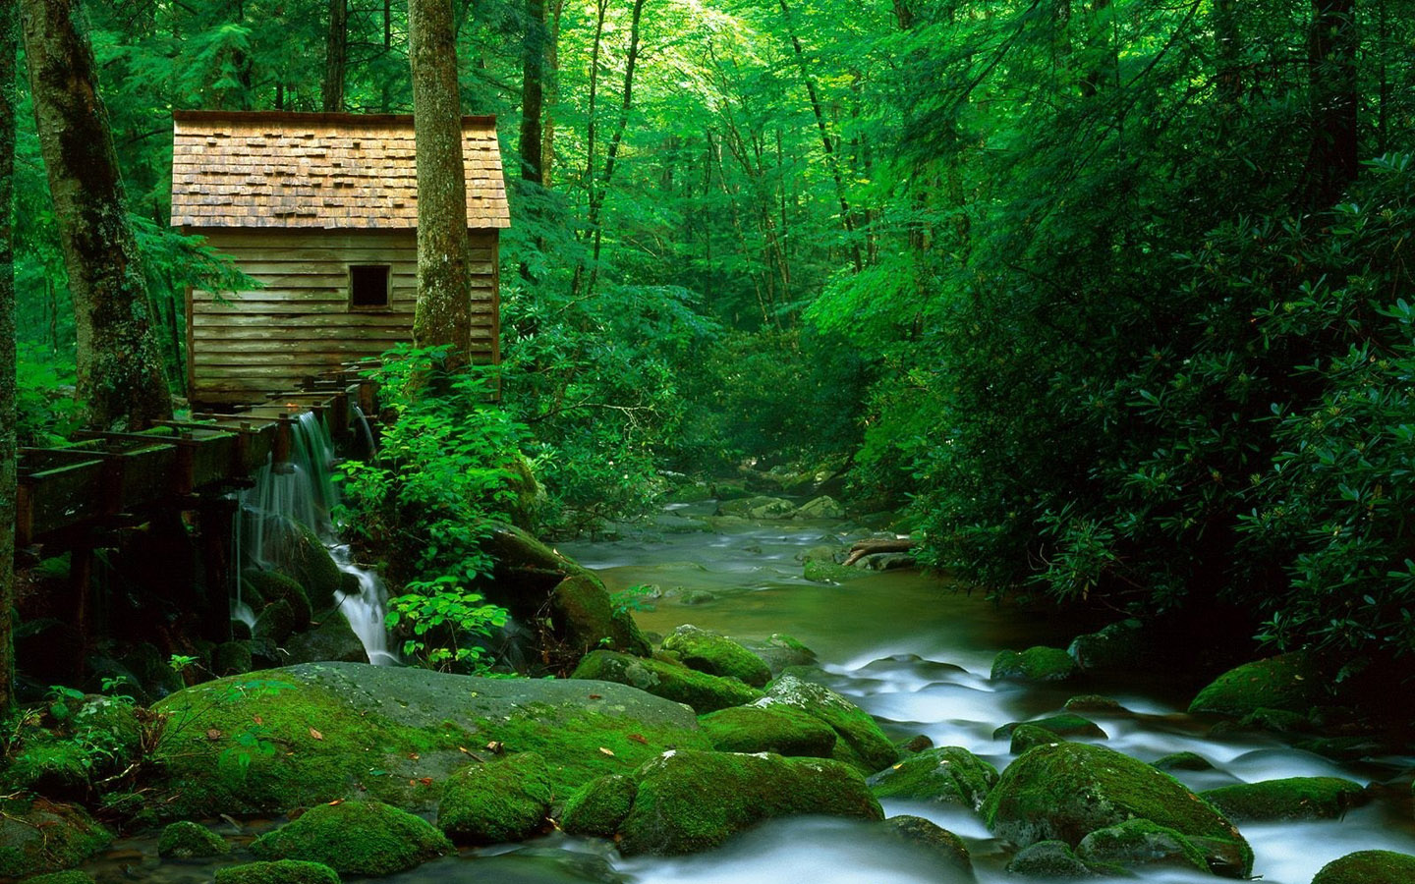

Slide 12


Slide 13
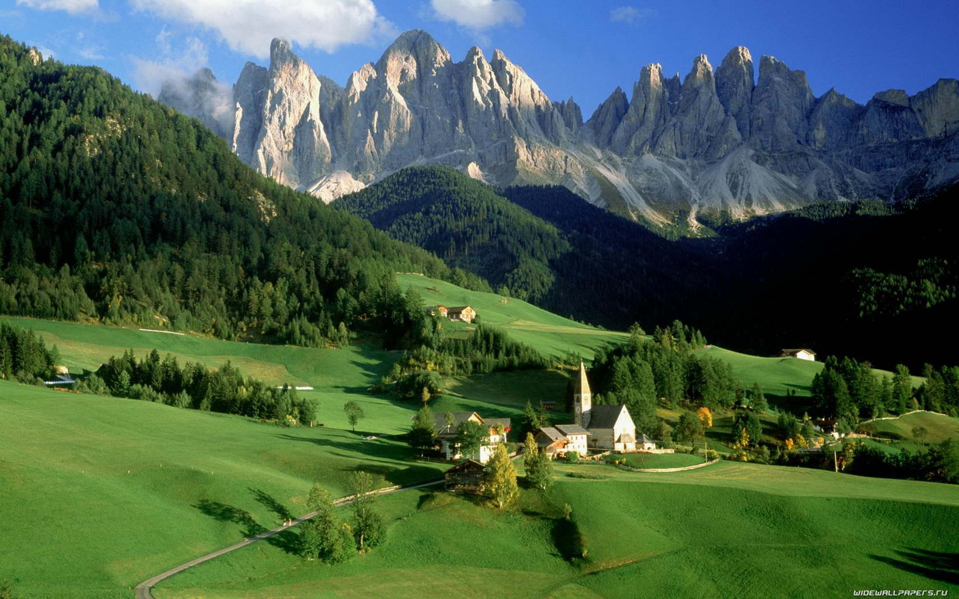

Slide 14
CHAPTER ONE
1. Introduction to Environmental Chemistry
To understand the concept of environmental chemistry, it is important to have some appreciation of environmental science as a whole. Environmental science includes chemistry, biology, ecology, sociology and government.
Environmental science is the complex interactions that occur among the terrestrial, atmospheric, aquatic, living and anthropological environments.
Environment is an external factors that affect an organism.
Environmental science also defined as the study of the earth, air, water, and living environments, and the effects of technology.

Slide 15
Cont…
our physical universe is divided into solids, liquids and gases.
For convenience our physical environment can be divided into
atmosphere
geosphere
hydrosphere
biosphere
anthroposphere

Slide 16
The Atmosphere
The atmosphere is the gaseous envelope that surrounds the solid body of the planet.
Is the source of carbondioxide for plant photosynthesis and of oxygen for respiration.
Provides the nitrogen that nitrogen-fixing bacteria and ammonia-manufacturing industrial plants use to produce chemically-bound nitrogen, an essential component of life molecules.
Transports water from the oceans to land, thus acting as the condenser in a vast solar powered still.
Serves a vital protective function, absorbing harmful ultraviolet radiation from the sun and stabilizing Earth’s temperature.

Slide 17
    The Hydrosphere
The hydrosphere is the layer of water that covers approximately 70.8 percent of the surface of the earth.
Water: Covers about 70% of Earth’s surface and over 97 % of this water exist in oceans.
Occurs in all spheres of the environment—in the oceans as a vast reservoir of saltwater, on land as surface water in lakes and rivers, underground as groundwater, in the atmosphere as water vapor, in the polar icecaps as solid ice.
Is an essential part of all living systems and is the medium from which life evolved and in which life exists.
Carries energy and matter are through various spheres of the environment.

Slide 18
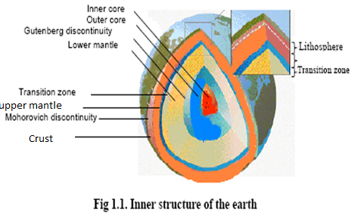
    The Geosphere
The geosphere, is part of the Earth upon which humans live and from which they extract most of their food, minerals, and fuels.
It is divided into layers, which include the solid, iron-rich inner core, molten outer core, and the lithosphere.
Lithosphere consists of the upper mantle and the crust.
Environmental science is most concerned with the lithosphere.

Slide 19
    The Biosphere
The Biosphere is the earth’s relatively thin zone of air, soil, and water that is capable of supporting life, ranging from about 10 km into the atmosphere to the deepest ocean floor.
Life in this zone depends on the sun’s energy and on the circulation of heat and essential nutrients.
Is virtually contained by the geosphere and hydrosphere in the very thin layer where these environmental spheres interface with the atmosphere.

Slide 20
    The Anthroposphere
The anthroposphere is that part of the environment that is made or modified by humans for use in human activities and human habitats.
Is a strongly interconnected to the biosphere.
Has strongly influenced the biosphere
For example, destruction of wild life habitat has resulted in the extinction of vast numbers of species.
It is the responsibility of human kind to make such changes intelligently to protect and nurture the biosphere.

Slide 21
  1.1. Basic concepts in Environmental chemistry
Environmental chemistry may be defined as the study of the sources, reactions, transport, effects, and fates of chemical species in water, soil, air, and living environments, and the effects of technology thereon.
Environmental chemistry clearly points the way to minimize the environmental impacts of the emissions and by-products of industrial systems.

Slide 22
1.2. Properties of chemicals in the environment
As the name implies, atmospheric chemistry deals with chemical phenomena in the atmosphere.
Vapor Pressure (Pv): The pressure exerted by a chemical in the vapor phase in equilibrium with its solid or liquid form.
Bioconcentration Factor (BCF): The equilibrium ratio of the concentration of a chemical in an exposed organism to the concentration of the chemical in the surrounding water.
Biodegradation: The transformation of chemical compounds by living organisms.

Slide 23
Cont…
Hydrolysis: A chemical transformation process in which a chemical reacts with water.
Photo oxidation: A process in which solar radiation generates an oxidizing agent, such as the hydroxyl radical, which reacts and transforms a chemical.
Water Solubility (S): is the maximum amount of a chemical that can be dissolved in a given amount of pure water at STP.

Slide 24
Cont…
Mobility: The tendency for a chemical to move in the environment (i.e., through soil with the percolation of water).
Persistence: The ability of a chemical substance to remain in a particular environment in an unchanged form.
Organic Carbon Partition Coefficient (K ): The proportion of a chemical sorbed to the solid or phase, at equilibrium in a two-phase, water/soil or water/sediment system expressed on an organic carbon basis.

Slide 25
Cont…
Percent Removal: The amount of the chemical that can be removed from sewage by standard waste water treatment processes, expressed in terms of the percent.
Photolysis: The transformation of a chemical by light energy.
Treatability: The amenability of a chemical substance or waste stream to removal during waste water treatment, without adversely affecting the normal operation of the treatment plant.

Slide 26
1.3. Environmental transformation and degradation
Transformation is partial change in structure of contaminants due to biological (biotic) or non biological (abiotic) reaction; transformation product may still retain toxicity.
Degradation is decrease in concentration of a contaminant due to nonreversible alteration of chemical structure.
We can classify environmental degradation as abiotic and biotic degradations.

Slide 27
    Abiotic transformation and degradation
    The most important abiotic reactions are photochemical transformations and chemically mediated transformations as hydrolysis, oxidation and reduction.
    Photo degradation does occur in aquatic systems and also in terrestrial areas mainly on the soil surface, e.g. mediated by humic matter.
During hydrolysis, H⁺ or OH⁻ originating from the dissociation of water attack the organic substrate, breaking an existent bond and forming a new one with the latter.
Hydrolysis in the soil aqueous phase may be pH moderated or pH independent.

Slide 28
Biotransformation and degradation
It is generally biotic reactions driven by microorganisms are of major significance for the fate and persistence of a pollutant in aquatic and terrestrial ecosystems.
Biodegradation is considered to be the dominant degradative route for various organic chemicals.
Aerobic biodegradation involves the breakdown of molecules either by biotransformation (primary biodegradation) into less complex metabolites or by mineralization (ultimate biodegradation) into inorganic chemicals (H₂O, CO₂).
The extent and rate of biodegradation depend on many factors like O₂, pH, temperature, moisture level or better water activity, microbial population, degree of adaptation, accessibility of nutrients, chemical structure of the compound, cellular transport properties, and chemical portioning in the growth medium.

Slide 29
Cont…
Microorganisms responsible for biodegradation may be divided in two major categories, based on their abilities to live under different environmental conditions
Oligotrophs are active under low concentrations of organic carbon and may be inhibited by high concentrations.
Eutrophs on the contrary, are microorganisms that proliferate under high carbon concentrations and may be inhibited at low concentrations.

Slide 30
Cont…
In general two types of biodegradation processes may be distinguished:
1. Primary biodegradation; any biologically induced structural transformation in the parent compound.
2. Ultimate biodegradation or mineralization; biologically mediated conversion of an organic compound that changes its molecular integrity to inorganic compounds and products associated with normal metabolic processes.

Slide 31
1.4. Matter and cycles of matter
Existing matter must cycle continuously for this planet to support life. Water, carbon, nitrogen, phosphorus, and even rocks move through cycles.
The Rock Cycle: Several geologic processes can change rock from one type to another. These processes include melting, cooling, cementation, heat, pressure, weathering, and erosion.
1. Sedimentary rocks: form when rocks break into smaller pieces and those pieces become cemented together,
2. Igneous rocks: form when hot, liquid rock called magma cools and becomes solid), and
3. Metamorphic rocks: form when rock is changed because of chemical processes or changes in temperature and pressure.

Slide 32
Endogenic and Exogenic Cycles
Materials cycles may be divided broadly
endogenic cycles, which predominantly involve subsurface rocks of various kinds,
endogenic cycles do not have a gaseous component. Cycles like phosphorus one of endogenic cycles.
exogenic cycles, which occur largely on Earth’s surface and usually have an atmospheric component.
Many are exogenic cycles in which the element in question spends part of the cycle in the atmosphere—O₂ for oxygen, N₂ for nitrogen, CO₂ for carbon.

Slide 33
The Water Cycle
The water cycle is the continuous movement of water between the atmosphere, the land, and the oceans.
Steps of water cycle are:
water from water surface and leaves of plants
vapor
Clouds
Fall back to Earth as precipitation (rain)
Water droplets become large enough

Slide 34
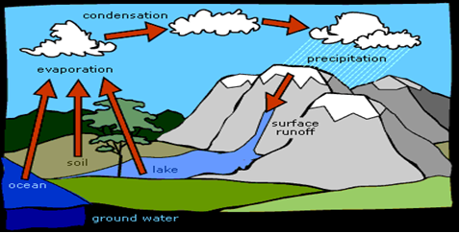
Water enters the atmosphere from surface water evaporation and plant transpiration.
Surface water loss due to evaporation and transpiration are generally combined and referred to as evapo-transpiration.

Slide 35
Carbon cycle
Carbon is circulated through the carbon cycle.
This cycle shows that carbon may be present as gaseous atmospheric CO2, constituting a relatively small but highly significant portion of global carbon.
Some of the carbon is dissolved in surface water and groundwater as HCO₃ ⁻ or molecular CO₂(aq).
A very large amount of carbon is present in minerals, particularly calcium and magnesium carbonates such as CaCO₃.

Slide 36
Cont…
The Carbon Cycle: Carbon is part of the proteins, fats, and carbohydrates in living things and it is also in the atmosphere, the water, the land, and the remains of living things.
Plants use (CO₂) to prepare energy
Animals eat plants, energy transferred to the animals.
Animals break down, carbon returned to the air as CO₂
CO₂ is reused by plants

Slide 37
The Nitrogen Cycle
The circulation of nitrogen among Earth’s spheres is called the nitrogen cycle.
Certain bacteria in soil change atmospheric nitrogen, N₂, into forms of nitrogen that plants can use.
Other organisms get the nitrogen that they need by eating plants.
When organisms die, decomposers release nitrogen from the dead organisms back into the soil.
Then, plants use some of this nitrogen. Some bacteria in soil change this nitrogen into atmospheric nitrogen, which returns to the air.

Slide 38
Four major nitrogen transformation process exist in nature
Nitrogen Fixation
The process of converting N2 into biologically available nitrogen is called nitrogen fixation.
N2 gas is a very stable compound due to the strength of the triple bond between the nitrogen atoms, and it requires a large amount of energy to break this bond.

Slide 39
Ammonification
When an organism excretes waste or dies, the nitrogen in its tissues is in the form of organic nitrogen (e.g. amino acids, DNA).
Various fungi and prokaryotes then decompose the tissue and release inorganic nitrogen back into the ecosystem as ammonia in the process known as ammonification.
The ammonia then becomes available for uptake by plants and other microorganisms for growth.

Slide 40
Nitrification
Nitrification is the process that converts ammonia to nitrite and then to nitrate and is another important step in the global nitrogen cycle.
Most nitrification occurs aerobically and is carried out exclusively by prokaryotes.
There are two distinct steps of nitrification that are carried out by distinct types of microorganisms.
The first step is the oxidation of ammonia to nitrite, which is carried out by microbes known as ammonia-oxidizers.
The second step in nitrification is the oxidation of nitrite (NO2-) to nitrate (NO3-).
This step is carried out by a completely separate group of prokaryotes, known as nitrite-oxidizing Bacteria.

Slide 41
Denitrification
Denitrification is the process that converts nitrate to nitrogen gas, thus removing bioavailable nitrogen and returning it to the atmosphere.
Dinitrogen gas (N2) is the ultimate end product of denitrification, but other intermediate gaseous forms of nitrogen exist
Some of these gases, such as nitrous oxide (N2O), are considered greenhouse gasses, reacting with ozone and contributing to air pollution.

Slide 42
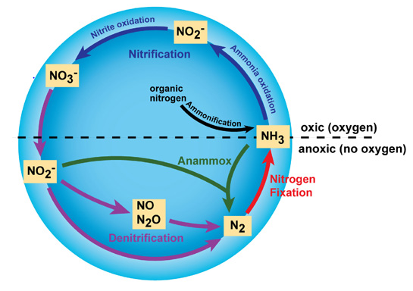
Four major nitrogen transformation process exist in nature

Slide 43
The Oxygen Cycle
It involves the interchange of oxygen between the elemental forms of gaseous O₂, contained in a huge reservoir in the atmosphere,
Elemental oxygen becomes chemically bound by various energy yielding processes, particularly combustion and metabolic processes in organisms.
It is released in photosynthesis.
The oxygen cycle is completed by the return of elemental O₂ to the atmosphere.
The only significant way in which this is done is through photosynthesis mediated by plants.

Slide 44
The Phosphorus Cycle:
There are no common stable gaseous forms of phosphorus, so the phosphorus cycle is endogenic.
Phosphorus is found in living things.
It is also found in soil, rock, and water.
The roots of plants absorb phosphorus from the soil and then, animals obtain phosphorus when they eat the plants.
When the animals die, the phosphorus returns to the soil through decomposition.
In the geosphere, phosphorus is held largely in poorly soluble minerals, as a calcium salt deposits Ca5 (OH) (PO4)3 of which constitute the major reservoir of environmental phosphate.

Slide 45
CHAPTER 2
2. AQUATIC CHEMISTRY AND WATER POLLUTION
2.1. Introduction to the Fundamentals of aquatic chemistry
The study of water is known as hydrology and is divided into a number of subcategories.
About 97% of Earth’s water is found in the oceans.
There is a strong connection between the hydrosphere, where water is found, and the lithosphere, which is that part of the geosphere accessible to water.

Slide 46
  2.2.The Properties of water, a unique substance
Water has a number of unique properties that are essential to life.
Some of the special characteristics of water include its polar character, tendency to form hydrogen bonds, and ability to hydrate metal ions.

Slide 47
Table 2.1. properties of water
Property | Effects and Significance
Excellent solvent | Transport of nutrients and waste products, making biological processes possible in an aqueous medium
Highest dielectric constant of any common liquid | High solubility of ionic substances and their ionization in solution
Higher surface tension than any other liquid | Controlling factor in physiology; governs drop and surface phenomena
Transparent to visible and longer-wavelength fraction of ultraviolet light | Colorless, allowing light required for photosynthesis to reach considerable depths in bodies of water
Maximum density as a liquid at 4˚C | Ice floats; vertical circulation restricted in stratified bodies of water
Higher heat of evaporation than any other material | Determines transfer of heat and water molecules between the atmosphere and bodies of water
Higher latent heat of fusion than any other liquid except ammonia | Temperature stabilized at the freezing point of water
Higher heat capacity than any other liquid except ammonia | Stabilization of temperatures of organisms and geographical regions

Slide 48
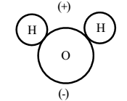
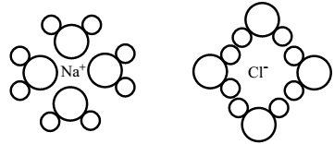
Cont…
Water’s properties can best be understood by considering the structure and bonding of the water molecules:
The water dipole maybe attracted to either positively or negatively charged ions.
Example, when NaCl dissolves in water the positive Na⁺ are surrounded by water molecules with their negative ends pointed at the ions, and the Cl⁻ are surrounded by water molecules with their positive ends pointing at the negative ions.

Slide 49
Cont…
Many minerals, some organic pollutants, proteinaceous materials, some algae, and some bacteria are suspended in water as very small particles.
Water has its maximum density at 4˚C, a temperature above its freezing point.

Slide 50
  2.3. Water Quality
Liquid freshwater exists on Earth either as surface water (lakes, rivers, streams, ponds, etc.) or as groundwater.
An aquifer is a layer of rock or soil capable of holding large amounts of water.
A significant difference between surface water and groundwater is the accumulation of sediments by the former.
The tools used to measure water quality called <“indicators”.
The quality of water that we use for different purposes can be evaluated by using biological, physical and chemical parameters.

Slide 51
Physical Water Quality Parameters
Suspended solids, turbidity, color, taste and odor, and temperature fall in physical category.
Suspended solids - Sources and impacts Solids can be dispersed in water in both suspended and dissolved forms.
We can classifiy ss in to two
Tss and tds
Solids suspended in water may consist of inorganic substances such as clay and silt or organic particles such as plant fibers, algal and bacterial remains.
Other suspended material may also result from human use of the water and industrial use.

Slide 52
Cont…
Suspended materials in water make the water aesthetically unpleasant and provide adsorption sites for chemical and biological agents.
Biologically active (live) suspended solids may include disease causing organisms as well as organisms such as toxin-producing strains of algae.
Suspended solids could be divided into filterable residues and non-filterable residues.
EPA has set a maximum suspended- solids standard of 30 mg/L for most treated wastewater discharges.

Slide 53
Cont…
Turbidity: is the measure of the extent to which light is either absorbed or scattered by suspended particles in water.
Absorption and scattering are known to be influenced by both the size and surface characteristics of the suspended material.
Therefore, turbidity cannot be a direct quantitative measure of suspended solids.
Turbidity in surface waters results from soil erosion.
Turbidity makes drinking water aesthetically displeasing and the colloidal materials associated with turbidity provide adsorption sites for chemicals that may be harmful or cause undesirable tastes and odors and for biological organisms that may be harmful to health.

Slide 54
Cont…
Color: Due to foreign materials (iron oxides cause reddish water) natural water is often colored.
The water coloration coming from filterable suspended matter is said to be apparent color and that contributed by dissolved solids, which remain after removal of filterable suspended matter, is known as true color.
Colored water is less marketable both for domestic and industrial use.
Highly colored water is unsuitable for laundering, dyeing, papermaking, beverage manufacturing and dairy production.

Slide 55
Cont…
Taste and odor: Organic materials or, their biological decomposition, are known to produce both taste and odor problems in water.
Also, certain species of algae secrete an oily substance that may result in both taste and odor.
The combination of two or more substances neither of which would produce taste or odor by itself may sometimes result in taste or odor problems.
Alkaline mineral imparts a bitter taste to water, while metallic salts may give a salty or bitter taste.
Taste and odor make water aesthetically displeasing to consumers.
Some of the substances that impart bad taste and odor may be carcinogenic.

Slide 56
Cont…
Temperature: it is not used as a parameter to evaluate potable water or wastewater directly.
The temperature of surface waters governs to a large extent the biological species present and their rates of activity.
It also influences most chemical reactions that occur in natural water system the solubility of gases in water.
Shallow bodies of water are more affected by ambient temperatures than are deeper bodies.
Algal growth is often accelerated in warm water and can become a problem when cells cluster into algae mats.

Slide 57
Cont…
Game fish requires cooler temperatures and higher dissolved-oxygen levels.
Most chemical reactions involving solids are accelerated by an increase in temperature.
The solubility of gases decreases at elevated temperatures and thus the level of dissolved oxygen will decrease.
This is undesirable situation since biological oxidation of organics in streams is dependent on adequate supply dissolved oxygen.

Slide 58
Chemical water quality parameters
Total dissolved solids, alkalinity, hardness, fluorides, metals, organics and nutrients are chemical parameters water quality management.
Dissolved Oxygen (DO): is essential for the survival and propagation of aquatic organisms and it may declined by different pollutants.
If the amount of oxygen dissolved in water falls below the minimum requirements for survival, aquatic organisms may die.
DO concentrations are lowest in the morning, climbing the day due to photosynthesis and peaking near dusk, then steadily declining during the hours of darkness.

Slide 59
Cont…
Biochemical oxygen demand (BOD): Is a chemical procedure for determining how fast biological organisms use up oxygen in a body of water.
The BOD test indicates the amount of biologically oxidizable carbon and nitrogen that is present in wastewater or in natural water.
BOD is the amount of oxygen (DO) required for the biological decomposition of organic matter.
If the inhibitor is not added, the BOD will be between 10% and 40%higher than can be accounted for by carbonaceous oxidation.

Slide 60
Cont…
Chemical oxygen demand (COD): This test is carried out on the sewage to determine the extent of readily oxidizable organic matter, which is of two types:
a. Organic matter which can be biologically oxidized is called biologically active
b. Organic matter which cannot be oxidized biologically is called biologically inactive.
COD gives the oxygen required for the complete oxidation of both biodegradable and non-biodegradable matter.
It is a measure of the oxygen equivalent of the organic matter content of a sample that is susceptible to oxidation by a strong chemical oxidant.
It is an indirect method to measure the amount of organic compounds in water.
It is expressed in (mg/L), which indicates the mass of oxygen consumed per liter of solution.

Slide 61
Cont…
COD always oxidize things that the BOD cannot or will not measure; therefore, COD is always higher than the BOD.
The common compounds which cause COD to be higher than BOD include sulfides, sulfites, thiosulfates and chlorides.

Slide 62
Cont…
pH : is a measure of the hydrogen ion concentration of water, and is used to indicate degree of acidity.
Photosynthesis by phytoplankton (algae) consumes carbon dioxide during the day, which results in a rise in pH.
Nutrients: The most important plant nutrients, in terms of water quality, are phosphorus and nitrogen.
TP (total phosphorous) includes all of the various forms of phosphorus (organic, inorganic, dissolved, and particulate) present.

Slide 63
    2.3.1. Water quality requirements
Water quality requirements, expressed as water quality criteria use-specific or targeted to the protection of the most sensitive water use.
Water quality criteria provide basic scientific information about the effects of water pollutants on a specific water use.
Water quality criteria are based on variables that characterize the quality of water and/or the quality of the suspended particulate matter, the bottom sediment and the biota.
Many water quality criteria set a maximum level for the concentration of a substance in a particular medium which will not be harmful when the specific medium is used continuously.

Slide 64
    2.3.2. Nature and types of Water pollutants
Quality of drinking water has been a factor in determining human welfare.
The possible sources of chemical contaminations are wastes from industrial chemical production, metal plating operations, and pesticide runoff from agricultural lands.
Some specific pollutants include industrial chemicals such as chlorinated hydrocarbons; heavy metals (cadmium, lead, and mercury); saline water; bacteria and general municipal and industrial wastes.

Slide 65
Sources of water pollution
1). Agricultural runoff: Drainage systems conduct any soil contaminants to surface water and to groundwater.
It includes agricultural chemicals (pesticides, chemical fertilizers), heavy metals leached from the soil by acid rain, atmospheric pollutants carried in rainfall, bacteria from organic fertilizers.
2). Rain: it transfer atmospheric pollutants by dissolving directly to surface water.
3). Drainage: from municipal and industrial waste disposal sites and effluent from industrial discharge is potential source of contamination if not controlled.

Slide 66
Cont…
4). Runoff: from mine tailings, which may be rich in heavy metals, can contaminate both surface and ground waters.
5). Municipal sewage discharge: Even if treated, this discharge may carry phosphate detergents, chlorine, and other dissolved xenobiotics into water courses.
6). Natural sources: Natural toxicants such as methyl mercury can form as a result of bacterial action on mercury leached from rock.

Slide 67
    2.3.3. Water treatment
The treatment of water may be divided into three major categories:
    ⁃Treatment for specialized industrial applications
    ⁃Treatment of wastewater to make it acceptable for release or reuse
    ⁃Purification for domestic use
The type and degree of treatment are strongly dependent upon the source and intended use of the water.

Slide 68
Cont….
Contact of the water with air (aeration) removes volatile solutes such as hydrogen sulfide, carbon dioxide, methane, and volatile odorous substances such as methane thiol (CH₃SH) and bacterial metabolites.
Contact with oxygen also aids iron removal by oxidizing soluble iron (II) to insoluble iron(III).
The addition of lime as CaO or Ca(OH)₂ after aeration raises the pH and results in the formation of precipitates containing the hardness ions Ca²⁺ and Mg²⁺.
Much of the solid material remains in suspension and requires the addition of coagulants (such as iron(III) and aluminum sulfates, which form gelatinous metal hydroxides) to settle the colloidal particles.

Slide 69
Cont…
Activated silica or synthetic polyelectrolytes may also be added to stimulate coagulation or flocculation.
The settling occurs in a secondary basin after the addition of carbon dioxide to lower the pH.
Sludge from both the primary and secondary basins is pumped to a sludge lagoon.
The water is finally chlorinated, filtered, and pumped to the city water mains.

Slide 70
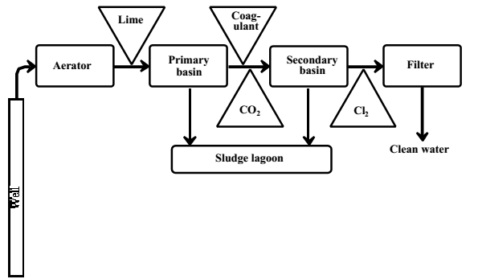
Cont….
Fig2.1. Figure 2.4. Schematic of a municipal water treatment plant.
Figure 2.1. Schematic of a municipal water treatment plant.

Slide 71
Cont….
Sewage include turbidity, suspended solids (ppm), total dissolved solids (ppm), acidity (H⁺ concentration pH), and dissolved oxygen (in ppm O₂).
Biochemical oxygen demand is used as a measure of oxygen-demanding substances.
Current processes for the treatment of wastewater may be divided into three main categories of primary treatment, secondary treatment, and tertiary treatment.

Slide 72
Cont….
Primary treatment of wastewater consists of the removal of insoluble matter such as grit, grease, and scum from water.
The first step in primary treatment normally is screening.
Secondary wastewater treatment is designed to remove BOD,
The most obvious harmful effect of biodegradable organic matter in wastewater is BOD, consisting of a biochemical oxygen demand for dissolved oxygen by microorganism-mediated degradation of the organic matter.
In addition, potentially hazardous toxic metals may be found among the dissolved inorganics.

Slide 73
Cont…
Tertiary waste treatment (advanced waste treatment): is used to describe a variety of processes performed on the effluent from secondary waste treatment.
Contaminants removed by tertiary waste treatment fall into the general categories of
(1) suspended solids,
(2) dissolved organic compounds, and
(3) dissolved inorganic materials, including the important class of algal nutrients.
Suspended solids are primarily responsible for residual biological oxygen demand in secondary sewage effluent waters.

Slide 74
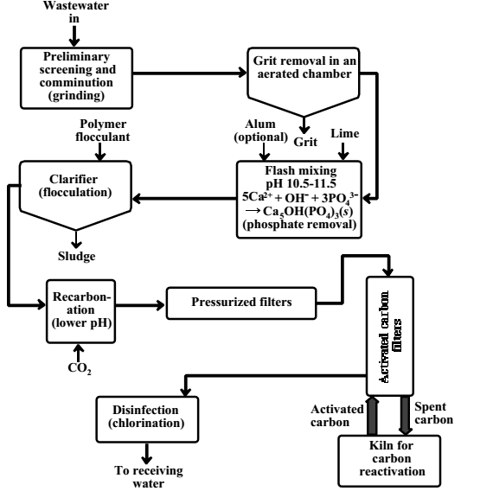
Municipal Wastewater can also treat by Physical-Chemical Treatment methods.
Figure 2.2. Major components of a complete physical-chemical treatment facility for municipal wastewater.

Slide 75
CHAPTR 3
3. ATMOSPHERIC CHEMISTRY AND AIR POLLUTION
3.1. Importance and physical characteristics of the atmosphere
Exclusive of water, atmospheric air is 78.1% (by volume) nitrogen, 21.0% oxygen, 0.9% argon, and 0.03% carbon dioxide.
Normally, air contains 1-3% water vapor by volume.
In addition, air contains a large variety of trace level gases at levels below 0.002%, including neon (1.818 x 10⁻³ %, ), helium (5.24 x 10⁻⁴ %), methane (1.6 x 10⁻⁴ %), krypton (1.14 x 10⁻⁴ %), nitrous oxide, hydrogen, xenon (8.7 x 10⁻⁶ %), sulfur dioxide (~2 x 10⁻⁸%), ozone, nitrogen dioxide, ammonia (10⁻⁸-10⁻⁷%), and carbon monoxide (~1.2 x 10-5%).

Slide 76
    Importance of the atmosphere
The atmosphere is a protective blanket which nurtures life on the Earth and protects it from the hostile environment of outer space.
The atmosphere is the source of carbon dioxide for plant photosynthesis and of oxygen for respiration.
It provides the nitrogen that nitrogen-fixing bacteria and ammonia-manufacturing plants use to produce chemically-bound nitrogen, an essential component of life molecules.
As a basic part of the hydrologic cycle the atmosphere transports water from the oceans to land, thus acting as the condenser in a vast solar-powered still.

Slide 77
Cont….
The atmosphere absorbs most of the cosmic rays from outer space and protects organisms from their effects.
By absorbing electromagnetic radiation below 300 nm, the atmosphere filters out damaging ultraviolet radiation that would be very harmful to living organisms.

Slide 78
    Physical characteristics of the atmosphere
The density of the atmosphere decreases sharply with increasing altitude as a consequence of the gas laws and gravity.
More than 99% of the total mass of the atmosphere is found within approximately 30 km (≈ 20 miles) of the Earth’s surface.
Such an altitude is miniscule compared to the Earth’s diameter.
Atmospheric pressure decreases as an approximately exponential function of altitude largely determines the characteristics of the atmosphere.

Slide 79
Stratification of the Atmosphere:
Troposphere: is the lowest layer of the atmosphere extending from sea level to an altitude of 10-16 km.
Decreasing temperature with increasing altitude from the heat-radiating surface of the earth.
The upper limit of the troposphere, has a minimum temperature of about -56˚C
The stratosphere: is the atmospheric layer directly above the troposphere.
The temperature rises to a maximum of about -2˚C with increasing altitude due to the presence of ozone (O₃).

Slide 80
Cont….
The heating effect is caused by the absorption of ultraviolet radiation energy by ozone.
The region of maximum ozone concentration is found within the range of 25-30 km high in the stratosphere where it may reach 10 ppm.
The maximum temperature occurs at a higher altitude due to the effective absorbsion of UV radiation by ozone and most of this radiation is absorbed in the upper stratosphere where it generates heat.

Slide 81
Cont….
Mesosphere: The absence of high levels of radiation-absorbing species immediately above the stratosphere results in a further temperature decrease to about –92˚C at an altitude around 85 km.
The upper regions of the mesosphere and higher define a region called the exosphere from which molecules and ions can completely escape the atmosphere.
Thermosphere: part of the atmosphere which is above 80 km altitude.
It extending to the far outer reaches of the atmosphere, in which the highly rarified gas reaches temperatures as high as 1200˚C by the absorption of energetic radiation (< 200 nm) in the region.

Slide 82
Cont…
In the outer space of the thermosphere, most particles consist of single atoms, H, He, and O etc.
At lower altitude (200 -100 km), diatomic molecules N₂, O₂, NO etc are present.
The high temperature in this layer is generated from the absorption of intense solar radiation by oxygen molecules (O₂).

Slide 83
Figure 3.1Major regions of the atmosphere

Slide 84
  3.2. Atmospheric chemical reactions
Two constituents of utmost importance in atmospheric chemistry are radiant energy from the sun, predominantly in the ultraviolet region of the spectrum, and the hydroxyl radical, HO•.
    3.2.1.Photochemical Processes, Ions and Radicals in the Atmosphere
The absorption by chemical species of light, can bring about reactions, called photochemical reactions.
Nitrogen dioxide, NO₂, is one of the most photochemically active species found in a polluted atmosphere and is an essential participant in the smog-formation process.

Slide 85
Cont…
Electronically excited molecules, ions consisting of electrically charged atoms or molecular fragments and free radicals are the three relatively reactive and unstable species that are encountered in the atmosphere.
They are strongly involved in atmospheric chemical processes.
Electronically excited molecules are produced when stable molecules absorb energetic EMR.
At altitudes of approximately 50 km and up, ions are so prevalent that the region is called the ionosphere.

Slide 86

Cont….
Energetic electromagnetic radiation in the atmosphere may produce atoms or groups of atoms with unpaired electrons called free radicals.
Because of strong pairing tendencies free radicals are highly reactive.
The hydroxyl radical, HO•, is the single most important reactive intermediate species in atmospheric chemical processes.
At higher altitudes it is produced by photolysis of water.

Slide 87
Cont….
In the presence of organic matter, hydroxyl radical is produced in abundant quantities as an intermediate in the formation of photochemical smog.
To a certain extent in the atmosphere, and for laboratory experimentation, HO• is made by the photolysis of nitrous acid vapor:
In the relatively unpolluted troposphere, it produced as the result of the photolysis of ozone,
Where O* excited oxygen atoms.
Hydroxyl radical is most frequently removed from the troposphere by reaction with methane or carbon monoxide:

Slide 88


Cont….
The highly reactive methyl radical, H₃C•, reacts with O₂, to form methylperoxyl radical, H3COO•.
The hydrogen atom produced above reacts with O₂ to produce hydroperoxyl radical:
The hydroperoxyl radical can undergo chain termination reactions, such as

Slide 89

Cont….
Reactions that can also regenerate hydroxyl radical:

Slide 90

    3.2.2. Acid-base reactions in the atmosphere
The atmosphere is normally at least slightly acidic
Atmospheric sulfur dioxide forms a somewhat stronger acid when it dissolves in water:
SO₂ + H₂O → H₂SO₄
In terms of pollution, strongly acidic HNO₃ and H₂SO₄ formed by the atmospheric oxidation of N oxides, SO₂, and H₂S are much more important because they lead to the formation of damaging acid rain.
Particulate calcium oxide, hydroxide, and carbonate can get into the atmosphere from ash and ground rock, and can react with acids.
Eg

Slide 91

Cont….
The most important basic species in the atmosphere is gas-phase ammonia.
The major source of atmospheric ammonia is from biodegradation of nitrogen containing biological matter and from bacterial reduction of nitrate:
Ammonia is particularly important as a base in the air because it is the only water soluble base present at significant levels in the atmosphere.
Dissolved in atmospheric water droplets, it plays a strong role in neutralizing atmospheric acids:

Slide 92
Cont…
These reactions have three effects:
      (1) They result in the presence of NH₄⁺ ion in the atmosphere as dissolved or solid salts,
      (2) They serve in part to neutralize acidic constituents of the atmosphere, and
      (3) They produce relatively corrosive ammonium salts.

Slide 93
    3.2.3. Reactions of atmospheric oxygen
Atmospheric oxygen takes part in energy-producing reactions, such as the burning of fossil fuels:
In addition to O₂, the upper atmosphere contains oxygen atoms, O; excited oxygen molecules, O₂*; and ozone, O₃.
Atomic oxygen, O, is stable primarily in the thermosphere. Atomic oxygen is produced by a photochemical reaction:
Oxygen atoms in the atmosphere can exist in the ground state (O) and in excited states (O*).
These are produced by the photolysis of ozone,

Slide 94

Cont….
By highly energetic chemical reactions such as
Oxygen ion, O⁺, which may be produced by ultraviolet radiation acting upon oxygen atoms,
It may react with molecular oxygen or nitrogen, to form other positive ions.
The decomposition of ozone in the stratosphere is catalyzed by a number of natural and pollutant trace constituents, including NO, NO₂, H, HO•, HOO•, ClO, Cl, Br, and BrO.

Slide 95
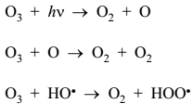

Cont….
The HO• radical is regenerated from HOO• by the reaction,
The NO consumed in this reaction is regenerated from NO₂
Ozone is an undesirable pollutant in the troposphere.
It is toxic to animals and plants and it also damages materials, particularly rubber.

Slide 96
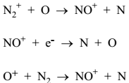
    3.2.4. Reactions of atmospheric nitrogen
Unlike oxygen, which is almost completely dissociated to the monatomic form in higher regions of the thermosphere, molecular nitrogen is not readily dissociated by ultraviolet radiation.
However, at altitudes exceeding approximately 100 km, atomic nitrogen is produced by photochemical reactions:
N₂ + hv → N + N other reactions that form monoatomic nitrogen are:

Slide 97

Cont….
A plausible sequence of reactions by which NO⁺ is formed is the following:
NO⁺ is produced directly by ionizing radiation in the lowest region of the ionosphere, which extends from approximately 50 km in altitude to approximately 85 km:

Slide 98
Cont…
Pollutant oxides of nitrogen, particularly NO₂, are key species involved in air pollution and the formation of photochemical smog.
For example, NO₂ is readily dissociated photochemically to NO and reactive atomic oxygen:
This reaction is the most important primary photochemical process involved in smog formation.

Slide 99
    3.2.5. Atmospheric carbon dioxide
Only about 0.035% (350 ppm) of air consists of carbon dioxide, it is the atmospheric “non pollutant” species of most concern.
The most obvious factor contributing to increased atmospheric carbon dioxide is consumption of carbon-containing fossil fuels.
The one significant photochemical reaction that carbon dioxide undergoes, and a major source of CO at higher altitudes, is the photo dissociation of CO₂ by energetic solar ultraviolet radiation in the stratosphere:

Slide 100
    3.2.6. Atmospheric water
The percentage of water in the atmosphere decreases rapidly with increasing altitude.
Clouds formed from water vapor reflect light from the sun and have a temperature-lowering effect.
Water vapor in the atmosphere acts as a kind of “blanket” at night, retaining heat from the earth’s surface by absorption of infrared radiation.
The cold tropopause serves as a barrier to the movement of water into the stratosphere.

Slide 101
Cont…
Thus, little water is transferred from the troposphere to the stratosphere, and the main source of water in the stratosphere is the photochemical oxidation of methane:
The water thus produced serves as a source of stratospheric hydroxyl radical as shown by the following reaction:

Slide 102
  3.3. Air quality
Ambient air quality is defined as the physical and chemical measure of pollutant concentrations in the ambient atmosphere to which the general population will be exposed.
Air quality is affected by pollutants emitted by numerous sources.
These sources include power generation activities, industrial processes, waste disposal, transportation (vehicles), biomass burning, domestic fuel burning, landfill sites, waste water treatment and agriculture.

Slide 103
  3.4. Nature and classification of air pollutants
    3.4.1. Gaseous inorganic air pollutants
    A number of gaseous inorganic pollutants enter the atmosphere as the result of human activities.
    Those added in the greatest quantities are CO, SO₂, NO, and NO₂.
    Other inorganic pollutant gases include NH₃, N₂O, N₂O₅, H₂S, Cl₂, HCl, and HF.
    1. Production and control of carbon monoxide
    Carbon monoxide, CO, causes problems in cases of locally high concentrations because of its toxicity.

Slide 104

Cont…
    It shows a positive correlation with the density of vehicular traffic, and a negative correlation with wind speed.
Carbon monoxide emissions may be lowered by employing a leaner air-fuel mixture.
It is generally agreed that carbon monoxide is removed from the atmosphere by reaction with hydroxyl radical, HO•:

Slide 105

Cont…
2. Sulfur dioxide sources and the sulfur cycle
Sulfur enters the atmosphere largely as SO₂ and H₂S from volcanoes, and as (CH₃)₂S and H₂S from the biological decay of organic matter and reduction of sulfate.
Any H₂S that does get into the atmosphere is converted rapidly to SO₂ by the following overall process:
The initial reaction is hydrogen ion abstraction by hydroxyl radical, followed by the following two reactions to give SO₂:

Slide 106
Cont…
Approximately half of the sulfur in coal is in some form of pyrite, FeS₂, and the other half is organic sulfur.
Essentially all of the sulfur is converted to SO₂ and only 1 or 2% to SO₃.
Low levels of sulfur dioxide in air do have some health effects.
Its primary effect is upon the respiratory tract, producing irritation and increasing airway resistance, especially to people with respiratory weaknesses and sensitized asthmatics.

Slide 107
Cont…
Therefore, exposure to the gas may increase the effort required to breathe.
Mucus secretion is also stimulated by exposure to air contaminated by sulfur dioxide.
Although SO₂ causes death in humans at 500 ppm, it has not been found to harm laboratory animals at 5 ppm.
Atmospheric sulfur dioxide is harmful to plants.
Acute exposure to high levels of the gas kills leaf tissue, a condition called leaf necrosis.

Slide 108
Cont…
The edges of the leaves and the areas between the leaf veins show characteristic damage.
Chronic exposure of plants to sulfur dioxide causes chlorosis, a bleaching or yellowing of the normally green portions of the leaf.
In areas with high levels of sulfur dioxide pollution, plants may be damaged by sulfuric acid aerosols.
The main effects of sulfur dioxide pollution is deterioration of building materials.

Slide 109
Cont…
Many kinds of recovery processes have been investigated, including those that involve scrubbing with magnesium oxide slurry, sodium hydroxide solution, sodium sulfite solution, ammonia solution, or sodium citrate solution.
Sulfur dioxide trapped in a stack-gas-scrubbing process can be converted to hydrogen sulfide by reaction with synthesis gas (H₂, CO, CH₄).
The Claus reaction is then employed to produce elemental sulfur:

Slide 110
Cont…
3. Nitrogen oxides in the atmosphere
The three oxides of nitrogen normally encountered in the atmosphere are nitrous oxide (N₂O), nitric oxide (NO), and nitrogen dioxide (NO₂).
N₂O, a commonly known as “laughing gas,” is produced by microbiological processes and is a component of the unpolluted atmosphere at a level of about 0.3 ppm.
This gas is relatively unreactive and probably does not significantly influence important chemical reactions in the lower atmosphere.

Slide 111

Cont…
Its concentration decreases with altitude in the stratosphere due to photochemical reaction.
And some reactions with singlet atomic oxygen,
These reactions are significant in terms of depletion of the ozone layer.
Most NO_{x} entering the atmosphere from pollution sources does so as NO generated from internal combustion engines.
At high temperature N₂ + O₂ → 2NO

Slide 112
Cont…
Atmospheric chemical reactions convert NO_{x} to nitric acid, inorganic nitrate salts, organic nitrates, and peroxyacetyl nitrate.
The principal reactive nitrogen oxide species in the troposphere are NO, NO₂, and HNO₃.
Nitrogen dioxide is a very reactive and significant species in the atmosphere.
In the troposphere below 398 nm, photo dissociation occurs

Slide 113
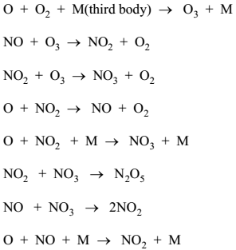
Cont…
Nitrogen dioxide ultimately is removed from the atmosphere as nitric acid, nitrates, photochemical smog as organic nitrogen.
In the stratosphere, nitrogen dioxide reacts with hydroxyl radicals to produce nitric acid:

Slide 114
Cont…
HNO₃ produced from NO₂ is removed as precipitation, or reacts with bases (ammonia, particulate lime) to produce particulate nitrates.
Nitric oxide (NO) is less toxic than NO₂.
Like carbon monoxide and nitrite, NO attaches to hemoglobin and reduces oxygen transport efficiency.
In a polluted atmosphere, the concentration of NO normally is much lower than that of CO due to this the effect on hemoglobin is much less.
Acute exposure to NO₂ can be quite harmful to human health.

Slide 115
Cont…
NO₂ in the laboratory causes leaf spotting and breakdown of plant tissue.
NO_{X} are known to cause fading of dyes and inks used in some textiles.
This has been observed in gas clothes dryers and is due to NOx formed in the dryer flame.
The net reaction destroys ozone.

Slide 116
Cont…
4. Acid rain
Acid rain is an air pollutant, Much of the sulfur and nitrogen oxides entering the atmosphere are converted to sulfuric and nitric acids, respectively.
Hydrogen chloride emissions cause acidic precipitation (acid rain) that is now a major pollution problem in some areas.

Slide 117

Cont…
5. Ammonia in the atmosphere
High concentrations of ammonia gas in the atmosphere are generally indicative of accidental release of the gas.
Ammonia is removed from the atmosphere by its affinity for water and by its action as a base.
Ammonia reacts with these acidic aerosols to form ammonium salts:
Ammonium salts are among the more corrosive salts in atmospheric aerosols.

Slide 118
Cont…
6. Fluorine, chlorine, and their gaseous compounds
Hydrogen fluoride gas is a dangerous substance that is so corrosive it even reacts with glass.
It is irritating to body tissues, and the respiratory tract is very sensitive to it.
Brief exposure to HF vapors at the ppt level may be fatal.
The acute toxicity of F₂ is even higher than that of HF.
Chronic exposure to high levels of fluorides causes’ fluorosis, the symptoms of which include mottled teeth and pathological bone conditions.

Slide 119
Cont…
Fluoride is a poison in plants, even very low levels of fluorides for prolonged periods results in damage.
Silicon tetrafluoride gas, SiF₄, is a pollutant produced during some steel and metal smelting operations that employ CaF₂, fluorspar.
Fluorspar reacts with sand, releasing SiF₄ gas:
Sulfur hexafluoride (SF₆) is the most powerful greenhouse gas known, with a global warming potential.

Slide 120
Cont…
Chlorine is quite toxic and is a mucous membrane irritant.
It is very reactive and a powerful oxidizing agent.
Chlorine dissolves in atmospheric water droplets, yielding hydrochloric acid and hypochlorous acid, an oxidizing agent:
Spills of chlorine gas have caused fatalities among exposed persons.
Incineration of chlorinated plastics, such as polyvinylchloride, releases HCl as a combustion product.

Slide 121

Cont…
7. Hydrogen sulfide, carbonyl sulfide, and carbon disulfide
Hydrogen sulfide is produced by microbial processes (decay of sulfur compounds and bacterial reduction of sulfate), released from geothermal steam.
H₂S emissions damages human health and even fatalities.
The symptoms of poisoning included irritation of the respiratory tract and damage to the central nervous system.
Both COS and CS₂ are oxidized in the atmosphere by reactions initiated by the hydroxyl radical.

Slide 122
    3.4.2. Organic air pollutants
The effects of organic pollutants in the atmosphere may be divided into two major categories.
1). Direct effects, such as cancer caused by exposure to vinyl chloride.
2). Formation of secondary pollutants, especially photochemical smog.
Ways of organic pollutants lost to the atmosphere include rain water, dry deposition, photochemical reactions, formation and incorporation into particulate matter and uptake by plants.

Slide 123
      Organic compounds from natural sources
Atmospheric hydrocarbons produced by living sources are called biogenic hydrocarbons.
Natural sources include vegetation, microorganisms, forest fires, animal wastes and volcanoes.
The greatest variety of compounds emitted by plants consists of esters.
Formaldehyde and acetaldehyde are produced by microorganisms, and acetaldehyde is emitted by some kinds of vegetation.
Because of their volatility, the lower alcohols, especially methanol and ethanol, predominate as atmospheric pollutants.
Phenols are more noted as water pollutants than as air pollutants.
Ethers are relatively uncommon atmospheric pollutants

Slide 124
Cont…
Ethylene oxide is a moderately to highly toxic, sweet-smelling, colorless, flammable, explosive gas used as a chemical intermediate, sterilant, and fumigant.
It is a mutagen and a carcinogen to experimental animals. It is classified as hazardous for both its toxicity and ignitability.
Many of the carboxylic acids found in the atmosphere probably result from the photochemical oxidation of other organic compounds.
Dichlorodifluoromethane is involved in stratospheric ozone depletion.

Slide 125
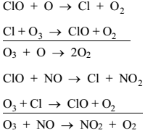
Cont…
The ClO species may react with either O or NO, regenerating Cl atoms and that cause the net destruction of ozone in the region of 25-45 Km:
Perfluorocarbons are potential to cause greenhouse warming.
From organosulpher compounds benzenethiol is a toxic liquid with a severely “repulsive” odor.
Organic sulfur compounds not highly significant atmospheric contaminants, but it cause local air pollution due to its bad odors.

Slide 126
    3.4.3. Photochemical smog
Smog is a type of air pollution produced when sunlight acts upon motor vehicle exhaust gases to form harmful substances such as ozone (O₃), aldehydes and peroxyacetylnitrate (PAN).
Burning gasoline in motor vehicles is the main source of smog in most regions today.
The trace gas species formed in photochemical smog include the secondary oxidants ozone, PANs, and inorganic sulfuric and nitric acids.
These oxidants and acids play important roles in the effects of smog on agriculture and ecosystems, in human health, and in materials damage on urban, regional, and global scales.

Slide 127
Cont…
Both aerosols and trace gas species present in smog are also important in determining the radiative balance of the troposphere, a property known as the greenhouse effect.
These species can heat the atmosphere by absorbing infrared and solar radiation, trapping it in the troposphere.
Aerosols can also contribute to cooling of the atmosphere, both directly by scattering incoming solar radiation back to space and indirectly by enhancing cloud formation.
The net effect of aerosols on the radiative balance of the atmosphere depends on the types of aerosols present, their chemical compositions, and where in the atmosphere they are formed.

Slide 128

Smog formation
The formation of photochemical smog is
Primary photochemical reaction producing oxygen atoms
A large number of specific reactions are involved in the overall scheme for the formation of photochemical smog.

Slide 129
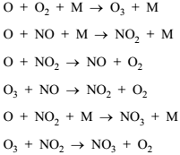



Cont…
There are a number of significant atmospheric reactions involving nitrogen oxides, water, nitrous acid, and nitric acid.

Slide 130
      Effects of smog
The harmful effects of smog occur mainly in the areas of:
      (1) human health and comfort,
      (2) damage to materials,
      (3) effects on the atmosphere, and
      (4) toxicity to plants.
Ozone at 0.15 ppm causes coughing, wheezing, bronchial constriction, and irritation to the respiratory mucous system in healthy, exercising individuals.
In addition to ozone, oxidant peroxyacyl nitrates and aldehydes found in smog are eye irritants.
Ozone attacks natural rubber and similar materials by oxidizing and breaking double bonds in the polymer.

Slide 131
Cont…
Smog has a known harmful effect on plants due to oxidants in the smoggy atmosphere.
The three major oxidants involved are ozone, PAN (peroxyacetyl nitrate), and nitrogen oxides.
Of these, PAN has the highest toxicity to plants, attacking younger leaves and causing “bronzing” and “glazing” of their surfaces.
Fortunately, PAN is usually present at only low levels.
Nitrogen oxides occur at relatively high concentrations during smoggy conditions, but their toxicity to plants is relatively low.
About ≈0.06 ppm of ozone may temporarily cut photosynthesis rates in some plants in half.

Slide 132

    3.4.4. Chlorofluro compounds and ozone layer depletion
Stratospheric ozone, O₃, serves as a shield to absorb harmful ultraviolet radiation in the stratosphere, protecting living beings on the earth from the effects of excessive amounts of such radiation.
The two reactions by which stratospheric ozone is produced are:
It is destroyed by photodissociation
The net result is O + O₃ → 2O₂

Slide 133
Cont…
Absorption of electromagnetic radiation by ozone converts the radiation’s energy to heat and is responsible for the temperature maximum at the boundary between the stratosphere and the mesosphere at an altitude of ≈ 50 km.
The reason that the temperature maximum occurs at a higher altitude than that of the maximum ozone concentration arises from is that ozone is such an effective absorber of ultraviolet light, so that most of this radiation is absorbed in the upper stratosphere where it generates heat and only a small fraction reaches the lower altitudes, which remain relatively cool.
Ozone destruction would have some significant adverse consequences. One major effect would be on plants, including crops used for food.
Human exposure would result in an increased incidence of cataracts.

Slide 134

Cont…
The effect of most concern to humans is the elevated occurrence of skin cancer in individuals exposed to ultraviolet radiation.
photochemical reactions that alter the function of DNA so that the genetic code is improperly translated during cell division.
This can result in uncontrolled cell division leading to skin cancer.
The major culprit in ozone depletion consists of chlorofluorocarbon (CFC) compounds (Freons).
In the stratosphere, the photochemical dissociation of CFCs by intense ultraviolet radiation, yields chlorine atoms,
This reaction catalysis is the destructions of ozone.

Slide 135
    3.4.5.Green House Gases and Global warming
Infrared-absorbing trace gases (other than water vapor) in the atmosphere that contribute to global warming.
It is known that CO₂ and other greenhouse gases, such as CFC, CH₄, absorb infrared radiation by which earth loses heat and these gases increases due to world industrialization.
Carbon dioxide is the gas most commonly thought of as a greenhouse gas; it is responsible for about half of the atmospheric heat retained by trace gases.
CH₄, is 20–30 times more effective in trapping heat than is CO₂.
Other trace gases that contribute are chlorofluorocarbons and N₂O.

Slide 136
Cont…
An increase in the concentration of CH₄, CFC, or other greenhouse gases has a comparatively much larger effect than CO₂.
Effects of global warming
world is expected to have a more extreme weather, with more rain during wet periods, longer droughts, and more powerful storms.
Melting of the polar ice caps, leading to a rise in sea level.
Climate change may bring extinction for many of the world‘s plant species, and for animal species that are not easily able to shift their territories.

Slide 137
END
of
CHAPTER 1,2 & 3
By: Hunachew Anduaalem (Msc)

