Slide 1
Vertebrate Zoology(BIOL.2034)

Slide 2
UNIT ONE:PHYLUM CHORDATA AND THEIR CHARACTERISTICS

Slide 3
Introduction
What is vertebrate Zoology?
  What are Chordates?
  What are the General characteristics of chordates?
  What are Distinctive features of chordates?
  Are there common features shared by chordates and non chordates ?
  Are Chordates advanced than non chordates?
  Where chordates come from? How?

Slide 4
Conti---
Vertebrate Zoolology: is a branch of Zoology that study about animals that have back bone in general.
The word Chordate derived from two Greek words:
  chorde = string or cord
  ata = bearing Refers Notochord
The phylum chordate is the largest groups in duetrostome phyla

Slide 5
Conti---
Chordates occupy a greater variety of habitats and have more complicated mechanisms of self maintenance than other group in the animal kingdom
  They occupied the marine habitat at first time (especially the primitive chordates) then followed by freshwater, land and air.
  Compared to invertebrate, the total numbers of chordate species are insignificant (3%)

Slide 6
General characteristics of chordates (features found in most but not in all)
The presence of integument body covering of epidermis and dermis
Have usually two pairs of jointed appendages
Have highly developed segmented muscle system (attached to the skeleton of un-segmented trunk) to provide support and movement.
Have complete digestive system.
Have circulatory system consisting of a ventral heart of two to four chambers. (a closed blood vessel system of arteries, veins and capillaries; blood fluid containing red blood cells with hemoglobin and WBC)
Have well developed coelom (body cavity) (mostly filled in internal organs and lined by the peritoneum).

Slide 7
Conti--
  Excretory system consisting of paired kidneys.
  Have 10 or 12 pairs of cranial nerves (with both motor and sensory functions; an autonomic nervous system in control of involuntary functions of internal organs).
  Have endocrine system of ductless glands scattered throughout the body.
  Have usually separate sexes (each sex containing paired gonads).

Slide 8
Distinctive features of chordates
All chordates posses 4 distinctive features at some stage of their life history. These are:
    Dorsal tubular and single nerve cord
    Notochord
    Paired pharyngeal poaches (gill slits)
    Post anal tail
  These features are always appearing at some embryonic stage, but they may be persistent or altered or may disappear in the later stages of the life cycle.
  In Vertebrates, the notochord is replaced by back bone.

Slide 9
Conti---

Slide 10
Conti---
Dorsal tubular and single nerve cord
    It exists dorsally along the antero-posterior axis of the body.
    Embryologically, the nerve cord originates from the dorsal ectoderm.
    Develops dorsally above the notochord.
    In most spp, it modified into the brain anteriorly and spinal cord posteriorly
    The nerve cord serves for the integration and coordination of the body activities.
    Ectodermal origin
  Q? How can you distinguish chordates nerve cord from invertebrates nerve cord??

Slide 11
Conti---
Notochord
  It is an elastic rod-like structure extending the length of the body
  situated immediately above the alimentary canal and just below the dorsal tubular nerve cord.
  It is a cylinder rod that develops from the endoderm in all chordates.
  It is formed from special type of vacuolated cells and remains covered by a sheath, known as notochord sheath
  Modified to vertebrae and cover the spinal cord in vertebrates
  Functions
    Allows flexibility along the long axis of the body, but does not allow compression

Slide 12
Conti---
    Serve as hydrostatic organ and adds stability to the shape of the organism.
    Acts as a place of muscle attachment to allow lateral movements of the tail for swimming
    Its evolution seems general transformation from a sessile life style to a motile life style.
    Helps to classify the phylum chordate based on its structure

Slide 13
Conti---
Pharyngeal (gills) slits
  During some point in the life time of all chordates, the wall of the pharynx is pierced by a longitudinal series of openings called the pharyngeal slits.
    In tunicates and cephalochordates, they used to capture small food particles.
    In fish-like vertebrates and juvenile amphibians, develops into gills that are organs of gas exchange.
    In adult amphibians and tetrapods, they transforms into the auditory tube and middle ear chamber.

Slide 14
Conti---
Post anal tail
  It is a posterior elongation of the body (tail) extending beyond the anus.
  It may persist or lost during development.
  The tail contains skeletal elements and muscles:
    Provide a source of locomotion in aquatic species, such as fishes.
    In some terrestrial vertebrates, the tail also helps with balance, courting, and signaling when danger is near.
    In humans, the post-anal tail is vestigial, that is, reduced in size and nonfunctional

Slide 15
Characters Common to Chordates and Higher Non chordates
Axiation
Bilateral symmetry
Triploblastic condition
Eucoelom
Metamerism: external metamersim in chordates restricted on a certain body parts
Organ-system

Slide 16
Advancements of Chordata over Other Phyla
Endoskeleton
Efficient respiration
Efficient Circulation
Centralized nervous system
Permanent locomotary appendages
Extra-embryonic membranes
Jaws
Temperature regulation (Poikilothermic or homeothermic)

Slide 17
Activity1: Compare Chordates with Nonchordates base on the following features
Features | Chordates | Nonchordates
Symmetry
Metamerism
Grade of organization
Germ layers
Coelom
Notochord
Gut position
Pharyngeal gill-slits
Blood vascular system
Heart
Dorsal blood vessel
Nervous system
Nerve cord
Reproduction

Slide 18
POSSIBLE INVERTEBRATE ANCESTOR OF CHORDATES
There are two possible lines of descent that have been proposed about the origin of chordates
(i). The Arthropod - Annelid- mollusk line (protostomia branch)
  Annelids and arthropods are related to chordates because of their
    metameric segmentation
    Bilateral symmetry
    Central nervous system with brain
    Longitudinal nerve cord

Slide 19
Conti---
Similarities are analogy, not homology because of:-
  Exoskeletons vs endoskeletons.
  Solid nerve cords vs hollow nerve cords.
  Formation torsion in mollusca.
  Different coelom formation (Protostomes vs. Deuterostomes).

Slide 20
Cont---
(ii). Echinoderm - Hemichordate line (Deutrostomia branch)
  This line is the most acceptable relative to other b/c echinoderms and chordates share several important characteristics. These are:-
    Radial cleavage
    Coelom formed by enterocoelous process
    Tornaria larvae of hemichordate is similar to Dipleurula larvae of Echinodermata
    Biochemically, all deuterostomes use an identical phosphagen source (i.e creatine) in the energy cycle of their muscular contraction but arginine for protostomes

Slide 21
  CLASSIFICATION OF PHYLUM CHORDATA
It has two main groups (non taxonomically)
  Protochordata (lower chordates)→They lack a head and a cranium, so they are also known as Acraniata.
  Common features of protochordates includes
    They are filter feeder
    Have colorless blood
    Lack capilaries
    Respiration is through gills and all are aquatic
  Includes:
    Subphylum Hemichordata
    Subphylum Urochordata
    Subphylum Cephalochordata
  Euchordata (higher chordates)
    Subphylum Vertebrata

Slide 22
Subphylum Hemichordata
All hermichordates are marine.
Some are solitary and slow moving, others are sedentary and colonial.
Now regarded to be an independent phylum of invertebrates close to Echinodermata.
Body structure:
  Body is stout and unsegmented, and has a worm–like or vase–like
  Three distinct regions namely proboscics, collar and trunk are present.
  They are bilaterally symmetrical and triploblastic.
  They have organ-system level of organization.

Slide 23
Conti---
Digestive tract is complete.
Proboscis contains a hollow out growth from the gut, called stomochord and was regarded as notochord in the past.
All feed on microorganisms and debris by filtering or ciliary mechanism.
Respiration occurs by a pair to numerous pairs of gill slits or through the general body surface.

Slide 24
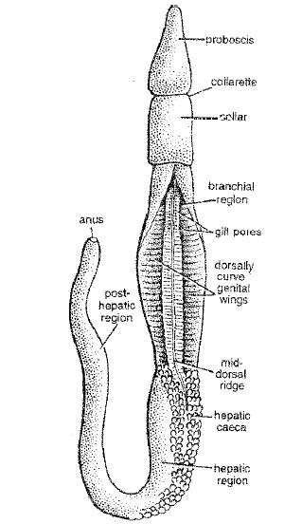
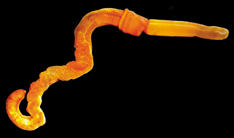
Conti---
e.g. Balanoglossus (Acorn worm)

Slide 25
Subphylum Urochordata = Tunicates
They are marine, mostly sessile, filter–feeders.
Body is enclosed in a leathery test or tunic sheath, composed of tunicin (cellulose) so called tunicates.
The notochord occurs only in the tail of larva and disappears in the adults called retrogressive metamorphosis.
The nerve chord (neural tube) is present in the larva, but is replaced by a single dorsal ganglion in the adult.
The gill slits persist in the adults
Circulatory system is of open type.
Excretory system is lacking.
Asexual reproduction occurs by budding.

Slide 26
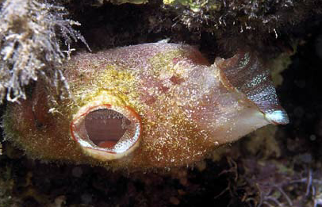
Conti---

Slide 27
Subphylum Cephalochordata
The notochord extends up to the cephalic or head region.
The nerve chord persists throughout the life, but no brain is formed.
The gill slits are numerous and persist in the adults.
Tail persists throughout the life
They are commonly called lancelets, because of their similarities in appearance to a lancet (a small edged surgical knife).

Slide 28
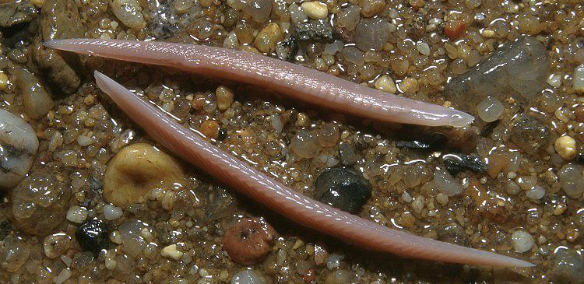
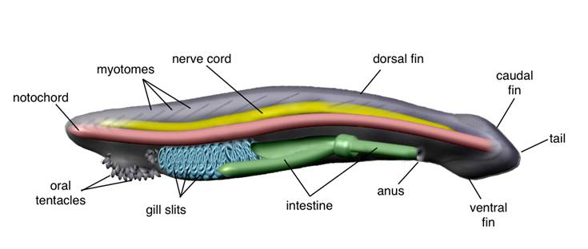
Conti---

Slide 29
Subphylum Vertebrata
This subphylum consists of vertebrate animals
The term vertebrate derived from their vertebral column or the backbone (their axial endoskeleton).
  Notochord is modified to vertebral column
Those animals are also called as Craniata due to having skull.

Slide 30
Conti---
Vertebrates are mainly divided into two main groups due to the absence and presence of jaw.
  Jawless vertebrates= Agnatha
    Class Ostracoderm= extinct fishes
    Class Cyclostoma = extant fishes (lambrey and hag fishes)
  Jawed vertebrates= Gnathostomata
    Superclass Pisces:
      Class Placodermi-extinct fishes with primitive jaws
      Class Chondrichthyes-Cartilaginous sharks, rays and skate
      Class Osteichthyes-bony fishes

Slide 31
Conti---
Super classTetrapoda
  Class Amphibia-frogs, toads, salamanders
  Class Reptilia-turtles, lizards and snakes
  Class Aves-birds
  Class Mammalia-mice, whales, men

Slide 32
UNIT TWO: PRIMITIVE FISHES

Slide 33
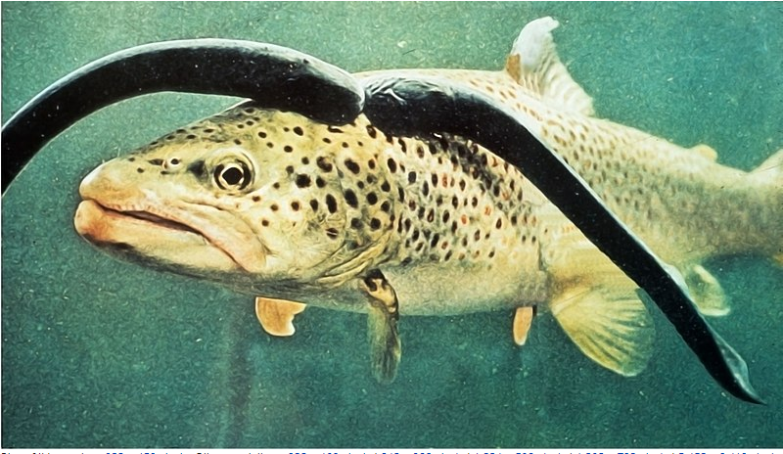
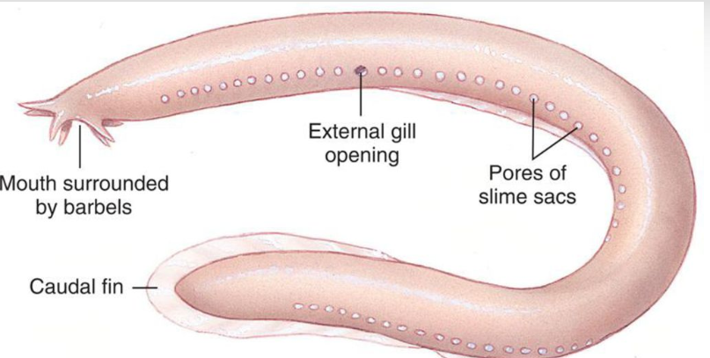
2.1.Agnatha
Agnathans consists of:
  Extinct class ostracoderm and
  Extant classes or living members such as
    Hagfish (myxini) about 32 species
    Lamprey (cephalaspidomorphi) about 41 sp

Slide 34
Conti---
General characteristics of class Ostracoderm:
  They had no jaws and no pectoral or pelvic fins but had only median fins
  Armoured fishes or bony-skin fishes
    The head was encased in a solid shield made of broad bony dermal plates
    The rest body was covered with smaller bony scales
  The first vertebrates to possess a lateral line system (sense organ that used to detect movement and vibration in the surrounding water as well as inner ear with 2 semicircular canals).
Why were they so heavily armoured ?
  The heavy exoskeleton(armoured plate) served as a protection against the giant scorpion-like arthropods

Slide 35
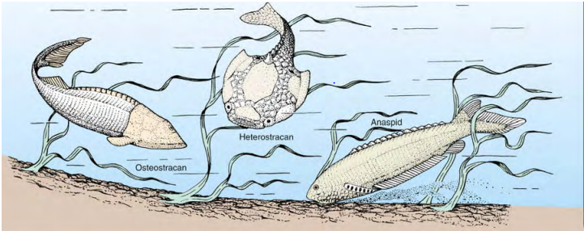
Conti---

Slide 36
Conti---
General characteristics of lampreys and hagfish
  No jaw
  No paired appendages or fins
  No scales in their skin
  Body is elongated, cylindrical
  Mouth is ventral or terminal but circular
  Have two chambered heat (1 atrium and 1 ventricle).
  Have variable body temperature (poikilothermic).
  Blood with WBC and nucleated circular RBC.

Slide 37
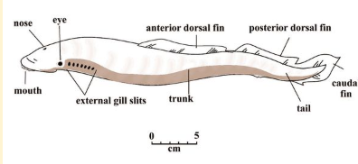
Conti---
  7 pairs of gills in lamprey and 5 to16 paired gill in hagfish
  Gonads are single and ductless
  Feeding is by rasping the tissue on large preys
Q, What is the difference between lamprey and hagfish?

Slide 38
Conti---
Features | Lampreys | Hag fish
Habitat | Marine as well as freshwater | Exclusively marine, burrowing in sand
Parasitism | Externally parasitic or non parasitic species | Behave as internal parasites
Feeding | Rasp away flesh and suck out blood of host fishes | Primarily scavengers, burrowing into dead
Breeding | Anadromous, (migrate to fresh water rivers and streams for spawning) | Spawn on ocean floor
Mouth position | Ventral | Terminal
Brain | Better developed | Poorly developed
Cranial nerves | 10 pairs present | 8 pairs present

Slide 39
2.2. Gnathostoma: Jawed Vertebrates
Basically, they have:
  Jaw and jaw suspension
  Additional single fins and paired fins
  Different type of scales
Jaws are very important for:
  Feeding
  Defense
  Reproduction
Jaws were evolved from gill arches
  Gill arches are structures that support and keep the gill from closing or collapsing

Slide 40
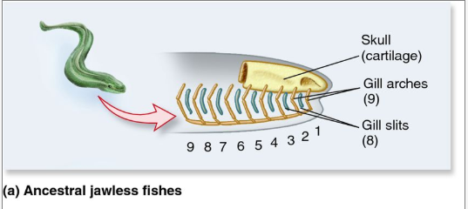
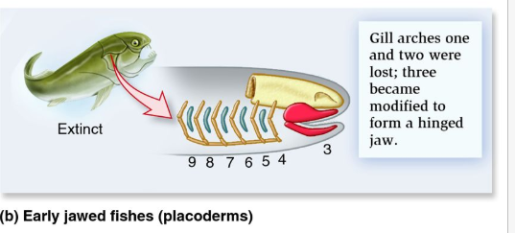
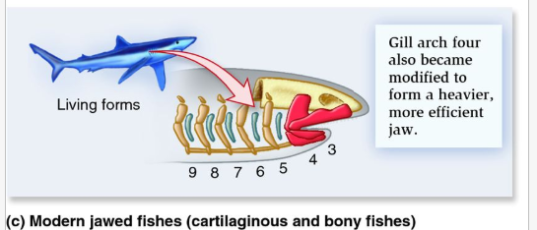
The Evolution of Jaws in Fish (Agnathan vs Gnathostome)

Slide 41
Jaw suspension
Jaw suspension means the attachment of the lower jaw with the upper jaw or skull for efficient biting and chewing.
There are 4 types of jaw suspension:
  Autodistylic: The upper jaw connected to the skull by a ligament, hyoid arches remain free. It is the characteristics of acanthodians and other extinct fish.
  Amphistylic: the upper jaw and the hyomandibula attached to the cranium. The jaw articulate to the skull both directly and by way of the hyomadibula. It occurs in earliest fish.

Slide 42
Conti---
  Hyostylic (Holostylic): hyomandibula connects upper jaw with skull. It is common in living species (elasmobranchea and some bony fish).
  Autostylic: The upper jaw directly connected to the skull without any connecting device, thus the lower part of the cranium is the jaw. It is more flexible to open and close and it occurs in teleosts, Dipnoan.

Slide 43
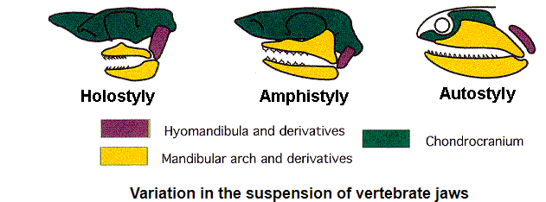
Conti---

Slide 44
Fish Fins: Types and function
The fins are the most distinctive features of fish
Fins are membranous or webbed processes internally strengthened by radiating and the dermal fin rays.
A fin can contain:
  only spiny rays
  only soft rays or
  a combination of both.
If both are present, the spiny rays are always anterior
Spines are generally stiff and sharp.
Rays are generally soft, flexible, segmented, and may be branched.

Slide 45
Conti---
Types of fins :
  Single type fins
    Dorsal fin: are located on the and serves to protect the fish against rolling and assist in sudden turns and stops. A fish can have up to 3 dorsal fins.
    Caudal fin: is the tail fin, located at the end of the caudal peduncle
    Anal fin: located on the ventral surface behind the anus
    Adipose fin : found on the back behind the dorsal fin and just forward of the caudal fin
    Fin lets: are small fins, generally behind the dorsal and anal fins

Slide 46
Conti---
  Paired fins
    Pectorial fins: are located on each side usually just behind the operculum, and homologous to the forelimbs of tetrapods.
      Used for the creation of the dynamic lifting force that assists. Example: shark in maintaining depths and enables the flight for flying fish.
    Pelvic fins: located ventrally posterior to the pectoral fins. located ventrally posterior to the pectoral fins
      help balance the fish, keep it level, and prevent it from rolling from side to side.

Slide 47
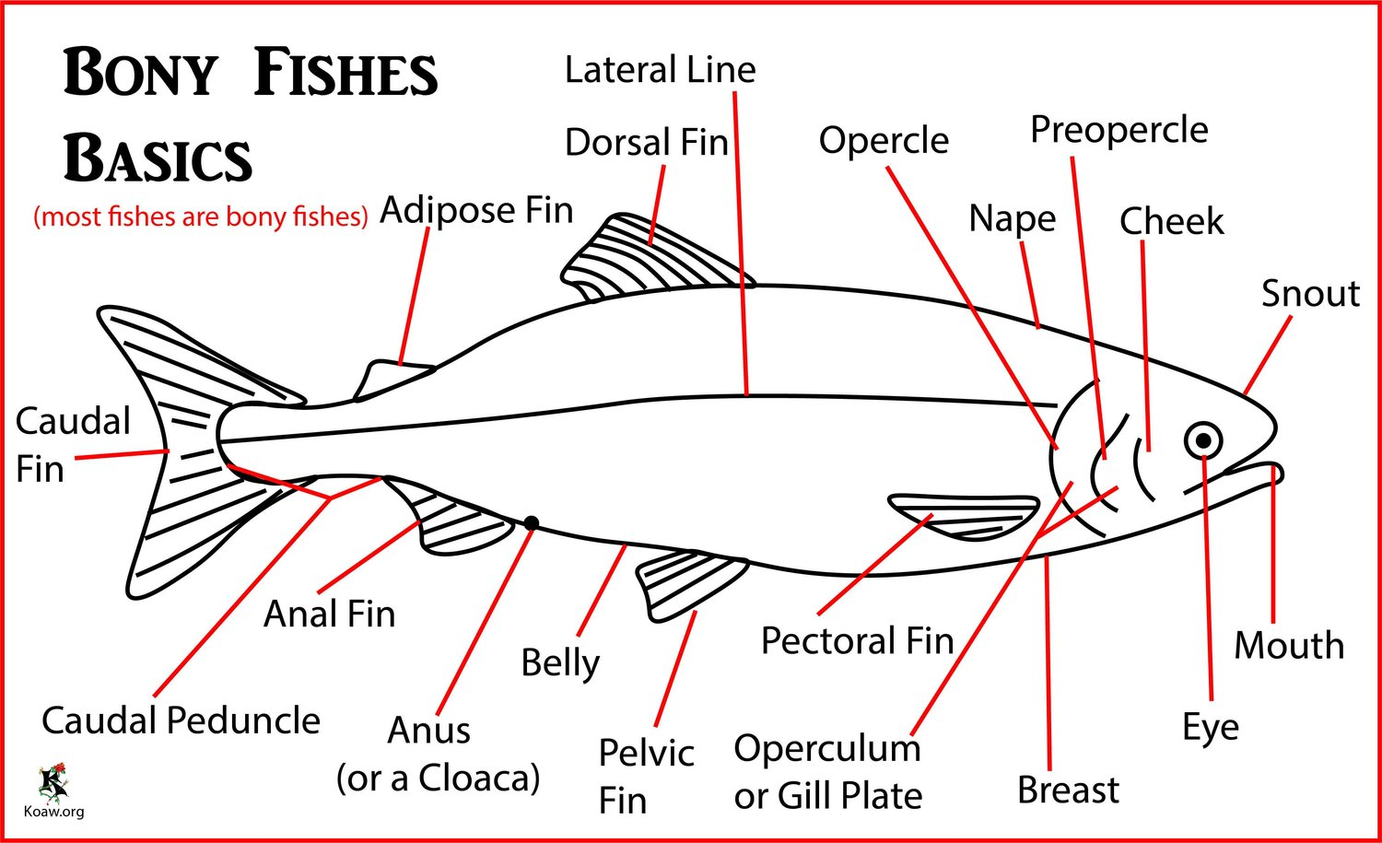
Conti---
Fin lets

Slide 48
Conti----
Types caudal fins based on the status of vertebral column at the tail:
  Protocercal Type: When the vertebral column extend straight to the tip of the tail and the caudal fin is divided equally.
    It is the most primitive type
    This type occurs in modem cyclostomes
    Isocercal: is very much elongated and symmetrical (E.g in Chimaera)

Slide 49
Conti---
  Diphycercal type
    It has lost the terminal upturned part of the vertebral column, and the vertebral column does not reach the end.
    It is similar to protocercal type but the vertebral column does not reach the end.

Slide 50
Conti---
  Heterocercal type: The vertebrate column bends upward and making the fin more asymmetrical. That is
    the caudal fin is divided into a narrow long dorsal lobe and a broader short ventral lobe.
    It is the characteristics of bottom feeders with ventral mouth and without swim bladder e.g elasmobranches (sharks, Skates and Rays).

Slide 51
Conti---
    The strokes of larger dorsal lobe in swimming serve to direct fish towards bottom
  Hypocercal type:
    The opposite of heterocercal condition
    The vertebral column terminates into a larger ventral lobe
    Hypocercal caudal fin is peculiar to flying fish, some primitive fishes and (fossil agnatha) ostracoderms.
    In flying fish (Cypselurus), the larger ventral lobe enables the fish to attain maximum speed for gliding as it leaves the water.

Slide 52
Conti---
  Homocercal:
    The advanced and most common type of caudal fin
    The terminal part of the vertebral column is bent upwards
    but the dorsal lobe of the caudal fin is lost during development and the ventral lobe divides into two equal parts
    so that the caudal fin appears symmetrical externally rather than internally
    It is the characteristics of fish with terminal mouth and with swim bladder. E. g Teleosts.

Slide 53
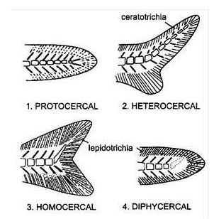
Conti----

Slide 54
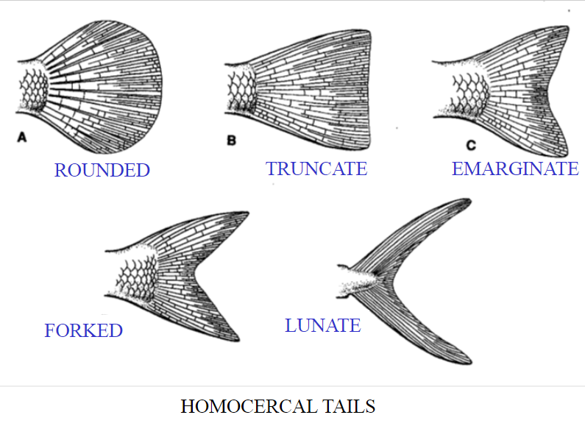
Type of homocercal fin

Slide 55
Types of fish scales
In many vertebrates, exoskeleton covering of the body is made of two types of scales
  Epidermal scale: derived from the malpighian layer of epidermis.
    They are well developed in terrestrial vertebrates such as reptiles, birds and mammals.
  Dermal scales: Are mesenchymal in origin and developed in fish
    Are small, thin, confide, calcareous or bony plates, which fit closely together or overlap.

Slide 56
Conti---
There are five types of dermal scales:
  Cosmoid scale
    Do not occurred in living fish,
    Are the characteristics of certain osracoderms and placoderms and extinct sarcoptergians
  Placoid scales
    Are the characteristics of elasmobranchians only. Placoid scales are closely set together in skin giving sandpaper like quality.
  Ganoid scales (Rhomboid)
    Are thick usually rhboid or dimond shaped
    They are the characteristics of chondrichians (polypteres, asipens and holostians. So that these fish are called gamoid fish.

Slide 57
Conti---
  Cycloid scale
    Are thin flexible transparent plates
    Circular in outline, thicker in the center.
    These scale used to determine the age of the fish.
    Found in lung fish, some holosteans (Amia) and the lower teleosteans such as carp and cod.
  Ctenoid scales:
    Are the characteristics of modern higher teleosts such as perch, sunfish and flounders.
    It is a small and comb like.

Slide 58
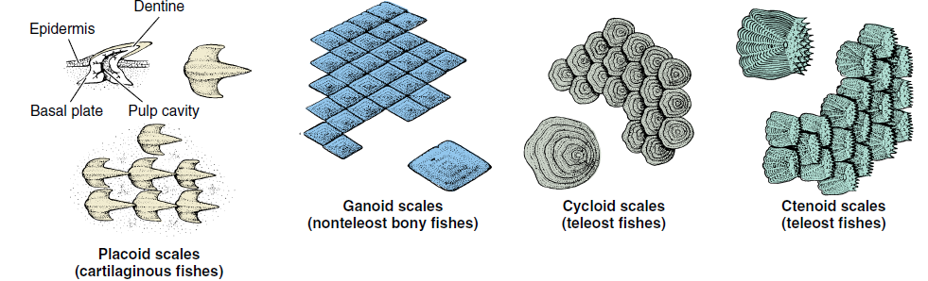
Conti---

Slide 59
Class Placoderm
Placoderms were known as armored fish or pale skinned fish
They combined the heavy boney armor of the osracoderm with powerful jaw and efficient fins
Jaws were found in all which originate from the first pair of gill bares (mandibular arch) in front of the first gill slits
Their jaws were immovable, bound to cranium or the rest of the head.
They had no teeth of modern type. Paired fins in most were found.

Slide 60
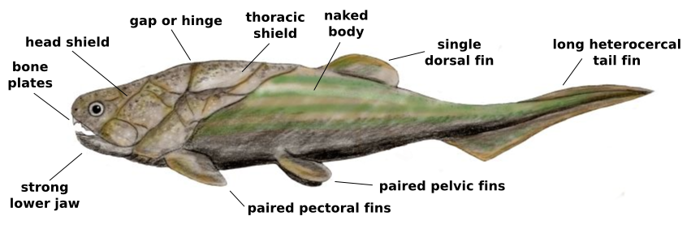
Conti---

Slide 61
UNIT THREE: ADVANCED FISH

Slide 62
3.1 Class Chondrichthyes (Cartilaginous fish)
The first extant jawed fish
It comprises about 850 living species
They contain two subclasses
  Subclass Elasmobranches and
  Subclass Holocephala

Slide 63
General Characteristics Cartilaginous fish
Are mostly marine and predaceous (predators)
Body shaped:
  Fusiform, laterally compressed (shark),
  Dorso-venteraly flattened (skates and rays)
Body size varies
  From 1 m (Dog fish, shark) to 17 m (large whale sharks)
They have both median and paired fins supported by fin rays
Their endoskeleton is entirely cartilage; notochord persists in adults between the adjacent vertebrae.

Slide 64
Conti---
Skin is covered by placoid scale or naked in some groups
Mouth is Ventral with placoid modified teeth, stomach is J-shaped with spiral intestine
Respiration is by 5-7 paired gills, No swim (air) bladder, no lung
Heart 2-chambered (1 auricle and 1ventricle)
  Sinus venosus and conus arteriosus present
  Both renal and hepatic portal systems present
  Temperature variable (poikilothermous).

Slide 65
Conti---
Kidneys opisthonephric
  Excretion ureotelic (high concentrations of urea and trimethylamine oxide in blood)
  Cloaca present
Brain with 10 pairs cranial nerves
Sexes separate
  Gonads paired
  Gonoducts open into cloaca
  Fertilization internal

Slide 66
Subclass Elasmobranches
5 - 7 gill openings plus spiracle anterior to first gill
Upper jaw not attached to braincase
Teeth deciduous and continually replaced
Claspers present in males (modified from pelvic fins) internal fertilization
Includes sharks, skates, rays and sawfishes

Slide 67
Order Squaliformes (Selachi)
True or modern Sharks
  (Whale shark, Hammerhead shark, white shark, tiger shark, Zebra shark, Dogfish shark)
Pelvic fines bear claspers in males
Mouth is Ventral or sub terminal in most

Slide 68
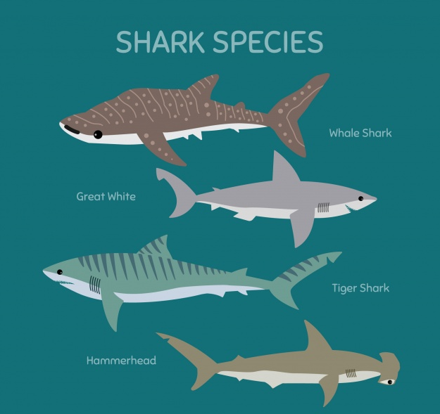
Conti---

Slide 69
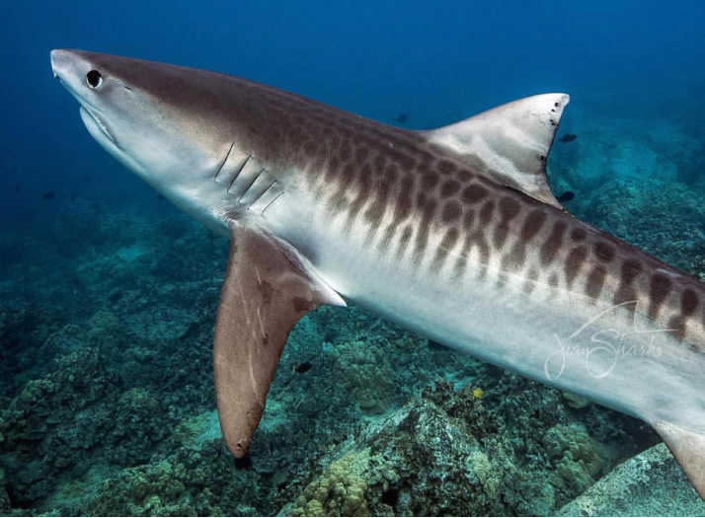
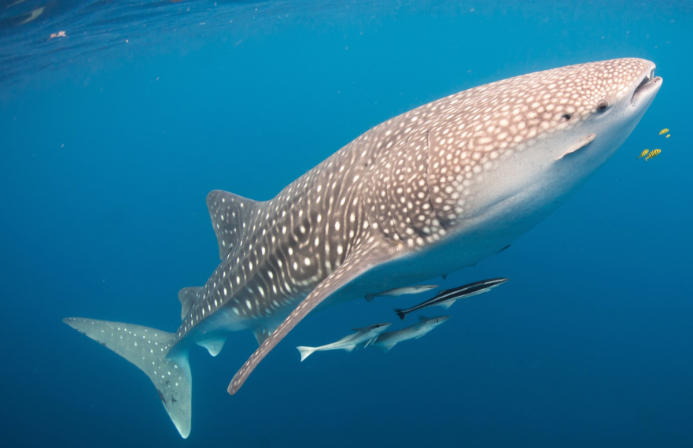
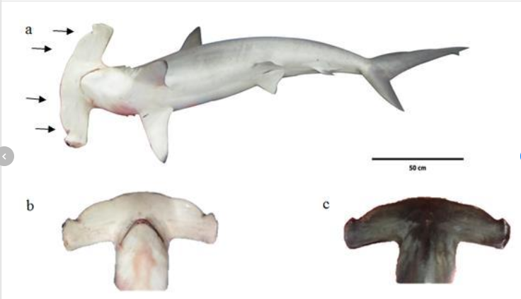
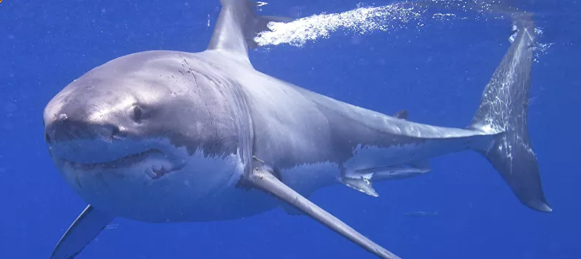
Conti----

Slide 70
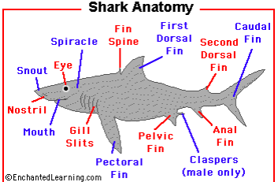
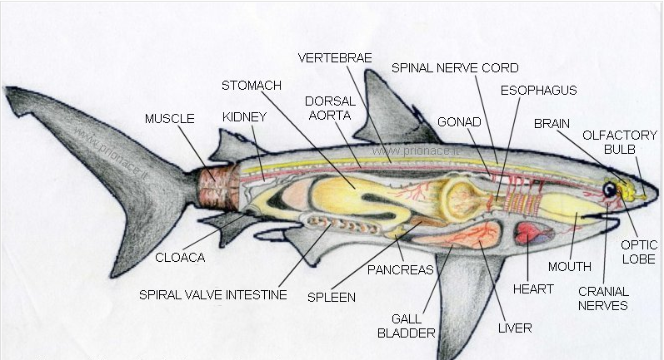
Conti---

Slide 71
Conti---
Sharks are fast swimmers b/c
  Having fusiform shape for penetrating the aquatic medium
  Having hetrocercal caudal fins for forward movement unlike paired fins
  Lighter body due to having cartilagenous skeleton and placoid scale
  Liver contains high amount of oil that increase buoyancy
  Live in marine b/c it is more dense than fresh water

Slide 72
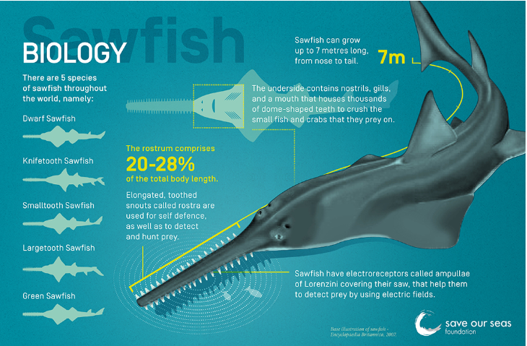
Order Pristiophoriformes : Sawfish

Slide 73
Order Rajiformes (Batoidea)
Includes Skates and Rays
  Have dorso-ventral flattened in shape
  Have dorsal eyes which is unusual in vertebrates
  Have spiracles located dorsally for the entrance of water
  Defense mechanism of sting rays
    Spines associated glands at caudal fin
  Electric rays produce electric current

Slide 74
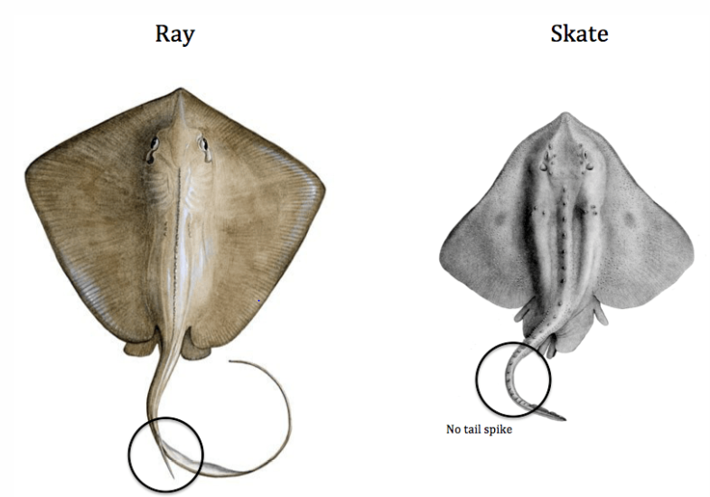
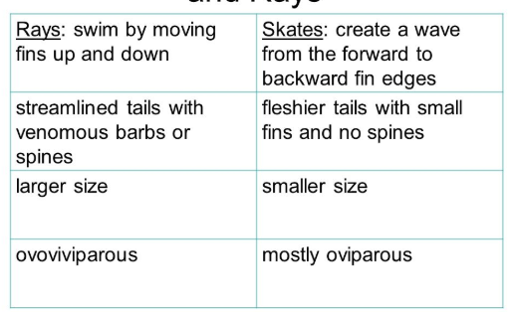
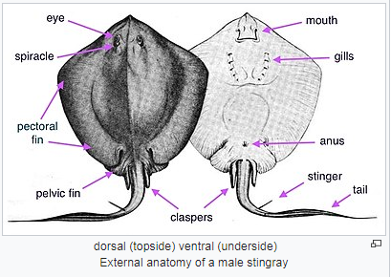
Conti---

Slide 75
  Subclass Holocephala
Includes only order Chimaeriforms
  Upper jaw fused to braincase (uncommon in fish)
  Flat, bony plates instead of teeth
  4 pairs of gills enclosed with fleshy operculum
  Mixed diet (Seaweed, mollesca, Echinoderms)
  Resemble to rat and commonly called rat fish
  Large head and long tail
  Large pectoral fins
  Use claspers for mating and Viviparous (uncommon in fish)

Slide 76
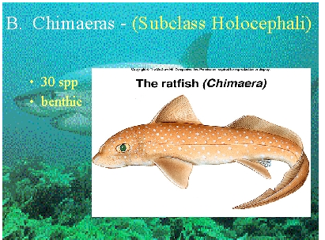
Conti---

Slide 77
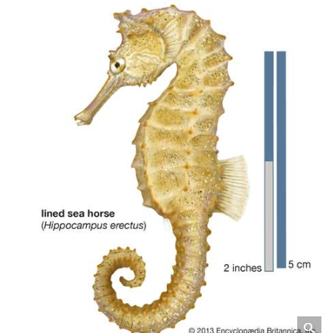
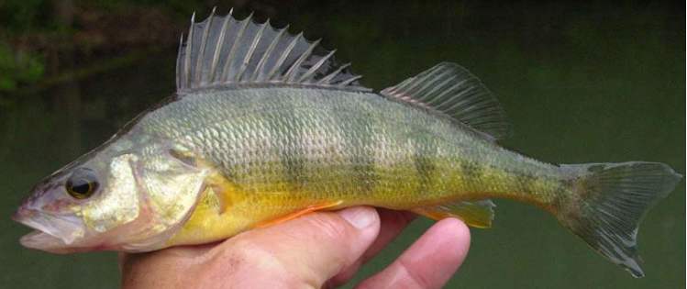
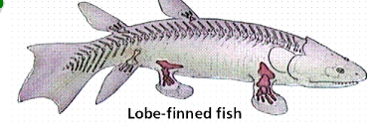
3.2 Class Osteichthyes (Bony fish)

Slide 78
General characteristics of Class Osteichthyes
95% of all fish are bony fish
They inhabit all water bodies (fresh, brackish and marine)
They vary greatly in shape
They have both median and paired fins supported by fin rays of cartilage or bone
  Tail is homocercal
  Relay for locomotion more on their pectoral fines than their tail.

Slide 79
Conti---
Skin have many mucous glands with dermal scale of 3 types
  Ganoid
  Cycloid and
  Ctenoid which are fully overlapped by a delicate mucous epidermis
Their endoskeleton is bone but cartilage in sturgeons and some others
Their mouth is terminal in most and subterminal in some.
  Jaws usually with teeth but some are toothless
  Jaw suspension in most is hyostylic and in some lower fish autostylic
  Stomach may be J shaped and cloaca lacking but anus present

Slide 80
Conti---
Respiration is by pairs of gills supported by bony gill arches.
  covered by operculum
Air or swim bladder present with or without duct
  connected to the pharynx except in a few bottom dwelling species in which they have been secondary lost
  The air bladder mainly serves in buoyant, but it is lung like in some (Dipnoi).

Slide 81
Conti---
They have closed circulation in most single but double in dipnoi
  It consists of venteraly located 2 chamber heart, sinus venosus and conus arterioles
  Blood contains oval nucleated RBC
  Have variable body temperature (poiklotherms)
They excrete by mesonephric kidney
  Excretion is ureotelic
  The body fluid of bony fish is hypotonic to sea water and requires active constant osmoregulation
They have 10 pairs of cranial nerves

Slide 82
Conti----
Their sense organ is with well developed lateral lines, internal ear with three semicircular canal, the nostrils are located on the snout
Sexes are separated
  Sex may be reversal in some
    Male to female (protandrous)
    Female to male (protogynous)
  Gonads paired, genital aperture present, fertilization external.
  Mostly they are oviparous

Slide 83
Classification of bony fish
Subclass actinoptergii
  Paired fins thin, broad, without fleshy and supported by dermal fin rays.
  One dorsal fin, may be divided.
  Caudal fin without epichordal lobe.
  Olfactory sacs not connected to mouth cavity.
  Popularly called ray-finned fishes

Slide 84
Conti----
Consists of three super orders:
  super order Chondrostei –Primitive bony fish
    Order polypteri forms- Bichir
      Dorsal fin of 8 or more finlets
      Ossified skeleton
    Order acipenseriforms-Acipenser (sturgeon), polyodon (paddle fish)
      Scaleless and skeleton is largely cartilaginous
  Super order Holostei:
    Mouth opening small.
    Ganoid or cycloid scales.
    Tail fin heterocercal.
    Intermediate ray-finned fish, transitional

Slide 85
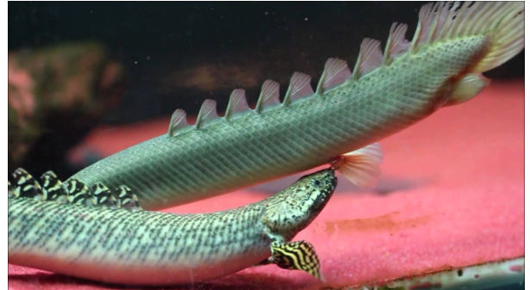
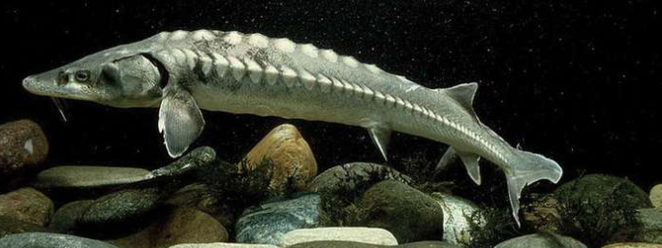
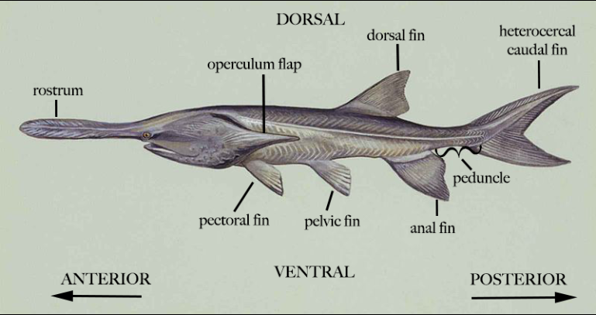
Conti---
Srugeon
Bichir
Paddle fish

Slide 86
Conti---
    Order Amiiforms-Amia (bow fish)
      Thin, overlapping cycloid scales
      Snout normal, rounded
      Long dorsal fin
      Example : Amia (Bowfin)
    Order semionotiformes
      Scales rhomboidal ganoid in oblique rows.
      Snout and body elongated.
      Example : Lepidosteus or Lepisosteus (Garpike)

Slide 87
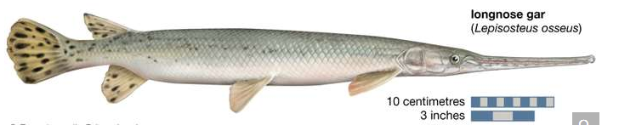
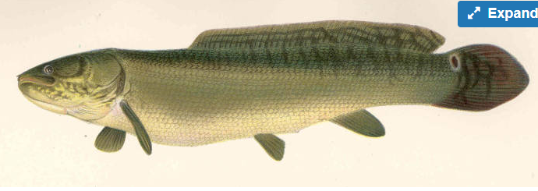
Conti---
Bowin fish

Slide 88
Conti---
    Super order Teleosts (complete bone)
    Mouth opening terminal, small.
    Scales cycloid, ctenoid or absent.
    Tail fin mostly homocercai
    Spiracle is lost
    Spiral valve in the intestine absent.
    Conus arteriosus greatly reduced
    The most diversified bony fish group

Slide 89
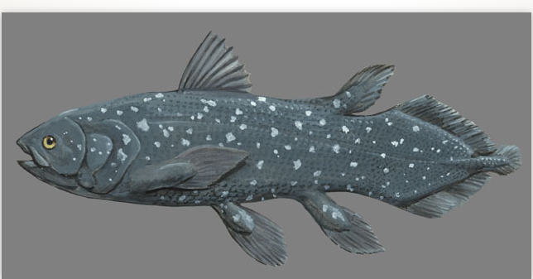
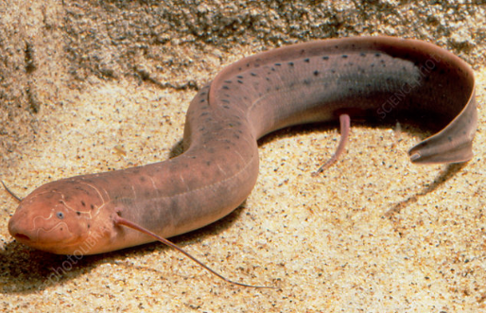
Conti---
Subclass Sarcoptergii (flesh fined fish)
  Order crossopterygii-latimeria and
  Order Dipnoi-lung fish (Neoceratodes, protopterus, lepidosiren)
L
African lung Fish (Protopterus annectens)
Latimeria chalumnae

