Slide 1
Chapter 11. SPARES PROVISIONING
Industry with a high level of investment, such as the oil and gas industry, needs a high level of availability.
Product support and its related issues such as spare parts play an important role in maintaining a system at a desired level of availability.
Reliability performance is a critical factor for product support and spare parts planning which can be influenced by operational environment. Therefore, all influence factors (covariates) on reliability performances must be considered in order to predicate the required number of spare parts.

Slide 2
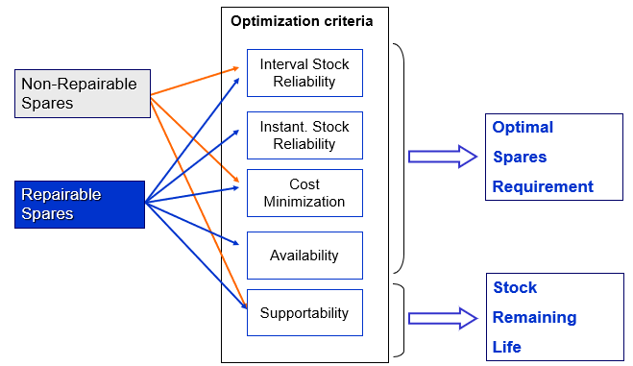
Cont’d
In general, provisioning means "providing" or making something available. The term is used in a variety of contexts.
11.1 Spares management

Slide 3
Criteria for Decision Making
Instant reliability
Interval reliability
Cost minimization
(Process) Availability

Slide 4
Cont’d
Due to the technology and economic issues, it is not possible to design a system without failure. Therefore, it is necessary to adopt appropriate and well-scheduled activities regarding support and spare parts to assure the desired level of availability throughout the system’s life.
However, spare parts provisioning is a complex problem and requires an accurate analysis of all factors that may affect the required number of spare parts.

Slide 5
Cont’d
Different reliability based statistical approaches have been developed for spare parts provision. The methods can be categorized in two main groups;
  Analytical methods, and
  Simulation methods.
The analytical methods are based on Renewal theory for non-repairable items. Birth and Death process have been frequently used for repairable items in the analytical methods.
The Monte Carlo method is one of the main simulation methods
In the reliability-based spare parts provision,
First step is to identify the reliability performance and failure rate of the item.
Second the number of the required spare parts and the probability of spare part availability can be estimated, However, to have an effective prediction, any factors which have an influence on the reliability performance of the item must be considered.

Slide 6
Cont’d
The reliability performance of an item can be influenced by different factors such as:
  The operational environment,
  Geographical location,
  Design material, maintenance history,
  Operator and
  Maintenance crew skill, etc.
The factors that may have an influence on the reliability performance of an item are referred to as covariates. Ignoring such covariates may lead to wrong result in reliability performance analysis and consequently on spare parts provisioning.

Slide 7
Cont’d
Spare parts are held to reduce the consequences of equipment downtime, playing an important role in achieving the desired equipment availability at a minimum economic cost.
The gap between theory and practice of spare parts management is investigated from the perspective of software integration, maintenance management information systems.

Slide 8
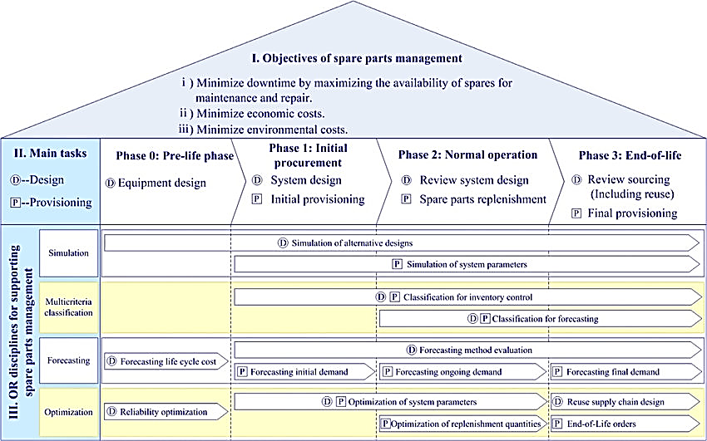
Cont’d

Slide 9
Objectives of spare parts management
The key questions in spare parts management are to decide which items are to be stocked as spare parts, when to (re)order them and how many items to (re)order. In this decision-making process, we should be clear about the objectives.
Maximizing spares’ availability,
Minimizing the economic costs. Is the sum of the inventory holding costs, stock-out penalty costs and ordering costs, and
Minimize enviromental costs

Slide 10
Main tasks of spare parts management through equipment lifecycle process
Equipment life cycle cost is closely connected to investment and management of spare parts inventories. In general, the equipment lifecycle process can be divided into three main phases, namely
    Initial procurement phase,
    Normal operation phase, and
    End-of-life phase.
The main tasks of spare parts management for each phase of the product lifecycle process are summarized below.
Initial procurement phase :
When a complicated piece of equipment is bought, spare parts are often bought simultaneously to satisfy the needs of equipment maintenance.
Then a decision must be made on the spare parts initial provisioning, and an inventory and forecasting system must be designed in advance.

Slide 11
Cont’d
Normal operation phase :
When equipment is used by the user, preventive maintenance may be carried out to prevent failure, while corrective maintenance is carried out as failures occur
In order to satisfy the needs of maintenance, a certain number and kinds of spare parts are supplied.
Successful equipment management depends on the proper execution of spare parts control is needed.
Therefore, the inventory system and forecasting parameters should be optimized (or at least improved) to provide sustainable supply support according to the operational requirements of the equipment.

Slide 12
Cont’d
End-of-life phase :
In Phase 3, a fundamental issue of supply chain design is whether products, or their components, should be reused, leading to refurbishment or remanufacturing, If not, then it may sometimes be necessary to set a ﬁnal order on spare parts according to the demand patterns at the end of the product life cycle (known as an ‘all-time buy’ or ‘last-time buy’).
This prompts a number of design issues to be resolved, including the methodologies for classifying and forecasting the demand, taking into account that no more orders may be made and simulating the consequences of alternative strategies for these parts in the end-of-life phase.

Slide 13
Forecasting
Forecasting spare parts demand is a basic requirement of spare parts management.
Because of the demand characteristics of spare parts, it is very diﬃcult to accurately forecast demand in this area.
the critical challenges of inventory management in service parts are inaccuracy of service parts forecasts ranks number two in the top ten challenges.
So it has been a hot topic in the industrial ﬁeld as well as in academic research.
There are many forecasting techniques and this section restricts attention to those forecasting methods which have been suggested for spare parts.
From a product lifecycle perspective, there are three kinds of forecasting tasks namely forecasting initial demand, ongoing demand and demand over the ﬁnal phase.

Slide 14
a. Time-series based forecasting
Forecasting approaches categorized in to three groups these are:
A time series is deﬁned as a time-ordered sequence of observations taken at regular intervals (e.g., hourly, daily, weekly, monthly, quarterly, annually).
Time-series forecasting is based on the assumption that future values of the series can be estimated from past values.
If there is sample historical data, time-series based forecasting is commonly used to forecast spare parts demand in practice.

Slide 15
b. Reliability based forecasting
The most appropriate time-series based forecasting approach depends on the availability of historical data.
In some cases, there is little time series data available to forecast the future demand. In such cases, practitioners can use reliability and maintenance variables to forecast spare parts demand, as long as these variables are known or may be estimated.
These models may also prove beneﬁcial when more extensive historical demand data are available, depending on their predictive strength.

Slide 16
c. Judgmentally based forecasting
There is some element of judgment in almost all forecasting processes.
In some cases, a forecast may be purely judgmental. For example, for new products, it may not be possible to generate a statistical forecast because of the lack of historical data on sales.
In other cases, a statistical forecast may be produced, but is then amended by a demand planner in the light of the planner’s judgment about changes in the internal or external environments.

Slide 17
11.2 Spare Parts Identification process
To stay in business, equipment manufacturers are expected not only to meet the needs identified by the client, but also to anticipate these needs and to demonstrate that the products and services offered are equivalent, if not superior to what is available on the market.

Slide 18
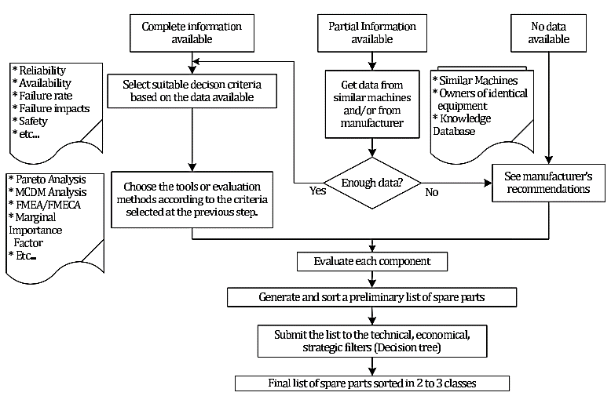

Slide 19
Decision tree with filters
Decisions are based on the manufacturers’ recommendations or on information from owners of similar equipment.
When complete information is available, then the decision-maker chooses the criteria according to which the components will be evaluated to determine if they should be on the list of spare parts.
A list of potential criteria is given in previous figure.
According to the criteria retained, evaluation and final decision-making methods are to be selected next.
Each component of the equipment is then evaluated according to the criteria and a total score is obtained.
A list of potential methods is also provided in previous figure.
A ranking of the components based on the final scores gives an ordered list of potential spare parts.

Slide 20

Desion tree
A ranking of the components based on the final scores gives an ordered list of potential spare parts. Once the preliminary list of spare parts is established, it is subjected to filters to select the parts to hold in stock and those to be supplied as needed.
This tree takes into account the cost of acquisition or production, repair costs, delays, whether there are early signs of failure or not, and if the component is a standard part or not. A standard part is a generic mass-produced part readily available at reasonable to low cost (e.g., seals, nuts and bolts, high replacement rate parts).
Selected components are then ranked in order of importance. This classification allows to pay more attention to the components considered as being more important, especially if the list of spare parts includes a large number of components and the resources available are limited or scarce.
Decision criteria most often used to justify that a spare part must be kept in stock to serve as a replacement are: criticality, reliability, availability, impacts of failure, failure rate and maintenance costs incurred in case of failure.
Any component i with RGi ratio greater than 1, is then kept in store as a spare.

Slide 21
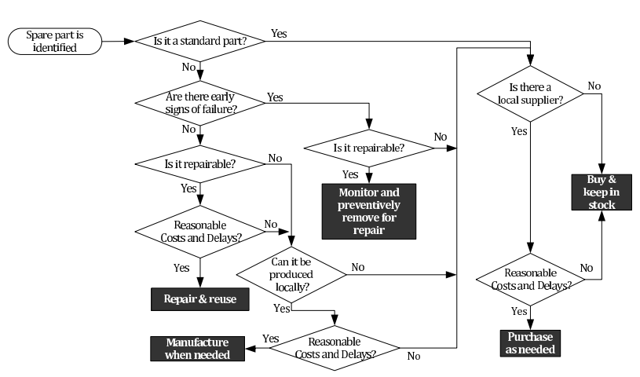

Slide 22
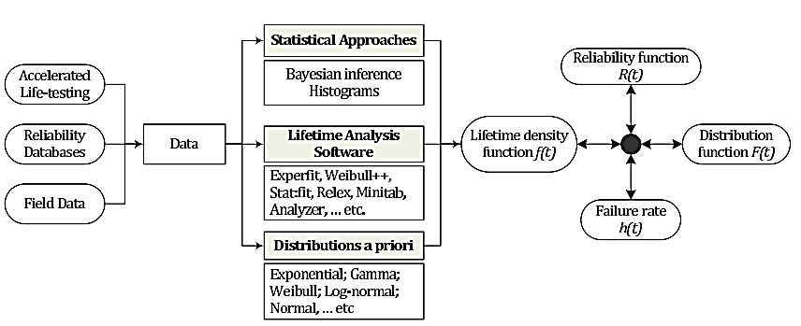
Determination of the required quantity of non repairable spares
For each component requiring spare parts, it is important to estimate the required amount of spares needed throughout the economic life cycle of the equipment.
To achieve this, one must estimate the average number of replacements at failure and, where applicable, the average number of preventive replacements.

Slide 23
Determination of the required quantity of repairable spares
A failed component, according to its degradation state, is repaired and put back in a “as new condition” or put in a state where it can resume operation.
The acquisition cost of these repairable components is generally high. If the repair is found to be not feasible for technical, economical or other reasons, the failed component is sent to a recycling or disposal facility.

Slide 24
Chapter 13. Reconditioning processes
To recondition a machine or piece of equipment means to repair or replace all the parts that are damaged or broken by repairing it, cleaning it, or replacing parts
Synonyms: restore, repair, renew, overhaul

Slide 25
Main elements which wants recondition before putting the vehicle on the lot
The reconditioning process ensures each vehicle is in good working order. Here are a few of the parts may need repair or replace before putting the vehicle on the lot:-
          A/C and heater
          Lights and radio
          Warning lights
          Engine and airbag warning lights
          Brakes
          Exhaust system
          Ignition system

Slide 26
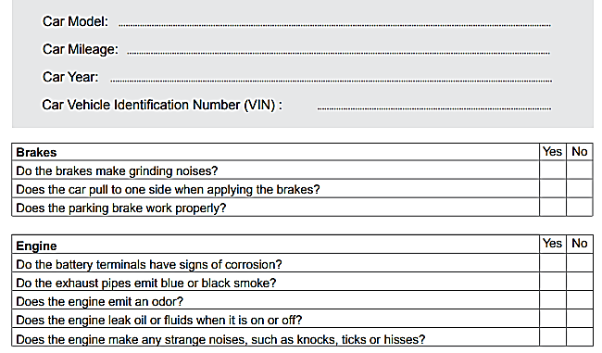
Used Car Inspection Checklist

Slide 27
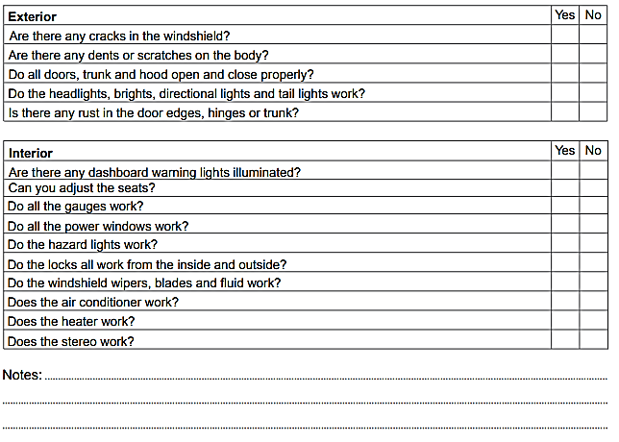
Cont’d

Slide 28
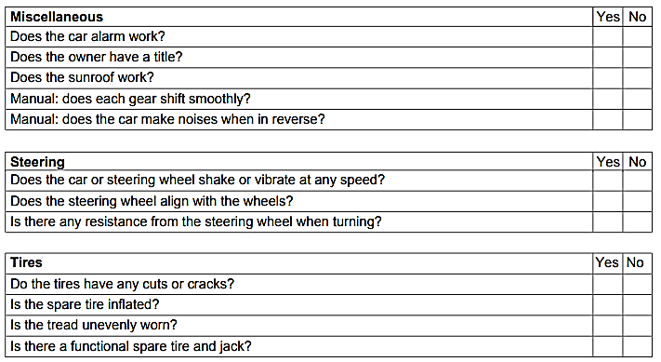
Cont’d

Slide 29
Example: Battery Reconditioning
The process of reconditioning a car battery is an operation that attempts to restore the ability of a dead battery to receive and store charge.
This process is a simple and straightforward operation that can be done in two ways. Almost the same method that uses different mediums.
The first option is restoring a dead car battery with the use of Battery Chem while the other method is carrying out the same process with the use of the Epsom Salt battery recipe solution.
During the process, both of the agents break down the sulfate buildups within the battery and its lead plates. This allows them to regain their ability to take in electricity and store it then convert it to power. Both of these processes are suitable for dead automotive batteries.

