Slide 1
Maintenance And installation of machinery
DEBRE MARKOS UNIVERSITY
INSTITUTE OF TECHNOLOGY
MECHANICAL ENGINEERING DEPARTMENT
Instructor : Endalk B. MSc…

Slide 2
Chapter 8
Reliability, Maintainability and Availability
8.1 Reliability
Means quality over the long run,
A product that “works” for a given long period of time is a
reliable one,
Since all units of a product will fail at different times,
reliability is a probability.
Note : lower equipment reliability means higher need for
maintenance.

Slide 3
cont. …
Reliability is ability of a product to perform, as expected, over certain time.
Formally defined as the probability that an item, a product, piece of equipment, or system will perform its intended function for a stated period of time under specified operating conditions.
In the simplest sense, reliability means how long an item (such as a machine) will perform its intended function without a breakdown.
Reliability is performance over time, probability that something will work when you want it to.

Slide 4
Cont.…
There are four factors associated with Reliability:
1. Numerical Value.
The numerical value is the probability that the product
will function satisfactorily during a particular time.
2. Intended Function.
Product are designed for particular applications and are
expected to be able to perform those applications.

Slide 5
Cont.…
  3. Life or time
  How long the product is expected to last. Product life
  is specified as a function of usage, time, or both.
  4. Operating Conditions;
  These describe the operating conditions (environmental factors, humidity, vibration, shock, temperature cycle, operational profile, etc.) that correspond to the stated product life.
.

Slide 6
Basic Reliability Terms
Failure
A failure is an event when an item is not available to perform its function at specified conditions ,
Frailer is when it is not capable of performing functions to specification.
Failure Rate
The number of failures per unit of gross operating period in terms of time, events, cycles.
MTBF - Mean Time Between Failures
The average time between failure occurrences.
The number of items and their operating time divided by the total number of failures. For Repairable Items

Slide 7
Cont.…
MTTF - Mean Time To Failure
The average time to failure occurrence.
The number of items and their operating time divided by the total number of failures.
For Repairable Items and Non-repairable Items
Hazard
The potential to cause harm.
Harm including ill health and injury, damage to property, plant, products or the environment, production losses or increased liabilities.
Risk
The likelihood that a specified undesired event will occur due to the realization of hazard or
during work activities by the products and services created by work activities.

Slide 8
Cont.
Maintainability
A characteristic of design, installation and operation, usually expressed as the probability that an item can be retained in, or restored to, specified operable condition.
Maintainability it is specified interval of time when maintenance is performed in accordance with prescribed procedures.
MTTR - Mean Time To Repair
The average time to restore the item to specified conditions.

Slide 9
Cont. ….
Maintenance Load
The repair time per operating time for an item.
Availability
A measure of the time that a system is actually operating versus the time that the system was planned to operate.
It is the probability that the system is operational at any random time t.
Supportability
The ability of a service supplier to maintain the Plant inbuilt reliability and ,
To perform scheduled and unscheduled maintenance according to the Plant inbuilt maintainability with minimum costs.

Slide 10
cont.
Reliability Engineering is concerned with analyzing failures and providing feedback to design and production to prevent future failures.
Reliability engineers usually speaks of
Failures Causes
Failure Modes
Failure Mechanisms
A failure is an event at which the system stops to fulfill its specified function.

Slide 11
Cont.…
Reliability measurement is based on the failure rate
Some products (Non-repairable) are scrapped when they fail e.g. bulb
Other products (Repairable) are repaired e.g. washing machine.

Slide 12
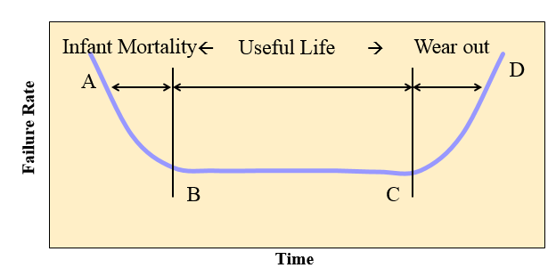
Failure rate over the life of a product
How Do Products Really Fail ?
Two common types of failures:
Sudden failure (no indicators): Stress exceeds strength ….
Degradation (gradual wear out): degradation indicator such as crack growth, change of resistance, corrosion, … This is ideal for Condition-Based Maintenance
Other failures may occur because of human errors.
The failure rate is expected to vary over the life of a product – ‘Bathtub Curve’

Slide 13
Bathtub Curve.
Bathtub Curve
A curve used in reliability engineering , describing a particular form of hazard function taking in to account three categories of failure.
A-B Early Failure / Infant mortality / Debugging / Break-in
‘Teething’ problems. Caused by design/material flaws
Eg: Joints, Welds, Contamination, Misuse, Miss - assembly
B-C Constant Failure / Useful life.
Lower than initial failure rate and more or less constant until end of life
C-D End of life failure / Wear out phase.
Failure rate rises again due to components reaching end of life
E.g.:- Corrosion, Cracking, Wear, Friction, Fatigue, Erosion, Lack of PM

Slide 14
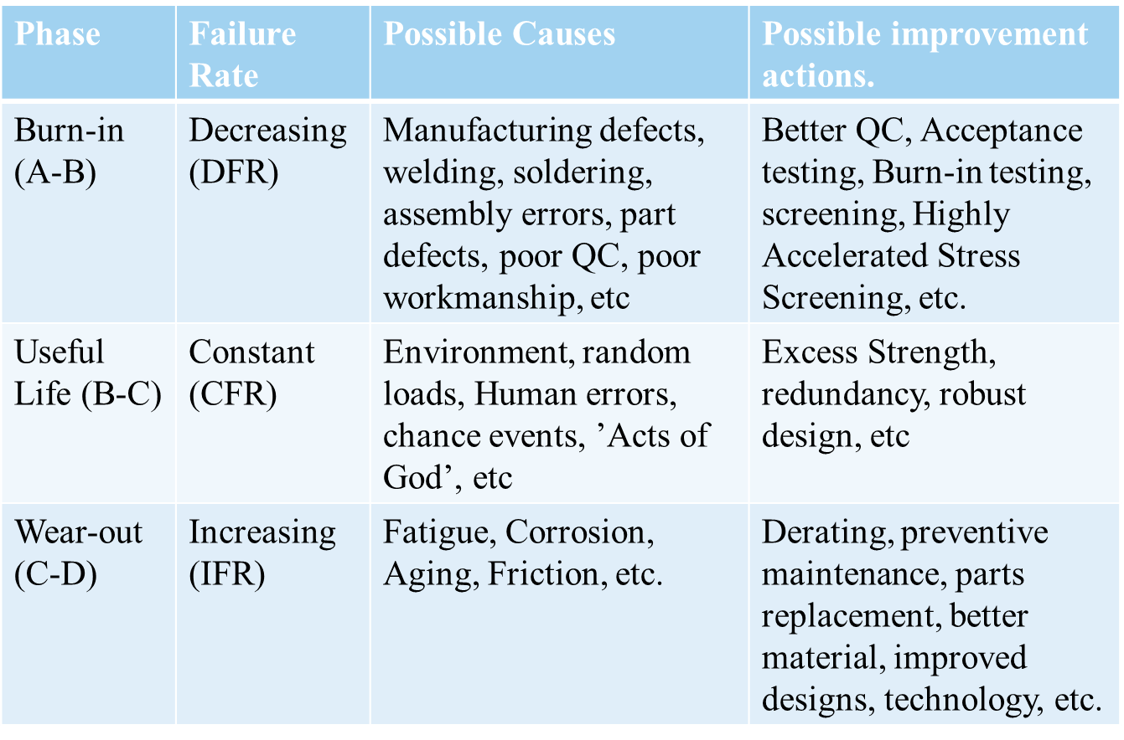
Bathtub Curve: Summary Table

Slide 15
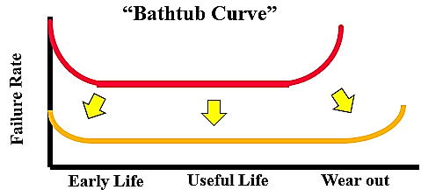
Managing Reliability
Reliability management is concerned with performance and conformance over the expected life of the product
A systems approach to planning for, designing in, verifying, and tracking the reliability of products throughout their life to achieve reliability goals.
Reliability of a system is often specified by the failure rate λ.
λ = failures per time unit (in a collection of systems)
For most technical products (incl. embedded systems), λ(t) is a “bath-tub curve“:

Slide 16
System Reliability
As products become more complex (have more components),
the chance that they will not function increases.
The method of arranging the components affects the reliability
of the entire system.
Components can be arranged in
a) Series
b) parallel, or a combination

Slide 17
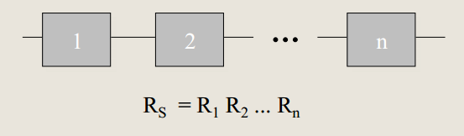
(a)Series System
For a series systems, the reliability is the product of
the individual components.
For a series systems, the reliability is the product of
the individual components.
As components are added to the series, the system reliability decreases.
Example : four wheels of a car

Slide 18
Cont..
Example
Consider series system structure of three independent component with same reliability of 0.9 for a specified time period t. Wheat will be the reliability of this structure for s specified time period t ?

Slide 19
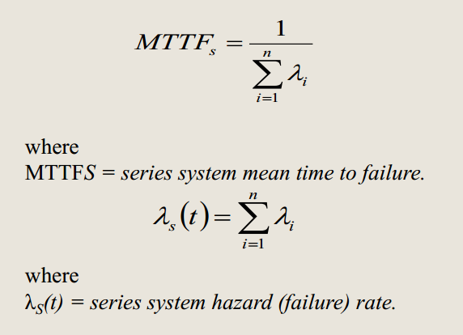
Cont..

Slide 20
Cont..
Example on system failure and MTTFS
Assume that the constant failure rates of tires 1 , 2, 3, and 4 of a car are λ 1 = 0.00001 failures per hour, λ 2 = 0.00002 failures per hour, λ3 = 0.00003 failures per hour, and λ 4 = 0.00004 failures per hour, respectively. For practical purposes, the car cannot be driven when any one of the tires punctures or split . Calculate the total tire system failure rate and mean time to failure of the car with respect to tires.
Solution
λS = 0.00001 + 0.00002 + 0.00003 + 0.00004 = 0.0001
failures per hour
MTTFS = 1 / λS = 1 /0.0001 = 10,000 h

Slide 21
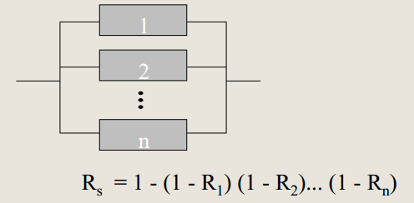
b)Parallel System
When a component does not function, the product continues to function, using another component, until all parallel components do not function.

Slide 22
Cont. …
Example
consider a parallel structure of three independent component. their reliability are estimated to be 0.9 , 0.8, and 0.5 for specified time period t. What will be the reliability of this structure for a specified period t.

Slide 23

Cont. …
Example on parallel system
An aircraft has two independent and active engines. At least one engine must operate normally for the aircraft to fly. Engines 1 and 2 reliabilities are 0.99 and 0.97, respectively. Calculate the probability of the aircraft flying successfully with respect to engines.
Solution
There is 99.97% chance that the aircraft will fly successfully with respect to engines.

Slide 24
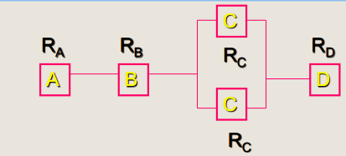


(c) Series-Parallel System or Mixed Configuration
Convert to equivalent series system

Slide 25
Cont..
Example on mixed configuration
Consider a mixed structure system reliability component A has reliability of 0.9, component B and C have the reliability of 0.8. calculate the reliability of this system for a specified period t ?

Slide 26
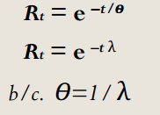
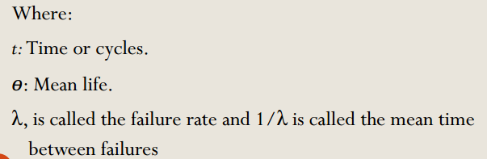
Exponential Failure Analysis
Exponential distribution:

Slide 27
Cont.…
Example
Following time to frailer of an item are exponentially distributed ; 75, 100 ,70 , 130 and 125 in hours . Calculate the reliability of the item for an operating period of 100 hours?

Slide 28

Weibull Failure Analysis
When β = 1 , the hazard function is constant and therefore
the data can be modeled by an exponential distribution with
ө =1 /λ .
When β<1 , we get a decreasing hazard function and
When β>1 , we get a increasing hazard function
When β>3.5, the Weibull distribution is an approximation for
the Normal distribution.
Where ß is the Weibull slope.

Slide 29
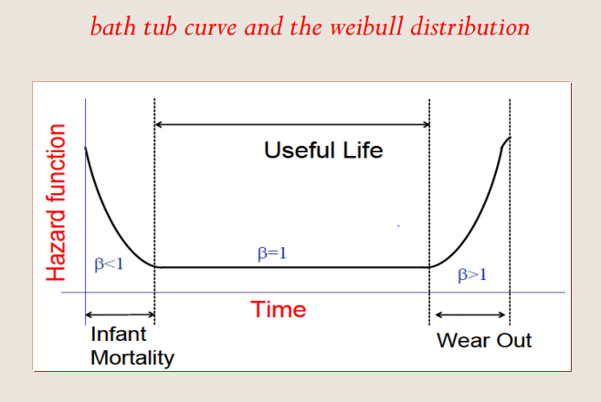
Cont…

Slide 30
Cont.…
Reliability analysis using wiebull distribution
Time to failure of a pipeline valve is assumed to have , wiebull distribution with a shape parameter 2 and scale parameter 4000 hours. Calculate the reliability of the valve for an operation period of 2000, 4000, and 6000 hours.

Slide 31
Reliability Characteristics
Non-Repairable Systems:
Reliability=Availability
Failure Rate
MTTF
Time to First Failure
MRL (Mean Residual or remaining Life)
Repairable Systems:
Availability …. (Function of Reliability and Maintainability)
Failure Rate and Repair Rate
MTBF

Slide 32
Failure Rate for Repairable and Non-repairable systems
MTBF (θ) = Total time / Total Number of failures
Average Failure Rate λ = 1 / θ → λ θ = 1
Fialer rate =no of failure divided by total no of hours
Example 1
1) 300 cars have accumulated 45000 hours, 10 failures are observed. What is the MTBF? and What is the failure rate?
Note: considering Car as repairable system, Use MTBF
MTBF = 45000/10 = 4500 hours.
Failure rate λ = 10/45000 = 0.00022 per hour.

Slide 33
Cont.….
Example 2 :
Five oil pumps were tested with failure hours of 45, 33, 62, 94 and 105. What is the MTTF and failure rate?
Note:- considering pumps as non repairable systems, Use MTTF.
MTTF = (45+33+62+94+105) / 5 = 67.8 hours
Failure rate λ= 5 / (45+33+62+94+105) = 0.0147 per hour.
Note that MTTF is a reciprocal of failure rate.

Slide 34
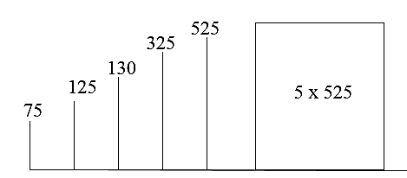
Example 3
10 components were tested. The components (not repairable) failed as follows:-
Component 1,2,3,4,5 failed after 75,125, 130, 325, 525 hours. Find the failure rate and mean time till failure.
Solution:-
No. of failures = 5
Total operating time = 75 + 125 + 130 + 325 + 525 + 5*525 = 3805
Failure rate λ = 5 / 3805 = 0.001314
Mean time till failure = 1/λ
=1/0.001314
= 761.04 hours.

Slide 35
Example 4
50 components are tested for two weeks. 20 of them fail in this time, with an average failure time of 1.2 weeks. What is the mean time till failure assuming a constant failure rate?
Answer:
No. Of failures = 20
Total time = 20*1.2 + 30*2 = 84 weeks
Failure rate = 20/84 = 0.238/week
Mean time till failure is estimated to be = (1/failure rate)
= 1/0.238 = 4.2 weeks.

Slide 36
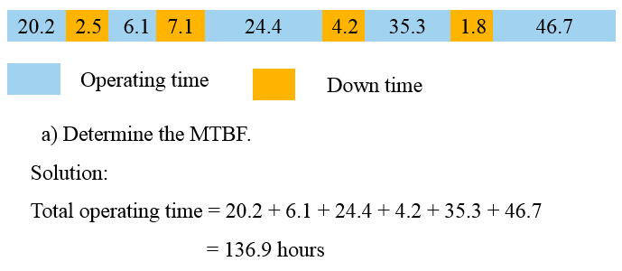
Example 5
The chart below shows operating time and breakdown time of a machine.

Slide 37
Cont.
λ = 4 / 136.9 = 0.02922
Therefore;
= MTBF = 1/ λ = 34.22 hours
b) What is the system reliability for a mission time of 20 hours?
R = e^{-λt} t = 20 hours
R= e^{-(0.02922)(20)}
^{R = 55.74%}

Slide 38
Maintainability
Maintainability is the measure of the ability of a system or item to be retained or restored to a specified condition when maintenance is performed by qualified personnel using specified procedure and resources.
Maintabnility can be measured with Mean Time To Repair (MTTR), MTTR is average repair time and is given by
MTBMA is Mean Time Between Maintenance Actions including preventive and corrective maintenance tasks.

Slide 39
OBJECTIVES OF MAINTAINABILITY
To influence design and to achieve event of maintenance thus reducing maintenance time & cost,
To estimate the downtime for maintenance which, when compared with allowable downtime, determines whether redundancy is required,
To estimate system availability by combining maintainability data with reliability data,
To estimate the man-hours and other resources required for performing maintenance,
For determining the costs of maintenance and for maintenance planning.

Slide 40
ADVANTAGES OF MAINTAINABILITY PREDICTION
It highlights areas of poor maintainability which require product improvement, modification or change of design.
It permits user to make an early assessment of whether the predicted downtime, the quality, quantity of personnel, tools and test equipment are adequate and consistent with the needs of system operational requirements.

Slide 41
Types of system maintenance actions:
corrective maintenance
Actions taken to restore a failed system to operational status,
Usually involves replacing or repairing the component that is responsible for the failure of the overall system,
Corrective maintenance is performed at unpredictable intervals because a component's failure time is not known a priori and,
The objective of corrective maintenance is to restore the system to satisfactory operation within the shortest possible time.

Slide 42
Cont.
Diagnosis of the problem
  Maintenance technician takes time to locate the failed parts or otherwise satisfactorily assess the cause of the system failure
Repair and/or replacement of faulty component
  Action is taken to address the cause, usually by replacing or repairing the components that caused the system to fail
Verification of the repair action
  Once components have been repaired or replaced, the maintenance technician must verify that the system is again successfully operating

Slide 43
B) preventive maintenance
The practice of replacing components or subsystems before they fail to promote continuous system operation
The preventive maintenance schedule is based on:
  Observation of past system behavior
  Component wear-out mechanisms
  Knowledge of components vital to continued system operation
Cost is always a factor in the scheduling of preventive maintenance
  Reliability may be a factor, but cost is a more general term because reliability & risk can be expressed in terms of cost
  In many circumstances, it may be financially better to replace parts or components that have not failed at predetermined intervals rather than wait for a system failure that may result in a costly disruption in operations

Slide 44
C) Inspections
Used to uncover hidden failures (also called dormant failures)
In general, no maintenance action is performed on the component during an inspection unless the component is found failed causing a corrective maintenance action to be initiated
Sometimes there may be a partial restoration of the inspected item performed during an inspection
  For example, when checking the motor oil in a car between scheduled oil changes, one might occasionally add some oil in order to keep it at a constant level

Slide 45
Maintenance Downtime
There is time associated with each maintenance action, i.e. amount of time it takes to complete the action.
This time is referred to as downtime & defined as the length of time an item is not operational
There are a number of different factors that can affect the length of downtime
  Physical characteristics of the system,
  Repair crew availability,
  Spare part availability & other ILS factors , and
  Human factors & Environmental factors
There are two Downtime categories for these factors: Waiting Downtime & Active Downtime.

Slide 46
Types of Maintenance Downtime
Waiting Downtime
  The time during which the equipment is inoperable or unworkable , but not yet undergoing repair
  For example, the time it takes for replacement parts to be shipped, administrative processing time, etc.
Active Downtime
  The time during which the equipment is inoperable and actually undergoing repair
  The active downtime is the time it takes repair personnel to perform a repair or replacement
  The length of the active downtime is greatly dependent on human factors and the design of the equipment
  For example, the ease of accessibility of components in a system has a direct effect on the active downtime.

Slide 47
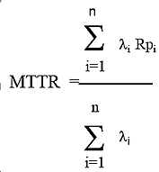
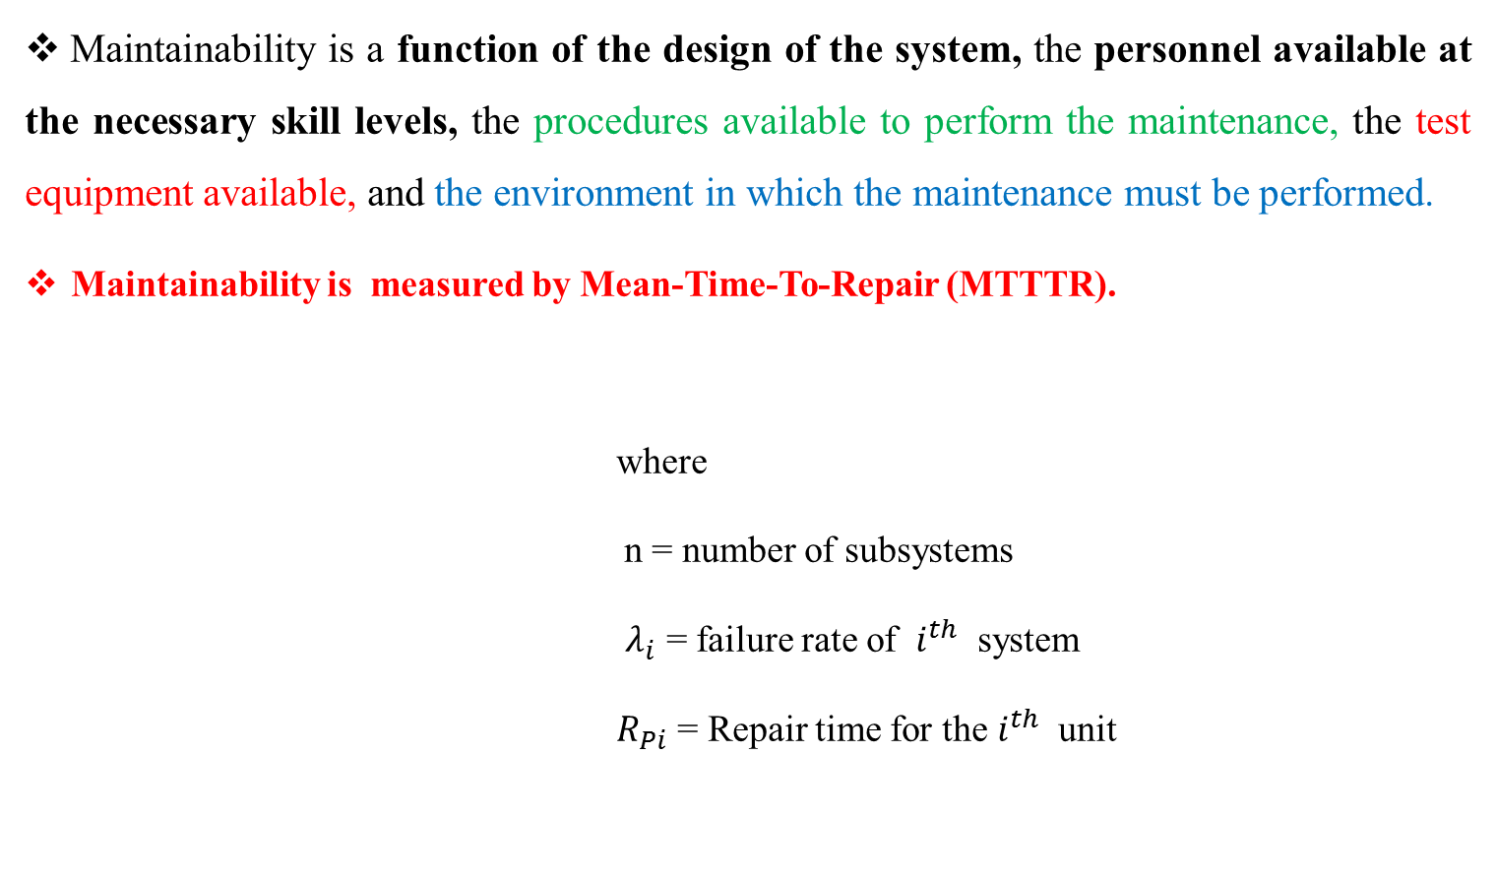
Cont.
Maintainability is a function of the design of the system, the personnel available at the necessary skill levels, the procedures available to perform the maintenance, the test equipment available, and the environment in which the maintenance must be performed.
Maintainability is measured by Mean-Time-To-Repair (MTTTR).
where
n = number of subsystems
$λ_{i}$ = failure rate of $i^{th}$ system
${ R}_{Pi}$ = Repair time for the $i^{th}$ unit

Slide 48
Probability of Repair Within the Allowable Downtime
To calculate the probability of performing a maintenance action within an allowable time interval use:
M(t) = 1 – e ^{- t / MTTR}
Where:
t = Allowable downtime
MTTR= Expected downtime (MTTR)
Mean-Time-To-Repair
The total corrective maintenance time divided by the total number of corrective maintenance actions during a given period of time.
Example: What is the probability of completing an action within 5 hours if the MTTR = 7 hours?
Solution: M(t) = 1 – e ^{- t/MTTR} = 1 – e^{5/7}
= 1 - .4895 = .5105
There is approximately a 51% probability of completion.

Slide 49
Availability
Availability defined as the probability that an item will be available when required or as the proportion of total time that an item is available for use.
May be defined as the probability an item is operable & can be committed at the start of a mission when the mission is called for at any unknown (random) point in time.
Example: For a lamp with a 99.9% availability, there will be one time out of a thousand that someone needs to use the lamp and finds it is not operating.

Slide 50
Cont..
Availability issues deal with at least three main factors for
- Increasing time to failure
-Decreasing downtime due to repairs or scheduled maintenance and
- Accomplishing items 1 and 2 in a cost be effective manner.
As availability grows , the capacity for making money increases because the equipment is in service a larger percent of time.

Slide 51
Availability analysis of the system requires a knowledge:
How the components are functional connected.
The failure process of the component.
The method of operation and the definition of the failure.
The repair or maintenance police.
The three common measures of availability are:
1. Inherent Availability (A_{I})
2. Achieved Availability (A_{A})
3. Operational Availability (A_{o})

Slide 52


Inherent Availability (A_{I})
This is the ideal state for analyzing availability. The only considerations are the MTBF and the MTTR. This measure does not take into account the time for preventive maintenance and assumes repair begins immediately upon failure of the system. This can also be defined as steady – state availability.
The measure for inherent (potential) availability (A_{I}) is :
A_{I} =
Where: λ = Failure rate = 1/ MTBF
μ = Repair rate = 1/MTTR
Example: A system has an MTBF of 2080 hours and a MTTR of 10 Hours. What is the inherent availability of the system?
Solution:
A_{I} =

Slide 53

Achieved Availability (A_{A})
Achieved availability is somewhat more realistic in that it takes preventive maintenance into account as well as corrective maintenance. The assumption here is that, as in A_{I}, there is no loss of time waiting for the maintenance action to begin.
The measure for achieved (final) availability (A_{A}) is :
A _{A} =
Where :-
MTBMA is the mean time between maintenance actions both preventive and corrective.
MMT is the mean Maintenance Action Time, and MMT is further decomposed into the effects of preventive and corrective maintenance and is given as:

Slide 54
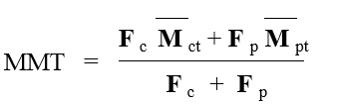
Where: F _{c} is the number of corrective maintenance actions per 1000 hours
F _{p} is the number of preventive maintenance actions per 1000 hours
M _{ct} is the mean active time for corrective maintenance (MTTR)
M _{pt} is the mean active time for preventive maintenance

Slide 55


Example : A system has a MTBMA of 110 hours, a F_{c} of ½, a F _{p} of 1, and M _{CT} of 2 hours, and M _{PT} of 1 hour. What is A _{A} ?
Solution :
First calculate MMT as :
Then determine A _{A} : A _{A} =

Slide 56


Operational Availability ( A ₀)
This is what generally occurs in practice. Operational availability takes into account that the maintenance response is not instantaneous, repair parts may not be in stock as well as other logistics issues.
The measure of operational (actual) availability A ₀ is :-
Where MDT is mean down time.
Example:- given MTBMA = 168 Hours and MDT = 4hours

Slide 57
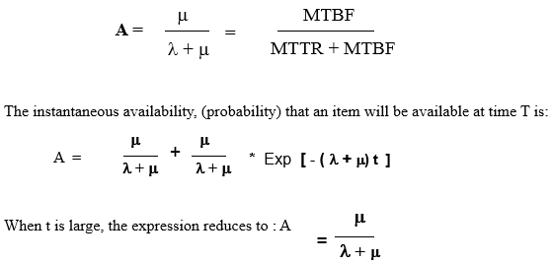
Availability for Constant Failures Rates and Mean Repair Rates
The steady – state availability was given earlier as:

Slide 58
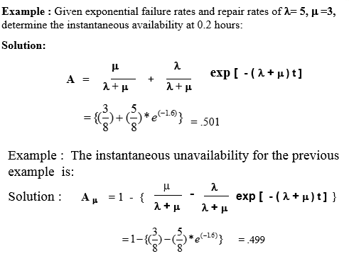

Slide 59
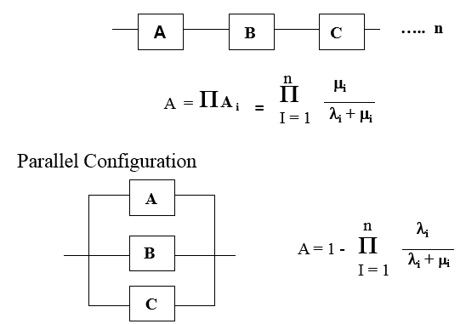
Other configurations to consider: The steady – state [A]
Series Configuration

Slide 60
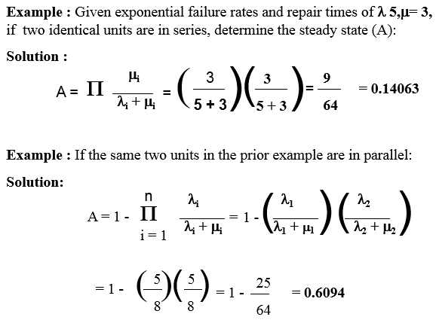

Slide 61
Thank you !!

