Slide 1
Maintenance And installation of machinery
DEBRE MARKOS UNIVERSITY
INSTITUTE OF TECHNOLOGY
MECHANICAL ENGINEERING DEPARTMENT
Instructor: Endalk B . (Msc)

Slide 2
Chapter three
Typical Damages of machine parts
3.1. Sliding bearings
The damage in sliding bearings is wear and fatigue
Static loads cause wear whereas dynamic loads cause wear and fatigue.
In cases where lubricant contains corrosion stimulating substances like acids produced by aging lubricant, water leaking in lubricant, etc. , corrosion also becomes an important damage.

Slide 3
....cont’d
But when dealing with damages of the system, the whole system has to be considered especially with respect to:-
• Alignment and shape of bush hole or bore,
• Lubricating, and
• Deformation of shaft under applied loads.

Slide 4
...cont’d
The process of wear depends on:-
wear velocity and operation conditions, particularly, temperature.
High temperature and high wear velocity produce overheating which change the properties of the material.
Presence of foreign substances in the lab. causes increased wear velocity.

Slide 5
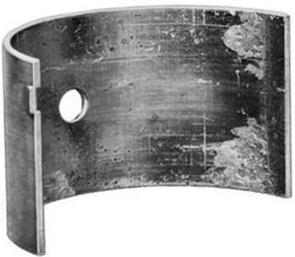
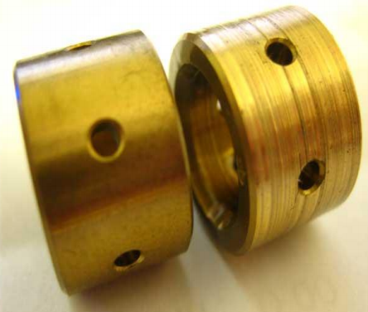
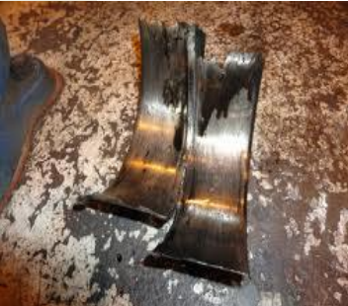
Example

Slide 6
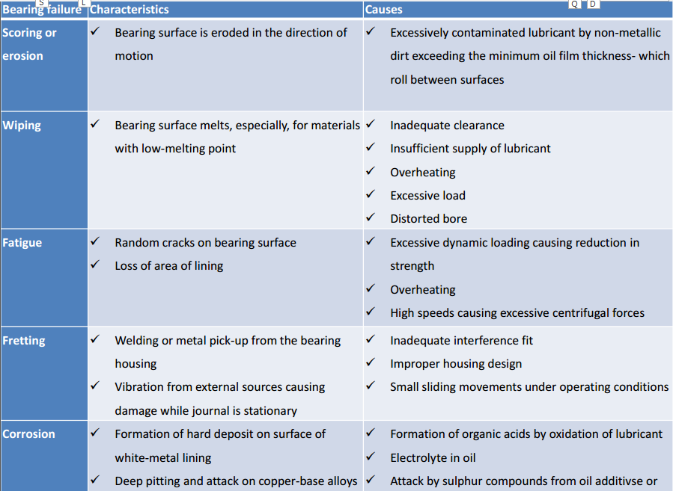

Slide 7
3.2. Anti - Friction Bearings
Roller and ball bearings
• Ball and roller bearings normally fail by fatigue.
• In the case of tightening and lubrication problems,
wear also can occur .
• Rarely failure can occur by random damages like
overload
High contact pressure causes damage of inner and
outer races.
In case of over load and assembly problems failure
takes place in a short time.

Slide 8
....cont’d
Wear of bearing elements increases axial and radial play, which can be a cause for vibration leading to increased fatigue.
Analysis of damage
Due to damages bearings will either get heated up or will run with abnormal noise and/or vibration.

Slide 9
Anti - friction bearing defects can be any one or combination of the following:-
–Bearing inner race loose on shaft,
–Housing bore loose on shaft,
–Bearing running dry and
–Miss-alignment.
Avoid it!!!
. Using sleeve,
. By undergoing knurling,
. Welding and
. Chromium plating.

Slide 10
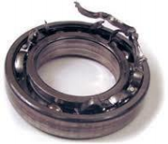
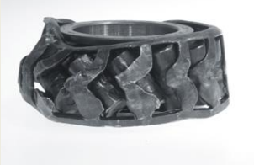
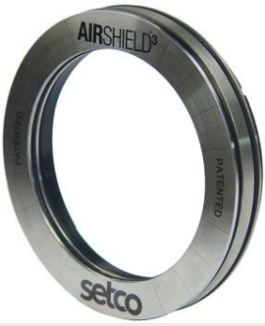
Examples
Caused due to miss alignment
Thrust bearing

Slide 11
Characteristics of damages in Anti Friction bearings
Damage characteristics | Reasons for damage
1. Running out of roundness | Damage at the rings (pitting, rippling) Contamination roundness Too much bearing clearance
2. Uncommon running noise 2.1. howling, whistling | Too small bearing clearance
2.2. Unequal noise: rattling, scrabbling | Too big bearing clearance Damage on racing tracks (pitting, toughening, impressions) Contamination Too viscous lubricant
2.3. gradual change of noise | Changing of effective bearing clearance (caused by change in temperature Fast fatigue process Fast arising of impressions
3. High temperature 3.1. Overheating | Too small bearing clearance Insufficient lubricant Excessive lubricant
3.2.Sudden increase in temperature | Lack of lubricant Fast arising of pitting

Slide 12
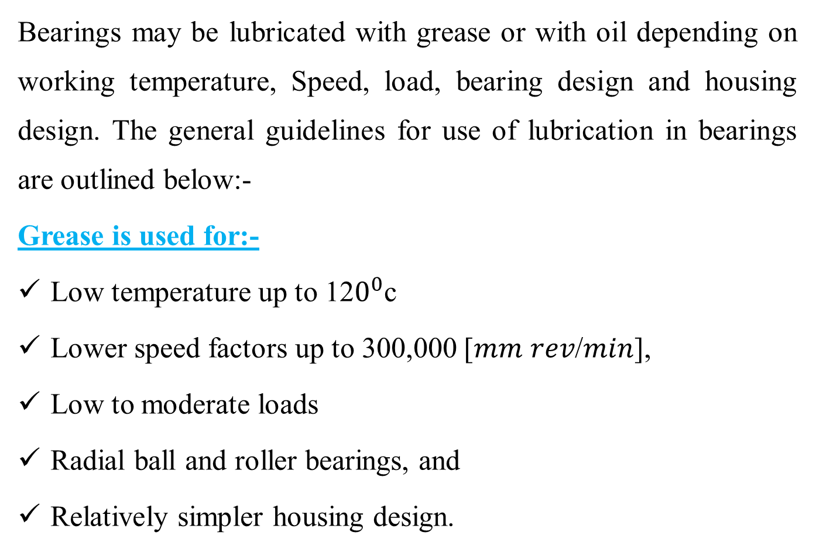
Preventing the damage using lubricant
Bearings may be lubricated with grease or with oil depending on working temperature, Speed, load, bearing design and housing design. The general guidelines for use of lubrication in bearings are outlined below:-
Grease is used for:-
Low temperature up to 12$0^{0}$c
Lower speed factors up to 300,000 [𝑚𝑚 𝑟𝑒𝑣/𝑚𝑖𝑛],
Low to moderate loads
Radial ball and roller bearings, and
Relatively simpler housing design.

Slide 13
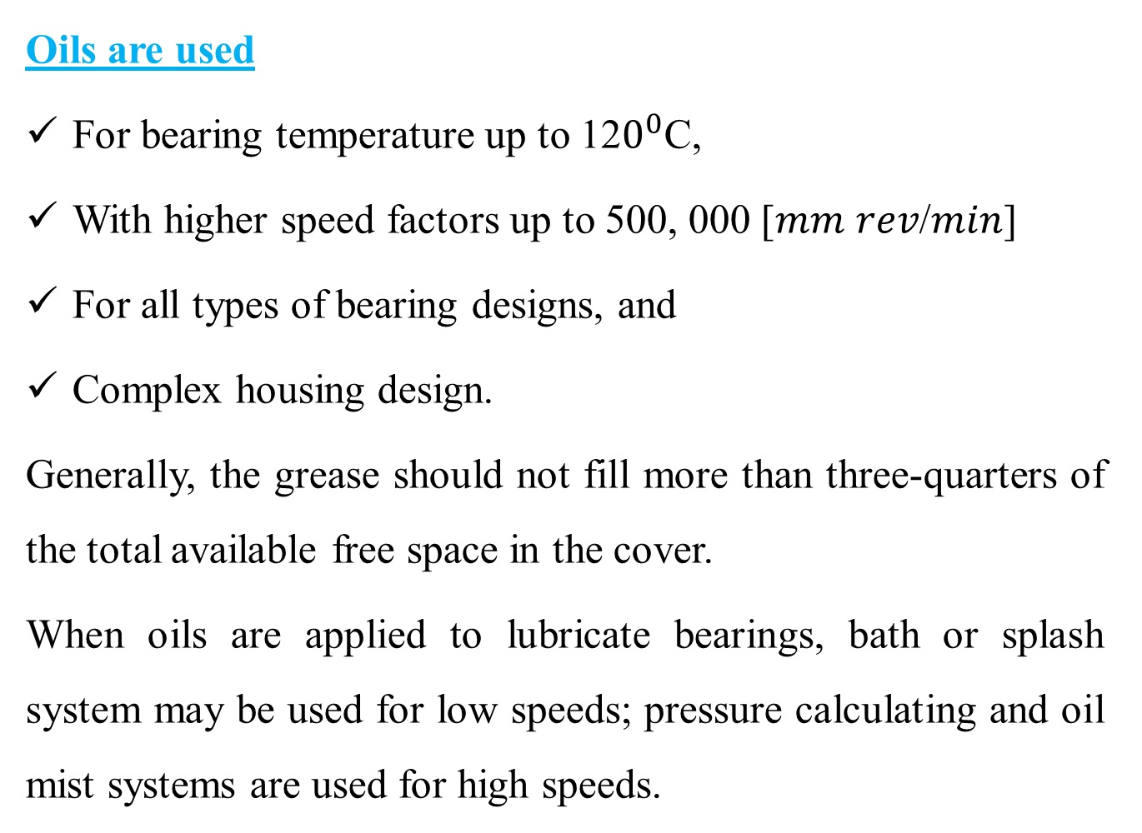
......cont’d
Oils are used
For bearing temperature up to 12$0^{0}$C,
With higher speed factors up to 500, 000 [𝑚𝑚 𝑟𝑒𝑣/𝑚𝑖𝑛]
For all types of bearing designs, and
Complex housing design.
Generally, the grease should not fill more than three-quarters of the total available free space in the cover.
When oils are applied to lubricate bearings, bath or splash system may be used for low speeds; pressure calculating and oil mist systems are used for high speeds.

Slide 14
3.3 Gear Damages
A gear pair has not failed until it can no longer be run.
This condition is reached when any one or both of the following has occurred:-
➢One or more teeth have broken away preventing transmission;
➢Teeth are so badly damaged or worn-out that unacceptable vibration and noise are set up when the gear runs

Slide 15
Typical failures of gear
Gear failure |  | Characteristics | Causes | Remedies
1. Surface fatigue (pitting)
a. Progressive Pitting | Pits continue to form with persistent running Rapid increase may large pieces of teeth breaking away Continuous line of pitting reduces bending resistance in the affected tooth |  | Over-stressing of gear Material | Remove cause of overload (e.g. correct alignment)
b. Deddendum attrition | Dedendum covered by a large number of small pits (with mat appearance) formation of a step at the pitch after a continued running |  | Possibly vibration in the gear unit | Use of more viscous lubricant

Slide 16
...cont’d
2. Scuffing
a. Light scuffing | Tooth surfaces appear dull and slightly rough in comparison with un-affected areas Wear in the direction of sliding at the tip and root of the engaging teeth |  | Disruption of the lubricant film with the gear tooth surfaces temperature reaching critical temperature of lubricating oil |  | Use of high grade oils with higher temperature
b. Heavy scuffing | Tooth surfaces severely roughened as a result of unchecked adhesive wear |  | Use of low viscous oils Shortage of lubricant |  | Avoid repeated light scuffing
3. Abrasive wear
a. Foreign matter in oil | Grooves are cut in the tooth flanks in the direction of the sliding | Dirt falling in an open gear Inadequate initial gear cleaning Dislodged scale in oil supply pipes |  | Use clean lubricant Prevent dirt from entering system periodic flushing of gear unit

Slide 17
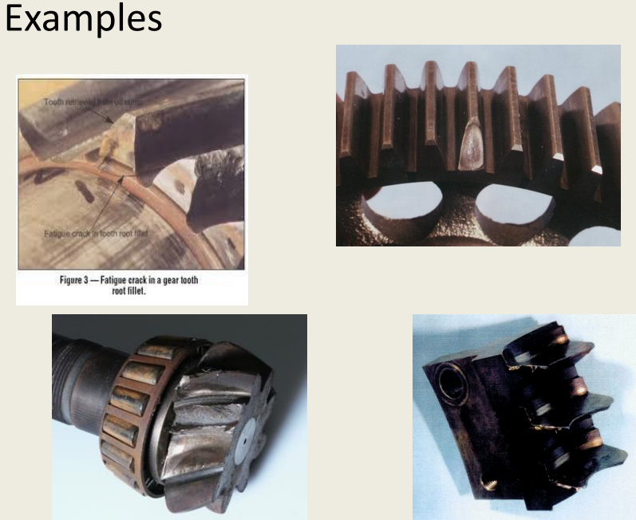

Slide 18
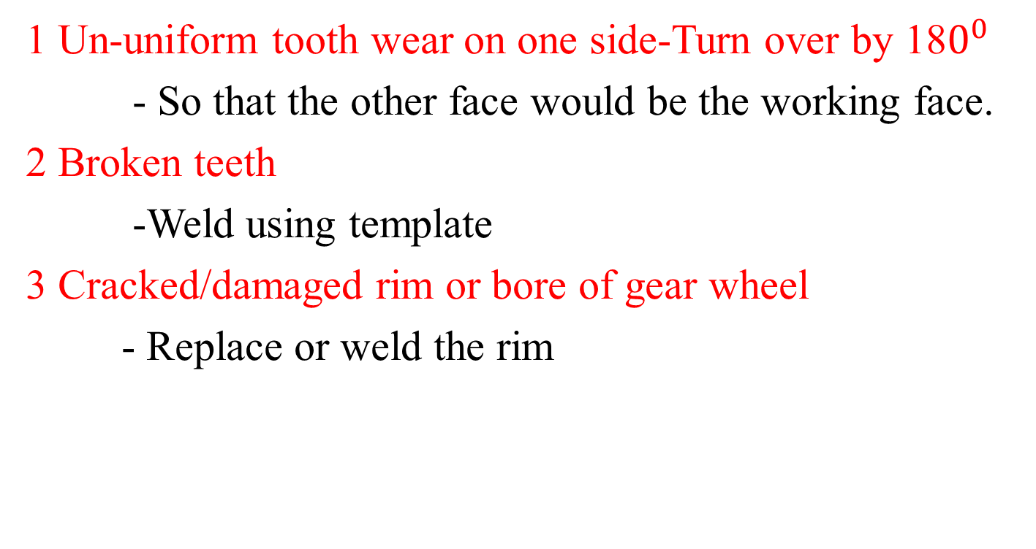
Repair of transmission gears
1 Un-uniform tooth wear on one side-Turn over by 18$0^{0}$
- So that the other face would be the working face.
2 Broken teeth
-Weld using template
3 Cracked/damaged rim or bore of gear wheel
- Replace or weld the rim

Slide 19
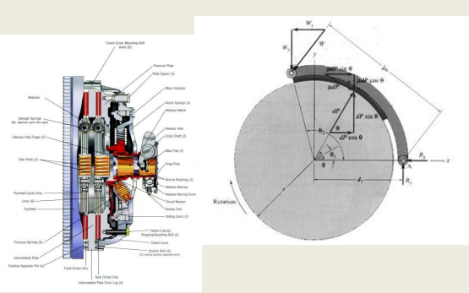
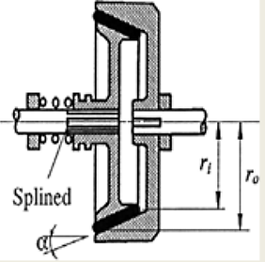
3.4 Damages of friction surfaces
Friction surfaces of clutches and brakes usually fail by wear and/or deformation.
Typical clutch typical brake

Slide 20
Brake damages
Brake metal surface failures, their characteristics and causes
Failure | Characteristics | Causes
1. Heat spotting | Heat spotted areas with reddish brown color | Distortion causing heavily loaded contact on a small area Uncomfortable mating
2. Crazing | Randomly oriented cracks on the rubbing surface of mating component | Overheating Repeated stress cycling from comp. to tension (heating and cooling)
3. Scoring | Scratches of the rubbing path in the line of movement | Too soft metal for the friction material Abrasive material embedded in the lining material

Slide 21
....cont’d
Failure | Characteristics | Causes
1. Fade | Material degrades or flows at the friction surface resulting in decreased and loss in performance | Over heating caused by excessive braking or brake dragging
2. Metal pickup | Metal plucked from the mating member and embedded in the lining | Unsuitable combination of materials
3. Grab | Linings contact at ends only Noisy brake Erratic performance | Incorrect radiating of lining (fault in assembly)

Slide 22
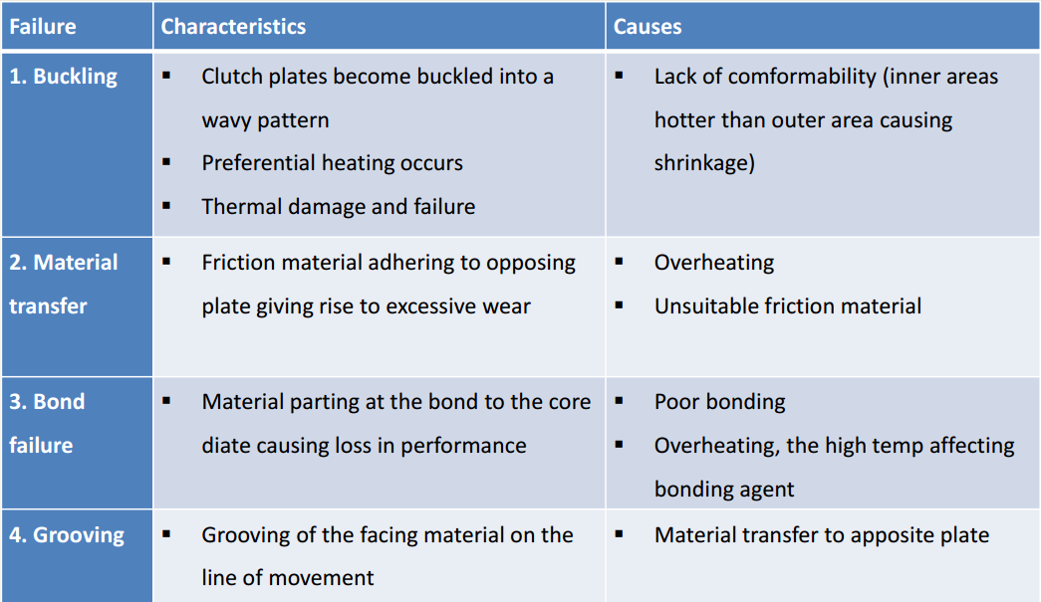
Clutch damages
Clutch failures, their characteristics and causes

Slide 23
3.5. Shaft failures
shafts are subjected to various loading condition and experience tension, compression, bending or any combination of these loading conditions
These loads can be stationary or may vary with time.
The basic causes of shaft failures are wear, fatigue and misalignment.

Slide 24
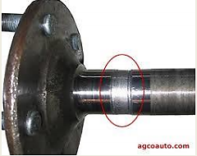
3.5.1 Shaft Failures due to wear
• Wear is a common cause of shaft failures. The wear process takes place by abrasive wear mechanism which is followed by removal of material from the surface of the shaft.
• Abrasive wear reduces shaft size and destroys shape of the shaft and causes shaft failure.

Slide 25
3.5.2 Fatigue failure
One of the more common causes of shaft failure is fatigue.
Fatigue failures commonly initiate at stress raisers. The mechanism of fatigue requires the simultaneous presence of three things:-
– There must be cyclic stresses on the shaft;
– These stress must be tensile in nature, and
– There must be plastic strain.

Slide 26
....cont’d
The process of fatigue is considered to consist of
three stages:-
– Initial fatigue damage involving plastic strains leading
to crack initiation;
– Crack propagation that continues to grow across the
part until the remaining cross section of shaft
becomes too weak to carry the imposed loads: and
– Final and sudden fracture of the remaining cross
section, due to overload

Slide 27
...cont’d
Some typical shaft features that act as stress raises are
– Corners, fillets, notches, etc.
– Key-ways, grooves, splines, etc.
– Press or shrink fits
– Welding defects,
– Metallurgical defects introduced by metal working such
as forging, machining, heat treating, etc.
Others service-related factors that are important factors in
fatigue initiation are damages caused by corrosion and wear

Slide 28
3.5.3 Shaft failures due to misalignment
Another common cause of shaft failures is misalignment. Misalignment can be introduced due to following problems;-
– Mismatching of mating parts,
– Original assembly error of equipment,
– Any maintenance activity resulting in maintenance induced alignment problems,
– Deflection or deformation of supporting components,
– Deflection or deformation of the shaft itself.

Slide 29
Remedies of shaft failures
Some of the remedies for preventing shaft failures are the following:-
– by using proper lubrication
– Misalignment can be eliminated by proper assembly procedures
– Fatigue can be reduced by proper design of local areas known as stress raisers
– Avoiding sharp surfaces during machining as much as possible eliminates the formation of stress raisers
– Use of proper fits and tolerances reduces misalignment, wear and fatigue

Slide 30
3.6. Seals
Seal - a device or substance that is used to join two things together so as to prevent them from coming apart or to prevent anything from.
Basic seal types and their characteristics :-
– Dynamic seals
• between surfaces in sliding contact or narrowly separated surfaces.
– Static seals
• between surfaces which do not move relative to each other
– Exclusive seals
• restrict access of dirt, etc., to a system, often used in conjunction with dynamic seals

Slide 31
Rubber seals
Symptoms | Cause | Remedy
- rubber brittle - possibly cracked - seal leaks | - rubber aging - exposure to the sunlight - overheat due to high fluid temperature or high speed | - renew seal - change rubber compound - improve seal environmental or operating conditions
- rubber softened, possibly swollen | - rubber incompatible with sealed fluid | - change rubber compound or change fluid
seal motion irregular - jerky - vibration | -stick-slip phenomena | - higher or lower speed may avoid problem - Change fluid temperature - change rubber
- seal friction very high on starting | - static friction (time dependent) | - probably inevitable - effect slowed by softer rubber or more viscous fluid
- seal permanently deformed | - permanent set (characteristic of rubbers) | -change rubber compound

Slide 32
O-rings, rectangular rubber rings, U-rings
Symptoms | Cause | Remedy
- Fine circumferential cut set back slightly from sliding contact zone - Ring completely ejected from its groove | - Extrusion damage | - Reduce back clearance - Check concentricity of parts - Fitting of back-up ring - Use reinforced seal - Use harder rubber
- Wear (not restricted to sliding contact) - Partial or total fracture | - Ring rolling or twisting in groove | - Replace O-ring by rectangular section ring or lobed type Ring

Slide 33
Lip seals
Symptoms | Cause | Remedy
Rotating lip seal Excessive leakage | - Damaged lip (during assembly) | - Remove cause of damage during assembly
Lip cracked in places | - Excessive speed - Poor lubrication - Hot environment | - Improve lubrication Reduce environmental temperature - Consider using alternative rubber compound
Reciprocating lip seal - Excessive wear/high friction | - Poor lubrication - Seal overloaded | - Replace single seal - Use heavy duty seal - For aqueous fluids leather may be better than rubber

Slide 34
End of Chapter Three

