Slide 1
Chapter 12
Network Analysis for Planning and
Control of Maintenance Work
Instructor ; Endalk B. MSc..

Slide 2
Scheduling
Is the process by which jobs are matched with resources and sequenced to be executed at a certain
points in time.
Scheduling deals with the specific time and phasing of planned jobs together with the orders to perform the work, monitoring the work, controlling it, and reporting on job progress.
Successful planning needs a feedback from
scheduling.

Slide 3
Reliable Schedule Must Take Into
Consideration
A job priority ranking reflecting the criticality of
the job.
The availability of all materials needed for the work
order in the plant.
The production should be in master schedule.
Realistic estimates and what is likely to happen.
Flexibility in the schedule.

Slide 4
Maintenance Schedule Can be Prepared at
Three Levels (Depend on The Time Horizon)
1. Long-range (master) schedule
2. Weekly schedule
3. Daily schedule

Slide 5
Long-Range (master) Schedule
Covering a period of 3 months to 1 year,
Based on existing maintenance work orders (blanket work order, backlog, PM, anticipated EM).
Balancing long-term demand for maintenance work with available resources.
Spare parts and material could be identified and ordered in advance.
Subject to revision and updating to reflect changes in the plans and maintenance work

Slide 6
Weekly Schedule
Covering 1 week.
Generated from the master schedule.
Takes into account current operations schedules and
economic considerations.
Allow 10% to 15% of the workforce to be available for
emergency work.
The schedule prepared for the current week and the
following one in order to consider the available backlog.
The work orders scheduled in this week are sequenced based
in priority.
CPM and integer programming techniques can be used to
generate a schedule.

Slide 7
Daily Schedule
Covering 1 day.
Generated from weekly schedule.
Prepared the day before.
Interrupted to perform EM.
Priorities are used to schedule the jobs.

Slide 8
Elements of Sound Scheduling
• Written work orders that are derived from a well conceived planning process. (Work to be done, methods to be followed, crafts needed, spare parts needed, and priority).
• Time standards.
• Information about craft availability for each shift.
• Stocks of spare parts and information on restocking

Slide 9
Elements of Sound Scheduling
Information on the availability of special equipment
and tools necessary for maintenance work.
Access to the plant production schedule and knowledge about when the facilities will be available for service without interrupting production schedule.
Well-define priorities for maintenance work.
Information about jobs already scheduled that are behind the schedule (backlog).

Slide 10
Scheduling Procedures (Steps)
Sort backlog work orders by crafts.
Arrange orders by priority.
Compile a list of completed and carry over jobs.
Consider job duration, location, travel distance, and the possibility of combining jobs in the same area.
Schedule multi-craft jobs to start at the beginning of every shift.
Issue a daily schedule (not for shutdown maintenance).
Authorize a supervisor to make work assignments
(dispatching).

Slide 11
Maintenance Job Priority System
Priorities are established to ensure that the most critical work is scheduled first.
It is developed under coordination with operations staff.
It should be dynamic.
It must be updated periodically to reflect changes in operation and maintenance strategies.
It typically includes three to ten levels of priority.

Slide 12
Scheduling Techniques
The objective of the scheduling techniques is to
construct a time chart showing:
The start and finish for each job.
The interdependencies among jobs.
The critical jobs that require special attention and
effective monitoring

Slide 13
Such Techniques are :
Modified Gantt chart
CPM
PERT
Integer and stochastic programming

Slide 14
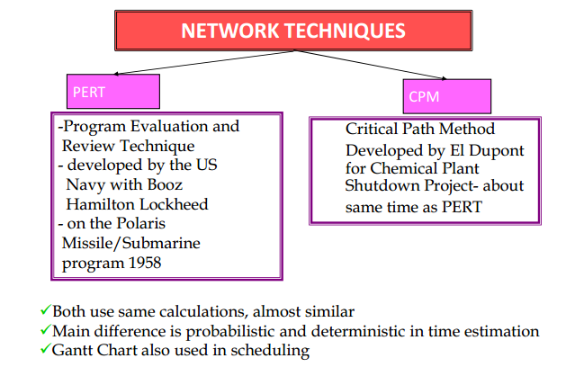

Slide 15
Network
Graphical interpretation of activities and event,
Shows dependency relationships between tasks or activities in a project,
Clearly shows tasks that must precede (precedence) or follow (succeeding) other tasks in a logical manner, and
Clear representation of plan – a powerful tool for planning and controlling project

Slide 16
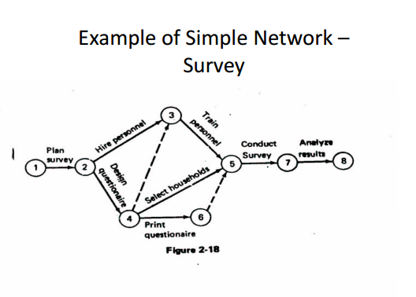
Cont..

Slide 17
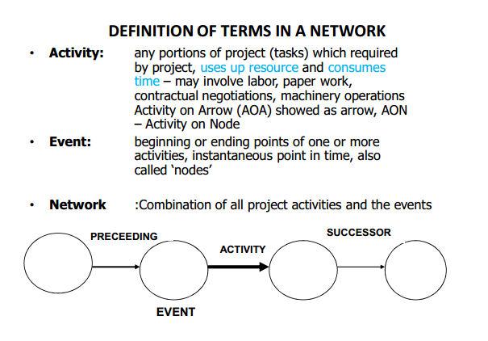

Slide 18
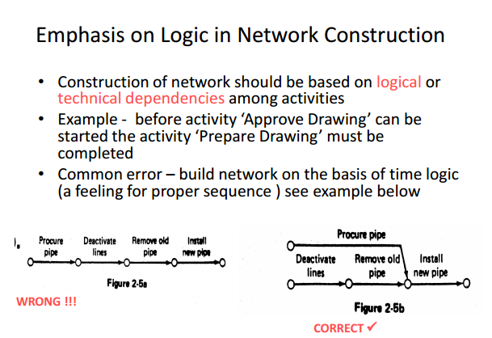
Cont.…

Slide 19
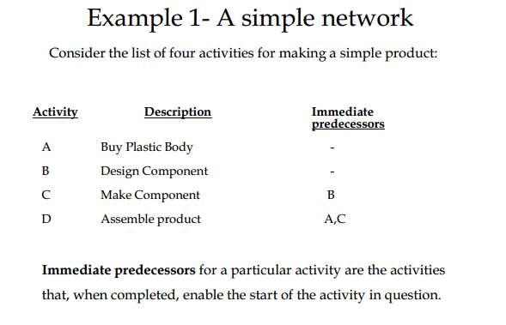
Cont.

Slide 20
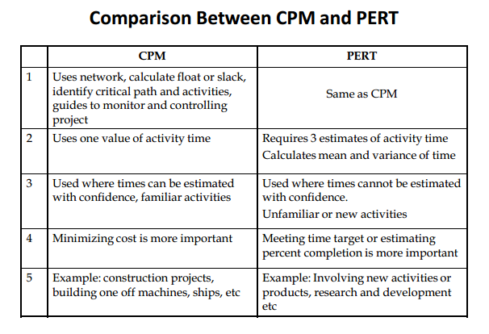
Cont..

Slide 21
BENEFITS OF CPM / PERT NETWORK
Consistent framework for planning, scheduling, monitoring, and controlling project.
Shows interdependence of all tasks, work packages, and work units.
Helps proper communications between departments and functions.
Determines expected project completion date.
Identifies so-called critical activities, which can delay the project completion time.

Slide 22
Cont..
Identified activities with slacks that can be delayed for specified periods without penalty, or from which resources may be temporarily borrowed
Determines the dates on which tasks may be started or must be started if the project is to stay in schedule.
Shows which tasks must be coordinated to avoid resource or timing conflicts.
Shows which tasks may run in parallel to meet project
completion date

Slide 23
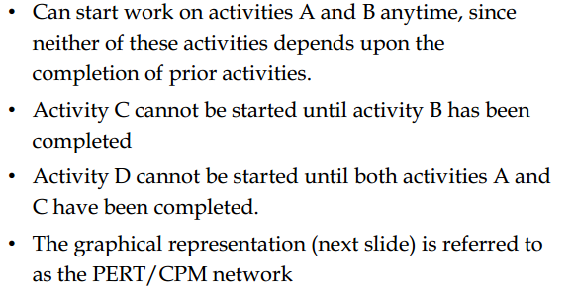
Sequence of activities

Slide 24
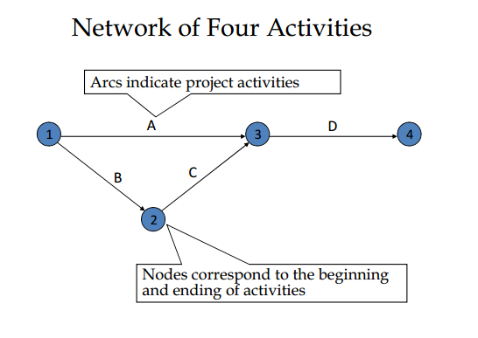
Solution

Slide 25
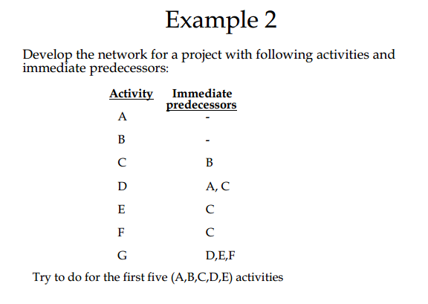
Cont..

Slide 26
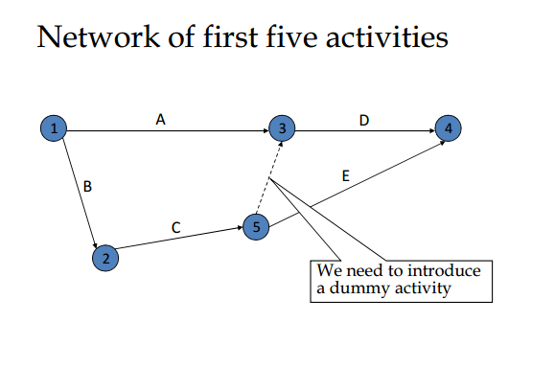
Solution

Slide 27
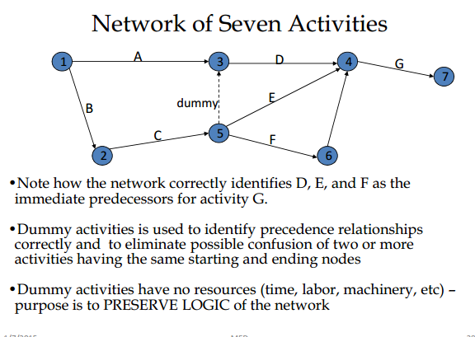
Solution

Slide 28
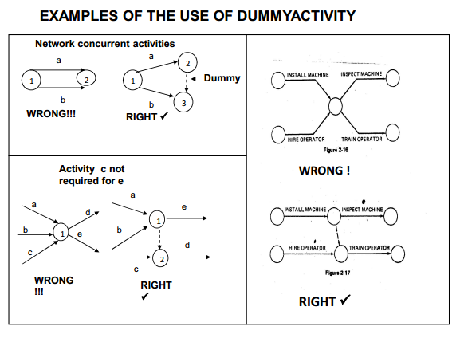
Cont.…

Slide 29
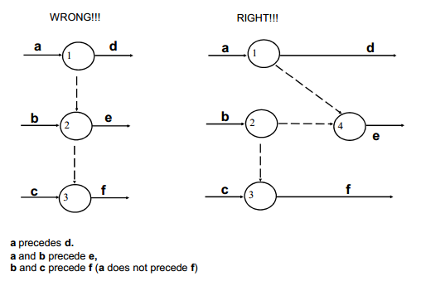
Cont..

Slide 30
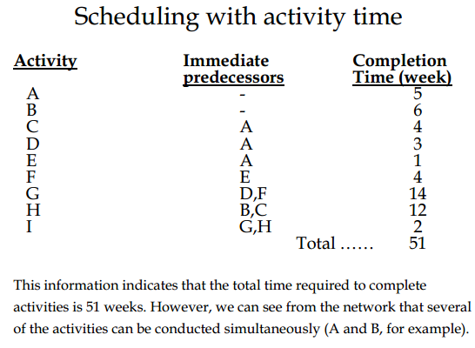

Slide 31
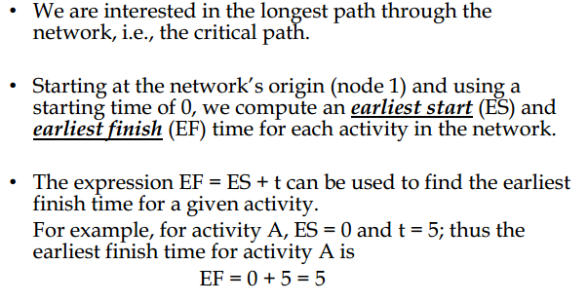
Earliest start & earliest finish time

Slide 32
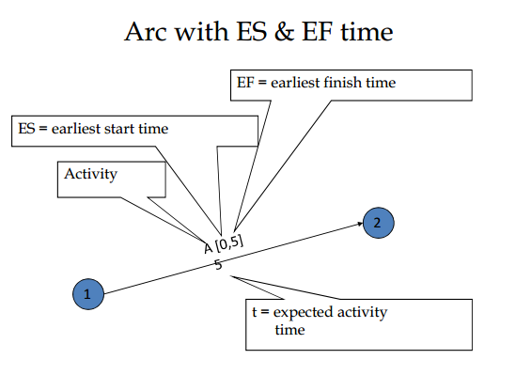
Cont.

Slide 33
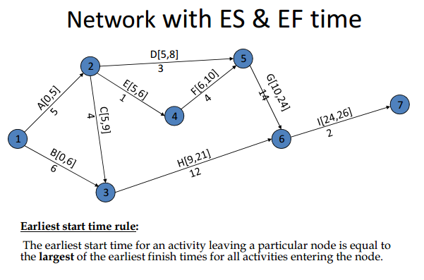
Network with ES and EF

Slide 34
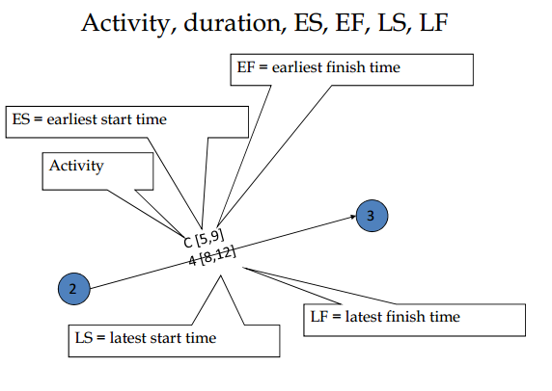
Activity and Duration

Slide 35
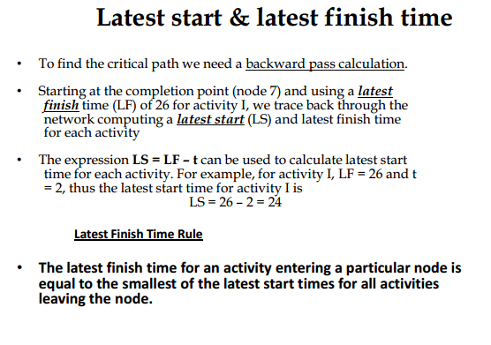
LS and LF Time

Slide 36
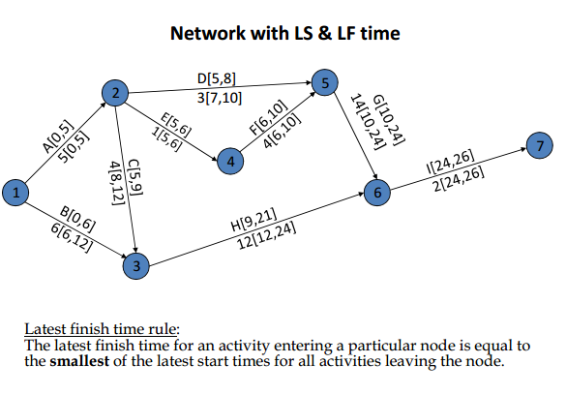
Network with LS and LF time

Slide 37
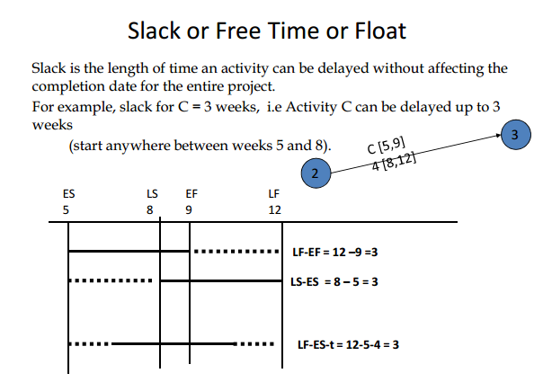
Slack or free time

Slide 38
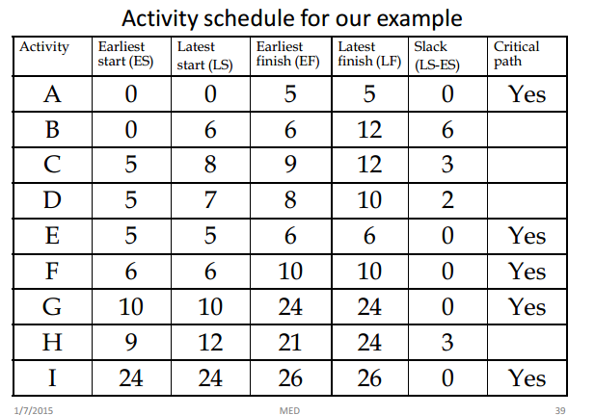
Example

Slide 39
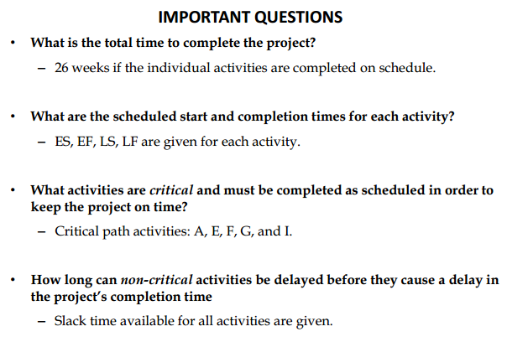
Cont..

Slide 40
Thank you !!!

