Slide 1
Part Four:
Marketing in Business enterprises
4.1 The Marketing Perspective
4.2 Marketing Mix-product, price, place, and promotion,
4.3 Marketing segmentation and market research,
4.4 Factors affecting the Business Environment

Slide 2
THE MARKETING PERSPECTIVE
Definition of Market:
Market is a group of potential customers having needs to satisfy, ability to buy & willingness to pay in order to satisfy these needs.
Also market is all the activities involved in the transfer of goods from the producer to the consumer
A social & managerial process by which individuals & groups obtain what they need & want through creating & exchanging products & value with others.

Slide 3
Cont…
Small business marketing consists of those business activities that relate directly to:
  Analyzing marketing opportunities
  Selecting target markets
  Developing the marketing mix
  Managing the marketing effort
The main concepts of marketing
-Marketing activities are integrated
-Organizations are market oriented
-Marketing focuses on selected markets
-Customer satisfaction is the core of marketing
-Marketing starts early before production.

Slide 4
Marketing Strategy
Marketing strategy: a process that can allow an organization to concentrate its resources on the optimal opportunities with the goals of increasing sales and achieving a sustainable competitive advantage.
Marketing strategy: includes all basic and long-term activities in the field of marketing that deal with the analysis of the strategic initial situation of a company.
Focus of Marketing Strategy
  Identify new markets that you can successfully target
  Making sure that your products and services meet customers needs and developing long-term and profitable relationships with those customers.
  Communicate the benefits of your business offerings to your target market

Slide 5
Strategy options
Customer benefits
Customers benefits
determine which
Generally applicable
extend
to:
competitive strategy
to:
is pursued:
* Price / costs
1.
Cost leadership
e.g. larger companies in
strategy
consumer goods sector
* Design
Niche strategy
e.g. small / medium
* Quality
-
2.
Differentiation
sized companies in
* Service
all industries, e.g.
strategy
3.
* Availability
*
Mould
making
*
Mechanical
engineering
* Safety

Slide 6
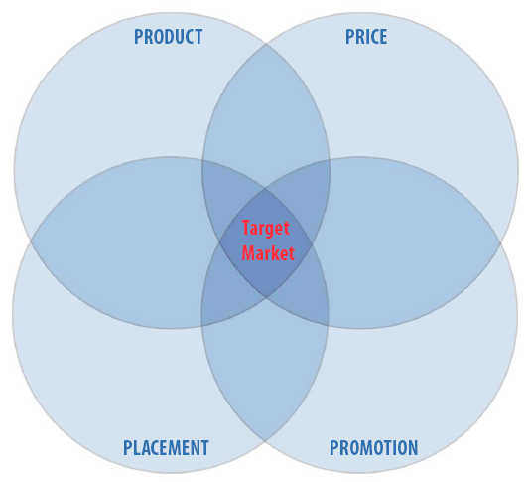
THE MARKETING MIX
Marketing mix is the term used to describe the combination of the four inputs which constitute the core of a company's marketing system:

Slide 7
THE MARKETING MIX
A marketing organization has to concentrate on four important aspects known as the 4P’s of marketing.
The marketing manager has to combine these 4 P’s (PRODUCT, PRICE, PROMOTION and PLACE.) in such a way that the combination provides satisfaction to the customer and profit to the manufacturer.
When these elements (4 P’s) are combined together they are called as “The Marketing Mix”.

Slide 8
Cont…
1.The product mix: Includes:
    Product planning and development
    Branding, Packaging , Labeling
2.The price mix: Includes
  Price polices
    Skimming pricing (Pricing above the market)
    Penetration pricing (Pricing below the market)
    Premium pricing (Pricing with the market)
  Discounts
    Quantity discount Seasonal discount
    Trade discount Cash discount
  Credits

Slide 9
Cont…
3. Place mix (Physical distribution mix):
Channels of distribution
Transportation
Warehousing
4. Promotion mix: Includes
Advertising
Personal selling
Sales promotion
Publicity

Slide 10
I. THE PRODUCT MIX
Product: is any commodity that satisfies the needs & wants of customer.
Product: is a bundle of tangible & intangible attributes, which satisfy the needs, & wants of customers.
In today market, a product can be
  A person (soccer players),
  Organization (privatized firms),
  Places (leased land),
  Objects (items),
  Idea (business plans or project proposal),
  Services (medication or barber), or mixes of these elements.

Slide 11
I. THE PRODUCT MIX
So, a product can be defined as anything, which comprises of benefits in forms of physical, service, and symbolic attributes to maximize buyers’ want satisfaction.
1.Product planning and development
Product planning includes three major types of decisions:
  Development and introduction of new products
  Modifications of existing products in keeping with the changing tastes and preferences of the target customers and
  Elimination of unprofitable or obsolete products

Slide 12
I. THE PRODUCT MIX
2. Branding
Brand name: the part of a brand, which consists of word, letters and/or numbers, which can be vocalized. E.g. OMO, Coke
Brand mark: the part of a brand that can be recognized but is not utter able. It can appear in the form of symbol, design, distinctive coloring or lettering.
Trademark: a brand or part of a brand that has been given legal protection so that the owner has exclusive rights to its use. After companies identify their trademark, they entail a term “™” or “®”
Trade Name: Trade name is the name of the business organization. A trade name may also be used as a brand name. In such a case it performs a dual function. It gives identification to the product as well as the manufacturer

Slide 13
I. THE PRODUCT MIX
Importance of a brand
The brand makes it easier for the seller to process orders and track down problems.
The seller’s brand name and trademark provide legal protection of unique product features.
Branding gives the seller the opportunity to attract a loyal profitable set of customers and helps to increase the control and share of the market.
Branding helps the seller to segment markets and expand the product mix.

Slide 14
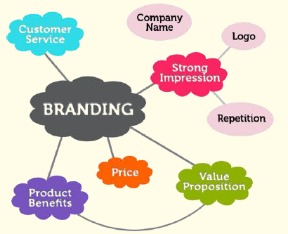
I. THE PRODUCT MIX
Good brand help to build the corporate image because it advertises the quality and size of the company.
Brands make it easy for customers to identify products or services.

Slide 15
I. THE PRODUCT MIX
Requirements of a good brand
Be easy to pronounce, recognize and remember
Be distinctive.
Suggest something about the product’s benefits or characteristics
Suggest about the product qualities such as action or use.
Be large enough to be applicable to new products that may be added to the product line.
Have a possibility of registration and legal protection.

Slide 16



I. THE PRODUCT MIX
Brand Elements
Brand
names
Slogans
URLs
Brand
Elements
Characters
Logos
Symbols

Slide 17
I. THE PRODUCT MIX
Qualities of a good brand
  Memorable
  Meaningful
  Likeability
  Transferable
  Adaptable
  Protectable

Slide 18
II. THE PRICE MIX
3.Packaging
  Packaging is a marketing process concerned with the design and production of the container or wrapper for a product.
  The container or wrapper or covering is called the package.
Importance of packaging
  Packaging serves several safety and utilitarian purposes
  Packaging may implement a company’s marketing program.
  Well-packaged products may increase profit possibilities in that it stimulates customers to pay more just to get the special package.

Slide 19
II. THE PRICE MIX
4.Labeling
Brand label: simply the brand alone applied to the product or to the package.
Grade label: a label, which identifies the quality with, a letter, number or word.
Descriptive label: it gives objective information about the use, construction, care, performance or other features of the product. Sometimes it is called informative label.
Eg. medicines

Slide 20
II. THE PRICE MIX
WHAT IS PRICE?
Is the amount of money consumers have to pay to obtain the product.
Price has operated as the major determinant of user choice traditionally.
Although non-price factors have become more important in recent decades price still remains one of the most important element determining market share and profitability.
Different companies set the price haphazardly as based on cost.
PRICE = Cost + Profit

Slide 21
II. THE PRICE MIX
Methods of Pricing
1.Cost plus pricing/ Mark Up pricing/
2. Skimming pricing
The following conditions should be satisfied
A sufficient number of buyers have a high current demand.
The high initial prices do not attract more competition to the market.
The high price communicates the image of a superior product.
3.Penetration pricing: below market price
4. Premium pricing: with market

Slide 22
II. THE PRICE MIX
The price could be too high or too low when compared to your competitors and / or what the customer is willing to pay for your product.
The major objectives of pricing are:
  Achievement of target return
  Maximization of profit
  Increase of sales volume
  Maintenance or increase of market share
  Stabilization of prices &
  Meeting competition

Slide 23
III. PLACE MIX
Place: Includes company activities that make the product available to target consumers.
Physical distribution includes:
    Channels of distribution
    Transportation
    Warehousing/ storing goods/
DEFINITION OF MARKETING CHANNELS
  The marketing (or distribution) channels refer to the activities, parties and channel structure required to transfer a product from its point of production to its point of consumption by the end customer

Slide 24
III. PLACE MIX
Direct channel
1.Door-to-door selling
2.Manufacturers’ sales branches
3.Direct mail
Indirect channel
Merchant Middlemen:-
  Whole seller:- Eg. Petram PLC and East Africa Trading are wholesalers of consumer products.
  Retailer:- Eg. Hadiya supermarket, and several Kiosks are found closer to sell the items to residential houses.
Agent Middlemen
  Commission agent, Brokers, Selling agents,
  E.g. -Sony Glorious, is an agent to Sony Electronics products,
    -Equatorial business is agent to Samsung.

Slide 25
III. PLACE MIX
Channel levels
Zero-level
One-level
Two-level
Three-level
Manufacturer
Manufacturer
Manufacturer
Manufacturer
Agent
Wholesaler
Wholesaler
Retailer
Retailer
Retailer
Consumer
Consumer
Consumer
Consumer

Slide 26
IV. PROMOTION MIX
Is sometimes known as marketing communication.
Means activities that communicate the merits of the product & persuade target customers to buy it.
Promotional objectives:
  Informing the product, Increasing sales
  Stabilizing sales / profit, Positioning the product
The promotional mix consists of four major tools
Advertising: such as informative Ad, Persuasive Ad and Reminder Ad
Personal selling – Oral presentation in conversation with one / more consumers for the purpose of making sale
Sales promotion – Includes: gifts, games, sampling, coupons, and window displays.
Publicity – Any information about the organization, its personnel or its products that appears in any medium on a non - paid basis.

Slide 27
IV. PROMOTION MIX
How companies inform, educate, persuade and remind consumers of their product benefits.
Approaches
      Conventional media
print, radio
online,
television
Very specific & Focused on target customer
sales promotions
public relations
personal selling
direct marketing

Slide 28
IV. PROMOTION MIX
Most business promotion
i. Advertising ii. Personal Selling
iii. Sales Promotion iv. Public Relations
Advertising
Advertising aims to:
Make business and product name familiar to the public
Create goodwill and build a favorable image
Educate and inform the public
Offer specific products or services
Attract customers to find out more about your product or service

Slide 29
IV. PROMOTION MIX
Personal selling
It means selling products personally.
Thus a salesperson plays three different roles
  Be persuasive
  A service provider
  Be informative
Public relations
It is the deliberate, planned and sustained effort to establish and maintain mutual understanding between an organization (or individual) and its (or their) public.

Slide 30
MARKET SEGMENTATION
Market segment is a group of individuals or organizations within a market that share one or more common characteristics.
The process of dividing a market in to segments is called market segmentation.
Bases for market segmentation
Geographic segmentation:- Region Urban, Suburban, Rural, Market density, Climate, Terrain (land, topography), City size, Country size, State size
Demographic segmentation:- Age, Gender, Race, Ethnicity, Income, Education, Occupation, Family size, Family life cycle, Religion, Social class
Psycho graphic segmentation:- Personality, Attributes, Motives, Lifestyles
Behavioral segmentation:- Volume usage, End use, Benefit, Expectations, Brand loyalty, Price sensitivity

Slide 31
Cont…
For a new venture, it's very essential to define clearly the specific group of potential customers whose needs the enterprise aims to fulfill.

Slide 32
Market Research
Marketing research is the systematic recording and analysis of data about problems relating to marketing.
American Marketing Association
Marketing research is the application of scientific method to the solution of marketing problems.
Luck, Wales, Taylor
It is important for any business to conduct it before established ,ongoing business and futurity….

Slide 33
End of Lecture Four
Next Lecture
Lecture Five
Financing and accounting in business
33

