Slide 1
Part two: creation of new venture
3.1 Small Business as Basic components of Economy
3.2 What is basic business idea
3.3 Steps in business setting
3.4 Developing a Business Plan

Slide 2
What is small business?
There are two approaches to define small Business. They are:
1. By some measure of size
2. using an economic /control definitions/criteria
A small business is a privately owned and operated business or
A small business typically has a small number of employees.

Slide 3
Measure of Size Criteria
Examples of criteria used to measure size are:
1. Number of employees
2. Sales volume
3. Asset size
4. Insurance enforce
5. Volume of deposits
Although the first criteria located above, employee, is the most widely used yardstick; the best criteria in any given case depends upon the user’s purpose.

Slide 4
Measure of Size Criteria
To provide a clear image of the small firms, the following general criteria for defining a small business are suggested:
A). Financing of the business is supplied by one individual or a small group.
b) Except for its marketing function, the firm’s operations are geographically localized.
c) Compared to the biggest firms in the industry is small
d) The number of employees in the business is usually fewer than 100

Slide 5
Economic /Control Criteria
The economic /control definition cover:
Market share:- The characteristics of a small firm’s share of the market is that it is not large enough to influence the prices of national quantities of goods sold to any significant extent.
Independence:- Means that the owner has control of the business himself.
Personalized management:- It implies that the owner activity participates in all aspects of the managements of the business, and in all major decisions-making processes. There is no delegation of authority.
All three of these characteristics must be satisfied if the business is to rank as a small business.

Slide 6
Types of small business
1. Family Enterprises
Family owned business varies widely and can include retail stores, contracting businesses, small manufacturing firms, and restaurants among others.
In the absence of a successor, the life of a venture is limited to the working life of its founder. Succession is a serious problem.
2. Personal service Firms(PSF)
3. Franchise:-The franchisee may receive Francis help, training, a protected market, and technical assistance with matters such as site selections, purchasing, accounting, and operations management.

Slide 7
Why are small business important to economy?
They make exceptional contributions as they provide
New job opportunity.
Introduce innovations-many scientific breakthrough originated with small organization. Photocopies, etc.
Stimulating economic competitions.
Reasons for more rapid growth of small firms in most developed countries.
New technologies, such as numerically controlled machine tools, may permit efficient production on a smaller scale
Greater flexibility is required as a result of increased global competitions
Consumers may be coming to prefer personalized products over mass produced goods.

Slide 8
Causes for small business failure
Incompetence- The owners simply mayn’t know how to run the enterprise.
Unbalanced experience- do not have rounded experience in the major activities of business production.
Lack of managerial experience- Do not know how to manage production.
Lack of experience in the line- the owner has entered a business field in which he or she has very little knowledge.
Neglect- the owner does not pay sufficient attention to the enterprise.
Fraud- involves intentional misrepresentations or deception (purchasing materials or goods for him/herself with the company’s money)
Disaster- refers to some unforeseen happening or ‘act of God’ (eg. Robberies and extended strikes.)

Slide 9
The following are specific managerial causes of small business failure
Inadequate records- unable to establish an adequate record keeping system.
Expansion beyond resources
Lack of information about customer
Failure to diversify market
Lack of marketing research.
Legal problems
Nepotism- favoritism toward family members
One person management
Lack of technical competence
Absentee management the owner stayed away for long period

Slide 10
Strength and weakness of small business
Strength
1. Independence
Most small business owners enjoy being their own boss, they like the freedom to do things than way.
2. Financial opportunities
Many small business owners make more money running their own company than they would be working for someone else.
3. Community services
if the person has reason to believe the public will pay for such output, he/she will start a company to provide it.

Slide 11
Strength and weakness of small business
4. Job security
when one owns a business, job security is ensured.
5. Family employment (benefits)
create the employment in the family
higher moral and trust occur in family-run business
6. Challenge.
They want to win or lose on their own abilities the challenge gives them psychological satisfaction

Slide 12
Weaknesses
1. Sales fluctuations
in some months sales are very high, while in other they drop off dramatically. The individual must balance cash inflows with cash outflows.
2. Competition- Owning a business is the risk of competition (eg. Restaurants)
3. Increased responsibilities- owner is often a bookkeeper, accountant sales person, personnel manager.
4. Financial loses- when the owner makes all major decisions
6. Risk of failure- the ultimate risk the small business owner manger faces is failure.

Slide 13
What is Business Idea?
A business idea is the response of a person/organization to solving an identified problem or to meeting perceived needs in the environment (markets, community, etc.).
Business idea: thinking of a goal for the unit in long run rather than to look for the immediate tomorrow. This long-term thinking is called business idea.
Finding a good idea is the first step in transforming the entrepreneur’s desire and creativity into a business opportunity.

Slide 14
Cont…

Slide 15
What is basic business idea?
Businessmen/businesswomen should think of long-term goal/profit.
The basic business idea is to meet the broadest needs of the customers, and has the long life perhaps from 5-50 years.
The basic business idea facilitates choice of product under an overall plan.

Slide 16
What is basic business idea?
The product line is relatively narrow and has a shorter life.
The product line consists of different families of product.
A unit with a basic business idea for example packaging can manufacture any of the following groups of the products:
Glass bottles
Plastic packages
Metal packages
Aluminum packages
Paper or wood packages.
The product range includes different size of the product with in the product line, in the examples given above different size of glass bottles can be manufactured for varied applications.

Slide 17
What is basic business idea?
The product is one item of the product range having different specifications like
size,
material used and
weight, etc.
In a dynamic business scheme, one has to carefully watch is one of the basic idea degenerating as regards.
Its ability to generate quick returns.
Its ability to permit quick changes in the products.

Slide 18
CONT…
To be a successful entrepreneur, one major determinant factor is the choice of a good business idea. To select the best business idea, the following steps needs to be pursued.
Identify your problem
Define your objectives
Identify, develop and analyze the possible alternative
Select the best alternative in light of the specific criteria set to the better fulfillment of the objective.

Slide 19
Why Generate Business Ideas?
Business ideas need to respond to market needs/consumer needs
Business ideas help entrepreneurs to stay ahead of the competition
Business ideas use technology to do things better
Business ideas are needed because the life cycles of products are limited
Business ideas can help specific groups of people (elderly, disadvantaged, those with disabilities)
Business ideas help to solve natural resource scarcity, pollution and depletion/reduction

Slide 20
Sources of Business Ideas
Good business ideas are a prerequisite for initiating a new business venture. Sources:
Hobbies/Personal Interests
Personal Skills and Experience
Media (newspapers, magazines, TV, Internet)
Business Exhibitions
Surveys
Customer Complaints
Natural scarcities and pollution
Changes in Society
Brainstorming
Being Creative
Ideas from overseas (Global) Potential Imports

Slide 21
Evaluating a Business Idea
Each business idea should be evaluated in terms of:
Present market: the size of the presently available market must provide prospects of immediate sales volume to support operations
Market growth: There should be prospects for rapid growth and high return on invested capital
Costs: Some of the costs of production will include: a) start up costs, b) costs of raw material inputs, c) labor costs, d) selling costs, e) efficiency of production processes, f) service, warranty, customer complaints and g) patents and licenses.
Business risks: Market stability in economic cycles, Technological risks, Import competition Size and power of competitors, Legislation and controls, Time required to generate profit

Slide 22
SWOT analysis
The SWOT approach compels individuals to think or reason out systematically and analytically the important factors strengths, weakness, opportunities, and threats.
Strength: is an inherent capacity, which an organization can use to gain strategic advantage over its competitors.
Weakness: is an inherent limitation or constraint, which creates a strategic disadvantage
Opportunity: refers to any factor that offer promise or potential for moving closer or more quickly towards the firms goal

Slide 23
Threat: is any factor that may limit or impede the business in the pursuit of its goals.
Threats can result from:
inability to get access to new technology
industry entry or exit barriers
Legislation

Slide 24
Cont…

Slide 26
Steps in business setting
1. The first key to success in any manufacturing activity is to select the right product. These must be examined with a view to assess:
The marketing aspects
Technical aspects
Financial aspects
2. Having selected a product, a detailed project report to be prepared. This will cover the following aspects.
A detailed estimate of demand is to be made.
Technical specifications of the process should be carefully studied.
The equipment required and their sources are to be specified
Requirement of space.

Slide 27
Cont…
3. Implementation of the detailed project report. Includes:
Deciding on form of ownership and registration
Obtaining finance ,Obtaining license
Establishing necessary infrastructures
4. Once all the required authorizations and sanctions have been obtained, simultaneous action is to be taken for the following. Pre-commissioning requirement
Ordering machinery from suppliers
Obtaining utilities like power and water connections after constructions of shed, if necessary.
Recruitment of staff,
Arranging supplies of materials
Arranging for distribution of the products

Slide 28
Cont…
5. Once these are complete, the plant is ready for commissioning trial run may be made. Commissioning of plant, Includes:
Trial run of machineries
Promotional activity for the product
Introduce the product to the market and obtain feedback
6. The unit is then ready for commercial production.
a. Commercial production
This is all about the feasibility study +pre & after implementation

Slide 29
Developing a Business Plan
WHAT IS A BUSINESS PLAN?
A business plan is a comprehensive set of guidelines for a new venture.
A business plan is also called a feasibility plan that encompasses the full range of business planning activities.
A business plan would present your basic business idea and all related operating, marketing, financial and managerial considerations.
What ever the name, it should lay out your idea, describe where you are, point out where you want to go, and how you propose to go there.

Slide 30
The Purpose of Business Plan
It can help the owner/manager crystallize/focus his/her idea and quantified on paper.
It can help the owner/manager set objectives and give him a yardstick against which to monitor performance.
It can also use as a vehicle to attract any external finance needed by the business. E.g. to get fund…

Slide 31
5. It can convince investors that the owner/manager has identified high growth opportunities.
6. It entails taking a long-term view of the business
7. It emphasizes the strengths and recognizes the weaknesses of the proposed venture.
8. The plan can alert the entrepreneur to sources of possible danger

Slide 32
Who Produce the Business Plan?
Managers:,
Owners:,
Lenders:
WHY THE BUSINESS PLANS ARE PRODUCED?
Assessing the feasibility and viability of the business/project: it is in every ones interests to make mistakes on paper, hypothetically testing for feasibility, before trying the real thing.
Setting objectives and budgets: having a clear financial vision with believable budgets is a basic requirement of everyone involved in a plan.
Calculating how much money is needed: a detailed cash flow with assumptions is vital ingredient to precisely quantify earlier the likely funds required.

Slide 33
The Format of a Business Plan
1. Where are we now?
An analysis of the current situations of the market place, the competitions, the business concept and the people involved. It will include any historical background relevant to the positions to date.
2. Where do we intend going?
Qualitative expression of the objectives, quantifiable targets will clarify and measure progress towards the intended goals.
3. How do we get there?
Implementing of accepted aims is what all the parties to a plan are interested in as a final result.

Slide 34
Components of Business Plan
Analysis of the current situation (where are we now?)
1. Identification of the business
a. Introduction
- relevant history and background
- Proposed date for commencement of trading /beginning of a plan
b. Names
- name of the business and trading name
- name of the managers/owners
c. Legal identity
- company/partnership/sole-trade/cooperative
- details of share or capital structure

Slide 35
Cont…
d. Location
-address-registered and operational
- brief details of premises.
e. Professional advisers, -Accountants, solicitors, bank
2. The key people
a. Existing management- Outline of background experience, skills and knowledge.
-Names of the management team
b. Future requirement -gaps in skills and experience and how they will be filled
- future recruitment intentions

Slide 36
Cont…
3. The nature of the business
a. Product(s)or service(s)-Description and applications
-Key suppliers
-Planned developments of product or service
b. Market and customers
–Definition of target market, classification of customers
- Trend in market place
c. Competition- description of competitors; strength and weakness of the major competitors.

Slide 37
Cont…
II. Future Direction (where do we intend going?)
i. Strategic Influence -SWOT Analysis
Opportunities and threats in the business environment
Socio-economic and Technological trends
Legislation, politics and Competition
Strengths and weaknesses
In its industry,
In the general environment:
ii. Strategic direction:
1. Objectives- general and specific
2. Policies- guidelines and rules
3.Activities- action plans and timetable of key activities

Slide 38
Cont…
III. Implementation of Aim (how do we get there?)
1. Management of resources
a) Operation:-premises, materials, equipment, insurance, management information system.
b) People/Human resource/- employment practices, recruitment, team management, training etc..
2. Marketing plan
a)Competitive edge- unique selling point of business (Critical products or service characteristics or uniqueness in relation to competitors)
b) Marketing objectives - specific aims for product or service in the market place
c) Marketing methods- product, pricing, promotion, distributions=4ps

Slide 39
Cont…
3. Money: financial analysis
a. Funding requirement- start up capital, working capital, asset capital, timing of funds required, security offered.
b. Profit and loss:-- 3 years forecast, sales variable costs, profit, overheads, net profit
c. Cash flow:-- 3 years forecast, receipts, payments, monthly and cumulative cash flow
d. Balance sheet - use of funds, source funds

Slide 40
Creativity, innovation and Entrepreneurship
Creativity is thinking new things, and
innovation is doing new things
Researchers believe that entrepreneurs succeed by thinking and doing new things or old things in new ways .
Entrepreneurship = creativity + innovation
The nurturing of small firm formation and growth has become increasingly important to the health of developed economies in general, and to the creation of new innovative industrial sectors in particular.

Slide 41
Cont…

Slide 42
What does it take to be creative ?
Initial Idea
A Willingness to engage in difficult work
Customers who are willing to buy your idea

Slide 43
The creative process
Idea Germination:
This is the seeding stage of a new idea.
It is the stage where the entrepreneur recognizes that an opportunity exists.
The idea germination takes place according to interest, curiosity of the entrepreneur

Slide 44
The creative process
Preparation:
On the basis of the idea, the entrepreneur starts looking for the answer to implement the idea.
If the idea is to launch a new product or service then market research is conducted and the entrepreneurs foresee the future of the product

Slide 45
The creative process
Incubation Process:
Give the subconscious time to reflect on the information (daydream, relax, etc.)
The entrepreneur starts thinking about the idea and implementation in his sub-conscious mind
Study the problem/opportunity in a wholly different environment
E.g. studying the pros and cons of manufacturing the product before he had launched it.

Slide 46
The creative process
Illumination
In this period, the idea re-surfaces in realistic way.
The entrepreneur comes out with viable plan to give practical shape by collecting raw material, arranging funds, policy–making for the implementation of idea.
Verification
Also called the validation or testing stage.
Validate the idea is useful (conduct experiments, prototypes, etc.)
This is the most difficult phase of creativity as obstacles begin to appear.
This is the developing stage in which knowledge is developed into application

Slide 47
THANK YOU

Slide 49
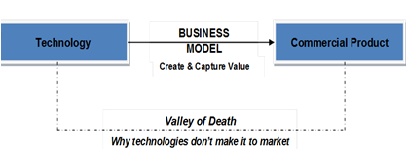
How to form and develop Technology based ventures?
Government policies:
Credit programs with State-subsidized rates
Share programs by Government venture-capital companies
Grants by the Government, especially for creating jobs and for research
Security programs by the Government for taking over part of the risk of the credit institutions for enterprises
Advisory services.

Slide 50
How to form and develop Technology based ventures?
Other support activities for enterprises with both public and private sector involvement, include:
Business consulting services:
Assistance with business development, developing business plans, tax advice, and so forth;
Technical consulting services:
More specialized services are provided such as:
Networking assistance between enterprises and science
Technology organizations,
Technology transfer,
The exchange of similar experiences and
The identification of potential for cooperation

Slide 51
Cont’d
Financing support activities:
Offer optimal conditions to enterprises, especially SMEs, in terms of:
rent and costs of spaces,
infrastructure and services.
Offer also assistance with accessing and using financial sources such as:
corporate financing,
business angels,
venture capital, and so forth;

Slide 52
Cont…
Intellectual property assistance:
Assistance with developing and patenting new and improved technology, including bringing it to the market for profit;
International assistance:
Assistance with the global networking of incubation and innovation centers for information exchange and technology transfer

Slide 53
Factors contributing to the Success of High Technology based Enterprises
The main catalytic factors for the success of high technology-based enterprises are :
national policies,
research and development institutions
technological entrepreneur development
innovative finance support systems & protecting intellectual property
science and technology parks
promoting and developing strategic business alliances and networking
standardization, quality control and marketing.

Slide 54
Technology transfer for business development
Technology transfer is, the process by which existing knowledge, facilities or capabilities are utilized and marketed to fulfill public and private needs.
It is the process by which basic science research and fundamental discoveries are developed into practical and commercially relevant applications and products.
Technology transfer processes constitutes technology transfer, technology promotion, technology deployment, technology innovation, technology development, technology research, technology assessment, technology information and communication, technology investment, technology collaboration and technology commercialization

Slide 55
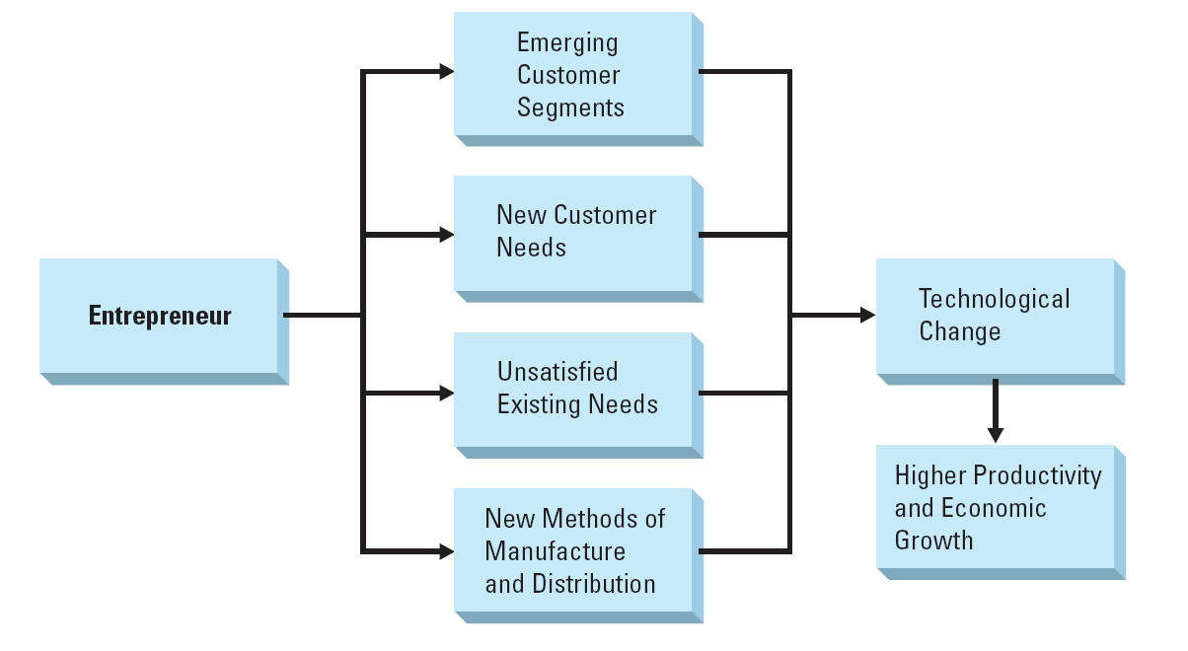
Entrepreneurship and Technological Change

Slide 56
THANK YOU

