Slide 1
Chapter Nine
Cryptography

Slide 2
Agenda
Cryptography overview
Symmetric key cryptography
Asymmetric key cryptography
Secure sockets layer (SSL) overview
Public key infrastructure
Streaming ciphers
Cryptographic Hashes
Steganography

Slide 3
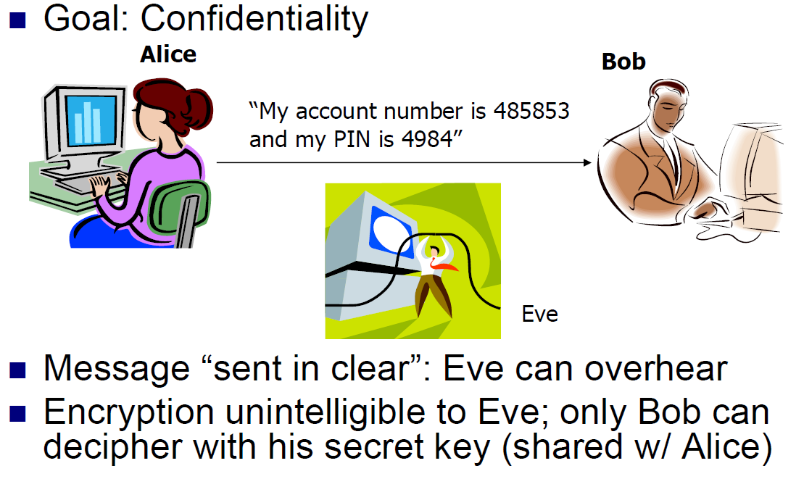
Introduction to Cryptography

Slide 4
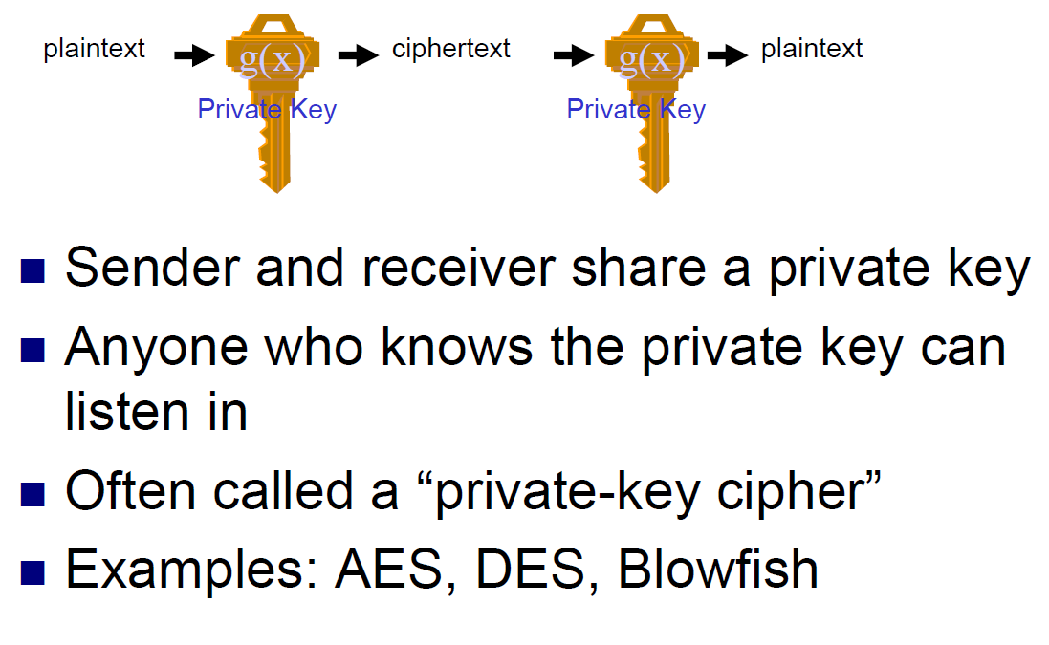
Symmetric Key Cryptography

Slide 5
Symmetric Cryptography Methods
Block Ciphers: blocks of 64, 128, or 256 bits are encrypted at one time
  Examples: DES, Triple DES, AES, Blowfish, IDEA, A5,Skipjack
  Each of these algorithms use different key lengths.
Stream Ciphers: only one byte or even a bit is
  encrypted at a time continuously
have different security properties, and some of them are ideal for different applications.

Slide 6
DES
Data Encryption Standard
was adopted in 1977 by the National Institute of Standards and Technology (NIST)
DES is a 64-bit block cipher.
  An n-bit block cipher encrypts n bits of plaintext at a time, and produces an n-bit result.
The key contains 8 parity bits
Was broken in 1998

Slide 7
Triple DES
Triple DES runs DES three times with three different keys.
Consists of taking an input message, m, encrypting with the first key (k1), decrypting the resulting message with the second key (k2), and then encrypting that message with the third key (k3).
Provides more security than DES
About three times slower than DES from a performance standpoint

Slide 8
AES
Advanced Encryption Standard
Adopted by NIST in October 2000 as a replacement for DES.
A replacement for DES and Triple DES that provides security with larger keys and faster execution time
Rijndael supports key and block sizes of 128, 192, and 256 bits, which is considerably larger than what DES offers
AES achieves better performance and uses less memory than DES or Triple DES

Slide 9
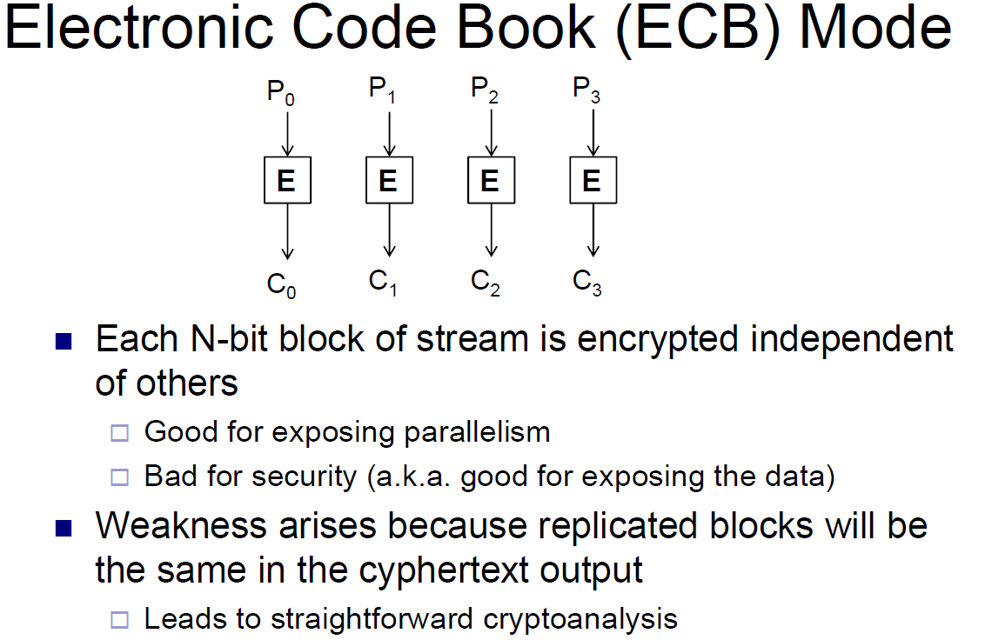
Encrypting More Data

Slide 10
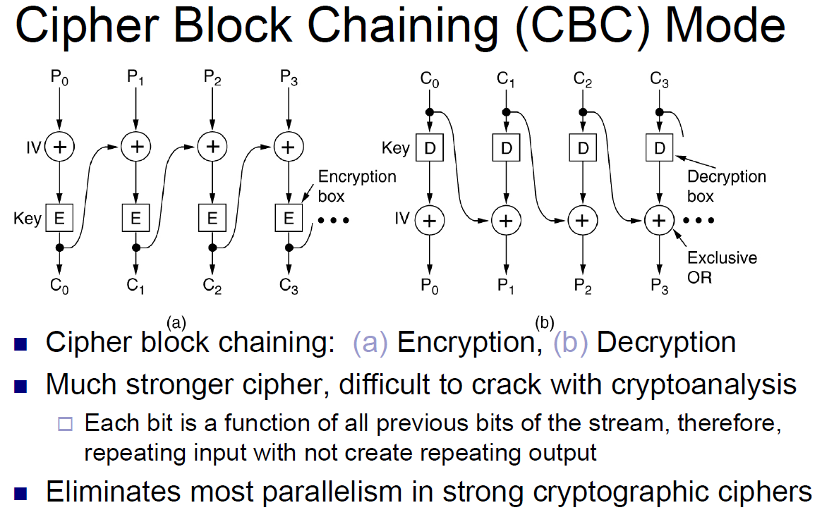
Encrypting More Data …

Slide 11
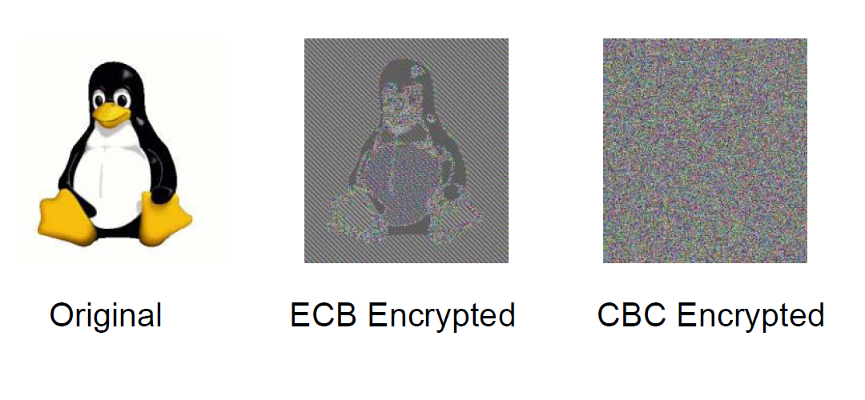
ECB vs. CBC Streaming Modes

Slide 12
Stream cipher
An infinite sequence of random bits is generated for use as the key, so the key bits are never reused
RC4 is a very popular stream cipher
Only one byte of plaintext is encrypted at a time
RC4 uses a fixed-size key as a “seed” that is used to generate an infinite stream of key bits

Slide 13
Steganography
All ciphers transform plaintext to random bits
Eve can tell Alice is sending sensitive info to Bob
Conceal existence of secret message
Use of a “covert channel” to send a message.

Slide 14
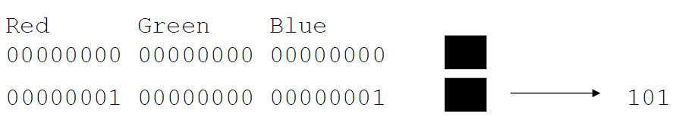
What is Steganography?
Study of techniques to send sensitive info and hide the fact that sensitive info is being sent
Ex: “All the tools are carefully kept” -> Attack
Other Examples: Invisible ink, Hidden in Images
Least significant bit of image pixels
Modifications to image not noticeable by an observer
Recipient can check for modifications to get message

Slide 15
Steganography vs. Cryptography
Key Advantage: when Alice & Bob don’t want Eve to know that they’re communicating secrets
Disadvantages compared to encryption
  Essentially relying on security by obscurity
  Useless once covert channel is discovered
  High overhead (ratio of plain bits/secret bits high)
Can be used together with encryption, but even more overhead (additional computation for both)

Slide 16
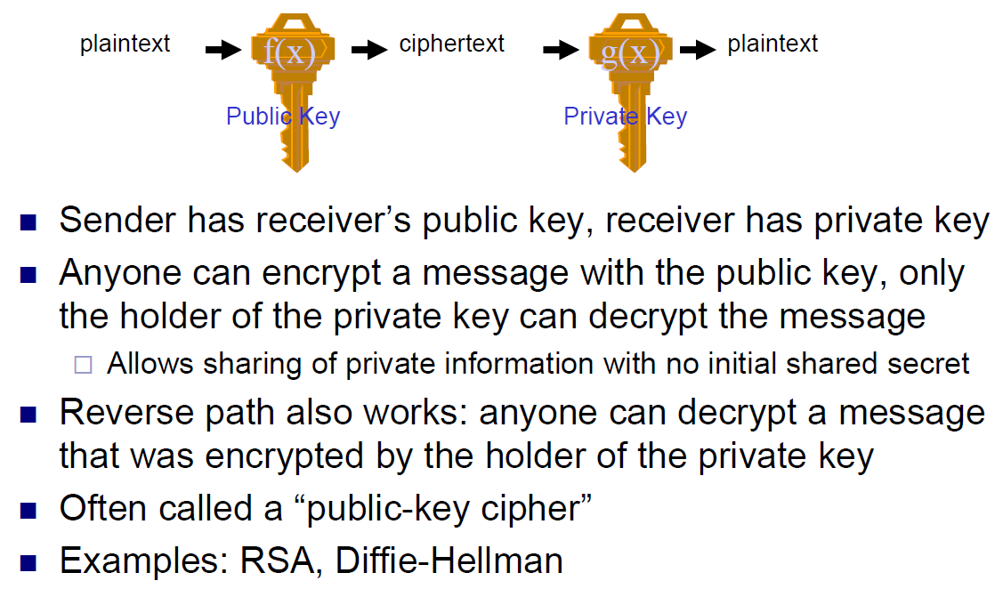
Asymmetric Key Cryptography

Slide 17
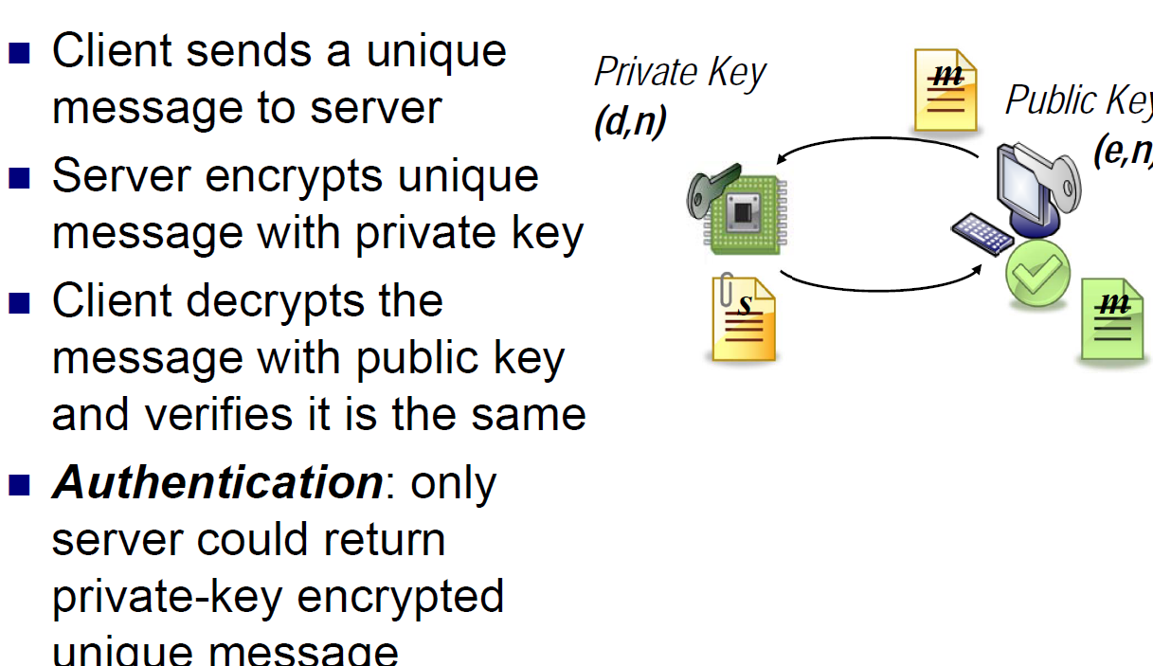
RSA Authentication

Slide 18
Symmetric vs. Asymmetric Ciphers
Symmetric Ciphers
  Fast to compute
  Require prior shared knowledge to establish private communication
Asymmetric Ciphers
  Orders of magnitude slower to compute
  No shared secrets required to establish private communication
Individual benefits create a need for both types of cryptography

Slide 19
Public-Key Infrastructure (PKI)
Anyone can send Bob a secret message
  Provided they know Bob’s public key
How do we know a key belongs to Bob?
  If imposter substitutes another key, can read Bob’s mail
One solution: PKI
  Trusted root authority (VeriSign, IBM, United Nations)
    Everyone must know the verification key of root authority
  Root authority can sign certificates
  Certificates identify others, including other authorities
  Leads to certificate chains

Slide 20
Verifying Integrity: Hash Functions
Goal: provide a (nearly) unique “fingerprint” of message
Hash function for L-bit hash must have three properties:
  1. Fast to compute y from m.
  2. One-way: given y = h(m), can’t find m’ satisfying h(m’) = y without O(2L) search
  3. Strongly collision-free: For m1 != m2, we find h(m1)=h(m2) with probability 1/2L
Widely useful tool, e.g., Has this web page changed?
Examples: MD5 (cryptographically broken), SHA-1, SHA-2

Slide 21
MACs and Signatures
A MAC is a sequence of bits that can be attached to a message to verify where it originated and that it has not been tampered with
Two types of MACs: one based on block ciphers and one based on hash functions

