Slide 1
Chapter Eight
Password Security

Slide 2
Agenda
Password systems ubiquitous, vulnerable
Early password security studies (1979) - Morris, Thompson: 86% of passwords can be cracked
Threats: Online & Offline Dictionary Attacks
Solutions: Hashing & Salting
Additional Password Security Techniques

Slide 3
8.1. A Strawman Proposal
Basic password system: file with username, password records (colon delimiter)
    john:automobile
    mary:balloon
    joe:wepntkas
Simple to implement, but risky
  All users compromised if hacker gets the passwd file
  Initial implementation in Java: MiniPasswordManager

Slide 4
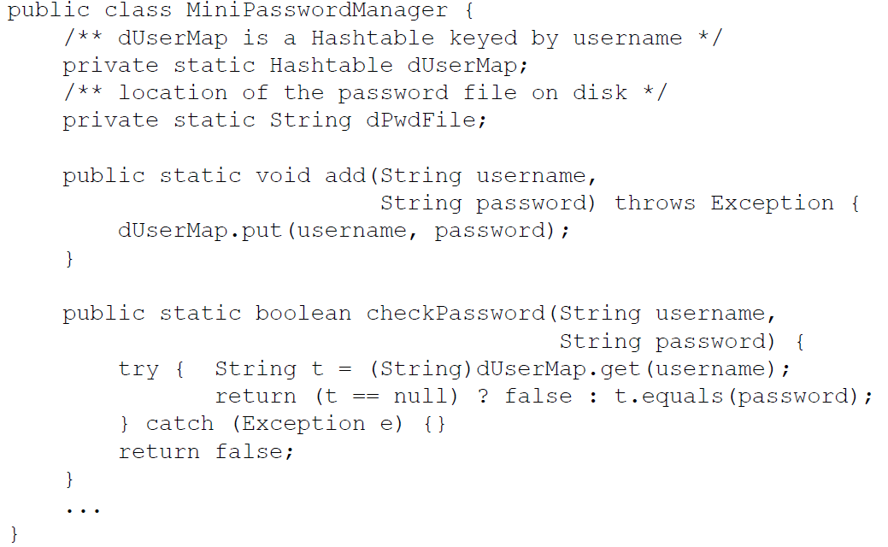
8.1. MiniPasswordManager

Slide 5
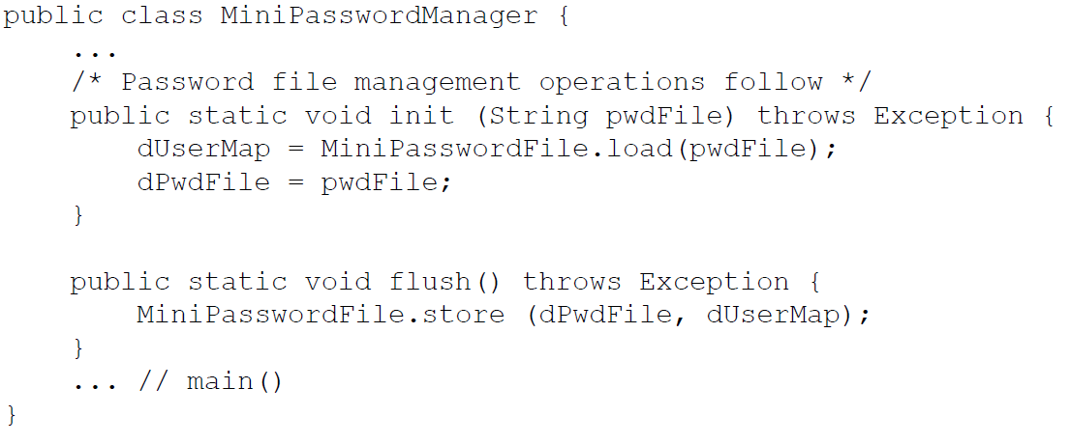
8.1. MPM: File Management

Slide 6
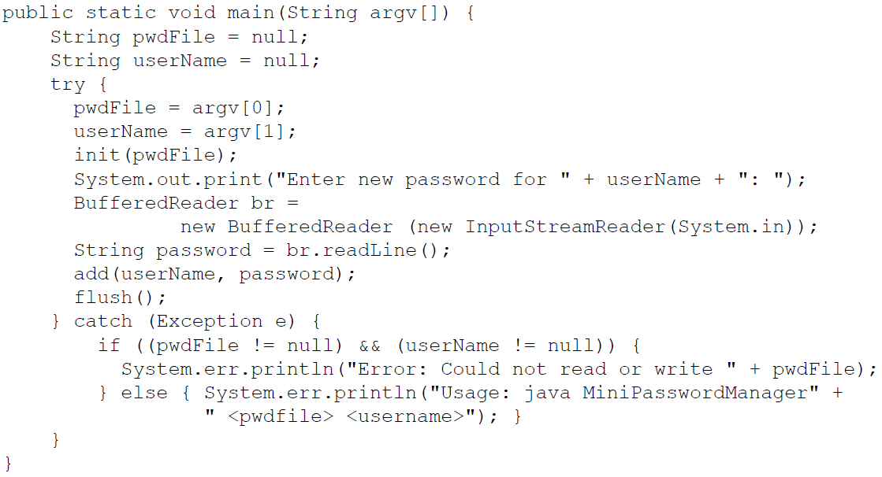
8.1. MPM: main()

Slide 7
8.1. MPM Analysis
Two key functions: username, password args
  add() – add entry to dUserMap hashtable
  checkPassword() – lookup in dUserMap
Read/Write dUserMap from/to disk using init()/store() flush()
MiniPasswordFile helper class exposes and load() methods for these tasks
More to do to make secure…

Slide 8
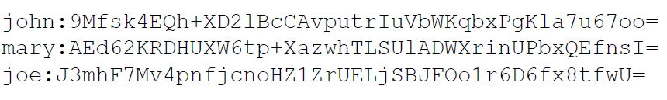
8.2. Hashing
Encrypt passwords, don’t store “in the clear”
  Could decrypt (e.g. DES) to check, key storage?
  Even better: “one-way encryption”, no way to decrypt
  If file stolen, passwords not compromised
  Use one-way hash function, h: preimage resistant
  Ex: SHA-1 hashes stored in file, not plaintext passwd

Slide 9
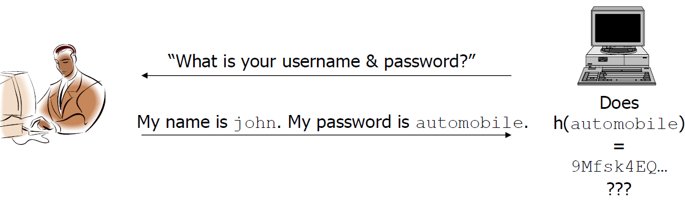
8.2. Hashing Example
Hash: “One-way encryption”
  No need to (can’t) decrypt
  Just compare hashes
  Plaintext password not in file, not “in the clear”

Slide 10
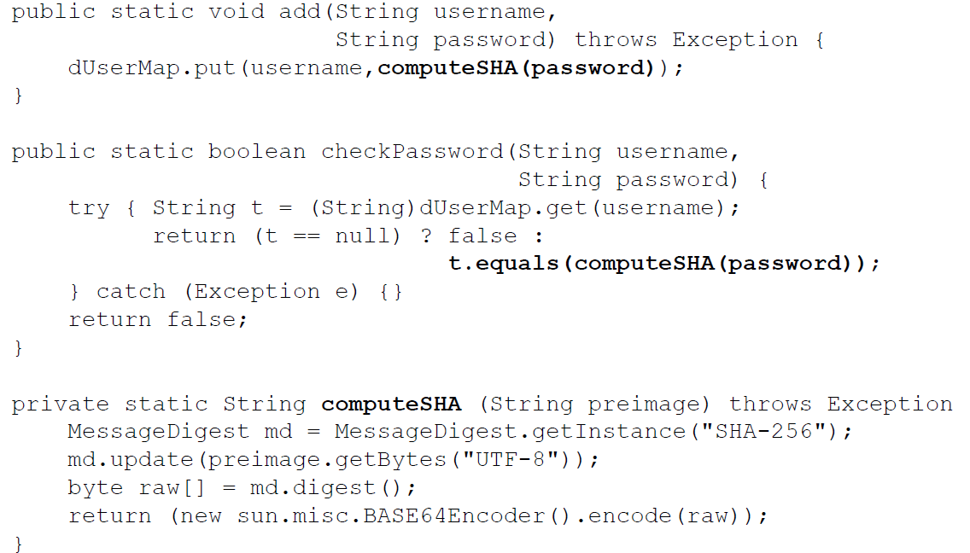
8.2. Hashing MPM Modifications

Slide 11
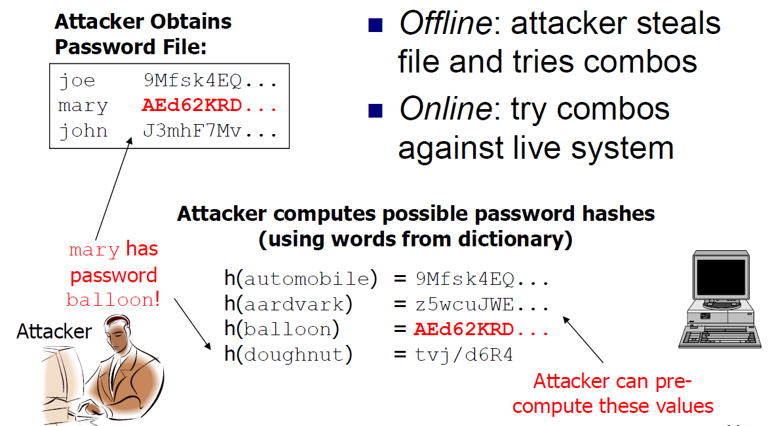
8.3. Off-line Dictionary Attacks

Slide 12
8.4. Salting
Salting – include additional info in hash
Add third field to file storing random # (salt)
Example Entry: john with password automobile
  john:ScF5GDhWeHr2q5m7mSDuGPVasV2NHz4kuu5n5eyuMbo=:1515
Hash of password concatenated with salt:
    h(automobile|1515) = ScF5GDhW...

Slide 13
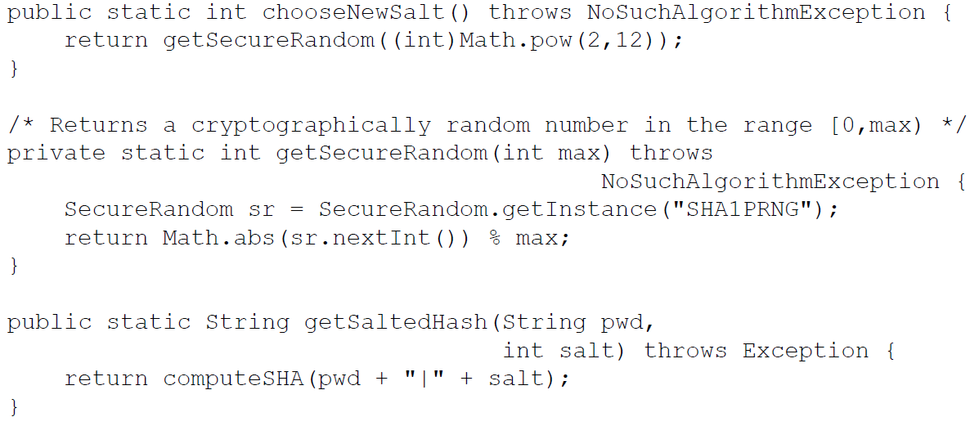
8.4. Salting Functions

Slide 14
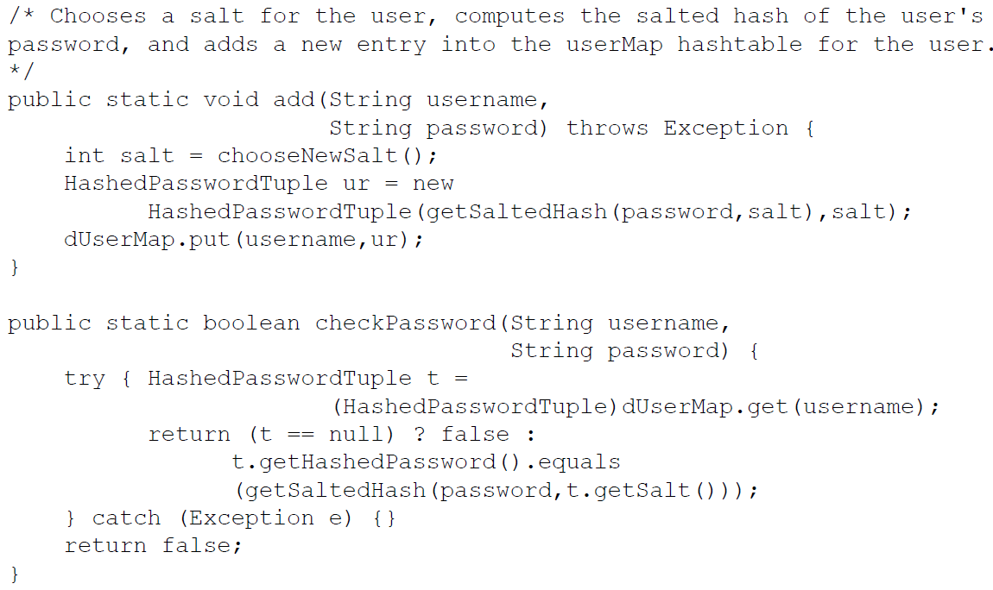
8.4. Salting in MPM (1)

Slide 15
8.4. Salting in MPM (2)
dUserMap stores HashedPasswordTuple, hashed password and salt
To add(), we chooseNewSalt() to getSecureRandom() number in [0, 4096)
getSaltedHash() to compute h(passwd|salt)
checkPassword() by comparing hash on file w/ salted hash of input password and salt on file

Slide 16
8.4. Salting: Good News
Dictionary attack against arbitrary user is harder
  Before Salts: hash word & compare with password file
  After Salts: hash combos of word & possible salts

Slide 17
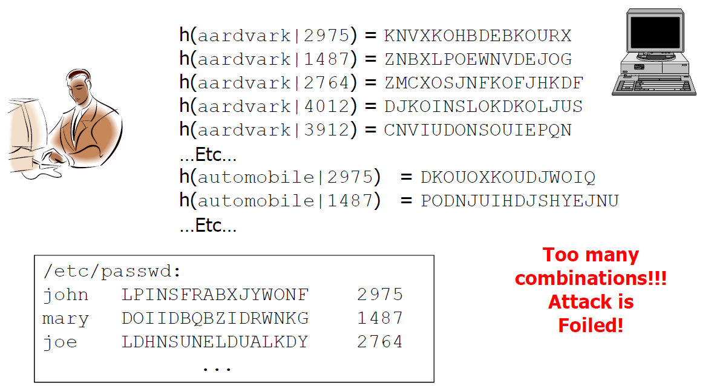
8.4. Off-line Dictionary Attack Foiled!

Slide 18
8.6. Additional Password Security Techniques
Several other techniques to help securely manage passwords: Mix and match ones that make sense for particular app
Strong Passwords Limiting Logins
“Honeypots” Aging
Filtering Pronounceable
Artificial Delays Last Login
Image Authentication One-Time Passwords

Slide 19
8.6.1. Strong Passwords
Not concatenation of 1 or more dictionary words
Long as possible: letters, numbers, special chars
Can create from long phrases:
  Ex: “Nothing is really work unless you would rather be doing something else” -> n!rWuUwrbds3
  Use 1st letter of each word, transform some chars into visually or phonetically similar ones
Protect password file, limit access to admin
  UNIX used to store in /etc/passwd (readable by all)
  Now stored in /etc/shadow (req’s privileges/admin)

Slide 20
8.6.2. “Honeypot” Passwords
Simple username/password (guest/guest) combos as “honey” to attract attackers
Bait attackers into trying simple combos
Alert admin when “booby-trap” triggered
Could be indication of attack
ID the IP and track to see what they’re up to

Slide 21
8.6.3. Password Filtering
Let user choose password
  Within certain restrictions to guarantee stronger password
  Ex: if in the dictionary or easy to guess
May require mixed case, numbers, special chars
  Can specify set of secure passwords through regular expressions
  Also set a particular min length

Slide 22
8.6.4. Aging Passwords
Encourage/require users to change passwords every so often
  Every time user enters password, potential for attacker to eavesdrop
  Changing frequently makes any compromised password of limited-time use to attacker
Could “age” passwords by only accepting it a certain number of times
But if required to change too often, then users will use insecure workarounds, e.g., post-it notes

Slide 23
8.6.5. Pronounceable Passwords
Users want to choose dictionary words because they’re easy to remember
Pronounceable Passwords
  Non-dictionary words, but also easy to recall
  Syllables & vowels connected together

Slide 24
8.6.6. Limited Login Attempts
Allow just 3-4 logins, then disable or lock account
  Attacker only gets fixed number of guesses
  Inconvenient to users if they’re forgetful
  Legitimate user would have to ask sys admin to unlock or reset their password
  Potential for DoS attacks if usernames compromised and attacker guesses randomly for all, locking up large percentage of users of system

Slide 25
8.6.7 Artificial Delays
Artificial delay when user tries login over network
Wait 2n seconds after nth failure from particular IP address
  Only minor inconvenience to users (it should only take them a couple of tries, 10 seconds delay at most)
  But makes attacker’s guesses more costly, decreases number of guesses they can try in fixed time interval

Slide 26
8.6.8. Last Login
Notify user of last login date, time, location each time they login
  Educate them to pay attention
  Tell user to report any inconsistencies
Discrepancies = indications of attacks
Catch attacks that may not have been noticed
  Ex: Alice usually logs in monthly from CA
  Last login was 2 weeks ago in Russia
  Alice knows something’s wrong, reports it

Slide 27
8.6.9. Image Authentication
Combat phishing: images as second-factor
Ask users to pick image during account creation
  Display at login after username is entered
  Phisher can’t spoof the image
  Educate user to not enter password if he doesn’t see the image he picked
Recently deployed by PassMark, used on
  www.bofa.com and other financial institutions

Slide 28
8.6.10. One-Time Passwords
Multiple uses of password gives attacker multiple opportunities to steal it
OTP: login in with different password each time
Devices generate passwords to be used each time user logs in
  Device uses seed to generate stream of passwords
  Server knows seed, current time, can verify password
OTP devices integrated into PDAs, cell-phones

