Slide 1
Chapter Six
Client-State Manipulation

Slide 2
Agenda
Web application – collection of programs used by server to reply to client (browser) requests
  Often accept user input: don’t trust, validate!
HTTP is stateless, servers don’t keep state
  To conduct transactions, web apps have state
  State info may be sent to client who echoes it back in future requests
Example Exploit: “Hidden” parameters in HTML are not really hidden, can be manipulated

Slide 3
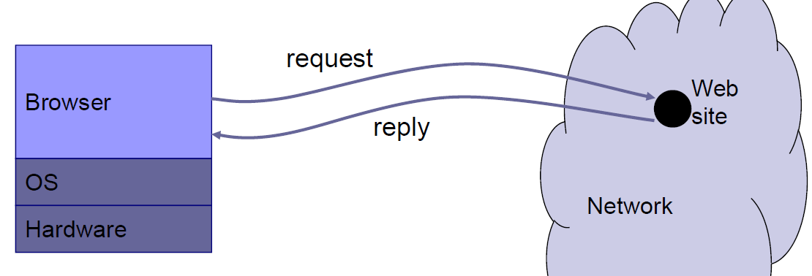
Browser and Network
Browser sends requests
  May reveal private info (in forms, cookies)
Browser receives information, code
  May corrupt state by running unsafe code
Interaction susceptible to network attacks
  Consider network security later
  in the course

Slide 4
HyperText Transfer Protocol
Used to request and return data
  Methods: GET, POST, HEAD, …
Stateless request/response protocol
  Each request is independent of previous requests
  Statelessness has a significant impact on design and implementation of applications
Evolution
  HTTP 1.0: simple
  HTTP 1.1: more complex

Slide 5
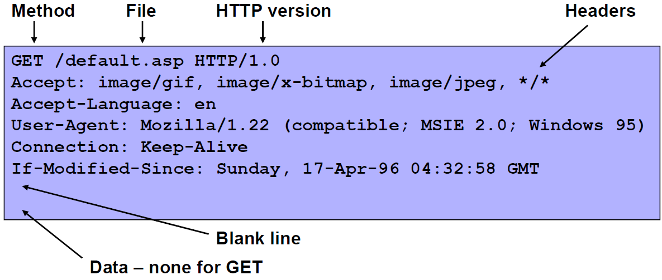
HTTP Request

Slide 6
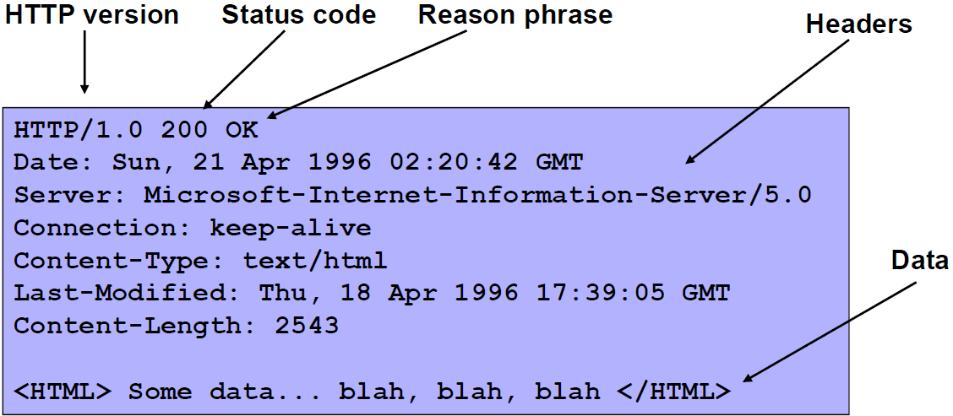
HTTP Response

Slide 7
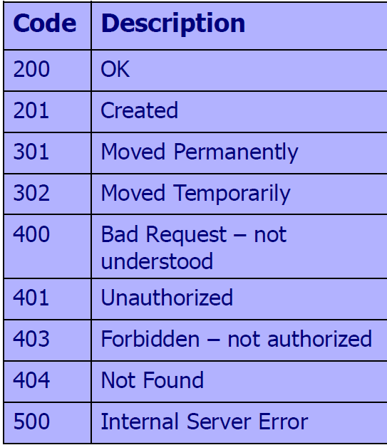
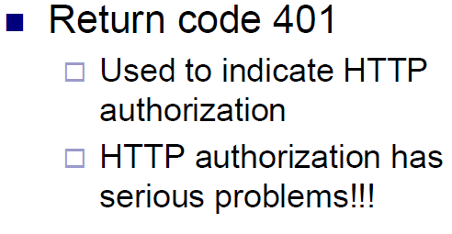
HTTP Server Status Codes

Slide 8
6.1. Pizza Delivery Web Site Example
Web app for delivering pizza
  Online order form: order.html – say user buys one pizza @ $5.50
  Confirmation form: generated by confirm_order script, asks user to verify purchase, price is sent as hidden form field
  Fulfillment: submit_order script handles user’s order received as GET request from confirmation form (pay & price variables embedded as parameters in URL)

Slide 9
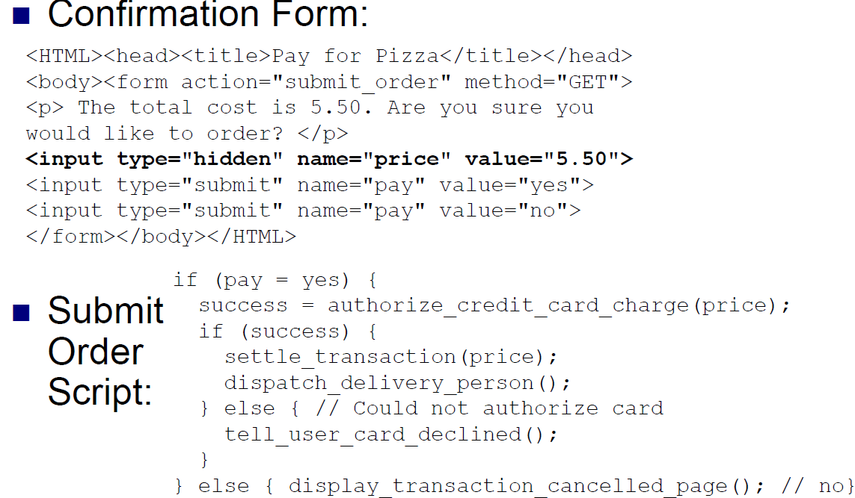
6.1. Pizza Web Site Code

Slide 10
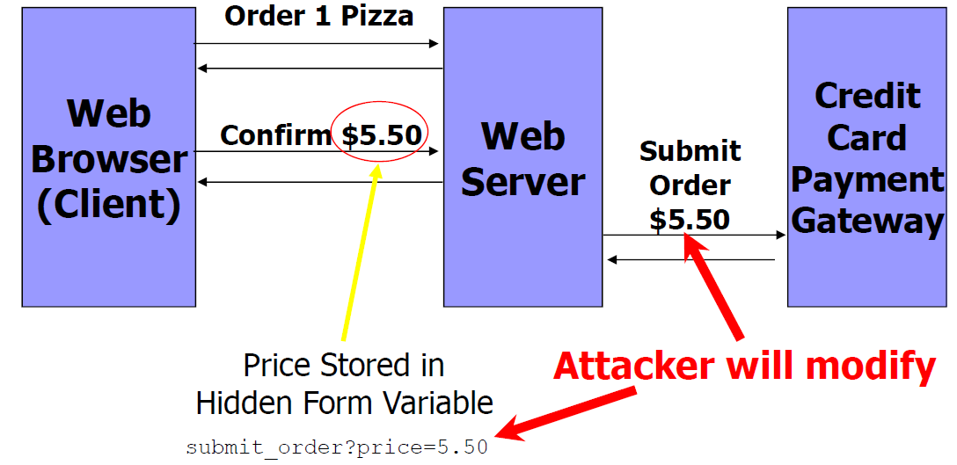
6.1. Buying Pizza Example

Slide 11
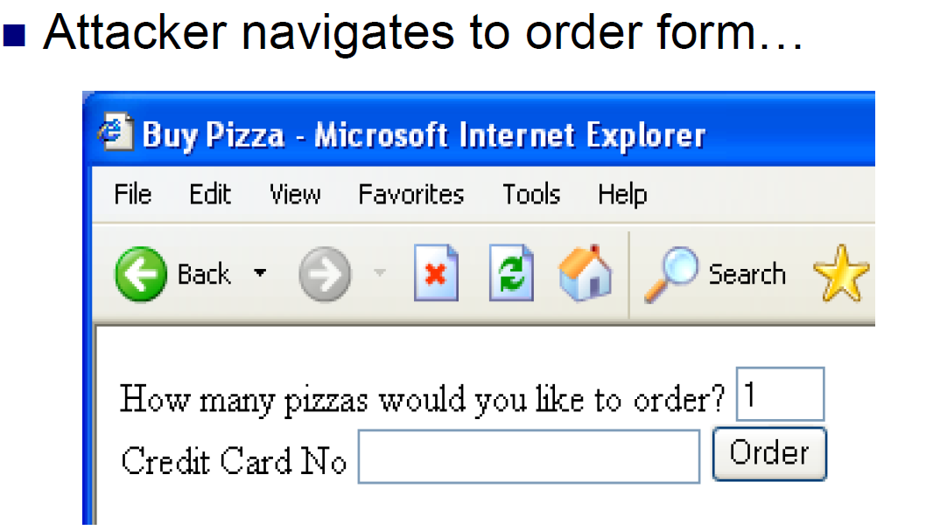
6.1.1. Attack Scenario (1)

Slide 12
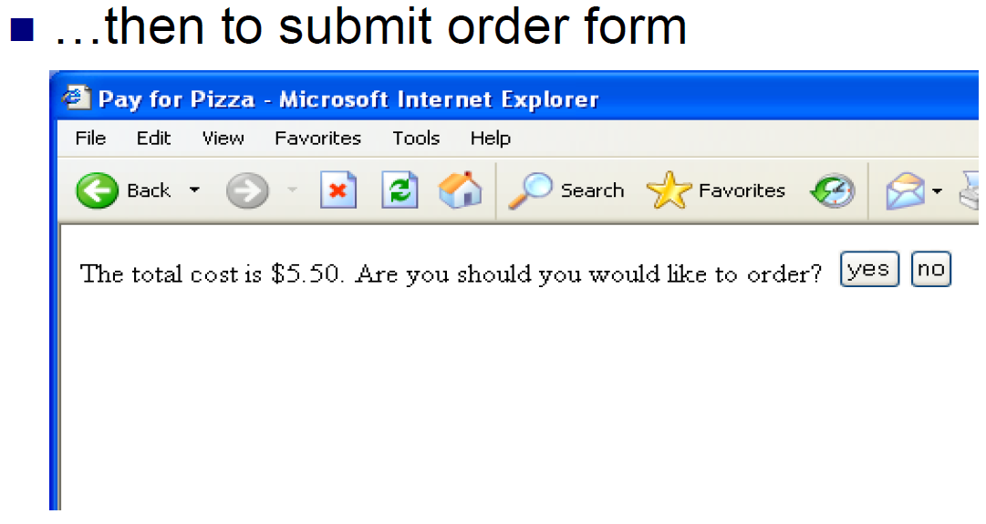
6.1.1. Attack Scenario (2)

Slide 13
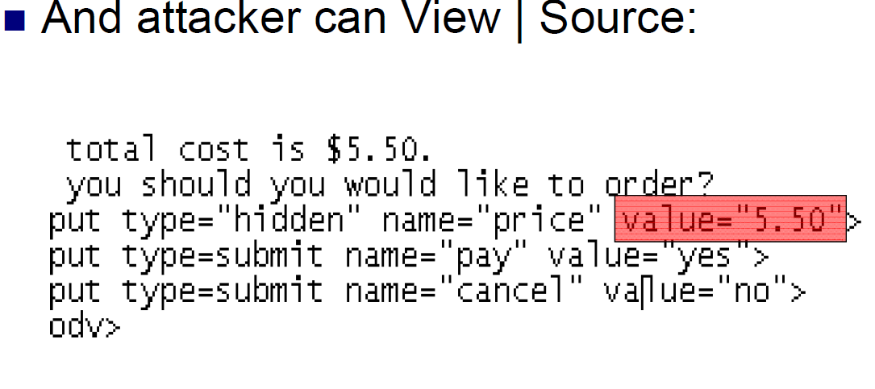
6.1.1. Attack Scenario (3)

Slide 14
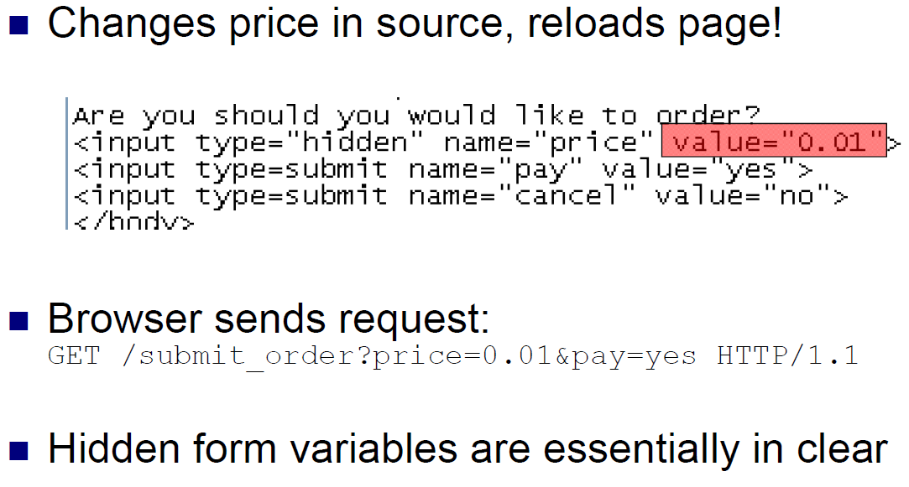
6.1.1. Attack Scenario (4)

Slide 15
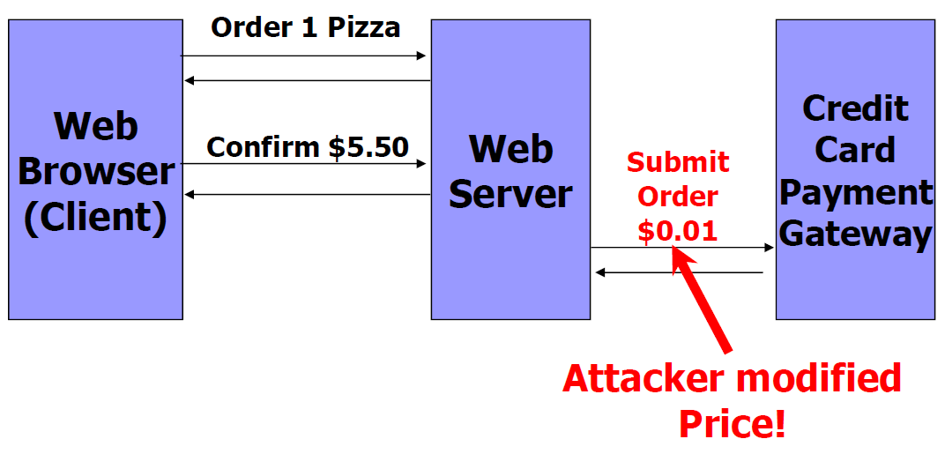
6.1.1. Attack Scenario (5)

Slide 16
6.1.1. Attack Scenario (6)
Command-line tools to generate HTTP requests
  curl or Wget automates & speeds up attack:
    Curlhttps://www.deliver-me-izza.com/submit_order ?price=0.01&pay=yes
  Even against POST, can specify params as arguments to curl or wget command
    curl -dprice=0.01 -dpay=yes https://www.deliver-mepizza.com/submit_order
    wget --post-data 'price=0.01&pay=yes https://www.deliver-me-pizza.com/submit_order

Slide 17
6.1.2. Solution 1: Authoritative State Stays on Server
Server sends session-id to client
  Server has table mapping session-ids to prices
  Randomly generated (hard to guess) 128-bit id sent in hidden form field instead of the price.
  <input type="hidden" name="session-id“ value="3927a837e947df203784d309c8372b8e“>
New Request
GET/submit_order?session-id=3927a837e947df203784d309c8372b8e&pay=yes HTTP/1.1

Slide 18
6.1.2. Solution 1 Changes
submit_order script changes:
  if (pay = yes) {
    price = lookup(session-id); // in table
    if (price != NULL) {
    // same as before
    }
    else { // Cannot find session
    display_transaction_cancelled_page();
    log_client_IP_and_info(); }
    } else {
    // same no case
  }

Slide 19
6.1.2. Session Management
128-bit session-id, n = # of session-ids
  Limit chance of correct guess to n/2128.
  Time-out idle session-ids
  Clear expired session-ids
  Session-id: hash random # & IP address – harder to attack (also need to spoof IP)
Con: server requires DB lookup for each request
  Performance bottleneck – possible DoS from attackers sending random session-ids
  Distribute DB, load balance requests
  Sessions ID can be stolen if transmitted in the clear

Slide 20
6.1.3. Solution 2: Signed State To Client
Keep Server stateless, attach a signature to state and send to client
  Can detect tampering through MACs
  Sign whole transaction (based on all parameters)
  Security based on secret key known only to server
<input type="hidden" name="item-id" value="1384634">
<input type="hidden" name="qty" value="1">
<input type="hidden" name="address" value="123 Main St, Stanford, CA">
<input type="hidden" name="credit_card_no" value="5555 1234 4321 9876">
<input type="hidden" name="exp_date" value="1/2012">
<input type="hidden" name="price" value="5.50">
<input type="hidden" name="signature“
value="a2a30984f302c843284e9372438b33d2">

Slide 21
6.1.3. Solution 2 Analysis
Changes in submit_order script:
  if (pay = yes) {
  // Aggregate transaction state parameters
  // Note: | is concatenation operator, # a delimiter.
  state = item-id | # | qty | # | address | # |
  credit_card_no | # | exp_date | # | price;
  //Compute message authentication code with server key K.
  signature_check = MAC(K, state);
  if (signature == signature_check) { // proceed normally }
  else { // Invalid signature: cancel & log }
  } else { // no pay – cancel}
  Can detect tampered state vars from invalid signature
Results in a performance hit
  Compute MACs when processing HTTP requests
  Stream state info to client -> extra bandwidth

Slide 22
6.2. Other Problems with GET
GET: form params (e.g. session-id) leak in URL
  Could anchor these links in lieu of hidden form fields
  Alice sends Meg URL in e-mail, Meg follows it & continues transaction w/o Alice’s consent
Referers can leak through outlinks:
  This <a href="http://www.grocery-store-site.com/"> link
Sends request: GET / HTTP/1.1 Referer: https://www.deliver-me-pizza.com/submit_order? session-id=3927a837e947df203784d309c8372b8e
Session-id leaked to grocery-store-site’s logs!

Slide 23
6.3. Cookies
Cookie - piece of state maintained by client
  Server gives cookie to client
  Client returns cookie to server in HTTP requests
  Ex: session-id in cookie in lieu of hidden form field
HTTP/1.1 200 OK
Set-Cookie: session-id=3927a837e947df203784d309c8372b8e; secure
Secure dictates using SSL
Browser Replies:
GET /submit_order?pay=yes HTTP/1.1
Cookie: session-id=3927a837e947df203784d309c8372b8e

Slide 24
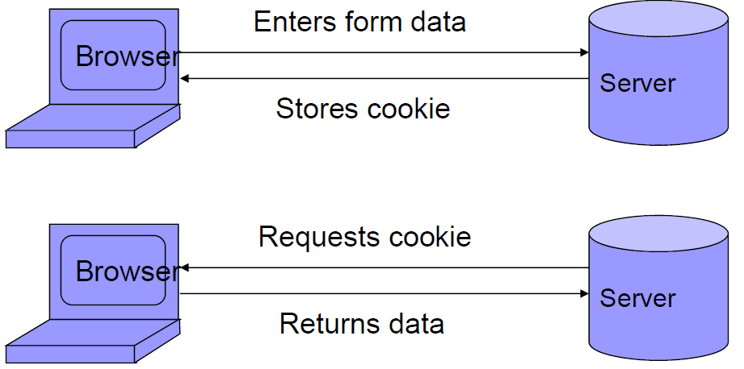
Store info across sessions?
Cookies
A cookie is a file created by an Internet site to store information on your computer

Slide 25
Browser Cookie Management
Cookie Ownership
  Once a cookie is saved on your computer, only the Web site that created the cookie can read it
Variations
  Temporary cookies
    Stored until you quit your browser
  Persistent cookies
    Remain until deleted or expire
  Third-party cookies
    Originates on or sent to another Web site

Slide 26
Third-Party Cookies
Example: browsing the Yahoo! Website
  Yahoo! sends most of the advertisements you see
  However, they also allow … third-party ad servers … to serve advertisements
  Because your web browser must request these … from the ad network web site, these companies can send their own cookies to your cookie file ...
  Popular ad servers use this cookie to track your actions around the web
  Opting Out of Third-Party Ad Servers
    “If you want to prevent a third-party ad server from sending and reading cookies on your computer, currently you must visit each ad network's web site individually and opt out (if they offer this capability).”

Slide 27
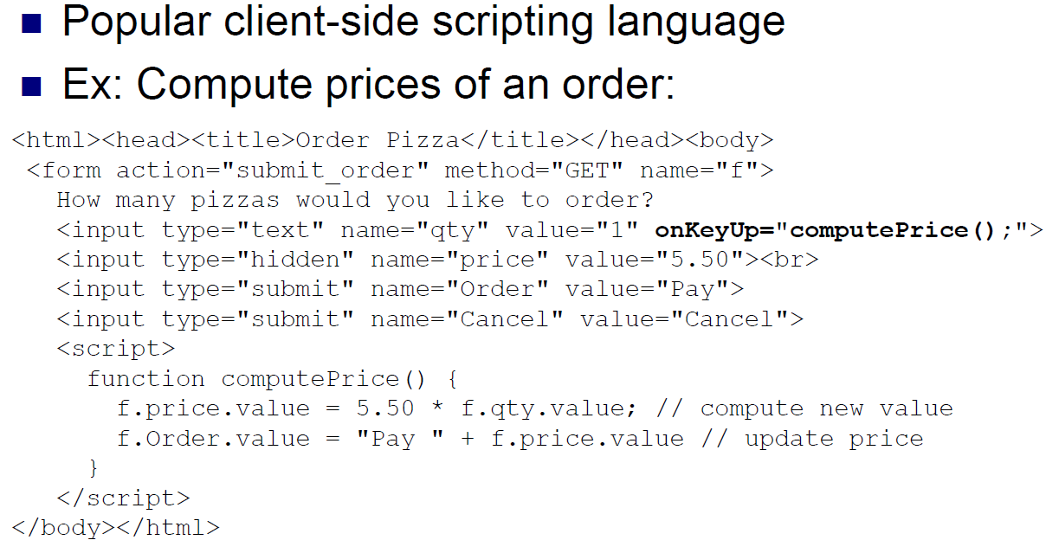
6.4. JavaScript (1)

Slide 28
6.4. JavaScript (2)
Evil user can just delete JavaScript code, substitute desired parameters & submit!
  Could also just submit request & bypass JavaScript
  GET /submit_order?qty=1000&price=0&Order=Pay
Warning: data validation or computations done by JavaScript cannot be trusted by server
  Attacker may alter script in HTML code to modify computations
  Must be redone on server to verify

