Slide 1
5-Chapter Five
Worms and Other Malware

Slide 2
Agenda
Worms spreading across Internet through vulnerabilities in software
History of Worms
  Morris Worm
  Code Red
  Nimda
  Blaster & SQL Slammer
Rootkits, Botnets, Spyware, and more Malware

Slide 3
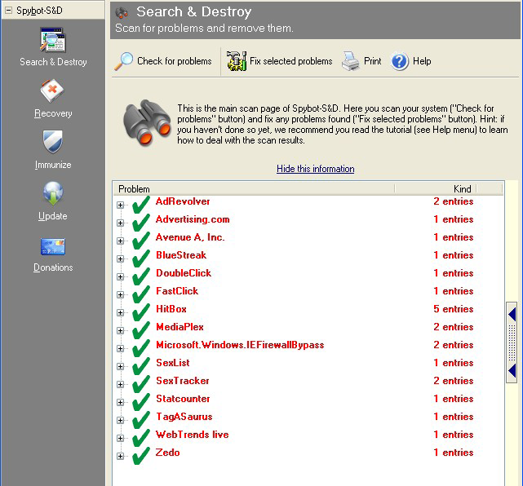
The Malware Zoo
Virus
Backdoor
Trojan horse
Rootkit
Scareware
Adware
Worm

Slide 4

What is a Virus ?
a program that can infect other programs by modifying them to include a, possibly evolved, version of itself
Fred Cohen 1983

Slide 5
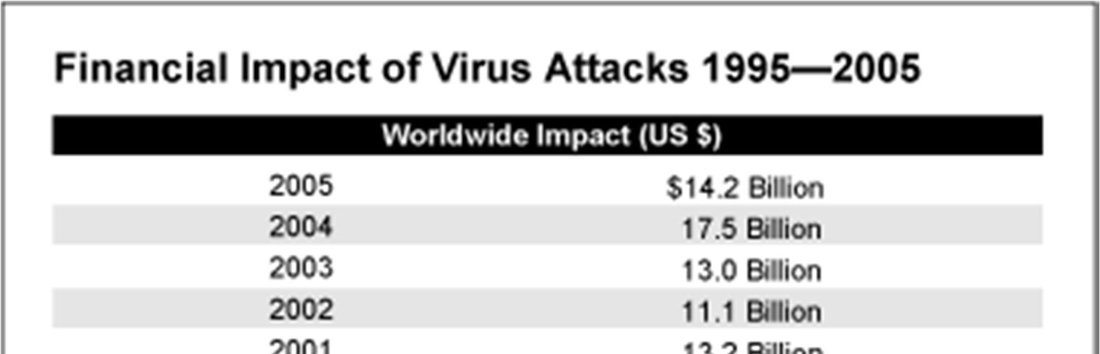
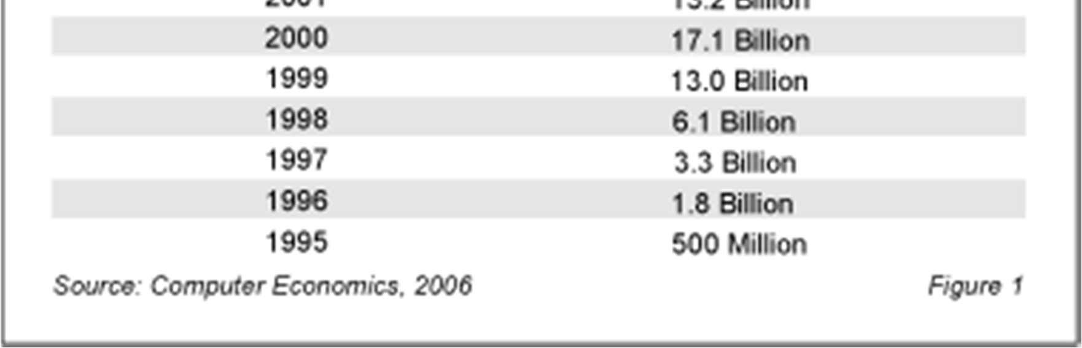
Aggregate statistics

Slide 6
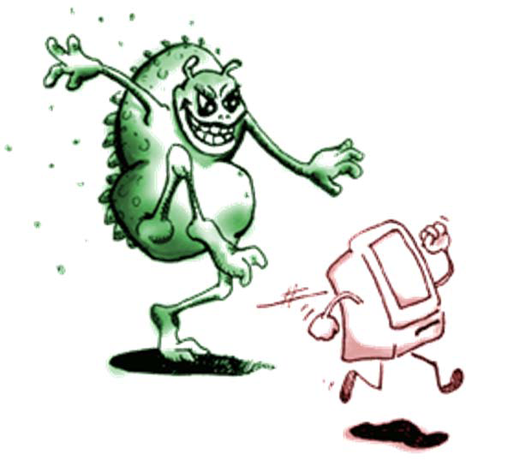
Some Virus Types
Polymorphic : uses a polymorphic engine to mutate while keeping the original algorithm intact (packer)
Metamorpic : Change after each infection

Slide 7
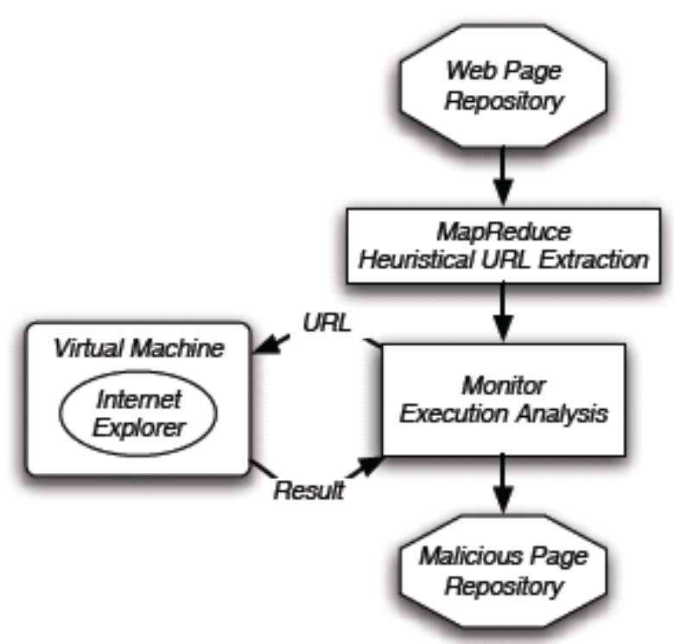
Distributing Virus and Other Malware
Most malware distribution through drive-by downloads (i.e. automatic installation of binary when visiting website)
  Uses pull-based model (e.g. links)
  Maximizes exposure by getting as many links as possible to malware distribution site
Search engines such as Google mark pages as potentially malicious to prevent

Slide 8
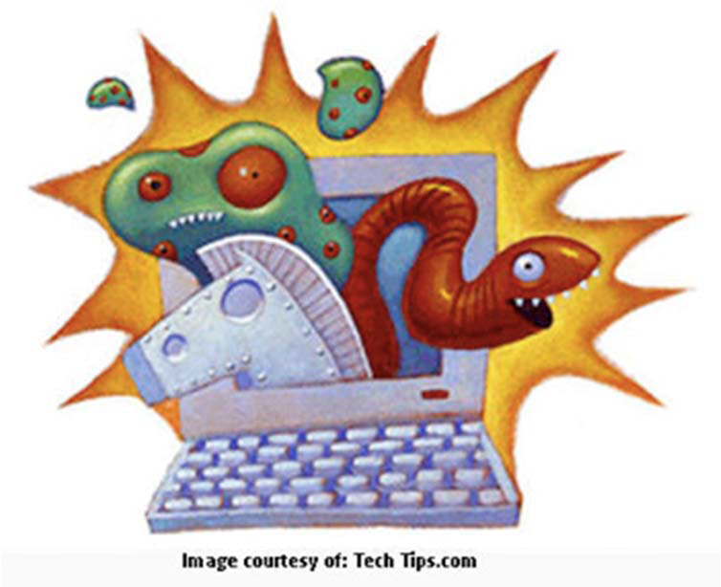
What is a worm
A computer worm is a self-replicating computer program. It uses a network to send copies of itself to other nodes and do so without any user intervention.

Slide 9
5.1. Virus vs. Worm
Virus: program that copies itself into other programs
  Could be transferred through infected disks
  Rate dependent on human use
Worm: a virus that uses the network to copy itself onto other computers
Worms propagate faster than viruses
  Large # of computers to infect
  Connecting is fast (milliseconds)

Slide 10
What is a trojan
A trojan describes the class of malware that appears to perform a desirable function but in fact performs undisclosed malicious functions that allow unauthorized access to the victim computer
Wikipedia

Slide 11
What is rootkit
A root kit is a component that uses stealth to maintain a persistent and undetectable presence on the machine
Symantec

Slide 12
Almost 30 years of Malware

Slide 13

Cost of worm attacks
Morris worm, 1988
  Infected approximately 6,000 machines
    10% of computers connected to the Internet
  cost ~ $10 million in downtime and cleanup
Code Red worm, July 16 2001
  Direct descendant of Morris’ worm
  Infected more than 500,000 servers
    Programmed to go into infinite sleep mode July 28
  Caused ~ $2.6 Billion in damages,
Love Bug worm: $8.75 billion

Slide 14
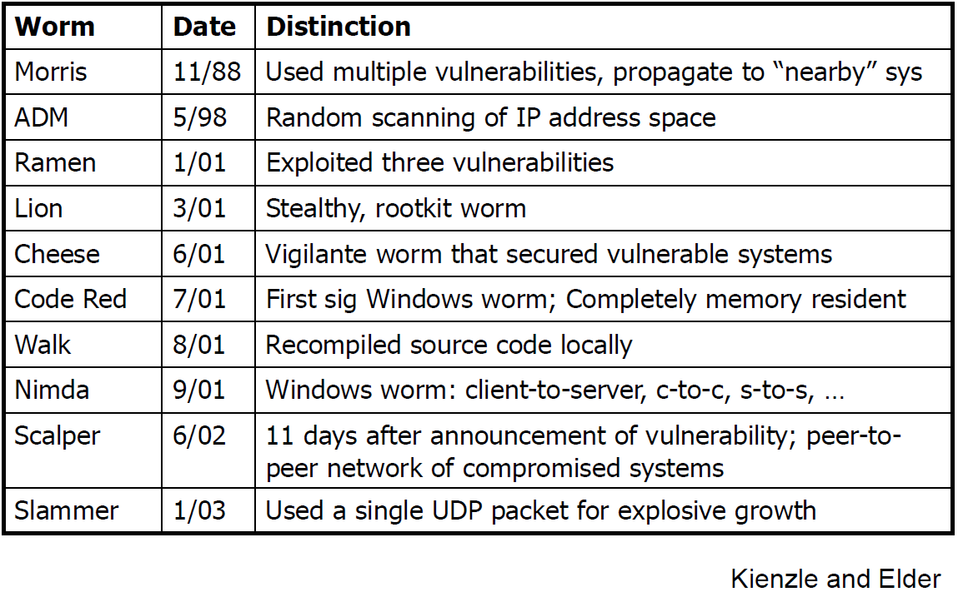
Some historical worms of note

Slide 15
2 Morris Worm: What It Did
Damage: 6000 computers in just few hours
Extensive network traffic by worm propagating
What: just copied itself; didn’t touch data
Exploited and used:
  buffer overflow in fingerd (UNIX)
  sendmail debug mode (execute arbitrary commands such as copying worm to another machine)
  dictionary of 432 frequently used passwords to login and remotely execute commands via rexec, rsh

Slide 16
Morris’ sendmail attack
Worm used debug feature
  Opens TCP connection to machine's SMTP port
  Invokes debug mode
  Sends a RCPT TO that pipes data through shell
  Shell script retrieves worm main program
    places 40-line C program in temporary file called x$$,l1.c where $$ is current process ID
    Compiles and executes this program
    Opens socket to machine that sent script
    Retrieves worm main program, compiles it and runs

Slide 17
Morris’ fingerd attack
Written in C and runs continuously
Array bounds attack
  Fingerd expects an input string
  Worm writes long string to internal 512-byte buffer
Attack string
  Includes machine instructions
  Overwrites return address
  Invokes a remote shell
  Executes privileged commands

Slide 18
Morris’ remote shell attack
Unix trust information
  /etc/host.equiv – system wide trusted hosts file
  /.rhosts and ~/.rhosts – users’ trusted hosts file
Worm exploited trust information
  Examining files that listed trusted machines
  Assume reciprocal trust
    If X trusts Y, then maybe Y trusts X
Password cracking
  Worm was running as daemon (not root) so needed to break into accounts to use .rhosts feature
  Dictionary attack, used ~400 common password strings

Slide 19
The Morris worm itself
Program is called 'sh‘
  Clobbers argv array so a 'ps' will not show its name
  Opens its files, then unlinks (deletes) them so can't be found
    Since files are open, worm can still access their contents
Tries to infect as many other hosts as possible
  When worm successfully connects, forks a child to continue the infection while the parent keeps trying new hosts
Worm did not:
  Delete system's files, modify existing files, install trojan horses, record or transmit decrypted passwords, capture superuser privileges, propagate over UUCP, X.25, DECNET, or BITNET

Slide 20
Detecting Morris’ Internet Worm
Files
  Strange files appeared in infected systems
  Strange log messages for certain programs
System load
  Infection generates a number of processes
  Systems were reinfected => number of processes grew and systems became overloaded
    Apparently not intended by worm’s creator
Thousands of systems were shut down

Slide 21
Stopping the Morris worm
System admins busy for several days
◻ Devised, distributed, installed modifications
■ Perpetrator
◻ Student at Cornell; discovered quickly and charged
◻ Sentence: community service and $10,000 fine
■ Program did not cause deliberate damage
■ Tried (failed) to control # of processes on host machines
■ Lessons?
◻ Security vulnerabilities come from system flaws
◻ Diversity is useful for resisting attack
◻ “Experiments” can be dangerous

Slide 22
5.2.2. The Morris Worm:
What We Learned
Diversity is good: Homogenity of OSes on
network -> attacker can exploit vulnerabilities
common to most machines
■ Large programs more vulnerable to attack
◻ sendmail was large, more bug-prone
◻ fingerd was small, but still buggy
■ Limiting features limits holes: sendmail debug
feature should have been turned off
■ Users should choose good passwords:
dictionary attack would have been harder

Slide 23
5.2.3. The Creation of CERT
Computer Emergency Response Team (CERT)
created due to damage and disruption caused
by Morris worm
■ Has become a leading center on worm activity
and software vulnerability announcements
■ Raises awareness bout cyber-security

Slide 24
5.2.4. The Code Red Worm (1)
Exploited
◻ Microsoft IIS web server buffer overflow
◻ “indexing server” feature: randomly scanned IP
addresses to connect to other IIS servers
■ Spread rapidly: > 2,000 hosts/min
■ Evaded automated detection
◻ Detectable more easily by humans than scanners
◻ Resident only in memory, no disk writes
■ Defaced home page of infected server

Slide 25
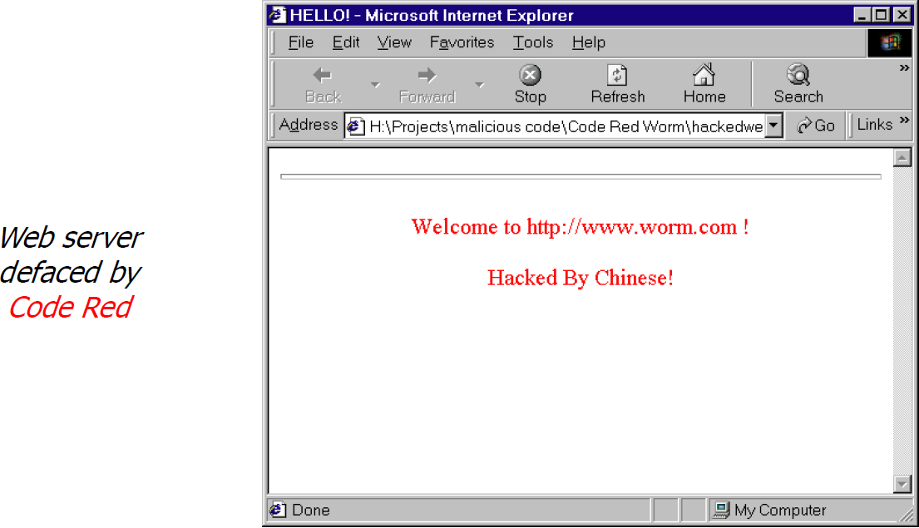
5.2.4. The Code Red Worm (2)

Slide 26
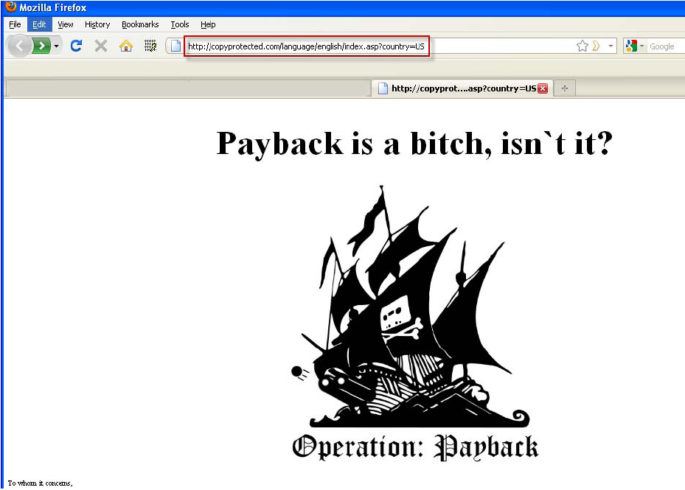
Website Defacement…

Slide 27
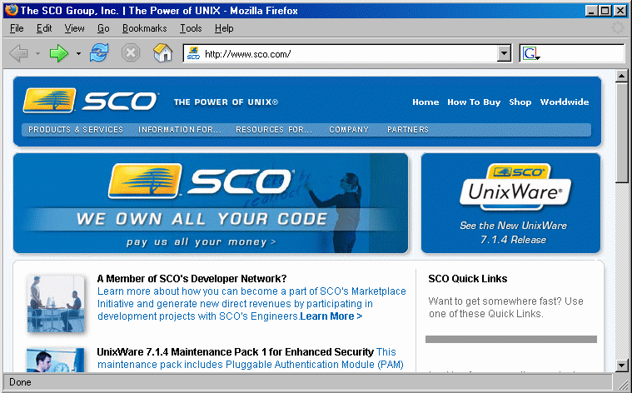
Website Defacement…

Slide 28
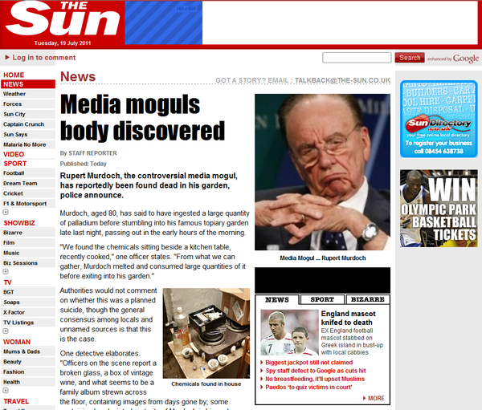
Website Defacement…

Slide 29
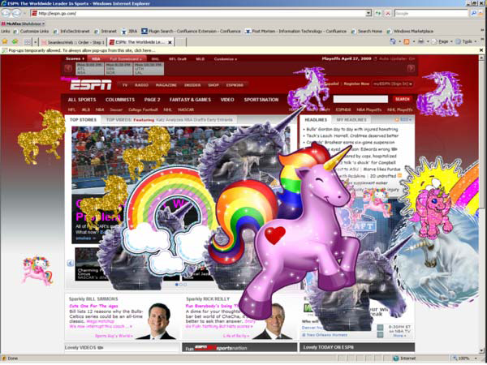
Website Defacement…

Slide 30
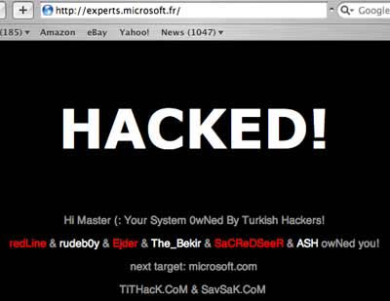
Website Defacement…

Slide 31
Code Red
Initial version released July 13, 2001
◻ Sends its code as an HTTP request
◻ HTTP request exploits buffer overflow
◻ Malicious code is not stored in a file
■ Placed in memory and then run
■ When executed,
◻ Worm checks for the file C:\Notworm
■ If file exists, the worm thread goes into infinite sleep state
◻ Creates new threads
■ If the date is before the 20th of the month, the next 99
threads attempt to exploit more computers by targeting
random IP addresses

Slide 32
Code Red of July 13 and July 19
Initial release of July 13
◻ 1st through 20th month: Spread
■ via random scan of 32-bit IP addr space
◻ 20th through end of each month: attack.
■ Flooding attack against 198.137.240.91 (www.whitehouse.gov)
◻ Failure to seed random number generator  linear growth
■ Revision released July 19, 2001.
◻ White House responds to threat of flooding attack by
changing the address of www.whitehouse.gov
◻ Causes Code Red to die for date ≥ 20th of the month.
◻ But: this time random number generator correctly seeded

Slide 33
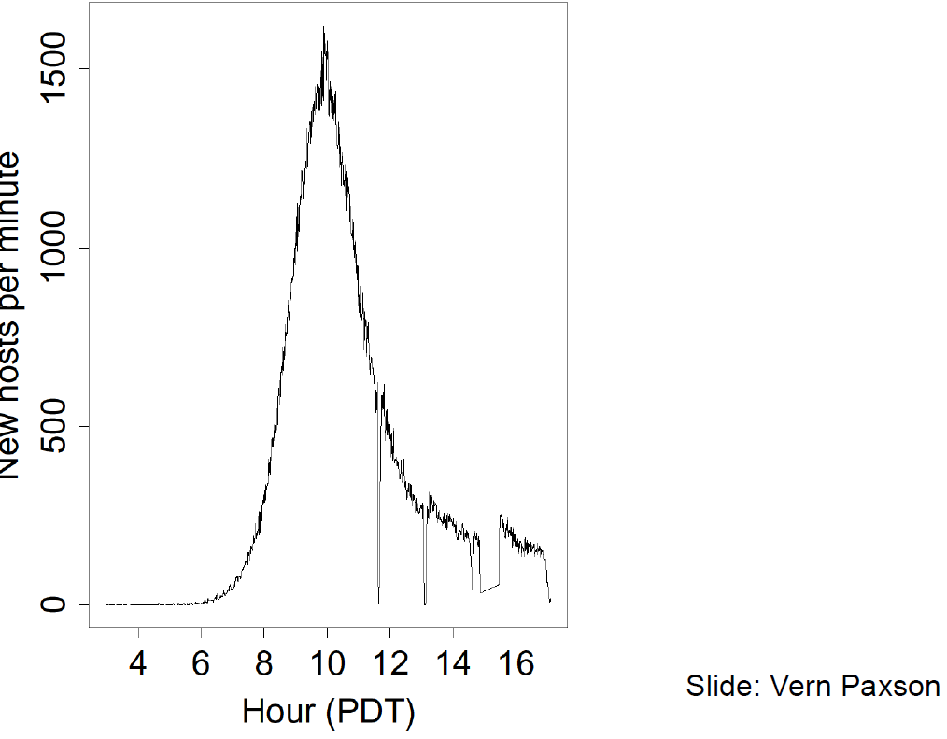
Growth of Code Red worm

Slide 34
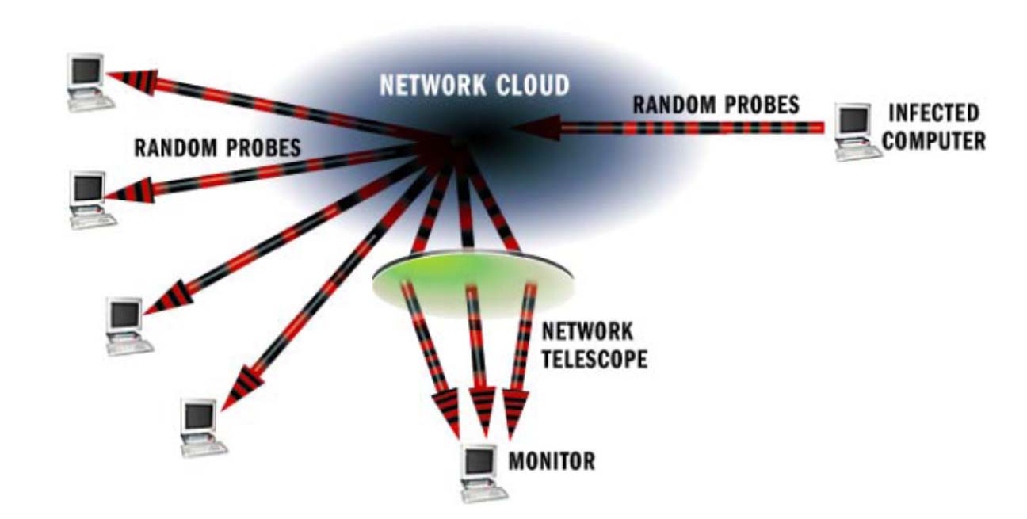
Measuring worms: network telescope
Monitor cross-section of Internet address space, measure traffic
◻ “Backscatter” from DOS floods
◻ Attackers probing blindly
◻ Random scanning from worms
■ LBNL’s cross-section: 1/32,768 of Internet
■ UCSD, UWisc’s cross-section: 1/256.

Slide 35
Spread of Code Red
Network telescopes estimate of # infected hosts: 360K.
(Beware DHCP & NAT)
■ Course of infection fits classic logistic.
■ Note: larger the vulnerable population, faster the worm
spreads.
■ That night ( 20th), worm dies …
… except for hosts with inaccurate clocks!
■ It just takes one of these to restart the worm on August
1st …
Slides: Vern Paxson

Slide 36
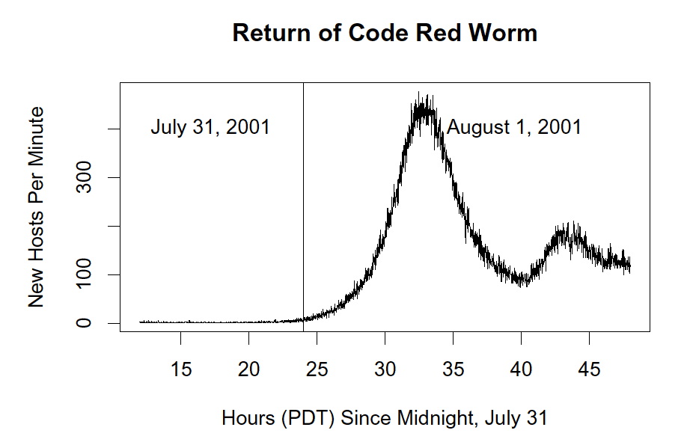

Slide 37
Code Red 2
Released August 4, 2001.
■ Comment in code: “Code Red 2.”
◻ But in fact completely different code base.
■ Payload: a root backdoor, resilient to reboots.
■ Bug: crashes NT, only works on Windows 2000.
■ Localized scanning: prefers nearby addresses.
■ Kills Code Red 1.
■ Safety valve: programmed to die Oct 1, 2001.

Slide 38
Striving for Greater Virulence: Nimda
Released September 18, 2001.
■ Multi-mode spreading:
◻ attack IIS servers via infected clients
◻ email itself to address book as a virus
◻ copy itself across open network shares
◻ modifying Web pages on infected servers w/ client exploit
◻ scanning for Code Red II backdoors (!)
⇒ worms form an ecosystem!
■ Leaped across firewalls.

Slide 39
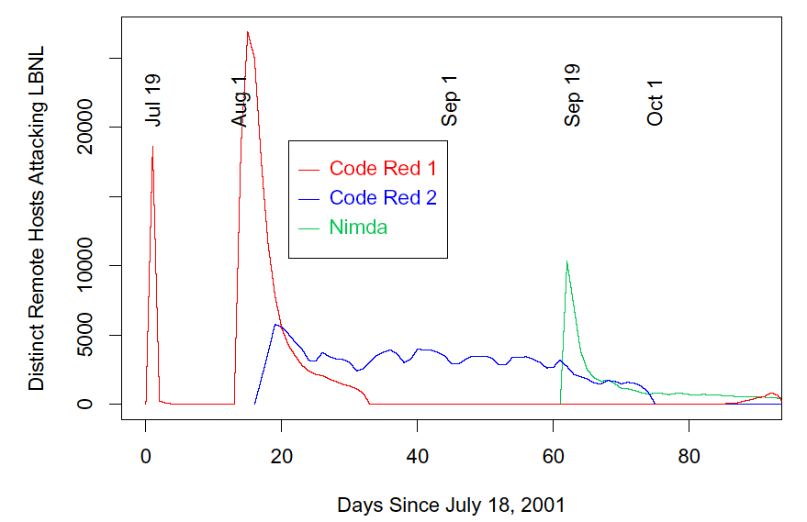

Slide 40
5.2.6. SQL Slammer Worm
Exploited another buffer overflow
◻ Took a single 376-byte UDP packet
◻ UDP connectionless -> spread quickly
◻ Infected 75,000, 90% w/in 10 mins.
■ Attacked Microsoft SQL Server DB App
■ Disabled server, scanned random IPs to infect
■ Impact
◻ Excessive traffic due to the worm propagating caused
outages in 13,000 BofA ATMs
◻ Phone network overloaded (no 911!)
◻ 5 DNS root down
◻ Airline flights were cancelled & delayed

Slide 41
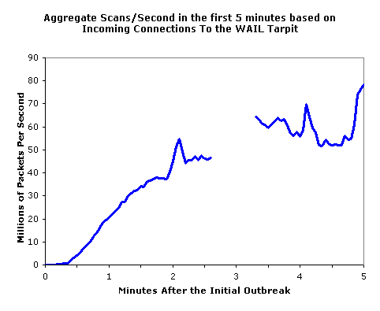
Slammer propagation

Slide 42
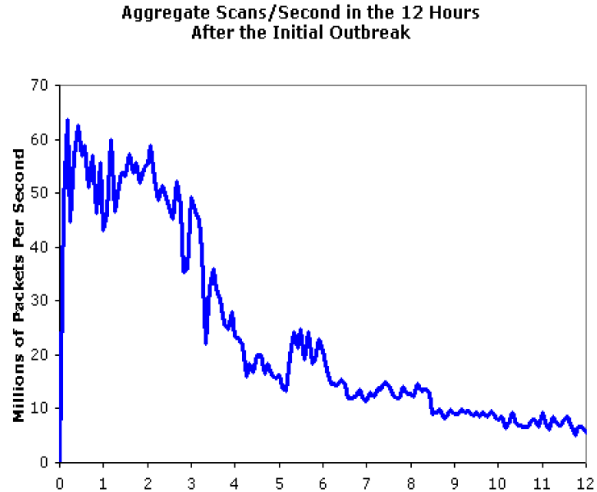
Number of scan/sec

Slide 43
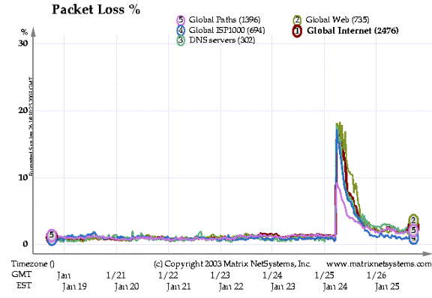
Packet loss

Slide 44
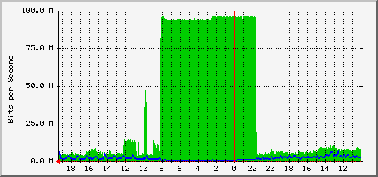
A server view

Slide 45
Worm Detection and Defense
Detect via honeyfarms: collections of “honeypots” fed
by a network telescope.
◻ Any outbound connection from honeyfarm = worm.
(at least, that’s the theory)
◻ Distill signature from inbound/outbound traffic.
◻ If telescope covers N addresses, expect detection when
worm has infected 1/N of population.
■ Thwart via scan suppressors: network elements that
block traffic from hosts that make failed connection
attempts to too many other hosts
◻ 5 minutes to several weeks to write a signature
◻ Several hours or more for testing

Slide 46
5.3. More Malware
Rootkits: imposter OS tools used by attacker to
hide his tracks
■ Botnets: network of software robots attacker
uses to control many machines at once to
launch attacks (e.g. DDoS through packet
flooding, click fraud)
■ Spyware: software that monitors activity of a
system or its users without their consent

Slide 47
5.3. More Malware
Keyloggers: spyware that monitors user
keyboard or mouse input, used to steal
usernames, passwords, credit card #s, etc…
■ Trojan Horses: software performs additional or
different functions than advertised
■ Adware: shows ads to users w/o their consent
■ Clickbots: bot that clicks on ads, leads to click
fraud (against cost-per-click or CPC ad models)

Slide 48
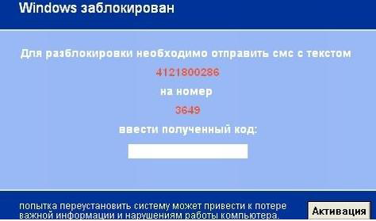
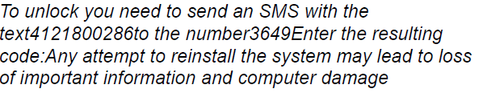
Ransomware
Trj/SMSlock.A
■ Russian
ransomware
■ April 2009

Slide 49
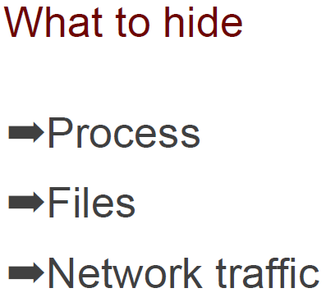
Subverting the Kernel with Rootkits
Kernel task
■ Process
management
■ File access
■ Memory
management
■ Network
management

Slide 50
Subverting techniques
Kernel patch
■ Loadable Kernel Module
■ Kernel memory patching (/dev/kmem)
■ Hypervisor-based code injection

Slide 51
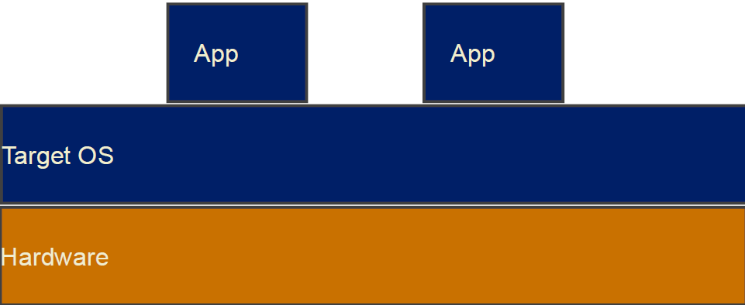
Hypervisor rootkit

Slide 52
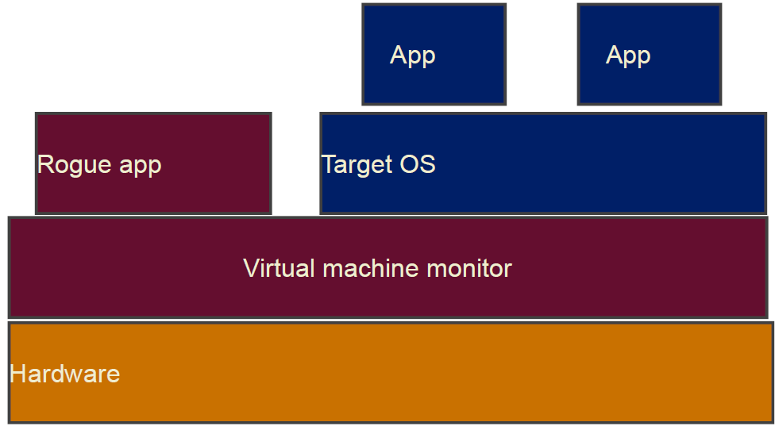
Hypervisor rootkit

