Slide 1
Chapter Three
Anatomy of an Attack:
Buffer Overflows

Slide 2
Security Vulnerabilities are Everywhere
Most often born out of software bugs
NIST estimates that S/W bugs cost U.S. $60B/year
Many of these errors create security vulnerabilities

Slide 3
Agenda
Buffer overflows: attacker hijacks machine
  Attacker injects malicious code into program
Preventable, but common (50% CERT advisories decade after Morris Worm)
Fixes: Safe string libraries, StackGuard, Static Analysis

Slide 4

6.1. Anatomy of a Buffer Overflow
Buffer: memory used to store user input, has fixed maximum size
Buffer overflow: when user input exceeds max buffer size
Extra input goes into unexpected memory locations

Slide 5

6.1.1. A Small Example
Malicious user enters > 1024 chars, but buf can only store 1024 chars; extra chars overflow buffer
void get_input() {
  char buf[1024];
  gets(buf);
}
void main(int argc, char*argv[]){
  get_input();
}

Slide 6
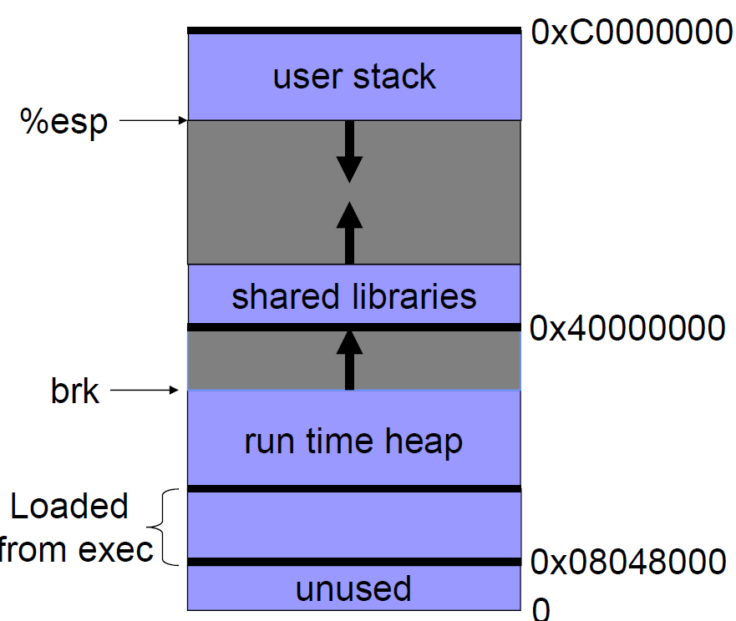
Linux process memory layout

Slide 7
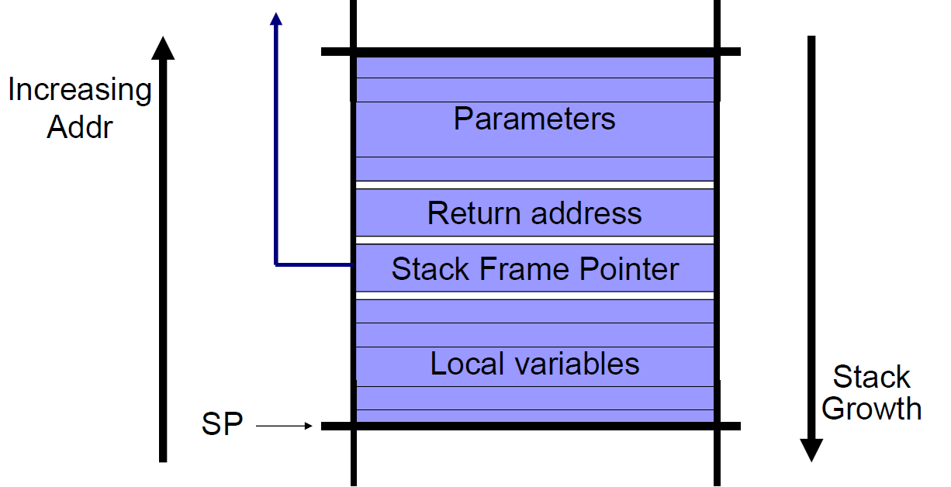
Stack Frame

Slide 8
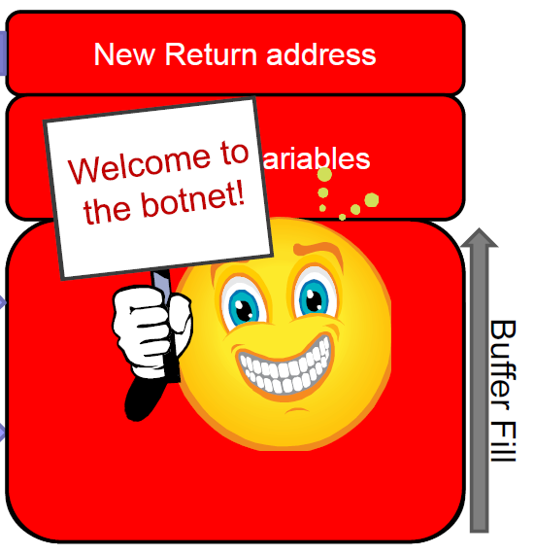
Buffer Overflow Attack
Buffer overflows constitute a large class of vulnerabilities
Goal: inject code into an unsuspecting machine, and redirect control
void foo()
{
int local_variables;
int buffer[256];
…
buffer = read_input();
…
return;
}
If read_input() reads
>256 ints

Slide 9
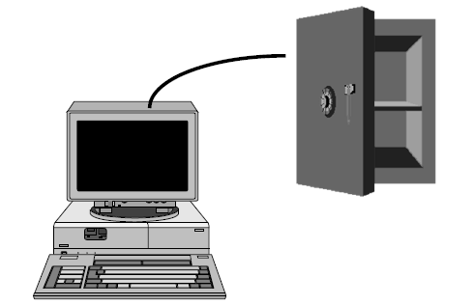
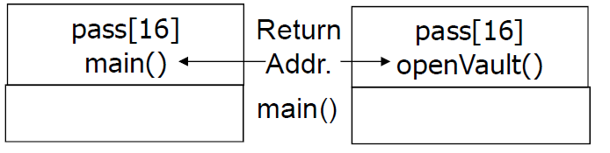
6.1.2. A More Detailed Example
int checkPassword() {
  char pass[16];
  bzero(pass, 16); // Initialize
  printf ("Enter password: ");
  gets(pass);
  if (strcmp(pass, "opensesame") == 0)
  return 1;
  else
  return 0;
}
void openVault() {
  // Opens the vault
}
main() {
  if (checkPassword()) {
    openVault();
    printf ("Vault opened!");
  }
}
checkPassword()
“Normal” Stack
Compromised Stack

Slide 10
6.1.2. checkPassword() Bugs
Execution stack: maintains current function state and address of return function
Stack frame: holds vars and data for function
Extra user input (> 16 chars) overwrites return address
  Attack string: 17-20th chars can specify address of openVault() to bypass check
  Address can be found with source code or binary

Slide 11


Basic Overflow Exploit
Suppose a web server contains a function:
  void func(char *str) {
    char buf[128];
    strcpy(buf, str);
    do-something(buf);
  }
When the function is invoked the stack looks like:
What if *str is 136 bytes long? After strcpy:

Slide 12
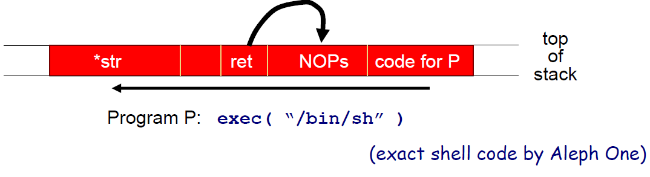
Basic Overflow Exploit (2)
Problem: no range checking in strcpy().
Suppose *str is such that after strcpy stack looks like:
When func() exits, the user will be given a shell!
Note: attack code runs in stack
To determine ret guess position of stack when func() is called

Slide 13
Exploiting Buffer Overflows
Suppose web server calls func() with given URL.
  Attacker sends a 200 byte URL, gets shell on server
Some complications:
  Program P should not contain the ‘\0’ character
  Overflow shouldn’t crash program before func() exists
Sample remote buffer overflows of this type:
  (2005) Overflow in MIME type field in MS Outlook.
  (2005) Overflow in Symantec Virus Detection
  test = CreateObject("Symantec.SymVAFileQuery.1")
  test.GetPrivateProfileString("file", [long string])

Slide 14
A Common Source of Vulnerabilities:
Unsafe C Lib Functions
  strcpy (char *dest, const char *src)
  strcat (char *dest, const char *src)
  gets (char *s)
  scanf ( const char *format, … ), etc
“Safe” versions strncpy(), strncat() are misleading
  strncpy() may leave buffer unterminated.
  strncpy(), strncat() encourage off by 1 bugs.

Slide 15
Buffer Overflow Defenses

Slide 16
Preventing hijacking attacks
1. Fix bugs:
  Audit software
    Automated tools: Coverity, Prefast/Prefix.
  Rewrite software in a type safe language (Java, ML)
    Difficult for existing (legacy) code …
2. Concede overflow, but prevent code execution
3. Add runtime code to detect overflows exploits
  Halt process when overflow exploit detected
  StackGuard, LibSafe, …

Slide 17
Marking memory as non-execute (NX)
Prevent overflow code execution by marking stack and heap segments as non-executable
  NX-bit on AMD and Intel processors
    NX-bit in every Page Table Entry (PTE)
  Deployment:
    Linux (via PaX project), OpenBSD
    Windows since XP SP2 (DEP)
Limitations:
  Some apps need executable heap (e.g. JITs)
  Does not stop all buffer overflow attacks

Slide 18
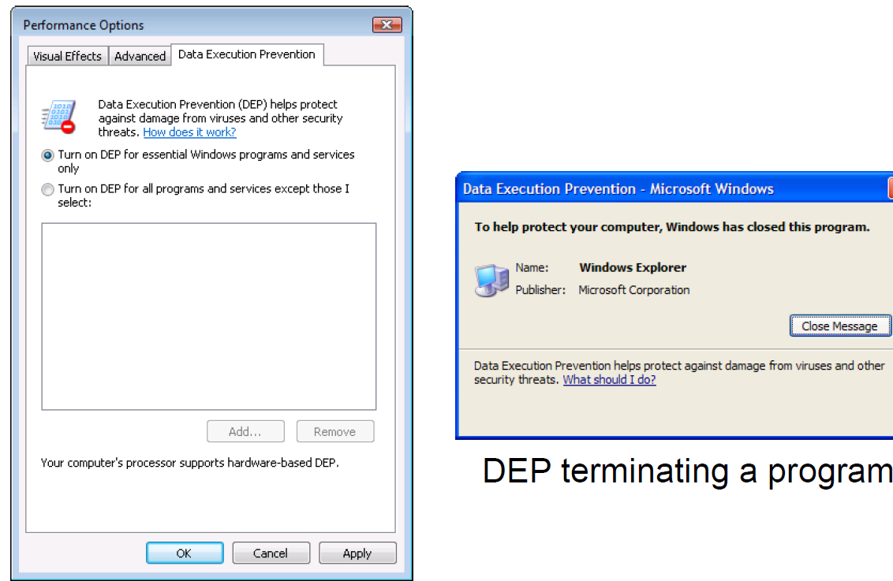
Examples: DEP controls in Windows

Slide 19
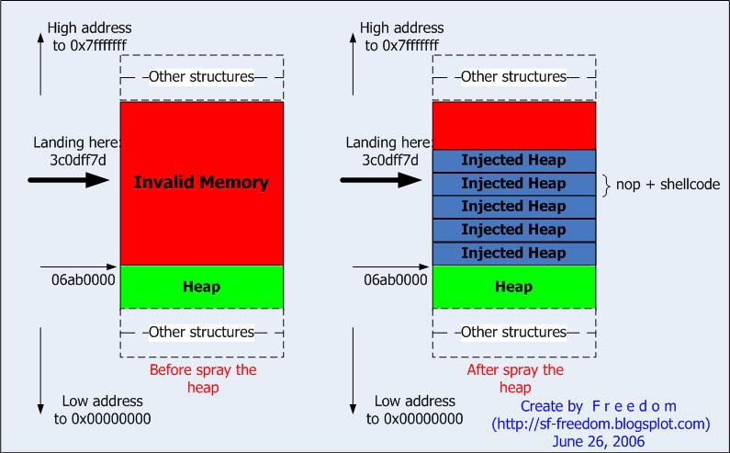
Escalate: No code allowed on stack
Use a heap-spray attack
Inject executable data into heap,
then perform random stack smash
Example, generate many strings in
JavaScript that are also real code
Generous heap sprays will likely
be found by subsequent buffer
overflow attack

Slide 20
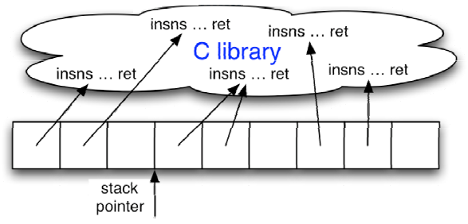
Escalate: No new code allowed at all
Use return-oriented programming to attack…
“RET” insn transfers control to top of stack
Attack introduces no new instructions, just craft injected stack returns to link function tails
New program is formed from sequence of fn tails

Slide 21
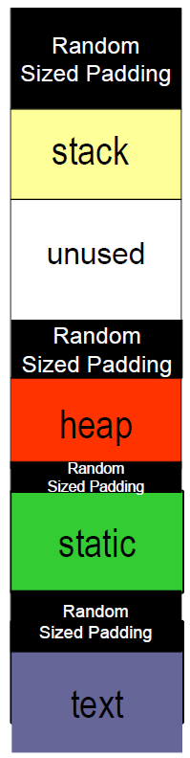
Address Space Layout Randomization (ASLR)
At load time, insert random-sized
padding before all code, data, stack
sections of the program
Successfully implementing a buffer
overflow code injection requires
guessing the padding geometry on
the first try
Implemented in recent Windows,
Linux and MacOS kernels

Slide 22
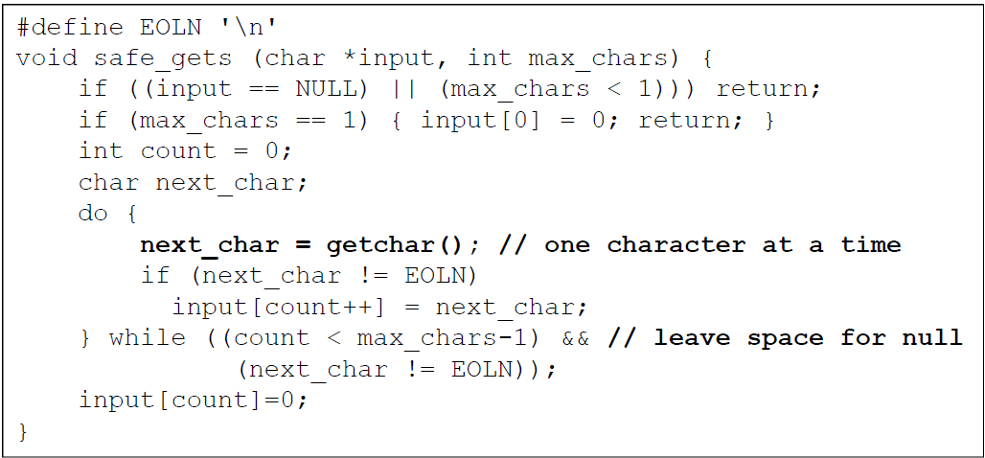
6.1.3. The safe_gets() Function
Unlike gets(), argument specifies max chars to insert
Use in checkPassword() instead of gets() to eliminate buffer overflow vulnerability
safe_gets(pass, 16);

Slide 23
6.2 Safe String Libraries
C – Avoid (no bounds checks): strcpy(), strcat(), sprintf(), scanf()
Use safer versions (with bounds checking): strncpy(), strncat(), fgets()
Microsoft’s StrSafe, Messier and Viega’s SafeStr do bounds checks, null termination
Must pass the right buffer size to functions!
C++: STL string class handles allocation
Unlike compiled languages (C/C++), interpreted ones (Java/C#) enforce type safety, raise exceptions for buffer overflow

Slide 24
6.3. General Approaches
Rewriting old string manipulation code is expensive, any other solutions?
StackGuard/canaries (Crispin Cowan)
Static checking (e.g. Coverity)
Non-executable stacks
Interpreted languages (e.g., Java, C#)

Slide 25
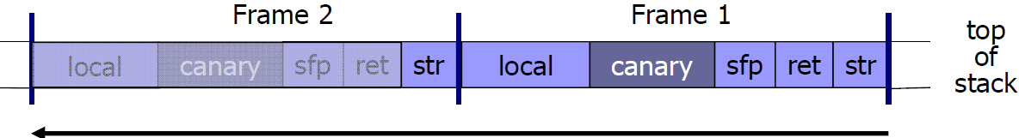
Stack Canaries with StackGuard
Implemented in compiler (GCC), runtime check of stack integrity
Embed “canaries” in stack frame before the return address, in function prologue, verify their integrity in function epilogue
Canary is a per-instance random value that attacker must guess on the first try for a successful attack
About 10% overhead for typical programs
Can be thwarted with overflow attacks on function pointers

Slide 26
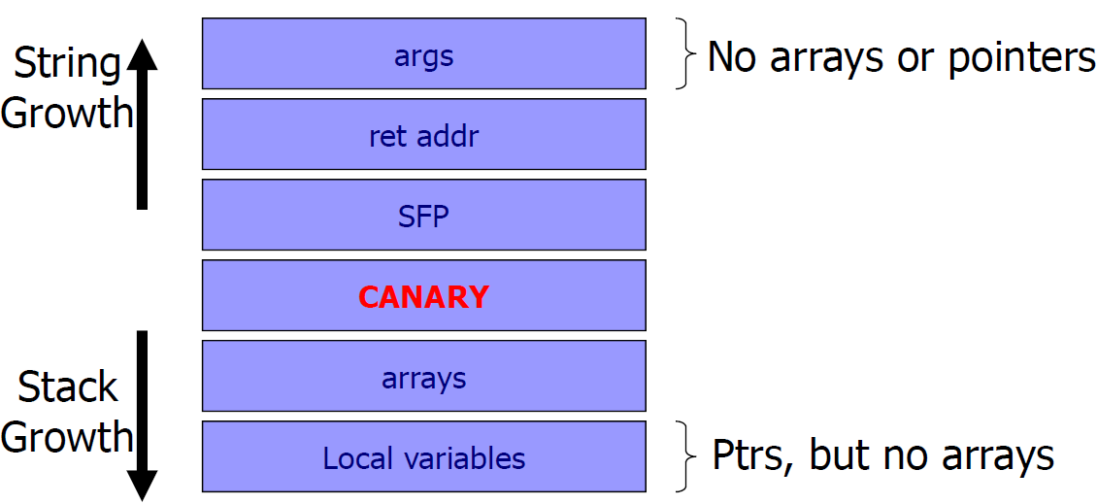
StackGuard Variant - ProPolice
IBM enhancement of StackGuard, in GCC on OpenBSD
Moves pointers in front of arrays, to avoid overflows

Slide 27
MS Visual Studio /GS [2003]
Compiler /GS option:
  Combination of ProPolice and Random canary.
  Triggers UnHandledException in case of Canary mismatch to shutdown process.

Slide 28
Run time checking: Libsafe
Solution 2: Libsafe (Avaya Labs)
  Dynamically loaded library (no need to recompile app.)
  Intercepts calls to strcpy (dest, src)
    Validates sufficient space in current stack frame:
    If so, does strcpy, otherwise, terminates application

Slide 29
Encrypting Pointers with PointGuard
Encrypt all pointers while in memory
  Using a per-instance random key, generated at startup
  All pointers XOR’ed with key (decrypted) when loaded from memory or when stored back (encrypted)
  Pointers cannot be overwritten by overflow while in regs
Protects return addresses and function pointers
Attackers must guess, on the first try, the random key to implement a successful attack
  Otherwise, when pointer is overwritten its XOR decrypted value will access a random memory address
Very difficult to thwart, but has ~20% slowdown

Slide 30
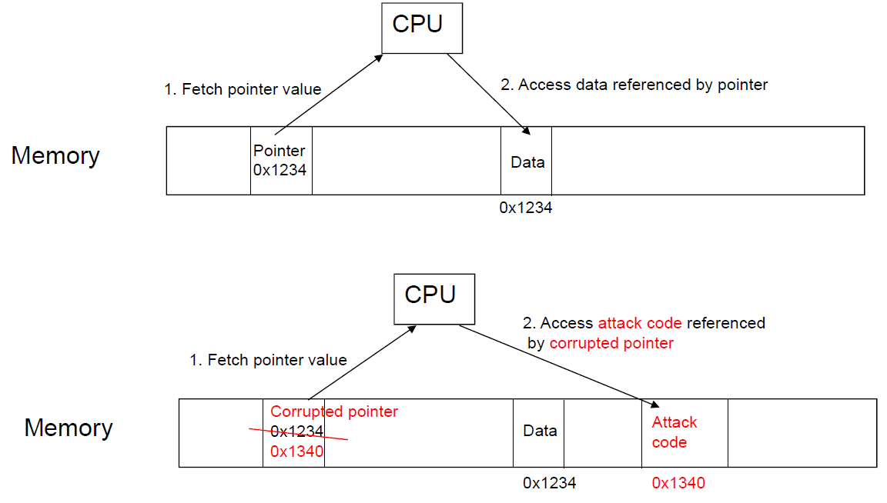
Normal Pointer Dereference

Slide 31
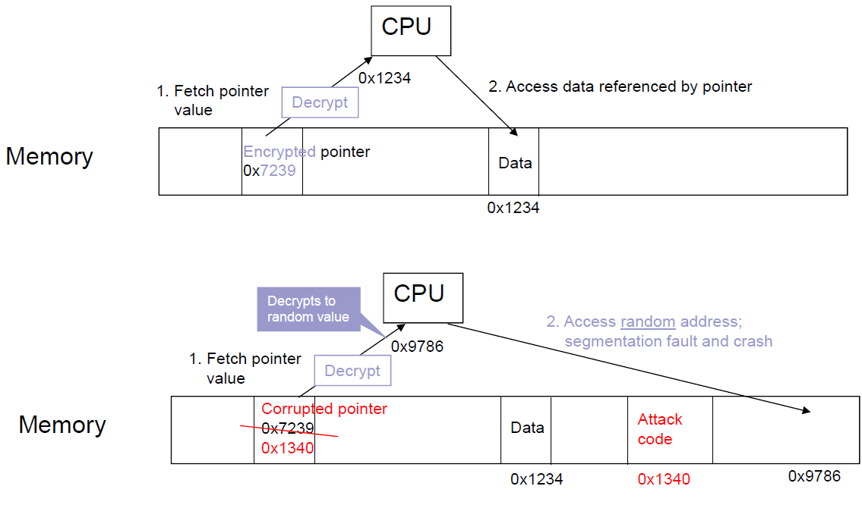
PointGuard Dereference

Slide 32
6.3.2 Static Analysis Tools
Static Analysis: analyzing programs without running them
Meta-level compilation
  Find security, synchronization, and memory bugs
  Detect frequent code patterns/idioms and flag code anomalies that don’t fit
Ex: Coverity, Fortify, Ounce Labs, Klockwork
  Coverity found bugs in Linux device drivers

