Slide 1
Chapter Two
Security Concepts

Slide 2
Agenda
Seven Key Security Concepts:
Authentication
Authorization
Confidentiality
Data / Message Integrity
Accountability
Availability
Non-Repudiation
System Example: Web Client-Server Interaction

Slide 3
1.1. Security Is Holistic
Physical Security
Technological Security
Application Security
Operating System Security
Network Security
Policies & Procedures
All Three Required

Slide 4
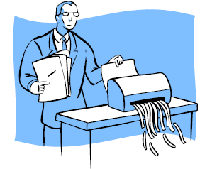
1.1.1. Physical Security
Limit access to physical space to prevent asset theft and unauthorized entry
Protecting against information leakage and document theft
Ex: Dumpster Diving – gathering
sensitive information by sifting
through the company’s garbage

Slide 5
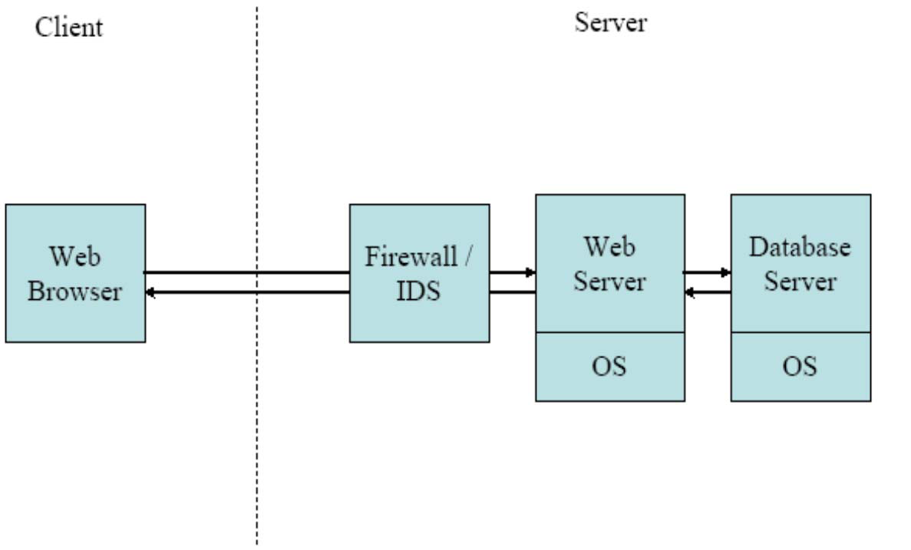
1.1.2. Technological Security (1) (Application Security)
Web Server & Browser Example
No flaws in identity verification process
Configure server correctly
local files
database content
Interpret data robustly

Slide 6
1.1.2. Technological Security (2) (OS & Network Security)
Apps (e.g. servers) use OS for many functions
OS code likely contains vulnerabilities
Regularly download patches to eliminate (e.g. Windows Update for critical patches)
Network Security: mitigate malicious traffic
Tools: Firewalls & Intrusion Detection Systems

Slide 7
1.1.3. Policies & Procedures
Ex: Social engineering attack - taking advantage of unsuspecting employees (e.g. attacker gets employee to divulge his username & password)
Guard sensitive corporate information
Employees need to be aware, be educated to be somewhat paranoid and vigilant

Slide 8
Security Concepts/ 7-Security Goals
Authentication
Authorization
Confidentiality
Data / Message Integrity
Accountability
Availability
Non-Repudiation

Slide 9
Archetypal Characters
Alice & Bob – “good guys”
Eve – a “passive” eavesdropper
Mallory – an “active” eavesdropper
Trent – trusted by Alice & Bob

Slide 10
1.1 Authentication
Identity Verification
How can Bob be sure that he is communicating with Alice?
Three General Ways:
Something you know (i.e., Passwords)
Something you have (i.e., Tokens)
Something you are (i.e., Biometrics)

Slide 11
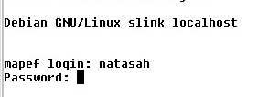
1.1.1. Something you KNOW
Example: Passwords
Pros:
Simple to implement
Simple for users to understand
Cons:
Easy to crack (unless users choose strong ones)
Passwords are reused many times
One-time Passwords (OTP): different password used each time, but it is difficult for user to remember all of them

Slide 12
1.1.2. Something you HAVE
OTP Cards (e.g. SecurID): generates new password each time user logs in
Smart Card: tamper-resistant, stores secret information, entered into a card-reader
ATM Card
Strength of authentication depends on difficulty of forging

Slide 13
1.1.3. Something you ARE
Technique | Effectiveness | Acceptance
Palm scan | 1 | 6
Iris Scan | 2 | 1
Retinal Scan | 3 | 7
Fingerprint | 4 | 5
Voice Id | 5 | 3
Facial Recognition | 6 | 4
Signature dynamics | 7 | 2
Biometrics
Pros: “raises the bar”
Cons: false negatives/positives, social acceptance, key management
False positive: authentic user rejected
False negative: impostor accepted

Slide 14
1.1.4. Final Notes
Two-factor Authentication: Methods can be combined (i.e. ATM card & PIN)
Who is authenticating who?
Person-to-computer?
Computer-to-computer?
Three types (e.g. SSL):
Client Authentication: server verifies client’s id
Server Authentication: client verifies server’s id
Mutual Authentication (Client & Server)
Authenticated user is a “Principal”

Slide 15
1.2 Authorization
Checking whether a user has permission to conduct some action
Identity vs. Authority
Is a “subject” (Alice) allowed to access an “object” (open a file)?
Access Control List: mechanism used by many operating systems to determine whether users are authorized to conduct different actions

Slide 16
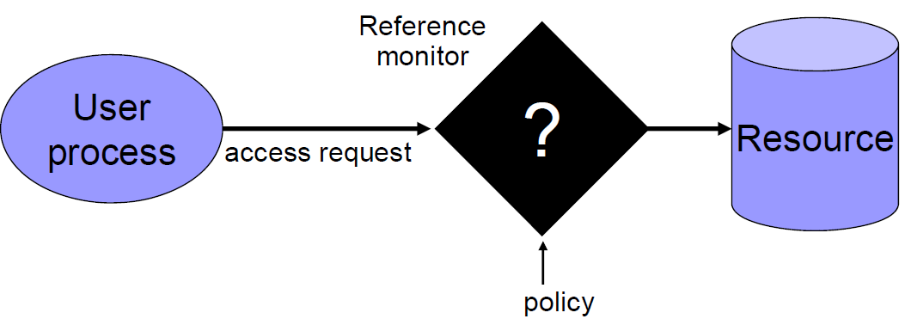
Access control
Assumptions
System knows who the user is
Authentication via name and password, other credential
Access requests pass through gatekeeper (reference monitor)
System must not allow monitor to be bypassed

Slide 17
1.2.1 Access Control Lists (ACLs)
User | Resource | Privilege
Alice | /home/Alice/* | Read, Write, Execute
Bob | /home/Bob/* | Read, Write, Execute
Set of three-tuples
<User, Resource, Priviledge>
Specifies which users are
allowed to access which
resources with which privileges
Privileges can be assigned based on roles (e.g. admin)

Slide 18
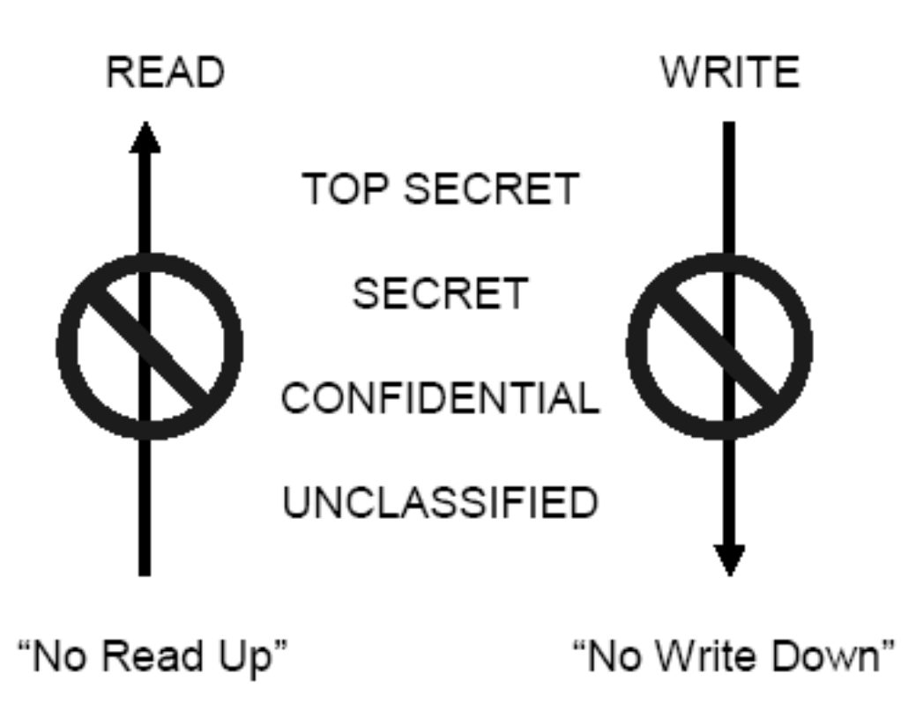
1.2.3. Bell-LaPadula Model
Classifications:
Top Secret
Secret
Confidential
Unclassified
3 Rules/Properties
Simple property
*-property
(confinement)
Tranquility property

Slide 19
Bell-LaPadula Confidentiality Model
When is it OK to release information?
Two Properties (with silly names)
Simple security property
A subject S may read object O only if C(O) <= C(S)
*-Property
A subject S with read access to O may write object P only if C(O) <=C(P)
In words,
You may only read at or below your classification and only write
at or above your classification

Slide 20
1.3 Confidentiality
Goal: Keep the contents of communication or data on storage secret
Example: Alice and Bob want their communications to be secret from Eve
Key – a secret shared between Alice & Bob
Sometimes accomplished with
Cryptography, Steganography, Access Controls, Database Views

Slide 21
1.4 Message/Data Integrity
Data Integrity = No Corruption
Man in the middle attack: Has Mallory tampered with the message that Alice sends to Bob?
Integrity Check: Add redundancy to data/messages
Techniques:
Hashing (MD5, SHA-1, …), Checksums (CRC…)
Message Authentication Codes (MACs)
Different From Confidentiality:
A -> B: “The value of x is 1” (not secret)
A -> M -> B: “The value of x is 10000” (BAD)
A -> M -> B: “The value of y is 1” (BAD)

Slide 22
1.5. Accountability
Able to determine the attacker or principal
Logging & Audit Trails
Requirements:
Secure Time stamping (OS vs. Network)
Data integrity in logs & audit trails, must not be able to change trails, or be able to detect changes to logs
Otherwise attacker can cover their tracks

Slide 23
1.6 Availability
Uptime, Free Storage
Ex. Dial tone availability, System downtime limit, Web server response time
Solutions:
Add redundancy to remove single point of failure
Impose “limits” that legitimate users can use
Goal of DoS (Denial of Service) attacks are to reduce availability
Malware used to send excessive traffic to victim site
Overwhelmed servers can’t process legitimate traffic

Slide 24
1.7 Non-Repudiation
Undeniability of a transaction
Alice wants to prove to Trent that she did communicate with Bob
Generate evidence / receipts (digitally signed statements)
Often not implemented in practice, credit-card companies become de facto third-party verifiers

Slide 25
2 Concepts at Work (1)

Slide 26
2 Concepts at Work (2)
Availability:
DVD-Factory ensures its web site is running 24-7
Authentication:
Confidentiality:
Bob’s browser and DVD-Factory web server set up an encrypted connection

Slide 27
2 Concepts at Work (3)
Authorization:
DVD-Factory web site consults DB to check if Bob is authorized to order widgets on behalf of PCs-R-Us
Message / Data Integrity:
Checksums are sent as part of each TCP/IP packets exchanged (+ SSL uses MACs)
Accountability:
DVD-Factory logs that Bob placed an order for Sony DVD-R 1100
Non-Repudiation:
Typically not provided w/ web sites since trusted third party (TTP) required to complete transaction

