Slide 1
Chapter One
Introduction to Computer Security

Slide 2
Goals of This Course
Give you a basic understanding of computer security
With special emphasis as to how it relates to the endeavor of system design
Equip you with the basic knowledge and terminology to successfully engage your security-focused colleagues in meaningful discussion and collaboration

Slide 3
What is Computer Security?
System correctness
If user supplies expected input, system generates desired output
Security
If attacker supplies unexpected input, system does not fail in certain potentially dangerous ways

Slide 4
Why Are There Security Vulnerabilities?
Lots of buggy software...
Why do programmers write insecure code?
Awareness is the main issue
Some contributing factors
Few courses in computer security
Programming text books do not emphasize security
Few security audits
C is an unsafe language
Programmers have many other things to worry about
Legacy software (some solutions, e.g. Sandboxing)
Consumers do not care about security
Security is expensive and takes time

Slide 5
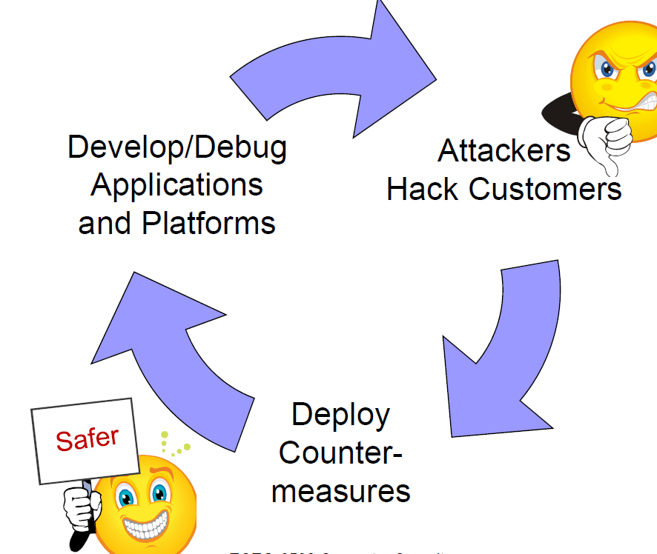
The Security Arms Race

Slide 6
A vulnerability that is “too complicated for anyone to ever find” will be found!
Security is a Process not a product!

Slide 7
Why Do Attackers Attack?
To gain control of machines, e.g., BotNets
To gain access to private information, e.g., credit card numbers
To punish/embarrass individuals and institutions
To educate and advocate, e.g., FireSheep
To earn reputation in the cracking community, e.g., hackers vs. script kiddies
Etc…

Slide 8
Current Trends

Slide 9
Some things in the news
Nigerian letter (419 Scams) still works:
Michigan Treasurer Sends 1.2MUSD of State Funds !!!
Many zero-day attacks
Google, Excel, Word, Power point, Office …
Criminal access to important devices
Numerous lost, stolen laptops, storage media, containing customer information
Second-hand computers (hard drives) pose risk
Vint Cerf estimates ¼ of PCs on Internet are bots

Slide 10
Some Terminology of the Trade
Hackers
Skilled programmers
Attackers
White Hat – Good guys, report vulnerabilities
Black Hat – Bad guys, exploit vulnerabilities for personal gain, regardless of impact
Gray Hat – Somewhere in between
Script Kiddies
Call themselves hackers, but use premade scripts
Ethical Attacker
Hired to attack a system to find vulnerabilities

