Slide 1
Chapter Five
Lecture 6
  Optimization in Power System

Slide 2
Lecture outline
Optimization in power system
Lambda iteration method
Transmission losses,
Coordination equation,
Incremental losses,
penalty factors,
Unit commitment

Slide 3
What is optimization?
Optimization is the mathematical discipline which is concern with finding the maxima and minima of function, possibly subject to the constraints for continuous and differential functions.
It is derived from the latin word optimus

Slide 4
Where can we use optimization?
Architecture
Electrical network
Economics
Materials design
Image processes
Transportation
Nutrition etc.

Slide 5
What do we optimize
A real function of N variable f(X1, X2, X3….Xn) with or without constraints.
Identify the problem or opportunity
Understand the system
Formulate a Mathematical model
Methodology Of Optimization Techniques
Verify the model
Select the best alternative
Present the result of the analysis
Implement and evaluate

Slide 6
Identify the problem or opportunity
What are the objectives?
Is the proposed problem too narrow?
Is it too broad?

Slide 7
Understand the system
What data should be collected?
How will data be collected?
How to different component of the system interacted each other?

Slide 8
Formulate a Mathematical model
What kind of model should be used?
Is the model accurate?
Is the model too complex?

Slide 9
Verify the model
Do output match current observation for current inputs?
Are outputs reasonable?
Could the model be erroneous?

Slide 10
Select the best alternative
What if there are conflicting objectives?
Inherently the most difficult step.
This is where software tools will help us!

Slide 11
Present the result of the analysis
Must communicate results in laymans term.
System must be user friendly .

Slide 12
Implement and evaluate
User must be trained on the new system.
System must be observed over time to ensure it works properly.

Slide 13
Optimization in power system
Power system engineering has the longest history of development among the various areas of electrical engineering
Power system are getting larger and more complicated day by day because of:
Increase of load demand
Fossil fuel demand of thermal power plants

Slide 14
Importance of optimization in power system
When the power systems are getting larger and more complicated day by day then their will be some limitations like:
Rising costs
Rising emission into the environment
Therefore optimization is become essential for the operations of power system utility in term of
Fuel cost saving
Environmental preservation

Slide 15
Optimization aim and focus
To minimize the cost of power generation in regulated power system
To maximize social welfare in deregulated power system, while satisfying various operating constraints.

Slide 16
Introduction
ED problem
Economic Dispatch is the process of allocating the required load demand between the available generation units such that the cost of operation is minimized.
  Is determination of economically feasible operating point of generators in the presence of various constraints
  Constraints
    Total power demand and power generation limits of each generator
UC problem
  Is the problem of deciding which units to operate so that total cost is minimized

Slide 17
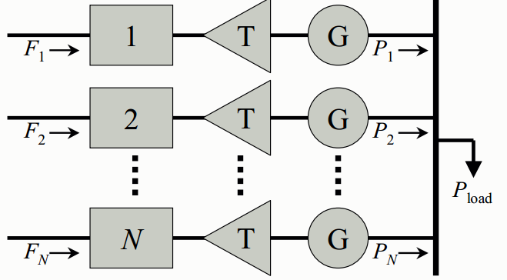
Cont’d
The electric power system representation for Economic Dispatch consists of models for the
generating units and can also include models for the transmission system.
Consider a system that consists of N thermal-generating
units serving an aggregated electrical load, Pload
Input to each unit: cost rate of fuel consumed, Fi
Output of each unit: electrical power generated, Pi
Total cost rate, F_{T}, is the sum of the individual
unit costs essential constraint:
The sum of the output powers must equal
the load demand
The problem is to minimize F_{T}

Slide 18


Cont’d…
Necessary condition for extreme values
  Objective function is
    Where Fi is the cost of generator i
  constraints are
    Total generation should at least equal total load
    Min and max generation limits

Slide 19


cont’d…
Taking the first constraint only and using Lagrangian multiplier:
Taking the derivative with respect to power generation of each unit and setting it equal to zero
The incremental cost of each generator must be equal to a constant value λ.

Slide 20
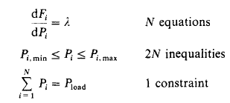
Cont’d…
Including the max and min power generation limits of each unit, the condition for presence of solution for ED problem is

Slide 21
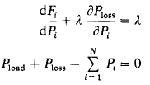
Network Losses
Consider a similar system, which now has a transmission network that connects the generating units to the load
The economic dispatch problem is slightly more complicated
The constraint equation must include the network losses, Ploss
The objective function, FT is the same as before
the constraint equation must be expanded as:

Slide 22
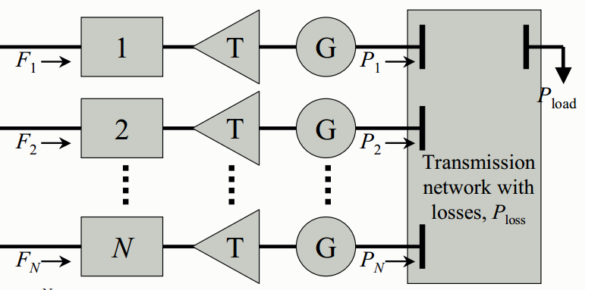
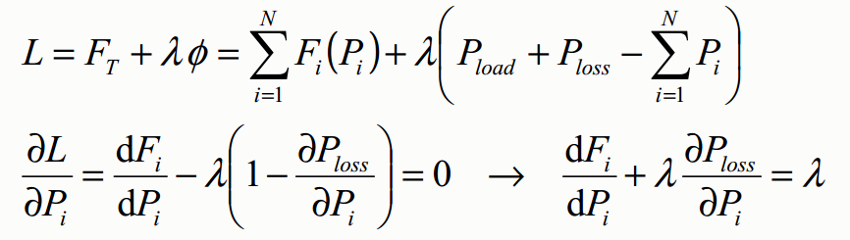
Cont’d
The same math procedure is followed to establish the necessary conditions for a minimum-cost operating solution
Lagrange function and its derivatives w.r.t. the input power:

Slide 23
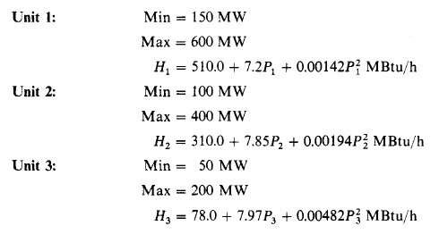
Example
A power system company operate three steam powered units having spec as shown below
Fuel cost is 1.1, 1.0 and 1.2 $/Mbtu respectively for the three generators. Determine the economic dispatch if total power demand is 700MW.

Slide 24
Lambda iteration method for ED
It is a method used to compute the economic power generation level of generators using iteration
Start with an initial guess of λ.
Compute the power generation of each unit.
Compute the difference between demand and the total generation.
Repeat until the error is less than tolerance value

Slide 25
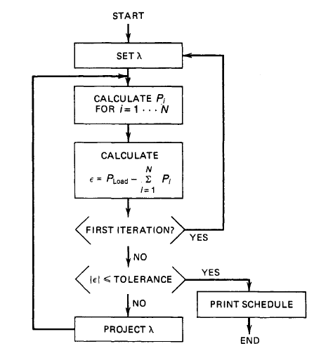
Cont’d…

Slide 26
UNIT Commitment
Economic dispatch gives the optimum schedule corresponding to one particular load on the system.
The total load in the power system varies throughout the day and reaches different peak value from one day to another.
Different combination of generators, are to be connected in the system to meet the varying load.
When the load increases, the utility has to decide in advance the sequence in which the generator units are to be got.
Similarly, when the load decreases, the operating engineer need to know in advance the sequence
in which the generating units are to be shut down.

Slide 27
Cont’d
The problem of finding the order in which the units are to be brought in and the order in which the units are to be shut down over a period of time, say one day, so the total operating cost involved on that day is minimum, is known as Unit Commitment (UC) problem.
Thus UC problem is economic dispatch over a day. The period considered may a week, month or a year.

Slide 28
Cont’d
But why is this problem in the operation of electric power system?
Why not just simply commit enough units to cover the maximum system load and leave them running?
Note that to “commit” means a generating unit is to be “turned on”; that is, bring the unit up to speed, synchronize it to the system and make it to deliver power to the network.
“Commit enough units and leave them on line” is one solution. However, it is quite expensive to run too many generating units when the load is not large enough.

Slide 29
Example
The following are data pertaining to three units in a plant.
Unit 1: Min. = 150 MW; Max. = 600 MW
C1 = 5610 + 79.2 P1 + 0.01562 P1² Rs / h
Unit 2: Min. = 100 MW; Max. = 400 MW
C2 = 3100 + 78.5 P2 + 0.0194 P2² Rs / h
Unit 3: Min. = 50 MW; Max. = 200 MW
C3 = 936 + 95.64 P3 + 0.05784 P3² Rs / h
What unit or combination of units should be used to supply a load of 550 MW most economically?

