Slide 1
ECE 4251, Generation Planning
Lecture 2
Generation Planning and Design
Instructor: Yalew Gebru (MSc.)
School Electrical & Computer Engineering
Institute of Technology
Debre Markos University
P.O.Box :269, Debre Markos, Ethiopia
E-mail: Yalew1404@gmail.com
28 April 2020

Slide 2
ECE 4251, Generation Planning
LECTURE OUTLINE:
  General Overview of Generation Planning
  Unit Size and Potentials of Energy Resources
  Methods of Energy Conversion Technologies
  General Layout and design of Generating Stations
  Reliability of Generation Systems and supply Schedule
  Environmental and Social Impacts of Generation Stations

Slide 3
  ECEG 4251, General Overview of Generation Planning
General Overview
The previous section presented some overall principles and complexities of system planning and load forecasting. This section examines the major issues in the development of a long-term expansion plan for the generating systems.
The forecast of electrical demand is clearly one of the most important for generating system analysis. The forecast typically must be for power (kW), energy (kW-h) and load variation for time intervals within a year, such as a month or season, for all years of the study. If a great deal of effort is to be devoted to analysing the alternative expansion possibilities, the demand forecast should also receive a significant effort.
There are two distinct types of uncertainty in demand forecasting. First, there is the uncertainty that results from the randomness of the load at any time because of, for example, weather conditions. This type of uncertainty is, of course, a major concern for the load dispatcher. The other type of uncertainty is associated with the estimate of future demand, i.e. the estimate may be too high or too low.

Slide 4
ECEG-4251, Generation Planning
Underestimating future demand can create serious difficulties because service dates for new facilities can seldom be advanced appreciably. The result may be a generating system with low reliability and the inability to serve some portion of demand. Overestimating the demand is also undesirable because excess generating equipment imposes increased costs on the system.
The function of an electric power system is to provide a reliable and continuous source of electricity whenever requested. To provide this service, each of the three main components of an electric power system — generation, transmission and distribution — must perform as required.
The generation system consists of physical facilities that convert energy resources (e.g. coal, oil, uranium, running bodies of water) into electricity. The transmission system then transports the generated electricity to the local service communities. The distribution system within each community provides the actual connection from the transmission system to each customer, and enables the customer to consume electricity upon demand.

Slide 5
ECEG-4251, Generation Planning
An electric power system is a dynamic system which is a balance of supply and demand:
(a) The supply of electricity, consisting of physical devices that must be designed, constructed, operated, maintained, and eventually replaced as each device wears out, and
(b) The demand for electricity, which changes as a function of time from instantaneous (seconds, minutes), to short term (hours, days) and to the longer term (months, years).
Therefore, a major objective for an electric power system is to keep a continual balance between the supply and demand for electricity.
Power system expansion planning is the process of analysing, evaluating and recommending what new facilities and equipment must be added to the power system in order to replace worn-out facilities and equipment and to meet changing demand for electricity.
This section is concerned with the methodologies developed for planning the expansion of the generation component of a power system

Slide 6
ECEG-4251, Generation Planning
The following examples illustrate the statement of wider objectives of the energy plan:
To develop the energy supply system leading to lowest cost to consumers,
To maximize reliability and safety in the energy supply system,
To develop a diversified energy supply system with less dependence on imported oil,
To maximize the use of indigenous energy supplies,
To maximize the use of renewable resources,
To provide energy for optimum industrial development,
To reduce the use of non-commercial fuel and subsequent deforestation,
To minimize environmental effects.

Slide 7
Generation Planning Objectives:
Generation planning determines the sequence or scheduling of future generation plants that serve the forecasted energy and peak power demand in a sustainable and economic manner. During generation planning the following issues shall be addressed:
The Generation type, location, technology, size, potential, construction period and timing of future generation plants that will be added to the power system.
The generation investment cost, Operating and Maintenance (O&M) cost both fixed and variable costs
Generation fuel consumption or running cost for thermal plants
Environmental and social impacts and their associative costs
Retirement plan for existing generation stations
The annual average and firm energy of the generation plants for the expected life time of each generation plants.
Long-run marginal generation cost for each kWh energy unit.

Slide 8
ECEG-4251, Generation Planning
  Unit size and Potentials of Energy Resources
The key parameters relevant to generating units include unit sizes and the set of factors that determine unit availabilities. The unit availability can be described in terms of three contributing elements:
forced outage rates,
repair times and
scheduled maintenance.
It is important in reliability analysis to recognize that unit sizes directly influence forced outage rates on overall system reliability. For example, a single unit rated at 1000 MW (e) with a forced outage rate of 10% does not result in the same performance as 10 units rated at 100 MW (e) each, all with forced outage rates of 10%.

Slide 9
ECEG-4251, Generation Planning
    Energy Resource Options:
They can be defined as net providers of energy
Primary Energy Resources are subdivided into:
Non-renewable energy sources: fossil fuels (coal, oil, natural gas (CH4))
Definition: Nonrenewable energy is energy obtained from static stores of energy that remain bound unless released by human interaction. Nonrenewable energy supplies are also called finite supplies.
Renewable energy sources: solar energy, wind energy, Hydropower, biomass sources; geothermal energy are seasonally and slowly recovered energy sources.
Definition: Renewable energy is the term used to cover those energies that occur naturally and repeatedly in the environment and can be harnessed for human benefit. The ultimate sources of most of these energies are the sun, gravity and the earth’s rotation

Slide 10
ECEG-4251, Generation Planning
1. Fossil fuel energy Recourses (Non-Renewable Energy Resources)
Energy technologies using oil, gas and coal are the basis of most commercial energy supply systems. The systems that extract, process, transport and deliver fossil fuels are characterized by large centralized facilities (e.g. refineries, pipelines, coal mines).
In the context of energy planning, this centralized character of fossil fuel systems means that the supply technologies can be evaluated by considering large projects and determining the viability of these projects by means of traditional engineering and economic analysis procedures. Obviously, the use of fossil fuels involves many different stages and each stage has a variety of alternative approaches.

Slide 11
ECEG-4251, Generation Planning
2. Renewable Energy Resource
Renewable resources are an important part of the energy supply available to a country and must therefore be considered as part of the resource base. However, these resources cannot be characterized in the same way as fossil fuels.
The definitions of the different types of 'reserves' do not make sense for renewable. In some cases, for example solar and wind, the concept of a reserve base has no real meaning. Each renewable resource must be treated somewhat differently and characterized separately for planning purposes.
Note that in almost all cases it is necessary to make some assumptions about the performance of the technology used to extract usable energy in order to arrive at an estimate of the resource base. This is quite different from the process used for fossil fuels.

Slide 12
ECEG-4251, Generation Planning
Another factor complicating the analysis of renewable resources is that many systems are not large centralized facilities that can be analysed by traditional project analysis techniques. Rather, there are many small decentralized systems (solar water heaters, small wind electric generators, biogas plants, mini-hydro plants, etc.) which must be analysed in a different manner.
The user chooses the renewable system or the conventional system on the basis of his perception of the delivered cost of energy (including investment cost, fuel cost, operating costs, reliability, convenience, etc.).
Whatever analytical methodology is employed to construct future supply/ demand balances, the usefulness of the approach to planning efforts is apparent when alternative conditions are evaluated. This is where the planner can gain insight into the potential effects of different strategies and policies on the development of the energy sector.

Slide 13
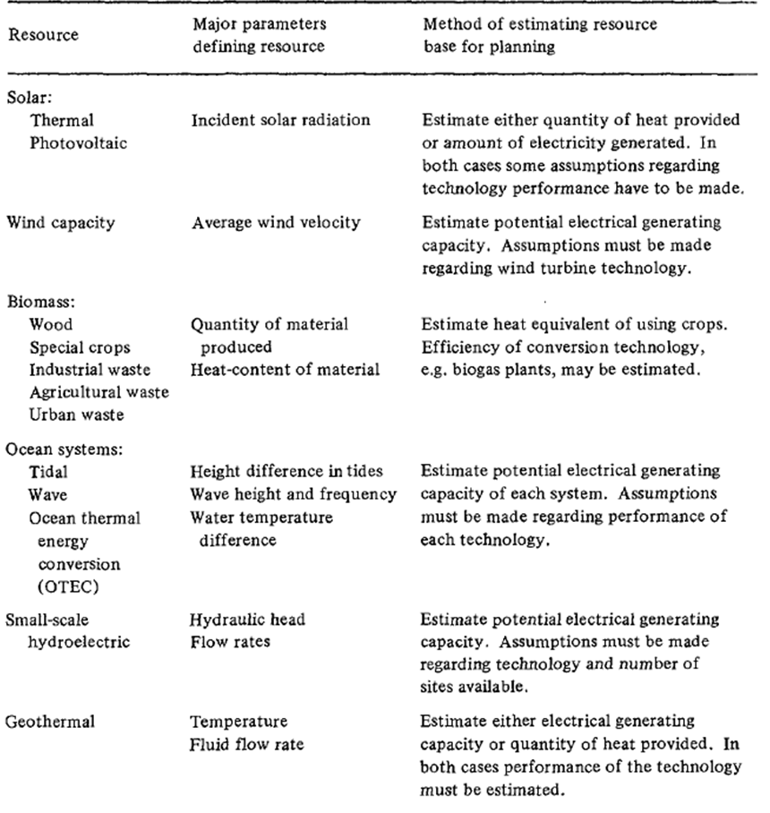
ECEG-4251, Generation Planning
The different methods of renewable and non-renewable generation systems with the corresponding types of fuel energy resources are indicated here.

Slide 14
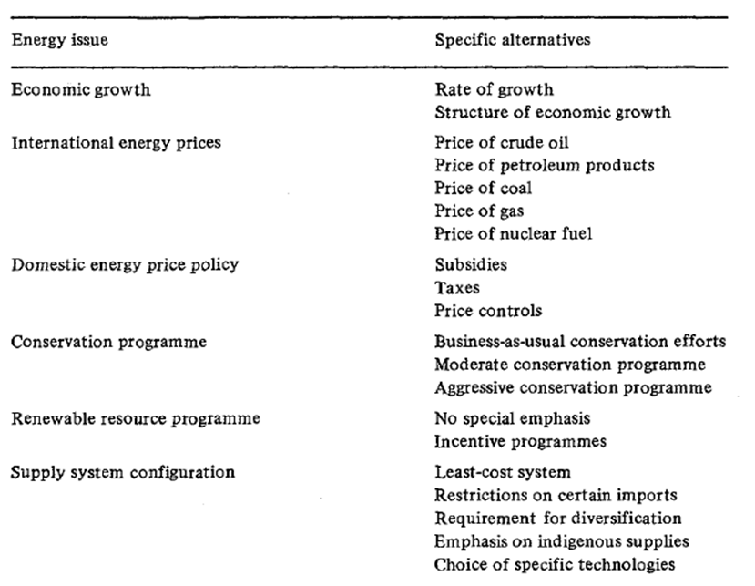
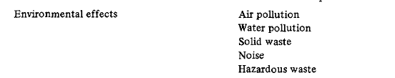
ECEG-4251, Generation Planning
Evaluation of Alternative Scenarios during supply modelling

Slide 15
ECEG-4251, Generation Planning
  Methods of Energy Conversion Technologies
Various technologies are currently available as candidates for expanding electrical generating systems. Each has a unique set of characteristics that must be considered from a system viewpoint to determine the mix of future additions that provides the best outcome for the stated objectives for expansion. In addition to existing technologies, long-term studies of generation expansion must consider whether advanced technologies will become available and, if so, what their costs and characteristics will be.
Power generation technologies may be classified into existing major options and potential future options
Advanced versions of each technology are also being developed, such as breeder reactors, fluidized-bed combustion of coal, more efficient combustion turbines, and combined cycle based on coal gasification coupled with various combinations of steam turbines, fuel cells, combustion turbines and magneto-hydrodynamic generators.

Slide 16
ECEG-4251, Existing Energy Conversion Methods and Process
Electrical power can be generated from several sources of energy as given below:
By Conversion of Chemical Energy in Coal, oil, Peat, gas or other conventional fuels into heat by burning and then into mechanical energy by hot gas or steam rising and using it in a Gast or steam turbine respectively. The Gas turbine or steam turbine drives a generator which inturn produce electrical energy.
By Conversion of Potential Energy in water stored in elevated reservoirs to kinetic energy and then to mechanical and electrical energy using hydraulic turbines and generators.
By Conversion of Kinetic Energy in wind using wind turbines and Generators
By Conversion of Solar Energy directly in to electrical energy using solar cells and/or heat by solar radiation and then into mechanical energy by steam turbines which derives a generator to produce electrical power.
By Conversion of Nuclear Energy via heat and steam into electrical power
By Conversion of Geothermal energy in the Earth using steam turbines to derive generators which inturn generate Electrical power.
By the Use of Electrolytic Cells in which chemical energy can be converted quickly into Electrical energy.

Slide 17
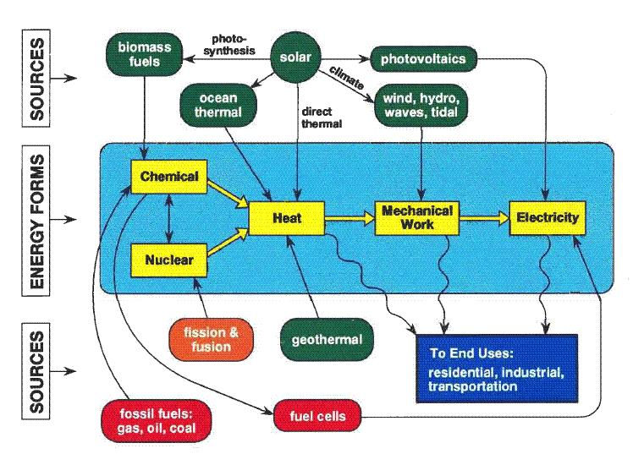
ECEG-4251, Existing Energy Conversion Processes

Slide 18
ECEG-4251, TYPES OF POWER GENERATING PLANTS
The existing types of power plants may be divided mainly into the following groups.
Base,
intermediate and
peak loads
The base load, intermediate and peak load plants are classified according to the plant capacity factor that defines rate ate which the plant operates throughout a year.
Plant Capacity Factor:
The plant capacity factor is the ratio of the actual energy produced to the maximum possible energy that could have been produced during the same period. Thus, for a given duration of plant operation:
Plant Capacity Factor = (Average Load + Losses)/Plant installed capacity
= [(Peak load * Load Factor) + (Losses)]/Plant Capacity
= kWh generated in a year/(kW_{inst} * 24 *365)

Slide 19
ECEG-4251, Generation Planning
For base load operation the chief requirements are
  low specific operating cost (i.e. cost/kWh supplied)
  high availability
  High capital cost, since it can be spread over a large amount of energy, is normally acceptable
  The ability to provide a rapidly changing output is not important
For a peak load operations the desired requirements are:
  Ability to start and provide full output within, say, 30 minutes.
  Low capital cost (because this can only be spread over a small amount of energy), with operating cost being only secondary considerations
  A siting near generation centres or accessible transmission facilities so as to minimize transmission costs and losses.
  It is advantageous if the peak load plant can in emergency be used as a back up to supply the base load.

Slide 20
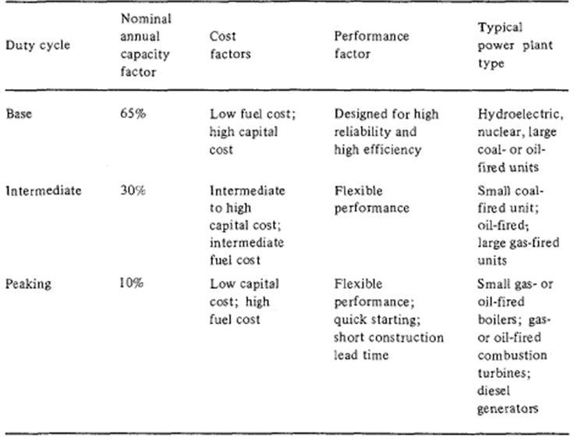
ECEG-4251, Generation Planning
For maximum reliability and economy it would be desirable to have a close match between system generation capacity and system demand. The power system planner should take these factors into account when considering system requirements.

Slide 21
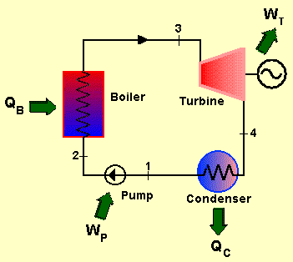
      ECEG-4251, Generation Planning- Steam turbine plant
Components of a Basic Steam Cycle Liquid water is compressed to a high pressure by a pump. The pressurized water is heated and vaporized in a boiler, which is fuelled by coal, oil, gas, biomass or nuclear fission. Hot and compressed water vapor has high energy content, which is utilized by the turbine generating work. After expansion in the turbine the vapor enters a condenser, which brings the vapor to liquid form.
Larger capacity steam turbine plants therefore best suited to base load operation. The annual plant capacity factor is usually between 50-80%. The modern steam turbine power plant has a thermal efficiency in the range 30-35%.

Slide 22
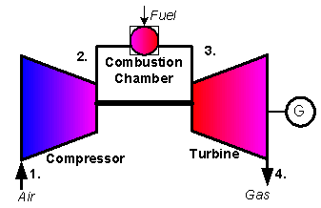
ECEG-4251, Generation Planning - Gas Turbine Plant
Components of a Basic Gas Cycle
Ambient air is sucked in and pressure is raised in the compressor.
Fuel is injected into the compressed air in the combustion chamber, and combustion takes place, increasing the temperature of the gas.
Hot pressurized gas expands in the turbine, generating work.
Work required for pressurizing relatively cold air (in the compressor) is smaller than work produced during expansion at higher temperatures (in the turbine). This is the basic reason why the gas turbine cycle generates net work.
Since the gas turbine plants use expensive fuels it is usually best suited to peak and/or intermediate load operation. The modern gas turbine power plant has a thermal efficiency in the range 35-40%.

Slide 23
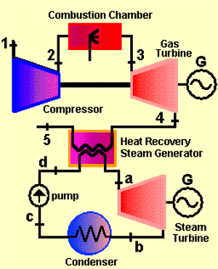
ECEG-4251, Generation Planning - Combined Gas Turbine Plant
Components of a Combined Gas Turbine Cycle The combined cycle consists of 3 main subsystems: Gas turbine – representing topping cycle, Steam turbine – representing bottoming cycle, Heat recovery steam generator (HRSG), Rule of thumb for a gas/steam combined cycle.

Slide 24
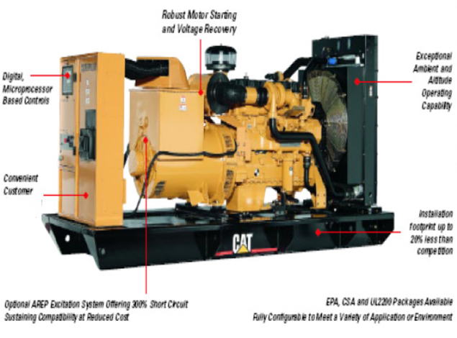
ECEG-4251, Generation Planning - Diesel Plant
Where steam turbine units of economic capacity are avoided due to the small magnitude of the load, as is the case on many developing systems, diesel plants can be used to supply the base load. Diesel power plants have high efficiency, particularly in the larger sizes (up to 10MW). Low speed and medium speed diesels are used for the purpose. Low speed plant is the more suitable: it has relatively high capital cost compared with that of medium speed plant but by far the longer life time. Medium speed diesel plants are particularly suitable for mid-merit duty.
For peak load duty gas turbine compete with high speed (1000 rev/min) diesels.

Slide 25
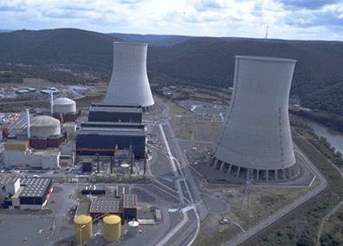
ECEG-4251, Generation Planning - Nuclear Plant
The specific capital cost of a nuclear power station is over twice that of a fossil-fueled station, but its specific operating cost may be as much as 50% lower; to minimize total costs, it is important that a nuclear station should be operated at high annual capacity factor to supply the base load.
They supply 16% of the world's electricity, as base-load power, and their efficiency is increasing. For different reasons there is a renewed interest in nuclear energy in the world. An obvious concern is that ageing reactors need to be replaced.
Nuclear power is highly controversial; the building of new nuclear power stations has stopped in many countries in the world.

Slide 26
ECEG-4251, Generation Planning - Nuclear Plant
Advantages of nuclear power plants compared to other energy sources:
  Almost no green house gases emissions during operation.
  Produces no smog, sulphur dioxide mercury, NOx or particulates.
  During uranium mining, building and decommissioning of the power stations the emissions are relatively small.
  Small solid waste generation in normal conditions
  Relatively low fuel costs and large reserves.
Disadvantages of nuclear power plants compared to other energy sources:
  Risk of major accidents, the Chernobyl accident was clearly a setback to nuclear power. More than 10 000 lives were lost and thousands suffered major health impacts, in addition to the significant environmental and social impacts.
  Nuclear waste: Radioactive waste is produced; it is potentially dangerous for thousands of years.
  Risk of nuclear weapon proliferation.
  High initial and maintenance costs, plus high costs of plant decommissioning

Slide 27
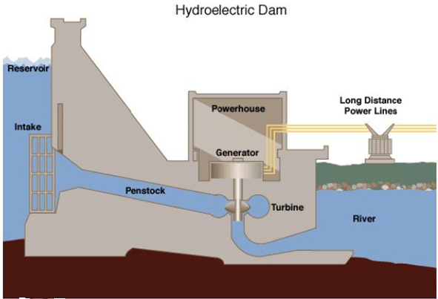
      ECEG-4251, Generation Planning - Hydro-electric Plant
The capital cost of hydro-electric scheme depends upon the nature of the scheme, but is usually high. Such schemes usually are located at some distance from load centres, therefore have associated high transmission costs. Once the plant is operational, the subsequent costs are very low and therefore are attractive for base load operation.

Slide 28
      ECEG-4251, Generation Planning - Hydro-electric Plant
The quick starting facility of hydro-electric plant and its ability to handle rapidly changing loads make it ideally suited to peak-load operation. It might appear at the first sight that the high capital cost and low operating cost of a hydro-electric scheme are the reverse of what is required for peak-load plant, I.e. it also can be used as Base load Operation
Hydroelectric power plant:
  Is one of the prevailing energy-producing technologies
  It provides about 20% of the world’s electricity
  In the ”developing world” the proportion rises up to 40%

Slide 29
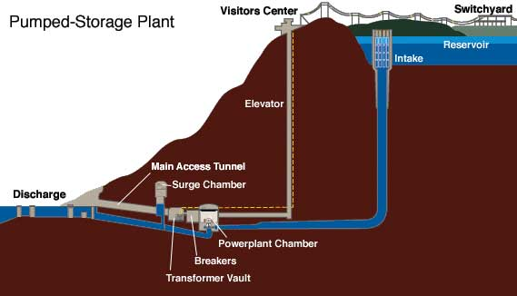
ECEG-4251, Generation Planning - Pumped Storage Plant
Where the flow of water is insufficient for a peak load hydro electric plant of the desired capacity to be constructed and operated, this flow may be supplemented by the provision of pumped storage. The operational advantage of hydro-electric plant for peak-load operation may thus still be obtained, with pumping being carried out during off-peak or low load periods.

Slide 30
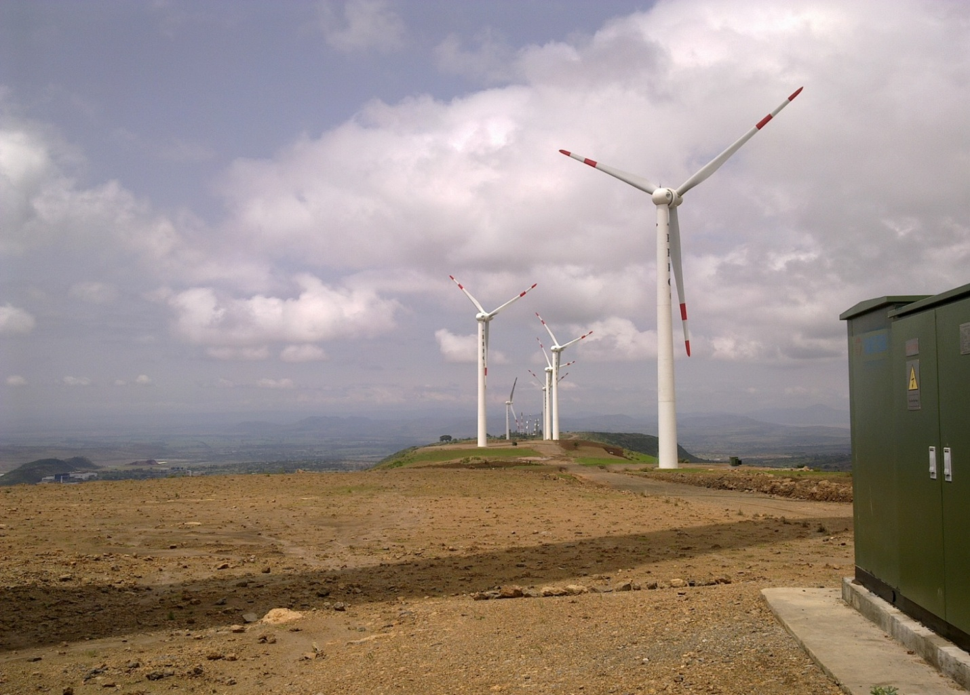
ECEG-4251, Generation Planning - Wind power Plants
Wind turbines are the fastest growing and most cost-effective renewable energy technology, producing electricity with no fuel and no pollution. A wind turbine obtains its power input by converting the force of the wind into torque (turning force) acting on the rotor blades by means of converting the kinetic energy of the wind into kinetic energy of a rotating shaft.
Adama-I Wind Power Farm

Slide 31
ECEG-4251, Generation Planning - Wind power Plants
The wind is solar power in kinetic form then mechanical form in the turbine shaft.
Wind energy is created by the uneven heating of the earth by the sun
A small part (around 2 %) of the energy of solar radiation on earth is converted into kinetic energy of flowing air – the wind
Wind’s velocity and direction depend on the imposed pressure gradients, the local geography and certain other forces
The wind is a free-flowing fluid stream.
Energy conversion from free-flowing fluid streams is limited because energy extraction implies decrease of fluid velocity (decrease of kinetic energy of the stream), which cannot fall down to zero, the stream should continue traveling and cannot stop entirely.

Slide 32
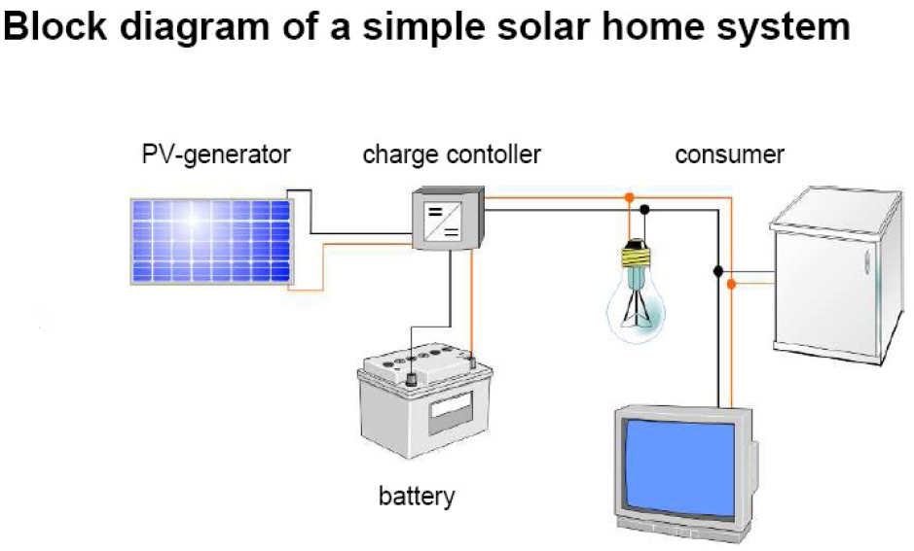
ECEG-4251, Generation Planning - Solar Power Plant
If the demand (load) to be met is electricity instead of heat, there are two common methods of converting solar energy into electricity:
By collecting solar energy as heat and converting it into electricity using a thermal power plant or engine or
By using photovoltaic cells to convert solar energy directly into electricity.

Slide 33
ECEG-4251, Generation Planning - Solar Power Plant
Wind and solar generate energy at unpredictable or uncontrolled times, and it may be that their output cannot therefore be relied upon. A part or all of the output can be made reliable if some form of storage is provided. Battery storage is expensive and is appropriate only for small generators.
If such plant is connected to a large network which is able to absorb its maximum output whenever this may occur, storage facilities may not be necessary. In this case, elsewhere on the system, there is no saving in plant capacity but there is a saving in fuel (or water) consumption.

Slide 34
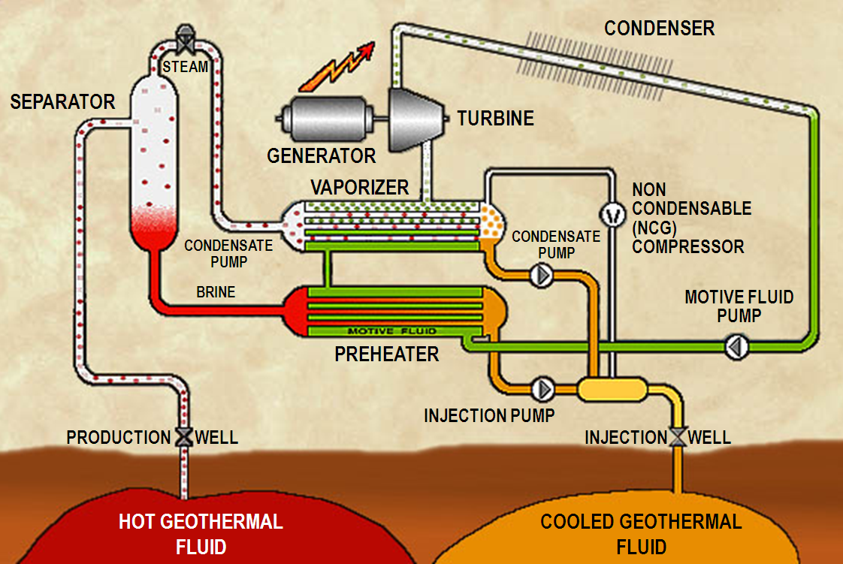
ECEG-4251, Generation Planning - Geothermal Power Plant
Geothermal energy is the thermal energy stored in the earth’s crust. 'Geothermal energy' is often used nowadays, however, to indicate that part of the Earth's heat that can, or could, be recovered and exploited by man.

Slide 35
ECEG-4251, Generation Planning - Geothermal Power Plant
Geothermal energy originates from the inner core of the earth and it is evident on the earth's surface in the forms of volcanoes, geysers, and hot springs.
Even though the amount of energy within the earth is basically infinite, our ability to use it is limited by site considerations.
Favourable sites for geothermal energy extraction are rare and occur where magma, or hot molten rock of the earth's mantle, has been pushed up near the earth's surface through faults and cracks in the crust.

Slide 36
ECEG-4251, Generation Planning
  General Layout and design of Generating Stations
This section discuses the general layout of generation power plants and their critical characteristics in planning and designing of the generation expansion systems. Since, the scope of the course is limited; this section will only consider the typical generation layouts and an overview of design analysis for hydroelectric generation plants.
Although hydroelectric generation plays a relatively small role in the overall pattern of electricity generation of industrialized countries, it is still a very important issue in hydro-dominated systems such as those of Ethiopia, Canada and Norway.
Power systems with a large hydroelectric component have some special characteristics which should be taken into account in expansion planning studies.

Slide 37
ECEG-4251, Generation Planning – HEPP characteristics
Hydroelectric Power Dominant system Characteristics
Capital investments are high and tend to be concentrated. Also, these costs are basically associated with the needs of energy production. Once these requirements are met, the peak requirements are satisfied at low incremental costs.
The energy production of a hydroelectric system depends on the amount of water available at each plant of the system. Since it is impossible to have prior knowledge of the future inflows, the energy benefit associated with the construction of a hydroelectric plant can only be expressed probabilistically.
The availability of peak power in a hydroelectric plant is a function of the plant head, which in turn depends on the stored water volume. Peak offer is therefore also dependent on hydrological conditions.
Many reservoirs are multipurpose, i.e. they have other applications besides power generation, some of which, such as flood control and irrigation, conflict with the requirements of power generation. The planning and operation of such systems should therefore be integrated with other sectors of the economy.

Slide 38
ECEG-4251, Generation Planning – HEPP characteristics
Other characteristics Hydroelectric Power plants that affect the transmission system:
The hydroelectric projects tend to be located far from the main load centres, making long-distance transmission of huge power blocks an important issue.
Since most of the peaking equipment will be installed in the hydroelectric plants, the capacity for peak modulation will be low in the main load centres, which will have to import peak power from distant hydroelectric plants.
Finally, hydroelectric development costs are very site-specific. According to World Bank figures, typical costs are around US $1500 per kW of installed capacity, although they may range from US $1150 to US $1300 in Ethiopia but proposed schemes must be studied individually.
Given these factors, planning activities in hydro-dominated systems tend to differ from those concerned with thermal system planning, both in terms of simplifying assumptions and methodological approaches. This section analyses the influence of hydroelectric characteristics on power system planning methodologies.

Slide 39
ECEG-4251, Generation Planning – HEPP characteristics
Hydropower technology utilizes the potential energy difference between different parts of a water body at a rate which is roughly proportional to the product of water level difference, commonly referred to as head, and the water discharge. Hence, hydropower planning and design are directed towards increasing these two quantities by proper site selection and construction measures.
The energy derived from the water in a conventional hydroelectric power plant is the sum of the potential energy (determined by position or elevation) and of the kinetic energy (determined by the water flow speed). The potential energy of stationary water is easily converted into kinetic energy in the form of flowing or falling water to drive a hydraulic turbine.
The two parameters are of paramount importance:
- The water flow, water mass flow rate, or water discharge Q (m3/s);
The height of the fall h (m).
The power (kW) of a hydroelectric power station is proportional to the product of these two parameters, as shown below.

Slide 40
ECEG-4251, Generation Planning – HEPP characteristics
E = W = mgh, m = ρv
E = ρvgh [Joules]
Where: m = mass of water
ρ = density of water = 1000 kg/m³
v = volume of water m³
h = height of water fall (m)
g = acceleration due to gravity = 9.806 m/s²
Then the power available is
P = dE/dt = d(ρvgh)/dt
= ρgh(dv)/dt
P_{th} = ρghQ watts ; Where: Q = dv/dt water flow rate m³/s
As the water flow is variable day by day, month by month, year by year, this simple dependence shows that the available power from the hydroelectric plant is variable with time. The reservoir is the tool that can adapt in some way the naturally variable characteristics of a hydroelectric power station to the also variable demand characteristics of an electric power system.

Slide 41
ECEG-4251, Generation Planning – HEPP characteristics
Since the amount and reliability of discharge, as well as the possibility of creating additional head by structural methods, depend entirely on the local hydrological and geomorphological conditions, respectively, hydropower planning and design result in highly site-specific rather than standard solutions.
Hydroelectric power plants contain four structures unique to this type of plant:
The Forebay,
Penstocks,
Hydraulic turbines and
Draft tubes
The forebay serves as a water storage system during times of reduced plant loads and as a water supply system during periods of load increases. If the hydroelectric plant is located at the base of a dam, the water reservoir acts as the forebay. For plants situated at the end of a canal, it can be enlarged to provide a forebay. In installations where a pipeline supplies the water, a surge tank constitutes the forebay.

Slide 42
ECEG-4251, Generation Planning – HEPP characteristics
The connection between the forebay and the turbine inlet or scroll case is called a penstock. The flow in the penstocks is controlled by forebay penstock gates, turbine-penstock or a combination of the two.
The draft tube connects the turbine outlet with the tailrace (water exhaust channel) or the tail-water (free water to which the plant water is exhausted). The draft tube slows down the water at the turbine exit with a minimum of energy loss, thus allowing the removal of more energy from the water by the turbine. During normal operation, the water pressure in the draft tube is below atmospheric pressure.
Hydraulic turbines perform a continuous transformation of the potential and kinetic energy of a fluid into useful power. They are classified as either impulse or reaction turbine, depending on the type of hydraulic action involved.

Slide 43
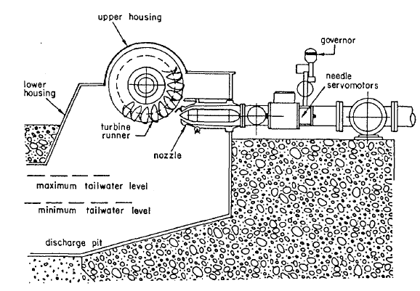
ECEG-4251, Generation Planning – HEPP characteristics
In an impulse turbine, the available energy head is converted into kinetic energy by a contracting nozzle, the action taking place by the impact of the water jets on a set of spoon-shaped blades at nearly atmospheric pressure. The only modern turbine of the impulse type is the Pelton turbine, also called the Pelton wheel.
An impulse turbine cannot develop all of the total available head. The nozzle has to be set above tail-water level. Usually a high flood level is selected for tail-water. The vertical distance between nozzle and average tail-water is permanently lost.

Slide 44
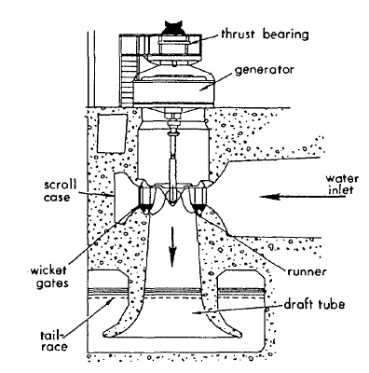
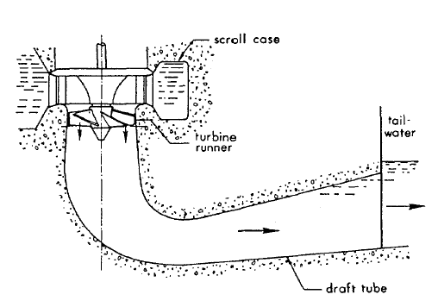
ECEG-4251, Generation Planning – HEPP characteristics
In a reaction turbine, part of the total available energy head is converted into kinetic energy, the remainder being maintained as a pressure head which then decreases through the turbine passage. The pressure head is required because the water flows through the penstock, turbine and draft tube, forming a closed conduit system. The water entering the turbine exerts an impulse on the turbine runner in the direction of the flow, and the discharged water exerts a reaction on the runner in the direction opposite to the flow. Reaction turbines operate with radial, axial or mixed flow through the runner. The Francis turbine and the propeller turbine are two widely used types of reaction turbine

Slide 45
ECEG-4251, Generation Planning – HEPP characteristics
Certain characteristics of hydroelectric power plants should be taken into consideration in generation system expansion planning studies & design. The most important are the following:
    Owing to rapid start-up and flexibility for changing power output quickly, in rapid response to changes in demand, they are especially suitable for increasing the performance and efficiency of a large electric power system.
    They can provide spinning reserve for emergencies as well as economic and effective peak power supply.
    They have lower maintenance and operating costs, longer lifetime and lower outage rates than available alternatives. (On the other hand, the investment costs are usually high.)
    Because of low total operating costs, their production costs are particularly insensitive to future cost escalation.
    The best sites not yet developed are usually located far from the power demanding centres and therefore require long and costly high-voltage electrical transmission lines.

Slide 46
ECEG-4251, Generation Planning – HEPP characteristics
    Unlike thermal plants, their output (of both power and energy) is to a certain degree uncertain since it depends on the uncertain properties of natural river flows. For supply systems in which hydroelectric sources constitute a sizeable level of capacity, the stochastic or random effects of hydraulic inflow are usually very significant.
    Their annual generation is, in general, limited by the annual water inflow and the size of their reservoir, if any; contrary to thermal power plants whose annual generation is mainly limited by the possible annual operating hours (availability).
    Economies of scale are very high. In particular, for hydroelectric power schemes with large reservoirs, the marginal cost of additional generating capacity tends to be very small.
    With a total annual firm energy output limited for hydrological reasons and usually small marginal cost of capacity, it follows that, at least in combined hydro-thermal systems, the most economic utilization of hydroelectric power will be obtained for small ratios of annual energy (kW-h) versus capacity (kW), i.e. for short operation durations (hours) during high demand periods (peaking). In such circumstances, hydroelectric power is competing with the least efficient steam-electric plants and with thermal peaking stations, such as gas turbines and diesel generators.

Slide 47
ECEG-4251, Generation Planning – HEPP characteristics
    In cases where the marginal costs of capacity is exceptionally high, i.e. for schemes with long penstocks or in predominantly hydro-oriented systems or in decentralized small systems, there is also economic scope for hydroelectric power plants with long operation times, i.e. base load operations. In this case, hydroelectric power is competing with base load plants using fossil or nuclear fuels or other base load hydroelectric plants most often in combination with run-of-river plants with small or no storage reservoirs.
    There are three principal means of increasing the hydropower contribution within existing thermal or hydro-thermal power systems:
      To increase peaking power by installing additional capacity in existing plants.
      To increase total energy production by increasing total inflow through additional inter-river diversions, or by increasing storage volume through increasing the height of or reconstructing existing dams. In projects with a low utilization rate at present, total energy may also be increased by increasing the installed capacity.
      To construct new hydropower schemes with due consideration of later development according to (a) and/or (b)

Slide 48
ECEG-4251, Generation Planning – HEPP characteristics
    The economics of action according to 11 (a) above are highly favoured by the generally low marginal cost of additional capacity, as already mentioned. The economics of action according to 11 (b) cannot be generalized since these measures are considered highly site-specific. The economics of new hydroelectric power installations according to 11 (c) are characterized by relatively high investment for the first stage, with subsequently lower marginal costs for power and near-zero variable operation cost.
    Electricity production can be limited by alternative uses of water, e.g. for irrigation, navigation, flood control, water supply, recreation. Electric system expansion planning considering hydroelectric plants must then be adapted to other alternative uses of water. In many cases, the use of river discharges for energy purposes will also be stimulated by the need for integrated utilization of water resources for other purposes.
    The construction and operation of various hydroelectric power stations in the same river must take into account definite water management rules (cascade operation). This must allow for the fact that a certain volume of water has much more energetic value upstream than downstream. (The same amount of water will pass different turbines generating more power.) Also, the construction of any reservoir upstream which is or is not part of a power plant will increase the firm available energy of the plants downstream (minimum power level) available for base load.

Slide 49
ECEG-4251, Generation Planning
  2.5 Reliability of Generation Systems and supply forecasting
Reliability is important in long-range electric system expansion planning. Reliability concepts are required to establish target reliability levels and to consistently analyse and compare the future reliability levels of alternative expansion plans. The overall goal of electric system planning is, broadly, to provide acceptable levels of service reliability to customers at the lowest possible cost.
A reliable generation system is typically characterized as having sufficient redundancy for random equipment failures not to be perceived by the customers as service interruptions.
Electric service reliability can be defined as the level of continuity and quality of electrical supply to a utility customer's end-use device.

Slide 50
ECEG-4251, Generation Planning - Reliability
The generation planner must design the future generating system to be responsive to such problems as:
Random breakdowns of generating equipment (forced outages);
Variations in demand to be met by the generating system (including random variations);
Variations in hydraulic conditions which affect hydroelectric capacity and energy available to the generating system;
Changes in anticipated new capacity scheduled to come on line, e.g. delays or cancellations because of financial and other constraints.
Scheduled maintenance of generating equipment and refuelling of nuclear units (if available);
The reliability of a system depends on the reliability of its generation system, which often consists of many different types of units that are randomly forced off-line by technical problems; the planner must aware and discuss the method used to model the random unavailability of a unit.

Slide 51
ECEG-4251, Generation Planning - Reliability
The section deals with a technique used to determine whether a generation expansion plan satisfies desired level of reliability defined by two reliability indices:
loss of load probability, LOLP and
expected value of demand not served,ε(DNS).
The focus is to analyse the reliability of a proposed expansion strategy for isolated and interconnected systems, considering:
Load forecast uncertainty
Unit availability
Unit maintenance schedule
Interconnection constraints
Frequently the planning staff will collectively define a number of feasible expansion alternatives on the basis of:
Load growth
Construction time
availability of sites
Availability of fuel

Slide 52
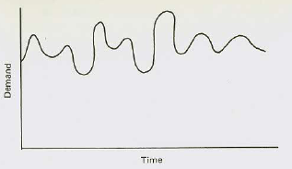
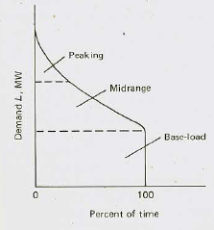
ECEG-4251, Generation Planning - Reliability
Loss Of Load Probability, LOLP
The Probabilistic load Model that best suits our needs here describes the probability that the load will exceed a certain value, for we are interested in determining the probability that load exceeds installed capacity (IC) of a particular proposed generation system (the LOLP).
The best representation of a load that suits our purpose in this case is the load duration curve. This is because the issue here is to determine the probability that the load exceeds the installed capacity of a particular generating system.

Slide 53
ECEG-4251, Generation Planning - Reliability
expected value of demand not served,ε(DNS).
In addition to the LOLP reliability index, we shall find it useful to determine the expected value of the demand not served ε(DNS), associated with a given generation system expansion plan. Using the two indices a planner can choose an expansion plan that is a compromise between cost and reliability.
By definition the expected value of any random variable can be found by multiplying each value of the random variable by its corresponding probability and summing the results.
This is for a discreet variable and for the case of continuous function replaces the summation with integral. Let X is a random variable with probability density function f(x). The expected value of X or the mathematical expectation of X is the sum of the two products.
Similarly if the random variable is a demand, the following is the expected value of demand

Slide 54
ECEG-4251, Generation Planning - Reserve Margin
Reserve Margin and load-following capability of a system are operational parameters that affect system reliability but are not always recognized in reliability models.
Reserve margin is a measure of the generating capacity available over and above the amount required to meet the system load requirements. It is defined as the difference between the total available generating system capacity and the annual peak system load, divided by the peak system load, i.e. it is the excess of installed generating capacity over annual peak load expressed as a fraction (or in percentage) of annual peak load.
While this deterministic reliability index does not directly reflect system parameters such as generation mix, unit size and forced outage rates, it does provide a reasonable relative estimate of reliability performance when parameters other than reserve margin remain essentially constant.
Load-following capability is important because load losses can occur during rapid load fluctuations even though ample capacity may be theoretically available. Production costs, as well as reliability, are affected since it may be necessary to dispatch units with higher variable costs but greater load-following capability as a precautionary measure

Slide 55
ECEG-4251, Generation Planning
  2.6 Environmental and Social Impacts of Generation Stations
During the conceptual and design phases of a new power plant, or during expansion of an existing facility, environmental factors should be considered not only for ethical reasons but because, for example, emissions can have an adverse effect on local plant personnel, nearby communities and industries.
Although provision of environmental controls will cause additional expense, they may in the long run prove their worth.
    Emissions into the atmosphere
Sulphur dioxide is produced by combustion of the sulphur contained in coal.
Reduction Method:
remove all or part of the sulphur in the fuel by pre-combustion treatment, which can take the form of either coal cleaning or oil or natural gas 'sweetening‘
flue gas desulphurization (FGD) systems (scrubbers), which can remove up to 95% of the inlet SO₂ from a flue gas.

Slide 56
ECEG-4251, Generation Planning - Environmental and Social Impacts
Particulates come from ash in the fuel being burned. They have been linked to a variety of lung diseases, soiling of buildings and clothing, and crop damage.
- several techniques for removing particulates from gas streams, e.g. cyclones, electrostatic precipitators, and fabric filters.
Nitrogen oxides are produced as a result of fuel combustion. They have been linked to smog (by combination with hydrocarbons) and, to a smaller extent, acid deposition.
- Nitrogen oxide emissions are most effectively reduced during the fuel combustion process. For gas- or oil-fired turbines, injection of water vapour (which basically lowers the flame temperature) is an effective means of reducing these emissions.
    2. Thermal pollution
No process is completely efficient, and thermal emissions occur in thermal power plants (fossil or nuclear). The difference between the theoretical and actual amounts is the thermal emission from the power plant.

Slide 57
ECEG-4251, Generation Planning - Environmental and Social Impacts
Like all resource development projects, hydroelectric power development has environmental consequences, in which context there are both positive and negative effects, including:
Positive
  Swamp control;
  Landscape management, e.g. creation of lakes of recreational value;
  Flood control.
Negative
  Consequences of initial reservoir impoundment, which can involve loss of productive agricultural lands in the reservoir area;
  Disruption of existing aquatic and terrestrial ecosystems;
  Loss of woods and scenic stretches on the river;
  Changes in water quality due to thermal stratification and oxygen depletion in the reservoir;
  Changes in scour and sedimentation patterns within and downstream of the reservoir and/or other perceived environmental dangers to human values and natural biological systems;
  Additional environmental impacts of long transmission lines, when required, from the project site to the area where the power is used.

Slide 59
Any Question ?
?
?
?
?
?
?
?
?
?
?
?
?
?
?

