Slide 1
DEBRE MARKOS UNIVERSITY
DEBRE MARKOS INSTITUTE OF TECHNOLOGY
SCHOOL OF ELECTRICAL AND COMPUTER ENGINEERING
Power System Planning And Operation
Instructor:-Yalew G.

Slide 2
Introduction
What constitutes a power system?
Generating system:
These are power/energy sources to the power system. They are categorized either by the type of energy source (Fuel) or by the energy conversion method they utilize.
Energy Sources:
They can be defined as net providers of energy. The energy required to obtain these fuels is much less than what they can produce by combustion, nuclear reaction etc. Their energy yield ratio is very high. These energy sources can be coal, oil, gas, atomic energy, biomass, water, daylight and wind.
Energy Converter
They convert the energy from the energy source to the electrical energy. The conversion systems can be thermal, hydro, solar, wind…etc.

Slide 3
Cont’d…
There are different types of Generation systems.
Hydro generation (11 -generation stations)
Run off river type
Dam type
Pumped storage
Thermal generation
Coal
Diesel
geothermal
Nuclear Generation
Wind generation
Solar generation
Tidal generation
Ethiopian generation system is comprised of three types of generations
Koka-41 MW average energy generation capability | Tis Abay II-32MW
Awash 2 and 3 -32 MW | Gilgel Gibe I-184 MW
Fincha– 133 MW | Gibe II-420 MW
M.Wakena – 138MW | Gibe III-1870 MW
Tis Abay I-11MW & | Tekeze-300MW & Beles-460MW

Slide 4
Cont’d…
Thermal
Aluto Langano Geothermal – 7.3 MW
Diesel
Dire Dawa
Awash
Kality
Wind farm generation
Adama I &II 34 and 152 Mw
Ashegoda 120 MW

Slide 5
Transmission System
This component of the power system transmits the bulk electrical energy from generation system where it is produced to main load centers. It is comprised of :
Step-up (11-15/132 or 230 or 400kV) and step down substations (400,230,132,66kV/33,15kV)
The transmission lines
400kV Transmission line
230kV Transmission line
132kV Transmission line
66kV Transmission line
45kV Transmission line

Slide 6
Distribution System
The distribution system distributes the energy from the substations medium voltage out put to customers. It is comprised of:
MV Lines (15kV and 33kV)
MV/LV transformer (15,33/400V)
Distribution Lines (380V-3phase and 220V-single phase)

Slide 7
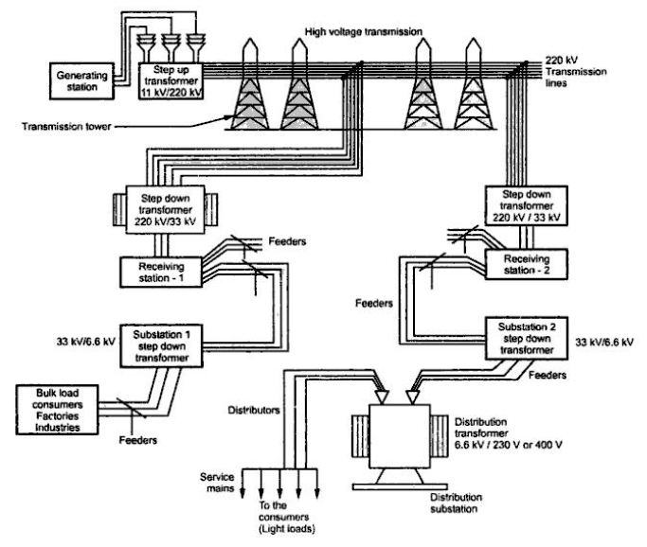
Overall structure of power system

Slide 8
Objectives of power system
To generate enough energy from the most adequate generating stations,
To transmit this energy in big quantities to the load centers at low price and efficiency,
To distribute this energy to the customers assuring good quality,

Slide 9
Power System Planning
Objective of the power system planning is to optimize the facilities necessary to provide adequate electrical energy supply at the lowest reasonable cost.
In system planning the future development of the electrical system is planned.
It gives the necessary basis for detailed technical design.

Slide 10
cont’d…
1. Generation Planning:
Here the sequence of generation plants that serve the forecasted load with sufficient reliability and in most economic way is determined.
It identifies the technology, size and timing of the future generating plants to be added to the power system.
The generation planning determines the following:
Added capacity (technology, size and time)
Investment cost
Fuel consumption by type
Operation and maintenance costs
Retirement plan for existing generation capacity

Slide 11
2. Transmission Planning:
Transmission planning is closely related to the generation planning.
The objectives of transmission system planning is to develop year by year expansion plans for the transmission system based on existing systems, future load and generation scenarios, right-of-way constraints, cost of construction, line capabilities and reliability criteria.
The transmission system is a link between production sources and consumers. The electricity demanded at any moment has to be generated within that moment and delivered to the consumption site.
Therefore, planning basic for reliable and sufficient transmission capacity is required.

Slide 12
Cont’d…
The complicated behavior of a large transmission system, and the claim that it shall perform under widely different operational conditions and unpredictable future situations makes planning difficult, yet important.
In transmission network planning the need for new substations and lines as well as the need for reinforcement in the existing system is defined. These are normally done using simulation tools such as power flow and contingency analysis.
With this tool the planner can evaluate the capability of each alternative expansion plan for providing the level of performance desired.
Since lines and equipment’s must be operated within their design capability, the network topology must be such as to avoid any damaging overloads, even under the occurrence of contingency.

Slide 13
3. Distribution Planning
Distribution planning must not only consider substation siting, sizing, number of feeders to be served, voltage levels, type and size of the service area, but also the coordination of overall sub transmission and even transmission planning efforts in order to ensure the most reliable and cost effective system design.
Economic analysis is an important part of system planning. Different methods are used in the evaluation and comparison of development alternatives.
System planning must be done on a long term basis. Usually, long term plans are made for a period of up to 25 years.
This long span is needed as the future development of the system must be taken into account to reach an economical solution. Life time of power system equipment’s varies widely.

Slide 14
Cont’d…
Transmission lines have a life time of 35 years. Hydro powers have a life time of 60 years. Thermal generators have a life time of 20 years. Therefore, a longer time span is required to understand the economic benefit and loss of any option.
On the other hand a long design and construction time of for example a power plant also requires.
Separate medium-term plans are made, too. They are more detailed than the long term plan. They normally range up to 6 years.
Short term plans up to 3 years serves more operational purpose.
The final output of a power system planning is usually include investment Program, adequate, security, and quality power to customer.

Slide 15
Load forecasting
Throughout the world, electrification is an ongoing process. The reason for this phenomenon is the preference for electrical energy..
The increasing demand in the in power system is due to several factors such as population growth, growth of per capita income, migration to urban areas and increase in energy using product.
Demand forecasts are used to determine the capacity of generation, transmission and distribution system.
System and energy forecast to determine the type of generation facilities required.

Slide 16
Cont’d…
There is a time lag between awareness of a future event or need and serving that need. In order to serve the need adequate generation, transmission and distribution system have to be put in place. This takes a definite time.
The time lag is the main reason for forecasting and planning.
Delivery of requested power and energy always requires some time for the construction of the generation and transmission facilities.
For this reason one is always compelled to estimate the future demand of the system.

Slide 17
Cont’d…
Some words about the load shading because of shortage of rain related to shortage of energy. The system dam size or the amount of energy stored in the reservoirs during the rainy season may not be adequate to serve the demand up to the end of the dry period. And the current load shadings are capacity related.
The problems are associated with transmission and distribution capacity shortages. For a long term planning knowing that there is capacity problems we introduce plants which have relatively small installation costs and have high operating costs.
The accuracy of a forecast is crucial to any electric utility, since it dictates the timing and characteristics of major system additions.
Industrial facilities reduce production, commercial establishments have interrupted hours of service, households suffer inconvenience, goods may be damaged people may be injured.

Slide 18
Cont’d…
Depending on the number and duration of failures to meet load, customers may resort to any number of ways of protecting themselves from loss or inconvenience. Theses may be as direct as installing backup generating capacity or as easy as avoiding storage of frozen foods.
They can go to candles, battery sourced lighting etc. which have additional cost to the customers and also have reduced service quality. Such protective responses are also a cost to the economy since they divert resources (worker’s time, capital) away from other preferred uses.
For this reason economic cost of reliability is considered as part of the system planning process.

Slide 19
Cont’d…
On the other extreme the cost of building too much generating capacity is less visible. From an engineering point of view, the system may be performing well, with few customers compliant, and production targets may be met on schedule. From an economic point of view the system may be consuming too many resources to provide a quality of service that the economy cannot afford. Perhaps a more tangible way of looking at the cost of overbuilding is to compare it with other productive use the capital can be put to.
Three characteristics of utilities set them apart from most industries and heighten the negative consequences of in accurate expansion plans:
They commit relatively large amount of capital for long periods,
Comparatively long lead times are needed to add to their production capacity,
They provide a critical input to the production process of many other industries.

Slide 20
Objectives of demand forecasting:
To meet the demand of different customer categories
The reserve capacity is expensive, and it produces no energy and hence no revenue. Thus we aim to minimize the uncertainty of load forecast.
Estimation of monthly peaks are needed so that equipment maintenance outage may be scheduled.
Estimation of sensitivity between load variation and weather variation (day, week, month, season) to determine weather-load model.
Long term demand forecast is necessary for system future development.
Assignment 1 :
Power system expansion planning starts with a forecast of anticipated future load requirements. Estimates of both demand and energy requirements are crucial to effective planning. Load forecasting is a general term for both demand and energy. Demand is the time rate of change of energy. Demand forecasts are used to determine the capacity of generation, transmission and distribution system additions and distribution system additions, and energy forecasts determine the type of facilities required. For example, if a demand forecasts stated that 100MW of capacity was needed and a corresponding annual energy forecast stated the need for 200,000MWh, in all probability a peaking generating unit would be installed, instead of a base-load unit.

Slide 21
Classification and Load
There are five broad categories of loads-domestic, commercial, industrial, agricultural and residential.
N.B: Commercial and agricultural loads are characterized by seasonal variations.
Industrial loads are considered base loads that contain little weather dependent variation.
Their characteristics are given below,
Domestic - This type of load consists mainly of lights, fans, domestic appliances such as heaters, refrigerators, air conditioners, mixers, ovens, heating ranges and small motors for pumping, and various other small household appliances. The various factors are: demand factor 100 percent, diversity factor 1.2-1.3 and load factor 10-15 percent.
Commercial - This type of load consists mainly lighting for shops and advertisement boarding's, fans, air conditioning;" heating and other electrical appliances used in commercial establishments, such as shops, restaurants, market places, etc. The demand factor is usually 90-100 percent, diversity factor is 1.1-1.2 and load factor is 25-30 per cent.
Industrial - These loads may be of the following typical power range,

Slide 22
Cont’d…
Municipal load: It consist of street lighting, power require for water supply and drainage purpose.
Irrigation load: This type of load is the electric power required for pumps driven by motors to supply water to fields.
Traction load: This type of loads includes tram cars, trolleys buses, railway etc.

Slide 23
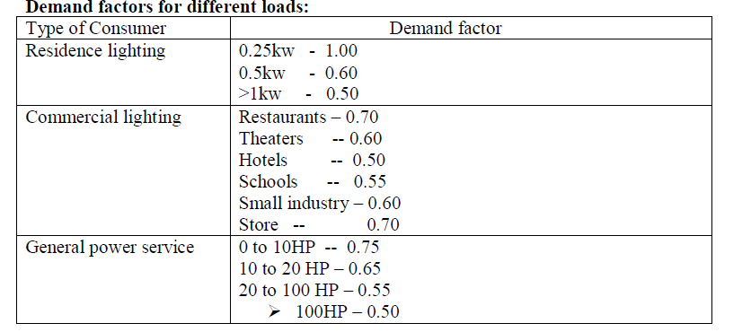
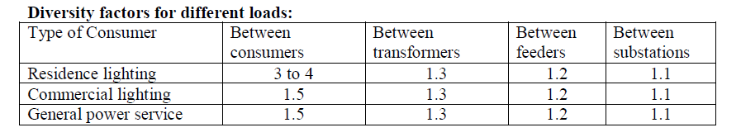
Cont’d…

Slide 24
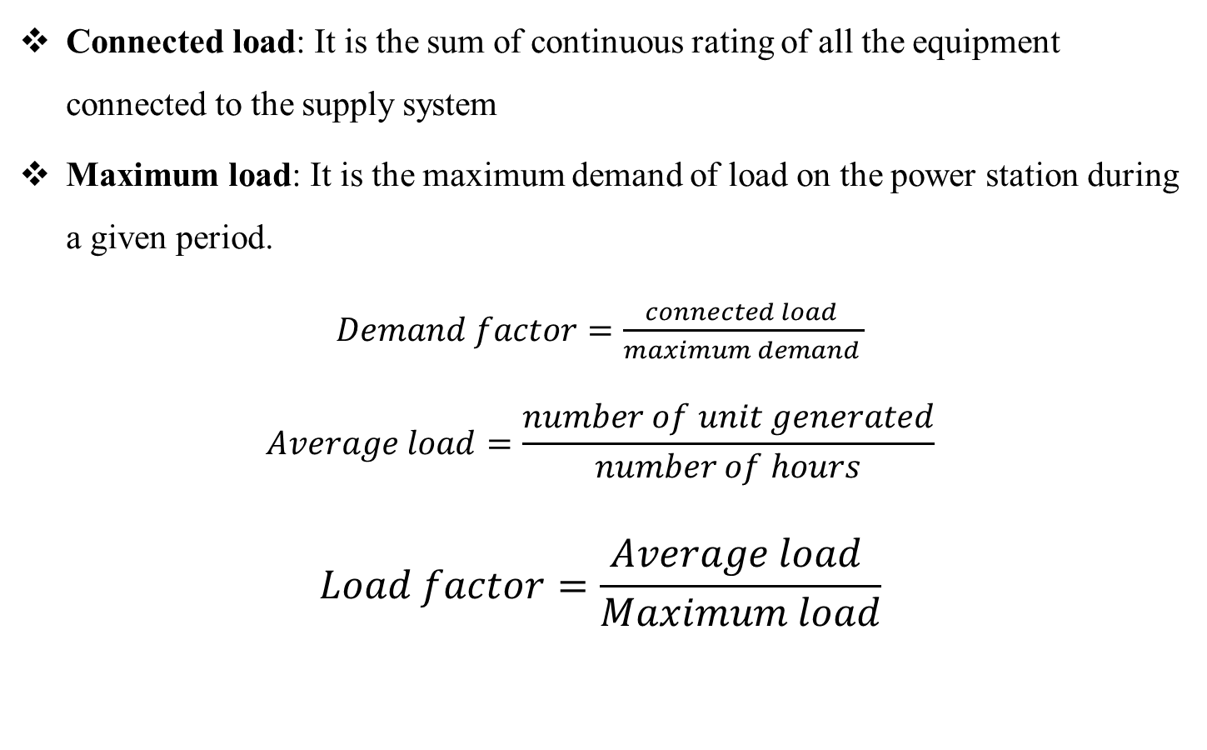
Important terms and factors:
Connected load: It is the sum of continuous rating of all the equipment connected to the supply system
Maximum load: It is the maximum demand of load on the power station during a given period.
$Demand factor=\frac{connected load }{maximum demand }$
$$Average load=\frac{number of unit generated}{number of hours}$$
$$Load factor=\frac{Average load }{Maximum load}$$

Slide 25
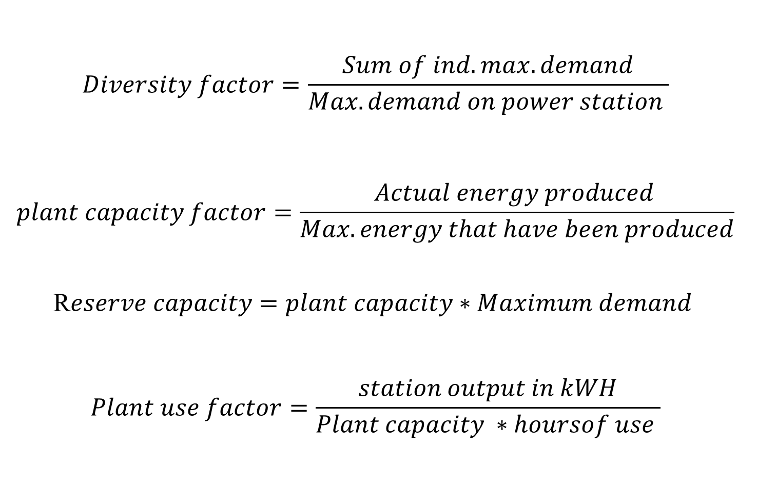
Cont’d…
$$Diversity factor=\frac{Sum of ind.max.demand}{Max.demand on power station }$$
$$plant capacity factor=\frac{Actual energy produced }{Max.energy that have been produced}$$
R$eserve capacity=plant capacity∗Maximum demand$
$$Plant use factor=\frac{station output in kWH}{Plant capacity ∗hoursof use }$$

Slide 26
Characteristics of Loads:
Residential loads have the most seasonal fluctuations. And they are responsible for the seasonal variations of the system peak.
Again in some parts of the world commercial loads are characterized by seasonal fluctuations just like that of the domestic category. In the case of Ethiopia there is no demand seasonality. The characteristics of the commercial load in most part of the country are similar to the domestic category. The Addis Ababa case is very much different.
Industrial loads are considered base load that contain little weather dependent variations. The same is true for the Ethiopian case. The industrial load peak is during the day. Due to shift work most of the load continues till midnight.

Slide 27
Cont’d…

Slide 28
Load Curves and Load duration curves:
The load on power stations varies from time to time. These variations during the hole day (24 hours) are recorded half hourly and plotted against time on graph. This graph is called a load curve.
Total system load for each hour is the sum of generation units output (measured at generation level).
The highest point on the load curve represents the maximum demand (peak demand) on the station on that day. The area under the load curve gives the total energy supplied on that day. And if this area is divided with the number of hours gives the average load on the station.
Load curves can be daily, weekly, monthly and yearly depending on the period of observation.

Slide 29
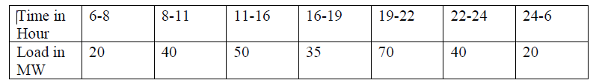
Cont’d…
Average Load= Total Energy/Total Hours
The ratio of the average load to the peak load gives the load factor.
Load Factor=Average Load/Peak Load
Ethiopia’s power system has a load factor of around 0.6. The industrialized countries have a load factor higher than this.
A load duration curve is a curve of MW verses hours and shows the total time during which the load equated or exceeded the power shown.
Example.
A system with a single power plant has the following daily load variation.
Draw the daily load curve
Determine the maximum demand
Determine the average load
Determine the load factor
Draw the load duration curve

Slide 30
Objectives of Load Forecasting:
Operational planning
Unit commitment
Maintenance scheduling
Economic load dispatch
Real time state monitoring
Requirements of load forecasting:
Statistics ,Trained personnel and Instrumentation
Factors affecting Load forecasting:
Economic conditions of the people
Population growth
Degree of Industrialization
Weather condition
Cost of electricity
Pattern of energy consumption
National policy
Availability of national resources
Existing status of rural electrification

Slide 31
Approach to Load forecasting:
Peak demand or energy approach
By combining the forecasting of various load components to determine the total load forecasting or historical load trend
While taking weather conditions
Average of all the methods
Mathematical methods
Peak demand and Energy forecast demand:
Peak demand forecasts are used to determine the capacity of generation, transmission and distribution additions and the energy forecasts are used to determine the type of facilities required such as taking decisions to the establishment of peak or base plants etc.
In the Energy forecast approach first the energy forecasts are made and by using the forecasted values and load factors, the peak demands are obtained there from.

Slide 32
Advantages and Disadvantages of Peak demand approach:
It can be directly related to weather variables such as temperatures etc.
Peak demand varies erratically.
Advantages and Disadvantages of Energy forecast demand approach:
Growth of energy trend is less erratic
It can be easily to the related to the economic and demographic factors like Industrialization, population, per capita income etc.
Since the system load factors can vary erratically, hence the determination of load factor forecasts in difficult.
If the future energy requirements are met , peak demand can be satisfied through interconnected system.

Slide 33
Peak demand forecast
Peak demand forecast is important due to the seasonal variation of the capacity demand by sectors. Thus a forecast that should analysis the peak capacity demand of the customers is done usually by projection the peak demand of a day, week, month or year using the different forecast methods until the projection end year.
The maximum instantaneous load within a given utility service territory is called its peak demand. In electric systems with predominantly thermal capacity, it is more important to know the peak demand than to know the amount of electrical energy demanded, since the peak demand often sets the capacity expansion goal.
For systems with large amounts of hydroelectric capacity, it may be more important to know energy demand because these systems may have energy limitations. Knowledge of the peak demand is also important for planning the type of generating capacity that should be built, when it should be scheduled for maintenance, and how much reserve will be needed (both spinning and standby).

Slide 34
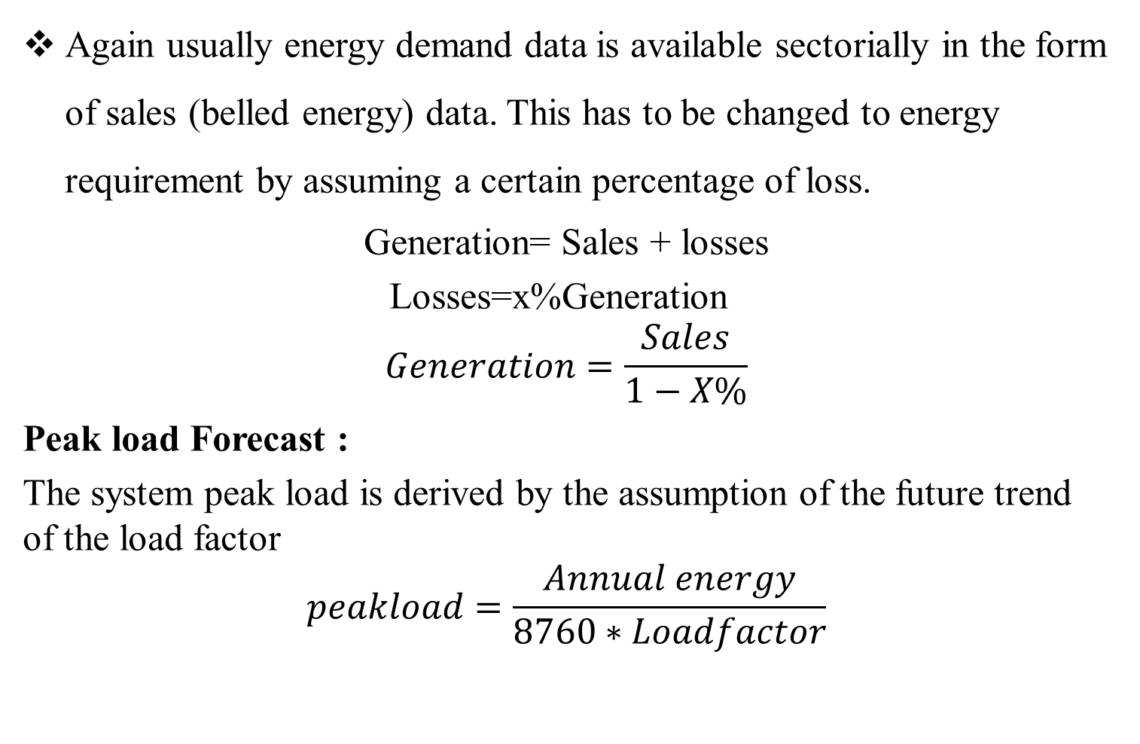
Estimation of Generation requirement:
Again usually energy demand data is available sectorially in the form of sales (belled energy) data. This has to be changed to energy requirement by assuming a certain percentage of loss.
Generation= Sales + losses
Losses=x%Generation
$$Generation=\frac{Sales}{1−X\%}$$
Peak load Forecast :
The system peak load is derived by the assumption of the future trend of the load factor
$$peakload=\frac{Annual energy}{8760∗Loadfactor}$$

Slide 35
Scenario technique:
In the scenario technique several different forecasts are made for electric energy demand. These forecasts are usually based on assumptions concerning the independent variables. This method helps to study the influence of different factors on energy demand.
Energy Forecast:
Since energy or sales forecasting at this time is highly subjective , we shall devote only modest space to the general philosophy prevalent in the industry. Again every utility has its own way of arriving at an energy forecast , and the approach we discuss here may or may not agree with one used by a particular utility.
Every forecasts tend to be developed using correlation and extrapolation primarily, tempered with sound project of future conditions Generally to arrive at a total energy forecast, the forecasts, for the three major classes of customers (Residential, Commercial, Industrial ) are determined and then combined.
Each class is forecast separately because of different characteristics associated with these classes. We shall briefly describe the basic philosophy used in determining these three forecasts.

Slide 36
Sectorial Modeling:
The energy demand is usually forecasted using the below methods for each category of demand( Domestic, commercial, industrial etc.). These have to be aggregated in order to determine the total energy forecast.
Residential energy requirements are dependent on many things, but the major factors are
1. Residential customer
2. Population per customer
3. Per capita energy consumption
Clearly , if forecast of residential sales could be obtained simply by multiplying the three factors. To obtain the forecast values of these three factors, either simple curve-fitting methods or more sophisticated regression analysis can be used. Such an approach to residential sales forecasting is usually referred to as the Population method.

Slide 37
Total component and direct approach:
In the component approach the growth trend of individual components can be well taken care of
Direct approach is easier to follow
Direct approach is more indicative of the overall growth trends
Weather dependence: Depends upon weather
Average of all the methods : It gives accurate load forecasting

Slide 38
Types of Load forecasting:
Long term forecasting:
It covers the period from 10 to 20 years .This depends mainly on the policy of government regarding the allotment of funds for the purpose of power.
It indicates where , when and how much additional generation , transmission and to distribution is required.
It helps the utilities to plan their investments to the maximum advantages and to evolve the optimum tariffs for the various categories of consumers.
It helps in the suitable formulation of the future national power policies.
The absence of long range forecast may create regional imbalances and bottleneck despite adequate over all investment.
Medium term Forecasting or Intermediate Forecasting:
It covers the period of 5 to 10 years. This actually connects the long term forecasting with short term forecasting.
This is used for formulating the immediate power development program me.

Slide 39
Short term forecasting
It covers the period for hours, weeks, months or up to a few years. This helps to schedule the generation etc. from hourly to hourly basis.
Framing / Reviewing of plans for the establishment of future points of supply from the point of view of their timings.
Framing / Reviewing of plans for power factor correction at various points in the system and helps in the optimization of plant utilization.
In case power is being improved from other sources as well having difference in tariffs between them, short term forecasting can help in proper and economic use pf such sources.

Slide 40
Load Forecasting Methods:
Forecasting techniques may be divided into three broad Classes. Techniques may be based on extrapolation, correlation , end use approach.
Extrapolation (Time series Regression):
Extrapolation method makes the assumption that past rate of change in electricity use or in electricity use per customer will continue into the future. A mathematical formula is often developed.
The parameters of the formula are estimated by regression analysis, thereby minimizing the random error of the model. In its simplest form, it is a graphical fitting of a trend curve to the time series of past electricity. Reasons for any big exceptions from the general trend must be carefully analyzed. For example due to shortage of supply there can be restrictions in power generation.
This type of consumption in any given year has to be totally neglected or corrected in a proper way.

Slide 41
Cont’d…
Advantages of extrapolation method:
It is the simplest type of forecast
It requires only access to basic electricity sales and peak statistics
It can be developed by the use of simple statistical models
Disadvantages of Extrapolation Method:
They assume, generally that the future will be like the past, which often turns out to be untrue.
Changes in technology, structural shift in the economy or in demography and changes in regulations are just a few of the parameters that are extremely difficult to capture with the extrapolation forecast.
Extrapolation method is primarily used for short term forecast (one to five years), for which the assumption that the future will be like the past is logical.
The essential prerequisite for a time series forecasting technique is data for the last 10 to 30 time periods.

Slide 42
Cont’d…
Three different forms of equations which uses the time series regression analysis:
o Linear equation:
Demand=a*Year+b
o Parabolic equation :
Demand=a*year^2+b*Year+c
o Polynomial Equation:
Demand=aYears^3+bYears^2+cyears+d

Slide 43
Econometric Method.
Econometric Method depends on the relationships between electricity use or peak demand and various economic or demographic variables.
A specific functional relationships between past electricity demand and these independent variables will be postulated. Then future electricity demand is related to the predicted development of the independent variables.
Generally they assume that historical relation in the past continue to hold in the future.
Mostly used independent variables include:
GDP, Population, Electrified Population, Price and GDP/Capita
The dependent variables
Energy demand

Slide 44
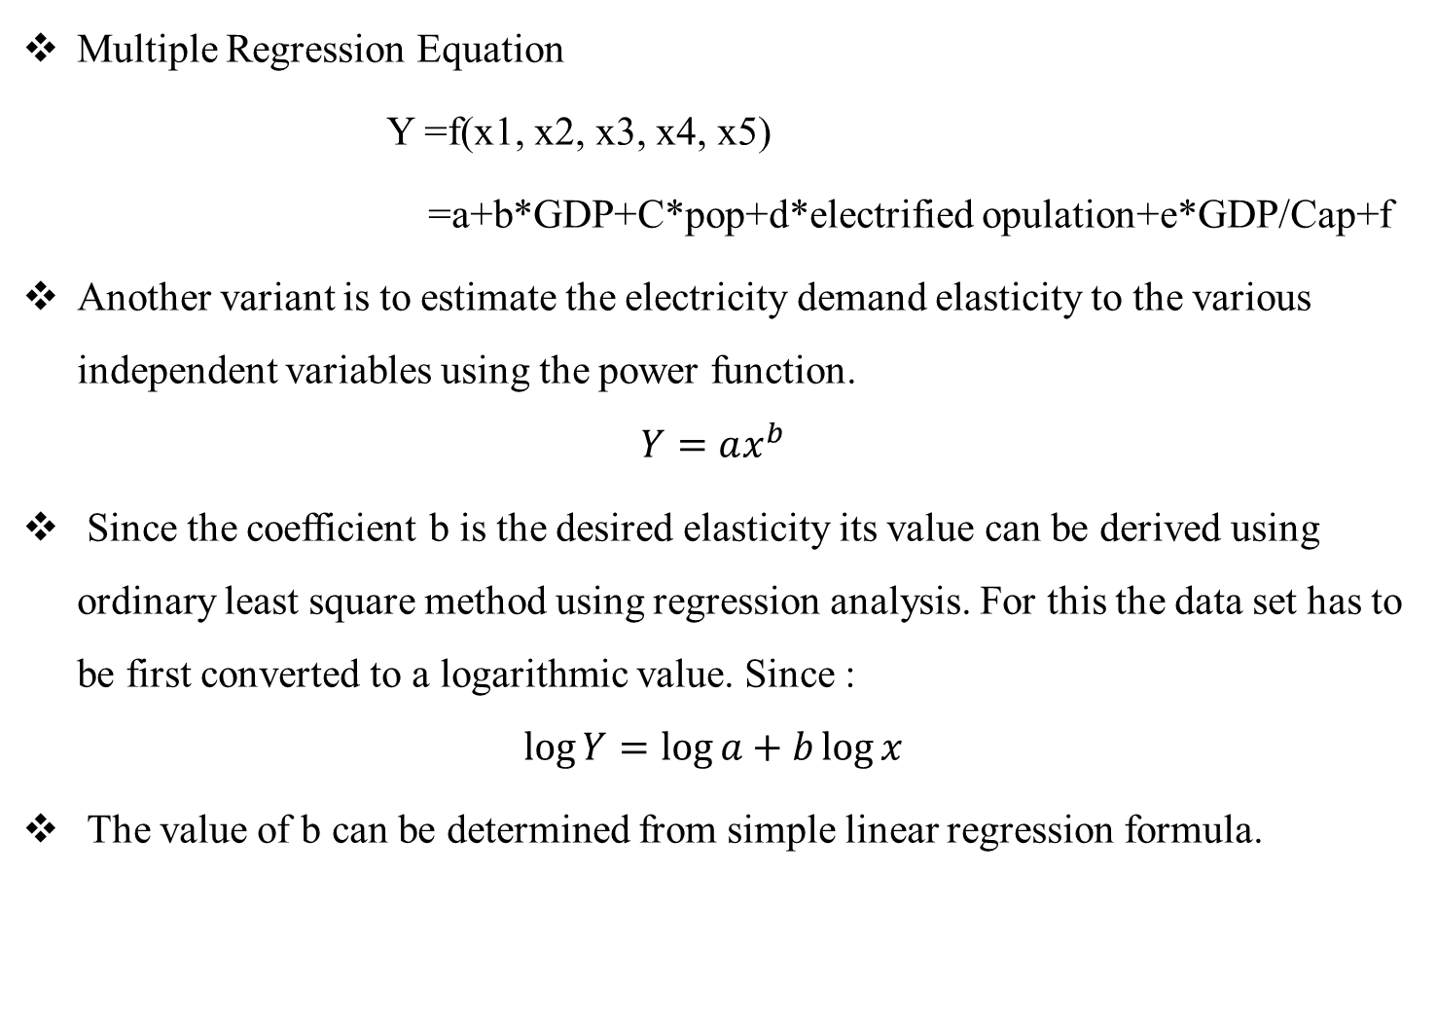
Multiple Regression Equation
Y =f(x1, x2, x3, x4, x5)
=a+b*GDP+C*pop+d*electrified opulation+e*GDP/Cap+f
Another variant is to estimate the electricity demand elasticity to the various independent variables using the power function.
$$Y=ax^{b}$$
Since the coefficient b is the desired elasticity its value can be derived using ordinary least square method using regression analysis. For this the data set has to be first converted to a logarithmic value. Since :
$$\log{Y=\log{a}+b\log{x}}$$
The value of b can be determined from simple linear regression formula.

Slide 45
Cont’d…
Examples of economic and other variables often used to develop econometric relationships are:
Household income
Electricity prices (by customer group)
Labor productivity
Commercial sector output (by sub sector)
Price of other fuels
Use of other fuels (gas,oil,coal,..etc)
Employment (by sector and subsector)
Industrial or agricultural productivity

Slide 46
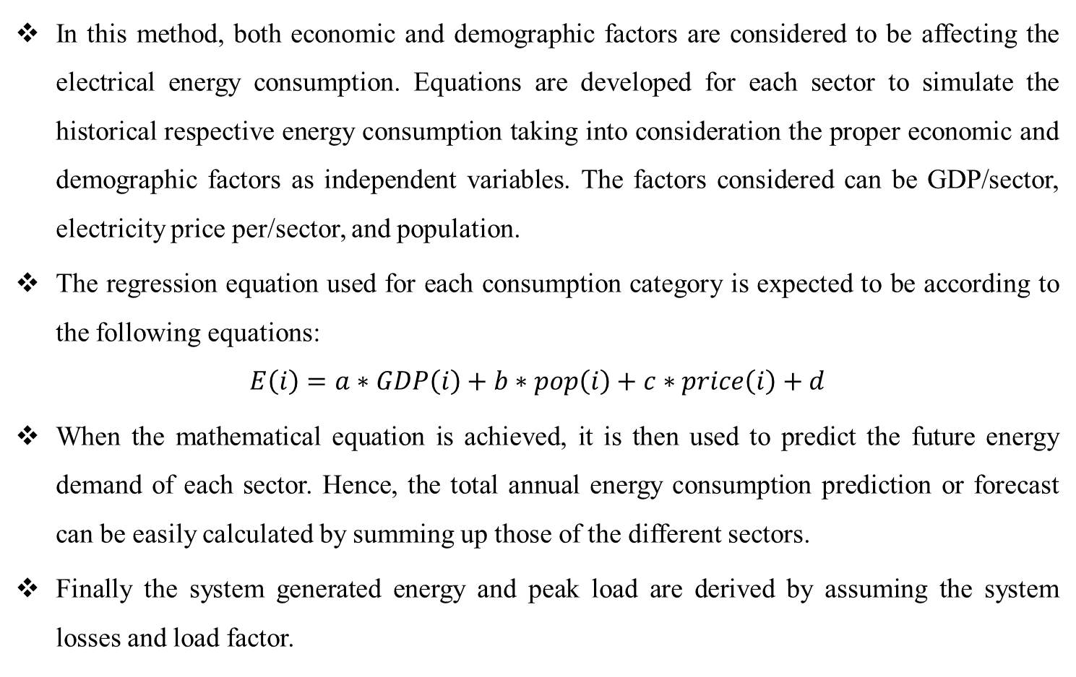
Econometric Regression Method
In this method, both economic and demographic factors are considered to be affecting the electrical energy consumption. Equations are developed for each sector to simulate the historical respective energy consumption taking into consideration the proper economic and demographic factors as independent variables. The factors considered can be GDP/sector, electricity price per/sector, and population.
The regression equation used for each consumption category is expected to be according to the following equations:
$$E\left(i\right)=a∗GDP\left(i\right)+b∗pop\left(i\right)+c∗price\left(i\right)+d$$
When the mathematical equation is achieved, it is then used to predict the future energy demand of each sector. Hence, the total annual energy consumption prediction or forecast can be easily calculated by summing up those of the different sectors.
Finally the system generated energy and peak load are derived by assuming the system losses and load factor.

Slide 47
End use Approach:
End use forecast is different from time series and econometric forecast in that they attempt to build up estimates of electricity needs starting with an analysis of what electricity will be used.
End use approach estimates total usage by forecasting small segments of usage.
End use approach used for long term demand forecast (20-30 years)
Advantages of End use Forecast:
They can be quite detailed, providing more information for planners.
They are not usually technically complex, requiring mostly simple arithmetic to carry out
Can provide integrated forecast of both energy and peak power demands
The assumption used in forecasting are usually relatively easy to follow, to check and revise.
End use forecast makes it more straightforward to estimate the impacts of energy efficiency options and demand side management
Useful for planning demand side management strategy (DSM, Motors, lambs)

Slide 48
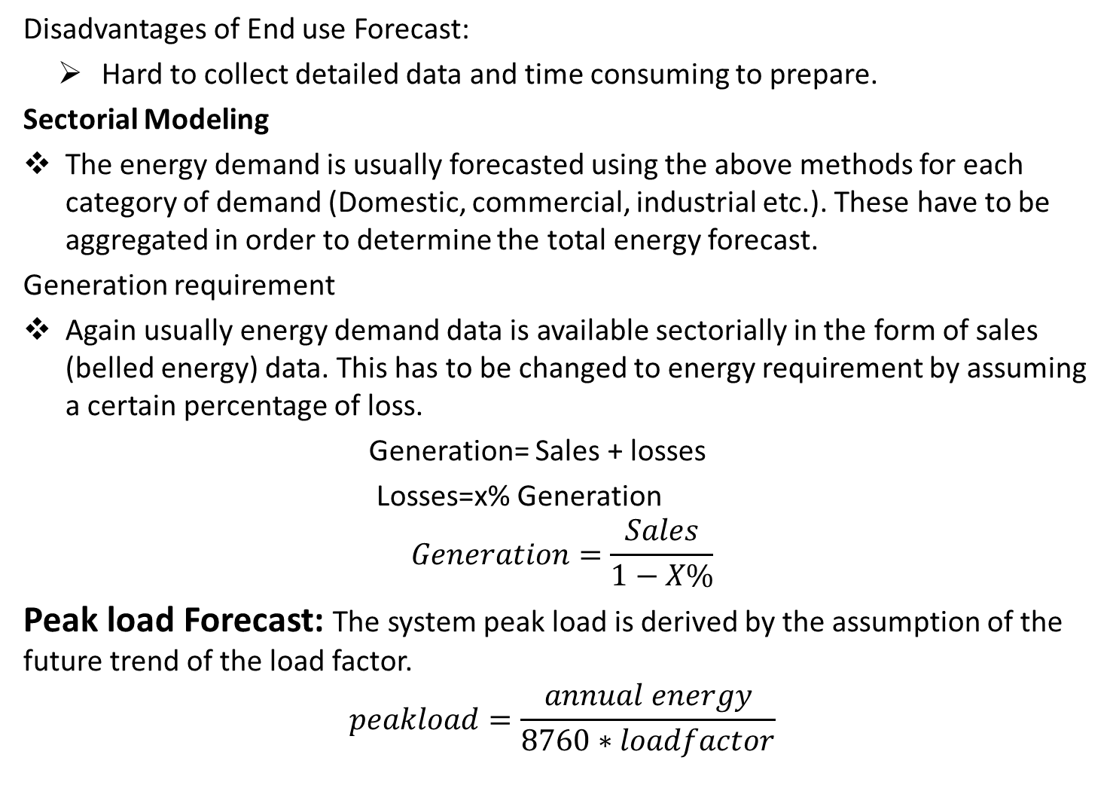
Disadvantages of End use Forecast:
Hard to collect detailed data and time consuming to prepare.
Sectorial Modeling
The energy demand is usually forecasted using the above methods for each category of demand (Domestic, commercial, industrial etc.). These have to be aggregated in order to determine the total energy forecast.
Generation requirement
Again usually energy demand data is available sectorially in the form of sales (belled energy) data. This has to be changed to energy requirement by assuming a certain percentage of loss.
Generation= Sales + losses
Losses=x% Generation
$$Generation=\frac{Sales}{1−X\%}$$
Peak load Forecast: The system peak load is derived by the assumption of the future trend of the load factor.
$$peakload=\frac{annual energy}{8760∗loadfactor}$$

Slide 49
Scenario technique
In the scenario technique several different forecasts are made for electric energy demand. These forecast are usually based on assumptions concerning the independent variables. This method helps to study the influence of different factors on energy demand.
Regression Analysis
Regression in general is a relationship between the variable that will be forecasted (dependent) and another variable (independent).
Simple regression refers to a single independent variable.
Multiple regression refers to a multiple independent variables.

Slide 50
Cont’d…
Regression equations
1. Straight Line
Y=a+bX
2. Parabola
Y=a+bx+cx^2
3 . Polynomial
Y=a+bx+cx^2+dx^3
4 . Exponential
Y=a+b^x

Slide 51
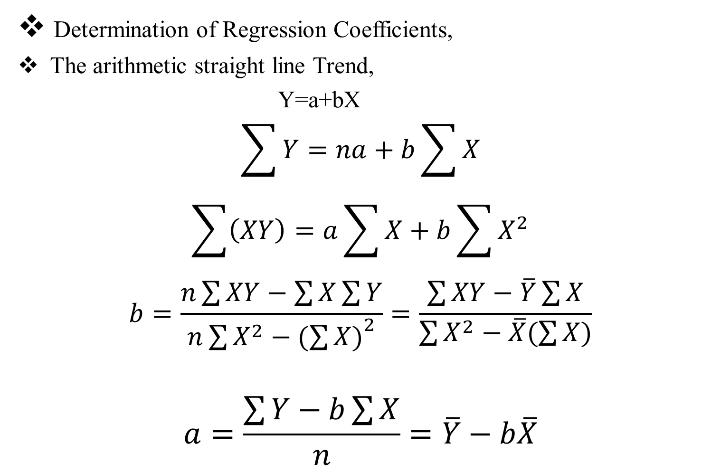
Cont’d…
Determination of Regression Coefficients,
The arithmetic straight line Trend,
Y=a+bX
$$\sum{Y}=na+b\sum{X}$$
$$\sum{\left(XY\right)=a\sum{X}+b\sum{X^{2}}}$$
$$b=\frac{n\sum{XY−\sum{X\sum{Y}}}}{n\sum{X^{2}−{(\sum{X)}}^{2}}}=\frac{\sum{XY}−\overline{Y}\sum{X}}{\sum{X^{2}−\overline{X}(\sum{X})}}$$
$$a=\frac{\sum{Y−b\sum{X}}}{n}=\overline{Y}−b\overline{X}$$

Slide 52
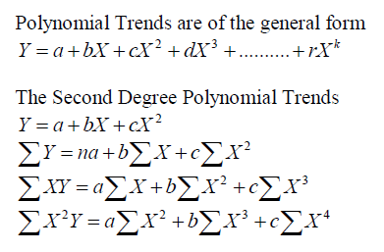
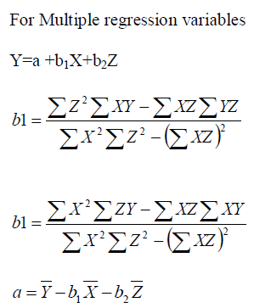

Slide 53
In other way above methods can be considered as
Multiple regression Method,
Discounted Multiple regression Method,
Sheers Formula,
Discounted Fitting Curves,
Historical Trend method,
Fprecasting by Probability Approach,
Weather load model,
Methods of Norms,
Field Survey method and
Stochastic model

Slide 54
Recap
In power system structure contains generation, transmission, distribution system.
Power system planning include generation, transmission, distribution planning.
Load forecasting ,

Slide 55
Questions Slot
List and explain the different types of loads
Explain electricity forecasting and its types.
Explain different time-frames of load forecasting.
Explain, in detail, the trend projection method used in load forecasting. Use necessary diagrams.
Mention and explain factors affecting the load of utility in forecasting modeling.

Slide 56
Cont’d…
Explain the structure of power system with types of transmission and distribution networks.
Mention and explain the different types of power resources.
Explain the Power system planning.

Slide 57
END is not the end!!!!!!!!!!!!!!

