Slide 1
Introduction to Fuzzy Logic

Slide 2
Fuzzy Logic | Introduction
What Is Fuzzy Logic ?
• Form of multi-valued logic (algebra) derived from fuzzy set theory.
• Designed to deal with reasoning that is approximate rather than accurate.
• Consequence of the 1965 proposal of fuzzy set theory by Lotfi Zadeh.
• In contrast with "crisp logic", where binary sets have binary logic,
fuzzy logic variables may have a truth value that ranges between 0 and 1. Can include linguistic variables, like: high, low, hot, cold, and very.

Slide 3
Fuzzy Logic | Introduction
The term fuzzy refers to things which are not clear or are vague. In the real world many times we encounter a situation when we can’t determine whether the state is true or false, their fuzzy logic provides a very valuable flexibility for reasoning. In this way, we can consider the inaccuracies and uncertainties of any situation.
In Boolean system truth value, 1.0 represents absolute truth value and 0.0 represents absolute false value. But in the fuzzy system, there is no logic for absolute truth and absolute false value. But in fuzzy logic, there is intermediate value too present which is partially true and partially false.

Slide 4
Characteristics of Fuzzy Logic
Here, are some important characteristics of fuzzy logic:
Flexible and easy to implement machine learning technique
Helps you to mimic the logic of human thought
Logic may have two values which represent two possible solutions
Highly suitable method for uncertain or approximate reasoning
Fuzzy logic views inference as a process of propagating elastic constraints
Fuzzy logic allows you to build nonlinear functions of arbitrary complexity.
Fuzzy logic should be built with the complete guidance of experts

Slide 5
Crisp vs. Fuzzy
Fuzzy Logic vs. Probability
Fuzzy Logic | Probability
Fuzzy: Tom's degree of membership within the set of old people is 0.90. | Probability: There is a 90% chance that Tom is old.
Fuzzy logic takes truth degrees as a mathematical basis on the model of the vagueness phenomenon. | Probability is a mathematical model of ignorance.
Crisp | Fuzzy
It has strict boundary T or F | Fuzzy boundary with a degree of membership
Some crisp time set can be fuzzy | It can't be crisp
True/False {0,1} | Membership values on [0,1]
In Crisp logic law of Excluded Middle and Non- Contradiction may or may not hold | In the fuzzy logic law of Excluded Middle and Non- Contradiction hold
Classical Set vs. Fuzzy set Theory
Classical Set | Fuzzy Set Theory
Classes of objects with sharp boundaries. | Classes of objects do not have sharp boundaries.
A classical set is defined by crisp boundaries, i.e., there is clarity about the location of the set boundaries. | A fuzzy set always has ambiguous boundaries, i.e., there may be uncertainty about the location of the set boundaries.
Widely used in digital system design | Used only in fuzzy controllers.

Slide 6
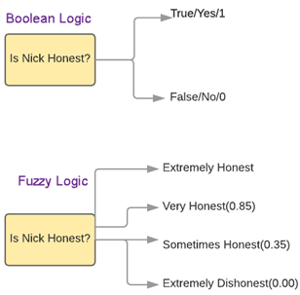
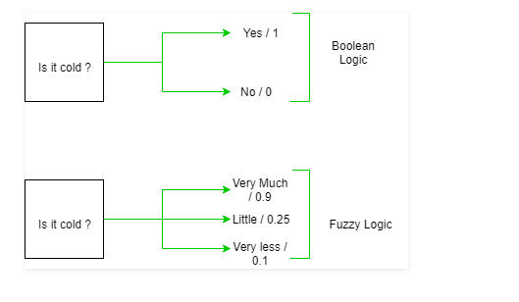
Fuzzy logic examples
See the below-given diagram. It shows that in fuzzy systems, the values are denoted by a 0 to 1 number. In this example, 1.0 means absolute truth and 0.0 means absolute falseness.

Slide 7
When not to use fuzzy logic
However, fuzzy logic is never a cure for all. Therefore, it is equally important to understand that where we should not use fuzzy logic.
Here, are certain situations when you better not use Fuzzy Logic:
If you don't find it convenient to map an input space to an output space
Fuzzy logic should not be used when you can use common sense
Many controllers can do the fine job without the use of fuzzy logic

Slide 8
ARCHITECTURE
Its Architecture contains four parts :
RULE BASE: It contains the set of rules and the IF-THEN conditions provided by the experts to govern the decision making system, on the basis of linguistic information. Recent developments in fuzzy theory offer several effective methods for the design and tuning of fuzzy controllers. Most of these developments reduce the number of fuzzy rules.
FUZZIFICATION: It is used to convert inputs i.e. crisp numbers into fuzzy sets. Crisp inputs are basically the exact inputs measured by sensors and passed into the control system for processing, such as temperature, pressure, rpm’s, etc.
INFERENCE ENGINE: It determines the matching degree of the current fuzzy input with respect to each rule and decides which rules are to be fired according to the input field. Next, the fired rules are combined to form the control actions.

Slide 9
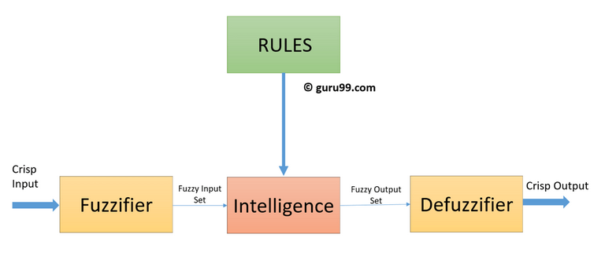
DEFUZZIFICATION: It is used to convert the fuzzy sets obtained by inference engine into a crisp value. There are several defuzzification methods available and the best suited one is used with a specific expert system to reduce the error.

Slide 10
Membership function
Definition: A graph that defines how each point in the input space is mapped to membership value between 0 and 1. Input space is often referred as the universe of discourse or universal set (u), which contain all the possible elements of concern in each particular application. There are largely three types of fuzzifiers:
Singleton fuzzifier
Gaussian fuzzifier
Trapezoidal or triangular fuzzifier

Slide 11
What is Fuzzy Control?
It is a technique to embody human-like thinking's into a control system.
It may not be designed to give accurate reasoning but it is designed to give acceptable reasoning.
It can emulate human deductive thinking, that is, the process people use to infer conclusions from what they know.
Any uncertainties can be easily dealt with the help of fuzzy logic.

Slide 12
Conventional control
In the case of classical operations of process control one has to solve the non-linear function u. Furthermore, it is very important that one also finds the proportionality constants KI,KD, and KP. In the case of fuzzy controller, the non-linear function is represented by a fuzzy mapping, typically acquired from human beings. The above intuition can be expressed more formally as an algebraic equation involving three proportionality constants

Slide 13
Cnt.
The weighted sum of these three actions is used to adjust the process via a control element such as the position of a control valve or the power supply of a heating element. Conventional control theory uses a mathematical model of a process to be controlled and specifications of the desired closed-loop behaviour to design a controller.
This approach may fall short if the model of the process:
•is difficult to obtain, or
•is (partly) unknown, or
•is highly non-linear

Slide 14
Fuzzy controller
Logical rules with vague predicates can be used to derive inference from vague formulated data. The idea of linguistic control algorithms was a brilliant generalization of the human experience to use linguistic rules with vague predicates in order to formulate control actions.
A Fuzzy Controller is a device that is intended to model some vaguely known or vaguely described process. A knowledge-based system for closed-loop control is a control system which enhances the performance, reliability, and robustness of control by incorporating knowledge which cannot be accommodated in the analytic model upon which the design of a control algorithm is based, and that is usually taken care of manual modes of operation, or by other safety and ancillary logic mechanisms.

Slide 15
Cnt.
There are two types of fuzzy controllers:
Mamdani (linguistic) Controller, Direct closed-loop controller.
Takagi-Sugeno-Kang Controller, Supervisory controller.
The controller can be used with the process in two modes: Feedback mode when the fuzzy controller will act as a control device, and Feed Forward mode where the controller can be used as a prediction device. All inputs to, and outputs from, the controller are in the form of linguistic variables. In many ways, a fuzzy controller maps the input variables into a set of output linguistic variables. Usually, a plant, process, vehicle, or any other object to be controlled is called a systems. The feedback controller is expected to ‘guarantee a desired response’, or output y.

Slide 16
cnt
Regulation: is a process described in the control theory literature as a process for ‘keeping the output y close to the set point (reference input)w, despite the presence of disturbances, fluctuations of the system parameters, and noise measurements’. (Error=w−y). A controller is implemented using the control algorithm

Slide 17
Advantages of Fuzzy Logic System
The structure of Fuzzy Logic Systems is easy and understandable
Fuzzy logic is widely used for commercial and practical purposes
It helps you to control machines and consumer products
It may not offer accurate reasoning, but the only acceptable reasoning
It helps you to deal with the uncertainty in engineering
Mostly robust as no precise inputs required
It can be programmed to in the situation when feedback sensor stops working
It can easily be modified to improve or alter system performance
inexpensive sensors can be used which helps you to keep the overall system cost and complexity low
It provides a most effective solution to complex issues

Slide 18
Disadvantages of Fuzzy Logic Systems
Fuzzy logic is not always accurate, so The results are perceived based on assumption, so it may not be widely accepted.
Fuzzy systems don't have the capability of machine learning as-well-as neural network type pattern recognition
Validation and Verification of a fuzzy knowledge-based system needs extensive testing with hardware
Setting exact, fuzzy rules and, membership functions is a difficult task
Some fuzzy time logic is confused with probability theory and the terms

Slide 19
Examples of Fuzzy Logic
in a Fuzzy Logic washing machine, Fuzzy Logic detects the type and amount of laundry in the drum and allows only as much water to enter the machine as is really needed for the loaded amount. So, less water will heat up quicker - which means less energy consumption.
Additional properties:
•Foam detection: Too much foam is compensated by an additional rinse cycle.
•Imbalance compensation: In the event of imbalance calculate the maximum possible speed, sets this speed and starts spinning.
•Water level adjustment: Fuzzy automatic water level adjustment adapts water and energy consumption to the individual requirements of each wash programme, depending on the amount of laundry and type of fabric.

Slide 20
Application
The Blow given table shows how famous companies using fuzzy logic in their products.
Product | Company | Fuzzy Logic
Anti-lock brakes | Nissan | Use fuzzy logic to controls brakes in hazardous cases depend on car speed, acceleration, wheel speed, and acceleration
Auto transmission | NOK/Nissan | Fuzzy logic is used to control the fuel injection and ignition based on throttle setting, cooling water temperature, RPM, etc.
Auto engine | Honda, Nissan | Use to select geat based on engine load, driving style, and road conditions.
Copy machine | Canon | Using for adjusting drum voltage based on picture density, humidity, and temperature.
Cruise control | Nissan, Isuzu, Mitsubishi | Use it to adjusts throttle setting to set car speed and acceleration
Dishwasher | Matsushita | Use for adjusting the cleaning cycle, rinse and wash strategies based depend upon the number of dishes and the amount of food served on the dishes.

Slide 21
Cnt.
Elevator control | Fujitec, Mitsubishi Electric, Toshiba | Use it to reduce waiting for time-based on passenger traffic
Golf diagnostic system | Maruman Golf | Selects golf club based on golfer's swing and physique.
Fitness management | Omron | Fuzzy rules implied by them to check the fitness of their employees.
Kiln control | Nippon Steel | Mixes cement
Microwave oven | Mitsubishi Chemical | Sets lunes power and cooking strategy
Palmtop computer | Hitachi, Sharp, Sanyo, Toshiba | Recognizes handwritten Kanji characters
Plasma etching | Mitsubishi Electric | Sets etch time and strategy

Slide 22
Thank You

