Slide 1
INTRODUCTION
August 2014

Slide 2
Contents
Background
Power and energy calculations
Potential evaluation
Turbines
Hydropower resource assessment

Slide 3
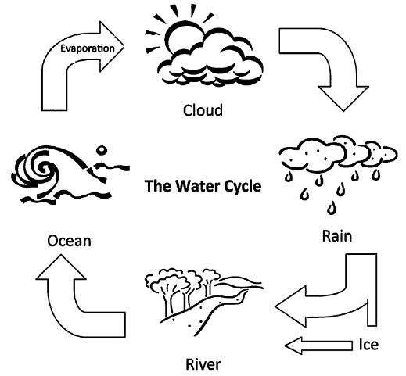
Background
Water cycle
(1) Solar energy heats water on the Earth surface, which causes its evaporation
(2) Water vapor condenses into clouds and falls as precipitation or snowing on the Earth surface
(3) Water flows through streams to rivers back into the oceans
Hydropower resource assessment
Notes:
The amount of precipitation that drains into river basins determines the amount of water available for producing hydropower.
Seasonal variations in precipitation and long-term changes in precipitation patterns, such as droughts and floods, have significant impacts on hydropower production

Slide 4
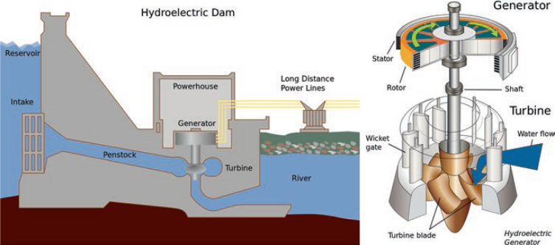
Components of hydropower
Hydropower resource assessment

Slide 5
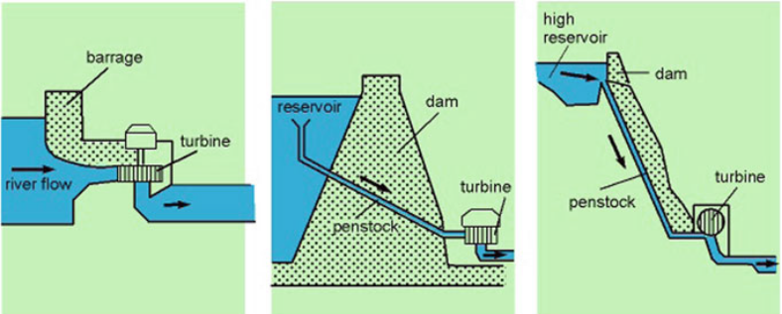
Run of river Dam system High lying reservoir
Hydropower resource assessment

Slide 6
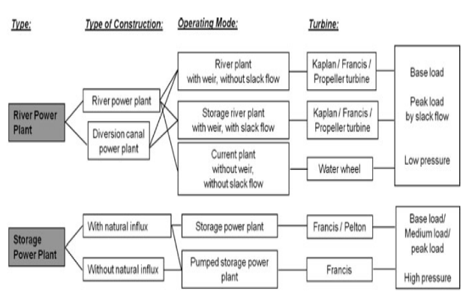
Types of hydropower
Hydropower resource assessment

Slide 7
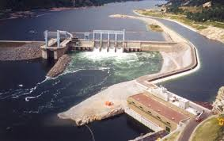
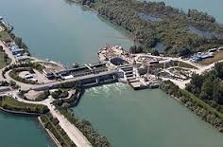
Run-of-river hydropower
No, or very little, storage capacity behind the dam
generation is dependent on the timing and size of river flows
Hydropower resource assessment
Notes:
Run-of-river hydropower projects have no, or very little, storage capacity behind the dam and generation is dependent on the timing and size of river flows.
Reservoir (storage) hydropower schemes have the ability to store water behind the dam in a reservoir in order to de-couple generation from hydro inflows. Reservoir capacities can be small or very large, depending on the characteristics of the site and the economics of dam construction.
Pumped storage hydropower schemes use off-peak electricity to pump water from a reservoir located after the tailrace to the top of the reservoir, so that the pumped storage plant can generate at peak times and provide grid stability and flexibility services.

Slide 8
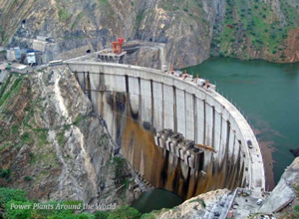
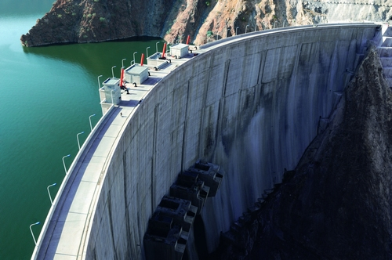
Reservoir (storage) hydropower
Gibe III hydroelectric
Tekeze Hydropower Station
Have the ability to store water behind the dam in a reservoir in order to de-couple generation from hydro inflows.
Reservoir capacities can be small or very large
  characteristics of the site and
  the economics of dam construction.
Hydropower resource assessment
Notes:
http://www.chinadaily.com.cn/m/hubei/gezhouba/2014-02/24/content_17272472.htm

Slide 9
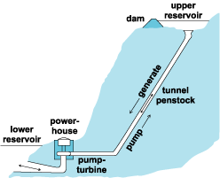
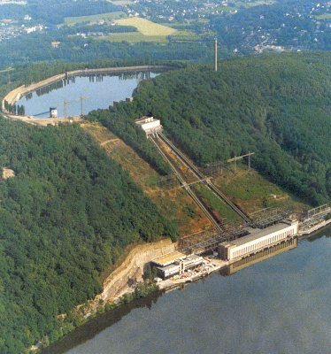
Pumped storage hydropower
http://www.sustainable-energybih.org/hpp?lang=en
Source: http://paginas.fe.up.pt/~ee07300/
Water is pumped from lowers reservoirs into higher reservoirs. When it is needed, the pumped water flows back down to generate electricity.
Hydropower resource assessment
Notes:
References:
http://www.electricitystorage.org/technology/tech_archive/nas_batteries

Slide 10
Classification of hydropower by size
 | Capacity | Comment
Large-hydro | 100 MW or more | Feeding into a large electricity grid
Medium-hydro | 20 MW to 100 MW | Almost always feeding a grid
Small-hydro | 1 MW to 20 MW | Usually feeding into a grid
Mini-hydro | 100 kW to 1 MW | Either stand-alone, mini-grid or grid connected
Micro-hydro | 5 kW to 100 kW | Provide power for a small community or rural industry in remote areas away from the grid
Pico-hydro | few hundred watts up to 5 kW | Often used in remote areas away from the grid
Hydropower resource assessment

Slide 11
Classification of hydropower by size - Ethiopia
Size | Capacity limits | Units
Large | 30 | MW
Medium | 10 – 30 | MW
Small | 1 – 10 | MW
Mini | 501 – 1 000 | kW
Micro | 11 – 500 | kW
Pico |  | kW
Hydropower resource assessment

Slide 12
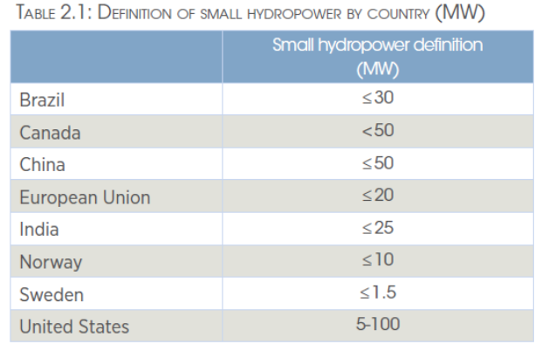
Hydropower resource assessment

Slide 13
Classification of hydropower by head
 | Head
High head | H > 100 m
Medium head | 30 m < H < 100 m
Low head | H < 30 m
Hydropower resource assessment

Slide 14
Global Hydropower installed capacity in 2015
Source: International Hydropower Association | 2016 Hydropower Status Report
Hydropower resource assessment

Slide 15
Hydropower in Africa (2015)
Source: International Hydropower Association | 2016 Hydropower Status Report
Hydropower resource assessment

Slide 16
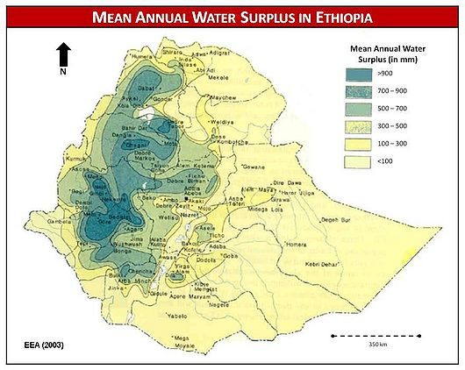
Hydropower projects in Ethiopia
Technical potential: 45 GW
Economic potential: 30 GW
Source: https://energypedia.info/wiki/File:Mean_Annual_Water_Surplus_in_Ethiopia.jpg
Hydropower resource assessment

Slide 17
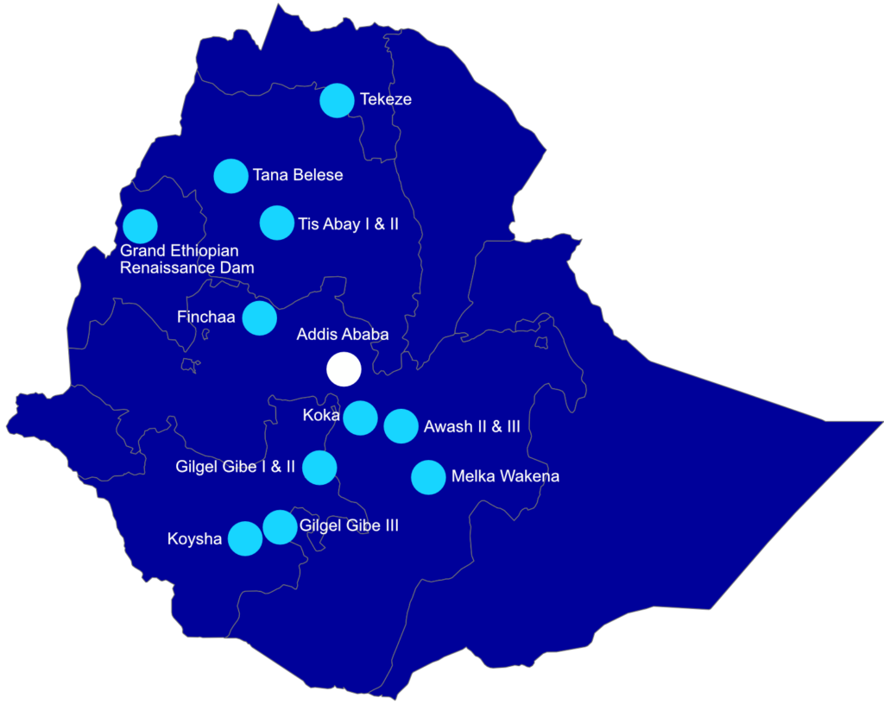
Hydropower projects in Ethiopia
In operation: 4 068 MW
Under construction/implementation: 9 252 MW
Average cost: US$ 1 200/kW
Hydropower resource assessment

Slide 18
Performance Variables
Hydropower resource assessment

Slide 19
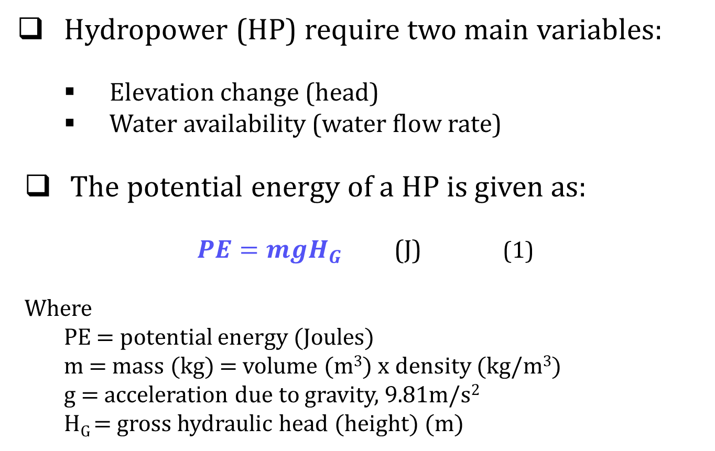
Energy and Power Calculations
Hydropower resource assessment
Notes:
http://www.statkraft.com/energy-sources/Power-plants/Norway/Saurdal

Slide 20
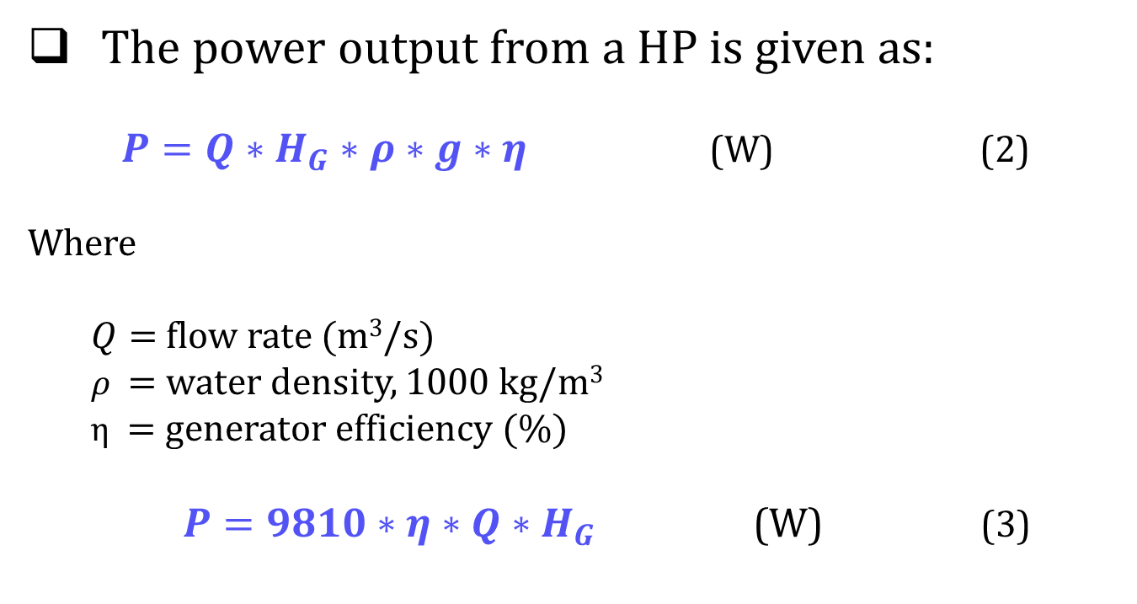
Power output
Hydropower resource assessment

Slide 21
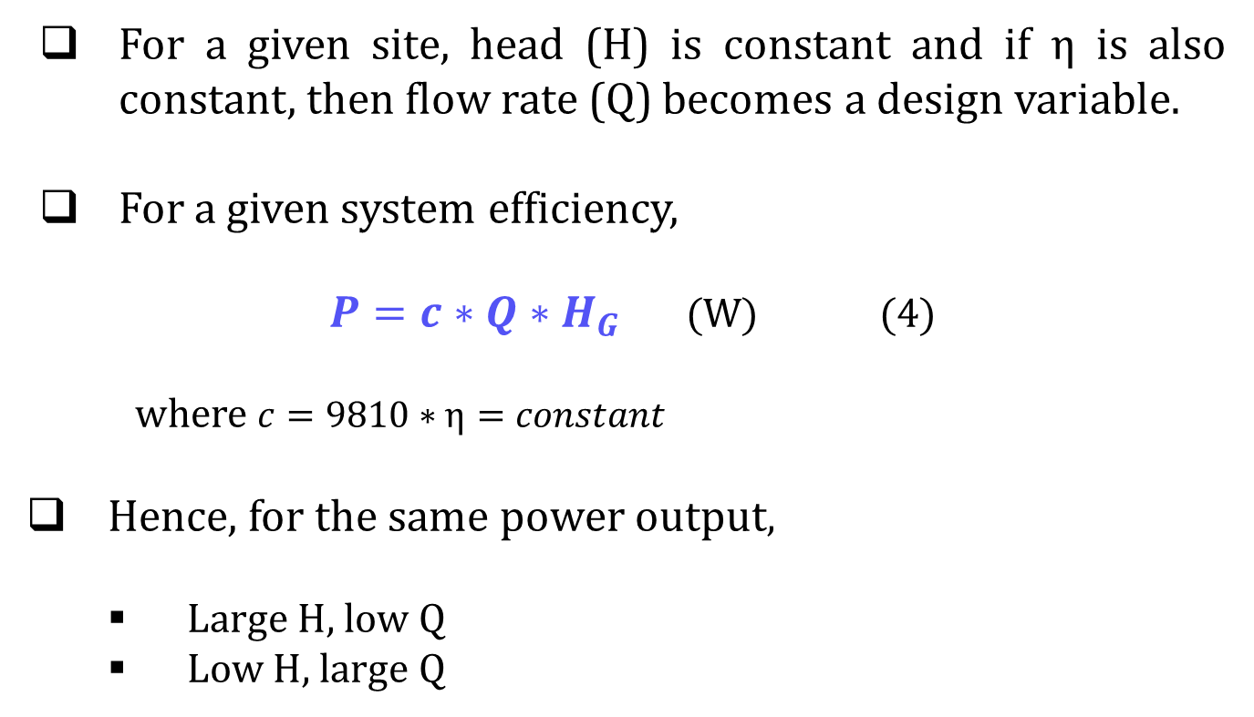
Power output
Hydropower resource assessment
Notes:
http://www.statkraft.com/energy-sources/Power-plants/Norway/Saurdal

Slide 22
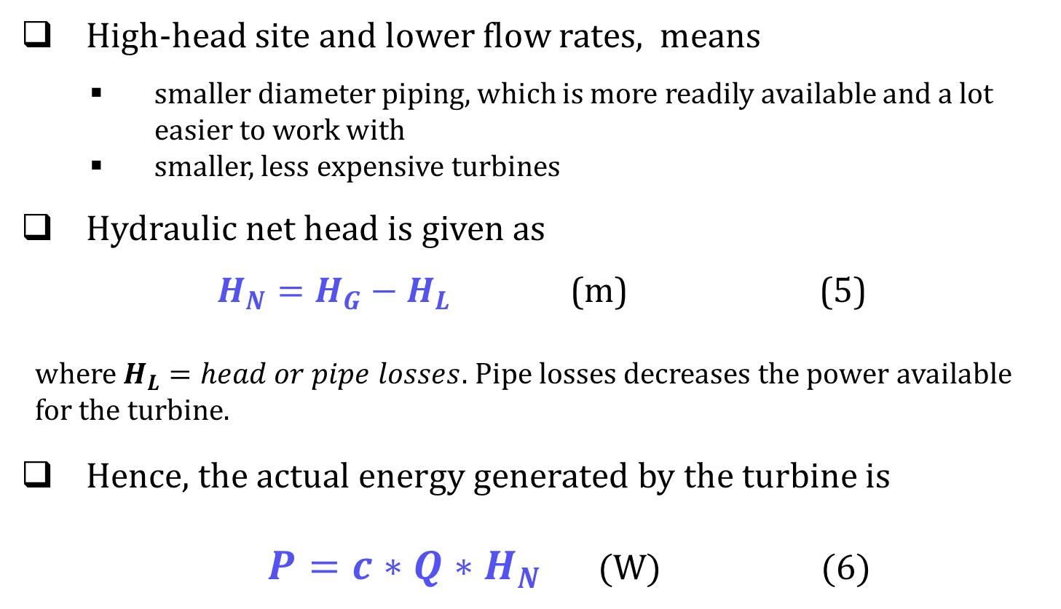
Power output
Hydropower resource assessment

Slide 23
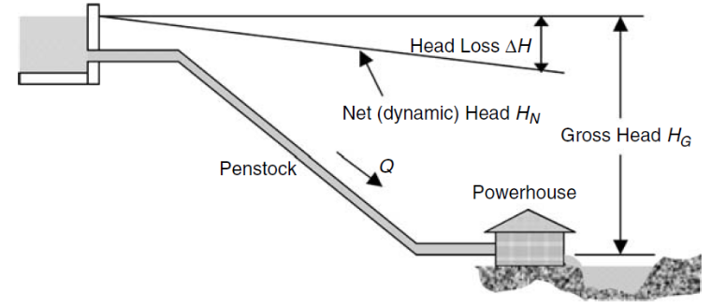
Power output
Pipe losses depends on:
  pipe diameter,
  flow rate,
  length of the pipe,
  inside pipe surface roughness level, and
  number of bends, valves, and elbows
Hydropower resource assessment
Notes:
http://www.statkraft.com/energy-sources/Power-plants/Norway/Saurdal

Slide 24
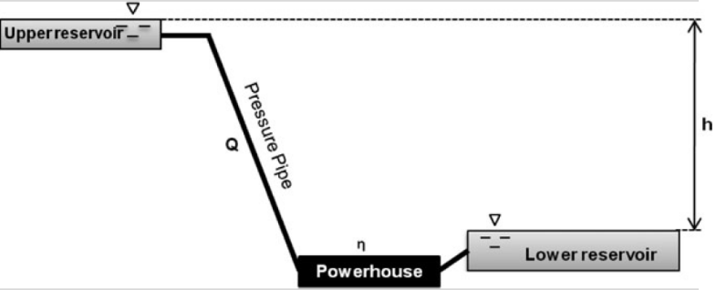
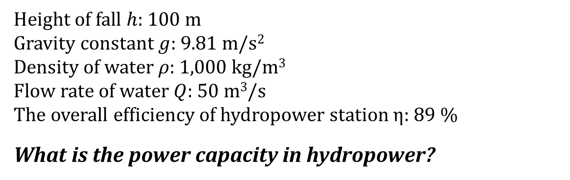
Class exercise 1
Hydropower resource assessment

Slide 25
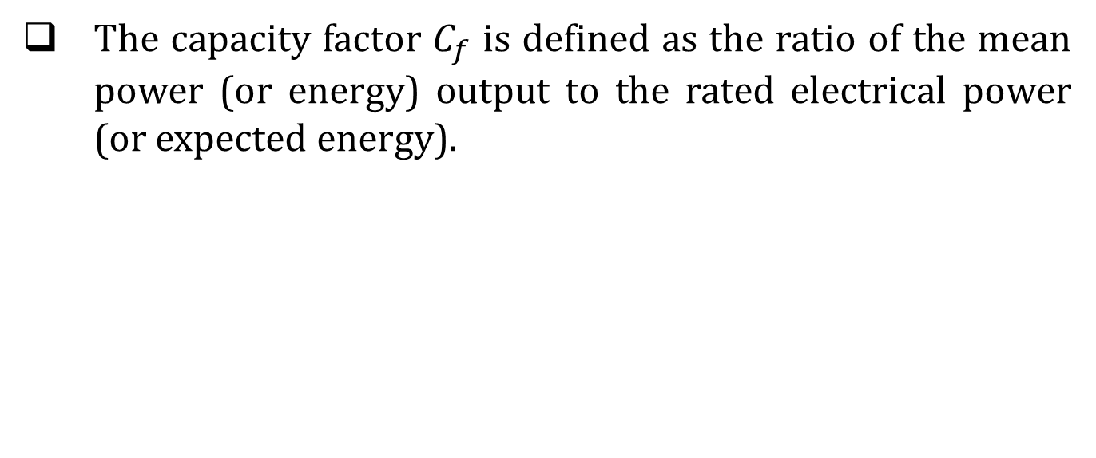
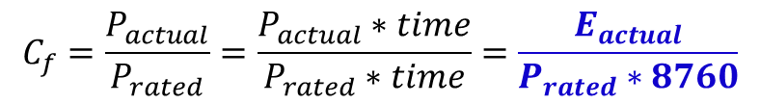
Capacity factor
Based annual energy production
Hydropower resource assessment

Slide 26
Class exercise 2
If the estimated annual energy production by Gibe II, which have installed capacity of 420 MW, is 1350 GWh, what is the capacity factor of this power plant?
Source: https://en.wikipedia.org/wiki/Gilgel_Gibe_II_Power_Station
Hydropower resource assessment

Slide 27
Site evaluation
Hydropower resource assessment

Slide 28
Potential evaluation
Estimate the vertical distance between the lower and upper reservoirs (HEAD)
Volumetric flow rate of water (FLOW)
  Estimate the volume of the available reservoir (volume)
  Energy storage duration (time)
Site topographic
Hydropower resource assessment

Slide 29
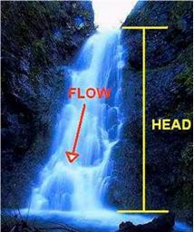
Potential evaluation
Hydropower resource assessment
Notes:
http://www.statkraft.com/energy-sources/Power-plants/Norway/Saurdal

Slide 30
Head measurement methods
Head is the vertical distance that water falls from the intake to the turbine.
  The actual head seen by a turbine will be slightly less than the measured gross head due to losses.
Methods
  Using a topographic map
  Using altimeters, dumpy levels and other surveying type of equipment.
Hydropower resource assessment
Notes:
http://www.statkraft.com/energy-sources/Power-plants/Norway/Saurdal

Slide 31
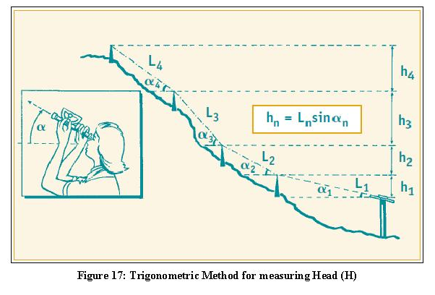
Trigonometric method
http://learning.uonbi.ac.ke/courses/SMR408/scormPackages/path_2/lecture_3.html
Hydropower resource assessment
Notes:
http://www.statkraft.com/energy-sources/Power-plants/Norway/Saurdal

Slide 32

Carpenters’ level method
http://learning.uonbi.ac.ke/courses/SMR408/scormPackages/path_2/lecture_3.html
Hydropower resource assessment
Notes:
http://www.statkraft.com/energy-sources/Power-plants/Norway/Saurdal

Slide 33
Flow rate measurement methods
Flow rate is the quantity of water available in a stream or river and may vary widely over the course of a day, week, month and year
Carry out hydrology study of your site
  to predict the variation in the flow during the year.
  the minimum quantity of water available
It is important to know the mean stream flow and the extreme high- and low-flow rates.
Hydropower resource assessment

Slide 34
Common methods:
  Bucket or container method
  Velocity-Area float method;
  Weir method and
  Propeller-or-cup-driven current meter
Use the lowest mean annual flow as the basis for the system design
Hydropower resource assessment
Notes:
Environmental and climatic factors and human activities in the watershed determine the amount and characteristics of stream flow on a day-to-day and seasonal basis.

Slide 35
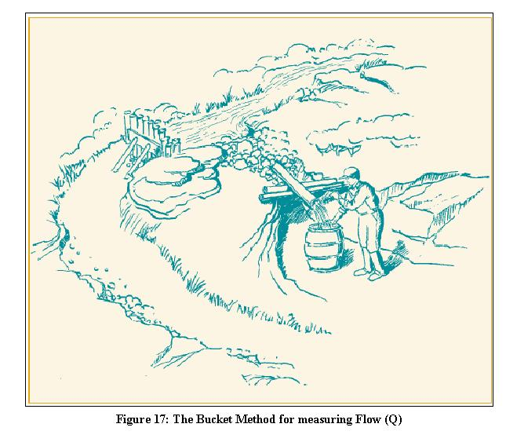
Bucket or container method
http://learning.uonbi.ac.ke/courses/SMR408/scormPackages/path_2/lecture_3.html
Hydropower resource assessment

Slide 36
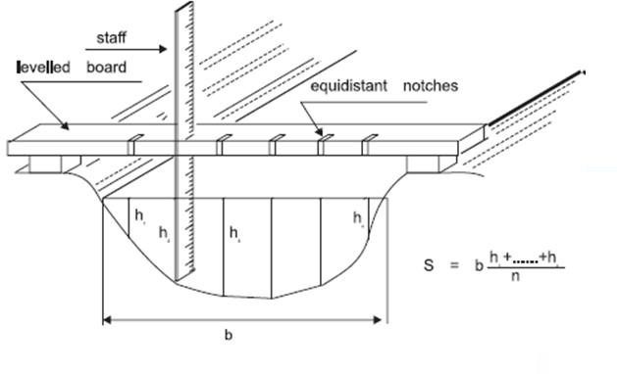
Volume –area or float method
http://learning.uonbi.ac.ke/courses/SMR408/scormPackages/path_2/lecture_3.html
Hydropower resource assessment

Slide 37
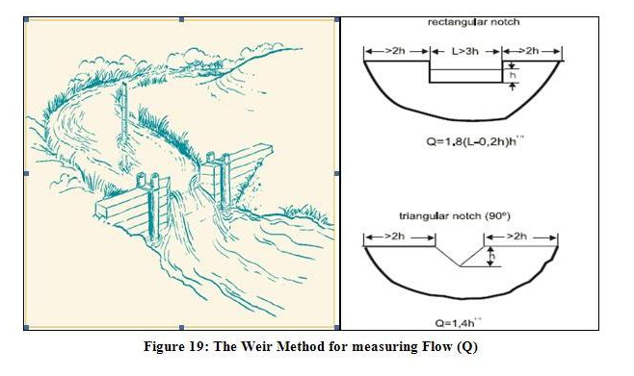
Weir method
http://learning.uonbi.ac.ke/courses/SMR408/scormPackages/path_2/lecture_3.html
Hydropower resource assessment

Slide 38
Flow duration curve
FDC indicates flow available for power generation as percentage of time during the year.
FDC are useful in determining the relative variability of flow between two points in a river basin or between two basins.
  if a stream is highly regulated, the curve will approach a horizontal line
Depending on the available flow measurement data, FDC can be plotted on daily, weekly or monthly basis.
Hydropower resource assessment

Slide 39
Steps in plotting FDC
Assume that the monthly flow at a site is given below:
Plot the hydrograph
  Graph of the flow rate as a function of time
Month | Jan | Feb | Mar | Apr | May | Jun | Jul | Aug | Sep | Oct | Nov | Dec
Flow (l/s) | 236 | 175 | 122 | 146 | 231 | 1200 | 2400 | 3300 | 1700 | 700 | 427 | 325
Hydropower resource assessment

Slide 40
Hydrograph
Hydropower resource assessment

Slide 41
Rank the flow rate from lowest to highest
  Estimate the exceedance rate
Rank | Flow rate (l/s) | Month | Months exceeded | % of Exceedance
1 | 122 | Mar | 12 | 100,00
2 | 146 | Apr | 11 | 91,67
3 | 175 | Feb | 10 | 83,33
4 | 231 | May | 9 | 75,00
5 | 236 | Jan | 8 | 66,67
6 | 325 | Dec | 7 | 58,33
7 | 427 | Nov | 6 | 50,00
8 | 700 | Oct | 5 | 41,67
9 | 1200 | Jun | 4 | 33,33
10 | 1700 | Sep | 3 | 25,00
11 | 2400 | Jul | 2 | 16,67
12 | 3300 | Aug | 1 | 8,33
Hydropower resource assessment

Slide 42
Flow duration curve – flow rate vs % exceedance
Hydropower resource assessment

Slide 43
% exceedance – depend on the nature of the available data
Available data | Number of data | % Exceedance for highest flow rate
Daily | 365 | 0,27
Weekly | 52 | 1,92
Monthly | 12 | 8,33
Hydropower resource assessment

Slide 44
Hydropower installed capacity
Size of hydropower depends on the electricity demand, desire amount of electricity (or power) to be met.
Remember!
Suitable site depend on
  Flow rate - range of flow rates available during the year determines the design discharge for power generation.
  Topography of the site – determines the gross head available as well as feasible water ways alignment.
Hydropower resource assessment

Slide 45
Class exercise 3
A remote community with 150 households is considering building a micro hydropower plant to meet its electricity needs. Based on a household survey, the demand for electricity in the community is estimated to be as follows:
Domestic demand: 300 W per household, which includes a few light bulbs, a television set and a mobile charging outlet.
Computer centre: One at the centre of the town, which requires 300 W.
Photocopying service: An entrepreneur is considering providing this service. Power requirement is estimated at 500 W.
The community also requires some agro-processing facilities as follows:
  One rice mills, which requires about 10 kW of power
  One corn-/wheat grinding plant, which requires 7.5 kW of power
  One oil-expelling plant, which requires 7.5 kW of power
Based on the above information/data the hydropower plant size needs to be determined
Hydropower resource assessment

Slide 46
Class exercise 4 (continuation of exercise 3)
The site survey for the micro hydropower plant is Exercise 4 indicates that a gross head of 70 m is available. The hydrological study shows mean monthly flows as shown in Table below.
Assume an overall efficiency of 65%, estimate
the potential power output each month
the monthly energy output
Recommend a suitable hydropower installed capacity
Month | Jan | Feb | Mar | Apr | May | Jun | Jul | Aug | Sep | Oct | Nov | Dec
Flow (l/s) | 236 | 175 | 122 | 146 | 231 | 1200 | 2400 | 3300 | 1700 | 700 | 427 | 325
Hydropower resource assessment

Slide 47
Introduction to
Hydropower Technology
Hydropower resource assessment

Slide 48
Turbines
Mode of operation
Impulse turbines
Reaction turbines
Pelton
Turgo
Crossflow
Kaplan
Francis
Hydropower resource assessment

Slide 49
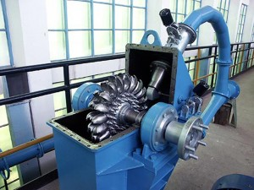
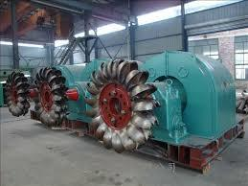
Impulse turbines
Impulse turbines capture the kinetic energy of high-speed jets of water squirting onto buckets along the circumference of a wheel.
High-head, low flow situations
Commonly used in micro-hydro system
Hydropower resource assessment
Notes:
http://www.statkraft.com/energy-sources/Power-plants/Norway/Saurdal

Slide 50
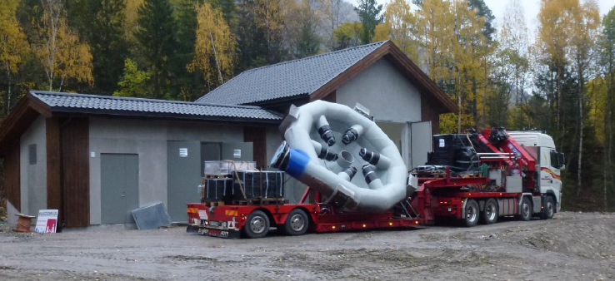
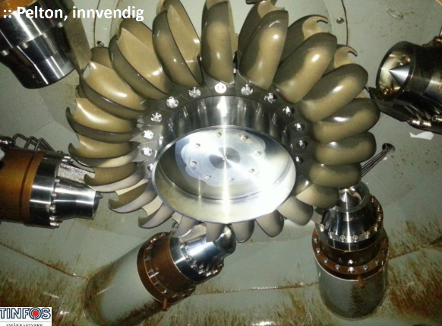
Hydropower resource assessment

Slide 51
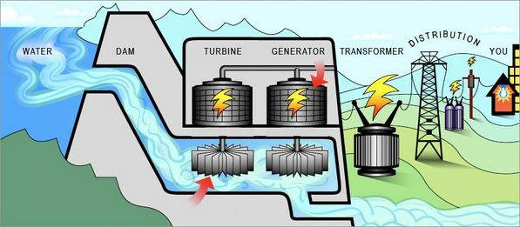
Reaction turbines
Reaction turbines use the water flow to generate hydrodynamic lift forces that propel the runner blades.
Reaction turbines have a runner that always functions within a completely water-filled casing.
Hydropower resource assessment
Notes:
http://www.statkraft.com/energy-sources/Power-plants/Norway/Saurdal

Slide 52
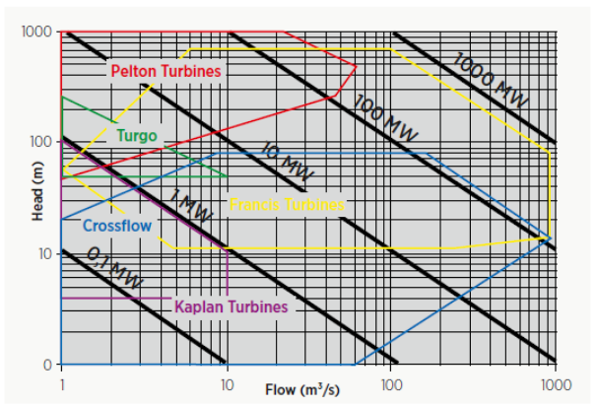
Selection of turbines
Function of two variables:
Head
Flow rate
Source: IRENA (2012) Renewable energy technologies –cost analysis series. Volume 1 Power Issue 3/5 (Hydropower)
Hydropower resource assessment
Notes:
eeeeeAdara

Slide 53
Questions?
Hydropower resource assessment

