Slide 1
The real property market and Urban land use pattern
Contents
conditions to be necessary for a perfect market
The primary reason for the inefficiency of the real property market
Types of urban land uses
Factors that determine urban land use
Urbanization forces
Urban location

Slide 2
Why the real property market is imperfect and inefficient
The conditions to be necessary for a perfect market are:
Many buyers and sellers
A homogeneous product
Full information
Free entry and exit
However, the real estate market is imperfect and
Inefficient due to its distinct characteristics

Slide 3
Cont…
The primary reason for the inefficiency of the real property market is the heterogeneity of the properties being sold.
It is heterogeneous because it is fixed in location. Even identical, properties cannot be physically brought together and traded in a single market place. Identical properties will differ because their locations are different, and cannot be changed.

Slide 4
Cont…
A second reason for the high degree of heterogeneity is that the problem of location is compounded by the fact that the price of the characteristics of properties may vary with location. For example view, noise etc.
If the prices of these characteristics vary from area to area and from location to location the problem that the market has to solve is made more difficult.

Slide 5
Cont…
The third reason is that all properties differ in some way, consisting of differing bundles of characteristics.
In this the property market is totally different from most other markets, where identical goods may be traded on a daily basis by most market participants, both buyers and sellers.

Slide 6
Cont…
Most of these participants do not acquire information over time. It follows that the cost of acquiring information is high relative to the cost of transaction. Thus the property market is not efficient. Prices in one area will rise, or fall, relative to prices in another.
Finally, some part of any change in relative prices results from economic change. Comparison between efficient and imperfect

Slide 7
Urban land use patterns
Types of urban land use
Urban land use comprises two elements:
The nature of land use which relates to which activities are taking place
the level of spatial accumulation, which indicates their intensity and concentration.
Central areas have a high level of spatial accumulation and corresponding land uses, such as retail.

Slide 8
Cont…
Peripheral areas have lower levels of accumulation. Most economic, social or cultural activities imply a multitude of functions, such as production, consumption and distribution. These functions take place at specific locations and are part of an activity system

Slide 9
Cont…
Individuals, institutions and firms have an imprint on land use in terms of their locational choice.
The representation of this impression requires a typology of land use, which can be formal or functional:

Slide 10
Cont…
Formal land use representations are concerned with qualitative attributes of space such as its form, pattern and aspect and are descriptive in nature.
Functional land use representations are concerned with the economic nature of activities such as production, consumption, residence, and transport, and are mainly a socioeconomic description of space.

Slide 11
Cont…
Different types of urban land use:
Commercial land use: Some urban areas are used for commercial activities, such as shops, offices and banks.
Residential land use: Some urban areas are used for residential purposes, where buildings are built for people to live in.
Transport land use: Some urban areas are used for transport facilities, such as roads, bus terminals and airport.

Slide 12
cont…
Institutional land use: Some urban areas are used for institutional services, such as offices, police stations, schools and libraries.
Recreational land use: Some urban areas are used for recreational purposes, such as playgrounds, gardens and parks.
Mixed land use: In some areas, there is more than one type of land use..

Slide 13
Factors that determine urban land use
Urban land use is determined by several decisions made by firms, households and government particularly local government.
In a dynamic economy, new firms emerge and have to choose where to locate. Finally, government authorities affect land use through the control of development, overall transport policy, and the sitting of roads, and comprehensive redevelopment.

Slide 14
Cont…
General Accessibility :
General accessibility, embraces the concept of transport cost including others, the benefit of a particular location in terms of the movement costs it avoids and the revenue earning capacity it affords.
Business firms need general accessibility to factors of production such as lobar and to markets while households require accessibility to work place, shops, schools and recreational facilities

Slide 15
Cont…
Special Accessibility :
Location decision may also be affected by special accessibility obtained from external economies of concentration and complementarity in addition to general accessibility. External economies of concentration can take the form of a ready supply of trained labour (such as secretarial skill).

Slide 16
Cont…
Cost and availability of finance:
High interest rates will reduce the amount of borrowings that purchasers can afford, thus depressing the demand for urban land
Demographic features of the population :
The size of the population (in relation to a given area of land), age distribution, rate of household formation, rate of natural increase, immigration and emigration, geographical distribution, internal migration, etc., will have an effect on the demand and urban land use.

Slide 17
Cont…
Physical characteristics of the site
size, gradient, sub-soil, vegetation, prevailing winds, views, etc.
Proximity to amenities
Schools, shops, parks, sporting facilities, transport facilities, etc.
Proximity to employment opportunities

Slide 18
Cont…
Rental opportunities - A thriving rental market might raise the value of land
Multiple occupancy - if planning laws permit higher density housing, then the land value may increase
Inflation and the expectation of inflation - the expectation of future inflation (or capital growth) will make people willing to pay higher prices
Government grants

Slide 19
Cont…
Re-zoning or the prospect of re-zoning - Huge increases in land values often occur when land is re-zoned from a lower to a higher use, eg. from farming to residential or from residential to industrial. The expectation of a future re-zoning will promote an upward trend in land values, accelerating as the actual re-zoning approaches

Slide 20
Cont…
Zoning restrictions - the value of land will tend to rise if the amount of land zoned for a particular purpose in a particular area is less than the amount required for that purpose in that area.
The state of the economy - land prices, like the prices of other commodities will be affected by the general state of the economy, eg. by the affluence of the population, employment (and unemployment), and wealth and income factors.

Slide 21
Cont…
Neighborhood effects
Surrounding developments etc. can affect the value of a property. For example, the construction of a busy road, an airport or a factory could reduce land values. Conversely, the construction of a bridge, development of a recreational park, or the closure of a street to through traffic could raise land values.

Slide 22
Cont…
Speculation - On the one hand it is argued that speculators, by withholding land from the market or by only allowing it to 'trickle through' in small quantities, force land prices up and expolit the end users of land. On the other hand, it is argued that speculators perform a useful role in the urban land market: they assist in the operation of the price mechanism by ensuring that sites are allocated to the highest bidder and thus put to their 'highest' use, and by investing funds and taking risks they facilitate the development process

Slide 23
Cont…
Development costs - The costs of development and of the projected profits to the developer can affect the supply of urban land
Administrative delays - Developers frequently argue that a major contributing factor to the high price of developed sites is the time taken to obtain the required approval from many departments.

Slide 24
Cont…
Taxes and land rates - As an example, high levels of land tax and rates have the potential to discourage people from holding large amounts of land and could therefore encourage them to bring that land onto the market

Slide 25
Urban structure and Location
Urbanization forces and forms of growth
cities begin for several reasons such as defence, trade or as political or religious centres.
Economic forces are likely to reinforce the original imputed. Initially, growth was associated with industrialization which induced more intensive use of existing buildings, changes in their use and outward expansion.

Slide 26
Cont…
More recently urban growth in developed nations has taken four main forms:
The first one is that there has been urban renewal usually with much higher buildings
The second one is the existence of inter-urban competition resulting in the movement of between cities as some grow and others decline

Slide 27
Cont…
The third one is that there has been a movement of population from the inner and older part of the city to the suburbs and outlaying towns and villages on account of increase in income and the development of fast and convenient trans port system
Fourthly, a hierarchy of urban centres has evolved differing in size and importance, provincial, regional, national and international.

Slide 28
Cont…
The birth of every city is resulted from some function that it served for the economic world at large
For example, In the industrial world, manufacturing cities served the markets of an entire continent, if not worldwide

Slide 29
Cont…
resource extracting cities frequently ship to worldwide markets. In addition to this, University cities serve entire states or nations in the world. Similarly, Medical cities serve far more than the needs of a local population.
The economic base of a city is a set of economic activities that a city provides for the world beyond its boundaries. The economic base of a city determines its growth or decline.

Slide 30
Cont…
Local Economic Activity:
There are also local economic activities (sometimes referred to as secondary activities) of a city in contrast to the economic base activities of a city. It is clear that activities in a city that provide services for the local businesses and households are recirculating the income derived through economic base activities

Slide 31
Cont…
Quality of Life and Leadership
The quality of life and leadership is the other factor in addition to the existing labour forces characteristics in the local growth of a city
Knowledge intensive firms highly consider the quality of life issues. Mostly, these firms want to be established at the locations where the characteristics of the community are attractive to current and prospective employees in terms of (school, recreational environment etc)

Slide 32
Cont…
Industry Economies of Scale: The growth of an industry within a city can create special resources and cost advantages for that industry. This phenomenon is called industry economies of scale
Agglomeration Economies:
As cities grow, external economies arise in both production and consumption through the concentration of many types of activities.

Slide 33
Cont…
They develop additional productive resources. Important examples include improved transportation facilities such as airline service and shipping terminals, the development of subsidiary industries, a pool of skilled labour, the establishment of technical schools geared to the needs of the industries, specialized non financial business services

Slide 34
Cont…
The emergence of such specialized resources in response to demand from multiple industries is referred to as agglomeration economies.
One particular effect of agglomeration economies in real estate is that it causes institutional investors to favour real estate investment in large urban markets

Slide 35
Location and land use
Land that is close to the market or a supply of labour (a ‘prime’ site) will yield the same output as land that is further away (a ‘secondary’ site) but would incur lower labour and capital costs due to its accessibility advantages.

Slide 36
Cont…
In 1826 the German landowner Johann von Thünen applied Ricardian rent theory.
Von Thünen’s theory was a cost-based model that ignored intensity of land use and revenue differentials. Tansport costs will increase as
distance from the central market increases.
As the theory assumes that the total revenue remains constant, the surplus profit decreases as the distance to the market increases.

Slide 37
Cont…
Revenue/ cost
Total cost including transport
R Total revenue
Surplus profit
Fixed cost
0 Y
(market location) Distance from market
Figure 2: Von Thunen’s single use revenue and cost model (Harvey and Jowsey
2004

Slide 38
Cont…
As the theory assumes that the total revenue remains constant, the rent (surplus profit ) decreases as the distance to the market increases. Beyond distance Y this use is no longer profitable as costs exceed revenue.

Slide 39
Cont…
Revenue/ cost Total cost for A
Total cost for B
R E Revenue for both uses
B
A
o x Y
Distance from market

Slide 40
Cont…
The figure above. Introduces a second land use (A) for which fixed production costs are lower, OA, but the final product is more bulky than the original land use (B) and therefore incurs more steeply rising transport costs as distance to the market increases. Assuming revenue is the same from both products, close to the market land use A has the greatest surplus (revenue less costs) available to bid as rent (AR as opposed to BR).

Slide 41
Cont…
So land use A is able to outbid land use B but only up to distance X from the market, after which, because B’s total production costs do not rise so steeply, it is able to outbid A.
Like agricultural land uses, what urban land uses desire is accessibility, not just access to the market (where the customers are) but also access to factors of production (particularly labor and capita) and to other complementary land uses.

Slide 42
Cont…
Since value depends on economic rent, and rent on location and location on convenience, and convenience on nearness, we may eliminate the intermediate steps and say that value depends on nearness.’
Theoretically, as Kivell (1993) points out, in a monocentric urban area the centre is where transport facilities maximize labour availability, customer flow and proximate linkages, and therefore attracts the highest capital and rental values.

Slide 43
Cont…
As CBD affords maximum accessibility, rents are high in this area. Therefore, the firm has to trade off the level of rent against accessibility, i.e., distance from the CBD so as to decide where to locate its operation.
The central force creating cities is the demand for proximity – it is the “economic gravity” that holds a city together

Slide 44
Cont…
Since we are focussed on the effect of accessibility on location choices in urban areas, it is possible to simplify it by making the general assumption that Central Business District (CBD) is the point of maximum accessibility (for example marketing goods, or for a railway station or harbour as dispatch points).CBD is the optimum location for shops, commerce and services with greater accessibility.

Slide 45
Cont…
In attempting to quantify spatial variation in rent and land use, Alonso (1964) adapted von Thünen’s agricultural land use model to urban land use. Alonso suggested that activities can trade off falling revenue and higher costs (including transport) against lower site rents as distance from the centre increases.

Slide 46
Cont…
This can be illustrated by defining ‘bid–rent’ curves (similar in nature to indifference curves) that indicate the maximum rent that can be paid at different locations and still enable the business to earn normal profit,

Slide 47
Cont…
Imposing the land price curve (that shows the actual market rent at an increasing distance from the CBD) derived in the monocentic on the following bid rent curve diagram enables us to determine the most profitable location of the firm. Considering the market rent, the firm will make an effort to locate its operation on its highest bid rent curve that is the one nearest to the origin.

Slide 48
Cont…
Therefore, it will locate at distance H where the land price curve is tangent to the bid-rent (iso-profit) curve in view of the fact that this will be the most profitable location of the firm at the current market rents.

Slide 49
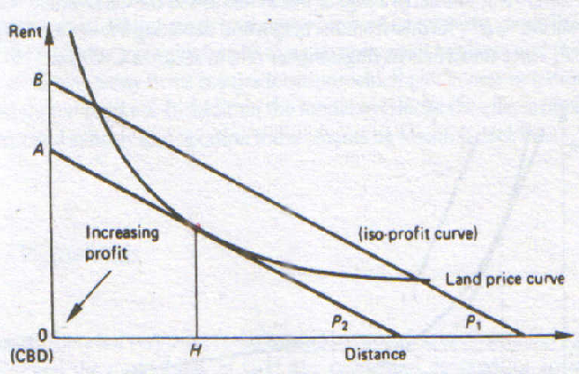
Cont…

Slide 50
Cont…
Some urban land uses place greater emphasis on accessibility than others and these will have steeper bid–rent curves since a considerable drop in rent will be necessary to compensate for the falling revenue as distance from the central business district (CBD) increases. Rent gradients emerge, illustrated
in the following figure for each land use where the steepest gradient prevails.

Slide 51
Cont…
Retailers outbid office occupiers because they are particularly dependent on a central location where the market is located, accessibility is maximized and transport costs are minimized. The availability of such sites is very limited and therefore supply is almost perfectly inelastic

Slide 52
Cont…
Office occupiers, in turn, outbid industrial occupiers. Consequently rents generally decline as distance from the central area increases. Basically greater accessibility leads to higher demand, which, in turn, causes rents to rise and land use intensity to increase. This competitive bidding between perfectly informed landlords and occupiers within a simplified market allocates sites to their optimum use.

Slide 53
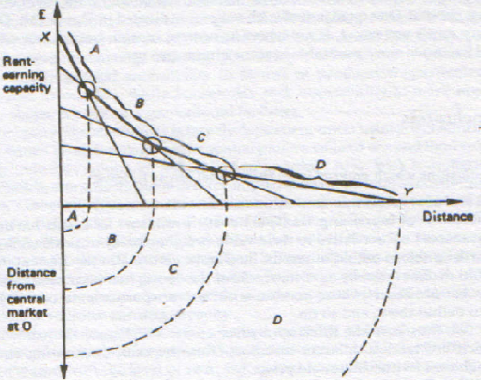
Rent Earning Capacity and Land Use

Slide 54
Multiple land use rent gradient
Office Bid rent
Manufacturing
zone
Residential
zone
Bid Rent
Manuf. Bid rent
Residential bid rent
Office zone
U’
U’’
Distance to center

Slide 55
Cont…
However, this model has its own weakness that is emanated from the assumption that CBD is the only point having accessibility value. In doing so It ignores the development of ring road and motorways which provide accessibility outside the CBD for inter city freight movement by road transport
It fails to recognise the fact that many firms require locations which give access to national and international markets.
It fails to notice the effects of planning control and subsidy and taxation inducements to location decisions.

Slide 56
The concentric zone theory
In Burgess' model of internal urban structure the organization of the city is illustrated by a series of concentric circles which may be used to designate both the successive zones of urban extension and the types of areas differentiated in the process of expansion.
This concentric ring model depicts urban land use in concentric rings: the Central Business District (CBD) in the middle of the model, and the city expanded in rings with different land uses.

Slide 57
Cont…
According to this model, a city grows outward from a central point in a series of rings. The innermost ring represents the central business district (CBD). It is surrounded by a second ring, the zone of transition, which contains industry and poorer-quality housing.
The third ring contains housing for the working-class and is called the zone of independent workers' homes.

Slide 58
Cont…
The fourth ring has newer and larger houses usually occupied by the middle-class. This ring is called the zone of better residences.
The outermost ring is called the commuter's zone. This zone represents people who choose to live in residential suburbs and take a daily commute into the CBD to work.

Slide 59
Cont…
The Loop or Central Business District is the focal point for interaction within the city and would therefore be situated at centre of the zone city.
The transitional zone which encircles the CBD is an area of low class dwelling units which are being invaded by the expanding business and manufacturing establishments of the first zone of land use.

Slide 60
Cnt…
The third zone is the area that alleviates the pressure of expansion in the second zone. This area is one of low class residential land use which is little better than the zone in transition.
The fourth zone, the middle class residential, is an area of better residential units which is the area of the white collar worker. The last of the concentric zones is the high class residential which is made up of high rent apartment buildings and/or districts of restricted single family dwellings.

Slide 61
Burgess concentric zone
CBD
Zone of transition
Zone of independent
workers homes
Zone of better residences
Commuter zone

Slide 62
Radial Sector Theory
It is a theory of urban structure proposed in 1939 by an economist named Homer Hoyt. It is basically an elaboration of concentric zone theory by permitting the development of more irregular pattern.
Certain areas of a city are more attractive for various activities, whether by chance or geographic and environmental reasons.

Slide 63
Cont…
While accepting the existence of a central business district, Hoyt suggested that zones expand outward from the city centre along railroads, highways, and other transportation arteries.
Recognizing that the various transportation routes into an urban area, including railroads, sea ports, and tram lines, represented greater access, Hoyt theorized that cities tended to grow in wedge-shaped patterns or sectors emanating from the central business district and cantered on major transportation routes

Slide 64
Cont…
Higher levels of access meant higher land values, thus, many commercial functions would remain in the CBD but manufacturing functions would develop in a wedge surrounding transportation routes.

Slide 65
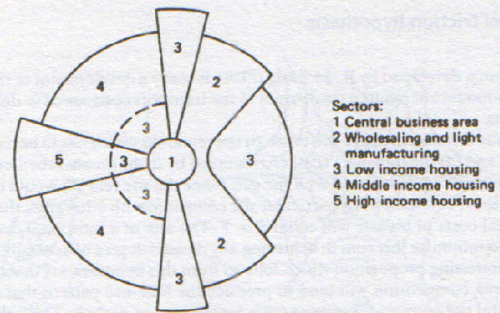
Hoyts Sector Model

Slide 66
Multiple Nuclei Model
This model was developed by Geographers C.D. Harris and E. L. Ullman in 1945. This model takes the view that large cities have a structure which is essentially cellular as it states that a city contains more than one centre (nuclei) around which activities revolves.

Slide 67
Cont…
Such nuclei may have had different origins, existing as minor settlement before the growth of a city began or developing where the growth of population and purchasing power supports a suburban shopping or business centres.
Distinctive type of land use has been grown up over time around a separate nuclei and this existing pattern is strengthened by the general factors determining the allocation of land to specific use

Slide 68
Cont…
For example, a university node may attract well-educated residents, pizzerias, and bookstores, whereas an airport may attract hotels and warehouses. Incompatible land use activities will avoid clustering in the same area, explaining why heavy industry and high-income housing rarely exist in the same neighbourhood.

Slide 69
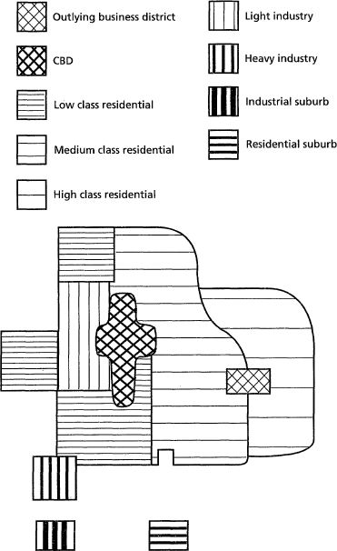
Harri’s and Ullman’s multiple nucllei model

Slide 70
Cont…
By giving greater weight to factors such as topography, historical influences and special accessibility emanated from economic and social forces, the multiple nuclei theory is provides a more flexible approach to urban form than the earlier models that are based on transport cost and accessibility to a single central area

Slide 71
Cont…
Analysts have long recognized that cities are made up of different land uses. We have seen the dynamics of how this different land use is composed and how it can be changed using bid rent curves as a tool of analysis. But transportation modes and production technology are the dominant factors in determining the number and location of nuclei with in a city. Urban structure has been changed according to the change in mode of transportation and production technology.

Slide 72
Cont…
I than you

