Slide 1
Land Economics
Mulugeta Tenaw (MSc)
Institute of Land Administration, DMU
March, 2020

Slide 2
UNIT ONE: INTRODUCTION
1.1 Definitions of Land Economics
-How do you define land?
Land is the ultimate resource, without it life on earth cannot be sustained.
Land is a scare resource involving a wide range of rights and responsibilities.
When poorly managed, it leads to
disputes,
conflict,
degradation and other problems,
all of them drivers of slum development and poverty in urban areas.

Slide 3
Continued…….
Land economics is a branch of the economics field which focuses on the use of land and the role of land in economies. That is it deals with the efficient use of land.
Land itself is a resource like labor or capital, especially when the land harbours deposits of natural resources like minerals, oil, or timber.
It is also a fixed resource: the amount of available land on Earth is finite, although land speculation may create situations in which the supply of land cannot meet the demand.

Slide 4
Continued…
The study of land economics is often closely wrap up in politics, especially politics on a local scale.
Powerful planning commissions and lobbies may be able to push the nature of land use in their communities, shaping land use policies and the economics of locally available land in ways which sometimes surprise economists.
Regional and national governments also play a role in land economics, by establishing policies which are designed to balance the needs of individuals against the needs of the government and the population as a whole.

Slide 5
1.2. Basic Land Value concepts and Principles
Although the concept of value is based on individual-specific criteria, the principle of market value is more concrete.
Market value for a specified good represents the price or monetary value at which the good is exchanged between a willing buyer and seller.
Further, the exchange must take place between knowledgeable persons, who are fully aware of all characteristics and factors that are relevant to the transaction. The transaction must occur based on the free will of both parties, and not be made under duress.

Slide 6
Continued…
From a valuation perspective, however, the underlying question involves which “market” of buyers and sellers must be considered, the current market or the potential market.
While this distinction may be fairly obvious in a fully developed residential area where the current and potential markets are one and the same, the distinction is less obvious in areas in transition. Potential (Highest and Best) Use Value Underlying Henry George’s views on value is the concept of highest and best use of land.

Slide 7
Continued…
In short, it is that use which generates the highest net return to the owner of land over time. The concept of highest and best use requires some judgment from the appraiser in determining what use, perhaps among several possibilities, returns the greatest value to the owner of the land.

Slide 8
Continued..
In assessing the highest and best use of land (Site), four aspects must be considered:
First, the use must be physically possible on the particular site. This may be as simple as the acreage of the site, or may pertain to soil and substructure characteristics;
Second, the use considered must be legal, meeting all zoning requirements;
Third, the use must be financially feasible, providing a reasonable rate of return to the owner; Finally, the possible use must be the most productive one, yielding the highest net return.

Slide 9
1.3 The Role of Land in Our Society
land is a physical entity with inherent ownership rights that can be legally limited for the good of society.
Land is also a major source of wealth, which, in economic term, can be measured in money or exchange value.
Land and its products have economic value only when they are converted into goods or services that are useful, desirable, paid for by consumers, and limited in supply.
The economic concept of land as a source of wealth and an object of value is central to appraisal theory.

Slide 10
Continued…
As a resource, land is protected for the good of society. As a marketable commodity, the ownership, use, and disposal of land are regulated so that individual rights are not violated.
All laws and operations of government are intended to serve the public. Thus, in the public interest, society may impose building restrictions, zoning and building ordinances, development and subdivision regulations, and other land use controls.
These controls affect what may be developed, where development may occur, what activities may be permitted subsequent to development.

Slide 11
Continued…
As the nature and extent of land use controls change, so do the nature and extent of private land ownership.
Such changes impact markets and ultimately real estate values. Consequently, real estate appraisers must be familiar with the regulations and restrictions that apply to land use and understand how these regulations affect a specific property.

Slide 12
1.4 Characteristics of Land as a factor of Production
Land is primary input and factor of production which is not consumed but without which no production is possible.
It is the resource that has no cost of production and, although its usage can be switched from a less to more profitable one, its supply cannot be increased.
The “land” includes all physical elements in the wealth of a nation bestowed by nature; such as climate, environment, fields, forests, minerals, mountains, lakes, streams, seas, and animals.

Slide 13
Continued….
As an asset, it includes anything on the ground (such as building, crops, fences, trees, water), above the ground (air and space rights), under the ground (mineral rights).
As collateral, land is very attractive to lenders because it cannot be destroyed, moved, stolen, or wasted.

Slide 14
Continued….

Slide 15
Continued….
Land is the entire material universe exclusive of people and their products. Everything physical (other than human beings) which is not the result of human effort is within the economic definition of land.
This concept thus includes not merely the dry surface of the earth, but all natural materials, forces and opportunities .
To understand the meaning of land as a factor of production, and we must conceive and define land broadly, as the entire set of natural opportunities.

Slide 16
Continued…
It is needed for all production, for all human life and activity of any kind. When most people think of "land," their mental picture is of farm land: crops, or, pastures. But in fact, the most valuable natural resource in modern society is urban land.
In cities, activities take less land area per head, but more land value, because the price of city land (per unit of area) is hundreds, sometimes thousands of times higher than the price of rural land.

Slide 17
Continued…
Distinguishing the factors of production is crucial to our analysis.
Labor is only human exertion; capital is only physical products of human labor; land is only things not created by human labor.
They are not convertible into each other. (For example: something can be built on land, but if the building is destroyed, the value of the bare land remains.)

Slide 18
UNIT TWO:SUPPLY & DEMAND OF LAND: THE ECONOMIC DETERMINANTS OF LAND RENT
2.1 Supply and Demand of Land
The price of a commodity, service, or product is created by the interaction of supply and demand.
Market analysis investigates supply and demand as economic forces that establish the price of real estate product.
Supply and demand are the forces that form the foundation for the allocation of resources in a market.

Slide 19
Continued…
Demand is the quantity of a product buyers are willing and able (if demand is effective) to purchase at a particular price at which the good is being sold.
The supply of a good (or service) is the quantity that producers are willing and able to supply on the market at a particular price.

Slide 20
Continued…
One of the causes of inefficiency in the land and property market (Real Estate Market) is its inability to respond quickly to shifts in demand. Economic equilibrium will therefore not be reached.
Property markets work in cycles, which respond to various factors– interest rates, inflation or deflation, economic growth or slump, effective demand, political stability or instability, and people’s general optimism or pessimism.

Slide 21
2.2.1 The Price Elasticity of Supply and Demand of Land
The price elasticity of supply and demand of land is a central concept in the land market. Because land is a finite resource, its supply is relatively inelastic: no matter how high the price of land, one cannot increase its physical acreage.
Increasing demand for urban land can rarely be met by increasing supply, as land is relatively inelastic. As a result, prices are bound to increase disproportionately to supply in ways that negatively affect poorer people in urban areas.

Slide 22
Continued…
By changing the development rights on land, densities can be increased and land can be used in more complex ways. However, this takes some time.
This has significant consequences for urban development.
With price inelasticity of supply – as witnessed in the land market – the quantity of land that can be supplied is limited.

Slide 23
2.2.2 Derived Demand
Demand for some products is indirect, because they are means to an end: it is not the thing itself that is desired, but what that thing makes possible.
Derived demand is an important concept for land, since people need land for what the land makes possible – what it yields – and not for the land in itself. But there are exceptions, particularly in the African context, where there is a desire for the land itself because of its symbolic value.

Slide 24
Continued…
If land is fertile, there is of course greater demand for it than for infertile land. Similarly, in an urban context it is what you can do on the land which is important.
The demand for land is ‘derived’ from that potential use. Land is used for various activities: retail shops, factories, housing, public uses such as parks or hospitals, or farming in agricultural areas.
Demand for types of land varies depending on what the land is used for and the kinds of activities that will take place on the land.

Slide 25
Continued…
What people are prepared to pay for land is linked to what they are allowed to use that land for, and therefore what income they are able to derive from that land. Retail and commercial uses for land in the right place in a city tend to allow land users to extract greater profit.

Slide 26
2.3 The Economic Determination of Land Rent
2.3.1 Concepts of Land Rent
Classical (Ricardian) Rent Theory
The basic theory of rents and land values as it was developed by the classical economists implied that these were wholly demand determined. The assumption of Ricardian rent theory is that the supply of land is fixed, and that a single product is produced from this given supply of land.

Slide 27
Continued…
Two conclusions:
First, the rent of land is solely demand determined; since the supply of land is fixed variations in rents can only occur through shifts in the demand curve
Thus the rent of land is high because the price of the produce is high and not vice versa, since the demand for land is derived from the demand for the produce.

Slide 28
Continued..
Second, taxes levied on rents will not affect either the rent paid or the quantity of land supplied. The latter is fixed no matter what the price paid for it and the rent paid will be OR, as determined by the demand for land, no matter what proportion of this is taken in tax. The price of land is determined by the price the developer expects to be able to get for the developments he puts on the land

Slide 29
Neoclassical Rent Theory
According to neoclassical economists, land had alternative uses and it followed that, like any other factor of production, it must receive its due remuneration. Further, since each piece of land had an opportunity cost-the rent that could be obtained in the most profitable alternative use, it followed that the rent of land did enter into the cost of production

Slide 30
Continued….
The rent of land for a particular use is not solely determined by the demand for the product.
The increase in the rent of land is not caused by the increase in the price of the produce. Rather the price of the produce has risen because the rent of land has risen. Thus, the price of produce is high because the rent of land is high, and not vice versa.

Slide 31
Continued…
Moreover, the second conclusion from the Ricardian analysis can also be incorrect, in that land taxes can affect the use of land.
Any form of land tax which differentiates between land uses would not be neutral in its effect, but would result in a shift in the use of land from the higher to the lower taxed use with the tax being passed on in the form of a higher price for the product of the land taxed at the higher rate.

Slide 32
2.3.2 Land Rent and Productivity
Classical (Ricardian) Theory
According to this theory, value of land, and hence land rent derives from productivity.
Earliest model of productivity comes from Ricardo (1821) who looked at land fertility.
In his model he put a number of assumptions. These are,

Slide 33
Assumptions:
Fixed inputs/output prices (price takers),
Zero profit,
3 levels of fertility,
Land to highest bidder,
Location (transports costs) can be ignored, owners are not farmers
On fertile land, a farmer can produce same amount of corn with fewer inputs
The price of this type of land is bid up
All profit accrues to the landowner in the form of rents
Payment to farmer is considered a cost

Slide 34
Ricardo model
MC
ATC
ATC
$10
$
Profit=rent>>to landowner
Price determined exogenously by supply and demand in market
Profit=rent>>to landowner
$8
$4
ATC
MC
MC
Q=amt of corn
220
160
“A” land
“B” land
“C” land
“A” land has lowest production costs= highest rents
“C” land’s rent is 0 because costs are greater than revenue

Slide 35
Ricardo
Land value/rent is a function of productivity ( fertility) and Ignore location as the prime determinant of land value/rent
The model doesn’t explains why more “central” locations command higher rents and have higher market values than fringe areas.
Doesn’t realize the fact that a pattern of different rent exists as different locations have different use capacities.

Slide 36
Von Thunen model (1826)
It replace fertility of land with location as the prime determinant of land rent
No longer assume that transportation is costless
His model explains why more “central” locations command higher rents and have higher market values than fringe areas
The price of land or rent is determined by the interaction of demand and supply in the market economy.
The pattern of land use reflects the competition between alternative uses for sites in the markets.
Therefore, land use and land value are determined simultaneously.
The greatest demand will be for those sits that have the greatest relative advantage.
Those users, such as offices; that can use the site more intensively will be able to pay the highest price or rent.

Slide 37
Von Thunen's Regional Land Use Model
If modern economics began with Adam Smith, modern location economics began with Von Thunen (1826).
He was the first to develop a basic analytical model of the relationships between markets, production, and distance.
For this purpose he looked upon the agricultural landscape.
The relative costs of transporting different agricultural commodities to the central market determined the agricultural land use around a city.
The most productive activities will thus compete for the closest land to the market and activities not productive enough will locate further away.
The model has a set of basic assumptions which reflects agricultural conditions around a city in the early 19th century:

Slide 38
Von Thunen put the following assumptions so as to analyze the effect of transport cost on location decisions.
Isolation. There is one isolated market in an isolated state having no interactions (trade) with the outside. There is a central market (CBD)
Ubiquitous land characteristics. The land surrounding the market is entirely flat and its fertility uniform.
Transportation. It is assumed there are no transport infrastructures such as roads or rivers and that farmers are transporting their production to the market using horses and carts.
Transportation costs are dependent of the type of commodity being transported to the market as well as the distance involved.
Or assumed there is a uniform horse- and - cart transport facilities to the central market
Different foods can be grown but since this differ in bulk the cost of transporting them to the market differs
For each type of product transport cost vary with directly and proportionally to the central market

Slide 39
Different products have different cost patterns
Receipts from the cultivation of one hectare of land are the same for all types of product
The model compares the relationships between production cost, the market price and the transport cost of an agricultural commodity and is expressed as follows:
R = Y(p-c) – Yfm Where
R = Rent per unit of land, Y = Yield per unit of land, p = market price per unit of yield,
c = Average production costs per unit of yield, m = Distance from market (in kilometers or miles) and f = Freight rate per unit of yield and unit of distance.

Slide 40
All agricultural land uses are maximizing their productivity (rent), which in this case is dependent upon their location from the market (Central City).
The role of farmer is to maximize his profit which is simply the market price minus the transport and production costs.
The most productive activities (gardening or milk production) or activities having high transport costs (firewood) locate nearby the market

Slide 41
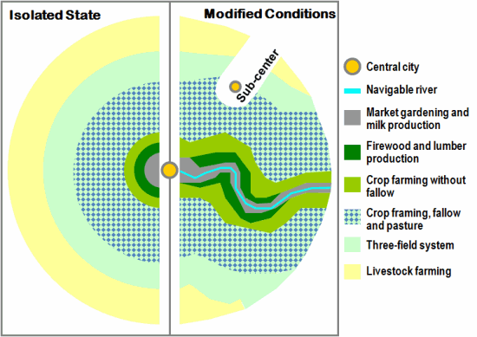

Slide 42
UNIT THREE: MARKET DETERMINANTS OF PROPERTY VALUE
3.1 Creation, Growth and Decline of Cities
Why do cities exist? When they do not exist?
Cities exist because economic activities such as production and exchange of goods and services bring people together.
No cities would exist if
there were no comparative advantage in production Or
the cost of transport is so high that trade isn’t worthwhile
No comparative advantage: means that everyone has the same tradeoff between production of two goods.

Slide 43
Initially, growth was associated with industrialization which induced more intensive use of existing buildings, changes in their use and outward expansion.
It is clear that economic activities such as production and exchange of goods and services bring people together.
Travelling to the location of production or exchange requires time and cost whether it is travelling to work at a factory, a management meeting, calling on a customer, going shopping, or going to a show, concert, or sporting event

Slide 44
Example of comparative advantage and transport costs:
Possible production per day if each country spent all his/her time on each good:
Can country A and B trade so that both are better off? (Assume that trade must be voluntary
Country | Wheat | Cloth
A | 3 | 2
B | 2 | 8
Assume that the cost of transporting either good is .25 per unit
Country B has a comparative advantage in production of cloth and country A in production of wheat. Why?
Proposed bargain that makes them both better off: Country B specializes in cloth and Country A specializes in wheat.

Slide 45
Where do Cities Develop?
It is clear that cities begin for several reasons such as defence, trade or as political or religious centres
Economists have noted several answers about the place where the cluster of cities occur
Cities developed historically at natural harbors, since they were centers for trade between their hinterlands and abroad. In the U.S., early cities collected goods from the hinterland (agricultural products, furs, ..) and exported them to Europe. NY, Boston, Philadelphia, Baltimore, and Charleston are all natural harbors. Later, cities developed where there were railroad junctions (e.g., Atlanta).

Slide 46
Port cities also developed manufacturing.
It was efficient to process inputs at places where they had to be unloaded and reloaded (from canal or train to ship) anyway
In the pre-industrial society,- around a religious institution or a castle
preindustrial cities as derived by trade and exchange .The most convincing locations for such cities were the intersections of different modes of transportation.
In the industrial era, the intersection of rail transportation with seaports or with other rail lines became locations for cities.
Historical changes in transportation modes have brought changing fortunes to many cities. Still other cities were born of mining and resource extraction. The birth of every city is resulted from some function that it served for the economic world at large.

Slide 47
What about scale economies in transportation?
Transportation normally has scale economies, meaning that the cost per mile falls as the distance rises. Why?
· There is a fixed cost of loading/unloading, so best to do it the minimum number of times.
· The cost per unit of distance falls as the distance increases, because more efficient modes of transport can be used (use truck for short distances, rail or ship are cheaper for long distances).
This implies a reason for locating production either at the source or at the market, to avoid having to pay the fixed costs of loading more often and to get the advantage of a single long haul for either the input or the output

Slide 48
More general model of where firms locate:
Suppose you own a firm and are considering where to locate. You want to minimize total costs, not just transportation costs. You consider:
· Transport cost
· Labor cost
· Cost of land
· Cost of materials
· Taxes: state and local, not Federal (why?)
· Cost of professional services: lawyers, advertising, etc.
· Research and development
· Energy costs
· Security and insurance costs

Slide 49
What else is needed for cities to develop?—agglomeration economies
Agglomeration economies refer to increases in the efficiency of production when it occurs in a single city, either in one large factory or many small ones.
Factors that increase agglomeration economies:
Scale economies.
Definition: If all inputs into production are doubled, then output more than doubles. Inputs are labor, capital, materials.
Why do they occur?
As the scale of urban production grows larger, it becomes more efficient because large-scale production justifies investing in additional capital equipment, such as a large loom or a water mill. With more capital, each worker can produce more.
Another reason for economies of scale is that the volume of containers increases as the cube of their size (dimension), while the cost of the container increases as the square of the size. So larger containers are more efficient. Examples of production involving containers include storage bins for grain or boilers for heating.

Slide 50
2. Division of labor: production is divided into several stages and each worker does one stage. Larger scale production justifies more division of labor (more stages of production).
3. Economies of Scope: efficiency increases when multiple types of firms locate close together.
Economies of scope in production: When two industries are located close together, production is more efficient. This is because the presence of one industry lowers the other industry’s costs. (The cost reduction may be one-way or reciprocal.)
Example: early cities were pilgrimage centers, centers for storage of grain, and military centers (soldiers defended the grain). There are economies of scope from combining religious and military centers, because defenders are more motivated if they think that their gods are being attacked.
Modern examples: higher productivity if multiple firms producing different stages of goods for the same industry locate in the same city, since different stages of production have different economies of scale.

Slide 51
Example of button-making and dress-making: button-making has larger economies of scale than dress-making, because dress production is subject to frequent fashion-induced changes. But dress producers buy buttons, so both types of firms are both more productive if they locate near each other
Example of law firms, accountants, public relations firms, and advertising agencies that sell to large corporations. All of these services are produced to order, so the buyer and seller need to get together to decide on the exact product characteristics.
Labor market pooling: when multiple firms in related industries locate in the same city, it is worthwhile for workers to obtain specialized training. Example, a patent lawyer wants to work where many firms invent new products (few firms hire patent lawyers fulltime).
Firms gain because they don’t have to train their own specialized workers.
Firms also trade information through their workers.

Slide 52
4.Economies of scope in sales:
Shopping is more productive when different types of sellers are located together. Each seller’s presence increases demand for other sellers’ goods. Example is a shopping mall. Each seller draws customers and they patronize other stores as well. People come to buy shoes, but also buy toys and clothes, etc.
In large cities, shopping is more productive because many sellers of similar goods are located together.
Each additional seller causes demand for all sellers’ goods to rise Larger clusters may have more of the same type of store or a greater variety of stores.

Slide 53
There is always a tension between transport costs and economies of scale/scope in determining whether particular types of production occur in cities or production occurs at home (self-sufficiency).
Sometimes the balance changes: people do laundry at home today, but it used to be a specialized urbanized industry. (People sent linen to be laundered where the water was clean.) But diapers aren’t washed at home anymore, instead they are produced in large urban factories and thrown away.
5. Cities as centers of innovation.
Putting many firms of the same type together causes innovations to occur that make production more efficient. Four cities in the US (NY, SF, Boston and LA) are responsible for half of all product innovations in the US. Patent applications are also much more likely to come from cities.
Cities generate more innovation in part because they have more educated residents. Educated people migrate to cities because their skills get higher returns (higher wages) in cities than in rural areas.

Slide 54
Limits to Agglomeration Economies— what limits the size of cities?
Pollution.
Disease:
cities permit the spread of disease. In the past, cities had higher death rates than rural areas, because diseases spread more easily in crowded conditions (everyone lived in unsanitary conditions, but diseases didn’t spread in rural areas).
Leading urban killers: cholera (water-borne)
Bubonic plague (carried by fleas and rats)
Smallpox
Malaria (carried by mosquitoes)
Tuberculosis (airborne)
High land costs in cities make housing expensive. Wages rise to offset this, but not always enough.
Cities make face-to-face contact inexpensive, but telecommunications replace the need for face-to-face contact. Will that mean cities no longer have a productive advantage?

Slide 55
This depends on whether forms of communication are complements or substitutes. An example of complements is that when people live close to each other, they may both see each other face-to-face and also telephone. (This is based on telephone records, which show that people are more likely to telephone others who live nearby.) Applied to newer forms of telecommunications, this might mean that telecoms increase demand to locate in cities. But there is little data on newer forms of telecommunications, so these may be substitutes.
High costs of commuting in large cities.

Slide 56
3.2 Firms Location Decision
The central force creating cities is the demand for proximity – it is the “economic gravity” that holds a city together
General assumption that :
Central Business District (CBD) is the point of maximum accessibility (for example marketing goods, or for a railway station or harbour as dispatch points).
CBD is the optimum location for shops, commerce and services with greater accessibility.
As CBD affords maximum accessibility, rents are high in this area.
Therefore, the firm has to trade off the level of rent against accessibility, i.e., distance from the CBD so as to decide where to locate its operation.

Slide 57
Bid Rent of Firms in the CBD
Profit: π= PQ-NC-TC(d)-R(d)
Profit= price*quantity – non land costs- transport costs (function of distance) – rents (function of distance);
TC(d)= cost/ton/mile* distance*quantity
Then R(d)= PQ-NC-TC(d)
Freight Costs and Rents
Freight costs decrease with proximity to city center
Through leftover principle, rents increase as transport costs decrease
Hence, there will be a downward sloping bid rent function; it will be linear for fixed factor producers and convex for flexible producers.

Slide 58
Flexible versus fixed producers
Fixed: R(d)= P*Q-NC-TC(d)
Flexible: π= P*Q-NC-TC(d)-R(d)*L(d), Where L(d) is amount of land used at distance d; this results in rent function: R(d)= (P*Q-NC-TC(d))/L(d)
Flexible farmer substitutes non land for land input: spends more on equipment and labor as land gets more expensive
Flexible produce = factor substitution = lower costs* = higher profits
By leftover principle, higher profits= higher bid rents

Slide 59
Monocentric city firms’ bid rent function
flexible producer
The flexible firm outbids the fixed factor firm everywhere but point u’’. At u’, the fixed factor producer uses too much land
Bid Rent
B
Fixed-factor producer
A
u’
u’’
Distance from export hub

Slide 60
Bid Rent Curve for Different Firms
Some firms may put more emphasis on location than other factors. For instance, those firms that consider the Central Business District as the consumer market for their product will have steeply sloped bid rent curve
Likewise, proximity to the central business district is very important for those firms that are labour intensive such as offices. All of these types of firms will need to locate its operation near to the CBD
Alternatively, firms that are land intensive such as warehousing and manufacturing will have less steeply-sloping bid rent curve represented

Slide 61
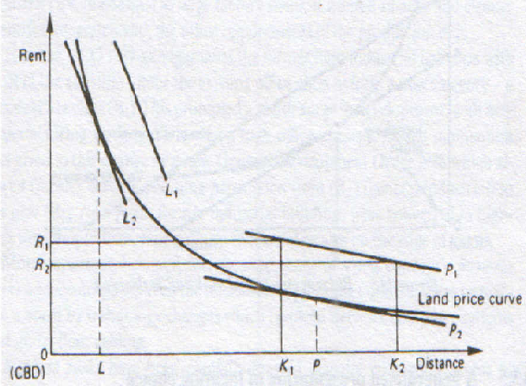
Bid Rent Curve for Different Firms
The analysis indicates that the urban area will end where agriculture (the most land intensive industry) is not outbid by other users
However, as accessibility to the urban market is crucial for market gardening, it will be likely for it to be located on the urban fringe to
a greater extent than will that of dairy farming and cereal production.

Slide 62
All firms are attracted to center, but only some will be willing to bid enough
Office firms have steepest bid rent fn, and will occupy the most central land
Market allocation is efficient, because the office industry has the most to gain from being in the center; manufacturing could gain too, but not as much, so it’s willing to locate a little further out.
However, this model has its own weakness that is emanated from the assumption that CBD is the only point having accessibility value. In doing so
It ignores the development of ring road and motorways which provide accessibility outside the CBD for inter city freight movement by road transport
It fails to recognise the fact that many firms require locations which give access to national and international markets.
It fails to notice the effects of planning control and subsidy and taxation inducements to location decisions.

Slide 63
3.3. Households Location Decision
Residential demand for accessibility tends to be more complicated as it may depend on the utility of certain locations and even of particular sites expressed in terms of:
Travel time and cost related to distance from work, shops, schools, entertainment, cultural activities and recreational activities
Non monetary consideration of the such as space, fresh air, peace, security, location prestige, neighbour and family ties
The definition of accessibility from the residential point of view embraces the above two attributes of residential utility (advantages of a particular location in terms of movement and convenience)

Slide 64
Accessibility to the CBD, with no doubt, is beneficial as we have examined in our earlier discussion.
However, there is a pull to the suburbs because of the lower rent in the suburbs and greater accessibility to more house space and garden, modern schools, playing fields , parks and golf courses in the suburbs than in the CBD
We will pay more attention for spaces with particularly consideration of the house and the garden. Those residents who live in close proximity to the CBD may obtain the benefit of accessibility but the higher rental fee required there limits the amount of space that they can obtain.
Nevertheless, moving to the suburbs so as to get space and environmental benefits at a lower rent makes the residents to incur higher transport cost for commuting to CBD for work specially shopping, entertainment, cultural activities, and central government services such as city administration office, library, art gallery and so on

Slide 65
However, one ought to consider the reality that the monetary benefit generated from accessibility is based not only on transport cost incurred but also on the frequency of the trip to and from the CBD
Normally accessibility to the work place is of relatively high importance since it usually involves at least five trips a week, outweighing trips for recreational activities.
As a result households must trade-off transport costs to the CBD against the extra space offered by the suburbs in deciding where to live. In other words they have to choose between distance from the CBD and the level of rent.
The shape of the bid rent curve depends up on family tests and disposable income. Family tests will be influenced largely by the composition of the households, particularly the number of children and their ages.

Slide 66
Family test
Young family -will tend to have flat bid rent curves . Coz will require space and access to schools, the transport costs of the breadwinner’s daily trip to work in the CBD are relatively not so important.
Single people, old people or families consisting mainly of wage earners will tend to have the steeper bid rent curves
disposable income
low incomes – their demand is travel elastic with respect to rent, and their bid rent curves slope steeply down wards.
the higher income -travel elastic since they can afford transport costs. Indeed at very high income travel is comfortable in chauffeur-driven cars with time being spent usefully in reading, dictating letters and so on.
In other words, as income increases, accessibility to work proves to be an inferior good, people preferring to spend more of their income on transport to obtain space and environmental advantages on the fringe of the urban area.

Slide 67
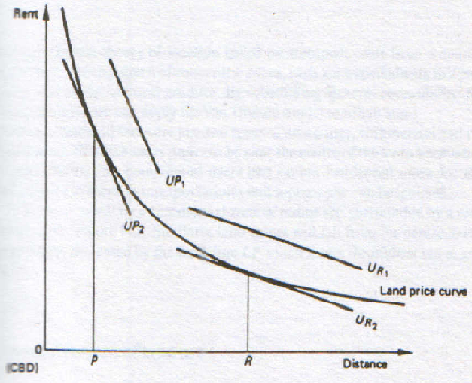
Bid rent curves
Bid Rent Curve for Different Households

Slide 68
Who occupies what?
Activities are arranged according to transport costs; those with the highest costs occupy the most central land
Activity with the highest transport cost will have the highest bid rent curve
All firms have tug-of-war between locating centrally to keep transport cheap, and locating in the suburbs to keep workers’ commute cost lower (and hence pay lower wages)
CBD wins because cost of freight hauling greater than cost of moving workers
workers live on the periphery because they are cheap to transport (i.e. commuting costs are low) relative to cost of moving freight (for manufacturers).
For offices, same problem, because of high price of moving executives around for meetings. If office is in suburbs, executive is constantly going to CBD

Slide 69
Multiple land use rent gradient
Office Bid rent
Manufacturing
zone
Residential
zone
Bid Rent
Manuf. Bid rent
Residential bid rent
Office zone
U’
U’’
Distance to center

Slide 70
Locational choices
Residential Zone
Manufacturing Zone
Office Zone
U’
U’’

Slide 71
Modern Land Use model : the location choice of the households/firms
Land use models need to account for these attributes in order to properly model the location choice of the households but, at the same time, need to consider the heterogeneity in preferences between households
In classical urban economic theory, the location choice of the household is treated as a decision where the main considered variables are
Accessibility, Space and Environmental amenities
Accessibility: accounts for traveling costs and benefits associated with the different activities that the household’s members will perform at different locations in the city.
Space: refers to the size and quality of the housing unit itself.
Environmental amenities: include land use attributes like the presence and intensity of different economic activities (commerce, service, industry, education, etc.) and neighborhood quality.
A location will be characterized by its attributes in these three dimensions and the household will make a choice by accounting for the trade-off between them at each possible location.

Slide 72
The location preferences of a household are related with its attributes which, at the same time, define their basic needs and constraints
Household Attributes
From a modeling point of view, the heterogeneity in location preferences will depend on the households’ characteristics or attributes. Therefore, identifying the relevant attributes to characterize the households as heterogeneous decision makers is fundamental in the context of a location choice model
Several attributes that characterize households are listed, and their potential effect in the location choice process is described
Income: The income of the household defines its upper threshold for rent or housing price and determines the choice set of locations and housing types at which the household has access. Income has also shown to be a spatial segregation/agglomeration variable; indeed households tend to prefer neighborhoods with an average income close to their own
_

Slide 73
Size: The number of members in a household determines the space needs of the household in terms of housing size (surface, number of rooms). Changes in the household size (that can be correlated with the birth of children) may trigger a relocation of the household or even a change in the ownership/renting status
Number of children: The presence of children triggers specific needs and preferences in terms of location and housing. For example, households with children might give priority to locations with good accessibility to educational or recreational facilities
Marital Status: There is evidence that this attribute has an effect on location choice preferences. The marital status can be an indicator of stability in the household in terms of the long-term decisions that are usually taken by a couple.
Age: Most of the time the considered variable is the age of the head of the household which, intersected with the household size and the potential presence of children, helps to identify the current life cycle of the household Different ages yield heterogeneous preferences in location, mobility habits and/or restrictions. For example, old households might prefer to avoid isolation and to locate near to services and commerces . Furthermore, it is interesting to observe that there exists an inverse relationship between the probability a household relocate and its age

Slide 74
Sex: The sex of the head of the household can have a significant effect in location preferences. This can be easily explained by the differences between genders but is mostly relevant in the case of single-parent families.
Ethnic group: As with income, race or ethnic origin has proved to be a factor that affects residential location choice . Spatial segregation and agglomeration phenomena that are due to this variable are often observed in cities with different ethnic groups of large size
Number of workers: This variable affects the internal household dynamics. For example, a family with both parents working will make different decisions regarding commuting and performance of secondary activities than a family with one parent dedicated to household activities. Also, the number of workers in a household (or alternatively the activity status of each member) is likely to affect the location decision, making access to work places more relevant. In some situations the choice of the residential location can be conditioned to the job location
Education: Although traditionally not used in land use models, there is evidence that the education level of the head of the household can affect location preferences . In recent modeling efforts, the education level has been used as an indicator of lifestyle preferences which could be used in a latent class approach to better model and understand location choice

Slide 75
Current tenure status: A relocating household will have to choose between buying or renting their next dwelling. If this is a higher level decision than the choice of the dwelling itself, it will reduce the number of available alternatives for the household. There is evidence that the current tenure status affects the decision of future tenure status, therefore affecting location choice. More specif tenure types, like leasing or subletting, can also be considered for this variable.
Number of cars: The level of car (or any other motorized vehicle) ownership is a decision made by the household as a result of changes in its life cycle. It is not clear if the number of cars affects the residential location by changing the perceived accessibility of locations or if the chosen location determines the needed number of cars . Regardless the actual cause, there is an observed relationship between car ownership and residential location. For example, well motorized households might choose locations where no public transport is available, while transit-captive households are likely to prefer locations better connected to the public transport network.
Public transport subscription: Also a non-traditional variable in land use models, the public transport subscription or pass is an available alternative in most European cities, eliminating the variable cost in transportation by public transport. The presence of this type of subscription in a household is likely to affect the mobility habits of the household, having one or more of its members prone (or committed) to the use of public transport. Besides the obvious effects in travel behavior, a subscription to the public transport system should also affect location choice, making more attractive zones that are well served by the public transport system

Slide 76
Location Characteristics
Besides the specific needs of a household, which define some attributes for the desired housing unit that have to be fulfilled (and that can often be represented as hard constraints), preferences aspects, concerning the location or the neighborhood, also enter into the decision-making process
These location attributes can be classified in three categories: those related to land use , those related to socio-economic considerations and those related to transportation
Land Use Attributes
For their convenience, households often tend to favor neighborhoods with good local facilities and infrastructure. Such kind of land use attributes can
be categorized by their type of economic activity.
Commerce: the presence of commerce is a basic need for households. Availability of retail is likely to make a location more attractive for residential location. However very high densities of commerce are likely to discourage the location of households, considering the externalities that this might produce (congestion, crowds, noise, etc.). Therefore this variable should not be treated in a linear way.
Services: availability of services (hospitals, post offices, banks, libraries, theaters, sports facilities, etc.) is also likely to increase the attractiveness of a location for households.
Education. This attribute is particularly relevant for households with children. However, quality can play a more important role than quantity. For example, high quality schools availability might enter in the household location decision-making process as a necessary condition
_

Slide 77
Industry. Industry is usually a big source of jobs and therefore households will prefer to have access to it. However, the presence of industry usually generates negative externalities that make nearby locations unattractive
Socio-Economic Attributes
The average income of a neighborhood is important regarding its attractiveness. Indeed, households, when relocating, tend to look at the social marker of the population living in the area of interest. In particular, the median neighborhood income is predominant in the household location choice this aspect might lead to social segregation and hence to gentrification and suburbanization phenomena
Considerations about race and ethnic group are also likely to be part of the relocation decision-making process. Especially for immigrants, living in communities might be facilitating the process upon the arrival into a new country. such type of segregation phenomena might be due both to race and socio-economic considerations.
Safety aspects become more and more visible and hence considered nowadays . For that reason, urban safety is an attribute that might be taken into account (for example using crime rate indicators) within the household relocating process.

Slide 78
Neighborhood familiarity is also considered in the household location choice . Indeed, in correlation with some of the attributes described above, it has been widely observed that, when relocating, most of households . This can be notably explained by the fact that people might prefer to stay close to their social network (family and friends).
Transportation Related Attributes
The transportation system affects the perceived quality of a location because of the need of the household members to perform different activities at different locations in the city. The location of the household in the city will determine their travel time or travel cost to the different possible activities, ultimately affecting their perceived travel-benefit. At the same time, the transportation system generates externalities that might affect the perception that a household has on a particular location.
The possible transportation related attributes to be included in a land use modeling framework are listed in the three following categories.
(a) Access
The link between land use and transportation has traditionally been modeled through the concept of access, understood as the economic benefits derived from the interaction (contact) between two activities. Access can be categorized in two different types of benefit:

Slide 79
Accessibility: the benefit obtained from visiting other locations in the city to perform activities.
ii. Attractiveness: the benefit obtained from being visited from other locations.
In the context of location choice, accessibility affects residential location (the members of a household need to travel to perform activities at different locations) while attractiveness is usually related with non-residential location (e.g. commerce is visited by shoppers, industry in general is visited by workers).
Other measurements, like travel time or cost, can be used as indirect measurements of access and are nowadays the standard for location choice modeling, especially in agent-based and micro simulation models. They provide a much more specific and explicit measure of the quality of the transportation system at each location but, at the same time, lack the comprehensiveness of the benefit measure. We analyze this type of variables below.

Slide 80
(b) Trip Variables
The use of explicit trip variables such as travel time and cost allows to understand the location preferences of households regarding observable attributes of the transportation system. This type of variable becomes particularly relevant when the transport/land use model incorporates an agent- or activity-based transport model (due to the potential disaggregation of the data). Travel time or travel cost can be disaggregated (depending on the capabilities of the available transport model) in the following dimensions:
– Purpose
– Period of the day
– Mode
The selection of the purposes, periods or modes to be considered in the location choice model becomes relevant when we want to account for travel behavior of individuals in an activity-based fashion but will finally depend on the available transportation model.
In general, existing land use models consider only trips to work or only trips during the morning peak-hour. The inclusion of more dimensions in these variables may represent an advantage in terms of model quality but at the same time increases the complexity of the interaction between the transportation and the land use model.

Slide 81
(c) Transportation Networks and Infrastructure
The presence of infrastructure and transportation networks affects location choice beyond their effect on the accessibility of a location. The distance to highways or public transport stations may be correlated with other access measurements but they also may generate added value or negative externalities that are not necessarily related with travel cost or travel time. Examples of this are the noise or pollution generated by a highway or an airport, or the added value that a neighborhood acquires when improved bike or pedestrian facilities are implemented. A list of possible attributes of this type is given next:
Distance to (or presence of) public transport networks
Distance to (or presence of) highways
Distance to attractive points in the city like the central business district, airports,
train stations, etc.)
Presence of other transport facilities (bike lanes, facilities for pedestrians, etc.)

Slide 82
Urban Structure, Changing transportation and Technology
Theories of Urban Structure
Urban structure is the arrangement of land use in urban areas.
Sociologists, economists, and geographers have developed several models, explaining where different types of people and businesses tend to exist within the urban setting. Three models are described in this article.
Urban structure can also refer to the urban spatial structure, which concerns the arrangement of public and private space in cities and the degree of connectivity and accessibility.

Slide 83
THEORIES OF URBAN STRUCTURE: Models to describe the development of cities.
There are several theories or models put forth as an explanation and description of urban structure.
Some of them are the Zonal model (concentric zone theory ) developed by Ernest Burgess (1925), the sector theory by (Hoyt, 1939), multiple nuclei theory described by Ullman and Harris (1945), and hybrid land use model (W. Isard (1955). ) have been gaining popularity with the increased study of urbanized area in the social sciences and urban geography in particular
Zonal model (concentric zone theory
Sector model
Multiple nuclei model
Hybrid land use model

Slide 84
CONCENTRIC ZONE THEORY (Earnest Burgess)
This model was the first to explain distribution of social groups within urban areas.
It was created by sociologist Ernest Burgess in 1924.
According to this model, a city grows outward from a central point in a series of rings. The innermost ring represents the CBD
This concentric ring model depicts urban land use in concentric rings: the Central Business District (or CBD) in the middle of the model, and the city expanded in rings with different land uses.
city has a single centre, otherwise known as the CBD (Central Business District)
It is surrounded by a second ring, the zone of transition, which contains industry and poorer-quality housing.
The third ring contains housing for the working-class and is called the zone of independent workers' homes.
The fourth ring has newer and larger houses usually occupied by the middle-class

Slide 85
This ring is called the zone of better residences.
The outermost ring is called the commuter's zone.
This zone represents people who choose to live in residential suburbs and take a daily commute into the CBD to work.
It is assumed that the poor cannot afford to commute long distances, and also that they must live in the older and cheaper houses near the centre, so low class residential are near the CBD

Slide 86
Central Business District (CBD)
Zone of transition
Zone of independent workers' homes
Zone of better residences
Commuter Zone

Slide 87
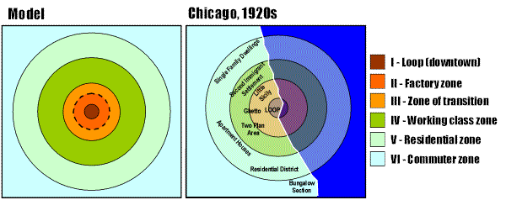

Slide 88
SECTOR MODEL (Homer Hoyt)
His model, the sector model, proposed that a city develops in sectors instead of rings.
Certain areas of a city are more attractive for various activities, whether by chance or geographic and environmental reasons.
As the city grows and these activities flourish and expand outward, they do so in a wedge and become a sector of the city.
Recognizes the existence of land use zones, but suggests that there are sectors or wedges of land uses in the city. Due to the emergence of star-shaped transportation routes, such as bus lines and streetcar lines. As such, the industrial would lie in a sector along the rail lines coming into the city centre and poorer people live adjacent to industrial near their jobs. Rich live on the opposite side of town far from the industry and poor -middle income in between
If a district is set up for high income housing, for example, any new development in that district will expand from the outer edge.
To some degree this theory is just a refinement on the concentric model rather than a radical restatement.

Slide 89
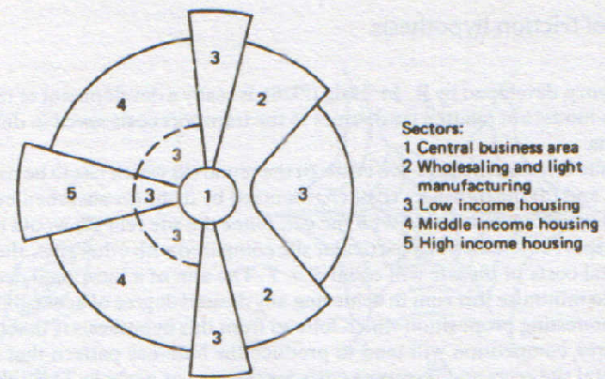

Slide 90
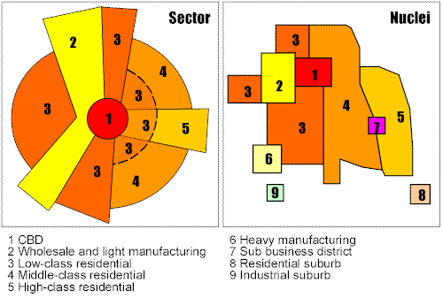

Slide 91
MULTIPLE NUCLEI MODEL (Chauncy Harris and Edward Ullman)
Geographers C.D. Harris and E. L. Ullman developed the multiple nuclei model in 1945
According to this model, a city contains more than one center around which activities revolve.
Some activities are attracted to particular nodes while others try to avoid them.
For example, a university node may attract well-educated residents, pizzerias, and bookstores, whereas an airport may attract hotels and warehouses.
Incompatible land use activities will avoid clustering in the same area, explaining why heavy industry and high-income housing rarely exist in the same neighbourhood.
In general it is refinement of first two, but incorporates outlying shopping malls, industrial areas and large residential suburbs. Developed only with the use of automobiles, mostly since 1945. CBD no longer has a monopoly on retail and commercial activities since outlying malls and industrial parks compete with it. Industry also moves to the edge of the city where land is cheaper

Slide 92
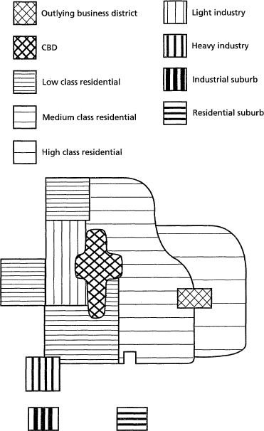
This model takes the view that large cities have a structure which is essentially cellular as is it states that a city contains more than one centre (nuclei) around which activities revolves.
Such nuclei may have had different origins, existing as minor settlement before the growth of a city began or developing where the growth of population and purchasing power supports a suburban shopping or business centres.

Slide 93
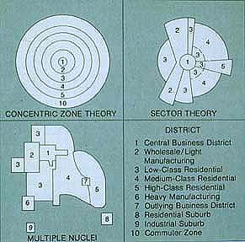

Slide 94
Hybrid Land Use Representation
Hybrid models are an attempt to include the concentric, sector and nuclei behavior of different processes in explaining urban land use.
They are an attempt to integrate the strengths of each approach since none of these appear to provide a completely satisfactory explanation.
Thus, hybrid models, such as that developed by Isard (1955),
consider the concentric effect of central locations (CBDs and sub-centers) and the radial effect of transport axis, all overlain to form a land use pattern.
Also, hybrid representations are suitable to explain the evolution of urban special structure as they combine different spatial impacts of transportation on urban land use, let them be concentric or radial, and this at different points in time.
Since both the concentric, sectorial and zonal models had problems dealing with specific conditions, hybrid representations of urban land uses were developed.
This model illustrates that some urban land uses are oriented along major transport axis (sectors), while others, notably industrial and commercial, are located in nuclei where they reach both scale and agglomeration economies.
The urban land use is thus an overlay of different transport effects, let them be sectorial, zonal or nuclear

Slide 95
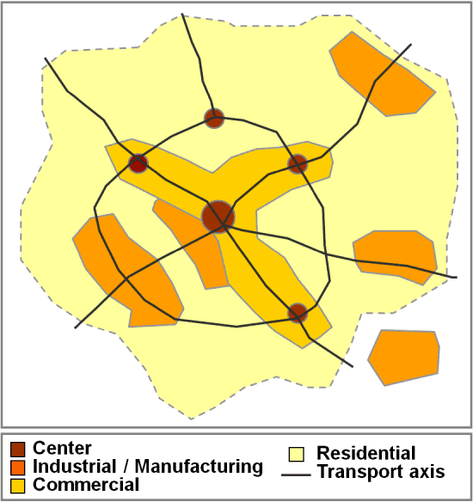

Slide 96
Changing transportation, technology and the Urban Form
Evolution of Transportation and Urban Form
Historically, movements within cities tended to be restricted to walking, which made medium and long distance urban linkages rather inefficient and time-consuming.
Thus, activity nodes tended to be agglomerated and urban forms compact.
Many modern cities have inherited an urban form created under such circumstances, even though they are no longer prevailing. The dense urban cores of many European, Japanese and Chinese cities, for example, enable residents to make between one third and two thirds of all trips by walking and cycling.
At the other end of the spectrum, the dispersed urban forms of most Australian, Canadian and American cities, which were built recently, encourages automobile dependency and are linked with high levels of mobility.

Slide 97
Many major cities are also port cities with maritime accessibility playing an enduring role not only for the economic vitality but also in the urban spatial structure with the port district being an important node.
The evolution of transportation has generally led to changes in urban form.
The more radical the changes in transport technology have been, the more the alterations on the urban form.
Among the most fundamental changes in the urban form is the emergence of new clusters expressing new urban activities and new relationships between elements of the urban system.
In many cities, the central business district (CBD), once the primary destination of commuters and serviced by public transportation, has been changed by new manufacturing, retailing and management practices.
Whereas traditional manufacturing depended on centralized workplaces and transportation, technological and transportation developments rendered modern industry more flexible.

Slide 98
In many cases, manufacturing relocated in a suburban setting, if not altogether to entirely new low costs locations.
Retail and office activities are also suburbanizing, producing changes in the urban form.
Concomitantly, many important transport terminals, namely port facilities and railyards, have emerged in suburban areas following new requirements in modern freight distribution brought in part by containerization.
The urban spatial structure shifted from a nodal to a multi-nodal character.
Initially, suburban growth was mainly taking place adjacent to major road corridors, leaving a lot of vacant or farm land in between.
Later, intermediate spaces were gradually filled up, more or less coherently.
Highways and ring roads, which circled and radiated from cities, favored the development of suburbs and the emergence of important sub-centers that compete with the central business district for the attraction of economic activities.
As a result, many new job opportunities have shifted to the suburbs (if not to entirely new locations abroad) and the activity system of cities has been considerably modified.

Slide 99
Different parts of a city have different dynamism depending on its spatial pattern..
Transportation and Urban Dynamics
Both land use and transportation are part of a dynamic system that is subject to external influences.
Each component of the system is constantly evolving due to changes in technology, policy, economics, demographics and even culture or values.
As a result, the interactions between land use and transportation are played out as the outcome of the many decisions made by residents, businesses and governments. The field of urban dynamics has expended the scope of conventional land use models, which tended to be descriptive, by trying to consider relationships behind the evolution of the urban spatial structure.
This has led to a complex modeling framework including a wide variety of components.
Among the concepts supporting urban dynamics representations are retroactions, where as one component influences others. The changes will influence the initial component back, either positively or negatively. The most significant components of urban dynamics are:

Slide 100
Land use.
This is the most stable component of urban dynamics, as changes are likely to modify the land use structure over a rather long period of time.
This comes as little surprise since most real estate is built to last at least several decades. The main impact of land use on urban dynamics is its function of a generator and attractor of movements.
Transport network.
This is also considered to be a rather stable component of urban dynamics, as transport infrastructures are built for the long term.
This is particularly the case for large transport terminals and subway systems that can operate for a very long period of time. For instance, many railway stations are more than one hundred years old.
The main contribution of the transport network to urban dynamics is the provision of accessibility. Changes in the transport network will impact accessibility and movements.

Slide 101
Movements.
The most dynamic component of the system since movements of passengers or freight reflect almost immediately changes.
Movements thus tend more to be an outcome of urban dynamics than a factor shaping them.
Employment and workplaces.
They account for significant inducement effects over urban dynamics since many models often consider employment as an exogenous factor.
This is specifically the case for employment that is categorized as basic, or export oriented, which is linked with specific economic sectors such as manufacturing. Commuting is a direct outcome of the number of jobs and the location of workplaces.
Population and housing.
They act as the generators of movements, because residential areas are the sources of commuting. Since there are a wide array of incomes, standards of living, preferences and ethnicity, this diversity is reflected in the urban spatial structure.

Slide 102
Effects of Transportation Technologies
Technological developments in production, construction, travel, transportation and trade, have radically changed the functions and forms of urban centers and have strengthened suburbs to enlarge in the urban periphery.
Especially beginning of an extensive urban process with the factory system which appeared as a result of industrial revolution, led to an increase in different infrastructures in cities.
However the transportation system, directed by the car, spoiled this system and opened the way for people and industrial and commercial activities to be directed from urban centers towards the periphery.
In connection with transportation technology, another factor that caused the city being spread to the surroundings of the city, were intensive investments made for access to the transportation network.

Slide 103
These investments have increased the speed and compatibility of transportation in unit time. Thus, the new income orginalling from the decreasing transportation expenses has turned back to the economy for travelling to city centre, establishing business relations
Information, telecommunication and transportation technologies change urban form as well. This change began after the Second World War and it became dramatic in the 1950’s
Auto way lanes, strengthened urban development and took agricultural areas under threat. Within this process, it can be said that cities have been formed as centers where telecommunication and transportation technologies and means and information systems became dense.
Effects of development continuing in these technologies, increased gradually after the second Industrial revolution.
Currently, it can be said that globalization has transformed the basic dimensions of societies with its investments and effects on the spatial form and dynamics of cities

Slide 104
The issue about how to articulate these relations remains, particularly in the current context of interdependency between local, regional and global processes.
Globalization has substantially blurred the relationships between transportation and land use as well as its dynamics.
The main paradigm concerns that factors that used to be endogenous to a regional setting have become exogenous.
Consequently, many economic activities that provide employment and multiplying effects, such as manufacturing, are driven by forces that are global in scope and may have little to do with regional dynamics.
For instance, capital investment could come from external sources and the bulk of the output could be bound to international markets.
The complexity of urban dynamics is further complicated by different temporal rates of change among its main components.
While land use and transportation networks are very slow to change, their associated movements can change and adapt very quickly.
As a result, changes in an urban area will range accordingly.

Slide 105
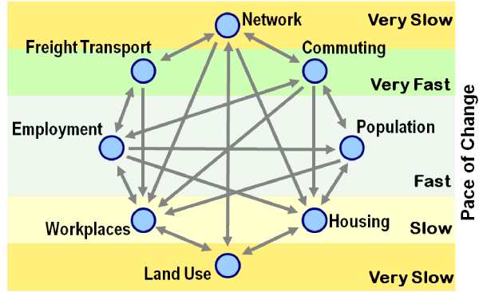
Technological changes have also been linked with the relocation of industrial and even service activities.
Global telecommunication facilities can favor the outsourcing of several services to lower cost locations, such as the case of call centers in India indicates.
Dynamics of Urban Change , Source: Wegener (1995).

Slide 106
UNIT FOUR: THE ROLE OF GOVERNMENT IN REAL ESTATE MARKETS
4.1 Need of Government to Regulate Land Use
Ground for government intervention in the markets, in general ,are the following:
Physical market defects
Imperfect competition
Immobility of factors of production
Externalities
The provision of public goods

Slide 107
Continued......
The state should regulate the use of land so as to protect the general health, wealth and safety of the society.
Locational Monopoly
monopoly is a market structure in which,
no close substitutes
Price maker
Producing less out put than competitive market
However, monopoly pricing in the real estate market by owners is less common than usually observed since most land uses have near substitutes that effectively provide competition.
city transportation, water, and sewer systems represent natural monopolies as it would be costly to establish competition.

Slide 108
Continued.......
Another form of potential land monopoly is the holdout.
For example, land must be acquired for most large public projects such as roads. When assembly of multiple private parcels is involved, one or more land holders can “hold hostage” the entire project by refusing to sell at a reasonable price, thus extracting wealth from other citizens.

Slide 109
Continued.......
Externalities
Externalities can be either positive or negative.
Examples of positive externalities are the beneficial effects on property value from nearby parks and recreation facilities, quality neighborhood schools, quality architecture, attractive commercial areas, well kept landscapes and so forth.
Under provision of positive externalities is an argument for government intervention to encourage more.

Slide 110
Continued......
Negative externalities, unaccounted negative effects of a land use on the value of surrounding properties, have the opposite result. This overproduction of negative externalities is an argument for government intervention to reduce their output.

Slide 111
Possible Government Action to Allow For Externalities
It may introduce a pricing system to bring externalities into consideration
taxation and subsidies may take the idea of 'charging' a stage further
physical control which is frequently used in the field of land resources to minimize externalities.
externalities may be 'internalized' by the parties’ concerned combin­ing or by widening the area of control.
the government may itself assume responsibility for providing certain goods and services.

Slide 112
Incomplete Information
Unless there is full information for the building profile it may be difficult even for a building expert, let alone others, to fully assess the quality of the construction and the safety hazards it may harbour.
Building codes remain an important protection against safety hazards. In similar fashion, subdivision regulations ensure minimum street design standards for traffic safety, adequate provision for fire hydrant and fire fighting access, and other matters of safety and health.

Slide 113
Public Planning for Land Use Control and Environmental Hazards
Planning is a method of controlling the free operation of the market economy.
According to the theory of public planning ,directing land use practices from a society’s point of view is the best means of correcting market failure.
In these activities incompatible land uses are more efficiently separated, both congestion and environmental effects are more completely incorporated in to the land use and development decision processes, and buyers are best protected from incomplete information about structures.

Slide 114
Comprehensive planning
A comprehensive plan is a general guide to a community’s future growth and development.
In its most complete form the community’s land use plan should address
The community’s future population growth
Its requirements for water and other natural resources
Its physical characteristics (e.g., existing development and soil conditions)
Its need for public services (e.g., schools and utilities) and
Its need for various types of land use (e.g., single family residential and office), financial resources, and political constraints.

Slide 115
Continued......
A comprehensive plan, therefore, tries to show future growth and development so as to accommodate the various needs of the community.
Many communities and some states have developed detailed plans to “manage” growth, particularly those communities and states experiencing rapid growth.

Slide 116
Zoning and Other Tools of Public Land Use Control
The comprehensive plan is usually general in nature. Its implementation must be through a variety of specific land use regulations.
These regulations grow out of the police powers of government to make laws to assure the health, safety and welfare of citizens.
The conventional kinds of land use regulations, which remain the “work horses” of land use control.

Slide 117
Continued......
These include:
building codes
zoning
subdivision regulations.

Slide 118
Modern Tools of Land Use Control
Planned Unit Developments
Performance Standards
Impact Fees
Growth Restrictions

Slide 119
Difficulties of Control by Planning
First, planning lacks flexibility as regards individual preferences
Second, planning may take insufficient account of certain benefits which exist in the current land-use situation.
Third, planning tends to overlook certain repercussions of the controls imposed.
Fourth, planning tends to be negative in character.
Fifth, case-by-case examination of applications for planning permission leads to delays in arriving at a decision

Slide 120
Continued...........
Finally, it must be remembered that the planning process itself uses up re­sources and so, like other activities, must only be undertaken to the point where the marginal benefit equals marginal cost. It is not therefore appropriate for dealing with only minor faults in the land and property markets.

Slide 121
Environmental Hazards
Environmental hazards are regulated by federal, state, and local agencies.
The scope and intensity of environmental regulation means property owners are subject to huge dollar amounts of potential liability if environmental hazards are found on their properties.

Slide 122
Government’s Power of Eminent Domain and to Tax Real Property
The Government’s Power of Eminent Domain- Eminent domain (in USA)/compulsory purchase (in Europe), one form of government intervention in land use, is the right of the government to acquire private property without the owner’s consent for public use in exchange for just compensation.

Slide 123
Continued..........
Werin (1982) distinguishes three different reasons for compulsory purchase. These are:
The property owner may veto a transfer that is the owner blankly refuses the to sale his property on any account
The seller may be in a monopolistic position
Reallocating resources from the seller to the buyer, which as a rule means in favour of the community
Just compensation is the market value of the property, if completely taken, or the total value of all financial loss if partially taken.

Slide 124
The Power of Government to Tax Real Property
The term tax is defined as; “compulsory levy that is the most important source of government revenue”
Taxes are classified into two groups as direct and indirect.
Property tax is a kind of wealth tax. As declared in Land Administration Guidelines (1996), any taxation systems should;

Slide 125
Continued.......
serve clearly defined social objectives
raise significant amount of revenue
be exclusively under the control of the government authority
be administered in a way that public understands and sees as fair
be relatively simple and cheap to collect
be designed to make it difficult to avoid making payments
distribute the tax burden equitably across the community
encourage the good use of resources

Slide 126
Continued..............
Property taxes are the oldest and most prevalent form of taxation- considered as a local tax as it is frequently used to fund local government’s activities.
As indicated by MUNRO (2000), property taxes may be classified broadly into ‘annual’ and ‘incidental’ taxes.
Taxes levied annually on property are seen as wealth tax in every country. The annual levy may be based on-estimated market value, or the assessed rental value of the land or property, or in some countries area of the property (DALE and MCLAUGHLIN 1999). Incidental taxes arise because a specific event triggers the tax, such as the sale of the property, or its change to more valuable use.

Slide 127
Mechanics of the Property tax
Property tax rates are determined by local or central governments and in many countries local governments levy rates that differ by property class.
Different tax rates may be imposed for different classes of property (residential, commercial, and industrial, for example).

Slide 128
The basic formula for determining the property tax rate is :
;
denotes the tax rate;
the budget expenditures
Where
the income from sources other than property tax;
the total assessed value of all properties and
the value of property exemptions.

Slide 129
Example 1
Consider a community’s budget, which forecasts expenditures for the coming year of 65 million birr. Tax income from non property sources is projected to be 25 million birr, and the community contains properties with a total assessed value of 2.5 billion birr. The total value of properties exempted from the property tax is 500 million birr. Thus, the tax base is 2 billion birr. Determine the property tax rate based on this given.
According to the above formula the property tax rate can be calculated as follows:

Slide 130
Interpretation
It can be interpreted as 2 percent of the taxable value of all properties in the community is required in taxes to pay for the community’s expenditures during the coming year.

Slide 131
Tax Exempt Properties
Most communities contain a number of tax exempt properties.
Such properties include government owned properties and others exempted by state law or the state constitution.
This category typically includes universities, schools, hospitals, places of worship, and other property of religious organizations. Exempt properties lower the tax base of the community, thus raising the taxes of other property owners.

Slide 132
Calculation of effective tax rate

