Slide 1
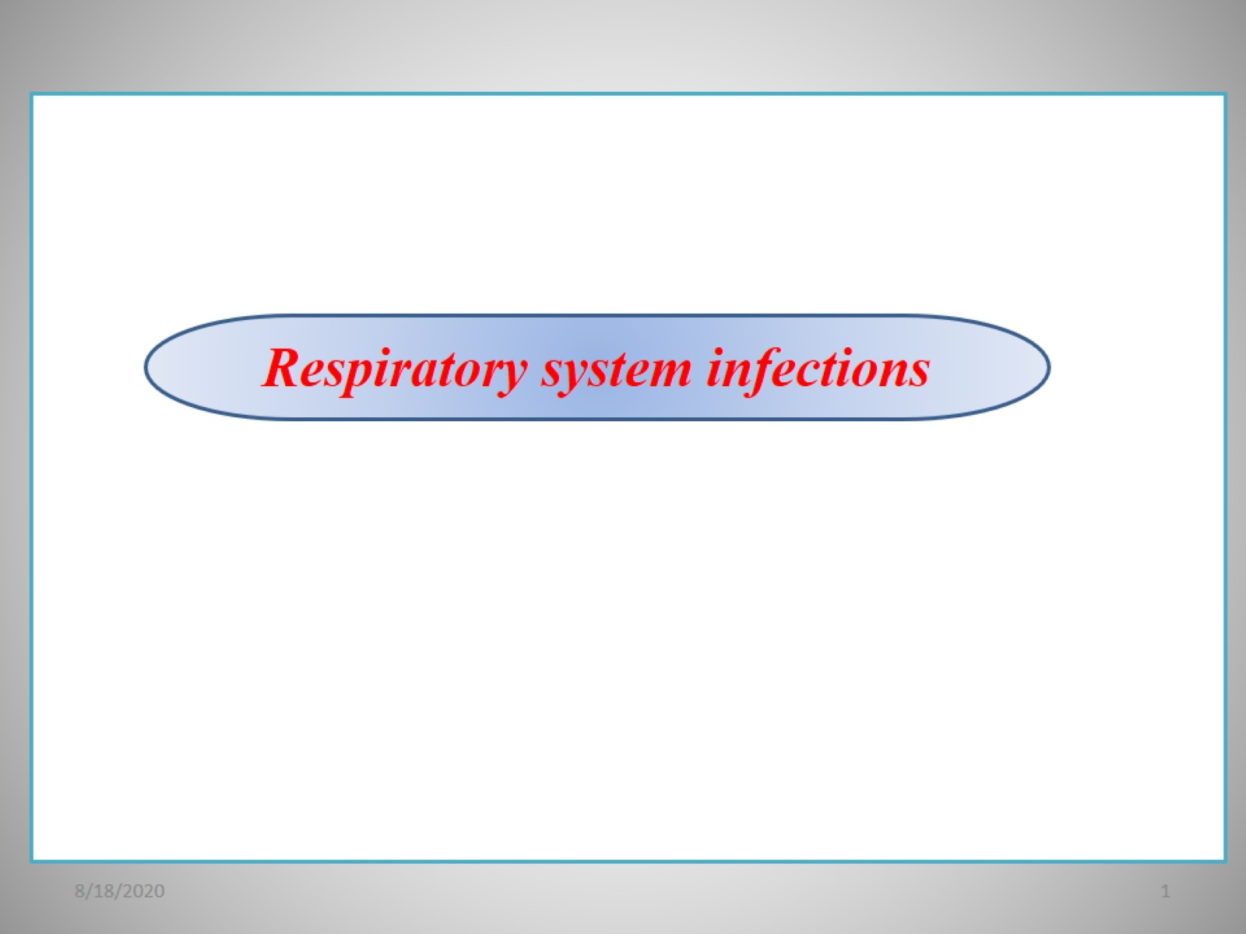

Slide 2
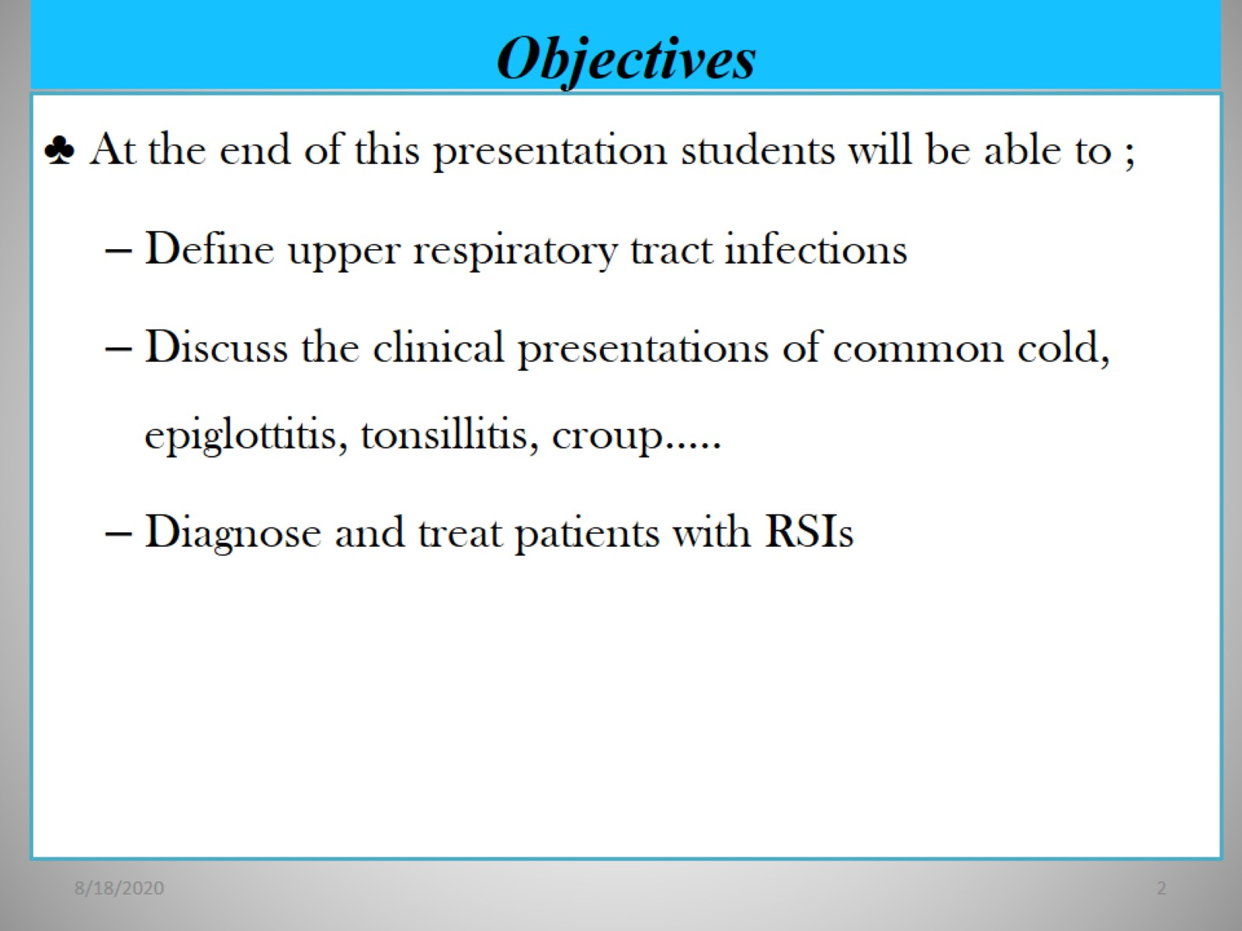
Objectives

Slide 3
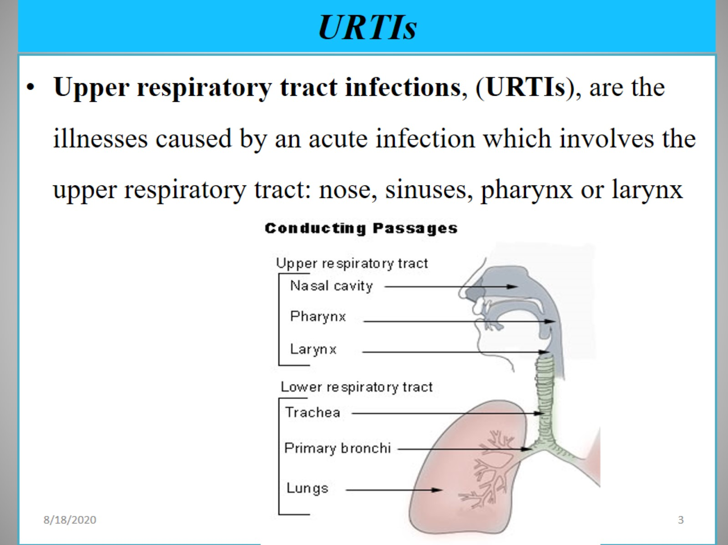
URTIs

Slide 4
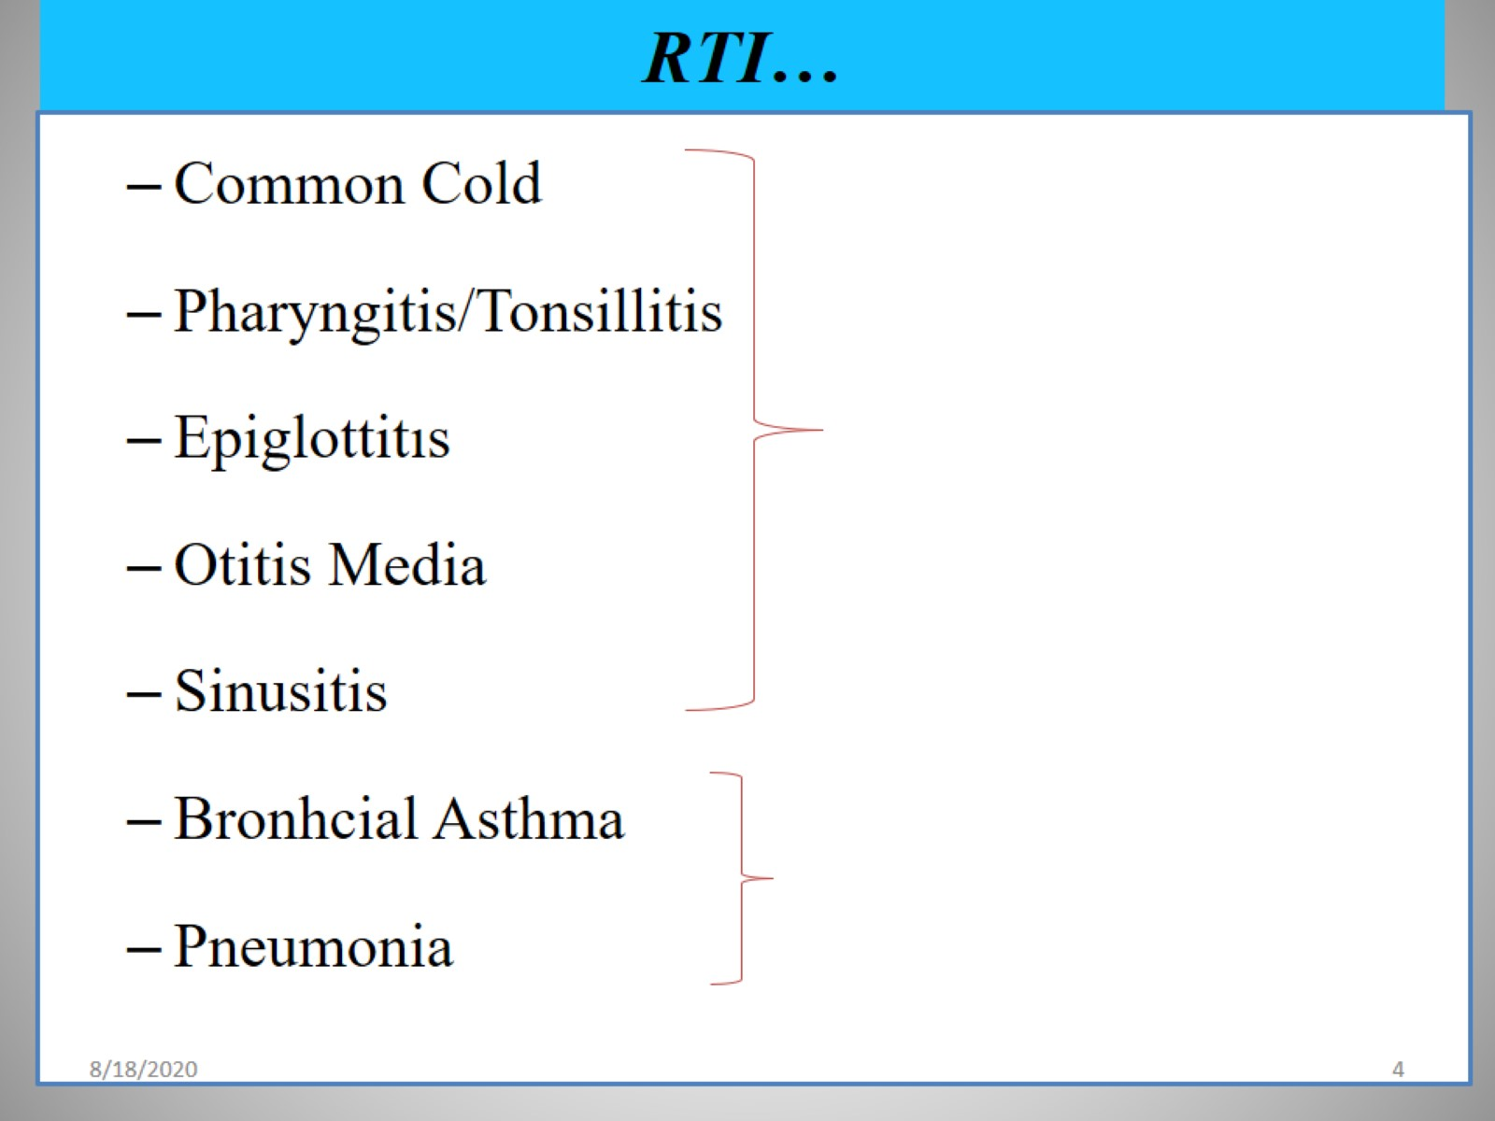
RTI…

Slide 5
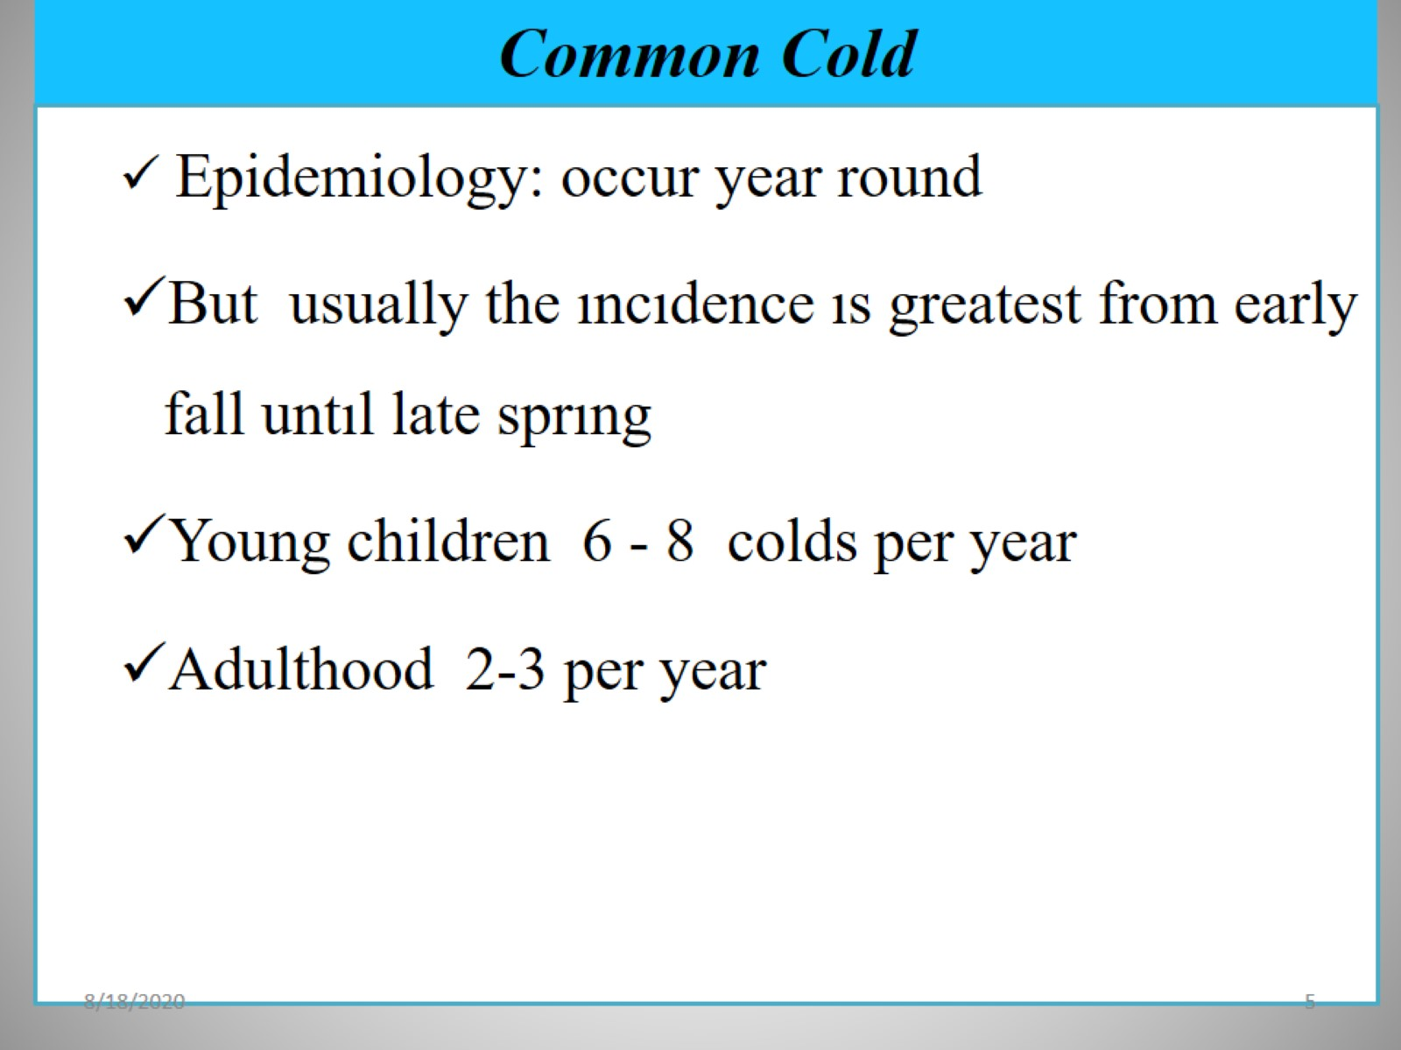
Common Cold

Slide 6
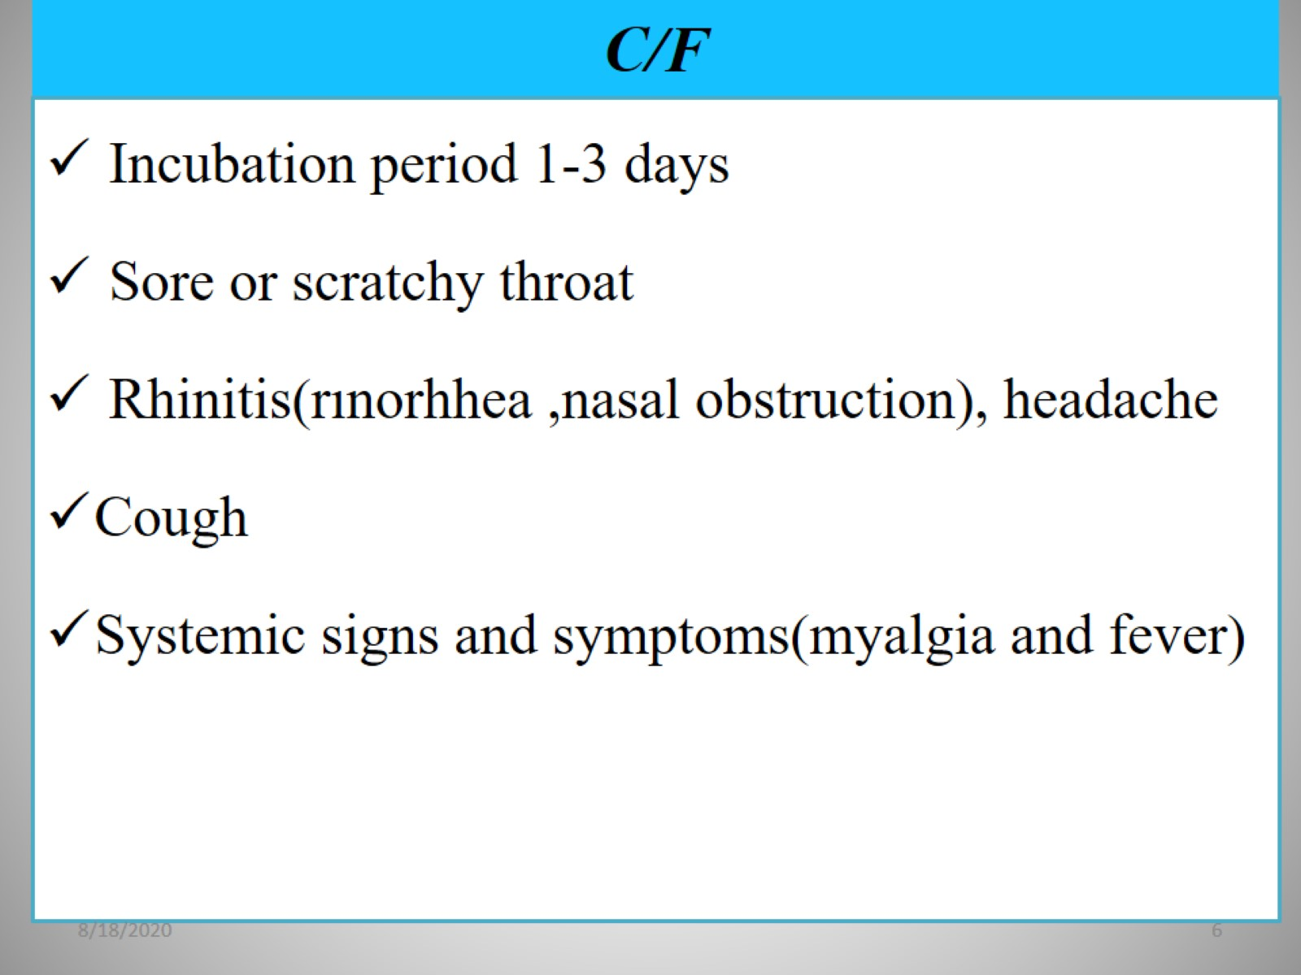
C/F

Slide 7
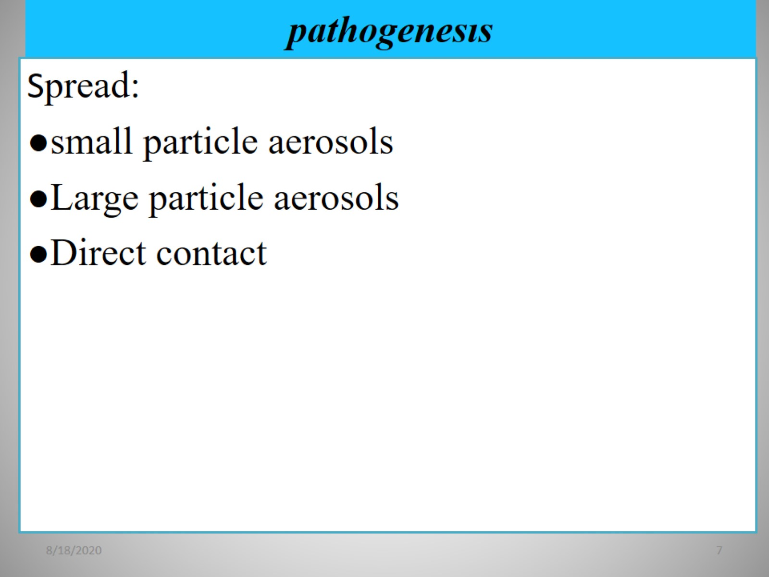
pathogenesıs

Slide 8
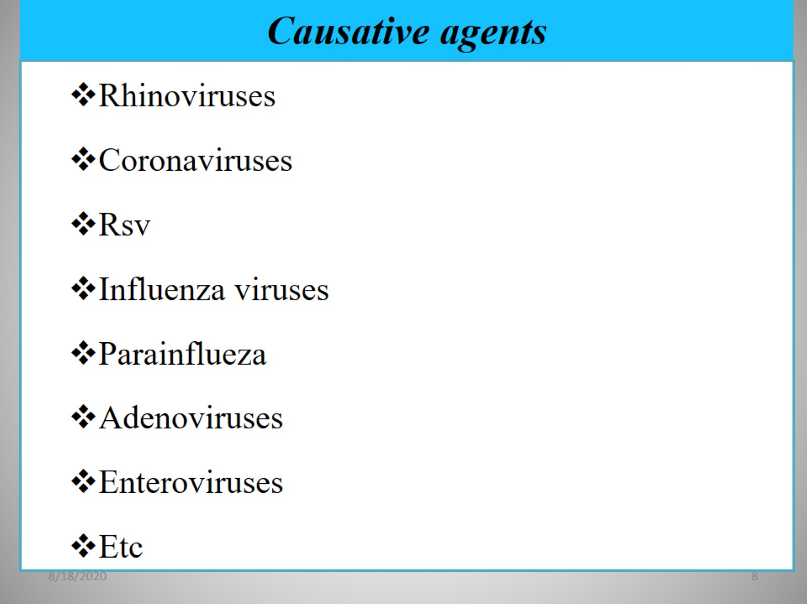
Causative agents

Slide 9
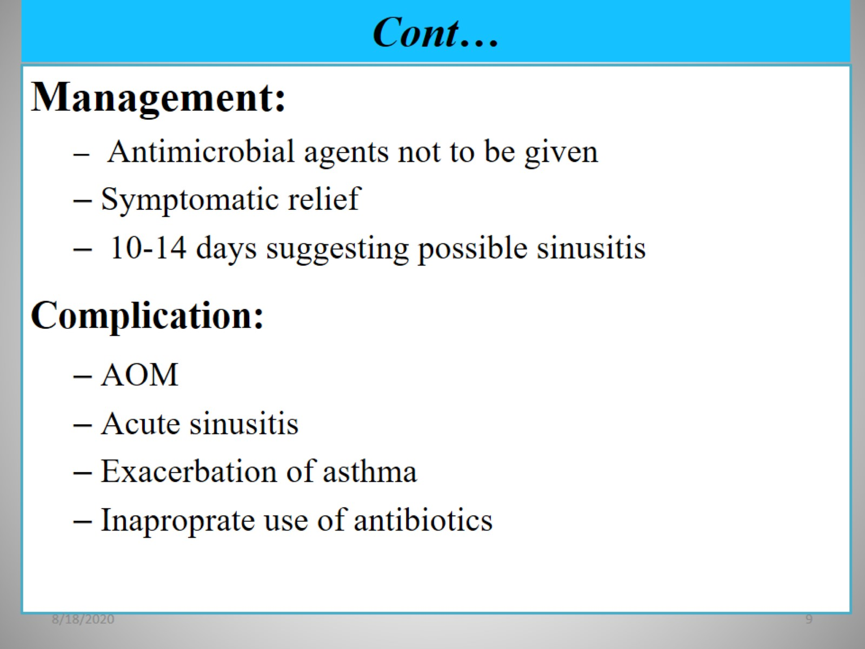
Cont…

Slide 10
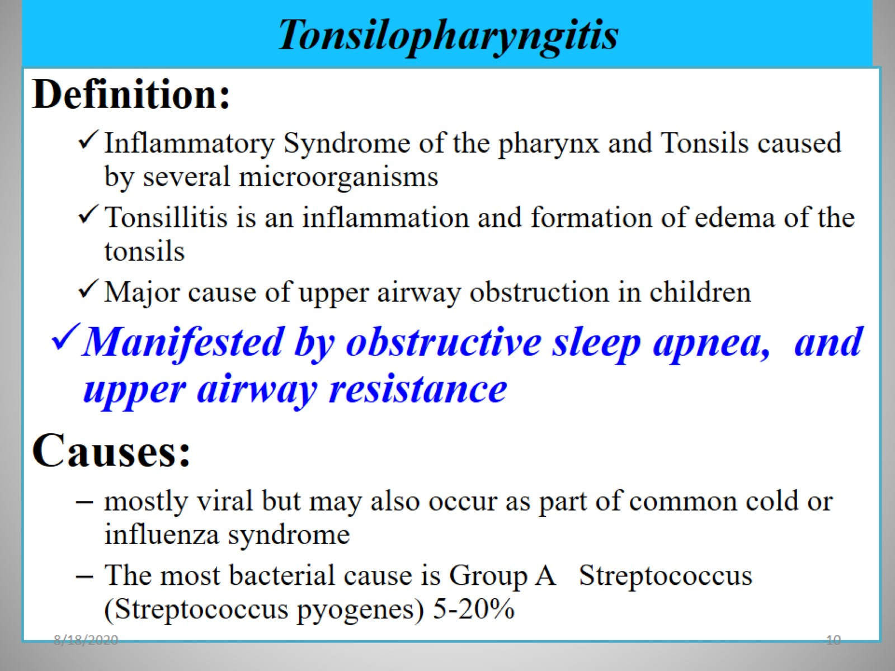
Tonsilopharyngitis

Slide 11
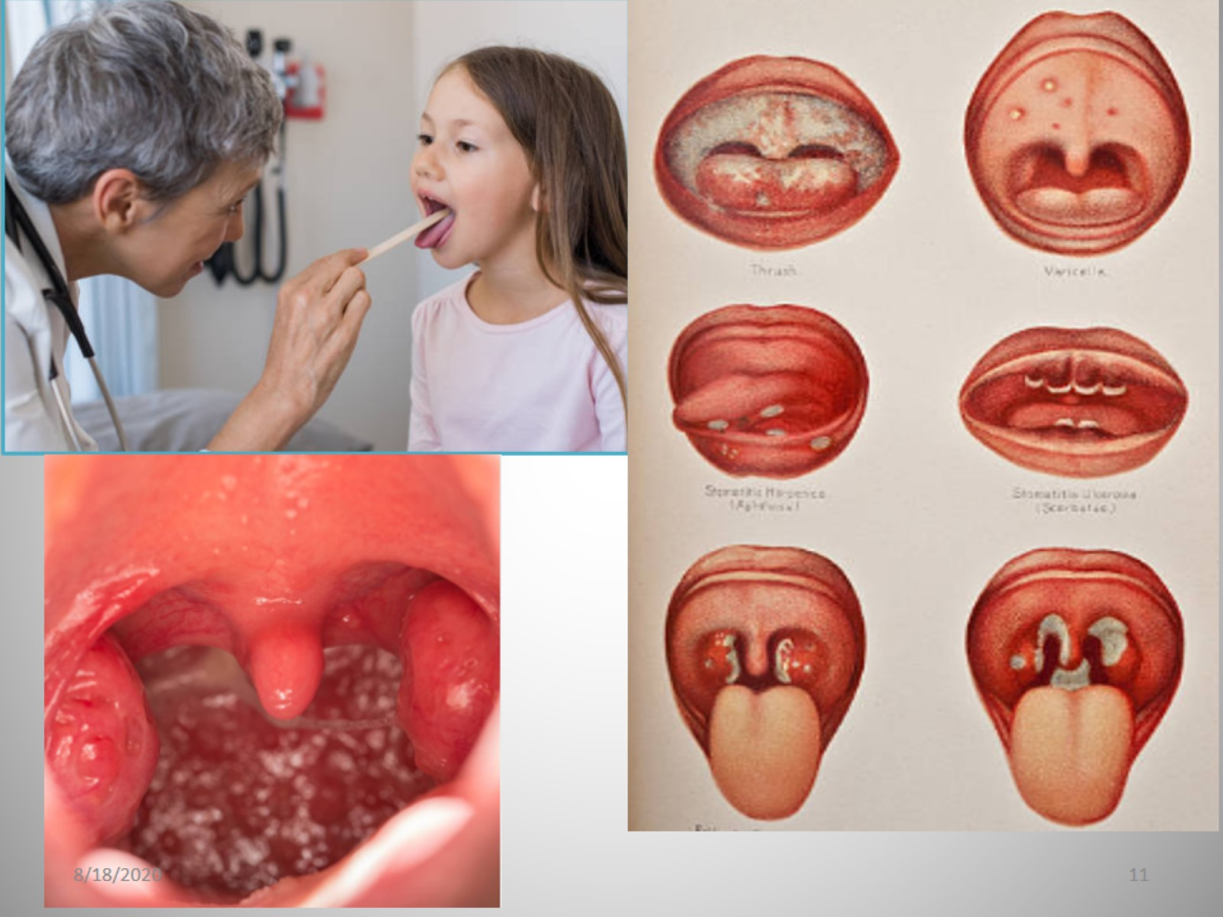

Slide 12
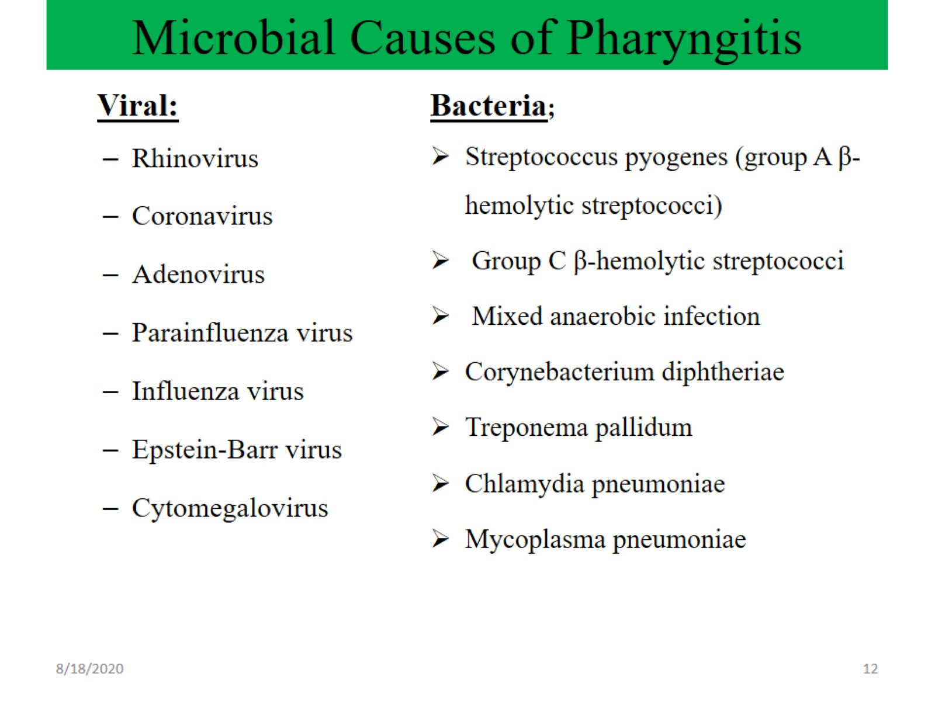
Microbial Causes of Pharyngitis

Slide 13
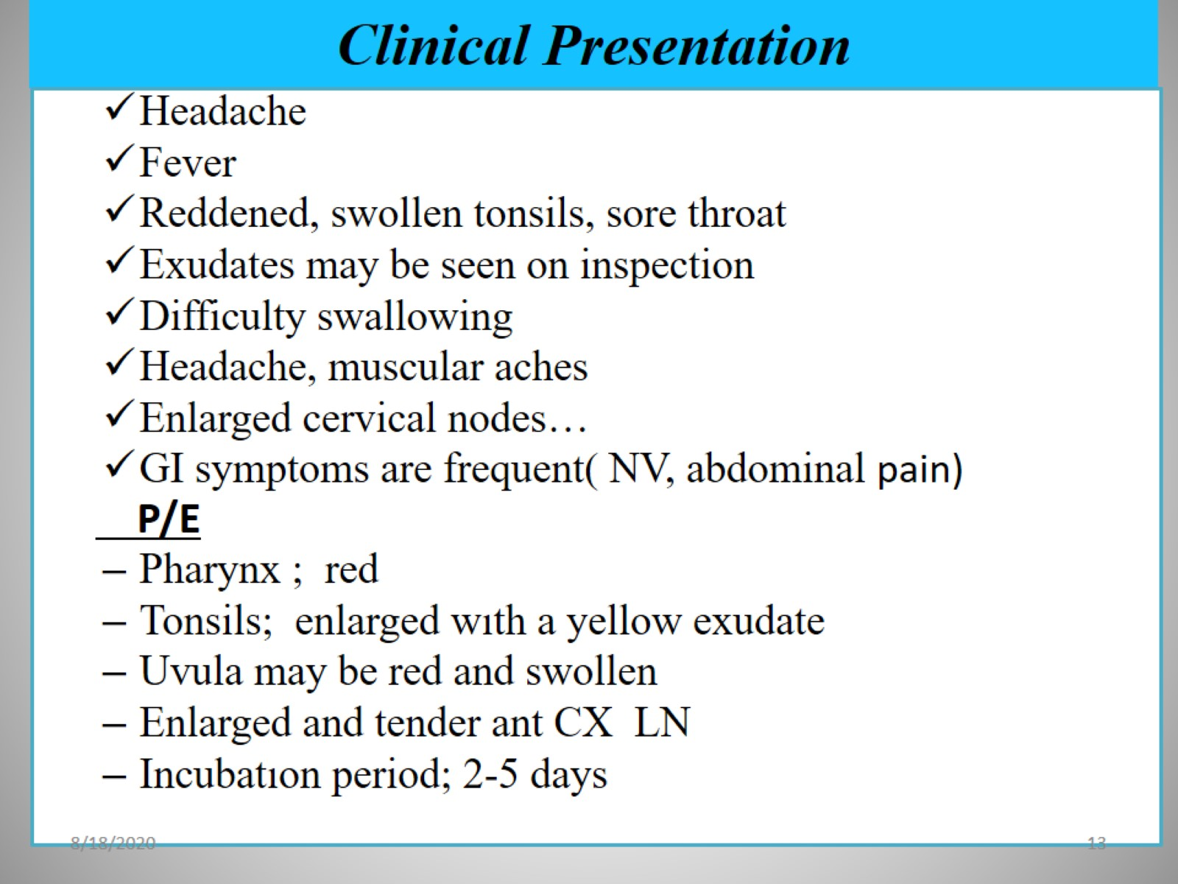
Clinical Presentation

Slide 14
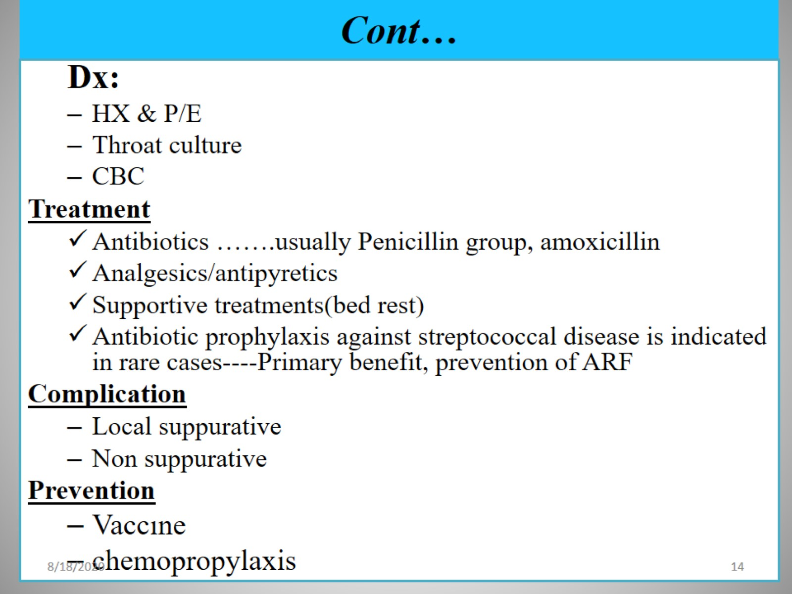
Cont…

Slide 15
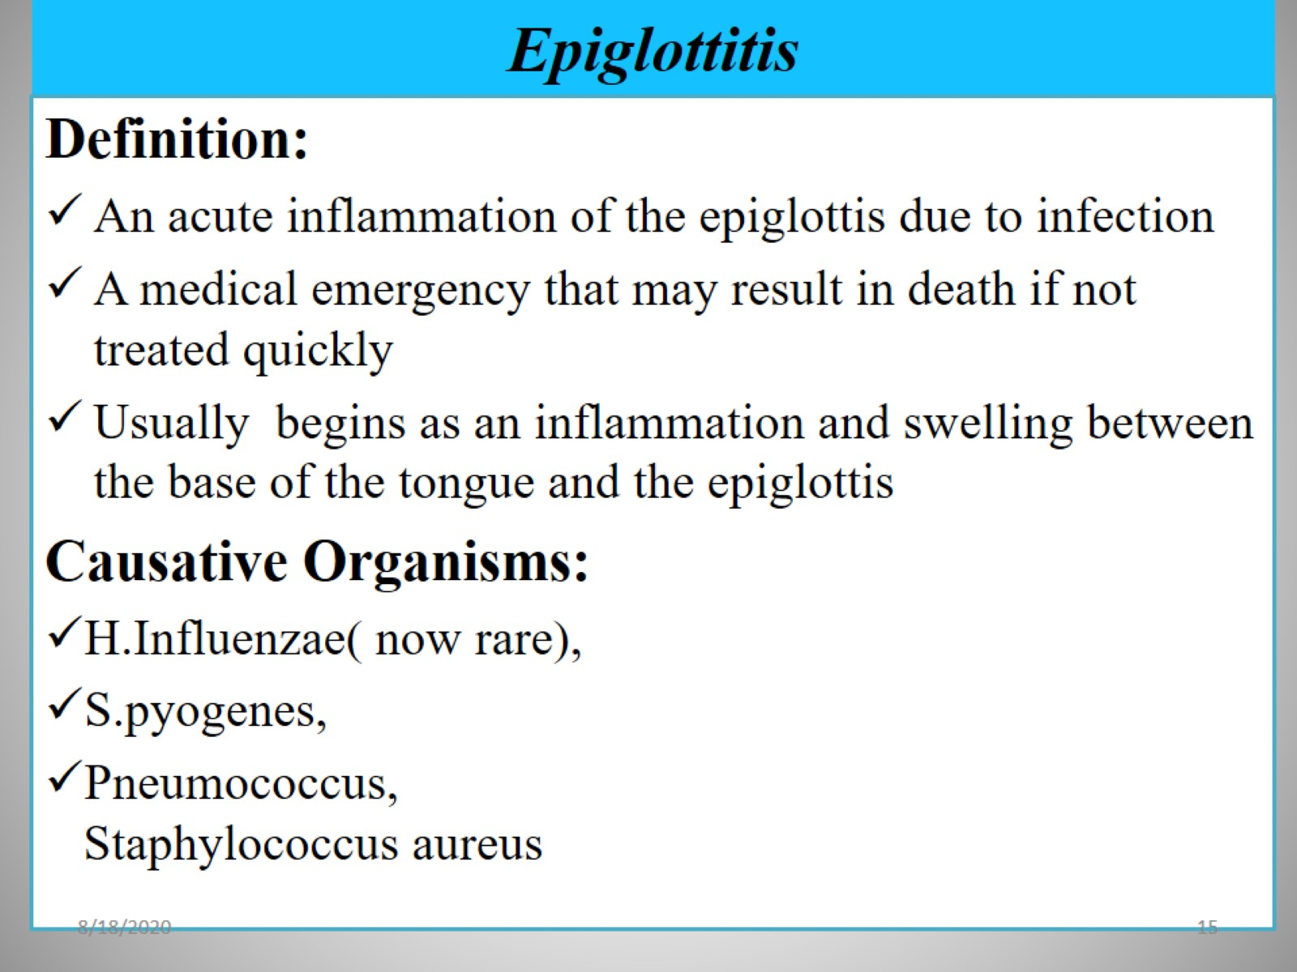
Epiglottitis

Slide 16
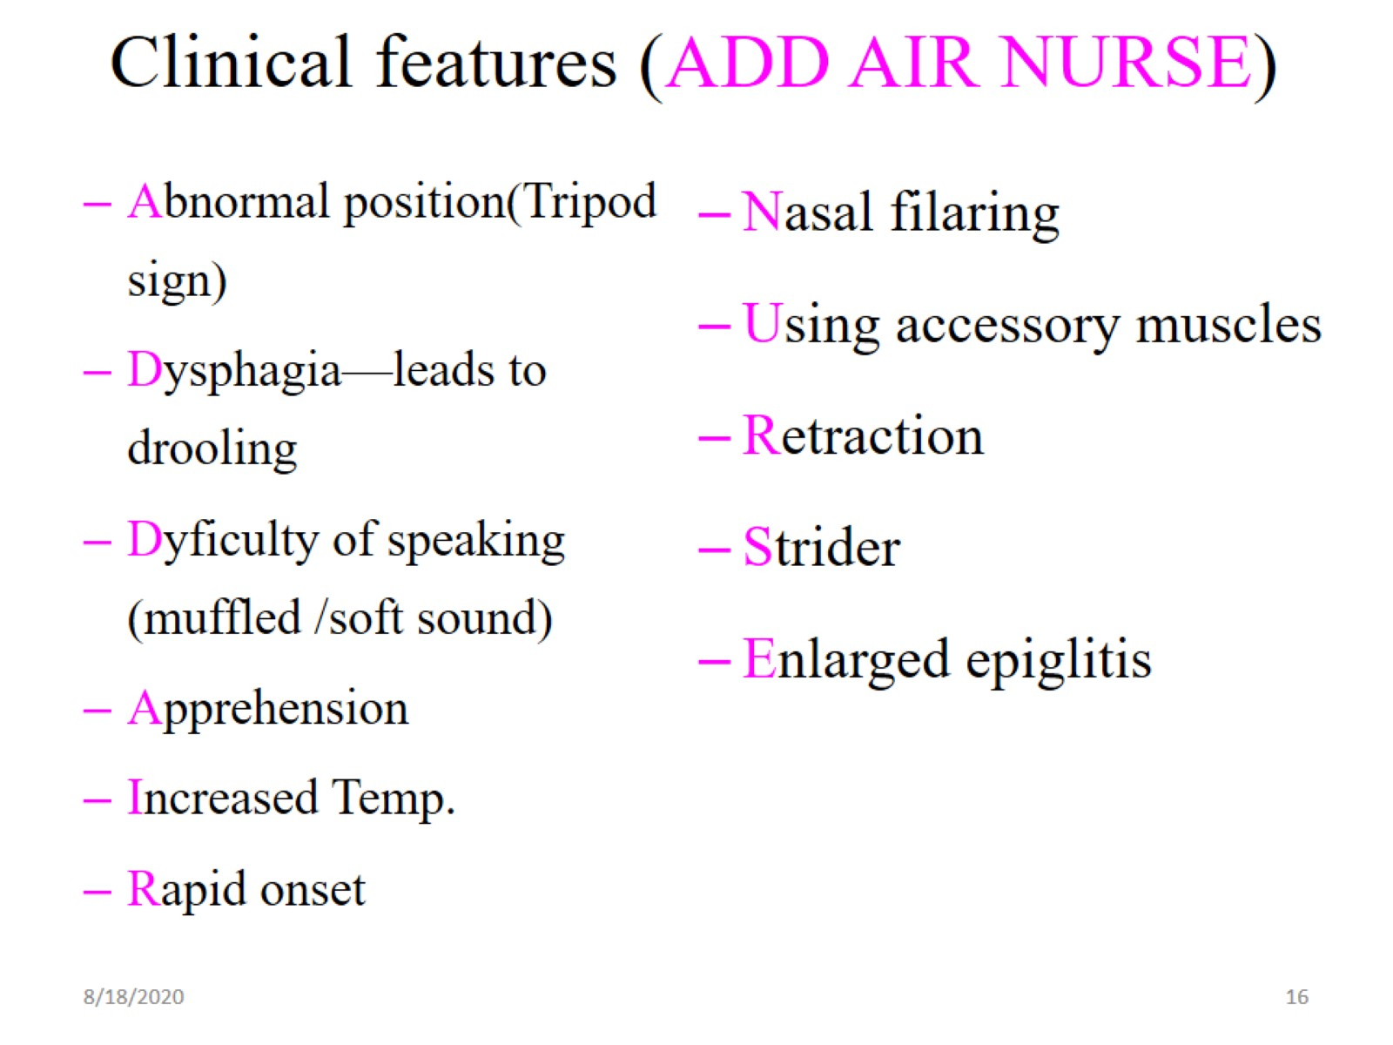
Clinical features (ADD AIR NURSE)

Slide 17
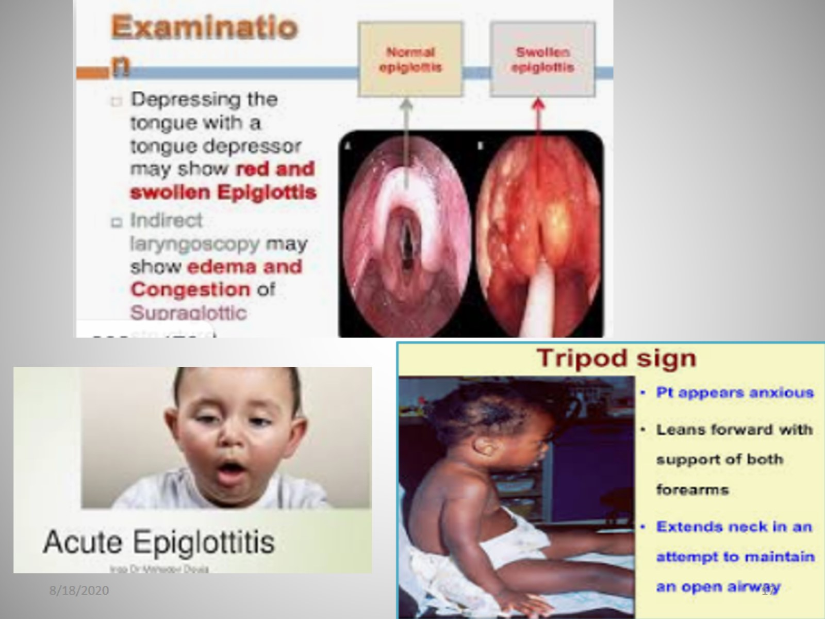

Slide 18
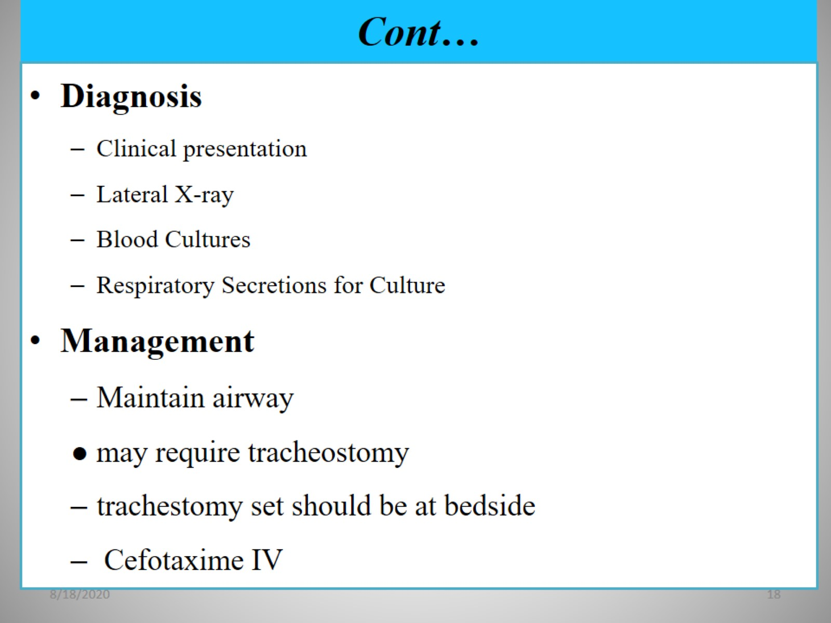
Cont…

Slide 19
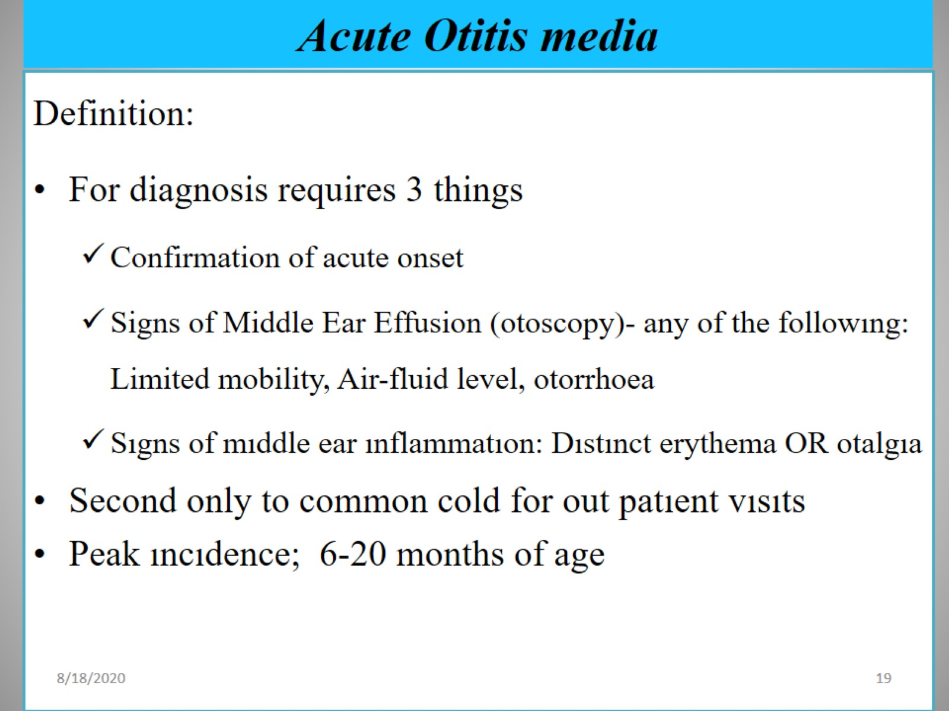
Acute Otitis media

Slide 20
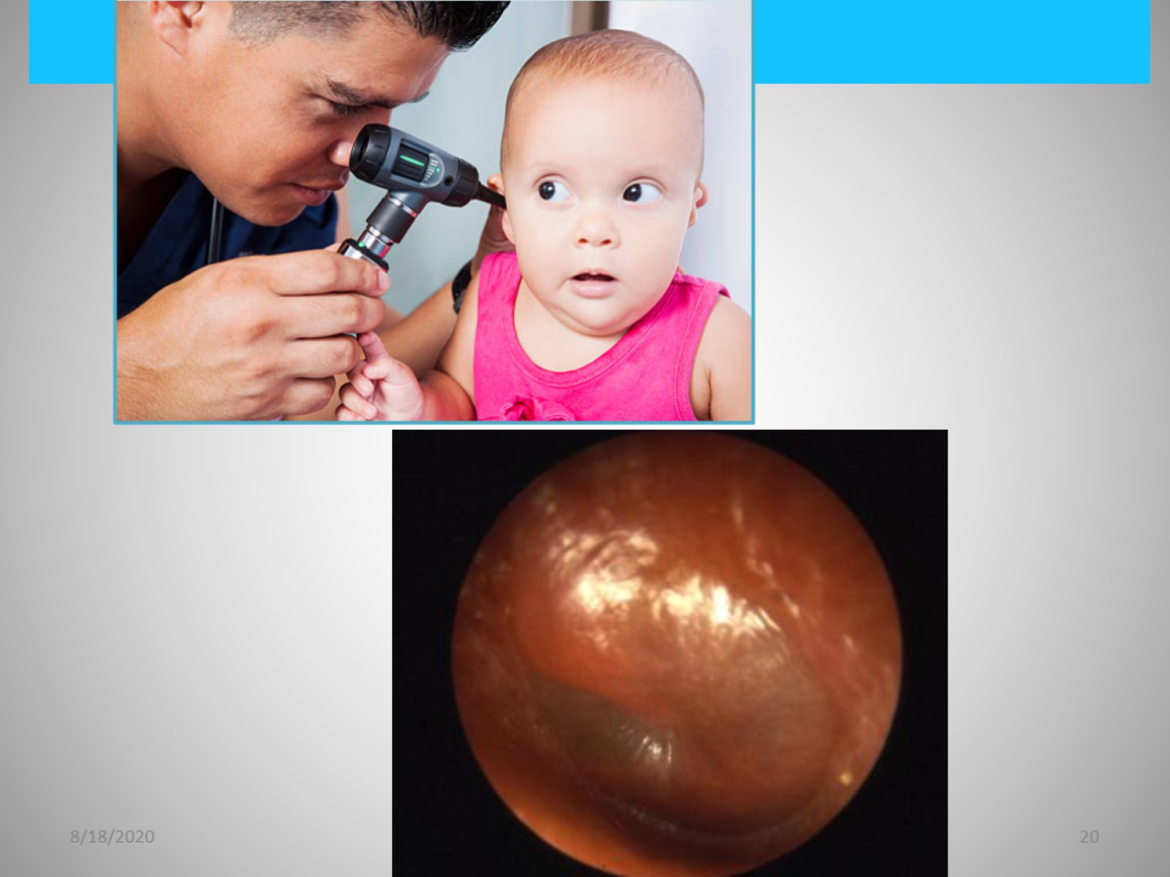

Slide 21
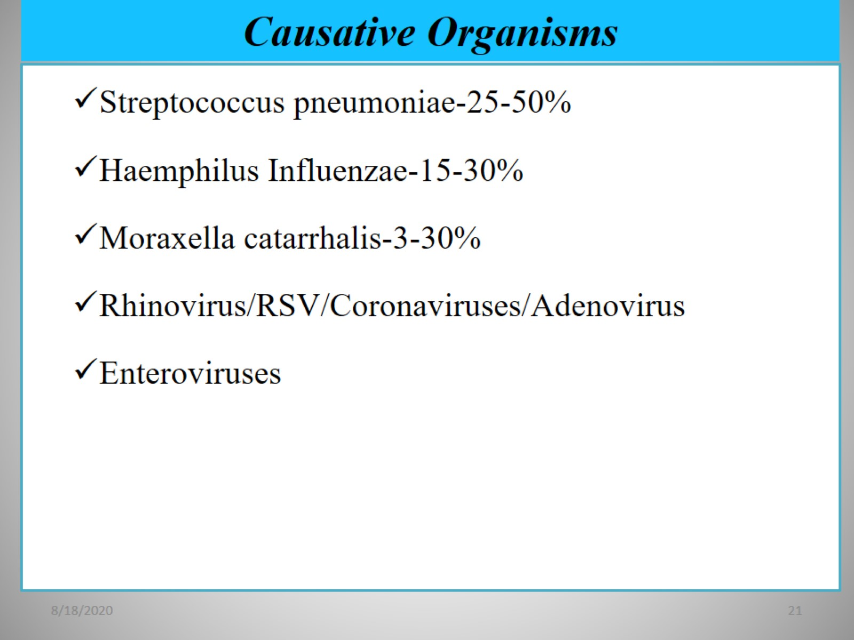
Causative Organisms

Slide 22
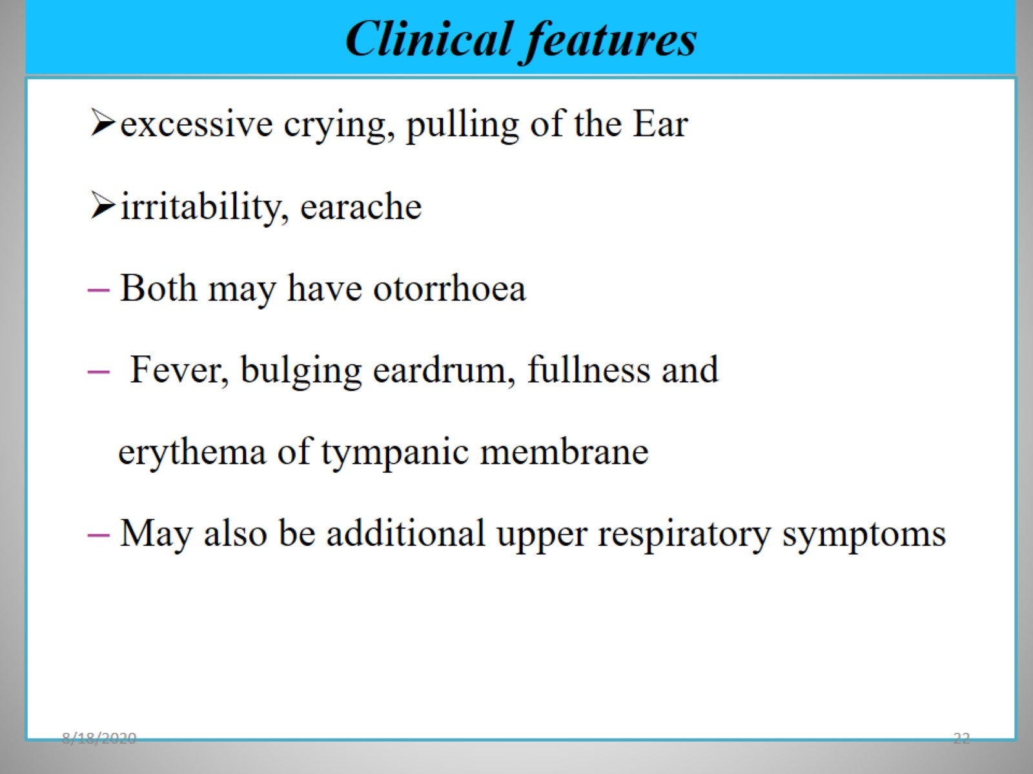
Clinical features

Slide 23
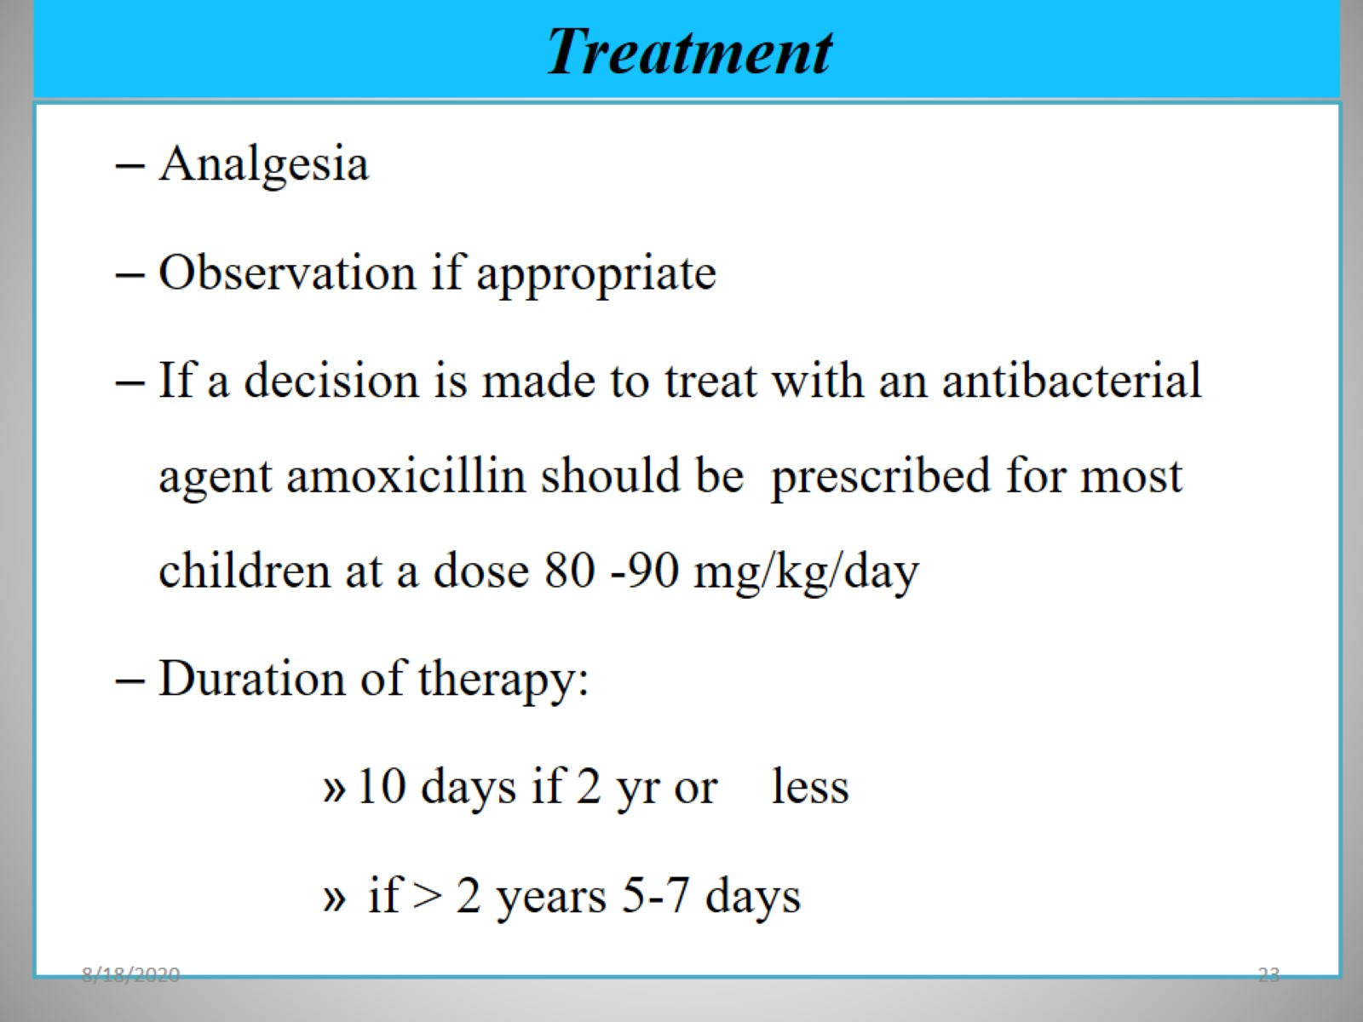
Treatment

Slide 24
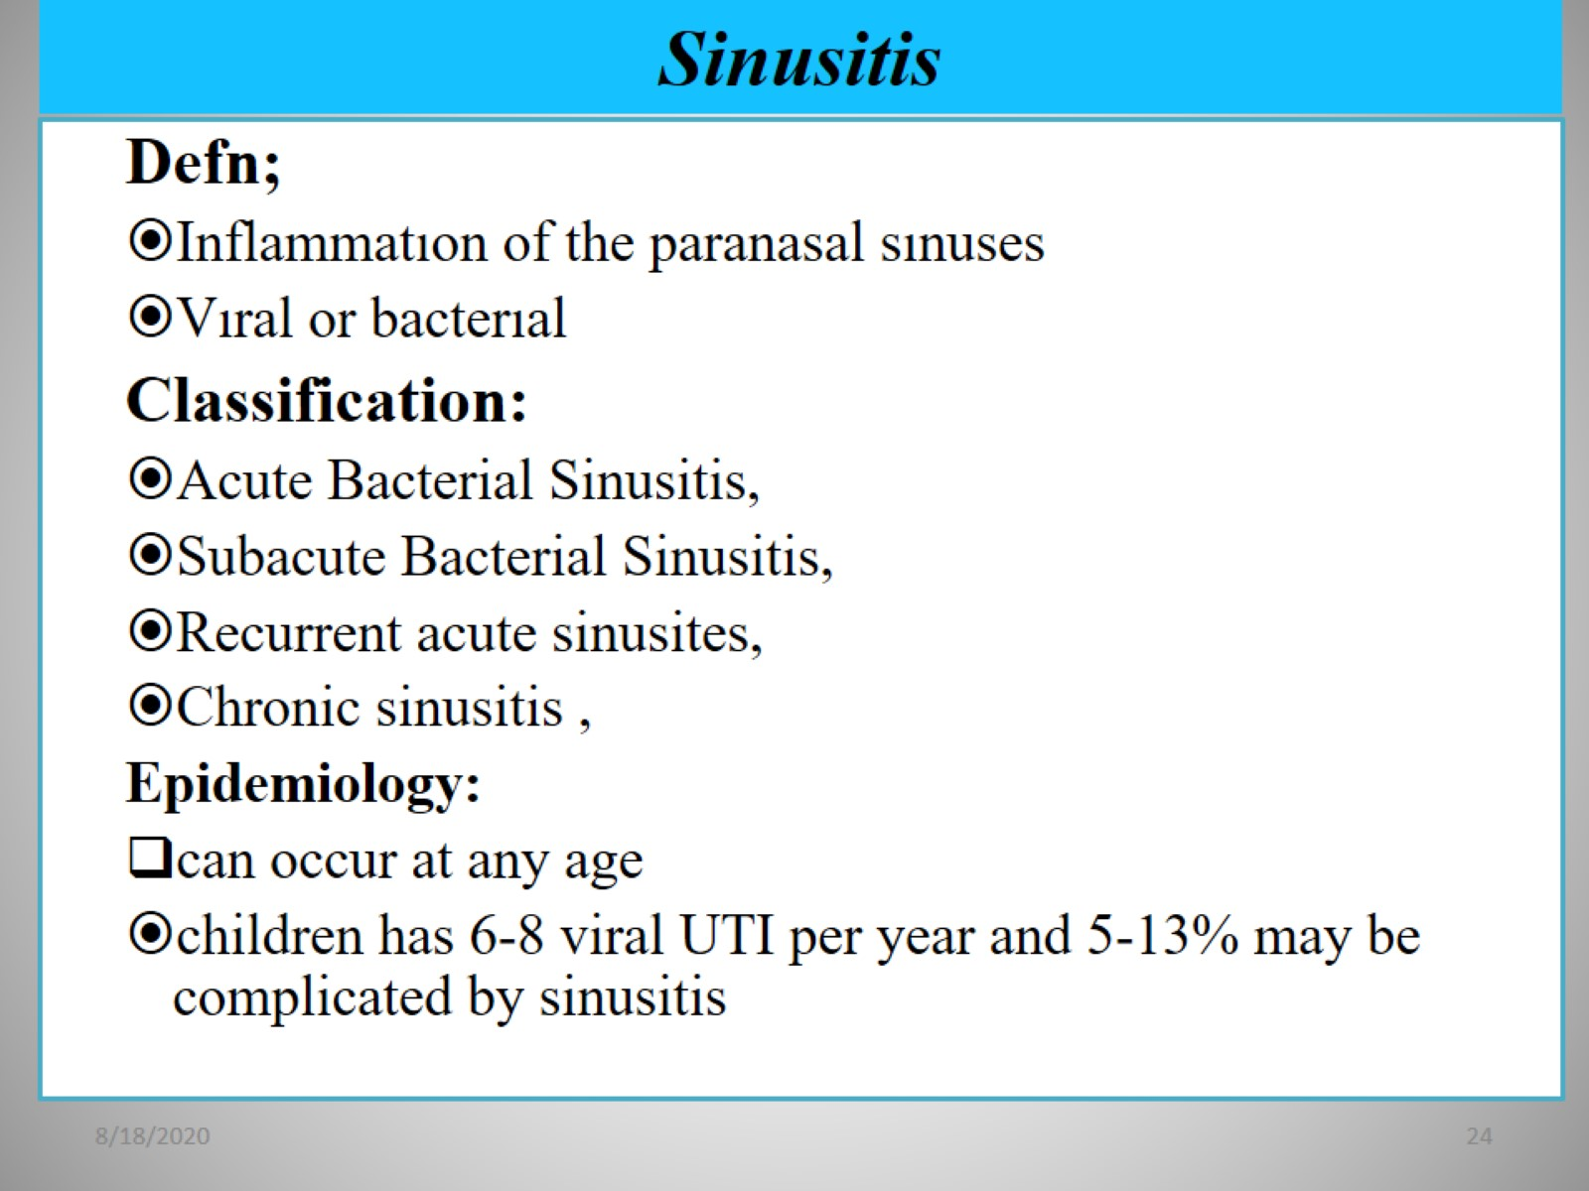
Sinusitis

Slide 25
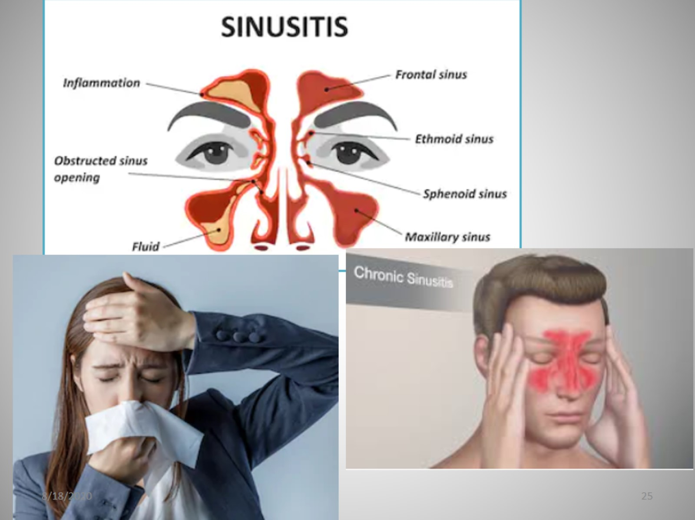

Slide 26
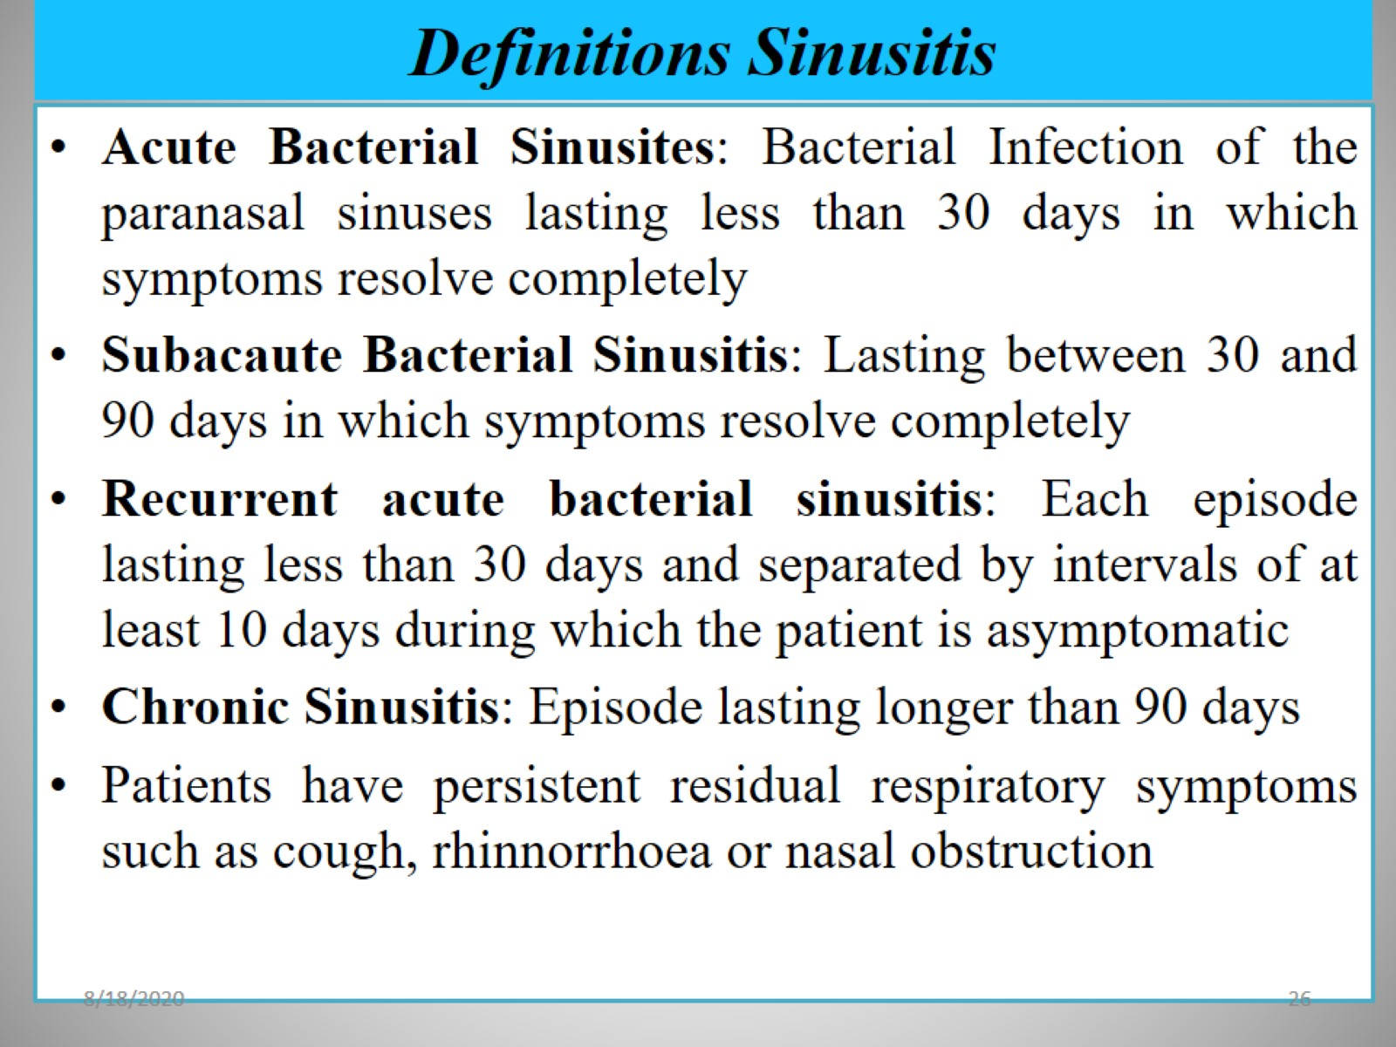
Definitions Sinusitis

Slide 27
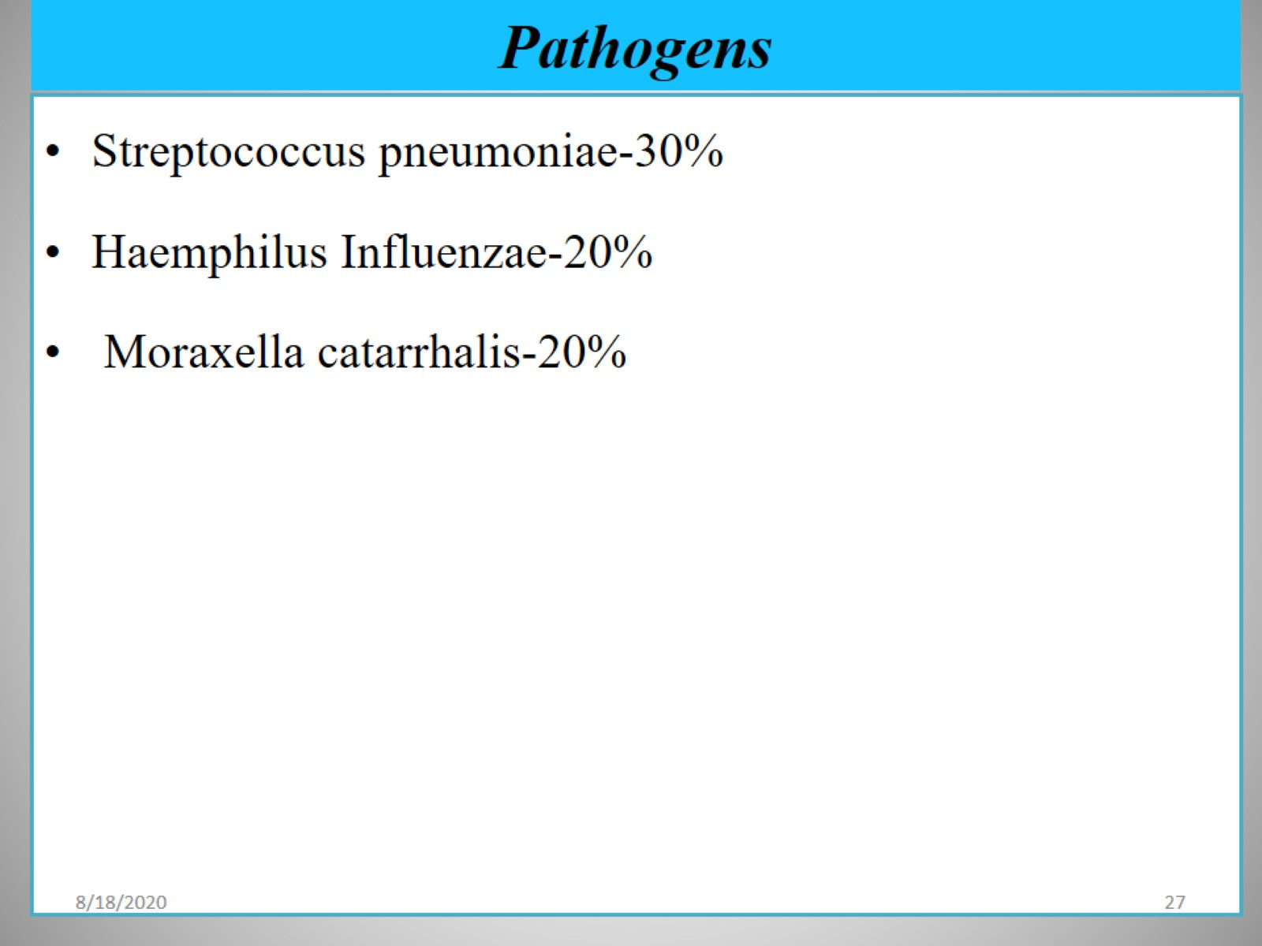
Pathogens

Slide 28
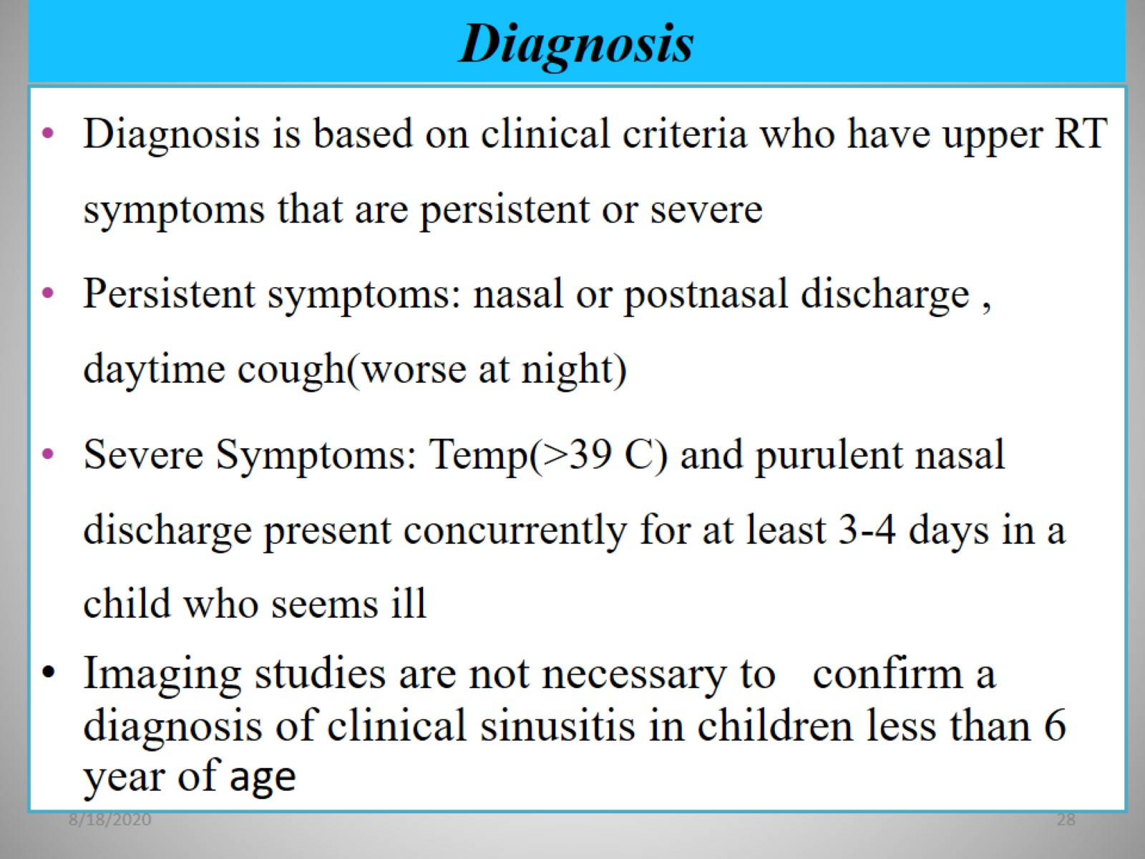
Diagnosis

Slide 29
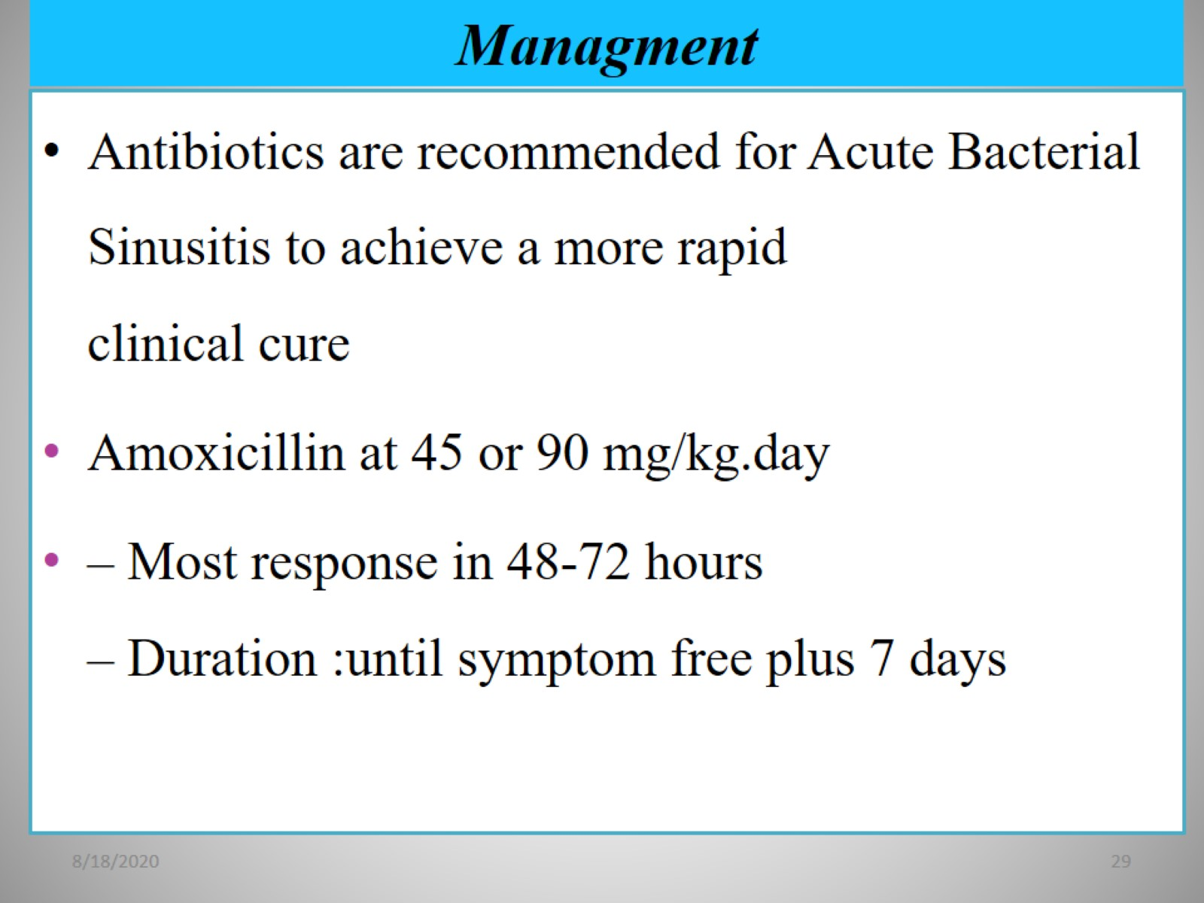
Managment

Slide 30
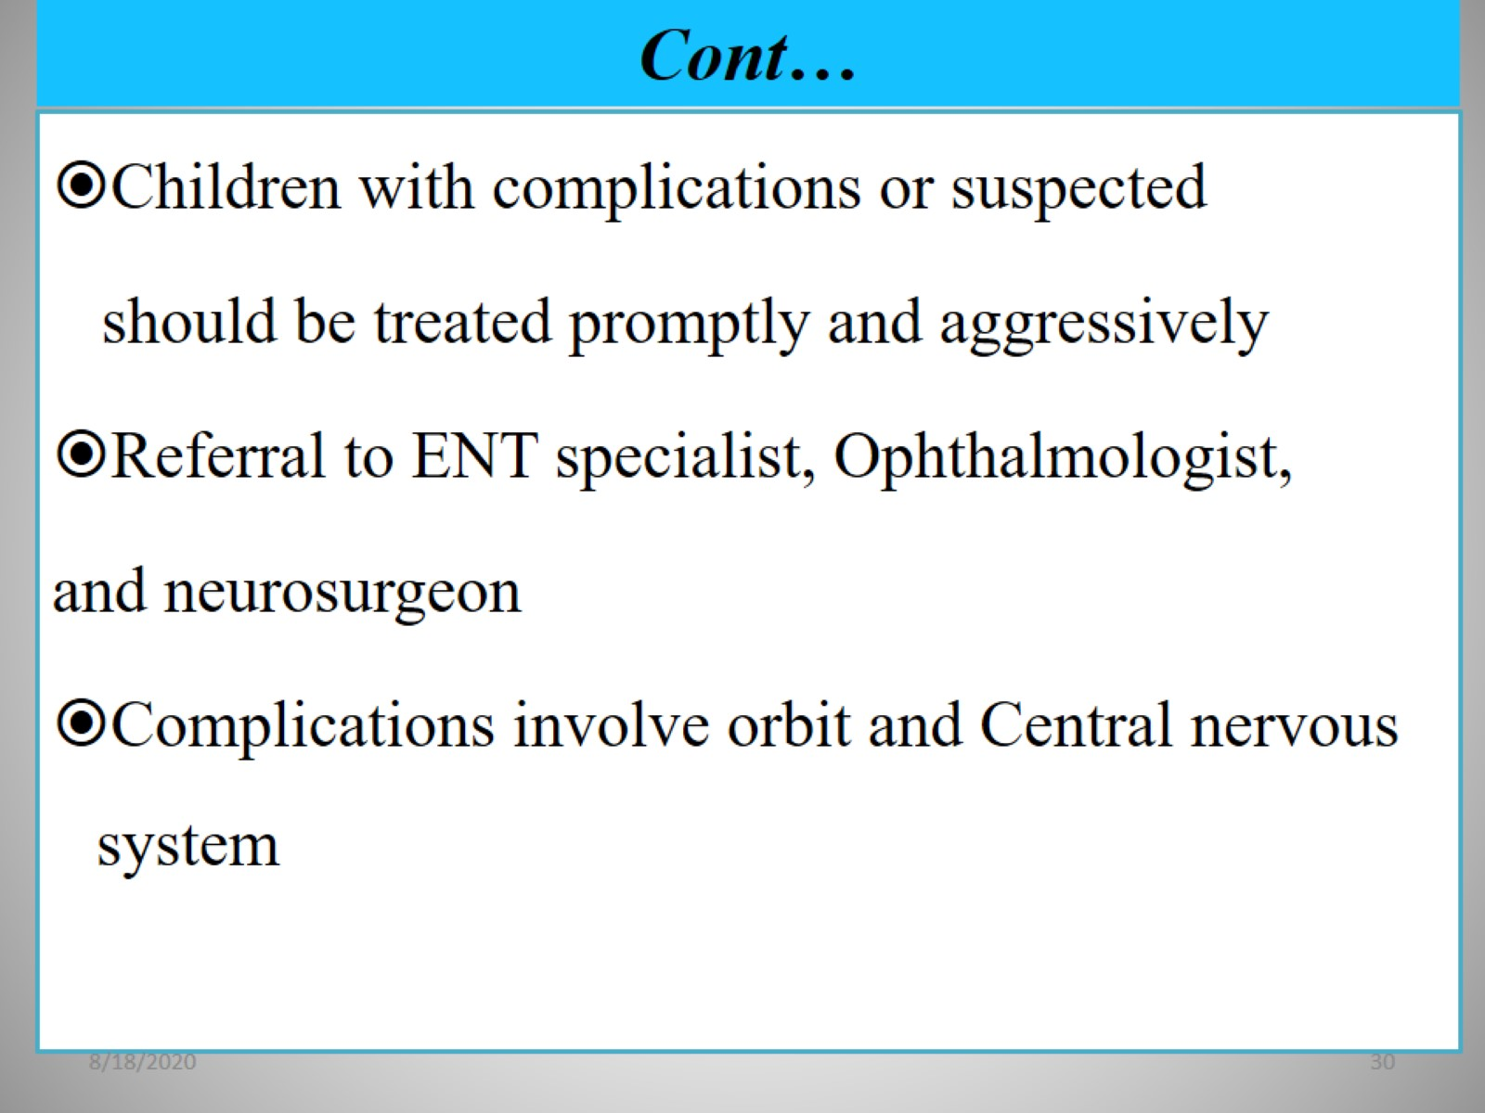
Cont…

Slide 31
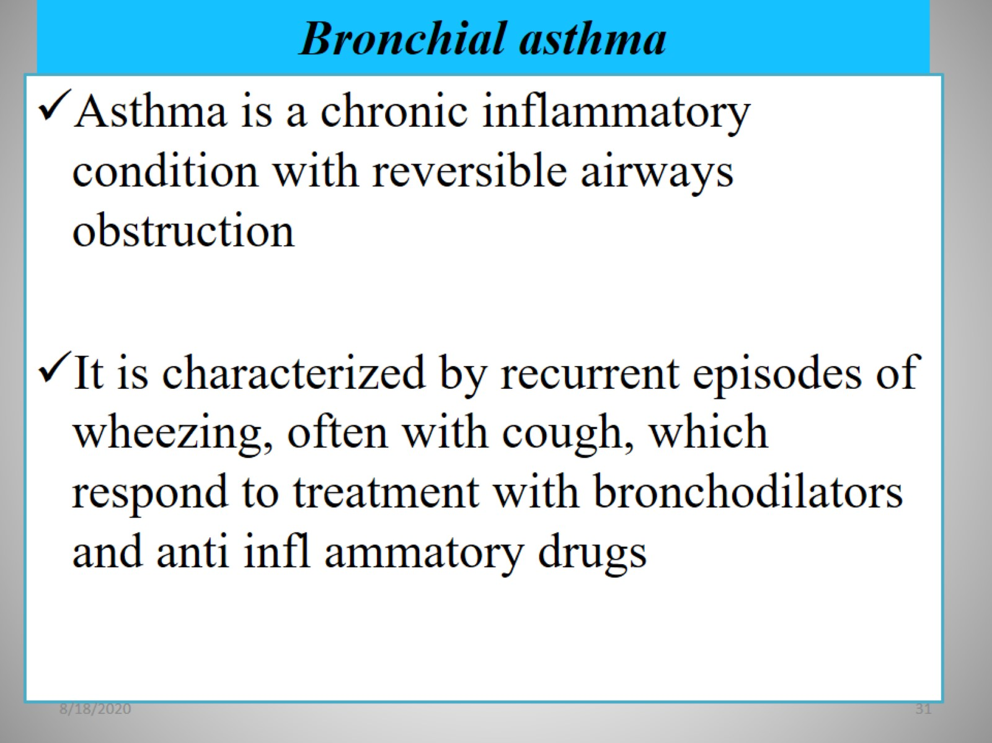
Bronchial asthma

Slide 32
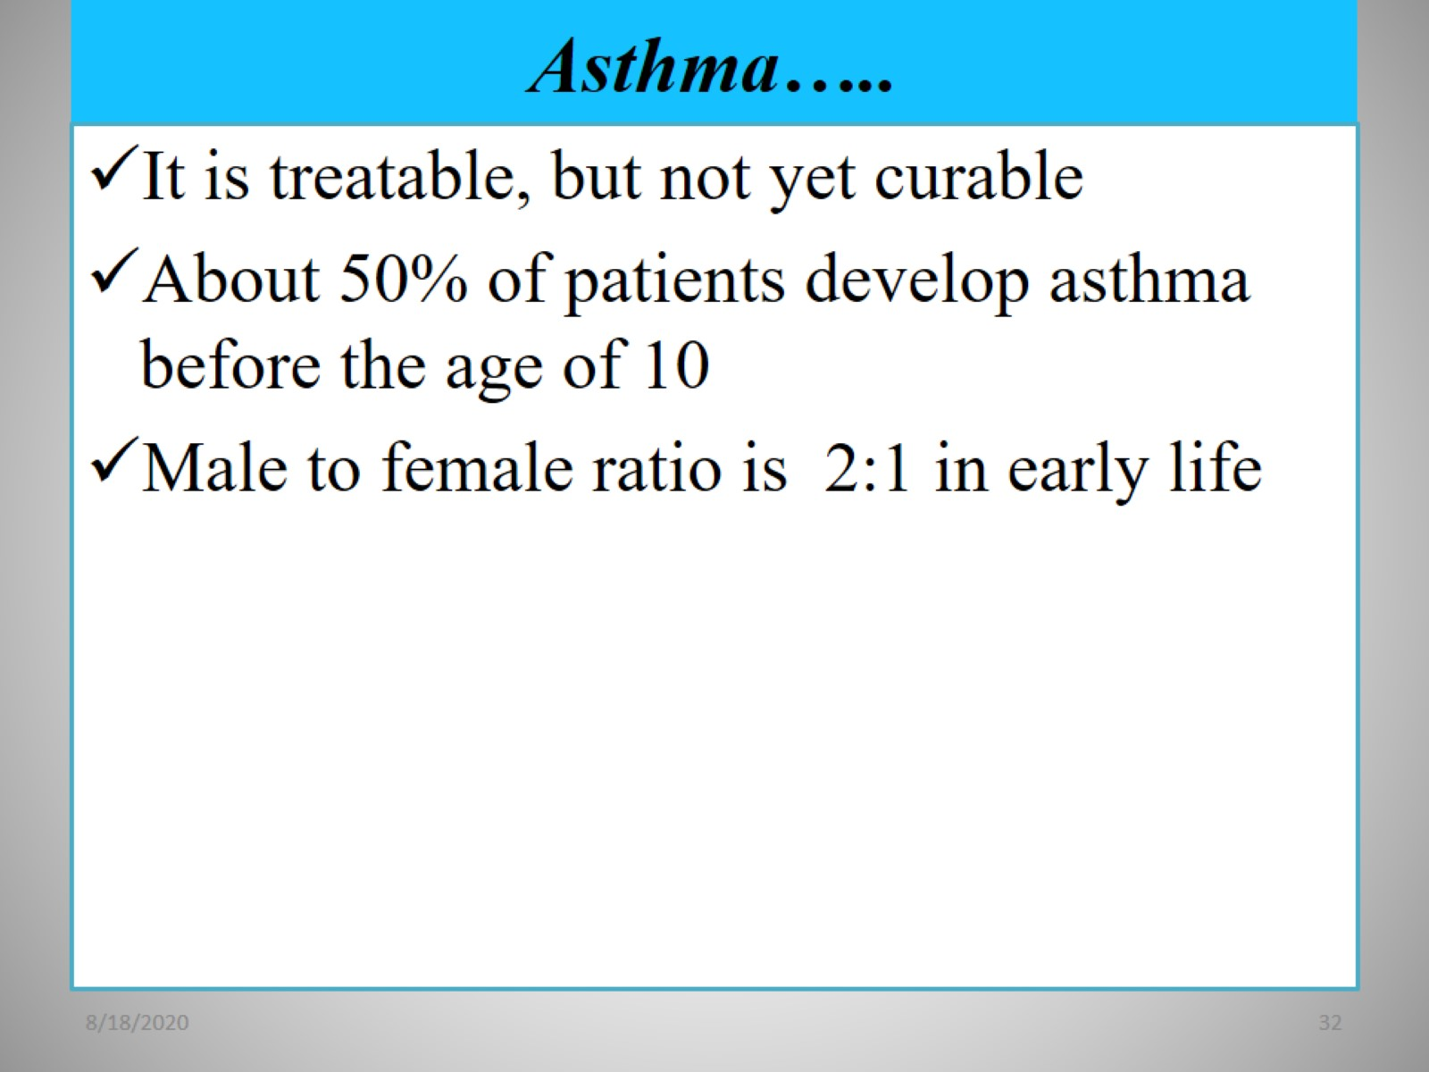
Asthma…..

Slide 33
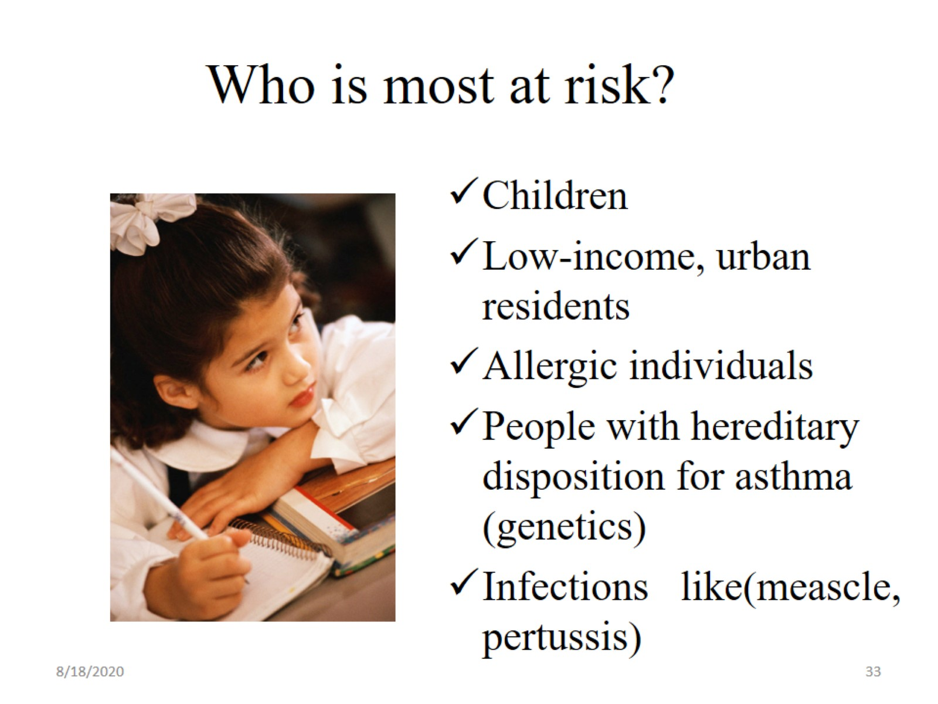
Who is most at risk?

Slide 34
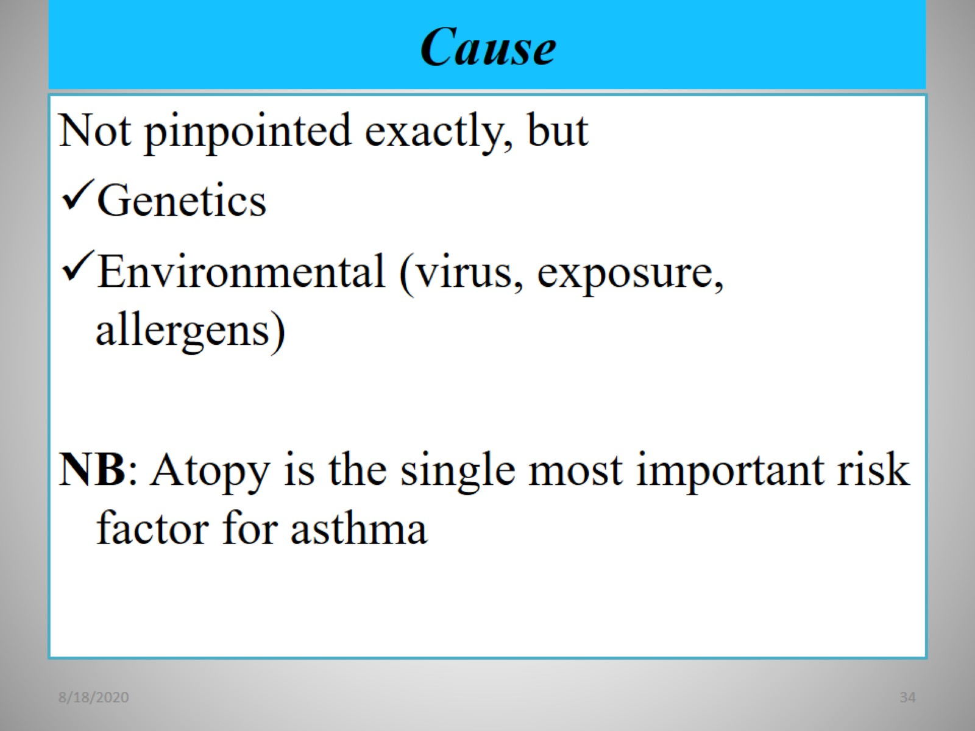
Cause

Slide 35
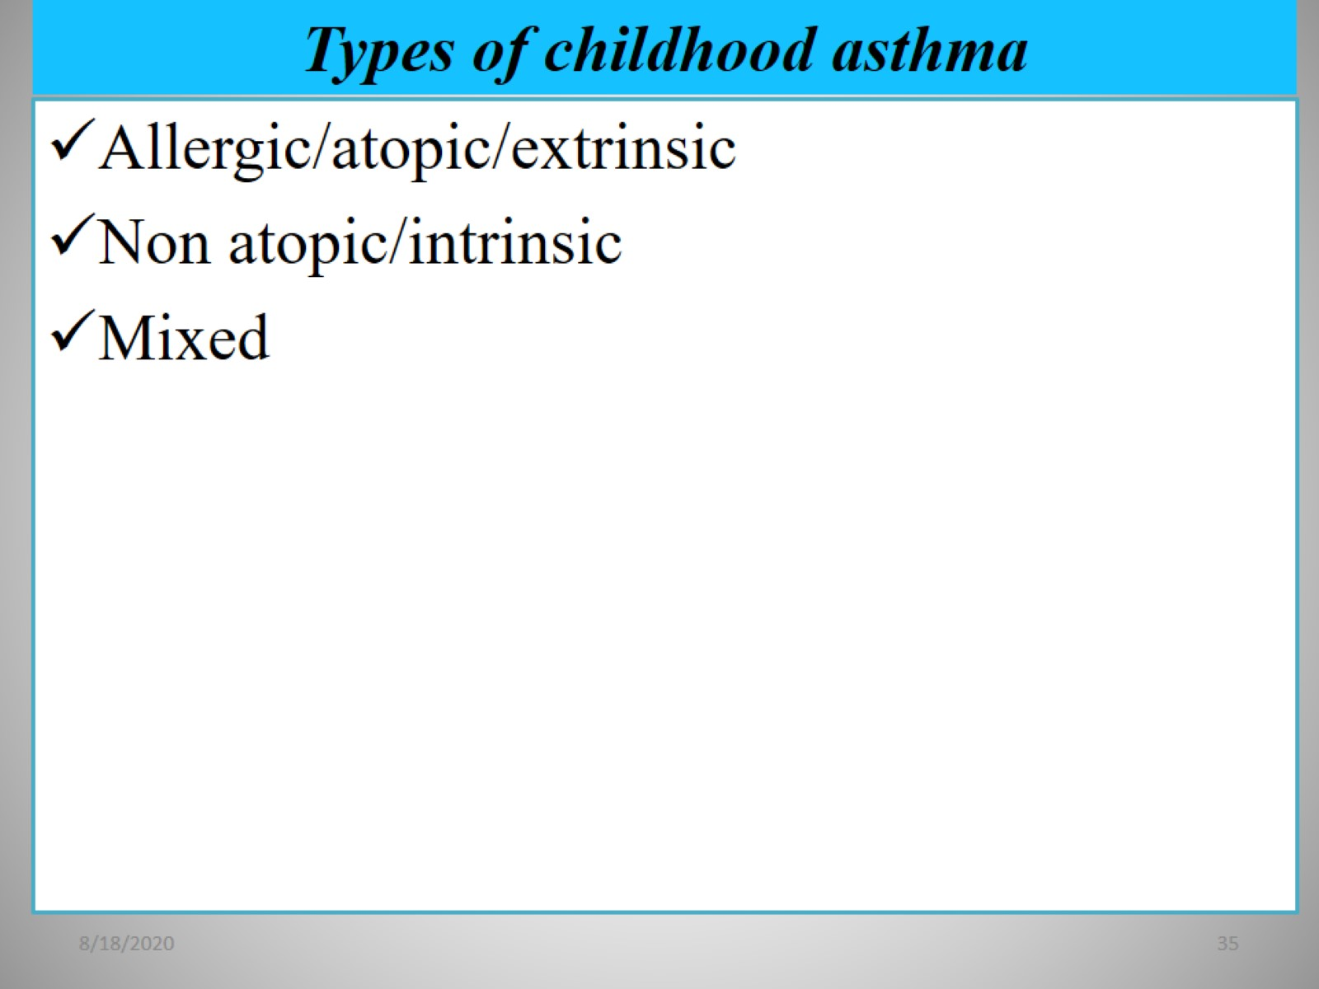
Types of childhood asthma

Slide 36
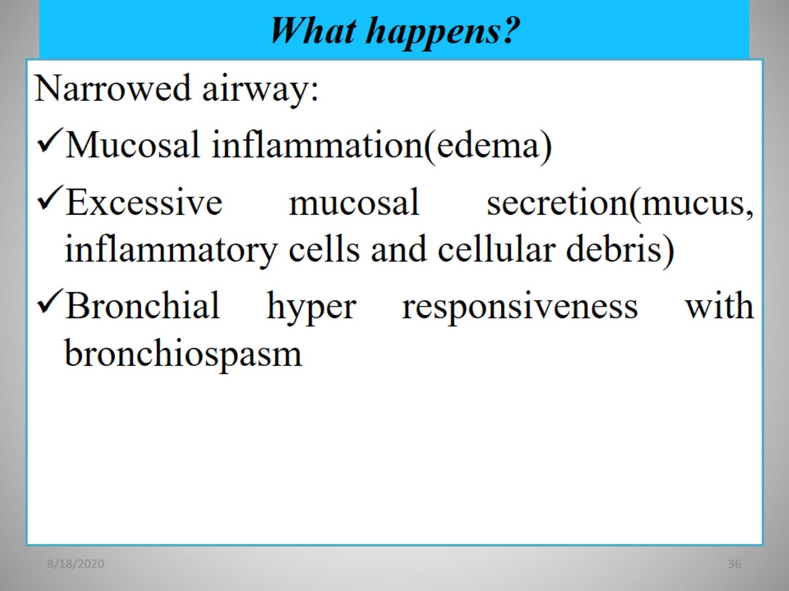
What happens?

Slide 37
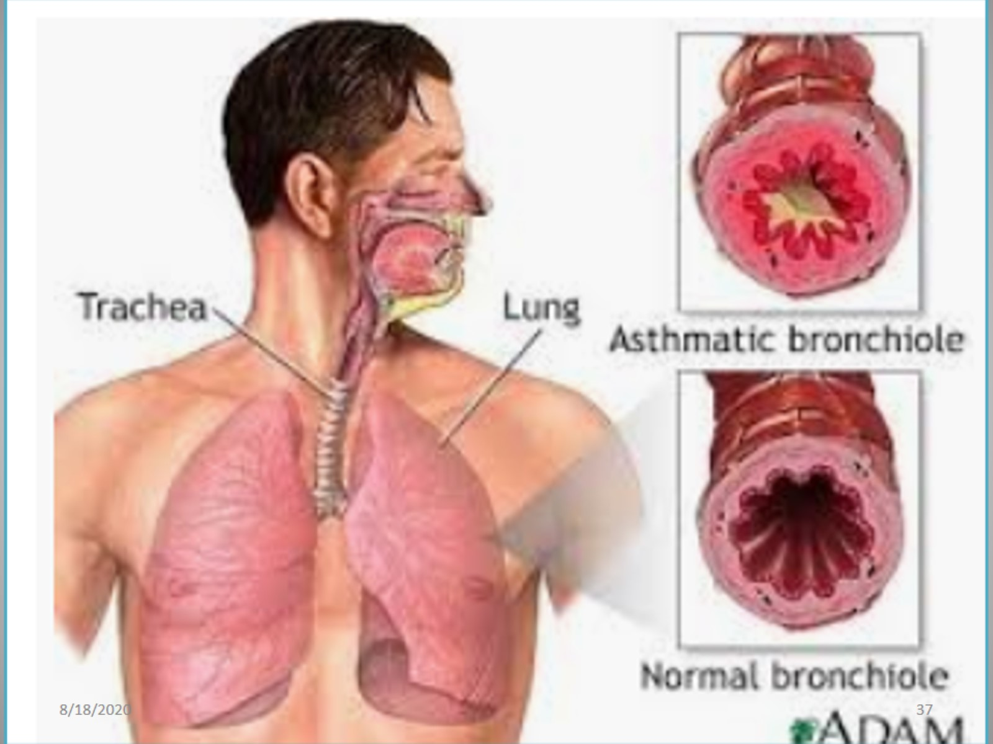

Slide 38
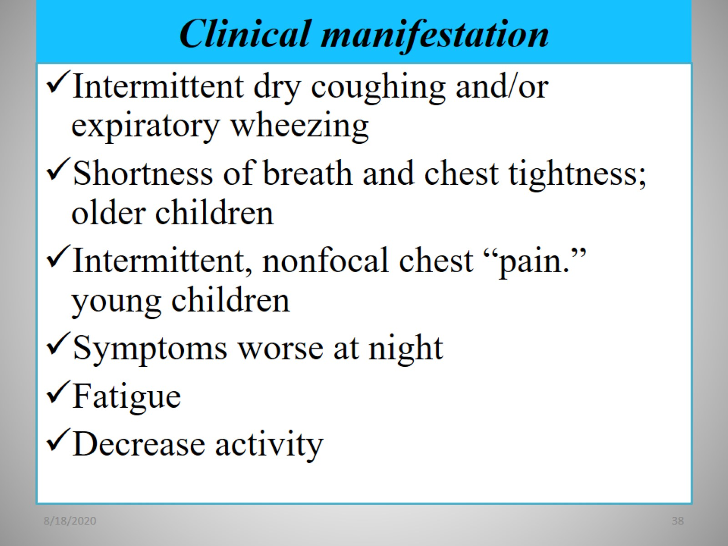
Clinical manifestation

Slide 39
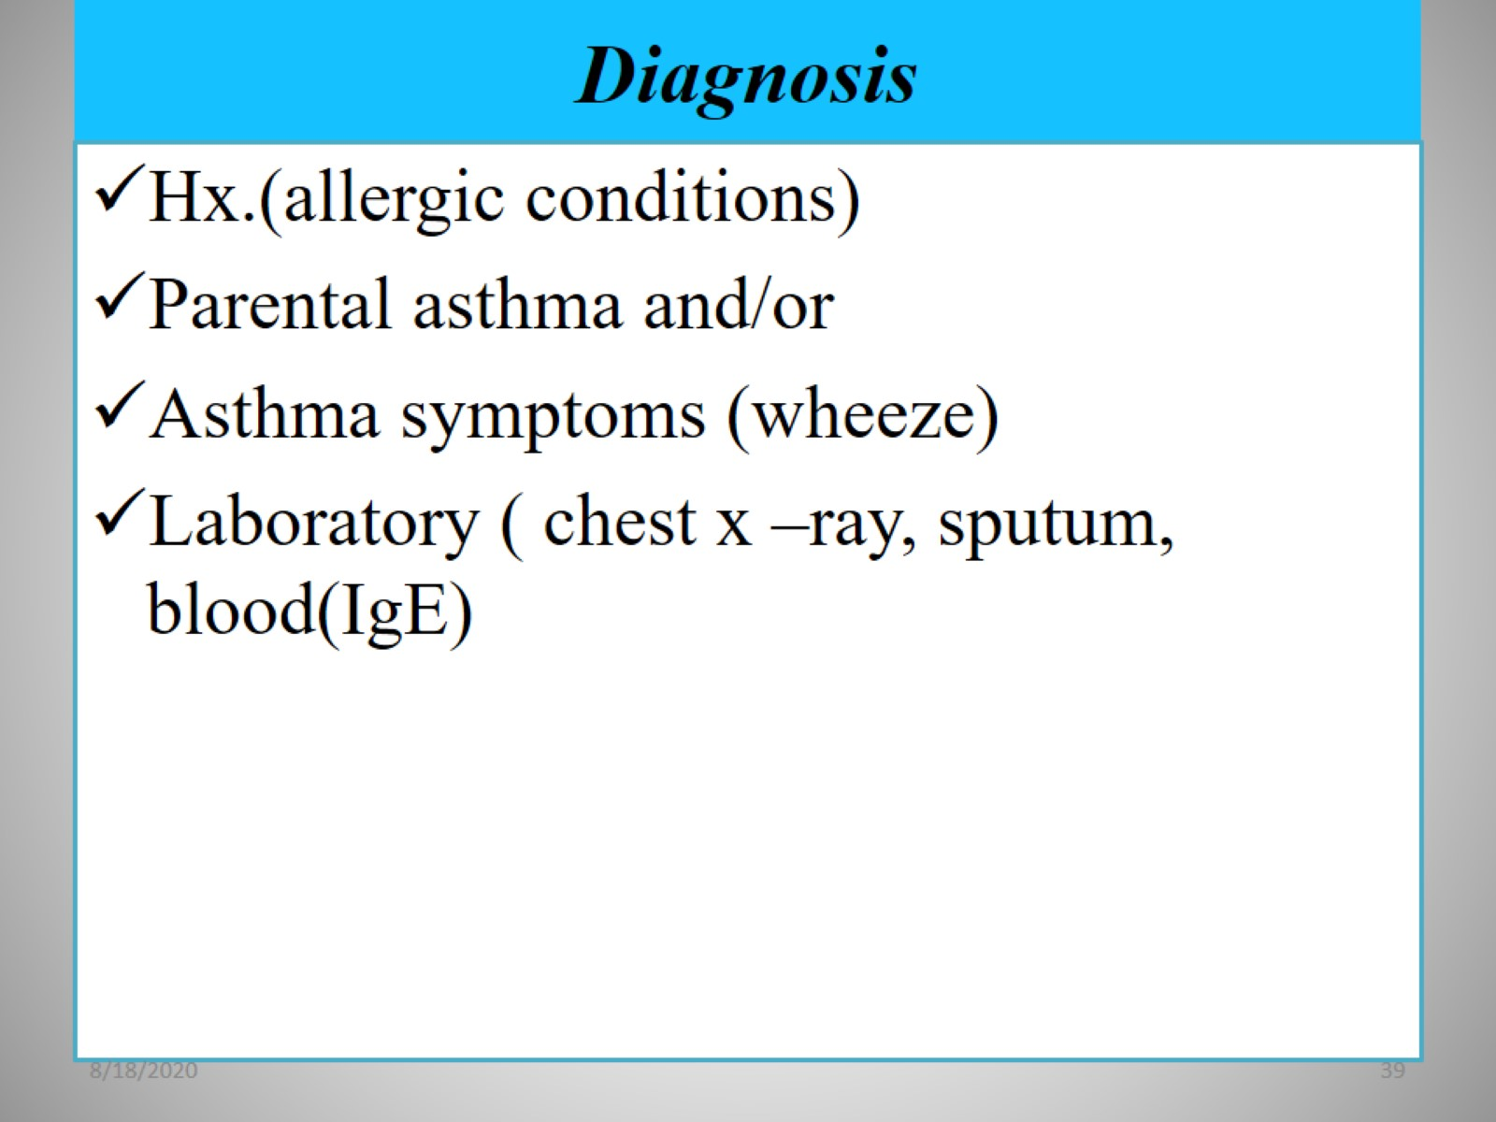
Diagnosis

Slide 40
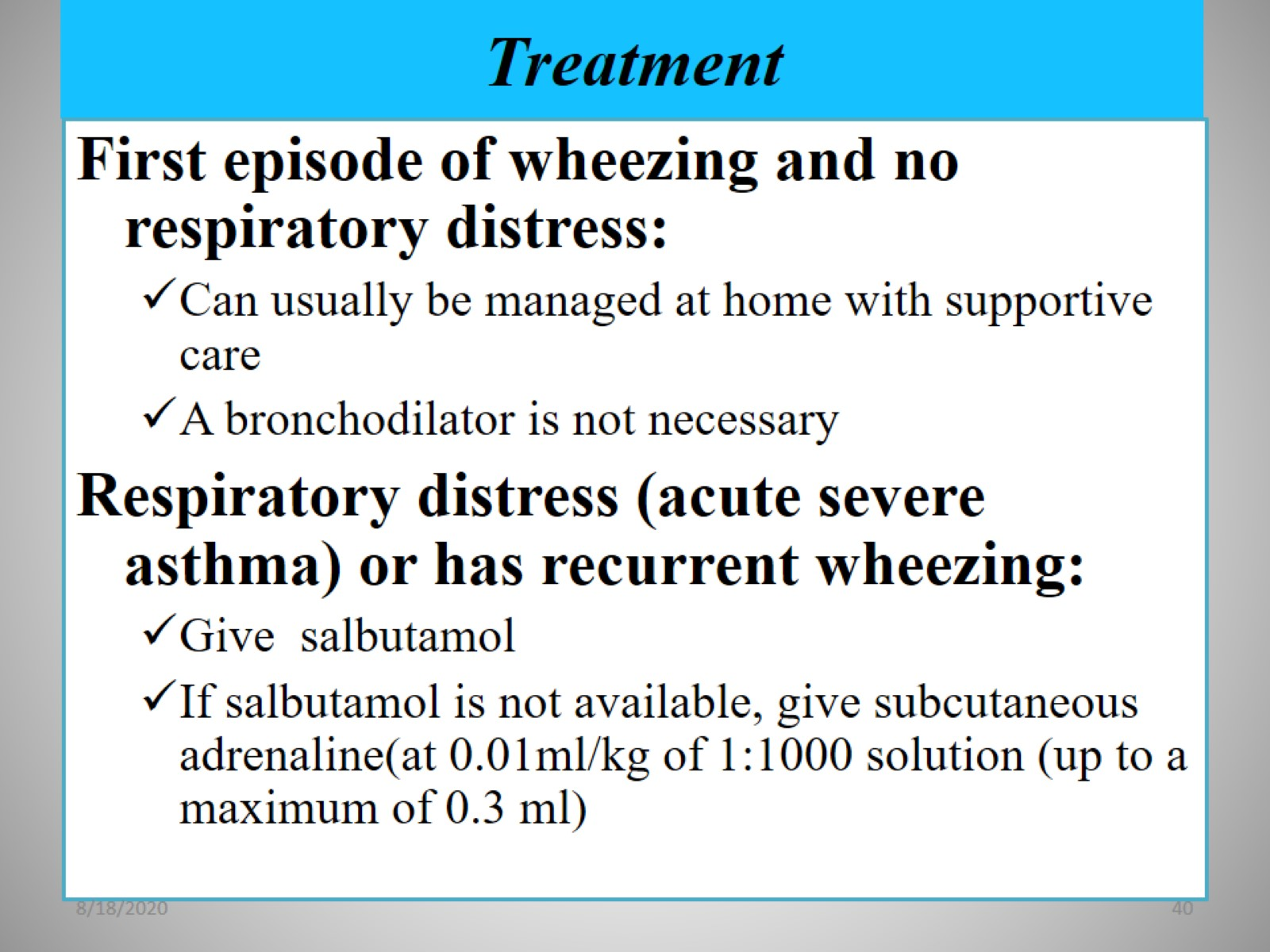
Treatment

Slide 41
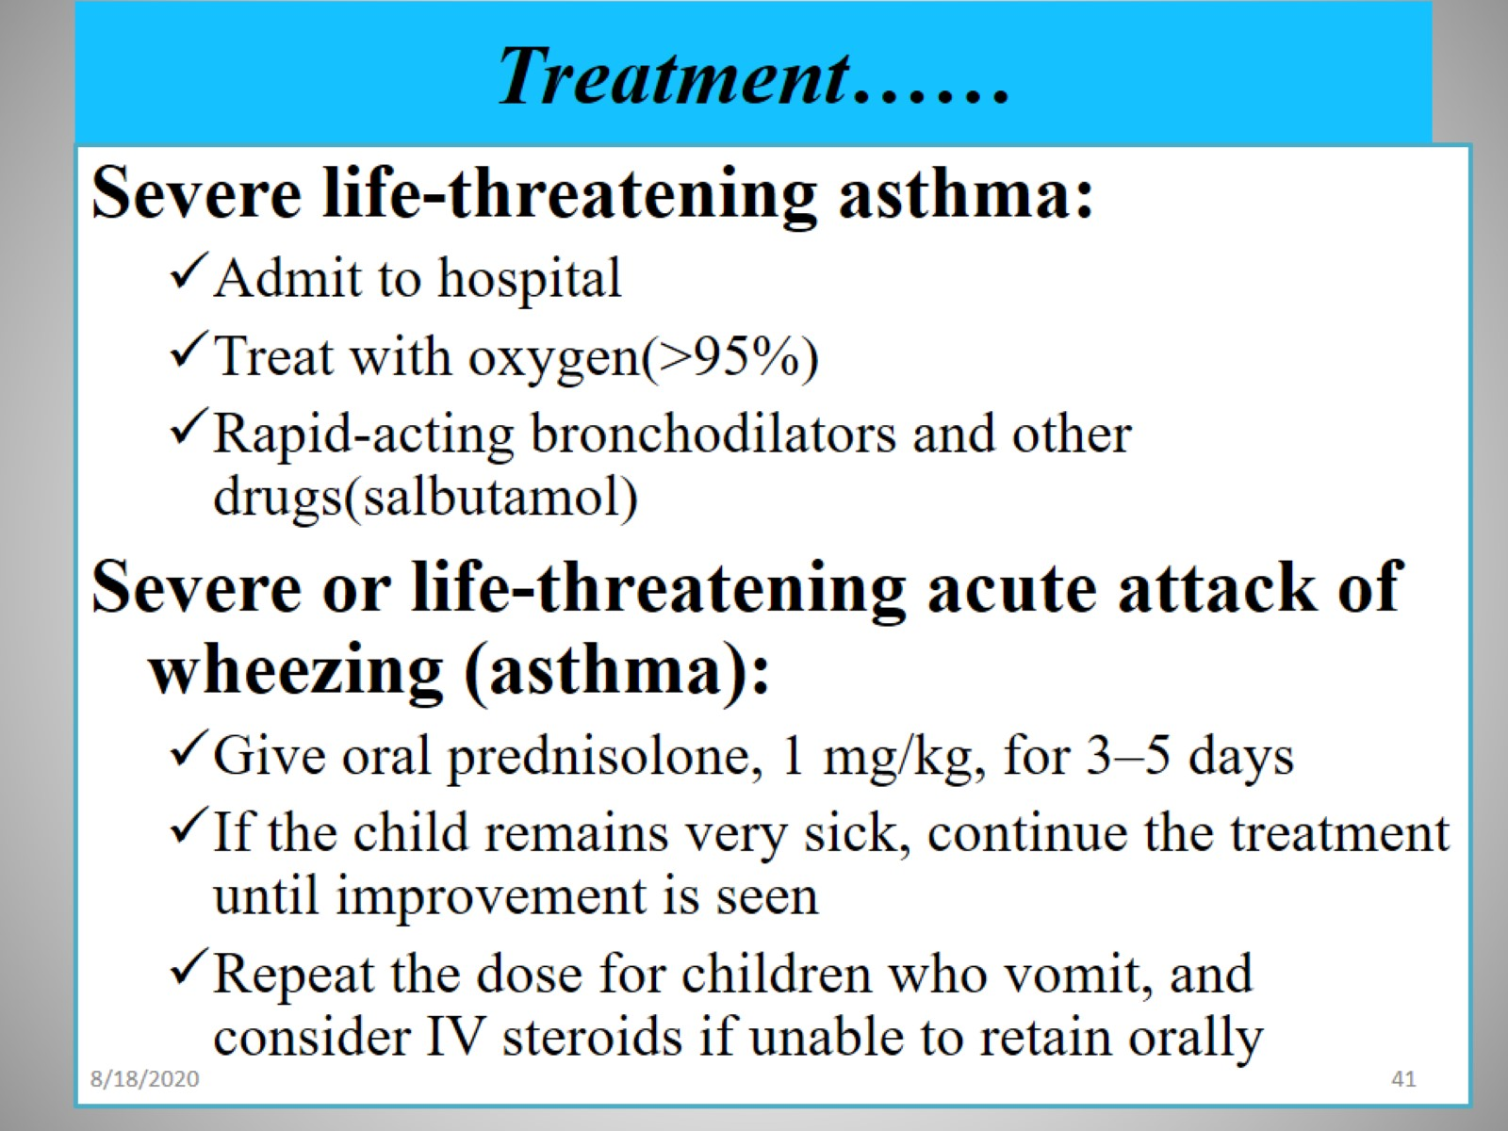
Treatment……

Slide 42
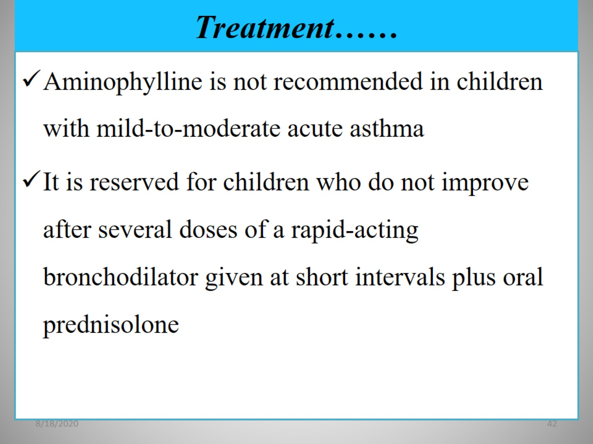
Treatment……

Slide 43
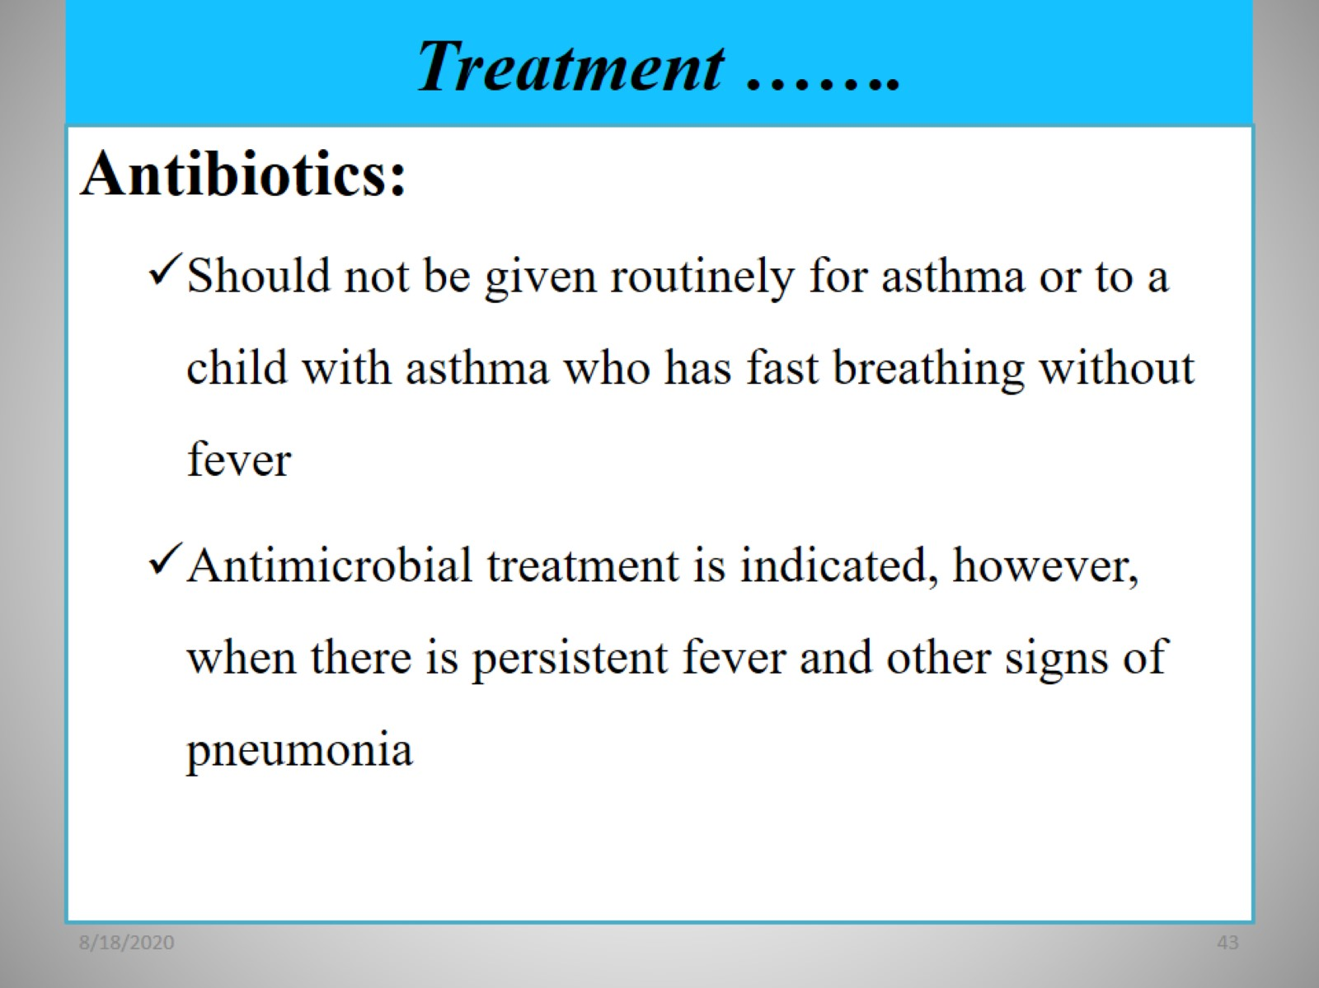
Treatment …….

Slide 44
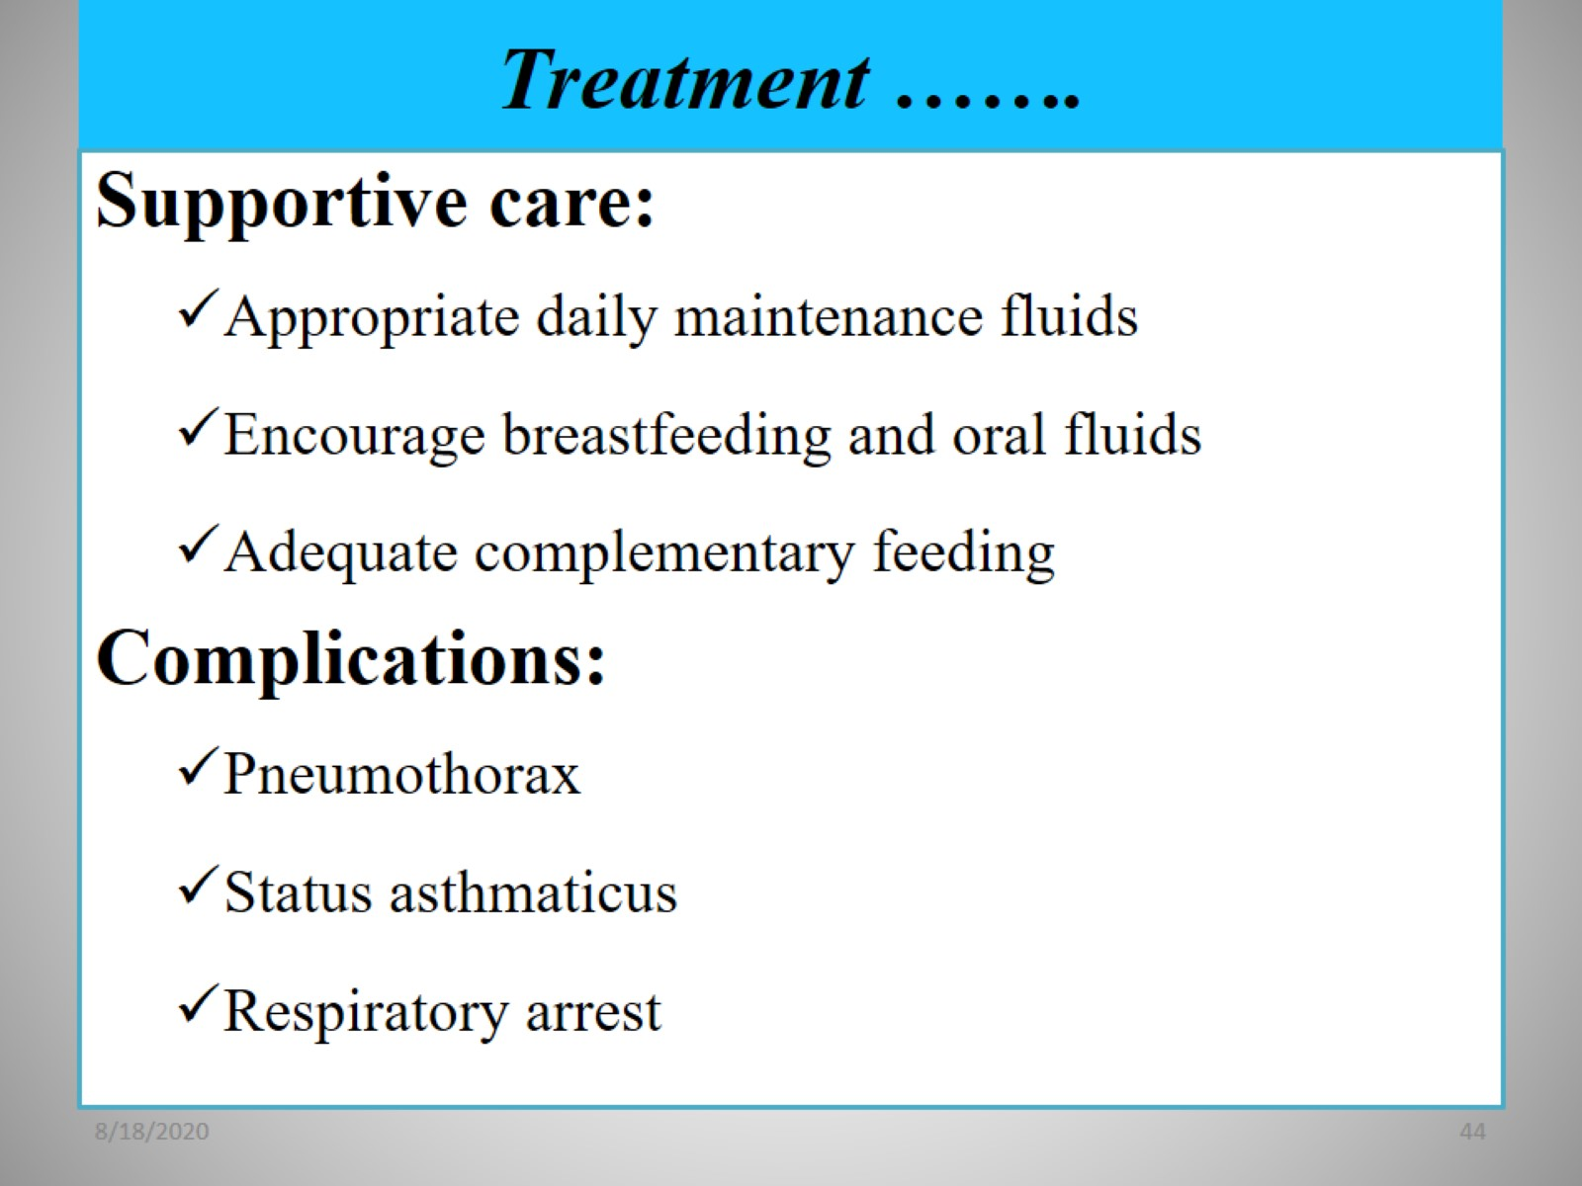
Treatment …….

Slide 45
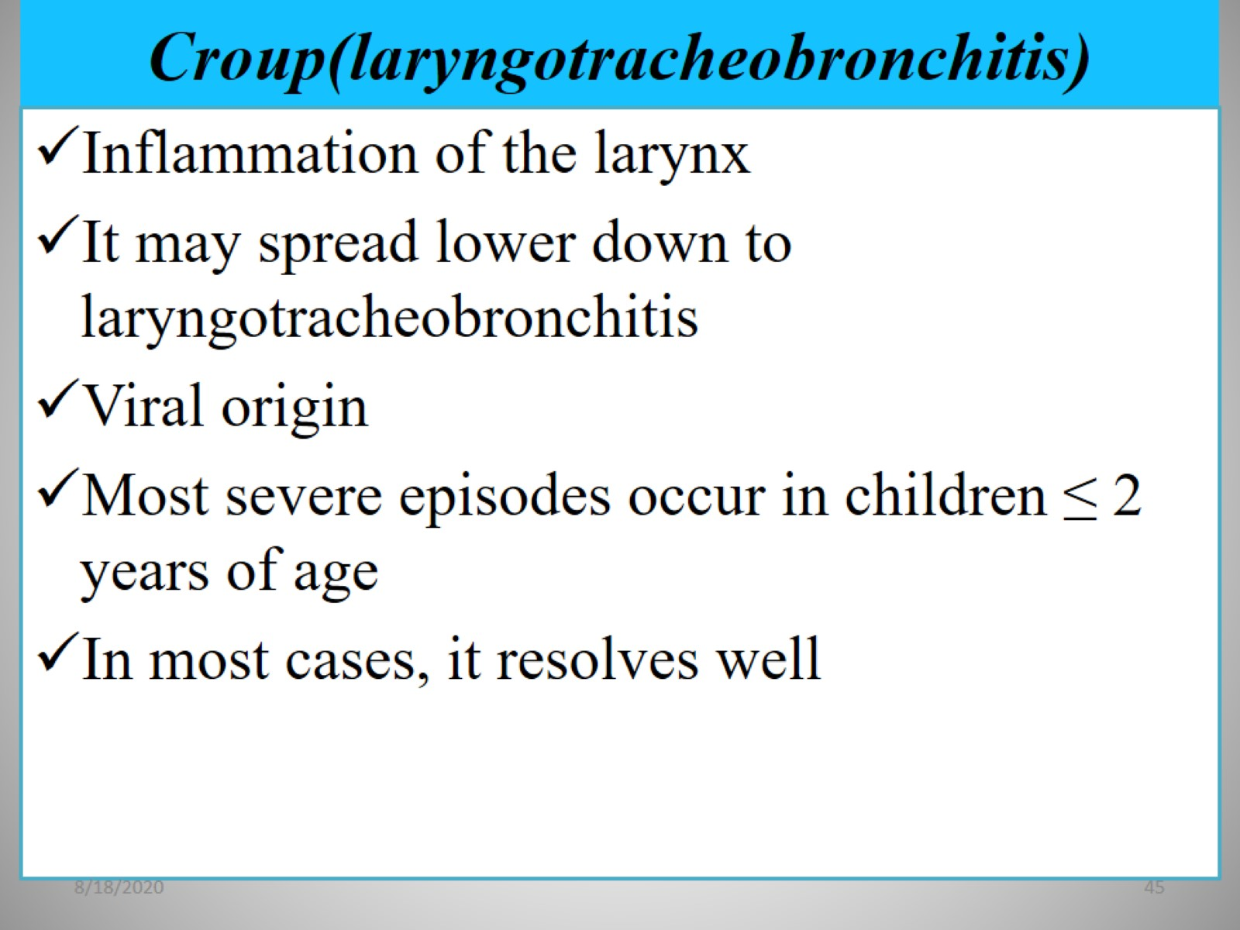
Croup(laryngotracheobronchitis)

Slide 46
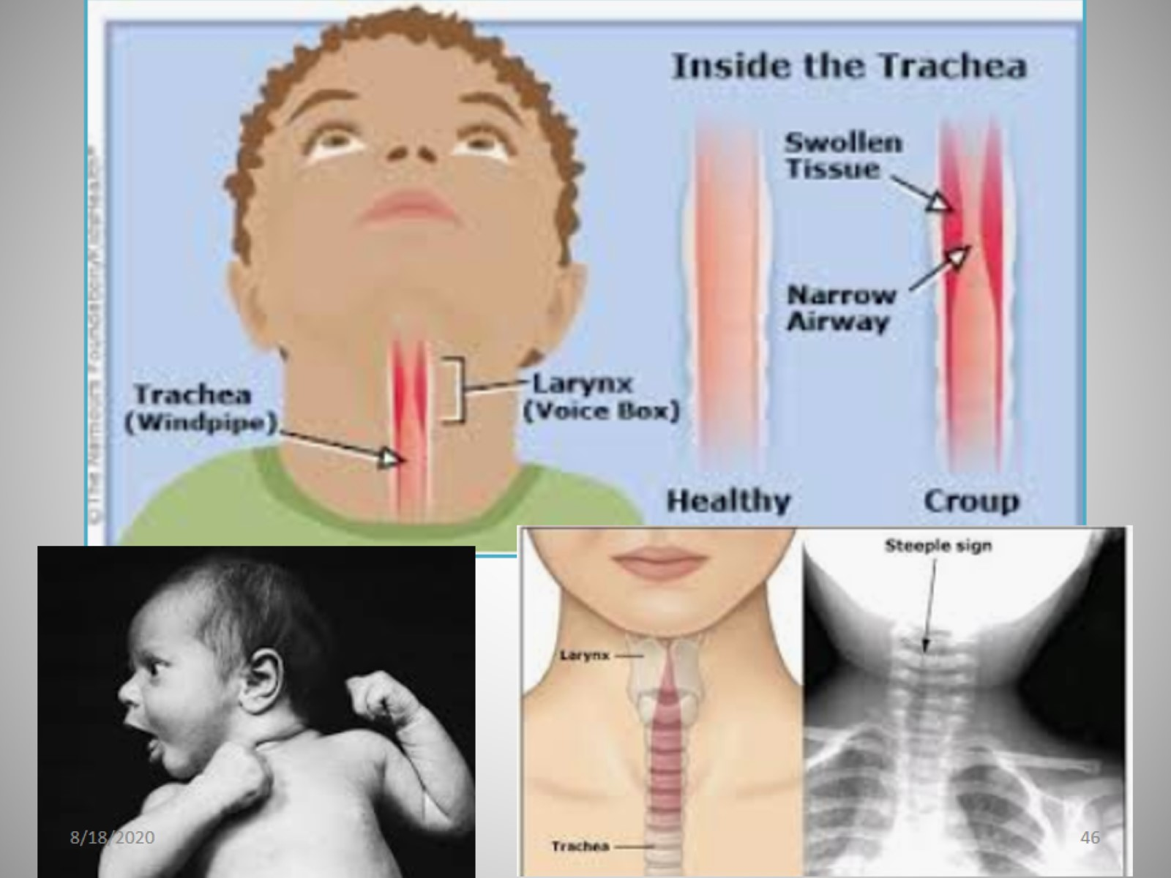

Slide 47
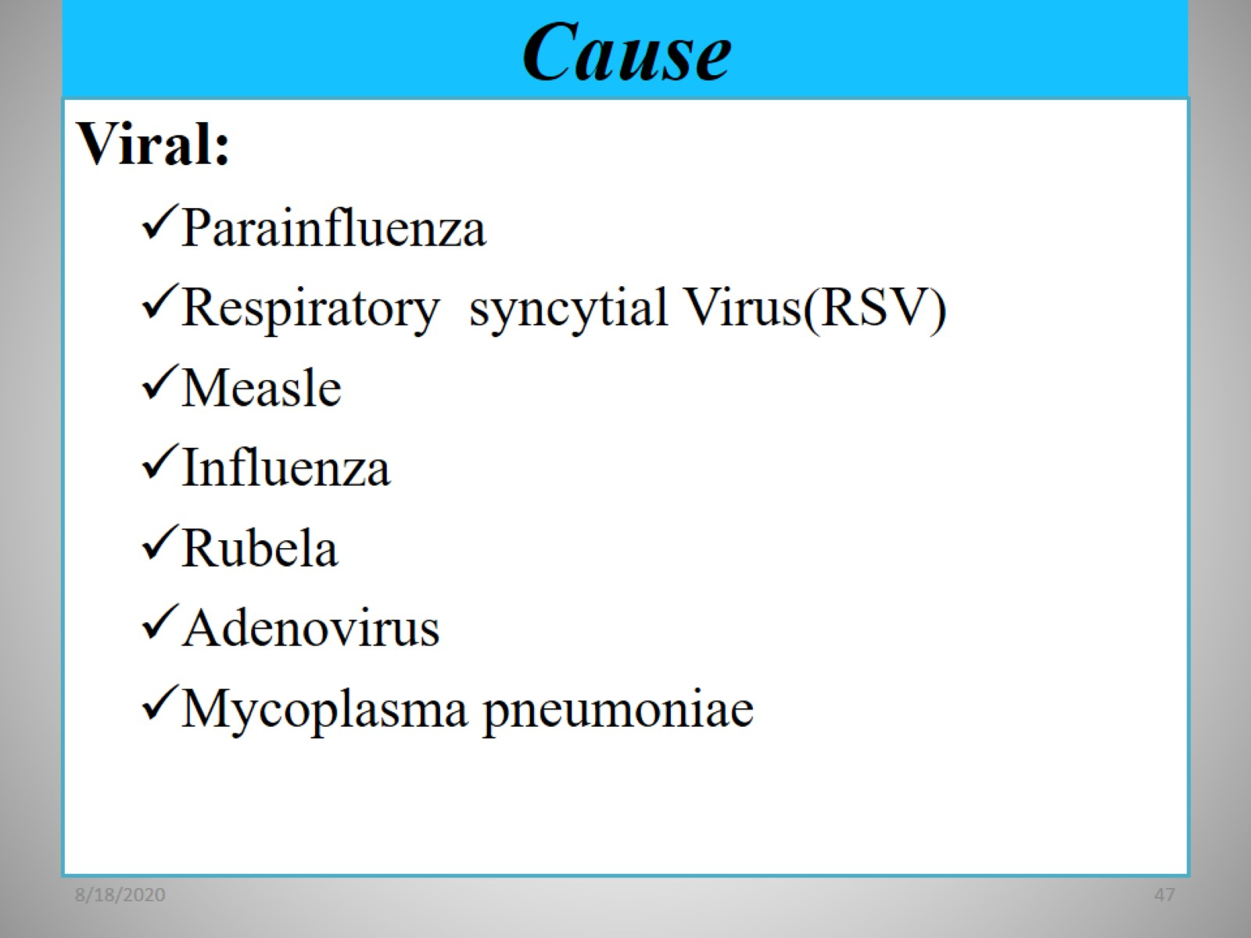
Cause

Slide 48
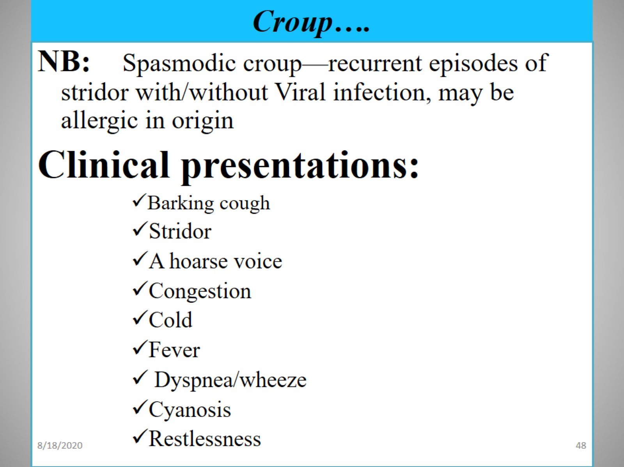
Croup….

Slide 49
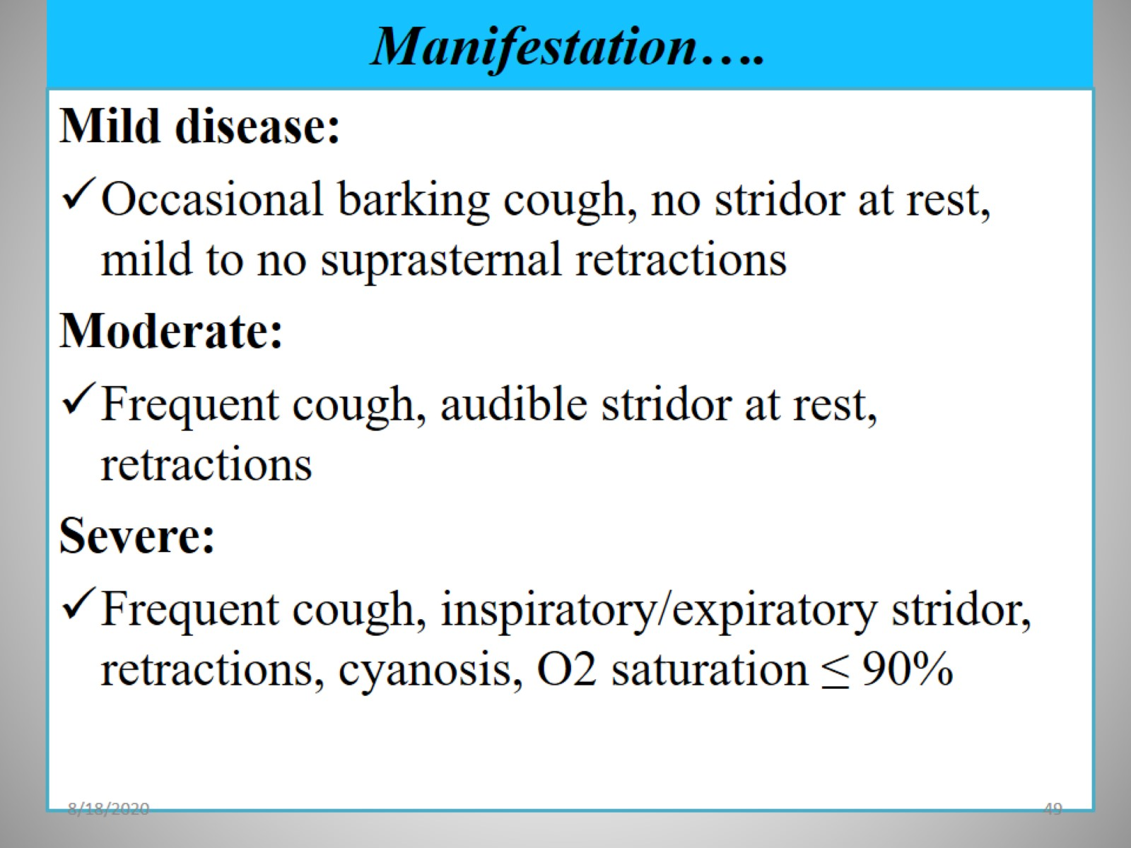
Manifestation….

Slide 50
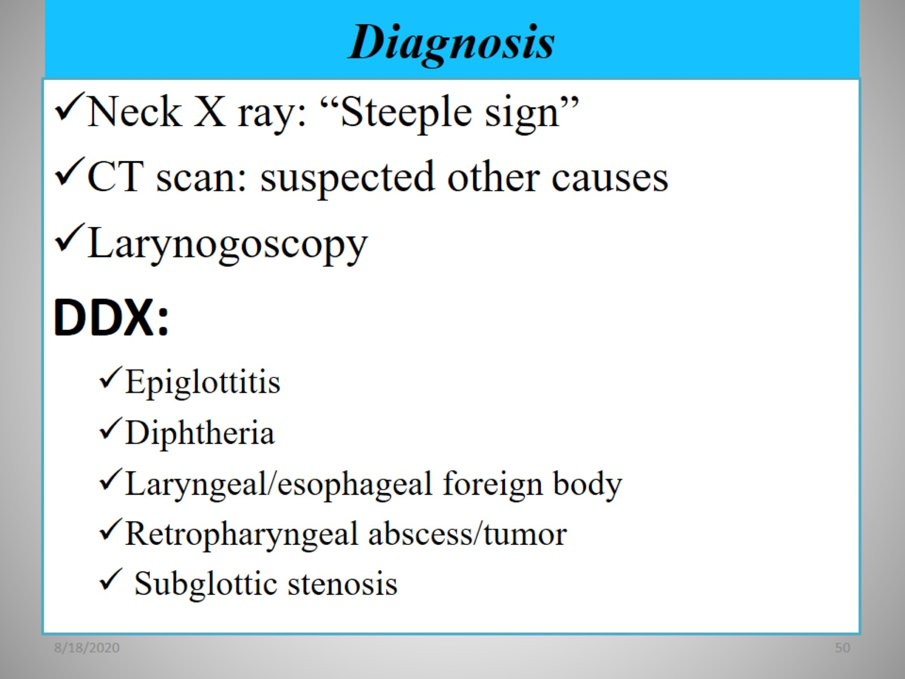
Diagnosis

Slide 51

Treatment

Slide 52

Summary

Slide 53

Pneumonia

Slide 54

Epidemiology

Slide 55

Cont…

Slide 56

Etiology of pneumonia

Slide 57

Cont…

Slide 58

Cont...

Slide 59

Cont...

Slide 60

Risk factors

Slide 61

Pathogenesis

Slide 62

Cont...

Slide 63

Cont...

Slide 64

Cont...

Slide 65

Cont...

Slide 66

Cont...

Slide 67

Cont...

Slide 68

Classification of pneumonia

Slide 69

Cont...

Slide 70

Cont...

Slide 71

Cont...

Slide 72

Cont...

Slide 73

Clinical presentation

Slide 74

Cont...

Slide 75

Cont...

Slide 76

Cont...

Slide 77

Cont...

Slide 78

Cont...

Slide 79

Cont...

Slide 80

Severity Assessment of pneumonia

Slide 81

Severity Assessment of pneumonia

Slide 82

Diagnosis

Slide 83

Viral vs bacterial pneumonia

Slide 84

Bacterial Vs Viral pna

Slide 85


Slide 86

Differential Dx

Slide 87

Management

Slide 88

Management

Slide 89

    Child ≥ 5 years old

Slide 90

In patient Management /admission

Slide 91

In patient Management

Slide 92

Complications

Slide 93

Cont…

Slide 94

Nursing Interventions

Slide 95

Cont...

Slide 96

Prevention

Slide 97


