Slide 1
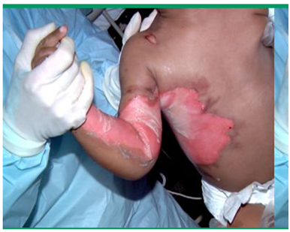
Overview of pediatrics skin disorders
By Wudie. E (MSc in pediatrics and child health nursing)

Slide 2
Objectives
At the end of this session, you will be able to;
Define common pediatric skin lesions
Describe some diagnostic tests
Identify common pediatric skin problems
Identify diagnose and treat of common skin infections
Describe burn
Identify causes of burn
Identify level of burn and its management
Identify prevention of burn
Identify complications of burn

Slide 3
Introduction
Skin is the largest and most superficial organ of the body.
Integumentary system contains: skin, hair, nails and glands.
Nearly one third(1/3rd) of the pediatric out patient visits involve a dermatology complaints.
Beyond primary skin disorder, skin is a marker of underlying systemic disease and many hereditary syndromes in children.

Slide 4
Anatomy of the skin
The skin consists of 3 layers :
1. Epidermis; Non vascular outermost layer, continuously dividing cells
It provides the initial barrier to the external environment
Contains melanocytes and gives color to the skin
2. Dermis; It is the middle layer of the skin
Takes the largest portion of the skin and provides strength and structure.
Notes:
Four types of cells in epidermis
Keratinocytes – deepest, produce keratin (tough fibrous protein)
Melanocytes - make dark skin pigment melanin
Merkel cells – associated with sensory nerve endings
Langerhans cells – macrophage-like dendritic cells

Slide 5
Con’t….
It consists of glands (sebaceous, sweat), hair follicle, blood vessels, and nerve endings.
3. Subcutaneous tissue (hypodermis)
The inner most layer
It is composed of a type of cell known as adipocytes specialized in accumulating and storing fats.
Contains major vascular networks, fat, nerves, and lymphatics.

Slide 6
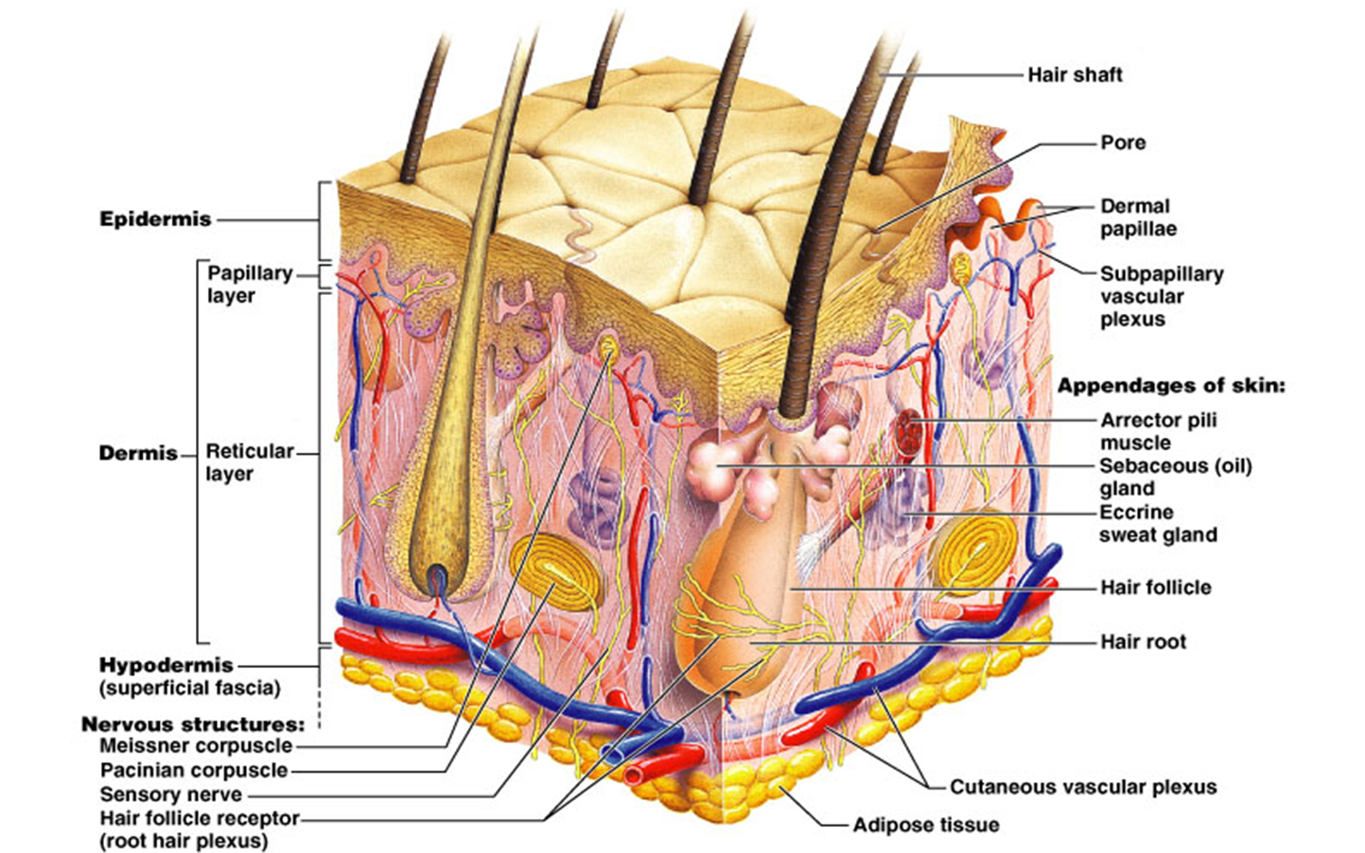
Con’t….
Figuer 1. layers of the skin
Notes:
Eccrine glands…glands that secret sweats in human body

Slide 7
Function of the skin
Protection e.g. protect from UV rays and infection
Thermoregulation
Immunologic response
Fluid balance (excretion)
Secretion of wastes
Sensory perception
Vitamin D synthesis
Notes:
Protection
Sensory perception
Temperature regulation
Vitamin synthesis
Aesthetic

Slide 8
Skin examination
Observe and feel the skin for the following:
Color
Moisture
Temperature
Texture
Mobility and Turgor
Lesions

Slide 9
Diagnosis(Dx)/Approach to cases
History
Physical examination
Dx by morphology:
Identify the primary lesions
  The size in millimeters
  Secondary changes
  Arrangement and distribution of the lesion

Slide 10
Diagnostic tests
Diagnostic studies of the skin are;
  Skin test (scraping)
  Skin biopsy
  Culture and sensitivity test

Slide 11
Morphology of skin lesions
Primary skin lesions:
Initial pathologic change
2. Secondary skin lesions:
Result from external forces such as scratching, picking, infection, or healing of primary lesions.

Slide 12
Primary skin lesions:
Macule : Flat, non palpable discoloration < 1 cm in size
Patch :Flat ,non palpable discoloration > 1 cm in size
Papule: Solid palpable lesion < 1cm in size, flat topped or dome-shaped
Nodule : Dome- shaped solid palpable lesion > 1 cm diameter
Plaque: Raised flat, solid palpable lesion > 1 cm.

Slide 13
Primary skin lesions cont….
Tumor Solid elevated lesion > 2 cm diameter;
Vesicle :Fluid-filled (clear) < 1 cm diameter, usually < 0.5cm
Bulla : Large fluid-filled (clear) elevation > 1 cm diameter
Pustule : Vesicle or bulla with purulent fluid
Cyst : Cavity lined with epithelium containing fluid, pus, or keratin
Notes:
Pustule ;A raised lesion filled with a fluid exudate, giving it a yellow appearance. (acne, folliculitis)

Slide 14
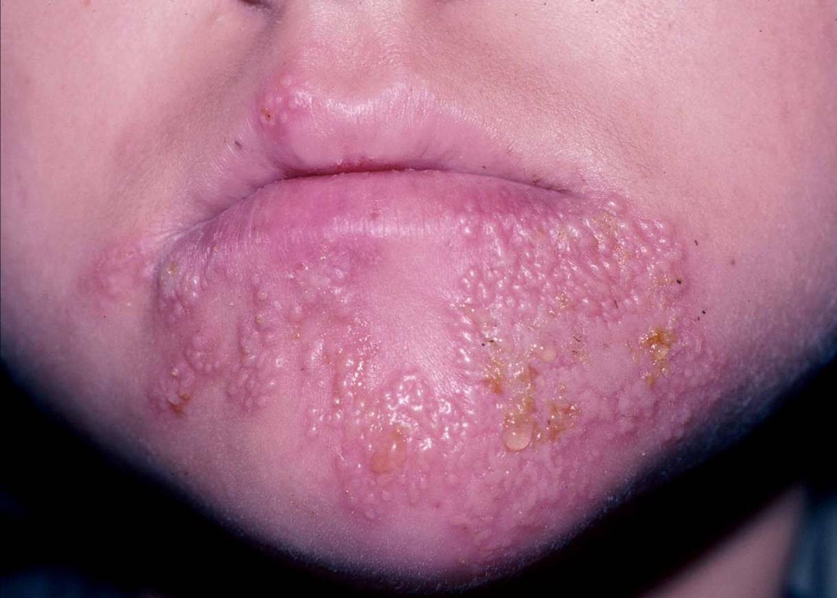
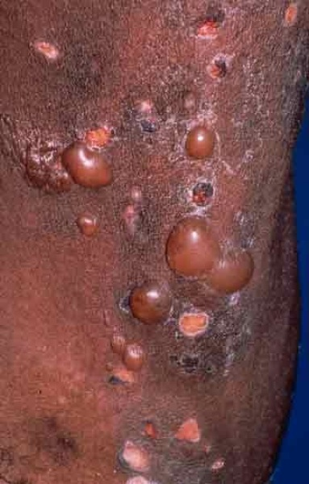
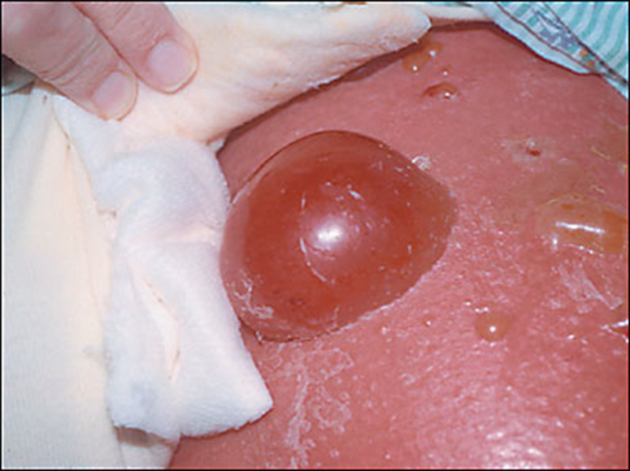


Cont….

Slide 15
Secondary skin lesions
Exudate: Moist serum, blood or pus from either an erosion, blister or pustule
Scale: Dry, flaky surface with normal/abnormal keratin; present in proliferative disorders
Lichenification: Accentuation of normal skin lines caused by thickening, primarily of the epidermis, due to scratching or rubbing.
Excoriation: Localized damage to skin secondary to scratching
Scar: Healed dermal lesion caused by trauma, surgery, infection.
Fissure: Linear crack in the skin, down to the dermis eg. warts
Notes:
Erosions & oozing: Moist circumscribed, slightly depressed areas representing a blister base with the roof of the blister removed (burns)
Lichenification Accentuation of normal skin lines caused by thickening, primarily of the epidermis, due to scratching or rubbing
Accentuation…………more noticable or prominent
ATROPHY: The skin surface is depressed because
of thinning or absence of the dermis or
subcutaneous fat. (atrophic scar, fat necrosis)
CRUSTING: Represents dried exudates of plasma
combined with the blister roof, which sits on the
surface of the skin after acute dermatitis. (impetigo
, contact dermatitis)
SCALING: Whitis plates present on the skin
surface. (psoriasis, ichthyosis) {desquamation
refers to peeling of sheets of scale after an acute
injury to skin eg. Burn, toxic drug reaction}
EXCORIATION: Oval to linear depressions in the
skin with a complete removal of the epidermis
, exposing a broad section of red dermis. (atopic
dermatitis)
FISSURE: Linear, wedge-shaped cracks in the
epidermis extending down to the dermis and
narrowing at the base. (warts)
EROSIONS AND OOZING: Moist
, circumscribed, slightly depressed areas
representing a blister base with the roof of the
blister removed. (burns , dermatitis)
Excoriation………… eg. atopic dermatitis

Slide 16
Common disorders of the skin
I. Inflammatory and allargic skin disorders
II. Bacterial infections
Cellulitis
Folliculitis
Boil (furuncle)
Carbuncle
Impetigo
Acne
Psoriasis
Atopic dermatitis
Contact dermatitis
Sebhorric dermatitis

Slide 17
Skin disorder cont…
III. Fungal infections
IV. Viral infections
Tineapedis (athlet's foot)
Tinea captis
Tinea corporis
Tinea versicolor
Herpes simplex(cold sore)
Herpes zoster (shingles)
V. Parasitic infestations
Scabies
Pediculosis

Slide 18
I. Inflammatory and allergic sikn disorders
A. Acne
Is a very common skin condition characterised by blackheads or white heads and pus filled spots (pustules) .
It usually starts at puberty but occasionally may occur in young children.
Cuases: hormonal(testosterone)reaction with sebaceous gland, acne bacterium and familial history

Slide 19
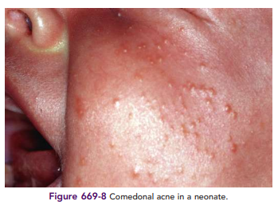
Sign and Symptoms
Oily skin
Blackheads and white heads
Red spots and yellow pus-filled pimples
Scars
Occasionally, large,
tender spots or cyst may
develop

Slide 20
Diagnosis of acne
History
Acne is easily recognized by the appearance of
spots and by their distribution on the face, neck, chest or back during physical exam .
Treatment:
Topical retinods
Topical antibiotics
Topical(gels, creams and lotions) eg. Benzoyl peroxide

Slide 21
Inflammatory and allergic con’t…
B. Eczema, also known as dermatitis, is a syndrome characterized by superficial inflammation of the epidermis and itching
Types
A. Atopic Dermatitis(Autoimmune allergy to own skin)
Is a Chronic, highly inflammatory skin disease, associated with remitting course.
Notes:
Dermatitis /eczema/
It is inflammation of the skin.
Classification of eczema
Deferent classifications are used based on:
Morphological appearance
Site or location
Causative agent
But the most acceptable and practical way to classify eczema is into:
Endogenous and
Exogenous dermatitis
Endogenous dermatitis: the causative factor acts from inside and it includes:
Atopic
Seborrheic
nummular and
stasis dermatitis
Exogenous dermatitis: the causative factor act from outside and it includes:
Contact dermatitis
Infective dermatitis
Dermatitis can be acute or chronic
Acute eczema – refers to a rapidly devolving red rash which may be blister and swollen where as
Chronic dermatitis – refers to:
Long standing irritable area
Darker than the surrounding skin
Thickened / lichnified / and much scratched.
Eczema …to boil over
AD is a Chronic, highly pruritic inflammatory skin disease, associated with remitting & flaring course, that starts during infancy and early childhood and persists into puberty and sometimes adulthood.
Is characterized by an immediate (type 1) hypersensitivity reaction.

Slide 22
Atopic dermatitis con’t…
Starts during infancy and early childhood and persists into puberty and sometimes adulthood.
It is characterized by an immediate (type 1) hypersensitivity reaction.

Slide 23
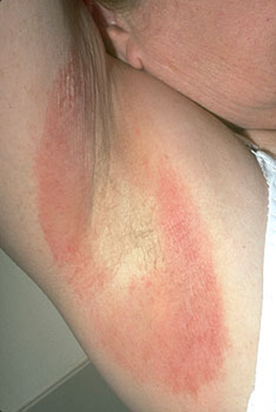
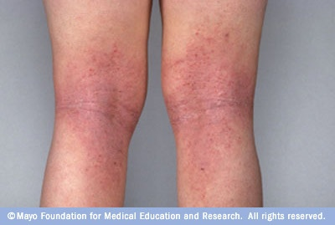
Con’t….
Most pts have a genetic predisposition for hypersensitivity reactions such as asthma, allergic rhinitis, and chronic urticaria.
Figuer 5.
Figuer 4. Figuer 5.

Slide 24
Atopic dermatitis…
The eczema comes and goes
Triggered by dryness of the skin, infections, heat, sweating, contact with allergens or irritants and emotional stress
Mostly affected sites are;
Antecubital area, popliteal, elbow
and knee folds, wrists, ankles, face
Notes:
bath with cold or luke warm water once
daily using mild soaps

Slide 25
Atopic dermatitis…
The cause is unknown.
But it could be a defect in the control of IgE
production by T-lymphocytes.
S/S: Dry skin and rubbing
Dx: Clinical
Rt; Bath with cold or luke warm water
Topical corticosteroids may be used

Slide 26
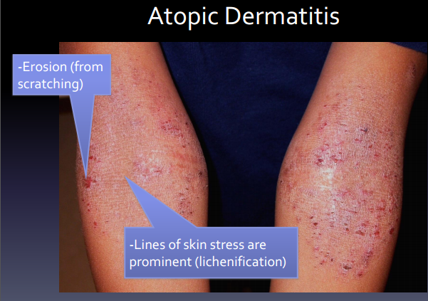
Atopic dermatitis con’t…..

Slide 27
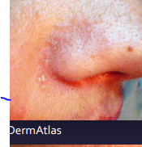
B. Seborrhic dermatitis
Is a common chronic dermatitis cxed by redness and greasy scaling that occurs in regions
where the sebaceous glands are
most active, such as: scalp, border
of forehead
The eczema comes and goes
Notes:
Common in males, in oily area…ozer name dandruff,may mistaken diaper rash in baby
•Rxt:
Scalp: anti seborrheic shampoo (e.g.,
selenium sulfide, zinc pyrithione)
Skin: low-potency topical
corticosteroid or topical imidazole.
Inflammatory response to
superficial yeast infection
• Treatment:
– Scalp: antiseborrheic shampoo daily wz warm water (e.g.,
selenium sulfide, zinc pyrithione)
– Skin: low-potency topical
corticosteroid or topical imidazole

Slide 28
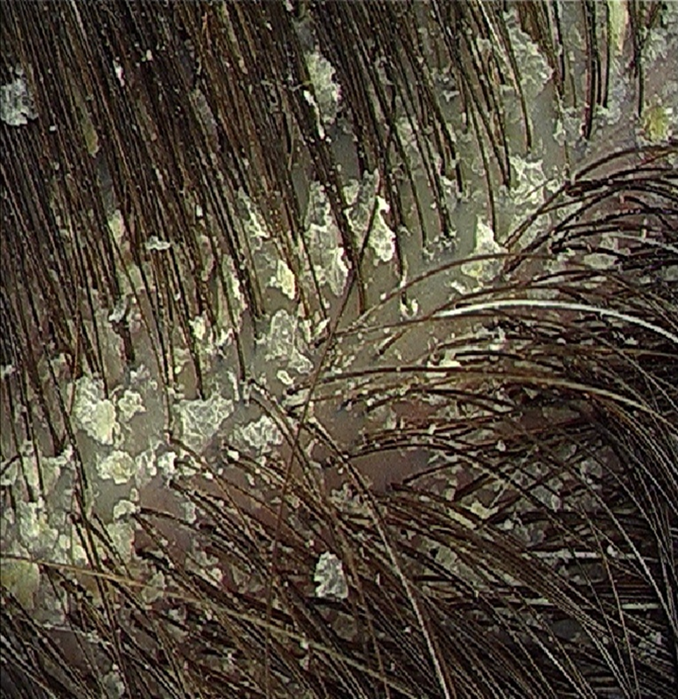
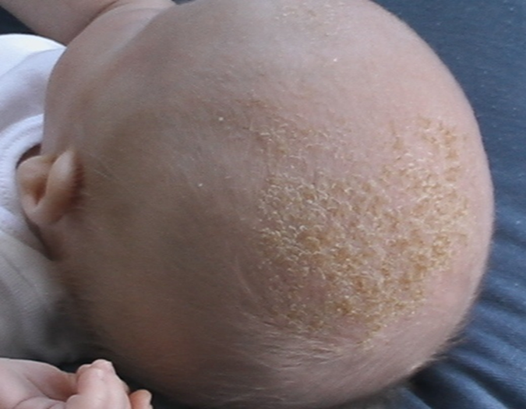
Cont…
Rx: Scalp: anti seborrheic shampoo (e.g..,
Selenium sulfide, zinc pyrithione)
Skin: low-potency topical corticosteroid or topical imidazol.

Slide 29
C. Contact dermatitis:
It is an acute or chronic inflammation which is caused by contact of the skin with an irritant or an allergen.
It is inflammatory reaction of the skin to physical, chemical or biological agent.
Common causes of contact dermatitis are on hands , arms and legs are excessive use of H2O, soap (if not washed off properly) detergents, jewellery, dyes, bleaches, perfume, nail polish/remover.

Slide 30
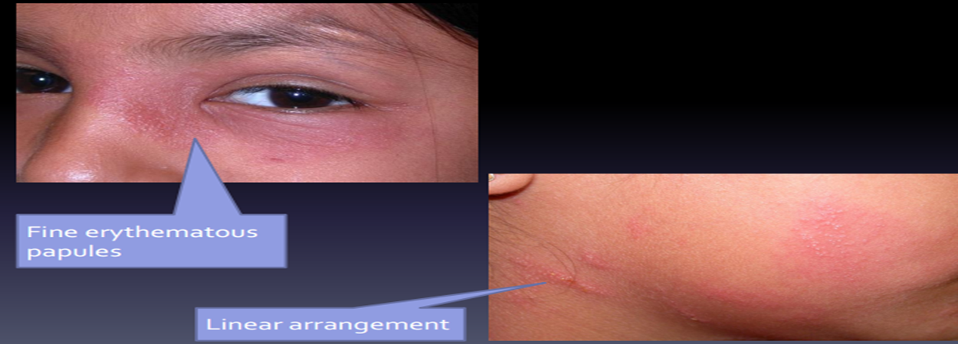
Contact dermatitis cont…

Slide 31
Manifestations of dermatitis(all types)
Sever itching (Pruritus) constant symptom
Redness and dry skin (xerosis)
Lichenification
Excoriation
Scaling skin
Papules, blisters,
Oozing and crusts
Color change

Slide 32
Management of dermatitis (all types)
Stop the use of irritants, allergies (contact eczema)
Mild topical steroid such as hydrocortisone 1% cream twice daily until lesions clear
In severe itching use antihistamines E.g.: promethazine or hydroxyzine at night, citrizine or loratidine at day time/night
In bacterial super infection use antibiotics
An imidazole cream twice daily/ketoconazole 1-3 weeks (seborrhoic eczema)
Notes:
Hydroxyzine….antihistamine antipsychotic mgt of pruritis

Slide 33
Management con’t…
Keep the site clean
Explain to the Patient, and Parents that is not serious and will disappear in time.
Shorten finger nails and covered at night/parental education
In photo allergies – sun protection by wide rim sun hat, stay indoor, sunscreen, etc…

Slide 34
D. Psoriasis
Is a chronic recurrent, hereditary, non infectious disease of the skin caused by abnormally fast turn over of the epidermis
The turn over may be up to 40 times than normal and as a result the epidermis is not able to develop normally.
The skin becomes red, inflamed, and the scales are thicker than normal

Slide 35
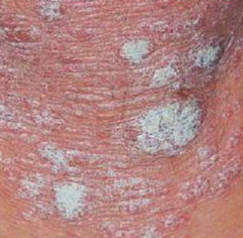
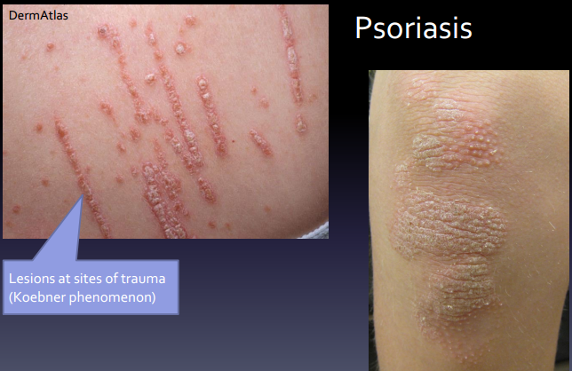
Psoriasis….
It produces the so called candle-wax phenomenon, when you scratch such a patch it becomes silvery white.
Sites can be extensor areas of extremities especially elbow, knees, buttocks, shoulder and scalp.

Slide 36
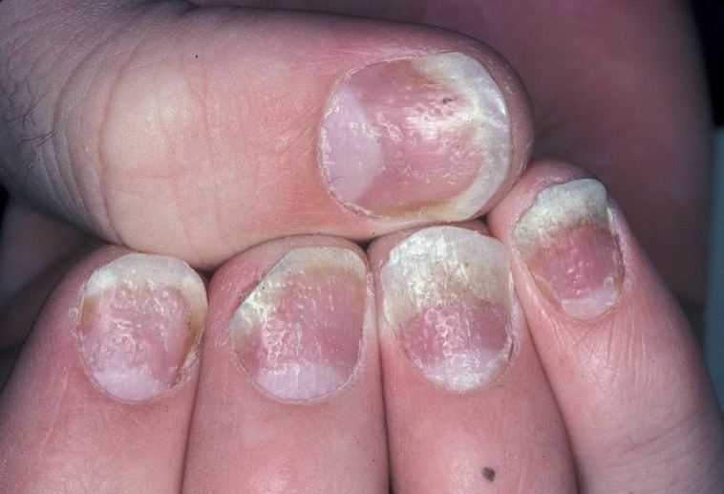
Psoriasis…
Periods of emotional stress and anxiety aggravate the condition.
Sign and symptom/S/S.
May itch severely in body folds covered with silvery scales
  Diagnosis (DX)
Classical plaque type lesions with silvery scales.
Positive family history well help
Bilateral symmetrical appearance
Notes:
Can cure but it reoccurs
Diagnostic evaluation
Confirmed by classical plaque type lesions with silvery scales.
Positive family history well help
Bilateral symmetrical appearance

Slide 37
Management of psoriasis…
There is no cure for psoriasis but can slow down the rapid turn over of epidermis
Salicylic acid 2-10% ointment BID to reduce scaling
Moisturizers (Vaseline, paraffin oil, or cream)
Treat any super infection with antibiotics if necessary
Notes:
Acne vulgaris mgt
Management
Hormonal treatment...= Estrogen based contraception’s.
Dietary therapy ……..= avoid chocolate, cola, fried foods, milk product……
Hygienic therapy ……= wash with soap and water 2x per day.
=avoid oil based cosmetics or creams.

Slide 38
Investigation for all types of dermatitis
Identification of allergens (Prick Skin Test or Patch test)
Full blood count (Increase of Eosinophiles)
Complication all dermatitis types;
Secondary infection (bacterial, viral, fungal, etc)
Post inflammatory Hypo or Hyper pigmentation
Lichenification

Slide 39
II. Bacterial infection
A. Cellulitis
Is infection of the skin and subcutaneous tissue
Caused by bacteria like streptococcus/s. a
Results from break in the skin
Infection rapidly spread through lymphatic system

Slide 40
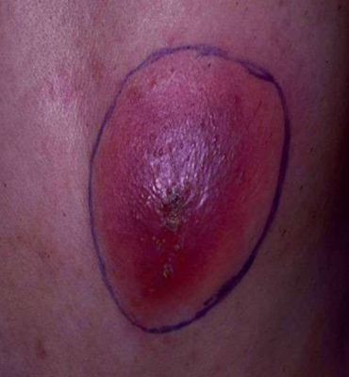
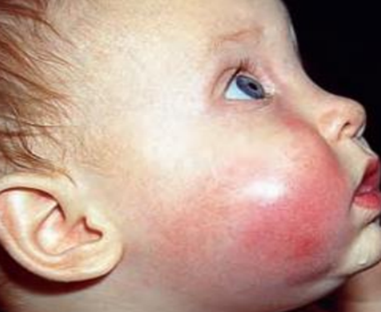
Clinical features
S/S of cellulitis include:
Tender,
Red, hot
Swollen area that is well
demarcated
Possible fluctuant abscess

Slide 41
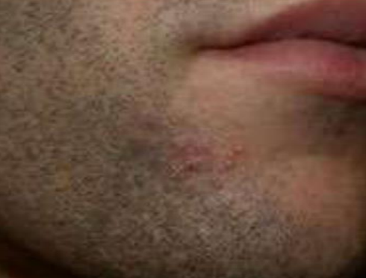
B. Folliculitis
Is an inflammation of the hair follicle
Sign & symptom
Single or multiple papules or pustules
Commonly seen in the hairy areas of shaving &Women’s legs
S.aureus, fungus & virus also cause it.
Mgt;
Avoid shaving
Evacuate & apply GV
If sever, topical TTC until lesion heals
Notes:
Macule : Flat ,non palpable discoloration < 1 cm in size
Patch :flat ,non palpable discoloration > 1 cm in size
Papule: solid palpable lesion < 1cm in size,flat topped or dome-shaped
Nodule : Dome- shaped solid palpable lesion > 1 cm diameter
Tumor Solid elevated lesion > 2 cm diameter;
Plaque: Raised flat, solid palpable lesion > 1 cm;
Vesicle :Fluid-filled (clear) < 1 cm diameter, usually < 0.5cm
Bulla : Large fluid-filled (clear) elevation > 1 cm diameter
Pustule : Vesicle or bulla with purulent fluid
Cyst Cavity lined with epithelium containing fluid, pus, or keratin

Slide 42
C. Furuncles/Boils
Is painful circumscribed, acute ,localized, deep seated, red, hot, very tender, inflammatory perifollicular staphylococcal abscess
Is a deeper form of Folliculitis with a purulent core
Common microorganism: S.aureus

Slide 43
C. Furuncles/Boils con’t…
The lesion begins in the opening of hair follicle or sebaceous gland
Sites can be back of the neck, face, buttocks, thighs, perineum, breasts, axilla, nose, genitallia, etc.
Most common on persons who are carriers of staphylococcus, contact with oils or grease, diabetes, poor habits of personal hygiene, immunosuppression, obese, malnutrited, etc..

Slide 44
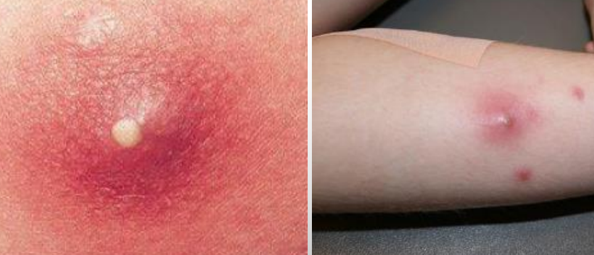
Furuncles…

Slide 45
Sign and symptom
Hard nodule initially then fluctuant abscess with centrally yellow pustule, then ruptures.
It can be isolated single lesion or multiple lesions.
Hotness and pain at the site.
Dx: Gram stain of the pus, culture and sensitivity test of blood/pus.
Rx: Cloxacilline 50-100mg/kg/24 hours divided in to 4 doses for 10 days.
Notes:
Papule…<1cm
Nodule…>1cm
Pustule….bulla or vesicle wz prulent fluid

Slide 46
D. Carbuncles
Multiple furuncles
Is an aggregation of interconnected furuncles that drain through multiple openings in the skin.
Exposure to grease and oil increase the risk.
Microorganism mostly: S.aureus
Sign & symptom
Fever, chills, extreme pain, malaise
Common sites are back of the neck, shoulder, buttock.
Notes:
Carbuncle and furuncles are more superficial than subcutaneous abscess…carbuncle is SC

Slide 47
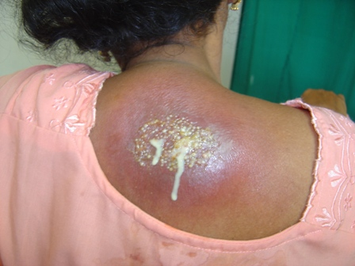
Diagnosis
Gram stain of the pus
Culture of pus/blood
Leukocytosis ( >20,000 cells/mm3)
Mgt
Bed rest
Systemic antibiotics Cloxacilline 50-100mg/kg/24 hours divided in to 4 doses for 10 days
Extraction make incision to drain pus: Should be done by caution not to contaminate other area.
Notes:
universal precaution (were gloves, wash hand...)
Systemic antibiotics like Cloxacilline 50-100mg/kg/24 hours divided in to 4 doses
Extraction make incision to drain pus: Should be done by caution not to contaminate other area.

Slide 48
E. Impetigo
Is an acute, contagious, rapidly spreading infection and is a very common bacterial infection of the superficial skin
Two types; based on existence of bullae;
Non Bullous Impetigo: More common form
Bullous impetigo: Less common form
Causative agents S. aurous or GABHS or both

Slide 49
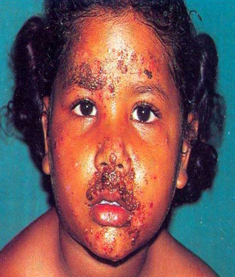
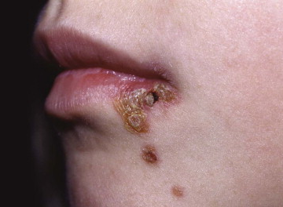
Sign & symptom
Superficial pustules or blisters which becomes oozing with yellow crusts

Slide 50
Impetigo con’t…
Honey-colored lesions especially for non bullous impetigo
Blisters break easily and form crusts
Dx: Clinical, swab for bacterial culture and sensitivity test
Complications
Ulcerations - Septicemia - Staphylococcal scaled skin syndrome (SSSS)

Slide 51
Management
Analgesia to relieve pain, soaks will help to remove the crust, rest, avoid friction and irritation from tight clothing
Topical antibiotic ointment
Systemic antibiotics like:
Cloxacilline 50-100mg/kg/24 hours divided in to 4 doses.
Erythromycin 25-50mg/kg/24hrs divided in to 4 doses 7-10 days
Cut finger nails short to minimize damage to lesion and to prevent autoinoculation from scratching.
Notes:
H2O2

Slide 52
III. Fungal skin disorder
Dermatophytoses (Mycoses)
Is a fungal infection of the skin, hair, scalp and nails
Types
A .Tinea pedis (Athlete’s foot)
Is itchy, whitish scaling lesions and inflammation of the superficial skin of the feet and interdigital spaces of the toes.
Notes:
Topical anti fungal
First line: Benzoic acid + salicylic acid (Whitfield’s ointment) thin film of 6%+3% ointment applied BID until the infection clears (usually for 2-3 weeks).
Alternatives: Clotrimazole, thin film of 1% cream applied BID for 2-3 weeks Or Miconazole thin film of 2% cream applied BID until the infection clears (usually for 2-3 weeks).
Systemic anti fungal
Grisofulvin 500-1000mg P.O. Daily for 4-8 weeks or
Ketoconazole 200-400mg/day P.O. for 3 weeks
Keep feet as dry as possible
Small pieces of cotton can be placed between toes to absorb moisture.
Avoid sharing of shoes /socks

Slide 53
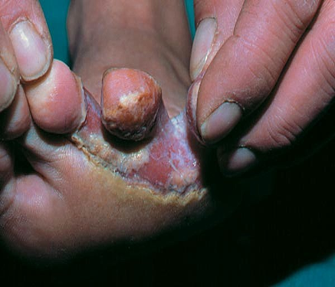
Fungal skin disorder con’t….
Common between the 4th and 5th toe.
Often seen in people wearing rubber boots/shoes.

Slide 54
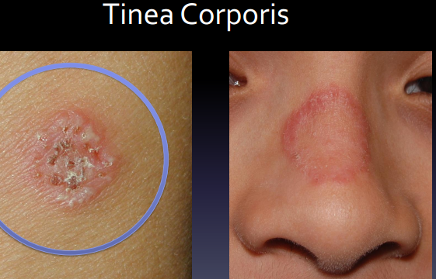
B. Tinea corporis (Tinea circinata)
Fungal infection of the epidermis (hairless part of the body)
It affects the trunk, legs, arms/neck, excluding the beard area, feet, hands, face, and shoulders.
S/S ; intensive itching and large patches occurs
Spread by direct contact, fomites, occasionally from dogs or cats.
Dx –
Skin scraping under
microscope by using KOH
Skin biopsy for histolegi-
cal exam
Notes:
Characteristically appears as annular lesions with
central clearing and an itchy, palpable
erythematous advancing edge.
• Active edge shows vesicles and pustules .
• It is usually caught from pets.
• Diagnosis – Skin scraping and KOH examination.
Culture - For identifying the species of
dermatophytes

Slide 55
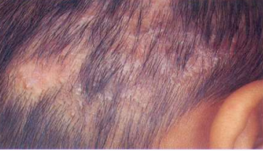
C. Tinea capitis (ring worm)
Is a contagious fungal disease of the scalp and hair shaft
Sign & symptom
One or more round patches with scaling
Hair loss (temporarily), alopecia
Lymph nodes in the neck swell & the patient may
have fever and headache
DX
Clinical
Microscopy of affected hairs
Culture
Notes:
For identifying the species of dermatophytes

Slide 56
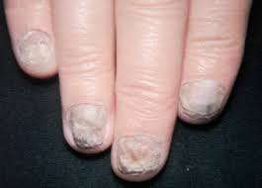
D. Tinea unguium
Is a chronic fungal infection of the toe/finger nails
Characterized by thickened nail, friable, lusterless and
accumulation of debris under the free edge of the nail.
The nail may be
destroyed
Only treated by
systemic antifungal
Notes:
Keto and grisoflvin

Slide 57
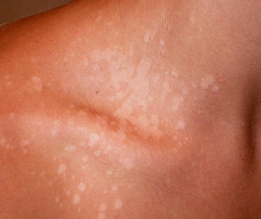
E. Tinea versicolor (pityriasis versicolor)
Is a common chronic superficial fungal infection which is caused by the unicellular yeast pityrosporum which is normally present on the trunk.

Slide 58
Management/all forms
Keep the space in between the toes dry
Avoid shoe that are too tight/hot/ for tiniea pedis, keep the area dry, avoid sharing shoes
Treat secondary bacterial infection if present
Imidazole cream/ Whitfield's ointment BID for a minimum of 4 wks
Add ketoconazole 2% shampoo BID for 2-4wks/ tenea versicolor
Notes:
White field …ointment
Clotrimazole cream…cream
Topical anti fungal
First line: Benzoic acid + salicylic acid (Whitfield’s ointment) thin film of 6%+3% ointment applied BID until the infection clears (usually for 2-3 weeks).
Alternatives: Clotrimazole, thin film of 1% cream applied BID for 2-3 weeks Or Miconazole thin film of 2% cream applied BID until the infection clears (usually for 2-3 weeks).
Systemic anti fungal
Grisofulvin 500-1000mg P.O. Daily for 4-8 weeks or
Ketoconazole 200-400mg/day P.O. for 3 weeks
Keep feet as dry as possible
Small pieces of cotton can be placed between toes to absorb moisture.
Avoid sharing of shoes /socks
. Tinea cruris /ring worm of the groin/
Tinea cruris (jock itch) is ring worm of the groin, which may extend to the inner thighs and buttock area.
It occurs most frequently in
Young joggers,
Obese person and
In those who wear tight under clothing.

Slide 59
Con’t…
Griseofulvin 10-15mg/kg once daily for 2-6wks first line Rx for both tinea corporis and tinea capitis
Ketaconazole 3-6mg once daily for 1-2 wks
If sever itching antihistamines /mild steroids can be used
NB: Recommend to avoid sharing combs and towels to prevent Tinea capitis

Slide 60
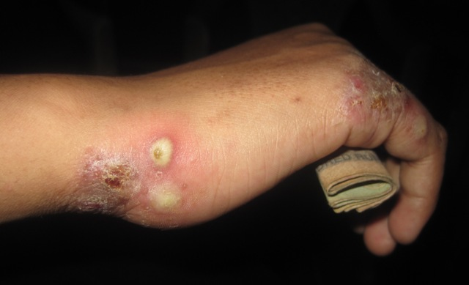
IV. Parasitic skin disorder
A. Scabies
Is an infestation of the skin caused by a parasite called mite sarcoptes scabies, a mite which lays its eggs in burrow in the stratum and induces an intensively
itchy inflammatory response
It is contagious skin condition
Sign and Symptom
Small blisters and papules
Sever itching, when warm particularly
at night
Common sites are between fingers, ides
of the hands, sides of the wrists, buttocks,
nipple and genital region
Notes:
Burrow…intra epidermal tunnel created by the moving female mite…2-10mm

Slide 61
Management
DX: Microscopic identification of skin scraping
to see mites, larvae or ova
RX; Treat all close contacts of the patient and family
Benzyl benzoate 25% emulsion dilute with one
part water (1:1) for children, dilute with 3 parts water (1:3) for infants.
Apply for 3 consecutive nights and wash off each morning.
Permethrin 5 % cream, use antihistamines for itching
If infected use antibiotics, keep skin clean
Complications - Secondary skin infection, Sepsis…
Notes:
Permethrin…insectiside,killing and paralysing the mites and their eggs

Slide 62
B. Pediculosis
Is an infestation with a louse which may be found in;
Scalp- Pediculosis capitis, body- Pediculosis corporis
Hair bearing region- Pediculosis pubis (phthiriasis)
Causes: Over crowding, poor personal hygiene, prolonged wearing of the same cloth
Sign and symptom
Itching (excoriation), the presence of lice and nits
Notes:
Nits…egg of louse

Slide 63
Management
Improve personal hygiene
Change clothing
Permethrin (1%), pyrethrums and, less preferably, malathion and ivermectin
Treat secondary bacterial infection if present
Notes:
Permethrin drug gp of Pyrethrins… to kill scabies
Permethrin…insectiside,killing and paralysing the mites and their eggs
Ivermectin….anti infective agent active against several parasitic nematodes and scabies

Slide 64
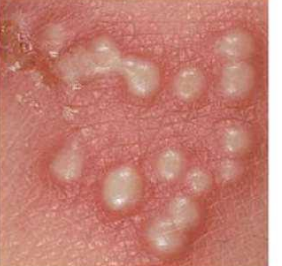
V. Viral skin disorder
It is an acute contagious infection of the skin or mucus membrane caused by virus.
Types:
Herpes simplex: Is an infection which is caused by herpes simplex virus that causes vesicular eruption (cold sore or fever blister)
on lip ( herpes labialis)
and on genitalia (herpes
genitalia)
Notes:
Vesicle
Caused by HS1

Slide 65
Sign and Symptom
Burning sensation at the site, then a group of blisters appear then break down to form superficial ulcer.
Highly contagious
Diagnose–Clinical, viral culture
Rx – Analgesia for pain, Zink oxide to sooth the skin
Acyclovir 20-40mg/kg 3-4 times per day for 7 days
TTC ointment if it is bacterial infection

Slide 66
B. Herpes zoster (shingles)
Is an acute unilateral and segmental inflammation of the dorsal root of a nerve by varicella zoster infection.
It is a highly contagious systemic disease that normally results in lifelong immunity.
Causes:
Herpes zoster virus
People with no prior immunologic exposure to varicella virus, most commonly children

Slide 67
Sign and symptom
A localized vesicles in cluster form on one side of the body/unilateral/
Itching, tenderness, prolonged fever, skin lesion and severe pain on the site
The thoracic, cervical and ophthalmic nerves are frequently affected
After 1-2 weeks crusts begin to fall off with residual scaring

Slide 68
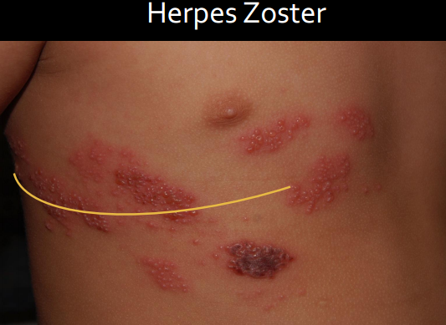
Herpes zoster cont…
Over 10% of patients develop a persistent burning sensation
Common in HIV patients, old patients
and malignancy cases
Mgt;
Analgesia with NSAIDs
Antibiotics for secondary
infections

Slide 69
Cont….
In immune competent children with sever cases (disseminated or mucosal involvement) give Acyclovir 20mg/kg a day for 5 days
Complications:
Bacterial super infection, extra-cutaneous complication with neurological manifestation
Hemorrhagic complications in immune compromised children

Slide 70


Slide 71
Introduction
Burn is defined as a traumatic injury to the skin or other organic tissue primarily caused by thermal or other acute exposures.
It occur when some or all of the cells in the skin or other tissues are destroyed by heat, electricity, radiation, or caustic chemicals.
Burn injury is one of the common injuries accompanied by high risk of mortality and morbidity.

Slide 72
Burn con’t…..
The morbidity includes significant disfigurement and psychological trauma as a result of a painful and prolonged stay in the hospital.
Human skin can tolerate temperatures up to 42-44⁰ C
But >45⁰C, protein damage exceeds the capacity of the cell to repair.
The peak incidence of burn injury occurs in toddlers (1 to 3 years of age), and the injuries usually occur as the result of scalding from hot liquids.

Slide 73
Etiology
Burn is the 5th most common cause of accidental death in children.
The different cause of burn are:
  Flame (57%)
  Scalding (32%)
  Chemical (7%)
  Electricity and radiation (4%)

Slide 74
Risk factors
Playing with matches, cigarette lighters, fires in fireplaces
Associated with lack of supervision
Child abuse
Male children are at increased risk in flame burn while females are in scalding burn.
Overcrowding
Medical conditions

Slide 75
Classification of burn
First-degree burn:
Burns involve only the epidermis and are characterized by swelling, erythema, very painful and heals without scaring (similar to mild sunburn).
Tissue damage is usually minimal, there is no blistering and leaving no residual scars.
Pain resolves within 48-72 hrs.

Slide 76
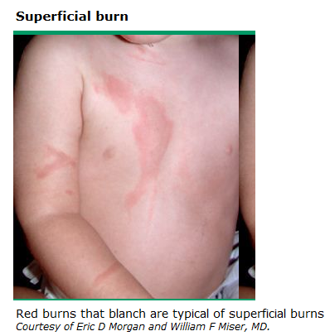
Classification of burn con’t…

Slide 77
Classification of burn con’t…
2. Second-degree burn (partial thickness)
  Involves injury to the entire epidermis and a variable portion of the dermal layer (vesicle and blister formation are characteristic).
  It is pink to dark and has blisters, still painful and it is blanching.
  It heals with a scar after many weeks.

Slide 78
Classification of burn con’t…
  A superficial 2nd -degree burn is extremely painful because a large number of remaining viable nerve endings are exposed.
  Heal in 7-14 days as the epithelium regenerates in the absence of infection.

Slide 79
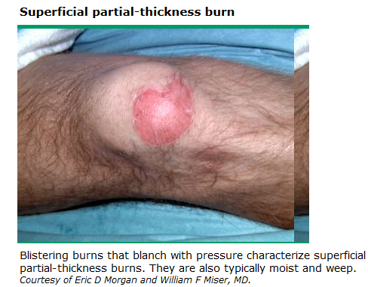
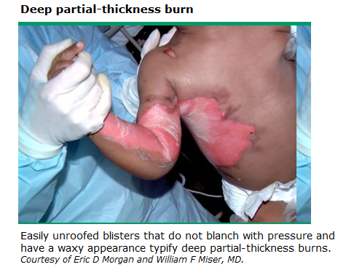
Classification of burn con’t…

Slide 80
Classification of burn con’t…
3. Third degree burns (full thickness):
It involves the destruction of the entire epidermis, dermis and hypodermis leaving no residual epidermal cells to repopulate the damaged area.
It is not blanching, no blister, no pain sensation
It has a pale or charred color, a leathery appearance and heals with scare.

Slide 81
Classification of burn con’t…
  The wound cannot epithelialize and can heal only by wound contraction or skin grafting.
  The absence of painful sensation and capillary filling demonstrates the loss of nerve.

Slide 82
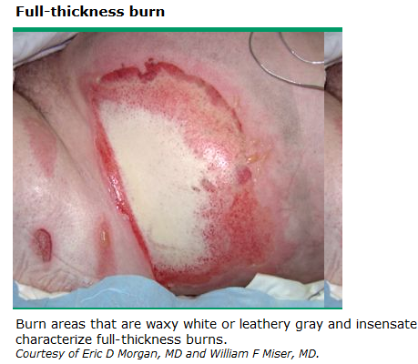
Classification of burn con’t…

Slide 83
Classification of burn con’t…
4. Fourth degree burns
Fourth degree burns are deep and potentially life-threatening injuries.
In addition to the three layers, it extends through the skin into underlying tissues such as fascia, muscle, and/or bone.
NB: Even though third and fourth degree burns are not painful, the adjacent areas burns may be painful.

Slide 84
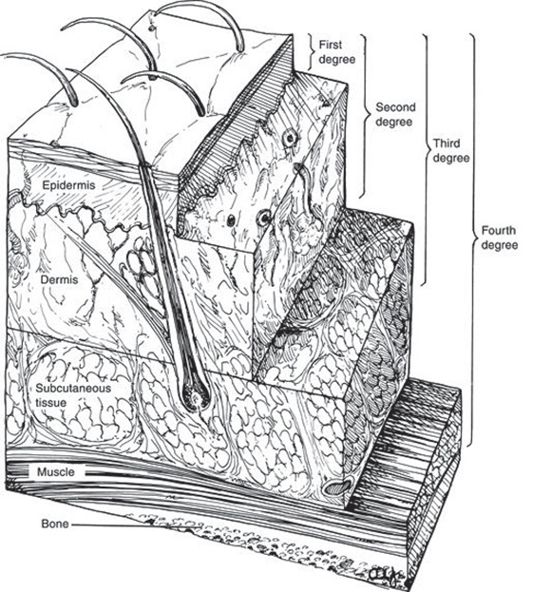

Slide 85
Extent of body surface area injured
Various methods are used to estimate the TBSA(total body surface area) affected by burns; the most common methods are :
      1. The rule of nines
      2. Lund and Browder method
      3. Palm method

Slide 86
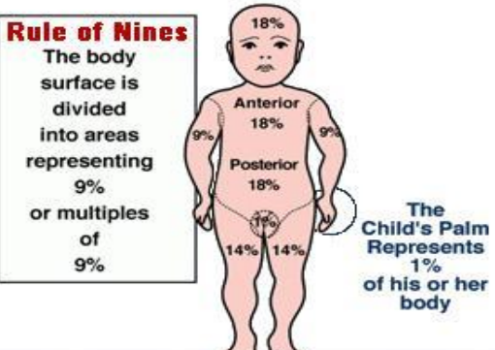
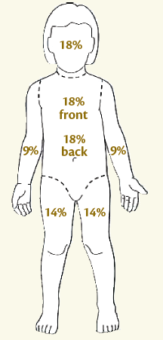
Rule of Nine

Slide 87
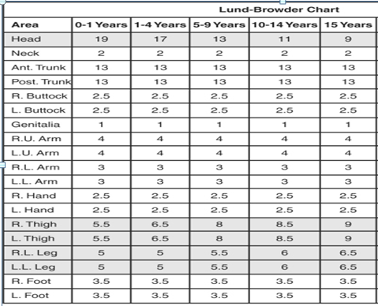

Slide 88
Palm method
In patients with scattered burns, a method to
estimate the percentage of burn is the palm method.
The size of the patient’s palm from crease at wrist to tip of extended fingers is approximately 1% of TBSA.

Slide 89
Management of burn
Pre-Hospital care/ first aid
Disconnect the person from the source of electricity
Remove clothing and jewelry.
Cool burns or scalds by immediate immersion of water with in for at least 20 min.
This stops the heat as well as decreases the progression of burn.
But avoid it for large area burn as it increases hypothermia and also don’t use ice as it causes hypothermia.

Slide 90
Management con’t…
Similarly don’t use grease (e.g. butter, oil)
since it predisposes for infection and doesn’t disperse heat
Cover with dry sheet and do not break blisters

Slide 91
Indications for Hospital Admission
Burns affecting >10% of BSA in children
Burns >10-20% of BSA in adolescent
3rd - Degree burns and Chemical burns
Electrical burns caused by high-tension wires
or lightening
Inhalation injury, regardless of the amount of
BSA burned.

Slide 92
Indication for H. Admission con’t…
Inadequate home or social environment
Suspected child abuse or neglect
Burns to the face, hands, feet, perineum, genitals, or major joints
Burns in patients with preexisting medical conditions
Complicate the acute recovery phase
Associated injuries (fractures) and pregnancy

Slide 93
Management con’t…
Airway & Breathing:
Mange as trauma patient, since the airway swelling increases in the next 24 hours.
There is a need of early advanced airway (intubation or tracheotomy).
Administer 100% oxygen to displace carbon monoxide during inhalation burn.

Slide 94
Management con’t…
Circulation/Fluid resuscitation:
Secure urgently an IV line for burns of ≥10% of BSA, for all inhalation and electric burns
If IV access couldn’t be found, use intraosseous
Don’t put adhesive plaster circumferentially to the body.
As swelling increases in the next 24 hours, it can cause circulatory insufficiency

Slide 95
Management con’t…
For children with severe burn (>20% BSA), give 20 mL/kg of crystalloids till assessment of the extent of the burns and calculation of the rest of the fluid of the 24 hours is completed
Then use the Parkland formula (i.e. 4 mL /kg/% BSA), in addition to the patients calculated maintenance fluid.

Slide 96
Management con’t…
Lactated Ringer solution in 5% dextrose, normal saline with 5% glucose or half-normal saline with 5% glucose can be used.
Half of the fluid is given over the 1st 8 hr, calculated from the time of onset of burn.
The remaining is given over the next 16 hr.
Total fluid = normal maintence IV fluid + extra fluid for burn
Fluid Calculation Example: A 16 kg boy with a 19% burn to his body. Total fluid = normal maintence IV fluid + extra fluid for burn.

Slide 97
Management con’t…
Normal maintenance fluid = (10 x 100) + (6 x 50) = 1300 ml in 24 hours = 54 ml/hr
Extra fluid = extra 4ml/kg for every 1% of area burnt = 19% x 4 x 16 = 1216 ml.
Total extra 1/2 of extra in first 8 hours = 608 ml or = 76 ml/hr and 1/2 of extra in next 16 hours = 608ml over next 16 hours = 38 ml/hr for 16 hours.
Total IV fluids for first 8 hours: = normal (54ml/hr) + extra (76ml/hr) = 130ml/hr for 8 hours IV fluids for next 16 hours = normal (54ml/hr) + extra (38ml/hr) = 92ml/hr for 16 hours.

Slide 98
Prevent infection
Most frequent pathogens in burns are Staphylococcus aureus, Pseudomonas aeruginosa and the Klebsiella-Enterobacter species.
Apply topical antimicrobials, antibiotics/antiseptics
Clean and dress the wound daily, monitor and assess for pain
Aseptic wound care and dressing 1-2 times/day
A high-protein intake is also needed for wound healing (hypermetabolic state).
Encourage range of motion exercises to prevent contractures.

Slide 99
Complication of burn
  Hypovolemic shock
  Fluid electrolyte and plasma loss
  Cardiac arrhythmias and Cardiac arrest
  Infection and Sepsis
  Metabolic Acidosis and pulmonary complications
  Decrease temperature and renal & hepatic damage
  Extensive and disabling scarring

Slide 100
Long term complication of burn
Hypertrophic scars
Susceptibility to minor trauma, chemicals, or cold
Dry skin
Contractures
Itching and neuropathic pain
Alopecia
Chronic open wounds
Skin cancers
Amputations
Osteoporosis
Heat exhaustion

Slide 101

