Slide 1
PMTCT
BY ASTER S.

Slide 2
Objectives
By the end of this session the student will be able to describe the:
  Overview of MTCT of HIV
  Guiding principles of PMTCT program
  Counseling (Pre & Post, counseling)
  National strategies and guidelines to address MTCT of HIV/AIDS

Slide 3
Overview
Classification of HIV
HIV type (distinguished genetically)
  HIV-1 - worldwide pandemic (current ~ 33 M people)
  HIV-2 - isolated in West Africa; causes AIDS much more slowly than HIV-1 but otherwise clinically similar

Slide 4
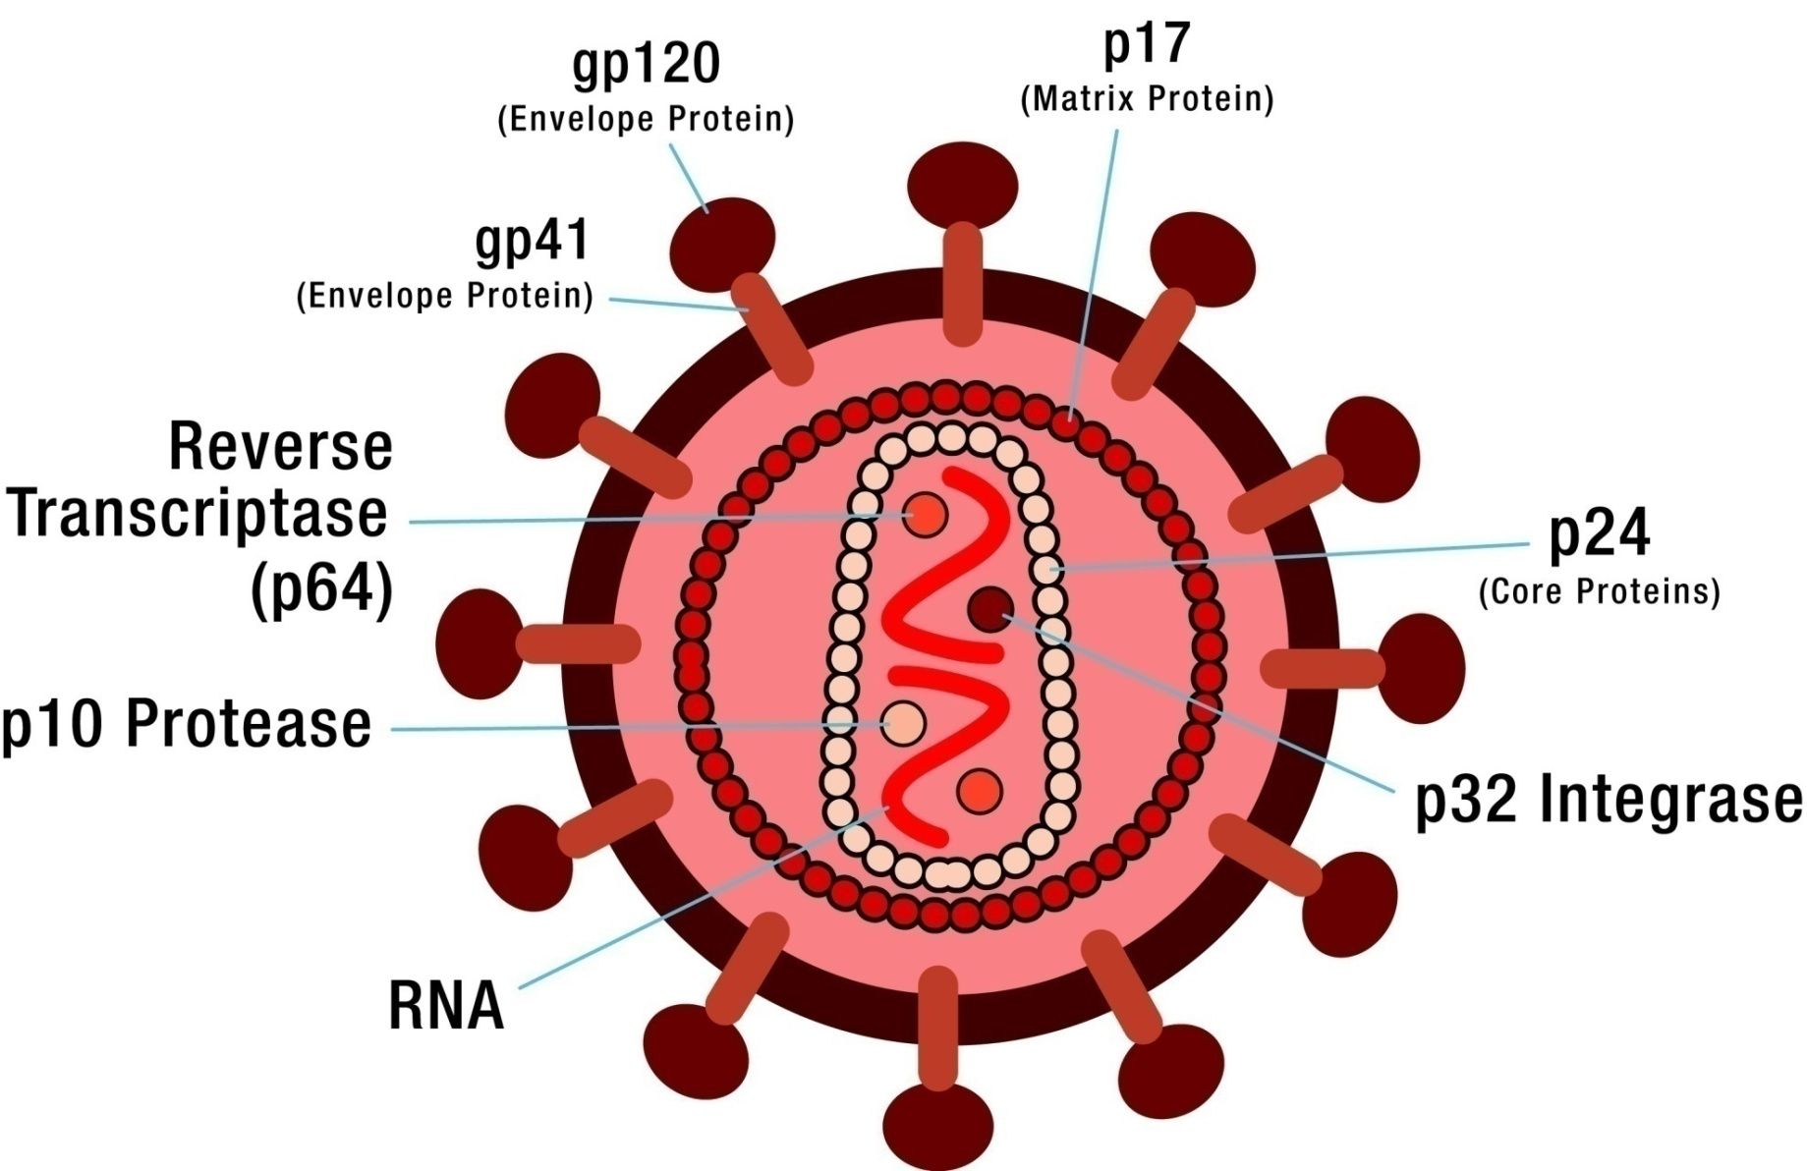
Structure of HIV cell
Notes:
But please take few minutes and look at the phenotype (or physical appearance/structure) of HIV

Slide 5
2010 UNAIDS report
Number of PLHIV: 33.3 million
Children living with HIV: 2.5 million
Proportion of women living with HIV stable, slightly under 52%
New HIV infections including in children declining
AIDS-related deaths decreasing
UNAIDS report on the global AIDS epidemic 2010. Geneva: UNAIDS.

Slide 6
HIV infections in sub-Saharan Africa
Total PLHIV: 22.5 million
  Range 20.9–24.2 million
  68% of the global total
Total deaths:1.3 million
  72% of the global total
Notes:
Look at the 2007 estimate of the different indicators of HIV
HIV-1 - worldwide pandemic (current ~ 33 M people)
HIV-2 - isolated in West Africa; causes AIDS much more slowly than HIV-1 but otherwise clinically similar

Slide 7
HIV infections in Ethiopia
According to the EDHS 2011 adult HIV prevalence is 1.5%( 4.2 % in urban and 0.6% in rural)
In addition, 734,048 people are currently living with HIV/AIDS( 579,964 adults and 154,084 children 0-14) in 2013
Note that the number of children living with HIV is significantly higher than the previous estimate despite reported decline in the rate of new infection in children

Slide 8
HIV infections in Ethiopia
According to estimates, there are 34,524 HIV positive pregnant women in Ethiopia by 2013
Tremendous efforts to improve PMTCT made; as a result Coverage of effective ARVS to prevent mother to child transmission has increased to 41.5% in 2005 EFY

Slide 9
PMTCT Indicators
New ANC attendees
Tested for HIV
HIV positive results
Male partner tested for HIV
Initiated on ART
Already on HAART
Opting for 6 months EBF at 1st visit
Live Births (HIV-exposed)
ARV prophylaxis dispensed
ARV prophylaxis taken by woman during labor

Slide 10
PMTCT Indicators, contd.
ARV prophylaxis taken by Newborn
HEI Started on Cotrimoxazole within two months
HIV test/DNA-PCR to HIV-exposed baby at 6 weeks
HIV test/rapid antibody test to HIV-exposed baby at 18 months
HIV test of baby at 6 weeks - positive
HIV test of baby at 18 months - positive

Slide 11
Goals of PMTCT programs
Majority of children with HIV were infected through MTCT (during pregnancy, L&D, and breastfeeding)
PMTCT programs aim to:
  Reduce and ultimately eliminate new pediatric HIV infections—in Ethiopia more than 95% from MTCT
  Serve as entry point to HIV care and support services for women and their families
  Provide opportunity for testing and passing HIV prevention messages to women and their families

Slide 12
The four-pronged approach to PMTCT
Primary prevention of HIV infection
Prevention of unintended pregnancies among HIV-infected women
Prevention of HIV transmission from HIV-infected women to their infants
Treatment, care and support of HIV-infected women, their infants and families

Slide 13
HIV test and counseling
All women with unknown HIV status coming for MNCH services should have their HIV status determined.
Encourage pregnant/lactating women to attend HTC with their partners and ensure that children of HIV positive mothers are tested.
Remind pregnant women during pre-test sessions that they can decline HIV testing without any subsequent consequence.
Result of HIV testing should always be offered in a confidential setting.
Effective post-test counseling of patients testing positive is essential assure their participation in full PMTCT services.

Slide 14
Components of post test counseling for an HIV positive woman
1. Informing the result is positive:
  Thank the patient for waiting
  Tell result is positive
  Describe what a positive result means
  Give patient time to react; provide supportive environment that allows her to express what the positive test result means for her.
  Give patient the opportunity to express her concerns and worries.
  Assure her that you will do everything you can to keep her healthy and her baby free of HIV.
Notes:
Facilitator can mention to trainees that a more detailed suggested “script” for post-test counseling is included in the participant handout, which trainees will have a chance to familiarize themselves with prior to an upcoming role-playing exercise.

Slide 15
Cont.…
2. Provide clinical care recommendations:
  Inform on benefit of treatment for both woman and baby
  Ask if the woman has heard about HIV medicines
  Inform the woman that you are trained in treating HIV, and that she will need not go to anyone else to get the medicine that can keep her healthy and her baby protected
  Emphasize the importance of taking medication regularly, and that it has become much easier to take—just once daily. Still it requires commitment and determination
  Inform that the medicine will be beneficial for years and years, and that it is designed to be a life long treatment

Slide 16
Cont…
3. Address disclosure and partner referral:
  Explore what would be her feeling in letting her partner know of her HIV status
  Explore possible partner reactions
  Discuss why it is important to discuss with partner, and why partner should be tested
  Discuss places where partner could be tested
  Ask her how you can help her to bring partner for testing
  Assure her that her partner will not be contacted unless she consents

Slide 17
Cont..
4. Address risk issues and provide referrals:
Discuss risk reduction strategies
      Having partner tested
      Discourage multiple sexual partner
      Abstinence
      Condom use (male or female)
      Prevention and treatment of STIs

Slide 18
Cont..
5. Topics for discussion at later visits:
  Advice on birth preparedness and emergency plan
  Advice on facility delivery
  Discuss on optimal infant feeding
  Discuss on infant feeding options
Notes:
Facilitator may wish to say: “Depending on whether birth is imminent, these are topics that can generally wait until a follow-up ANC visit.”

Slide 19
Post test counseling during labor
Follow similar procedures to offer post test counseling for HIV positive woman in labor
However, laboring women have the following particular needs:
  ART should be started immediately
  There is a need to ensure commitment to on-going follow-up and commitment to adherence to treatment.
Mother Support Group should visit the patient prior to her discharge to help assure follow-up.

Slide 20
WHO clinical staging for HIV
WHO suggests stages of HIV conditions
Combines clinical manifestations and immunologic deterioration
Helps in follow up and decision-making regarding responses for ART treatment and other prevention and care interventions for HIV positive pregnant mothers

Slide 21
WHO clinical staging for HIV
Primary HIV Infection
Stage 1 -Asymptomatic or persistent generalized lymphadenopathy (PGL)
Stage 2 - mild disease
Stage 3 - moderate disease
Stage 4 – severe disease (AIDS)

Slide 22
Opportunistic infections: definition
Infections that develop as a result of damage to the immune system are called opportunistic infections or OIs
These infections take advantage of weakened immune systems
Infections tend to appear at predictable stages of immune deterioration
Notes:
These are infections that do not normally occur in young healthy people. They only occur when the HIV (or another disease process, for example, some cancers) has destroyed enough CD4 cells to leave the individual vulnerable to these specific OIs.
They usually occur in people with CD4 counts less than 200.

Slide 23
ARVs: When to start treatment
The goal of ART is to reduce the number of virus in the blood and increase the number of CD4 as much as possible
Before Starting ART for HIV +ve pregnant mothers ,adherence preparation has to be made
Staring ART earlier have benefits to prevent MTCT and improve maternal health
All infants born to HIV-infected women should receive a course of ARV drugs as post-exposure prophylaxis.

Slide 24
Option B+
Option B+ is
“test and treat” strategy in which triple ARVs are started as soon as HIV is detected in a pregnant woman irrespective of CD4 count and gestational age
Care of both mother (including provision of ART) and infant stays at the PMTCT clinic from antenatal diagnosis to cessation of breast feeding at 18-24 months, fostering long term relationship between PMTCT provider and the clients
improving retention of both mother and infant in care.
Notes:
Treatment (ART) intended to be given for life
Specific ART regimen that requires just once a day dosing (either with one or two tablets), which will result in convenience for the patient and good drug adherence

Slide 25
The Benefits of Option B+
Requires just one/two pills taken once daily
No need for CD4 test to initiate ART
Makes breast feeding safer
Avoids the need for extended infant ARV prophylaxis (Option A)
Mothers start treatment early, so quality of life and survival are better

Slide 26
Cont..
Maintains continuity of care: ANC to post-weaning so improves infant testing as well as post-partum uptake of FP services.
Minimize HIV transmission among discordant partnership
Ongoing treatment of mother will protect future pregnancies from moment of conception.

Slide 27
Ethiopia’s 1st Line ART Regimen for HIV positive pregnant and lactating women
1. Women diagnosed at ANC, labor, or post-partum should started TDF/3TC/EFV as soon as diagnosed.
2. Women started on TDF/3TC/EFV prior to pregnancy can transfer their ART care to the PMTCT service provider integrated into MNCH care.
Notes:
3TC lamivudine
TDF tenofovir disoproxil fumarate

Slide 28
3. Women who get pregnant while on an ART regimen other than TDF/3TC/EFV should continue to be followed at the ART clinic for ART management while receiving ANC and PNC at the PMTCT clinic.
4. If woman on a non-TDF/3TC/EFV regimen wishes to have ART managed at PMTCT site, her ART Clinic provider must determine it is safe to switch regimens to TDF/3TC/EFV and agree to do so.

Slide 29
Why TDF & 3TC and EFV?
TDF and 3TC can be given once a day.
TDF is safe drug with rare side effect and toxicity than other ARVs.
TDF and 3TC are rarely discontinued due to side effects or toxicity, compared to the other NRTIs.
Why EFV? Choice is between EFV and NVP. NVP can cause severe liver and skin toxicity especially in pregnant women with high CD4 count.
EFV recently found to be safe in 1st trimester and is dosed once daily.

Slide 30
Detailed Option B+ Recommendation Ethiopia
Maternal regimen:
1. During pregnancy:
      TDF/3TC/EFV if for the first time
      Continue same ART regimen if already initiated (unless ART provider agrees to switch to TDF/3TC/EFV)
      If on AZT prophylaxis; Shift to TDF/3TC/EFV

Slide 31
2. During labor and Delivery:
  If on ART continue same regimen of ART
  For women presenting for the first time initiate TDF/3TC/EFV
  If on AZT prophylaxis; Shift to TDF/3TC/EVF
3. Lactating or post partum.
    Continue ART if started
    Initiate TDF/3TC/EVF if on no treatment
Infant regimen: NVP for six weeks post partum

Slide 32
Simplified infant NVP dosing recommendations
Infant age | Daily dosing
Birth to 6 weeks Birth weight 2000 – 2499 g Birth weight > 2500 g | 10mg Once daily 15mg Once daily

Slide 33
PMTCT during Labor and delivery
Artificial rupture of membrane(ARM) increases risk of HIV transmission
  ARM not indicated if labor progressing well.
  If prolonged labor due to poor uterine contraction: perform ARM at > 6cm cervical dilatation and augment
Do not perform routine episiotomy except for specific obstetric indications (e.g. vacuum extraction)
Avoid frequent vaginal examination
Do not milk the umbilical cord before cutting.

Slide 34
PMTCT during Labor and delivery
Newborn and Postnatal care
Do not suction with nasogastric tube unless there is meconium-stained liquor.
Immediately after birth, wipe the baby dry with a towel to remove maternal body fluids.
Give BCG and polio vaccine after birth to all babies born to HIV infected mothers (as for all infants).
Provide NVP prophylaxis for the duration of 6 weeks irrespective of the feeding status. Give first dose following delivery.
Transfer the baby and the mother to ANC clinic for further follow up.

Slide 35
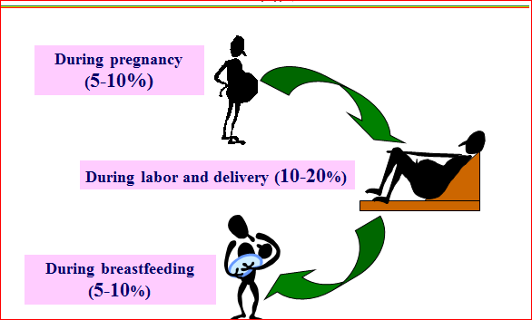
Timing of Mother to Child Transmission of HIV
Notes:
This slide presents the risks of MTCT following the degree of color. Infants acquire HIV in utero, intrapartum and postpartum.
Substantial proportion of transmissions occur near and during labor & delivery
Intervention can be effective in settings where women access antenatal care late in pregnancy
Substantial proportion of transmissions (35-40%) occur during breast feeding.
Data from the BHITS study estimates this risk is ~ 0.8% per month.

Slide 36
Risk factors for postnatal HIV transmission
Mother with recently acquired infection
Advanced HIV disease is mother
  High viral loads in blood or breast milk
  Low CD4 counts
Longer exposure to breast milk
  Transmission of HIV can occur at any point during lactation
  Transmission rates increase with duration of breast-feeding
Mixed feeding
Maternal breast problems
  Mastitis
  Cracked nipples
Conditions of baby’s mouth
Notes:
Many studies have demonstrated that the sickest moms are at highest risk to transmit HIV infection both during pregnancy as well as during breastfeeding.
Viral load, CD4 and AIDS diagnosis are markers of maternal infection status.
Furthermore, virus in genital fluids near the time of delivery has been associated with increase in transmission risk.
Recent HIV acquisition refers to a mother who seroconvert's while breastfeeding
Postnatal transmission occurs during breastfeeding and women with advanced disease are more likely to transmit to their babies.
A knowledge of these risk factors helps prioritize interventions to decrease postnatal transmission of HIV. At a glance the priority areas are treating sick mothers, promoting maternal breast health, and avoiding mixed feeding.

Slide 37
Safely feeding infants while reducing postnatal transmission of HIV infection
Same populations
HIV infections through
breastfeeding:
300,000 per year (UNAIDS)
Mortality through avoidance of
breastfeeding
1,500,000 per year (UNICEF)
Notes:
The risk of HIV transmission thru breastfeeding is high.
Replacement feeding may prevent HIV transmission but in resource limited settings the risk of death from artificial feeding and avoidance of breastfeeding must be weighed against the risk of HIV infection.

Slide 38
How can postnatal transmission be decreased?
Screen mothers for any illnesses
Treat sick mothers
  Treat or refer pregnant and lactating HIV-infected women with low CD4 and advanced disease
Actively support exclusive breastfeeding for as long as possible until 6 months
  Avoid mixed feeding
  Avoid early weaning
  Avoid abrupt weaning
Complementary feeding should be initiated after 6 months and breastfeeding should continue until 12-18 months
Notes:
The best approach to reducing postnatal transmission is to:
screen mothers for any illness, treat illnesses that is available in the facility or refer treatment eligibility and provide HAART is important
support exclusive breastfeeding for as long as possible up to 6 months
introduce complementary foods only at 6 months

Slide 39
Approaches to decreasing risk of MTCT associated with breastfeeding
Complete avoidance of breastfeeding
Shortened duration of breastfeeding
Exclusive breastfeeding
ART for mother and/or child
Improve breastfeeding practices
Preventing maternal HIV infection
Notes:
Over the course of this session, we will review data on these approaches. As hinted by the bullets, some of these approaches have been more successful than others.

Slide 40
HIV and infant feeding: global recommendations
Exclusive breastfeeding for the first 6 months recommended for HIV-infected women if AFASS criteria cannot be met
Continue breastfeeding after 6 months if AFASS criteria cannot be met, with regular assessment of safety of replacement feeding
Notes:
Affordable
Feasible
Accessible
Safe
Sustanable

Slide 41
National Recommendations
Ethiopia’s preferred infant feeding option for
HIV-infected women:
Exclusive breastfeeding for 1st 6 months
Early cessation of breastfeeding should be avoided since this is associated with increased risk of death from diarrheal illnesses, malnutrition and pneumonia

Slide 42
National Recommendations cont’d
Alternative infant feeding option:
For women who choose to use replacement feeding, every effort should be made to ensure that it is done SAFELY
Home-modified animal milk shall be used only as a temporary gap-filling measure, for short duration, otherwise infant formula is preferred for the 1st 6 months of life

Slide 43
Optimal breastfeeding practices: key messages
Initiate breastfeeding within the 1st hour after birth
Give colostrum – 1st natural immunization for baby
Breastfeed on demand, day and night, 8 – 12 times
Exclusively breastfeed until baby is 6 months old (not even water; medications, vitamins and ORS only)
Start complementary feeding at 6 months
Notes:
We will go into more detail for each of these points in the following slides.

Slide 44
6. Practice proper positioning and attachment
7. Seek medical attention for breast problems
8. Mothers need to take 2 additional varied meals from locally available food types
9. Mothers need to take iron and iodized salt
10. HIV-infected mothers need regular follow-up

Slide 45
References
Federal Ministry of Health Addis Ababa, Ethiopia, National Comprehensive PMTCT/MNCH Training Package

Slide 46
END
Thank you!!!

