Slide 1
NTRODUCTION TO EMBRYOLOGY AND FETAL DEVELOPMENT AND
NORMAL PREGNANCY

Slide 2
Objective
At the end of this secession the students will be able to:-
Describe the process of fertilization and the development of the fetus
Describe the structures of placenta and its functions
Describe the fetal circulation
Describe fetal skull

Slide 3
NTRODUCTION TO EMBRYOLOGY AND FETAL DEVELOPMENT
Conception
Analogous terms are fertilization, impregnation or fecundation.
Fertilization is the union of the ovum and a Spermatozoa.
occur fairly quickly after release of the ovum because it usually occurs in the outer third of a fallopian tube, the ampullar portion.
The functional life span of aspermatozoa is about 48 hours / may be as long as 72 hours or longer.
Therefore, sexual coitus during this time may result in fertilization /pregnancy

Slide 4
Development of the Fertilized Ovum
After fertilization the ova passes through the fallopian tube and reaches the uterus 3 or 4 days later.
The fertilized ovum divides into two ,four, eight, and sixteen until a cluster of cells morula is formed.
Divisions occur once every 12 hours.
Next, fluid filled the cavity or blastocele appears in the morula
becomes blastocyst.

Slide 5
Cont.………………….d
a single layer out side of the blastocyst is trophoblast which form the placenta and chorion .
while the remaining cells clumped together at one end forming the inner cell mass which becomes the fetus, umbilical cord and the amnion.
Embedding of the blastocyst is normally completed by the 11th day after ovulation and the endometrium closes over it completely

Slide 6
The Decidua
This is the name of endometrium during pregnancy consists three layers.
The basal layer lies immediately above the myometrium.
The functional layer consists of tortus glands which are rich in secretions.
The compact layer forms the surface of the decidua and is
composed of stroma cells and the neck of the glands

Slide 7
Trophoblast
Those trophoblastic cells are developing into the placenta, which will nourish the fetus and differentiate into layers,
The outer syncitiotrophoblast (syncitium) is composed of nucleated protoplasm helps breaking down of tissue during embedding.
The inner cytotrophoblast a well defined single layer of cells produces a hormone called human chorinic gonadotrophin (HCG).

Slide 8
Inner cell mass
The inner cell mass is forming the fetus itself. The cells differentiate into three layers:
The ectoderm mainly forms the skin and nervous system
The mesoderm forms bones , muscles ,heart and blood vessels , including those are in placenta.
The endoderm forms mucous membranes and glands.
The three layers together are known as the embryonic plate.
The amniotic cavity: lies on the side of the ectoderm and the yolk sac lies on the side of the endoderm provides nourishment for the embryo until the trophoblastic is efficiently developed to take over.

Slide 9
Functions of Placenta
Respiration
As pulmonary exchange of gases does not take place in the uterus
so the fetus must obtain oxygen and excrete carbon dioxide through the placenta
Nutrition
Food for the fetus derives from the mother’s diet
The placenta broken down into forms and select those substances required by the fetus.
Storage
The placenta metabolizes glucose ,stores in the form of glycogen and reconverts it to glucose as required.
Also stores iron and the fat soluble vitamins.

Slide 10
Cont.…………….d
Excretion
The main substance excerted from the fetus is carbondioxide
Bilirubin will also be excreted as red blood cells frequently.
Protection
It provides a limited barrier to infection with the exception of the treponeona of syphilis.
Viruses can cross freely and may cause congenital abnormalities as in the case the rubella virus and HIV virus.

Slide 11
Cont.……………………..…….d
Endocrine - Human chorinnic gondotroghin (HCG) is produced by the cytotrophoblastic layer of the chorinonic villi.
Oestrogens as the activity of the corpus luteum declines, the placenta takes over the production of oestrogen
Human placental lactogen (HpL) has a role in glucose metabolism in pregnancy.
Progestrone

Slide 12
The Fetal Circulation
At the birth there is a dramatic alteration in this situation and almost instaneous change must occur.
In addition to the placenta ,the umblical cord enable the fetal circulation to take place while allowing for the changes at birth.
The Umbilical vein Leads from the umblical cord to the underside of the liver and carries blood rich in oxygen and nutrients.
It has a branch which joins the portal vein and supplies the liver.

Slide 13
Cont.……………………….d
The ductus vensous (from a vein to a vein) connects the umblica vein to the inferior venacava.
At this point the blood mixes with deoxygenated blood returning from the lower parts of the body.
Thus the blood throughout the body is at best partially oxygenated.
The foramen ovale (oval opening) is a temporary opening between the atria which allows the majority of blood entering
from the inferior vencava to pass left atrium.
The reason for this diversion is that the blood does not need to pass through the lungs since it is already oxygenated.

Slide 14
Cont.…………………….d
The ductus arteriosus (from an artery to an artery) leads
from the bifuraction of the pulmonary artery to the descending aorta, entering it just beyond the point where the subclavian and carotid arteries leave.
The hypogastric arteries branch off from the internal iliac arteries and become umbilical arteries when they enter the umbilical cord. They return blood to the placenta. This is the only vessel in the fetus which carries unmixed blood.

Slide 15
Cont.………………………….d
Adaptation to extra Uterine life
At birth the baby takes a breath and blood is drawn to the lungs through the pulmonary arteries.
It is then collected and returned to the left atrium via the pulmonary veins resulting in a sudden inflow of blood.
The placental circulation ceases soon after birth and so less blood returns to the right side of the heart.
In this way the pressure in the left side of the heart is greater while that in the right side of the heart becomes less
it leads to stops the blood flowing from right to left.

Slide 16
Cont.………………….d
The cessation of the placenta circulation results in the collapse of the umbilical vein, the ductus venosus and the hypogastric arteries.
These vesels after collapse change to the following structure.
The umbilical vein → the ligamentaum teres
The ductus venosus → the ligamentum venosum
The ductus arteriosus → the ligamentum arteriousm
The foramen ovale → the Fossa ovalis
The hypogastric arteries → the obliterated hypogastic arteries

Slide 17
The Placental Circulation
The placenta is completely formed and functioning from 10weeks after fertilization.
Between 12 and 20 weeks gestation the placenta weighs more than the fetus.
Fetal blood, low in oxygen, is pumped by the fetal heart towards the placenta along the umbilical arteries.
Having absorbed oxygen the blood is returned to the fetus via the umbilical vein.

Slide 18
Appearance of the Placenta at Term
The placenta measures about 20 cm in diameter and 2.5cm thick from its center.
It weighs approximately one sixth of the baby’s weight at term
It has two surfaces.
1. The maternal surface :
maternal blood gives this surface a dark red color
part of the basal decidua will have been separated with it.
The surface is arranged in about 20 lobes which are separated by sulci

Slide 19
Cont.…………………………..d
2. The fetal surface.
The amnion covering the fetal surface of the placenta gives it a whitish, shiny appearance.
Branches of the umbilical veins and arteries are visible and spreading out from the insertion of the umbilical cord .

Slide 20
Amniotic sac
Consists of a double membrane.
Chorionic – Outer layer adhere to the uterine wall.
Amnion-The inner layer of the amniotic sac containing an amniotic fluid secreted by the amnion
fetal urine also contributes to the volume from the 10th weeks of the gestation on wards .
The total amount of amniotic fluid is about 1 litter and diminished to 800ml at 38 weeks of gestation (term).
If exceeds 1500 ml, the condition is known as polyhdramnous and less than 300ml oligohydraminous.
It constitutes 99% water and the remaining 1% is dissolved organic maters including substances and waste products.

Slide 21
Cont.…………………….d
Function of amniotic fluid
Allows for free movement of the fetus
Protects the fetus from injury
Maintains a constant temperature for the fetus
During labor it protects the placenta and umbilical cord from the pressure of uterine contraction aids effacement of the cervix and dilation of the uterine o’s

Slide 22
Anatomical Variations of the Placenta and the Cord
Succenturiate lobe of placenta :
A small extra lobe separate from the main placenta and joined to it by blood vessels
The danger is may be retained in utro after delivery, lead to hemorrhage and infection.
Circumvallate placenta :
An opaque ring is seen on the fetal surface, formed by a doubling back of the chorion and amnion.
may result in the membranes leaving the placenta nearer the center instead of at the edge as usually.

Slide 23
Cont.……………………..d
Bipartite Placenta:
Two complete and separate lobes are present, each with a cord leaving it.
The bipartite cord joins a short distance from the two parts of the placenta.
Danger-The extra lobe may retained during delivery.

Slide 24
Cont.…………………………d
Battledore insertion of the cord :
The cord is attached at the very edge of the placenta
Likely it is detached up on applying traction during active management of the third stage of labor.
Velamentous insertion of the cord :
It is inserted into the membranes some distance from the edge of the placenta.
The umbilical vessels run through the membranous from the cord to the placenta.
The vessels may tear with cervical dilatation and would result in sudden blood loss.

Slide 25
Placenta infarction
Placental infarction occurs when the blood supply to an area is blocked and tissue necrosis results.
most common on the maternal surfaces and associated with vascular disease of the utero- placental unit.
As the area becomes necrotic, fetal circulation is reduced because blood flow through the placenta will decrease.
If the circulation through the rest of the organ is sufficient, a fetus may survive 20% to 30% of the placenta is infracted.
Placental infractions can be treated.

Slide 26
Placental tumors (Haemongiomata of the Placenta)
These tumors are relatively common, found in approximately 1 percent of all placentas.
Most tumors are small without clinical significance but a few are large and associated with hydraminious, antepartum hemorrhage and premature labor.

Slide 27
Umbilical Cord
The umbilical cord extends from the fetus to the placenta
Transmits the umbilical blood vessels, two arteries and one vein.
These are enclosed and protected by Wharton’s jelly, (a gelatinous substance formed from mesoderm).
The whole cord is covered in a layer of amnion continuous with that covering the placenta.
The length of the average cord is about 50cm,considered to be short less than 40cm.

Slide 28
The fetal skull
Is a bony box like cavity which contains and protects the delicate brain of the fetus.
It is the most important part of the fetus because;
  It contain the delicate brain
  It is the least compressible part of the fetus.
  It is the most difficult part to deliver whether it comes first or last.
  It is the largest part of fetus.

Slide 29
The fetal skull…
Division
The fetal skull is divided into three parts:
The vault – is the large dome shaped part above the imaginary line drown from below the occipital protuberance to the orbital ridges.
The face - area extending from the orbital ridges to the junction of the chin and neck.
The base - is composed of bones which are firmly united to protect the vital centers in the medulla.

Slide 30
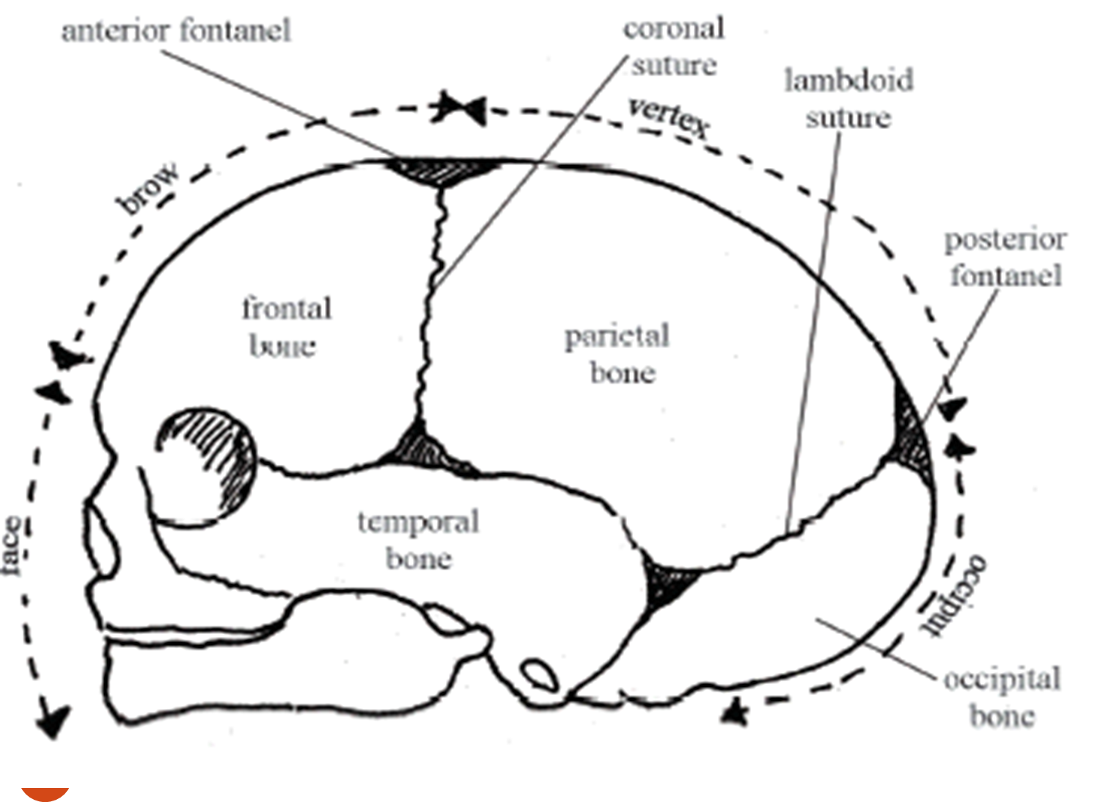
Cont.…………………………d

Slide 31
The fetal skull…
Bones of the vault
There are five main bones in the vault of the fetal skull.
One occipital bones. which forms the back of the skull and part of its base.
It joins with the cervical vertebrae (neck bones in the spinal column, or backbone)
Its ossification center is known as occipital protuberance.
It is roughly triangular in shape.
In its lower part it forms the margins of the foramen magnum.

Slide 32
The fetal skull…
Two parietal bones – lie on either side of the skull.
The ossification center of each bone is called partial eminence.
They are the largest of the cranial bones.
Roughly square in shape and curves as they lie over the parietal lobes of the brain.
Two frontal bones – form the forehead or sinciput.
Their ossification centers are named frontal eminence or frontal bosses.

Slide 33
Cont.…………………….d
Fuse in to a single bone by 8 years
The two temporal bones, one on each side of the head, closest to the ear.
Understanding the landmarks and measurements of the fetal skull will help you to recognise normal and abnormal presentations of the fetus during antenatal examinations, labour and delivery.

Slide 34
The fetal skull…
Sutures
Is an area of membrane between the skull bones where ossification has not been completed.
Overlap during the process of molding at the time of birth.
Types of sutures
Lambdoidal suture – separate the occipital bone from the two parietal bones.
It is shaped like the Greek letter Lambda

Slide 35
Fetal skull….
Sagital suture- runs between the two parietal bones and runs from the anterior fontanel in front to the posterior fontanel behind.
Frontal sutures- runs between the frontal bones, extending from the root of nose below, to the anterior fontanelle above.
Coronal suture- separate frontal bones from parietal bones, passing from one temple to the other.

Slide 36
The fetal skull…
Fontanels
Are areas where two or more sutures are meet.
There are two fontanels having great obstetrical importance.
The anterior fontanel or bregma :-is formed where the sagital, coronal and frontal sutures meet.
It is diamond in shape.
It is much longer than posterior fontanel.
Pulsation of cerebral vessels can be felt through it.
Normally closes at 18 months of age

Slide 37
The fetal skull…
Posterior fontanel
occurs at the junction of the lambdoidal and sagital sutures.
It is very small and triangular in shape
It is normally closes by 6 weeks of age

Slide 38
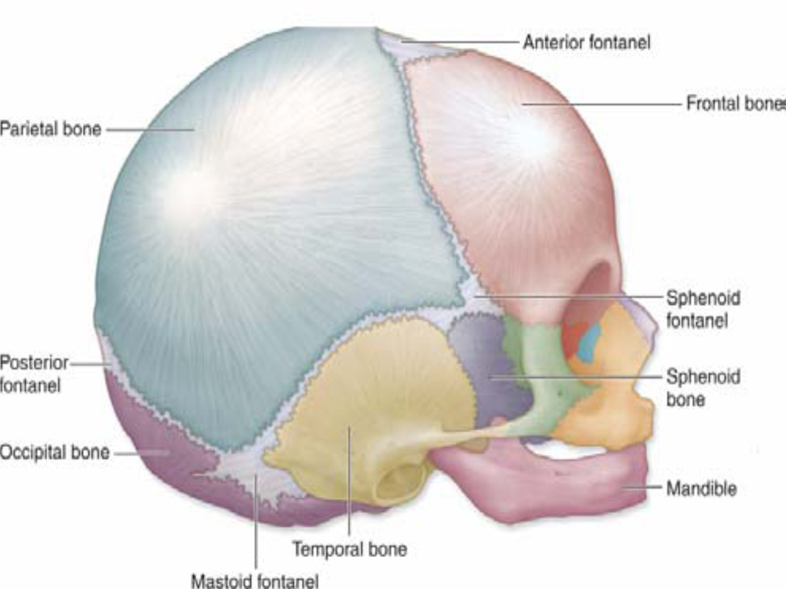
Cont.…………………………….d

Slide 39
The fetal skull…
The Regions of the skull
Vertex –is bounded by the anterior and posterior fontanels and parietal eminences
Occiput – is the area between the base of the skull and the posterior fontanel. It is unusual and very risky for the occiput to be the presenting part.
Sinciput (brow) – extends from the anterior fontanel and coronal suture to the orbital ridge
Face – extends from the orbital ridges and the root of the nose to the junctions of the chin and neck.
The point between the eye brow in known as the glabella.

Slide 40
Cont.…………………………d
Attitude: is the relationship of the fetal parts to one another, (head & limb to its trunk) & the normal attitude is flexion.
Presenting part - is the part of the fetus felt at the lower pole of the uterus & felt on abdominal examination and on vaginal examination.
Presentation - is the part of the fetus in the lower pole of the uterus & the normal presentation is vertex.
Abnormal presentations are - Breech ,face,brow,shoulder
-

Slide 41
Cont.………………………….d
Position- is the relationship between the denominators of the presentation to the six areas of the mother’s pelvis.
Normal position is anterior or lateral .
Denominator -The part of the fetus which determines the position.
Vertex - Occiput
Breech - Sacrum
Face - Mentum
Engaged - When the biparital diameters of the fetal head passes through the pelvis brim

Slide 42
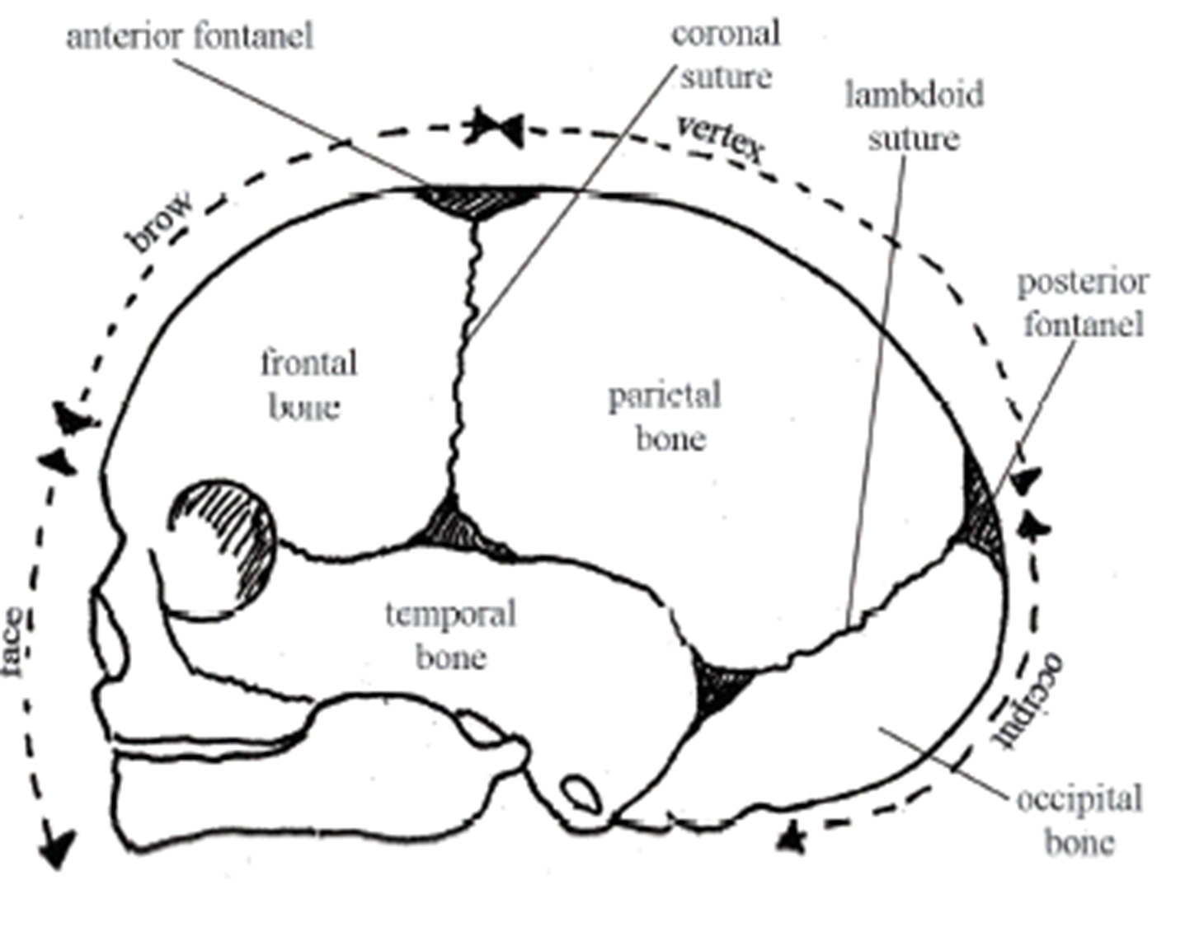

Slide 43
The fetal skull…
Land marks of the fetal skull
Occipput
Vertex
Sinciput
Posterior fontanel (Lambda)
Glabella
Mentum (chin)
Anterior fontanel (Bregma)
Occipital protuberance

Slide 44
The fetal skull…
Diameters of the fetal skull
Transverse Diameters
Biparietal diameter- between the parietal eminenences and measures 9.5cm
Engagement occur as this diameter pass through the plane of the brim.
Bi- temporal diameter – runs between the two extremities of the coronal sutures and is 8.2cm in length.

Slide 45
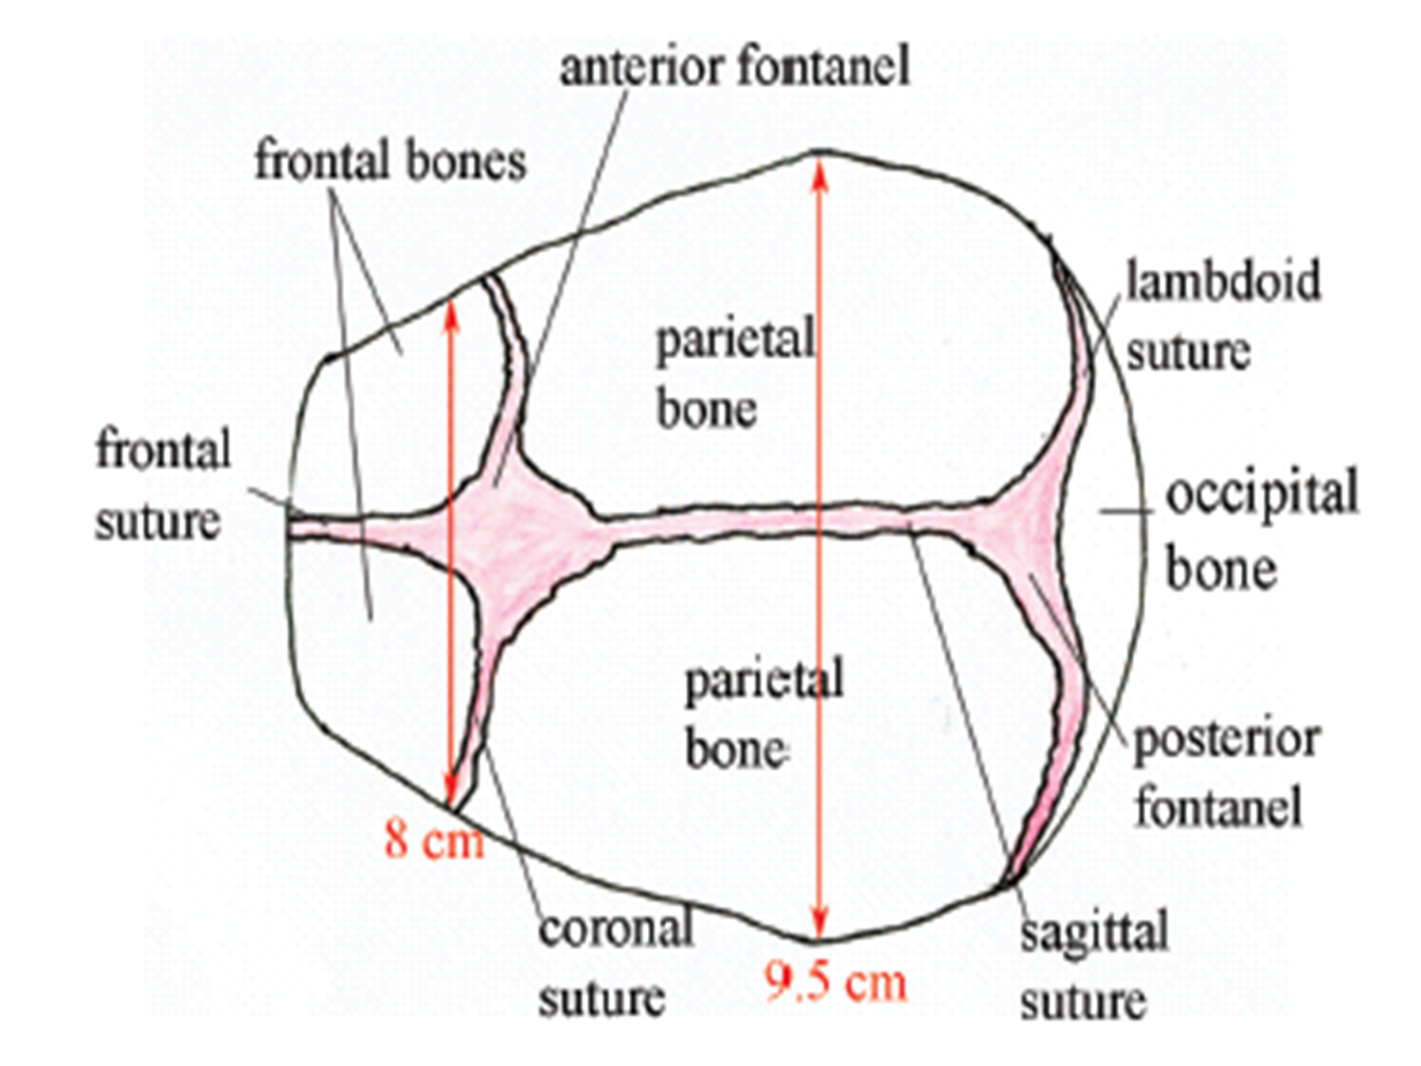
Cont.……………………..d

Slide 46
The fetal skull…
Anteroposterior or longitudinal diameters
  Subocipitobregmatic- measured from below the occiput to the bregma. It measures 9.5cm.
  Suboccipito frontal – measured from below occipital protuberance to the center of the frontal sutures, and measures 10cm.
  Occipito frontal – measured between the occiput and the glabella. It is 11.5 cm in length
  Mento-vertical – measured from the point of the chin to the highest point on the vertex slightly nearer to posterior fontanel then anterior, and it measures 13.5cm.

Slide 47
The fetal skull…
  Sub mento vertical – measured from the point where the chin joins the neck to the highest point on the vertex. It is 11.5 cm in length
  Sub mento bregmatic - measure from the point where the chin joins the neck to the center of the bregma and measures 9.5 cm

Slide 48
The fetal skull…
The scalp tissue
There are five layers of scalp tissue :
Skin containing hairs, (outer covering)
Subcutaneous tissue
Muscle layer – containing the tendon of Galea
Connective tissue – a loose layer
Periosteum – which covers the skull bones
Two conditions involving these tissue can arise during labor and both cause a swelling on the infant’s head
1.Caput succedaneum – is an edematous swelling of the subcutaneous tissues of the fetal skull.
It occurs in early rupture of membranes in the 1st stage of labor, because there is no bag of fore waters to take the pressure of dilating cervix off the fetal head.

Slide 49
The fetal skull…
Characteristics of the Caput succedaneum ;
It is present at birth
Occurs on the part of the head
It may lie over a suture line
It pits on pressure
It disappears with in 24 - 48hrs
No treatment required unless it is excessive

Slide 50
The fetal skull…
2.Cephelo hematoma – this swelling is due to bleeding between the skull bone and periosteum which covers it.
The bleeding occurs because of friction between the skull bones and the periosteum.
Characteristics ;It is not present at birth, but appears 2-3 days after wards .
The swellings is limited by the periosteum and can there fore only occur over the bone , although it may be bilateral .It can not lie over a suture. The head is usually red- and bruised in appearance.

Slide 51
Cont.…………………….d
It takes 6 weeks to disappear completely .
Treatment is only required of the hematoma increase in size over a number of days.
RX- vit. K, injection to raise the prothrombin level and assist clotting .

Slide 52
The fetal skull…
Molding
Is the change which takes place in the shape of the fetal skull as pass through the birth canal.
As the head descends through the pelvis in response to the down ward pressure of uterine contractions, so the skull bones overlap each other.
Molding takes place gradually with out being prolonged, the cerebral membranes and blood vessels are not likely to be damaged .

Slide 53
The fetal skull…
The dangerous types of molding are :
Excessive molding
Occurs when labor is prolonged or where the skull bones are not completely ossified (in prematurity ).
Upward molding
Occurs when the baby delivers in the persistent occipito posterior position and the after coming head of the breech passes through the pelvis.
It can result in intracranial hemorrhage .

Slide 54
The fetal skull…
Rapid molding
Occurs in a precipitate delivery, and during the delivery of the head of breach presentation.
Results from rapid compression and decompression of the head which can rupture of the cerebral membrane .
The infant is subjected to severe molding will suffer some degree of asphyxia at birth as a result of intracranial compression, thus they should be seen by pediatrician and get vit .K (0.5-mg/kg).

Slide 55
NORMAL PREGNANCY
Objectives
At the end of this secession the students will be able to:-
Define Preparation for Parenthood ?
Describe physiological changes during pregnancy.
Discuss minor disorder of pregnancy
Describe Antenatal care
Describe MTCT/PMTCT during pregnancy.

Slide 56
Cont.……………………….d
Definitions of terms.
Obstetrics - is a medical specialty focusing on the care of woman during pregnancy , child birth and postpartum.
Gynecology - is a medical specialty focusing on disorders or diseases of reproductive system.
Conception & fertilization - the union of egg & sperm in the bench mark of the beginning of pregnancy.
Pregnancy - the condition of having a developing conception with in the maternal body.
The state from conception to delivery of the fetus.
The normal duration is 280 days counted from the 1st day of last menstrual period.

Slide 57
Cont.………………………….d
Embryo-human conceptus from fertilization through eight weeks of pregnancy.
Fetus- from eight weeks until delivery.
Gestational age- duration of pregnancy expressed in completed weeks and is calculated from the first day of last normal menstrual period(LNMP/LMP).
Developmental age(fetal age)- is age of the offspring calculated from time of implantation.
Gravid- pregnant
Gravidity- total number of pregnancy including abortion
Parity- total number of live birth

Slide 58
Cont.……………………………..d
Prenatal - occurring before birth
Intranatal - occurring with in birth
Postnatal - occurring after birth
Premigravida - a women pregnant for the 1st time
Multigravida- a women pregnant more than one times
Primiparas - a women having born one child
Multipara- a women having born more than one child
Grundmultipara- a women born more than five child

Slide 59
Preparation for Parenthood
Childbirth Preparation
Preconception care/issues
Childbearing decisions
Childbirth education
Types of childbirth classes
Support during labor

Slide 60
Cont.…………………………………d
Preconception Care
Timing
Mental and physical health
Genetic counseling
Dental Health
Nutrition – Folic acid, 800mg/day during child bearing age to prevent neural defects/anemia.
Supplements
When do you stop contraception?

Slide 61
Cont.…………………………..d
Childbearing Decisions
Choosing care provider for mom and baby
Choice of birth setting
Birth plan
Labor support decisions
Sibling preparation

Slide 62
Cont.…………………….d
Childbirth Education
Goals of education
Childbirth programs
Early classes – 1st trimester
_2nd & 3rd trimester
Breastfeeding classes
Sibling Preparation
Grandparent classes
Cesarean Birth

Slide 63
Support During Labor
Body-Conditioning Exercises
Relaxation Exercises -fatigue increases muscle tension and pain perception, decreases coping ability (make sure they’re rested)
Breathing Techniques – increase pain threshold and ability to cope, sense of control, uterus functions more efficiently
Support individuality - self care activities

Slide 64
Supportive Relaxation Techniques
  Comfort measures
  Massage
  Effleurage- A form of massage involving smooth strokes of the skin with one's hands.
  Rest
  Imagery - visualization
  Vocalization
  Warm water
  Music
  Birthing ball

Slide 65
Physiological Changes of Pregnancy
There are physiological ,biochemical and anatomical changes during pregnancy.
These changes may be systemic or local.
Most of the systemic changes return to pre pregnancy status 6 weeks after delivery.
These changes occur to maintain a healthy environment for the fetus with out compromising the mother’s health.
And prepare for the process of delivery and care of the newborn.
Understanding of the normal changes helps to understand coincidental disease processes.

Slide 66
Gastro Intestinal Tract (GIT)
• Nutritional requirements including for vitamin and minerals are increased so usually mother's appetite increase
Pregnant women tend to rest more often conserving energy and there by enhancing fetal nutrition
Oral cavity feels salivation
Gums- hypertrophic easily bleed (due to increased systemic estrogen)
Gastrointestinal mobility May be reduced due to increased progesterone (w/c decreased the hormone motline stimulate smooth muscles in GIT)
Hence gastric emptying is slowed leads to GIT constipation (due to increased water absorption)

Slide 67
Cont.……………………d
Stomach Production of gastrin and mucous increase and decreases PH,
PUD usually improve or disappear because of these changes during pregnancy ,However because of the enlarging uterus heart burn is common due to gastric reflex.
Enlarging uterus slower emptying time, increase intra gastric pressure, acidity and gastric reflex
The anatomical position of small and large intestine as well as appendix will shift because of the enlarging uterus

Slide 68
Gallbladder
Progesterone decreased motility → decreased empty time of bile →stasis →stone formation and infection.
Liver
No morphological changes but functional changes
Decreased plasma protein (albumen) an globulin (synthesized by liver) increases serum alkaline phosphatase activity.

Slide 69
Urinary systems
Each kidney increase in length and weight
The renal pelvis and ureter dilate and lengthen
Thus there is an increase urinary stasis increase risk of infection and stone formation
Renal function
Change occur due to increased maternal and placental hormones (ACTH, ADH, cortisol, etc.) and increase in plasma volume
Glomerular Filtration Rate increase by 50% (begins early and last up to term

Slide 70
Cont.…………………………..d
Renal blood flow rate increase by 20-25% (early to mid trimester) after the end of 2nd trimester remain constant.
Urine volume dose not increase although glomerular filtration rate increase because of reabsorption.
Creatinine and BUN decrease because of increased clearance rate
Glycosuria is not necessarily as normal
Protein urea changes little during pregnancy
Bladder
Is displaced upward and anteriorly by enlarged uterus as a result it increases pressure leading to urinary urgency and frequency

Slide 71
Hematological system:
Increase in blood volume – most striking change
The change occurs until term and the average increase in volume is 45-50%
The mechanism for increase the volume of blood is not well understood (aldosterone related factor during pregnancy may contribute to this effect) increase water and salt retention.
RBC increased by 33%

Slide 72
Cont.………………..d
Iron need increases because of increase in red blood cell mass
This is why Iron supplementation is necessary during pregnancy.
WBC total count usually increase
Platelets increase in production
Clotting factors - Several factors increase- F- I, F-VIII mainly
To lessees extent, F-VII, IX, X and XII
Decrease- F- XI, F-XIII

Slide 73
Cardiovascular System
Heart slightly shift in position
Enlarging Uterus → diaphragm→ displace up ward → shift of apex beat
Cardiac capacity increase by 70-80ml and Cardiac out put increase a 49% during pregnancy reach may at 20-24 weeks of gestation the constant until term
HR increase by 15 b/min than non pregnancy

Slide 74
blood pressure
Systemic blood pressure declines slightly during pregnancy
There is little change in SBP but DBP decrease by 5-10 mmHg from 12-26 weeks, then increase to non pregnant level by term.
Venous pressure
- No change in the upper body
- Increase in the lower extremities enlarged
- Decrease venous return to the heart increases pressure and results in edema.

Slide 75
Pulmonary system
Capillary dilatation occurs in the respiratory route (Naso pharynx, larynx, trachea, bronchi) → make breathing difficult through nose, enlarged Uterus pushes the diaphragm and the lungs as well.
Functional respiratory changes include
A slight increase in respiratory rate
50% increase in minute ventilation
40% increase in minute tidal volume
Progressive increase in oxygen consumption (15-20% above non pregnant level by term)

Slide 76
Changes in the Breast
Breast increases in size with enlargement of the nipple and increased vascularity and pigmentation of areola.
Change in Skin
Hyperpigmentation over some part of the body ,Face (fore head,cheek) - cholasma
Abdomen –sub umbilical midline dark purplish pigmentation of linea alba- linea nigra Stretch mainly Striea gravidarum
Enlarging abdomen → stretch on collagen fibers of the skin and effect of ACTH

Slide 77
Change in Vagina and Uterus
Vagina– increase in capacity and length secondary to the hypertrophy of the lining epithelium and muscle layer.
Increased glycogen content in the wall secondary to the effect of estrogen .
Increases vascularity and change the color to purple
Fold increases by term
Uterus – Upper part fundus and body change in to upper uterine segment
Lower part cervix and isthmus change in to lower uterine segment
Weight increases from 60gm to l kg at term, volume 10ml to 5 liters.

Slide 78
3.7 Minor Disorders of Pregnancy
Minor disorders are only disorders that occur during pregnancy and are not life threatening.
Nausea and vomiting- This presents between 4 and 12 weeks gestation. Hormonal influences are listed as the most likely causes.
It is usually occurs in the morning but can occur any time during the day, aggravated by smelling of food.
Management:
- Reassure the mother
- Small frequent meals (dry meals)
- Reduce fatty and fried containing foods.
- Rest

Slide 79
Cont.……………………d
2. Heart burn: - is a burning sensation in the mid chest region.
Progesterone relaxes the cardiac sphincter of the stomach and allows reflex of gastric contents into esophagus.
Heart burn is most troublesome at 30-40 weeks gestation because at this stage is under pressure from the growing uterus.
Management:
Small and frequent meal, sleeping with more pillows than usual.
For persistence/sever case/ prescribe antacids.

Slide 80
Cont.………………………d
3. Pica: - This is the term used when mother craves certain foods of unnatural substances such as coal, soil...etc.
The cause is unknown but hormones and changes in metabolism are blamed.
Management:
Seek medical advice if the substance craved is potentially harmful to the unborn baby.

Slide 81
Cont.……………………..d
4. Constipation: - Progesterone causes relaxation and decreased peristaltic activity of the gut, which is also displaced by the growing uterus.
Management:
Increase the intake of water, fresh fruit, vegetables and roughages in the diet.
Exercise is helpful especially walking

Slide 82
Cont.………………….d
5. Backache - The hormones sometime soften the segments to such a degree that some support is needed.
Management:
- Advice the mother to sleep on firm bed.
- Advice support mechanisms of the back.

Slide 83
6. Urinary frequency
pregnancy pressure by the enlarging uterus explain the common complaint of frequency of urination.
UTI is also common as the result of incomplete emptying of the bladder and stasis of urine. Microscopy of urine must be done in all cases.

Slide 84
7 .Ptyalism
Hyper salivation is also common. It is not related to increased salivation production; rather it is the result of reduced swallowing from nausea.
8. Hemorrhoids
Exacerbation or recurrence of previous hemorrhoids due to increase pressure in the rectal veins caused by obstruction of venous return by the large uterus and constipation during pregnancy

Slide 85
Cont.…………………….d
9. Fainting: - In early pregnancy fainting may be due to the vasodilation occurring under the influence of progesterone before there has been a compensatory increase in blood volume.
The weight of the uterine contents presses on the inferior venacava and slows the return of blood to the heart.
Management: Avoid long period of standing
- Sit or lie down when she feels slight dizziness
- She would be wise not to lie on her back except during abdominal examination

Slide 86
Cont.…………………..d
10 . Varicosities- Progesterone relaxes the smooth muscles of the veins and result in sluggish circulation.
The valves of the dilated veins become insufficient and varicosities result.
It occurs in legs, anus (hemorrhoids) and vulva.
Management:
Exercising the calf muscles by rising on the toes
Elevate the leg and rest on the table
Support thighs and legs
Avoid constipation and advise adequate fluid intake.
Sanitary pad give support for vulva varicosities

Slide 87
Diagnosis of Pregnancy
Pregnancy is mainly diagnosed on the symptoms reported by the woman and signs elicited by a health care provider.
Signs and symptoms of pregnancy
These signs and symptoms are divided in to three
classifications; presumptive, probable, and positive.
Possible (presumptive) signs
Early breast changes-increase in size, darkening of areola,

Slide 88
Cont.………………………d
Amenorrhea-a women having regular cycle with out the use of hormonal contraceptives
Morning sickness
Bladder irritability like frequency of micturition
Quickening -the date of the first fetal movement felt by the mother provides an indicator of pregnancy.

Slide 89
Cont.………………………..d
A primigravid women feels it at 18-20 weeks the multi gravid at 14-16 weeks
2. Probable signs
Presence of HCG in
- blood
- urine
Uterine growth
Braxtonhicks contractions
Ballottement

Slide 90
Cont.………………………d
3. Positive signs
Visualization of fetus by
- Ultrasound 6 weeks of gestation
- X-ray after 12 weeks of gestation
Fetal heart sounds by
- Ultrasound
- Fetal stethoscope or fetoscope (20th to 24th weeks of gestation)
Fetal movements by
- Palpation
- Visible

Slide 91
Antenatal Care
Definition: - Antenatal care is the care given to a woman during her pregnancy.
Objectives:
To promote and maintain good health of the mother and fetus during pregnancy
To ensure that the pregnancy result in healthy infant and healthy mother.
To detect early and treat appropriately 'high risk conditions (Medical or Obstetrical).
To prepare the woman for Labour, Lactation and the subsequent care of the baby.

Slide 92
Definitions of terms
Gravidity: Pregnancy
Primigravida :a woman pregnant for the first time
Multigravida : a woman who has had two or more pregnancies
Parity : refers to delivery,
Nulliparous :a woman who has not given birth to a child birth)
Multipara : a woman who has given birth to more than one child
Grand multipara : woman who has given birth to or more children
Lie: is the relationship of the long axis (spine) of the fetus to the long axis of the mother’s uterus,
The normal lie is longitudinal and abnormal are transverse, oblique and variable.

Slide 93
Cont.…………………….d
Presenting part: is the part of the fetus felt at the lower pole of the uterus
felt on abdominal examination and on vaginal examination.
Presentation: is the part of the fetus in the lower pole of the uterus
the normal presentation is vertex, abnormal are breech, face, brow and shoulder.
Position: is the relationship of the denominator to the six areas of the mother’s pelvis,
normal position is anterior or lateral abnormal is Malposition is Occipital posterior position.

Slide 94
Cont.…………………..d
Positions of vertex presentation.
Left occiputo anterior (LOA) - the occiput points to the left iliopectineal eminence. The sagital suture is on the left oblique diameter.
Right occiputo anterior (ROA) - the occiput points to the right iliopectineal eminence. The sagital suture is in the left oblique diameter of the pelvis.
Left occiputo lateral (LOL) - The occiput points to the left iliopectineal line mid way between the iliopectineal eminence & the sacroiliac joint. The sagital suture is in the transverse diameter.

Slide 95
Cont.……………………d
Right occiputo lateral (ROL) - The occiput point to the right iliopectineral line midway between iliopectineal eminence & sacro iliac joint. The sagital suture is in the transverse diameter of the pelvis.
Left occiputo posterior (LOP) - The occiput points to the left sacroiliac joint. The sagital suture is in the left oblique diameter of the pelvis.

Slide 96
Cont.…………………………d
Right occiputo posterior (ROP) - The occiput point to the right sacroliliac joint. The sagital suture is in the right oblique diameter of the pelvis.
Direct occiputo anterior (DOA) - The occiput points to the symphysis pubis. The sagital suture is in the anterior posterior diameter of the pelvis.
Direct occiputo posterior (DOP) - The occiput points to the sacrum, the sagital suture is in the anterior posterior diameter of the pelvis.

Slide 97
Cont.………………………….d
Crowned: When the Bi-parietals pass the ischial spines and the head no longer recedes between contractions.
Attitude: is the relationship of the fetal parts to one another,the normal is flexion, abnormal are extension and deflection
Denominator: The part of the fetus which determines the position.
Vertex- occiput, breach -sacrum. Face- mentum).
Engaged: when the Bi-parietal diameters of the fetal head passes through the pelvic brim.

Slide 98
History Taking
1.1. Identification
Name
Age- significant if less than 20 years and greater than 35 years
Marital status
Address- far distance from health institution
Religion
Occupation
Date of admission
Ward and bed number

Slide 99
Cont.………………………d
1.2 Chief compliant
Patient may have come for routine antenatal care follow up or may come with one or more specific complaints.
Note the duration of each compliant
1.3 History of present pregnancy
Get information on the following points
Gravidity
Parity
Abortion.
Last normal menstrual period (LNMP)
Expected date of delivery (EDD)

Slide 100
Cont.………………………….d
Expected date of delivery (EDD) which could be calculated by
1. Naegales rule (using European calendar)
        LNMP – 3 months + 7 days
      Ethiopian calendar
        LNMP + 9 months + 10 days if pagume is not passed
        LNMP + 9 months + 5 days if pagume is passed (4 in leap year)
Calculate gestational age (GA) in completed weeks and days as follow
        GA = Visiting date - LNMP
        7

Slide 101
Cont.……………………..d
Quickening: the first time the mother felt fetal movement
      In premigravida it is around 18-20 weeks and in multigravida is it around 16-18 weeks of gestation
presence of Antenatal care elsewhere.
Place and number of visits, what was done and laboratory results.
Elaboration of chief compliant

Slide 102
Cont.………………………d
Danger symptoms of pregnancy (vaginal bleeding, sever headache, blurring of vision, epigastric or sever abdominal pain, profuse vaginal discharge, absence or reduction of fetal movement, fever and persistent vomiting)
Common complaints in pregnancy (like nausea and vomiting, weakness)
Pregnancy: unplanned, unwanted and unsupported
Ask positive and negative statement according to the patient compliant

Slide 103
Cont.……………………..d
1.4 past obstetric history: the following should be asked for all previous pregnancies in chronologic order
Date, month and year of gestation for example first deliver in may 2000
Length of gestation: abortion (< 28 weeks), preterm (< 37 complete weeks), term (> 37 completed weeks to 40 weeks), postdate (> 42 weeks to 42 weeks), post term (> 42 completed weeks).
Significant antenatal medical problems like hypertension , ante partum haemorrhage, diabetes
Onset of labour (spontaneous or induced)
Fetal presentation (vertex, face, brow, breech or shoulder)

Slide 104
Cont.……………………………..d
Duration of labour
Mode of delivery (spontaneous vaginal, instrumental delivery, caesarean section or destructive delivery)
Fetal out come (alive or dead, sex of the new born, weight of the new born, malformation and current condition)
Post partum complication- postpartum haemorrhage and Breast feeding

Slide 105
Cont.………………………d
1.5 gynaecology history
Family planning methods – use, type, duration and side effect
Sexual history- assess risk of sexually transmitted infections and HIV/AIDS
Gynaecology operations- female genital mutilation, laparotomy, dilatation and curettage, evacuation and curettage, manual vacuum aspiration
Menstrual history (age of menarche, interval of period 21-36 days, amount of flow 10-80 ml, duration of flow2-8 days, normally dark red and non-clotting )

Slide 106
Cont.……………………….d
1.6 Past medical and surgical history:
History of diabetes mellitus, hypertension, hypo or hyper thyroidism, which may affect pregnancy or get aggravated by pregnancy
Blood transfusion important in haemolytic disease of the new born
Drugs because of risk of teratogenicity or allergic reaction
Maternal infection- TORCH syndrome.

Slide 107
Cont.………………………..d
1.7 Personal, family and social history
Childhood development
Educational status
Habit like alcohol, smoking and elicit drug use
Occupation- exposure to radiation ansthesia- halothane, chemical factory and others
Income- low socio economic status associated with obstetric problems like preeclampsia, preterm
Family history- diabetes mellitus, hypertension, multiple pregnancy, genetic disorder

Slide 108
Cont.………………………d
1.8 Review of systems: check all systems
2. Physical examination
Examination must be done in a private room in the presence of an assistant preferably female
Proper explanation must be offered to the patient before, during and after the examination
Bladder should be emptied and the patient properly positioned on the couch
Warm hand and instruments must be used
Adequate light, appropriate gloves and swabs should be prepared.
Always keep eye contact through out the examination.

Slide 109
cont.………………….d
Examination of the Pregnant Woman at First Visit
Objective:
To diagnose pregnancy
To identify high risk pregnancy
To give advice for pregnant mother
General Appearance
As she walks in, observe any deformity, stunted growth, limp etc. does she look well or pale and tired?

Slide 110
Cont.……………………….d
Clinical Observation
Height; - 150 cm or less needs special care.
Weight:- The average weight gain during pregnancy is about 12-14 kg
In the first trimester a woman should gain o.4 kg per month and in the second and third trimester she should gain 0.4 kg per week.
It is Considered as excessive if it is more than 3 kg a month during the second and third trimester;
It is less than normal if it is less than 1 kg per month during the second and third trimester.

Slide 111
Cont.…………………….d
The average distribution is as follow: the fetus 3300gm, the placenta 600gm, amniotic fluid 800ml, uterus 900-1000gm, breast 400gm, blood 1200ml, deposition of fat 2500gm and extracellular fluid 2600ml.
Blood pressure: - Checked and recorded at each visit,
Physical Examination:-
Appearance: - The hair of a healthy woman is shining and glossy, bright eyes and clear,
Face: - Oedema, sign of anaemia
Neck - Swollen glands

Slide 112
Cont.…………………….d
Respiratory and Cardiovascular System
Steps in examination are essentially the same as non pregnant patients.
Note that the following are normal finding in pregnancy
Decrease diaphragmatic excursion due to diaphragm elevation by gravid uterus
Point of maximal impulse (PMI) deviation to left is possible in pregnancy
S3 gallop may be heard
Functional systolic murmur may be heard

Slide 113
Cont.………………………d
Breast Examination
Asses the size, any lumps in the breast
Nipples are they inverted or flat?
Teach the mother self - examination of the Breast
Abdominal Examination
AIMS
To observe signs of pregnancy
To assess fetal size and growth
To assess fetal health
To diagnose the location of fetal parts.
To detect any deviation from normal.

Slide 114
Cont.………………………..d
Steps for Abdominal Examination
1. Inspection
2. Palpation
3. Auscultation
Inspection (5s)
Shape:-
- Longitudinal, ovoid in primigravida
- Round and Broad in transverse lie in multipara.

Slide 115
Cont.……………….……………d
b) Size:- Should correspond with the supposed period of gestation
c) Skin: - The dark line of pigmentation which is lineanigra
is there any rash?
d) Strae gravidarum
e) Scar - Any operation scar(c/s)

Slide 116
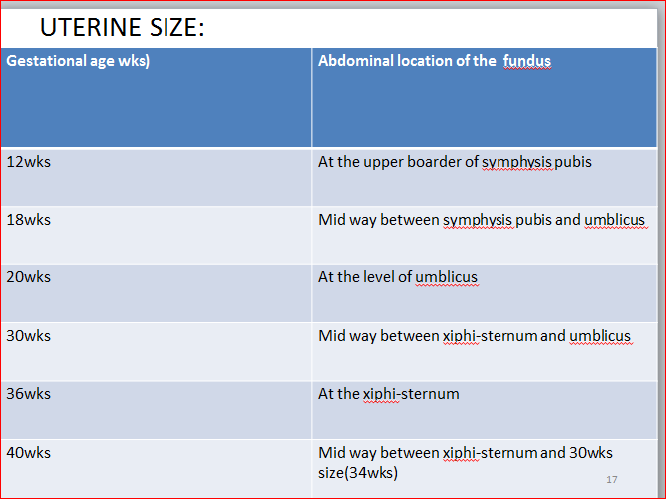
On palpation

Slide 117
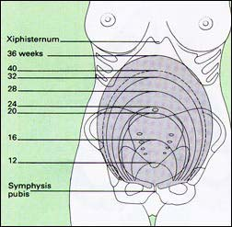
Uterine Position over Time
117

Slide 118
Cont.……………………………….d
A. The first leopold maneuver or fundal palpation
1. Fundal height and fundal palpation (1st Leopold Maneuver)
1.1 Fundal Height
At about 12 to 14 weeks of pregnancy, the uterus is palpated above the symphysis pubis as a firm globular sphere;
It reaches the umbilicus at 20 to 22 weeks, the xyphoid process at 36 weeks, and then often returns to about 4 cm below the xyphiod due to “lightening” at 40 weeks.
Method: Measure distance of fundus with points on abdomen and assessing the fundal height in finger breadth below the xiphisternum or measure by centimeter.

Slide 119
Cont.………………………d
1. 2 .Fundal height measurement: first correct for asymmetry before measurement. Then use one of the following methods
Finger method- one finger above umbilicus is equal to two weeks and below umbilicus one finger is equal to one week.
Uterus felt at symphysis pubis corresponds to 12 weeks.
At the umbilicus it is 20 weeks and at xiphysternum it is 38 weeks
b. Tape measurement- symphysis to fundal height in centimetre with tape meter between 18-34 weeks is accurate to within two weeks of actual gestational age.

Slide 120
Cont.………….……….d
II. Determine what occupies the fundus.
If soft, irregular, bulky mass is found it is breech.
If hard, round, smooth ballotable mass is found, it is the head.
  Method of Fundal palpation- use two hands using palms of hands palpate on either side of the fundus.
Finger held close together, palpate the upper pole of the uterus & feel that as it is hard or soft or irregular.

Slide 121
Cont.…………………………d
B. The Second Leopold manoeuvre or lateral palpation
Determines the lie of the foetus which could be longitudinal, transverse or oblique lie
In longitudinal lie it determines on which side of the abdomen is the foetal back.
The back of the fetus is linear, rigid and smooth in outline.
The extremities are felt as small irregular and bulky masses.
The fetal heart beat is best heard on the back side
Method of lateral palpation- always facing the mother, fix the hand on the center of the abdomen, fix the right hand & palpate with the left hand & vise versa.

Slide 122
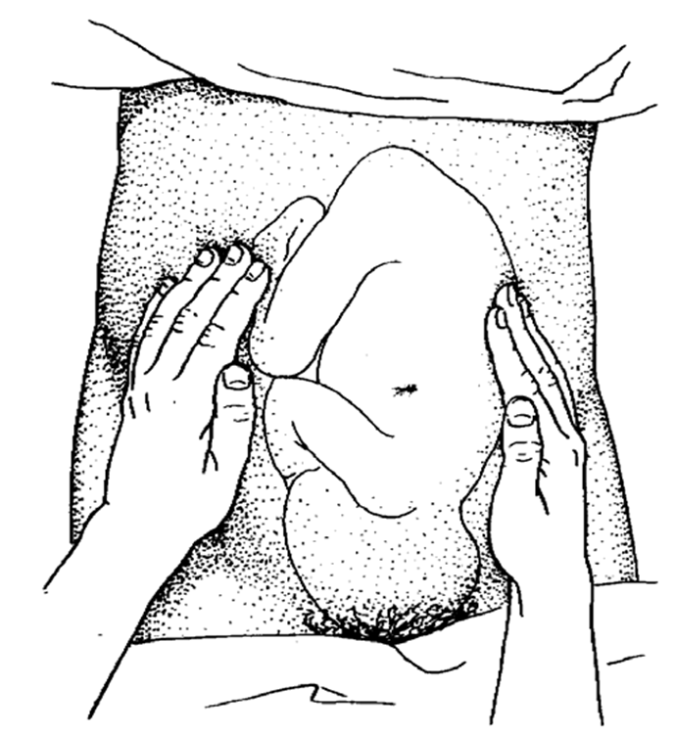
Techniques of Lateral palpation

Slide 123
Cont.………………………d
C. The Third Leopold manoeuvre or pelvic palpation
Determine what part of the foetus occupies the lower uterine pole which is also called the presentation.
The possibilities are the head (cephalic presentation), the breech (breech presentation), and the shoulder (shoulder presentation)
In cephalic presentation it determines the descent by using rule of fifth which measures the distance between upper border of symphysis pubis to the anterior shoulder.
5/5 is floating head, 4/5 is fixed head, 2/5 denotes engaged head.
It determines the attitude of the fetus (relation of head to the trunk).
The provider face towards the maternal extremities.

Slide 124
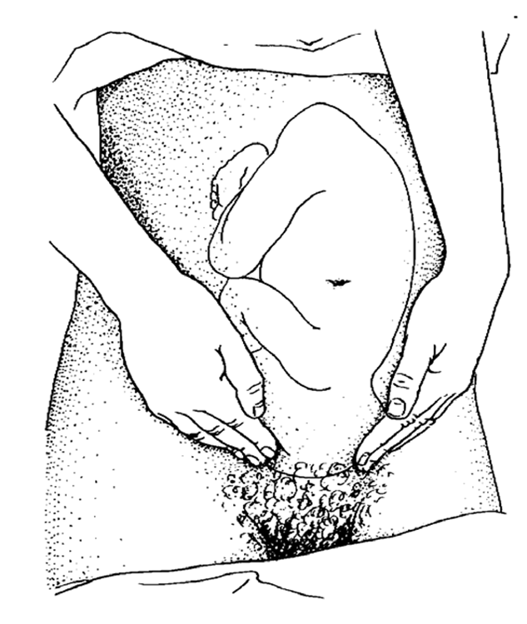
Techniques of Deep pelvic palpation

Slide 125
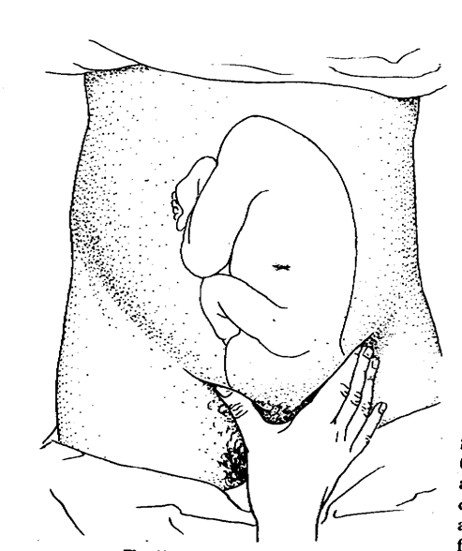
Cont.…………………………d
D. The fourth Leopold manoeuvre or paw lik grip
It is the only manoeuvre that is done with one hand.
It assesses presentation of the foetus

Slide 126
Cont.……………………d
2.6.4. Auscultation
Fetal heart beat first heard in the back side at 16-18 weeks in multipara and 18-20 weeks in primi gravida
In breech, it is heard above the umbilicus.
In cephalic presentations it is below the umbilicus
In occipito posterior presentation, it is heard in the flanks.
Method – use feto scope
Hand should not touch it while listening.
Ear must be enclose form contact with the feto scope.

Slide 127
Pelvic assessment
By x-ray of the pelvis
Clinical (assessing sign of contracted pelvis)
Head fitting
Head fitting
The head is the best pelvimeter
METHOD 1: Head fitting, sitting patient Method :
Let her lie on a couch, place hand on the Symphysis pubes and get the woman to sit up by her own effort.
The effort should force the head in to the pelvis.

Slide 128
Cont.……………………d
METHOD 2 : Left hand grip method
Grasp the fetal head with left hand and push it down wards and backwards
if a sense of give is felt the head has entered and there is no over and no cephalo pelvic disproportion.
Genito-Urinary System
- Frequency of micturition
- Check for abnormal discharge

Slide 129
Cont.……………………..d
Circulatory System
Varicosities: - Varicose veins may occur in the legs, anus (hemorrhoids) and vulva.
Vulvar varicosities are rare and very painful.
The Vulva
- Vulval warts
- Purulent irritating discharge
The Lower Limbs
Examine for bones alignment and deformities.
Check pitting oedema in the lower limbs by applying fingertip pressure for 10 seconds over the tibial bone

Slide 130
Laboratory test
Urine:- For Protein and glucose
Blood Tests:-V.D.R.L.
- Rhesus and blood grouping.
- Hemoglobin
Points to Be Advised On
The advantages of antenatal check up
The use of tetanus toxoid vaccine.
The danger of lifting heavy loads (exercise).
Rest at least 10 hrs at night and 2 in the afternoon, clothing should be confortable
Breast care
Diet - Rich in Iron and protein

Slide 131
Report the following danger signs
Vaginal bleeding
Reduced fetal movements
Frontal or recurring headaches
Sudden swelling
Rupture of the membrane
Premature onset of contractions
Maternal anxiety for whatever reason

Slide 132
Frequency and timing of ANC visit
1. Traditional or standard (western) model
Recommends the first visit to take place as early as the first missed period
This allows accurate dating of pregnancy and design appropriate preventive and therapeutic intervention
Subsequent visit are planned every four week until 28 weeks
Every two weeks between 28-36 weeks
Every week after 36 weeks

Slide 133
Cont.………………………..d
2. The new WHO model (focused ANC)
Is an approach to ANC that emphasizes
Individualized care
Client centered
Fewer but comprehensive visits
Disease detection not risk classification
Care by a skilled provider

Slide 134
Four goals of focused ANC
Early Detection And Treatment Of Problems And Complications
Prevention Of Complications And Disease
Birth Preparedness And Complication Readiness
Health Promotion

Slide 135
The FOCUSED ANC SYSTEM
Privacy/Confidentiality Are Assured
Continuous Care Provided By Same Provider
Promotes Partner/ Support Person Involvement
Adheres To National Protocols
Referral Facilitated
ANC, PNC And Family Planning Services Are Linked And Housed Within The Same Location If Possible

Slide 136
Cont.………………………d
FOUR VISITS
  FIRST <16 Weeks
  SECOND 24-28 Wks
  THIRD 30-32 Wks
  FOURTH 36-40 wks
It means good clinical decisions must be made at each visit

Slide 137
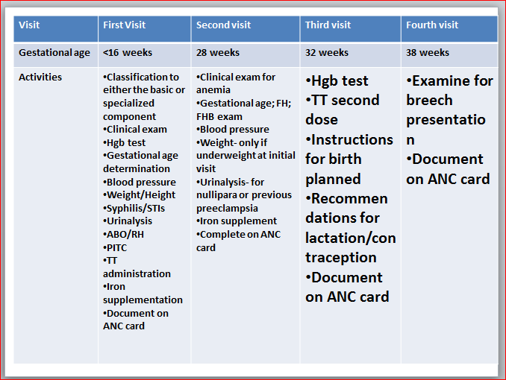
Cont.………………………..d

Slide 138
Cont.…………………….d
In the focused ANC in the initial visit women are grouped into two using the classifying form
Women with out any risk factor are enrolled in the basic component of the new model that needs only three visit until delivery
Women with any identified risk factor need special care that may need frequent visit or even referral to hospital
The classifying form has 18 components that are grouped into three:

Slide 139
Cont.………………………….d
Obstetric history: previous still birth/neonatal loss, history of three or more consecutive abortions, birth weight of less than 2500 or more than 4000 gram, admission in the last pregnancy for preeclampsia or hypertension, previous cervical or uterine surgery
Current pregnancy: diagnosed or suspected multiple pregnancy, age less than 18 or more than 35 years, RH isoimmunisation, vaginal bleeding, pelvic mass, diastolic blood pressure of more than 90 mmHg.
General medical condition: insulin dependent diabetes mellitus, renal or cardiac disease, known substance abuse, any other sever medical illness should be assessed.

Slide 140
Subsequent visit
History focuses: on new complaints and problems since the last visit, inter current illness and medication
Quickening time and foetal movement
Danger sign of pregnancy
Any change on the personal history of the women.
physical examination: focuses on the general appearance.
Vital sign mainly the blood pressure, weight
Check for signs of anaemia, fundal height, foetal lie and presentation.

Slide 141
Health promotion (advice and counselling)
Advice the pregnant women about the advantage of balanced diet, Avoidance of drugs, smoking and alcohol
The need of adequate rest, hygiene and safe sex
Discuss about minor complaints of pregnancy and the danger signs of pregnancy
Discuss about whom to contact and where to go if this symptoms develop
Inform the women to record the time of quickening
Education about and preparation for delivery should be done starting from the third visit
The need for clean and safe delivery should be stressed
Breast feeding and family planning after delivery should be discussed

Slide 142
Care provision (care provided)
Individualized delivery plan should be planned starting from the first visit including arrangement for transportation in case of emergency and place of birth
Universal ferrous sulphate prophylaxis for nutritional anaemia should be given starting from the first visit
Tetanus toxoid vaccine should be given
Appropriate prophylaxis and treatment of intestinal parasite and malaria should be offered
Where indicated ART should be given to HIV positive pregnant women
Appropriate management of complaints
Timing and importance of next visit should be discussed

Slide 143
The Birth Preparedness And Complication Readiness Plan
Elements of a birth preparedness and complication readiness plan are
  Facility or place of birth
  Skilled provider
  Transportation
  Funds
  Support person
  Decision maker
  Blood donor
  Danger signs in labor

Slide 144
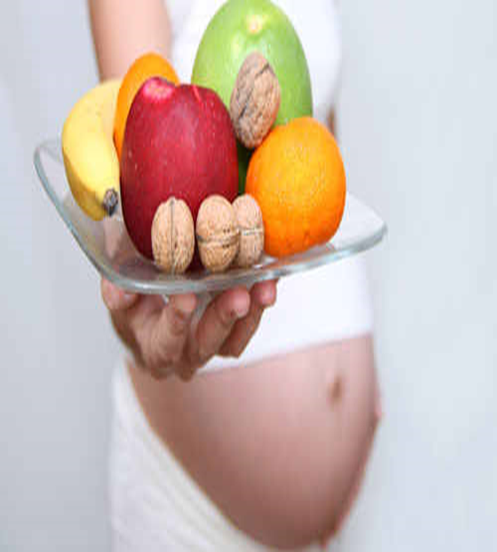
Maternal nutrition
Nutrition is one of the many factors that influence the outcome of pregnancy.

Slide 145
Cont.…………………………d
The nutritional status of a woman before and during pregnancy is related to the birth weight of her child
LBW infants have less chance of survival; when they do survive, they are more prone to disease, growth retardation and impaired mental development.
use of micronutrient- containing prenatal vitamins before and during pregnancy is associated with reductions in the risk of congenital defects, preterm delivery, low infant birth weight, and preeclampsia.

Slide 146
Cont.………………………..d
Both maternal under nutrition and over nutrition reduce placental-fetal blood flows and cause stunt fetal growth.
Promoting optimal nutrition will not only ensure optimal fetal development, but will also reduce the risk of chronic diseases in adults.

Slide 147
Good prenatal care + maternal nutrition
improved health of woman and baby
Reduction in maternal and infant mortality
Achievement of MDG 4 & 5.

Slide 148
The end

