Slide 1

Health Science College
Department of Public Health
Course Title- Sexually Transmitted Infections
Prepared By-Hailemariam Abiy (BSc N,MPH)
Nursing Students
January , 2018

Slide 2
Sexually transmitted diseases
At the end of the session you will be able to
    Explain the routes of transmission for the common sexually transmitted infections (STIs).
    Describe factors that influence STIs transmission
    Describe the magnitude of STIs
    Discuss about the public health impacts of STIs
    Describe the name and pharmacological treatment of the seven syndrome managment.

Slide 3
Sexually transmitted diseases
What is STIs?, what type of organisms cause STI?
The most common mode of transmission is unprotected sex
Other forms of transmission are
  Mother to child
    During pregnancy (HIV & syphillis)
    At delivery (gonorrhea ,chlamydia &HIV)
    Through breast feeding
  Unsafe (unsterile ) use of needles or injections
  Contact with blood or blood products (syphilis, HIV & hepatitis B,C )
STIs are infectious diseases that are transmitted by intimate contact, mainly sexual intercourse .
STIs are caused by more than 30 different pathogens including bacteria, viruses, protozoa, fungus and ecto - parasites

Slide 4
Public health impact of STI
  Public health impacts of failure to diagnose and treat STIs at an early stage may result in serious complications and sequela.
  The most serious health consequences of STIs, other than HIV/AIDS, tend to occur in women men and newborn children are .
Complications in women include :
      Cervical cancer, pelvic inflammatory disease
      Infertility, chronic abdominal pain
      Ectopic pregnancy, preterm labor and related maternal mortality

Slide 5
Public health impact of STI…
Complications in newborns include
      Congenital syphilis
      Gonococcal infection of the conjunctiva - a potentially blinding condition
      Chlamydial pneumonia and perinatal hepatitis B infection
      Premature deliveries, low birth weight, growth retardation.
Complications in men:
    Urethral stricture
    Infertility

Slide 6
Factors increasing transmission of STIs
Biological factors- Age, Sex, Immune status
  young women 15-24 years, and women at menopause, are at high risk
Behavioral factors –changing in sexual partners, having multiple sexual partner , having sex with ‘casual’ partners, having sex with female sex worker or Having unprotected sex, alcohol or drug use during sex
Socio-cultural factors - women have very little decision making power over sexual practices and choices, including use of condoms
      When women tend to be economically dependent,
      early married off to an elder male at a very young age, thus exposing the girl to infections
      Some culture men allowing them to have more than one sexual partner.
      Harmful traditional practices ,Skin-piercing ,tattoos ,Circumcision using shared knives,needles

Slide 7
Epidemiology of STIs
  Sexually transmitted infections are also called sexually transmitted diseases (STDs) or venereal diseases.
  The most widely known are gonorrhea, chlamydia, syphilis and HIV.
  most common mode of STIs transmission in Ethiopia is sex through the vaginal route (though cases of anal transmission are also common) and Heterosexual
  STIs are a major public health problem in all countries, especially in developing countries
  According to 2008 WHO estimates, 499 million new cases of curable STIs (syphilis, gonorrhea, chlamydia and trichomoniasis) occur annually throughout the world in adults aged 15-49 years.
  According to 2011EDHS 1% of Ethiopian women and men reported having had an STI in the past 12 months.

Slide 8
Epidemiology of STIs
There is little information on the incidence and prevalence of STIs in Ethiopia with many reason.
Study was conducted from January - June 2013 in 8 health facilities located in Amhara, Oromia and Addis Ababa by EHNRI showed
Which showed commonest syndrome as
    Vaginal discharge 50%
    Urethral discharge 31%,
    Genital ulcerative disease 9%
    Lower abdominal pain 7.3%and
    Presented with two syndrome.3%

Slide 9
Epidemiology of STIs
About16% of the STI patients were co-infected with HIV (8.1% male and 21% female) and HIV prevalence is higher on STI patients with lower abdominal pain (41% ) and genital ulcer (24.5%).
Young people (20-34yrs) are highly affected (68.2%),with a larger proportion of females( 61%).
The Main Aims of STIs Prevention and Control are:-
  Interrupting the transmission of STIs
  Prevent development of disease and complications
  Reducing the risk of acquiring and transmitting HIV

Slide 10
Model for STI Control
  Reduce risk through education for communities and risk groups
  Condoms promotion through improving the availability of it to the sexually active individual
  Case finding and screening programs through partners’ notification
  Promotion of health seeking behavior during an early STI symptom recognition.

Slide 11
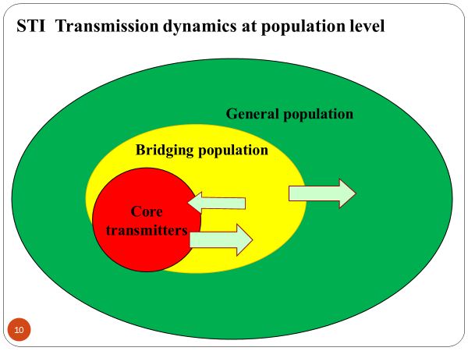
Most At Risk Population (MARPG) for HIV and STI
.

Slide 12
Most At Risk Population (MARPG) for HIV and STI
Core -Female sex workers and their clients
Bridge- long distance drivers and daily laborers,
core or bridging population groups are most at risk in the transmission of HIV and STI than the general population.
Approaches to STI Case Management
  Globally, service providers use one of the three diagnostic approaches:
    etiologic,
    clinical and
    syndromic approach.

Slide 13
Etiologic approach
Advantages:-
✓Avoids over treatment
✓Conforms to traditional clinical training
✓Satisfies patients who feel not properly attended to
✓Can be extended as screening for the asymptomatics

Slide 14
Disadvantage of etiologic approach
Requires skilled personnel and consistent supplies
Treatment does not begin until results are available
It is time consuming and expensive
Testing facilities are not available at primary level
Some bacteria fastidious and difficult to culture (H.ducrey, C.trachomatis)
Lab. results often not reliable
Mixed infections often overlooked
Miss-treated/untreated infections can lead to complications and continued transmission

Slide 15
Clinical approach
Advantages:-
✓Saves time for patients
✓Reduces laboratory expenses
Disadvantages:-
✓Requires high clinical accuracy
✓Most STIs cause similar symptoms
✓Mixed infections are common and failure to treat may lead to serious complications
✓Doesn’t identify asymtomatic STIs

Slide 16
Syndromic Approach
Syndrome – is group of symptoms patient complains about and clinical signs you observe during examination
Different organisms that cause STIs give rise to only limited number of syndromes
There are seven syndromes (aim is to identify and manage accordingly)

Slide 17
Key Features of Syndromic Management
Problem oriented (responds to patient’s symptoms
Highly sensitive and does not miss mixed infections
Treats the patient at first visit
Can be implemented at primary health care level
Use flow charts with logical steps
Provides opportunity and time for education and counseling

Slide 18
Approaches to STI Case Management…
  Traditionally, a presumed STI has been diagnosed by either clinical alone (which is often inaccurate) or etiologic approach
    laboratory-based test, which can be complicated and expensive and commonly delays in treatment.
    Clinical- many STI has similar clinical manifestation which are confusing to determine and may delay/and missing in treatment
  Limitations of Syndromic management
    Misses sub-clinical infection
    Needs validation study – Require prior research to determine the common causes of particular syndromes
    Needs training

Slide 19
Approaches to STI Case Management
Recently Syndromic management is based on the
  identification of a group of symptoms and
  easily recognized signs associated with infection with well-defined pathogens.
Taking this into account, Ethiopia has been implementing syndromic approach since 2001 by adopting the WHO generated guidelines to serve as a national guideline for the management of STIs.

Slide 20
Approaches to STI Case Management
Why Syndromic Approach is preferred in our setting?
  S/S of STI are rarely specific to a particular causative agent
  Laboratories are either non-existent or non functional due to resources
  Dual infections are quite common and both clinician and laboratory may miss one of them
  Waiting time for lab. results may discourage some patients
  To reduce Failure of cure at first contact

Slide 21
The Five Steps in Syndromic STI Case Management
History taking and examination
Syndromic diagnosis and treatment, using flow charts
Education and counseling on HIV testing and safer sex, including condom promotion and provision
Management of sexual partners
Recording and reporting

Slide 22
Criteria for the selection of STI drugs
Availability
Low cost
High efficacy (at least 95%)
Acceptable toxicity and tolerance (safety)
Organism resistance unlikely to develop or likely to be delayed
Single dose
Oral administration
Not contraindicated for pregnant or lactating women.

Slide 23
Syndromic Approach
The following syndromes are commonly encountered STI syndromes expected in patients with STI and the history should address questions related to each specific syndrome.
    Urethral discharge or burning sensation on urination in men: Onset, history of unprotected casual sex, the amount of discharge.
    Vaginal discharge: change of color, amount and odor of vaginal discharge, history of STI in the partner, multiple sexual partners and change in sexual partner.
    Genital ulcer in men and women: The onset, history of recurrence, presence of pain, location and whether the ulcer is single or multiple.
    Lower abdominal pain in women: The onset, type of pain, radiation, severity, presence of vaginal discharge, last menstrual period, and systemic symptoms like fever, nausea and vomiting.
    Scrotal swelling: The onset, presence of pain, history of trauma and history of concomitant urethral discharge.
    Inguinal Bubo: Presence of pain, ulceration, discharges and the locations of the swelling.
    Neonatal conjunctivitis; onset, presence of unilateral or bilateral eye distharge, sticky eyes and swollen eyelids

Slide 24
Common STI Syndromes
SYNDROME | MOST COMMON CAUSE
Genital ulcer | Syphilis, chancroid, herpes lymphgranuloma venerium(LGV)
Urethral discharge | Gonorrhea, chlamydia
Vaginal discharge | Vaginitis(trichomniasis, candidisis gonorrhea, chlamydia)
Lower abdominal pain | Gonorrhea, chlamydia, mixed anaerobes
Scrotal swelling | Gonorrhea, chlamydia
Inguinal bubo | Syphilis, chancroid ,chlamydia
Neonatal conjunctivitis | Gonorrhea, chlamydia

Slide 25
Complications of STIs:
CAUSE | COMPLICATIONS
Gonococcal & chlamydial infections | Infertility in men & women, Epididymitis, Ectopic pregnancy, Chronic pelvic pain, Urethral stricture, hepatitis
Gonorrhea | Blindness in infants, Disseminated gonococcal infection
Chlamydia | Chlamydial pneumonitus in infants
Gonococcal, chlamydial & anaerobic infection | Pelvic & generalized peritonitis
Acquired syphilis | Permanent brain & Heart disease
Congenital syphilis | Extensive organ & Tissue damage
Human papilloma virus | Genital cancer, Obstructed labor

Slide 26
Prevention and Control of STIs Involves
Early diagnosis and treatment
Promotion of safer sexual behavior
Promotion of health care-seeking behavior,
Targeting vulnerable groups

Slide 27
1. MALE URETHRAL DISCHARGE SYNDROME
The causative agents are many; but the two most common agents are
  Neisseria gonorrhea(acute onset purulent discharge ) and
  Chlamydia trachomatis(scant mucopurulent discharge) ( 81% and 36.8% respectively according the 2014 EPHI
Some of the other causative micro-organisms are
  mycoplasma genitalium,
  Trichomonas vaginalis, and
  Ureaplasma urealyticum.
Most of the time occurs due to mixed infection of the two common agent

Slide 28
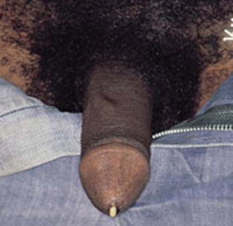
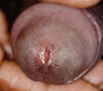
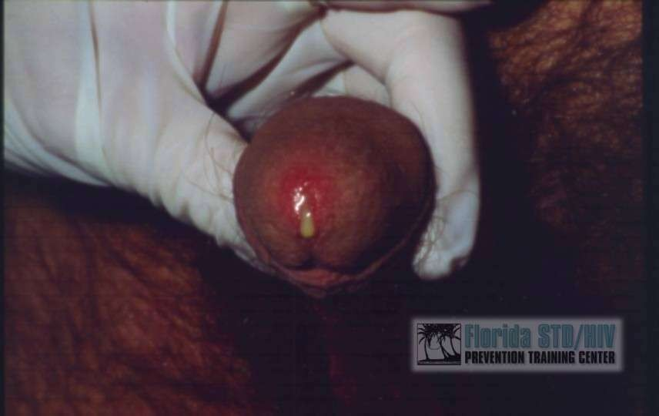

Slide 29
MALE URETHRAL DISCHARGE…
Treatment
  Ceftriaxone /Spectinomycin IM stat Plus
  Azithromycin 1gm po stat/Doxycycline/Tetracycline for 7 days/Erythromycin for 7 days in cases of contraindications for Tetracycline (children and pregnancy)
    Note: The preferred regimen is Ceftriaxone IM stat plus Azithromycin 1gm po stat.
Educate /council about:
  Risk reduction
  Treatment compliance
  Proper and consistent use of condom
  Partner notification and management
  Importance of HIV testing
  Abstinence from sex till all symptoms resolve.

Slide 30
MALE URETHRAL DISCHARGE…
Recurrent/Persistent Urethral Discharge Syndrome - not responds on the above Rx
  If non-compliant or re-exposure occurs ,re-treat with the initial regimen with due emphasis on drug compliance and/or partner management.
    If they have compliance - Cover Mycoplasma genitalium and T. vaginalis
  the recommended drug for persistent or recurrent urethral discharge syndrome in Ethiopia is:
    Metronidazole 2 gm po. stat/Tinidazole 1gm po once for 3 days (Avoid Alcohol!) PLUS
    Azithromycin 1 g orally in a single dose (only if not used during the initial episode to address doxycycline resistant M.genitalium)
  Referral - If men require treatment with a new antibiotic regimen

Slide 31
2. Genital Ulcer Syndrome
It is an open sore or a break in the continuity of the skin or mucous membrane of the genitalia as a result of sexually acquired infections.
  Commonly genital ulcer is caused by bacteria and viruses.
Etiologies of genital ulcer syndrome are:
  Herpes simplex virus (HSV-1 and HSV-2)
  Treponema pallidum –syphilis
  Haemophilius ducreyia- Chancroid
  Chlamydia trachomatis- LGV
  Klebsiella granulomatis (donovanosis)
  ,Lymphogranuloma Venereum (LGV- Caused by C. trachomatis serovars L1, L2, or L3 LGV primarily infects the lymphatics)
  HSV2 alone was the leading cause of genital ulcer in both males and females constituting 44% and 76% of the cases respectively

Slide 32
Clinical Features Syphilis (Hard chancre)
– A disease characterized by a primary lesion, a later secondary eruption on the skin and mucus membranes, then a long period of latency, and finally late lesion, of skin, bones, viscera, CNS and CVS
Etioiopy – Treponema pallidum, a spirochete
Genital ulcer occurs in the primary stage of the disease.
It starts as a small papular lesion that rapidly ulcerates to produce a non –tender, indurated lesion with a clean base and a raised edge known as hard chancre.

Slide 33
Infectious Dose: ~57 organisms¹
Incubation Period – 21 days (median)
3 clinical stages of syphilis
  Primary:
    Painless sore (chancre) at inoculation site
    Resolves in 1-5 weeks
  Secondary:
    Rash, Fever, Lymphadenopathy, Malaise
  Tertiary/Latent:
    CNS invasion, organ damage

Slide 34
Clinical manifestations
The clinical presentation is divided in to three
Primary syphilis
Consists of hard chancre, the primary lesion of syphilis, together with regional lymphadenitis.
The hard chancre is a single, painless ulcer on the genitalia or elsewhere (lips, tongue, breasts) and heals spontaneously in a1-5 weeks with out Rx.
The lymph glands are bilaterally enlarged and not painful. There will not be suppuration.

Slide 35
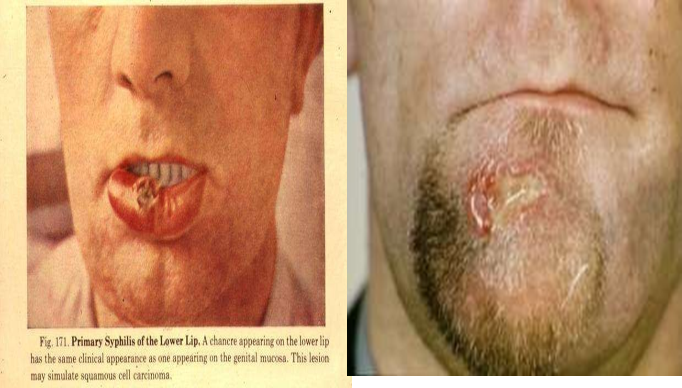
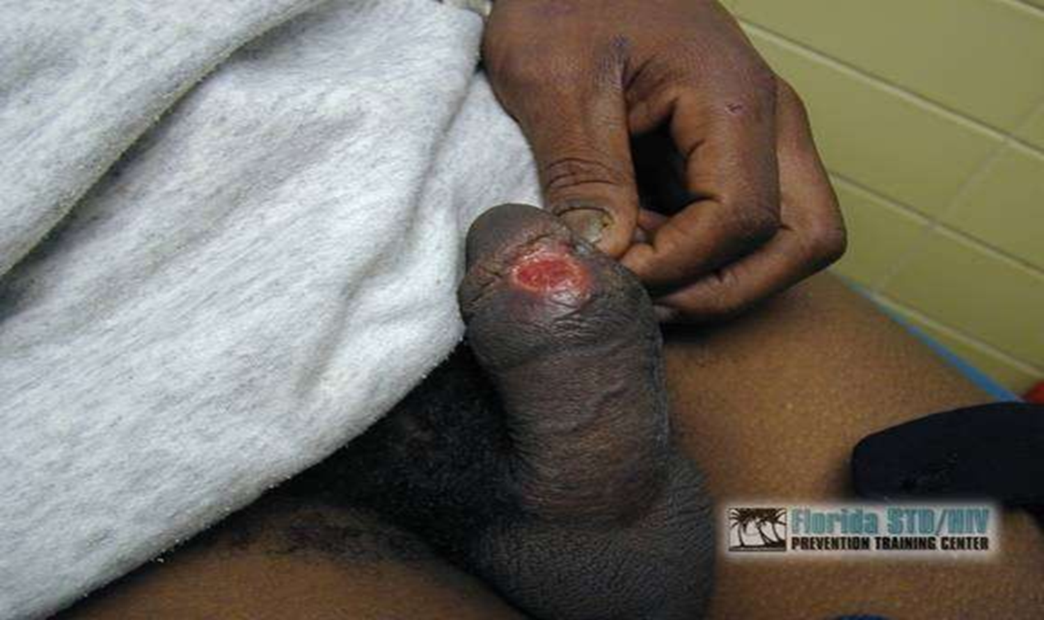
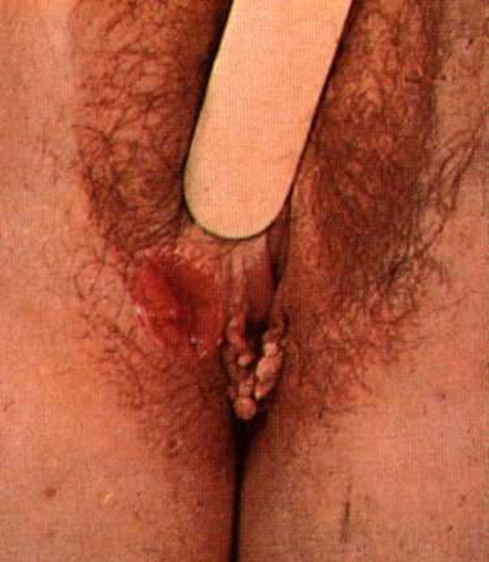

Slide 36
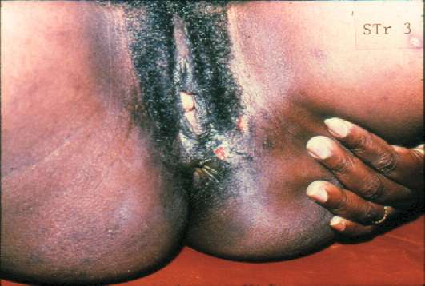


Slide 37
Secondary syphilis
It is characterised by a non-itchy rash over the trunk and the extremities, arising 1 to 6 months after primary syphilis.
a generalized secondary eruption appears, often accompanied by mild constitutional symptoms.
These early rashes tend to be symmetrical, quickly passing and don’t itch.
These early skin lesions are highly infective and many spirochetes are demonstrated in them.
Condylomata Lata-highly infectious
Latent syphilis is the stage between secondary and tertiary syphilis in which an infected patient shows few or no symptoms.

Slide 38
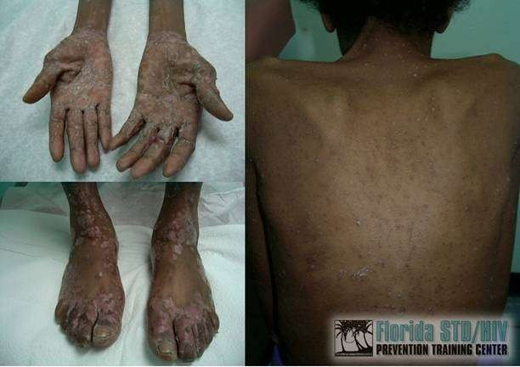
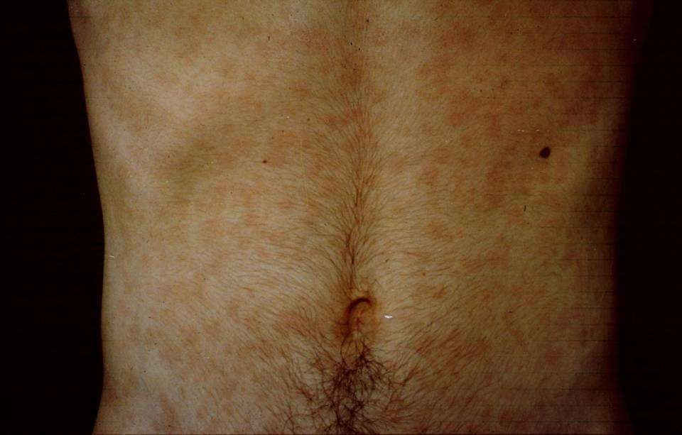
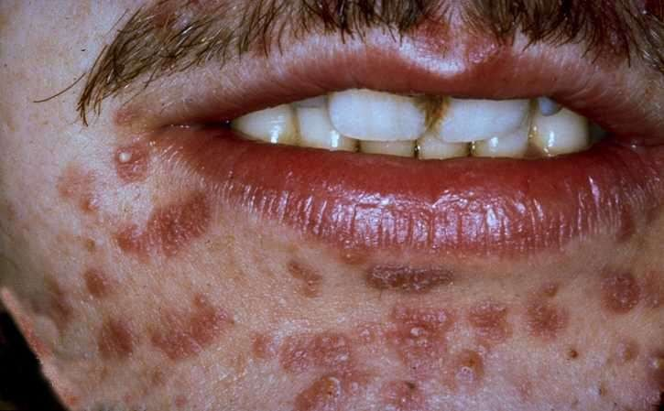
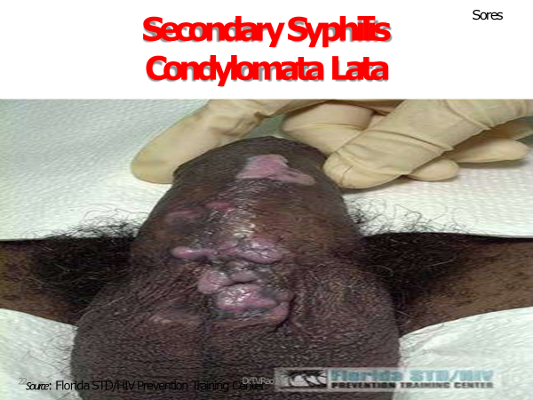

Slide 39
Tertiary syphilis is a rare phenomenon characterised mainly by soft tumour-like balls of inflammation destructive, non- infectious lesions of the skin, bones, viscera, and mucosal surfaces.
Some individuals with tertiary syphilis may show serious neurological (nervous system) or cardiovascular problems (heart and blood vessels).
Like disabling in the CVS (aortic incompetence, aneurysms) or CNS (dementia, paralytica, tabes dorsalis)
Tertiary syphilis takes 1 to 10 years to develop, but it can take up to 50 years.

Slide 40
Serologic Tests for Syphilis: Treponemal Assays
Principle:
–Infection leads to production of specific antibodies directed against T. pallidum
Treponemal tests detect IgG or total IgM/IgG antibodies directed against T. pallidum

Slide 41
Treponemal Assays:
Limitations
Remain positive despite treatment
  Cannot be used to monitor response to therapy
Conventional Methods
  Subjective interpretation requiring technician expertise to read
Newer Methods
  Expensive instrumentation
  Higher cost/test

Slide 42



Serologic Tests for Syphilis:
Non-Treponemal Assays
Principle:
  T. pallidum infection leads to the production of reagin
    Reagin – Antibodies to substances released from cells damaged by T. pallidum
  Reagin reacts with cardiolipin
    Cardiolipin – a phospholipid component of certain
eukaryotic and prokaryotic membranes
Examples of non-treponemal tests:
  Rapid Plasma Reagin (RPR)
  Venereal Disease Research Laboratory (VDRL)
Dr.T.V.Rao MD
33

Slide 43
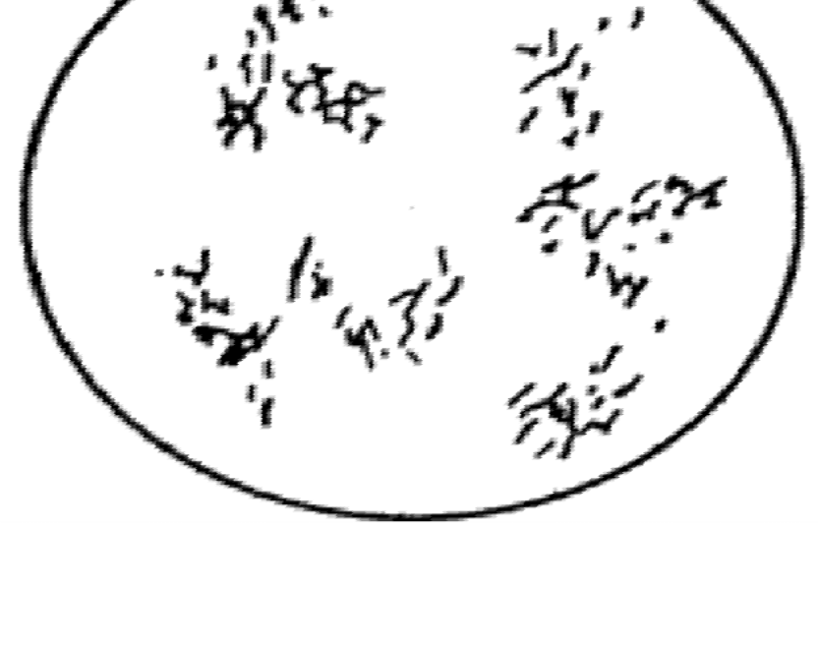



VDRL
Each preparation of antigen suspension should first be examined by testing with known positive or negative serum controls.
The antigen particles appear as short rod forms at magnification of about 100x. Aggregation of these particles into large or small clumps is interpreted as degrees of positivity
Reactive on left, non-reactive on right

Slide 44
Rapid Plasma Reagin Test - RPR
General screening test, can be adapted to automation.
CANNOT be performed on CSF.
Antigen
  VDRL cardiolipin antigen is modified with choline chloride
to make it more stable
  attached to charcoal particles to allow macroscopic reading
  antigen comes prepared and is very stable.
Serum or plasma may be used for testing, serum is
not heated.
RPR appears to be more sensitive than the VDRL.

Slide 45
Non-Treponemal Tests:
Advantages
Rapid turnaround time – Minutes
Inexpensive
No specialized instrumentation required
Usually revert to negative following therapy
–Can be used to monitor response to therapy

Slide 46




Non-Treponemal Tests:
Limitations
Results are subjective
  Intra- and Inter-laboratory variability
Non-specific
  False positive results can result from other infectious or non-infectious conditions
    EBV, Lupus, etc.
Limited sensitivity in early/primary syphilis and in late/latent syphilis
Low throughput
  Problematic for high volume laboratories

Slide 47
Reverse Algorithm
Treponemal test (eg, EIA)
Reactive
Non-reactive
Non-Treponemal test (eg, RPR)
Negative for syphilis
Reactive
Non-reactive
Syphilis
Second Treponemal Test (e.g., TP-PA)
Reactive Non-reactive
Evaluation Required* Negative for syphilis

Slide 48
Chancroid /soft chancre/
It is caused by bacteria termed Haemophilus ducreyi
In the majority of cases it presents with painful ulcers and sores in the genital area (particularly in the foreskin of the penis)
Many patients also develop a bubo, Inguinal adenopathy that becomes necrotic and fluctuant (buboes) follow the ulcer on one side of the groin that exudes liquid.
By contrast, most infected women do not show any symptoms.
Penile auto amputation complication

Slide 49
Herpes genitalia (Genital herpes)
Latency and frequent recurrence
characterize herpes genitalias producing a life long infection after the primary infection.
The lesions are painful initially presenting erythematous macules, which then progress to vesicles, pustules, ulcers and finally crusts.
Prolonged and severe disease with extensive tissue involvement and higher rate of dissemination occur in patients with HIV infection.
First episode primary genital herpes is x-zed by fever, head ache, malaise and myalgias.
Pain, itching, dysuria, vaginal and urethral discharge, and tender inguinal lymph adenopathy are the predominant local symptoms.

Slide 50
LGV (lymphgranuloma venerium)
The diseaese starts as a small painless papule that develops to an ulcer.
LGV is caused by C. trachomatis serovars
L1, L2, or L3 . The most common clinical manifestation of LGV among heterosexuals is tender inguinal and/or femoral lymphadenopathy that is typically unilateral.
After a week or so painful regional lymphadenopathy develops with symptoms of fever, chills, head ache, malaise, anorexia and wt loss.
Elephantiasis of genitalia, scrotum and vulva occur in either sex.
Complication
Genital edema
Salphingitis
Infertility
PID

Slide 51
Klebsiella granulomatis (donovanosis)
Granuloma inguinale is a genital ulcerative disease caused by the intracellular gram- negative bacterium Klebsiella granulomatis (formerly known as Calymmatobacterium granulomatis).

Slide 52
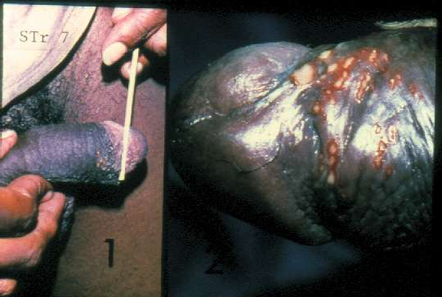
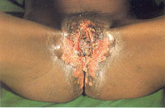

Slide 53
2. Genital Ulcer Syndrome…
Untreated complications, life threatening so must be treated aggressively and promptly.
1.Treatment for Non- Vesicular Genital Ulcer
    Benzathine penicillin 2.4 mu IM stat /Doxycycline(in penicillin allergy)for 14 days plus
    Ciprofloxacin for 3 days /Erythromycin for 7 days Plus
    Acyclovir 400mg tid orally for 10 days (or 200mg five times per day of 10 day)
2. Treatment for Vesicular, multiple or recurrent genital ulcer
  Acyclovir 200 mg five times per day for 10 days Or Acyclovir 400 mg tid for 7 days
3. Treatment for recurrent infection: Acyclovir 400 mg tid for 7 days.

Slide 54
3. Vaginal Discharge Syndrome
STI related discharge is abnormal in color, odor and amount accompanied by pruritus.
The most common causes are
  Neisseria gonorrhea
  Chlamydia trachomatis
  Trichomonas vaginalis
  Gardnerella vaginalis (Polymicrobial)
  Candida albicans
Bacterial vaginosis (Gardnerella vaginalis) is the leading cause of vaginal discharge in Ethiopia followed by candidiasis, trichomoniasis, gonococcal and chlamydia and cervicitis in that order.

Slide 55
Chlamydia trachomatis
More than three million new cases annually
Responsible for causing cervicitis, urethritis, Proctitis, lymphogranuloma venereum, and pelvic inflammatory disease
Direct and indirect cost of chlamydial infections run into billions of dollars
Potential to transmit to newborn during delivery
– Conjunctivitis, pneumonia
Dr.T.V.Rao MD
76

Slide 56
3. Vaginal Discharge
The common risk factors for development of discharge syndrome secondary to cervicitis:
  Multiple sexual partners in the last 3 month
  New sexual partner in the last 3 month
  Ever traded sex
  Age below 25 years
The presences of one or more risk factor suggest cervicitis.

Slide 57
Cervicitis
The presence of purulent or mucopurulent exudation from the cervical os frequently indicates gonococcal or chlamydial infection.
On speculum examination the presence of redness, contact bleeding, spotting and endocervical discharge suggests the diagnosis of cervicitis

Slide 58
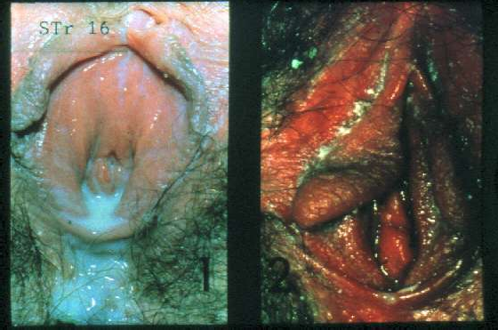
51

Slide 59
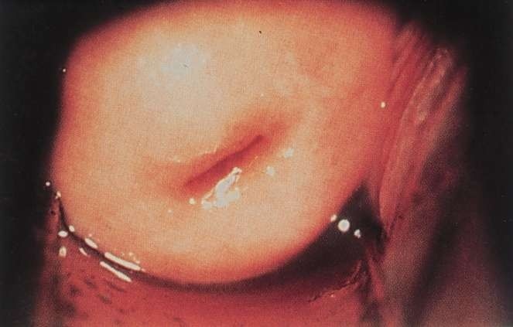
Normal Cervix
Source: Claire E. Stevens, Seattle STD/HIDVr.TP.V.rReavo eMnDtion Training Center
77

Slide 60
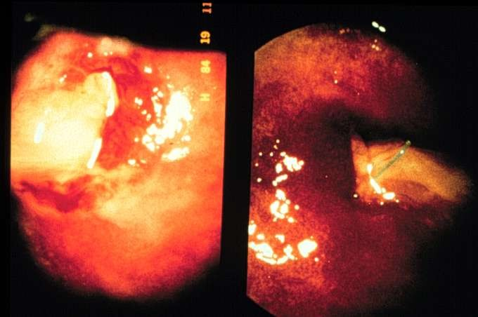
Chlamydia Cervicitis
Source: St. Louis STD/HIV Prevention Trai^{D}n^{r.}i^{T}n^{.V}g^{.Ra}C^{o M}en^{D}ter
78

Slide 61
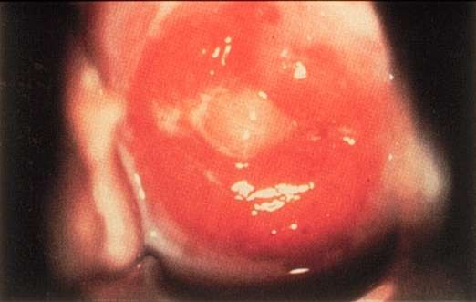
Mucopurulent Cervicitis
Source: Seattle STD/HIV Prevention Traini^{D}n^{r.}g^{T.V.}C^{Ra}eºn^{M}te^{D} r
79

Slide 62
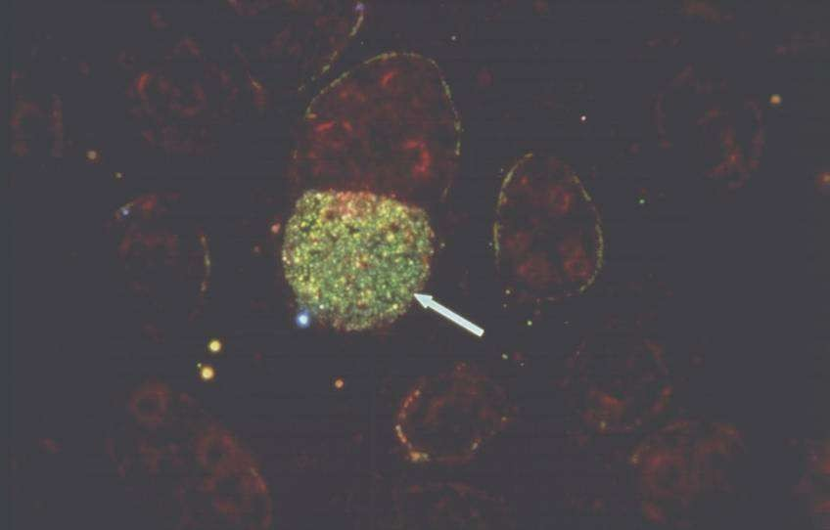
Chlamydia Direct Fluorescent Antibody (DFA)
Source: Centers for Disease Control and P^{D}r^{r}e^{.T.}v^{V.}e^{Ra}nºt^{M}io^{D}n
82

Slide 63
3.Vaginal Discharge Syndrome…
Some of the complications are:
  Pelvic Inflammatory Disease (PID)
  Peritonitis and intra-abdominal abscess
  Adhesions and intestinal obstruction
  Ectopic pregnancy
  Premature Rupture of Membrane (PROM) in case of pregnant women
  Chorioamnionitis
  Post-partum endometritis
  Pre-term labor in case of pregnant women
  Low birth weight ,Infertility , Chronic pelvic pain.

Slide 64
3.Vaginal Discharge Syndrome…
Risk Assessment Positive
  Ceftriaxone /Spectinomycin IM stat Plus
  Azithromycin 1gm po stat/Doxycycline for 7 days Plus
  Metronidazole for 7 days
  If discharge is white or curd-like add Clotrimazole vaginal pessary 200 mg at bed time for 3 days
  Note: The preferred regimen is Ceftriaxone IM stat Plus
  Azithromycin 1gm po stat plus Metronidazole for 7days

Slide 65
3.Vaginal Discharge Syndrome…
Risk Assessment negative
Metronidazole for 7 days If discharge is white or curd-like add Clotrimazole vaginal pessary 200 mg at bed time for 3 days

Slide 66
4. Lower Abdominal Pain/Pelvic Inflammatory Disease (PID)
It refers to a clinical syndrome resulting from ascending infection from the cervix and/or vagina.
PID comprises a spectrum of inflammatory disorders of the upper female genital tract, including any combination of endometritis, salpingitis, tubo-ovarian abscess and pelvic peritonitis.
The commonest pathogens associated with PID, which are transmitted sexually, are C. trachomatis and N. gonorrhoea.

Slide 67
4. Lower Abdominal Pain/Pelvic…
Other causes may or may not be transmitted sexually include:
    Mycoplasma genitalium
    Bacteroides species
    E. coli
    H. influenza
    Streptococcus

Slide 68
Complications of PID
Bilateral lower abdominal pain or pelvic pain is the most common clinical complaints but ranges from abrupt and fulminant presentation to a subacute form with mild symptoms often described as dull pain.
Lower abdominal tenderness together with cervical excitation tenderness are indicative of PID.
Peritonitis and intra-abdominal abscess
Adhesions and intestinal obstruction
Ectopic pregnancy
Infertility
Chronic pelvic pain
Recurrent PID

Slide 69
PID Treatment
For outpatient Rx
  Ceftriaxone /Spectinomycin 2gm i.m stat
  Plus
  Azithromycin 1gm po stat/Doxycycline 100 mg for 14 days
  Plus
  Metronidazole 500 mg po b.i.d for 14 days
Admit if there is no improvement within 72 hours
Note : The preferred regimen is Ceftriaxone 250mg IM/IV stat plus Azithromycin 1gm po stat Plus Metronidazole 500 mg bid for 14 days
Inpatient PID, ceftriaxone, spectinomycin or azithromycin should continue for 24hrs then doxycycline and metronidazole should continue for a total of 14 days.

Slide 70
5. Scrotal Swelling Syndrome
Patients who are younger than 35 years, the swelling is likely to be caused by sexually transmitted infections.
  Manifested by Pain and swelling of the scrotum, Tender &hot scrotum on palpation, Edema and erythema of the scrotum, Dysuria, Sometimes frequency and urethral discharge.
The cause can be infectious or non-infectious.
  Infectious scrotal swelling caused by:N. gonorrhea ,C. trachomatis, T. pallidum, M. tuberculosis, Mumps virus , Pseudomonas aeruginosa and Filarial diseases.
  Non infectious caused by trauma, tumor, and torsion of the testis or inflammation of the epididymis

Slide 71
Scrotal Swelling Syndrome
Complications :
  Destruction and scarring of testicular tissues, Infertility, Impotence , Prostatitis
The treatment of scrotal swelling is similar to that of urethral discharge.
  In addition analgesia and scrotal support may be indicated as required.
Ceftriaxone 250mg i.m stat/ Spectinomycin 2gms i.m stat. Plus Azithromycin 1gm po stat plus Doxycycline 100mg po bid for 7 days/ Tetracycline 500mg qid for 7 days
  Note :The preferred regimen is Ceftriaxone 250mg IM stat plus Azithromycin 1gm po stat.

Slide 72
6. Inguinal Bubo Syndrome (Swollen Glands)
It is defined as swelling of inguinal lymph nodes as a result of STIs but not infections on the lower extremities or in the perineum could produce swelling of the inguinal lymph nodes.
The common causes of inguinal and femoral bubo are:
  Chlamydia trachomatis (L1, L2 and L3)
  Klebsiella granulomatis (donovanosis)
  Treponema pallidum
  Haemophilius ducreyia

Slide 73
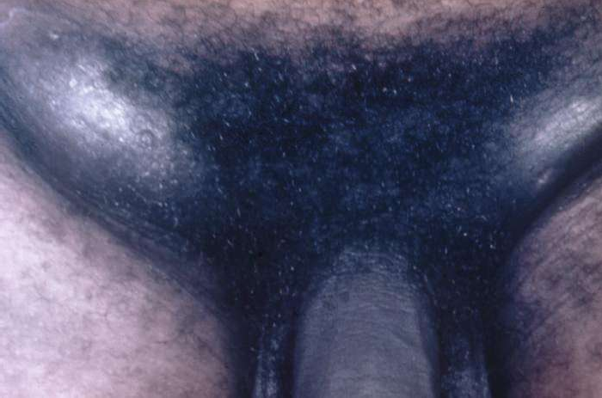
Inguinal Bubo
64
Courtesy of CDC/ Susan Lindsley

Slide 74
COMPLICATIONS Inguinal Bubo Syndrome
  Fistula or sinus formation
  Multiple draining sinus
  Extensive ulceration of genitalia
  Extensive scarring
  Proctocolitis with tenesmus and bloody purulent discharge.
  Retroperitoneal lymphadenopathy
  Chronic untreated LGV may result in lymphatic obstruction, elephantiasis of the genitalia
  Rarely hematogenous dissemination to lung, liver, spleen and bone.

Slide 75
Inguinal Bubo Treatment
Treatment regimen for inguinal bubo syndrome in Ethiopia is:
  Ciprofloxacin 500mg bid orally for 3 days
  Plus
  Doxycycline 100 mg bid orally for 14 days /Erythromycin 500mg po qid for 14 days.
  If patient have genital ulcer, add Acyclovir 400mg tid orally for 10 days( or 200mg five times per day for 10 days)
Note: surgical incisions are contraindicated; aspirate pus with hypodermic needle through the health skin

Slide 76
Neonatal Conjunctivitis
Neonatal conjunctivitis (ophthalmia neonatorum) is an ocular redness, swelling and drainage which can be sometimes purulent due to pathogenic agents or irritant chemicals occurring in infants less than 4 weeks of age.
Some of the common etiologic causes of neonatal conjunctivitis are: N. gonorrhea, C. trachomatis, S. pneumoniae, H. influenzae, S. aureus
Some of the complicationsare:
  Pseudo membrane formation
  Corneal edema
  Thickened palpebral conjunctiva Corneal opacification
  Corneal perforation
  Endophthalmitis
  Blindness

Slide 77
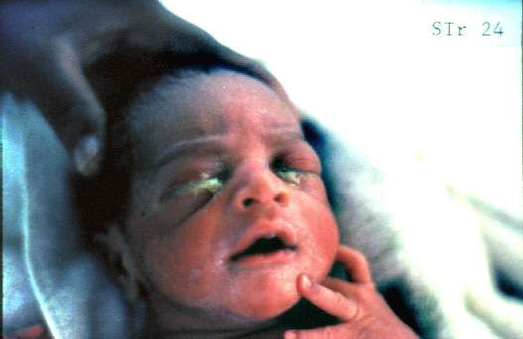

Slide 78
Neonatal Conjunct….
The recommended treatment of neonatal conjunctivitis :
  Ceftriaxone 50mg/kg IM stat maximum dose 125/ Spectinomycin 25 mg/kg IM stat maximum dose 75mg
  Plus
  Erythromycin 50mg/kg orally in four divided doses for 14 days
Note: TTC is used as prophylaxis for neonatal conjunctivitis but note for treatment

Slide 79
Sexually transmitted diseases(STD)
Relationship between STIs and HIV
  Transmission has been described as an epidemiological synergy.
  HIV and STIs share the same risk factors So very critical to strengthen STI prevention and control program
    to improve quality of life and to overcome the complications caused by the infections, and
    also to prevent the spread of HIV infection.
  HIV infection affects STIs.
  Conventional STI facilitate the acquisition and transmission of HIV infection •
      Effective management of STI can reduce HIV infection.

Slide 80
Why We deal STI with HIV
STIs facilitate the transmission of HIV
HIV increases the risk of STIs infection
STI control is also important for preventing the spread of HIV from PLHIV
Educating clients about the transmission, treatment and control of STIs and HIV
Providing risk reduction counselling by focusing on the prevention of STIs and HIV
Condom promotion and provision for all clients
Consideration and Encouragement for HIV testing and offering PICT
Partner counselling and treatment: management of partners for STIs is an essential component of STIs to stop further recurrent infection among partners.
Referral of patients and their partners to counselling units and laboratories for HIV and syphilis testing, or to higher health care if they do not respond to syndromic treatment of STIs.

Slide 81
HIV and AIDS
What is HIV?
Human Immunodeficiency Virus
A retrovirus virus that can escape – and infect – the immune system and various organs
Particularly “likes” to infect CD4 cells
Leads to “immunodeficiency” by depleting CD4 cells

Slide 82
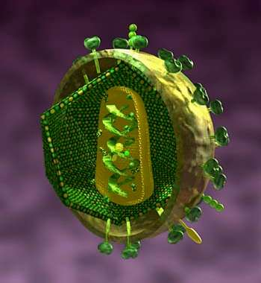
The HIV virus
■ This cutaway diagram of HIV shows its outer shell and most of its internal parts

Slide 83
HIV and AIDS
What is AIDS?
Acquired Immune Deficiency Syndrome
“Immune deficiency” or “immunodeficiency” = weak immune system
When immune system is too weak, the body is left open to diseases; infections & cancers

Slide 84
Transmission of HIV
Blood
Seminal fluids
Pre-ejaculatory fluids
Breast milk
Vaginal secretions
Sexual- oral, vaginal & anal
Mother to child- delivery, breast milk
IDU (unclean needles) + Hep. C co-infection
Needle stick injury = PEP
Blood transfusion prior to 1985

Slide 85

Risk factors of transmission
Unsafe sex-
Use of dirty or contaminated syringes & needles
INJECTABLE DRUG USE –materials used for injections :

Slide 86
Risk factors of transmission: Mother to child
Mother to child during pregnancy, labor, delivery, breastfeeding
25% of transmission during birth without treatment
With treatment and Caesarean, transmission can be reduced to 2%

Slide 87
Symptoms of HIV infection
General symptoms
Flu like symptoms such as fatigue, fever, sore throat, swollen lymph nodes, headache, loss of appetite or rash.
Symptoms may last as long as a few weeks.

Slide 88
4 Stages of HIV infection
Primary infection - general symptoms or sero-conversion - making antibodies to HIV (1 to 3 months)
Asymptomatic- feeling well, maybe swollen lymph glands (SLG)
Symptomatic- SLG, night sweats, fever, diarrhea, weight loss, tiredness, thrush
AIDS – Ols, cancers

Slide 89
Primary HIV Infection
Asymptomatic Acute retroviral syndrome
Clinical Stage 1
Asymptomatic Persistent generalized lymphadenopathy

Slide 90
Clinical Stage 2
Moderate unexplained weight loss presumed or measured body weight)
Recurrent respiratory infections
(<10% of
(sinusitis,
tonsillitis, otitis media, and pharyngitis)
Herpes zoster
Angular cheilitis
Recurrent oral ulceration
Papular pruritic eruptions
Seborrheic dermatitis
M•ay 11F, 20u20ngal nail infections
79

Slide 91
Clinical Stage 3
Unexplained severe weight loss (>10% of presumed or measured body weight) Unexplained chronic diarrhea for >1 month
Unexplained persistent fever for >1 month (>37.6ºC, intermittent or constant) Persistent oral candidiasis (thrush) Oral hairy leukoplakia Pulmonary tuberculosis (current) Severe presumed bacterial infections (e.g., pneumonia, empyema, pyomyositis, bone or joint infection, meningitis, bacteremia) Acute necrotizing ulcerative stomatitis, gingivitis, or periodontitis Unexplained anemia (hemoglobin <8 g/dL) Neutropenia (neutrophils <500 cells/µL) Chronic thrombocytopenia (platelets <50,000 cells/µL)

Slide 92
Clinical Stage 4
HIV wasting syndrome
Pneumocystis pneumonia
Recurrent severe bacterial pneumonia
Chronic herpes simplex infection (orolabial, genital, or anorectal site for >1 month or visceral herpes at any site)
Esophageal candidiasis (or candidiasis of trachea, bronchi, or lungs)
Extrapulmonary tuberculosis
Kaposi sarcoma
Cytomegalovirus infection (retinitis or infection of other organs)
Central nervous system toxoplasmosis
HIV encephalopathy
Cryptococcosis, extrapulmonary (including meningitis)
Disseminated nontuberculosis mycobacteria infection
Progressive multifocal leukoencephalopathy
Candida of the trachea, bronchi, or lungs
Chronic cryptosporidiosis (with diarrhea)
Chronic isosporiasis
Disseminated mycosis (e.g., histoplasmosis, coccidioidomycosis, penicilliosis)
Recurrent nontyphoidal Salmonella bacteremia
Lymphoma (cerebral or B-cell non-Hodgkin)
Invasive cervical carcinoma
Atypical disseminated leishmaniasis
Symptomatic HIV-associated nephropathy
Symptomatic HIV-associated cardiomyopathy
Reactivation of American trypanosomiasis (meningoencephalitis or myocarditis)

Slide 93
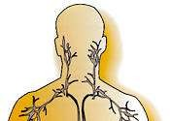
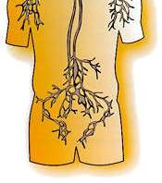
The Immune System
CD4 and other immune cells are mostly found in the “lymphatic system” and the bloodstream

Slide 94
HIV test
Window period of 3 months following exposure.
The test detects antibodies to the virus NOT the virus itself.
Test can be done named, unnamed or anonymous test Includes 2 test .
  Standard ELSIA followed by Western Blot.
  ELISA done 2x (repeatedly reactive)
  Western Blot , confirmatory test

Slide 95
Immune markers: CD4 and Viral load
CD4 ( T4) are white blood cells that control infections; decrease with HIV replication
Normal range is 500-1400 cells/mm³ [slightly higher in women]
Higher CD4s = stronger immune system
Percentage of CD4s are 30-50% of lymphocytes

Slide 96
CD4
Generally gets lower, the longer one has been HIV+
CD4 counts can vary from lab test to test, and may be temporarily lowered by common infections such as flu.

Slide 97
Viral load
A measurement of amount of HIV virus in blood
This is only about 2% of the total HIV - rest is in lymph nodes, gut, sexual fluids, CNS and elsewhere
Can be anywhere from hundreds (100s) to millions (1,000,000s) per millilitres

Slide 98
HIV progression: Viral load
Generally, the higher the viral load, the faster CD4 counts will drop.
Higher viral load = more stress on immune system & higher risk of disease progression
HIV treatment recommendations also depend on viral load as well as CD4s
Two people with same CD4 count will have different risks if their viral loads are different

Slide 99

Typical untreated HIV disease
“Primary infection”
Antibodies form
CD4 cells
Risk of illness
…Symptom-free period…
Viral load
(years)
(weeks)
TIME
May 11, 2020
88

Slide 100
Opportunistic Infections (OIs)
Infections that take “opportunity” of a weakened immune system
Include malignancies (cancers) such as Kaposi’s Sarcoma
Some less serious (e.g. oral thrush), some life-threatening (e.g. PCP, toxoplasmosis)
100

Slide 101
Opportunistic Infections (OIs)
Risk of OIs as CD4
Some, are “AIDS-defining illnesses” and some are not.
Most are quite treatable if detected early on or prevented through anti-HIV drug therapy.
Once OIs occur, more likely to recur.
101

Slide 102
Ols and CD4 counts
Most OIs can be prevented (“prophylaxis”) or treated (eg, Septra for PCP pneumonia)
OIs are much less common in the era of highly active antiretroviral therapy (HAART)
Overall trend is more important than any single count
102

Slide 103
Opportunistic Infections
If the CD4 is at 200 or below, more susceptible to PCP, CMV, Toxoplasmosis, lymphoma, etc.
The current guidelines for treating People with HIV/AIDs with prophylaxis are; if the CD4+ count is below 200cells/mm3
103

Slide 104
The immune status Vs the CD4 counts the lymphocyte counts & the presence of symptomatic disease.
Clinical Condition CD4 cell count Lymphocyte count
Well with no symptoms
>500cells/mm³
>2500cells/mm³
350-500cells/mm³
1000-2500cells/mm³
Minor symptoms
Major symptoms and opportunistic diseases
200-350 cells/mm³
500-1000cells/mm³
<200 cells/mm³
AIDS
<500cells/mm³
104

Slide 105
Women and OIs
Cervical dysplasia
Cervical cancer
Menstrual problems
PID (Pelvic Inflammatory Disease)
Thrush (oral)
Yeast infections (vaginal)
105

Slide 106
HIV and TB Co-infection
Can become infected with TB at any CD4+ count
One can develop active TB easily if one has advanced HIV disease + TB infection
TB can make the HIV virus multiply faster and can increase progression of HIV disease much worse
106

Slide 107

Antiretroviral drugs for HIV
Antiretroviral drugs:
What we use to treat HIV
The viral life cycle and the different classes of drugs
107

Slide 108
Goals of anti HIV therapy
HIV can infect cells and remain there
Drugs cannot completely eliminate the virus
By stopping/slowing the virus multiplication, viral load is reduced
Lowered stress on immune system allows it to recover.
108

Slide 109
Antiretroviral drugs
HIV can’t reproduce on its own
Needs to infect and “hijack” human cells (like CD4 cells) to “replicate”
Infected cells are like little “assembly lines” producing new viruses
Antiretroviral drugs are designed to stop the assembly lines from forming and/or replicating the HIV virus.
109

Slide 110







The HIV “life cycle” and the classes of drugs
HIV
Fusion (T-20)
Assembly (Protease)
(Indinavir, ritonavir,etc)
Reverse Transcription (AZT, 3tc, d4T)
Integration
Infected cell
110

Slide 111
Antiretroviral drug classes
On market:
Reverse transcriptase inhibitors:
  “Nucleoside analogues” and
  “Non-nucleoside analogues”
Protease inhibitors
In market or in development:
Fusion/entry inhibitors
Integrase inhibitors
111

Slide 112
Side effects of HIV medication
Long term
Coronary disease-lipids, cholesterol
Diabetes 2-insulin resistance
Lipodystrophy or lipoatrophy
Bone loss
Short term:4-9 wks
Nausea, diarrhea,
fever, chills, peripheral neuropathy, anemia, neutropenia, gastrointestinal, etc.
112

Slide 113
Pregnancy and HIV
Consider treatment if VL >1,000 copies/mL
Factors; HIV-positive women are at increased risk for premature birth
Premature birth increases the risk of HIV transmission .
Even if the viral load is low (< 1,000 copies) it is always a good idea for the mother to be on HAART just incase the membranes rupture prematurely increasing the fetus' risk of acquiring HIV.
113

Slide 114
When to Start Medications from Medical Point of View
Still a subject of debate; no consensus
Anyone asymptomatic with viral loads of > 100,000 copies/mL and/or CD4 counts of < less than 350 cells/mm³
All pregnant women with VL greater than 1,000 copies/mL
Anyone who has symptomatic HIV disease
114

Slide 115
Risk and benefit of delaying antiHIV therapy
Risks:
Possibility of irreversible immune system damage that may have been reversible with early therapy.
Possibility that suppression of viral replication may be more difficult at later stage
Increased risk of transmitting virus to others
Benefits:
Minimizing treatment-related negative effects on quality of life and drug toxicities.
Preserving future treatment options.
Delaying development of drug resistance.
115

