Slide 1
Debre Markos University
Health Science College
Department of Public Health
For 2nd year Public Health students
Course Title: Epidemiology
Part I: By Animut Takele
(BSc in PH, MPH in Epidemiology)
May, 2020

Slide 2
Course outline
Chapter1: Introduction to epidemiology: definition, history, use, scope, ETC.
Chapter 2: Natural history of disease, levels of prevention and infectious disease cycle
Chapter 3: Communicable disease and disease causation
Chapter 4: Measures of disease
Chapter 5: Source of epidemiological data
Chapter 6: Epidemiological study design (descriptive and analytical designs)
Chapter 7: Measures of association
Chapter 8: Epidemiologic surveillance
Chapter 9: Evaluation of evidence base and judgment of causality
Chapter 10: Disease screening
Chapter 11: Investigation of outbreak/epidemic

Slide 3
Lecture on introduction to Epidemiology
Learning objective
At the end of this session the students will be able;
  To define basic concepts in community health
  Definition of epidemiology
  History of Epidemiology
  List use/applications of Epidemiology
  Mention scope of epidemiology
  Define basic assumptions of epidemiology and disease causation

Slide 4
Basic Concepts In Community Health
Health defined as;
Definition of health has negative and positive models
Negative model- defines health as the absence of the constraints of health.
  That is you are healthy if you are not ill.
  The renewal of health in a diseased individual is the removal of the disease.
  This model equates health with the absence of disease
Positive model is by WHO- a state of complete physical, mental and social well being and not merely the absence of disease or infirmity.
  This definition is also simplified to “ The ability to lead a socially and economically productive life”

Slide 5
Basic concepts health cont.…
Disease- is a physiological/psychological dysfunction
Illness- a subjective state of the person who feels aware of not being well
Sickness- is a state of social dysfunction that is a role that the individual assumes when ill
Risk factors - are factors positively associated with the risk of developing disease but are not sufficient.
  Some risk factors are associated with many diseases while some diseases are associated with many factors.

Slide 6
Basic concepts health cont.…
Community- refers to a group of people who share some thing in common.
  Examples of common denominators may be neighborhood, work place, race, religion or social activity.
  Communities are characterized by people’s engagement in activities that demand interrelationship of efforts, they give rise to shared culture, and they are often sited in a particular geographic location.
Community medicine- is a system of delivery of comprehensive health care to the people by a health team to improve the health of a community.

Slide 7
Basic concepts health cont.…
Here (community medicine) the community replaces the individual patients as the primary focus of concern.
  The problem here is to evaluate the health of a defined community including those members who would benefit from, but could not seek medical care.
  These approach requires techniques and skills in addition to those needed for clinical practice.

Slide 8
Basic concepts health cont.…
Clinical medicine- medical care of individuals. Typically these are sick people who have presented for help.
  In community medicine, the community replaces the individual patients as the primary focus of concern.

Slide 9
Basic concepts health cont.…
Community diagnosis- is the process of identification and detailed description of the most important problems of a given community.
  It may be broad or narrow in scope, and may deal with only a single topic or a single sub group.

Slide 10
Basic concepts health cont.…
The task of community diagnosis requires statistical knowledge in addition to medical skills
Ways that one could make community diagnosis are:
  Discussion with community leaders and health workers-community felt health problems
  Attending community gatherings-community felt health problems
  Survey of available health records
  Field survey
  Analysis of data collected and compilation of report in order to reach at community diagnosis

Slide 11
Basic concepts health cont.…
Community diagnosis provides basis for decision on:
  The need for intervention
  Type of intervention needed
  Target group at whom intervention should be directed
  Provide baseline for later intervention

Slide 12
Basic concepts health cont.…
Preventive medicine- deals with the measures to protect the individuals from the diseases, and to keep them in a state of positive health.

Slide 13
Basic concepts health cont.…
Social medicine – is a study of man as social being in relation to his environment.
  It is a branch of medical science dealing with the study of community health with respect of social aspects (social, economical, cultural, psychological, environmental and genetic factors) in the community as a whole.
Epidemiological and statistical aspects are also dealt with

Slide 14
Basic concepts health cont.…
Public health- Is the science and art of preventing diseases, prolonging life and promoting health by community efforts and governments action.
Public health is:
  Preventing disease
  Prolonging life
  Improving quality of life
  Eliminating health inequalities
  Organizing community to promote active participation

Slide 15
Basic concepts health cont.…
Core functions of public health
Assessment- of health need, by conducting surveillance and specific studies
Leadership - program design, resource allocation and social mobilization
Provision of services- assure availability of quality and comprehensive health services through accessible outlets

Slide 16
What is epidemiology ??
Definition
The word epidemiology comes from the Greek words
  Epi, = “on or upon,”
  Demos, = “people,”
  Logos, = “the study of.”
Many definitions have been proposed over time by different scholars.
Kuller LH: Am J Epid 1991;134:1051
Epidemiology is the study of "epidemics" and their prevention

Slide 17
Definition Epidemiology…
Anderson G.quoted in Rothman KJ: Modern Epidemiology
  Epidemiology: the study of the occurrence of illness
Last JM: A Dictionary of Epidemiology
  The study of the distribution and determinants of health related states and events in populations and the application of this study to control of health problems“

Slide 18
Definitions…
Epidemiology
It is the study of frequency, distribution, and determinants of diseases and other health-related conditions in a human population
and
The application of this study to the prevention of disease and promotion of health

Slide 19
Components of the definition
1. Study: Systematic collection, analysis and interpretation of data
Epidemiology is a scientific discipline, sometimes called “the basic science of public health.” It has, at its foundation, sound methods of scientific inquiry.
Epidemiology involves collection, analysis and interpretation of health related data
Epidemiology is a science

Slide 20
Components…
2. Frequency: the number of times an event occurs
Epidemiology studies the number of times a disease occurs
  We measure frequency of death using mortality rates, which quantify occurrence of death and morbidity rates, which quantify occurrence of illness
It answers the question How many?
Epidemiology is a quantitative science

Slide 21
Components…
3. Distribution: Distribution of an event by person, place and time (PPT)
Epidemiology studies distribution of diseases
  Refers not only geographic distribution of diseases but also, to its distribution in time (seasonal fluctuation), according to the type of persons most or least affected (age group, occupation).
  It answers the question who, where and when? Of occurrence of health and health related events
Epidemiology describes health events

Slide 22
Components…
4. Determinants: Factors the presence/absence of which affect the occurrence and level of an event
Epidemiology studies what determines health events
  Factor which may be event, characteristic or any definable entity that brings about change in health and health related conditions.
  It refers to “why diseases occur in certain places? In a certain period? Or in a certain population groups?”
It answers the question how and why?
Epidemiology analyzes health events

Slide 23
Components…
5. Diseases & other health related events
Epidemiology is not only the study of diseases but events like birth, death, migration etc
    Examples of health related conditions are; Injuries Vital events, birth, death, marriages, divorce , Health related behaviors (Sexual behavior, Smoking, Alcoholism, Drug abuse, Social factors).
  The central concern of epidemiology is promotion and maintenance of health through the prevention of diseases.
It studies all health related conditions
Epidemiology is a broader science

Slide 24
Components…
6. Human population
Epidemiology diagnoses and treats communities/populations
  Epidemiology is concerned with population, there is strong interrelation with clinical medicine.
  Characterize a basic difference in approach between epidemiology and clinical medicine.
  In epidemiology, we study effects of diseases on populations, while in clinical medicine we study effects of diseases on individuals
Epidemiology is a basic science of public health

Slide 25
Components…
7. Application
Epidemiological studies have direct and practical applications for prevention of diseases & promotion of health
Is an applied science. The ultimate purpose of all epidemiological studies is the prevention and control of health problems.
Studying the frequency, distribution and determinants of diseases is to identify effective diseases prevention and control strategies.
Epidemiology is a science and practice
Epidemiology is an applied science

Slide 26
History of Epidemiology
Seven land marks in the history of Epidemiology
Hippocrates (400 B.C.)
  He displayed an extraordinary awareness of the impact of environment and behavior on personal wellbeing.
John Graunt (1620-1674)
  Is an English man, attributed to most important advance in epidemiology
  Published natural and political observations on the bills of mortality.
  He was the first to quantify patterns of birth, death and diseases occurrence, noting male births out numbered female births, urban deaths out numbered rural deaths, high infant mortality rate, and seasonal variations.

Slide 27
History of Epidemiology…
Lind (1747)
  Used an experimental approach to study causes of scurvy by showing it could be treated effectively with fresh fruit.
William Farr (1839)
  He took responsibility for medical statistics in the office of the registrar General for England and Wales.
  He established application of vital statistical data for the evaluation of health problems.
Jon Snow (1854)
  He was an English physician. He demonstrated that the risk of mortality due to cholera was related to the drinking water provided by a particular supplier in London.
  He is coined as “the father of field epidemiology.”

Slide 28
History of Epidemiology
Alexander Louis (1872): Systematized application of numerical thinking (quantitative reasoning)
Bradford Hill (1937): Suggested criteria for establishing causation
Epidemiological thought emerged in 460 BC
Epidemiology flourished as a discipline in 1940s

Slide 29
Purposes Of Epidemiology
1. Establishing causation of diseases
  Is an antecedent event, condition or characteristic that was necessary for the occurrence of the disease at the moment it occurred, given other conditions are fixed.
2. Elucidation the natural history of diseases
  Is essential to make prognosis or the likely outcome of a patients illness.
  Gives basis for rational decision about therapy.

Slide 30
Purposes cont.…
3. Description of health status of populations
Measure disease frequency- quantify disease
Assess distribution of disease
  Who is getting disease?
  Where is disease occurring?
  When is disease occurring?
Formulation of hypotheses concerning causal and preventive factors

Slide 31
Purposes cont.…
4. Identify determinants of diseases
Purpose of epidemiologic study is the identification of determinants of disease, whose manipulation could lead to prevention and control of diseases.
Hypothesis is developed after description of occurrence by person, place and time.
Hypotheses are tested using epidemiologic studies
  Determinants of health are Genetic factors, Lifestyle, Poverty and effluence, Health care facilities, Environment, physical, biological and psychological

Slide 32
Purposes cont.…
Among the determinant, the most amenable for modification is the physical environment.
Providing conducive physical environment implies:
    Safe water
    Sanitary conveniences
    Clean environment
    Good food etc.

Slide 33
Purposes cont.…
5. Evaluation of intervention programs
  Efficiency, effectiveness, feasibility and impact
    Any program designed to prevent and control a disease must be accompanied by methods for assessing whether the measures are effective in reducing the frequency of the disease.
6. Classification of diseases
  e.g. based on route of transmission
    Gonorrhea- as STD
    Shigellosis- under diarrhea diseases based on its clinical manifestation of diarrhea and as fecal- oral route of transmission.

Slide 34
Uses of Epidemiology
In historical study and projecting in to the future of health and diseases in the population
For community diagnosis of the presence, nature and distribution of health and diseases among the population
To study the working of health services
To estimate the individuals chances and risks of disease
To help complete the clinical picture of diseases
In identifying syndromes from the distribution of clinical phenomena among sections of the population
In the search for causes of health and diseases

Slide 35
Scope of epidemiology
Originally, Epidemiology was concerned with investigation & management of epidemics of communicable diseases
Lately, Epidemiology was extended to endemic communicable diseases and non-communicable infectious diseases
Recently, Epidemiology can be applied to all diseases and other health related events

Slide 36
Epidemiology includes
Infectious and non infectious diseases
Injuries and accidents
Nutritional deficiencies
Mental disorders
Maternal and child health
Congenital anomalies
Cancer
Occupational health
Environmental health
Health behaviors
Violence etc

Slide 37
Fields Of Epidemiology
As epidemiology continues to develop and to expand into new areas, the field has diversified into many forms:
Surveillance, “shoe-leather” epidemiology (outbreak investigations), and epidemic control
Microbial epidemiology – biology and ecology of pathogenic microorganisms, their lifecycles, and their interactions with their human and non-human hosts
Descriptive epidemiology – examination of patterns of occurrence of disease and injury and their determinants
“Risk factor” epidemiology – searching for exposure-disease associations that may provide insights into etiology and avenues for prevention

Slide 38
Field cont.…
Clinical epidemiology and the evaluation of healthcare – assess accuracy, efficacy, effectiveness, and unintended consequences of methods of prevention, early detection, diagnosis, treatment, and management of health conditions
Molecular epidemiology – investigate disease at the molecular level to precisely characterize pathological processes and exposures, to elucidate mechanisms of pathogenesis, and to identify precursor conditions
Genetic epidemiology – the confluence of molecular biology, population studies, and statistical models with an emphasis on heritable influences on disease susceptibility and expression
Entrepreneurial epidemiology – building institutions and careers by winning research funding and facilities

Slide 39
Field cont.…
Big Epidemiology– multisite collaborative trials, such as the Hypertension Detection and Follow-up Program (HDFP), Coronary Primary Prevention Trial (CPPT), Multiple Risk Factor Intervention Trial (MRFIT), Women’s Health Initiative (WHI)
Testimonial epidemiology – giving depositions and testifying in court or in legislative hearings on the state of epidemiologic evidence on a matter of dispute
Nutritional epidemiology: is a special area or discipline of epidemiology that deals with nutritional determinants of diseases.
Social epidemiology – interpersonal and community-level factors influencing health at the population level

Slide 40
Field cont.…
Reproductive epidemiology: Is simply the area of epidemiology concerned with reproduction.
  Is the study of distribution and determinants of health related states or event in a human populations and the application of this study to promote complete physical, mental, social well-being as it related to reproductive system and to its functions and processes
Global epidemiology – assessing the effects of human activity on the ecosystem that supports life on Earth.
Infectious diseases epidemiology:
Occupational epidemiology:
Environmental epidemiology:

Slide 41
Types of Epidemiology
There are two major categories of Epidemiology
1. Descriptive Epidemiology
Defines frequency and distribution of diseases and other health related events by time, place and person
Answers the four major questions: how many, who, where, and when?
Generate hypothesis about possible risk factors
Three major characteristics of descriptive Epidemiology
Time: Information organized by time:
  1. Shows the trained/ pattern of the disease over time
  2. Establishes the usual occurrence of diseases
  3. Helps to identify excess/un usual occurrence (epidemics)
  4. uses to predict seasonal and secular trends

Slide 42
Characteristics….
Place: Information organized by place:
Shows the geographic pattern/variation of the diseases..(urban/rural, birthplace, school district…)
Provides clue in identifying factors of disease occurrence either in the host/environment
Provides insight into the geographic problem
Person: Information organized by person:
Help to identify some modifiable factors in order to prevent or control the disease
Data includes:
  Inherent characteristics----(age, sex, race…)
  Biologic characteristics----(immune status…)
  Acquired characteristics---(Marital status…)
  Activities----------------------(occupation, smoking…)
  Living conditions------------(Socioeconomic status…)

Slide 43
Types of epidemiology…
2. Analytic Epidemiology
Analyses determinants of health problems
Test a hypothesis of cause-effect relationship
Its key feature is a comparison group to answers two major questions: how? and why?
Generally; Epidemiology answers six major questions: how many, who, where, when, how and why?

Slide 44
Basic Epidemiologic Assumption
Human diseases doesn’t occur at random or by chance
Disease is not randomly distributed throughout a population
    Epidemiology uses systematic approach to study the differences in disease distribution in subgroups
    Why certain individuals/group acquire disease and others not?
2. Human disease has causal and preventive factors
  That can be identified through systematic investigation of different population or sub group of individuals within a population at different place or time.
    Allows for study of causal and preventive factors

Slide 45
Basic features of Epidemiology
Studies are conducted on human population
It examines patterns of events in people
Can establish cause-effect relationship without the knowledge of biological mechanism
It covers a wide range of conditions
It is an advancing science

Slide 46
Lecture on Natural history of disease

Slide 47
Learning Objective
At the end of this session students will be abele ;
Define the natural history of disease
List stages of natural history of disease
Describe the level of disease prevention
Mention major infection process
Identify the spectrum disease occurrence

Slide 48
Natural history of diseases
Refers to the progression of a disease process in an individual over time, in the absence of intervention
  Are the health outcomes in ill persons who are not receiving a therapy that influence the rate of the outcomes?
  It is the course of illness in the absence of intervention
Gradient of infection- different types of host response to an infection
  Inapparent or sub clinical is equivalent to presence of an infection in a level below the threshold of clinical symptoms =>mild illness=>moderate illness=>severe=>recovery or death

Slide 49
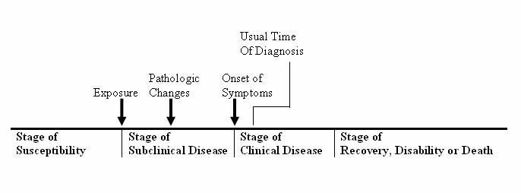
Stages in the natural history of diseases figure 2.1. natural history of disease

Slide 50
Stages in the natural history of diseases
There are four stages in the natural history of disease:-
1. Stage of susceptibility - this is a stage in which disease has not developed but the ground work has been laid by the presence of factors that favor its occurrence.
  Susceptible person is lacking sufficient resistance to particular pathogenic agent to prevent disease if or when exposed.
Under this stage there might the following
Incubation period- is the time interval between entry and development of signs and symptoms of disease.
It is the time interval between the entry of pathogenic micro organism and sufficient multiplication to cause pathology that will produce signs and symptoms of disease.

Slide 51
Stages cont.…
Incubation period in infectious diseases, is equivalent to combination of induction and latent periods in non infectious diseases.
  Induction period is the period of time from causal action until disease initiation.
  Latent period- is the period from asymptomatic disease to development of symptoms
For example
For hepatitis A, this range is about 2 to 6 weeks.
For leukemia associated with exposure to the atomic bomb blast in Hiroshima, the range was 2 to 12 years with a peak at 6 to 7 years

Slide 52
Stages cont.…
2. Stage of pre symptomatic disease or sub clinical stage
  There is no manifested disease or no signs and symptoms are detected
  The person does not know that he has any disease
  The sub clinical stage of disease may lead to the clinical stage or the individual may recover
  The probability of developing symptoms or disease after becoming infected is the pathgeneity of the interaction of the parasite with the host
  Pathogeneity is the ratio of clinical cases to sub clinical cases.
  An inapparent infection or silent infection is a successful infection that does not develop detected symptoms
  In apparent cases can be infectious.

Slide 53
stages cont.…
3. The clinical stage
  In this stage the person has symptoms and signs of disease
  There are various grades of illness with different outcomes depending on the agent host interaction
  Some diseases are short and mild that every one recovers quickly while others are very serious leading to complications and death
Examples:
  Rabies has a relatively short but severe clinical stage and almost always results in death
  Diabetes Mellitus has a relatively longer clinical stage and eventually results in death if the patient is not properly treated

Slide 54
Stages cont.…
4. Stage of recovery or disability
Some diseases run their course and then resolve completely either spontaneously or under the influence of therapy
However there are a number of conditions which give rise to residual defects of short or long term duration leaving the person disabled to a greater or lesser extent

Slide 55
Levels of prevention
The important tasks of health workers are preventing people from getting sick, preventing sick people from getting worse, becoming disabled or becoming chronically sick or dying
There are four important levels of prevention: Primordial, primary, secondary and tertiary
1. Primordial prevention
Existence of underlying condition leading to causation
The aim is to avoid the emergence and establishment of the social, economic, and cultural patterns of living that are known to contribute to an elevated risk of disease.
Target: Total population and selected groups
  Example: smoking, environmental pollution, care belt

Slide 56
Levels cont.…
2. Primary prevention- is preventing healthy people from becoming sick.
In order to carry out effective primary prevention, we must ask why healthy people become sick. We must know who most at risk of getting the disease.
It includes health promotion, specific protection and prevention of disease occurrence.
Some of primary prevention are:
  Immunization
  Provision of safe water supply
  Health related behavioral change through health education
  Provision of adequate housing
  Safe disposal of human excreta
  Control of vectors of diseases
  Protection against accidents and occupational hazards
  Good nutrition, adequate clothing, rest and recreation

Slide 57

Levels cont.…
3. Secondary prevention
It involves detecting people who already have the disease as early as possible in order to cure the patient and prevent chronic disease and disability.
When primary prevention has failed, a healthy person becomes sick.

Slide 58
Levels cont.…
Secondary prevention thus involves the detection and treatment of those people in the sub clinical stage
Early detection depends on the clinical stage and availability of investigation facilities
Limit severity and spread of disease, that is decrease secondary cases
4. Tertiary prevention
  Is the prevention of more disability and death
  The aims are:
    Disability limitation and Rehabilitation
    In a patient who can not be cured, tertiary prevention have many objectives:

Slide 59
Levels cont.…
Objectives of rehabilitation:
  Restore function- e.g. surgical correction of leprosy =>medical rehabilitation
  Vocational training- so that the individual can earn his/her livelihood=>vocational rehabilitation
  Integrate family with society – social rehabilitation
  Instill self confidence- psychological rehabilitation

Slide 60
Determinants of Prevention
Successful prevention depends upon:
  A knowledge of causation,
  Dynamics of transmission,
  Identification of risk factors and risk groups,
  Availability of prophylactic or early detection and treatment measures,
  An organization for applying these measures to appropriate persons or groups, and
  Continuous evaluation and development of procedures applied

Slide 61
The Infectious disease cycle
Infection: Entry and development/multiplication of disease causing micro organisms in man or animals. May be contained or progress to disease depending on the immunity
Latent infection: the organism is not being shed, but may get reactivated after some time e.g. HSV (herpes simplex virus)
Pathogeneity: is the probability of developing symptoms or disease after becoming infected and is host and agent interaction
Nosocomial or hospital acquired infection- contract infection during his/her stay in hospital e.g. UTI (catheter), AIDS (unsafe injection)

Slide 62
Conti…
Community acquired infection: infection that occurs in the community/general population (as distinguished from nosocomial infection).
Cross infection- contracted from fellow patients/hospital environment
Iatrogenic diseases (physician induced)-as a result of treatment or investigation procedures in the hospital e.g. allergy and adverse reaction to drugs
Infectious disease- disease resulting from an infection e.g. leprosy and malaria
  Thus, this phrase is interchangeably used with the expression communicable disease, as both mean the same.

Slide 63
Conti…
Infestation-lodgment, development, and reproduction of arthropods on the surface of the body e.g. itch mite. Also presence of parasitic worms in the gut e.g. safaris and ancylostoma.
Contamination- presence of infectious agent on body surface, in/on cloths, beddings, toys, surgical instruments, dressings and other inanimate articles like water, milk or food.
Pollution- presence of offensive but not necessarily infectious agent in the environment e.g. water, soil pollution
Contagious- disease transmitted through physical contact e.g. scabies, STI and leprosy.
Communicable disease- disease caused by specific micro organism which is transmitted from person to person, animal to animal, animal to man and environment to man either directly or indirectly e.g. cholera, typhoid, STD etc.

Slide 64
Conti…
Disinfection: The procedure of killing infectious agents outside the body by direct exposure to chemical or physical agents.
Disinfestations: The procedure of destroying or removing undesired small animal forms, particularly arthropods rodents, present upon the person, the clothing, or in the environment of an individual, or on domestic animals using chemical or physical agents.

Slide 65
Spectrum of disease
Spectrum of diseases- is the sequence of events that occur in human from the time of exposure to etiological agent to death
In infectious diseases, this spectrum is known as gradient of infection- which reflects the sequence of manifestations of illness in the host reflecting his response to the infectious agent
Gradient of infection is different types of host response to an infection:
  Inapparent or sub-clinical=> presence of an infection in a level below the threshold of clinical symptoms=> mild illness=> moderate illness=> severe/recovery or death

Slide 66
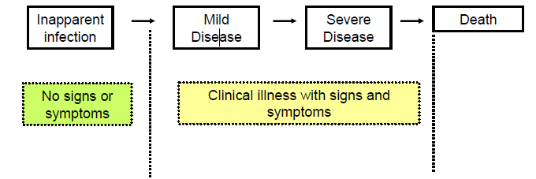
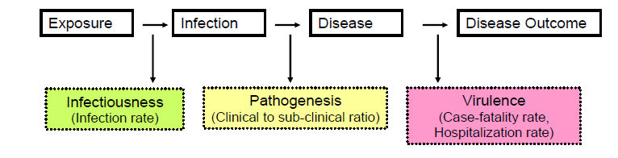
Fig: The Spectrum of Illness from Communicable Disease
Fig: Outcomes at Each Stage of Infection

Slide 67
Spectrum of disease…
The frequency with which these different manifestations occur differ with the specific infectious disease- measles 90% apparent, mumps 66% apparent and polio more than 90% in apparent.
  Hence clinically apparent imply tip of iceberg and inapparent imply bottom of iceberg.
  In fact this situation is called hippopotamus effect or iceberg phenomena.
Inapparent infection- is the presence of an infection below the threshold of clinical symptoms.

Slide 68
Spectrum of disease…
The importance are:
    May exceed clinical cases in number
    May be more infectious than overt cases
    Play role in determining the size of the susceptible, since they may induce protective antibody e.g. polio

Slide 69
  The Infectious disease cycle
Major components of the chain of infection
Six Factors are required for the occurrence of infectious diseases
  Infectious agent
  Reservoir of infection
  Portal of Exit
  Mode of Transmission
  Route of Entry, and
  Susceptible host

Slide 70
Chain of disease infection

Slide 71
The chain of infectious/disease cycle
Are model to understand the infectious process that form links in the occurrence and propagation of disease:
1. Infectious agent/etiology
Is an organism that is capable of producing infection or infectious disease
The biological properties of the agent may play a major role in its epidemiology
In order to survive the agent must be able to:
    Multiply
    Emerge from the host
    Reach the new host
    Infect the new host

Slide 72
Major components …
These can generally be grouped into the following five major taxonomic groups
  Virus: e.g. HIV; measles; Polio Herpes, etc.
  Bacteria: e.g. M. tuberculosi; N. meningitidis; N. gonorrheae
  Protozoa: e.g. Plasmodia species; E. histolytica; Giardia lamblia, Leishmania species, etc.
  Fungi: e.g. Candida albicans; Cryptococcus neoformans; Histoplasma capsulatum
  Metazoa: e.g. Helminths

Slide 73
Factors affecting disease occurrence
Microorganism ≠ Infectious Agent
Exposure ≠ Infection
Infection ≠ Disease
  Why exposure to microorganisms is not always followed by infection?
  Why infection is not always followed by the development of a manifest disease?
  Does infection with a given infectious agent result in a disease of same degree of severity in all individuals?
  All this can be affected by Intrinsic properties of Microorganisms and host agent interaction. It is characterized by
    Infectivity,
    Pathogenicity,
    Virulence or immunogenicity.

Slide 74
Intrinsic properties of Microorganisms
Infectivity: is the ability of an agent to invade and multiply (produce infection) in an exposed host
  Includes a time range from exposure to infection.
  Infectivity is a measure of the progression of an infectious agent from exposure to infection
  It is the ability to cause infection in an exposed susceptible host, and is measured by the infection rate (infectiousness).
  It is the proportion of exposed persons who become infected

Slide 75
Cont..…
Factors that affect infectivity of an agent
  Host and environmental factors
  The dose of infective agent
  The route of entry
  Source of infection
  The strain of the agent
Infectivity and infectiousness don’t necessarily imply the same meaning
Infectiousness of a host at a given time in the course of disease is specific for a given disease
Some diseases can be transmitted during the incubation period, some only during the active phase of the disease, and some for years after recovery (chronic carrier state).

Slide 76
Cont…
Pathogeneicity: is the ability of an agent to produce a clinically manifest disease in susceptible host.
  the proportion of infected persons who develop clinical disease ( ratio of clinical to subclinical)
  Such measurement of pathogenicity is not possible in a population
  It can, however, be determined by studying a population using laboratory methods during and following an outbreak of a particular disease for which reliable and valid laboratory diagnostic methods are available.

Slide 77

Cont.…
Virulence: this is the ability of an agent to produce severe disease.
    It is the ability to cause disease in a susceptible host
    the proportion of persons with clinical disease who become severely ill or die.
    It is measured by determining the proportion of clinical cases resulting in severe clinical manifestations, including sequel.
    Measured by case fatality and hospitalization rate

Slide 78
Cont.…
  Factors that influence the degree of infectivity, pathogenicity, and virulence include:
Strain of agent
Dose of agent
Route of infection
Host factors like host age, host nutritional status; host immune response;
Treatment, especially on virulence; and
Season, through influencing exposure to the agent and other factors that enhance the entry of the agent into the body and its transmission

Slide 79
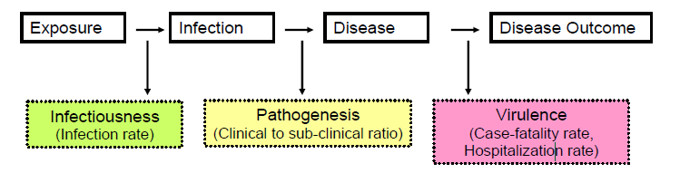
Cont…
Immunogenicity: It is the ability of an infection to produce specific immunity

Slide 80
Major components …
2. Reservoir
Is the person or animal, arthropod, plant, soil or substance in which an infectious agent can thrive and from where it can be transmitted to another host
Types of reservoir
  Man as a reservoir of infection-hepatitis B virus or Salmonella typhi
  Animals as a reservoir of infection-brucellosis (cows and pigs), anthrax (sheep), plague (rodents), trichinosis (swine), and rabies (bats, raccoons, dogs, and other mammals).
  Non-living things as a reservoir of infection

Slide 81
Major components …
3. Portal of exit
Way in which the agent gets excreted from the host
This is the site on the reservoir of infection through which the infectious agent escapes from the reservoir.
This includes:
  Gastrointestinal Tract (GIT) e.g. Typhoid fever, Amoebiasis etc.,
  Respiratory Tract e.g. Tuberculosis, common cold
  Skin and Mucous membrane e.g. STDS, Scabies, ring worm

Slide 82
Major components …
4. Mode of spread (Transmission)
Means of spread from reservoir to susceptible host
  This is the mechanism by which an infectious agent is transferred from a reservoir of infection to a new host
Infectious agent thrive in person, animal, arthropod, plant, soil and substance, and spread to susceptible through source.
  The material containing an infectious agent through which the actual transfer of the agent from the reservoir to susceptible host takes place e.g. in pulmonary TB, sputum is the source
  Reservoir: may be person, animal, arthropod, plant, soil or substance.

Slide 83
Major components …
Human reservoir may be overt case, sub clinical case or carrier
Animal reservoir e.g. rabies (dogs), Japanese encephalitis (birds, pigs)
Soil: Clostridium tetanus, Boves anthraces
Zoonotic- communicable disease transmitted from vertebrate animals to man under natural conditions e.g. rabies, plague, anthrax, salmonellas, hydatid cyst, bovine TB, and monkey pox.
Man to vertebrate: zoonanthroposis e.g. TB
Vertebrate to man: anthropozoonosis e.g. rabies

Slide 84
Major components …
Epizootic (epidemic in animals) e.g. anthrax, brucellosis, rabies, plaque fever. encephalitis
Enzootic (endemic in animals) : e.g. anthrax, rabies, brucellosis and endemic typhus
Two main modes of transmission:
1. Direct
Direct contact: no intervening agency from reservoir/source to a susceptible host like touching, kissing, sexual contact
Droplet infection: direct projection of droplets spray of saliva or nasopharyngeal secretion 30-60cm.
  In to hosts nose or mouth by acts like sneezing coughing or talking e.g. common cold, diphtheria, TB, meningococcal meningitis.
  Risks are overcrowding and lack of ventilation.

Slide 85
Major components …
Contact with soil: tetanus, mycosis
Bite of animal: rabies
Placental/vertical: syphilis, AIDS, drugs.
2. Indirect
Vehicle: water, food, milk, milk products, ice, blood, serum, plasma or other biological products.
Vector: is an organism that transports an infectious agent to a susceptible host or to a suitable vehicle.
Biological vector : development or multiplication of disease causing organism before it is being transmitted to susceptible host.

Slide 86
Major components …
Mechanical vector : is one in which the agent is directly infective to the host, and hence need not go through a period of multiplication or development.
  Invertebrate: flies, mosquitoes, fleas, lice bugs, ticks, mites and Cyclops
  Vertebrate: mice, rats and bats
Man-arthropod: malaria
Mammal or bird-arthropod: plague, Japanese encephalitis
Air (droplet nuclei): TB, influenza, chicken pox, measles and plaque fever/dust=TB, streptococcal infection.
Fomites: inanimate things other than food, water or milk e.g. cloths (soiled), towels, handkerchiefs, cups, spoons, toys, pencils, door handle, lavatory chains, syringes and surgical dressings diphtheria, typhoid, bacillary dysentery, eye and skin infections

Slide 87
Major component spread…
Hands and fingers:
  Risks factors are lack of hygiene
  Pathogens from skin, nose, feces are transmitted to susceptible host
    e.g. typhoid, dysentery, infective hepatitis, intestinal worms, staphylococcal and streptococcal infections.
Spread of disease through person to person transmission
Person to person transmission of an infectious agent is one of the main methods of disease spread in a community and is dependent on:
Generation time
  This refers to the period between exposure/infection and the maximum communicability of the exposed host regardless of whether the disease is apparent or in apparent.

Slide 88
    Spread of disease person to person cont.…
  In case of apparent infections generation time may be equivalent to incubation period.
Herd immunity
  This refers to a community resistance to spread of an infectious agent as a result of immunity gained by high proportion of individual members of the community
  Though it may not be important to achieve 100% immunity, successful breakage of the chain of infection can be achieved if the immunity is close to 100%
Secondary attack rate
  This is an important measure of spread of disease among contacts of an index case.
  It has great use in epidemic situations

Slide 89
Major components …
5. Portal of entry
Route through which infectious agent enters the host.
  Gastrointestinal Tract (GIT) e.g. Typhoid fever, Amoebiasis etc.
  Respiratory Tract e.g. Tuberculosis, common cold
  Skin and Mucous membrane e.g. STDS, Scabies, ring worm
6. Susceptible host
This is a person who is highly likely to acquire infection when exposed to the agent
  Host- a person or animal that harbors an infectious agent under natural conditions
  Obligate host-the only host for specific organism e.g. man in typhoid
  Definitive or primary host- one in which parasite attains maturity (man in Ascaris) or passes its sexual stage (mosquito in malaria).
  Intermediate host- one in which larval or asexual stage of parasite is spent (man in malaria)

Slide 90
    Time course of an infectious and disease
The time lines of infection begin with the successful infection of the susceptible host by infectious agent
Dynamics of infection: susceptible, latent period, infectious period and non infectious (removed, dead, recovered).
=> Time line for infection is important for the parasite/agent and public health
Dynamics of disease: susceptible, incubation period, symptomatic period, non diseased (dead, removed, immune, carrier).
=>Time line for disease is important to infected person and physician/health worker

Slide 91
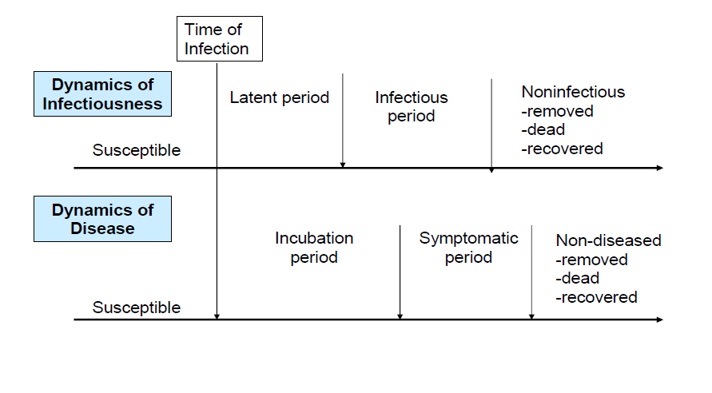
Time lines for Infection and Disease.

Slide 92
Time course of an infectious disease
Latent period- the time interval between recovery and occurrence of relapse/recrudescence in clinical disease.
  the time interval from infection to development of infectiousness
Prepatent period- time interval between infections (biological onset) to a point at which the infectious agent starts to shade
  It can be first detected laboratorically
Communicable period (Infectious period): -the period during which an infected host can transmit the infection to others
Incubation period- it includes the time interval between infection (biological onset) and the first clinical manifestation of the disease.

Slide 93
Incubation Period…
Is the time interval between entry and development of signs and symptoms of disease.
It is the time interval between the entry of pathogenic micro organism and sufficient multiplication to cause pathology that will produce signs and symptoms of disease.
  Incubation period (in non infectious diseases): is equivalent to induction + latent period.
  Chicken pox- latent period is less than incubation period, therefore quarantine has no use
  Malaria has incubation period of 14 days, stages infective to mosquito develop 10 days after incubation period.

Slide 94
Incubation Period…
HIV- short latent period. Two periods of latency:
  Latent period for infectiousness
  Latent period for sero-conversion
    Virulence, load and host response determine incubation period
Short incubation period implies 2-3 days e.g. cholera, influenza
Intermediate incubation period implies 10-21 days e.g. typhoid
Long incubation periods imply several weeks- months/years e.g. leprosy, TB and rabies

Slide 95
Incubation period…
Use of knowing of IP
  Trace source of infection and contacts
  Determine the period of surveillance/ quarantine
  Prevention of disease by using immunoglobulin and antiserum
  Determine an epidemic as point source or propagated/ exponential
  Assess prognosis of an infectious disease

Slide 96
    Carriers and their role in disease transmission
Carrier State: A condition in which a man or animal harbors and excretes infectious agent without overt clinical signs and symptoms
Carrier is a person without apparent disease who is nonetheless capable of transmitting the agent to others
  The importance of carriers in the transmission of disease depends on their:
    Number
    Detectability,
    Mobility, and
    Chronicity.

Slide 97
Carrier…
Epidemiologically, carriers are more important than over clinical cases because identification may require sophisticated investigation but important to control transmission e.g. AIDS
Carriers may be:
  Healthy / Asymptomatic / Carrier: in this type of carrier state infection remains inapparent, i.e. No signs and / or symptoms suggesting clinical disease are manifest
    Transmitting infection without ever showing signs of the disease. e.g. Meningococcus, hepatitis B virus.
Incubatory carriers - transmitting infection by shedding the agent before the onset of clinical manifestations or
  These are infected individuals who excrete the pathogen during the incubation period, i.e. before the onset of clinical disease. e.g. Measles, mumps, hepatitis

Slide 98
Carrier…
Convalescent carriers - These are people who continue to harbor and excrete the infectious agent after recovering from the illness
  Transmitting infection after the time of recovery from the disease
  e.g. Salmonella typhi, hepatitis B
Chronic carriers - In this type, the carrier state persists for a long period of time or indefinitely
  Shed the agent for a long period of time, or even indefinitely. e.g. Salmonella typhi, hepatitis B virus

Slide 99
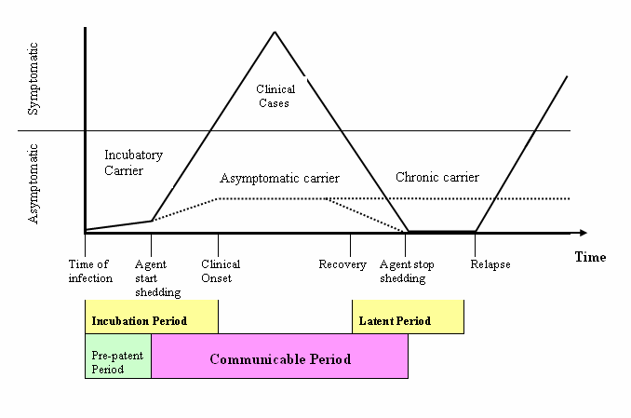
Time Course of a Disease in Relation to Its Clinical Expression and Communicability
Generation period

Slide 100
Herd immunity
The chain of infection may be interrupted if the agent does not find a susceptible host.
  This may occur if a high proportion of individuals in a population is resistant to the agent.
Through such herd immunity, immune persons limit the spread of the infection to the relatively few who are susceptible by reducing the probability of contact between infected and susceptible persons

Slide 101
Conditions under which herd immunity best functions
A single reservoir
Direct transmission
Total immunity
No shedding of the agent by immune hosts
A uniform distribution of immunes,
No overcrowding.
Seldom all fulfilled

Slide 102
Difficulties in Infectious Disease Epidemiology
Identification of infectious source
Identification of susceptible host
Quantification of infectiousness and susceptibility
Knowing strain of the parasite
Defining and identifying contacts between infective and susceptible
Contact rate efficacy: is change in contact due to intervention
Exposure or behavior efficacy: is exposure change due to intervention
Risk factors for susceptibility vs. risk factors for exposure
Transmission probability: is conditional while incidence rate, and incidence proportion are unconditional

Slide 103
Transmission probability
The given contact between source or infectious host and susceptible host, successful transfer of parasite occurs so that the susceptible host becomes infected.
Transmission probability, helps understanding of the dynamics of infection and effects of intervention
It is depends on
  Characteristic of infectious source (person, insect vector and contaminated inanimate object)
  The parasite
  Susceptible host
  Type and definition of contact

Slide 104
Lecture on communicable disease and disease causation

Slide 105
Learning objective
At the end of this session students will be abele to
Definitions of communicable diseases terms
Identify disease causation theories
Mention different models infectious diseases process
Differentiate epidemiological triad and Rothmans model

Slide 106
Definition terms
Communicable/infectious/ diseases:
An illness due to a specific infectious (biological) agent or its toxic products capable of being directly or indirectly transmitted from man to man, from animal to man, from animal to animal, or from the environment (through air, water, food, etc…) to man.
Infection:
  The entry and development or multiplication of an infectious agent in the body of man or animals.
  An infection does not always cause illness.

Slide 107
Definition terms
Contamination:
  The presence of an infectious agent on a body surface, on or in clothes, beddings, toys, surgical instruments or dressings, or other articles or substances including water and food.
Infestation:
  The lodgment, development and reproduction of arthropods on the surface of the body or in the clothing, e.g. lice, itch mite.
  This term could also used to describe the invasion of the gut by parasitic worms, e.g. Ascariasis.
Contagious disease:
  The one that transmitted through contact.
  Examples include scabies, trachoma, STD, &leprosy

Slide 108
Definition terms
Vector of infection:
  An insect or any living carrier that transports an infectious agent from an infected individual or its wastes to a susceptible individual or its food or immediate surroundings.
  Both biological and mechanical transmissions encountered.
Nosocomial infections:
  Nosocomial (hospital acquired) infection is an infection originating in a patient while in a hospital or another health care facility.
  It has to be a new disorder unrelated to the patient’s primary condition.
  Examples include infection of surgical wounds, hepatitis B and urinary tract infections.

Slide 109
Definition terms
Opportunistic infection:
  This infection takes the opportunity provided by a defect in host defense (e.g. immunity) to infect the host and thus cause disease.
  For example, opportunistic infections are very common in AIDS organisms include Herpes simplex, cytomegalovirus, M. tuberculosis….
Zoonosis, epizootic and enzootic:
  Zoonosis: is an infection that is transmissible under natural conditions from vertebrate animals to man, e.g. rabies, plague, bovine tuberculosis.
  An epizootic is an outbreak (epidemic) of disease in an animal population e.g. rift valley fever.
  An Enzootic is an endemic occurring in animals, e.g. bovine TB.

Slide 110
Definition
Eradication and Elimination:
  Elimination is termination of all transmission of infection by the extermination of the infectious agent through surveillance and containment.
  Eradication is an absolute process, an “all or none” phenomenon, restricted to termination of infection from the whole world.
  The term elimination sometimes used to describe eradication of a disease from a large geographic region.
  Diseases, which are amenable to eradication, in the meantime are polio, dracunculiasis, leprosy and neonatal tetanus.

Slide 111
Importance of studying communicable Diseases Epidemiology
The following points are some of the reasons indicating importance of studying communicable diseases epidemiology
  Changes of the pattern of infectious diseases
  Discovery of new infections
  The high possibility some chronic diseases have an infective origin.
  Surveillance of infectious disease
  Identification of source of outbreaks
  Studies of routes of transmission and natural history of infections
  Identification of new interventions

Slide 112
Theories/ principles of diseases causation
Disease causation
The cause of a disease is an event, condition or characteristics that precede the diseases event and without which the disease event either would not have occurred at all or would not have occurred some latter time.
  Not all associations between exposure and diseases are causal.
  If disease does not develop without the factor being present, then we term the causative factor “necessary” if the disease always result from the factor then we term the causative factor “sufficient “

Slide 113
Theories of disease causality
What causes a disease? Ninetieth century theories
Contagion theory
Supernatural theory
Personal behavior theory
Miasma theory

Slide 114
Contagion theory
This theory was common at the beginning of the 19th century.
Most official disease prevention activities were based on the hypothesis that illness is contagious.
It required:
  Keeping sick people away from well people.
  The institution of quarantine of ships
  Setting up military cordons around infected towns
  Isolation of households if they were infected, and
  Fumigating or washing the bedding &clothing of the sick.

Slide 115
Problems of Contagion theory…….
Problems confounded the acceptance of this theory were :
  There were too many instances where people become ill regardless of their isolation from human contact
  and
  Too many others where brave souls nursed the dying and carried their bodies to the graveyard yet remained well.

Slide 116
Supernatural theory
Proponents of this theory argue that supernatural forces cause disease.
Disease prevention measures based on this theory were important to the religious people.
The view among them was that disease is a punishment for transgression of God’s laws.
Because epidemic took a great toll on the poor than the rich, the healthier rich can employ the supernatural theory as a justification for berating for the poor for sinful behavior i.e. presumed idleness, intemperance and uncleanness.
This theory expressed a political philosophy.
People could not advocate the belief that sin causes disease with out at the same time implicitly supporting the idea that government need to redress poverty.

Slide 117
Personal behavior theory
This theory held that disease results from wrong personal behavior.
It was democratic and ante authoritarian in intent since it gave responsibility to individuals to control their own lives.
In this formulation the source of the disease was not tied up with the mysterious ways of God, instead people caused their own disease by living fully unhealthy.
Hence, improper diet, lack of exercise, poor hygiene and emotional tension become the focus of preventive actions.
This theory does not blame the poor for the illness and in many aspects; it was homage to middle-class life.

Slide 118
Miasma theory
This theory argues that disease is caused by the odor of decaying of organic materials.
It dates back to the Hippocratic idea that disease is related to climate.
It contrasted sharply from the other three theories since it conceptually separated the source of the disease from the victim of the disease.

Slide 119
Theories…
Twentieth century theories
Germ theory
Lifestyle theory
Environmental theory
Multi-causal theory

Slide 120
The Germ Theory
This theory rapidly over took other explanations of disease causations.
It held the notion that microorganisms cause diseases and it is possible to control diseases using antibiotics and vaccines.
There was criticism on this theory by Thomas Mckeown that stated as the incidence of all major infectious diseases begun to fall several decades before the introduction of vaccines and antibiotics.
Thus rising of living standards was responsible for the reduction of disease not the discovery of antibiotics and vaccines.

Slide 121
The Life Style Theory
This holds that unhealthy lifestyles are causes for diseases.
This hypothesis blames stress, lack of exercise, the use of alcohol and tobacco improper nutrition for most chronic diseases.
This theory rejects the notion central to the classic germ theory, that a single disease has a single etiology.

Slide 122
The Life Style Theory……
Instead they emphasize the interrelatedness of many variables in disease causality, principally those under the control of the individual.
Nevertheless, this approach resembles the germ theory, for it conceives of disease as an individual event, the difference is that prevention, instead of requiring physicians’ ministrations, demand personal behavior change.
The critics surrounding this theory state that the change for lifestyle requires overall social change.

Slide 123
The Environmental Theory
Environmental theory explains that significant number of chronic disease are caused by toxins in the environment and
It implies that disease prevention, instead of requiring medical treatments or personal hygiene, demands change in the industrial production.
The first aspect of the environmental hypothesis is occupational hazards,
The second concentrates on toxic substances in the air, water and soil (advocates of this theory places particular emphasis on radioactivity),
and
The third aspect focus on synthetic additives to foods “organic foods”.

Slide 124
The Multi Causal Theory
It is also called the web of disease causation.
The theory express that there are multiple factors for a cause of a single disease entity.
But it is incapable of directing a truly effective disease prevention policy as the theories it replaces.
Its shortcomings are it gives few clues about how to prevent disease,
The actual prevention policies it implies are inefficient in many ways,
and
There is a gap between what it promises and what epidemiologist’s deliver.

Slide 125
General Models of Causation
In epidemiology, there are several models of disease causation that help to understand disease process.
The most widely applied models are:
  The epidemiological triad (triangle)
  the wheel
  the web.
  The sufficient cause and component causes models (Rothman’s component causes model)

Slide 126
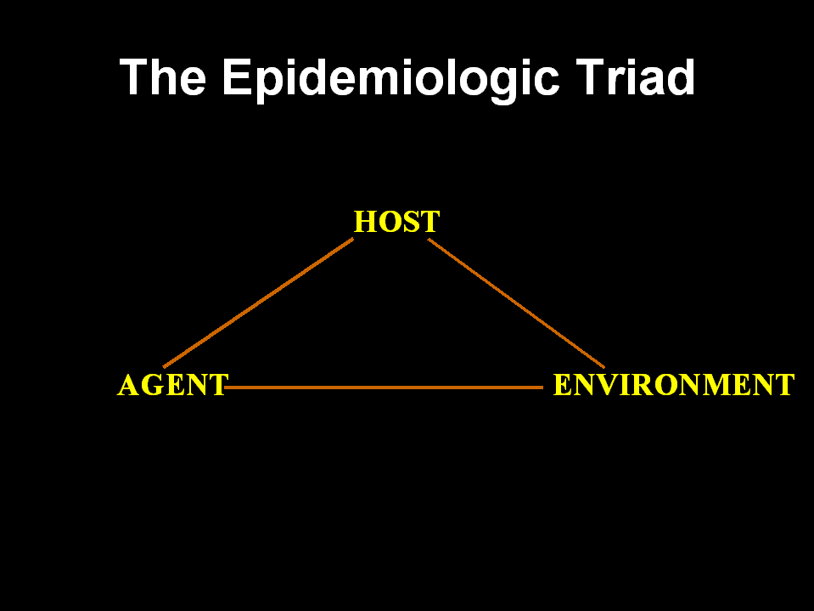
The Epidemiologic Triad
HOST
AGENT
ENVIRONMENT
Notes:
The best known, but most dated model of communicable disease, is the Epidemiologic Triad. This model comprises a susceptible host (the person at risk for the disease), a disease agent (the proximate cause), and an environmental context for the interaction between host and agent.

Slide 127
Agent factors
Infectious agents: agent might be microorganism virus, bacterium, parasite, or other microbes. e.g. polio, measles, malaria, tuberculosis
Generally, these agents must be present for disease to occur.
Nutritive: excesses or deficiencies (Cholesterol, vitamins, proteins)
Chemical agents: (carbon monoxide, drugs, medications)
Physical agents (Ionizing radiation,…

Slide 128
Host factors
Host factors are intrinsic factors that influence an individual’s exposure, susceptibility, or response to a causative agent.
Host factors that affect a person’s risk of exposure to an agent:
  e.g. Age, race, sex, socioeconomic status, and behaviors (smoking, drug abuse, lifestyle, sexual practices and eating habits)
Host factors which affect susceptibility &response to an agent:
  Age, genetic composition, nutritional and immunologic status, anatomic structure, presence of disease or medications, and psychological makeup

Slide 129
Environmental factors
Environmental factors are extrinsic factors which affect the agent and the opportunity for exposure
Environmental factors include:
  Physical factors such as geology, climate,..
  Biologic factors such as insects that transmit an agent; and
  Socioeconomic factors such as crowding, sanitation, and the availability of health services.

Slide 130
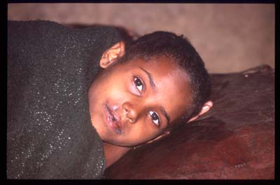
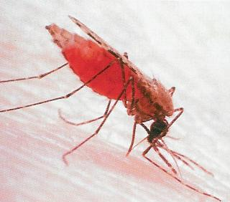
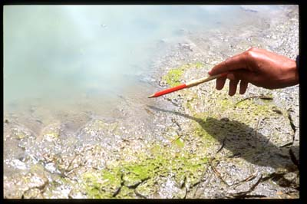
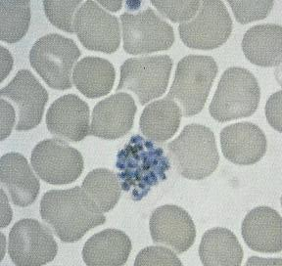
Malaria
Agent
Vector
Host
Environment

Slide 131
The epidemiologic triad Model
Host:
Intrinsic factors, genetic, physiologic factors, psychological factors, immunity
Health
or
Illness
?
Agent:
Amount, infectivity, pathogenicity, virulence, chemical composition, cell reproduction
Environment:
Physical, biological, social

Slide 132
2. Web of Causation
There is no single cause
Causes of disease are interacting
Illustrates the interconnectedness of possible causes
  Developed to de-emphasis agent
  Chain of causation
  Complexity of origin is web
  Multiple factors promote or inhibit
Emphasizes multiple interactions between host and environment

Slide 133
Web of Causation
phenotype
social organization
behavior
microbes
Disease
genes
environment
Unknown factors
workplace

Slide 134
Web of Causation - CHD
Stress
Genetic susceptibility
Medications
Smoking
Lipids
Disease
Gender
Physical activity
Unknown factors
Inflammation
Blood pressure

Slide 135
Example of a Web of Causation
Overcrowding
Malnutrition
Exposure to Mycobacterium
Susceptible Host
Infection
Tuberculosis
Tissue Invasion and Reaction
Vaccination
Genetic

Slide 136
3. The Wheel of Causation
The Wheel of Causation de-emphasizes the agent as the sole cause of disease
It emphasizes the interplay of physical, biological and social environments
It also brings genetics into the mix

Slide 137
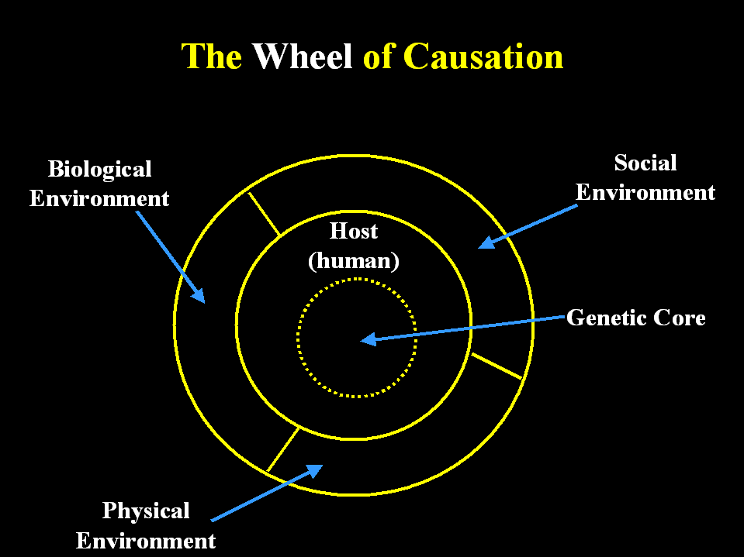
The Wheel of Causation
Biological Environment
Social Environment
Host (human)
Genetic Core
Physical Environment

Slide 138
4. The sufficient cause and component causes models (Rothman's Component Causal Model)
Sufficient causes:
  Sufficient cause is a “minimum set of conditions, factors or events needed to produce a given outcome.
  A set of conditions without any one of which the disease would not have occurred
  Not usually a single factor, often several
Necessary cause:
  A necessary cause is a causal factor whose presence is required for the occurrence of the effect.
  If disease does not develop without the factor being present, then we term the causative factor “necessary”.
  Must be present for disease to occur, disease never develops in the absence of that factor.
  A component cause that is a member of every sufficient cause

Slide 139
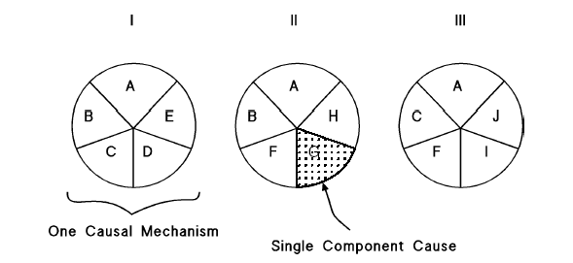
The sufficient cause and component causes model (Rothman’s component causes model)

Slide 140
Rothman’s component causes model...
The factors or conditions that form a sufficient cause are called component causes.
Example
  The tubercle bacillus is required to cause tuberculosis but, alone, does not always cause it,
  So tubercle bacillus is a necessary, not a sufficient, cause.

Slide 141
Rothman’s Component Causes Model…
Rothman's model has emphasised that the causes of disease comprise a collection of factors.
  These factors represent pieces of a pie, the whole pie (combinations of factors) are the sufficient causes for a disease.
  It shows that a disease may have more than one sufficient cause, with each sufficient cause being composed of several factors.
  The factors represented by the pieces of the pie in this model are called component causes.
  Each single component cause is rarely a sufficient cause by itself, But may be necessary cause.
Control of the disease could be achieved by removing one of the components in each "pie" and if there were a factor common to all "pies“ (necessary cause) the disease would be eliminated by removing that alone.

Slide 142
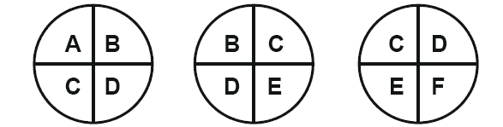
All factors (component causes) together form the sufficient cause while component cause “C” and “D” constitutes the necessary cause.

Slide 143
Lecture on Measures of disease occurrence

Slide 144
Learning objective
After this session the student will be able;
  Differentiate the four quantitative descriptors (Number, Ratios, proportion, and Rates)
  Calculate and use measures of disease occurrence
  Calculate prevalence & incidence of diseases
  Differentiate point prevalence, period prevalence, cumulative incidence, and incidence density
  Calculate and use mortality measures
  Differentiate crude, specific, & adjusted mortality measures

Slide 145
Measurement and disease occurrence
Disease occurrence- is understanding that onset of disease is not instantaneous event and “ disease” is not a constant state, but gradual biological process
  Measurement of disease occurrence requires simplified definitions and assumptions
Often reported as perceived illness, symptoms or sickness than measure of biological entities of disease
Case ascertainment is based on:
  Signs and symptoms
  Physical examination
  Laboratory results

Slide 146
Measurement and…
Also, case ascertainment may be based on:
  Confirmed
  Possible/probable
  Suspected case definitions
Measurement-is a standard common to a number of events, situations or objects by which they may be compared.
  Is the assignment of numbers/names or events according to set of rules
Variables- names, numbers, labels etc given to different events, situations or objects which takes different values in different persons, place or time

Slide 147
Measurement…
Variables may be:
  Qualitative-magnitude absent
  Quantitative-magnitude present
  Or
Discrete- that fall into only a limited number of separate categories with no possible intermediate level- use proportion/frequency
  Discrete variables may be dichotomous (male/female) or multichotomous- e.g. good, better, worse
Continuous-have the greatest degree of quantification of data, not restricted to particular values and limited only by accuracy and precision
  Continuous variables are expressed in terms average

Slide 148
How do we measure diseases?
Four quantitative descriptors to measure disease occurrence
Numbers/counts
Ratios
Proportions
Rates

Slide 149
Number disease measurement of disease occurrence
Use of actual number of events
As noted, one of the basic tasks in public health is identifying and counting cases.
Usually derived from case reports submitted by health-care workers and laboratories to the health department, or epidemiological studies.
Allow public health officials to determine the extent and patterns of disease occurrence by time, place, and person.
Indicate clusters or outbreaks of disease in the community.
valuable for health planning
  For example, a health official might use counts to plan how many infection-control isolation units or doses of vaccine needed.
The number of individuals who meet the case definition is count of cases in diseases occurrence
  Eg. 2,116,047 cases of Malaria (confirmed with P. falciparum) in Ethiopia in 2005 (FMoH, HHRIs 2005 E.C (2012/2013)

Slide 150
Number Measurement cont.…
Calculating the magnitude of disease occurrence with a count is simple and useful for certain purposes, such as allocating health resources.
However, simple counts do not provide all the information a health department needs.
For some purposes, the counts must put into context, based on the population in which they arose.
For other purposes, it is more helpful to have a denominator under the count that indicates the size of the study population.
The remaining four measures address this issue.

Slide 151
Ratio measure cont.…
Quantifies the magnitude of one occurrence X, in relation to another event Y as X/Y
The relative size of two quantities.
No specific relationship is necessary between the numerator and denominator
Numerator not necessarily included in the denominator.
A special fraction in which the numerator includes only individuals who meeting one criterion
(e.g. the case definition)
and
The denominator includes only individuals in the study population who meet another criterion
(e.g. do not meet the case definition but are at risk).

Slide 152
Ratio measures cont.…
Not dependent upon time.
Less frequently used as measure of disease frequency
  Example-1: 1 case of colon cancer for every 1 case of breast cancer.
  Example-2: 2 female cases of major depression to 1 male case of major depression.
  Example-3: Ratio of TB cases in community A to B is 1:10

Slide 153
Ratio measures cont.…
After either the numerator divided by the denominator, the numerator or denominator is usually set one,
  The result is often expressed as the result "to one" or written as the result “ :1 ”
  Note that in certain ratios, the numerator and denominator are different categories of the same variable, such as:
  eg. Male : female (male to female ratio)
  In other ratios, the numerator and denominator are completely different variables, such as:
  the number of hospitals in a city and the size of the population living in that city.

Slide 154
Calculating Ratios for Different Variables
Example-A: ANRS of Ethiopia with 19,626,000 persons has 19 Hospital. Calculate the ratio of Hospitals per person?
19 ⁄ 19,626,000 × 10^{n} = 0.0000009681 Hospitals per person.
For easily understood the result, set 10^{n} = 10⁷ = 10,000,000.
The ratio becomes: 0.0000009681 × 10,000,000 = 9.681 Hospitals per 10,000,000 persons.
You could also divide each value by 9.681, and express this ratio as 1 Hospital for every 1,032,947 persons.
(Source: HHRI 2005 EFY, Health facility to population Ratio by Region)

Slide 155
Calculating Ratios for Different Variables
Ethiopia’s IMR estimated for 2013(EFY) was 52/1,000 LBs
Kenya’s IMR estimated for 2013(EFY) was 54/1,000 LBs.
Calculate the ratio of the IMR in Ethiopia to that in Kenya.
  52 ⁄ 54 × 1 = 1:1.04.
Thus, Kenya’s IMR was estimated to be 1.04 times as high as Ethiopia’s IMR for 2013 EFY.
(Source: HHRIs, 2005 EFY, Population Health, & Environment Data &Estimates for the Countries &Regions of the World EFY 2013).

Slide 156
Proportion measures cont.…
A ratio in which the numerator is included in the denominator
It is comparing of a part to the whole population in which the occurrence takes place
Denoted as A/(A+B);
A fraction in which the numerator (A) includes only individuals who meet the case definition and
The denominator totals (A+B) the numbers of individuals who meet the case definition plus those in the study population who do not meet the case definition and are at risk.

Slide 157
Proportion measure cont.…
Not dependent upon time, expressed as a fraction, decimal, or a percentage.
Indicates the fraction of the population that affected by the disease or condition.
Common descriptive measures, linked to estimating risk.
Its result ranges between 0 and 1 or 0-100% (Percentage=proportion x100)
Example-1: 30% of persons over 50 years of age have screened for colon cancer.
For a proportion, 10^{n} is usually 100 (or n = 2) and is often expressed as a percentage.
The statements "one fifth of the residents became ill" and "twenty percent of the residents became ill" are equivalent.

Slide 158
Rat measures cont.…
A proportion with time element.
It measure the occurrence of an event overtime
In epidemiology, a rate is a measure of the frequency with which an event occurs in a defined population over a specified period.
Put disease frequency in the perspective of the size of the population,
Particularly useful for comparing disease frequency in different locations, at different times,
Among different groups of persons with potentially different sized populations
It measure of risk.
  e.g U5 measles cases in 2000/U5 population in 2000

Slide 159
Which community is more affected?
Community A has 100 cases of disease X
and
Community B has 1000 cases of disease X,
which community is more affected?

Slide 160
When we call..
When we call a measure a ratio, we mean a non-proportional ratio
When we call a measure a proportion, we mean a proportional ratio that doesn’t measure an event overtime
When we call a rate, we mean a proportional ratio that does measure an event in a population overtime
Types of rates
Crude rates: Apply to the total population in a given area
Specific rates: Apply to specific subgroups in the population (age, sex etc) or specific diseases
3. Standardized rates: used to permit comparisons of rates in population which differ in structure (e.g age structure)

Slide 161
Measures of Morbidity
To describe the presence of disease in a population, or the probability (risk) of its occurrence, we use one of the morbidity frequency measures
In public health terms, disease includes illness, injury, or disability
All of these can be further elaborated into specific measures for age, race, sex, or some other characteristic of a particular population being described

Slide 162
Measures of Morbidity...
Incidence - Quantifies number of new cases of disease that develop in a population at risk during a specified time period
Incidence
  Trends over time -> public health implications
  Fundamental for studies of causality
  Exclude prevalent cases to focus on causes of disease, separate from causes of “survival with disease”

Slide 163
Incidence Rates
Occurrence of new disease per unit of person time
  Are the most common way of measuring and comparing the frequency of disease in populations
It measures the rate at which people without the disease develop the disease during a specified period of time
It expresses the probability or risk of illness in a population over a period of time
  Since incidence is a measure of risk, when one population has a higher incidence of disease than another, we say that the first population is at a higher risk of developing disease than the second, all other factors being equal

Slide 164

Incidence Cont.…
We can also express this by saying that the first population is a high-risk group relative to the second population
  It is used to study disease aetiology of the disease
Required data:
    Period of observation;
    Number of new cases;
    Time of disease onset /diagnosis
    Population at risk (denominator)

Slide 165
Types of incidence measures
There are two specific types of incidence measures: Cumulative incidence rate and incidence density
Cumulative incidence (CI): is the proportion of people who are become diseased during a specified period of time
CI= Number of new cases during a specified period of time
Total Population at risk in the specified period of time
It is a measure of the probability or risk of disease, i.e., what proportion of the population will develop illness during the specified time period.
This can occur in closed population

Slide 166
Incidence rate…
Closed population- adds no new cases and loses people only to death
  The finding in cumulative incidence and used for life table analysis
  Denominator is population at the beginning and similar to risk of death
Cumulative IR~IR when rate is low and study period short
There are assumptions:
  Population is closed
  Event under study is inevitable (no competing risk)
  Number of events compared to population at risk is small

Slide 167
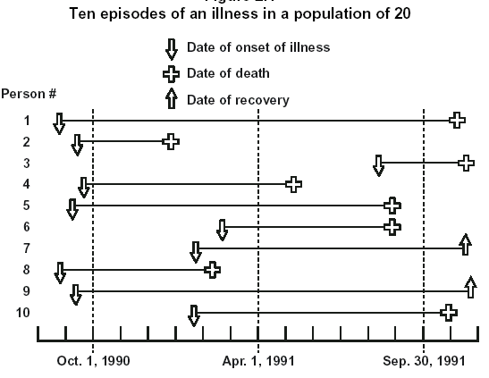
Figure of illness in a 20 population

Slide 168
Example
The data of above figure represents ten episodes of an illness in a population of 20 over a period of 16 months. Each horizontal line represents the portion of time one person spends being ill. The line begins on the date of onset and ends on the date of death or on the date of recovery. Calculate the incidence rate from October 1, 1990 to September 31, 1991, using the midpoint population as the denominator.
Incidence rate, October 1, 1990 to September 31, 1991; for the denominator use the total population at midpoint (total population minus those who have died before April, 1991).
  x = new cases occurring 10/1/90-9/31/91 = 5
  y = total population at midpoint = 20 - 2 = 18
  x /y x 10n =/18 X 100 =27.8
So the one-year incidence was 28 cases per 100 population

Slide 169
Incidence Density/person-time rate
Measures the rate at which new cases of disease occur in the population at risk during a defined period
The number of new cases of disease (incident number) divided by the sum of person-time is the incidence rate of the population over the period
  Time at risk and population at risk are important concepts
  Event is also counted only once
The population at risk is dynamic and each person in the population contributes the amount of time that they remained under observation and free from disease (person-time)
Incidence Density = number of new cases of disease in specified period x10^{n} Total person-time of observation

Slide 170
Incidence density cont.…
The numerator is still the number of new cases, but the denominator is the sum of the time each person is observed, totalled for all persons.
For incidence density, the denominator is measured in person-time units rather than persons, which accounts for…
  Persons who enter the population after the study period begins,
  Persons who are ‘lost’ during the study period, and
  Persons who develop the disease during the study period and are no longer at risk of developing the disease

Slide 171
Incidence density cont.…
When an incidence rate incorporates time into the denominator sometimes we call it person- time rate (an incidence density),
Each person is observed from a set beginning point to an established endpoint (onset of disease, death, migration out of the study, or end of the study)
What is person-time?
  100 people followed for 1 year each=100 person-years
  10 people followed for 10 years each=100 person years
  50 people followed for 1 year each plus 25 people followed for 2 years each=100 person-years
  Time unit=month, year, day; person-time=person-year, person-month,

Slide 172
Incidence density cont...
Incidence density is more useful when we are interested in how quickly people develop illnesses, assuming a constant rate over time
Total person-time for the denominator is computed by either…
  Summing the amount of person-time contributed by each person in the population during the study period, or
  Multiplying the average size of the population at the mid-point of the study period times the number of years representing the total study period.

Slide 173
Incidence density cont...
Open population- gain population over time through in migration or birth or lose alive people through out migration.
Differs from closed population in that:
  Individual contribution need not begin at same time
  Some migrate to it
  Some are born to it
  For specific age group people can enter by aging into it
  Can exit by dying, aging out of defined age group, emigrating or becoming diseased

Slide 174

Incidence density cont.…
Example
Investigators enrolled 2,100 men in a study and followed them over 4 years to determine the rate of heart disease. The follow-up data are provided below. Calculate the person-time incidence rate of disease.
We assume that persons diagnosed with disease and those lost to follow-up were disease-free for half of the year, and thus contribute ½ year to the denominator.
Initial enrolment: 2,100 men free of disease
  After 1 year: 2,000 disease-free, 0 with disease, 100 lost to follow-up
  After 2 years: 1,900 disease-free, 1 with disease, 99 lost to follow-up
  After 3 years: 1,100 disease-free, 7 with disease, 793 lost to follow-up
  After 4 years: 700 disease-free, 8 with disease, 392 lost to follow-up
1. Identify x: x = cases diagnosed = 1 + 7 + 8 = 16
2. Calculate y, the person-years of observation:

Slide 175
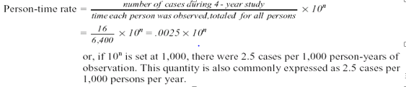
Alternative methods
A second way to calculate the person-years of observation is to turn the data around to reflect how many people were followed for how many years, as follows:
  700 men x 4.0 years = 2,800 person-years
  8 + 392 = 400 menx3.5 years = 1,400 person-years
  7 + 793 = 800 menx2.5 years = 2,000 person-years
  1 + 99 = 100 menx1.5 years = 150 person-years
  0 + 100 = 100 menx0.5 years = 50 person-years
      Total = 6,400 person-years of observation
This is exactly equal to the average population at risk (1,400) times duration of follow-up (4 years).

Slide 176
Prevalence
Is the amount of disease present in a population
  Quantifies number of existing cases of disease in a population at a point or during a period of time
  That is, it estimates disease burden
Commonly used for chronic diseases or those with long duration
  P= All new +pre existing cases during given time
population during same time period
Use of prevalence is good for chronic diseases but misleading for acute or acute episodes of chronic illnesses
Has limited value for evaluation of interventions

Slide 177
Prevalence…
Prevalence is affected by:
  New and effective treatment
  Increased survival despite incidence unchanged or even decreasing
  Prevalence decreases due to new curative therapy, despite more people acquiring disease
  Population movement

Slide 178
Prevalence rate
Prevalence, sometimes referred to as prevalence rate, is the proportion of persons in a population who have a particular disease or attribute at a specified point in time or over a specified period of time.
  Numerator is number of existing cases
  Denominator is your population of interest (including all those in numerator)

Slide 179
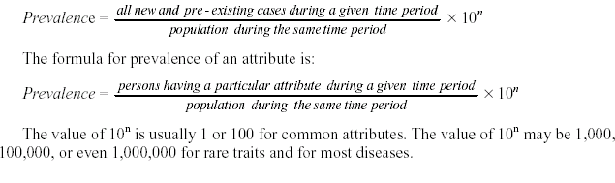
Prevalence rate...

Slide 180
Prevalence rate...
Prevalence rate is affected
  Severity of illness
  Duration of illness
  The number of new cases
Types of prevalence
  Point prevalence - number of persons with a specific disease at one point in time divided by total number of persons in the population
  Period prevalence - number of persons with disease in a time interval (eg, one year) divided by number of persons in the population
  Prevalence at beginning of an interval plus any incident cases

Slide 181
Point and period prevalence
The amount of disease present in a population is constantly changing
    Sometimes, we want to know how much of a particular disease is present in a population at a single point in time to get a kind of “stop action” or “snapshot” look at the population with regard to that disease
We use point prevalence for that purpose
    The numerator -is the number of persons with a particular disease or attribute on a particular date
    Point prevalence is not an incidence rate, because the numerator includes pre-existing cases

Slide 182
Continued---
At other times we want to know how much of a particular disease is present in a population over a longer period
Then, we use period prevalence.
  The numerator in period prevalence is the number of persons who had a particular disease or attribute at any time during a particular interval
  The interval can be a week, month, year, decade, or any other specified time period.

Slide 183
Comparison of prevalence and incidence
The prevalence and incidence of disease are frequently confused
They are similar, but differ in what cases are included in the numerator
  Numerator of Incidence = new cases occurring during a given time period
  Numerator of Prevalence = all cases present during a given time period
The numerator of an incidence rate persons whose illness began during a specified interval
The numerator for prevalence includes all persons ill from a specified cause during a specified interval (or at a specified point in time) regardless of when the illness began
A case is counted in prevalence until death or recovery occurs

Slide 184
Example
Two surveys were done of the same community 12 months apart. Of 5,000 people surveyed the first time, 25 had antibodies to histoplasmosis. Twelve months later, 35 had antibodies, including the original 25. We will calculate the prevalence at the second survey, and compare the prevalence with the 1-year incidence.
1. Prevalence at the second survey:
  x = antibody positive at second survey = 35
  y = population = 5,000
x/y X10^{n} = 35/5,000 x 1,000 = 7 per 1,000
2. Incidence during the 12-month period:
  x = number of new positives during the 12-month period = 35 - 25 = 10
  y = population at risk = 5,000 - 25 = 4,975
x/y x10^{n} = 10/4,975 x1,000 = 2 per 1,000

Slide 185
Characteristics of Prevalence
Cause and effect measured simultaneously
  Impossible to infer causation
Useful for planning (e.g. beds, clinics, workforce needs)
High prevalence ≠ high risk
  Could reflect increased survival(improved care, behavior change - long duration)
Low prevalence⇒ could reflect rapid fatal or cure process - short duration)
Easy to obtain ⇒need only 1 measurement

Slide 186
Prevalence rate increased by
Longer duration of the disease
Prolongation of life of patients without cure
Increase in new cases
Immigration of cases
Out migration of health people
In-migration of susceptible people
Improved diagnostic facility
Prevalence rate decreased by
Shorter duration of disease
High case-fatality rate from disease
Decreases in new cases (decrease in incidence)
In-migration of healthy people
Out migration of cases
Improved cure rate of case

Slide 187
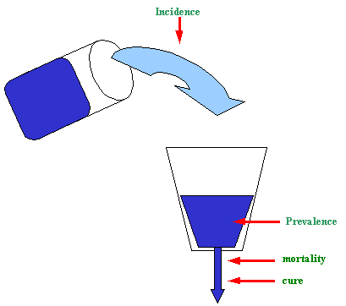
Relationship between prevalence and incidence

Slide 188
Relationship between prevalence and incidence
Prevalence is based on both incidence (risk) and duration of disease
High prevalence of a disease within a population may reflect high risk, or it may reflect prolonged survival without cure
Conversely, low prevalence may indicate low incidence, a rapidly fatal process, or rapid recovery
Thus, prevalence rate is directly proportional to both incidence rate and to the average duration of the disease and thus expressed as
p ~ IR x D

Slide 189
Relationship...
To decrease incidence, preventive activities are necessary
To decrease prevalence, treatment of cases, “kill them”
Under certain circumstance the point prevalence rate is equal to the product of incidence rate and average duration of the disease
P = IR X D

Slide 190
Continued…
Assumptions of equation:
  “Steady state” i.e. the population size is constant for a long period of time
  Incidence is constant
  Distribution of durations is constant
  Prevalence of disease is low (<0.10 or 10%)
Example: Figuring duration from prevalence and incidence
    Lung cancer incidence = 45.9/100,000 PY
    Prevalence of lung cancer = 23/100,000 P
    Average D = P/I = 23/100,000 P
    45.9/100,000 PY = 0.5 years
    CONCLUSION: individuals with lung cancer survived, on average, 6 months from diagnosis till death

Slide 191
Uses of Prevalence, Incidence
Prediction of future illness
  Incidence - Need to assess causation
Clinical decision making
  Prevalence useful in guiding diagnostic and treatment decisions
Comparisons of health states
  Compare proportion of population with one disease vs. another (prevalence)
  Compare rate of disease amongst risk groups (incidence)
    E.g., rates of lung cancer in smokers vs. non-smokers
Prevalence may be more useful when
  Onset of health state not clear
  Population at risk difficult/impossible to ascertain
  Planning for health resources and facilities
  We often use prevalence to measure the occurrence of chronic diseases such as osteoarthritis which have long duration and dates of onset which are difficult to pinpoint.
Incidence more useful when
  Causal factors are of interest

Slide 192
Exercise 1
In a study population of 900 inhabitants there are 50 cases of tuberculosis and 18 cases of hypertension. During the first six months there are 15 new cases of tuberculosis and 6 new cases of hypertension. At the end of the year the total of new cases is 25 for tuberculosis and 11 for hypertension. During the same period, 6 new cases of tuberculosis died and 6 were cured. In the same period, 3 cases of hypertension died and no case of hypertension was cured.
Calculate the following rates
  Prevalence rate at the beginning of the study
  Incidence rate of tuberculosis and hypertension at the end of the first six months
  Incidence rate of tuberculosis at the end of the year
  Prevalence rate of tuberculosis and hypertension at the end of the year

Slide 193
Attack Rate
An attack rate is a variant of an incidence rate, applied to a narrowly defined population observed for a limited time, such as during an epidemic
The attack rate is usually expressed as a percent, so 10^{n} equals 100
For a defined population (the population at risk), during a limited time period,

Slide 194
Example
Of 75 persons who attended a thanksgiving ceremony, 46 subsequently developed gastroenteritis.
To calculate the attack rate of gastroenteritis we first define the numerator and denominator:
  x = Cases of gastroenteritis occurring within the incubation period for gastroenteritis among persons who attended the ceremony = 46
  y = Number of persons at the ceremony = 75
  Then, the attack rate for gastroenteritis is
AR= 46/75*100% =61%

Slide 195
Secondary Attack Rate
A secondary attack rate is a measure of the frequency of new cases of a disease among the contacts of known cases
To calculate the total number of household contacts, we usually subtract the number of primary cases from the total number of people residing in those households

Slide 196
Example
Seven cases of hepatitis A occurred among 70 children attending a child care center. Each infected child came from a different family. The total number of persons in the 7 affected families was 32. One incubation period later, 5 family members of the 7 infected children also developed hepatitis
Calculate the attack rate in the child care center and the secondary attack rate among family contacts of those cases.
1. Attack rate in child care center:
x = cases of hepatitis A among children in child care center = 7
y = number of children enrolled in the child care center = 70
AR= x/y*100% = 7/70*100% =10%

Slide 197
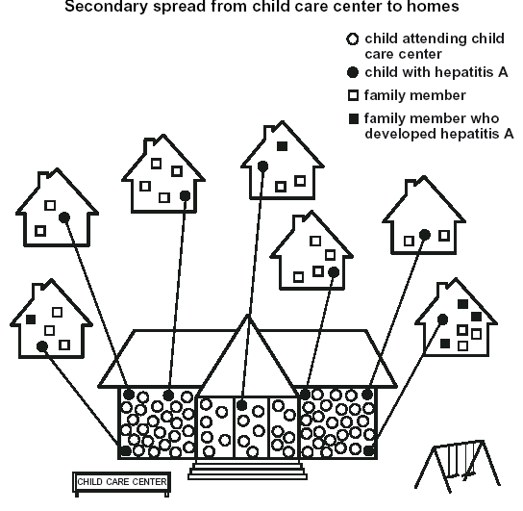
Figure of secondary attack rate

Slide 198
Example...
Secondary attack rate
  Cases of hepatitis A among family contact of children with hepatitis
  A=5
  Y= number of person at risk in the families(total number of family members-children already infected) = 32-7=25
  Secondary attack rate= x/y*100% = 5/25*100%=20%

Slide 199
Measures of Mortality
These measures magnitude of deaths in a community
Some are crude like the crude death rate
Others are cause-specific mortality rate
Some others are adjusted like standardized mortality ratio
Common mortality rates are (read more)
Crude death rate
Age-specific mortality rate
Sex-specific mortality rate
Cause-specific mortality rate
Proportionate mortality ratio
Case fatality rate
Fetal death rate
Perinatal mortality rate
Neonatal mortality rate
Infant mortality rate
Child mortality rate
Under-five mortality rate
Maternal mortality ratio

Slide 200
Mortality rates…
Crude rate
    Apply to the total population of a given area
    It is easier to obtain ( calculate )
    It is difficult to interpret in comparing different countries
    It is less informative
    Actual summary rates
B. Specific rates
    It is difficult to calculate
    It is easier to interpret in comparing different countries
    It is more informative
    Apply to homogeneous subgroups

Slide 201
Mortality rates…
C. Adjusted rates
  Are summary rates
  Permit unbiased comparison
  Easy to interpret
  Factious rates
  Absolute magnitude depends on standard population
  Opposing trends in subgroups masked
  Undergone statistical transformations

Slide 202
Mortality rates…
Crude death rate
  It is the mortality rate from all causes of deaths for the population.
  Numerator is all deaths

Slide 203
Mortality rates…
Cause- specific mortality rate
It is the mortality rate from a specified cause for a population.
The numerator is the number of deaths attributed to a specific cause
The denominator is similar with the denominator of crude death rate
It is a measure of risk of dying from a certain cause

Slide 204
Mortality rates…
Case- fatality rate
  It measures the risk of dying of a disease among those with the disease.
  It indicates how much the disease is fatal and the causative agent is virulent

Slide 205
Mortality rates…
Proportionate-mortality ratio
  It is not a measure of risk of death.
  It is a measure of importance of certain disease as a cause of death.
  A higher proportionate mortality ratio does not necessarily imply higher risk of death from the disease.

Slide 206
5. Fetal Death Rate
6. Prenatal Mortality Rate
7. Neonatal Mortality Rate

Slide 207
Adjusted rates of mortality
Standardization
Def^{n}: A method used to compare the occurrence of death or mortality for a country or region.
In essence, adjustment that weights an over all figure( disease occurrence or mortality) according to the risk factor profile of the country or region.
Type of standardization
Direct; depends on use of a population whose age-structure is standardized.
Indirect: depends on standard stratum-specific rates.

Slide 208
Standardization mortality cont.…
Example: Mortality in UK vs. Kenya
Death by age
 | UK |  |  | Kenya
 | Deaths | Pop^{n} | Rate | Deaths | Pop^{n} | Rate
All ages | 654.6 | 58,649 | 11.2 | 250.1 | 29,008 | 8.6
 | UK |  |  | Kenya
Age | Deaths | Pop^{n} | Rate | Deaths | Pop^{n} | Rate
0-29 | 29 | 22,287 | 1.3 | 90 | 16,825 | 5.4
30-59 | 105.9 | 25,219 | 4.2 | 71 | 10,443 | 6.8
60+ | 521.6 | 11,143 | 46.8 | 88.2 | 1,740 | 50.7
All ages | 656.4 | 58,649 | 11.2 | 250.1 | 29,008 | 8.6

Slide 209
Adjusted Mortality rates…
Direct standardization
Comparative mortality figure
  It is an age standardized ratio
CMF = Age standardized mortality in Kenya = 1084.5 =1.49
Age standardized mortality in UK 726.5
Interpretation
The expected mortality of Kenya is 49% higher than the expected mortality of UK if the age-structure is standardized similarly for both using the above standard population.
Age | Standard Popn | Uk expected | Kenya Expected
0-29 | 56,000 | 0.0013 X 56,000 =72.8 | 0.0054 X 56,000 =302.4
30-59 | 33,000 | 0.0042 X 33,000 =138.6 | 0.0068 X 33,000 =224.4
60+ | 11,000 | 0.0468 X 11,000 =514.8 | 0.0507 X 11,000 =557.7
All ages | 100,000 | 726.2 | 1084.5

Slide 210
Adjusted mortality rates…
Indirect standardization
Standardized Mortality ratio (SMR)
SMR= observed deaths = 250.1 X 100 = 170%
Expected deaths 147.2
Interpretation
the number of observed deaths in Kenya is about 70 % higher than the number expected if Kenya had the same mortality experience as the UK.
Age | UK Mortality | Kenya Popn | Kenya Expected Deaths
0-29 | 0.0013 | 16,825 | 21.9
30-59 | 0.0042 | 10,443 | 43.9
60+ | 0.0468 | 1,740 | 81.4
All ages |  |  | 147.2

Slide 211
Adjusted mortality rates…
If SMR > 1
  More deaths are observed in the smaller population than would be expected on the bases of rates in the larger (standard) population.
If SMR<1
  Fewer deaths are observed than expected.
  This method is used to compare two populations, in one of which the ASMR are not known or are excessively variable because of small numbers.

Slide 212
Source of epidemiological data

Slide 213
Learning objectives
At the end of this section the students will be able to:
Describe sources of epidemiologic data
Mention importance of census and its limitation
Describes vital registration and health survey
List health service records of data and importance

Slide 214
Sources of epidemiologic data
There are different source of information on health and health related conditions in community.
The information obtained from these sources is used for:-
  Health planning, programming and evaluation of health services.
  Providing facts for decision making
  Indicate present and future requirement of the community.

Slide 215
Sources of data…
There are various sources of health and health related data, which include
  Population census,
  Vital registration system,
  Health sample surveys,
  Population registers (Health service records)
  International migration statistics and
  Other sources.

Slide 216
Sources of data…
Mainly sources are from enumeration and registration
This is not really based on the method of getting facts
It lies in the nature of the facts themselves: one is a record of persons and the other is a record of events.
The enumeration method encompasses censuses and sample surveys, while the registration method refers mainly to vital statistics registration system and population registers.
Therefore, census produces the stock of a population of a given country or area in a static way (showing the size and composition at a given point in time).

Slide 217
Sources of epidemiologic data…
On the other hand, vital statistics registration system provides a flow of a record of vital events (that determine the process of change), in a dynamic way.
Therefore, censuses, vital statistics registration system, sample surveys and population registers are the principal sources of demographic data.

Slide 218
Sources of data…
They can be put categorically as follows:
  Enumeration Method
    Censuses (population and housing)
    Sample Surveys (demographic and social)
  Registration Method
    Vital Statistics Registration System
    Population Registers

Slide 219
1. CENSUS
It is defined as periodic count or enumeration of a population.
  A population census is the largest, most extensive and costly government exercise of a country.
Census could be seen as an inventory exercise of governments, about the individual entities under their administration.
It is designed to give mainly the stock of a country’s population at a given point in time.
A population census is defined as the total process of collecting, compiling, evaluating, analysing and publishing or otherwise disseminating demographic, economic and social data pertaining, at a specified time, to all persons in a country or delimited part of a country (UN, 1998).

Slide 220
Census…
It provides information on:-
  Size and composition of a population
  The force that determine these variability
  The trends anticipated in the future.
There are two types of census counts
1.1. Defacto
Counts persons according to their location at time of enumeration.
Excludes those who are temporarily away.
Those counted once will not be counted again
It lasts only for one night

Slide 221
Defacto…
Advantages: -
It offers less chance for double entry (commission) and omission as compared to the de-jure approach.
As persons are counted at any place they are found during the time of enumeration, the de-facto approach could present a true picture of the total population of a given country.
Disadvantages:-
Difficult to obtain information regarding persons in transit.
Provide incorrect picture of community (As people are enumerated at the place where they are found, temporary residents are included, so that the system does not provide an accurate area wise distribution of population.)
Vital statistics usually distorted.

Slide 222
1.2. Dejure
Counts according to their usual place of residence. Excludes temporarily visits.
Advantages:-
  Give permanent picture of community.
  provides more realistic and useful statistics
Disadvantages:-
  Some person may be omitted
  Some may be counted twice
  Information collected regarding persons away is often incomplete or incorrect.

Slide 223
Census…
In Ethiopia census was conducted in 1984, 1994 and 2007.
Data was collected on:-
  Age, sex, and size of the population
  Mortality, fertility
  Language, ethnicity
  Housing
From this information (data) different health indices could be calculated such as, CBR, CDR, ASMR and SSMR.

Slide 224
Essential features or characteristics of census
1. Territoriality
Refers to the specification of area (whether it is at national or regional level) with in which the population count is to be made.
  Should refer to people inhibiting a well defined territory
This is more necessary because political and administrative boundaries are often subjected to adjustments.

Slide 225
Essential features or characteristics of census
2. Universality
It should include every individual in the area (no omission or duplication).
  It should includes all persons irrespective of their ethnic and socio-economic characteristics.
3. Periodicity
It should be taken at regular intervals (preferably every 10 years).
  However, several countries have failed to maintain regularity
Strict adherence to periodicity tends to improve the quality of data and makes analysis of data easier.

Slide 226
Essential features or characteristics of census
4. Simultaneity
Information should relate to a well-defined point in time.
  Any population is subject to constant changes in its size and characteristics.
  Thus, population has to be expressed with reference to a point of time.
The reference point of time is called the census moment or census time.
  In practice, it is not possible to count the entire population at an instant of time and secure simultaneity.
5. Individual enumeration/individuality
Information pertaining to a single individual in a household should be recorded separately.
Information be obtained from personal contact.

Slide 227
Phases of Census
The activities are generally divided into the following three broad phases:
Phase I: Pre-census enumeration activities:
These are tasks employed in the planning and preparatory works, which covers the longest period of the census time schedule. It takes about two years.
The main activities carried out in this phase are:
Decision about the system of enumeration to be used;
Fixing the date of the census and set out pre-census programme;
Decision on the content of the questionnaire;

Slide 228
Phases of Census…
Testing all forms and procedures including final pre-test;
Preparation of detailed maps and list all dwellings;
Recruiting and training of the field staff; enumerators and supervisors;
Planning the programme for processing of the data;
Inform the public and obtain their co-operation.

Slide 229
Phases of Census…
Phase II: Census enumeration activities: This phase referees to the actual data collection operation. The field data collection phase covers the shortest period of the census time schedule, ideally a day.
Phase III: Post census enumeration activities: These are tasks mainly concentrate on the analysis and publication of the census results.
  The main activities are:
    Retrieval of census documents from the field;
    Conducting the post-enumeration survey (quality check is usually done on a small sample of the census blocks following a population census);
    Processing, publication and dissemination.

Slide 230
Uses of a census
Gives complete and valid picture of the population composition and characteristics
Serves as a sampling frame
Provides with vital statistics of the population in terms of fertility and mortality.
Census data are utilized in a number of ways for planning the welfare of the people
Planning and calculating health indicators

Slide 231
Common errors in census data
  Conducting national wide census is very expensive, Omission and over enumeration may encountered
  Misreporting of age due to memory lapse, preference of terminal digits, over/under estimation.
  Overstating of the status within the occupation.
  Under reporting of births due to problem of reference period and memory lapse.
  Under reporting of deaths due to memory lapse and tendency not to report on deaths, particularly on infant deaths.
  Generates large amounts of data which takes a very long time to complete and analyze.
  Carried out every 10years, therefore it cannot assess yearly changes.

Slide 232
2. Vital statistics
A vital statistics system can be defined as including the legal registration, statistical recording and reporting of the occurrence of and the collection, compilation, analysis, presentation and distribution of statistics pertaining to ‘vital events’ which in turn include live births, deaths, foetal deaths, marriages, divorces, adoptions, legitimating, recognitions and legal separations” (UN, 1985).

Slide 233
Vital statistics…
Certificate issued for each birth and death.
Use calculating health indicators like
  Birth and death rates
  Cause specific rates-since cause of death is recorded on death certificate.
Main characteristics of vital statistics are:-
  Comprehensive-all birth and death should be registered.
  Compulsory by law-should be enforced by law
  Compiled centrally-so that it can serve as source of information.
  Continues-it should be an ongoing process.

Slide 234
3. Health service records
Are the major sources of health information in Ethiopia.
It is the way all that health institutions report their activities to the ministry of health.
Notification of Infectious Diseases
There are some internationally notifiable diseases.
WHO member states report on Plague, Cholera, and Yellow fever. Moreover, every country has its own list of notifiable diseases.
The major problems related to this source (health service records) are low compliance and delays in reporting.
Advantages:-
  Early obtainable
  Available at low cost
  Continuous system of reporting
  Causes of illness and death available

Slide 235
Health service records…
Limitations:-
  Lack of completeness
  Lack of representativeness-small proportion of diseased population seeks medical advices.
  Lack of denominator-catchment is not known in majority of cases.
  Diagnosis varies across the level of health institutions.
  Lack of compliance with reporting.
  Irregularity and incompleteness of published compilations.

Slide 236
4. Health surveys
Are studies conducted on a representative sample population to obtain more comprehensive data for monitoring the health status of a population.
There are two types of health surveys.
a) Surveys of specific diseases:-are studies conducted on each specific diseases .e.g.
  EPI
  Control of diarrheal diseases
  Prevention and control of HIV/AIDS
  TB and leprosy control

Slide 237
Health surveys…
b) Surveys of general health status
  Are studies on general health status of the population.
  Are based on interview, physical examination and laboratory tests.
  Are reliable than surveys of specific diseases

Slide 238
Health surveys…
Advantages of survey based on interview:-
  More representative for the health conditions of the community.
  Denominator is known
  Data are more uniform in quality
Limitations:-
  Data accuracy is dependent on the memory and cooperation of the interviewee.
  More expensive

Slide 239
Data collection methods
This all epidemiology data sources are collected through different way but the most commonly used methods are;
  Observation
  Interview and questioners
  Documentary sources - Clinical records and other personal records, death certificates, publications etc.

Slide 240
Lecture on Epidemiological study designs

Slide 241
Learning objective
At the end of this session the students will be able:
Define role of epidemiology in public health importance
Identify criteria for selection of study design
Identify main category of epidemiological study design
List features of descriptive design
List features of analytic design
Mention major difference between different study design
List advantages and limitation each study design and its application

Slide 242
Introduction
Role of epidemiology
To diagnose community health problems
To identify natural history and etiology of diseases
To evaluate and plan health services
Therefore, to achieve these roles
-------we use epidemiological study designs.
The common goal in epidemiological studies is understanding the frequency, pattern, and causes of disease in populations.

Slide 243
Introduction…
Epidemiology: is primarily concerned with the distribution and determinants of disease in human population.
Study Design: is an arrangement of conditions for the collection and analysis of data that leads to the most accurate answer to the research question and the most economical way.
  The basic design strategies used in epidemiologic research can be broadly categorized according to whether such investigations focus on describing the distributions of disease or elucidating its determinants.
Broad categories of epidemiological studies: according to their focus of investigation
  Descriptive studies: focus on the distribution of disease
  Analytic studies: focus in elucidating the determinants of disease

Slide 244
Epidemiological Study designs
Descriptive | Analytic
Characterize disease occurrence by time, place and person. Generate testable hypothesis as to the cause of disease Dealing with population as a study unit Correlational or ecological Dealing with individual as study unit Case report or series Cross sectional survey | Concerned with the search for causes and effects. Test hypothesis about association between exposure and outcome. Observational studies Case-control Cohort Intervention studies Experimental

Slide 246
Classification of Study designs
Epidemiological Study Designs
Descriptive
Ecological
/Correlational
Case Report/
Case Series
Analytic
Experimental/ Interventional
Observational
Cross-Sectional
Cohort
Case-control
Preventive
Therapeutic/
clinical
Community
Trial
Filed trial

Slide 247
Selection of study design
Depends on
  Objective /focus/research question ( Descriptive & Analytic)
  The role of the investigator ( Observational & Experimental)
  Based on timing ( one time & Longitudinal (Follow-up) studies
  Based on direction of follow-up/data collection ( Prospective & retrospective)
  Based on type of data they generate( Qualitative & Quantitative)
  Based on study setting ( community based, institution based and laboratory based)

Slide 248
Descriptive epidemiology
Descriptive epidemiology is a way of organizing data related to health and health related events by person (Who), place (Where) and time (When) in a population.
Provides information about:
  The magnitude of the problem,
  The populations at greatest risk of acquiring a particular disease, and
  The possible cause(s) of the disease

Slide 249
Descriptive study design…
Time: Information organized by time
  Easily shows the trend of the disease over time and establishes the usual occurrence of the disease in the population which is essential in identifying excess occurrence (epidemics).
  It can also be used to predict seasonal and secular (long-term) trends.
Place: This provides information on geographic distribution of the disease.
  Provides clue in identifying factors influencing the occurrence of the disease either in the host or environment.

Slide 250
Descriptive study design…
Person: Describing disease occurrence by personal characteristics
  Important to identify some modifiable factors in order to prevent or control the disease.
Person data include:
  The inherent characteristics of people (age, ethnic group, gender),
  Their acquired characteristics (educational, marital, immune, or nutritional status),
  Their activities (occupation, leisure activities, use of alcohol, tobacco, or medications), or
  The conditions in which they live (socioeconomic status, access to health care).

Slide 251
Descriptive study design…
Descriptive studies (important features)
Are mainly concerned with the distribution of diseases with respect to time, place and person
Provide useful information for health managers to allocate resource and to plan effective prevention programmers
Generate epidemiological hypothesis: an important first step in the search for disease determinants or risk factors.
Can use information collected routinely which are readily available in many places. (less expensive and less time-consuming than analytic studies)
Are the most common type of epidemiological design strategies in medical literature.

Slide 252
1. Correlational/ecological studies
Uses data from entire population to compare disease frequencies
  Between different groups during the same period of time, or
  In the same population at different points in time.
Does not provide individual data, rather presents average exposure level in the community
Cause could not be ascertained
Correlation coefficient (r) is the measure of association in Correlational studies.

Slide 253
Correlational/ecological studies (cont.)
Example:
Average per capita fat consumption and breast cancer rates compared between countries.
Comparing incidence of dental cares in relation to fluoride content of the water among towns in the rift valley.
Mortality from CHD in relation to per capita cigarette sales among the regions of Ethiopia.

Slide 254
  Ecological / correlational……
The design is similar to cross-sectional study design
(B)
Group Exposure
Individual Exposure
(C)
Group outcome
(D)
Exposur Vs Outcome
Positively Correlated
(F)
Exposure Vs Outcome
not correlated
(E)
Exposur Vs Outcome
Negatively correlated
(A)
Source Population

Slide 255
Correlational/ecological studies (cont.)
Strength
Can be done quickly, inexpensively, and often using available data (routine records and reports for example, death rates, per capita income, national food consumption…)
Low cost/cheap and convenience
Measurement limitations at individual level,
Eg environmental contact.
Other designs may be unable to measure interest on ecologic effect

Slide 256
Correlational/ecological studies (cont.)
Limitation
Inability to link exposure with disease in a single individual.
  Data on exposure and outcome are not linked at the individual level; association found with aggregate data (average values) may not apply to individuals (Prone to ecological fallacy)
Average exposure levels rather than actual individual values, ecological fallacy or bias.
Lack of ability to control for effects of potential confounding factors.
Conversely, lack of correlation does not necessarily imply absence of valid statistical association (Berksons fallacy)
It may mask a non-linear relationship between exposure and disease.
    E.g. non-linear relationship in alcohol consumption and mortality from CHD ("J" shaped curve)

Slide 257
2. Case Reports/Case series
Report or describe the experience of a single individual or a group of individuals with the same diagnosis or health problem
Derived from either the practice of one or more health care professionals or a defined health care setting (hospital, health center or specialized clinic)

Slide 258
Case Reports/Case series…
2.1. Case study/report
A most basic type of descriptive study of individuals comprising of a careful and detailed report of a single patient by one or more physician
  E.g. the progress of symptom and sign, response of treatment
It is the study of health profile of a single individual using a careful and detailed report by one or more clinicians
  It is common form that is published in articles
It is made using
  Simple history, physical examination and Lab./ radiologic investigation
  Eg It was a single case report that formulated the hypothesis of oral contraceptive use increases venous thrombo-embolism

Slide 259
Case Reports Case series
2.2. Case series
A sequence of case reports with common elements such as similar clinical features and suspected common exposures
  Individual case report can be expanded to a case series, which describes characteristics of a number of patients (usually 2-14) with a similar disease
Similar to case report, it is usually made on cases having new and/ or unusual disease (giving interest to clinicians)
It is often used to detect the emergence of new disease or an epidemics

Slide 260
Examples of case-series studies
Five young, previously health homosexual men were diagnosed as having Pneumocystis carinii pneumonia at Los Angeles hospital during a six month period from 1980 to 1981
  This form of pneumonia had been seen almost exclusively among older men and women whose immune systems were suppressed
This unusual circumstance suggested that these individuals were actually suffering with a previously unknown disease, subsequently it was called AIDS

Slide 261
Uses of case report/series studies
Useful for the recognition of new disease
Important for constructing the natural history of disease
Formulate a research hypothesis and detection of epidemics
Can be valuable early evidence for associations between exposures and diseases which can be studied in more detail

Slide 262
Limitations of case report/ series studies
No appropriate comparison group may result in false leads, wasted energy and resources
Cannot be used to test for presence of a valid statistical association
Since based on the experience of one person:
  Presence of any risk factor may be coincidental (by chance)
  Not a true epidemiologic design
Studies are prone to atomistic fallacy (the opposite of ecological fallacy).
  Example: at an individual level a high income may be associated with lower rate of suicide but this does not mean that societies which are rich have a lower rate of suicide.

Slide 263
3. Cross-Sectional Studies
Measure disease and exposure status simultaneously among individuals in a well-defined population at a point in time
  Is generally called prevalent study
  Snapshot of the health status of populations at a certain point in time
Steps in the conduct of cross-sectional studies:
1. Define a population of interest (reference population)
2. Recruiting a representative sample (adequate size, random selection)
3. Measure the variables of interest (disease or exposure) at the same point in time
4. Sorting (if necessary) & Analyze the data

Slide 264
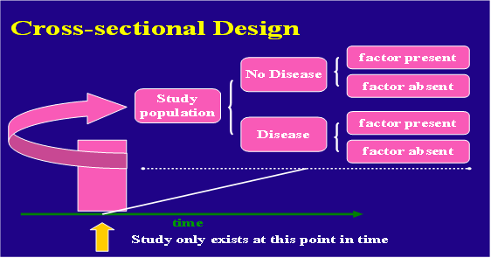
Cross-sectional…

Slide 265
Characteristics of cross-sectional studies:
Assess both exposure and outcome simultaneously
Are based on point prevalence rates with only few exceptions
Are frequently made on total population samples
Subdivision of the total population takes place after data collection unlike in cohort & case- control studies
Are cheaper, easier & useful for studies of exposures that are unalterable over time or relatively permanent features for individuals
E.g.-blood group, ethnicity, sex, etc.

Slide 266
Cross-Sectional Studies
Data are obtained only once
  Individuals with a defined disease, risk factor, or other condition of interest are identified at a point in time
May be used first step in longitudinal or case control studies
Can have descriptive or analytic purposes
  The descriptive type is carried out to study prevalence of health related events at a point in time/snapshot
    Diseases, risk factors, coverage of interventions, health service utilization, knowledge, attitude and practice
  The analytic type is carried out to assess association between exposure and outcome
    Exposure and disease status are assessed simultaneously among individuals at the same point in time
    Measures of association is made using odds ratio

Slide 267
Cross-Sectional Studies
Since exposure and disease status is assessed at a single point in time, temporal relationship between exposure and disease can not be clearly determined
  “Chicken egg dilemma”
Study prevalent cases rather than incident cases
  The person might have changed the behaviour that resulted to the disease
  Prevalent cases represent survivors who may be atypical with respect to exposure status
    Incidence-prevalence/selective survival/Neyman’s bias
Therefore identify a mix of risk factors (incidence) and prognostic factors (duration)
Best used for screening hypotheses if in etiological search
Generally provide weak evidence regarding causation

Slide 268
Cross-Sectional Studies
Numerators and denominators in cross-sectional studies:
Numerators- two probabilities: -
Referring to the exposure-prevalence rate of the outcome is compared between exposed & non-exposed subgroups
Referring to the outcome-the prevalence rate of the exposure is compared in those with & without the outcome
Denominator-total population in the sample, based on the comparison being made (exposure prevalence or outcome)

Slide 269
Cross-Sectional Studies
Example:
Respiratory problems
Yes no total
Smoking Yes 70 50 120
no 30 70 100
Total 100 120 220
Prevalence of smokers (among respiratory problems)
=70 x100=70%
100
Prevalence of respiratory problems (among smokers)
=70 x100=58.3%
120

Slide 270
Cross-Sectional Studies
Advantages
  Less expensive: a one-step, one-time collection of data
  It starts with reference population, thus making possible generalization
  Provide much information useful for planning health services & medical programs
  Show relative distribution of conditions, Diseases, injury & disability in groups & populations
  Are based in a sample of a major population & do not relay on individuals that present themselves for medical treatment.
  Important to establish generate hypothesis

Slide 271
Cross-Sectional Studies
Disadvantages
  It is difficult to know which occurred first, the exposure or the outcome, this is known as 'chicken or egg dilemma'
  It may not show strong cause-effect relationship if sample size is small
  Potential bias in measuring exposure
  Not feasible for rare diseases
  Does not yield incidence or true relative risk
  Prevalent rather than incident (new) cases are used – the exposure could be associated with survival after dx occurrence, rather than development of the disease

Slide 272
Analytic epidemiologic study
Purpose
To test hypothesis about causal relationship
To search for cause & effect
To compare treatment regimens / prevention programs
To assess diagnostic tests
To quantify the association b/n exposure & outcome (measure of association)
Focuses on determinants of diagnosis by testing hypothesis

Slide 273
Basic Question in Analytic Epidemiology
Are exposure and disease linked?
  Exposure Disease
Look to link exposure and disease
  What is the exposure?
  Who are the exposed?
  What are the potential health effects?
  What approach will you take to study
The relationship between exposure and effect?

Slide 274
Time frame of Studies
Prospective Study
  Looks forward,
  Looks to the future, examines future events, follows a condition, concern or disease into the future
Retrospective Study
  To look back´,
  Looks back in time to study events that have already occurred

Slide 275
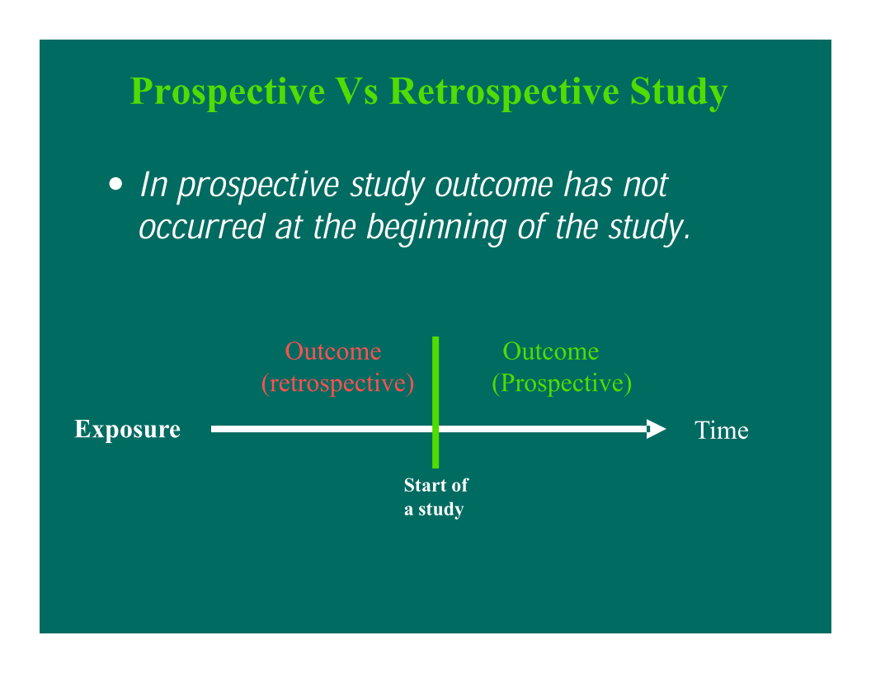

Slide 276
Types of analytic study design
There are two types of analytic study designs
  Observational- to simply observe
  Interventional - manipulation or determination
Observational studies
Information is obtained by simple observation of the event (two basic types): -
  Case control study
  Cohort study
  Cross sectional (some times)
Interventional
The investigator manipulate the outcome assigned subjects as treatment or placebo groups
  Experimental study

Slide 277
1. Case-Control Studies
Syn: case-comparison study, case-referent study, retrospective study
Def/n: past history of exposure is compared in cases and their controls for their exposure status
  Look back at exposure (retrospective) - It assess retrospectively on exposure status.
Case control studies aim to identify potential associations between ‘risk’ factors or exposure and a particular disease or outcome

Slide 278
Case-Control Studies…
Unit of observation and analysis: Individual (not group)
Case-control studies are the most frequently undertaken analytical epidemiological studies
They are the only practical approach for identifying risk factors for rare diseases
They are best suited to the study of diseases for which medical care is sought, such as cancers or hip fracture
It is relatively cheaper
Measure of association is using OR

Slide 279
Case control study
past time present time
Exposed
Cases (people with disease)
Non – exposed
Exposed
Controls (people without the disease
Non – exposed
Direction of inquiry

Slide 280
Case-control design
Select a group of subjects with disease (cases) and
  Try to characterize their pre-disease exposure status
Select a group of subjects without disease (controls)
  try to characterize their exposure status
Compare how common exposure was among cases with how common it was among controls, as a measure of exposure-disease association (measure of association)

Slide 281
Outcome in case control study
Can we study outcome other than disease ?
The outcome has traditionally been the presence or absence of disease.
 However, other outcomes can also be studied e.g. disability, smoking cessation etc.
Start by defining a CASE
  Clinical definition insufficient
  List of criteria
  Reproducibility
  Certainty of diagnosis
  Severity

Slide 282
Selection of Cases
Select cases after the diagnostic criteria and definition of the disease is clearly established
  Study cases should be representative of all cases
  The study need not include all cases in the population
Cases may be located from hospitals, clinics, disease registries, screenings, etc
Incident cases are preferable to prevalent cases for reducing
  Recall bias
  over-representation of cases of long duration

Slide 283
Selection of Cases…
Hospital-based Vs population-based cases
Hospital-based
  Easy and inexpensive to conduct but it is prone for selection bias.
Population-based
  Avoids selection bias,
  Allows the description of a disease in the entire population
  The direct computation of rates of disease in exposed and non exposed persons.

Slide 284
Selection of Cases…
Incident Vs Prevalent cases
  The ideal set of cases would be new (incident) and representative of all cases of the health problem under study
Prevalent cases:
  Increase sample size available for rare disease
  Difficult to establish temporal sequence between exposure and outcome. E.g. Coffee consumption and peptic ulcer disease.
Incident cases:
  Helpful to establish temporal relationship between exposure and outcome.
  Records are easily obtainable and recall is not a serious problem.

Slide 285
Selection of Controls
Main challenge in case-control studies
Controls should come from the same population at risk for the disease as the cases
Should be similar to cases, except for disease status
  E.g., hospital controls for hospital cases
Should be representative of all persons at risk for the disease in the population
  E.g., population-based controls
Multiple controls can be used to help add statistical power when cases are unduly difficult to obtain
  Using more than one control group lends credibility to the results
  More than 3 controls for a case is usually not cost-efficient

Slide 286
Selection of Controls…
Non-hospitalized Controls
Population-based (random sample)
  Costly and difficult
School rosters, neighborhood, friends
  Similar socioeconomic status (SES)
Hospitalized Controls
Captive source (compliant and economical)
Better recall of exposures
But hard to define reference population
Are a selected group
  E.g., more smokers, drinkers and oral contraceptive users
Select specific “other diagnosis?”

Slide 287
How many cases and controls?
Based on:
Availability of cases and controls
List the main risk factors
Review the prevalence of the risk factor in the controls
What would be the expected prevalence of the risk factor in controls

Slide 288
Case control: numbers and ratio
A single control group is optimal in most studies
Add more control groups only
  when you are not confident with the control group or
  when you see a clear deficiency in your control group or
  when there is a clear advantage by adding another control
Conditions for multiple controls:
  when a single control group is considered to be not appropriate
  when the selected group has a specific deficiency that could be avoided by inclusion of another control group
Control-case ratio
  Efficiency of a study can be maximized up to control-case ratio of 4:1

Slide 289
Selection of controls
When we select controls should be consider the following:
  Avoiding selection bias
  Avoiding information (‘recall’) bias

Slide 290
Hospital Controls
Advantages:
   Easily identified and readily available-reduced cost.
   More likely than healthy individuals to be aware of antecedent exposures or events – minimize recall bias
   Controls are also likely to have been subject to the same intangible selection factors -minimize selection bias
   More likely to be cooperative -reduce non-response bias
Disadvantages:
   Ill individuals are different from healthy
   Danger of altering the direction of association or masking a true association b/n exposure and outcome

Slide 291
General Population Controls
Advantages:
 Generalizability is possible
Good when cases are selected to represent affected individuals in a defined population.
  For example, if cases to that particular hospital are coming from a geographically defined area selection of controls from the entire population could be possible.
Disadvantages:
Costly and time-consuming
Recall bias - controls may not recall exposures with the same level of accuracy
People might be less motivated to participate, which increases non-response rate

Slide 292
Strengths of C-C Studies
Can use prevalent cases
Retrospective design is inexpensive and quick to complete
Can study rare diseases
Can examine multiple exposures
Usually requires a smaller study population than a cohort study
Relatively cheap
Quick and easy to complete, cost effective

Slide 293
Weaknesses of C-C Studies
Uncertainty of exposure-disease time relationship
Inability to provide a direct estimate of risk
Very prone to biases (recall & selection bias)
Misclassification of exposures and outcomes
Selection of controls
Cannot yield a population level measure of disease incidence/prevalence.

Slide 294
Sampling case control
Sample size - for test of significant difference between two proportions, the following formula can be used:
Parameters:
n - size of sample in each group
P_{1 ,}P₂–estimated population prevalence in the comparison groups
β = 1- Power (the probability that if the two proportions differ the test will produce a significant difference)
  Usually a power of 80% is used

Slide 295
2. Cohort studies
Cohort
  A group of people who share a common experience or condition
  E.g. Birth cohorts, cohort of smokers, occupational exposures
Cohort studies
  The observation of a cohort over time to measure outcome(s)
  Because the data on exposure and disease refer to different points in time, cohort studies are longitudinal, like case-control studies
  Longitudinal, follow-up or incidence studies , prospective study??
Notes:
British Doctors Study (Doll – smoking)
Benzene-workers (leukemia)
Coke-oven workers (lung cancer)
Asbestos workers (lung cancer)
Patients treated with radiation (cancer)
Veterans (post-traumatic stress disorder)

Slide 296
Definition ...
They have 2 primary purposes:
  Descriptive: to describe the incidence rates of an outcome
  Analytic: to analyse associations between the outcomes and risk factors
Begin with a group of people free of disease
Who are classified into subgroups according to exposure to a potential cause of outcome
The whole cohort is followed up to see how the subsequent development of outcome differs between the groups with and without exposure (Figure 1)

Slide 297
Definition...
Basic elements
  Disease free at entry
  Selected by exposure status rather than outcome
  Follow up is needed to determine the incidence of the outcome
  Compares incidence rates of exposed against unexposed group
a. Exposure status
  Study subjects should be disease free.
  Define study subjects using inclusion /exclusion criteria
b. Possible outcome in cohort
  No disease
  Diseased
  Lost to follow up

Slide 298
The design of Cohort Study
disease
Factor
present
Study
population
free of
disease
no disease
Factor
absent
disease
no disease
Cohort Design
present
future
time
Study begins here

Slide 299
Types of cohort
Prospective vs. Retrospective (Concurrent vs. Non-concurrent)
  Depending on temporal relationship between initiation of the study /timing of data collection/ and occurrence of the disease
  Cohort studies have been called prospective studies, but this terminology is confusing and should be avoided
    the term “prospective” refers to the timing of data collection and not to the relationship between exposure and effect

Slide 300
Prospective cohort studies
Exposure and outcome data is collected after start of the study
  Cohorts Identified in the present
  Exposure status or possible
  explanatory/prognostic factors determined in the present
  Cohorts followed-up to identify outcome
  Ascertainment of outcome done in future

Slide 301
Retrospective cohort
All the exposure and effect data have been collected before the actual study begins
This type of investigation is called a historical cohort study
Conduct
  To identify cohort in the past using records/databases
  To determine exposure or prognostic factors in the past using again records or databases then
  To identify outcome in past or present or future (in case of mixed cohort)

Slide 302
Retrospective cohort...
Costs can occasionally be reduced by using a historical cohort (identified on the basis of records of previous exposure)
This sort of design is relatively common for studies of cancer related to occupational exposures
For example, records of military personnel exposure to radioactive fall-out at nuclear bomb testing sites have been used to examine the possible causal role of fall-out in the development of cancer over the past 30 years

Slide 303
Prospective vs. Retrospective
Can be conducted more quickly and cheaply
  All relevant events have occurred
  Efficient for disease with long latency periods
Depend on availability of routine data
  Incompleteness
  Lack of data on confounding variables

Slide 304
Design and data collection
1. Define and identify cohorts
1.1. Identify population at risk
Selection of Exposed Population
  Depends on research question
  Outcome must not be rare in exposed
  Accessible and compliant subjects
    E.g., Nurse’s Health Study, Physicians
Selection of Non-exposed Group
  Similar to exposed
  Control for confounding factors

Slide 305
Design and data collection...
1.2. Screen identified subjects for the disease and omit the prevalent cases
2. Define, assess, identify and classify exposure
3. Follow-up and ascertain outcome
  Timing of outcome events-case definition

Slide 306
Sources of Exposure Information:
Self Report (interviews, surveys, etc.)
  Advantages:
    Opportunity to question subjects on as many factors as necessary.
    Good for collecting information on exposures not routinely recorded.
  Disadvantages:
    Subject to response bias (e.g. due to stigma, response expectations, etc.).
    Subject to interviewer bias
Pre-existing Records:
  Advantages:
    Inexpensive and Relatively easy to work with
    Usually unbiased -data were collected for other purposes

Slide 307
Sources of Exposure Information…
  Disadvantages:
    Exposure information may not be precise enough to address the research question.
    Records frequently do not contain data on potential confounding factors.
Direct Measurement
  Can provide objective and unbiased exposure ascertainment (e.g. blood pressure, serum samples, environmental measurements, etc.).
Death certificates (National Death Index) –for some causes
Clinical history
Medical examination (periodic re- examination of the cohort)
Hospital discharge logs

Slide 308
Sampling of cohort
Sample size - for test of significant difference between two proportions, the following formula can be used:
Parameters:
n - size of sample in each group
P_{1 ,}P₂–estimated population prevalence in the comparison groups
β = 1- Power (the probability that if the two proportions differ the test will produce a significant difference)
  Usually a power of 80% is used

Slide 309
Advantages cohort
  Elucidates temporal relationship between exposure and outcome (It shows temporal sequence)
It is possible to examine a range of outcomes of particular value when exposure is rare
Minimize selection bias – prospective
Can examine multiple effect of a single exposure
Allow direct measure of incidence of disease in the exposed & none exposed.
Notes:
Cohort studies allow for examination of multiple effects of a single exposure. For example, the Nurses’ Health Study has examined the relationship of oral contraceptives with breast and ovarian cancer, malignant melanoma as well as myocardial infarction.

Slide 310
Disadvantages
Time-consuming - prospective
  Require long periods of follow-up since disease may occur a long time after exposure
  Many exposures investigated are long-term in nature and accurate information about them requires data collection over long periods
Expensive - prospective
  Often involve following large number of individuals for many years
Incompleteness of records – retrospective
  Require the availability of adequate records
Loss-to-follow-up – bias
  Validity of results - seriously affected by losses to follow up
Inefficient for rare disease

Slide 311
3. Experimental /Intervention studies
Investigator determines who is exposed, ideally using random methods
Investigator allocates the exposure and follows for an outcome
Intervention trails could be done for various purposes:
  Proof of concept trail: designed solely to produce knowledge about cause and effect, does not test the efficacy of the intervention in actual practice.
  Prevention trail: interventions are to prevent disease and study participants are persons without disease.
  Clinical trial: interventions are treatment based on drugs and study participants are persons with disease.

Slide 312
Key Features of Experimental Design
Investigator manipulates the condition under study
Always prospective

Slide 313
Classification experimental study design
1. Based on population
  Clinical trial - usually performed in clinical setting and the subjects are patients.
  Field trial - used in testing medicine for preventive purpose and the subjects are healthy people. E.g. vaccine trial
  Community trial- unit of the study is group of people/community. E.g. fluoridation of water to prevent dental caries.
2. Based on design
  Uncontrolled trial - no control group. Control will be past experience (history).
  Non-randomized controlled- there is control group but allocation into either group is not randomized.
  Randomized controlled - there is control group and allocation into either group is randomized.

Slide 314
Classification…
3. Based on objective
  Phase I – clinical pharmacologic study
    Trial on small subjects to test a new drug with small dosage to determine the toxic effect, safe dose range.
    Scale: 20-80 healthy individuals
  Phase II – safety and efficacy studies
    Trial on small group to determine the therapeutic effect
    Scale: 100-200 patients
  Phase III - study on large population to test effectiveness
    Randomized Controlled Trial (RCT)
    Often it is multi-centered …… licensing
  Phase IV
    Post marketing surveillance
    Long term prospective assessment of effects & side-effects

Slide 315
Experimental design...
Although experimental studies come in many types, principles are the same and clinical trials dominate the field
A clinical trial is a prospective study evaluating the effect and value of intervention(s) in human beings under pre-specified conditions.
  It is the most definitive tool for evaluation of the applicability of clinical research
It represents a key research activity with the potential to improve the quality of health care and control costs through careful comparison of alternative treatments.

Slide 316
Randomized controlled trial
An investigation involving intentional change in some aspect of the status of the subjects, e.g., introduction of a preventive/therapeutic regimen,
  It is a design that could bring high quality of a research that resembles a controlled experiment “gold standard”
It is similar to cohort study design that individuals are enrolled on the bases of their exposure.
What is the difference b/n cohort and experimental studies?
  Investigator assigns subjects to exposure & non exposure
  Makes follow up to measure for the occurrence of a disease

Slide 317
Randomized controlled trial…
Based on population it can be classified as
  THERAPEUTIC (secondary prevention)
    Interventions made among patients
    Usually made in health institutions =(clinical trial)
  PREVENTIVE (primary prevention)
    Interventions performed among healthy people.
    If individuals are considered as study subjects
    -- field trial
    If the community are considered as study subjects
    --community trial

Slide 318
INTERVENTION STUDIES...
CLINICAL TRIAL: ( therapeutic trial) A research activity that involves the administration of a test regimen to humans to evaluate its efficacy & safety.
Recovery
Treatment
No recovery
Population
Pt with Diseased
Recovery
Placebo
Manipulation
No recovery
Time and direction of inquiry

Slide 319
2. Field trial
Diseased
Intervention
Not diseased
Population
persons with out Diseased
Diseased
No intervention
Not diseased
Manipulation
Time and direction of inquiry

Slide 320
3. Community trial
Experiment in which the unit of allocation to receive a preventive or therapeutic regimen is an entire community or political subdivision.
Examples include the trials of fluoridation of drinking water and of heart disease prevention in Ethiopia and Eritrea

Slide 321
Community trial ……
Diseased
Intervention
Community/clusters with out Diseased
Not diseased
Population
No intervention
Diseased
Not diseased
Manipulation
Time and direction of inquiry

Slide 322
Selection of Participants
Source population
Threats to external validity
Study population
Threats to internal validity
Randomize
Treatment
No treatment

Slide 323
Population At Large
Define Condition
Population With Condition
Entry Criteria
Study Population
Enrollment
Study Sample

Slide 324
Sample size
Calculating sample sizes for trials with dichotomous outcomes (eg, sick vs well) requires four components:
type I error (α),
Power (β),
event rate in the treatment group(p1),
RR or event rate in the control group(p2) ,RR=P1/p2

Slide 325
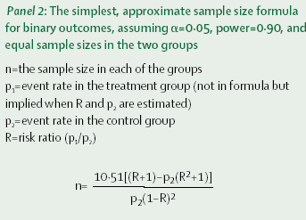

Slide 326
Experimental study…
The quality of "gold standard“ in intervention/experimental studies can be achieved through
  Randomization
  Use of placebo
  Double Blinding

Slide 327
Randomization
Methods of randomization
Fixed allocation/Randomization
  Simple Randomization
  Stratified Randomization
Advantages of Randomization
  Removes the potential of bias in the allocation of participants.
  Prevents confounding
  produce comparison groups or increase confidence on the result
Constrained
randomization

Slide 328
Applying Intervention
Use of Placebo
  an inert material indistinguishable from active treatment or standard treatment
  Need to control for therapeutic aspects of prescribing a medication or procedure not directly due to the medication or procedure itself
  Advantages, “placebo”?
  Tendency to report favourable response regardless of physiological efficacy
  Placebo is used as blinding procedure /patient
  Disadvantages of placebo
    Ethical issues

Slide 329
Blinding
Blinding: Means that the subject, investigator or both do not know to what group the subject is assigned to.
  Controls for
    Information bias (e.g., observer bias)
    Reduce loss to follow up (reduce selection bias)
Blinding is when the observers and/or subjects are kept ignorant as to the group to which the subjects are assigned

Slide 330
  Blind studies
Single blind
  The patients do not know which treatment they receive
Double blind
  The patient and the observer or the physician do not know
Triple blind
  The patient, the observer and the analyst do not know

Slide 331
Analysis of Intervention Studies
The basic analyses are:
  comparison of the two groups with baseline characteristic to ensure similarity.
  Calculation and comparison of rates of the incidence of the outcome for exposed and non-exposed.
    Relative risk of disease
    Efficacy of a drug or vaccine
Results of Randomized Trials
  Relative risk RR= incidence in exposed/incidence in non-exposed
  Efficacy of treatment or vaccine

Slide 332
Experimental…..
ADVANTAGES
  Randomization minimize bias & confounding
  Blinding minimizes observer bias
  Placebo could blind patients
    Ability to demonstrate causal associations when appropriately designed
      Use of controlled conditions
      Powerful techniques – randomization & blinding
        Increase subject comparability
        Decrease potential bias and confounding
    Investigators control level of exposure
      Permits them to establish precise doses or procedures most appropriate to experiment

Slide 333
Disadvantage/weakness
Generalizability limited by selection of participants
Rare/late Side effects of intervention may not be recognize
  Limited applicability
  Ethical concerns limit use
      This is why RCTs focus on interventions that have the potential to reduce rather than increase the risks of morbidity or mortality
  Bias that can result from differential rates of compliance, withdrawal, or losses to follow-up between experimental and control groups
      Can alter the magnitude or direction of the relationship between the intervention and study outcome

Slide 334
Disadvantage/weakness
Long-term commitment
Considerable expenses necessary to implement and complete a trial
Some address narrowly focused questions in artificial settings
Applicability to real-world situations may not always be clear
Reliance on volunteers and use of strict exclusion criteria
Make it difficult to recruit sufficient subjects for a study
Can limit external validity of findings
Commercial, political and/or academic pressure

Slide 336
Reference
Kebede Y, Weldemichael K, Lulu K. Lectre note of epidemiology for health sciences. 2003.
Fletcher M. Principles and practice of Epidemiology. Addis Ababa, Ethiopia. 1992.
Greenberg RS, Daniels SR, Flanders WD, Eley JW, Boring JR, III. Medical Epidemiology.4th edition. McGraw Hill, USA. 2005.
Knapp RG & Miller MC III. Clinical Epidemiology and Biostatistics. Williams and Wilkins, Baltimore, Maryland. 1992.
Hennekens C. Epidemiology in Medicine.
Bonita R. Basic Epidemiology, 2nd ed.
Woodward M. Study Design and Data Analysis, 2nd ed.
Gregg. M. B Field Epidemiology 2nd ed. Oxford University Press, 2002.
Rothman K. J. Greenland S. Modern epidemiology 3nd ed, Lippincott Williams & Wilkins 1998.
Center for Communicable Diseases prevention and Control. Principles of Epidemiology: An introductory to applied epidemiology and biostatistics 3rd ed. United States
Federal Ministry of Health of Ethiopia. National Technical Guideline for Integrated Disease Surveillance and Response June, 2003
United States. Department Of Health And Human Services Public Health Service Centers for Disease Control and Prevention (CDC) Principles of Epidemiology 2nd ed: An Introduction to Applied Epidemiology and Biostatistics Atlanta, Georgia 30333

Slide 337
THANK YOU!!!

