Slide 1
Nutrition in HIV

Slide 2
Objectives
At the end of this session, the learner will be able to;
Discuss the effect of HIV/AIDS on nutrition
Discuss the WHO recommendation regarding with infant feeding in HIV infected infant .

Slide 3
Effects of HIV/AIDS on Nutrition
The disease HIV/AIDS as well treatment have a negative effect on nutrition
Some of HAART affect
- how the body absorbs and utilize nutrients including fatigue, poor appetite and nausea.
Nutritional needs of HIV patients are greater
- the immune systems are fighting of opportunistic infections

Slide 4
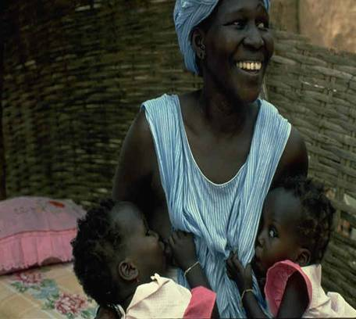
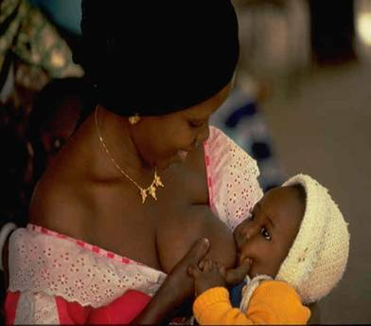
Infant Feeding and HIV

Slide 5
WHO Recommendations on Infant Feeding
“When replacement feeding is acceptable, feasible, affordable, sustainable, and safe, avoidance of all breastfeeding by HIV-infected mothers is recommended.
Otherwise, exclusive breastfeeding is recommended during the first six months of life.
To minimize HIV transmission risk, breastfeeding should be discontinued as soon as feasible, taking into account local circumstances, the individual woman’s situation and the risks of replacement feeding ( including infections other than HIV and malnutrition.)”

Slide 6
Mothers who have been tested& HIV positive
Should be provided with information on the risks& benefits of different infant feeding options
So that she chooses & advised to implement the safest feeding option for her situation.

Slide 7
Infant feeding option
Exclusive breastfeeding: HIV transmission lower than with mixed feeding; high rates achievable with good counseling and support
Replacement feeding: no risk of transmission, but HIV-free survival at 18 months not higher than for breastfeeding in many settings
Replacement feeding with home-modified animal milk not recommended during first six months
All infants need additional/replacement foods from six months
Mixed feeding
  Carries higher risk than exclusive breastfeeding
  Strongly discouraged.

Slide 8
There are 3 options if HIV positive mother chooses breast feeding;
Option 1- safer breast feeding
1- exclusive breast feeding from 0-6 months.
2- maintain good breast health by correct positioning, attachment etc.
3- the mother should practice safe sex.
4- mothers with breast problems(mastitis, sore nipples, abscess) should stop breast feeding from the infected breast & seeks prompt treatment.

Slide 9
5- stop breast feeding as soon as complementary feeding is acceptable, feasible, affordable, sustainable& safe or when the baby is started on complementary feeding at the age of 6 months.
6- stop breast feeding if the mother develops full-blown AIDS.
7- introduce complementary feeding at 6 months.

Slide 10
Option 2- wet nursing
:- is breast feeding by a woman who is not the infant’s mother.
Option 3- Heat treated breast milk
:- The mother expresses her breast milk safely & heats the breast milk to boiling point before feeding to her infant with a cup. The heat treated milk should be used within 1 hour.

Slide 11
To be a better option for the individual than exclusive breastfeeding, replacement feeding has to be AFASS:
Acceptable
Feasible
Affordable
Sustainable AND
Safe
For the mother and baby

Slide 12
ACCEPTABLE-no cultural or social barrier, and has no fear of stigma. She will be able to cope with pressure from family and friends to breastfeed.
FEASIBLE -The mother has adequate time, knowledge, skills and other resources to prepare the replacement food.
Do mothers have extra time , home infrastructure and family support, to prepare formula.

Slide 13
AFFORDABLE- The mother and family can purchase formula, including all ingredients, fuel, clean water, soap and equipment.
SUSTAINABLE -Availability of a continuous and uninterrupted supply and dependable system of distribution of formula for as long as the infant needs it.
SAFE -Replacement foods are correctly and hygienically prepared and stored, and fed in nutritionally adequate quantities, with clean hands and with clean utensils, preferably by cup.

Slide 14
Preferred infant feeding options in Ethiopia:
Exclusive breastfeeding for the first six months (breast milk only and medication, not even water, should be given)
• Counselling and support on “safer breastfeeding practices” to avoid breast problems associated with increased risk of virus transmission (mastitis, cracked nipples etc.)
• Avoidance of mixed feeding during the first six months since this is associated with increased risk of HIV transmission

Slide 15
Preferred infant feeding options in Ethiopia:
Avoidance of early cessation of breastfeeding since this compromises survival in both HIV-infected and uninfected infants
Advise about risks of relactation [restarting breastfeeding after weaning] which is associated with increased breast milk viral load
Prompt treatment of breast problems (cracked nipples, mastitis, breast abscess), and lesions in the infant’s mouth
Notes:
In the minority of women who choose to use replacement feeding, every effort should be made to ensure that it is done SAFELY.
Ensure mother can safely provide formula
No breastfeeding should be practiced with replacement feeding [mixed feeding]
Provide clear information about risks of formula and that this is not the option currently recommended
Mothers should use commercial infant formula. Home-modified animal milk should only be used as a temporary measure since it does not provide all the micronutrient needs of infants <6 months of age

Slide 16
Alternative Infant feeding option in Ethiopia:
In the minority of women who choose to use replacement feeding, every effort should be made to ensure that it is done SAFELY.
Ensure mother can safely provide formula
No breastfeeding should be practiced with replacement feeding [mixed feeding]
Provide clear information about risks of formula
Mothers should use commercial infant formula. Home-modified animal milk should only be used as a temporary measure since it does not provide all the micronutrient needs of infants <6 months of age

Slide 17
Alternative Infant feeding option :
Ensure mother has an uninterrupted supply of formula for at least twelve months
Teach mother how to prepare the replacement feeding and provide intensive counselling on hygienic preparation of formula at each visit
Avoid bottle feeding, in order to avoid risk of diarrhoea and malnutrition
Ensure close follow-up to monitor growth and nutritional status monthly to prevent malnutrition and gastroenteritis during the first two years of life

Slide 18
Recommendations for feeding Children with HIV
Solid foods should be introduced gradually to match the age and developmental characteristics of the child
Care givers should feed children a variety of locally available fruits and vegetables and animal products if available to increase intake of essential vitamins and minerals
Feeding should be done patiently and persistently with supervision and love, especially for the HIV infected child who may be frequently ill and suffering from fever, mouth sores and decreased appetite.
Provide a daily multivitamin supplement, if available, to help prevent nutrient deficiencies,

Slide 19
HIV infected children should be;
Routinely assessed for nutritional status
Symptomatic children and having a condition that increase energy demand (i.e TB, chronic OI or malignancies) should receive an additional 25-30% of energy.
If severely malnourished , should be treated as per guide line with an additional 50-100% energy.
Should receive recommended daily allowance of micronutrient daily
If between 6 and 59 months, should receive high dose Vit A supplementation as per guideline

Slide 20
Thank you for your attention

