Slide 1
HIV/ AIDS IN PEDIATRICS

Slide 2
Objectives
At the end of this session, the learner will be able to;
Discuss the immunological and viral load difference and disease progression in children
Discuss mode of transmission and risk factor in children
Identify the WHO clinical staging
Discuss the diagnosis of HIV in children
Discuss care of HIV infected children including treat ment regimens

Slide 3

Is HIV and AIDS the same thing?

Slide 4
Definition
HIV is a virus that attacks the immune system and damages the body's ability to fight infections.
AIDS is a potentially fatal condition that develops in the most advanced stage of HIV.

Slide 5
HIV
“Human Immunodeficiency virus
A specific type of virus (a retrovirus) that causes AIDS
HIV invades the helper T cells to replicate itself.
No Cure

Slide 6

AIDS
Acquired Immunodeficiency Syndrome
Disease limits the body’s ability to fight infection
A person with AIDS has a very weak immune system
Incubation period is 2 to 5 years
No Cure

Slide 7
Epidemiology
One of the major cause of childhood and infant morbidity and mortality
Approximately 37.9 million people across the globe with HIV/AIDS
1.7 million was children <15 years old ( UNAIDS ,2018 )
Sub Saharan Africa contributes to >90% of pediatric HIV cases
Estimated 1.7 million people worldwide become newly infected with HIV
160,000 was children less than 15 years old.
UNAIDS, 2018

Slide 8
In Ethiopia
Approximately 690,000 people was living with HIV/AIDS
36,000 were children less than 15 years
Estimated 23,000 individuals become newly infected with HIV
2,700 were children less than 15 years
Estimated annual death of 5760
UNAIDS AND WORLD BANK, 2018

Slide 9
Life cycle of HIV AIDS

Slide 10
Mode of transmission
>90% of transmission is via Mother to child transmission
Overall risk of MTCT is 35%
During pregnancy, labor and delivery is about 20%
Postnatal 15%
Risk factors for MTCT
Maternal factors
High viral load
Low CD4 count with advanced disease
Mixed feeding
Cracked nipples and breast abscess
Viral and parasitic placental infection
Maternal malnutrition

Slide 11
B. Infant factors
Prematurity
Oral thrush and ulcer
Birth order (first twin) in twin pregnancies
Instrumental delivery

Slide 12
Mode of t….
The rest includes
  Sexual transmission
    Child abuse
    Adolescent
  Via infected blood
    Blood transfusion
    Unsterile needle sharing
    Scarification by traditional healers

Slide 13
Disease progression in children
  Disease progression is much more rapid in children
  Immune system is immature and still developing
  Infants have more CD4 cells
  Vertically infected children have three patterns of disease progression
  - Rapid progressors (25-30%)
  - slow progressors (50-60%)
  - Long term non progressors (5-25%)

Slide 14
Immunological differences in Children
CD4 count is much higher in children
Immature immune system
Immune systems in younger children may have a greater capacity to reconstitute than adults
- Children usually have a good immunological response to ART

Slide 15
Viral load differences in children
Adults with acute HIV infection have high viral loads that rapidly decline over a few weeks to a “set point” within 6 months of infection
Children have extremely high levels of plasma virus during the first year of life
  This level declines more slowly over several years; their set point is achieved much later than adults

Slide 16
Pathogenesis
HIV attacks and destroys cells, known as CD4 cells, of the immune system. A person is considered to have AIDS if CD4 cell counts in the blood drop below a threshold or if the person has an AIDS-defining condition such as tuberculosis or toxoplasmosis.

Slide 17

WHO clinical Stages of HIV
Notes:
c.stage- help
to determine the degree of damage to immune system
To determine the likely prognosis and identify th response to ARV RX if there is no easy or affordable access to viral load or CD4 testing

Slide 18

Clinical Stage 1
Persistent generalized lymphadenopathy
no symptoms at all
Infected person can infect other people

Slide 19

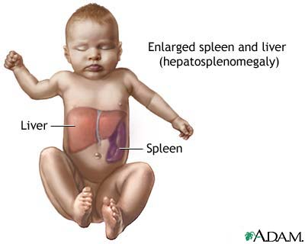
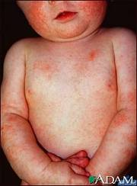
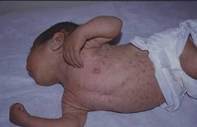
Clinical Stage 2
Lasts for an average of ten years
Hepatosplenomegaly
Papular pruritic eruptions
Sebhorric dermatitis

Slide 20
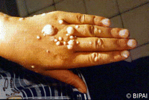
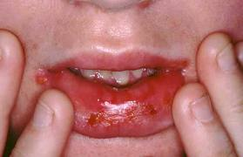
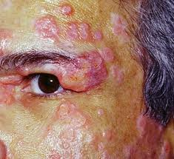
Clinical Stage 2
Extensive human papilloma virus infection
Extensive molluscum contagiosum
Fungal nail infections
Recurrent oral ulcerations

Slide 21
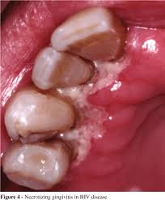
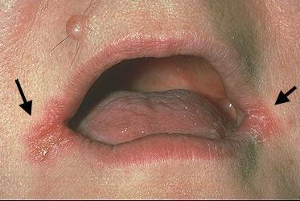
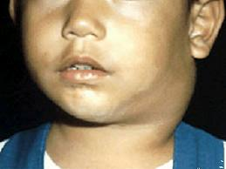
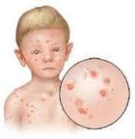
Clinical Stage 2
Lineal gingival erythematic (LGE)
Angular cheilitis
Parotid enlargement
Herpes zoster
Recurrent or chronic RTIs (otitis media, otorrhoea, sinusitis)

Slide 22
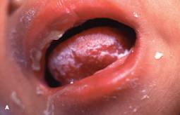
Clinical Stage 3
Conditions where a presumptive dx can be made on the basis of clinical sign or simple investigation
Moderate unexplained malnutrition not adequately responding to standard therapy
Unexplained persistent diarrhea (14 days or more )
Unexplained persistent fever (intermittent or constant, for longer than one month)
Oral candidacies (outside neonatal period )
Oral hairy leukoplakia

Slide 23
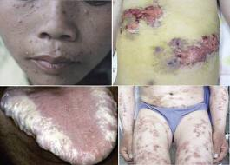
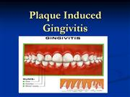

Clinical Stage 3
Acute necrotizing ulcerative gingivitis/periodontitis
Pulmonary TB
Severe recurrent presumed
bacterial pneumonia

Slide 24
Clinical Stage 3
Conditions where confirmatory testing is necessary
Chronic HIV-associated lung disease including brochiectasis
Lymphoid interstitial pneumonitis (LIP)
Unexplained anaemia (<8g/dl), and or neutropenia (<1000/mm3) and or
thrombocytopenia (<50 000/ mm3) for more than one month

Slide 25
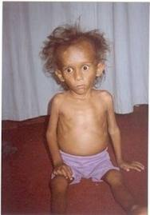
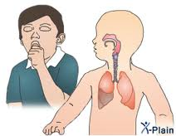
Clinical Stage 4
Conditions where a presumptive dx can be made on the basis of clinical sign or simple investigation
Unexplained severe wasting or severe malnutrition not adequately responding to standard therapy
Pneumocystis pneumonia

Slide 26
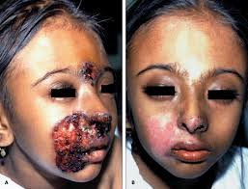
Clinical Stage 4
Recurrent severe presumed bacterial infections (e.g. emphysema, pyomyositis, bone or joint
Infection (meningitis, but excluding pneumonia)
Chronic herpes simplex infection; (orolabial or cutaneous of more than one month’s duration)

Slide 27
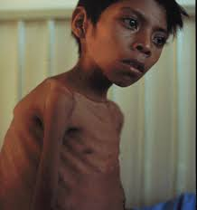
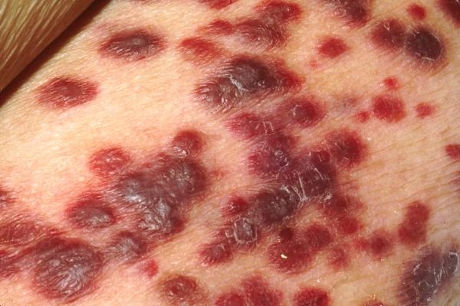
Clinical Stage 4
Extra pulmonary TB
Kaposi’s sarcoma
Esophageal candidacies

Slide 28
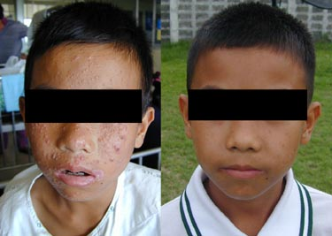

Clinical Stage 4
Conditions where confirmatory diagnostic testing is necessary:
CMV infection (CMV retinitis or infection of organs other than liver, spleen or lymph nodes; onset at age one month or more)
Extra pulmonary cryptococcosis including meningitis
Any disseminated endemic mycosis (e.g. extra pulmonary histoplasmosis)

Slide 29
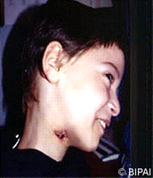
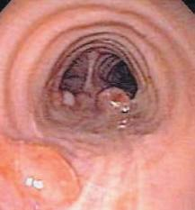
Clinical Stage 4
Disseminated non-tuberculous mycobacterium infection
Candida of trachea, bronchi or lungs
Visceral herpes simplex infection

Slide 30
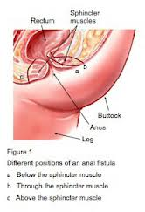
Clinical Stage 4
Acquired HIV associated rectal fistula
Cerebral or B cell non-Hodgkin lymphoma
Progressive multifocal leukoencephalopathy (PML)
HIV-associated cardiomyopathy or HIV-associated nephropathy

Slide 31
Diagnosis of HIV in children

Slide 32
Laboratory diagnosis of HIV/AIDS in Infant / children
HIV DNA PCR at 4-6 weeks
  Identifies >95% of HIV positive infants
HIV antibody tests at 9-18 months
  Will identify exposed infants
  Will confirm HIV negative if not breastfeeding within last 3 months
HIV antibody tests ≥ 18 months confirm HIV infection if positive

Slide 33
Presumptive diagnosis of clinical stage 4 (CHILDREN)
An infant is HIV-antibody positive (ELISA or rapid test), aged under 18 months and symptomatic with two or more of the following:
  +/– oral thrush
+/– severe pneumonia
+/– severe wasting/malnutrition
+/– severe sepsis

Slide 34
Presumptive diagnosis of clinical stage 4 (CHILDREN)
Other factors that support the diagnosis of clinical stage 4 HIV infection in an HIV-sero positive infant are:
Recent HIV related maternal death
Advanced HIV disease in the mother.

Slide 35
Diagnostic Algorithm for Infants
< 18 months of age
Infant 4-6 weeks of age
Or at first health encounter
HIV DNA PCR
HIV DNA PCR POSITIVE
HIV-INFECTED
DNA PCR NEGATIVE
Continue follow-up and CTX
Refer for HIV care &
treatment
ILL Infant
WELL Infant
HIV Rapid Antibody Test
>6-12 weeks after weaning
Repeat
DNA PCR
HIV Antibody Positive@
HIV Antibody Negative
UNINFECTED
HIV DNA PCR POSITIVE
HIV-INFECTED
HIV DNA PCR
NEGATIVE
HIV DNA PCR
Refer for HIV care &
treatment
HIV DNA PCR POSITIVE
HIV-INFECTED
HIV DNA PCR NEGATIVE
UNINFECTED
@ Positive HIV Antibody diagnoses HIV infection
if > 18mo at time of weaning; It is not necessary to test with DNA PCR
Notes:
PLEASE NOTE, IF the infant is > 18 months of age a positive antibody confirms HIV infection

Slide 36
Diagnostic Algorithm for Children
> 18 months of age
Child > 18 months of age*
Rapid HIV Antibody Test
HIV Antibody POSITIVE
HIV-INFECTED
HIV Antibody NEGATIVE
Non-breast feeding child
UNINFECTED
Breast feeding child
remains at risk of infection
Refer for HIV care &
treatment
Repeat HIV Rapid Antibody
>6-12 weeks after weaning
HIV Antibody POSITIVE
HIV-INFECTED
HIV Antibody NEGATIVE
UNINFECTED
Refer for HIV care &
treatment

Slide 37
Interpretation of HIV test result
Positive virology test (DNA PCR) implies that the baby is HIV infected at any age (two test).
Positive antibody test at 18 months or more implies that the child is HIV infected

Slide 38
Care of HIV exposed children

Slide 39
Infants born from HIV positive mother is defined as exposed infants.
Components of clinical care for HEI
History
Physical examination
Growth assessment
Developmental assessment
Infant feeding
Immunization
ARV prophylaxis ( Nevirapin)

Slide 40
8. Cotr-imoxazole preventive therapy
9. TB risk assessment
10. Determination and evaluation of infection status
11. Current assessment and plan
12. Follow up visit and schedule

Slide 41
ART drugs for pediatrics

Slide 42
When to start ART?
ART should be initiated in all children living with HIV regardless of WHO clinical staging and CD4 cell count . But as apriority, ART should be initiated
- In all children less than or equal to 2 year OR
- In children younger than 5 years with clinical staging 3 and 4, CD4 count less than or equal to 750cells/mm3 or CD4 percentage <25%
- Children 5 years and older with WHO clinical staging of 3 or 4 and CD4 cell count less than or equal to 350cells/mm3 .

Slide 43
Infants and young children living with HIV have a high risk of poor out comes
- 52 % of children born with HIV dying before the age of 2 years
- Around 30% will die on the first year of life

Slide 44
ART drugs for pediatrics
Growth should be assesses continuously
To determine dose of ART drugs
To avoid low drug exposure and development of resistance and virologic failure
Treatment regimen in pediatrics
A. For infants and young children less than 3 year
ABC+3TC+LPV--------1st line
ABC+3TC+NEV-------2nd line
B. Children >3yr,but<10 year
ABC+3TC+EFV-------1st line
ABC+3TC+NEV-------2nd line

Slide 45
C. Adolescent
TDF+3TC+EFV----------1st line
AZT+3TC+NEV----------2nd line

Slide 46
Criteria to select ART regimen
Potency
The use of non-thymidine analogue
The convenience of once daily dosing and the use of FDCs whenever possible
Availability and cost
Notes:
FDC- fixed dose combination

Slide 47
Infant prophylaxis
Infant born to mothers with HIV who are at high risk of acquiring infection;
* Breast feed;
- Receive dual prophylaxis of AZT BID and NEV once daily for 6 weeks
* On replacement feeding
- Come with in 72 hours after delivery, start the same regimen
- If come too late, no need of prophylaxis

Slide 48
If mother first diagnosed to HIV infection or breast feeding infant first identified as HIV exposed in post partum period;
- Should infant prophylaxis continued for additional 6 weeks or for a total of 12 weeks (AZT twice daily + NEV for the 1st 6 week and the same regimen or NEV only for the next 6weeks).
If infant mother on ART before pregnancy and remains on it;
* Breast feed
-Infant should receive NEV once daily for 6 wk
* On replacement feeding
- Infant should receive NEV daily or AZT twice a day (if infant is evaluated with in 72 hr ).

Slide 49
Monitoring response to ART and diagnosing treatment failure

Slide 50
Viral load test
Is a standard method
2. CD4 count and clinical monitoring
Can be used for diagnosis of treatment failure when viral load testing is not available

Slide 51
READ TOXICITIES OR SIDE EFFECT OF EACH ARV DRUG?

Slide 52

Thank You!

