Slide 1
Dietary therapy I
Habtamu T.(BSc, MPH in public health nut.)
Debremarkos university College of health science, department of human nutrition and food science
May/2020

Slide 2
Topics will be covered
Introduction • Basic principles of diet therapy and dietary management of disease • Basic concept of diet therapy and factors determining choice of diet for the sick • Food choice and diet planning guide Chapter I. Diet Modification 1.1 Consistency of modified diet 1.2 Energy and fiber content of modified diet 1.3 Nutrient density 1.4 Frequency of feeding Chapter II. Types of feeding 2.1 Enteral feeding 2.2 Parenteral feeding Chapter III. Tools for planning regular and therapeutic diets 3.1 Composition tables 3.2 Dietary standards Chapter IV. Weight management 4.1 Overweight management 4.2 Underweight management 4.3 Role of exercise in weight management
Chapter V. Disease management 5.1 Gastrointestinal system 5.2 Infancy and early childhood disease 5.2.1 Electrolyte and fluid balance for diarrhea Feeding disorders and the managements of feeding disorders

Slide 3
Objectives:
At the end of this unit the student will be able to
Define Dietary therapy I
Reason out why we use nutritional therapy.
Describe the mode of food choice.
Mention biological determinants of food choice.
Explain what mean healthy eating.
List economic and physical determinates of food choice.
Describe Food choice diet planning guide.
Mention the concepts of dietary modification
Explain the types of nutritional feeding
Describe the tools for planning regular and therapeutic diet
Describe the weight management procedures and principles
Diet management for specific diseases

Slide 4
Methods of evaluations
Continuous assessment:50%
  Assignment:10%
  Clinical report:5%
  Quiz:10%
  Test:20%
  Partticipation:5%
Final examination:50%

Slide 5
Assignments
1. Meal planning for health family
2. Meal Planning for Various Age Groups
3. Role of exercise in weight management
4. Feeding disorders and the managements of feeding disorders

Slide 6
Introduction
What is Dietary Therapy?
It is the application of nutrition science in the promotion of health, peak performance and individual care.
Nutrition care that encompasses the assessment and treatment of any disease, condition, or illness- Medical nutrition therapy
Nutritional therapy practitioners use a wide range of tools to assess and identify potential nutritional imbalances and understand how these may contribute to an individual's symptoms and health concerns.
Notes:
Primary prevention is the implementation of practices
that are likely to avert the occurrence of disease.
Many nutritional changes have been promoted to
thwart particular diseases, but most, with the exception
of actual vitamin deficiency diseases, lack solid evidence
of effectiveness. Excessive body weight is clearly
related to heart disease, stroke, type 2 diabetes mellitus,
some cancers, joint diseases, and some fertility disorders.
The difficulty lies in motivating people to change
behavior today for possible benefits in the perhaps distant
future. Maintaining a healthy body weight is a primary
prevention strategy.
Secondary prevention is the institution of monitoring
techniques to discover incipient diseases early
enough to enhance the opportunity to control their
effects. If a person’s risk for diabetes is found in the
prediabetes stage by testing blood sugar levels, noninvasive
treatments such as weight loss and diet modification
can successfully derail or delay the development
of the disease.
Tertiary prevention is the use of treatment techniques
after a disease has occurred to prevent complications
or to promote maximum adaptation. For
example, clients with various diseases that cause swallowing
disorders can be helped to maintain nourishment
and to avoid choking incidents with nutritional
Interventions
Nutrition care that encompasses the assessment and treatment of any disease, condition, or illness- Medical nutrition therapy
Includes
Modified diet
Nutrition education
Specialized nutrition support with oral nutrition supplements
Tube feedings
Intravenous nutrition

Slide 7
Cont.…
Nutritional therapy is recognized as a complementary medicine and.
Is relevant for individuals with chronic conditions, as well as those looking for support to enhance their health and wellbeing.
Many different foods can have dramatic effects on the way your body responds to certain disease processes.
If someone has digestive complaints, or certain pain diseases, many foods can drastically interfere with recovery and could potentially make the disease process much worse.

Slide 8
Cont.…
Diet Therapy is person specific for the specific disease process that they endure(undergo).
We also offer weight loss diet programs and cleanses.
We cannot emphasize enough, the importance of proper nutrition and dietary habits.

Slide 9
Cont.…
The wrong foods can interfere with a body's recovery process, but the right foods can drastically improve.
  The body's ability to heal,
  Recovery from disease,
  and prevent disease from even happening.
One of the main strengths of dietary therapy is its power as a foundational treatment.
Food has therapeutic properties the same as drugs or herbs, but:
  often less specific
  less drastic
  And little side effect
It may be slower to take effect, but it will impact every system of the body.
Notes:
Foundational treatment= initial treatment

Slide 10
Cont.…
A properly applied dietary therapy and smart food choices can only prevent someone from getting ill; it will make it so that fewer or no medications are needed when they are:
  Practitioners consider each individual to be unique and
  Recommend personalized nutrition
  and lifestyle programs rather than a 'one size fits all' approach

Slide 11
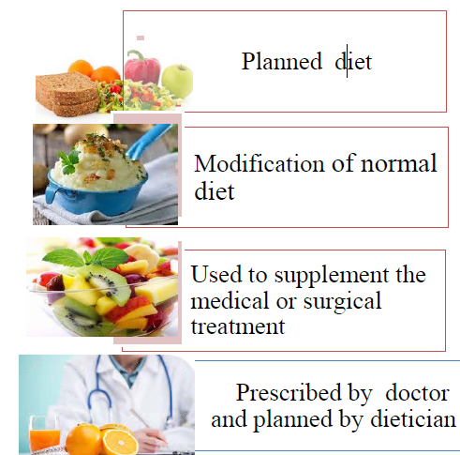
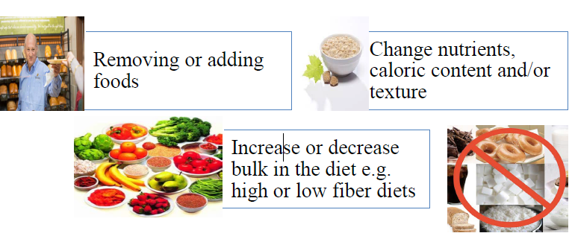
Cont.…
What is therapeutic diet

Slide 12
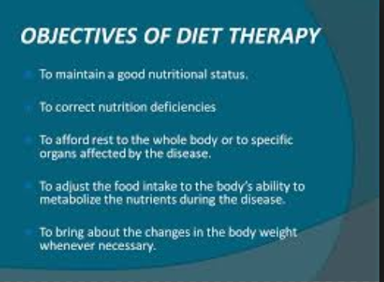
Cont.…

Slide 13
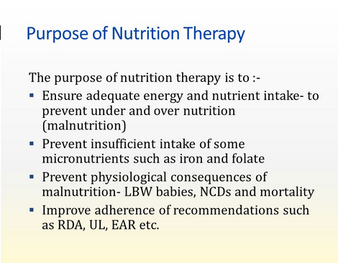
Cont.…

Slide 14
Why Use Nutritional Therapy?
Some people simply want to check that they are on the right track with regard to healthy eating.
Others may want to lose weight or get help with their symptoms.
Nutritional therapists recognize that each person is an individual with unique requirements and take time to define personalized nutrition plan rather than a 'one size fits all' approach

Slide 15
Cont.…
Nutrition and lifestyle approaches to healthcare have been shown to support the health of all the major systems of the body:
  Skeletal
  Muscular
  Nervous
  Respiratory
  Cardiovascular
  Digestive
  excretory
  Endocrine
  immune
  Reproductive and integumentary [skin, hair, nails]).
Typical priorities in nutritional therapy consultations are support to achieve optimum energy levels, healthy blood sugar balance, emotional and psychological wellbeing, optimum gastrointestinal health and tolerance to a broad range of food group.

Slide 16
Cont.…
Equipping the students with the knowledge of dietary therapy will further assist the students in understanding what happens and what to do when the body is injured, diseased or placed under stress.
help you to understand what the food composition is look like, the relevant nutrients for the building up of the body and different disorders in relation with deficit of nutrients.

Slide 17
Cont.…
Generally, the purpose of nutrition therapy is to :
Ensure adequate energy and nutrient intake- to prevent under and over nutrition (malnutrition)
Prevent insufficient intake of some micronutrients such as iron and folate
Prevent physiological consequences of malnutrition- LBW babies, NCDs and mortality
Improve adherence of recommendations such as RDA, UL, etc.

Slide 18
Common reasons therapeutic diets may be ordered:
To maintain nutritional status
To restore nutritional status
To correct nutritional status
To decrease calories for weight control
To provide extra calories for weight gain
To balance amounts of carbohydrates, fat and protein for control of diabetes

Slide 19
Cont.…
To provide a greater amount of a nutrient such as protein
To decrease the amount of a nutrient such as sodium
To exclude foods due to allergies or food intolerance
To provide texture modifications due to problems with chewing and/or swallowing.

Slide 20
Common therapeutic diets include:
1. Nutrient modifications
  No concentrated sweets diet
  Diabetic diets
  No added salt diet
  Low sodium diet
  Low fat diet and/or low cholesterol diet
  High fiber diet
  Renal diet
2. Texture modification
  Mechanical soft diet
  Puree diet

Slide 21
Cont.…
3. Food allergy or food intolerance modification
  Food allergy
  Food intolerance
4. Tube feedings
  Liquid tube feedings in place of meals
  Liquid tube feedings in addition to meals
5. Additional feedings- In addition to meal, extra nutrition may be ordered as:
  Supplements
  Nourishments
Notes:
• Supplements – usually ordered as liquid nutritional shakes once,
twice or three times per day; given either with meals or between
meals
• Nourishments – ordered as a snack food or beverage items to be
given between meals mid-morning and/or mid-afternoon
• HS snack – ordered as a snack food or beverage items to be given at
the hour of sleep

Slide 22
The Determinants of Food Choice
Given the priority for population dietary change there is a need for a greater understanding of the determinants that affect food choice.
The key driver for eating is of course hunger but what we choose to eat is not determined solely by physiological or nutritional needs.

Slide 23
Cont.…
Some of the other factors that influence food choice include
  Biological determinants such as hunger, appetite, and taste
  Economic determinants such as cost, income, availability
  Physical determinants such as access, education, skills (e.g. cooking) and time
  Social determinants such as culture, family, peers and meal patterns
  Psychological determinants such as mood, stress and guilt
  Attitudes, beliefs and knowledge about food

Slide 24
Cont.…
Food choice factors also vary according to life stage and vary from one individual or group of people to others .
Thus, one type of intervention to modify food choice behavior will not suit all population groups.
Rather, interventions need to be geared towards different groups of the population with consideration to the many factors influencing their decisions on food choice.

Slide 25
Biological determinants of food choice
Are Hunger and satiety
Our physiological needs provide the basic determinants of food choice.
Humans need energy and nutrients in order to survive and will respond to the feelings of hunger and satiety (satisfaction of appetite, state of no hunger between two eating occasions).
The central nervous system is involved in controlling the balance between hunger, appetite stimulation and food intake

Slide 26
Biological determinants…
Macro-nutrients i.e. carbohydrates, proteins and fats generate satiety signals of varying strength.
The balance of evidence suggests that fat has the lowest satiating power, carbohydrates have an intermediate effect and protein has been found to be the most satiating.

Slide 27
Biological determinants…
The energy density of diets has been shown to exert potent effects on satiety; low energy density diets generate greater satiety than high energy density diets.
The high energy density of high-fat and/or high-sugar foods can also lead to ‘passive over consumption, where excess energy is ingested unintentionally and without the consumption of additional bulk
An important satiety signal may be the volume of food or portion size consumed.

Slide 28
Palatability
Palatability is proportional to the pleasure someone experiences when eating a particular food.
It is dependent on the sensory properties of the food such as taste, smell, texture and appearance.
Sweet and high-fat foods have an undeniable sensory appeal.
It is not surprising then that food is not solely regarded as a source of nourishment but is often consumed for the pleasure value it imparts

Slide 29
Sensory aspect
Taste’ is consistently reported as a major influence on food behavior.
In reality ‘taste’ is the sum of all sensory stimulation that is produced by the ingestion of a food.
This includes not only taste but also smell, appearance and texture of food.
These sensory aspects are thought to influence, in particular, spontaneous food choice.

Slide 30
Economic and physical determinants of food choice
Cost and accessibility
  Cost of food is a primary determinant of food choice
  Low-income groups have a greater tendency to consume unbalanced diets and in particular have low intakes of fruit and vegetables.
  However, access to more money does not automatically equate to a better quality diet but the range of foods from which one can choose should increase.

Slide 31
Cont.…
  Accessibility
    Accessibility to shops is another important physical factor influencing food choice, which is dependent on resources such as transport and geographical location.
  Education and Knowledge
    level of education can influence dietary behavior during adulthood

Slide 32
Social determinants of food choice
problems that face different sectors of society, requiring different levels of expertise and methods of intervention
Cultural influences lead to the difference in the habitual consumption of certain foods and in traditions of preparation, and in certain cases can lead to restrictions such as exclusion of meat and milk from the diet.

Slide 33
Cont.…
Social context
  Social influences on food intake refer to the impact that one or more persons have on the eating behavior of others, either direct (buying food) or indirect (learn from peer's behavior), either conscious (transfer of beliefs) or subconscious.
  Social support can have a beneficial effect on food choices and healthful dietary change

Slide 34
Psychological factors
Stress
  The effect of stress on food intake depends on the individual, the stressor and the circumstances.
  In general, some people eat more and some eat less than normal when experiencing stress.

Slide 35

Cont.…
Summary
Food choice depends on:
Personal preference
Habits
Ethnic Heritage or Tradition
Social Interactions
Availability
Convenience
Economy
Positive and Negative Associations
Emotional Comfort
Values
Body Weight and Image
Nutrition and Health Benefits

Slide 36
Food choice and diet planning guide
Healthy food choices are important for good health and well-being.
Eating well means eating a variety of nutrient-packed foods and beverages from the food groups and staying within calorie needs.
This, combined with choosing foods low in saturated and trans fats, cholesterol, added sugars, and salt (sodium) will help to ensure that you are eating a healthy diet while helping to maintain a healthy weight.
If you choose to drink alcoholic beverages, do so sensibly and in moderation

Slide 37
Quick Guidelines for healthy eating
Eat three meals a day and an evening snack. Do not skip meals
Eat the same types of foods each meal. Choose a variety from each group. Include fresh fruit, vegetables, lean dairy products, lean meats and whole grains.
Limit desserts/sweets and sugars.
Choose chicken without the skin, fish, and lean cuts of meats. Trim/healthy/ fats you can see

Slide 38
Cont.…
Watch your weight. If you need to lose weight, do it slowly
Include exercise as part of your daily activity.
Start an exercise program that is at least 30 minutes, 3-5 times per week.
Walking is a great way to exercise.
Include high fiber foods in your diet. Fiber will help control your blood sugars.
Fiber is found in fresh fruits, vegetables and whole grain breads and cereals.

Slide 39
Diet-Planning Principles
Diet planners have developed several ways to select foods.
Whatever plan or combination of plans they use, though, they keep in mind the six basic diet-planning principles
Diet-planning principles:
  Adequacy
  Balance
  kCalorie (energy) control
  Nutrient Density
  Moderation
  Variety
Notes:
Balance The art of balancing the diet involves consuming enough-but not too
much-of each type of food. The essential minerals calcium and iron, taken together,
illustrate the importance of dietary balance. Meats, fish, and poultry are
rich in iron but poor in calcium. Conversely, milk and milk products are rich in calcium
but poor in iron. Use some meat or meat alternates for iron; use some milk and
milk products for calcium; and save some space for other foods, too, because a diet
consisting of milk and meat alone would not be adequate. • For the other nutrients,
people need whole grains, vegetables, and fruits.
kCalorie (Energy) Control Designing an adequate diet without overeating requires
careful planning. Once again, balance plays a key role. The amount of en ergy
coming into the body from foods should balance with the amount of energy
being used by the body to sustain its metabolic and physical activities. Upsetting this
balance leads to gains or losses in body weight. The discussion of energy balance
and weight control in Chapters 8 and 9 examines this issue in more detail, but the
key to kcalorie control is to select foods of high nutrient density.
Nutrient Density To eat well without overeating, select foods that deliver the most
nutrients for the least food energy. Consider foods containing calcium, for example.
You can get about 300 milligrams of calcium from either 11/ 2 ounces of cheddar
cheese or 1 cup of fat-free milk, but the cheese delivers about twice as much food energy
(kcalories) as the milk. The fat-free milk, then, is twice as calcium dense as the
cheddar cheese; it offers the same amount of calcium for half the kcalories. Both
foods are excellent choices for adequacy's sake alone, but to achieve adequacy while
controlling kcalories, • the fat-free milk is the better choice. (Alternatively, a person
could select a low-fat cheddar cheese.) The many bar graphs that appear in Chapters
10 through 13 highlight the most nutrient-dense choices, and the accompanying
"How to" describes how to compare foods based on nutrient density.
Moderation Foods rich in fat and suga r provide enjoyment and energy but relatively
few nutrients. In addition, they promote weight gain when eaten in excess. A
person practicing moderation . eats such foods only on occasion and regularly selects
foods low in solid fats and added sugars, a practice that automatically improves
nutrient density. Returning to the example of cheddar cheese versus fat-free
milk, the fat-free milk not only offers the same amount of calcium for less energy,
but it also contains far less fat than the cheese.
Variety A diet may have all of the virtues just described and still lack variety, if a
person eats the same foods day after day. People should select foods from each of the
food groups daily and vary their choices within each food group from day to day for
several reasons. First, different foods within the same group contain different arrays
of nutrients. Among the fruits, for example, strawberries are especially rich in vitamin
C while apricots are rich in vitamin A. Variety improves nutrient udequncy.!
Second, no food is guaranteed entirely free of substances that, in excess, could be
harmful. The strawberries might contain trace amounts of one contaminant, the
apricots another. By a lternating fruit choices, a person will in gest very little of either
contaminant. (Contamination of foods is discussed in Chapter 19.) Third, as the
adage goes, variety is the spice of life. A person who eats beans frequently can enjoy
pinto beans in Mexican burritos today, garbanzo beans in Greek salad tomorrow,
and baked beans with barbecued chicken on the weekend. Eating nutritious meals
need never be boring.

Slide 40
The Food Guide Pyramid
Is a good basic guide to choosing healthy foods
Keep these Low: | Look for More of these:
saturated fats | fiber
trans | vitamins A, C, & E
fats | magnesium & iron
cholesterol | Potassium and calcium
Sodium

Slide 41
Cont.…
Key Recommendations of the Dietary Guidelines for Americans 2005
Adequate Nutrients within Energy Needs
Consume a variety of nutrient-dense foods and beverages within and among the basic food groups; limit intakes of saturated and trans fats, cholesterol, added sugars, salt, and alcohol.
Meet recommended intakes within energy needs by adopting a balanced eating pattern.

Slide 42
Cont.…
Weight Management
To maintain body weight in a health y range , balance kcalories from foods and beverages with kcalories expended.
To prevent gradual weight gain over time, make small decreases in food and beverage kcalories and increase physical activity.

Slide 43
Cont.…
Physical Activity
Engage in regular physical activity and reduce sedentary activities to promote health, psychological well-being, and a healthy body weight.
Achieve physical fitness by including cardiovascular conditioning, stretching exercises for flexibility, and resistance exercises or calisthenics for muscle strength and endurance.

Slide 44
Cont.….
Food Groups to Encourage
Consume a sufficient amount of fruits, vegetables, milk and milk products, and whole grains while staying within energy needs.
Select a variety of fruits and vegetables each day, including selections from all five vegetable sub groups (dark green, orange, legumes, starchy vegetables, and other vegetables) several times a week.
Make at least half of the grain selections whole grains
Select fat-free or low-fat milk products

Slide 45
Cont.…
Fats
Consume less than 10 percent of kcalories from saturated fats and less than 300 milligrams of cholesterol per day, and keep trans fats consumption as low as possible.
Keep total fat intake between 20 and 35 percent of kcalories; choose from mostly polyunsaturated and monounsaturated fat sources such as fish, nuts, and vegetable oils.
Select and prepare foods that a re lean , low fat, or fat-free and low in saturated and /or trans fats.

Slide 46
Cont.…
Carbohydrates
Choose fiber-rich fruits, vegetables, and whole grains often.
Choose and prepare foods and beverages with little added sugars
Reduce the incidence of dental caries by practicing good oral hygiene and consuming sugar and starch-containing foods and beverages less frequently.

Slide 47
Cont.…
Sodium and Potassium
Choose and prepare foods with little salt (less than 2300 milligrams sodium or approximately 1 tea spoon salt daily).
At the same time, consume potassium-rich foods, such as fruits and vegetables.
Reduce intake for HTN and increase potassium.
Alcoholic Beverages
Those who choose to drink alcoholic beverages should do so sensibly and in moderation (up to one d rink per day for women and up to two drinks per day for men).
Some individuals should not consume alcoholic beverages.

Slide 48
Cont.…
Food Safety
To avoid microbial food borne illness, keep foods safe:
  Clean hands,
  Food contact surfaces,
  Fruits and vegetables;
  Separate raw, cooked, and ready-to-eat foods;
  Cook foods to a safe internal temperature;
  Chill perishable food promptly;
  Defrost food properly.
Avoid unpasteurized milk and products made from it; raw or undercooked eggs, meat, poultry, fish, and shellfish; unpasteurized juices; raw sprouts.

Slide 49
Cont.…
To avoid microbial foodborne illness:
Clean hands, food contact surfaces, and fruits and vegetables. Meat and poultry should not be washed or rinsed.
Separate raw, cooked, and ready-to-eat foods while shopping, preparing, or storing foods.
Cook foods to a safe temperature to kill microorganisms.
Chill (refrigerate) perishable food promptly and defrost foods properly.
Avoid raw (unpasteurized) milk or any products made from unpasteurized milk, raw or partially cooked eggs or foods containing raw eggs, raw or undercooked meat and poultry, unpasteurized juices, and raw sprouts.

Slide 50
Cont.…
Key Recommendations for Specific Population Groups
Infants and young children, pregnant women, older adults, and those who are immunocompromised. Do not eat or drink raw (unpasteurized) milk or any products made from unpasteurized milk, raw or partially cooked eggs or foods containing raw eggs, raw or undercooked meat and poultry, raw or undercooked fish or shellfish, unpasteurized juices, and raw sprouts.
Pregnant women, older adults, and those who are immunocompromised: Only eat certain deli meats and frankfurters that have been reheated to steaming hot.

Slide 51
Healthy Eating
About strict nutrition philosophies, staying unrealistically thin, or depriving yourself of the foods you love.
Rather, it’s about feeling great, having more energy, stabilizing your mood, and keeping yourself as healthy as possible.

Slide 52
Healthy eating tip
1.Set yourself up for success
2. Moderation is key
3. It's not just what you eat, it's how you eat
4. Fill up on colorful fruits and vegetables
5.Eat more healthy carbs and whole grains
6.Enjoy healthy fats & avoid unhealthy fats
7.Put protein in perspective
8.Add calcium for strong bones
9.Limit sugar and salt

Slide 53
Thank you!!!

Slide 54
Chapter 2
Diet Modification
What Mean Modified diet?
It is any diet altered to include or exclude certain components, such as calories, fat, vitamins and minerals.
What is the reason?
Diets are typically modified for therapeutic reasons, including treatment of high blood pressure, low body weight or vitamin and mineral deficiencies.

Slide 55
Cont.…
1.Standard diet: a diet that includes all foods and meets the nutrient needs of healthy people; also called a regular diet.
2.Modified diet: a diet that is altered by changing food consistency or nutrient content or by including or eliminating specific foods; also called a therapeutic diet.

Slide 56
Cont.….
Any diet can be modified
Common therapeutic modifications includes:
    lowering fat intake,
    increasing or decreasing caloric intake depending on weight,
    and increasing certain nutrients, such as iron, calcium or potassium.
Modified diets used to treat food allergies include those that eliminate gluten, dairy products, tree nuts and artificial ingredients, such as food coloring or preservatives

Slide 57
Cont.…
Dietary modification in nutrition therapy
Regular
Liquid
Soft
Diabetic
Low Calorie
High Calorie
Low Cholesterol
Fat-restricted
Sodium-restricted
Protein
  Bland
  Low-residue

Slide 58
Benefits
To combat a potentially serious condition
Diets low in fat and cholesterol, for example, may help avoid clogged arteries that can lead to heart attack or stroke

Slide 59
Risks
Diets high in protein can worsen liver or kidney problems and create nutrient deficiencies.
Drastically limiting your calories can lead to unhealthy body image, anorexia and rebound weight gain.

Slide 60
Consistency of modified
A modified consistency diet provides foods in a physically altered form, such as chopped, ground or pureed.
The diet is based on your individual food tolerances.
People with a decreased ability to chew may benefit from this consistency diet.
Conditions that warrant the use of this diet include absence of teeth, loose dentures, sore gums and head and neck injuries or surgeries

Slide 61
Helpful Hints
Cut starches into small pieces, mash or puree.
Cook fruits; cook or steam vegetables. Use canned food and chop, mash or puree.
Cook meats (or meat substitutes) with moist heat; chop, slice, grind or puree).
Puree, grate or melt dairy products.
To puree foods, first cut foods into medium-size pieces as necessary. Place desired amount in food processor or blender. Add hot broth or gravy to meats and hot starches. Add juice or milk to fruits and cold starches. Blend until smooth.
Dry items such as meat, biscuits, cereal, crackers and cakes can be moistened with milk, soup or juice to improve tolerance

Slide 62
Guidelines for Consistency Modifications of Foods and Liquids
1. Alterations to the consistency of foods and/ or liquids presented to the individual are made in accordance with the recommendation of an occupational therapist or speech and language pathologist and implemented according to the order of the person’s primary care provider/doctor.

Slide 63
Cont.…
2. Food consistencies are described on specific consistency forms and displayed in pictures contained in manual.
3. The prescribed liquid consistency can be indicated on the food consistency form or in another format that specifies how liquids are to be served to the individual

Slide 64
Cont.…
4. Some foods such as soups, cold cereal with milk, fruits that emit liquid when chewed (oranges, watermelon, etc.) and canned fruit have a dual consistency (liquids and solids in one food item).
The clinician will provide information on the food consistency form or other approved regional format about any special considerations staff will need to follow when serving such foods

Slide 65
Cont.….
5. When a thickened liquid is prescribe, the food consistency served must be at least as thick as the prescribed liquid.
6. Caregivers should receive specific training in the modification of foods and/ or liquids by the appropriate clinician in the region / home before preparing a prescribed consistency

Slide 66
Food consistency could be
Clear Liquid – is clear and served at room temperature; used to minimize stimulation to GI tract; usually transitional; before or after GI surgery or coming off IV nutrition
Blenderized Liquid – foods that have been blenderized to a smooth consistency so they can be consumed through a straw; liquids are added before slenderizing to achieve desired consistency

Slide 67
Cont.…
3. Pureed – liquid foods and foods of a smooth, soft consistency that require no chewing; foods are processed to mashed potato consistency
4. Full Liquid – liquid at body temperature and very soft desserts made from milk &eggs
5. Mechanical Soft – soft foods that require minimal chewing; foods are modified in texture but not flavour

Slide 68
Liquid Consistencies
Thin – low viscosity liquids, including clear liquids, water, tea, coffee, soda, ice cream, frozen yogurt, fruit juices, plain gelatin, and nutritional supplements
Nectar-like – medium viscosity liquids including nectars, vegetable juices, and milkshakes without thickness
Honey-like – viscous liquids with the consistency of honey
Spoon-thick – high viscosity liquids, too thick for a straw; liquids of this consistency can be plopped at room.

Slide 69
What You Can Eat on a Full Liquid Diet?
This diet includes thicker liquids like milk, citrus juice, vegetable juices, plain ice cream and creamed soups.
It's also used after some types of surgery or as a treatment for digestive system disorders.
Like the clear liquid diet, it's only meant to be temporary; if you need to stay on it for more than a few days, you'll need to add a liquid dietary supplement

Slide 70
What You Can Eat On a Pureed Diet?
A pureed diet is useful for people who can't chew or have trouble swallowing.
It's also good for people who are too weak or are recovering from certain medical procedures.
It can include most foods that are found in a normal diet (except for hard foods and raw foods).
The difference is that everything needs to be in a liquid state or puréed to the consistency of pudding.

Slide 71
What You Can Eat On a Mechanical Soft Diet
This is a step up from the pureed diet.
You still can't eat any hard foods, but most anything that's soft and squishy can be consumed.
Meats can be shredded instead of sautéed and small pieces of food (under 1/4 in length) are acceptable.
But the pureed diet and mechanical soft diet can be followed for a long time if necessary

Slide 72
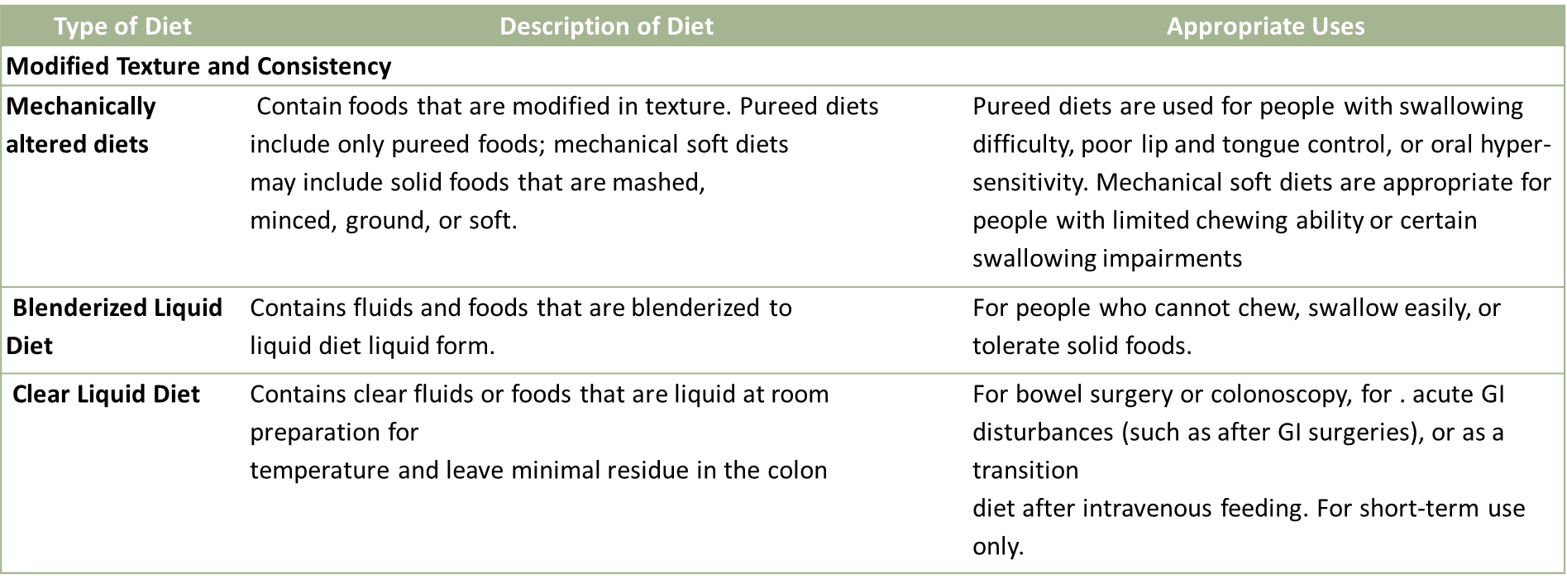
Cont.…

Slide 73
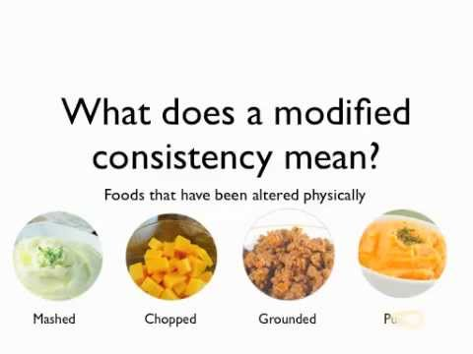
Cont.…

Slide 74
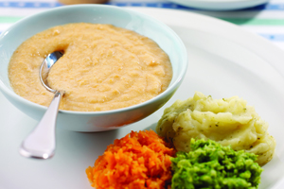

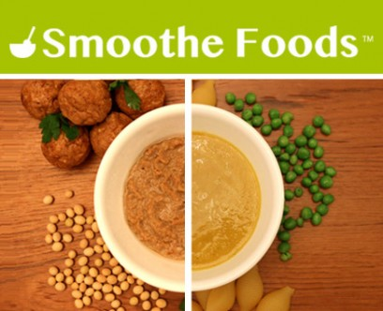
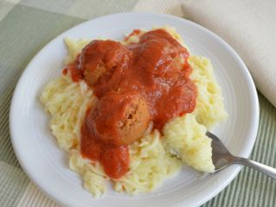
Cont.…

Slide 75
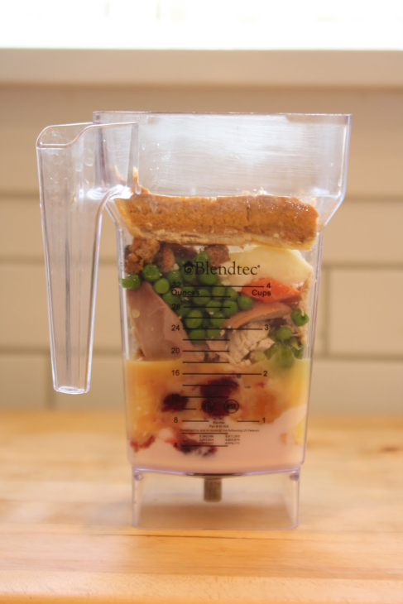

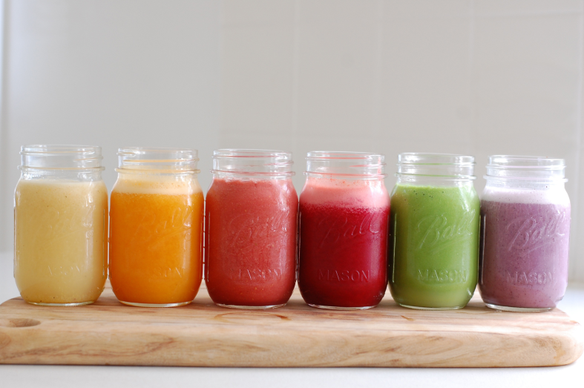
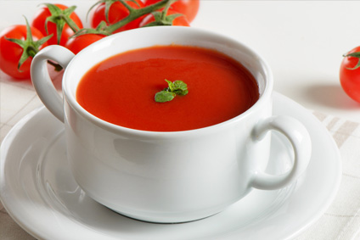
Blenderized Liquid Diet

Slide 76

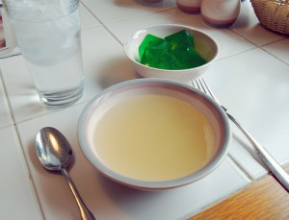


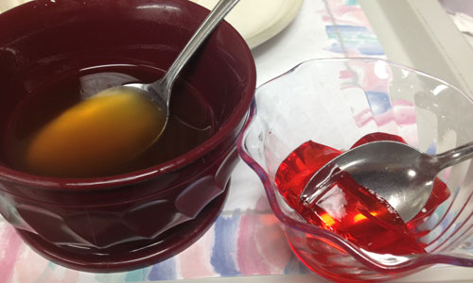
Clear Liquid Diet

Slide 77
Energy and fiber content of modified diet
Determining the energy content of foods depends on:
1. The components of food that provide energy (protein, fat, carbohydrate, alcohol, organic acids and novel compounds) should be determined by appropriate analytical methods;
2. The quantity of each individual component must be converted to food energy using a generally accepted factor that expresses the amount of available energy per unit of weight; and

Slide 78
Cont.…
3. The food energies of all components must be added together to represent the nutritional energy value of the food for humans.
The energy conversion factors and the models currently used assume that each component of a food has an energy factor that is fixed and that does not vary according to the proportions of other components in the food or diet

Slide 79
Modified fiber
Dietary fiber, or sometimes roughage are the indigestible portion of food derived from plants and waste of animals that eat dietary fiber.
Two main components
Soluble fiber dissolves in water.
    It is readily fermented in the colon into gases and physiologically active byproducts, and can be prebiotic and/or viscous.
    Soluble fibers tend to slow the movement of food through the system.

Slide 80
Cont.…
Insoluble fiber does not dissolve in water.
  It can be metabolically inert and provide bulking, or it can be prebiotic and metabolically ferment in the large intestine.
  Bulking fibers absorb water as they move through the digestive system, easing defecation.

Slide 81
Nutrient density
Nutrient-dense foods are defined by the ratio of nutrients to calories. The more highly nutrient-dense a food is, the more nutrients it provides per calorie.
Nutrient-dense foods are rich in vitamins, minerals, phytochemicals and antioxidants – and are low in calories

Slide 82
Cont.…
Nutrient density has several meanings:
Most commonly, nutrient density is defined as a ratio of nutrient content to the total energy content.
Nutrient-dense food is opposite to energy-dense food (also called "empty calorie" food).
According to the Dietary Guidelines for Americans 2005, nutrient-dense foods are those foods that provide substantial amounts of vitamins and minerals and relatively few calories.
Fruits and vegetables are the nutrient-dense foods, while products containing added sugars, processed cereals, and alcohol are not.

Slide 83
Cont.…
How to Calculate Nutrient Density
Nutrient density is the vitamin or mineral content of a food per unit of energy.
Energy intake, or calorie need, is regulated by satiety and appetite to a large degree.
Energy needs can be satisfied before a person's need for vitamins and minerals is met, "Nutritional Assessment of Athletes.“
Meeting calorie needs without nutrient needs can lead to a deficiency

Slide 84
Cont.…
Steps for calculating nutrient density
Can be calculated for specific foods using the Index of Nutritional Quality, or INQ, rating system.
Step 1
Take the amount of the nutrient per 100 g and divide it by the recommended daily allowance (RDA) for that nutrient for your age and gender. In an egg, for example, there are 12.4 grams of protein.
The RDA for a male adult is 63 grams of protein. So 12.4 divided by 63 gives you about 0.1968

Slide 85
Cont.….
Step 2
Take the calories per 100 g of the food and divide it by the recommended daily calorie intake for your age and gender.
The egg has 141 calories in 100 grams.
The recommended calorie intake for an active adult male is 2,900.
Dividing 141 by 2,900 gives you roughly 0.0486

Slide 86
Cont.…
Step 3
Divide the number you got using the RDA calculation by the number you got in the calorie calculation.
So you will take the 0.1968 and divide it by the 0.0486 to get an answer that roughly equals four.
If the food is between two and six, it is considered a good source for that nutrient, or to have good nutrient density under the INQ rating system.

Slide 87
Cont.…
Table 5. Nutrient Density of Representative Foods for Key Nutrients Amount Supplied Per 100 Calories of Food
Food | Protein (g) | Iron (mg) | Zinc (mg) | Thiamin (mg) | Riboflavin (mg) | Niacin (mg) | B6 (mg) | B12 (mcg)
Beef, composite (lean only) | 13.7 | 1.4 | 3.2 | 0.04 | 0.12 | 1.89 | 0.17 | 1.21
Pork, composite (lean only) | 11.6 | 0.5 | 1.5 | 0.30 | 0.15 | 2.18 | 0.18 | 0.36
Lamb, composite (lean only) | 13.7 | 1.0 | 2.6 | 0.05 | 0.16 | 3.07 | 0.08 | 1.27
Veal, composite (lean only) | 16.3 | 0.6 | 2.6 | 0.03 | 0.17 | 4.30 | 0.17 | 0.84
2% Low-fat Milk | 6.7 | 0.1 | 0.8 | 0.08 | 0.33 | 0.17 | 0.09 | 0.73
Regular Soft Drink | 0.1 | 0.1 | 0.0 | --- | --- | --- | --- | ---
Cinnamon Danish Pastry | 1.8 | 0.5 | 0.2 | 0.07 | 0.07 | 0.71 | --- | ---
Bagel, plain | 3.8 | 1.3 | 0.3 | 0.19 | 0.11 | 1.66 | 0.02 | ---
Baked Potato, with skin | 2.1 | 1.2 | 0.3 | 0.10 | 0.30 | 1.51 | 0.32 | ---
Apple, raw with skin | 0.3 | 0.3 | 0.1 | 0.03 | 0.02 | 0.13 | 0.08 | ---
Popcorn, air-popped | 3.1 | 0.7 | 0.9 | 0.05 | 0.07 | 0.51 | 0.06 | ---

Slide 88
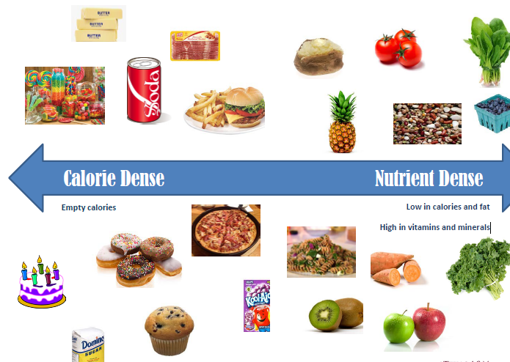
Cont.…

Slide 89
Nutrient-Dense vs. Energy-Dense
Nutrient-Dense: These foods provide more nutrients and generally fewer calories per unit volume.
They are loaded with the nutrients that we need to thrive (e.g. fruits, vegetables, whole grains).
Energy-Dense: These foods provide more calories (energy) per unit of volume than nutrient-dense foods.
Although energy-dense sounds healthy, it is not, because these "empty calories" primarily come from refined sugars and fat

Slide 90
Frequency of feeding
Feeding frequency affects various physiological parameters, particularly gastric and intestinal function, as well as behavior
Feeding frequency will be depend on
Nutritional Requirements and
Dietary Assessment

Slide 91
Essential Nutrient Requirements
ENERGY
For weight to remain stable, energy intake must match energy output.
The major components of energy output are resting energy expenditure (REE) and physical activity;
minor sources include the energy cost of metabolizing food (thermic effect of food or specific dynamic action) and shivering thermogenesis (e.g., cold-induced thermogenesis)

Slide 92
Cont.….
The average energy intake is about 2800 kcal/d for men and about 1800 kcal/d for women, though these estimates vary with body size and activity level
Formulas for estimating REE are useful for assessing the energy needs of an individual whose weight is stable.
Thus, level by multiplying by 1.2 for sedentary, 1.4 for males, REE = 900 + 10w, and for females, REE = 700 + 7w, where w is weight in kilograms.
The calculated REE is then adjusted for physical activity moderately active, or 1.8 for very active individuals.
The final figure provides an estimate of total caloric needs in a state of energy balance.

Slide 93
Protein
Dietary protein consists of both essential and nonessential amino acids that are required for protein synthesis, whereas certain amino acids can also be used for energy and gluconeogenesis
For adults, the recommended dietary allowance (RDA) for protein is about 0.6 g/kg desirable body weight per day, assuming that energy needs are met and that the protein is of relatively high biologic value.

Slide 94
Cont.…
Combinations of plant proteins that complement one another in biologic value or combinations of animal and plant proteins can increase biologic value and lower total protein requirements

Slide 95
Fat
Fats are a concentrated source of energy and constitute on average 34% of calories.
However, for optimal health, fat intake should total no more than 30% of calories

Slide 96
Factors Altering Nutrient Needs
The DRIs are affected by:
  age
  sex
  rate of growth
  Pregnancy
  Lactation
  physical activity
  composition of diet,
  concomitant diseases,
  and drugs.
When only slight differences exist between the requirements for nutrient sufficiency and excess, dietary planning becomes more difficult.

Slide 97
Cont.…
Growth, strenuous physical activity, pregnancy, and lactation increase needs for energy and several essential nutrients.
Energy needs rise during pregnancy, due to the demands of fetal growth, and during lactation, because of the increased energy required for milk production.
Energy needs decrease with loss of lean body mass, the major determinant of REE

Slide 98
Chapter 3
Types of Feeding
There are multiple types of feeding based on the individuals’ problem and recommended nutrients
Enteral or parenteral routes
  Enteral feeding via a tube placed into the gut to deliver liquid formulas containing all essential nutrients
  Preferred route because of benefits derived from maintaining the digestive, absorptive, and immunologic barrier functions of the gastrointestinal tract

Slide 99
Cont.…
Enteral nutrition (EN) means the feeding of an appropriate formula or liquid via a tube to a client’s GI tract.
Parenteral nutrition (PN) designates that nutrients are being provided via an intravenous route.

Slide 100
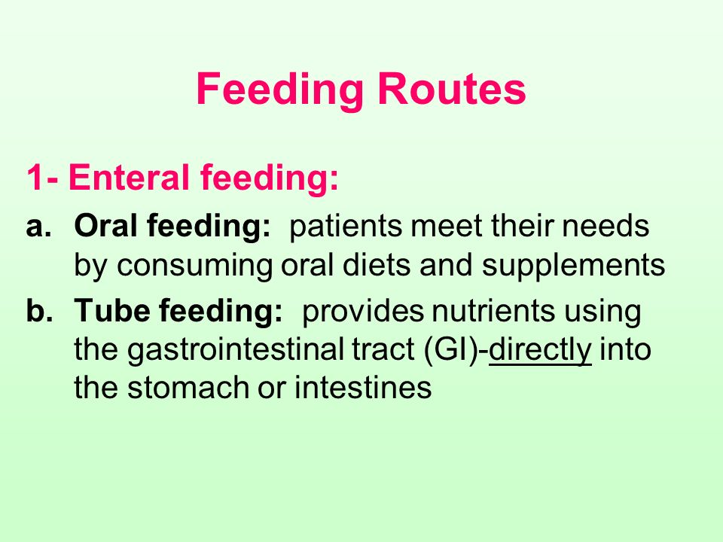
Cont.…

Slide 101
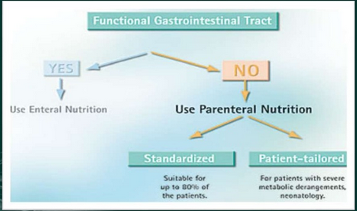
Cont.…

Slide 102
Enteral Tube Feeding
Nasogastric Tube Feeding
Feeding of individual by inserting a tube by nostril
purposes
  Restore or maintain nutritional status
  Administer medications
Tube feedings are the second way nutrients can be delivered to clients.

Slide 103
Cont.…
EN is the delivery of a formula (which includes breast milk for infants) into a functioning GI tract through a tube.
This feeding route should only be considered if the functioning GI tract is sufficient in length for adequate absorption and there is an inability for the client to consume nutrients, either totally or in part, orally.
With some medical conditions, oral feeding is impossible, insufficient, or impractical.

Slide 104
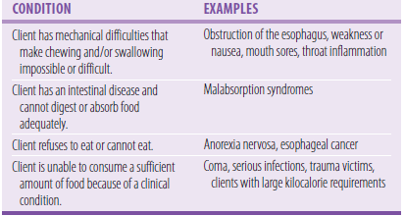
Cont.…
Indications

Slide 105
Cont.…
Problem
uncomfortable and possibly quite distressing.
procedure is very quickly, although sometimes it can take more than one attempt to get the tube into the right place.
Embarrassing and feel self-conscious.
NG tubes can be pulled out of the stomach if they aren't fixed securely.
Sometimes the tube may fall out completely and will then need to be replaced.

Slide 106
Cont.…
Occasionally the tube may become dislodged.
This can result in the tip of the tube entering the lungs. .
NG tubes can sometimes become blocked.
If the feed is given too quickly it can flow up into the gullet/throat/, which can be very unpleasant and may make you feel sick.
Medicines can be given to control this, so let your doctor know if this occurs

Slide 107
Tube Placement
Feeding tubes can enter the body through the nose or through a surgically made opening.
A nasogastric (NG) tube runs from the nose to the stomach.
A nasoduodenal (ND) tube runs from the nose to the duodenum.
A nasojejunal (NJ) tube runs from the nose to the jejunum. These types of tubes are for short-term use because of client discomfort and tissue irritation.

Slide 108
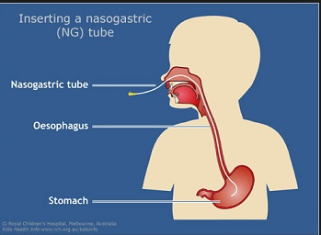
Cont…

Slide 109
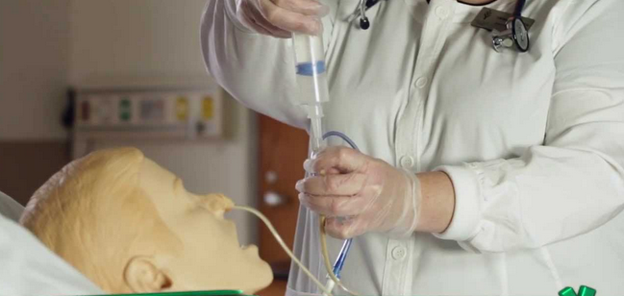
Cont.…

Slide 110
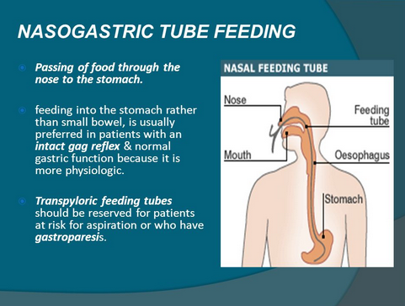
Cont.…

Slide 111
Cont.…
PEG tube can be placed percutaneously with the aid of an endoscope or surgically if the client is already undergoing abdominal surgery or has a condition that makes working with an endoscope difficult for long-term use.
Notes:
percutaneous endoscopic gastrostomy, or
PEG)

Slide 112
Cont.…
Administration
Tube feedings can be administered continuously, intermittently, or by bolus. Clogging of the tube occurs significantly more often with continuous rather than intermittent feedings.
Recommend the following for when administering EN:
1. Evaluate all clients for risk of aspiration.
2. Ensure that the feeding tube is in the proper position before initiating feeding.
3. Client’s head should be elevated at a minimum of 30° to 45°.

Slide 113
Cont.…
4. Check gastric residual volume (GRV) every 4 hours during the first 48 hours for gastrically fed clients.
In adults, if the GRV is 250 mL or greater after a second gastric residual check, a promotility agent should be considered.
If the GRV is 500 mL or greater, EN should be held and consideration given to a feeding tube placed in the small bowel.
5. Flush tubes according to guidelines given for the type of feeding.

Slide 114
Monitoring of tube feeding
Nutritional status
Fluid balance
And GI tolerance should be monitored in tube-fed clients.
Notes:
Nutritional status monitoring begins with a comparison
of the client’s kilocalorie and protein allowances
to the volume and composition of the nutritional product
used. Initially the client’s kilocalorie and protein allowances
are not met because a tube feeding is usually
started at a low volume to increase gastrointestinal tolerance.
Changes in the client’s medical status and treatment,
physical activity, and tolerance to the tube feeding
may continually alter the volume and kind of feeding
the client requires. Therefore, the caloric and protein
content of the tube feeding requires reassessment.
In stable clients, serum levels of sodium, blood urea
nitrogen, hemoglobin, and albumin are indicators of
fluid status. Urine osmolality can be used to monitor
hydration status. Urine osmolality is normally 50 to
1400 mOsm, with a usual range 300 to 900 mOsm and
an average of 850 mOsm. Decreased osmolality indicates
overhydration, and increased osmolality indicates
dehydration.
Fluid intake and output need to be recorded daily.
Fluid intake should be at least 500 mL greater than
output in clients who are neither overhydrated nor underhydrated.
This 500-mL surplus is needed to cover
insensible losses in feces and from the skin and lungs.
Clinical signs of hydration status include skin turgor,
presence of axillary sweat, condition of the mucous
membranes, and the presence or absence of edema.
Constipation is another possible sign of dehydration.
Gastrointestinal tolerance can be assessed by the absence
or presence of diarrhea, bowel sounds, nausea,
distension, and vomiting. The type of feeding delivered,
the volume given, or the delivery rate can cause diarrhea.
Diarrhea is frequently caused by medications. Antibiotics,
laxatives, H2 receptor blockers, and antacids
with magnesium can cause stools to become watery.
Medications that contain sorbitol can also have a laxative
effect.
Gastric residuals are usually measured several times
daily or about every 4 hours in clients at risk with tubes
leading into the stomach. Because elevated residuals
indicate delayed gastric emptying and a potentially
increased risk for aspiration, feedings are advanced
only when gastric residuals are less than 250 mL
(www.adaevidencelibrary.com, 2008; McClave et al,
2009).

Slide 115
Complication of NGT
Mechanical
Gastrointestinal
Metabolic
  Aspiration
  Tube displacement
  Cramping, distention, bloating, gas pains, nausea, Vomiting
  Dehydration
  Diarrhea
  Over hydration
  Hyperglycemia
  Hypernatremia, etc…

Slide 116
Parenteral feeding
PN feeding, in which nutrients are delivered to the client through the veins (intravenously), is the third means of feeding.
PN is normally used in acute care settings in the following circumstances:
  In a previously healthy individual admitted to an intensive care unit after 7 days of hospitalization when EN is not feasible.
  There is evidence of protein-calorie malnutrition and it is not possible to feed enterally.
  An individual is going to undergo major GI surgery, and it is not possible to feed enterally, PN should be initiated 5 to 7 days before surgery and continued after the surgery.
  An individual undergoes major GI surgery and is not.
  able to be fed enterally for 7 or more days.
  If an individual is unable to meet energy requirements after 7 to 10 days by enteral route alone, PN supplementation may be considered

Slide 117
Cont.…
refers to the infusion of complete nutrient solutions into the blood stream via a peripheral vein or, more commonly, by central.
It should be used only if the intestines do not work adequately, if the client has an obstruction or has fistula, if the bowel rest is required

Slide 118
Cont.…
Peripheral parenteral nutrition (PPN)
means to feed the client via a vein away from the center of the body in a line terminating in a peripheral site
Intravenous (IV) feeding (PPN) is routine in some health-care institutions.
IV solutions, usually containing water, dextrose, electrolytes, and occasionally other nutrients, are used to maintain fluid, electrolyte, and acid–base balance.
Intravenous solutions do contain kilocalories.

Slide 119
Cont.…
Central Parenteral Nutrition/Peripherally Inserted Central Catheter
When nutrients are infused into a terminal central vein, parenteral nutrition is often referred to as CPN.
The superior vena cava is commonly used for CPN, and CPN can deliver greater nutrient.
A line inserted peripherally but threaded into a central vein is CPN.

Slide 120
Monitoring
Careful administration of the central line solution is important.
Most institutions have a strict protocol that must be followed by all health-care professionals.
A protocol is a description of the steps for performing a procedure.
Protocols vary widely from one institution to another.
Most CPN protocols include the following:
  A slow start
  A strict schedule
  Close monitoring
  Instructions for increasing the volume
  Maintenance of a constant rate
  Instructions for a slow withdrawal

Slide 121
Cont.…
Initial Assessment
Vital signs (respiration, pulse, temperature)
Body weight and height
Serum electrolytes, glucose, creatinine, blood urea nitrogen levels
Serum magnesium, calcium, phosphorus levels
Serum triglycerides and cholesterol levels
Liver function tests
Serum albumin and pre-albumin
Complete blood count
Energy, protein, fluid, and micronutrient needs

Slide 122
Cont.…
Routine Every 4 to 8 Hours
■ Vital signs
Every 24 Hours
■ Weight
■ Fluid intake and output
■ Serum electrolytes, glucose, creatinine, blood urea nitrogen
levels; daily for 5 days or until stable, then twice a week Weekly
■ Serum ammonia, serum calcium, phosphorus, magnesium, total protein, and albumin
■ Complete blood count
■ Reassessment of actual oral, enteral, and PN intake
Other monitors may be indicated depending on the client’s
clinical condition.

Slide 123
Before and between feeding
Complete physical assessment and client history
  weight and take a weight history
  Identify and condition that would affect TPN (renal or cardiac disease)
  Assess nutritional needs of clients who are unable to ingest nutrients normally.
  Identify the caloric intake necessary to promote positive nitrogen balance, tissue repair, and growth
  Observe for correct additives in each hyper alimentation bottle is important.
  Check lable of solution with physician’s orders
  Check rate of infusion on physician’s order

Slide 124
Cont.…
Assess ability of client to understand instructions during the procedure.
Ensure potency of the central venous line following the insertion
Observe catheter insertion site for signs of infection, thrombophlebitis, or possible infiltration.
Inspect dressing over central line to ensure a dry, non-contaminated dressing.
Planning/Objective Setting
To provide a nitrogen source for clients unable to ingest protein normally.

Slide 125
Cont.…
To provide adequate calories for clients unable to tolerate oral feedings.
To provide nutrients for clients requiring by pass of the gastrointestinal tract.
To provide increased calories where regular IV solutions are insufficient.
To prevent or correct a deficiency of essential fatty acids.
To provide a contamination free mode of delivering the hyper alimentation solution

Slide 126
Implementation
Assisting with catheter insertion
Maintaining central vein Infusions
Changing parenteral hyper alimentation Dressing and Tubing
Maintaining hyper alimentation for children

Slide 127
Gastrostomy/Jejunostomy Feedings
Installation of liquid nourishment through a tube that enters a surgical opening (called a gastrostomy) through the abdominal wall in to the stomach.
jejunostomy feeding is the installation of liquid nourishment through a tube that enters a surgical opening (a jejunostomy) through the abdominal wall in to the jejunum

Slide 128
Main purposes for feeding tubes
Removing gas and fluids from the stomach,
Providing nutrition and hydration,
Promoting healing after surgery,
Removing toxic substances from the stomach and to diagnosing gastrointestinal motility

Slide 129
Cont.…
Jejunostomy Feeding Tube
a permanent feeding tube placed in the small intestine
Esophagostomy Feeding Tube
  The Esophagostomy tube is beneficial to a person when damage to the nasal cavity or jaw prevents nasogastric placement

Slide 130
Purpose of both feedings
provide adequate nutritional intake during the recuperative phase of illness or injury, when the patient's ability to ingest or absorb nutrients is impaired, and
Support the patient during the systemic response to inflammation, injury, or infection during an extended critical illness.
Notes:
SNS is also used in patients with permanent loss of intestinal length or function. In addition, an increasing number of elderly patients living in nursing homes and chronic care facilities receive enteral feeding, usually as a consequence of inadequate nutritional intake

Slide 131
Monitoring Guidelines for TPN
Monitor for signs of infection or sepsis at the insertion site, which is the most common complication of TPN
Weigh client daily – observe for fluid gain or loss. Weight gain may indicate fluid overload rather than increased nutritional gain.
Monitor electrolyte and protein levels daily in the beginning of treatment. Magnesium and calcium imbalance may occur.
Monitor serum glucose levels observing for hyperglycemia (thirsty, polyuria)
Assess blood urea nitrogen and creatinine levels – increases may indicate excess amino acid intake.
Check liver function test results – abnormal value may indicate an excess of lipids or problems in protein or glucose metabolism.

Slide 132
Design of Individual Regimens
Fluid Requirements
  normal daily requirement for fluid is 30 mL/kg of body mass from all sources (IV infusions, per tube, or oral intake), plus any replacement of abnormal losses
Energy Requirements
  Based on energy expenditure
Protein or Amino Acid Requirements
  recommended dietary allowance for protein is 0.8 g/kg/ d

Slide 133
Summary
Nutritional care includes four areas:
  Assessing the client’s need for nutrients,
  Determining the best method for delivering nutrients,
  Monitoring nutrient intake and
  Counseling clients about nutritional needs
Nutrients can be delivered to clients:
  Orally
  Enterally via a feeding tube or
  Parenterally

Slide 134
Summary…
One principle is followed when selecting a feeding route: If the gastrointestinal tract works, use it to maximum capability.
Oral feedings should be considered before EN.
EN should be considered before PN .
PN can be delivered peripherally or centrally.
Clients on either EN or PN need to be closely monitored.

Slide 135
Chapter IV
Tools for Planning Regular and Therapeutic Diets

Slide 136
Different tools to plan regular and therapeutic diets
    Nutrition Care Manual (NCM)
    Facility policies
    Procedures
    local, state, and
    National requirements

Slide 137
Nutrition care manual (NCM) and Therapeutic Diet Tips and Tools
Use the sample approval form for facility customization; print and sign.
Print the update summary listing annual changes and present to the appropriate facility committee.
Use the manual’s table of contents for appropriate facility committee approval.
Use the printable handouts to show rationale, food lists, and sample menu.

Slide 138
Cont.…
  The food lists can be used by the facility when planning patient room service or cycle menus to determine appropriate food choices.
  The food lists are resources to answer patient and provider questions about recommended and not recommended foods.

Slide 139
Therapeutic diet
Is a diet which requires
  reducing or avoiding having certain types of food or nutrient,
  adding a certain type of food or nutrient
  Changing the consistency of food or changing pattern of eating.
  Modifications of normal diet used to improve specific health conditions.

Slide 140
1. Food Composition tables
Provides users with detailed information on the nutritional composition of foods
Food composition data (FCD)
  Food composition data (FCD) are detailed sets of information on the nutritionally important components of foods and provide values for energy and nutrients including protein, carbohydrates, fat, vitamins and minerals and for other important food components such as fiber.

Slide 141
Food composition databases tend to be compiled using a variety of methods
1. Chemical analysis
2. Imputing and calculating values from data already within the database
3. Estimating FCD values from other sources
4. Data evaluation and quality
5. Food composition database
6. Documentation

Slide 142
Food composition table for use in Ethiopia I
Included items 210
Analysis result for:
  Proximate composition
  Minerals
  Vitamins

Slide 143
Food composition table for use in Ethiopia II
Compiles amino acids contents and biological data of protein on Ethiopian foods.
Analysis result of amino acids:
  18 amino acids from 99 items
Analysis result for biological data and chemical score:
  Level of protein
  Chemical score
  Number of items included 226.

Slide 144
Food composition table for use in Ethiopia III
Number of items included 620
Analysis result for
  proximate composition
  Minerals such as P , Ca and Fe.
  Vitamins such as carotene, thiamine ,riboflavin ,niacin and tryptophan
Notes:
Number of items included 620
Analysis result for
proximate composition
Minerals such as P , Ca and Fe.
Vitamins such as carotene, thiamine ,riboflavin ,niacin and tryptophan

Slide 145
Food composition table for use in Ethiopia IV
Number of items included 305
Analysis result for:
  Proximate composition
  Minerals such as P, Ca, Fe, Zn, Cu, Na and k.
  vitamins

Slide 146
With out food composition data countries cannot:
Analyze the nutrient intake or develop nutrient requirements and safe upper limits
Carry out epidemiological research on nutrient intake and disease
Produce accurate food labels
Formulate institutional and therapeutic diets
Promote nutritionally important plants and animals to improve health or for breeding
Inform consumers about good food choice

Slide 147
Food composition users
Nutritionist, dietitians
Researchers, epidemiologist
Economists
Program coordinators
Food analysts and technologists
Food and nutraceuticles manufacturers
Agriculture planners
Food safety
General public health

Slide 148
Uses of food composition data
Nutrition and Health related
– Dietary and Health assessment
– Food guide pyramid
– Daily calorie and nutrient requirement estimation
– Clinical diets
– Nutritional policies
– Epidemiological research on relationship between diet and disease, example chronic disease
– Devising emergency food supplies

Slide 149
Cont.…
Trade
Nutrition labeling
Food regulation
Consumer protection
Plant breeding

Slide 150
Limitation in use of FCT
Variability in composition of foods
Partial or limited coverage of foods
Partial or limited coverage of nutrients
Limitation of methods for measuring food intake

Slide 151
2. Dietary standards
The food in the diet usually expressed in terms of digestible nutrients supposed to be best adapted for humans under different conditions
Purpose
  the planning of diets or food supplies and
  Evaluation of dietary histories/to evaluate the nutrient adequacy of the food eaten.
Notes:
Standard based on nutrient density is the best one

Slide 152
Benefits of dietary standards
Time and cost savings resource,
Can help manufacturers demonstrate and authenticate the quality of the dietary supplement ingredients they manufacture and use
Increased safety of dietary supplement ingredients
Enhanced reliability of analytical test results:
Reference standards are frequently used by test laboratories to calibrate analytical methods or as quality control samples.

Slide 153
Thank you

Slide 154
Chapter 5
Weight Management
Weight management is a long-term approach to a healthy lifestyle.
It includes a balance of healthy eating and physical exercise to equate energy expenditure and energy intake.
Nutrition is an important part of maintaining a healthy body weight.
Developing healthy eating habits while using tips that will keep us fuller longer can be useful tools in weight management.

Slide 155
Cont.…
Knowing what your body needs is important to weight management and can control overconsumption and under consumption of food.
It does not include fad diets that promote quick, temporary weight loss.
It focuses on the long-term results that are achieved through slow weight loss, followed by retention of an ideal body weight for age, sex and height

Slide 156
Methods of Weight Management
1. Increase protein intake, especially at breakfast
Why it is important:
The satiating property of dietary protein is influenced by the time of protein consumption.
Studies have shown that protein intake at breakfast has a greater satiety effect than later meal times.
Firstly, protein has a greater thermogenic effect than carbohydrates and fat, which enables the body to burn more calories.

Slide 157
Cont.…
Secondly, a high protein breakfast appears to slow gastric emptying, which attributes to the fact that protein appears to be the most satiating macronutrient.
Finally, a high protein breakfast increases the activity of glucagon, which activates the pathways for glucose synthesis.
One study showed that fat loss was approximately twice as much in the high-protein diet group than the moderate-protein diet group in overweight and obese individuals

Slide 158
Cont.…
2.Plate size can affect calorie consumption
  Using smaller plates helps to consume smaller portion sizes and this leads to the consumption of fewer calories.
  Studies have shown that portion size influences energy intake.
3. Eat more soup
  Soups have a significant satiety effect and studies have demonstrated that compared to solid foods, soup ingestion decrease the amount of energy intake.

Slide 159
Cont.…
Compared to having no soup, it has been shown that eating soup reduces total energy intake of a meal.
When soup is consumed before a meal, a decrease of 20% of energy is consumed in the meal
4. Choose the low calorie foods
5. Eating more dairy can aid in fat loss
Eating diet high in dairy decreases total body fat.

Slide 160
Cont.…
This occurs because a high amount of dietary calcium increases the amount of energy and fat excreted from the body.
Studies have shown that saturated, monounsaturated and polyunsaturated fats all have a higher excretion rate with a high calcium intake.
high intakes of calcium cause calcium soap formation and/ or binding of bile acids in the intestine.
Dairy sources of calcium demonstrate greater weight loss than supplemental calcium intake.
This may be due to the other bioactive components present in milk, which may aid in metabolic efficiency and fat loss

Slide 161
Cont.…
6. Vegetable
  Increase satiety and decrease hunger
  Have a low energy density, which is mainly due to the high water content and partly due to the fiber content
  7. Fiber
  Dietary Fiber has been suggested to aid weight management by inducing satiety, decreasing absorption of macronutrients and promoting secretion of gut hormones
  Hormone secretion is affected during fiber ingestion.

Slide 162
Cont.…
Insulin response is reduced and cholecystokinin (CCK) in the small intestine is increased.
Insulin regulates blood glucose levels while CCK adjusts gastric emptying, pancreatic secretion and gall bladder contraction.
There is direct correlation between CCK and satiety after foods of different fiber contents are consumed.
Fiber may have the added benefit of helping consumers decrease food intake throughout the day

Slide 163
Cont.…
8. Caffeine
  associated with increased energy expenditure and subsequent weight loss
9. Green Tea
  It has been associated with decreasing blood glucose, inhibiting hepatic and body fat accumulation, and stimulating thermo genesis.
  Green tea has also been shown to increase energy expenditure and fat oxidation in humans, independent of the caffeine content
Notes:
Catechins are polyphenol that are a major component of green tea extract.

Slide 164
Overweight management
Obesity is a state of excess adipose tissue mass
Obesity is a global problem, independent of age
Now reaching epidemic proportions around the world
intra abdominal and abdominal subcutaneous fat have more significance than subcutaneous fat present in the buttocks and lower extremities.
This distinction is most easily made clinically by determining the waist-to-hip ratio, with a ratio >0.9 in women and >1.0 in men being abnormal

Slide 165
Etiology of Obesity
Obesity is a heterogeneous group of disorders
Due to the complexity of the neuroendocrine and metabolic systems that regulate energy intake, storage, and expenditure, it has been difficult to quantitate all the relevant parameters

Slide 166
Cont.…
Role of genes versus environment
Obesity is commonly seen in families, and the heritability of body weight is similar to that for height
Cushing's syndrome(increased cortoson secretion)
Hypothyroidism
Insulinoma (Over eating to prevent hypoglycemia)

Slide 167
Steps to Manage Weight
Build more lean muscle
Fight off hunger with more filling foods
Avoid temptation
Count calories
Plan your meals in advance
Consider adding minutes to your exercise plan
Measure your portions
Weigh yourself daily
Include dairy in your diet
Let your plate be your guide
Watch less TV
Eat breakfast

Slide 168
Underweight management
Is a term describing whose body weight is considered too low to be healthy
usually refers to people with a body mass index (BMI) of under 18.5 or a weight 15% to 20% below that normal for their age and height group
occur because of
    an inadequately nutritious diet relative to a person's energy needs (generally called malnutrition)

Slide 169
Cont.…
    Disease processes, changes in metabolism, hormonal changes, medications or other treatments, disease or
    Treatment-related dietary changes, or
    Reduced appetite associated with a disease or
    Treatment can also cause unintentional weight loss

Slide 170
Weight loss issues related to specific diseases
Chronic obstructive pulmonary disease (COPD)
Cancer
HIV/AIDS
Gastrointestinal disorders
Infection
Renal disease
Cardiac disease
Connective tissue disease
Neurologic disease, including dementia
Oral, taste or dental problems

Slide 171
Causes
genetics,
metabolism,
lack of food (frequently due to poverty),
illness
anorexia nervosa

Slide 172
Treatment
Diet(increase calorie intake) include eating calorie-dense foods, such as dried fruits, cheese, and nuts
Exercise (Muscle hypertrophy increases body mass).
Weight lifting exercises are effective in helping to improve muscle tone as well as helping with weight gain
Appetite stimulants(Antidepressants, such as mirtazapine or amitriptyline, and antipsychotics, particularly chlorpromazine and haloperidol as well as tetrahydrocannabinol (found in cannabis), all present an increase in appetite as a side effect), B vitamin supplements

Slide 173
Kind of exercise
Best type of exercise is one that you will do on a regular basis
Physical activities that increase your heart rate and move large muscles (such as the muscles in your legs and arms) are good choices
Walking is a popular choice and does not require special equipment, except for appropriate shoes.
Other good options include swimming, biking, jogging, and dancing

Slide 174
How much should do exercise
A good goal for many people is to work up to exercising 5 times a week for 30 to 60 minutes at a time.
If 30 to 60 minutes at a time sounds difficult to fit into a busy schedule, you can split up your physical activity into smaller chunks of time.
Try exercising for 10 minutes at a time throughout your day.
For example, take the stairs instead of the elevator or go for a walk during your lunch break.
Remember: exercise has so many health benefits that any amount is better than none

Slide 175
You should do before and after exercise
start an exercise session with a warm-up period.
During this time (about 5 to 10 minutes), start by slowly stretching your muscles and then gradually increase the intensity of your activity
After you are finished exercising, cool down for about 5 to 10 minutes.
Stretch your muscles and let your heart rate slow down gradually.
You can use the same stretching exercises you did during your warm-up period

Slide 176
How can you prevent injuries?
don’t try to do too much too soon.
Start with an activity that is fairly easy for you, such as walking.
Do it for a few minutes a day, several times a day.
Slowly increase the amount of time and the intensity of the activity.
For example, increase your walking time and speed over several weeks
Stop exercising if you feel very out of breath, dizzy, faint, or nauseous, or if you feel pain

Slide 177
Warm-up and cool-down stretches
Keep your breathing slow and natural. Do not hold your breath.
Move slowly and steadily. Avoid jerky movements to prevent injury.
Not bounce while stretching. Bouncing can cause muscles to tear

Slide 178
Chapter 6
Disease Management
Disease management refers to multidisciplinary efforts to improve the quality and cost-effectiveness of care for selected patients suffering from chronic conditions
"a system of coordinated healthcare interventions and communications for populations with conditions in which patient self-care efforts are significant

Slide 179
Cont.…
Knowledge sharing, knowledge building and a learning community are integral to the concept of disease management
The primary goals of disease management are to prevent chronic diseases, improve the quality of life for people who do develop them and reduce costs

Slide 180
Types of disease mgt strategies
1. Primary prevention strategies aim to prevent the onset of chronic disease.
2. Secondary prevention strategies seek to mitigate the impact of chronic disease once it has developed to avoid unnecessary complications

Slide 181
Primary prevention strategies
Tend to focus on healthy behaviors.
There is increasing evidence that the major chronic conditions in large part stem from or are worsened by individual lifestyles.
These types of strategies are viewed as yielding long-term positive results.
They also are more difficult to pin down in terms of savings in cost.

Slide 182
Secondary prevention strategies
Tend to focus on making sure patients get the necessary medical tests and treatments they need to control their disease.
These strategies are viewed as yielding quicker and more easily measured results in terms of improvements in health and savings in cost.

Slide 183
Nutrition for Disease Management and Prevention
Eating a healthy diet may help to reduce risk of certain health conditions, but eating a poor quality diet might increase your chances of becoming ill.
Dietary changes may be an important component of treatment too.

Slide 184
The 5 Common Digestive Disorders
When it comes to the human body, one of the most sensitive components is the digestive system.
It's easily upset by disease, emotional factors, and even malfunctions in other parts of the body.

Slide 185
5 Common Digestive Disorders
Celiac Disease
This autoimmune disorder affects around 1 percent of people globally.
It's an abnormal sensitivity to gluten, a protein in wheat, barley, and rye

Slide 186
Cont.…
Signs include:
Diarrhea
Mal-absorption
Weight loss
Abdominal pain and swelling
Food intolerance
Diagnosis
blood tests and/or tissue biopsy.
Treatment
a strict, gluten-free diet

Slide 187
2. Irritable Bowel Syndrome (IBS)
Affects patients between ages 35 and 50.
It strikes 1 out of every 5 women, and around 1 in 10 men.
not dangerous, it causes significant pain/cramping.
Both diarrhea and constipation are common.
Less common are excessive gas, feeling overly full, and mucus discharge.

Slide 188
Irritable Bowel Syndrome
This is a chronic functional gastrointestinal disorder.
characterized by :
  abdominal pain or discomfort and altered bowel habits at least three times a month over at least 3 months for which other gastrointestinal causes have been excluded.
IBS is estimated to affect 10% to 15% of the population,
Usually in people younger than 45 years Clients are symptomatic during the day but not while sleeping.

Slide 189
Cont.…
The most common signs and symptoms of irritable bowel syndrome are:
  Cramping
  Bloating, abdominal distention
  Abdominal pain, often relieved by passage of flatus or stool
  Constipation or diarrhea.
  Mucus in stools

Slide 190
The causes of IBS are not well understood.
Researchers believe a combination of physical and mental health problems can lead to IBS
Up to two-thirds of individuals with IBS believe their symptoms to be diet-related and modify their consumption to avoid food triggers

Slide 191
Treatment for IBS is symptomatic. In general, a balanced diet with few restrictions is advised.
Avoidance of specific carbohydrates (fructose, lactose) and sugar alcohols (sorbitol, Xylitol) may prove helpful.

Slide 192
Cont.…
Doctors diagnose IBS after ruling out other conditions like food intolerance.
The illness affects how food moves through the large intestine and is characterized by periodic flares.
Finding an effective treatment is difficult because no cause has been pinpointed.
Some doctors advise patients to eat more fiber, take anti-cramping medications, and avoid stress

Slide 193
Inflammatory Bowel Diseases (IBDs)
Normally, the immune cells protect the body from infection.
In people with IBD, however, because the immune
system mistakes food, bacteria, and other materials in the
intestine for foreign substances, it attacks the cells of the
intestines.
In the process, the body sends white blood cells into the lining of the intestines where they produce
chronic inflammation and a cascade of nutritional effects.

Slide 194
IBDs are complex, multifactorial disorders in which the body loses its tolerance to its own gut microorganisms.
The two most common IBDs are:
Crohn disease (CD), also known as ileitis or regional enteritis,
Ulcerative colitis.
The two diseases share some similar characteristics but also have major differences

Slide 195
Cont.…
IBD is an umbrella for some serious digestive illnesses.
No specific cause of IBD but suspect a combination of a faulty immune system, genetics, and environmental factors.
While Crohn's occurs anywhere in the digestive tract and is incurable, ulcerative colitis develops only in the colon and is cured by removing it

Slide 196
Beyond general goals, the nutritional care of clients with IBD must be individualized according to the nutritional

Slide 197
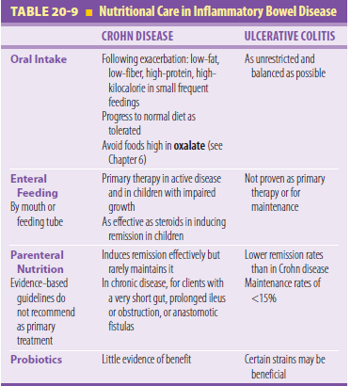
Cont.….

Slide 198
Major symptoms of both illnesses include
Diarrhea
Rectal bleeding
Abdominal pain and cramping
Urgency to move bowels
Diagnostic tools
blood tests and radiographic studies.
Treatment
Medications ranging from anti-inflammatory drugs to immune-suppressants, dietary changes to reduce symptoms, and surgery.
Neither stress nor a specific food causes IBD

Slide 199
3. Gastro-esophageal Reflux Disease (GERD)
Occurs when a one-way valve known as the lower esophageal sphincter doesn't close correctly, allowing digestive juices plus stomach contents to travel up the esophagus.
The condition even affects infants.
Doctors sometimes need to perform an endoscopic exam to diagnose it
Most common symptom is heartburn that climbs from the stomach to the throat or middle of the chest.

Slide 200
Treatment
Treatment consists primarily of dietary changes, over-the-counter antacids or reflux drugs, and/or prescription medications.

Slide 201
4. Gastroparesis
This is a condition that slows or inhibits the stomach's ability to empty its contents, also known as delayed gastric emptying.
It typically affects more women than men, though the reason being is unknown
Most people with this condition have not been diagnosed with a known cause, despite medical tests; this is called idiopathic gastroparesis.
For those with an identifiable cause, diabetes is the most common culprit

Slide 202
Cont.…
High levels of blood glucose in diabetics over time can damage the vagus nerve, which controls the stomach muscles and movement of food through the digestive tract.
Gastroparesis can affect those with both type 1 and type 2 diabetes

Slide 203
Common symptoms of gastroparesis
Nausea
Feeling full after consuming a small amount of food
Heartburn
Abdominal bloating
Treatment
combination of nutritional changes and medication can help manage the severity of symptoms

Slide 204
Maintaining a healthy digestive system
Good (healthy) digestion is a 'silent' process - digestion in some form is taking place while we rest, eat, sleep or work.
We generally only become aware of digestion when something goes wrong (e.g if you eat foods that don't agree with your body or drink too much alcohol or say, if you become constipated or have gas).

Slide 205
Maintaining a healthy digestive system-key points
Eat a healthy diet
Eat moderately, slowly and regularly
Exercise regularly
Reduce/manage stress levels
Quit smoking

Slide 206
Gastrointestinal Problems
Difficulty Swallowing
People with Parkinson’s tend to swallow less often and less completely, and as a result some 70 percent have too much saliva, which often pools in their mouth.
Sucking on hard candy, preferably sugarless can stimulate swallowing and provide temporary relief from drooling.

Slide 207
Cont.…
An effective treatment, available by prescription, is atropine eye drops taken on or under the tongue.
Adjusting anti-Parkinson’s medications may also make it easier to swallow
In addition, medical conditions unrelated to Parkinson’s can lead to difficulty swallowing.

Slide 208
Nausea
Nausea or bloating can result when the stomach empties its contents into the small intestine too slowly, a condition called gastroparesis

Slide 209
Constipation
Defined as fewer than three bowel movements per week.
a bowel movement less often than once a day indicated a risk of developing Parkinson’s four times higher than average.

Slide 210
Cont.…
Constipation
According to a research survey in Mumbai, over 70 per cent of the persons studied complained of constipation.
Persons, who have little or no exercise especially elderly persons, suffer from atonic constipation.
They limit their food selection to soft, low-fiber foods; they limit fluid intake to prevent urination,
especially at night. They become dependent on laxatives and yet find no relief, as the causative factors are not eliminated.
Treatment:
The following changes in routine and diet help to get rid of the constipation:
(i) Increase fluid intake to 1200 to 1500ml. i.e., 5 to 6 glasses of water in addition to other beverages and liquid foods (soups, buttermilk, etc.)
(ii) Include 200 to 250g of vegetables and fruits in the diet and
(iii) Exercise regularly e.g., walking ¾ to 1 hour daily,
(iv) Do fitness exercises, and/or
(v) Suryanamasksars or yoga daily.

Slide 211
Cont.…
Diet:
Their diet needs to be modified gradually to high fiber diet as listed below :
1. Eat whole wheat chapati and bhakari as major part of the meal and reduce intake of white
bread and polished rice
2. Include cooked preparations of germinated pulses in the diet.
3. Take two or more servings of cooked vegetables such as cluster and other beans, gourds
(snake, ridge, bitter, sponge, etc.)
4. Eat raw vegetables such as cabbage, carrot, cucumber, tomatoes, radish etc.
5. Include two or more servings of fruits such as amla, banana, papaya, chiku, guava, melons,
jackfruit, berries, apples, etc.
6. Take beverages such as buttermilk, lemon squash, mango panhe, kokum drink, to increase
fluid intake.
7. Drink 5 to 6 glasses of water, as a drink to ensure movement of food in the digestive tract
and smooth elimination of waste products.

Slide 212
Other causes for constipation
Not drinking enough water
A diet low in fiber
Lack of exercise
Travel or other change in routine
Eating large amounts of dairy products
Stress
Resisting the urge to have a bowel movement
Antacid medicines containing calcium or aluminum
Other medications (especially strong pain medicines such as opioids, antidepressants, and iron pills)
Medical problems such as irritable bowel syndrome (IBS), diabetes, and colorectal cancer
Pregnancy

Slide 213
Infancy and early childhood disease
Ethiopia has one of the highest under-five mortality rates with more than 321,000 children under the age of five dying every year.
More than70% of these child deaths are due to five diseases, namely pneumonia, diarrhea, malaria, measles and malnutrition, and often to a combination of these conditions

Slide 214
Care of the Under-Fives
why under five need special health care:
Large numbers: constitute 15–20% of population in developing countries.
High mortality(major causes of death in this group are due to malnutrition and infection, both preventable).
Morbidity: (major diseases which affect this preschool age group are: diphtheria, whooping cough tetanus, diarrhea, dysentery, malnutrition, accidents all are preventable)

Slide 215
Acute Respiratory infection
Danger Signs
If any sign indicating complications or severely deteriorated general condition (danger sign) is present, the child is classified as having very severe disease

Slide 216
Danger signs
Not able to drink
Convulsion
Abnormally sleepy or difficult to awake
Strider in a calm child
Severe under nutrition

Slide 217
Mental Retardation
Retarded in his psychomotor development (milestones) we suspect subnormal intelligence and speak of mental retardation
A. He cannot sit without support at age 9 months, can not stand at at age 15 months, and cannot walk at age 18 months
B. He cannot lough loudly at age 6 months, speak three words at age 2 years, and follow a few simple directions at age 3 years
C. He cannot grasp actively at age 6 months, and take small objects with thumb and finger at age 1 year

Slide 218
Causes
a. Inherited abnormalities (microcephalus, hydrocephalus).
b. An abnormality of chromosomes the carrier of inheritance in the cellular nucleus the feature of mongolism (Down’s syndrome)
c. Perinatal problems (prematurity, asphyxia)
d. Hypothyroidism (cretinism)
e. Environmental factors (pronounced parental neglect)
f. Deafness can mimic mental retardation

Slide 219
Cretinism/ hypothyroidism
Defects or complete absence of the thyroid gland with insufficient production thyroid hormone causes severe retardation of physical and mental development of the child, sometimes known as cretinism

Slide 220
Clinical Features
1. Delayed growth and development
2. Signs of slow metabolism (hair and skin dry, thick and coarse)
3. Goiter may be present or thyroid gland may be absent

Slide 221
Urinary Tract Infection
infection within urinary system
Etiologic agents
    GI flora Organisms responssible for 75 % of all cases
    Streptococci and staphylococci cause most other cases.
    Contributing causes

Slide 222
Tuberculosis

Slide 223
Meningitis
is an inflammation of the meninges
caused by viral, bacterial or fungal organisms.
classified as aseptic, septic and tuberculosis meningitis

Slide 224
originate in one of two ways
  either through the blood stream as a consequence of other infections such as cellulites or
  by direct extension after traumatic injury to the facial bones

Slide 225
Cleft lip and palate
are congenital deformities due to the failure of various parts of the upper lip and palate to fuse
    Cleft lip is operated on about the age of three months
    cleft palate about the age of one year before speech detects have developed

Slide 226
Feeding Recommendations during sickness and health
Up to 6 months of age
Breast feed as often as the child wants, day and night, at least 8 times in 24 hours.
Do not give other fluids
Expose the child to sunshine for 20 to 30 minutes daily

Slide 227
6 Months up to 12 months
Add complement foods mashed potatoes softened with milks cereal and legumes
Give these foods with cup and spoon 1 or 2 times per day in addition to breast feed.
Give adequate servings of shiro fitfit, Merek fitfit, porridge,made of cereal and legume mixes, mashed potatoes and carrot, mashed gommen, egg and fruits.
Give adequate servings of: Porridge made of cereal and legume mixes. Shiro, kik, merek fitfit, mashed potatoes and carrot, gommen, undiluted milk and egg and fruits
Add some extra butter or oil to child’s food
Give these foods:-3 times per day if breastfed 5 times per day if not breastfed
Expose child to sunshine

Slide 228
12 months up to 2 years
Breast feed as often as the child wants, Give these foods 5 times per day
Give adequate serving of: porridge made of cereal and legume mixes. Shiro, kik, merek fitifit mashed potatos and carrot, gommen, undiluted milk and fruits
Add some extera butter or oil to child food

Slide 229
2 years and older
Give family food at least 3 times each day. Also twice daily, give nutrious food between meals, such as: egg, milk, fruits, kita, dabo

Slide 230
Feeding Disorder of Infancy and Early Childhood
is a child's refusal to eat certain food groups, textures, solids or liquids for a period of at least one month, which causes them to not gain enough weight or grow naturally

Slide 231
diagnosed if the child meets the following criteria
There is no gastrointestinal or other medical condition causing the eating problem.
The problem is not caused by a mental disorder or the unavailability of food.
The child is not eating an adequate amount of food, which means the child is not following the normal weight gain curve for his or her age, or he or she has lost a considerable amount of weight in one month or more

Slide 232
Nonmedical Causes
child is fearful or stressed about something.
fear of past traumatic incident, like choking.
child is not receiving adequate or healthy emotional care from his or her parent or primary caregiver, due to caregiver alienation or aggression. For example, a child may feel afraid of his or her parent’s temper, or the parent may suffer from a deep depression and may withdraw from the child.
child just doesn’t like foods of certain textures, tastes, or smells

Slide 233
Signs
  appears underweight
  does not eat as frequently (or as much) as he or she should
  is often irritable and cries frequently
  seems mentally distressed or withdrawn
  struggles to pass bowel movements and/or seems to be in pain when doing so
  often seems tired and sluggish
  vomits frequently
  lacks age-appropriate social skills and tends to shy away from others

Slide 234
CHAPTER 7:- ELECTROLYTE AND FLUID BALANCE FOR DIARRHEA
Diarrhea is defined as an increase in stool frequency and volume.
The stool is usually liquid, and 24 hrs output exceeds 250 gm/day
Normal bowel habit ranges from 3 times/day to 3 times/wk

Slide 235
Classification of diarrhea
Based on the duration of illness diarrhea can be classified into acute and chronic
A) Acute diarrheal disease
Lasts for 2 - 4 wks
It is usually infectious in origin
Resolves with or without intervention

Slide 236
Chronic diarrheal diseases
Lasts for more than 4 wks
The common causes include malabsorption, inflammatory Bowel Diseases (ulcerative colitis), irritable Bowel syndrome, colonic cancer, and HIV/AIDS.
Infectious causes are not common causes of chronic diarrhea

Slide 237
Based on the nature of diarrheal stool, acute diarrhea could be inflammatory or non inflammatory
A) Non-inflammatory diarrhea
Is watery, non-bloody diarrhea associated with periumblical cramps, nausea, and vomiting
It is small intestinal in origin
B) Inflammatory diarrhea -
Dysenteryis bloody diarrhea

Slide 238
Pathophysiologic classification
Secretory diarrhea
  Occurs when the secretion of fluid and electrolytes is increased or when the normal absorptive capacity of the bowel is decreased
  Diarrhea of secretary origin persists even if the patient fasts
B) Osmotic diarrhea
  It occurs due to the presence of poorly absorbed or non absorbable substance in the intestine which is osmotically active, resulting secondary accumulation of fluid and electrolytes.
  Such non absorbable substances include lactose in patients with lactase deficiency.
  This type of diarrhea is usually caused by malabsorption and disappears when patient fasts for 48-72 hrs

Slide 239
Managment
Fluid and electrolyt
Treat the cause

