Slide 1
Epidemiological study designs

Slide 2
Session objectives
After completing this session you will be able to
  Understand epidemiological study designs
  Differentiate the type of study design used by investigators
  Identify the merits and demerits of each study designs
  Apply epidemiological study designs to conduct a study.

Slide 3
Introduction
Role of epidemiology
To diagnose community health problems
To identify natural history and etiology of diseases
To evaluate and plan health services
Therefore, to achieve these roles
-------we use epidemiological study designs.
The common goal in epidemiological studies is understanding the frequency, pattern, and causes of disease in populations.

Slide 4
Epidemiology: is primarily concerned with the distribution and determinants of disease in human population.
Study Design: is an arrangement of conditions for the collection and analysis of data that leads to the most accurate answer to the research question and the most economical way.

Slide 5
Types of Epidemiologic study designs
Based on objective/focus/research question
Descriptive studies
  Describe: who, when, where & how many
2. Analytic studies
  Analyse: How and why

Slide 6
Types of study..
Based on the role of the investigator
Observational studies
  The investigator observes nature
  No intervention
Intervention/Experimental studies
  Investigator intervenes
  He has a control over the situation

Slide 7
Types of study…
Based on timing
1. One-time (one-spot) studies
  Conducted at a point in time
  An individual is observed at once
2. Longitudinal (Follow-up) studies
  Conducted in a period of time
  Individuals are followed over a period of time

Slide 8
Types of study…
Based on direction of follow-up/data collection
Prospective
  Conducted forward in time
2. Retrospective
  Conducted backward in time

Slide 9
Types of study…
Based on type of data they generate
Qualitative studies
  Generate contextual data
  Also called exploratory studies
2. Quantitative studies
  Generate numerical data
  Also called explanatory studies

Slide 10
Types of study…
Based on study setting
Community-based studies
  Conducted in communities
2. Institution-based studies
  Conducted in institutions
3. Laboratory-based studies
  Conducted in major laboratories

Slide 11
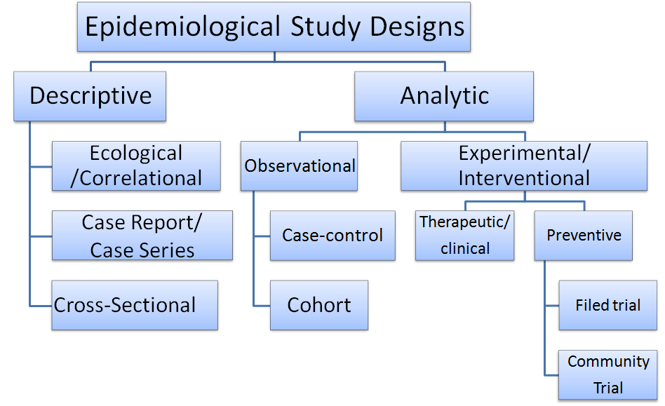
Types of study…

Slide 12
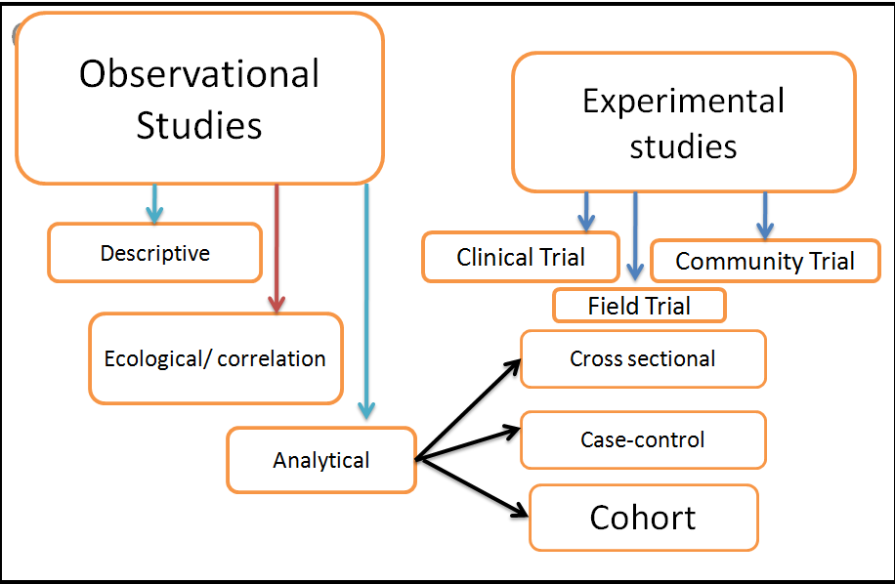
Types of study…

Slide 13
Introduction (…cont’d)
Purpose of Epidemiological Studies
Descriptive | Analytic
Characterize disease occurrence by time, place and person. Generate testable hypothesis as to the cause of disease | Concerned with the search for causes and effects. Test hypothesis about association between exposure and outcome.

Slide 14
Introduction (cont.)
Types of Epidemiological Design Strategies
Descriptive | Analytic
Dealing with population as a study unit Correlational or ecological Dealing with individual as study unit Case report or series Cross sectional survey | Observational studies Case-control Cohort Intervention studies

Slide 15
Selection of study design
Depends on
  Hypothesis being tested
  Resources available
  Current state of knowledge

Slide 16
Descriptive studies
Relatively cheap in terms of time cost, because it can use information already collected.
It usually describes:
Who gets a disease and who doesn’t ( person)
Where rates are highest and lowest ( place)
Temporal patterns of disease (time)

Slide 17
Descriptive…
It is the most common form of study in medical literatures
There are three forms of descriptive study designs
  Correlational /ecological design ( use population as study subject)
  Case report and/or case series studies
  Cross-sectional survey

Slide 18
1. Correlational /ecological study
Use data from entire population (as a whole) to compare disease frequencies.
Hence, it does not need data from individuals.
Can be done quickly and inexpensively, often by using already available data.
It has the following rationale
    Low cost and convenience
    Measurement limitations at individual level, Eg environmental contact.
    Other designs may be unable to measure interest on ecologic effect

Slide 19
Correlational/ecological….
For initial investigation of causal hypothesis like a cross-sectional study design data on both the exposure and outcome of interest will be collected at one time (simultaneously).
However the exposure and outcome of interest measured at group and not at individual level.

Slide 20
Correlational/ecological studies
Uses data from entire population to compare disease frequencies
  between different groups during the same period of time, or
  in the same population at different points in time.
  Time series may reduce some of the socioeconomic confounding that is a potential problem in ecological studies
Does not provide individual data, rather presents average exposure level in the community
Cause could not be ascertained
Correlation coefficient (r) is the measure of association in Correlational studies.

Slide 21
Correlational/ecological studies (cont.)
Example:
Average per capita fat consumption and breast cancer rates compared between countries.
Comparing incidence of dental cares in relation to fluoride content of the water among towns in the rift valley.
Mortality from CHD in relation to per capita cigarette sales among the regions of Ethiopia.
Relationship between average sales of an anti-asthma drug and the occurrence of an unusually high number of asthma deaths in different provinces of New Zealand.

Slide 22
Correlational/ecological studies (cont.)
Strength
Can be done quickly, inexpensively, and often using available data (routine records and reports-- for example, death rates, per capita income, national food consumption…)
Low cost/cheap and convenience
Measurement limitations at individual level, Eg environmental contact.
Other designs may be unable to measure
Interest on ecologic effect

Slide 23
Correlational/ecological studies (cont.)
Limitation
Inability to link exposure with disease in a single individual.
  Data on exposure and outcome are not linked at the individual level; association found with aggregate data (average values) may not apply to individuals (Prone to ecological fallacy)
Average exposure levels rather than actual individual values, ecological fallacy or bias.
Lack of ability to control for effects of potential confounding factors.
Conversely, lack of correlation does not necessarily imply absence of valid statistical association (Berksons fallacy)
It may mask a non-linear relationship between exposure and disease.
    E.g. non-linear relationship in alcohol consumption and mortality from CHD ("J" shaped curve)

Slide 24
Case Reports (Case series)
Report or describe the experience of a single individual or a group of individuals with the same diagnosis or health problem
  Derived from either the practice of one or more health care professionals or a defined health care setting ( hospital, health centre or specialized clinic)

Slide 25
Case Reports (Case series)…
2.1. Case study/report
A most basic type of descriptive study of individuals comprising of a careful and detailed report of a single patient by one or more physician
  E.g. the progress of symptom and sign, response of treatment
It is the study of health profile of a single individual using a careful and detailed report by one or more clinicians
  It is common form that is published in articles
It is made using
  Simple history, physical examination and Lab./ radiologic investigation

Slide 26
Case Reports …
Useful for the recognition of new disease
Important for constructing the natural history of disease
Help to formulate a research hypothesis and detection of epidemics
  It was a single case report that formulated the hypothesis of oral contraceptive use increases venous thrombo-embolism

Slide 27
Case report :Limitations
No appropriate comparison group
Cannot be used to test for presence of a valid statistical association
Since based on the experience of one person:
  Presence of any risk factor may be coincidental
  Not a true epidemiologic design

Slide 28
Case Reports (Case series)…
2.2. Case series
A sequence of case reports with common elements such as similar clinical features and suspected common exposures
  Individual case report can be expanded to a case series, which describes characteristics of a number of patients (usually 5-12) with a similar disease
Similar to case report, it is usually made on cases having new and/ or unusual disease (giving interest to clinicians)
It is often used to detect the emergence of new disease or an epidemics

Slide 29
Examples of case-series studies
Five young, previously health homosexual men were diagnosed as having Pneumocystis carinii pneumonia at Los Angeles hospital during a six month period from 1980 to 1981
  This form of pneumonia had been seen almost exclusively among older men and women whose immune systems were suppressed
This unusual circumstance suggested that these individuals were actually suffering with a previously unknown disease, subsequently it was called AIDS

Slide 30
Uses of case series studies
Can be valuable early evidence for associations between exposures and diseases which can be studied in more detail
Useful for the recognition of new diseases
Useful for constructing of the natural history of a disease,
Use to formulate a hypothesis and to detect an epidemic

Slide 31
Limitations of series studies
Are able to formulate a hypothesis but are not able to test for presence of valid association
  Their fundamental limitation is presence of a risk factor that is simply coincidental (by chance)
It is difficult to test for association because there is no relevant comparison group
Case-series lack a control (comparison) group, and so can result in false leads, wasted energy and resources

Slide 32
Case Reports (Case series) (cont.)
Strength:
useful for studying signs and symptoms (new syndromes) and creating case definitions for epidemiological studies. Example: AIDS
Case-series that include cases at various stages of an illness from mild cases to dead supplemented by investigation of the past medical history of these cases and observing them to death (doing autopsy as appropriate) can help build up a picture of the natural history of a disease
Very useful in providing critical information, for hypothesis generation.

Slide 33
Case Reports (Case series) (cont.)
Limitation:
Report is based on single or few patients, which could happen just by coincidence
Lack of an appropriate comparison group
Rates can not be calculated since the population corresponding to the source of cases can not be defined well
Detailed and complete risk factor information is difficult to obtain for all cases from records
Studies are prone to atomistic fallacy (the opposite of ecological fallacy).
  Example: at an individual level a high income may be associated with lower rate of suicide but this does not mean that societies which are rich have a lower rate of suicide.

Slide 34
Cross-Sectional Studies /prevalence survey/
Measure disease and exposure status simultaneously among individuals in a well-defined population at a point in time
  Is generally called prevalent study
  Snapshot of the health status of populations at a certain point in time
Steps in the conduct of cross-sectional studies:
1. Define a population of interest (reference population)
2. Recruiting a representative sample (adequate size, random selection)
3. Measure the variables of interest (disease &or exposure) at the same point in time
4. Sorting (if necessary) & Analyze the data

Slide 35
Cross-Sectional Studies (cont.)
Characteristics of cross-sectional studies:
Assess both exposure and outcome simultaneously
Are based on point prevalence rates
Are frequently made on total population samples
Subdivision of the total population takes place after data collection unlike in cohort & case- control studies
Are cheaper, easier & useful for studies of exposures that are unalterable over time or relatively permanent features for individuals E.g.-blood group, ethnicity, sex, etc.

Slide 36
Cross-Sectional Studies (cont.)
Data are obtained only once
  Individuals with a defined disease, risk factor, or other condition of interest are identified at a point in time
May be used first step in longitudinal or case control studies
Can have descriptive or analytic purposes
  The descriptive type is carried out to study prevalence of health related events at a point in time/snapshot
    Diseases, risk factors, coverage of interventions, health service utilization, knowledge, attitude and practice
  The analytic type is carried out to assess association between exposure and outcome
    Exposure and disease status are assessed simultaneously among individuals at the same point in time
    Measures of association is made using odds ratio

Slide 37
Cross-Sectional Studies (cont.)
Since exposure and disease status is assessed at a single point in time, temporal relationship between exposure and disease can not be clearly determined
  Egg and hen phenomena
Study prevalent cases rather than incident cases
  The person might have changed the behaviour that resulted to the disease
  Prevalent cases represent survivors who may be atypical with respect to exposure status
    Incidence-prevalence/selective survival/Neyman’s bias
Therefore identify a mix of risk factors (incidence) and prognostic factors (duration)
Best used for screening hypotheses if in etiological search
Generally provide weak evidence regarding causation

Slide 38
Factors Influencing Ds Prevalence
Increased by:
Longer duration of the disease
Prolongation of life of patients without cure
Increase in new cases
(increase in incidence)
In-migration of cases
Out-migration of healthy people
In-migration of susceptible people
Improved diagnostic facilities
(better reporting)
Decreased by:
Shorter duration of disease
High case-fatality rate from disease
Decrease in new cases (decrease in incidence)
In-migration of healthy people
Out-migration of cases
Improved cure rate of cases

Slide 39
Cross-Sectional Studies (cont.)
Advantages
  Less expensive: a one-step, one-time collection of data
  It starts with reference population, thus making possible generalization
  Provide much information useful for planning health services & medical programs
  Show relative distribution of conditions, Diseases, injury & disability in groups & populations
  Are based in a sample of a major population & do not relay on individuals that present themselves for medical treatment.

Slide 40
Cross-Sectional Studies (cont.)
Disadvantages
  It is difficult to know which occurred first, the exposure or the outcome, this is known as 'chicken or egg dilemma'
  It may not show strong cause-effect relationship if sample size is small
  Potential bias in measuring exposure
  Not feasible for rare diseases
  Does not yield incidence or true relative risk
  Prevalent rather than incident (new) cases are used – the exposure could be associated with survival after dx occurrence, rather than development of the disease
  Temporal sequence between exposure and disease cannot be established * i.e. which came first, chicken or the egg?

Slide 41
ANALYTIC EPIDEMIOLOGIC STUDY
PURPOSE
To test hypothesis about causal relationship
To search for cause & effect
To compare treatment regimens / prevention programs
To assess diagnostic tests
To quantify the association b/n exposure & outcome (measure of association)
Focuses on determinants of diagnosis by testing hypothesis

Slide 42
Basic Question in Analytic Epidemiology
Are exposure and disease linked?
  Exposure Disease
Look to link exposure and disease
  What is the exposure?
  Who are the exposed?
  What are the potential health effects?
  What approach will you take to study
The relationship between exposure and effect?

Slide 43
Time frame of Studies
Prospective Study
  looks forward,
  looks to the future, examines future events, follows a condition, concern or disease into the future
Retrospective Study
  to look back´,
  looks back in time to study events that have already occurred

Slide 44
Types of analytic study design
There are two types of analytic study designs
  Observational- to simply observe
  Interventional - manipulation or determination
OBSERVATIONAL STUDIES
Information is obtained by simple observation of the event (two basic types): -
  Case control study
  Cohort study
  Cross sectional (some times)

Slide 45
Case-Control Studies
Syn: case-comparison study, case-referent study, retrospective study
Defn: past history of exposure is compared in cases and their controls for their exposure status
  Look back at exposure (retrospective) - It assess retrospectively on exposure status.
Case control studies aim to identify potential associations between ‘risk’ factors or exposure and a particular disease or outcome

Slide 46
Case-Control Studies…
Unit of observation and analysis: Individual (not group)
Case-control studies are the most frequently undertaken analytical epidemiological studies
They are the only practical approach for identifying risk factors for rare diseases
They are best suited to the study of diseases for which medical care is sought, such as cancers or hip fracture
It is relatively cheaper
Measure of association is using OR

Slide 47
Case control study
past time present time
Exposed
Cases (people with disease)
Non – exposed
Exposed
Controls (people without the disease
Non – exposed
Direction of inquiry

Slide 48
Case-control design
Select a group of subjects with disease (cases) and
  Try to characterize their pre-disease exposure status
Select a group of subjects without disease (controls)
  try to characterize their exposure status
Compare how common exposure was among cases with how common it was among controls, as a measure of exposure-disease association (measure of association)

Slide 49
Outcome in case control study
Can we study outcome other than disease ?
The outcome has traditionally been the presence or absence of disease.
 However, other outcomes can also be studied e.g. disability, smoking cessation etc.
Start by defining a CASE
  Clinical definition insufficient
  list of criteria
  Reproducibility
  certainty of diagnosis
  Severity

Slide 50
Selection of Cases
Select cases after the diagnostic criteria and definition of the disease is clearly established
  Study cases should be representative of all cases
  The study need not include all cases in the population
Cases may be located from hospitals, clinics, disease registries, screenings, etc
Incident cases are preferable to prevalent cases for reducing
  Recall bias
  over-representation of cases of long duration

Slide 51
Selection of Cases…
Hospital-based Vs population-based cases
Hospital-based
  Easy and inexpensive to conduct but it is prone for selection bias.
Population-based
  Avoids selection bias,
  Allows the description of a disease in the entire population
  The direct computation of rates of disease in exposed and non exposed persons.

Slide 52
Selection of Cases…
Incident Vs Prevalent cases
  The ideal set of cases would be new (incident) and representative of all cases of the health problem under study
Prevalent cases:
  Increase sample size available for rare disease
  Difficult to establish temporal sequence between exposure and outcome. E.g. Coffee consumption and peptic ulcer disease.
Incident cases:
  Helpful to establish temporal relationship between exposure and outcome.
  Records are easily obtainable and recall is not a serious problem.

Slide 53
Selection of Controls
Main challenge in case-control studies
Controls should come from the same population at risk for the disease as the cases
Should be similar to cases, except for disease status
  E.g., hospital controls for hospital cases
Should be representative of all persons at risk for the disease in the population
  E.g., population-based controls
Multiple controls can be used to help add statistical power when cases are unduly difficult to obtain
  Using more than one control group lends credibility to the results
  More than 3 controls for a case is usually not cost-efficient

Slide 54
Selection of Controls…
Non-hospitalized Controls
Population-based (random sample)
  Costly and difficult
School rosters, neighborhood, friends
  Similar socioeconomic status (SES)
Hospitalized Controls
Captive source (compliant and economical)
Better recall of exposures
But hard to define reference population
Are a selected group
  E.g., more smokers, drinkers and oral contraceptive users
Select specific “other diagnosis?”

Slide 55
How many cases and controls?
Based on:
Availability of cases and controls
List the main risk factors
Review the prevalence of the risk factor in the controls
  What would be the expected prevalence of the risk factor in controls

Slide 56
Case control: numbers and ratio
A single control group is optimal in most studies
Add more control groups only
  when you are not confident with the control group or
  when you see a clear deficiency in your control group or
  when there is a clear advantage by adding another control
Conditions for multiple controls:
  when a single control group is considered to be not appropriate
  when the selected group has a specific deficiency that could be avoided by inclusion of another control group
Control-case ratio
  Efficiency of a study can be maximized up to control-case ratio of 4:1

Slide 57
Selection of controls
Considerations:
  Avoiding selection bias
  Avoiding information (‘recall’) bias

Slide 58
Hospital Controls
Advantages:
   Easily identified and readily available-reduced cost.
   More likely than healthy individuals to be aware of antecedent exposures or events – minimize recall bias
   Controls are also likely to have been subject to the same intangible selection factors -minimize selection bias
   More likely to be cooperative -reduce non-response bias
Disadvantages:
   Ill individuals are different from healthy
   Danger of altering the direction of association or masking a true association b/n exposure and outcome

Slide 59
General Population Controls
Advantages:
 Generalizability is possible
Good when cases are selected to represent affected individuals in a defined population.
  For example, if cases to that particular hospital are coming from a geographically defined area selection of controls from the entire population could be possible.
Disadvantages:
 Costly and time-consuming
 Recall bias - controls may not recall exposures with the same level of accuracy
 People might be less motivated to participate, which increases non-response rate

Slide 60
Strengths and Weaknesses of C-C Studies
Strengths
Weaknesses
Can use prevalent cases
Retrospective design is inexpensive and quick to complete
Can study rare diseases
Can examine multiple exposures
Usually requires a smaller study population than a cohort study
Relatively cheap
Quick and easy to complete, cost effective
Uncertainty of exposure-disease time relationship
Inability to provide a direct estimate of risk
Very prone to biases (recall & selection bias)
Misclassification of exposures and outcomes
Selection of controls
Cannot yield a population level measure of disease incidence/prevalence.

Slide 61
Measures of Association used in case-control studies
  Relative Odds or Odds Ratio (OR)
  Attributable Risk Percent (AR%) among exposed
  Population Attributable Risk Percent (PAR %) :
  *Attributable risk (AR) or Risk difference (RD)
  *Population attributable risk (PAR)
Measure of association of case-control study is odds ratio(OR)
OR= odds of disease in exposed
odds of disease in unexposed
  Odds Ratio = 1, null hypothesis
  When OR>1, risk factor
  When OR<1, it is protective factor

Slide 62
COHORT STUDIES- Definition
Cohort
  A group of people who share a common experience or condition
  E.g. Birth cohorts, cohort of smokers, occupational exposures
Cohort studies
  The observation of a cohort over time to measure outcome(s)
  Because the data on exposure and disease refer to different points in time, cohort studies are longitudinal, like case-control studies
  Longitudinal, follow-up or incidence studies , prospective study??
Notes:
British Doctors Study (Doll – smoking)
Benzene-workers (leukemia)
Coke-oven workers (lung cancer)
Asbestos workers (lung cancer)
Patients treated with radiation (cancer)
Veterans (post-traumatic stress disorder)

Slide 63
Definition ...
They have 2 primary purposes:
  Descriptive: to describe the incidence rates of an outcome
  Analytic: to analyze associations between the outcomes and risk factors
    Usual type
Begin with a group of people free of disease
Who are classified into subgroups according to exposure to a potential cause of outcome
The whole cohort is followed up to see how the subsequent development of outcome differs between the groups with and without exposure

Slide 64
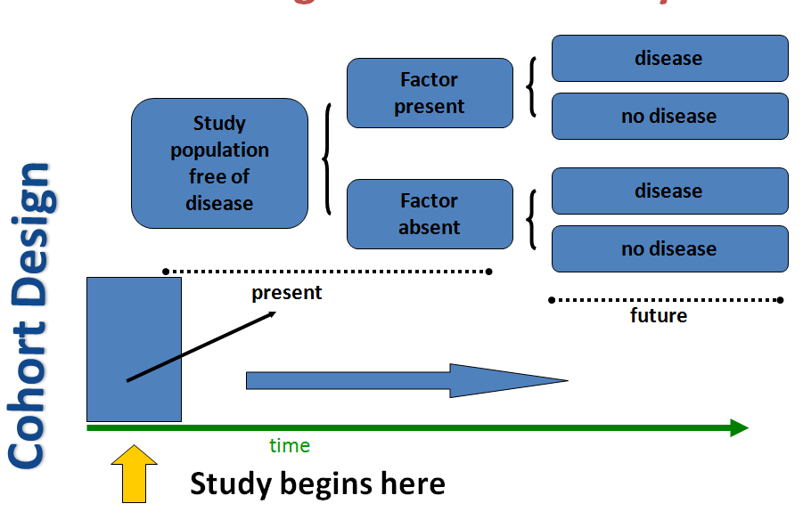
The design of cohort study

Slide 65
Definition...
BASIC ELEMENTS
  Disease free at entry
  Selected by exposure status rather than outcome
  Follow up is needed to determine the incidence of the outcome
  Compares incidence rates of exposed against unexposed group
a. EXPOSURE STATUS
  Study subjects should be disease free.
  Define study subjects using inclusion /exclusion criteria
b. POSSIBLE OUTCOME IN COHORT
  1. No disease 2. Diseased 3 Lost to follow up

Slide 66
Types
Prospective vs. Retrospective (Concurrent vs. Non-concurrent)
  Depending on temporal relationship between initiation of the study /timing of data collection/ and occurrence of the disease
  Cohort studies have been called prospective studies, but this terminology is confusing and should be avoided
    the term “prospective” refers to the timing of data collection and not to the relationship between exposure and effect

Slide 67
Prospective cohort studies
Exposure and outcome data is collected after start of the study
  cohorts Identified in the present
  exposure status or possible explanatory/prognostic factors determined in the present
  Cohorts followed-up to identify outcome
  Ascertainment of outcome done in future

Slide 68
Retrospective cohort
All the exposure and effect data have been collected before the actual study begins
This type of investigation is called a historical cohort study
Conduct
  Identify cohort in the past using records/databases
  Determine exposure or prognostic factors in the past using again records or databases then
  Identify outcome in past or present or future (in case of mixed cohort)

Slide 69
Retrospective cohort...
Costs can occasionally be reduced by using a historical cohort (identified on the basis of records of previous exposure)
This sort of design is relatively common for studies of cancer related to occupational exposures
For example, records of military personnel exposure to radioactive fall-out at nuclear bomb testing sites have been used to examine the possible causal role of fall-out in the development of cancer over the past 30 years

Slide 70
Retrospective vs. Prospective
Can be conducted more quickly and cheaply
  All relevant events have occurred
  Efficient for disease with long latency periods
Depend on availability of routine data
  Incompleteness
  Lack of data on confounding variables

Slide 71
Design and data collection
1. Define and identify cohorts
1.1. Identify population at risk
Selection of Exposed Population
  Depends on research question
  Outcome must not be rare in exposed
  Accessible and compliant subjects
    E.g., Nurse’s Health Study, Physicians
Selection of Non-exposed Group
  Similar to exposed
  Control for confounding factors

Slide 72
Design and data collection...
1.2. Screen identified subjects for the disease and omit the prevalent cases
2. Define, assess, identify and classify exposure
3. Follow-up and ascertain outcome
  Timing of outcome events-case definition

Slide 73
Sources of Exposure Information:
Self Report (interviews, surveys, etc.)
  Advantages:
    Opportunity to question subjects on as many factors as necessary.
    Good for collecting information on exposures not routinely recorded.
  Disadvantages:
    Subject to response bias (e.g. due to stigma, response expectations, etc.).
    Subject to interviewer bias
Pre-existing Records:
  Advantages:
    Inexpensive and Relatively easy to work with
    Usually unbiased -data were collected for other purposes

Slide 74
Sources of Exposure Information…
  Disadvantages:
    Exposure information may not be precise enough to address the research question.
    Records frequently do not contain data on potential confounding factors.
Direct Measurement
  Can provide objective and unbiased exposure ascertainment (e.g. blood pressure, serum samples, environmental measurements, etc.).
Death certificates (National Death Index) –for some causes
Clinical history
Medical examination (periodic re- examination of the cohort)
Hospital discharge logs

Slide 75
Analysis (Measures of Association used in cohort studies
RR=INCIDENCE EXP/INC NONEXP
Presence of association
    RR=1 – no association; RR<1 – negative association; RR>1 – positive association
    AR&AR%, PAR & %,
    P-value<0.05 – statistically significant association
Strength of association
  Weak – RR close to zero; Strong – RR far from zero

Slide 76
Advantages
  Elucidates temporal relationship between exposure and outcome (It shows temporal sequence)
it is possible to examine a range of outcomes of particular value when exposure is rare
Minimize selection bias – prospective
Can examine multiple effect of a single exposure
Allow direct measure of incidence of disease in the exposed & none exposed.
Notes:
Cohort studies allow for examination of multiple effects of a single exposure. For example, the Nurses’ Health Study has examined the relationship of oral contraceptives with breast and ovarian cancer, malignant melanoma as well as myocardial infarction.

Slide 77
Disadvantages
Time-consuming - prospective
  Require long periods of follow-up since disease may occur a long time after exposure
  Many exposures investigated are long-term in nature and accurate information about them requires data collection over long periods
Expensive - prospective
  Often involve following large number of individuals for many years
Incompleteness of records – retrospective
  Require the availability of adequate records
Loss-to-follow-up – bias
  Validity of results - seriously affected by losses to follow up
Inefficient for rare disease

Slide 78
3. Experimental studies
Individuals are allocated in to treatment and control groups by the investigator
If properly done, experimental studies can produce high quality data
They are the gold standard study design

Slide 79
Experimental…
Experimental studies can be
Therapeutic trials
  Conducted on patients
  To determine the effect of treatment on disease
2. Preventive trials
  Conducted on healthy people
  To determine the effect of prevention on risk

Slide 80
Classification of experimental studies
Based on the study subjects
  Clinical trial-usually performed in the clinical settings and the study subjects are patients.
  Field trial-used in testing medicines for preventive purpose and the study subjects are healthy people.
  Community trial- a field trial in which the unit of the study is group of people/community.

Slide 81
Experimental…
Based on the study design
  Uncontrolled trial - no control group. Control will be past experience (history).
  Non-randomized controlled trial - there is control group but allocation into either group is not randomized.
  Randomized controlled trial - there is control group and allocation into either group is randomized.

Slide 82
Experimental…
Based on Trial Objective
  Phase I – clinical pharmacologic study - trial on small subjects to test a new drug with small dosage to determine the toxic effect, safe dose range. Scale: 20-80 healthy individuals.
  ( Treatment Mechanism & Dose Finding study)
  Phase II–Safety and efficacy studies- trial on small group to determine the therapeutic effect. Scale: 100-200 patients.

Slide 83
Experimental…
  3. Based on Trial Objective
  Phase III - study on large population to test effectiveness. Randomized Controlled Trial (RCT), often it is multi-centered and needs licensing.
  Phase IV – Post marketing surveillance – Long term prospective assessment of effects & side- effects.

Slide 84
Purpose of experimental studies
When to choose an experimental design? Experimental studies are generally reserved for relatively "mature" research questions.
A lot of ground work has to be done before embarking on a clinical trial.

Slide 85
Purpose..
Experimental designs are chosen when one or more of the following conditions are fulfilled.
  The research question cannot be answered by observational studies
  Earlier observational studies have not answered the research question
  Existing knowledge is not sufficient to determine clinical or public health policy
  An experiment is likely to provide an important extension of this knowledge.

Slide 86
Experimental..
Interventions that can be evaluated are:-
  New drugs and new treatment of diseases,
  New medical and health care technology,
  New methods of primary prevention,
  New programs for screening,
  New ways of organizing & delivering health services,
  New community health programs and
  New behavioral intervention programs.

Slide 87
Experimental…
Generally, a good experimental design serves three purposes.
  Causation: It allows the experimenter to make causal inferences about the relationship between independent variables and a dependent variable.
  Control: It allows the experimenter to rule out alternative explanations due to the confounding effects of extraneous variables (i.e., variables other than the independent variables).
  Variability: It reduces variability within treatment conditions, which makes it easier to detect differences in treatment outcomes.

Slide 88
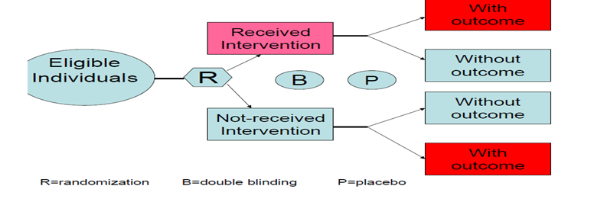
key features of experimental study design
There are two key futures of experimental of interventional study designs such as
-Investigator manipulates the condition under study
- Always prospective
Designs of experimental studies

Slide 89
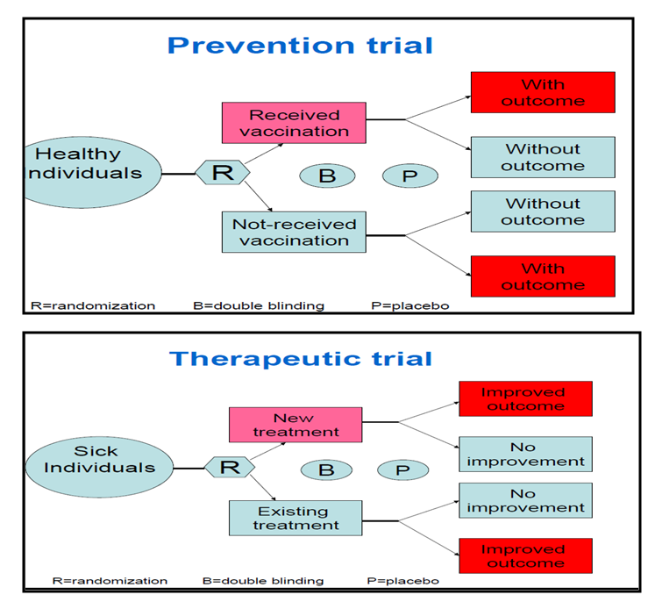

Slide 90
Experimental..
Challenges in intervention studies
Ethical issues
  Harmful treatment shouldn’t be given
  Useful treatment shouldn’t be denied
  Feasibility issues
  Getting adequate subjects
  Achieving satisfactory compliance
  Cost issues
  Experimental studies are expensive

Slide 91
Experimental…
The quality of “Gold standard” in experimental studies can be achieved through
  Randomization
  Blinding
  Placebo
Randomization: random allocation of study subjects in to treatment & control groups
  Advantage: Avoids bias & confounding
  Increases confidence on results
Blinding: Denying information on treatment/ control

Slide 92
Experimental…
Single blinding: study subjects don’t know to which group they belong
Double blinding: Care givers also don’t know to which group study subjects belong
Triple blinding: data collectors also don’t know allocation status
  Advantage: Avoids observation bias

Slide 93
Experimental…
Placebo: an inert material indistinguishable from active treatment
Placebo effect: tendency to report favourable response regardless of physiological efficacy
  Placebo is used as blinding procedure

Slide 94
Experimental..
Advantages
  Randomization minimize bias & confounding
  Blinding minimizes observer bias
  Placebo could blind patients
Disadvantage
  Generalizability limited by selection of participants
  Rare/late adverse effects of intervention may not be detected
  High ethical problem

Slide 95
Evaluation of evidence/judgment of causality
Objectives
At the end of this chapter students will be able:
  To look at validity of studies
  To describe role of chance, bias and confounding factors
  To evaluate the overall evidence for a cause-effect relationship

Slide 96
Evaluation of association
If we observe an exposure/disease association, we must consider:
1. Is the association valid?
(do the study findings reflect the true relationship between the exposure and disease?)
2. Is the association causal?
(Is there sufficient evidence to infer that a causal association exists between the exposure and the disease?)

Slide 97
Purpose of evaluation evidence
To determine if what is observed is a reflection of the truth?
Observed:
Prevalence are they true?
Incidence are there alternative
Relative Risk explanation?
Odds Ratio…

Slide 98
,
Judging Observed Association
Could it be due to selection or measurement bias?
No
Could it be due to confounding?
No
Could it be A result of chance?
Probably NOT
Could it be Causal?
Apply the criteria and make judgment of causality

Slide 99
Common problems in observed finding
Inadequacy of the observed sample
Inappropriate selection of study subjects
Inappropriate/unfair data collection methods

Slide 100
Alternative explanations for the observed association other than cause and effect relationships
The association may be the result of chance
The association may be the result of bias
Association can be the result of a confounding effect.
An apparent cause can be an effect, rather than a cause (reverse causation)
Cause can be both a cause effect (reciprocal causation)
e.g Vitamin A deficiency can cause diarrhoea or diarrhoea can cause Vitamin A deficiency

Slide 101
Validity of epidemiological studies
Validity: is a measure of the degree to which something truly represents what it is being measured.
Two types of validity - internal and external.
A. Internal validity - is the degree to which the results of the study are correct for the particular group of people studied
b. External validity (Generalizability) - is the extent to which the results of study apply to people not in it.

Slide 102
Role of chance
we can draw inferences about the experience of an entire population based on evaluation of only a sample.
One of the major problems in drawing such inference is that the play of chance may always affect the results observed simply because of random variation from sample to sample.
One of the major determinants of the degree to which chance affects the findings in any particular study is sample size
The smaller the sample , the more variability there will be in the estimates and the less likely the findings will reflect the experience of the total population.

Slide 103
Role of chance…
The larger the sample on which the estimate is based, the less variability and the more reliable the inference.
It is important to quantify the degree to which chance variability may account for the results observed in any individual study.
  This is done by performing an appropriate test of statistical significance.
  A measure that is often reported from all tests of statistical significance is the P value.
    P < 0.05 - statistically significant.
    P> 0.05 – no statistically significant association ( chance can not be excluded as a likely explanation)

Slide 104
Hypothesis testing (test of statistical significance)
Make explicit statement of hypothesis
Null Hypothesis
  H0: P1 = P2 (p= proportion developed outcome of interest)
  H0: RR = 1
Alternate Hypothesis
H1: P1 ≠ P2
H1: RR ≠ 1

Slide 105
Hypothesis testing
Perform Test of Significance
Use appropriate test
P-value ≤ 0.05 → Chance is unlikely explanation
  Reject the null hypothesis
  There is Statistically significant difference
It is always advisable to report the actual P value rather than merely that the results did or did not achieve statistical significance.
confidence interval (CI) is far more informative measure than P value to evaluate the role of chance

Slide 106
Confidence interval
Provide information that p-value gives.
  If null value is included in a 95% CI, by definition the corresponding P-value is >0.05.
Indicate the amount of variability (effect of sample size) by the width of the CI
  This information can not be obtained from p-value.

Slide 107
Interpretation of CI
Wide CI
↓
indicate greater variability
↓
suggest inadequacy of the sample size
Particularly important in interpreting non-significant results
Narrow CI→ suggest that truly there is no association
Wide CI→ suggest inadequacy of sample size to have adequate statistical power

Slide 108
Role of bias
Bias - is any systematic error in the design, conduct, or analysis of a study that results in a distorted estimate measurement
The key word in the understanding of the concept of bias is “different”.
Two main types of bias:
A. Selection bias
B. Information (Observation) bias

Slide 109
Selection bias (example)
Invitational (who gets invited into the study?)
Acceptance (who accepted the invitation?)
  Loss to follow-up
  Volunteer/Compliance bias
  Non-response bias
Selection bias is a particular problem in case control and retrospective cohort studies

Slide 110
Selection bias
1. Diagnostic bias
Diagnostic bias occurs when a disease is more likely to be diagnosed in some one with exposure to a suspected risk factor.
  For example women who take oral contraceptives (OCs) may be screened more often for breast cancer than women who do not take OCs because of the suspected link between OCs and breast cancer.
  This would result in breast cancer being diagnosed more readily in those who are exposed to Ocs.
2.Self selection/ Volunteer bias/ Compliance bias
People who accept to participate in a study, or people who refuse to participate are often quite different from the general population.

Slide 111
Selection bias…
3. Non-response bias
  It reduces the effective sample size, resulting in loss of precision of the survey estimates.
4. Loss to follow up
  It is major source of bias in cohort &intervention studies
  it is also a problem in intervention studies before outcome of interest occurs
5. Healthy worker bias
  Bias in occupational health studies which tend to underestimate the risk associated with an occupation due to the fact that employed people tend to be healthier than the general population

Slide 112
Ways of minimizing selection bias
Population-based studies are preferable
Avoid the inclusions as study subjects of people who have volunteered on their own
In case-control , select several different control groups.
In hospital-based case control study, controls are usually selected among patients with disease other than the disease studied.
keep losses to follow-up to an absolute minimum.
    For those who are lost, an assessment of as much outcome data as possible.

Slide 113
Ways of minimizing…
will lie.
Loss to follow up
  Calculate estimates of the exposure-disease association assuming the most extreme situations.
  Assumptions:
    all those who were lost to follow up developed the outcome of interest
    none developed the outcome of interest.
The results of these calculations provide a range within which the true association

Slide 114
2. Observation bias/information bias
Refers to bias which arises during the data collection process
It occurs b/c of mistakes in categorizing study subjects with respect to their exposure or disease status
1. Investigator bias/ Interviewer bias/ Observer bias
  Occurs when investigators collect information differently in different comparison groups
2. Response bias/ Recall bias
  Occurs as a result of difficulty to recall prior exposures

Slide 115
Information bias …
3. Social desirability bias
  Occurs because subjects are systematically more likely to provide a socially acceptable response.
4. Placebo effect
  In experimental studies which are not placebo controlled, observed changes may be ascribed to the positive effect of the subjects belief that the intervention will be beneficial.
5. Hawthorn effect
  Refers to the change in the dependent variable which may be due to the process of measurement or observation itself

Slide 116
Ways of minimizing information bias
Blinding: Three types of blinding
  Single blind
  Double blind
  Triple blind

Slide 117
Ways of minimizing…
2. Use of Placebo
Placebos are inert treatments intended to have no effect other than the psychological benefit of offering treatment.
  Can only be used if there is no accepted treatment for the condition under study.
Use of placebo minimizes the bias in the ascertainment of both subjective disease outcomes and side effects.
  It facilitates that both groups in the study gain equal attention.
Placebo effect: tendency for individuals to report favourable response to any therapy regardless of the physiologic efficacy of what they received.

Slide 118
Ways of minimizing…
same standard procedures, instruments, questionnaires, interviewing techniques should be used for data collection in both comparison groups
3. Classification of study subjects according to their outcome & exposure status should be based on the most objective & accurate methods available
4. when exposure status is determined by interview, it should be assessed in several different ways for both groups

Slide 119
Roles of confounding
Confounding is distortion of the estimated effect of an exposure on an outcome, caused by the presence of an extraneous factor associated both with the exposure and the outcome,
Confounding variable, confounder is a variable that can cause or prevent the outcome of interest, is not an intermediate variable, and is associated with the factor under investigation.

Slide 120
,
CONFOUNDING
E
Confounding IS
present
D
CF
Confounding NOT
present
E
?CF
D

Slide 121
Role of confounding…
Example of confounding effect.
An observed association between consumption of coffee and increased risk of MI could be due, at least in part, to the effect of cigarette smoking, since coffee drinking is associated with smoking and, independent of coffee consumption, smoking is a risk factor for MI.

Slide 122
Effect of confounding
Totally or partially accounts for the apparent effect
Mask an underlying true association
Reverse the actual direction of the association
Confounding must be dealt as quantitative problem; the amount of confounding rather than mere presence or absence that is important to evaluate.

Slide 123
Control for confounding variable
In the design:
  Randomization
  Restriction
  Matching (at design and analysis stage)
During analysis:
  Standardization
  Stratification
  Multivariate analysis

Slide 124
Epidemiological criteria (guidelines) for causality
An association rarely reflects a causal relationship but it may.
Criteria for causality provide a way of reaching judgements on the likelihood of an association being causal.

Slide 125
Hill’s Criteria for Causal Relation or JUDGMENT OF CAUSALITY /Brand – hill Criteria/
1. Strength of the association
  Refers to RR: the larger the RR, the greater the likelihood that the factor is causally related to the outcome
2. Dose-response relationship
  risk of disease increases with increasing exposure with the causal agent
3. Consistency of the relationship
  This criterion requires that an association uncovered in one study persist on testing under other circumstances, with other study population, and with different study methods
4. Temporal relationship
  exposure to the suspected factor must antedate the onset of disease

Slide 126
hill`s criteria for causal relation
5. Specificity of the association
  the association is more likely causal if a single exposure is linked to a single disease
6. Biological plausibility (coherence with existing information)
  Additional support for the causal nature of an association exists if a causal interpretation is plausible in terms of current knowledge about the factor & dx
7. Prevention
  If the exposure is a cause of the disease, then eliminating the exposure (or modifying host response to the exposure, for example through immunization ) should be followed by a decrease in the incidence rate of the disease

Slide 127
Judging the causal basis of the association
No single study is sufficient for causal inference
It is always necessary to consider multiple alternate explanations before making conclusions about the causal relationship between any two items under investigation.
Causal inference is not a simple process
  consider weight of evidence
  requires judgment and interpretation

Slide 128
Screening

Slide 129
screening
  At the end of this section students will be able to;
  Define Disease Screening
  Identify types of screening
  calculate and differentiate between sensitivity, specificity, positive and negative predictive values of a diagnostic test
  Recognize considerations in the Establishment of Screening Recommendations and Programs
  Recognize how to evaluate a screening program

Slide 130
screening
Definition:
Screening refers to the presumptive identification of a disease/defect by application of tests, examinations or other procedures in apparently healthy people.
Screening is an initial examination
Screening is not intended to be diagnostic

Slide 131
Aims of screening program
Changing disease progression efficiently
Altering natural course of disease
Protecting society from contagious disease
Allocating resources rationally
Selection of healthy people for job
Studying the natural history of disease

Slide 132
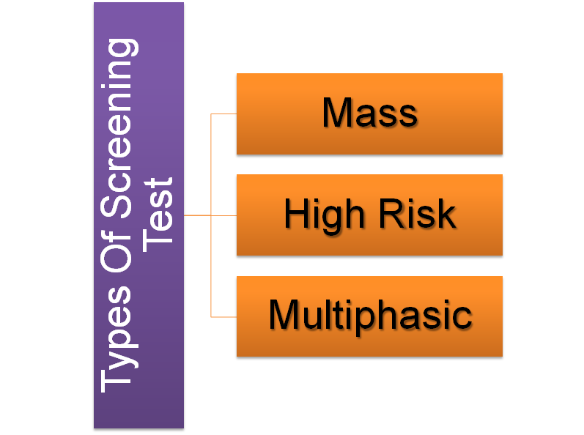
Types of screening

Slide 133
Population approach(mass)
Not Cost Effective
Potential To Alter The Root Cause Of Disease
Large Chance To Reduce Disease Incidence
Small Benefit To The Individual
Poor Subject Motivation

Slide 134
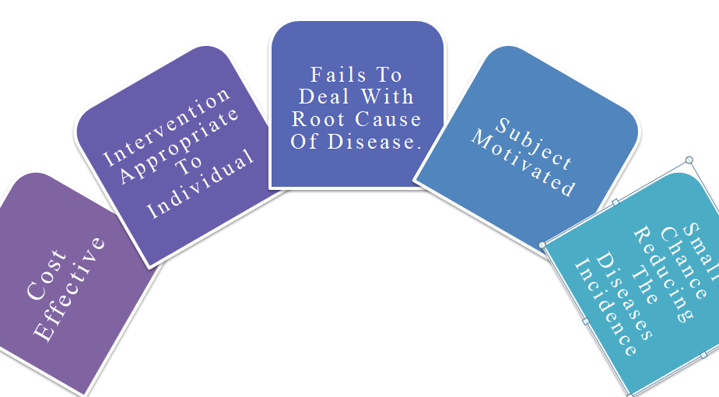
High risk strategy

Slide 135
Multiphasic approach
The application of two or more screening tests in combination to large number of people at one time than to carry out screening tests for single individual.
The procedure may also include health questionnaire, clinical examination and a range of measurements and investigation.

Slide 136
Criteria selecting disease for screening
Severity- The disease should be serious
Treatment- Early treatment should be more beneficial
Prevalence- Pre-clinical Prevalence should be high

Slide 137
Criteria For Successful Screening Test:
If a test is available, should it be used?
Successful Screening
Criteria for Disease
Criteria for Test

Slide 138
Criteria For Successful Screening Test:
Criteria for Disease:
  Present in population screened.
  High burden &of high public health concern.
  Screening +Intervention must improve outcome.
  Known natural history of the disease.

Slide 139
Criteria For Successful Screening Test:
Criteria for Test:
  Reliable.
  Valid.
  Simple and inexpensive.
  Very safe.
  Acceptable to subjects and providers.
  Cost-effective.
  Exit strategy.

Slide 140
Criteria For Successful Screening Test:
  Exit strategy:
    Facilities for diagnosis and appropriate treatments should be available for positive subjects.
    Ethically not acceptable to offer screening without available management.

Slide 141
Criteria For Successful Screening Test:
RELIABILTY:
What Is The Definition Of Reliability ?
What Are The Causes Of Unreliability ?

Slide 142
Criteria For Successful Screening Test:
Definition of Reliability:
  Repeatability, Reducibility, Precision.
  Getting the same results, when the test repeated in same target individuals in the same settings.

Slide 143
Criteria For Successful Screening Test:
Causes of unreliability:
  Observer variation.
  Subject variation – Biological.
  Technical method error variation.

Slide 144
Criteria For Successful Screening Test:
ACCEPTABILITY:
  The test should not be:
    Painful.
    Unsafe.
    Discomforting /Embarrassing.
    Socially/ believes not accepted.

Slide 145
Criteria For Successful Screening Test:
VALIDITY:
  Ability of the test to distinguish between who has the diseases and who does not.

Slide 146
Validity
Sensitivity
Specificity
Predictive Value
Yield

Slide 147
 | DISEASE |  |  | TOTAL
TEST |  | Diseased | No disease
 | Test +ve | a | b | a+b
 | Test -ve | c | d | c+d
TOTAL |  | a+c | b+d | a+b+c+d

Slide 148
Sensitivity
 | DISEASE |  |  | TOTAL
TEST |  | Diseased | No disease
 | Test +ve | a | b | a+b
 | Test -ve | c | d | c+d
TOTAL |  | a+c | b+d | a+b+c+d
Ability of the test to truly identify those who have the disease
Sensitivity= a/(a+c)
True Positive

Slide 149
Sensitivity
[[A 90% Sensitivity means that 90% of the diseased people screened by the test will give a “true positive” and the remaining 10% a “false negative results”]]
Positive test and have the disease.
Negative test and have the disease.

Slide 150
Specificity
 | DISEASE |  |  | TOTAL
TEST |  | Diseased | No disease
 | Test +ve | a | b | a+b
 | Test -ve | c | d | c+d
TOTAL |  | a+c | b+d | a+b+c+d
The ability of the test to correctly identify those who do not really have the disease
Specificity=
d/(b+d)
True
Negative

Slide 151
Specificity
[[A 90% Specificity means that 90% of the non diseased people screened by the test will give a “true negative” result, and the remaining 10% a “false positive results”]]
Negative test and do not have the disease.
Positive test and do not have the disease.

Slide 152
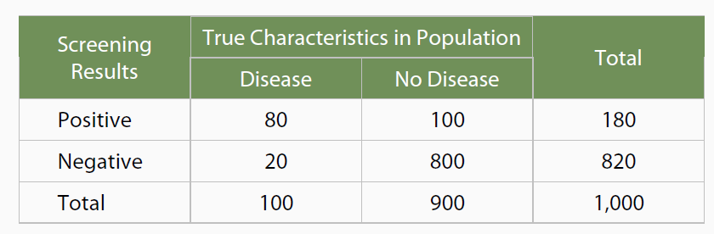
Assume a population of 1,000 people 100 have a disease 900 do not have the disease A screening test is used to identify the 100 people with the disease
Sensitivity = 80/ 100 X 100= 80%
Specificity = 800/ 900 X 100 = 88%

Slide 153
Practical Example
 | Brain Tumor
EEG Results | Present | Absent
Positive | 36 | 54,000
Negative | 4 | 306,000
Total | 40 | 360,000
Sensitivity = 36/40 X 100 = 90%
Specificity = 306,000/360,000 X 100 = 85%

Slide 154
 | DISEASE |  |  | TOTAL
TEST |  | Diseased | No disease
 | Test +ve | a (True Positive) | b (false Positive) | a+b
 | Test -ve | c (false Negative) | d (True Negative) | c+d
TOTAL |  | a+c | b+d | a+b+c+d

Slide 155
Predictive value
Positive Predictive value
Proportion of Individuals with positive test really have the disease
PPV=a/(a+b)
Negative Predictive value
Proportion of Individuals with negative test really have no disease
NPV= d/(c+d)
 | DISEASE |  |  | TOTAL
TEST |  | Diseased | No disease
 | Test +ve | a | b | a+b
 | Test -ve | c | d | c+d
TOTAL |  | a+c | b+d | a+b+c+d

Slide 156
Practical Example
Screening Test Results | Diagnosis |  | Total
 | Diseased | Not Diseases
Positive | 40 | 20 | 60
Negative | 100 | 9840 | 9940
Total | 140 | 9860 | 10,000
Sensitivity = 40/140 X100 = 28.57%
Specificity = 9840/9860 X100 =99.79%
Positive predictive value = 40/60X100 = 66.66%
Negative predictive value = 9840/9940X100 = 98.9%

Slide 157
Effects on Predictive Value
Prevalence Increases | PPV Increases; NPV Decreases
Prevalence Decreases | PPV Decreases; NPV Increases
Specificity Increases | PPV Increases
Sensitivity Increases | NPV Increases

Slide 158
Prevalence of a disease
The proportion of individuals with a disease
Prior/pre-test probability of a disease
Prevalence = P (D⁺)
= (a+c)/n

Slide 159
yield
Yield –the amount of previously unrecognized disease that is diagnosed and brought to treatment as a result of the screening program.
Proportion of cases detected by the screening program
Yield = a/n

Slide 160
Relation Between Sensitivity & Specificity
Sensitivity
Specificity
False Positive

Slide 161
Relation Between Sensitivity & Specificity
Specificity
Sensitivity
False Negative

Slide 162
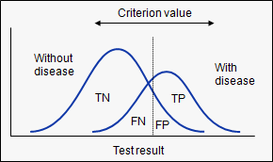
Relation Between Sensitivity & Specificity

Slide 163
Risk of Screening
True Positive
Labelling Effect
False Positive
False Negative
Delayed Diagnosis
Delayed Intervention
Anxiety
Fear From Future Test
Monetary Expenses
Complications

Slide 164
Multiple testing
Parallel testing:
  Tests are given concurrently
  At least one positive indicates disease
  Results in
    Greater sensitivity
    Increased PVN
    Decreased specificity

Slide 165
Multiple testing
Serial testing:
  Tests are administered sequentially
  All positive indicates disease
  Results in
    Lower sensitivity
    Increased specificity
    Increased PVP

Slide 166
Evaluation of screening program
Evaluation of a screening program involves consideration of two issues
Feasibility: Determined by acceptability of the screening program
2. Effectiveness: Determined by the outcome of the screening program

Slide 167
generally
In general, a screening test should be
  Reliable & valid
  Sensitive & specific
  Simple & acceptable
  Effective & efficient

Slide 168
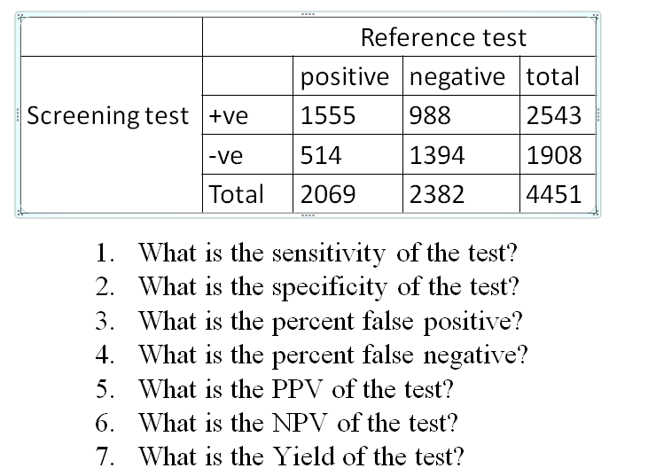
example

Slide 169
Epidemiological Surveillance

Slide 170
Learning objectives
At the end of this lesson you will be able to
  Define and differentiate surveillance Vs Survey
  Understand and use case definition
  State at least 5 uses of disease surveillance information.
  Identify types of surveillance.
  Describe steps in conducting surveillance.

Slide 171
Epidemiological surveillance
Surveillance is the continuous monitoring of disease and other health-related events relevant to the prevention and control of disease within the population.
The ongoing systematic collection, analysis, and interpretation of data essential to the planning, implementation, and evaluation of public health practice, closely integrated with the timely dissemination of these data to those responsible for prevention and control.(CDC)

Slide 172
Surveillance..
surveillance
survey
It is relatively cheap (for health department). Can often use existing system and personnel
Allow monitoring of trends of diseases over time
Ongoing collection allows to use enough cases for study
Quality control may be the major problem
May not provide representative data
It is costly, needs to use by hiring trained once
Represents only single point in time and informs little of anything about change in time
More in-depth data could be collected
More accurate assessment of true incidence and prevalence
Can identify those which don’t warrant medical care

Slide 173
Purpose of surveillance
The main purposes of surveillance are:
  To enable the early recognition, investigation, and control of outbreaks.
  To provide baseline information for priority setting, planning and evaluating disease control programs.
  To provide information for understanding the distribution of disease by time, place, and person, so as to provide clues for the investigation of disease etiology, again for the purpose of more effective control.

Slide 174
Uses of surveillance
Disease surveillance information is useful for:
  Estimating the magnitude of a problem
  Determining the geographic distribution of illness
  Portraying the natural history of a disease
  Detecting epidemics or defining a problem
  Generating hypotheses, stimulating research
  Evaluating control measures
  To identify changes in infectious agents, host and environmental factors
  Detecting changes in health practices
  Facilitating planning

Slide 175
Types of surveillance
Surveillance is based on two mechanisms for the detection of the disease
  Passive case detection- this involves cases detected in the course of the normal operation of the health service, through the self-reporting of patients to the health institutions.
  Active case detection- this involves an active search for cases, by special surveys or other methods outside of the routine health service activities.

Slide 176
Types of surveillance…
Based on these two mechanisms for the detection of diseases, we have three forms of surveillances:
1.Passive surveillance- this is the mechanism for routine surveillance, based on passive case detection, and on the routine recording and reporting system.
Surveillance where reports are awaited and no attempts are made to seek reports actively from the participants in the system. (Provider-initiated, based on a known set of rules and regulations)

Slide 177
Advantages of passive surveillance
Covers a wide range of problems
Does not require special arrangement
It is relatively cheap
Covers a wider area

Slide 178
Disadvantages of passive surveillance
The information generated is to a large extent unreliable, incomplete and inaccurate
Most of the time, data from passive surveillance is not available on time
Most of the time, you may not get the kind of information you desire
It lacks representativeness of the whole population since passive surveillance is mainly based on health institution reports

Slide 179
Types of surveillance..
2.Active surveillance- this refers to any surveillance activity outside of the routine system, undertaken for the further investigation of diseases outbreaks and other occurrences of public health importance.
Surveillance where public health officers seek reports from participants in the surveillance system on a regular basis, rather than waiting for the reports. e.g. by telephoning/contacting each participant twice a week, monthly... (Health Department-initiated)

Slide 180
Active surveillance
In contrast to passive surveillance:
usually limited to specific diseases over a limited period of time, such as after a community exposure or during an epidemic.
Can not be used for routine purposes
relatively expensive
Usually complete/accurate

Slide 181
Active surveillance
Indications of Active surveillance:
For periodic evaluation of ongoing programs
E.g. HIV/AIDS, EPI...
For programs which have time limit of operation
E.g. Small pox
With the occurrence of unusual situations:
  when a new disease/event discovered
  when investigating a new mode of transmission
  when a high-risk period is recognized
  when a disease appears in a new geographic area or found to affect a new subgroup of the population
  when previously eradicated disease reappear or low incidence disease occur at a higher level of endemicity

Slide 182
Active surveillance
The advantages of active surveillance
  The collected data is complete and accurate
  Information collected is timely.
The disadvantages of active surveillance
  It requires good organization
  It is expensive
  It requires skilled human power
  It is for short period of time(not a continuous process)
  It is directed towards specific disease conditions

Slide 183
3. Sentinel Surveillance System
Uses a pre-arranged sample of reporting sources to report all cases of one or more conditions.
Means of monitoring trends of health events in chosen population groups and chosen sites in a regular and consistent (Uniform) way.
Need not be representative:
  However it is very important to keep sites, facilities, procedures and populations remain similar
Selection of study population must be with minimal bias
Sufficient demographic data must be collected to detect changes in population composition

Slide 184
Main purpose of sentinel surveillance
To detect changes
To direct and focus control efforts
To develop intervention strategies
To promote further investigations
Provide the basis for evaluating preventive strategies and activities

Slide 185
Features of good surveillance system
Uses a combination of passive and active mechanisms
Collects the minimum data in a simplest possible way
Collects data in a manner useful for the workers who collect the data (To assure quality and enhance compliance)
Timely reporting
Provide timely and comprehensive response/action (Action targeted to case detection and treatment and as well as to the control of the disease)
Incorporate strong laboratory services for accurate
diagnosis

Slide 186
Critical information in surveillance
Person: Age, sex
Time: onset of disease, reporting period
Place: woreda, region
Risk factors
Number of cases (magnitude)
Treatment outcome: deaths, recovery (seriousness)
Mode of treatment: inpatient/outpatient

Slide 187
Most common limitation in surveillance system
Under reporting
Lack of representativeness of reported cases
Lack of timeliness
Inconsistency of case-definitions
Lack and shortage of qualified staff
Lack of motivation

Slide 188
The Most Common Means of Strengthening Surveillance System
Improving awareness of practitioners
Simplification of the process of reporting
Frequent feedback to those reporting
Widening the "net"
(e.g. obtaining reports from laboratories or schools, rather than relying on physicians)
Using active (rather than passive) surveillance.
Remember to "share the data, share the responsibility, and share the credit"

Slide 189
Selection of disease for surveillance
All diseases may not be included in surveillances:
The importance of a health event to be included in surveillance system, it should be assessed through certain criteria

Slide 190
Criteria of inclusion in surveillance
The current impact of the health event
  Having high incidence/ prevalence
  Mortality(overall and age-specific)
  Morbidity (hospitalization, disability, top morbidity)
  Severity (case fatality)
  Health care cost
  Eg. Malaria, pneumonia, TB, HIV/AIDS

Slide 191
Criteria inclusion in surveillance
Having Epidemic Potential
  (Eg. measles, cholera, meningitis)
  Surveillance internationally required
  (Eg. plague, yellow fever, cholera)
  Having available and effective control and prevention intervention
  (Eg. Schistosomiasis, onchocerciais, trypanosomiasis)
Can easily be identified using simple case definitions
Having intervention program already found in the country (Eg. IMCI, EPI)

Slide 192
List of priority disease in Ethiopia
Epidemic Prone diseases
  Cholera
  Bloody diarrhea
  Measles
  Meningitis
  Plague
  Viral hemorrhagic fever
  Yellow fever
  Typhoid fever
  Relapsing fever
  Endemic typhus
  Malaria
Diseases eradication targeted
  Polio (AFP)
  Dracunculosis (Guinea worm)
  Leprosy
  Neonatal tetanus
Public health important diseases
  Child pneumonia
  Diarrhea in children
  New AIDS cases
  Oncocerciasis
  STDs
  TB
  Rabies

Slide 193
Once diseases for surveillance are selected we should do the following items
Case definition of diseases included in the surveillance
Determine the population under surveillance
Determine time period of data collection
  (immediately, weekly, monthly)
Determine source of data, who should report
Determine how data are handled (confidentiality)

Slide 194
Once diseases for surveillance are selected we should do the following items
Epidemiologists ask,
Who gets the disease?
In what frequency is?
Is the frequency changing over time?
How does the frequency compare between population?”
Answering such questions requires:
  a case definition and
  estimating comparable disease frequency measures

Slide 195
Case definition
Case definition
  Standard set of criteria for deciding whether an individual should be classified as having the health condition of interest
It includes
  – Criteria: Signs and symptoms with or without a laboratory test
  – Restriction by time, place and person can be done depending on the nature of the disease
• Classification of case definition
  1. Confirmed: a case definition by appropriate lab. Test
  2. Probable: a case with typical clinical features of the disease without laboratory confirmation
  3. Possible/ Suspect: a case with few of the typical clinical features.
Use case definition consistently!!

Slide 196
Case definitions…
A case considered epidemiologically linked
to a laboratory-confirmed case;
“ if at least one case
  ….in the chain of transmission
  …..is laboratory confirmed.

Slide 197
Case definition
Example1: Measles (Rubella) case definition
The CDC has established case definitions for public health reporting purposes.
The CDC clinical case definition requires at least 3 characteristics to be present in a clinical case,
…rash, fever and cough, coryza or conjunctivitis
A patient characterized clinically without any laboratory testing

Slide 198
Case definition
Example1: Measles (Rubella) case definition
With laboratory results, if any of these four criteria met, the case of measles is laboratory confirmed.
  positive serological test,
  a rise in the measles antibody level,
  detection of measles-virus-specific nucleic acid
  isolation of the virus from the actual specimen

Slide 199
2.Determain population under surveillance
A surveillance system remains effective when it is continuously assessed
Periodically updating information about the catchment population is necessary
Important target groups usually include:
Under-5 years children
Women of child bearing age
People living in refuge etc..
(prepare detailed demographic data)

Slide 200
3. Time period of data collection
It is useful to identify problems and solve timely
There are three periods of reporting
  Immediate reporting:
  For disease that are not considered as endemic and are considered epidemic
  Eg, covid 19, cholera, plague, viral hemorrhagic fever, polio, yellow fever
  Suspected epidemic when a threshold is crossed

Slide 201
3. Time period of data collection
  Weekly reporting:
  For epidemic-prone diseases
  Eg, malaria, meningitis, dysentery, relapsing fever, typhoid fever, typhus
  On monthly bases
  For routine surveillance
  Eg, TB, leprosy, AIDS cases

Slide 202
Steps in surveillance
  Data collection:
  Sources include
  Mortality Report ( vital statistics)
  Morbidity Report ( notify able diseases report, Hospital report, Lab report etc)
  Epidemic Report
  Reports of lab utilization
  Reports of individual case investigation
  Special surveys
  Information on animal reservoir and vectors
  Demographic data
  Environmental data

Slide 203
Steps in surveillance
  Analysis:
  include
  Analyzing by time
  Analyzing by place
  Analyzing by person
  Interpretation
  Dissemination of surveillance data
  Link to public health action

Slide 204
OUTBREAK INVESTIGATION
AND
MANAGEMENT

Slide 205
Objectives
At the end of this lesson you will be able to
  use common terms in outbreak investigation appropriately
  develop an outbreak investigation plan
  describe a potential outbreak with regard to person, place and time.
  construct and interpret an epi-curve to describe the course of an outbreak
  practically use an outbreak management principles

Slide 206
Patterns of disease
Endemic-usual level of morbidity
  An endemic disease is a disease that occurs in a population with predictable regularity and with only minor deviations from its expected frequency of occurrence
  E.g. - Tb, Malaria, Typhoid, dysentery, HIV, Malnutrition, Meningitis, leshmaniasis, Trachoma, Scabies, Schistosomiasis, Onchocerciasis in Ethiopia
Patterns of endemicity
  Additional terms can be used to describe endemic diseases according to their frequency of occurrence:
  E.g. – Malaria – Holoendemic, Hyperendemic, Mesoendemic, Hypoendemic

Slide 207
Endemic
Hyperendemic is an endemic disease that affects a high proportion of the population at risk
Holoendemic-situation in which there is high level of infection among child population beginning early in life and adults show less incidence e.g. malaria
Mesoendemic is an endemic disease that affects a moderate proportion of the population at risk.
Hypoendemic is an endemic disease that affects a small proportion of the population at risk.

Slide 208
Epidemic
Definition - occurrence of health related condition in excess of its expected frequency in a given population
  Health related condition-infectious and non-infectious conditions
  Expected frequency-magnitude for the given period, place and population from previous data
  E.g. - Malaria, Measles, Meningitis, Cholera , Shigelloses, Diarrhea with dehydration, Plague, Typhoid fever, Relapsing fever, Epidemic typhus
Pandemic- global epidemic
  E.g. - HIV/AIDS, covid 19

Slide 209
Epidemic have the following patterns
Sporadic-irregular intervals E.g. – Plague
Periodic/Cyclic-regular intervals E.g. –measles, diarrhea,
Secular-slow changes over time E.g. – lung ca
Epidemic lasting long may remain endemic
Endemic disease can turn out to be epidemic
  Due to increase in susceptible, ecological changes, increase in carries, new strains

Slide 210
Epidemics…
Outbreak: is an epidemic of shorter duration covering a limited area.
  It is usually used interchangeably with Epidemic.
E.g. Outbreak of gastroenteritis after sharing a common meal at an event
Cluster: is an unusual aggregation of health events in a given area over a particular period.
  The emphasis in case of a cluster is aggregation in a certain locality than the actual number of cases.

Slide 211
Types of epidemics
Two principal types are well known; these are the common source and propagated/progressive
The two types can be distinguished by plotting an epidemic curve/time curve/
An epidemic, which shows the features of both types, is referred as mixed

Slide 212
Types of epidemics
1 . Common source epidemics
Caused by exposure of a group of people to a common noxious influence, such as an infectious agent or a toxin.
  Depending on duration of exposure:
    Point source Vs Common source with continued exposure
If the exposure to agent and simultaneous all with develop the disease within one incubation period referred as point source epidemic.
Rapid rise and fall of an epidemic curve suggests a point source epidemic called long normal distribution.

Slide 213
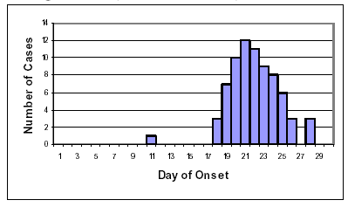
Types of epidemics…
Point source epidemics
  Exposure is brief and simultaneous
  Cases develop within one incubation period
  E.g. - food-borne outbreak
  Epidemic curve-rapid rise and fall of number of cases

Slide 214
Types of epidemics…
Continuous common source epidemic mainly wide peak in the epidemic curve, because of the range of exposures and range of incubation periods.
Intermittent common source-results in particular patterns of the epidemic curve that reflects the intermittent nature of the epidemic.

Slide 215
Types of epidemics…
Common source epidemic with continuous or intermittent exposure
  Exposure continues over a period of time
  Lasts for more than one incubation period
  E.g. – Outbreak of hepatitis A from exposure to food handler intermittently or continuously
  Epidemic curve-extended and irregular

Slide 216
Types of epidemics…
2. Propagated /progressive epidemics
Outbreak of this type can occur through direct person-to-person transmission
or the transmission could pass through a vector from infected to healthy person.
The epidemic curve would have a successive series of peaks reflecting increasing numbers of cases in each generation.

Slide 217
Types of epidemics…
Propagated/Progressive epidemics
  Occur as a result of transmission from person to person
  Lasts for more than one incubation period
  E.g. – Measles, Malaria, Shigellosis
  Epidemic curve-initial slow rise, succession of several peaks and usually sharp fall

Slide 218
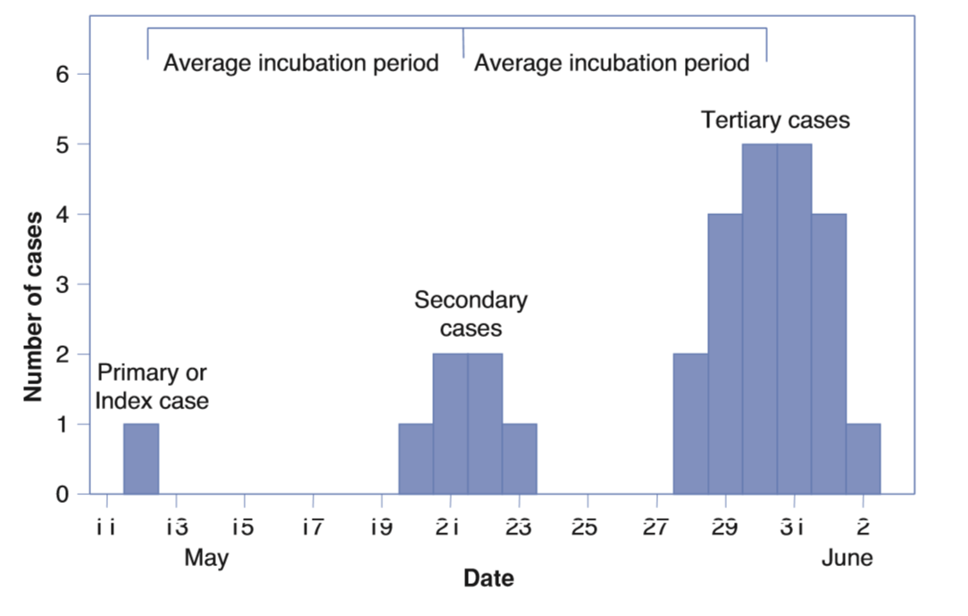
The epidemic curve for a propagative epidemic.

Slide 219
Types of epidemics..
Mixed
  Point source epidemic may be followed by propagated epidemic
  E.g. – Shigelloses epidemic following exposure to common contaminated food supply followed by person-to-person spread

Slide 220
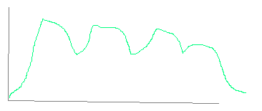
Mixed epidemics
Time
Intermittent common
Source- no clear pattern, may be a mixture of the two( e.g. common source=>second day=>person to person spread

Slide 221
Investigation and control of outbreak
Why do we investigate outbreaks?
Control and prevention measures
Evaluation of control programs e.g. EPI
Opportunity for research
Training opportunity
Public, political or legal concern

Slide 222
Epidemic investigation
Epidemic investigations: study of outbreaks, in local populations, to identify agent(s), transmission mode(s), and possible control measure(s)
Investigation-determining the causes so as to control the epidemic
  Causes:
    Agent
    Source
    Mode of transmission
    Contributing factors

Slide 223
Steps in epidemic investigation
1. Prepare for fieldwork
A. Investigation related preparation
  Specific knowledge
  Supplies and equipment
  Literature review
B. Administration related
  Observe all administrative procedures such as transportation and personal.
C. Consultation
  Clarify your and your team role in the field.
  Identify local contacts at the site.

Slide 224
Steps…
2. Verify the existence of an epidemic
Verify the diagnosis
Case definition
Is a standard set of criteria for deciding whether an individual should be classified as having the health condition of the interest.
Types of the case definition:-
  Confirmed/definite-a case with lab. Verification.
  Probable –a case with typical clinical features of the disease without lab. Confirmation.
  Possible-a case presented with fewer of the typical clinical features

Slide 225
Steps 2…
Compare expected cases vs. observed
Excess cases may be actual/real or artifactual
Actual:
  Change in incidence
  Change in age composition
  Catastrophes
  Duration of illness
Artifactual:
  Change in diagnostic methods
  Change in case detection
  Change in reporting
  Change in disease classification/ death
  Change in population count

Slide 226
Steps…
3. Describe the epidemic with respect to time, place and person.
  Epidemic curve-plots the cases by the time of onset and provides a time frame for the outbreak investigation.
  Spot map-plots cases by location and shows the geographic spreads of cases.
  Attack rates-calculate rates of illness in population at risk.

Slide 227
Steps…
4. Formulate and test hypothesis
Formulate hypothesis based on your characterization of the epidemic by time, place and person
The hypothesis should address:-
    The source of the agent
    The mode of transmission
    The exposure that cause the disease
    Determine the type of epidemic
    Define the population at risk

Slide 228
Steps..
5. Search for additional case.
Epidemiological – case control (healthy individuals from same population)
Laboratory analysis
Medical examination
6. Do descriptive epidemiology and describe the epidemic by PPT and do data analysis
7. Make a decision on the hypothesis tested
8. Intervention and follow up.
9. Report of the investigation/communicating finding

Slide 229
Managing outbreak/epidemics
Measures directed against the reservoir
    Domestic animals
        Immunization
        Distraction of infected animals
    Wild animals
      Post-exposure prophylaxis
    Humans
      Removal of the focus of infection.
      Isolation of infected person
      Treatment
      Disinfection of contaminated object
Quarantine –is the limitation of freedom of movement of apparently healthy persons or animals who have been exposing to a case of infectious diseases

Slide 230
Managing outbreak/epidemics
Measures that interrupt the transmission of organisms.
    Purification of water.
    Pasteurilization of milk.
    Inspection procedures designed to ensure safe food supply
    Improve housing condition
Measures that reduce host susceptibility.
    Active immunization
    Passive immunization
    Chemoprophylaxis

Slide 231
Activity
Describe management of covid 19?

Slide 232
Thank you!!!

