Slide 1
Nutrition during infancy and young child
By: Yidersail H.
Debremarkos university

Slide 2
Contents
Growth and development
infant and young child feeding
  Breast feeding
  Complementary feeding
infant feeding on the occasion of HIV/AIDS

Slide 3
Assignments
G1.1.The role of baby friendly hospital initiatives on reduction of under nutrition during perinatal periods.
2. Assess the nutritional status of pregnant women and assess the feeding habits of 15 women at Debre Markos HC.
G3. 1. Birth defects related to nutrition metabolism errors
2. assess the nutritional status of infants and assess the feeding habits of 15 infants at Wuseta HC.
G4.1. Harmful traditional practices that influence maternal and child feedings.
2. assess the nutritional status of children age less than five years for at least 20 children at Hidase health center
4. 1. Common Nutritional Problems and Concerns infant and children
2. assess the nutritional status of pregnant women and assess the feeding habits of 15 women at Gozamin HC.

Slide 4
Infant growth an development
Neonates
Neonatal Nutrition is important
  to meet the metabolic requirements of developing organ systems,
  satisfy normal growth requirements and
The Nutritional requirements of the term neonate differ from those of the preterm neonate(<37 weeks )
Preterm babies doesn’t have enough nutrient store so they need supplement
Neonates need 100–120 (cal/ kg/d) in order to grow properly

Slide 5
Infant growth an development
Infancy is a period a from birth to the end of the first year of life.
  Full-Term Infants -Infants born between 37 and 42 weeks of gestation.
  Preterm Infants- Infants born before 37 weeks of gestation.
  Infant Mortality Death that occurs within the first year of life.
Infancy is a time of rapid growth for the body, physiological and mental development.

Slide 6
Infant growth an development
Normal growth and development is characterized by a regulated increase in the size, mass and complexity of function of tissues and organs.
Infants grow and develop rapidly in the first two years, ma5/28/2020king them particularly vulnerable to nutritional inadequacies
energy intake utilized for growth is highest in the first 3 months after birth.
Infant feeding is the feeding of a child from birth to one year of age.

Slide 7
During the first two years of life, the infant’s diet changes from an exclusively milk- complimentary food then to family food
This progression in dietary changes corresponds to the physical growth and physiological development of the alimentary system and internal organs
The development during infancy is rapid than any other period in the life time of an individual

Slide 8
Growth and dev’t accompanied by a number of physiological changes which include.
Change in body size:
  A healthy normal infant doubles its birth weight by six months
  Triples the birth weight by the end of one year.
  The infant grows approximately 25 cm by the end of the first year.

Slide 9
Cont.…
Change in body composition
  Weight gain comprises of growth in muscles, organ tissue, skeletal tissue and skeletal structure
  At birth infants water content as high as 75 % and 12-15 %fat
  At the end 1year the water content decreases to 60 %and fat content increases to 24 %
  4 to 6 months, almost 1/3 of the infant’s energy requirement is used for growth.

Slide 10
Changes in gastro intestinal system:
  New born is able to digest simple proteins, emulsified fat and simple carbohydrates
  At the end of first year the child is able to digest all types of food.
Mental development
  Rapid increase in the number of brain cells in the first 5-6 months after birth then decline.

Slide 11
Feeding behavior
  At birth the baby is able to coordinate sucking, swallowing and breathing
  At 6 months chewing movements develops

Slide 12
Cont.…
The first two years of life provide a critical window of opportunity for ensuring children’s appropriate growth and development through optimal feeding
The rapid growth during infancy is followed by a generally slow growth between one to six years
At second year, the child increase in height is about 10cm and weight gain is 2 to 2.5 kg
After two years annual gain in height and weight is only six to seven cm and 1.5 to 2 kg respectively

Slide 13
Nutrient Requirement of infant
Requirements for macronutrients and micronutrients are higher on a per–kilogram basis during infancy and childhood than at any other developmental stage
Energy
  The caloric needs of typical infants are higher per body weight than at any other time of life
  infants require 108 k.cal/kg and 98 k.cal/kg during 0-6 months and 6-12 months of age respectively
  After 6 months 60- 80 % of energy requirement is met by breast milk and for the rest supplementary foods have to be given

Slide 14
Cont.…
Protein
  Recommended protein intake from birth up to 6 months averages 2.2 g of protein per kg of body weight
  Human milk provides all the amino acids essential for proper growth.
  After six months the protein requirement is 1.6 g/kg body weight.
Notes:
from 6 to 12 months the need is for 1.6 g of protein per kg

Slide 15
Cont.…
Fat
30 g/day of fat
Requirements for fatty acids on a per–kilogram basis are higher in infants than adults
Fat restriction is not recommended.
Breast milk provides 55% of its calories from fat, and this percentage reflects an adequate intake of fat by infant
Breast milk contains short-chain and medium-chain fatty acids (in addition to the long-chain)
  easier to digest and utilize than long-chain fatty acids

Slide 16
Cont.…
Vitamins and minerals
The vitamin and mineral needs of children increase with age
A balanced diet of nutritious foods can meet children’s needs for these nutrients
With the exception of vitamin D, the vitamins in breast milk are ample to support infant growth
The calcium content of breast milk is ideal for infant bone growth, and the calcium is well absorbed
Breast milk contains relatively small amounts of iron, but the iron has a high bioavailability
Zinc also has a high bioavailability, due to the presence of a zinc-binding protein

Slide 17
Cont.…
Vitamins A
350 mg per day throughout infancy is recommended
Vitamin K injection given at birth
  Prevent hemorrhagic disease , since the infant intestine is sterile ,it is free from bacteria that produce vitamin k .
Vitamin D
Vitamin D, is required for bone mineralization with calcium.
recommended level of 400 IU per day.
Calcium
Breast fed infant receive 300mg of calcium daily
Iron
1mg / kg body weight/day for an infant is recommended
Needed for growth, expansion of blood volume and for improving iron stores in the body
infants born with good iron stores sufficient to last for 4-6 months

Slide 18
Con…
B complex vitamins and vitamin C
breast fed infants derive the required B complex vitamin requirements from breast milk
25mg of vitamin C per day
Vitamin C have effect on non-haemiron absorption

Slide 19
Optimal Infant and Young Child Feeding (IYCF)
IYCF, refers to nutrition and care techniques that improve child survival and growth.
Adequate nutrition during infancy and early childhood is essential to ensure the growth, health, and development of children to their full potential
It is estimated that sub-optimal breast­feeding, especially non-exclusive breastfeeding in the first 6 months of life, results in 1.4 million deaths and 10% of the disease burden in children younger than 5 years

Slide 20
COMMEN TERMS
mixed feeding
    the infant is given some breast feeds and some artificial feeds, either milk or cereal other food or water
Bottle- Feeding;-the infant is feeding from a bottle ,regardless of its contents, including expressed breast milk
Artificial Feeding:-the infant is given breast milk substitute and not breast feeding at all
Replacement Feeding:-the process of feeding a child of an HIV-positive mother who is not receiving any breast milk with a diet that provides all the nutrients the child need.
Complementary Feeding: the process of giving an infant food in addition to breast milk or infant formula when either becomes insufficient to satisfy the infant’s nutritional requirements.

Slide 21
BREAST FEEDING
Mothers should exclusively breastfeed their infants for the first 6 months of life and thereafter, continue breastfeeding up to 24 months or beyond
Exclusively breastfeeding- giving no other food or drink – not even water – except breast milk(WHO).
  Drops or syrups consisting of vitamins, mineral supplements or medicines are permitted

Slide 22
IYCF PRACTICE CON….
Advantages of breast feeding to the infant
Human breast milk perfectly meets the needs of infants
Is a whole food for the infant, and covers all babies’ needs for the first 6 months.
Is always clean.
The infant benefits from the colostrum, which protects him/her from
Long-term benefits of breastfeeding include reduced risk of obesity and diabetes

Slide 23
Advantages of breast feeding to the infant
Is always ready.
Is easy to digest and Nutrients are well absorbed.
Contains enough water for the baby’s needs.
Infants are at lesser risk of food allergy
Psychological importance :-
  create a healthy, happy and emotional relationship between the mother and the infant.

Slide 24
Cont.….
It contains digestive enzymes such as amylase and lipase
Supplies growth factors that combine to mature the infant gut.
Provides the infant with immune factors necessary to fight illnesses
Breast milk contains immunologic substances such as IgA, lactoferrin, lysozymes, macrophages
Notes:
Immunological factors:-
Macrophages: digest bacteria and also develop immunity against infectious diseases.
Lymphocytes: produce antiviral substances
Lactoferrin : iron binding protein that inhibits the growth of E.Coli and other bacteria by binding the iron needed for their growth.
Lactobacillus bifidus factor :amino sugar which encourages the growth of the microorganism
enzyme: increase digestibility and also destroy the harmful microorganisms
Immunoglobulin: are defensive proteins which include all types of antibodies

Slide 25
Importance of breastfeeding for the mother
Breastfeeding is more than 98% effective as a contraceptive method during the first 6 months if
  the mother is exclusively breastfeeding, day and night and
  if her menses/period has not returned.
BM immediately after birth facilitates the expulsion of placenta
Breastfeeding reduces the risk of bleeding after delivery.
When the baby is immediately breastfed after birth, breast milk production is stimulated
Notes:
BM immediately after birth facilitates the expulsion of placenta because the baby’s suckling stimulates uterine contractions.

Slide 26
Cont.…
Immediate and frequent suckling prevents engorgement.
Breastfeeding reduces the mother’s workload.
Breast milk is available at anytime and anywhere, is always clean, nutritious and at the right temperature.
Breastfeeding is economical:
  formula costs a lot of money, and
  the non-breastfed baby or mixed-fed baby is sick much more often, which brings costs for health care.
Breastfeeding reduces risks of breast and ovarian cancer.

Slide 27
Importance of breastfeeding for the community/nation
Healthy babies make a healthy nation.
Savings are made in health care delivery
Improves child survival because breastfeeding reduces child morbidity and mortality.
Protects the environment
Breast milk is a natural renewable resource.
Not importing milks and utensils necessary for the preparation of these milks saves money that could be used for something else.
Notes:
Savings are made in health care delivery because the number of childhood illnesses are reduced, leading to decreased expenses.
Protects the environment (trees are not used for firewood to boil water, milk and utensils, and there is no waste from tins and cartons of breast milk substitutes).

Slide 28
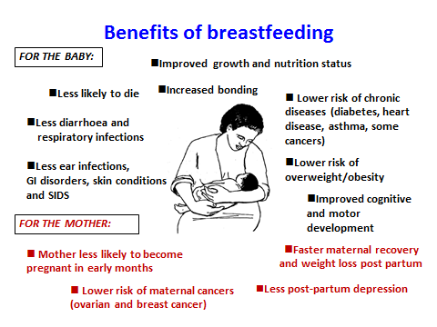

Slide 29
Nutrient content of 100ml of human breast milk and cows' milk compared
Type of milk | Energy | CHO | Protein | Fat | Ca | Iron | Vitamin A | Folate | Vitamin C
 | (kcal) | (g) | (g) | (g) | (mg) | (mg) | (µg) | (µg) | (mg)
Human milk | 70 | 7.0 | 1.03 | 4.6 | 30 | 0.02 | 48 | 5 | 5
Cows' milk (whole) | 61 | 5.4 | 3.3 | 3.3 | 119 | 0.05 | 31 | 5 | 1

Slide 30
Optimum breast feeding
1. Initiate breastfeeding immediately
2. Give colostrum
  Colostrum is th3 times richer in vitamin A and
  ten times richer in beta-carotene than mature milk
  baby’s first immunization.
3. Practice exclusive breastfeeding from 0-6 months
4. Breast feed the baby on demand
5. good attachment and positioning

Slide 31
Facts for Feeding 0-6 months
1.Initiate breastfeeding within 1 hour of birth
Serves as babies first immunization
Reduces risk of postpartum hemorrhage
Fosters mother-child bonding
Stimulates breast milk production

Slide 32
Facts for Feeding 0-6 months
2. provision of colostrum
. Establish good breastfeeding practices
  Proper positioning
  Proper attachment
  Observe signs of effective feeding
  No bottles
  Suckling increases breast milk production

Slide 33
Facts for Feeding 0-6 months
3. Breastfeed exclusively for first six months
  Do not give pre-lacteal feeds (e.g. liquids or foods)
  Do not give water
  Offering foods before 6 months can reduce BM production

Slide 34
Facts for Feeding 0-6 months
4. Practice frequent, on-demand breastfeeding, including night feeds
  12 times a day -- every 2 hours or more if needed -- especially in early months
  Frequent feedings maintain mother’s milk supply, maximize contraceptive effects and provide immune factors at each feeding.
  Frequent feeding avoids problems such as breast engorgement that can lead to mastitis
  Empty one breast before giving the other
  Adequacy of breastfeeds shown by baby urinating at least 6 times in 24 hours

Slide 35
Facts for Feeding 0-6 months
5. Feeding during and after illness
During illness: breastfeed more frequently
  limit the weight loss.
After illness: continue to breastfeed more frequently
    If infant too sick to suckle, then express breast milk and give with a cup & spoon, speed recovery
6. Feeding when mother is away or sick
  Mother should express breast milk into clean container
  Breast milk should be stored in clean covered container; 8-10 hours at room temperature in cool place or 72 hours in a refrigerator
  Caregiver feeds expressed breast milk from cup using spoon
Never use a bottle?

Slide 36
Facts for Feeding 0-6 months
BARRIERS TO BREAST FEEDING
  Belief that breast milk is not sufficient
  lack of adequate support system
  breast engorgement, cracked nipple, sore nipple
  chronic illness in mother ,psychosis , cancer

Slide 37
Complimentary feeding
At 6 months of age:
  Breast milk alone does not provide sufficient calories & nutrients to sustain optimal growth;
  complementary feeding becomes necessary to fill the energy and nutrient gap
  Infants are developmentally ready to take soft, and semi-soft foods in addition to breast milk

Slide 38
Cont.…
If complementary foods are not introduced at this age or if they are given inappropriately, an infant’s growth may falter.
In many countries, the period of complementary feeding from 6–23 months is the time of peak incidence of growth faltering, micronutrient deficiencies and infectious illnesses.

Slide 39
Complementary foods should be:
Timely -CFs are introduced at six months of age.
Adequate –provide sufficient energy, protein and micronutrients to meet a growing child’s nutritional needs
Safe –hygienically stored and prepared and fed with clean hands using clean utensils and not bottles and teats
Properly fed – meaning that they are given consistent with a child’s signals of hunger and that meal frequency and feeding methods are suitable for the child’s age.

Slide 40
Cont.…
Too Early CF introduction
Too Late CF introduction
diarrheal disease & risk of dehydration
decreased breast-milk production
Allergic sensitization
developmental concerns
potential growth failure
iron deficiency
developmental concerns

Slide 41
Cont.…
Between 6 and 12 months breast milk generally provides up to half or more of an infant’s nutritional requirements
between 12 and 24 months, up to one-third of requirements

Slide 42
Guiding principles for CF of the breastfed child
1.Practice exclusive breastfeeding from birth to 6 months of age, and introduce CF at 6 months of age (180 days).
2. Continue frequent, on-demand BF until 2 yrs of age or beyond.
3. Practice responsive feeding.
4. Practice good hygiene and proper food handling.
5. Start at 6 months of age with small amounts of food & increase the quantity as the child gets older, while maintaining frequent BF.

Slide 43
Cont.…
6. Gradually increase food consistency and variety as the infant grows older
7. Feed a variety of nutrient-rich foods to ensure that all nutrient needs are met.
9. Use fortified CF or vitamin-mineral supplements for the infant, as needed
10. Increase fluid intake during illness, more frequent breastfeeding

Slide 44
IYCF cont.….
RECOMMENDATIONS
1. Maintain breastfeeding up to two years of age along with complimentary feeding
2. Practice responsive feeding
  Feed infants directly and assist older children when they feed themselves.
  Feed slowly & patiently, encourage to eat, but don’t force them, talk to children during feeding with eye-to-eye contact.
  If children refuse many foods, try with different food combinations, tastes, textures and methods of encouragement.
  Minimize distractions during meals if they lose interest easily..
3. Complementary foods should be safely prepared and stored

Slide 45
Cont.…
4. Amount of food should be adequate for child’s age
  Introduce small amounts of food at 6 months and
  increase the quantity, as the child gets older, while maintaining frequent breastfeeding
5. Ensure appropriate food consistency
  by 6 months: pureed, mashed and semi-solid foods
  …by 8 months: “finger foods” & snacks
  …by 12 months: family foods
6. Ensure meal frequency and energy density
As child gets older, increase the number of times that the child is fed complementary foods

Slide 46
Cont.…
Average healthy breastfed infant, need:
2-3 meals per day at 6-8 months
3-4 meals per day at 9-11 months
4 meals per day at 12-24 months
Offer snacks 1-2 times per day

Slide 47
Cont.…
7. Ensure adequate nutrient content of complementary foods
Feed a variety of foods (micronutrients)
Meat, poultry, fish or eggs as often as possible
Vitamin A-rich fruits and vegetables daily
Provide diets with adequate fat content
Avoid giving drinks with low nutrient value,
8. Vitamin-mineral supplements or fortified products be used by the infant and mother when needed

Slide 48
Cont.…
9. Continue feeding during illness and feed more after illness
During illness increase fluid intake including more frequent breastfeeding, and encourage the child to eat soft, varied foods
After illness give food more often than usual and encourage the child to eat more
After illness, increased nutrient intake is needed to compensate for losses & allow for “catch-up growth”

Slide 49
updated IYCF indicators
8 Core Indicators:
Early initiation of breastfeeding(Proportion of children born in the last 24 months who were put to the breast within one hour of birth).
Exclusive breastfeeding for 6 months(Proportion of infants aged 0-5 months who are fed exclusively with breast milk)
Continued breastfeeding at 1 year (proportion of infants aged 12-15 months who are fed breast milk)

Slide 50
IYCF indicators con’d
4. Introduction of solid, semi-solid or soft foods(proportion of infants aged 6-8 months who receive solid, semi-solid or soft foods)
5. Minimum dietary diversity (Proportion of children 6-23 months of age who receive foods from 4 or more food groups
6. Minimum meal frequency (Proportion of breastfed and non-breastfed children 6-23 months of age who receive solid, semi-solid, or soft foods the minimum number of times or more: 2 for 6-8 mo., 3 for 9-23 mo., 4 for 6-23 mo.)

Slide 51
Cont.…
7. Minimum acceptable diet (Proportion of children 6-23 months of age who had both minimum meal frequency and dietary diversity)
8. Consumption of iron-rich or iron-fortified foods

Slide 52
Cont.…
Optional indicators
9. Children ever breastfed
10. Continued breastfeeding at 2 years
11. Age-appropriate breastfeeding
12. Predominant breastfeeding under 6 months
13. Duration of breastfeeding
14. Bottle feeding
15. Milk feeding frequency for non-breastfed children

Slide 53
cont.…
The 7 food groups include the following:
  1. Grains, roots and tubers
  2. Legumes and nuts
  3. Dairy products (milk, yoghurt, cheese)
  4. Flesh foods (meat, fish, poultry, and liver/organ meats)
  5. Eggs
  6. Vitamin A rich fruits and vegetables
  7. Other fruits and vegetables

Slide 54
Guidelines for feeding infants safely
Unpasteurized milk or unpasteurized food should not be fed to infants as they can introduce pathogens such as E. coli, Salmonella, or Cryptosporidium which cause diarrhoea or other more serious infections
To prevent botulism, infants under 1 year of age should not be fed honey
To prevent salmonella poisoning, raw eggs and foods containing raw eggs should not be fed to infants
Infant cereal or other solids should not be added to human milk or formula in a bottle as it may put the infant at risk for choking and aspiration

Slide 55
Cont.…
To avoid burns to an infant’s palate or face, formula or food warmed at high temperature should be shaken or stirred thoroughly, and the temperature tested, before serving .
Avoid hard, small and round, smooth, and sticky solid foods which may cause choking and aspiration
Avoid feeding an infant using a ‘propped’ bottle
Ensure that infants are always supervised during feeding.

Slide 56
CHILD FEEDING AND HIV/AIDS
Children living with HIV/AIDS are at great risk of malnutrition. HIV/AIDS stunts child growth and can
  reduce appetite, food intake, and nutrient absorption at a time when the body needs good nutrition the most to fight the infection.
  weakened immune system unable to fight the virus and infections like tuberculosis.
Many HIV-positive children suffer from severe acute malnutrition, a life-threatening condition.
To increase their chances of survival, these children need
  therapeutic foods to urgently treat malnutrition,
  antiretroviral treatment to stop the disease from progressing.

Slide 57
Cont.…
All HIV cases require 10% more energy when asymptomatic
20–30% more when symptomatic.
Children who are experiencing weight loss need between 50% and 100% more energy every day
HIV can be passed from a mother to her infant during pregnancy, during labour and delivery, and through breastfeeding

Slide 58
  5 -10 % risk of transmission of HIV during pregnancy
  10 -20% risk of transmission of HIV during labour and delivery
  10 -20 % risk of transmission of HIV through breastfeeding
Replacement feeding prevents breast milk transmission of HIV,
but in resource limited settings, the risk of death from artificial feeding must be weighed against the risk of HIV infection

Slide 59
Infant feeding options in the context of HIV/AIDS
Group1: Pregnant women whose HIV status is unknown or who have been tested and are HIV negative
Group 2: Pregnant women who have been tested and are HIV positive:
-counselling on option of BF
-provision of RVI drugs

Slide 60
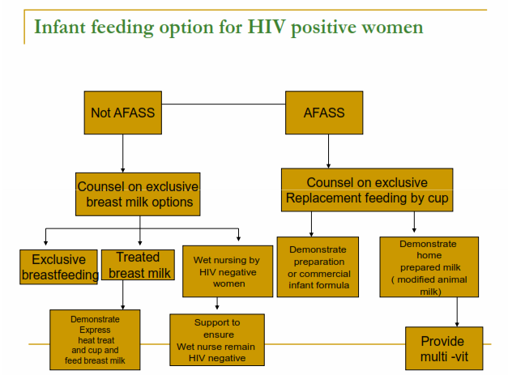

Slide 61
Cont.…
UNICEF/WHO Infant Feeding Recommendation for HIV-positive Women
When replacement feeding is acceptable, feasible, affordable, sustainable and safe, (AFASS) avoidance of breastfeeding by HIV-infected mothers is recommended.
Otherwise, exclusive breastfeeding is recommended during the first months of life and should be then discontinued as soon as it is feasible.

Slide 62
AFASS Criteria
Acceptable:
    The mother perceives no problem in replacement feeding.
    Potential problems may be cultural, social, or due to fear of stigma and discrimination.
Feasible:
    The mother (or family) has adequate time, knowledge, skills, resources and support to correctly mix formula or milk and feed the infant up to 12 times in 24 hours.

Slide 63
AFASS Criteria cont’d
Affordable: The mother and family, with community or health system support if necessary, can pay the cost of replacement feeding without harming the health or nutrition status of the family.
Sustainable: Availability of a continuous supply of all ingredients needed for safe replacement feeding for up to one year of age or longer.
Safe: Replacement foods are correctly and hygienically prepared and stored, and fed preferably by cup.

Slide 64
Cont.…
Options of replacement feeding:
Commercial infant formula
Home prepared infant formula (modified, with additional nutrients)
Enriched family diet with M/V supplements after 6 months

Slide 65
When replacement feeding IS NOT acceptable, feasible, affordable, sustainable and safe…
Option 1: Safer breastfeeding
Option 2: Heat treating breast milk
Option 3: Wet nursing by HIV negative woman
Option 4: Early cessation of breastfeeding

Slide 66
Cont.…
Factors that may decrease the risk of HIV transmission through breastfeeding include:
  Shorter duration of breastfeeding.
  Exclusive breastfeeding in the early months.
  Prevention and treatment of breast problems.
  Prevention of HIV-infection during breastfeeding.
  Early treatment of sores or thrush in the mouth of the infant.
Notes:
Shorter duration of breastfeeding.
The longer a child is breastfed by an HIV-positive mother the higher the risk of HIV infection. Breastfeeding for 6 months has about one third of the risk of breastfeeding for 2 years.
Exclusive breastfeeding in the early months.
A study done in Durban, South Africa showed that exclusive breastfeeding during the first 3 months of life resulted in a lower risk of MTCT than mixed feeding (breastfeeding combined with other foods, juices or water)
Prevention and treatment of breast problems.
Mastitis and cracked nipples and other causes of breast inflammation are associated with an increased risk of HIV-transmission.
Prevention of HIV-infection during breastfeeding.
The maternal viral load is higher shortly after a new infection resulting in an increased risk of infection of the child.
Early treatment of sores or thrush in the mouth of the infant.
Sores in the infant's mouth make it easier for the virus to enter the infant's body.

Slide 67
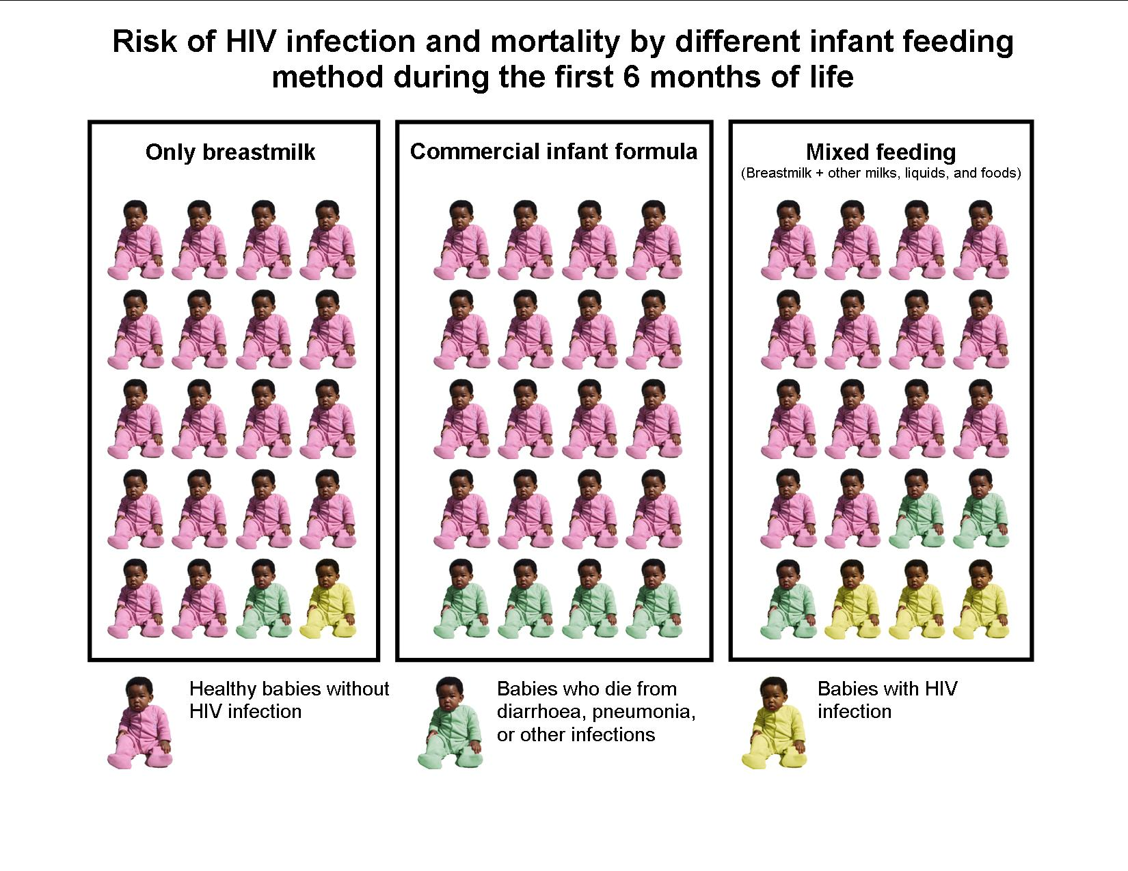

Slide 68
Thank you!!!

