Slide 1

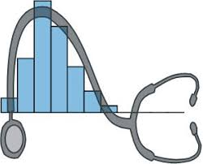
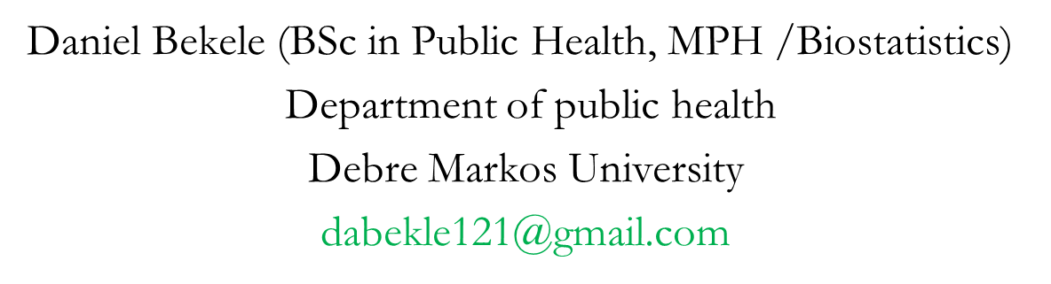
Numerical Summary Measures

Slide 2
Learning objectives
At the end of this chapter, the students will be able to:
  Identify the different methods of data summarization
  Compute appropriate summary values for a set of data
  Appreciate the properties and limitations of summary values

Slide 3
Descriptive Statistics
Numerical Summary Measures
Single numbers which quantify the characteristics of a distribution of values
    Measures of central tendency (location)
    Measures of dispersion

Slide 4
Descriptive……
A frequency distribution: a general picture of the distribution of a variable
But, can’t indicate the average value and the spread of the values

Slide 5
Measures of Central Tendency (MCT)
On the scale of values of a variable there is a certain stage at which the largest number of items tend to cluster.
Since this stage is usually in the centre of distribution, the tendency of the statistical data to get concentrated at a certain value is called “central tendency”
The various methods of determining the point about which the observations tend to concentrate are called MCT

Slide 6
Measures......
The objective of calculating MCT is to determine a single figure which may be used to represent the whole data set.
In that sense it is an even more compact description of the statistical data than the frequency distribution.
Since a MCT represents the entire data, it facilitates comparison within one group or between groups of data

Slide 7
Characteristics of a good MCT
A MCT is good or satisfactory if it possesses the following characteristics:
  It should be based on all the observations
  It should not be affected by the extreme values
  It should be as close to the maximum number of values as possible
  It should have a definite value
  It should not be subjected to complicated and tedious calculations
  It should be capable of further algebraic treatment
  It should be stable with regard to sampling

Slide 8
Measures......
The most common measures of central tendency include:
  Arithmetic Mean
  Median
  Mode
  Others

Slide 9

1. Arithmetic Mean
Ungrouped Data
The arithmetic mean is the "average" of the data set and by far the most widely used measure of central location
Is the sum of all the observations divided by the total number of observations.

Slide 10
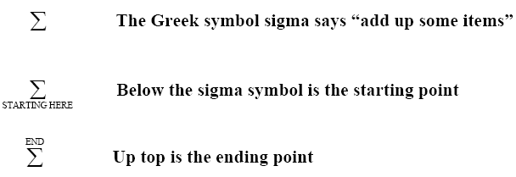
The Summation Notation

Slide 11
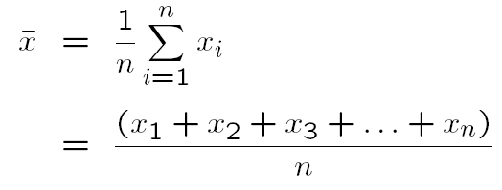
Arithmetic…..

Slide 12
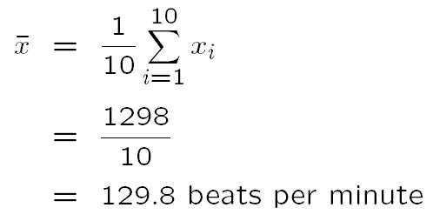
Arithmetic…..
The heart rates for n=10 patients were as follows (beats per minute):
167, 120, 150, 125, 150, 140, 40, 136, 120, 150
What is the arithmetic mean for the heart rate of these patients?

Slide 13
Arithmetic…..

Slide 14
Arithmetic…..
Example
Compute the mean age of 169 subjects from the grouped data.
Mean = 5810.5/169 = 34.48 years
Class interval | Mid-point (mi) | Frequency (fi) | mifi
10-19 20-29 30-39 40-49 50-59 60-69 | 14.5 24.5 34.5 44.5 54.5 64.5 | 4 66 47 36 12 4 | 58.0 1617.0 1621.5 1602.0 654.0 258.0
Total | __ | 169 | 5810.5

Slide 15
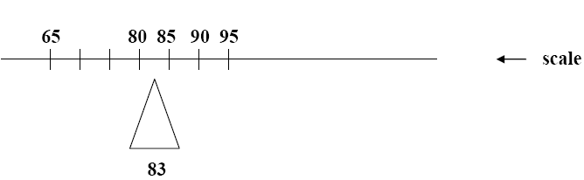
The mean can be thought of as a “balancing point”, “center of gravity”

Slide 16
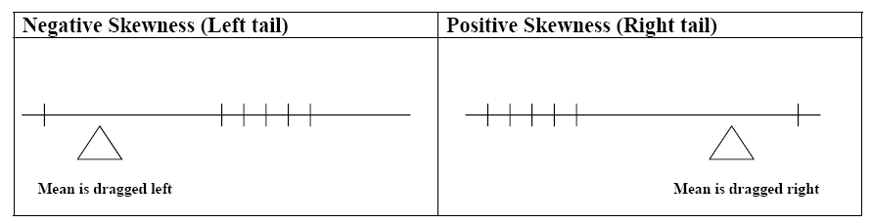
Arithmetic…..
When the data are skewed, the mean is “dragged” in the direction of the skewness
It is possible in extreme cases for all but one of the sample points to be on one side of the arithmetic mean & in this case, the mean is a poor measure of central location or does not reflect the center of the sample.

Slide 17
Properties of the Arithmetic Mean
The arithmetic mean is easily understood and easy to compute
For a given set of data there is one and only one arithmetic mean (uniqueness).
Easy to calculate and understand (simple).
Influenced by each and every value in a data set
Greatly affected by the extreme values.

Slide 18
2. Median
Ungrouped data
The median is the value which divides the data set into two equal parts.
If the number of values is odd, the median will be the middle value when all values are arranged in order of magnitude.
When the number of observations is even, there is no single middle value but two middle observations.
In this case the median is the mean of these two middle observations, when all observations have been arranged in the order of their magnitude.

Slide 19
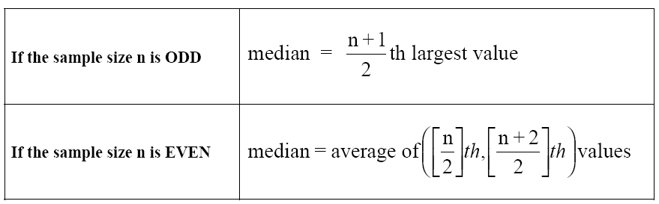
Median…..

Slide 20
Median…..

Slide 21
Median…..

Slide 22
The median is a better description (than the mean) of the majority when the distribution is skewed
Example
  Data: 14, 89, 93, 95, 96
  Skewness is reflected in the outlying low value of 14
  The sample mean is 77.4
  The median is 93

Slide 23
b) Grouped data
In calculating the median from grouped data, we assume that the values within a class-interval are evenly distributed through the interval.
The first step is to locate the class interval in which the median is located, using the following procedure.
Find n/2 and see a class interval with a minimum cumulative frequency which contains n/2.
Then, use the following formal.

Slide 24
Median…..
where,
L_{m} = lower true class boundary of the interval containing the median
F_{c} = cumulative frequency of the interval just above the median class
interval
f_{m} = frequency of the interval containing the median
W= class interval width
n = total number of observations

Slide 25
Example. Compute the median age of 169 subjects from the grouped data.
n/2 = 169/2 = 84.5
Class interval | Mid-point (mi) | Frequency (fi) | Cum. freq
10-19 20-29 30-39 40-49 50-59 60-69 | 14.5 24.5 34.5 44.5 54.5 64.5 | 4 66 47 36 12 4 | 4 70 117 153 165 169
Total |  | 169

Slide 26
Median…..
n/2 = 84.5 = in the 3rd class interval
Lower limit = 29.5, Upper limit = 39.5
Frequency of the class = 47
(n/2 – fc) = 84.5-70 = 14.5
Median = 29.5 + (14.5/47)10 = 32.58 ≈ 33

Slide 27
Properties of the median
There is only one median for a given set of data (uniqueness)
The median is easy to calculate
Median is a positional average and hence it is insensitive to very large or very small values
It is determined mainly by the middle points and less sensitive to the remaining data points (weakness).
It is not a good representative of data if the number of items is small

Slide 28
3. Mode
The mode is the most frequently occurring value among all the observations in a set of data.
It is not influenced by extreme values.
It is possible to have more than one mode or no mode.
It is not a good summary of the majority of the data.

Slide 29
Mode……
Mode
20
18
16
14
12
10
8
6
4
2
0

Slide 30
Ungrouped data
It is a value which occurs most frequently in a set of values.
If all the values are different there is no mode, on the other hand, a set of values may have more than one mode.

Slide 31
Mode……
Example
  1, 2, 3, 4, 4, 4, 4, 5, 5, 6
  Mode is 4 “Unimodal”
Example
  1, 2, 2, 2, 3, 4, 5, 5, 5, 6, 6, 8
  There are two modes – 2 & 5
  This distribution is said to be “bi-modal”
Example
  2.62, 2.75, 2.76, 2.86, 3.05, 3.12
  No mode, since all the values are different

Slide 32
Grouped data
To find the mode of grouped data, we usually refer to the modal class, where the modal class is the class interval with the highest frequency.
If a single value for the mode of grouped data must be specified, it is taken as the mid-point of the modal class interval.

Slide 33
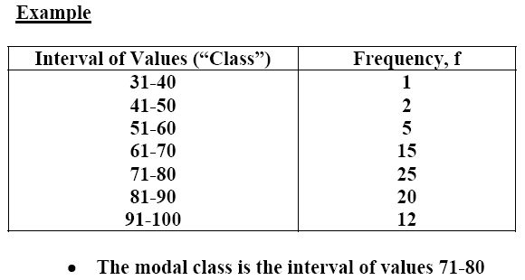
Mode……

Slide 34
Properties of mode
It is not affected by extreme values
It can be calculated for distributions with open end classes
Often its value is not unique
The main drawback of mode is that often it does not exist

Slide 35
Using measures of central tendency
Given a set of observations, an investigator may naturally ask which measure of central tendency is best to use with the data.
Two factors are important in making this decisions:

Slide 36
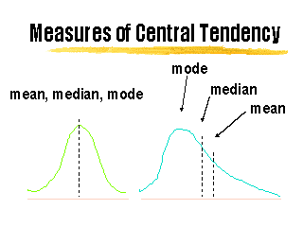
Which.....
  The scale of measurement (type of data)
  The shape of the distribution of the
  observations

Slide 37
which measure of central tendency is best with a given set of data
The arithmetic mean is used for interval and ratio data and for symmetric distribution
The median and quartiles are used for ordinal, interval and ratio data whose distribution is skewed.
For nominal data mode is the appropriate MCT
For discrete or continuous data, the “modal class” can be used

Slide 38
Which.....
Symmetric and unimodal distribution — Mean, median, and mode should all be approximately the same
Mean, Median & Mode

Slide 39
Which.....
Skewed to the right (positively skewed) —Mean is sensitive to extreme values, so median might be more appropriate
Mode
Median
Mean

Slide 40
Which......
Skewed to the left (negatively skewed) — The same to previous
Mode
Median
Mean

Slide 41
Measures of Dispersion
Consider the following two sets of data:
A: 177 193 195 209 226 Mean = 200
B: 192 197 200 202 209 Mean = 200

Slide 42
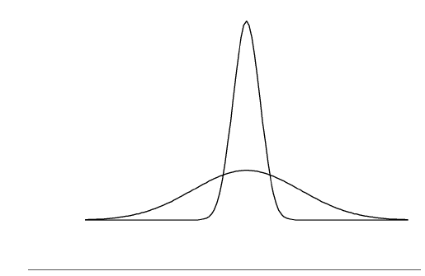
These two distributions have the same mean, median, and mode

Slide 43
Dispersion….
MCT are not enough to give a clear understanding about the distribution of the data.
We need to know something about the variability or spread of the values — whether they tend to be clustered close together, or spread out over a broad range

Slide 44
Measures of Dispersion
Measures that quantify the variation or dispersion of a set of data from its central location
Dispersion refers to the variety exhibited by the values of the data.
The amount may be small when the values are close together.
If all the values are the same, no dispersion

Slide 45
Dispersion……..
Other synonymous term:
  “Measure of Variation”
  “Measure of Spread”
  “Measures of Scatter”

Slide 46
Dispersion…..
Measures of dispersion include:
  Range
  Inter-quartile range
  Variance
  Standard deviation
  Coefficient of variation
  Standard error

Slide 47
1. Range (R)
The difference between the largest and smallest observations in a sample.
Range = Maximum value – Minimum value
Example
  Data values: 5, 9, 12, 16, 23, 34, 37, 42
  Range = 42-5 = 37

Slide 48
Properties of range
It is the simplest crude measure and can be easily understood
It takes into account only two values which causes it to be a poor measure of dispersion
Very sensitive to extreme observations
The larger the sample size, the larger the
range

Slide 49
2. Interquartile range (IQR)
Indicates the spread of the middle 50% of the observations, and used with median
IQR = Q3 - Q₁
Example: Suppose the first and third quartile for weights of girls 12 months of age are 8.8 Kg and 10.2 Kg, respectively.
IQR = 10.2 Kg – 8.8 Kg
i.e., 50% of the infant girls weigh between 8.8 and 10.2 Kg.

Slide 50

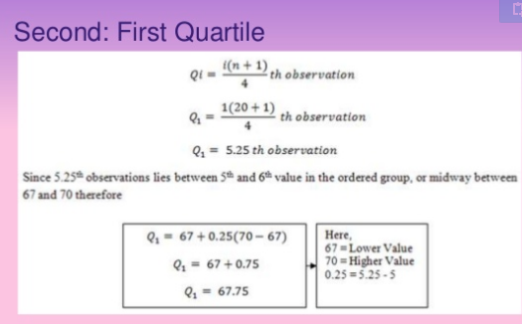
Example

Slide 51
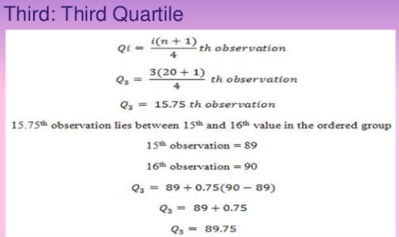
IQR=(Q3-Q1)
IQR=89.75-67.75
IQR= 22

Slide 52
Properties of IQR:
It is a simple and versatile measure
It encloses the central 50% of the observations
It is not based on all observations but only on two specific values
It is important in selecting cut-off points in the formulation of clinical standards
Since it excludes the lowest and highest 25% values, it is not affected by extreme values
Less sensitive to the size of the sample

Slide 53
3. Variance (σ², s²)
The main objection of mean deviation, that the negative signs are ignored, is removed by taking the square of the deviations from the mean.
The variance is the average of the squares of the deviations taken from the mean

Slide 54
Variance.....
It is squared because the sum of the deviations of the individual observations of a sample about the sample mean is always 0
0 = -
The variance can be thought of as an average of squared deviations
∑
-
x
x
i

Slide 55
Variance.....
Variance is used to measure the dispersion of values relative to the mean.
When values are close to their mean (narrow range) the dispersion is less than when there is scattering over a wide range.
Population variance = σ²
Sample variance = S²

Slide 56
Ungrouped data
Let X₁, X₂, ..., X_{N} be the measurement on N population units, then:

Slide 57
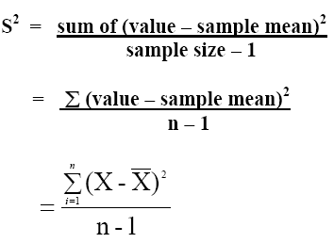
A sample variance is calculated for a sample of individual values (X1, X2, … Xn) and uses the sample mean (e.g) rather than the population mean µ.

Slide 58
b) Grouped data
where
m_{i} = the mid-point of the i^{th} class interval
f_{i} = the frequency of the i^{th} class interval
X = the sample mean
k = the number of class intervals

Slide 59
Properties of Variance
The main disadvantage of variance is that its unit is the square of the unit of the original measurement values
• The variance gives more weight to the extreme values as compared to those which are near to mean value, because the difference is squared in variance.
The drawbacks of variance are overcome by the standard deviation.

Slide 60
4. Standard deviation (σ, s)
It is the square root of the variance.
This produces a measure having the same scale as that of the individual values.

Slide 61
Standard deviation.....
Following are the survival times of n=11 patients after heart transplant surgery.
The survival time for the “ith” patient is represented as Xi for i= 1, …, 11.
Calculate the sample variance and SD

Slide 62
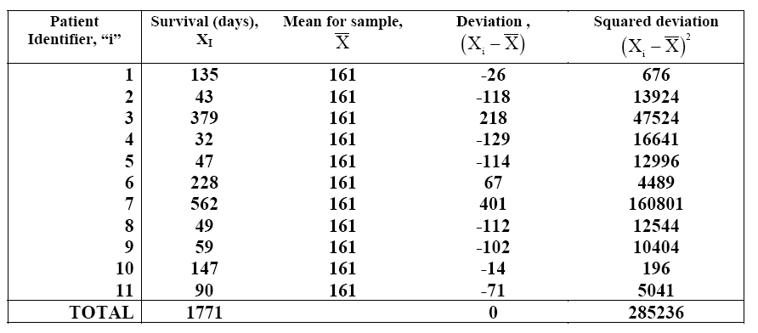
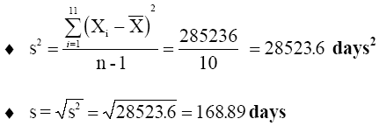
Standard deviation......

Slide 63
Example. Compute the variance and SD of the age of 169 subjects from the grouped data.
Mean = 5810.5/169 = 34.48 years
S² = 20199.22/169-1 = 120.23
SD = √S2 = √120.23 = 10.96
Class interval | (mi) | (fi) | (mi-Mean) | (mi-Mean)² | (mi-Mean)² fi
10-19 20-29 30-39 40-49 50-59 60-69 | 14.5 24.5 34.5 44.5 54.5 64.5 | 4 66 47 36 12 4 | -19.98 -9-98 0.02 10.02 20.02 30.02 | 399.20 99.60 0.0004 100.40 400.80 901.20 | 1596.80 6573.60 0.0188 3614.40 4809.60 3604.80
Total |  | 169 |  | 1901.20 | 20199.22

Slide 64
Properties of SD
The SD has the advantage of being expressed in the same units of measurement as the mean
SD is considered to be the best measure of dispersion and is used widely because of the properties of the theoretical normal curve.
However, if the units of measurements of variables of two data sets is not the same, then their variability can’t be compared by comparing the values of SD.

Slide 65
5. Coefficient of variation (CV)
When two data sets have different units of measurements, or their means differ sufficiently in size, the CV should be used as a measure of dispersion.
It is the best measure to compare the variability of two series of sets of observations.
Data with less coefficient of variation is considered more consistent.

Slide 66
Coefficient.....
CV is the ratio of the SD to the mean multiplied by 100.
 | SD | Mean | CV (%)
SBP Cholesterol | 15mm 40mg/dl | 130mm 200md/dl | 11.5 20.0
“Cholesterol is more variable than systolic blood pressure”

