Slide 1
Methods of data collection

Slide 2
Methods of data collection
An ideal data collection procedure should be clear, unbiased, reliable and valid.
There are four methods of data collection
Observation(measurement)
Interview(questionnaire)
Use of documentary sources
Others(FGDs, life history, case studies etc)
Notes:
Data collection techniques allow us to systematically collect data about our objects of study (people, objects,
and phenomena) and about the setting in which they occur.

Slide 3
Methods……
Observation- it is technique that involves systematically selecting, watching and recording behaviors of people or other phenomena and aspects of the population.
e.g. simple visual observation use of high level machines(X-ray, ultrasound) clinical examination etc

Slide 4
Methods……
Advantage- it gives relatively more accurate data on behavior and activities
Disadvantage- investigator’s(observers)bias
-it requires more resource and
skilled human power

Slide 5
Methods……
Interview(questionnaire)- there are different types of interview they are face to face, self administered questionnaire, telephone interview and postal/mail method
Questionnaires- are written documents which instruct the reader or listener to answer the question written for the purpose of a particular research. Interviewee(responder),interviewer(asker)
Two types of questionnaire
-structured
-unstructured

Slide 6
Methods……
Face to face interview
Advantage-both the interviewer and respondent
are together
- clarification about the question is possible
Disadvantage- it requires an interviewer skill
-time and financial problem

Slide 7
Methods……
Self administered questionnaires
Advantage-it may be sent to the respondent by using post office
-are cheapest because there is no need of trained person to collect data
- It can be coordinated being in central position

Slide 8
Methods……
Disadvantage-there may be low respondent rate
-requires intense follow up to set a high response rate
-no assurance the questionnaire were answered by the intended respondent
-incomplete questionnaire either due to omission or invalid response
- uneducated people can not fill it

Slide 9
Methods……
Telephone interview
Advantage-less expensive in terms of time and
money
-an interviewer can help the
respondent in case of difficulties

Slide 10
Methods……
Disadvantage- under representation of the groups without telephone
Problems with unlisted telephone numbers
Respondent may be substituted by another
Repeated call may be necessary
Mail /postal method-low response rate
- under representation of the illiterate individuals

Slide 11
Methods……
Use of documentary records
Such as clinical and personal records, death certificates, published mortality statistics, census publications etc are known as documentary sources
e.g. publications of CSA,MOH, newspapers and journals international publications like world bank, UNICEF and records of hospitals or any health institutions

Slide 12
Methods……
Others like FGDs, case history and life history are not commonly used but they used as a supplement
FGDs is used when we conduct a qualitative research

Slide 13
Common problems in collecting data
Language barrier
Lack of adequate time
Inadequately trained and experienced statistician
Expense
Biases
Suspicion
Cultural norms

Slide 14
Drafting the questionnaires
Is the questionnaire is the best method to collect my data?
List the major areas you wish to cover i.e. identify the variables you want to measure
The wording and sequence of information should be designed to motivate respondent
Do pretest to check weather the questionnaire is understandable or not by both the interviewer as well as the respondent

Slide 15
How we can select study variable?
Discuss the problem with friends or colleagues
Literature review
Consult authorities(experts)
Discuss the problem with focus groups in the population
e.g. key informants like edir and religious leaders

Slide 16
Types of questions
There are two types of questions
Open ended(free-response)
Close ended(restricted choice)
open ended
e.g. in your opinion what is the biggest barrier in getting your hospitals ANC unit patient

Slide 17
Types……
Advantages-it stimulates free thoughts of respondent
Helpful to obtain information on sensitive issues
Disadvantages- there may problem of recalling answers
It is not suitable for mailed question
Answers are difficult to code for statistical analysis
The problem of poor hand writing

Slide 18
Types……
Close ended- provides fixed answers
e.g. including your present visit how many times did you visit this hospital in the past two yrs?
Once B. Twice C. 3x D. 6x E. >6
Advantage-suitable for many forms of statistical analysis
Not difficult to code
Disadvantage-limits a variety of details

Slide 19
Types……
Partially open ended question
Advantage- provides alternatives if certain option are over looked
it identifies missing categories for future use
Disadvantage- respondent may ignore other options
e.g. if the house hold lost any of its members due to
death in the last 12 months what was the cause
of death. 1.Malaria 2. famine/hunger 3. car
accident 4.others specify

Slide 20
Types……
The selection of a method is based on practical considerations such as:
The need for resources
The acceptability of the procedures to the subjects
The probability that the method will provide a good coverage

Slide 21
Types……
How to choose an accurate and practicable method
from review of previous methodological studies or experiences in other studies
Through testing proposed methods on a small scale approach i.e. pre-test or pilot study to determine clarity of questions, the length of the time that an interview will take, how acceptable and convenient the proposed method .

Slide 22
Descriptive Statistics
Techniques used to organize and summarize a set of data in a concise way.
  Organization of data
  Summarization of data
  Presentation of data
Numbers that have not been summarized and organized are called raw data

Slide 23
Descriptive……..
Descriptive statistics include:
  Tables
  Graphs
  Numerical summary measures
    Measures of central tendency
    Measures of variability

Slide 24
Descriptive……..
Before summarization and organization, we need to know the types of variables and measurement scales of our data.
Before displaying or analyzing data, classify the variables into their different types

Slide 25
METHODS OF DATA ORGANIZATION AND PRESENTATION

Slide 26
Ordered array: A simple arrangement of individual observations in order of magnitude.
Frequency distribution: A table which involves a listing of all observed values of the variable being studied and how many times each value is observed.
a) Qualitative variable: Count the number of cases in each category.
b) Quantitative variable: Select a set of continuous, non-overlapping intervals such that each value in the set of observations can be placed in one, and only one of the intervals

Slide 27
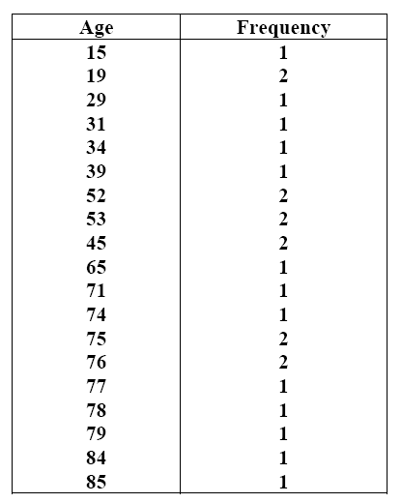
Ordered array

Slide 28
Methods…..
Frequency distribution: A table which has a list of each of the possible values that the data can assume along with the number of times each value occurs.
The actual summarization and organization of
data starts from frequency distribution.

Slide 29
Methods…..
For nominal and ordinal data frequency distributions are often used as a summary.
Example:
The % of times that each value occurs, or the relative frequency is often listed
Tables make it easier to see how the data are distributed

Slide 30
Methods…..
For both discrete and continuous data the values are grouped into non-overlapping intervals, usually of equal width.

Slide 31
Methods…..
(A). Qualitative variable: Count the number of
cases in each category.
Example: The ICU type of 25 patients entering intensive care unit at a given hospital:
1. Medical
2. Surgical
3. Cardiac
4. Other

Slide 32
Methods…..
ICU Type | Frequency | Relative Frequency
Medical Surgical Cardiac Other | 12 6 5 2 | 0.48 0.24 0.20 0.08
Total | 25 | 1.00

Slide 33
Methods…..
(B) Quantitative variable:
Select a set of continuous, non-overlapping intervals such that each value can be placed in one, and only one, of the intervals.
The first consideration is how many intervals to include

Slide 34
Methods…..
To group a set of observations we select a continuous, non-overlapping intervals such that each value in the set of observations can be placed in one and only one, of the intervals.

Slide 35
Methods…..

Slide 36
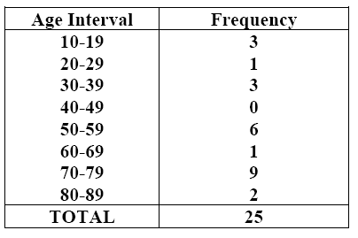
Methods…..

Slide 37
Methods…..
To determine the number of class intervals and the corresponding width, we use:
Sturge’s rule:
K=1+3.322(logn)
W=L-S
K
where
K = number of class intervals n = no. of observations
W = width of the class interval L = the largest value
S = the smallest value

Slide 38
Methods…..
Example
The birth weights (in Kilogram) of 30 children were
recorded as follow:
2.0, 2.1, 2.3, 3.0, 2.7, 2.8, 3.5, 3.1, 3.7, 4.0, 2.3, 3.5, 4.2,
3.7, 3.2, 2.7, 2.5, 2.7, 3.8, 3.1, 3.0, 2.6, 2.8, 2.9, 3.5, 4.1,
3.9, 2.8, 2.2, 3.1.
K = 1+3.322(log30) = 5.91
W = 4.2-2.0 = 0.37 ≈0.4
5.91

Slide 39
Methods…..
Birth weight | Tally mark | No. of children | % | Cumulative freq.
2.0 - 2.3 2.4 - 2.7 2.8 - 3.1 3.2 - 3.5 3.6 - 3.9 4.0 - 4.3 Total | |||| ||||| |||| ||||| |||| ||| ||| | 5 5 9 4 4 3 30 | 16.7 16.7 30.0 13.3 13.3 10.0 100.0 | 5 10 19 23 27 30

Slide 40
Methods…..
Cumulative frequencies: When frequencies of two or more classes are added.
Cumulative relative frequency: The percentage of the total number of observations that have a value either in that interval or below it.
Mid-point: The value of the interval which lies midway between the lower and the upper limits of a class.

Slide 41
Methods…..
True limits(class boundaries): Are those limits that make an interval of a continuous variable continuous in both directions
Used for smoothening of the class intervals
Subtract 0.5 from the lower and add it to the upper limit

Slide 42
Methods…..
Time (Hours) | True limit | Mid-point | Frequency
10-14 15-19 20-24 25-29 30-34 35-39 | 9.5 – 14.5 14.5 – 19.5 19.5 – 24.5 24.5 – 29.5 29.5 – 34.5 34.5 - 39.5 | 12 17 22 27 32 37 | 5 11 12 7 3 2
Total |  |  | 40

Slide 43
Guidelines for constructing tables
Keep them simple
Limit the number of variables to three or less
All tables should be self-explanatory
Include clear title telling what, when and where
Clearly label the rows and columns
State clearly the unit of measurement used
Explain codes and abbreviations in the foot-note
Show totals
If data is not original, indicate the source in foot-note

Slide 44
Types of tables
Simple or one way table: involves only a single variable
Two-way table: involves two characteristics and is formed when either caption or the stub is divided into two parts
Higher order table: three or more characteristics in a single table

Slide 45
Diagrammatic Representation

Slide 46
Advantages of diagrams
Much attractive than numerical facts
Required information can be obtained in Less time without mental strain.
Facilitates comparison
Pattern of change in data can be detected easily
Stays in memory for long time

Slide 47
Limitations of diagrams
Not an alternative to tabulation
No accuracy ensured , gives only approximate idea
Small/minute details can not be inferred

Slide 48
Diagrammatic……
Specific types of graphs include:
    Bar graph
    Pie chart
    Histogram
    Stem-and-leaf plot
    Box plot
    Scatter plot
    Line graph
    Others
Nominal, ordinal data
Quantitative data

Slide 49
1. Bar charts/ graphs
Used to display a frequency distribution for nominal and ordinal data
Categories are listed on the horizontal axis (X-axis)
Frequencies or relative frequencies are represented on the Y-axis (ordinate)
The height of each bar is proportional to the frequency or relative frequency of observations in that category

Slide 50
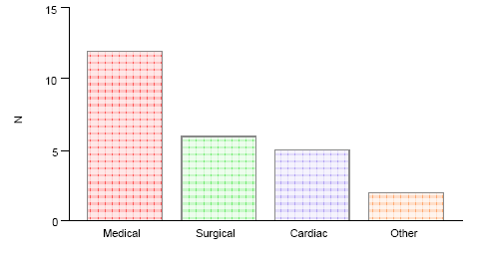
Bar chart for the type of ICU for 25 patients

Slide 51
Method of constructing bar chart
All the bars must have equal width
The bars are not joined together (leave space between bars)
The different bars should be separated by equal distances
All the bars should rest on the same line called the base
Label both axes clearly

Slide 52
Example: Construct a bar chart for the following data.

Slide 53
Bar…..

Slide 54
2. Sub-divided bar chart
If there are different quantities forming the sub-divisions of the totals, simple bars may be sub-divided in the ratio of the various sub-divisions to exhibit the relationship of the parts to the whole.
The order in which the components are shown in a “bar” is followed in all bars used in the diagram.
This can be actual or percentage component

Slide 55
Example: Plasmodium species distribution for confirmed malaria cases, Zeway, 2003

Slide 56
3. Multiple bar graph
Bar charts can be used to represent the relationships among more than two variables.
The following figure shows the relationship between children’s reports of breathlessness and cigarette smoking by themselves and their parents.

Slide 57
Multiple….
We can see from the graph quickly that the prevalence of the symptoms increases both with the child’s smoking and with that of their parents.

Slide 58
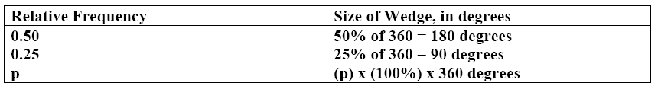
4. Pie chart
Shows the relative frequency for each category by dividing a circle into sectors, the angles of which are proportional to the relative frequency.
Used for qualitative and quantitative discrete
Used for a single categorical variable
Use percentage distributions

Slide 59
Steps to construct a pie-chart
Construct a frequency table
Change the frequency into percentage (P)
Change the percentages into degrees, where: degree = Percentage X 360º
Draw a circle and divide it accordingly

Slide 60
Example: Distribution of deaths for females, in England and Wales, 1989.
Cause of death | No. of death
Circulatory system Neoplasm Respiratory system Injury and poisoning Digestive system Others | 100 000 70 000 30 000 6 000 10 000 20 000
Total | 236 000

Slide 61
Pie….

Slide 62
5. Histogram
Histograms are frequency distributions with continuous class intervals that have been turned into graphs.
To construct a histogram, we draw the interval boundaries on a horizontal line and the frequencies on a vertical line.
Non-overlapping intervals that cover all of the data values must be used.

Slide 63
Histogram….
Bars are drawn over the intervals in such a way that the areas of the bars are all proportional in the same way to their interval frequencies.
The area of each bar is proportional to the frequency of observations in the interval

Slide 64
Example: Distribution of the age of women at the time of marriage
Age group | 15-19 | 20-24 | 25-29 | 30-34 | 35-39 | 40-44 | 45-49
Number | 11 | 36 | 28 | 13 | 7 | 3 | 2

Slide 65
Two problems with histograms
They are somewhat difficult to construct
The actual values within the respective groups are lost and difficult to reconstruct
The other graphic display (stem-and-leaf plot) overcomes these problems

Slide 66
6. Frequency polygon/curve
A frequency distribution can be portrayed graphically in yet another way by means of a frequency polygon.
To draw a frequency polygon we connect the mid-point of the tops of the cells of the histogram by a straight line.
The total area under the frequency polygon is equal to the area under the histogram
Useful when comparing two or more frequency distributions by drawing them on the same diagram

Slide 67
Frequency polygon for the ages of 2087 mothers with <5 children, Adam Tulu, 2003

Slide 68
I t can be also drawn without erecting rectangles by joining the top midpoints of the intervals representing the frequency of the classes as follows:

Slide 69
7. Box and Whisker Plot
It is another way to display information when the objective is to illustrate certain locations (skewness) in the distribution .
Can be used to display a set of discrete or continuous observations using a single vertical axis – only certain summaries of the data are shown

Slide 70
Box…..
A box is drawn with the top of the box at the third quartile (75%) and the bottom at the first quartile (25%).
The location of the mid-point (50%) of the distribution is indicated with a horizontal line in the box.
Finally, straight lines, or whiskers, are drawn from the centre of the top of the box to the largest observation and from the centre of the bottom of the box to the smallest observation.

Slide 71
How can the lower quartile, median and upper quartile be used to judge the symmetry of a distribution?
If the distribution is symmetric, then the upper and lower quartiles should be approximately equally spaced from the median.
2. If the upper quartile is farther from the median than the lower quartile, then the distribution is positively skewed.
3. If the lower quartile is farther from the median than the upper quartile, then the distribution is negatively skewed.

Slide 72
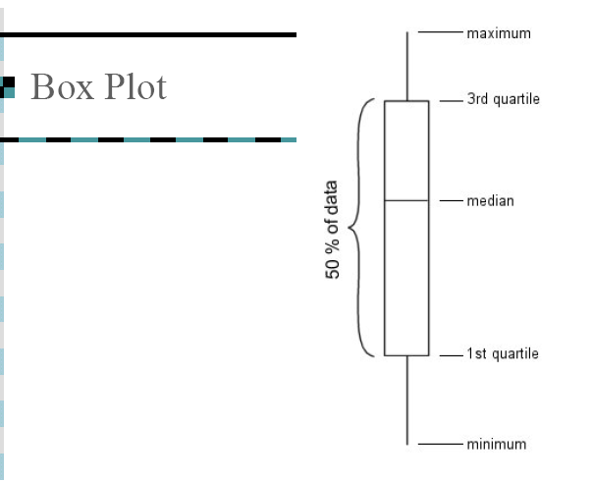
Box…..

Slide 73
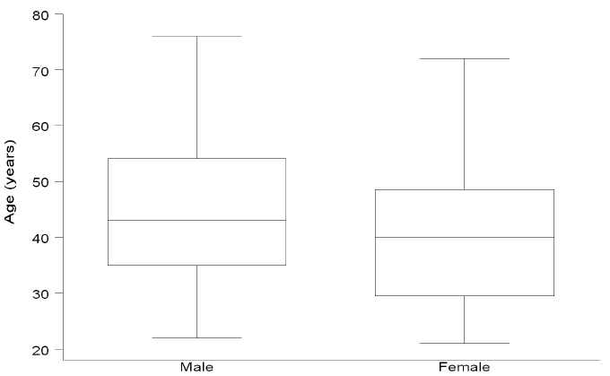
Box plots are useful for comparing two or more groups of observations

Slide 74
Outlying values
The lines coming out of the box are called the “whiskers”.
The ends of the “whiskers’ are called “adjacent values) [The largest and smallest non-outlying values].
Upper “adjacent value” = The largest value that is less than or equal to P75 + 1.5*(P75 – P25).
Lower “adjacent value” = The smallest value that is greater than or equal to P25 – 1.5*(P75 – P25).

Slide 75
Box…..
  The box plot is completed
  Draw a vertical bar from the upper quartile to the largest non-outlining value in the sample
  Draw a vertical bar from the lower quartile to the smallest non-outlying value in the sample

Slide 76
Box…..
  Outliers are displayed as dots (or small circles) and are defined by:
  Values greater than 75th percentile + 1.5*IQR
  Values smaller than 25th percentile − 1.5*IQR
  Any values that are outside the IQR but are not outliers are marked by the whiskers on the plot.
  IQR = P75 – P25
Example: 14,61 ,24,42,21,23,24,32.

Slide 77
Number of cigarettes smoked per day was measured just before each subject attempted to quit smoking

Slide 78
8. Ogive curve
Some times it may be necessary to know the number of items whose values are more or less than a certain amount.
We may, for example, be interested to know the no. of patients whose weight is <50 Kg or >60 Kg.
To get this information it is necessary to change the form of the frequency distribution from a ‘simple’ to a ‘cumulative’ distribution.
Ogive curve turns a cumulative frequency distribution in to graphs.
Are much more common than frequency polygons

Slide 79
Example: Heart rate of patients admitted to hospital Y, 1998

Slide 81
9. Scatter plot
Most studies in medicine involve measuring more than one characteristic, and graphs displaying the relationship between two characteristics are common in literature.
When both the variables are qualitative then we can use a multiple bar graph.
When one of the characteristics is qualitative and the other is quantitative, the data can be displayed in box and whisker plots

Slide 82
Scatter….
For two quantitative variables we use bivariate plots (also called scatter plots or scatter diagrams).
In the study on percentage saturation of bile, information was collected on the age of each patient to see whether a relationship existed between the two measures
A scatter diagram is constructed by drawing X-and Y-axes
Each point represented by a point or dot(•) represents a pair of values measured for a single study subject =POSTIVE RELATION

Slide 83
Scatter….

Slide 84
9. Line graph
Useful for assessing the trend of particular situation overtime.
Helps for monitoring the trend of epidemics.
The time, in weeks, months or years, is marked along the horizontal axis
Values of the quantity being studied is marked on the vertical axis.
Values for each category are connected by continuous line.
Sometimes two or more graphs are drawn on the same graph taking the same scale so that the plotted graphs are comparable.

Slide 85
No. of microscopically confirmed malaria cases by species and month at Zeway malaria control unit, 2003

