Slide 1

DEBRE MARKOS UNVERSITY
MEDICAL SURGICAL AND HUMAN NUTRTION MODULE, INTRODUCTION
TO HUMAN NUTRTION FOR MIDWIFE STUDENTS .
BY AYENEW.N(BSC IN PH, MPH IN HUMAN NUTRTION)
ayenewnegesse@gmail com
251-921936474

Slide 2
Course Description
Human Nutrition is important throughout the life to maintain or promote health and preventing diseases.
This Human Nutrition course is designed for nursing students
  the impact how nutrient/food affects our health
  and to have appropriate knowledge, attitude and practice on nutritional problems and interventions.
  The main topics included in this course are:
  introduction to human Nutrition,
      ,

Slide 3
Introduction……..
macro and micronutrients,
nutritional requirement through out the life cycle,
Nutritional problems of public health importance
The link between diet and disease
nutritional assessment methods
nutritional intervention approaches
Nutritional surveillance

Slide 4
Course objectives
After successful completion of this course the students will be able to:
  Describe the importance of Nutrition in Health Promotion and Disease Prevention
  Identify the main food sources and functions of macro and micro nutrients in the human body.
  Identify the nutritional needs at various life stages and able to give nutritional counseling and nutritional education.
  Explain the links between diet and disease and describe prevention and management of nutritional problems

Slide 5
CONTINUED……
Analyze current issues in nutritional conditions of Ethiopia and identify nutrition intervention strategies
Correctly measure & interpret anthropometric indices.
Properly assess , identify problem and counsel the mothers on child feeding practices.
Identify nutritional surveillance systems
Explain the nutritional intervention approaches

Slide 6
Introduction.
History of modern nutrition in health and disease
The history of Modern Nutrition in Health and Disease now spans more than five decades.
The title and this science was evolved from a book originally designated as Dietotherapy, initiated by Michael G. Wool, and Robert S. Good hart, as Coeditors, in 1950.
The second edition was the first to use the title Modern Nutrition in Health and Disease, subtitled Dietotherapy.

Slide 7
continued
Currently nutrition in 2012 includes Functional Foods and Nutraceuticals in Health Promotion, Prebiotics and Probiotics as Modulators of the Epigenetics, Mechanisms of Nutrient Sensing, Metabolic Consequences of Calorie Restriction, Bariatric Surgery, Metabolic Syndrome, Nutrition and Inflammatory Processes, Irritable Bowel Syndrome and Diverticular Disease, Food Insecurity in Children, Cancer Cachexia, Nutrition in Burn Injury, Dietary Patterns, and Approaches to Preventing Micronutrient Deficiencies.

Slide 8
Definition of some terms
Scientifically, food may be defined as any solid or liquid which when ingested will enable the body to carry out any of its life function.
Foods are made up of Macro and Micronutrients .
Nutrition is the sum total of the process by which living things receive and utilize the necessary materials for survival, growth and maintenance of worn out tissues.

Slide 9
Con…
Malnutrition is the condition that results from an imbalance between dietary intake and requirements.

Slide 10
.
FOOD are substances that are taken into the body to sustain life, provide energy, and promote growth.
NUTRIENTS, on the other hand, are substances that gives us nourishment. We take them from the foods we consume or the different types of liquid we drink.
DIET simply means what food we eat in the course of a 24-hour, one week, or one month, etc. period.

Slide 11
Nutrition and health
Nutrition is a key determinant factor for maintenance of your life as well as your health status.
Community health and nutrition are absolutely unseparated.
Currently both communicable and non communicable diseases are directly or indirectly associated with the effect of nutritional problems.

Slide 12
CONTINUED….
  Metabolic disorders related to nutritional problems
  Diabetes mellitus
  Hypertension
  Ischemic heart disease
  Colon cancer
  Infectious disease related to nutrition such as:
  Tuberculosis, HIV/AIDS
  Undernutrtion related disease such as measles, diarrheal disease, malaria and so on

Slide 13
NUTRIENTS
Nutrients are classified as micro nutrients and macro nutrients.
micro nutrients are not based on their small size rather based on their RDA is small as considered to that of macro nutrients.
The following six elements of nutrients are:
  carbohydrates
  Proteins
  Fats and oils
  Minerals
  Vitamins
  And water

Slide 14
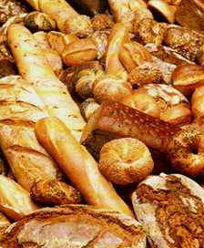
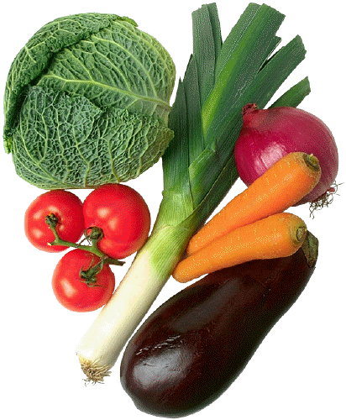
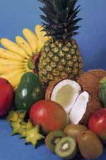
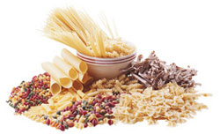
Carbohydrates

Slide 15
Continued…..
contents
Composions and classification of CHOs,
Digestion, absorptionand function of CHOs,
Food source, requirent of CHOs

Slide 16
Definition and classification
The formal definition is a class of compounds having the formula Cn(H2O)n; that is, the molar ratio of carbon to hydrogen to oxygen is 1:2:1.
Simple carbohydrates include the hexose monosaccharaides (e.g., glucose, galactose, and fructose) and the disaccharides: maltose (glucose-glucose), sucrose (glucose-fructose), and lactose (glucose-galactose).

Slide 17
Con…
Complex carbohydrates include the oligosaccharides that yield 3 to 10 monosaccharaides on hydrolysis; examples include trioses (glycerose, C3H6O3), tetroses (erythrose, C4H8O4), and pentoses (ribose, C5H10O5).
Pentose's are important constituents of nucleic acids.
Polysaccharides are larger complex carbohydrates containing more than10 monosaccharide units.
Common polysaccharides include starch, glycogen, pectin, cellulose, and gums.

Slide 18
Continued…
.
MONOSACCHARIDES:
  Glucose
  Fructose
  Mannose
  Galactose

Slide 19
DISACCHARIEDS:
. Sucrose
Lactose
Maltose
Trehalose: sugar stored in fungi: a disaccharide found in yeast, lichen, bacteria, and virus
NB. Raffinose – a trisaccharide present in molasses. a white crystalline slightly sweet sugar. Source: cottonseed meal, sugar beets, molasses.
Stachyose – a tetra saccharide present in beans

Slide 20
CON…
Raffinose and Stachyose are considered as antinutrients
Sugar alcohol are found in nature and also prepared commercially Mannitol and Dulcitol
Honey is a mixture of glucose and fructose.
      Honey has also medicinal effect.

Slide 21
Glycogen
Glycogen is present in the liver and muscle.
In most foods of animal origin it is a negligible source of dietary carbohydrate. The glycogen in the liver is a reserve fuel; it serves between meals and over night.
The breakdown of glycogen in the liver is facilitated by the hormone glucagon.

Slide 22
FUNCTIONS OF CHO
Carbohydrates provide a great part of the energy in all human diets. 85% of the energy may come from this source.
On the other hand in the diet of rich people the proportion may be as low as 40%. However, the cheapest and easily digestible fuel of man is carbohydrate.

Slide 23
FUN……..
Carbohydrates are components of body substances needed for the regulation of body processes.
Heparin, which prevents blood from clotting, contains carbohydrate.
Nervous tissue, connective tissue, various hormones, and enzymes also contain carbohydrate Ribose
carbohydrate is a part of (DNA) and RNA which contains ribose
Carbohydrate also is a component of a compound in the liver that destroys toxic substances.

Slide 24
Fun 2….
Carbohydrates are necessary for the proper use of fats.
If carbohydrate intake is low, larger than normal amounts of fats are called on to supply energy.
The body is unable to handle the excessive breakdown of fat. As the result, the fat does not burn completely, and abnormal amounts of certain breakdown products accumulate in the blood, causing a condition known ketosis.

Slide 25
DIGESTION AND ABSORPTION OF CARBOHYDRATES
The digestion of carbohydrates begins in the mouth by: Ptyalin (amylase) produced by the Salivary glands
No carbohydrate digestion takes Place in the stomach
Digestion occurs mainly in the small intestine through the action of pancreatic and intestinal juices.

Slide 26
Con….
Maltose………maltase………………..glucose+ glucose
sucrose………sucrose…….Fructose + glucose
Lactose………..lactase…………………galactose+glucose
NB. Amylase break down malt sugar.
Starch is the form in which Carbohydrate is stored in granules in the roots and seeds of plants.
    Dextrin
    Dextran

Slide 27
.
After digestion, the monosaccharaides, glucose, fructose and galactose are then transported across the epithelial cells and enter the portal vein.
After a meal the blood glucose rises to a maximum in about 30 minutes and then returns to the fasting level after 90 to 180 minutes.
In Health and with normal diet, the available carbohydrate is digested and absorbed completely in the small intestine.

Slide 28
There are three ways in which the tissues dispose blood glucose….
It may be utilized directly as a source of energy
It may be stored in the form of glycogen
If there is surplus of glucose, it will be converted into fats and deposited as fats in the body.
The tissues use as fuel a mixture of glucose and fatty acids. But the brain normally uses only glucose and requires around 80g daily.

Slide 29
SUPPLY OF ENERGY TO THE TISSUES
Intake – alimentary canal
Transport – blood and lymph
Storage – liver, muscle and adipose tissues
Transport – blood
Utilization – tissues

Slide 30
Con….
The two hormones, which control the metabolisms of carbohydrates, are:-
    Insulin
    Glucagon

Slide 31
Insulin
Insulin is secreted by the beta cells of the islets of Langerhans and the secretion is stimulated by:
  Hyperglycemia
  Parasympathetic nervous activity

Slide 32
Function of insulin is:
  To facilitate glucose transport to the liver and muscle cells
  To facilitate formation of glycogen in the liver and muscle cells
  To incorporate formation of protein from the amino acids.

Slide 33
Glucagon
Glucagon is secreted by the alpha cells of the islet of Langerhans and the secretion is stimulated by
  Hypoglycemia
  Sympathetic nervous activity
Its function is :To facilitate the breakdown of glycogen in the liver and muscle cells into glucose

Slide 34
Table. 1. Carbohydrate content of some food
Food Carbohydrate
Sugar 100%
White Flour 80%
Honey 76%
Biscuit, semi-sweet 75%
Jam 69%
Chocolate, milk 59%
White bread 50%
Potatoes 21%
Apple 12%
Peas 11%
Carrots 5.4%
Milk 4.7%_

Slide 35
proteins
Contents
Composions and classification of Protéines
Digestion, absorptionand function of Protéines,
Food source, requirent of Protéines

Slide 36
Composions and classification of Protéines
Proteins have long been recognized as fundamental structural elements of every cell of the body.
Specific proteins and protein derivatives have been recognized as functional elements in certain specialized cells glandular secretion, enzymes and hormones.
Proteins are the principal constituents of the tissues of the body and the body is also dependent upon food proteins and therefore, the quality and quantity of proteins in the daily diet are of prime importance.

Slide 37
classification
Table. 2. Essential and non-essential
amino acids.
ENA | NEAA
Lysine - Tryptophan Histidine Phenylalnine Leucine Isoleucine Thereonine Methionine Valine | Glycine Alanine Serine - Norleucine Aspartic acid Glutamic acid Hydroxy–glutamic acid Proline - Hydroxy – praline? Cetrulline Tyrosine Cystine Arginine

Slide 38
DIGESTION AND ABSORPTION OF PROTEIN
The digestion of protein in the alimentary tract is accomplished by the action of several proteolytic enzymes in the gastric, pancreatic and intestinal juices.
Any of these enzymes that have the power to attack native proteins must be secreted in an inactive form to prevent damage to the very tissues where they are formed

Slide 39
CON…
Pepsinogen is secreted by the gastric juice and activated by the Hydrochloric acid
Trypsinogen is secreted by pancreatic juice and activated by entrokinase
Chemotrypsinogen is secreted by pancreatic juice and activated by the active tripsin
Peptidase intestinal juice

Slide 40
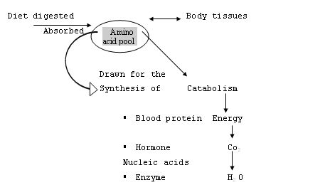
Amino acid pool

Slide 41
Nitrogen balance
Nitrogen balance refers to the situation where nitrogen intake from food is equal to nitrogen excretion.
This occurs in a healthy non-growing adult person taking adequate amount of energy from carbohydrates.
Basically the source of nitrogen for our body is the food that we eat.
Nitrogen is excreted through urine, feces, sweat etc.

Slide 42
Con….
Positive Nitrogen Balance
Pregnancy
Lactation
Growth
Recovery from illness (convalescent stage)
Negative Nitrogen Balance
Starvation
Devastating illness
Protein Energy Malnutrition

Slide 43
Functions of proteins
For growth and development.
Replacement of worn out tissues.
protein is the second largest store of energy in the body
after adipose tissue fat stores .
Body protein is made up of 20 different amino acids, each with different metabolic fates in the body.
muscle strength for breathing, immune function, organ function.

Slide 44
STABILITY OF PROTEIN IN FOODS
Chemically pure proteins are nearly stable, but in a moist state in which they are generally found in foods they decompose readily at room temperature.
This spoilage is due to bacterial action and may form substances toxic to the body. In this respect nitrogenous foods are unstable and will decompose more readily at room temperature than carbohydrates and fats.

Slide 45
SOURCE OF PROTEINS
Milk
Milk products
Meat
Poultry
Fish
Egg
Vegetables
Nuts
Bread and cereals

Slide 46
lipids
contents
Composions and classification of lipides,
Digestion, absorptionand function of lipides,
Food source, requirent of lipides
diseases related to lipides

Slide 47
Con….
Lipids are a group of organic compounds that are insoluble in water. The major (95%) of dietary lipids constitutes triglycerides (Fats and oils).

Slide 48
Defin….
A family of compounds soluble in organic compounds but not in water.
3 classes of lipids:
  Triglycerides: 95 % of lipids in foods
  Phospholipids: e.g..: lecithin
  Sterols: e.g..: cholesterol

Slide 49
Lipids: Fats and Oils
Fats: those lipids that are solid at room temperature(70 degrees F)
  beef fat, pork fat, etc...
Oils: those lipids that are liquid at room temperature(70 degrees F)
  vegetable oils

Slide 50
Lipids: Functions
Provide Calories: 9 Cal/ gram
Lipids carry fat soluble vitamins in food and in body
  Vitamins A, D, E, K
Provide building material for body
  adipose tissue, components of cell membranes, many hormones, nerve coverings

Slide 51
Lipids: Functions (cont.)
Thermal insulation
  1/2 of fat is subcutaneous
Protection for organs
  the rest of fat surrounds organs and protects them
Essential Fatty Acids: Linoleic and Linolenic Acids
  abundant in plant oils and fish oils

Slide 52
Generally lipids
Fats that are solid at room temperature are called fats because they are saturated
Palatability, it gives good test and we can consume more
Fats serves as insulator, it prevents heat loss from the body
Lubricant, it lubricates the gastrointestinal tract
It protects the delicate organs such as Kidney, Eyes, and Heart

Slide 53
PHOSPHOLIPIDS, STEROLS & LIPOPROTEINS
Phospholipids are structural compounds found in cell membranes. They are essential components of enzyme systems and are involved in the transport of lipids in plasma.

Slide 54
STEROLS
These are precursors of vitamin D, which are found both in plants and animals. Cholesterol-found in animal tissues, egg yolk and butter and Ergo sterol in plants
Lipids are transported in the blood in the form of lipoprotein (soluble fat protein complexes).
They are 25-30% proteins and the remaining as lipids

Slide 55
LIPOPROTEIN
These are compound lipids that contain both protein and various types and amounts of lipids.
They are made mostly in the liver and are used to transport water-soluble lipids.
Elevated levels of certain types of proteins are a high risk for the development of atherosclerosis.
Based on their density the lipoproteins are classified as High Density Lipoprotein (HDL), VLDL, and LDL

Slide 56
HIGH DENSITY LIPOPROTEIN
These primarily contain protein with small amounts of triglycerides and cholesterol.
HDL is protective against atherosclerosis

Slide 57
LOW DENSITY LEPOPRETEIN (LDL)
This is composed mainly of cholesterol.
LDL transports cholesterol from the liver to the tissues.
High serum level of LDL greatly increases the risk of atherosclerosis.
Diets that are high in saturated fatty acids are associated with elevation in LDL cholesterol.

Slide 58
VERY LOW DENSITY LEPOPROTEIN (VLDL)
It contains primarily triglycerides with some protein and cholesterol.
VLDL increases the risk of atherosclerosis

Slide 59
Chylomicrons
Chylomicrons – composed mainly of triglycerides encased in a protein and phospholipids coating.
It transports triglyceride from the intestine to the liver.
High serum chylomicrons level does not increase the risk of atherosclerosis.

Slide 60
Cholesterol
Cholesterol is found only in animal products
Plant foods, regardless of their fat content, do not contain cholesterol
Cholesterol is a fat like lipid that normally occurs in the blood and all cell membranes.
It is a major part of brain and nerve tissues
Cholesterol is necessary for normal body function as structural material in body cells
In the production of bile, vitamin D and a number of hormones including cortisone and sex hormone.

Slide 61
THE ESSENTIAL FATTY ACIDS ARE:
Linoleic acid
Linolenic acid
Arachidonic acid
The body synthesizes Linolenic acid and Arachidonic acid from Linoleic acid which must be supplied in the diet.

Slide 62
Continued….
Essential Fatty Acids are needed for the normal functioning of all tissues
Essential Fatty Acids form a part of the structure of each cell membrane.
Essential Fatty Acids help transport nutrients and metabolites across the cell membrane
Essential Fatty Acids are also involved in brain development
Essential Fatty Acids are needed for the synthesis of prostaglandin
Linoleic acid occurs abundantly in vegetable oils such as: -Corn oils
- safflower oils
-Cottonseed oils - soybeans oils
-Sesame oils - sunflower oils

Slide 63
DIGESTION OF FATS (SUMMARY)
In the mouth
Short chain and
Medium chain triglycerides
Enzyme – lingual lipase
End products – triglycerides

Slide 64
In the stomach
Short chain and medium chain triglycerides
Enzyme – Gastric lipase
End products – Fatty acids, glycerol, triglycerides monoglycerides

Slide 65
In small intestine
Triglycerides, triglycerides
Enzyme – Pancreatic lipase
End products – monoglycerides, fatty acids, glycerol
Resynthesizes in intestinal mucus to form
triglycerides – to blood stream through lymph.
Smaller portion enters blood capillaries.
Bile salts emulsify fats, allowing enzymes
to penetrate more easily

Slide 66
Triglycerides: Glycerol + 3 Fatty Acids
Glycerol: similar to sugar 3 carbons long
Fatty Acids: Can differ in two ways
  Degree of saturation
    Saturated: 0 double bonds
    Monounsaturated: 1 double bonds
    Polyunsaturated: 2 or more double bonds
  Chain length: how many carbons long it is
    4-6 Carbons: short chain
    8-12 Carbons: medium chain
    14+ Carbons: long chain

Slide 67
FOOD SOURCE OF FATS
Animal – Fish, butter, beef, pork, and lamb
Plant - vegetable, fruit (avocado, nuts, margarine).
Bile is important:
  In neutralizing the acidity of food mass
  In emulsifying fat molecules to fatty acids

Slide 68
VITAMINS
Definitions
Types of Vitamins
Functions of Vitamins
Characteristics of Vitamins
Deficiency syndrome of Different Vitamins and treatment.

Slide 69
definition
Are organic compound required in small amounts.
Vitamins are organic (carbon) compounds needed for normal function, growth and maintenance.
Vitamins are cofactors, they don’t do anything by themselves.
They are not a source of calories.

Slide 70
classification
Water soluble
Vitamin B1 (Thiamine)
Vitamin B2 (Riboflavin)
Vitamin B6 (pyridoxine)
Vitamin B12 (Cyano cobalamine) , stored in the body
Niacin (B3)
Path tonic acid (B5)
Folacin (B9)
Biotin (B7
Vitamin C (Ascorbic acid)
Fat soluble
Vitamin A (Retinol)
Vitamin D (Cholecalciferol)
Vitamin E (Tocopherol)
Vitamin K (Antihemorrhagic vitamin), not stored in the body

Slide 71
THE GENERAL FUNCTIONS OF VITAMINS:
To promote Growth
To promote Reproduction
To promote Health & vigor
To promote Nervous activity
To promote Normal appetite
To promote Digestion
To promote Utilization
To promote Resistances to infection.

Slide 72
CHARACTERISTICS OF WATER SOLUBLE VITAMINS:
They are widely distributed in natural foods
Vitamin B12 is found only in animal products
Soluble in water and absorbed in the intestine
Excess will be excreted
Deficiency syndrome develops faster
Most of these vitamins function as co-enzymes
They are important for cellular oxidation
They are heat labile

Slide 73
CHARACTERISTICS OF FAT-SOLUBLE VITAMINS:
Metabolized along with fats
Resistance to heat
Stored in the liver and adipose tissue
Slow to develop deficiency syndrome
Present only in certain foods, mostly in animal products, oily foods, yellow & green vegetable
Excess can be toxic to the body.

Slide 74
Dietary vitamin A
Dietary vitamin A is ingested in two main forms—preformed vitamin A (retinyl esters and retinol) and provitamin A carotenoids (b-carotene, a-carotene, and b-cryptoxanthin, lycopene, leutin, sisantin)
Although the proportion of vitamin A obtained from each of these form varies considerably among animal species and among individual human diets.
These precursors serve as substrates for the biosynthesis of two essential metabolites of vitamin A: 11-cis-retinal, required for vision, and all-trans-retinoic acid, required for cell differentiation and the regulation of gene transcription in nearly all tissues.

Slide 75
Absorption of Vitamin A
Retinoids
  Retinyl esters broken down to free retinol in small intestine - requires bile, digestive enzymes, integration into micelles
  Once absorbed, retinal esters reformed in intestinal cells
  90% of retinoid can be absorbed
Carotenoids
  Absorbed intact, absorption rate much lower
  Intestinal cells can convert carotenoids to retinoid

Slide 76
FUNCTIONS
Vision and Ocular Retinoid Metabolism
Cellular Differentiation
Development
Immunity
Antioxidant Properties of Carotenoids
Pharmacologic Uses of Retinoids

Slide 77
Food sources
Animal Foods | Plant Foods
Cod liver oil | Sweet potato
Liver & kidney | Carrots
Egg | Cantaloupe
Butter | Spinach
Milk & cheese | Apricot
Fish & meet | Papaya

Slide 78
Recommended Allowance
Life stage | μg/day
Infants | 400-500
Children | 300-600
Adolescent | 900M- 700F
Adult | 900M- 700F
Pregnant women | 750-800
Lactating women | 122-1300

Slide 79
DEFICIENCY AND TOXICITY
Surveys made by WHO indicated that more than 3 million children, most living in developing countries, develop xerophthalmia each year, and between 250,000 and 500,000 of them become blind.
By WHO criteria, vitamin A deficiency is considered a public health problem based on the regional prevalence of traditional eye signs of severe deficiency (e.g., corneal xerosis, Bitotis´t spots), as well as population-based cutoff levels for subclinical indicators (e.g., low serum retinol, low breast milk retinol levels.

Slide 80
…….
The prevalence of vitamin A deficiency in young children increases just after weaning . This increase is most likely a reflection of a combination of factors:
  (a) limited transfer of vitamin A from mother to fetus in utero, as has been shown in animal studies;
  (b) an inadequate amount of vitamin A in the mother's diet during lactation, resulting in a low breast milk vitamin A levels; and
  (c) an inadequate quantity of vitamin A in the child's post weaning diet.

Slide 81
Most susceptible populations: Preschool children with low F&V intake Urban poor Older adults Alcoholism Liver disease (limits storage) Fat malabsorption | Consequences: Night blindness Decreased mucus production Decreased immunity Bacterial invasion of the eye Conjunctival xerosis Bitot’s spots Xerophthalmia Irreversible blindness Follicular hyperkeratosis Poor growth

Slide 82
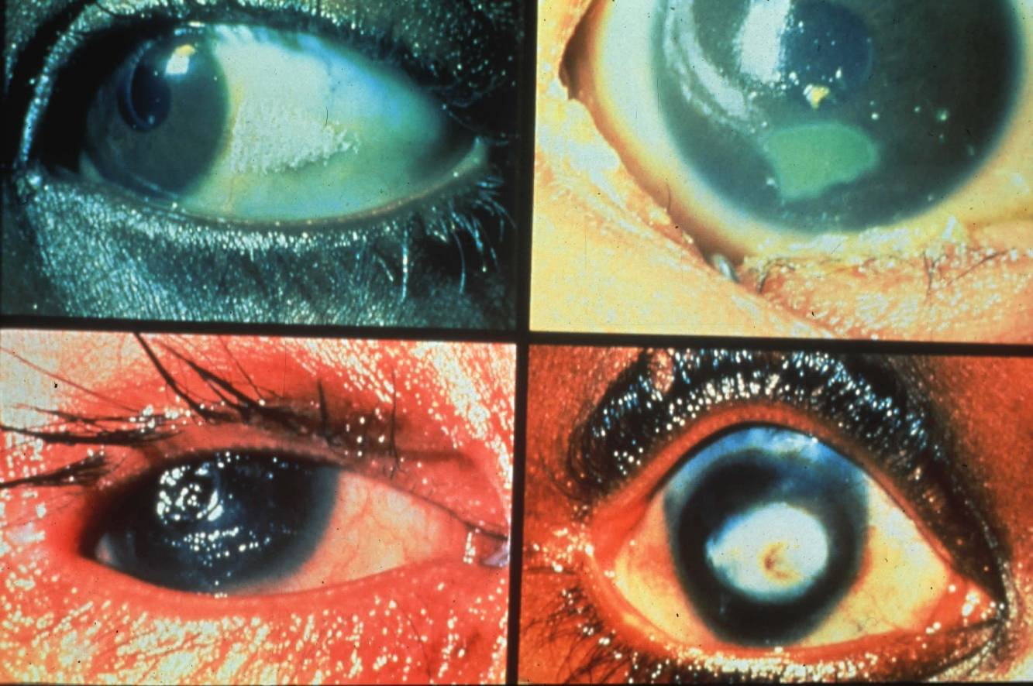
WHO Classification of Xerophthalmia
  1N Night blindness
  2B Bitot’s spots
  X3 Corneal xerosis
  X4 Corneal ulcerations -Keratomalacia
  X5 Corneal scars - permanent blindness

Slide 83
Over dosage toxicity
Toxicity occurs if a person takes mega dose==10XRDA
Signs and symptoms
  Bulging soft spot on head in babies (infants), sometimes hydrocephaly ("water on brain"),
  confusion or unusual excitement, diarrhea, dizziness,
  double vision, headache, irritability, dry skin, hair loss, peeling skin on lips, palms and in other areas, seizures, vomiting

Slide 84
Birth Defects (Teratogenesis)
Liver Abnormalities
Bone Mineral Loss

Slide 85
Con….
Prevention of and control of Vitamin A deficiency
1. High Dose vitamin A Supplementation
Targets : Children 6-59 months and Lactating women:
a) Universal Supplementation Schedule
Children 6-11 moths = 100,000 IU every 6 months
Children 12-59 months= 200,000 IU every 6 months

Slide 86
.
B.Diseases Targeted Supplementation Schedule
Preventive dose: a single dose of vitamin A at the contact of a child with acute respiratory infection (ARI), Diarrheal disease(DD) and Severe acute malnutrition (SAM)
Therapeutic dose: For Measles and Xerophthalmia - Give therapeutic doses of vitamin A (i.e. 3 doses) on day 1, day 2 and day 14, with the strength of the dose as stated above
Note: this dose should not be given to children who have already received a high dose vitamin A supplement within the preceding month

Slide 87
Con….
. 2.Breast feeding = Colustrum has high concentration of vitamin A, it is called the first immunization of the baby
.3. Dietary Modification: Fortification of oil, floor , sugar
.4. Dietary Diversification – Behavior change communication on the consumption of vitamin A friendly foods eg. Growing and consuming Orange fleshy sweet potatoes

Slide 88
Vitamin D
Also known as calciferol due to its role in calcium absorption
Main role is to maintain calcium and potassium levels
It is the only fat soluble vitamin that we can make- in the presence of sunlight
Can be made from cholesterol

Slide 89
Con….
Can be stored in fat tissues (as can all fat soluble vitamins)
Elderly and shut ins are at risk- not enough sunlight
We get vitamin D form fortified milk and cereal
Toxicity is very dangerous
  Occurs only from excess supplementation
  Can lead to calcium deposits in kidneys, heart and blood vessels

Slide 90
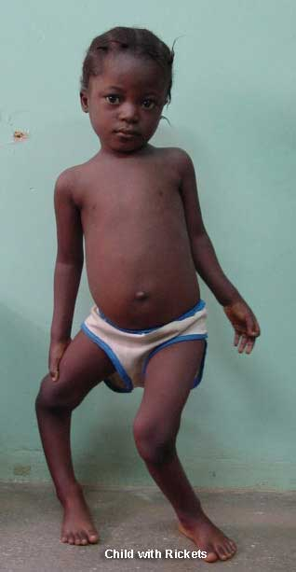
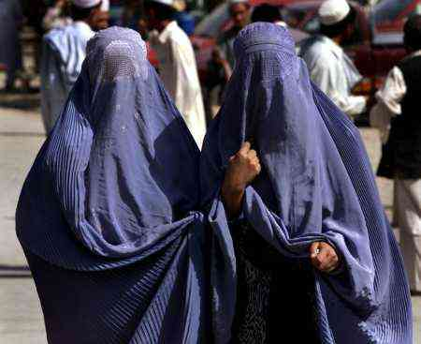
Rickets can be caused by lack of sunlight, but also from insufficient calcium.Vitamin D linked to calcium absorption.

Slide 91
Vitamin E
A family of eight naturally occurring compounds
Used as an anti-oxidant in foods
Since aging is considered an “oxidation” reaction, many “anti-oxidants” are used as dietary supplements
Deficiencies are not well understood
Role is stroke, cancer, heart, and immune response
Americans spend $300 million per year on vitamin E supplements

Slide 92
Vitamin K
Contributes to synthesis of seven blood clotting factors
Can be reactivated to continue biological action
Works as a cofactor for an enzyme that makes bone proteins.
Not stored in the body

Slide 93
Water Soluble Vitamins
B₁, thiamine
B₂, riboflavin
B₆, pyridoxamine
B_{12 cobalamine}
Biotin (b 7)
Panothenic acid 5
Niacin b3
Folacin b9
Vitamin C

Slide 94
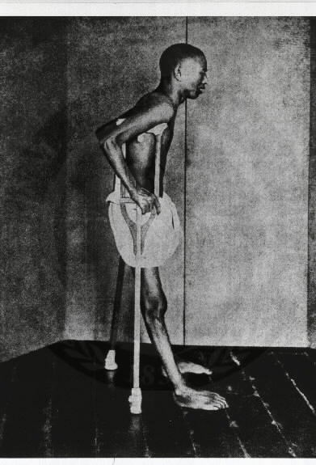
Water Soluble Vitamins
Vitamin B₁
  Thiamine
  Involved in carbohydrate metabolism
  Helps body metabolize glucose, affects central nervous system
  Deficiency causes Beri beri
  (Singlese, “I can’t, I can’t”)
B₂- riboflavin
  Energy metabolism

Slide 95
Water Soluble Vitamins
B₆ - Pyridoxine
  Neurotransmitter, co-enzyme in over 100 reactions
B₁₂ –
  Development of red blood cells
  Lack of it makes one anemic
  Hard for vegans to get

Slide 96
Water Soluble Vitamins
Biotin –
  Involved in fatty acid synthesis
  Deficiency causes skin disease and hair loss
Panthothenic acid
  Found in many foods
  Essential for metabolism of carbohydrates, protein, alcohol and fat

Slide 97
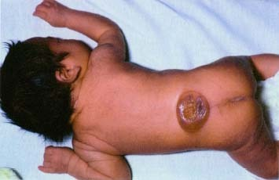
Water Soluble Vitamins
Folic acid/ folacine
  A major component of cell membranes
  Folacin = Folate = Folic acid
  Deficiency causes neural tube defects – in utero as well as ancphaly

Slide 98
Vitamin C
Ascorbic acid
Very inexpensive to add to food, marketing tool. Antioxidant
Deficiency leads to bleeding gums, hemorrhages
High in citrus fruits, limes, (Limeys)

Slide 99
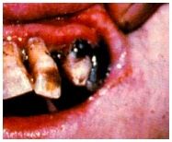
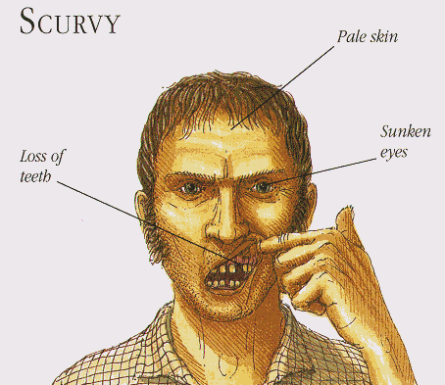
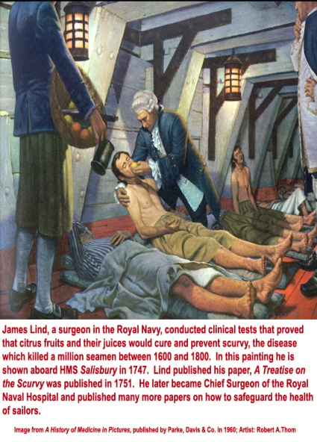
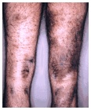
Vitamin C - Scurvy

Slide 100
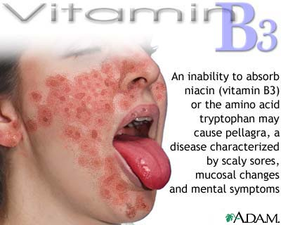
Niacin (B3)
Energy metabolism
Disease – pellagra – The Four D’s
  Dermatitis
  Diarrhea
  Dementia
  Death

