Slide 1
Nutrition problems of public health importance
For Bsc Midewifery students
By Ayenew.N (BSc, MPHN)

Slide 2
Contents of This topic
Protein-energy malnutrition
Iodine deficiency
Iron deficiency anemia

Slide 3
objectives
By the end of the course, the student should be able to:
  Know major macro and micronutrient deficiencies of public health importance in a developing settings with a special focus on the Ethiopian situation
  Describe the disease burden contributed by PEM, micronutrient deficiencies
  Explain the prevention and control measures of those deficiency states

Slide 4
introduction
Malnutrition is characterized by inadequate or excess intake of protein, energy, and micronutrients characterized by:
  Under nutrition - stunting , wasting and under weight.
  Over nutrition.

Slide 5
Protein energy malnutrition(PEM)
Underweight
Marasmus
Kwashiorkor
Marasmic kwashiorkor
Wasting
Stunting
SAM
MAM

Slide 6
Underweight(wt for age)
Define: weight-for-age less 80% expected
Encompasses both wasting and stunting
Most global data
High correlation with stunting
Prevalence directly describes the magnitude of the problem of growth faltering and stunting in young children

Slide 7
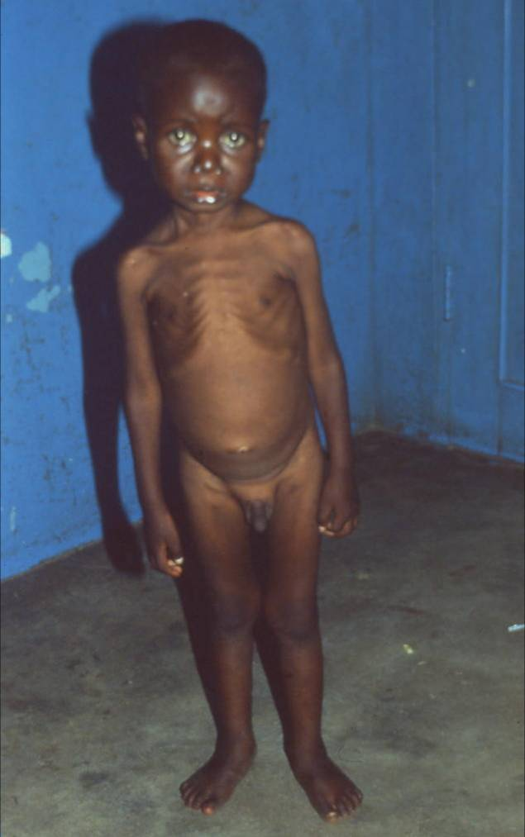
Marasmus
Weight for age < 60% expected
No edema
Often stunted
Hungry, relatively easier to feed
CFR=20-30%

Slide 8
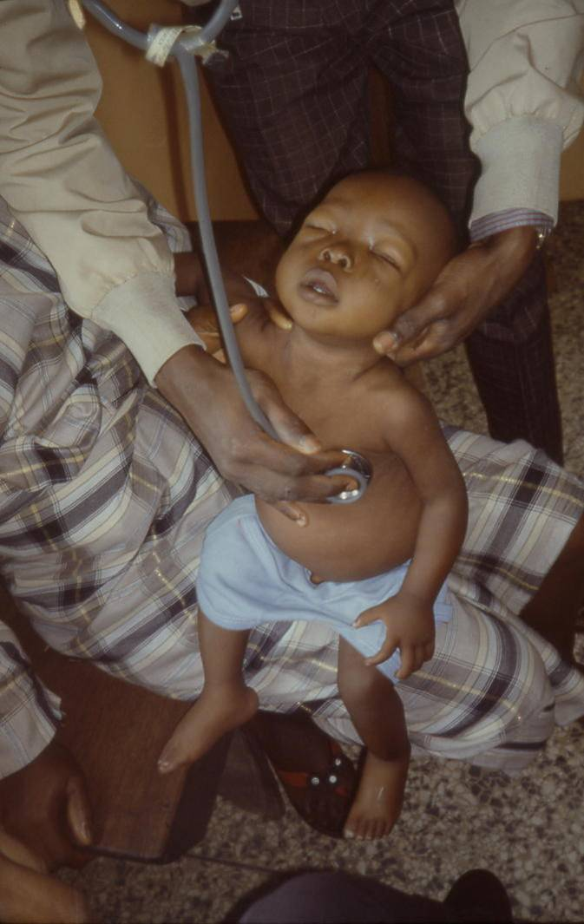
Kwashiorkor
(Edematous Malnutrition)
Underweight with edema
Irritable, difficult to feed
Electrolyte abnormalities
Highest mortality – 50 to 60%

Slide 9
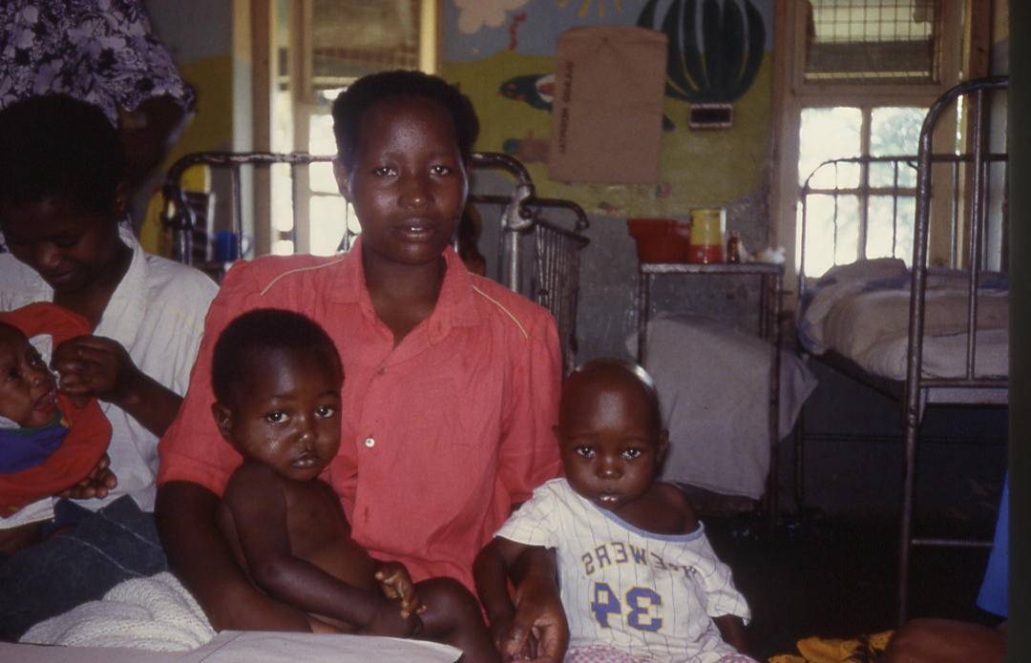
STUNTING
Height for age less than 90% expected

Slide 10
CLASSIFICATION OF ALL DEGREE OF PEM
Gomez classification: used on weight for age
1st degree of malnutrition is equivalent to
76 – 90% WFA
2nd degree of malnutrition is equivalent to
61 –75%
3rd degree of malnutrition is <60%

Slide 11
The disadvantage of this classification
A cut–off point of 90% of reference is high (80% being equivalent to–2.SD or the 3rd percentile)
It is difficult to know if the low weight is due to sudden acute episode or long standing chronic malnutrition.

Slide 12
Waterlow has suggested
Waterlow has suggested classification based on wasting (current malnutrition) or stunting (chronic malnutrition)
WFH = 80% of the Reference standard or
–2.SD below the median
HFA = 90% or – 2.SD below the median

Slide 13
Wellcome
Is used for classifying and screening severe malnutrition in children brought to hospital.
The Wellcome system makes use of two types of information.
WAF, and presence/absence of edema for making a diagnosis

Slide 14
Waterlow classification
Height | Weight
 | Above | Below
Above | Normal | Acute malnutrition
Below | Nutritional Dwarfism | Chronic Malnutrition

Slide 15
Welcome classification
 | Oedema present
WFA% | No | Yes
60 – 80 | Underweight | Kwashiorkor
<60 | Marasmus | Marasmic kwash

Slide 16
Severe Acute Malnutrition
SAM
Weight-for-height of 70% (extreme wasting)
Presence of bilateral pitting edema of nutritional origin, “edematous malnutrition
Mid-upper-arm circumference of less than 110 mm in children age 1-5 years old

Slide 17
FIVE Functional Consequences
Mortality
Illness
Intelligence loss
Reduced productivity
Impaired immune status

Slide 18

Manifestation OF PEM
Hidden problem
No obvious sign
Victim no aware
UNICEF/94-1173 Pirozzi

Slide 19
CON…..
Protein Energy malnutrition
It is multi-deficiency state
  Macro- nutrients
  Micro- nutrients
Clinical forms (welcome come Classification)
    Kwashiorkor (Oedematous)
    Marasmus (Non oedematous )
    Marasmic – Kwashiorkor
Growth failure without clinical signs
    Wasting - Acute malnutrition
    Stunting - Chronic malnutrition
    Underweight - Acute / Chronic

Slide 20
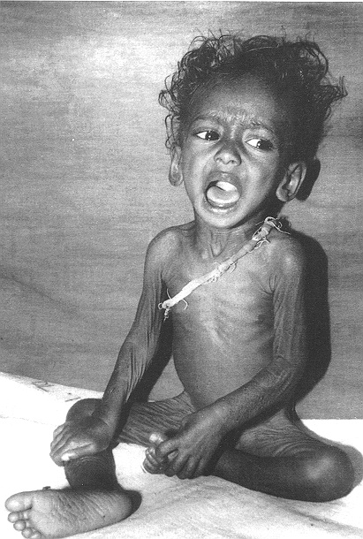
Marasmus
Clinical pictures of Marasmus
Growth retardation
Wasting of Subcutaneous fat and muscles (flabby muscles)
old man face (wizened (wrinkled)monkey)
sunken eye balls
increased appetite
Irritable always and has mild skin and hair change

Slide 21
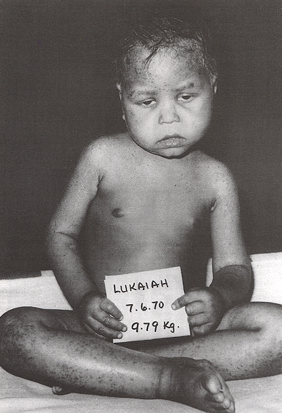
kwashiorkor
Hair - thinner and lighter
Moon face
No appetite
Skin lesionsApathetic and miserable
Oedema (symmetrical oedema involving
at least the feet)

Slide 22
HOW THEY DIFFER FROM NORMAL INDIVIDUAL
Reductive adaptation
is the physiological response of the body to under nutrition and the body conserves energy by:
  reducing physical activity and growth
  reducing basal metabolism by:
      slowing protein turnover
      slowing and reducing Na+/K+ pumps
  reducing inflammatory and immune responses

Slide 23
CONTINUED….
As a result Liver, Kidneys, Heart & Gut reduced their function. Na leaks into cells & K+ out.
Red cell mass is reduced
  release ‘free’ iron; ‘Free’ iron makes infections worse; generates free radicals.

Slide 24
Measuring malnutrition: nutrition indices and indicators
Anthropometric measurements of growth
  Weight
  Height/Length
  MUAC
  HC
  BMI for Age

Slide 25
INDEX
The most common indices to compare weight and stature measurements with reference curves are:
      Weight-for-age
      length or stature-for-age
      Weight-for-length for children < 2 years of age
      BMI-for-age for children 2 to 20 years of age.

Slide 26
Some indicators of under nutrition:
An is indicator an index + a cut-off point.
      W F A < 60% = is indicator of severe malnutrition (Stunting)
      W F H < 7o% = is indicator of severe wasting (Wasting)
BMI < 16 kg/m2 = indicator of severe chronic energy deficiency (Underweight).

Slide 27
ACUTE MALNUTRTION
Severe acute malnutrition (SAM)
    =WFH<70%
    =MUAC<110mm,
    =any grade bilateral pitting edema,
Moderate acute malnutrition (MAM)
    =WFH 70-79.9%,
    =MUAC 110-119mm,
    =No edema
Global acute malnutrition (GAM)
=SAM+MAM

Slide 28
The Global conceptual framework for the causes of malnutrition
Reduced educability, lost productivity, mortality, morbidity
Functional consequences
Nutritional Status
Manifestation
Immediate
Causes
Diet
Health
Household
Food Security
Care of Mother
and Child
Environ. Health,
Hygiene & Sanitation
Underlying
Causes
Human, Economic, and Institutional
Resources, manmade & natural calamities
Political and Ideological Structure
Basic
Causes
Ecological Conditions
Adapted from UNICEF
Potential Resources

Slide 29
Etiology of PEM
Theory of Low Protein Intake - Low protein intake, which leads to hypo-albuminemia, which in turn leads to edema.
Theory of Dys-adaptation - Edema is determined not only by diet but also by intrinsic differences among children with regard to their protein requirement or hormonal response. Hence, kwashiorkor develops in children that poorly adapted and Marasmus develops in children that are well adapted to the states of lower nutrient intake.
Theory of Aflatoxins - Hendricks reported from a study in Sudan that children with Aflatoxins developed edema compared to those with no aflatoxin intake.

Slide 30
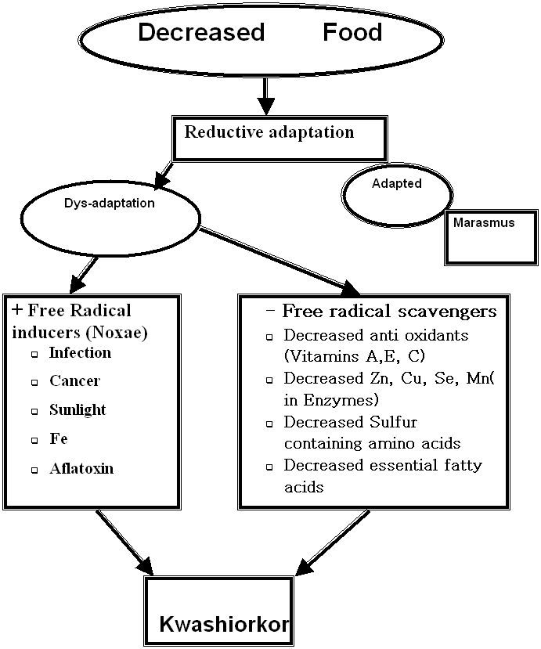
4. Free radical theory of PEM

Slide 31
Management of severe acute malnutrition
Successful management of SAM doesn’t require sophisticated facility & equipments or highly qualified personnel but it requires skilled HP & use of proper guideline and proper care & affection.
All SAM cases should be admitted to a therapeutic feeding program, either inpatient or outpatient after decision for admition.

Slide 32
10 Steps of routine care
32
STABILISATION
REHABILITATION
Day 1-2
Day 2-7+
Week 2-6
1.
Treat/prevent hypoglycaemia
2.
Treat/prevent hypothermia
3.
Treat/prevent dehydration
4.
Correct imbalance of electrolytes
5.
Treat infections
no iron
with iron
6.
Correct deficiencies of micronutrients
7.
Start cautious feeding
8.
Rebuild wasted tissues (catch-up growth)
9.
Provide loving care and play
10.
Prepare for follow-up

Slide 33
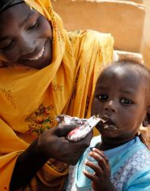
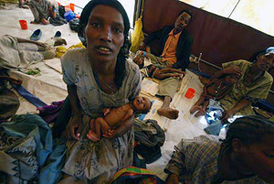

continued
Management of SAM
33
Debre Markos Univ, 2014.
12/31/2016

Slide 34
Trends in SAM management
Traditionally, children with SAM are treated in centre-based care: paediatric ward, therapeutic feeding centre (TFC), nutrition rehabilitation unit (NRU), other inpatient care sites.
  Currently, The centre-based care model is implemented based on guideline for Management of Severe Malnutrition of WHO.

Slide 35
cont…
During the past 5 years, an increasing number of countries and international relief agencies have adopted a community-based model for the management of acute malnutrition, called community-based therapeutic care (CTC).
The CTC model consists of four elements:
1. Measures to mobilize the community in order to encourage early presentation and compliance;

Slide 36
Cont …
2. Outpatient supplementary feeding protocols for those with moderate acute malnutrition and no serious medical complications;
3. Outpatient therapeutic protocols for those with severe acute malnutrition and no serious medical complications; and
4. Inpatient therapeutic protocols for those with acute malnutrition also suffering from serious medical complications.

Slide 37
Types of acute malnutrition
Acute malnutrition is divided into two types: moderate and severe.
defined according to anthropometry and the presence of bilateral pitting edema.
Moderate acute malnutrition
Moderate acute malnutrition (MAM), also known as wasting, is defined by a weight-for-height indicator between -3 and -2 z-scores (standard deviations) of the international standard or by a mid-upper arm circumference (MUAC) between 11 cm and 12.5 cm

Slide 38
Cont…
Severe acute malnutrition
WFH < -3z scores, is the most dangerous form of malnutrition. If left untreated, SAM can result in death. It can manifest in two ways:
- >Severe Wasting:
Severe wasting is characterized by a massive loss of body fat and muscle tissue. Children who are severely wasted look almost elderly and their bodies are extremely thin and skeletal.
- >Edema:
It is present on the lower limbs, and is verified when thumb pressure is applied on top of both feet for three seconds and leaves a pit or indentation in the foot, after the thumb is lifted.

Slide 39
Cont…
The edema may eventually spread to the legs and face, and the child appears puffy, and is usually irritable, weak and lethargic.
Other signs of edema include skin lesions, an enlarged liver and thinning hair.
Underneath the edema, the muscles have been severely weakened and the child experiences excruciating cramping and muscle pain.
Both types of severe acute malnutrition compromise the body’s vital processes.
Even if a child is treated and his/her nutritional status is restored, physical and mental development, and general health status may be adversely affected in the long term.

Slide 40
Cont…
Both moderate acute malnutrition and severe acute malnutrition may be accompanied by micronutrient deficiencies such as iron deficiency or nutritional anemia, iodine deficiency disorders and vitamin A deficiency
While children suffering from both moderate acute malnutrition and severe acute malnutrition are susceptible to illness, severely malnourished children are at greater risk of medical complications and death from illness, infections and micronutrient deficiencies

Slide 41
THERAPEUTIC FEEDING PROGRAMMES (TFP)
Objectives:
Therapeutic feeding, which consists of intensive medical and nutritional treatment of severely malnourished individuals, aims to reduce the risk of excess mortality and morbidity.
Therapeutic Feeding Components
1. Inpatient management of SAM with medical complications; and
2. Outpatient management of SAM without medical complications

Slide 42

WHO classification for selecting treatment modalities
Acute Malnutrition
Severe Acute Malnutrition
Moderate Acute Malnutrition
SAM with out medical
complications*
SAM with medical
complications*
Supplementary
Feeding
In-patient Care
/SC/
Outpatient Care
/OTP/

Slide 43
Management of Sever Acute Malnutrition
The principles of management of severe acute malnutrition, whatever the programme setting, are based on 3 phases.
Phase 1.
Patients without an adequate appetite and/or a major medical complication are initially admitted to an in-patient facility for Phase 1 treatment.
The formula used during this phase (F75) promotes recovery of normal metabolic function and nutrition-electrolytic balance.
Rapid weight gain at this stage is dangerous, that is why F75 is formulated so that patients do not gain weight during this stage.

Slide 44
Transition Phase.
A transition phase has been introduced for in-patients because a sudden change to large amounts of diet, before physiological function is restored, can be dangerous and lead to electrolyte disequilibrium.
During this phase the patients start to gain weight as F100 or RUTF is introduced. The quantity of F100 given is equal to the quantity of F75 given in Phase 1 or an equivalent amount of RUTF.
As this is resulting in a 30% increase in energy intake the weight gain should be around 6 g/kg/day; this is less than the quantity given, and rate of weight gain expected, in Phase 2.

Slide 45
Phase 2.
Whenever patients have good appetite and no major medical complication they enter Phase 2. Many patients who present with a good appetite are admitted directly into Phase 2.
This can occur in both in-patient and out-patient settings. In Phase 2 they are given RUTF (used in both in-patient and out-patient settings) or F100 (used in in-patient settings only) according to look-up tables.
Those formulas are designed for patients to rapidly gain weight (more than 8 g/ kg/day). The look-up tables are scaled so that the same tables can be used to treat patients of all weights and ages

Slide 46
In-patient:
Patients that are admitted can be treated on a 24/24 hour basis (receiving the dietA as in-patients with full medical surveillance and treatment of complications (either 6 or 8 meals per 24 hours are given).
For all in-patients, as soon as they regain their appetite and are ready for Phase 2 they should continue treatment as out-patients wherever the carer agrees and an out-patient programme is in place.

Slide 47
Out-patients.
Out-patient treatment is normally organized from the same facilities that have in-patients.
However, out-patient care, in the community, should also be organized from health posts or even non-clinical facilities that are close to the patients’ homes.
The patients attend on a weekly basis. Most patients can be managed entirely on an out-patient basis; so that there are
normally many more out-patients than in-patients. For each in-patient facility there should be several/many satellite out-patient distribution and assessment sites (“OTP sites”) close to the
community

Slide 48
Cont…
There needs to be a functioning communication and referral system between the health post/OTP site and the health centre/ hospital in-patient, so that patients can be quickly and easily transferred
from the in-patient facility to the out-patient programme as they enter Phase 2 and those out-patients, that fail to respond appropriately or who develop a complication can be admitted (temporarily) as in-patients.

Slide 49
Cont…
Patients who pass the appetite test should normally be directly admitted to the OTP, if the caretaker agrees, without passing through phase 1 and transition phase.
Patients that have started treatment as an in-patient, continue as out-patients to complete Phase 2.
Out-patient programmes are run on a weekly basis. Exceptions can be made for individual patients living in
very remote areas where they can be seen on a fortnightly basis after the initial two visits.

Slide 50
Link between in-patient and out-patient treatment

Slide 51
Admission criteria
All patients that fulfil any of the criteria should be offered therapeutic feeding in one of the available settings:
6 months to 18 years
W/H or W/L < 70% or
MUAC < 110 mm with a Length > 65 cm or
Presence of bilateral pitting edema
Adults
MUAC < 170 mm or
MUAC < 180 mm with recent weight loss or underlying chronic illness or
BMI < 16 with or
Presence of bilateral pitting edema (unless there is another clear cut cause)

Slide 52
ADMISSION PROCEDURES
Triage All the patients in waiting area .
Give All Severely Malnourished 10% sugar water solution to drink
Do Anthropometry
Do Appetite Test
Register the patient , Fill Multicharts (Critical Care Plan)
Take Hx and P/E (Should be differed for severely ill Children)
Explain to the care taker the procedures of your center.

Slide 53
Screening and triage
Notes:
For those that do not require “fast tracking” and fulfil the criteria for SAM - perform the
Appetite Test.
On arrival at the therapeutic feeding programme (OTP, TFU, health centre or hospital),
obviously ill children and those that will clearly need in-patient or other medical treatment
should immediately be given sugar water7 and “fast tracked” without having to wait for the
rest of the patients to be seen.
Screen the patients in the community (MUAC and check for oedema) and the waiting area of
the OPD of health facilities (MUAC, weight, height/ length, oedema).

Slide 54
Appetite Test
Why do the appetite test?
Anthropometric Vs metabolic malnutrition
Malnutrition changes the way infections and other diseases express themselves.
Often the only sign of severe metabolic malnutrition is a reduction in appetite.

Slide 55
The result of the appetite test
Pass.
1. A child that takes at least the amount shown passes the appetite test.
2. Determine if he/she has a major complication.
If s/he has no medical complication, has not got open skin lesions, edema +++ or both wasting and edema together then s/he should normally be treated as an out-patient
3. Explain to the carer the choices of treatment option and decide with the carer

Slide 56
Cont…
Fail
1. A child that does not take at least the amount of RUTF shown should be referred for in-patient care.
2. Explain to the carer the choices of treatment options and the reasons for recommending in-patient care; decide with the carer
3. Refer the patient to the nearest TFU for Phase 1 management

Slide 57
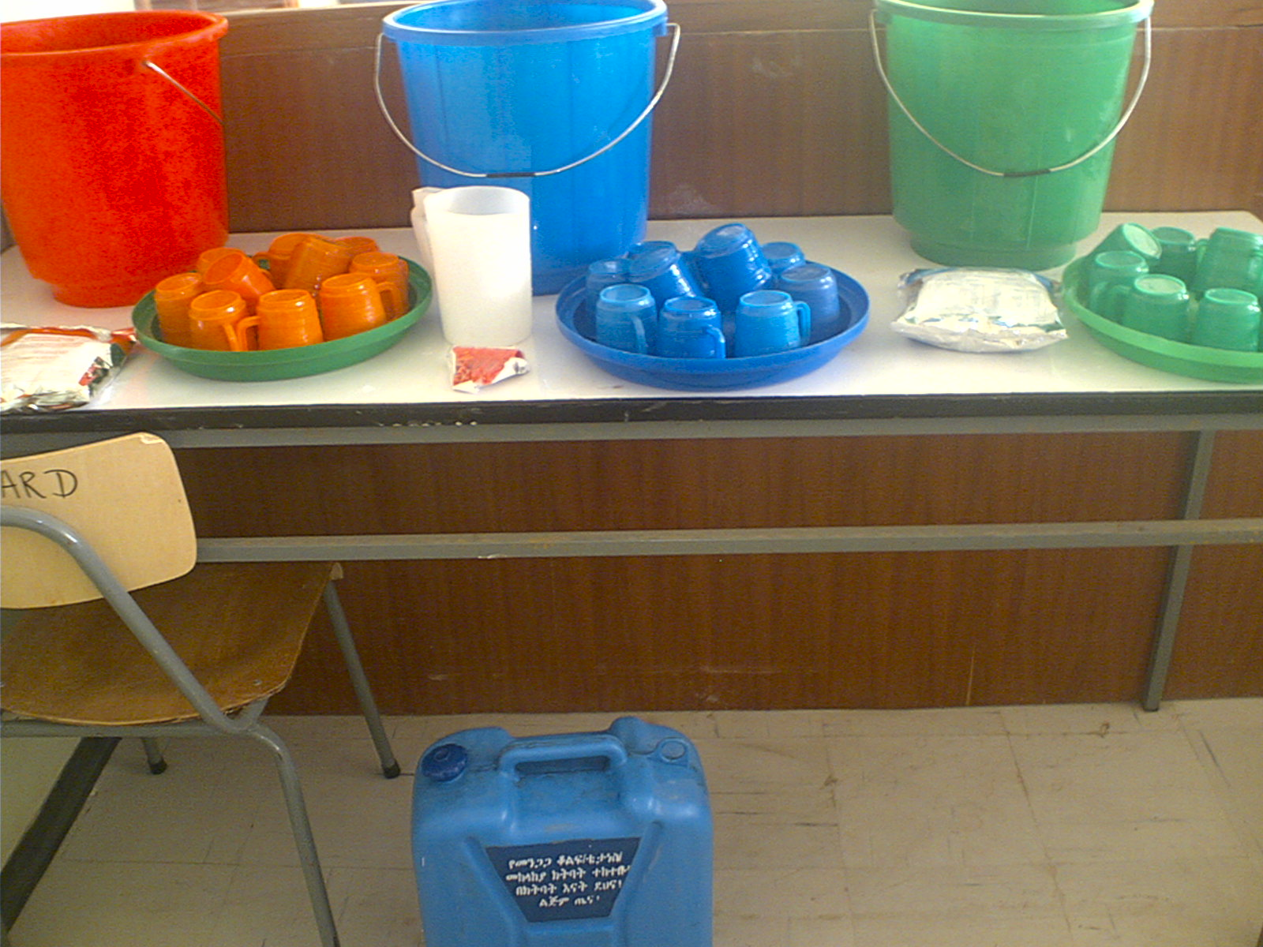
Inpatient Management of SAM with Medical Complications
Phase –I
Transition phase
Phase -II

Slide 58
Cont..
Phase –I (Acute phase)
Patients without an adequate appetite and or a major medical complication are initially admitted to an in-patient facility for Phase 1 treatment.

Slide 59
Medical complication
Bilateral pitting oedema Grade 3 (+++)
Marasmus-Kwashiorkor (W/H<70% with oedema or MUAC<11cm with oedema)
Severe vomiting/ intractable vomiting
Hypothermia: axillary’s temperature < 35°C or rectal < 35.5°C
Fever > 39°C
Fast Breath -- (60 resps/ min for under 2 months,50 for 2 to12month,>40 from 1 to 5 years and 30 resps/minute for over 5 year-olds

Slide 60
Cont…
Extensive skin lesions/ infection
Very weak, lethargic, unconscious, Fitting/convulsions
Severe dehydration based on history & clinical signs
Any condition that requires an infusion or NG tube feeding.
Very pale (severe anaemia), Jaundice, Bleeding tendencies
Other general signs the clinician thinks warrants transfer to the in-patent facility for assessment.

Slide 61
Activities in Phase – I
Therapeutic Feeding
Routine drugs
Prevent, diagnose and treat the above complication
Monitoring progress
Therapeutic Feeding
Diet to use
F75: (130ml = 100kcal) should be given
Eight feeds per day are given for 24h

Slide 62
Feed F75: (130ml=100kcal
The formula used during this phase (F75) which promotes recovery of normal metabolic function and nutrition-electrolytic balance.
Rapid weight gain at this stage is dangerous, that is why F75 is formulated so that patients do not gain weight during this stage.
  F75 has less sodium, proteins, fat, lower osmolarity and renal solute load than F100. It is less energy dense.
  Quantities: 100kcal/130ml/kg/d for children.

Slide 63
Feed F-75,…
  Feed by cup & saucer or NG-tube (not spoon)
Naso-gastric feeding
Indications
      Taking less than 75% of prescribed diet in phase 1
      pneumonia with a rapid respiration rate
      painful lesions of the mouth
      cleft palate or other physical deformity
      disturbances of consciousness.

Slide 64
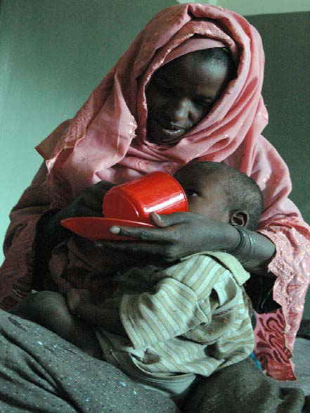
Feeding technique
The muscle weakness and slow swallowing of these children makes aspiration pneumonia very common.
The child should be on the carer’s lap against his chest, with one arm behind his back.
The carer’s arm encircles the child and holds a saucer under the child’s chin.
The child should be sitting straight (vertical).
The F75 is given by cup, any dribbles that fall into the saucer are returned to the cup

Slide 65
Routine medicines
Vitamin A: on the day of admission for all children except those with oedema or those who received in the past 6 months.
Give vitamin A to every patient on the day of discharge from “SC” or at 4th week of those in OTP.
Dose = 6 to 11 months: 100,000IU (or 3 drops or half a red capsule)
  12 months (or 8 kg) and more: 200,000IU (one red capsule)
Folic acid: 5 mg single dose for children with clinical sign of Anemia
Notes:
There are sufficient micronutrients in F100 to correct most sub-clinical deficiencies – overt clinical deficiencies should be specifically treated.
Two measles vaccines are often given – one on admission to protect the child from incubating measles and nosocomial infection – but the antibody response is not good. Therefore a second dose is given at discharge for protection.

Slide 66
Cont..
MALARIA
According to national guideline
NOTE: Never give IV infusions of quinine to a patient with SAM within the 1st two weeks of treatment.
MEASLES
In in-patient settings, all children from 9 months without a vaccination card should be given measles vaccine both on admission and discharge after Phase 2
In out-patient settings, all children from 9 months without a vaccination card should be given measles vaccine on the 4th week of treatment (including those that have been initially treated as in-patients).
DEWORMING
Albendazole or Mebendazole is given at the start of Phase 2 for patients that will remain as inpatients
For both those transferred from in-patients to Phase 2 as out-patients and those admitted directly to OTP de-worming is given at the 2nd out-patient visit (after 7 days).

Slide 67
Cont…
ANTIBIOTICS
Antibiotics should be given to every severely malnourished patient despite in the absence of clinical signs. Small bowel bacterial overgrowth occurs in all these children and cause:
Systemic infection by translocation across the bowel wall
Malabsorption of nutrients;
Failure to eliminate substances excreted in the bile, fatty liver, intestinal damage and can cause chronic diarrhoea

Slide 68
The antibiotic regimen:
1ST line treatment: oral amoxicillin 20mg/kg/d tid (if amoxicillin not available, use oral ampicillin)
2ND line treatment:
add chloramphenicol (do not stop amoxicillin) or
add gentamycin (do not stop amoxicillin) Or change to amoxicillin/clavulinic acid (Augmentin®)
3RD line: individual medical decision.
Frequently a systemic anti-fungal (Fluconazole) is added for any patient who has signs of severe sepsis or systemic candidiasis

Slide 69
Summary table of systematic treatment of patients
 | Direct admission to in-patient (Phase 1) | Direct admission to out-patient (Phase 2)
Vitamine A | 1 dose at admission (conditional) 1 dose on discharge do not give when transferred to OTP - it will be given in OTP | 1 dose on the 4th week (4th visit)
Folic Acid | 1 dose at admission if signs of anaemia | 1 dose at admission if signs of anaemia
Amoxicillin | In Phase 1 + 4 more days in transition | 1 dose at admission + give Rx for 7 days at home
Malaria | According to national protocol | According to national protocol
Measles (> 9/12) | 1 vaccine at admission if no card 1 vaccine at discharge | 1 vaccine on the 4th week (4th visit)
Iron | Add to F100 in Phase 2 | No, iron is already in all RUTF
Deworming | 1 dose at the start of Phase 2 | 1 dose on the 2nd week (2nd visit)

Slide 70
SURVEILLANCE/Monitoring
RECORD |  | FREQUENCY
Weight |  | Daily
Edema |  | Daily
Body temperature |  | Twice per day
Standard clinical signs | Stool | Daily
 | Vomiting
 | Dehydration
 | Cough
 | RR
 | Liver size
MUAC |  | Weekly
Length / Height |  | Every 3weeks

Slide 71
CRITERIA TO PROGRESS FROM PHASE 1 TO TRANSITION PHASE
The criteria to progress from Phase 1 to Transition Phase are both:
Return of appetite and
Beginning of loss of oedema (i.e. appropriate and proportionate weight loss) and
No IV line, no NGT.
Children with gross edema (+++) should wait in Phase 1 at least until their edema has reduced to moderate (++) edema.

Slide 72
Transition Phase
Diet
The ONLY change that is made to the treatment on moving from Phase 1 to the Transition Phase is a change in the diet that is given from F75 to RUTF or F100.
A transition phase has been introduced for in-patients because
A sudden change to large amounts of diet, before physiological function is restored, can be dangerous and lead to electrolyte disequilibrium.
During this phase the patients start to gain weight as F100 or
RUTF is introduced.
The quantity of F100 given is equal to the quantity of F75 given in Phase 1 or an equivalent amount of RUTF.
As this is resulting in a 30% increase in energy intake weight gain should be around 6 g/kg/day; this is less than the quantity given, and rate of weight gain expected, in Phase 2.

Slide 73
CRITERIA TO MOVE BACK FROM TRANSITION PHASE TO PHASE1
If the patient gains weight more rapidly than 6g/kg/d (this indicated excess fluid retention)
If there is increasing edema
If a child who does not have oedema develops oedema
If there is a rapid increase in the size of the liver
If any other signs of fluid overload develop.
If patient develops medical complication
If Naso-Gastric Tube is needed
If patient takes less than 75% of the feeds

Slide 74
CRITERIA TO PROGRESS FROM TRANSITION PHASE TO PHASE2
A good appetite (taking at least 90% of the RUTF or F100 prescribed) and no edema if inpatient continues.
For those who are going to continue as out-patients they can go when their appetite is good and oedema reduced to ++ or +.

Slide 75
Phase 2
Whenever patients have good appetite and no major medical complication they enter Phase 2.
Many patients who present with a good appetite are admitted directly into Phase 2.
This can occur in both in-patient and out-patient settings. In Phase 2 they are given RUTF (used in both in-patient and out-patient settings) or F100 (used in in-patient settings only) according to look-up tables.
Those formulas are designed for patients to rapidly gain weight (more than 8 g/kg/day).

Slide 76
Cont…
Fed F100* 6 times per day using the look-up chart plus one
porridge for the children >= 8kg. (porridge = 300 to 350kcal)
Given routine medicine
Monitored and any failure of response investigated

Slide 77
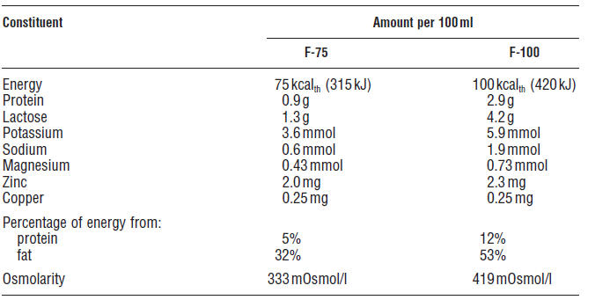
Composition of F-75 and F-100 diets

Slide 78
ROUTINE MEDICINE
Iron sulphate is added to the diet (1 tab 200mg Iron sulphate for 2 liters of F100*)
RUTF has iron already added to it – it should not be used for phase one or with any patient who has oedema, except in an emergency.
De-worming:
Albendazole 400mg Mebendazole 100mg
1 to 2 years ½ tablet once 2 ½ tablet once
>= 2years 1 tablet once 5 tablet once

Slide 79
Mebendazole 100mg
Age <1 year Not given
1 to 2 years 2 ½ tablet once
>= 2years 5 tablet once

Slide 80
FAILURE TO RESPOND

Slide 81
Cause of failure to respond
1. Problems with the treatment facility
Inappropriate patient selection
E.g. Poorly conducted appetite test
Inadequate instructions given to caretakers
Wrong amounts of RUTF dispensed to children
Excessive time between OTP distributions e.g. weekly better than fortnightly

Slide 82
Causes …
2. Problems of individual children and family
Sharing within the family
Unwilling caretaker
Caretaker overwhelmed with other work and responsibilities
Overlooked illnesses like HIV,TB

Slide 83
CRITERIA TO MOVE BACK FROM PHASE 2 TO PHASE 1
Failure of the appetite test
Increase/development of edema
Development of refeeding diarrhea sufficient to lead to weight loss
Fulfilling any of the criteria of “failure to respond to treatment”
Weight loss for 2 consecutive weighing
Weight loss of more than 5% of body weight at any visit
Static weight for 3 consecutive weighing
Major illness or death of the main caretaker so that the substitute caretaker requests inpatient Care

Slide 84
Discharge Criteria
W/H >=85% and
BMI >= 17.5
AND no oedema for 10days
Education has been completed
Immunisation is up-to-date
Adequate arrangements have been made for follow-up

Slide 85
3.1 Problem with centre based management model
Low coverage leading to late presentation
Overcrowding
Risk of creating a parallel system, rather than an integrated one.
Heavy staff work loads , with risk of defaulting
Cross infection
High default rates due to need for long stay

Slide 86
Problem with centre based management model,....
Potential for mothers to engage in high risk behaviours to cover meals
High financial cost
Prone to early discharge from treatment unit
Food taken by siblings or caretaker
Sharing of caretaker’s food

Slide 87
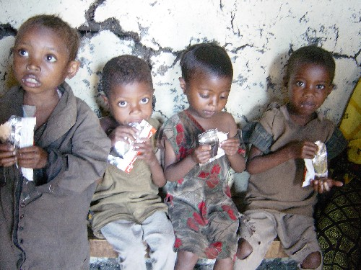
Community-Based Management of Acute Malnutrition (CMAM)

Slide 88
Community based management
A community-based approach to treating SAM
  Most children with SAM without medical complications can be treated as outpatients at accessible, decentralised sites
  Children with SAM and medical complications are treated as inpatients
  Community outreach for community involvement and early detection and referral of cases
Also known as community-based therapeutic care (CTC), ambulatory care, home-based care (HBC) for the management of SAM

Slide 89
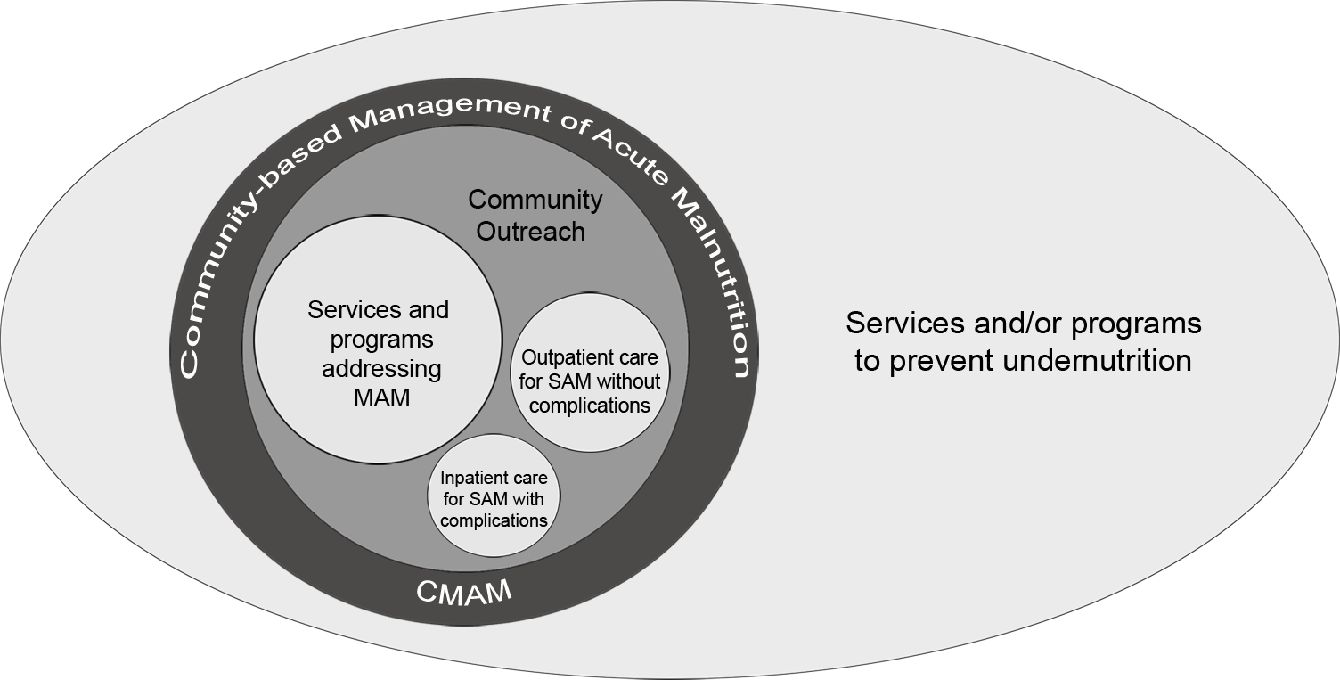
Core Components of CMAM (1)

Slide 90
Core Components of CMAM (2)
1. Community Outreach:
Community assessment
Community mobilisation and involvement
Community outreach workers:
  Early identification and referral of children with SAM before the onset of serious complications
  Follow-up home visits for problem cases
Community outreach to increase access and coverage
90
Notes:
90

Slide 91
Core Components of CMAM (3)
2. Outpatient care for children with SAM without medical complications at decentralised health facilities and at home
  Initial medical and anthropometry assessment with the start of medical treatment and nutrition rehabilitation with take home ready-to-use therapeutic food (RUTF)
  Weekly or bi-weekly medical and anthropometry assessments monitoring treatment progress
  Continued nutrition rehabilitation with RUTF at home
  ESSENTIAL: a good referral system to inpatient care, based on Action Protocol
91
Notes:
91

Slide 92
Core Components of CMAM (4)
3. Inpatient care for children with SAM with medical complications or no appetite
Child is treated in a hospital for stabilisation of the medical complication
Child resumes outpatient care when complications are resolved
ESSENTIAL: good referral system to outpatient care

Slide 93
Core Components of CMAM (5)
4. Services or programmes for the management of moderate acute malnutrition (MAM)
Supplementary Feeding
93

Slide 94
Principles of CMAM
Maximum access and coverage
Timeliness
Appropriate medical and nutrition care
Care for as long as needed
Following these steps ensure maximum public health impact!

Slide 95
Key Principle of CMAM
Maximum access and coverage
CTC is designed to achieve the greatest possible coverage by making services accessible to the highest possible proportion of a population in need.
It aims to reach the entire severely malnourished population.
95
Notes:
95

Slide 96
Timeliness
CTC aims to treat acute malnutrition before additional medical complications occur using:
  Active case finding to get the malnourished children early .

Slide 97
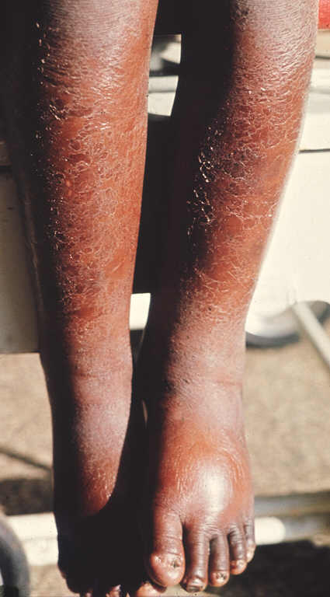
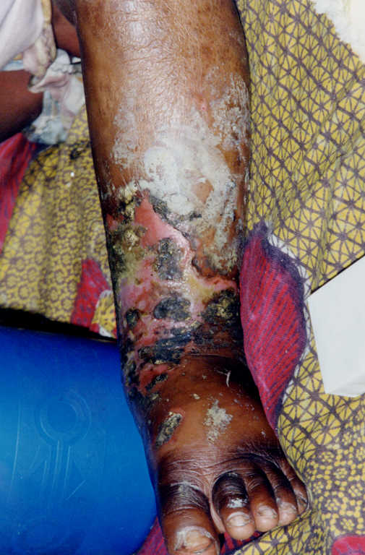
Timeliness: Early Versus Late Presentation

Slide 98
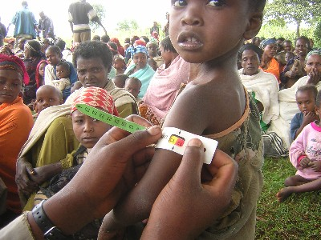
Timeliness (continued)
Find children before SAM becomes serious and medical complications arise
Good community outreach is essential
Screening and referral by outreach workers (e.g., community health workers [CHWs], volunteers)

Slide 99

Catching Acute Malnutrition Early
Inpatient care
Outpatient Care
SFP

Slide 100
Components of the CTC Programme and How They Fit Together
Death
Default
Recovery
Community mobilization
OTP
Death
Stabilization
Deterioration
Referral
Recovery
SC
Active case finding
Death
SFP
Default
Recovery
Default
Notes:
Stabilisation Centres (SC)
Inpatient
Equivalent to WHO phase 1 TFCs

Slide 101

1. Community Outreach
Key individuals in the community:
Promote CMAM services
Make CMAM and the treatment of SAM understandable
Understand cultural practices, barriers and systems
Dialogue on barriers to uptake
Promote community case-finding and referral
Conduct follow-up home visits for problem cases

Slide 102
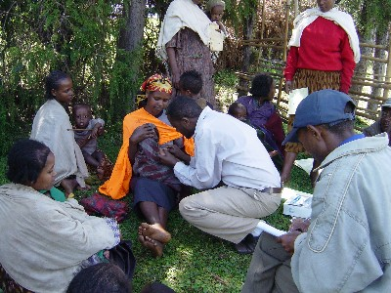
Community Mobilisation and Screening

Slide 103
2. Outpatient Care
Target group: children 6-59 months with SAM WITHOUT medical complications AND with good appetite
Activities: weekly outpatient care follow-on visits at the health facility (medical assessment and monitoring, basic medical treatment and nutrition rehabilitation)

Slide 104
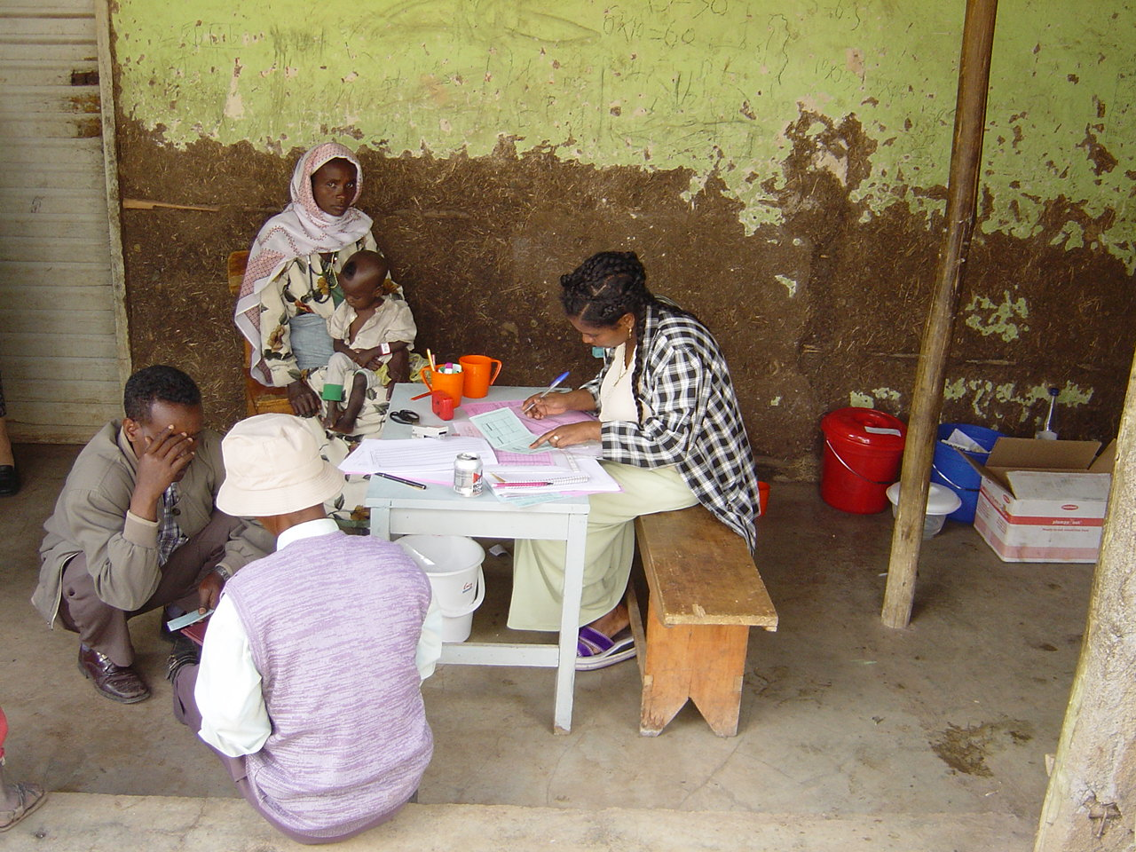
Clinic Admission for Outpatient Care

Slide 105
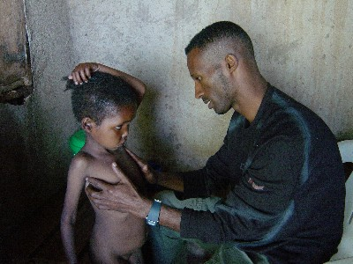

Outpatient Care:
Medical Examination

Slide 106
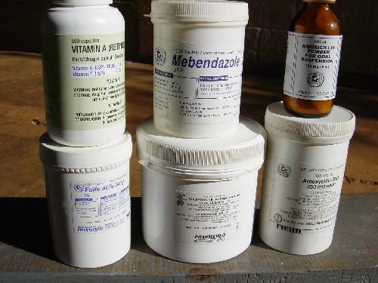
Outpatient Care:
Routine Medication
Amoxycillin
Anti-Malarials
Vitamin A
Anti-helminths
Measles vaccination

Slide 107
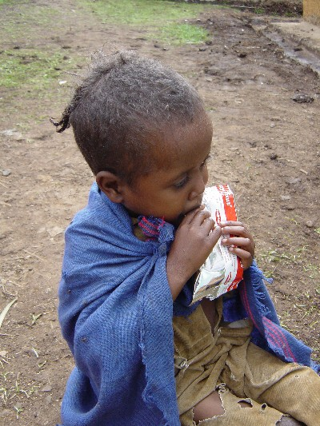
Outpatient Care: Appetite Test

Slide 108
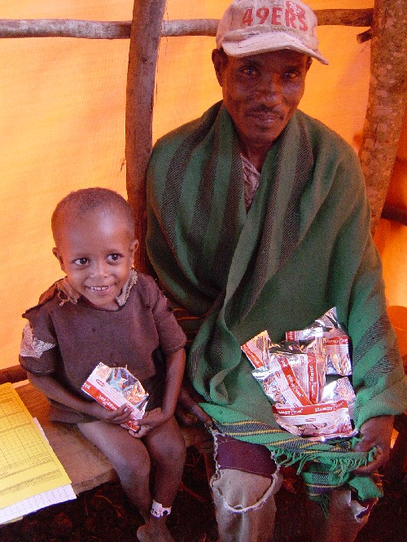
Ensure understanding of RUTF and use of medicines
Provide one week’s supply of RUTF and medicine to take at home
Return every week to outpatient care to monitor progress and assess compliance
RUTF Supply

Slide 109
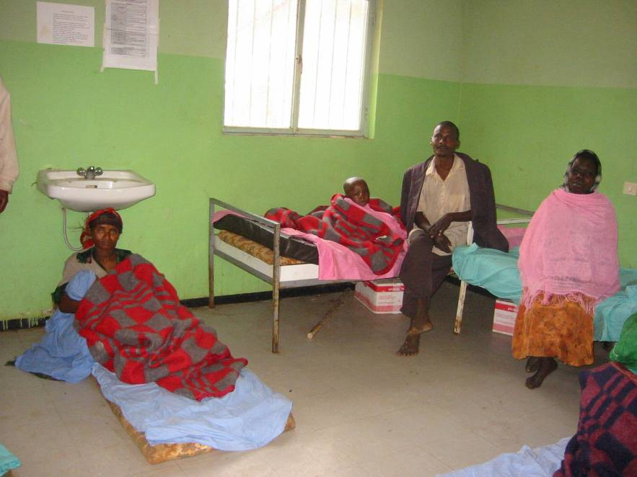
3. Inpatient Care
SAM with medical complications or no appetite
Medical treatment according to WHO and/or national protocols
Return to outpatient care after complication is resolved, oedema reduced, and appetite regained
All infants under 6 months with SAM receive specialised treatment until full recovery

Slide 110
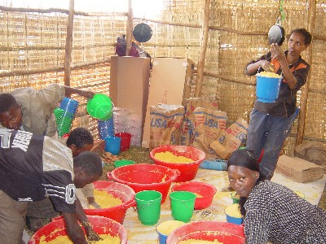
4. Services or Programmes for the Management of MAM
Activities
  Routine medication
  Dry supplementary ration
  Basic preventive health care and immunisation
  Health and hygiene education; infant and young child feeding (IYCF) practices and behaviour change communication (BCC)

Slide 111
Relationship Between Outpatient Care and Inpatient Care
Complementary
– Inpatient care for the management of SAM with medical complications until the medical condition is stabilised and the complication is resolving
Different priorities
  Outpatient care prioritises early access and coverage
  Inpatient care prioritises medical care and therapeutic feeding for stabilisation

Slide 112
CMAM in Different Contexts
Extensive emergency experience
  Some transition into longer term programming, as in the cases of Malawi and Ethiopia
Growing experience in non-emergency or development contexts
  e.g., Ghana, Zambia, Rwanda, Haiti, Nepal
Growing experience in high HIV prevalent areas
  Links to voluntary counselling and testing (VCT) and antiretroviral therapy (ART)

Slide 113
CMAM: It Works in
Emergency Contexts
Source: Valid International

Slide 114
The benefit from CTC
It could benefit children by reducing exposure to hospital-acquired infections and providing continuity of care after discharge.
It could benefit families by reducing the time carers spend away from home and the risk of possible neglect of siblings, and by reducing opportunity costs.
It could benefit the health system through capacity building and be the catalyst for strengthening nutrition activities within clinics.

Slide 115
The benefit from CTC,…
It could provide closer integration of curative and preventive services.
It could lower costs if fewer cases are referred to hospital or if children are discharged sooner than is currently the case.
If services improve and are more convenient for families, then uptake and coverage may increase.

Slide 116
Cost effectiveness
Basic nutrition or direct interventions
A set of effective interventions for universal implementation (e.g. supplementation with vitamin A and zinc, breastfeeding promotion, management of severe acute malnutrition)
Interventions relevant in specific contexts
If implemented at scale, the set of effective interventions would:
-Reduce all child deaths by about one quarter
-Reduce prevalence of stunting at 36 months by
about one third
Source: Lancet series 2008

Slide 117
Indirect interventions
Further reduction of Malnutrition also dependent upon addressing underlying and basic causes (e.g. social transfers, agriculture, health, water/sanitation, empowerment of women) Such programmers should be more systematically aligned behind nutrition objectives and designed to improve nutritional outcomes.

Slide 118
Summary
Public health approach to acute malnutrition
Maximise impact via coverage, access and appropriate level of care
Costs will be much cheaper than TFC
Provides viable exit strategies for emergency programmes
  High potential for local management
  Locally made therapeutic foods
High potential to provide support to PLWHA

Slide 119
Micro nutrient deficeinces

Slide 120
Iodine
Functions
Iodine is a trace element that combines with the amino acid, tyrosine, to form the thyroid hormone(T3 and T4) and is necessary for normal thyroid function.
Thyroid hormone accelerates cellular reactions, increases oxygen consumption and basal metabolic rate, influences growth and development, energy metabolism, differentiation and protein synthesis.
Ocean water, like seafood, is high in iodine content.
Goiter is more common in geographic areas that are inland and where iodine is not added to the soil through seepage of ocean water and ocean winds.

Slide 121
RDA
Age | RDA
0-6 months | 40mcg
6-12 months | 50mcg
1-3 years | 70mcg
4-6 years | 90mcg
7-10 years | 120mcg
11+ years | 150mcg
Pregnant | 375mcg
Lactating | 200mcg

Slide 122
Food sources
Drinking water
Sea foods
Foods grown on iodine containing soil.

Slide 123
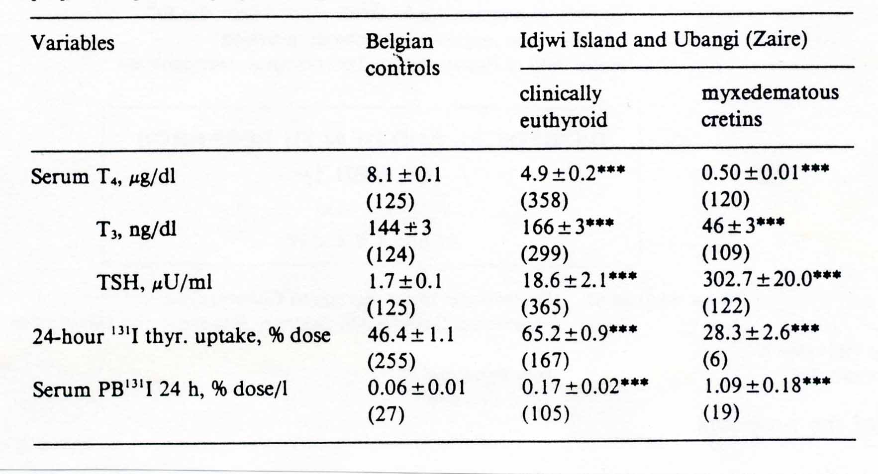
Hormones and iodine deficiency

Slide 124
Spectrum of disease

Slide 125
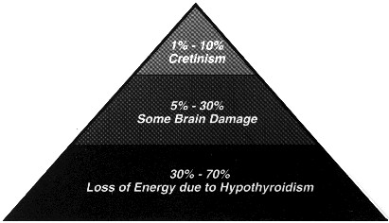
Importance of the problem

Slide 126
Goitre
Increase in size four to five times distal phalanx of the thumb
Aesthetic
Compression
Related hypothyroidism: is not a compensation
cancer
Iod Basedow (hyperthyroidism) due to hyperstimulation, mutation autonomous nodules

Slide 127


Slide 128


Slide 129


Slide 130


Slide 131


Slide 132
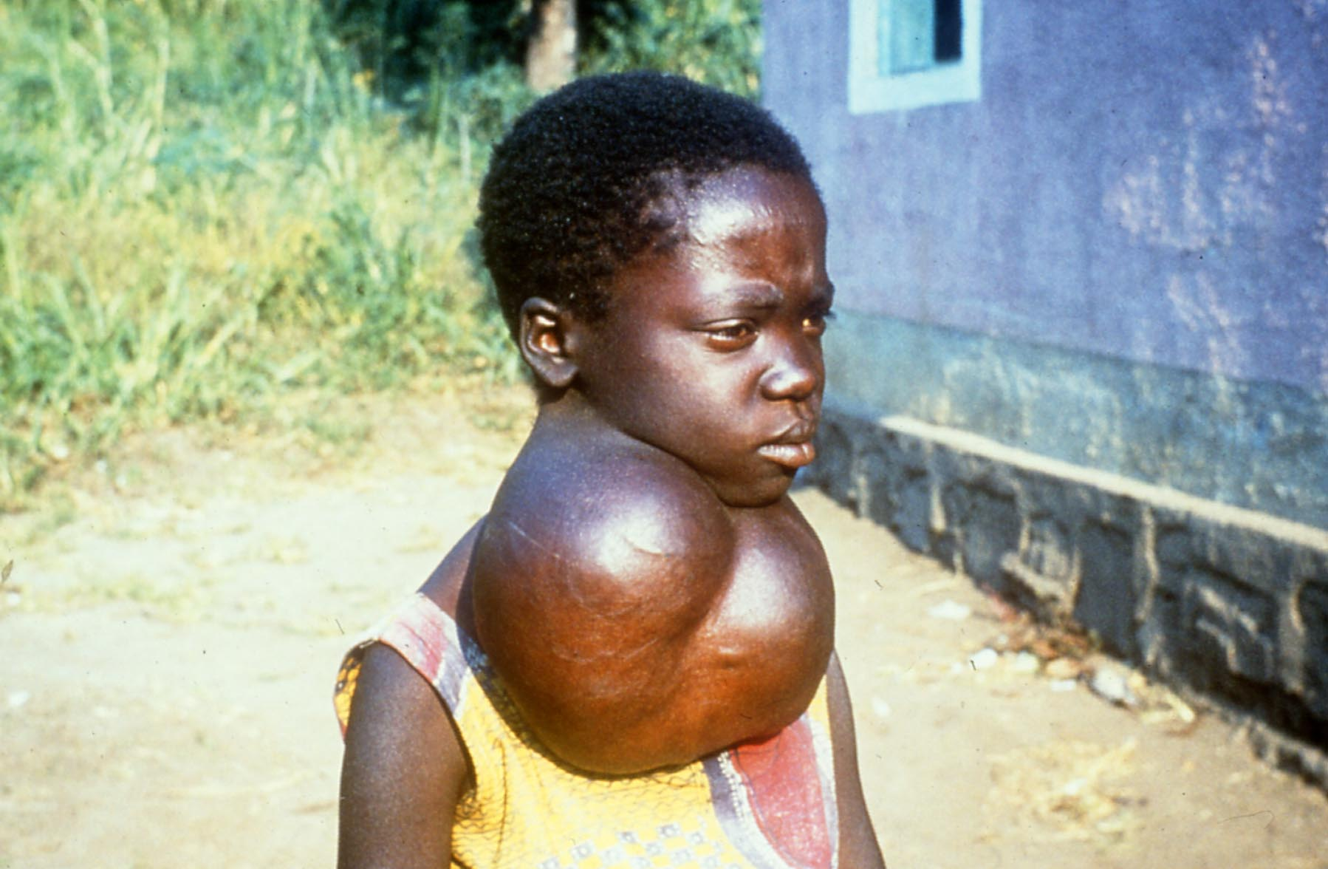

Slide 133


Slide 134
Iodine deficiency world wide
WHO Regions ª | Proportion of population with UI < 100 ตg/L (%) | Population with UI < 100 ตg/L (in millions) ^{b}
Africa | 47.6 | 48.342
The Americas | 14.1 | 9.995
Eastern Mediterranen | 55.4 | 40.224
Europe | 59.9 | 42.206
South East Asia | 39.9 | 95.628
Western Pacific | 19.7 | 36.082
Total | 36.9 | 272.438

Slide 135
Iodine defficency and the neonate
Perinatal mortality
Infant mortality
Low birth weight
Sub optimal Brain development.
Iodine deficiency mental retardation, retarded motor development.
General IQ decrease of 15 Points

Slide 136
Iodine deficiency and adults
Lack of energy
apathy, slow brains
goitre and mechanical complications
Nodular thyroid
hyperthyroidism
Pregnancy and cretinism

Slide 137
Deficiency
Iodine deficiency disorder refers to medical conditions ranging from simple goiter to deafness, mutism, squint and profound metal retardation called cretinism.
Globally, 30 % of the world’s population is affected by IDD and more than 150 million people are affected in Africa alone.
In Ethiopia,
38% of under five years old children have goiter and 35% of their biological mothers have goiters

Slide 138
Risk factors
Living in mountainous areas
Not eating sea foods
Eating large amounts of raw food that can cause thyroid goiter (goiterogens), such as spinach, lettuce, turnips, beets, rutabagas, kale are also at risk of developing iodine deficiency.

Slide 139

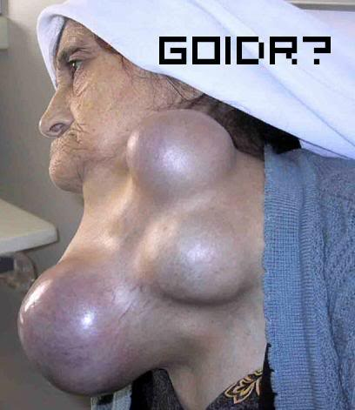
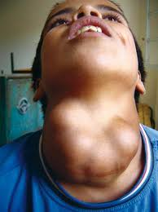
Clinical Manifestations
Fetus and Infants
  Depressed growth
  Delayed sexual development
  Mental retardation and learning disability
  Deafness and akinetic mutism
  Abortion and still birth
Adult deficiencies:
  Goiter
  Symptoms of low-thyroid-hormone level (children and adults):
  Listlessness
  Sluggish behavior
Beasts of burden
  Poor reproduction (abortion, still birth)
  Weakness

Slide 140
Endemic Goitor
An area is said to be endemic if 10% or more of child population has goiter.
Classification of Endemia of Iodine deficiency disorders by Severeity
Grades of severity of iodine deficiency disorders
 | Mild IDD | Moderate IDD | Severe IDD
1. Prevalence of goiter (total) | 5-19% | 20-29% | >=30%
2. Cretinism | 0 | 0 | 0-5
3. Median Urine iodine ug/d | 3.5-5 | 2-3.4 | 0-1.9
4. Prevalence of neonatal TSH > 50 ug/d | <1% | 1-5% | >5%

Slide 141
Intervention
1. Supply iodized salt for the whole family
The Quality and Standards Authority of Ethiopia, has set the iodine level to be 60-80 PPM as potassium iodated, after making allowance for losses of iodine during storage and distribution.
In Ethiopia, an iodine content of 80 – 100 PPM is required as KIO3 at the port of entry or at the packaging factory to satisfy the recommended daily requirement of 150µg of iodine per a person to prevent IDD

Slide 142
Universal salt iodization (USI) is the most widely practiced intervention in eliminating iodine deficiency disorders (IDDs).
Salt iodine testing is an important process indicator for monitoring progress towards USI.
Although considerable success in eliminating or reducing endemic goiter has been achieved through national salt iodization programs and mandatory iodization programs of household salt, IDD remains a problem
Consumption of iodized salt by the family can be communicated through the seven contacts of women and children with the health services, (ANC, delivery, PNC/FP visit, immunization visits, well baby and growth monitoring and promotion visits and sick child visits.

Slide 143
Severity of IDD | Choice of intervention methods
Mild IDD | Iodized salt at the concentration of 10-25 mg/kg. It may disappear with socioeconomic development
Moderate IDD | Can be controlled with iodinated salt at the concentration of 25 to 40mg/kg if the salt can be produced and effectively distributed. Otherwise iodized oil ether orally or by injection should be used through the primary health care system contacts
Severe IDD | Iodized oil either by injection or orally for the prevention and control of central nervous system defects
Source: Shils OS, Modern nutrition in Health and Diseases Vol II: 261.

Slide 144
2. Supplementation of Iodine Capsules
As a short-term strategy in highly endemic areas, Lipiodol (iodized oil capsules), should be distributed on a one - time basis to individuals.
This will cover the recipients for one to two years until salt iodization processes are in place.
Dosages are:
1 Capsule (200mg) for pregnant women and children under 5
- 2 Capsules(400mg) for women of reproductive age and children 5 to14 years of age

Slide 145
Iron
Function
Hemoglobin and myoglobin formation
Immunity (enhancing neutrophil function)
Cognitive development
Metabolic efficiency
Enhances Physical growth of children

Slide 146
Iron Mechanism in cognition
Iron in oligodendrocytes is required for proper myelination of the neurons used in sensory systems (visual, auditory) and learning and interacting behaviors (Lozoff & Black,2004).
Dopaminergic neurotransmitter systems related to behavioral development (eg, inhibition, affect, attention processing, and extraneous motor movements) are sensitive to changes in iron status.
Iron is also a cofactor for enzymes that synthesize neurotransmitters such as tryptophan hydroxylase (serotonin) and tyrosine hydroxylase (norepinephrine, dopamine) (Beard, 2003).
Iron deficiency has been linked to changes in neuronal metabolism in the hippocampus and prefrontal projections where memory processing occurs (deUngria et al 200).

Slide 147
IRON IN NATURE
Iron is among the abundant minerals on earth.
Of the 87 elements in the earth’s crust, Iron constitutes 5.6% and ranks fourth behind Oxygen (46.4%), Silicon (28.4%) and Aluminum (8.3%).
In soil, Iron is 100 times more than Ca, Na & Mg and1000 times more than Zinc and 100,000 times more than Iodine.

Slide 148
IRON DEFICIENCY
Iron deficiency is the most common micronutrient deficiency in the world affecting 1.3 billion people i.e. 24% of the world population.
In comparison only 275 million are iodine deficient and 45 million children below age 5 years are Vitamin A deficient.

Slide 149
IRON DEFICIENCY /2
Iron deficiency can range from sub-clinical state to severe iron deficiency anemia.
Different stages are identified by clinical findings & lab tests.
Anemia is defined as a hemoglobin below the 5th percentile of healthy population.
Most studies showed this cutoff point to be around 11 g/dl (-2SD below the mean).

Slide 150
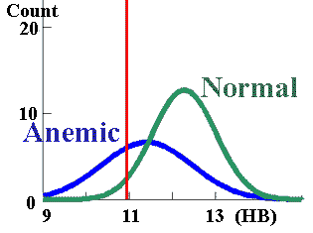
HB IN IDA

Slide 151
AT RISK GROUPS
    Infants
    Under 5 children
    Children of school age
    Women of child bearing age

Slide 152
ETIOLOGY
Inadequate intake of iron & of food, which enhances iron absorption.
High intake of inhibitors of iron absorption
Hookworm infestation.
Blood loss (heavy menses & use of aspirin & NSAID).
High fertility rate in womem.
Low iron stores in newborns.

Slide 153
DIETARY IRON
There are 2 types of iron in the diet; haem iron and non-haem iron
Haem iron is present in Hb containing animal food like meat, liver & spleen
Non-haem iron is obtained from cereals, vegetables & beans
Milk is a poor source of iron.

Slide 154
IRON ABSORPTION
Haem iron is not affected by ingestion of
other food items.
It has constant absorption rate of 20-30%
which is little affected by the iron balance
of the subject.
The haem molecule is absorbed intact and the iron is released in the mucosal cells.

Slide 155
Factors enhancing and inhibiting absorption of non-hem iron.
Enhancers | Inhibitors
Vitamin c Amino acids High altitude Hydrochloric acid Fermentation Alcohol Deficient stores | Phytates Tanins Polyphenoles Heavy metals Fibers Low altitude Replete stores Achlorhydria

Slide 156
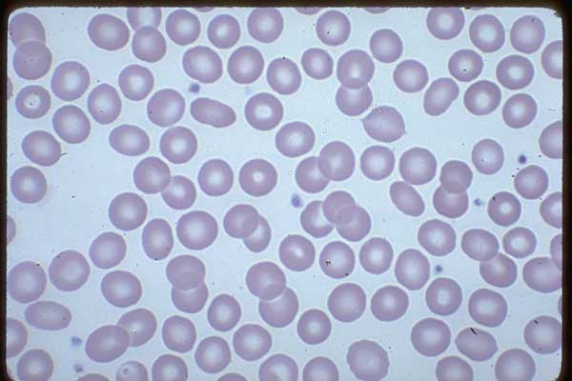
Normal Blood Film

Slide 157
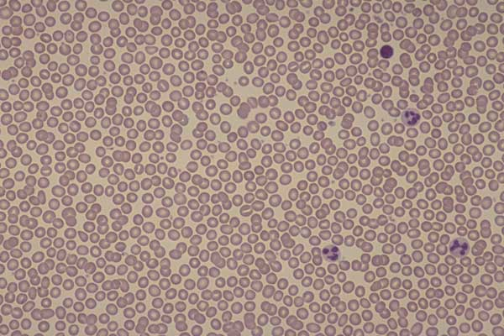
MICROCYTES

Slide 158
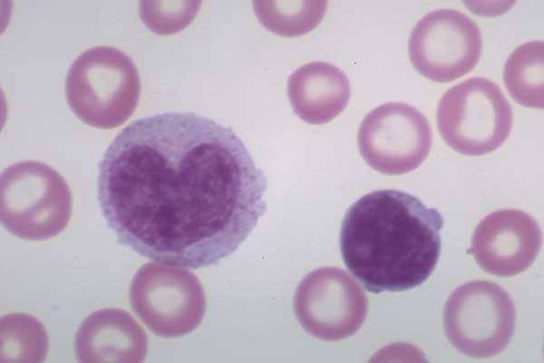
HYPOCHROMIA

Slide 159
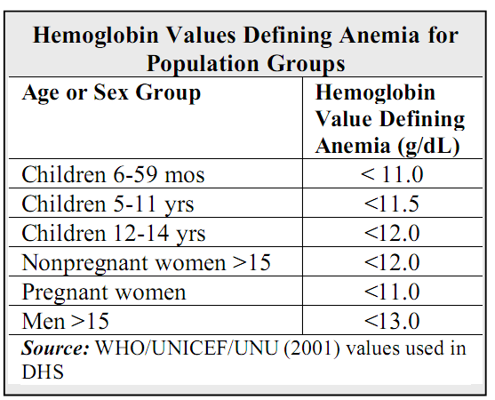

Slide 160
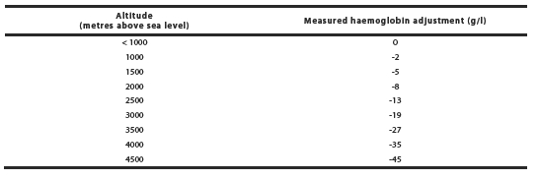
Altitude Correction Hemoglobin (WHO, 2011)

Slide 161
Signs and symptoms
Listlessness
Light headedness
Heart palpitations upon exertion
Fatigue
Irritability
Paleness of skin
Cracking of lips and tongue
General feeling of poor health
Pica (Geophargia during pregnancy)

Slide 162
Consequences
In adults, anemia with a hemoglobin concentration of less than 11g/dl leads to
Reduced physical work capacity
Reduced mental (cognitive) performance-Poor attention span and learning ability in children
Low tolerance to infections
Poor physical growth.
Premature birth, inter-uterine retardation, and low birth weight
When the hemoglobin concentration level falls below 4 g/dl it may result in death from anemic heart failure.

Slide 163
Intervention
Supplementation of iron and folic acid
Treatment of severe anemia
Deworming
Bed net distribution
Dietary diversification – increased production and consumption of locally available iron rich foods
Dietary modification -Fortification of foods with iron Supplementation of iron and folic acid

Slide 164
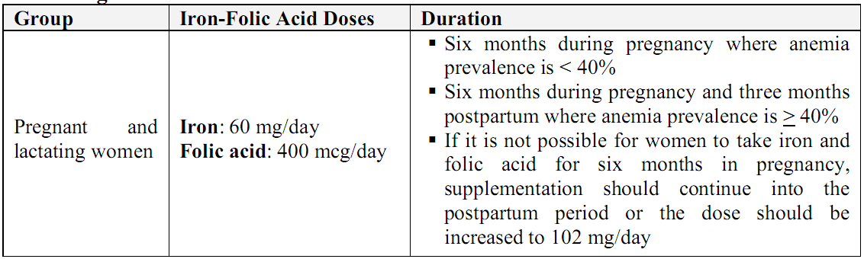
Universal Supplementation for Pregnant and Lactating Women

Slide 165
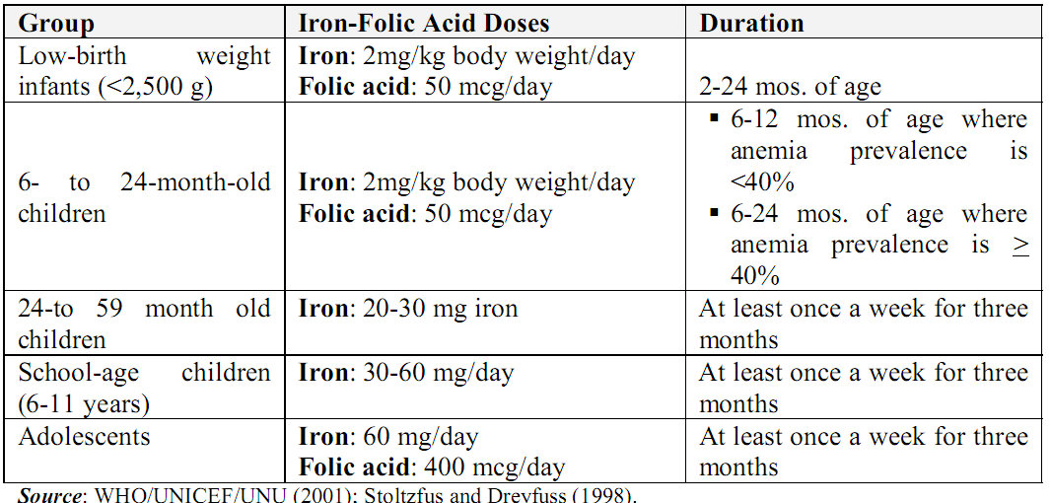
In areas where anemia prevalence in young children is 40% or more, delivery of iron supplements should continue through the second year of life and adolescent girls
Iron and Folic Acid Doses For Universal Supplementation for Children and Adolescents

Slide 166
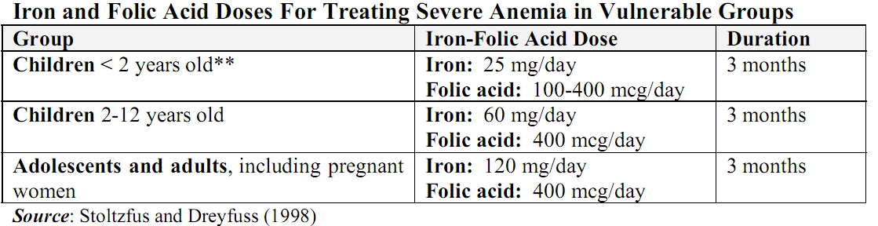
Therapeutic doses

Slide 167
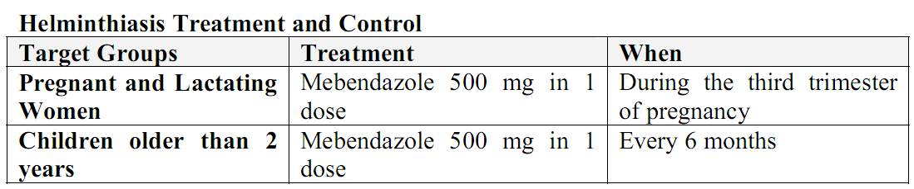
(Deworming)

Slide 168
Age | RDA
0-6 months | 5mg
6-12 months | 10mg
1-3 years | 10mg
4-6 years | 10mg
7-10 years | 10mg
MALES
11-18 years | 12mg
19+ years | 10mg
FEMALES
11-50 years | 15mg
51+ years | 10mg
Pregnant | 30mg
Lactating | 15mg

